Slide 1
Fast Luminosity Monitor
IV Curve and Transient Simulation
Wang Yilun (Nanjing University) Zhang Jialiang(Nanjing University)
Zhang Xiaoxu(Nanjing University) Zhang Lei (Nanjing University)

Slide 2
Contents
Introduction
Geometry & Doping
I-V Characteristic Curve
Transient Simulation
Conclusion

Slide 3
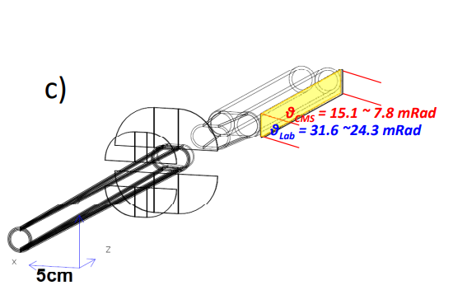
Introduction
Fast Luminosity Monitor is used to give bunch luminosity at CEPC
Integrated event rates along z-position can help monitoring z-position at IP
Polar angle $θ\sim 10 mrad$, highest radiation field at CEPC
Detect small angle Bhabha events
Electron showers generated in the copper beam pipe
Diamond is used for detector
Single crystal Chemical Vapor Deposition (sCVD), reducing defect densities
High carrier mobility : $2000\sim 2800 {cm}^{2}V^{−1}s^{−1}$
Wide bandgap, low dark noise : $5.47 eV$
Strong covalent bonds, high radiation hardness
Notes:
首先是介绍，在CEPC上，快速亮度探测器用于测量每个束团的亮度，为束流的校准提供信息。快速亮度探测器位于质心系下theta约为10毫弧度位置，探测小角度Bhabha散射粒子在铜束流管上产生的簇射。使用sCVD金刚石作为探测器的主要材料，其具有高载流子迁移率，和较宽的能隙，并具有很强的共价键，抗辐照能力较好

Slide 4
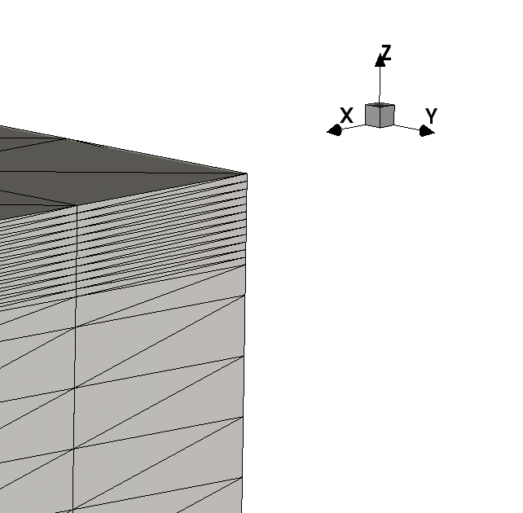
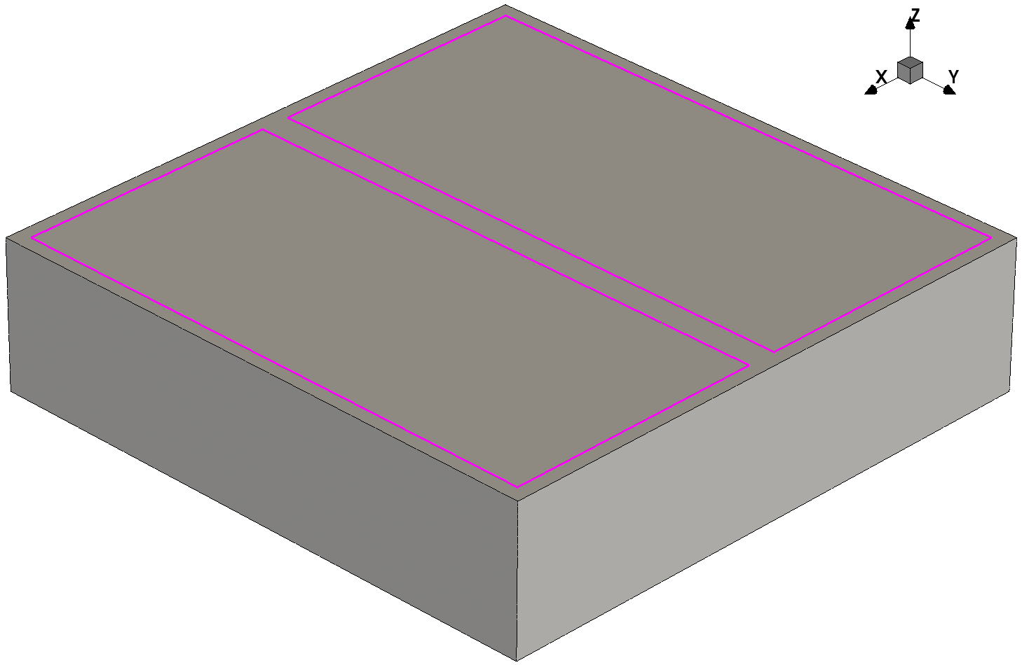
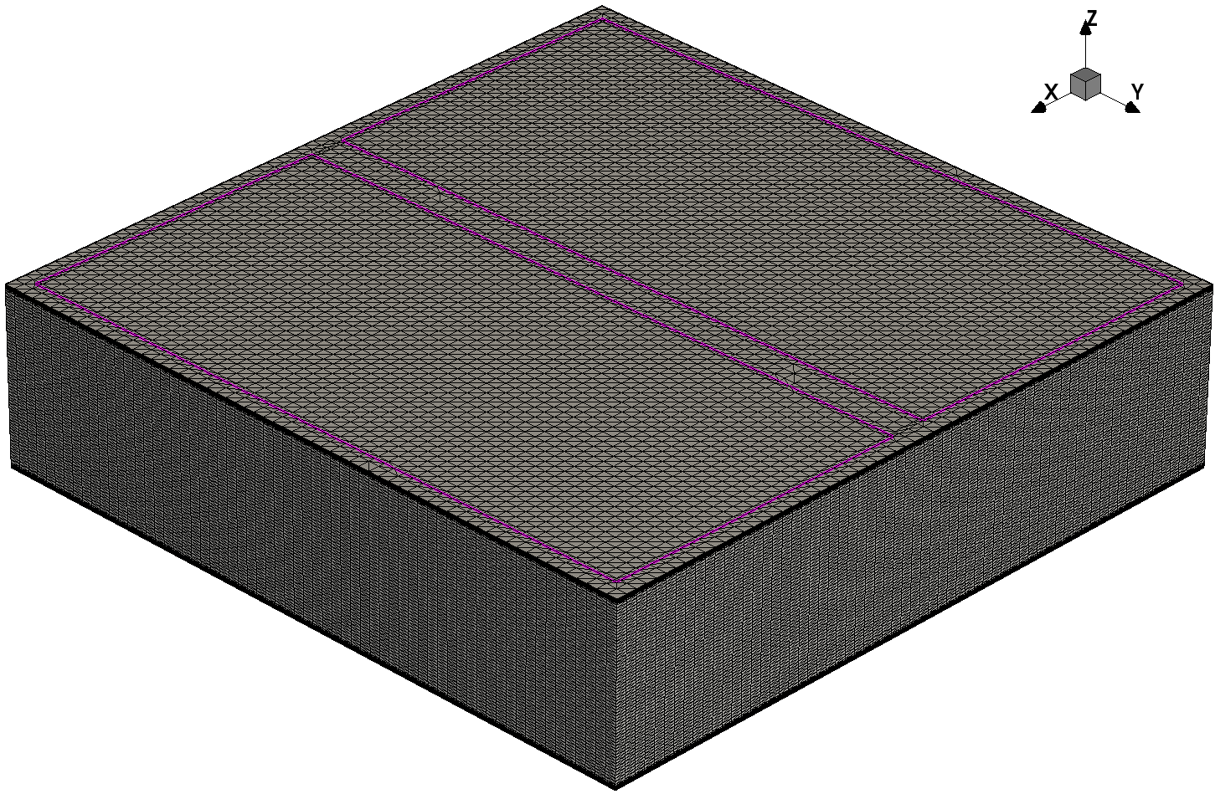
Geometry
Design for transient simulation testing later
$2000×2000×500 μm (x−y−z)$
Two electrodes on front side, each $900×1900 μm (x−y)$
One on back side, $1900×1900 μm (x−y)$
$$1 μm$$
$$10 μm$$
Notes:
用于模拟粒子击中的模型尺寸是2000*2000*500微米，正面两个电极，每个是900*1900微米，背面一个电极，1900*1900微米，电极均设置为欧姆接触。在接近电极的10微米区域增加网格密度，厚度从最大每格10微米降为1微米

Slide 5
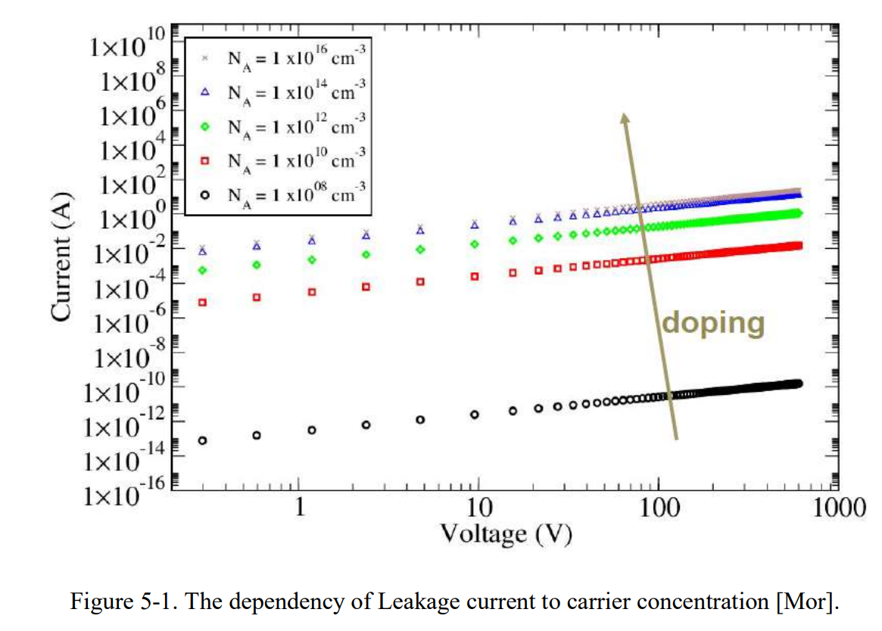
Doping
During CVD process, Boron and Nitrogen are common impurities
Boron Concentration $≠$ Carrier Concentration (Boron Active Concentration )
Add ${10}^{10}$ Boron Active Concentration
Notes:
根据文献中所述，金刚石中的硼杂质浓度为低于1ppb，也就是10的14次方每立方厘米。但硼的浓度并不是载流子的浓度，载流子浓度低于硼的浓度，文献中根据实验结果取值为10的10次方每立方厘米。根据生产厂家所说，我们使用的金刚石的硼杂质浓度会高于10的14次方，但载流子浓度还需要后续实验测量。目前模拟的载流子浓度暂时取10的10次方每立方厘米

Slide 6
I-V Characteristic Curve

Slide 7
I-V Characteristic Curve - Physics
Physics {
EffectiveIntrinsicDensity( OldSlotboom ) # doping bandgap narrowing effect
Mobility(
-ConstantMobility # do not use ConstantMobility model
DopingDep
HighFieldSaturation( Eparallel )
Enormal # mobility degradation at interfaces
)
Recombination(
SRH( DopingDep ) # doping dependent Shorkley-Read-Hall recombination
Avalanche
)
Temperature=298
Hydrodynamic
}
Notes:
这是使用的物理模型，有掺杂禁带变窄模型，迁移率模型，迁移率模型中关闭固定迁移率模型，使用依赖掺杂浓度的迁移率模型，高场饱和模型，界面散射模型。然后是依赖掺杂浓度的SRH复合和雪崩击穿模型。再加上流体力学模型和其所需的温度参数298开尔文，25摄氏度。

Slide 8
I-V Characteristic Curve - Physics
Physics {
EffectiveIntrinsicDensity( OldSlotboom )
Mobility(
-ConstantMobility
DopingDep
HighFieldSaturation( Eparallel )
Enormal
)
Recombination(
SRH( DopingDep )
Avalanche
)
Temperature=298
Hydrodynamic
}
Notes:
流体力学模型，包括掺杂浓度梯度的影响、载流子温度梯度的影响和电子空穴有效质量在空间不同区域不同时的影响。由于我们使用的金刚石是均匀掺杂，载流子种类相同，因此主要起作用的是载流子温度梯度影响，也就是考虑了载流子能量输运。

Slide 9
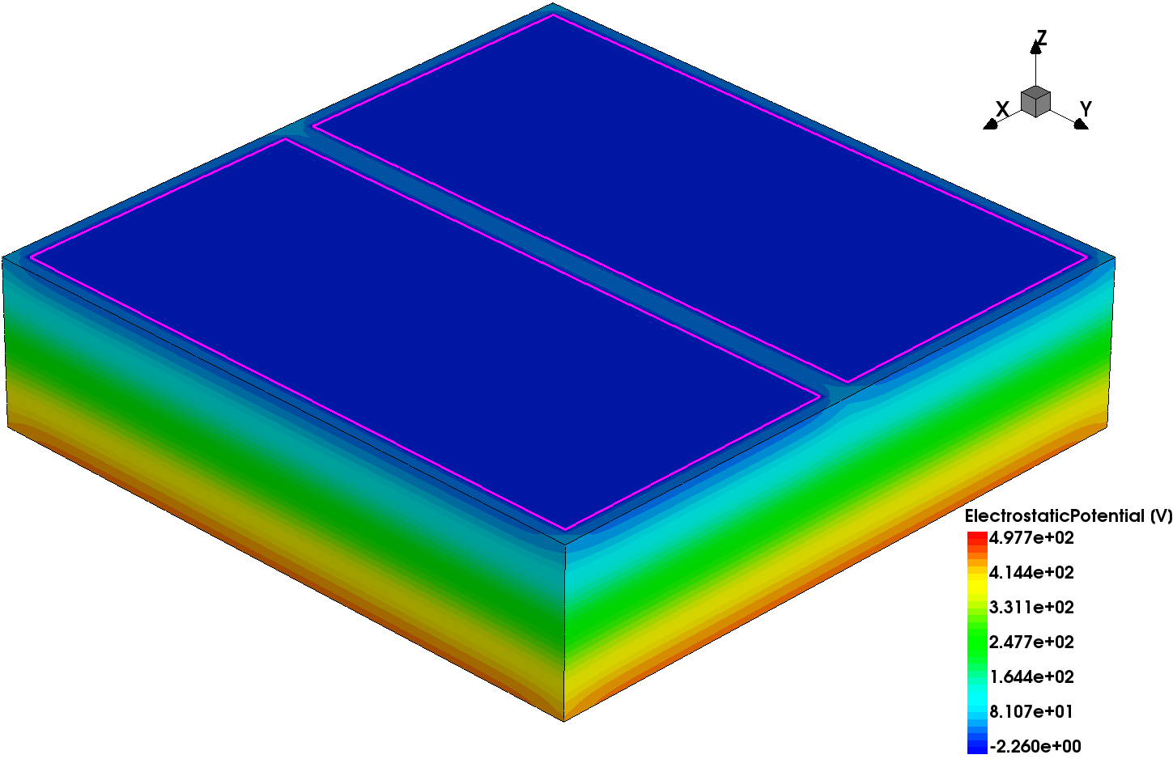
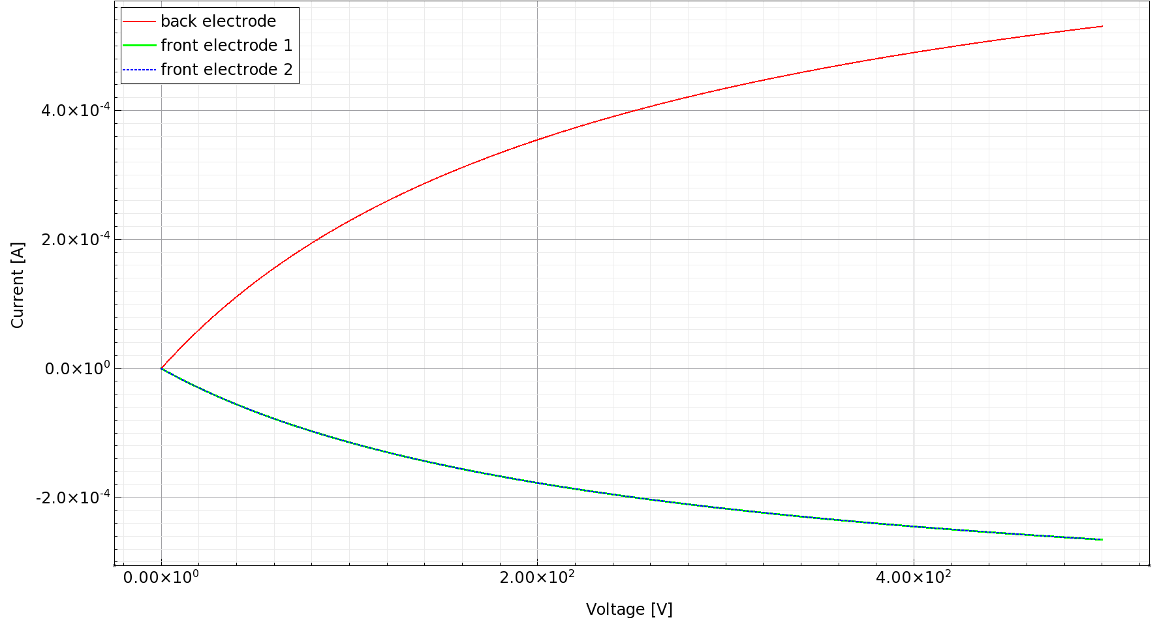
I-V Characteristic Curve
2 Electrodes on front side
Half the current
Doping : ${10}^{10} {cm}^{−3}$ Boron (Boron Active Concentration)
Notes:
这是掺杂浓度为10的10次方每立方厘米时的IV曲线，接触为欧姆接触，在反面的电极电压为500V时，电流约为0.53mA

Slide 10
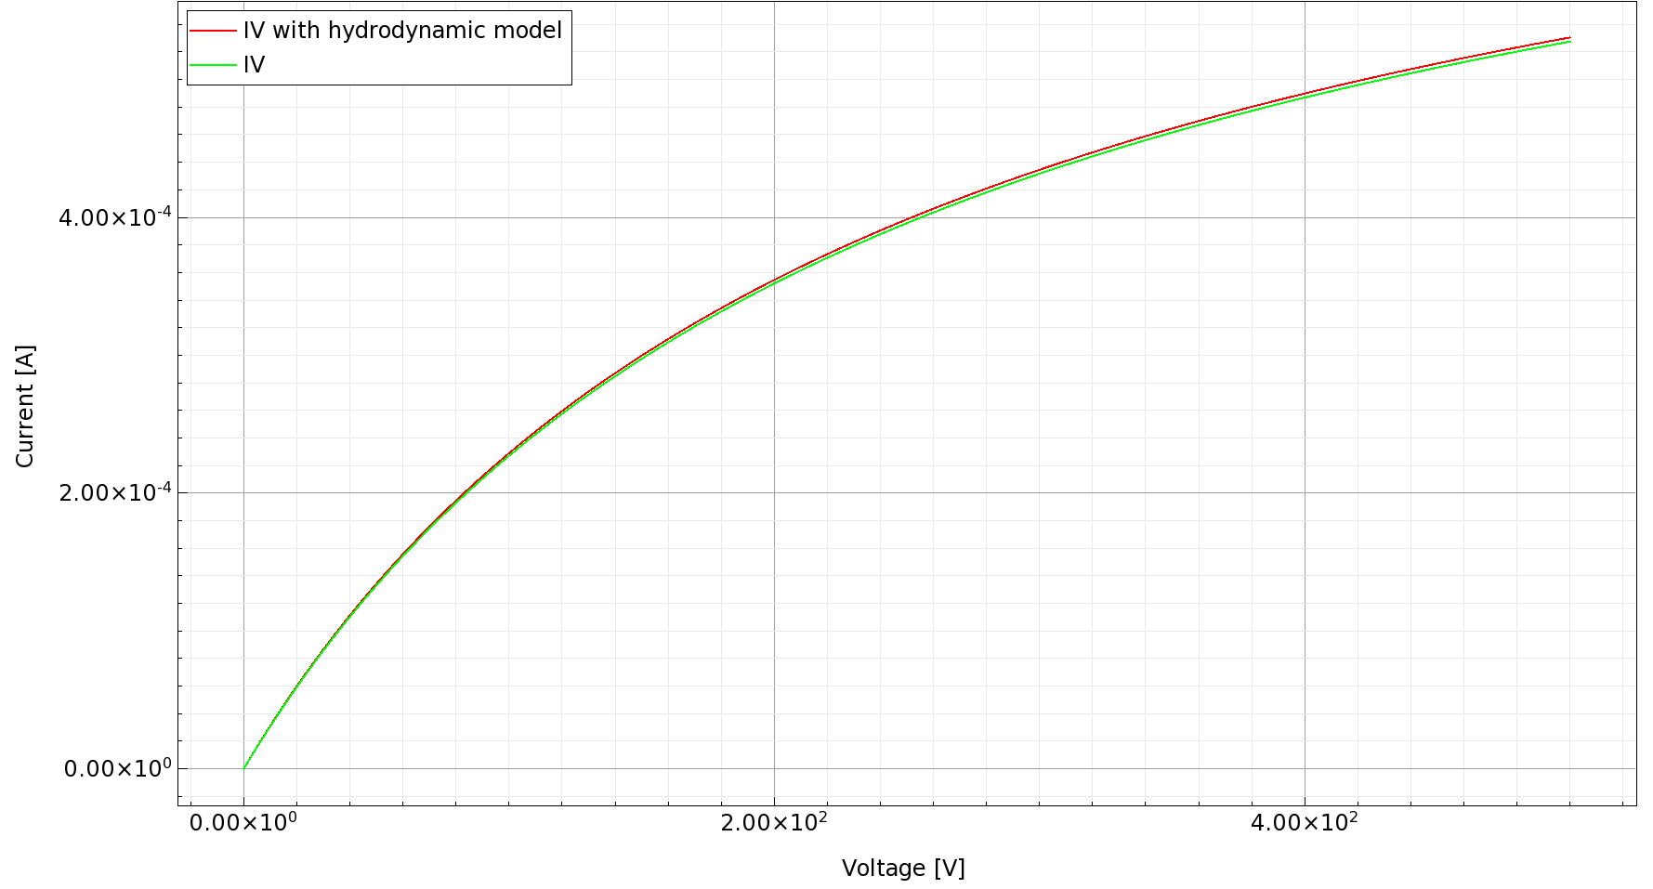
I-V Characteristic Curve
With hydrodynamic physics model, the current is slightly higher
Notes:
这是加了流体力学模型和不加流体力学模型的比较，加了流体力学模型后电流会略微增加

Slide 11
Transient Simulation

Slide 12
Transient Simulation - Physics
Physics {
EffectiveIntrinsicDensity( OldSlotboom )
Mobility(
-ConstantMobility
DopingDep
HighFieldSaturation( Eparallel )
Enormal
)
Recombination(
SRH( DopingDep )
Avalanche
)
Temperature=298
Hydrodynamic
HeavyIon(
Direction = (0,0,1)
Location = (0,0,-260)
Time = 1e-9
Length = 520
Wt_hi = 1
LET_f = 5.767e-6
Gaussian
PicoCoulomb
)
}
Simulation of electron hit
From (0, 0, -260) to (0, 0, 260), penetrate the detector
Wt_hi : radius
$1 μm$
LET_f : linear energy transfer
$5.767×{10}^{−6} pC/μm$
“Gaussian” : uses Gaussian distribution instead of exponential distribution
“PicoCoulomb” : specifies the unit to be $μm$ and $pC/μm$ for Wt_hi and LET_f respectively
same as IV simulation
Notes:
瞬态模拟的物理模型是在之前的稳态模拟的基础上增加了HeavyIon。HeavyIon模型中的参数为，粒子的初始位置、运动方向、运动距离、电离半径、能量转移。“Gaussian”表示电离的分布为高斯分布而不是指数分布，“PicoCoulomb”为设定参数的单位。将电离半径设置为1微米，能量转移为5.767*10的-6次方皮库伦每微米，粒子从底部正射入并穿过探测器

Slide 13
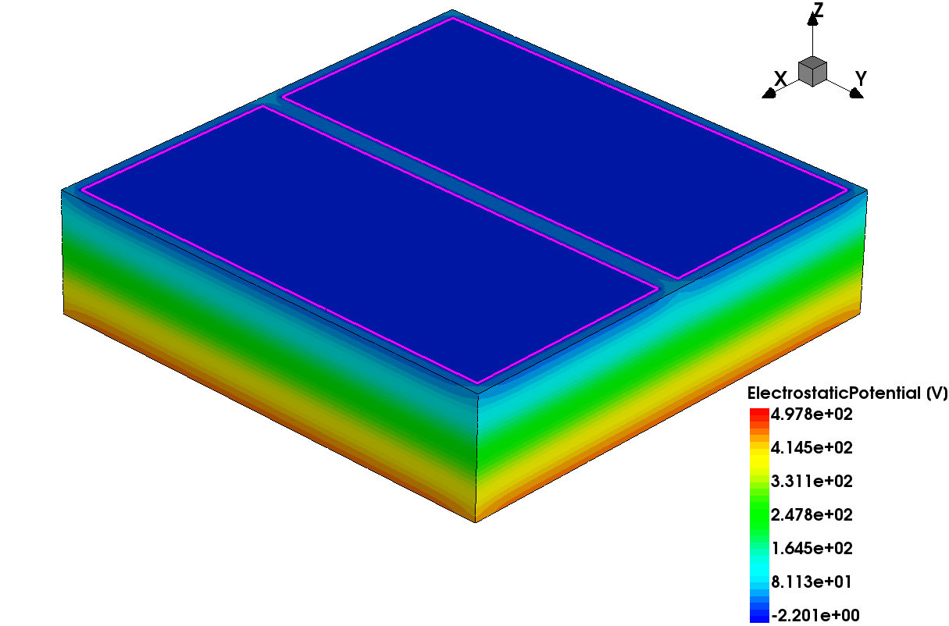
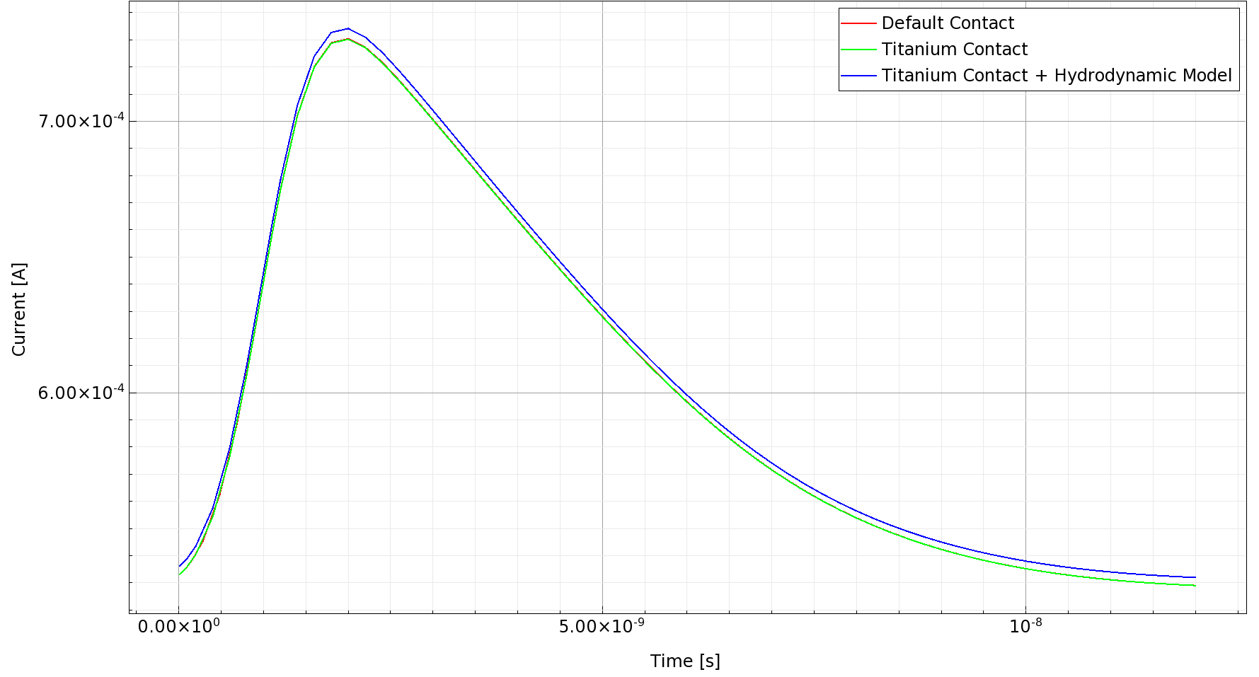
Transient Simulation
Center Hit
HeavyIon(
Direction = (0,0,1)
Location = (0,0,-260)
Time = 1e-9
Length = 520
Wt_hi = 1
LET_f = 5.767e-6
Gaussian
PicoCoulomb
)
With hydrodynamic physics model, the current is slightly higher
Notes:
这是瞬态模拟的结果，默认的接触和直接设置材料的结果相同，加入流体力学模型后电流略微增加。信号上升段为2ns，约5ns时减小一半，约10ns后结束

Slide 14
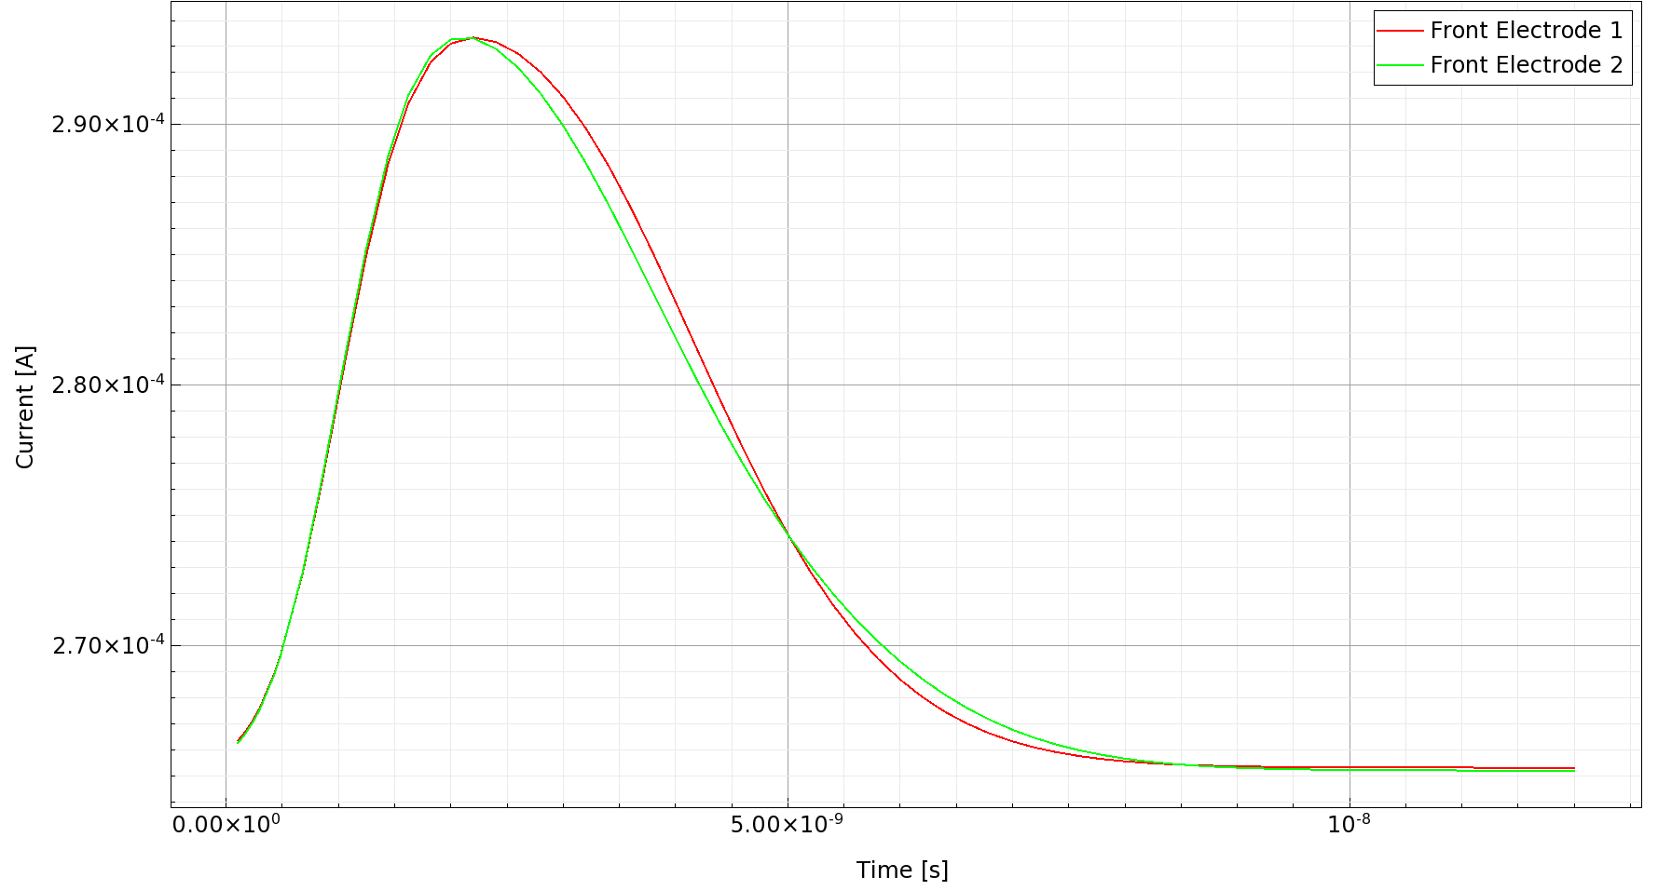
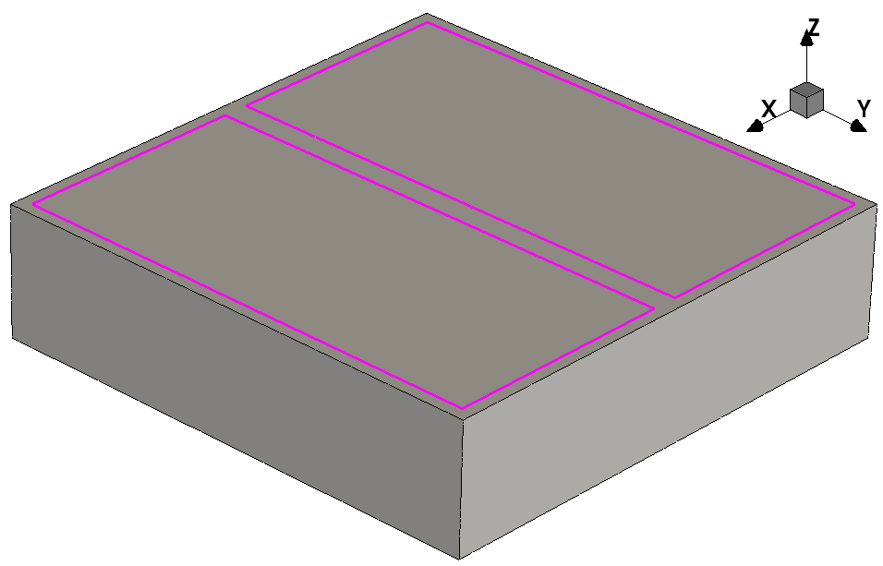
Transient Simulation
$θ=24.3 mrad$，穿过探测器中心
$$2$$
$$1$$
$$θ$$
Notes:
这是遇到的正在想办法解决的问题，首先是根据探测器的位置计算出，粒子应以 24.32~31.58 毫弧度的方向击中探测器，但设定方向后会报错。二是粒子设定在 1ns 时击中探测器，但实际模拟中在t=0就击中了探测器。三是肖特基接触不收敛的问题。

Slide 15
Conclusion
Fast luminosity monitor uses sCVD diamond, for its high carrier mobility, wide bandgap and high radiation hardness
The geometry of detector for particle hit simulation is built, while doping is set to ${10}^{10} {cm}^{−3}$
I-V characteristic curves are drawn, and the effect of adding hydrodynamic physics model is shown
Transient simulations of particle hitting the detector are performed, the signal produced is drawn
Notes:
总结，快速亮度探测器以气相沉积金刚石为材料，因其具有高载流子迁移率，宽能带和高抗辐照能力。构建了用于粒子击中模拟探测器的几何结构，并加入了10的10次方的硼掺杂。绘制了金刚石探测器的IV特性曲线，比较了加入流体力学物理模型与否的效果。对粒子击中进行了瞬态模拟，绘制了信号的曲线。

