Slide 1
Analysis code checking in the study of T/CP violation in $ψ\left(2s\right)→τ^{−}τ^{+}$

Slide 2
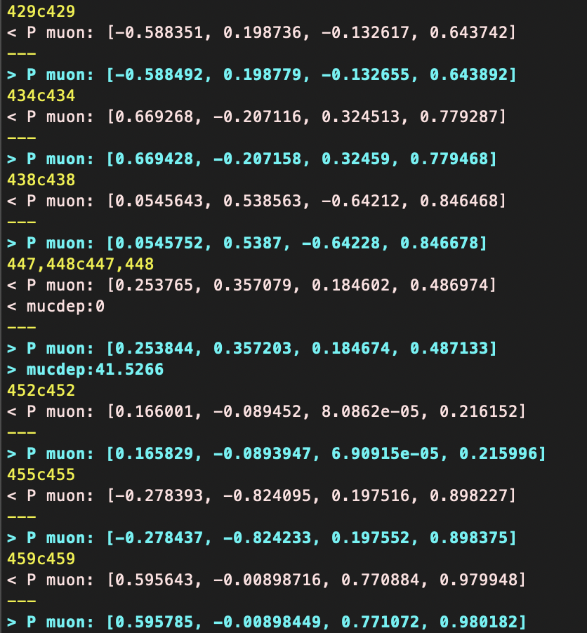
The muon momenta are slightly different (electron momenta are the same )
The MUC depth is missing in some events
Me
Yunhe
MUC depth

Slide 3
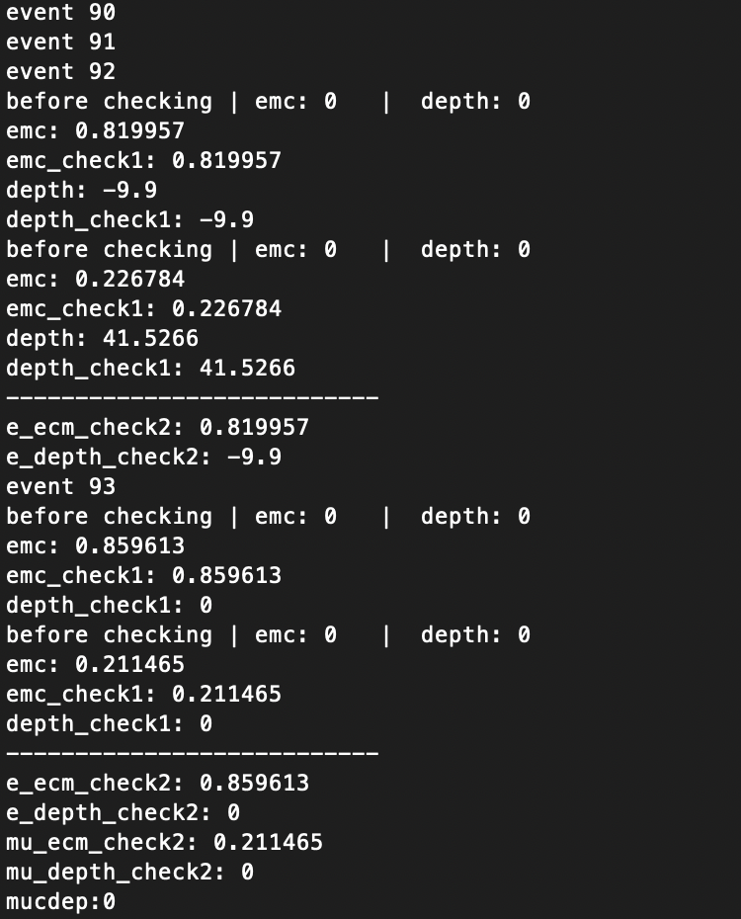
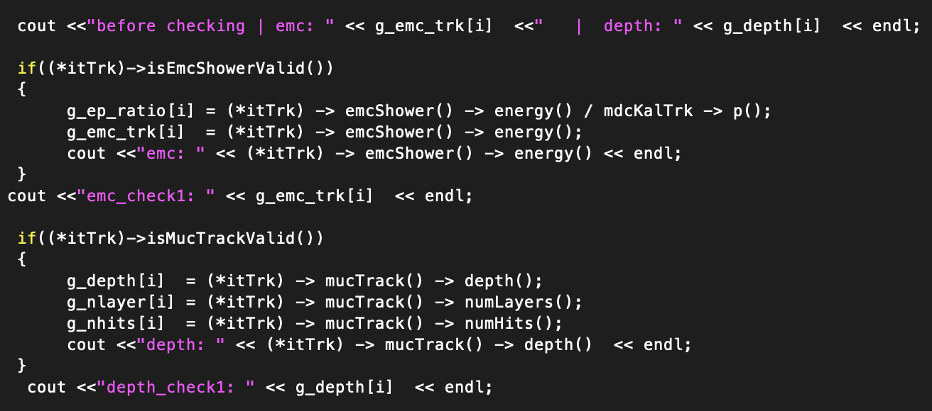
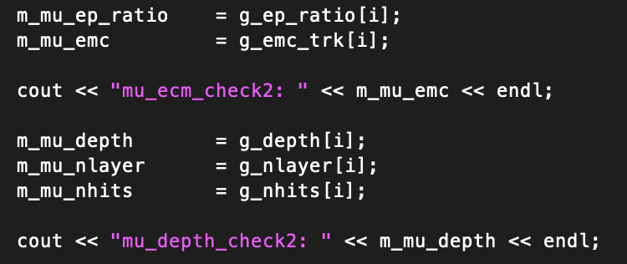
Use array (N=2) before save to Ntuple
EMC validation
MUC validation
EMC validation
MUC validation
Pass PID data
Doesn’t have MUC
validation
My results
My code
YH’s results

Slide 4
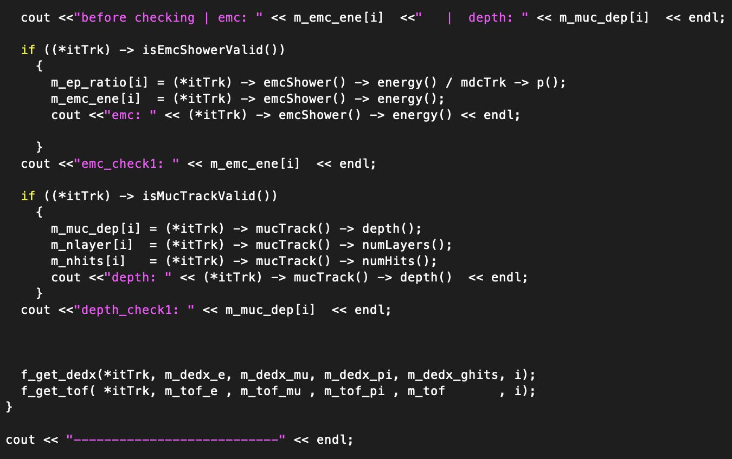
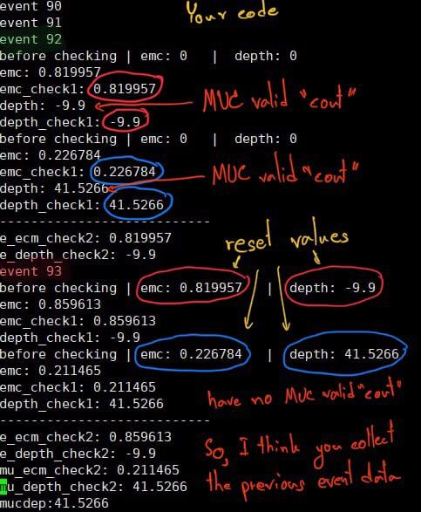
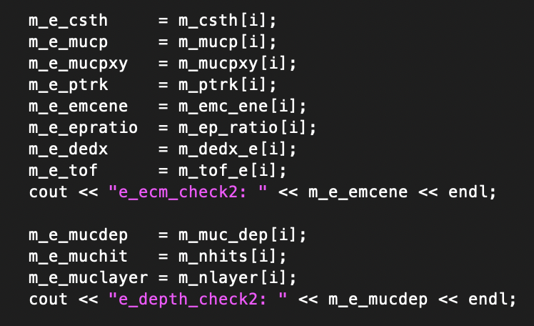
Use “NTuple” directly
Yunhe’s code

Slide 5
Cut Flow on my analysis code
Events selection | Signal MC
Total number | 1200000 (100.0%)
Charge choose | 1015688 (84.64%, 84.64%)
Photon choose | 881541 (73.46%, 86.79%)
PID | 605883 (50.49%, 68.73%)
Vertex fit | 605189 (50.43%, 99.89%)
$$P<1.2$$ | 605096 (50.42%, 99.87%)
$$E_{e}<1.2,E_{μ}<0.3$$ | 603588 (50.30%, 99.75%)
$$E/P_{e}>0.6$$ | 586678 (48.89%, 97.20%)
$$Muc_depth>0$$ | 379396 (31.62%, 64.67%)
$$Muc_depth>81×(P−0.65)$$ | 355104(29.59%, 93.60%)
$$M_{miss}<3.05$$ | 355101(29.59%, 99.99%)
$$|cosθ_{miss}|<0.8$$ | 307562(25.63%, 86.61%)
Total Efficiency | 25.63%
(Related with total N, Related with previous N)

