Slide 1
Summary of MicroBooNE’s Analysis

Slide 2
Background of sterile neutrino
Neutrino’s mass needs to explain(In standard model, neutrino is expected 0 mass), which lead to sterile neutrino hypothsisy.
MiniBooNE observed an anomalous excess of charge-current $ν_{e}$, which indicate exist of sterile neutrino.

Slide 3
Process of analysis
Based early study of MicroBooNE, I analyzed full data set of MicroBooNE collected as following steps:
Check the consistence of different period data set.
Calculate relative uncertainty of cross section, BNB flux(neutrino comes from BNB), detector, MC sample and dirt.
With all systematic uncertainty, calculate some kinds of $χ^{2}$ tests.
Then we can get the result.

Slide 4
Method of analysis
In analysis, following 7-channel are used :
FC $ν_{e}$CC
PC $ν_{e}$CC
FC $ν_{μ}$CC
PC $ν_{μ}$CC
FC $π^{0}$CC
PC $π^{0}$CC
NC$π^{0}$
After concerning some effect, MicroBooNE defined fiducial volume(3 cm inside the effective TPC boundary).

Slide 5
Data set used in analysis
MicroBooNE divided data set to five sample, this analysis used following data set:
Run1
Run2
Run3
Run4
Run5
Run1-3 are used in early analysis

Slide 6
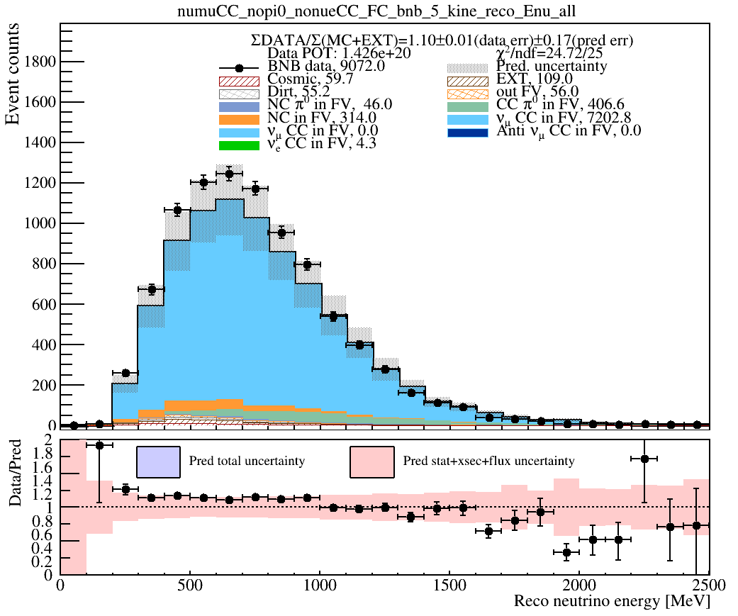
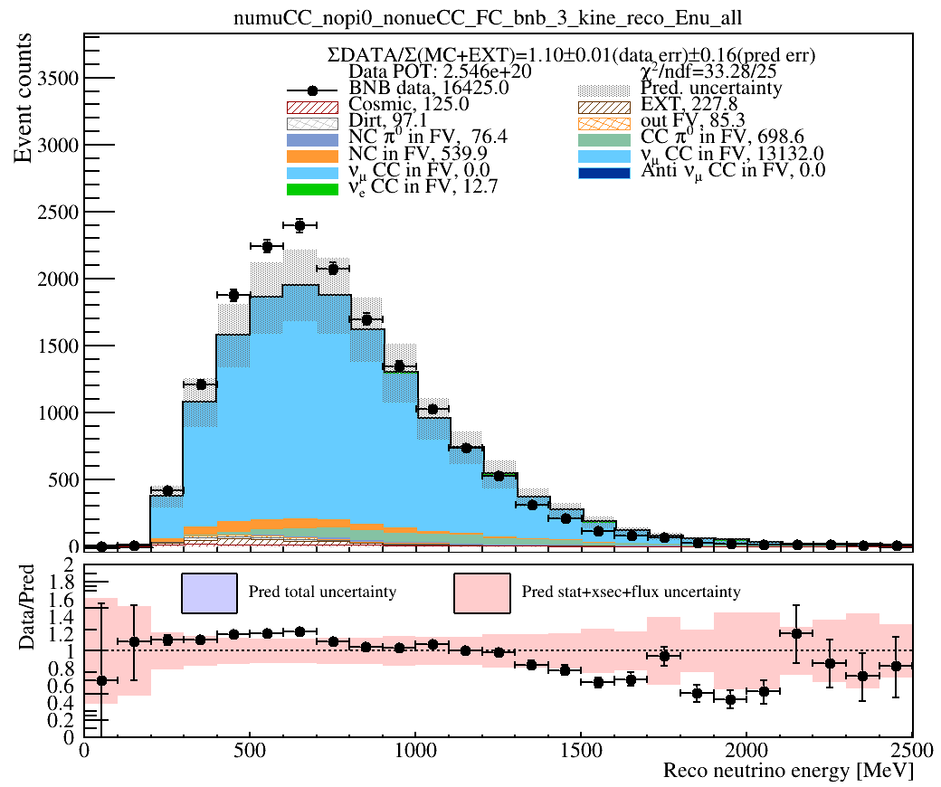
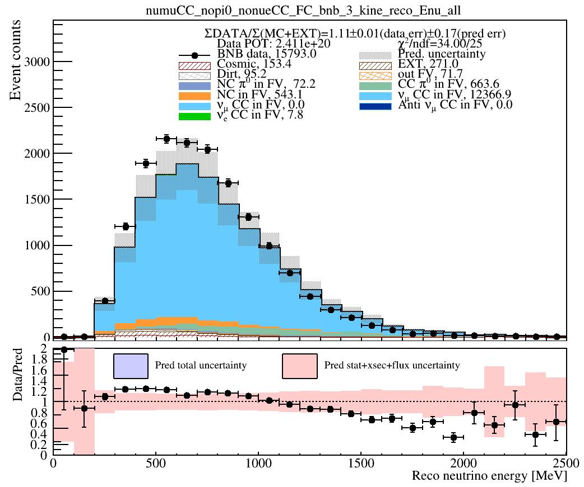
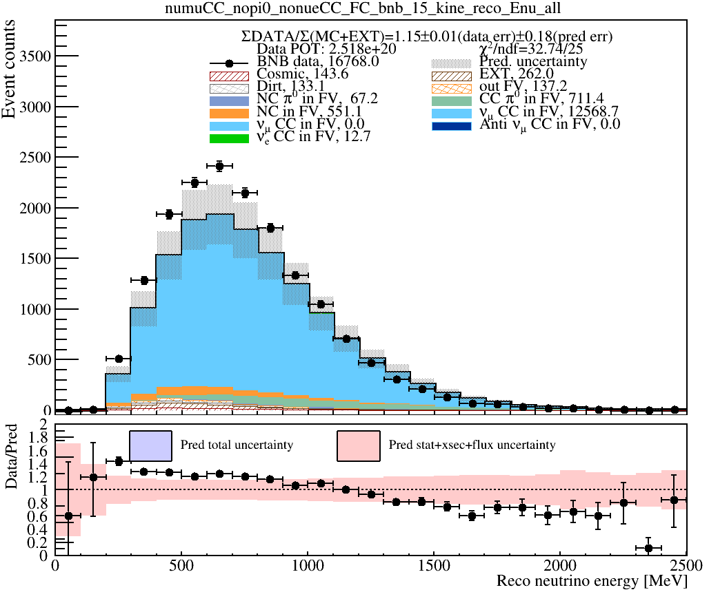
Previous:
FC $\text{CC}ν_{μ}$
Run1
Run2
Run3
X axis is reconstructed neutrino energy.
By checking the shape of distribution, we can find some consistence in these plots.
Run4
Run5
Systematic Uncertainties from MC、XsFlux、Dirt (no Det sys)
Notes:
Here is neutrino energy result of CC𝜈𝜇 FC channel , I only considered systematic uncertainties from MC、XsFlux , Dirt , but did not consider detector uncertainty , because we are still processing corsponding files
We can see similar shape across all the runs : data excess less than 1GeV , data deficit /ˈdefɪsɪt/ greater than 1GeV .
Comparing to run1-3 , there is a slightly higher data excess in run4/5 : about 10% excess in run1-3, 15-19% excess in run4/5 . but should be within systematics once we add in detector systematics
Furthermore, once we include detector systematics we still expect good chi2/ndf
I drew run4 breakdown plots , and they look good , so I put them in the backup section,
Similarly I drew tables of chi2/ndf , put them in the backup as well , we will be more carefully studied once we have detvar samples ready

Slide 7
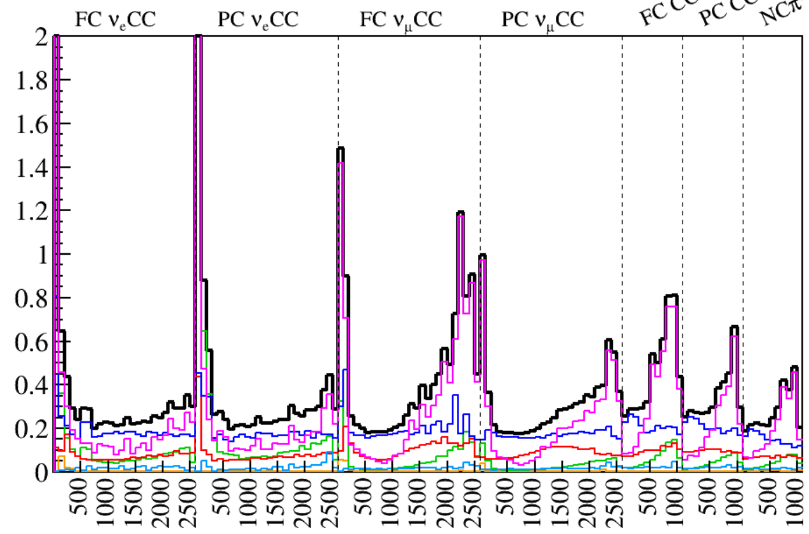
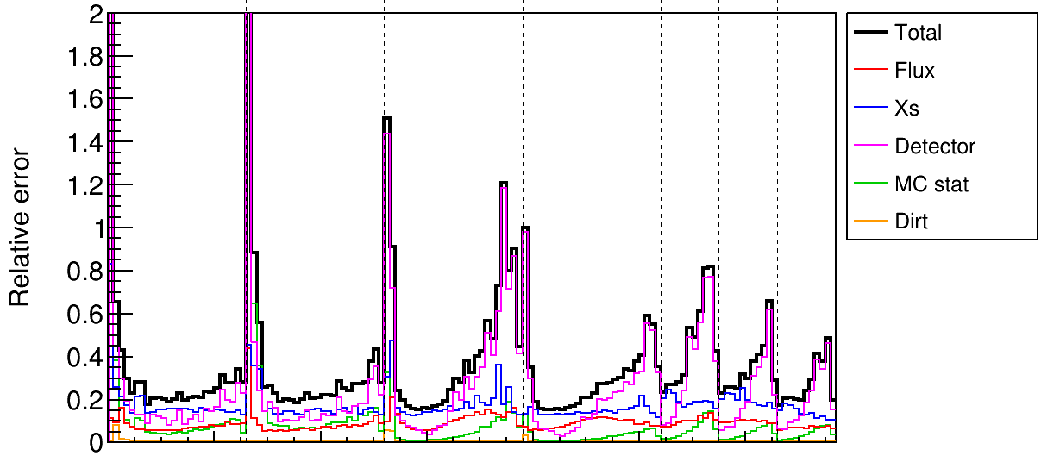
Recalculation of systematic uncertainty
Recalculated result
original result
reconstructed neutrino energy
reconstructed neutrino energy
I have recalculated original result correctly.

Slide 8
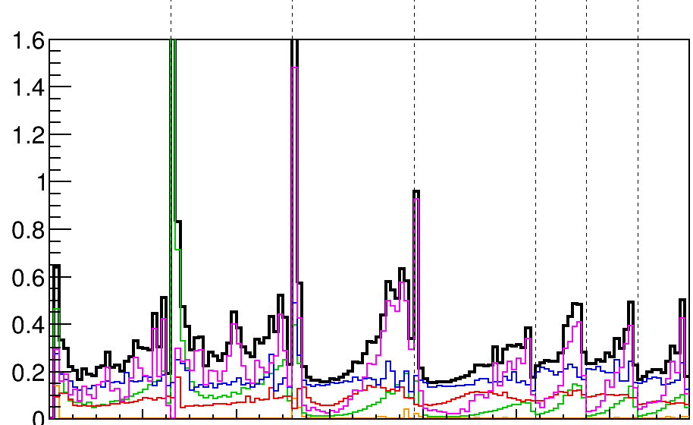
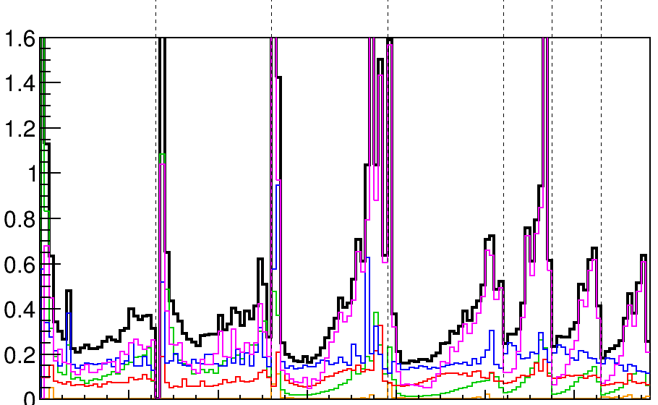
Calculation of systematic uncertainty
Run4
Run3
Big difference
reconstructed neutrino energy
reconstructed neutrino energy
As marked in left plot, detector relative uncertainty has big difference.

Slide 9
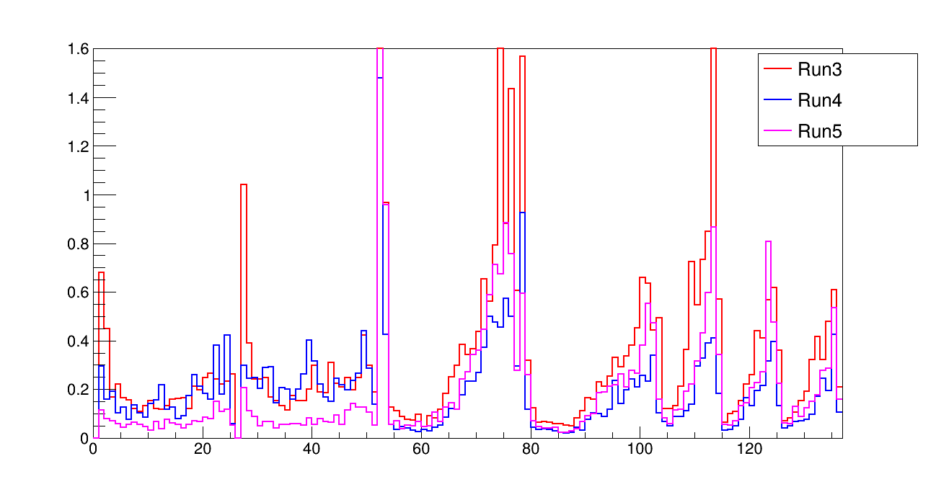
Comparison of detector uncertainty
FC $ν_{e}$CC
PC $ν_{e}$CC
FC $ν_{μ}$CC
PC $ν_{μ}$CC
$π^{0}$ 3channel
reconstructed neutrino energy
All seven channels of Run5 are smaller than those of Run3
The five channels of Run4 (e.g. excluding $ν_{e}$CC) are smaller than the result of Run3

Slide 10
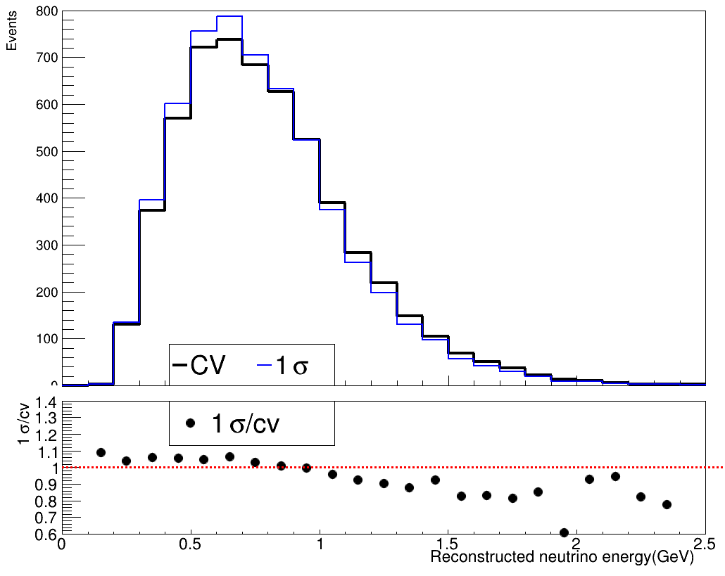
Method of calculating detector uncertainty
Blue curve is 1sigma value
Black curve is central value
Detector uncertainty calculated based on each run’s 9 detector samples.
Generally, detector relative uncertainty is calculated based on detector sample’s bias of central value of 1sigma value with statistical fluxion.

Slide 11
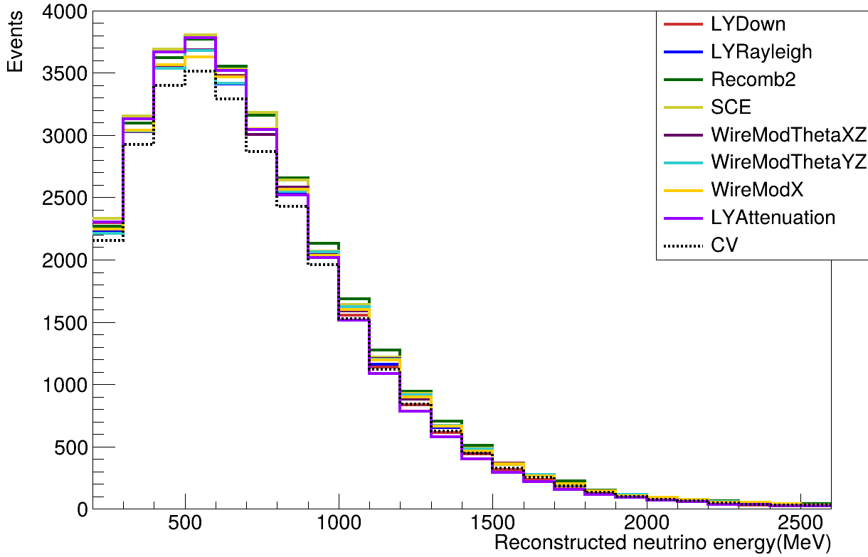
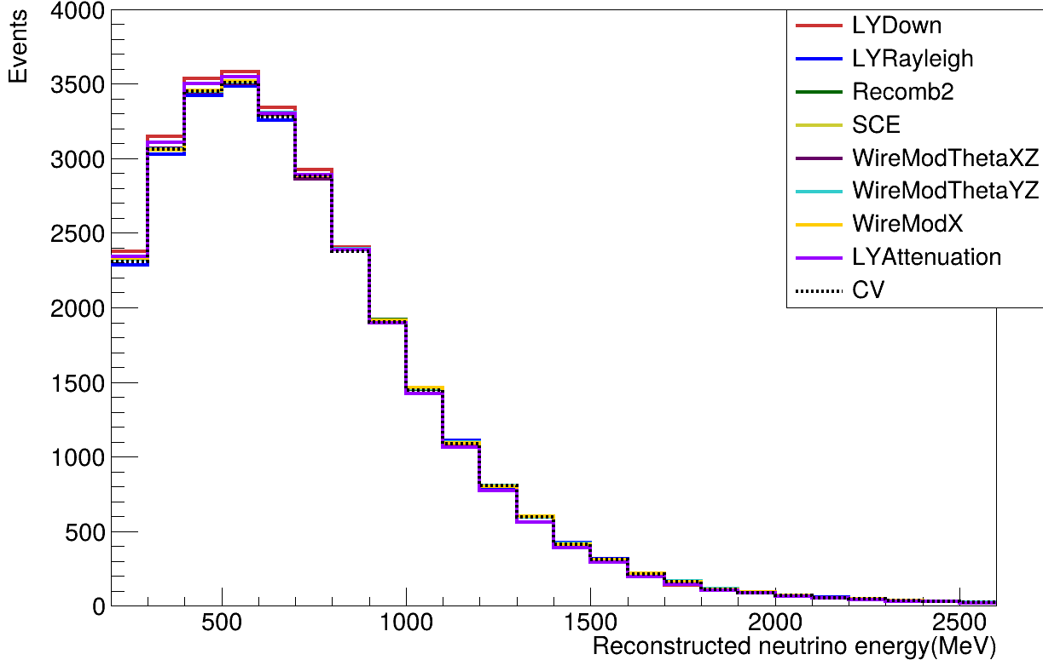
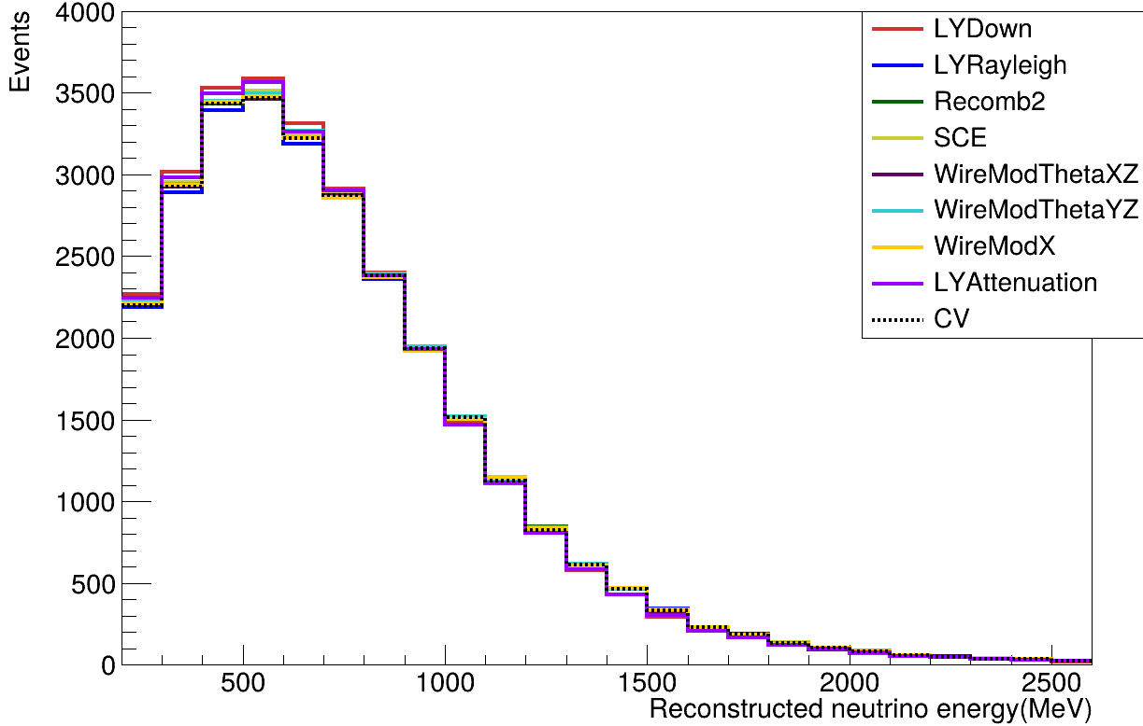
Checking on detector sample’s distribution
Run3: $ν_{μ}$
Run4: $ν_{μ}$
Run5: $ν_{μ}$
Different detector uncertainty may cause by detector sample themself.
Run4/5’s 1sigma curves are similar with cv curve.

Slide 12
Further things of analysis
We have confirmed what’s going wrong in detector samples(sample’s size of each run is different), so next plans are following:
Waiting for new detector sample.
Calculate some kinds of $χ^{2}$ tests: goodness of fit, simple-vs-simple likelihood ratio test and nest likelihood ratio test.
Then we will publish the final result.

