Slide 1
$J^{PC}$ quantum number for light ($qq\overline{q}\overline{q}$) fully charmed ($cc\overline{c}\overline{c}$), and, charmonium-like ($qc\overline{q}\overline{c}$) tetraquark
$J=\left|L−S\right|,$ $\left|L−S\right|+1, …, L+S$
${P=(−1)}^{L}$ and ${C=(−1)}^{L+S}$ (Deng et al., 2012)
L = 0,1,2
S = 0,1
L | S | J | P | C | $$J^{PC}$$
0 | 0 | 0 | + | + | $$0^{++}$$
0 | 1 | 1 | + | - | $$1^{+ −}$$
1 | 0 | 1 | - | - | $$1^{−−}$$
1 | 1 | 0 | - | + | $$0^{−+}$$
1 | 1 | 1 | - | + | $$1^{−+}$$
1 | 1 | 2 | - | + | $$2^{−+}$$
1 | 2 | 1 | - | - | $$1^{−−}$$
1 | 2 | 2 | - | - | $$2^{−−}$$
1 | 2 | 3 | - | - | $$3^{−−}$$
L | S | J | P | C | $$J^{PC}$$
2 | 0 | 2 | + | + | $$2^{++}$$
2 | 1 | 1 | + | - | $$1^{+ −}$$
2 | 1 | 2 | + | - | $$2^{+−}$$
2 | 1 | 3 | + | - | $$3^{+ −}$$
2 | 2 | 0 | + | + | $$0^{++}$$
2 | 2 | 1 | + | + | $$1^{++}$$
2 | 2 | 2 | + | + | $$2^{++}$$
2 | 2 | 3 | + | + | $$3^{++}$$
2 | 2 | 4 | + | + | $$4^{+ +}$$

Slide 2
Hamiltonian
$$H = H_{0}+ H_{SD},$$
$H_{0}=\sum_{i=1}^{n}{\frac{1}{2}M_{ave}}+\sum_{i=1}^{n}{\frac{P_{i}^{2}}{2m_{ij}}}+\sum_{i<j}^{n}{\left(−\frac{3}{16}\vec{λ_{i}}⋅\vec{λ_{j}}\right)}\left(A_{ij}r_{ij}−\frac{B_{ij}}{r_{ij}}\right)$,
$H_{SD}=H_{SS}+H_{LS}+H_{T}$,
$M_{ave}$ :the spin-averaged mass of meson
$m_{ij}$ :the reduced quark masses between $i$ and $j$
$A$ :a parameter of linear potential
$B$ :a parameter of the Coulomb’s potential
$\vec{λ_{i}}$ :The quark color operator
$H_{SS}$ :the spin-spin interaction
$H_{LS}$ :the spin-orbital interaction $H_{T}$ :the tensor interaction

Slide 3
$$H = H_{0}+ H_{SS} +H_{LS}+H_{T}$$
$H_{0}=\sum_{i=1}^{n}{\frac{1}{2}M_{ave}}+\sum_{i=1}^{n}{\frac{P_{i}^{2}}{2m_{ij}}}+\sum_{i<j}^{n}{\left(−\frac{3}{16}\vec{λ_{i}}⋅\vec{λ_{j}}\right)}\left(A_{ij}r_{ij}−\frac{B_{ij}}{r_{ij}}\right)$,
$H_{SS}=\frac{8 B_{ij}σ_{ij}^{3}}{3 m_{i}m_{j}\sqrt{π}}e^{−σ_{ij}^{2}r_{ij}^{2}}\vec{s_{i}}⋅\vec{s_{j}},$ $H_{T}=−\left(\frac{∂^{2}}{∂r_{ij}^{2}}−\frac{1}{r_{ij}}\frac{∂}{{∂r}_{ij}}\right)\frac{V_{v}}{{3m}_{i}m_{j}}$ $S_{12}$,
$$H_{LS}=\frac{1}{r_{ij}}\frac{dV_{v}}{dr_{ij}}\frac{1}{4}\left[\left(\frac{1}{{m_{i}}^{2}}+\frac{1}{{m_{j}}^{2}}+\frac{4}{m_{i}m_{j}}\right)\vec{L_{ij}}⋅\vec{S_{ij}}+\left(\frac{1}{{m_{i}}^{2}}−\frac{1}{{m_{j}}^{2}}\right)\vec{L_{ij}}⋅\left(\vec{s_{i}}−\vec{s_{j}}\right)\right]−\frac{1}{r_{ij}}\frac{dV_{s}}{dr_{ij}}\left(\frac{\vec{L_{ij}}⋅\vec{s_{i}}}{2m_{i}^{2}}+\frac{\vec{L_{ij}}⋅\vec{s_{j}}}{2m_{j}^{2}}\right)$$
$A=a+bm_{ij}, {B=B}_{0}\sqrt{\frac{1}{m_{ij}}},σ=$ ${σ_{0}m}_{ij}$
Fitted parameters
(a, b,${ B}_{0}$, $σ_{0}$) = (67413 ${MeV}^{2}$, 35 $MeV$, 31.7 ${MeV}^{1/2}, 0.72$), $M_{ave}\left(c\overline{c}\right)$ = 3068 MeV, $M_{ave}\left(b\overline{b}\right)$ = 9445 MeV,
$m_{u}=m_{d}=$420 $MeV$, $m_{c}=1270 MeV, m_{b}=4180 MeV$

Slide 4
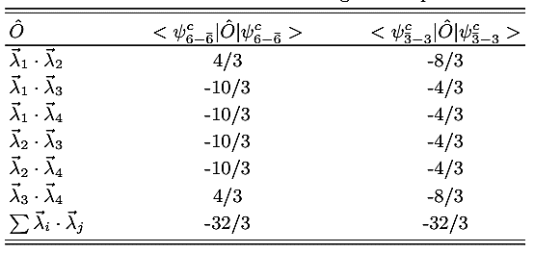
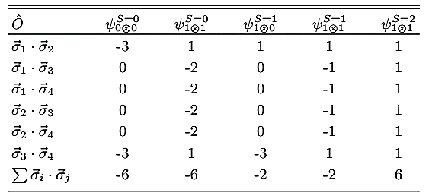
Color matrix elements of light tetraquark states.
Spin matrix elements of light tetraquark states.
(Zhao et. al., 2022)

Slide 5
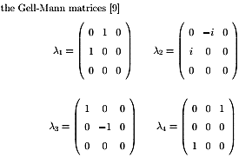
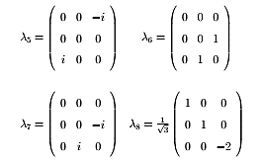
Meson
$$\left\langle ψ^{c}\left|{\vec{λ}}_{1}⋅{{\vec{λ}}_{2}^{∗}}\right|ψ^{c}\right\rangle =−\frac{16}{3}$$
Baryon
$\left\langle ψ^{c}\left|{\vec{λ}}_{i}{⋅\vec{λ}}_{j}\right|ψ^{c}\right\rangle =−\frac{8}{3}$, i=1,2,3, i<j
$\sum_{ⅈj}{{\vec{λ}}_{i}{⋅\vec{λ}}_{j}}$= ${(\vec{λ}}_{1}{⋅\vec{λ}}_{2}$)+ ${(\vec{λ}}_{1}{⋅\vec{λ}}_{3})$+ ${(\vec{λ}}_{2}{⋅\vec{λ}}_{3})$
Y. Yan, Applied Group Theory in Physics (Suranaree University of Technology, Nakhon Ratchasima, Thailand, 2020)

