Slide 1
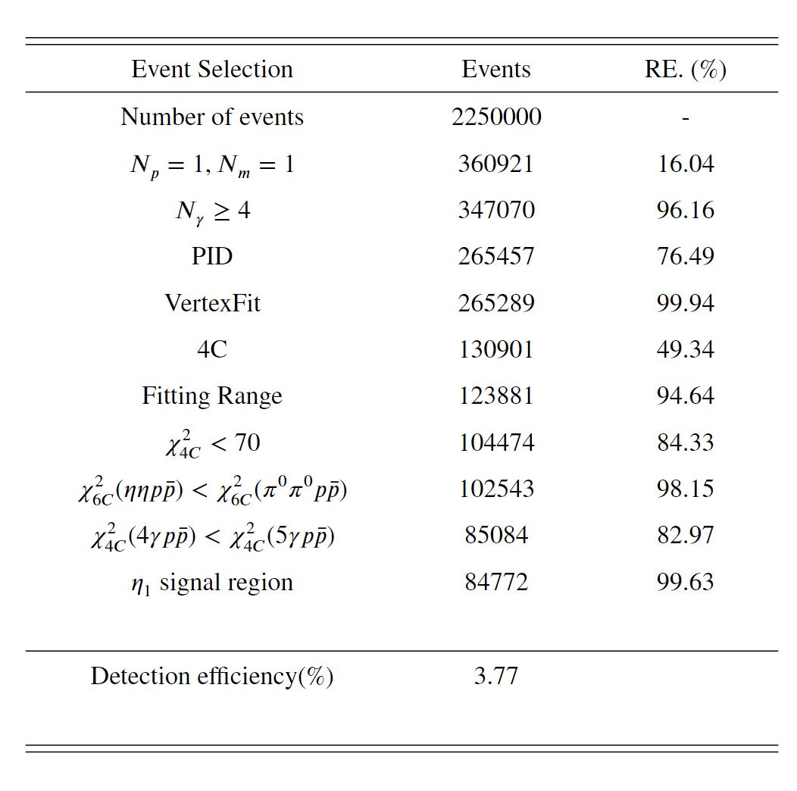
cutflow

Slide 2
Systematic uncertainty
n Tracking and PID efficiencies for proton
The uncertainties on the tracking efficiency are estimated using the control sample $J/ψ→p\overline{p}π^{+}π^{−}$ and determined to be 1.0% for each charged proton [1]. The uncertainties due to PID are studied using the control sample $e^{+}e^{−}→p\overline{p}π^{0}$and are estimated to be 1.0% for each proton [2].
n Photon reconstruction
The uncertainty on the photon is studied using the control sample $e^{+}e^{−}→{Yμ}^{+}μ^{−}$ and determined to be 0.5% per photon [3].
n Kinematic fit
The systematic uncertainty due to kinematic fit is estimated by comparing the efficiency before and after applying the helix correction to be 4.1%.
n cos θ distribution
There is a discrepancy between the cos θ_{p} distribution from data and MC simulation, indicating that the MC generator should be more complicated than PHSP. However, what we are concerned about is the corrected MC efficiency. We corrected the MC based on data cos θ_{p} distribution, and got the efficiency difference between before and after ”re-weight” is , which is taken as the systematic uncertainty.
[1] W. L. Yuan, X.-C. Ai, X.-B. Ji, S.-J. Chen, Y. Zhang, L.-H. Wu, L.-L. Wang, and Y. Yuan, Study of tracking efficiency and its systematic uncertainty from J/ψ → ppπ ⁺π ⁻ at BESIII, Chin. Phys. C 40, 026201 (2016).
[2] M. Ablikim et al. (BESIII Collaboration), Study of ψ(3686) → π0 h_{c,} h_{c} → Yη c via η c exclusive decays, Phys. Rev. D 86, 092009 (2012).
[3] V.Prasad, M.Ablikim, Study of photon detection efficiency in e ⁺ e⁻ → Yμ+μ ⁻process,[Online]

