Slide 1


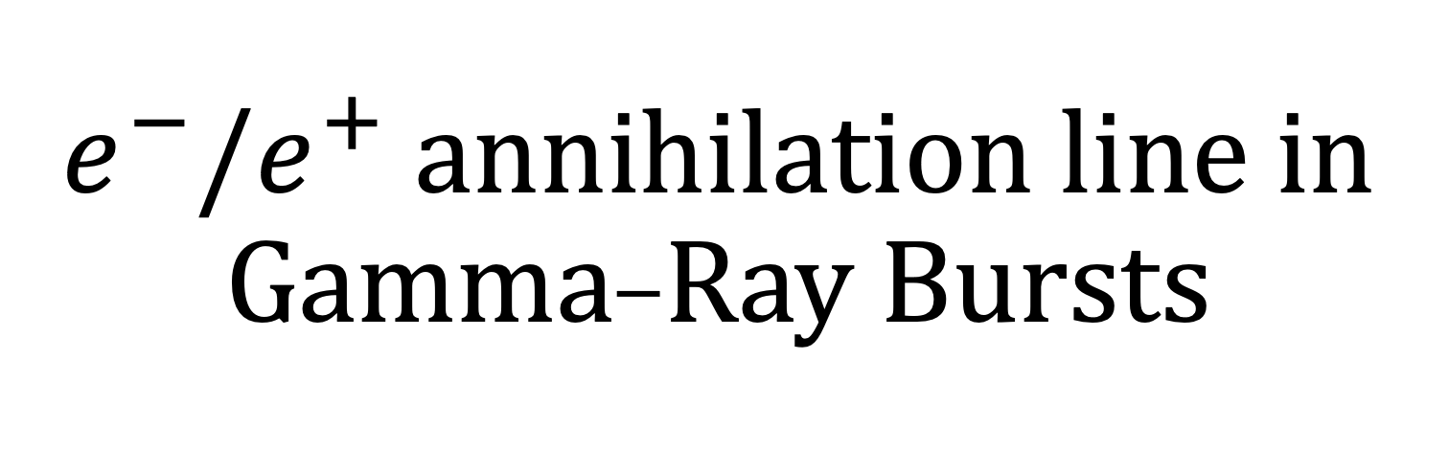
$e^{−}/e^{+}$ annihilation line in Gamma-Ray Bursts
易疏序 （Shu-Xu Yi）
2025年7月17日@吉林大学
Pair-creation and annihilation
GRB221009A
Other models
Search in other bursts
Gamma-ray bursts

Slide 2
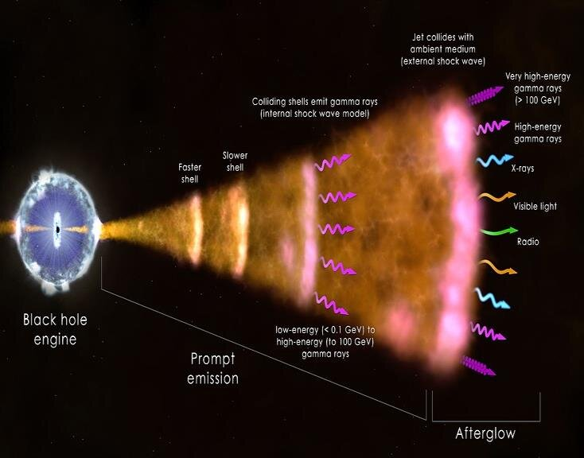
Central engine:
Hyper accreting black hole
BH spin energy?
Accretion energy?
Kinetic energy ?
Magnetic energy?
Relativistic jet
Shock?
Reconnection?
Electron random motion
Synchrotron ?
radiation
Pair-creation and annihilation
GRB221009A
Other models
Search in other bursts
Gamma-ray bursts

Slide 3
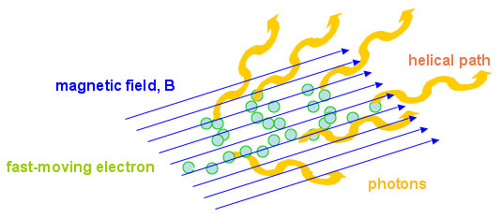
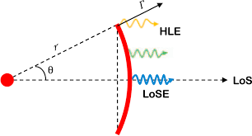

High Latitude effects/curvature effects
$$Γ\sim {10}^{2}$$
10keV~10MeV
See Zhang Zhen’s talk
Pair-creation and annihilation
GRB221009A
Other models
Search in other bursts
Gamma-ray bursts

Slide 4
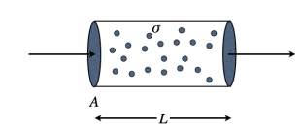
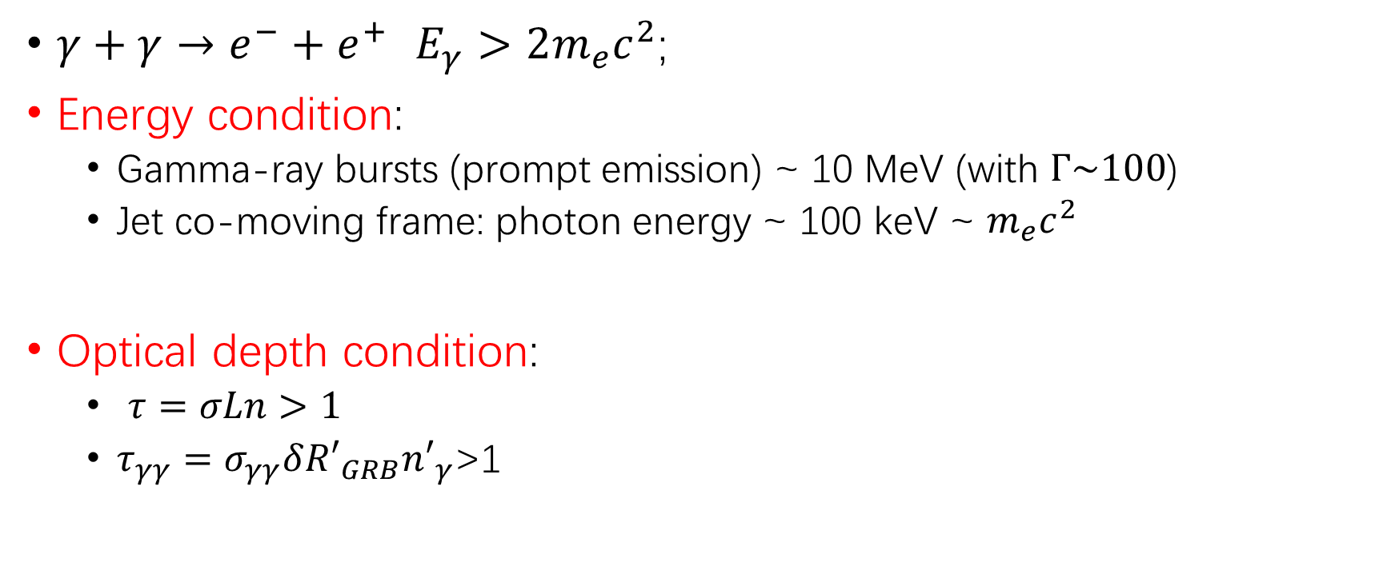
Pair-creation from gamma-gamma
$γ+γ→e^{−}+e^{+}$ $E_{γ}>2m_{e}c^{2}$;
Energy condition:
  Gamma-ray bursts (prompt emission) ~ 10 MeV (with $Γ\sim 100$)
  Jet co-moving frame: photon energy ~ 100 keV ~ $m_{e}c^{2}$
Optical depth condition:
  $τ=σLn>1$
  $τ_{γγ}=σ_{γγ}δ{R′}_{GRB}{n′}_{γ}$>1
Pair-creation and annihilation
GRB221009A
Other models
Search in other bursts
Gamma-ray bursts

Slide 5
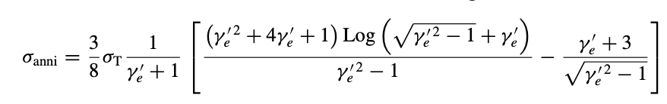

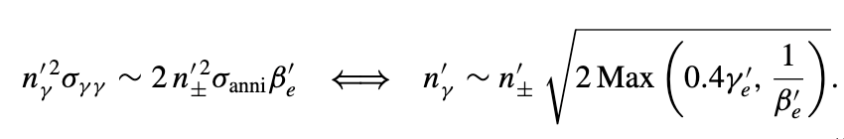

Pair-creation from gamma-gamma
decoupling from counter-reaction:
  $e^{−}+e^{+}⇌γ+γ$;
  $σ_{anni}≥σ_{γγ}$ the produced pairs immediately annihilate
  balance state between pair production and annihilation
(Zhang 2019)
Ruffini et al. 1999, 2000
Bianco, Ruffini & Xue 2001
Pair-creation and annihilation
GRB221009A
Other models
Search in other bursts
Gamma-ray bursts

Slide 6
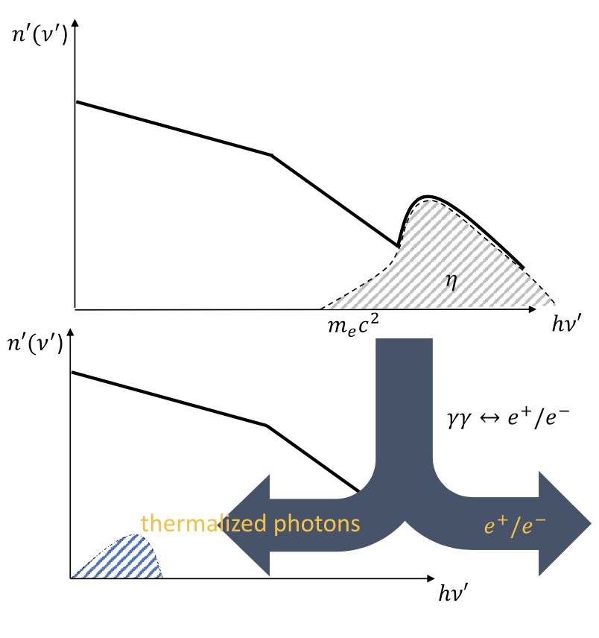
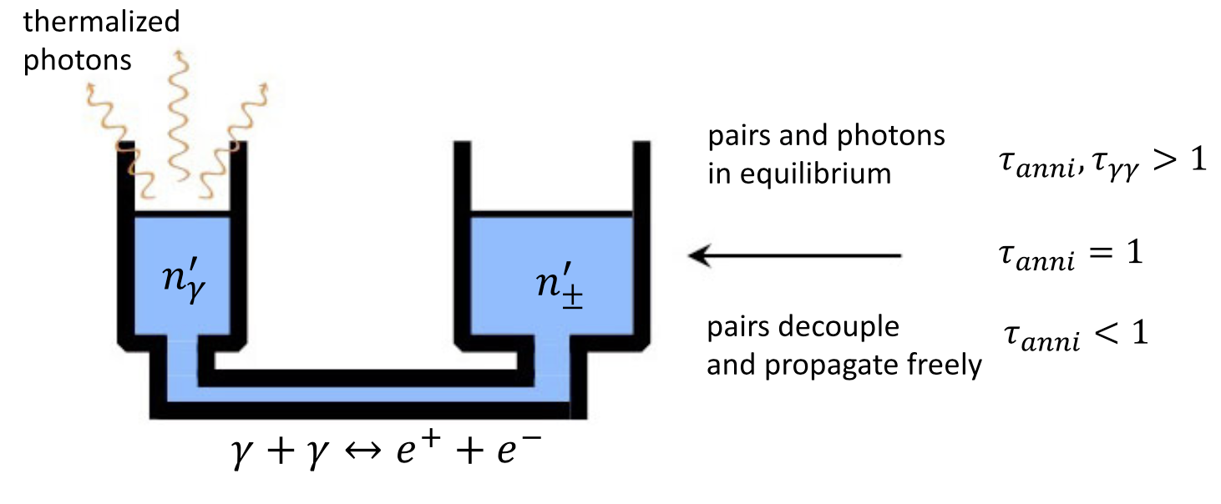
Pair-creation from gamma-gamma
decoupling from counter-reaction:
Yi et al. 2024; MNRAS 535, 982-989
Pair-creation and annihilation
GRB221009A
Other models
Search in other bursts
Gamma-ray bursts

Slide 7
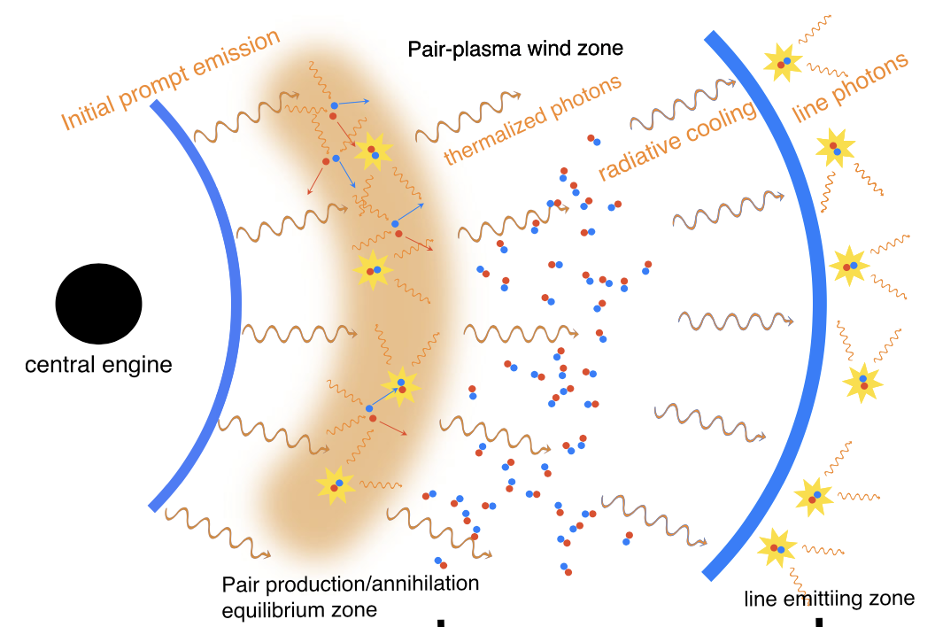
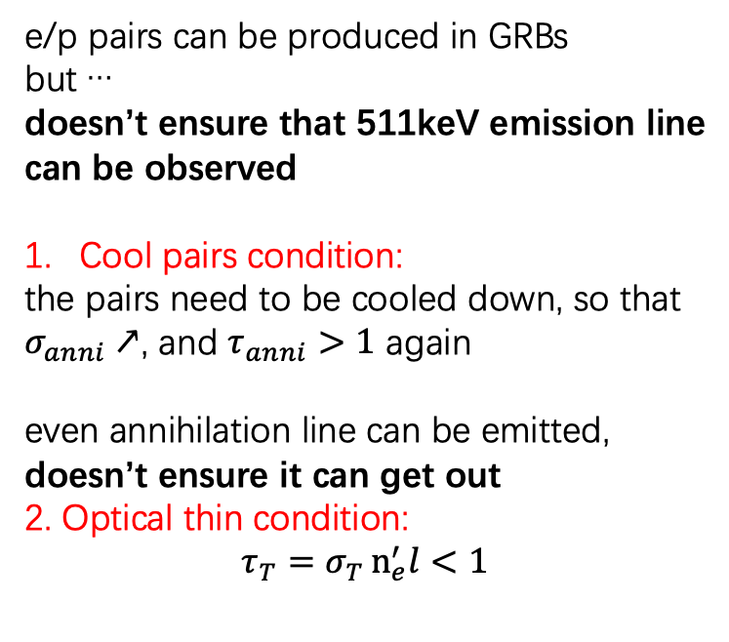
Pair-creation from gamma-gamma
e/p pairs can be produced in GRBs
but …
doesn’t ensure that 511keV emission line
can be observed
Cool pairs condition:
the pairs need to be cooled down, so that
$σ_{anni}↗$, and $τ_{anni}>1$ again
even annihilation line can be emitted,
doesn’t ensure it can get out
2. Optical thin condition:
$$τ_{T}=σ_{T}n_{e}^{′}l{<1 }$$
Yi et al. 2024; MNRAS 535, 982-989
Pair-creation and annihilation
GRB221009A
Other models
Search in other bursts
Gamma-ray bursts

Slide 8
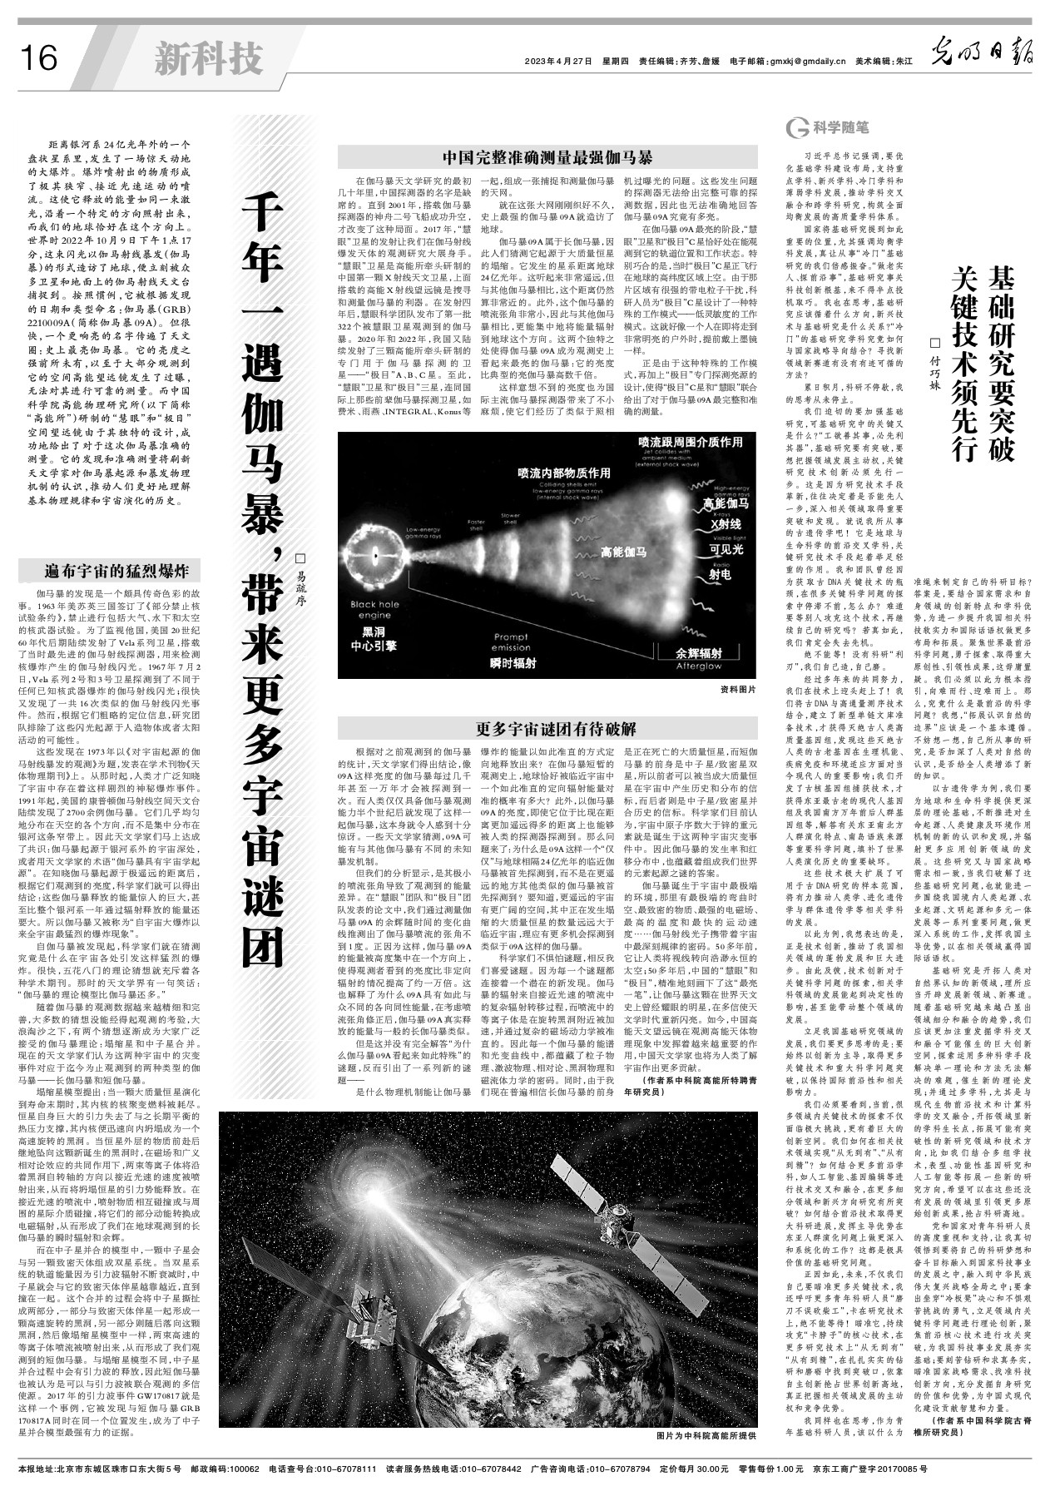
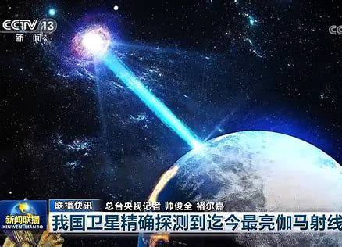
GRB221009A： the brightest of all time
GECAM
慧眼
Pair-creation and annihilation
GRB221009A
Other models
Search in other bursts
Gamma-ray bursts

Slide 9
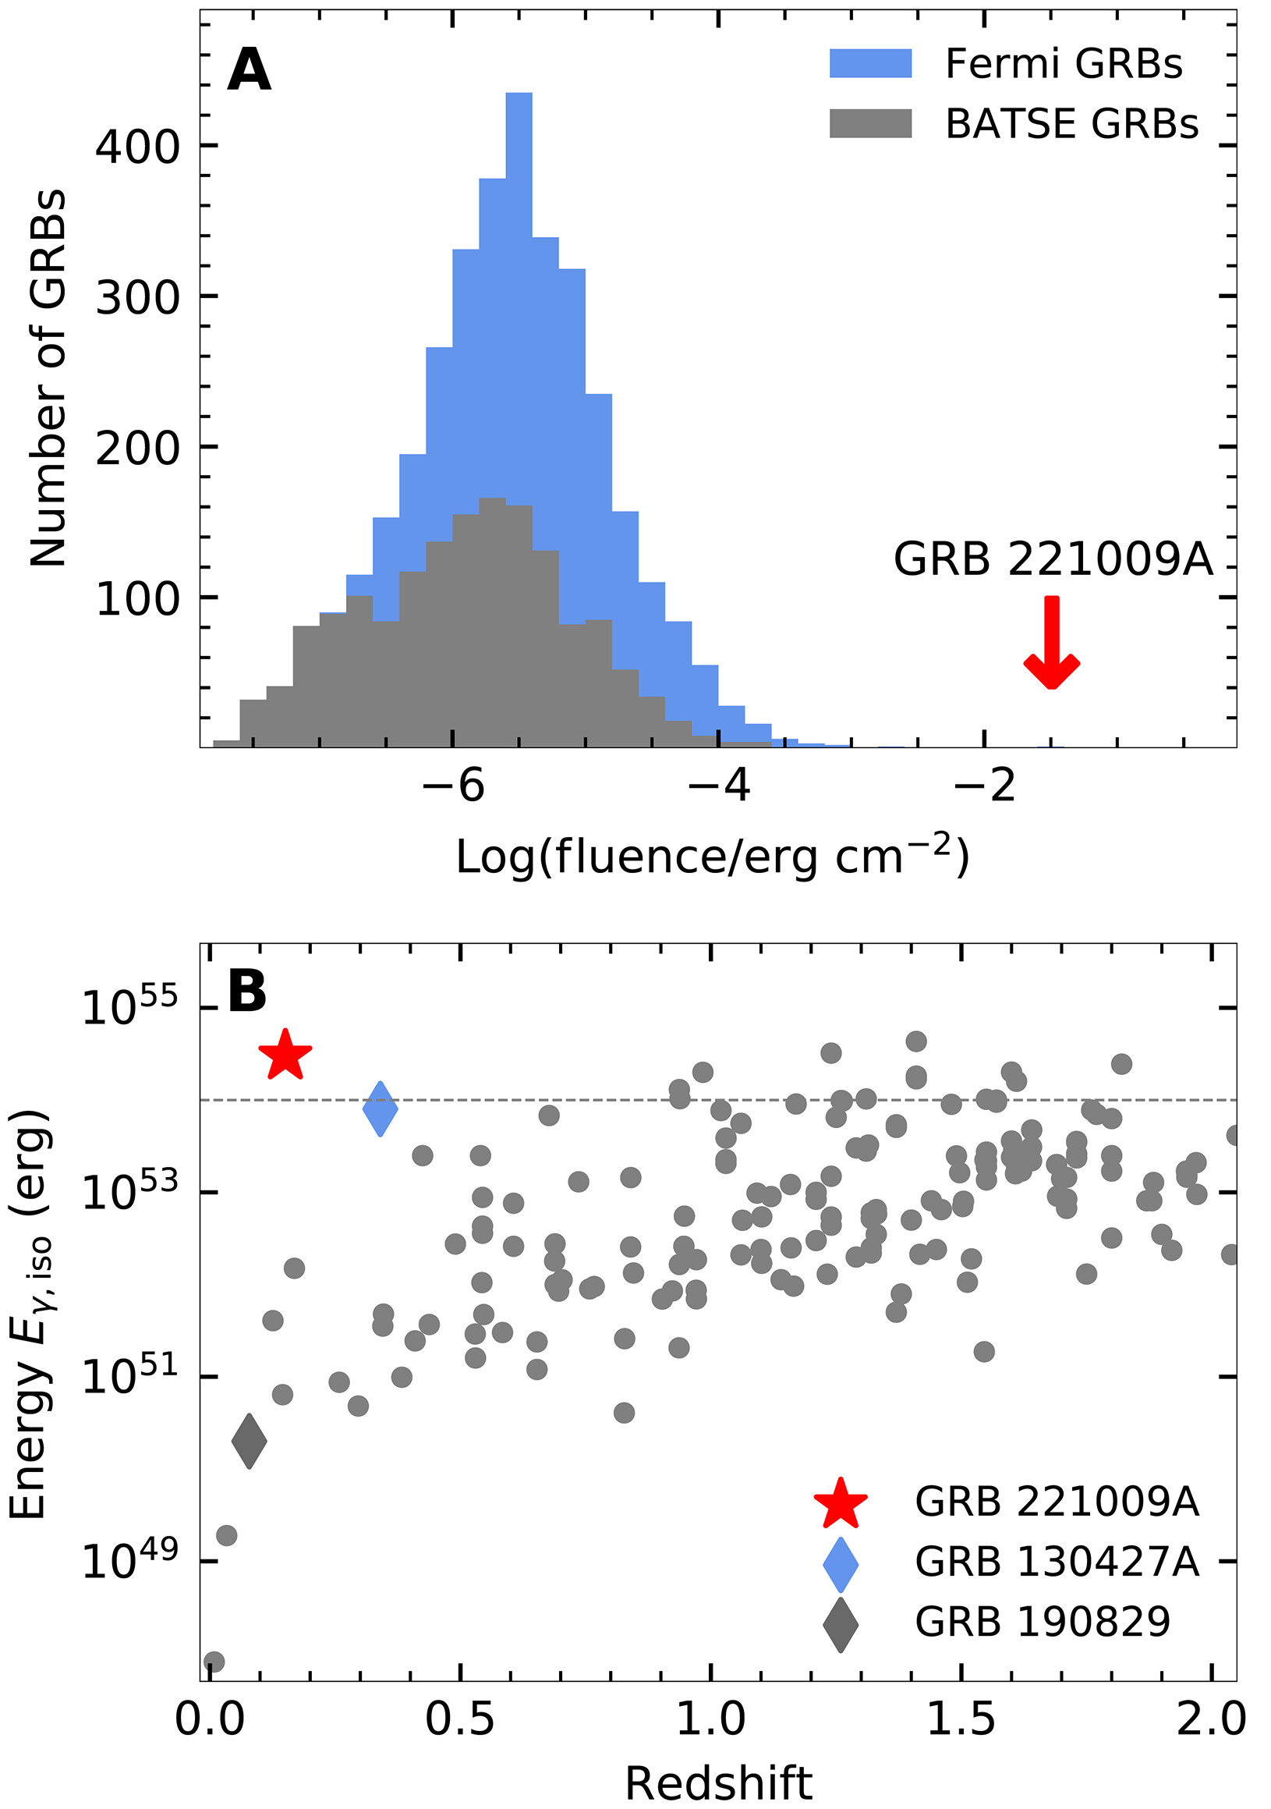
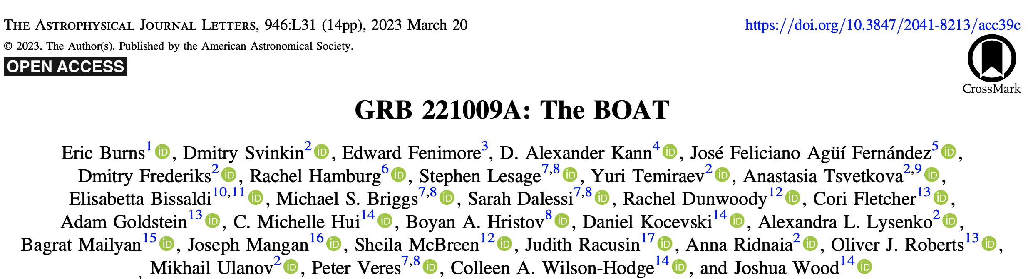
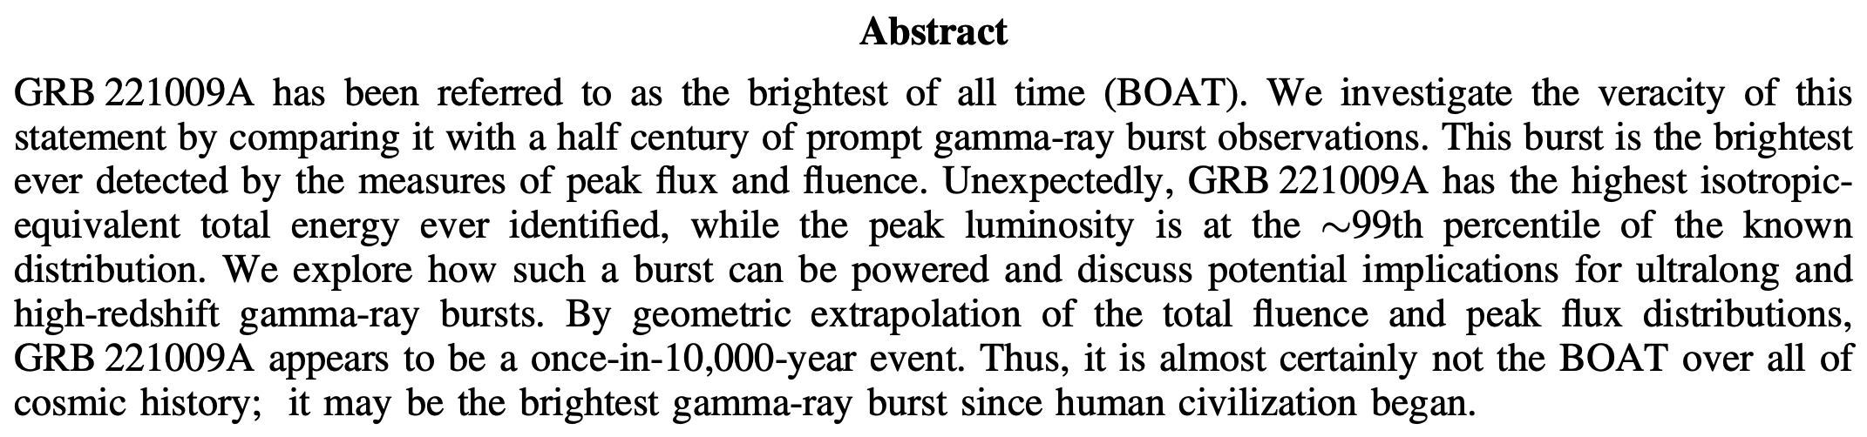
GRB221009A：the brightest of all time
O’Connor Science advance 9,23, 2023
Pair-creation and annihilation
GRB221009A
Other models
Search in other bursts
Gamma-ray bursts

Slide 10
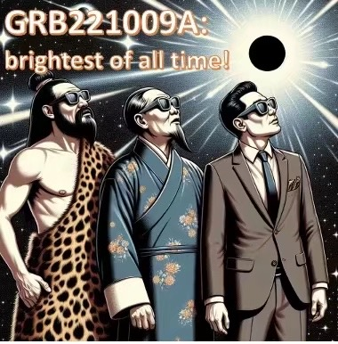
GRB221009A：the brightest of all time
Pair-creation and annihilation
GRB221009A
Other models
Search in other bursts
Gamma-ray bursts

Slide 11
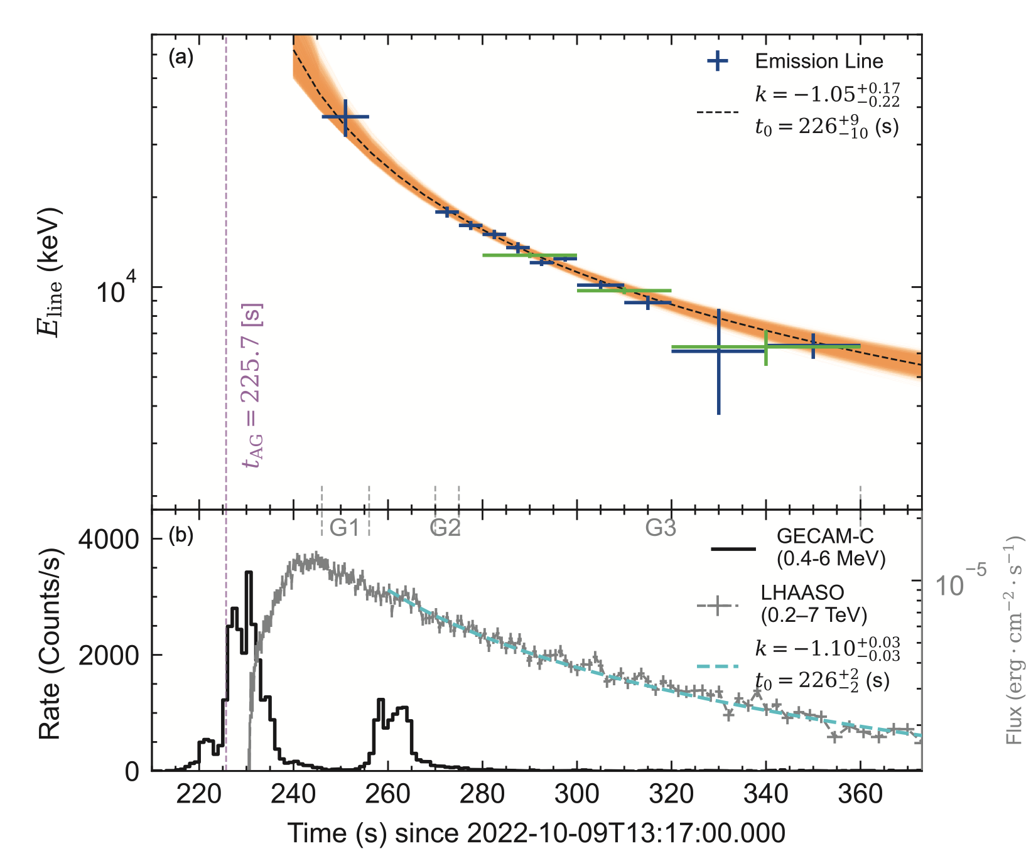
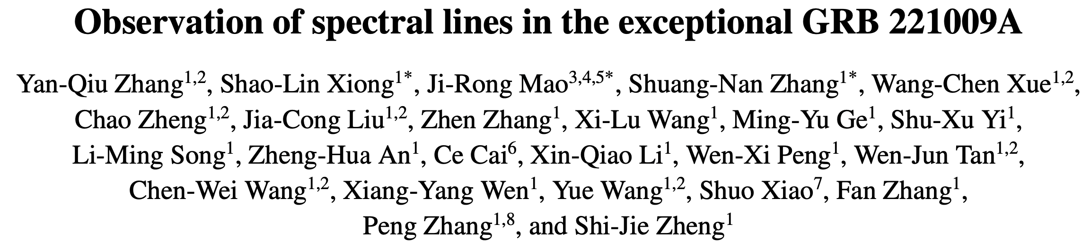
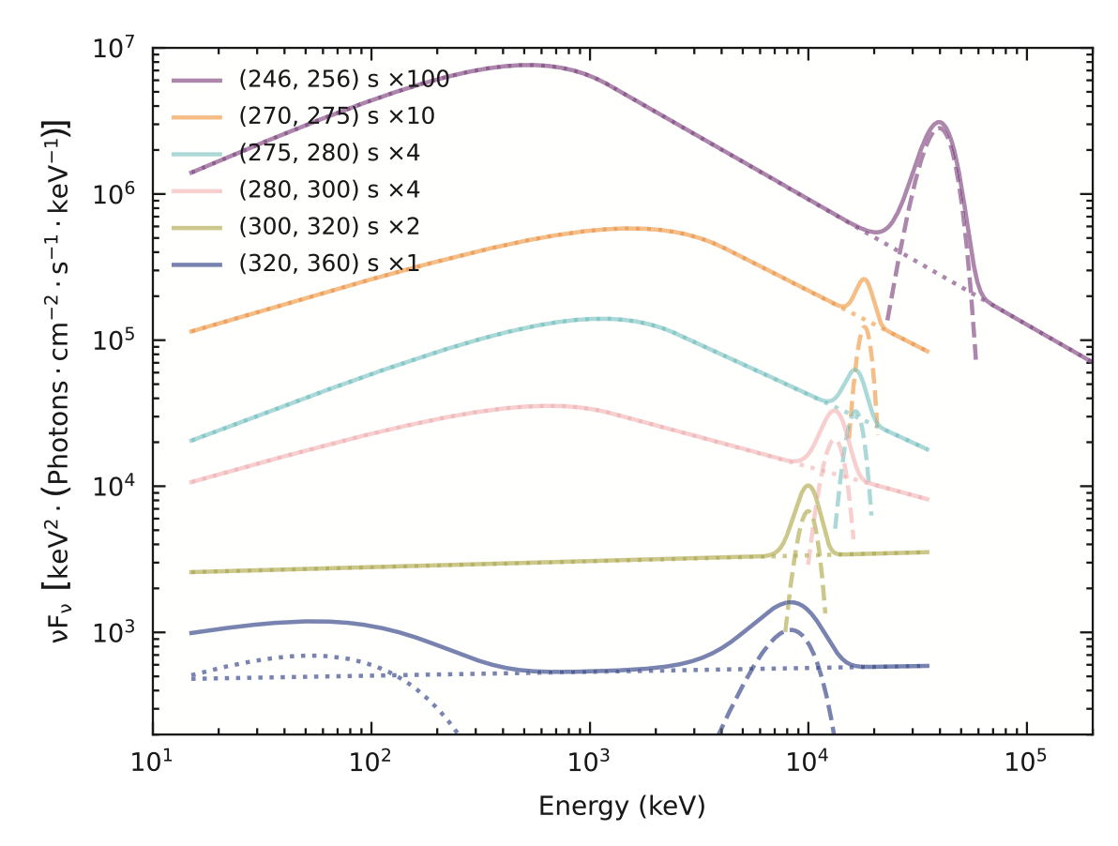
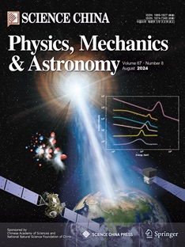
GRB221009A：the brightest of all time
Ravasio et al. reported evidence of line on arXiv
earlier, and later published on Science
Pair-creation and annihilation
GRB221009A
Other models
Search in other bursts
Gamma-ray bursts

Slide 12
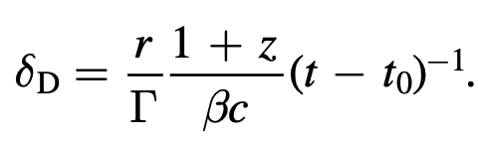
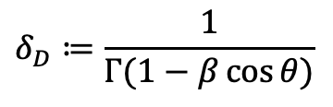

GRB221009A：the brightest of all time
$$E_{obs,line}=δ_{D}E_{line}^{′}$$
$$δ_{D}≔\frac{1}{Γ(1−β\cos{θ})}$$
Zhang Zhen’s talk in details
When $r=2.5×{10}^{16}$cm, and $Γ=500→E_{line}^{′}=511$keV
It is e/e+ pair annihilation line!
Zhang Zhen et al. ApJL 2024
Pair-creation and annihilation
GRB221009A
Other models
Search in other bursts
Gamma-ray bursts

Slide 13
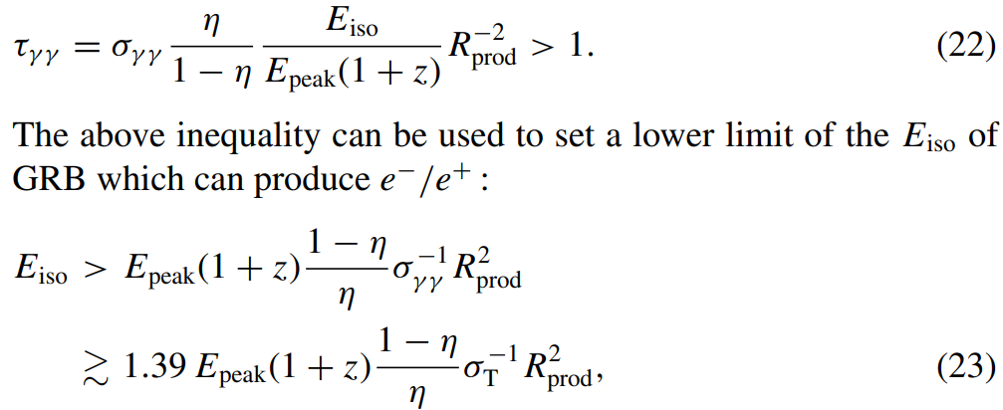
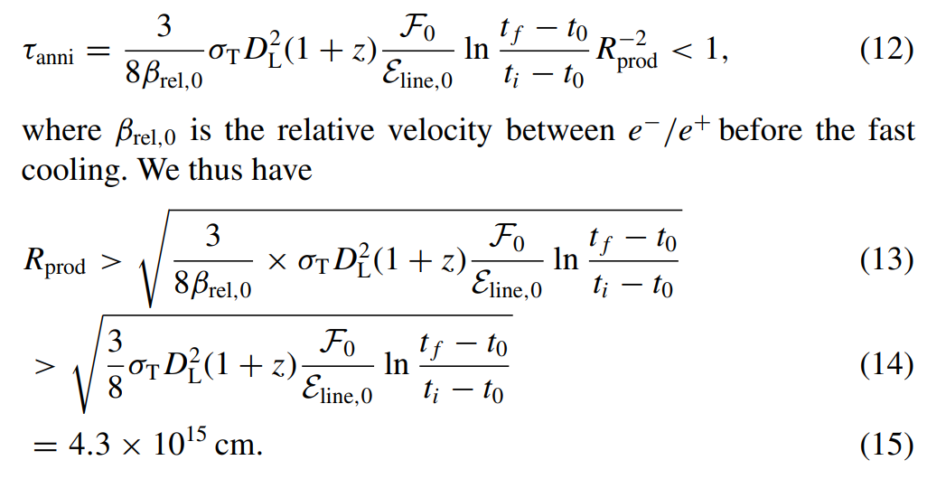
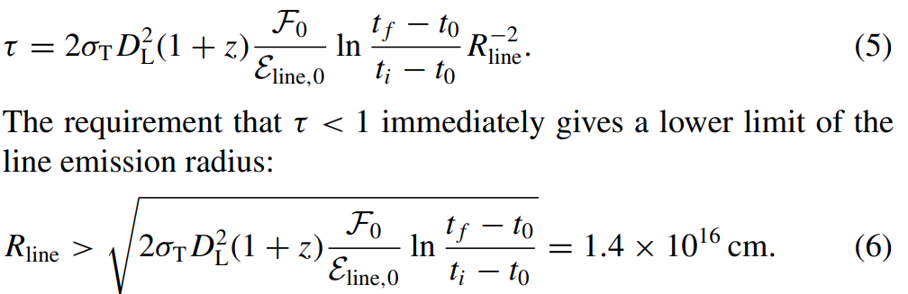
GRB221009A：the brightest of all time
1. pair creation condition
  Energy condition
  Optical depth condition
2. decoupling condition
3. cooling condition
4. optical thin condition
Yi et al. 2024; MNRAS 535, 982-989
Pair-creation and annihilation
GRB221009A
Other models
Search in other bursts
Gamma-ray bursts

Slide 14
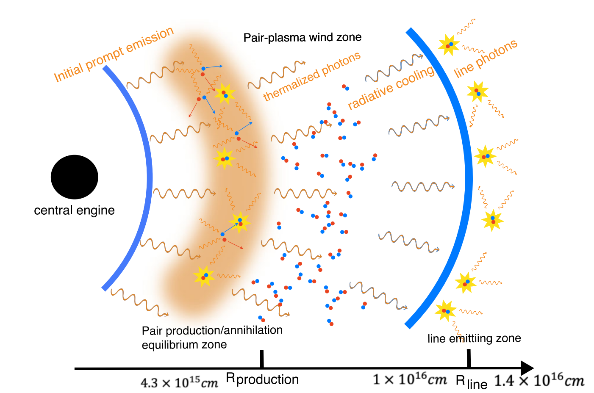
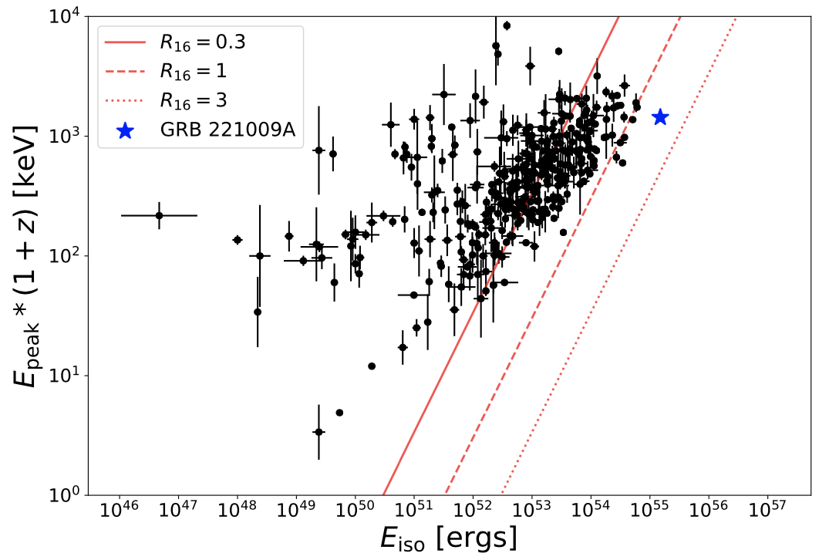
GRB221009A：the brightest of all time
Yi et al. 2024; MNRAS 535, 982-989
Pair-creation and annihilation
GRB221009A
Other models
Search in other bursts
Gamma-ray bursts

Slide 15
GRB221009A MeV line: other explanation
Reference Paper | Name of the Model | Problem of the Model
Zhang Zhen et al. 2024 | Dynamical evolution of the GRB jet | The bulk Lorentz factor of the shock would decrease to Γ ∼20 within ∼100 s, conflicting with TeV emission modeling
Zhang Zhen et al. 2024 | Thermal component | A blackbody-like spectral profile is much broader, incompatible with the observed narrow line width.
Y.-J. Wei et al. (2024) | keV-scale atomic line of a heavy element boosted by a jet | requiring \Gamma \gg 10^{3} for the observed line central energy up to ~37 MeV and failing to explain the power-law evolution of the line.
Zhang Zhen et al. 2024 | Nuclear decay of a specific radioisotope | - Difficulty in finding a feasible nucleosynthesis process to create such a radioisotope with a short lifetime and excessively large mass.The required mean lifetime \tau_{d} \gtrsim 10^{3}-10^{4} ~s and mass M_{iso} \gtrsim A_{iso} f_{d}^{-1} M_{\odot} are inconsistent with typical amounts synthesized in GRB-related explosive events.
Jiahuan Zhu, Hua Feng, and Tong Liu (2025) | Neutron capture | - The James Webb Space Telescope (JWST) near-infrared observations did not find evidence for r-process products associated with GRB 221009A, which may pose a caveat for the model.
Zhang Zhen’s talk in details
Pair-creation and annihilation
GRB221009A
Other models
Search in other bursts
Gamma-ray bursts

Slide 16
Line search in other bursts
Authors | Title | Main Content | Main Conclusions
Liao, Tong-Lei et al. | Spectral Line Search in Bright Gamma-Ray Bursts Observed by Fermi/GBM | Searched for emission lines in top 30 highest fluence GRBs via Fermi/GBM; no new lines confirmed, but found possible features at ~61 keV, 110 keV, 2.1 MeV. | ~110 keV line likely from instrumental effects; ~61 keV and ~2.1 MeV resemble known lines from ¹²⁷I and neutron capture; caution needed to distinguish origins; GRB 221009A's lines have special radiation mechanism.
Liao, Tong-Lei et al. | Candidate Spectral Lines at 6 and 15 MeV from GRB 200829A and GRB 160905A | Searched 3941 GRBs in Fermi/GBM (2008-2025); no confirmed lines, but found ~15 MeV (GRB 160905A) and ~6 MeV (GRB 200829A) candidates. | GRB 200829A's rest-frame ~13 MeV line (z=1.25) is close to GRB 221009A's, possibly sharing origin (e.g., blueshifted e⁺e⁻ annihilation); no >5σ lines in sample, only two ~3σ candidates, constraining GRB 221009A's line peculiarity.
Pair-creation and annihilation
GRB221009A
Other models
Search in other bursts
Gamma-ray bursts

Slide 17
Summary
伽马暴瞬时辐射中可能产生正负电子对湮灭谱线，但条件苛刻；
史上最亮伽马暴中发现MeV谱线：能量随时间幂律衰减
  符合正负电子湮灭线+高纬度效应；
其他解释存在各种困难
在其他伽马暴中搜索谱线，尚无确认
Pair-creation and annihilation
GRB221009A
Other models
Search in other bursts
Gamma-ray bursts
summary

