Slide 1
Group meeting
张旺
2025.4.3

Slide 2
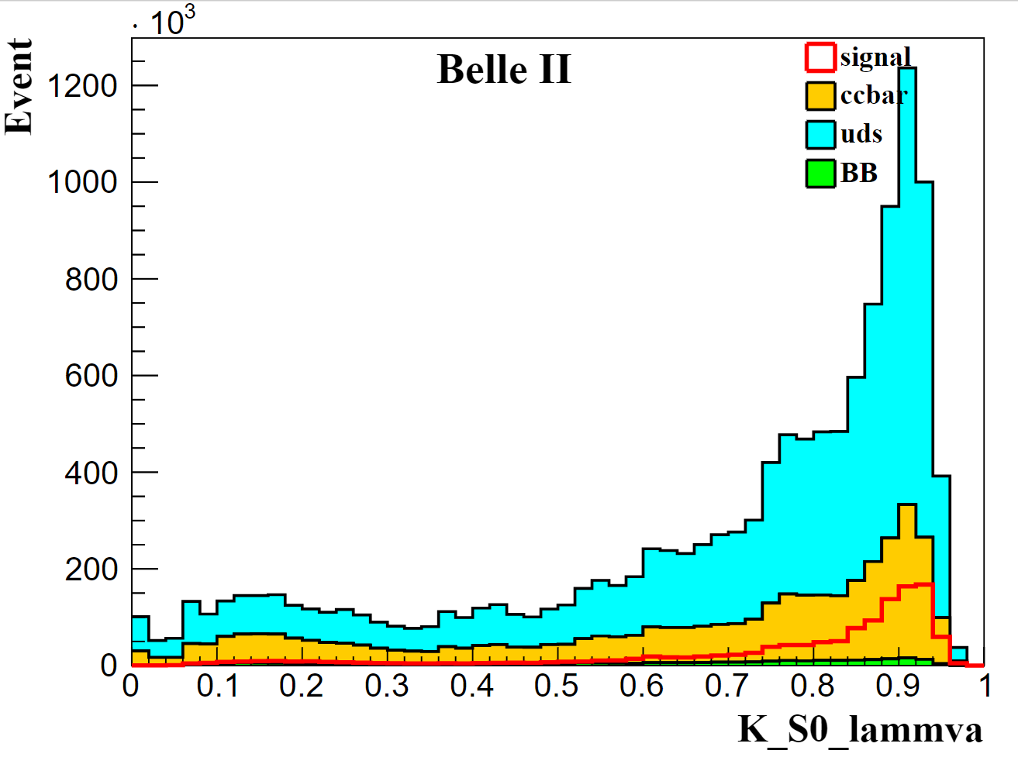
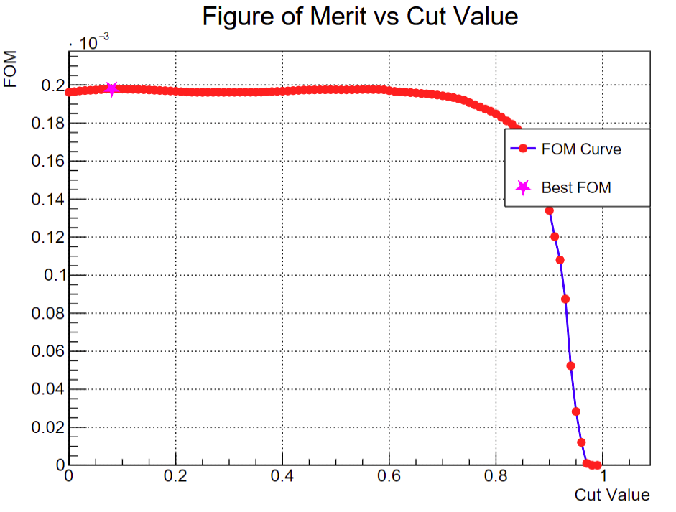
Ks_lammva>0.2
Target | Selection | signal efficiency | SCF
 | Baseline | 33.06% | 24.57%
gamma | coshelicity | 32.49% | 24.51%
 | gamma_E | 19.53% | 7.80%
$$π^{0}$$ | $π^{0}$ mass window | 19.32% | 7.44%
 | daughterAngle | 19.29% | 7.40%
 | chiSqrd | 18.39% | 6.94%
$$K_{S}^{0}$$ | $K_{S}^{0}$ mass window | 17.15% | 6.54%
 | V0mva | 15.84% | 6.53%
 | lammva | 15.77% | 6.53%
 | goodBelleKshort | 14.93% | 6.51%

Slide 3
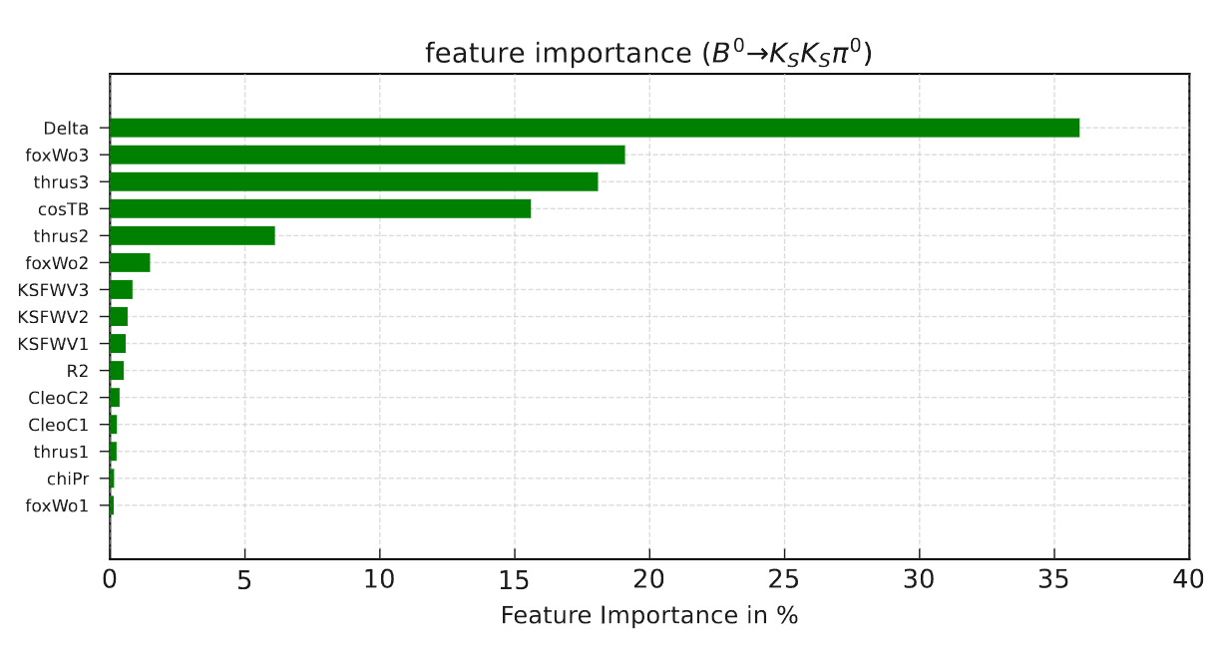
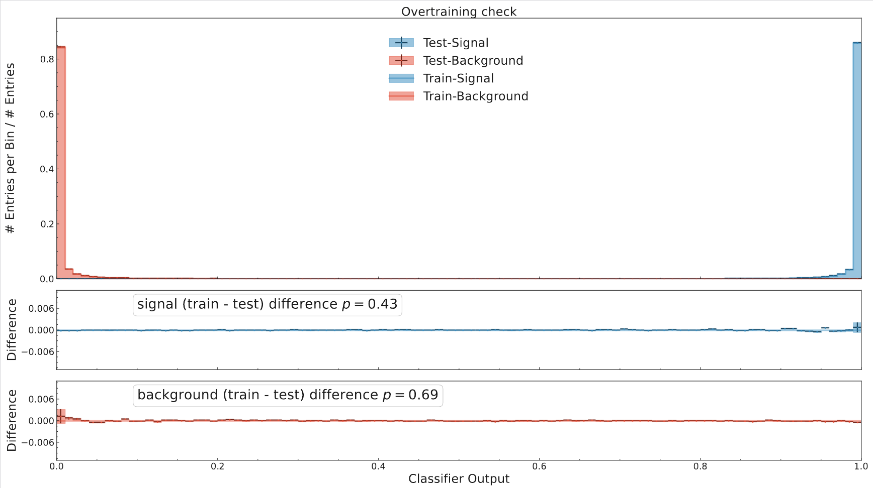
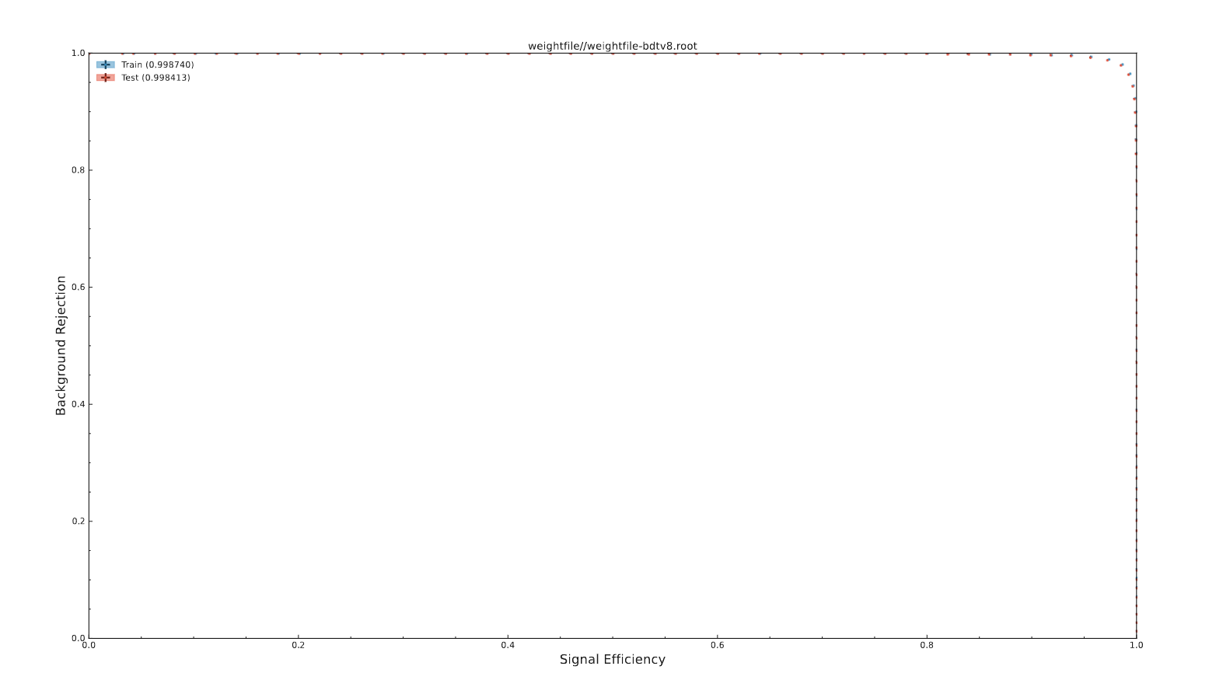
Continuum Suppression
Total 15 variables used in FBDT training
Event shape variables
Vertex fit variables
Train:400000 evevts each for signal and qqbar
Test:100000 evevts each for signal and qqbar
Train:0.998740
Test:0.998413

Slide 4
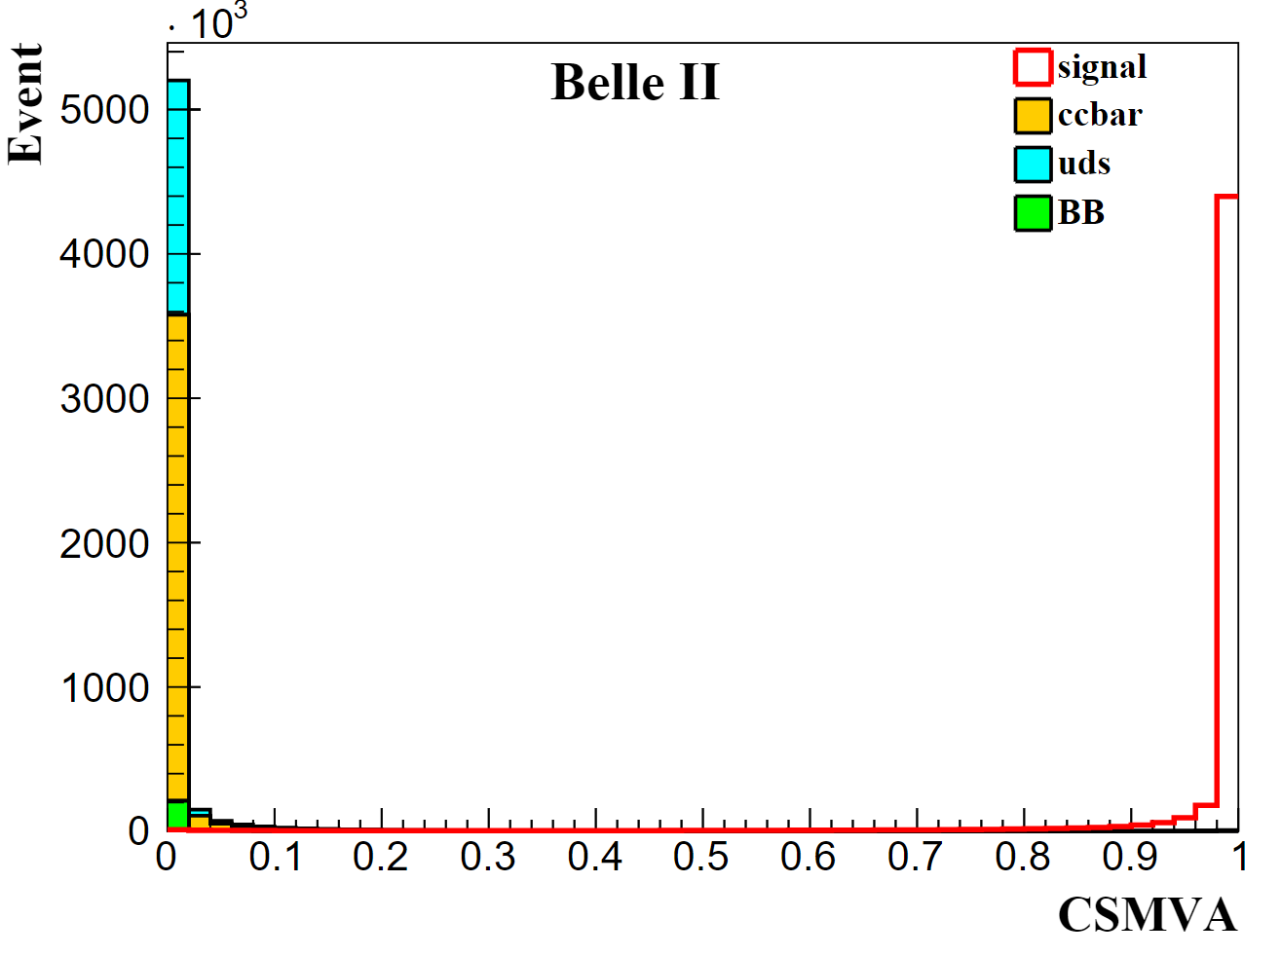
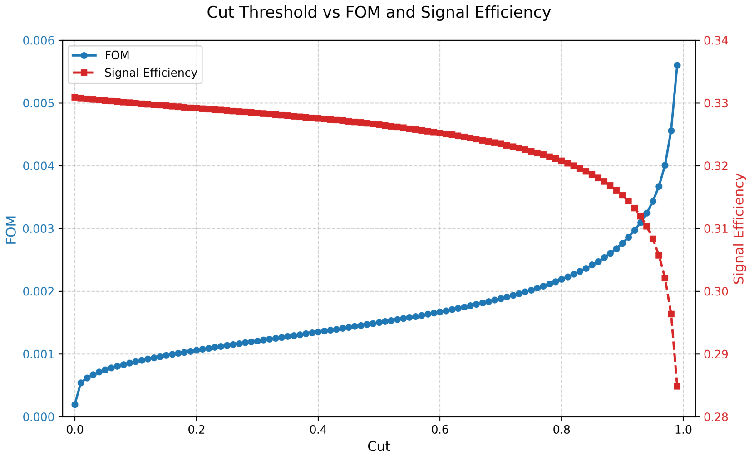
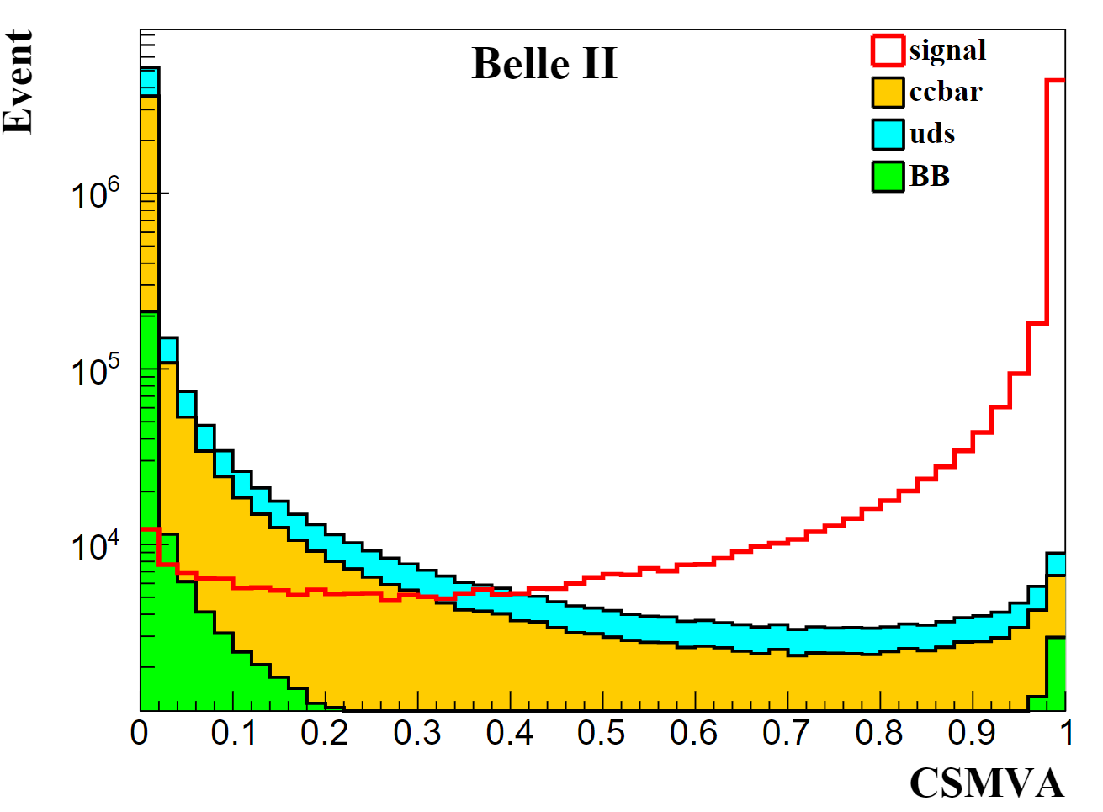
Continuum Suppression
CSMVA > 0.9

Slide 5
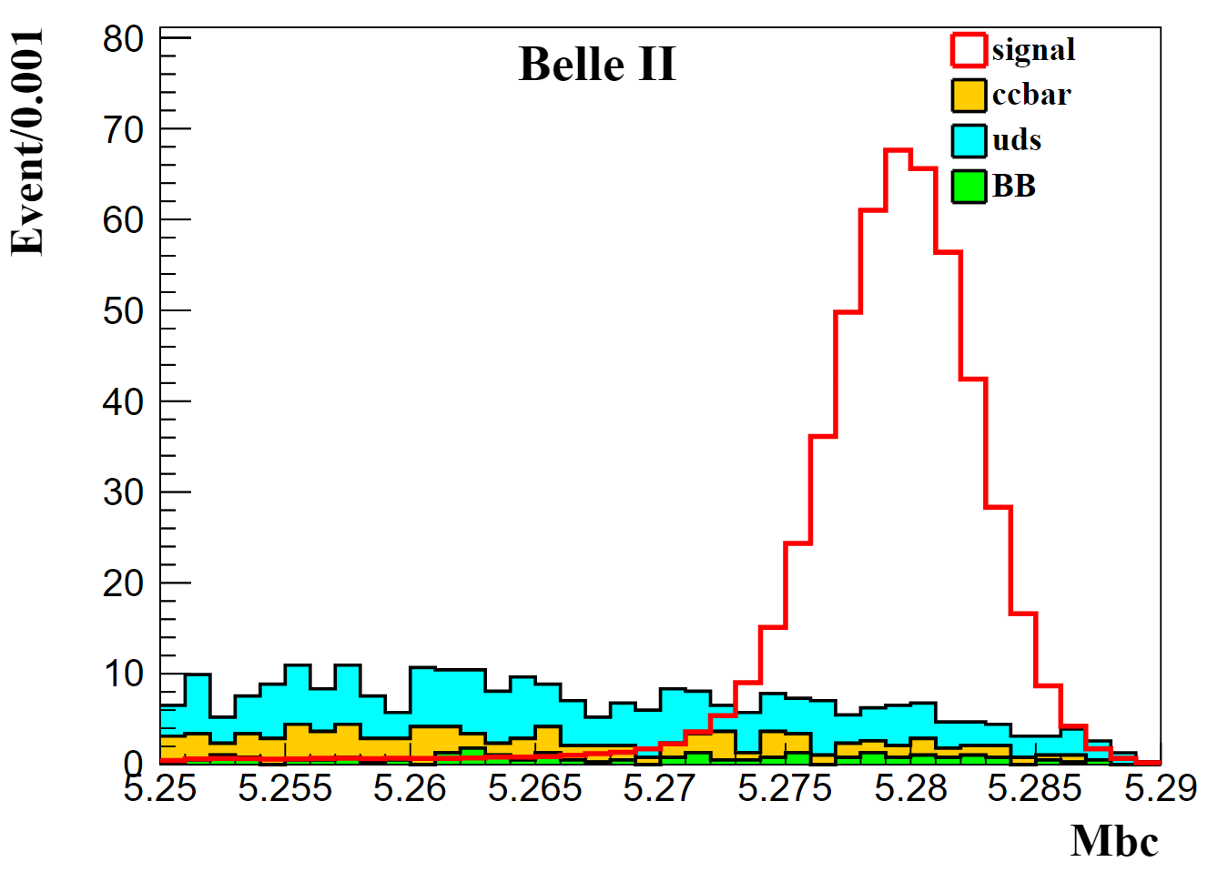
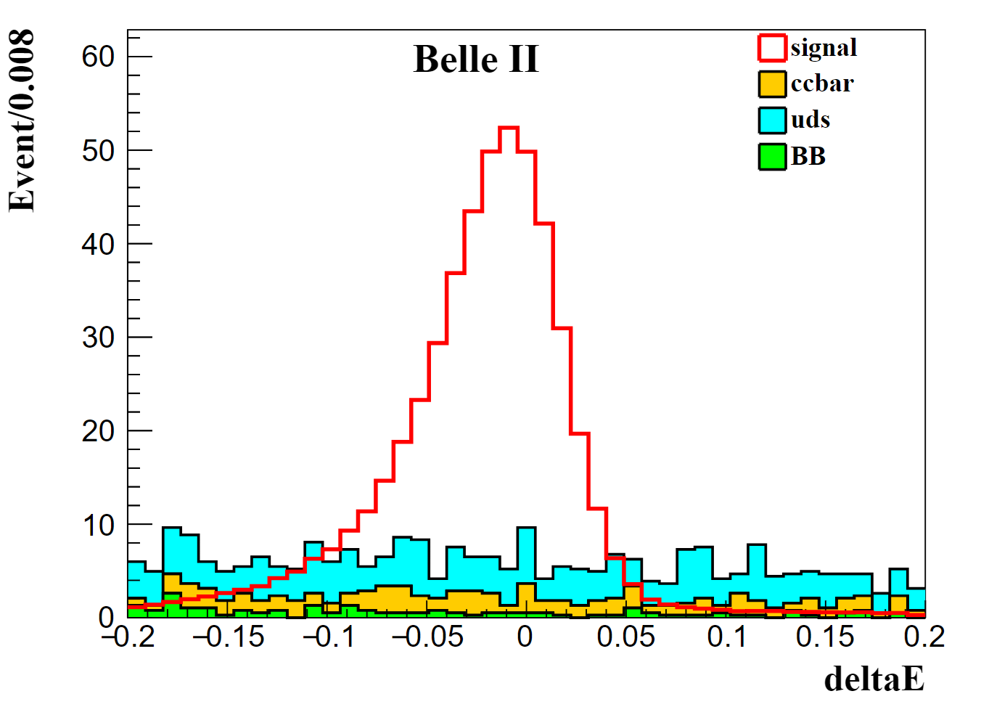
Cut flow
Target | Selection | signal efficiency | SCF
 | Baseline | 33.06% | 24.57%
gamma | coshelicity | 32.49% | 24.51%
 | gamma_E | 19.53% | 7.80%
$$π^{0}$$ | $π^{0}$ mass window | 19.32% | 7.44%
 | daughterAngle | 19.29% | 7.40%
 | chiSqrd | 18.39% | 6.94%
$$K_{S}^{0}$$ | $K_{S}^{0}$ mass window | 17.15% | 6.54%
 | V0mva | 15.84% | 6.53%
 | lammva | 15.77% | 6.53%
 | goodBelleKshort | 14.93% | 6.51%
CS | CSMVA | 14.36% | 6.24%
99.99% bkg off
65.09% signal remain
*scale to 365 fb⁻¹ , siganl is scaled to half of bkg

Slide 6
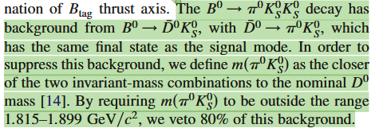
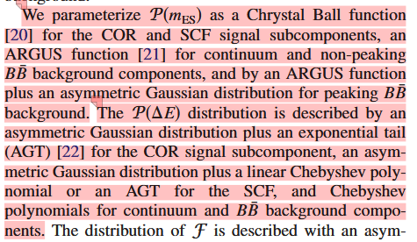
Ongoing
BBbar background
MC Fit
peaking bkg

