Slide 1

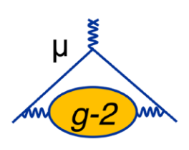

Final measurement with 0.12 ppm precision from the Muon g-2 Experiment at Fermilab
Bingzhi Li
Zhejiang Lab
On behalf of the Muon g-2 Collaboration
17th International Conference on Heavy Quarks and Leptons (HQL2025)
15 Sep 2025

Slide 2
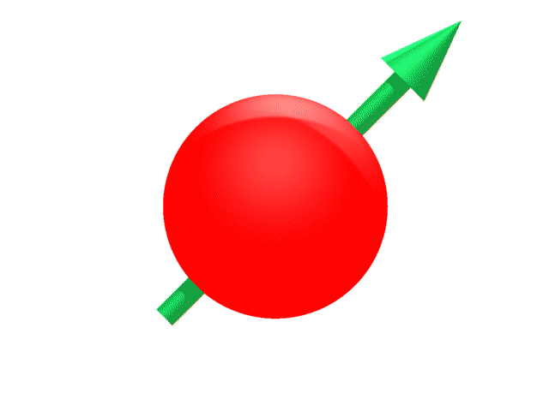
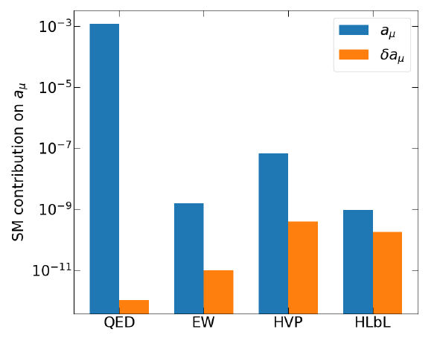
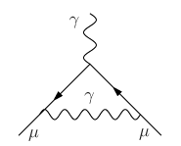
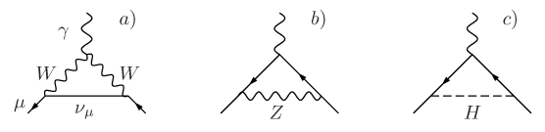
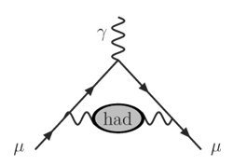
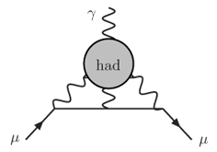
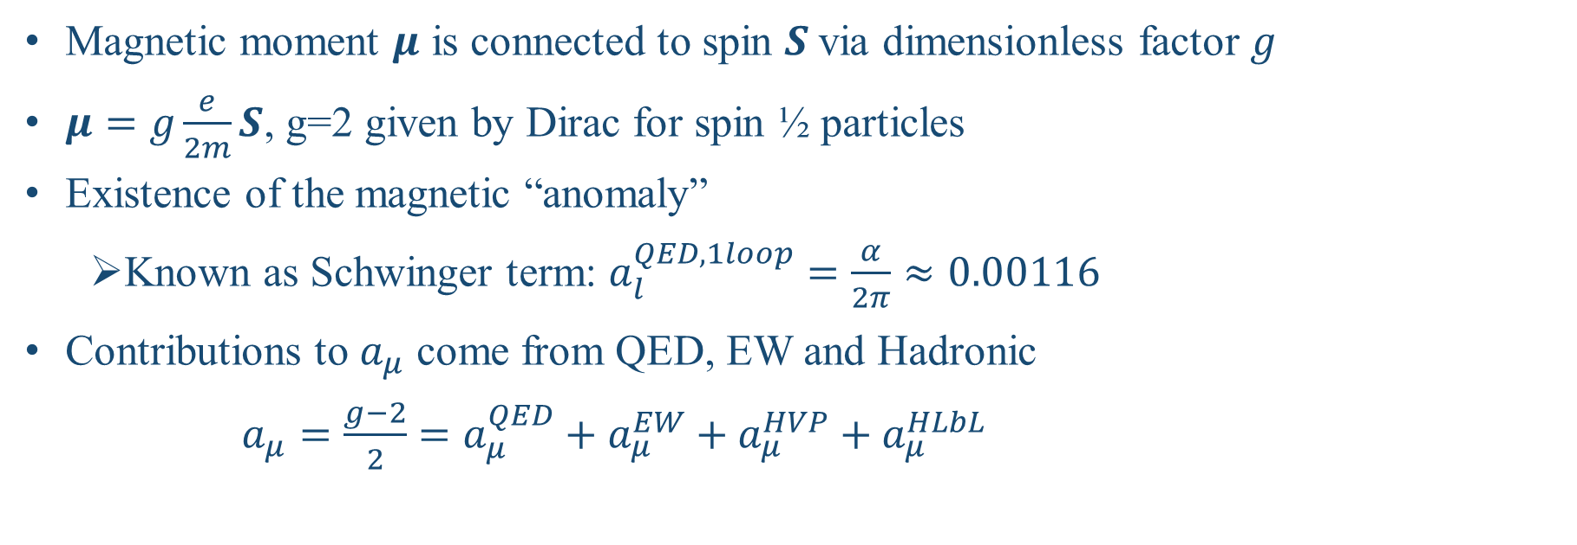
2
Muon Magnetic Moment
B
Magnetic moment $μ$ is connected to spin $S$via dimensionless factor $g$
$μ=g\frac{e}{2m}S$, g=2 given by Dirac for spin ½ particles
Existence of the magnetic “anomaly”
  Known as Schwinger term: $a_{l}^{QED,1loop}=\frac{α}{2π}≈0.00116$
Contributions to $a_{μ}$ come from QED, EW and Hadronic
$a_{μ}=\frac{g−2}{2}=a_{μ}^{QED}+a_{μ}^{EW}+a_{μ}^{HVP}+a_{μ}^{HLbL}$

Slide 3
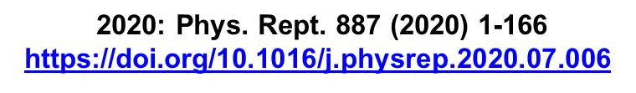
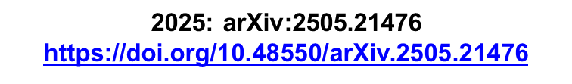
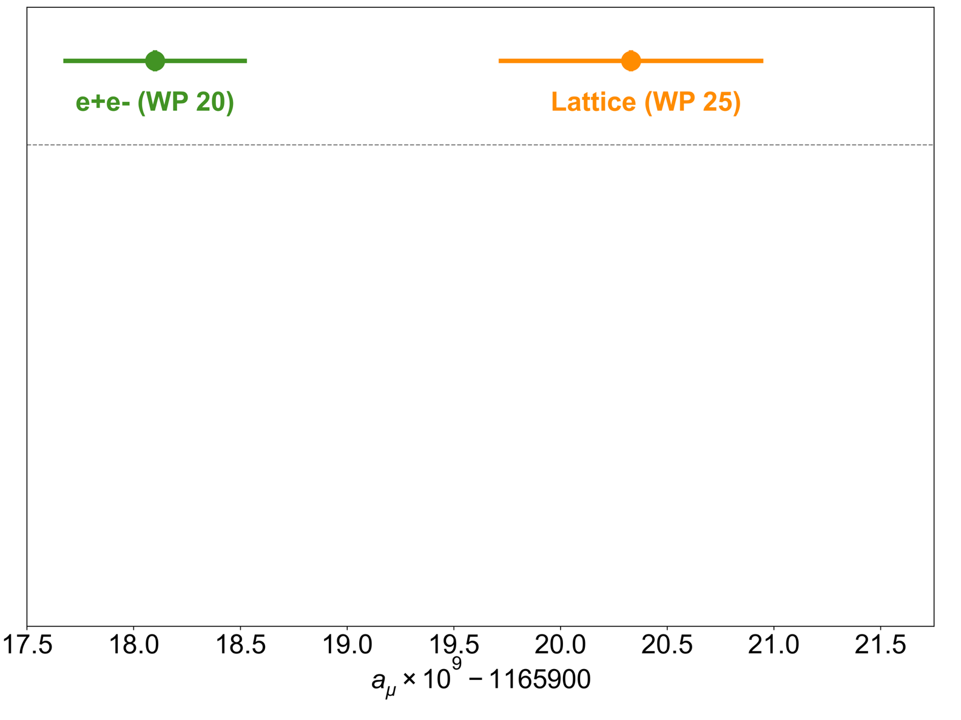
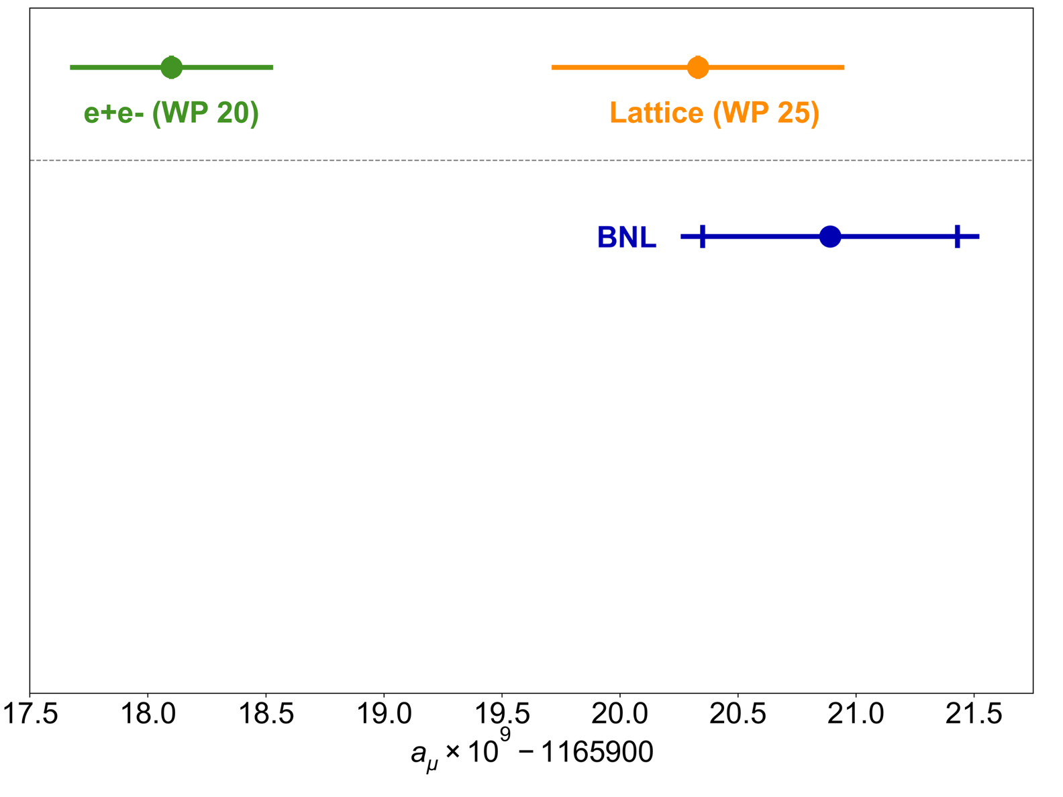
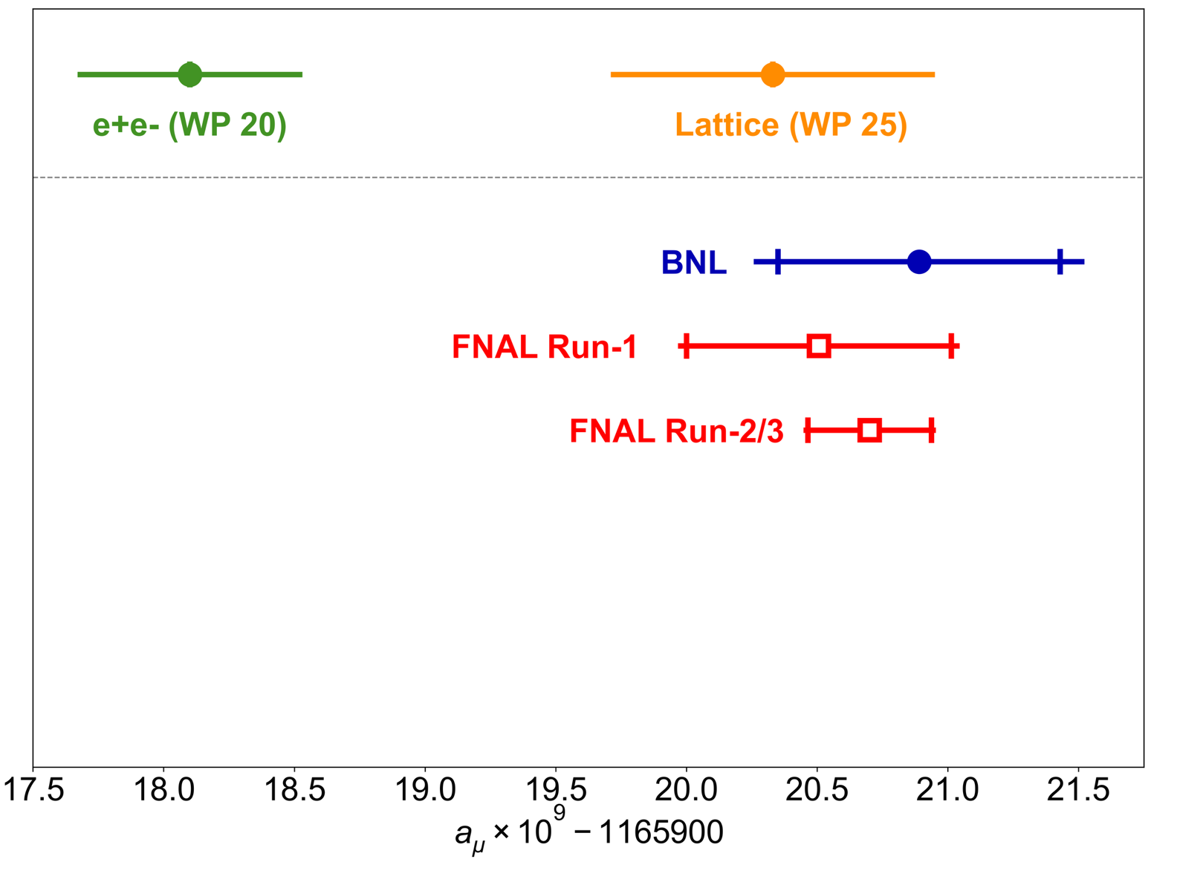
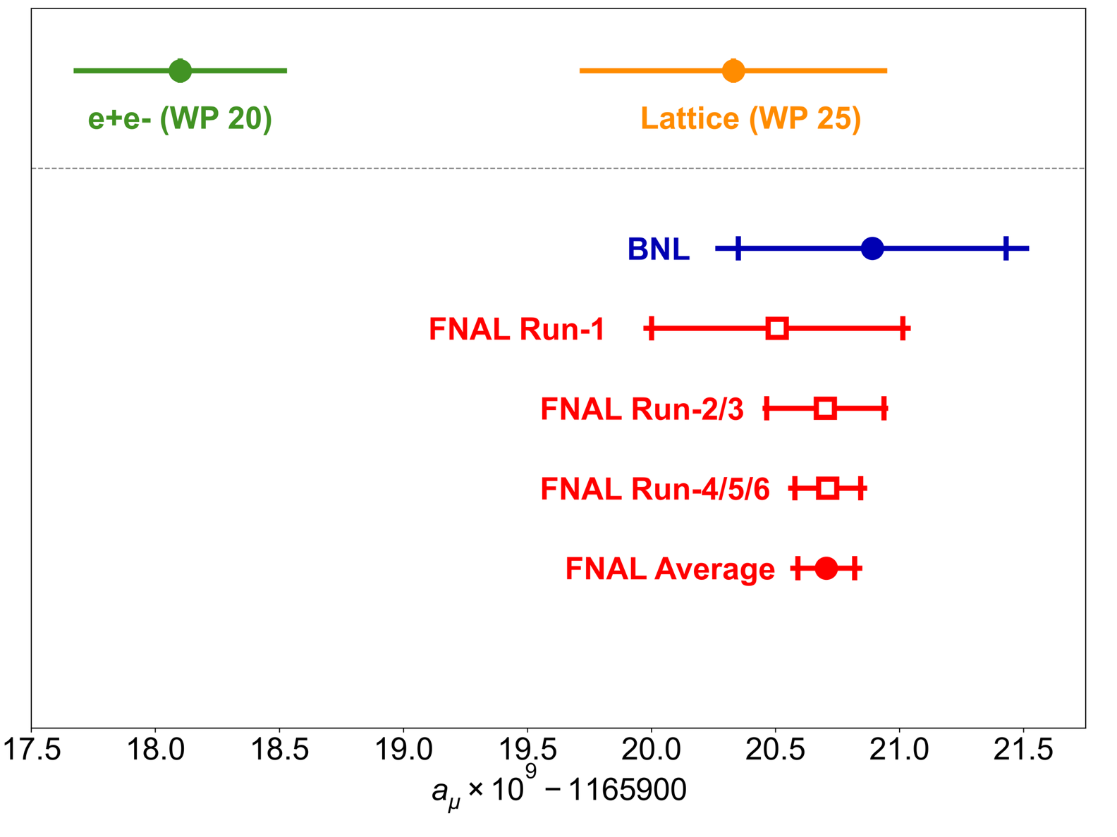
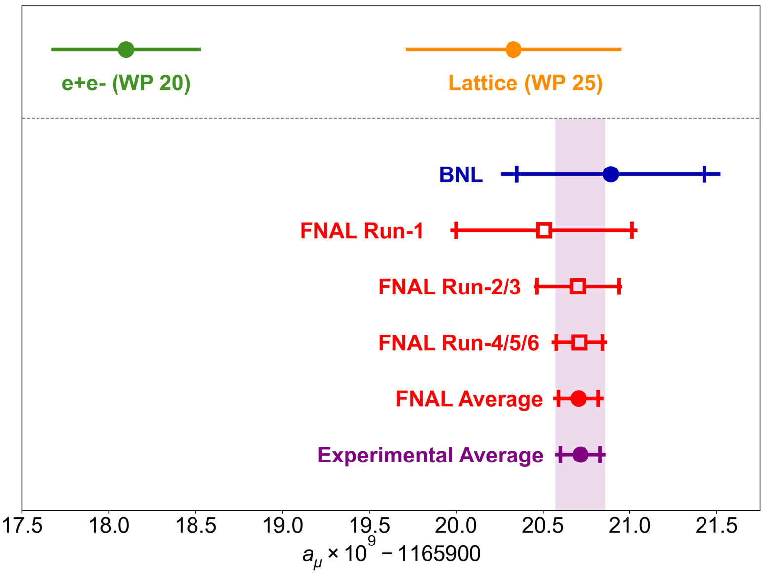
3
Comparison between experiment and SM
White Paper compilations released in 2020 and 2025:
Tension
https://doi.org/10.1103/PhysRevD.73.072003
BNL E821 (2004) disagreed with SM prediction at the time
https://doi.org/10.1103/PhysRevLett.126.141801
First FNAL results (2021 & 2023) confirm BNL result
https://doi.org/10.1103/PhysRevLett.131.161802
https://doi.org/10.48550/arXiv.2506.03069
Final FNAL result in June 2025:
a_{μ}(FNAL) = 0.001165920705(148) [127 ppb]
Dominates world average: 0.001165920715(145) [124 ppb]
Agree with lattice prediction, but tension with data-driven prediciton remains

Slide 4
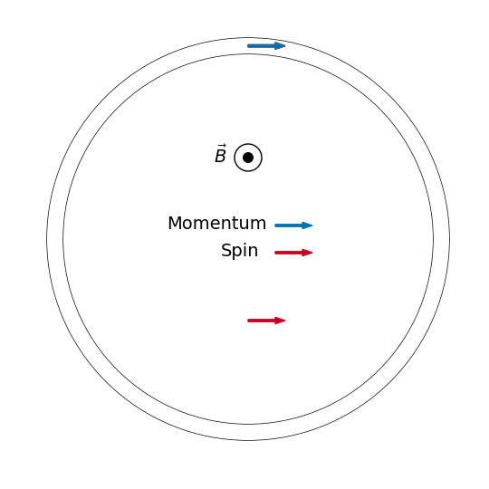


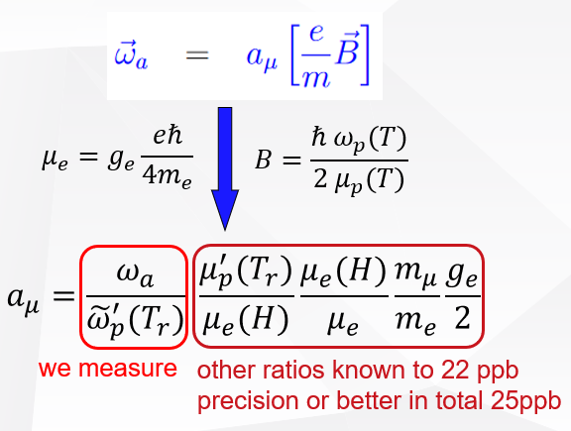

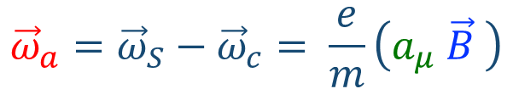
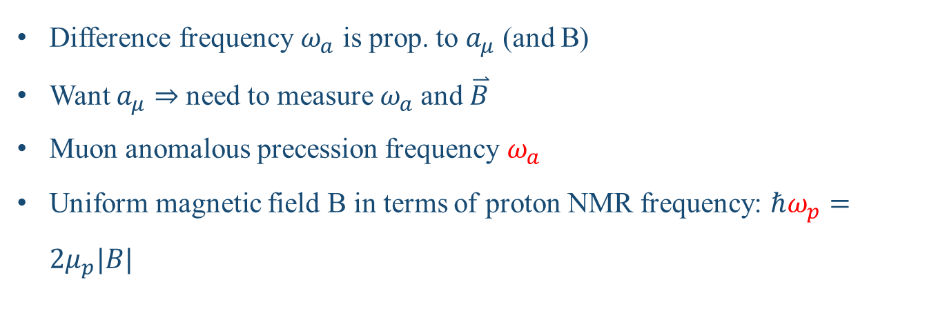
4
Overview of the Measurement Principle
•
$${\vec{ω}}_{a}={\vec{ω}}_{S}−{\vec{ω}}_{c}= \frac{e}{m}\left(a_{μ} \vec{B} \right)$$
$$g=2$$
Difference frequency $ω_{a}$ is prop. to $a_{μ}$ (and B)
Want $a_{μ}$ ⇒ need to measure $ω_{a}$and $\overset{⃑}{B}$
Muon anomalous precession frequency $ω_{a}$
Uniform magnetic field B in terms of proton NMR frequency: $ℏω_{p}=2μ_{p}|B|$
Notes:
Spin rotates ahead of momentum as muon orbits the ring
At each point in the ring spin rotates radially in & out at w_a

Slide 5
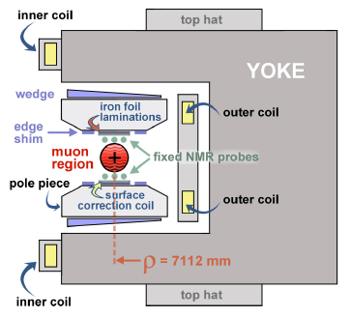
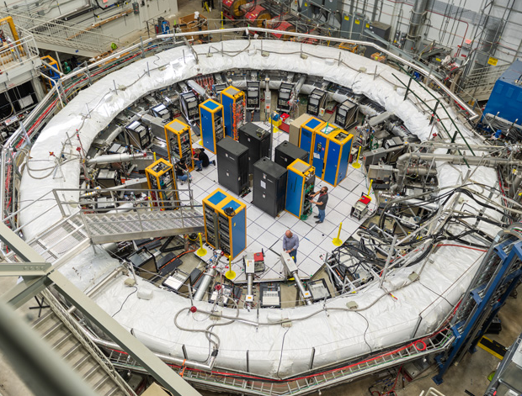
5
Storage Ring Magnet
cross-section of the yoke
B
Superconducting coils
C-shaped yoke
1.45T field strength
muon storage ring

Slide 6
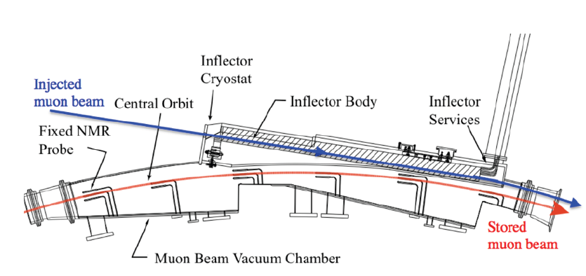
6
Storage the Muon: Injection
muon
The inflector magnet
Muon Injection
Cancel field in beam channel
Prevents strong deflection of the beam
Minimal perturbation to storage magnetic field
Superconducting inflector magnet are used to achieve above requirements
muon storage ring

Slide 7
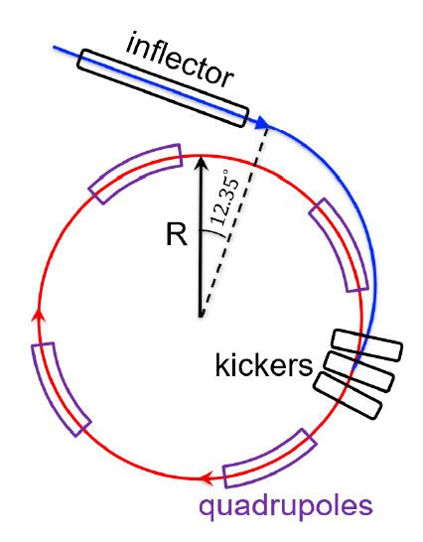

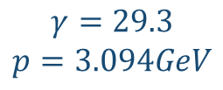
7
Storage the Muon: Kicker and ESQ
Muon Storage: Kicker
After inflector, muons enter storage region at 77 mm outside central closed orbit
The fast-kicker system steers muons onto stored orbit
muon
Muon Storage: Electrostatic Quadrupoles (ESQ)
Drives the muons towards the central part of storage region vertically
Aluminum ESQ cover ~43% of total ring
muon storage ring
$$γ=29.3$$
$$p=3.094GeV$$

Slide 8
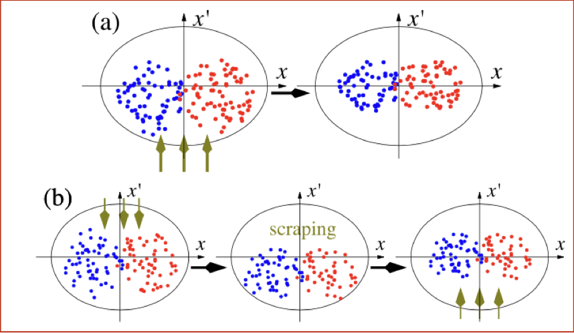
8
Storage the Muon: RF-matching System
muon
RF voltage was superimposed to the quad voltage (Run5/6)
Damp beam dynamics oscillations and scrap the beam
muon storage ring

Slide 9
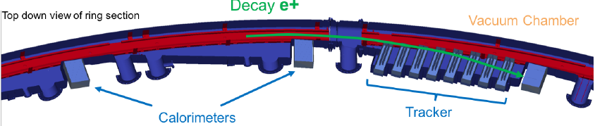
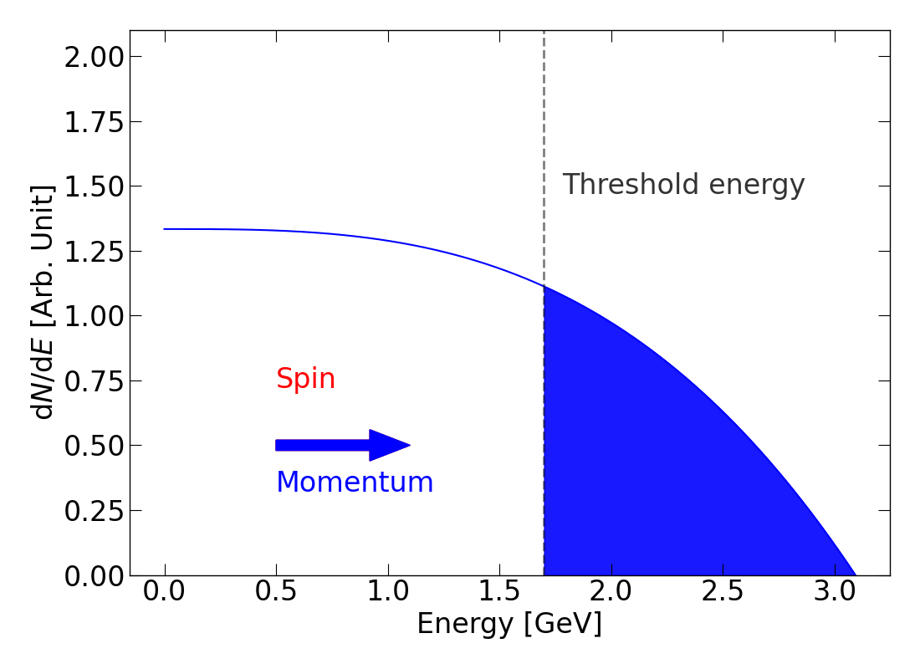
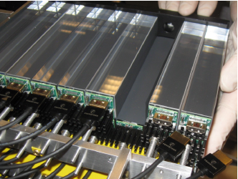
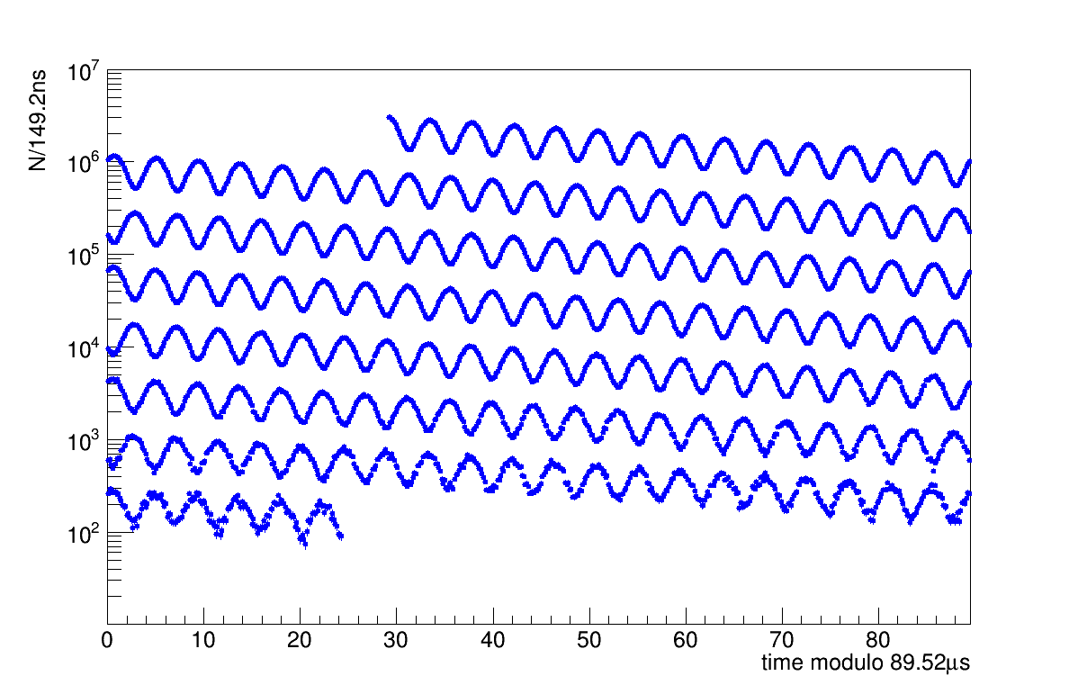
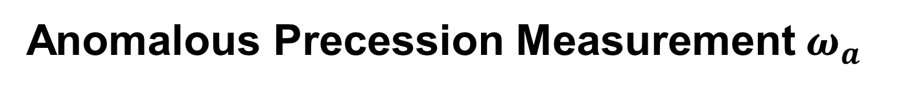

9
Anomalous Precession Measurement $ω_{a}$
Self-analyzing decay: $μ^{+}→e^{+}+ν_{e}+{\overline{ν}}_{μ}$
24 calorimeters of 9$×$6 PbF₂ crystals detect $e^{+}$
Highest-energy $e^{+}$ emitted preferentially along muon spin
Results in a “wiggle” arrival time of these $e^{+}$ in calorimeters
*More complicated due to beam dynamics

Slide 10
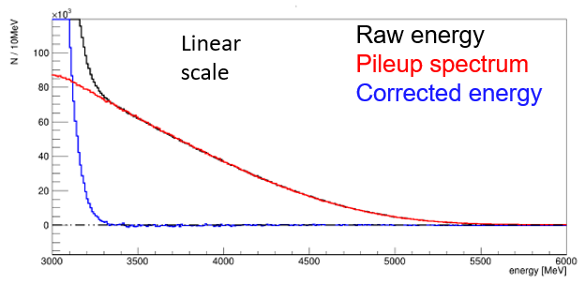
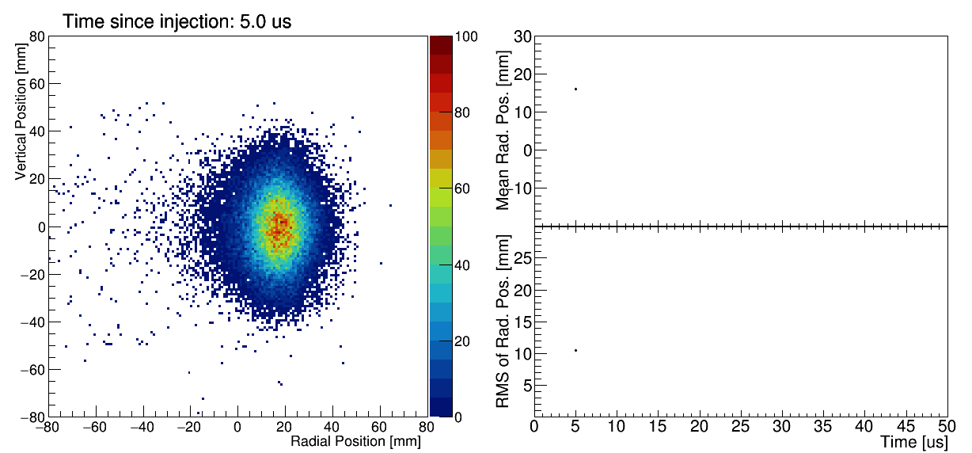
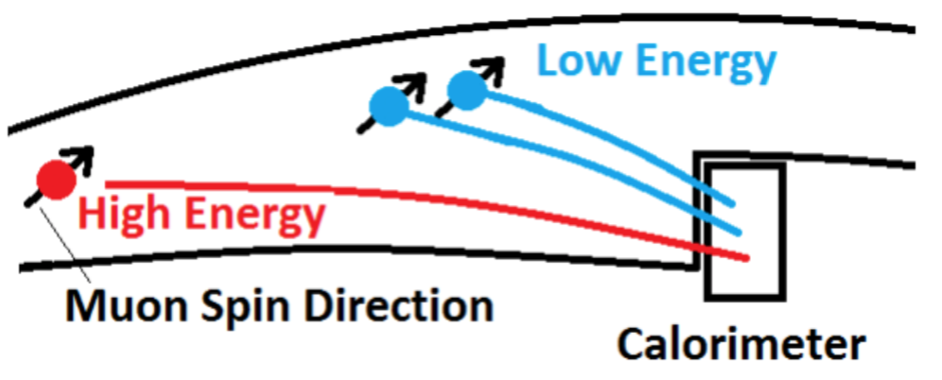
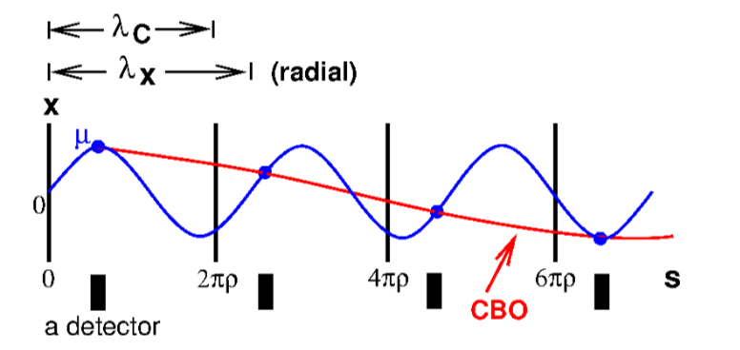
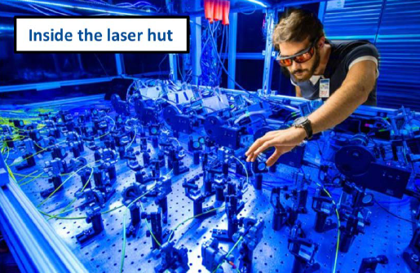
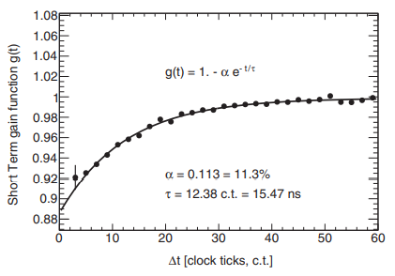
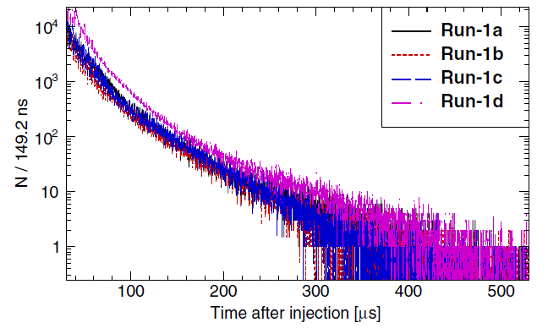
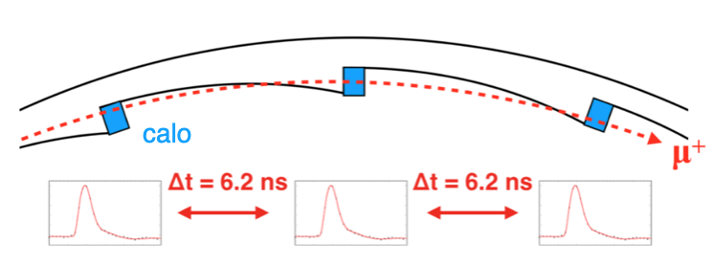
10
Anomalous Precession Measurement $ω_{a}$
Detector effect:
Event pileup which changes the phase and normalization
Beam Dynamic effect:
Coherent Betatron Oscillations (CBO) due to beam motion
Gain change in calorimeter determined from laser data
Muon losses during storage

Slide 11
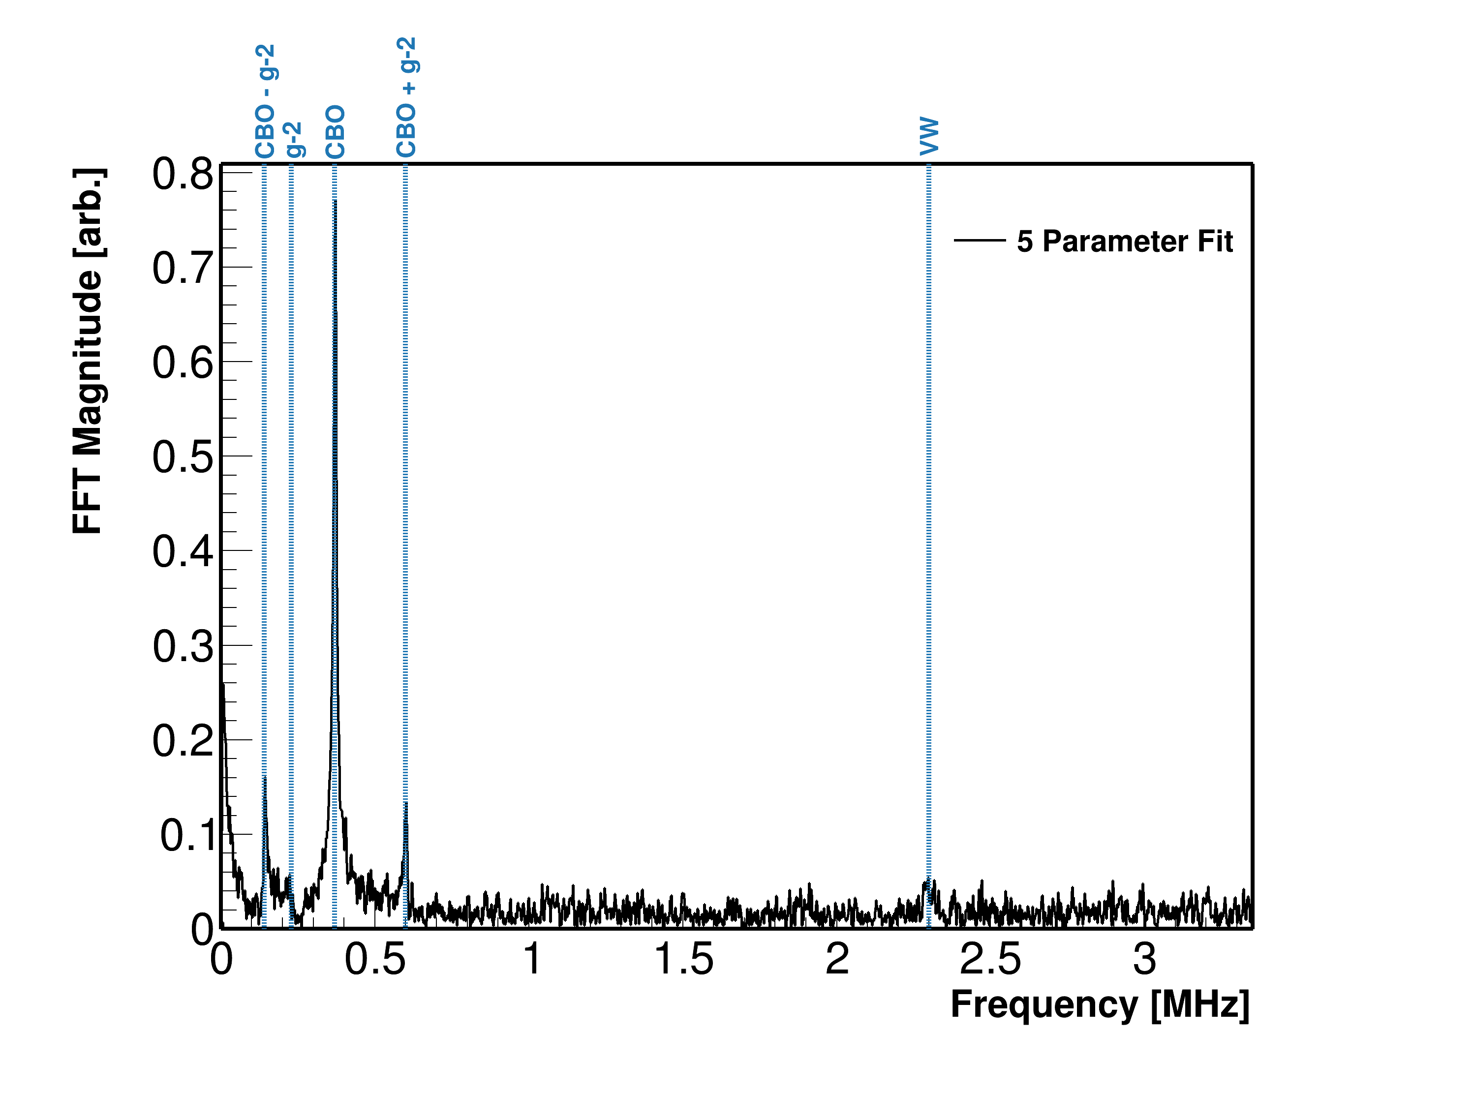
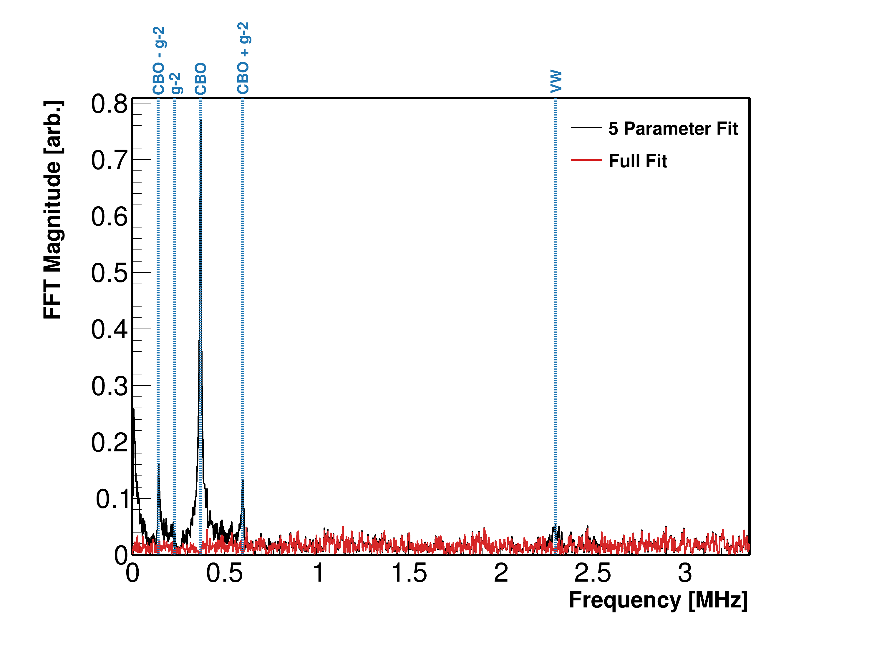
11
Anomalous Precession Measurement $ω_{a}$
FFT Power of (Data – Fit) [arb]
FFT Power of (Data – Fit) [arb]
Notes:
Fit with beam dynamics

Slide 12
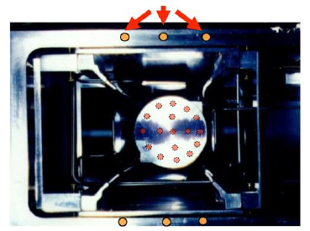
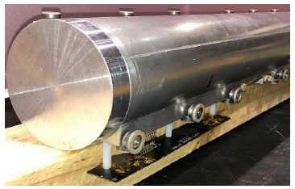
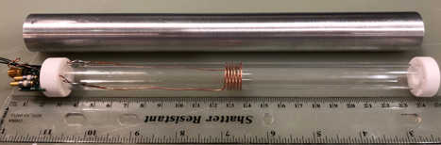
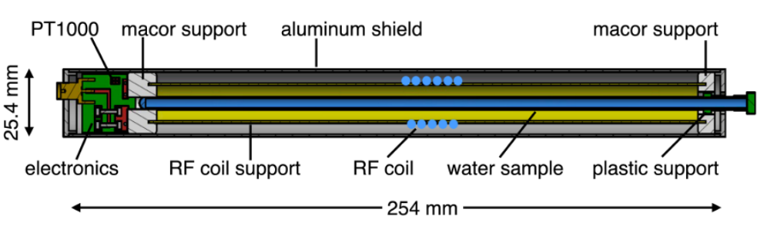
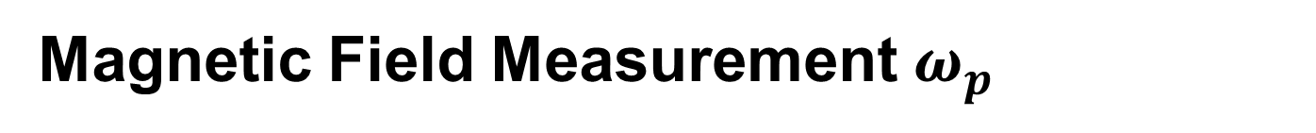
12
Magnetic Field Measurement $ω_{p}$
Fixed Probe
Method: Pulsed Nuclear Magnetic Resonance
Trolley
Fixed Probe:
- 378 fixed probes
- 72 azimuthal positions
- continuously track
field drift
Trolley:
- 9,000 measurements for each of
the 17 probes
- map the field every 2 or 3 days
- Synchronizes the fixed probes
to field maps
Calibration probe (CP):
Moveable probe
Pure water sample
Calibrate the trolley measurement
Tracking
Mapping
Correcting

Slide 13
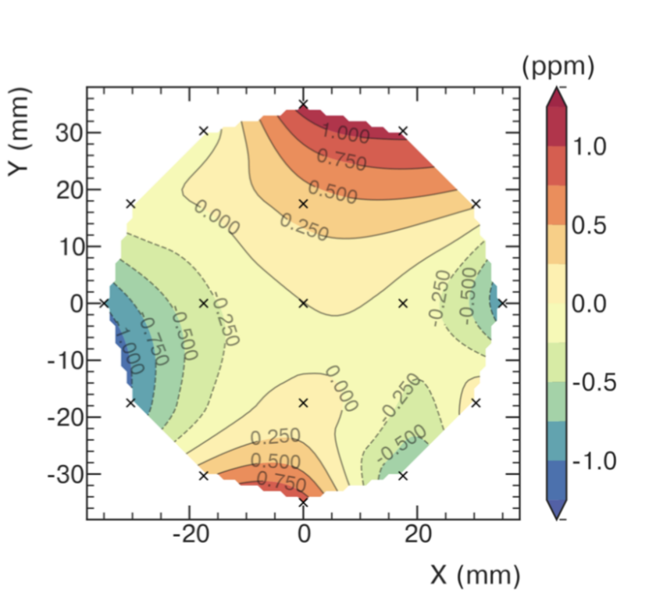
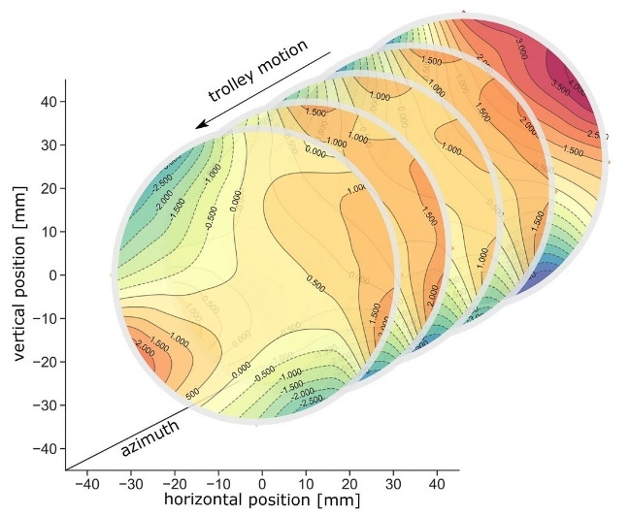
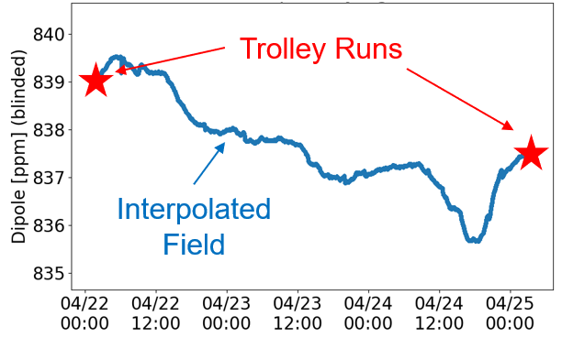
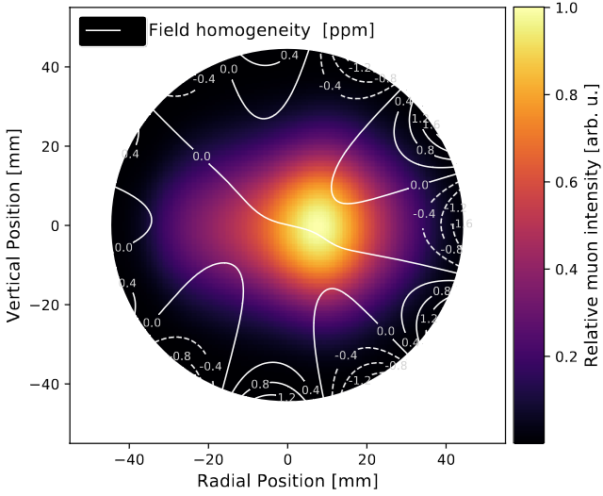

13
Magnetic Field Measurement $ω_{p}$
Azimuthally averaged field
Mapping
Mapping
Tracking
Correcting
Beam Distribution

Slide 14





14
Corrections
Beam Dynamics Corrections
$$\frac{ω_{a}}{{\tilde{ω}}_{p}^{′}(T_{r})}=\frac{ω_{a}^{m} (1 +C_{E}+C_{p}+C_{lm}+C_{pa}+C_{dd})}{{\tilde{ω}}_{p}^{′}\left(T_{r}\right) (1+B_{q}+B_{k})}$$
Transient Magnetic Field Corrections
$C_{e}$ : Electric field
$C_{p}$ : Pitch field
E-field & Up/Down motion: Spin precesses slower than in basic equation
$C_{pa}$: Phase acceptance
$C_{dd}$ : Differential decay
$C_{ml}$ : Muon loss
Phase changes over each fill:
Phase-Acceptance, Differential Decay, Muon Losses
$B_{k}$ : Transient field from eddy current in kickers
$B_{q}$ : Transient field from quad charging
Transient Magnetic Fields:
Quad Vibrations, Kicker Eddy Current,

Slide 15





15
Measurement of $a_{μ}$
Measured g-2 frequency
Corrections from the beam dynamics
blinding factor
$$ℛ_{μ}^{′}=\frac{ω_{a}}{{\tilde{ω}}_{p}^{′}(T_{r})}=\frac{f_{clock} ω_{a}^{m} (1 +C_{E}+C_{p}+C_{lm}+C_{pa}+C_{dd})}{f_{cali} \left\langle ω_{p}(x,y,φ,T_{r})×\right.\left.M(x,y,φ)\right\rangle (1+B_{q}+B_{k})}$$
Field Calibration
Muon time and spatial distribution
Corrections from the transient magnetic field
Measured magnetic field:
Trolley mapping
Fixed probe tracking

Slide 16


16
Improvements: Statistics / Running Conditions
Dataset | Publication | Statistical Error [ppb]
Run-1 | 2021 | 434
Run-2/3 | 2023 | 201
Run-4/5/6 | 2025 | 114
Total | - | 98
Temperature stability:
Thermal insulation added to the ring
A/C hall cooling after Run 2
Reduced magnetic field and SiPM gain variations

Slide 17


17
Improvements: Beam Oscillations
NoRF
HRF
10x reduction in horizontal CBO amplitude
5x reduction in vertical CBO amplitude
4x reduction in muon loss rate
Better centered muon distribution
Notes:
If RF is tuned correctly to the oscillation frequency:
Phase-shifts different individual muon oscillations
Reduces the oscillation of the mean of the particle ensemble

Slide 18




18
Improvements: Electric Field Correction
$$γ=29.3$$
$$p=3.094GeV$$
Focusing E-field makes magnetic field in muon rest frame
“magic” momentum (p_{μ} = 3.094 GeV) to cancel it
The momentum has distributions
Use 3 completely independent methods to extract the p_{μ} distribution
p_{μ} distribution

Slide 19

19
Improvements
Spin Precession - $ω_{a}=ω_{a}^{m}(1+C_{e}+C_{p}+C_{pa}+C_{dd}+C_{ml})$
  Additional measurements to identify a residual slow term in the calorimeter data
  Improved the fitting function to better modeling Beam Dynamic
Beam Dynamics - $ω_{a}=ω_{a}^{m}(1+C_{e}+C_{p}+C_{pa}+C_{dd}+C_{ml})$
  A new detector -MiniScifi- to further improve our understanding of the beam movement
  Improvements in analyses techniques to reduce uncertainties
  Simulation based estimations to pin down beam injection related systematics
B field - ${\tilde{ω}}_{p}^{′}=\left\langle ω_{p}^{′}×M\right\rangle \left(1+B_{k}+B_{q}\right)$
  Additional measurements to improve spatial-model of Kicker Transient Magnetic Field
  A new cross calibration of the NMR probes
  A new measurement to better understand the trolley systematics
Applied all these new knowledge to earlier results
  Correction over Run-2/3 +89 ppb with a slight increase on uncertainty (70 ->78 ppb)

Slide 20

20
New Muon g–2 Result
 | Stat. Uncertainty (ppb) | Syst. Uncertainty (ppb) | Total Uncertainty (ppb)
Run-1 | 434 | 159* | 462
Run-2/3 | 201 | 78* | 216
Run-4/5/6 | 114 | 76 | 139
Run-1-6 | 98 | 78 | 125
Electric Field
Pitch
Phase Acceptance
Differential Decay
Muon Loss
Transient Kicker
Transient ESQ
a_{μ}(FNAL) = 0.001 165 920 705(148) [127 ppb]
a_{μ}(Exp) = 0.001 165 920 715(145) [124 ppb]

Slide 21



21
J-PARC Experiment
A new different approach at J-PARC
No E-field, lower momentum
Positron tracking detector (silicon strip sensors)
Electric field will be eliminated by using reaccelerated thermal muon beam
Lower momentum muon beam + compact storage region with highly uniform magnetic field
Tracking detector for decay positrons —> reduced pile-up + able to measure the momentum direction of positrons.
Expects to start data taking ~2028
Φ580 mm

Slide 22



22
Outlook
Other analyses like Muon EDM, Dark Matter and Lorentz-CPT violation searches are under going
Muon EDM:
Current best limit from BNL Muon g-2:
$$\left|d_{μ}\right|<1.8×{10}^{−19}e∙cm (95\%CL)$$
we aim to improve to ~ ${10}^{−21}e∙cm$
Theory updates with new experimental input for data-driven HVP determination：
  experiment for new HVP evaluation

Slide 23


谢谢！
Thanks

Slide 24




Collaboration
Physics Week in Elba, Italy 2019

