Slide 1
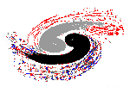



Institute of High Energy Physics, CAS
Theoretical review on light meson and heavy hadron spectroscopy
Qiang Zhao
Theoretical Physics Division
Institute of High Energy Physics, Chinese Academy of Sciences
zhaoq@ihep.ac.cn
17th International Conference on Heavy Quarks and Leptons (HQL 2025), Peking University,
Sept. 15-19, 2025

Slide 2
Institute of High Energy Physics, CAS
Some insights into the non-perturbative QCD phenomena
Qiang Zhao
Theoretical Physics Division
Institute of High Energy Physics, Chinese Academy of Sciences
zhaoq@ihep.ac.cn
17th International Conference on Heavy Quarks and Leptons (HQL 2025), Peking University,
Sept. 15-19, 2025

Slide 3
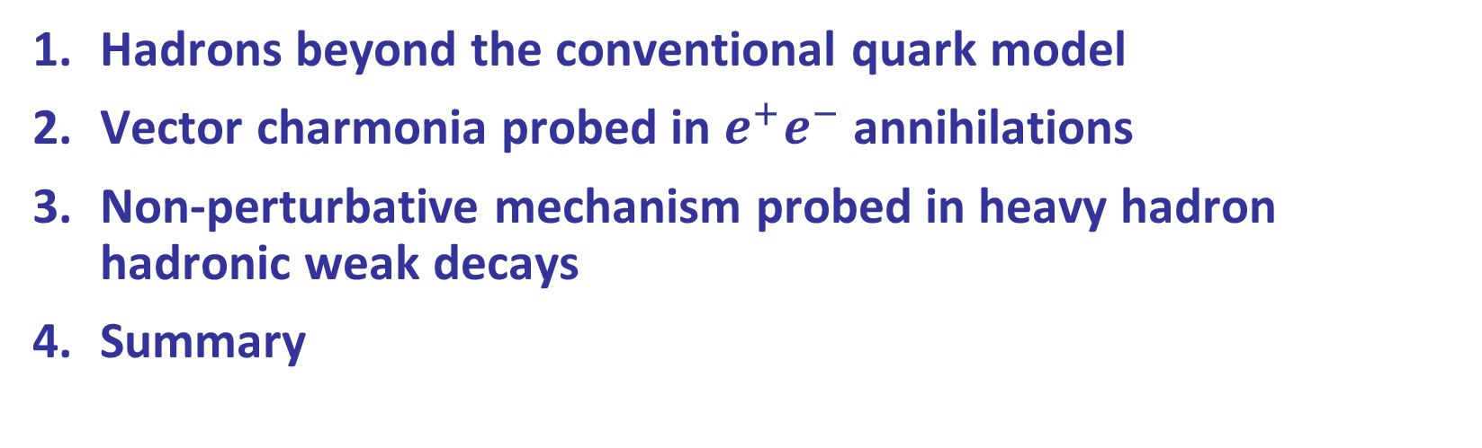
Outline
Hadrons beyond the conventional quark model
Vector charmonia probed in $e^{+}e^{−}$ annihilations
Non-perturbative mechanism probed in heavy hadron hadronic weak decays
Summary

Slide 4
1. Hadrons beyond the conventional quark model
Exotic hadrons
Exotics of Type-I:
J^{PC} are not allowed by Q‾Q configurations, e.g. 0⁻⁻,1⁻⁺ …
Direct observation
Hybrid
glueball
Tetraquark
Pentaquark
Exotics of Type-II:
J^{PC} are the same as Q‾Q configurations
Outnumbering of conventional QM states?
Peculiar properties?
Hadronic molecule
Deuteron
proton
u
π
d
u
d
“Exotics” of Type-III:
Leading kinematic singularity can cause measurable effects, e.g. the triangle singularity.
What’s the impact?
How to distinguish a genuine state from kinematic effects?
neutron
d
u
Evidence for QCD exotic states is a missing piece of knowledge about the Nature of strong QCD.

Slide 5
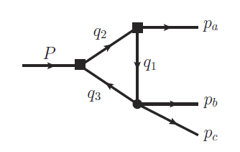
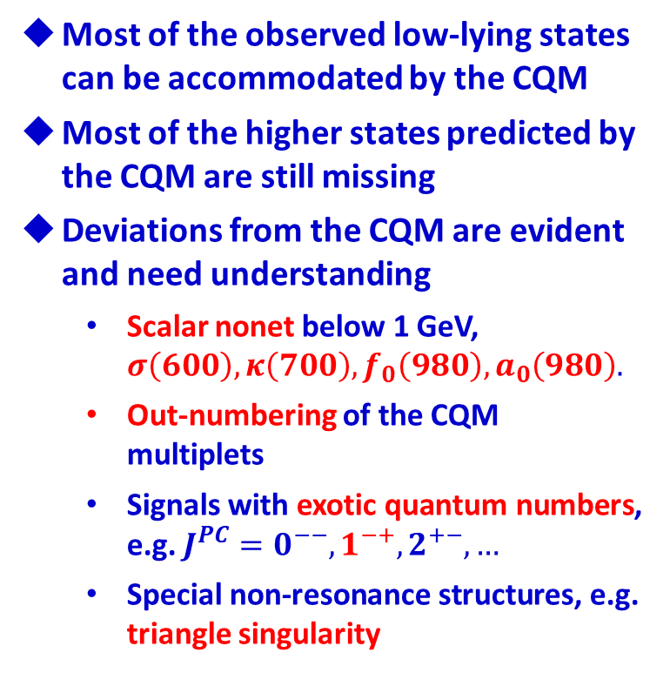
m₁
$q\overline{q}$ SU(3) flavor nonet: ‾3⊗3 =1⊕8
Most of the observed low-lying states can be accommodated by the CQM
Most of the higher states predicted by the CQM are still missing
Deviations from the CQM are evident and need understanding
  Scalar nonet below 1 GeV, $σ\left(600\right), κ\left(700\right), f_{0}\left(980\right), a_{0}\left(980\right).$
  Out-numbering of the CQM multiplets
  Signals with exotic quantum numbers, e.g. $J^{PC}=0^{−−}, 1^{−+}, 2^{+−}, …$
  Special non-resonance structures, e.g. triangle singularity
m₂
a₁(1420)?
η(1405) ?

Slide 6

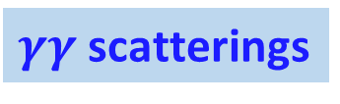



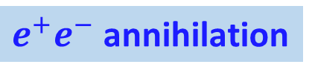












Ways to produce QCD exotics
$e^{+}e^{−}$ annihilation
$γγ$ scatterings
Hadron colli.
Weak decays
s
$\overline{u}$
$$e^{+}$$
π
$$γ^{∗}$$
$p$
$$Y(4260)$$
π
$u$
$$(XYZ)$$
$$e^{−}$$
$$Zc(3900)$$
b
$\overline{c}$
$J/$
$$γ^{∗}$$
$p$
u
c
$$(XYZ)$$
d
u
$$(XYZ)$$
d
$$(XYZ, P_{c})$$
Hadron physics is a natural part of large science facilities.

Slide 7

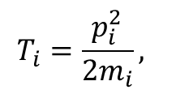
Success of Quark Model:
Hadrons are made of quarks (antiquarks) as QCD color singlet
Hamiltonian in a non-relativistic quark model :
$$T_{i}=\frac{p_{i}^{2}}{2m_{i}},$$
Cornell potential model
Godfrey-Isgur model
A lot of recent developments …
Potential smearing factor
W.L. Wu, L. Meng and S.L. Zhu, DeepQuark: deep-neural-network approach to multiquark bound states,'' [arXiv:2506.20555 [hep-ph]]
Coulomb
Spin-spin correl.

Slide 8
The connection between the quark model and QCD ONLY becomes clear in certain circumstances: in the heavy quark limit the soft QCD for quark-antiquark or quark-quark interactions can become much simpler.
Quenched LQCD simulation
G. S. Bali, et al., Phys. Rev. D62, 054503 (2000)
M. Foster and C. Michael (UKQCD), Phys. Rev. D59, 094509 (1999)

Slide 9


The QM state $χ_{c1}(2P)$ is about 60 MeV higher than the physical state $X(3872)$.
$D{\overline{D}}^{∗}$
$$X(3872)$$
W.J. Deng et al., PRD95, 034026 (2017)
[8] T. Barnes, S. Godfrey, and E. S. Swanson, PRD 72, 054026 (2005).
[11] B. Q. Li and K. T. Chao, PRD 79, 094004 (2009).
Godfrey and Isgur, PRD32, 189 (1985)

Slide 10
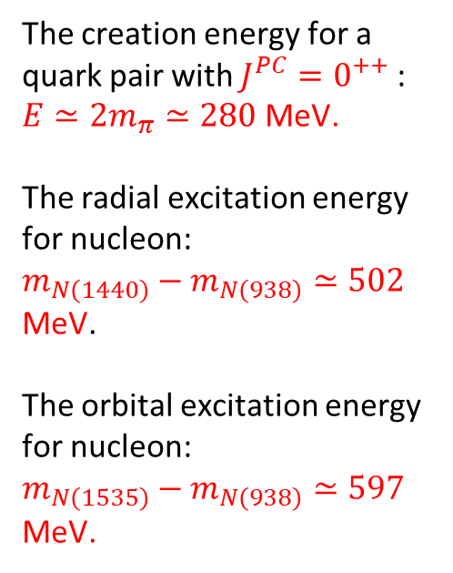
Open threshold effects: A missing piece of dynamics in the potential QM
Quenched LQCD simulation
The creation energy for a quark pair with $J^{PC}=0^{++}$ :
$E≃2m_{π}≃280$ MeV.
The radial excitation energy for nucleon:
$m_{N\left(1440\right)}−m_{N\left(938\right)}≃502$ MeV.
The orbital excitation energy for nucleon:
$m_{N\left(1535\right)}−m_{N\left(938\right)}≃597$ MeV.
Unquenched LQCD simulation
However, the effects of the open channels on the soft QCD potential is also evident!
G. S. Bali, et al., Phys. Rev. D62, 054503 (2000)
M. Foster and C. Michael (UKQCD), Phys. Rev. D59, 094509 (1999)
J. Bulava, et al., Phys. Lett. B793, 493 (2019)

Slide 11

The narrow two-body open thresholds:
Impact on the spectrum should have some systematic features.
S-wave thresh.
P-wave thresh.
The number of states would depend on the interactions between the threshold hadrons.
So far, the S-wave phenomena is evident.
Model-building is required.
$$T_{cc}(3875)$$
F.-K. Guo, C. Hanhart, U.-G. Meissner, Q. Wang, Q. Zhao, B.-S. Zou, Rev. Mod. Phys. 90, 015004 (2018)

Slide 12
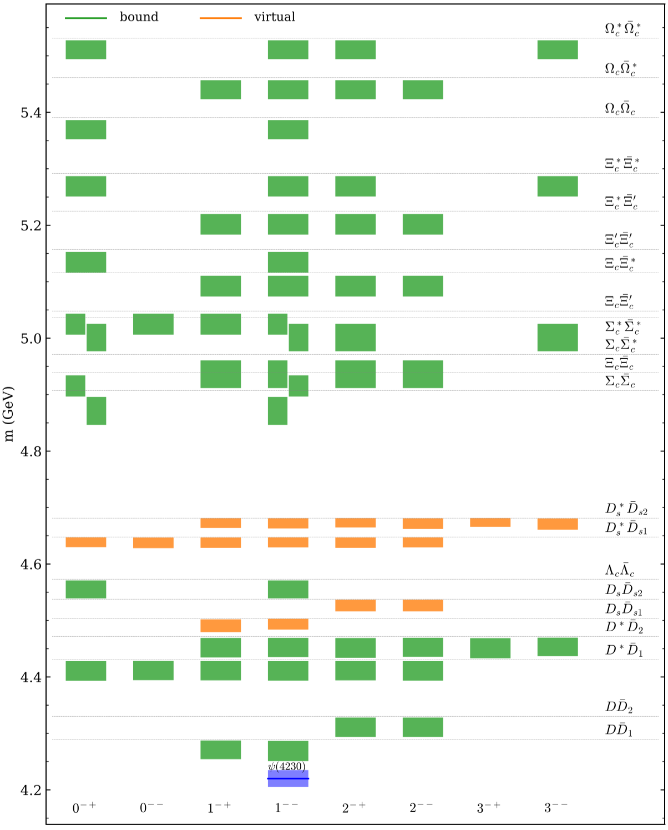
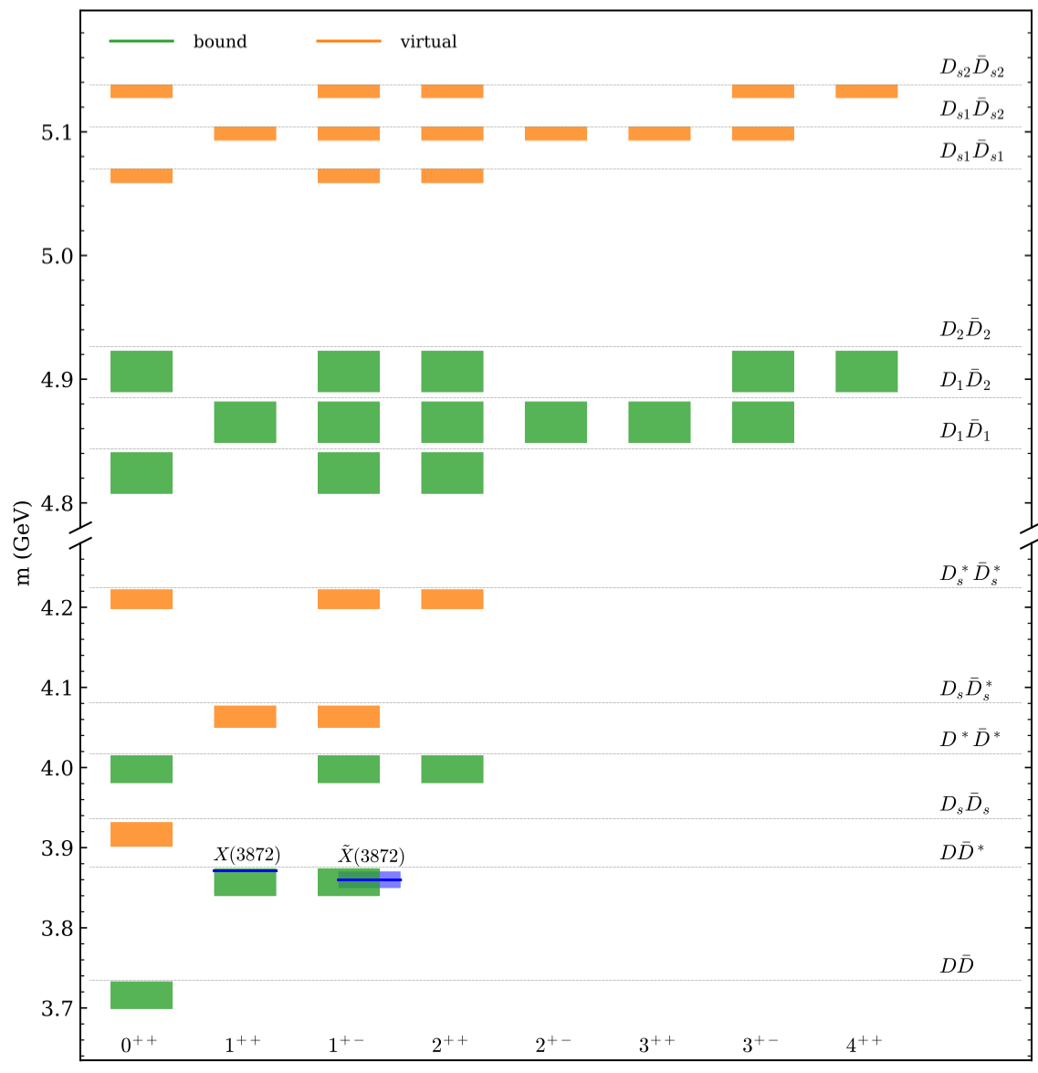
Implementation of EFT with heavy quark symmetry (HQS) and heavy quark spin symmetry (HQSS)
X.-K. Dong, F.-K. Guo, B.-S. Zou, Progr. Phys. 41 (2021) 65 [arXiv:2101.01021]

Slide 13
S wave thresholds and effects on the lineshapes
F.-K. Guo, C. Hanhart, U.-G. Meissner, Q. Wang, Q. Zhao, B.-S. Zou, Rev. Mod. Phys. 90, 015004 (2018)

Slide 14
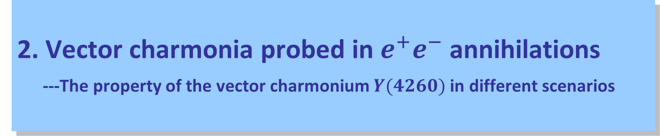
2. Vector charmonia probed in $e^{+}e^{−}$ annihilations
---The property of the vector charmonium $Y(4260)$ in different scenarios

Slide 15
1) Observations of Y(4260)
First evidence from BaBar in $e^{+}e^{−}→γ_{ISR} J/ψπ^{+}π^{−}$ and quickly confirmed by CLEO-c and Belle
BaBar, Phys.Rev.Lett. 95 (2005) 142001
* Particle Data Group renames $Y(4260)$ as $ψ(4230)$

Slide 16
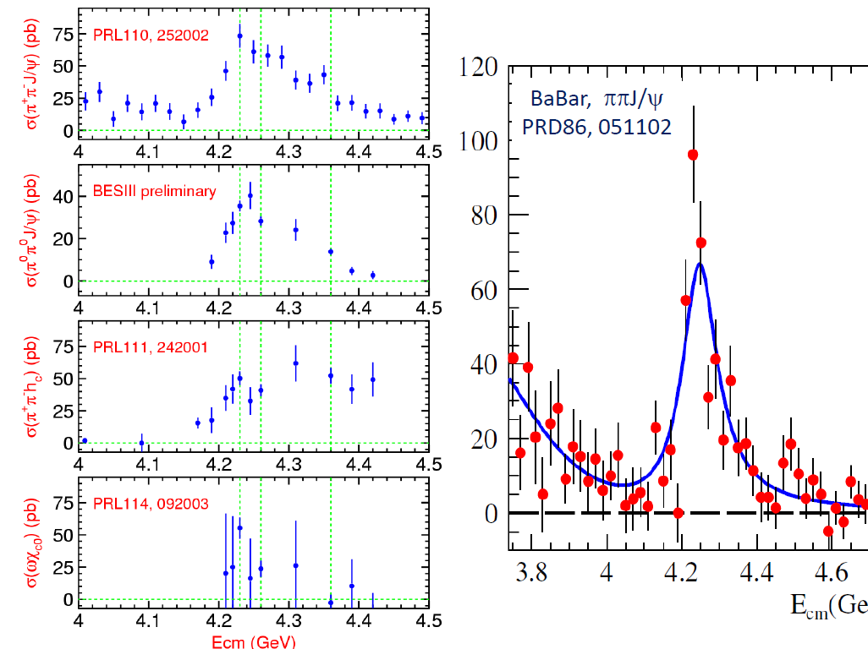
BESIII, arXiv:1611.01317 [hep-ex]
One state or two states?
BESIII, arXiv:1610.07044 [hep-ex]
BESIII, PRD106, 072001 (2022)
Gao, et al., 1703.10351[hep-ex]

Slide 17
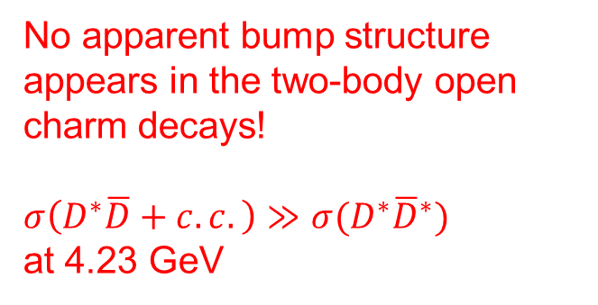
BESIII, 2112.06477[hep-ex]
Gao, et al., 1703.10351[hep-ex]
No apparent bump structure appears in the two-body open charm decays!
$σ\left(D^{∗}\overline{D}+c.c.\right)≫σ(D^{∗}{\overline{D}}^{∗})$ at 4.23 GeV

Slide 18
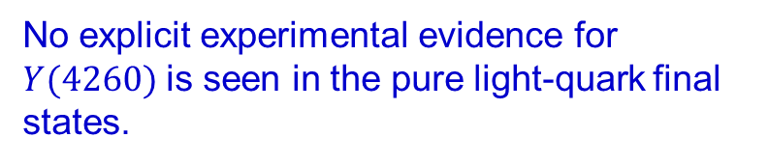
No explicit experimental evidence for $Y(4260)$ is seen in the pure light-quark final states.
Phys.Rev.D 104 (2021) 11, 112009; 2109.12751 [hep-ex]

Slide 19


Resonance parameters extracted around 4.26 GeV in different channels
BESIII
$$Y\left(4260\right)$$
$$ψ(4230)$$

Slide 20
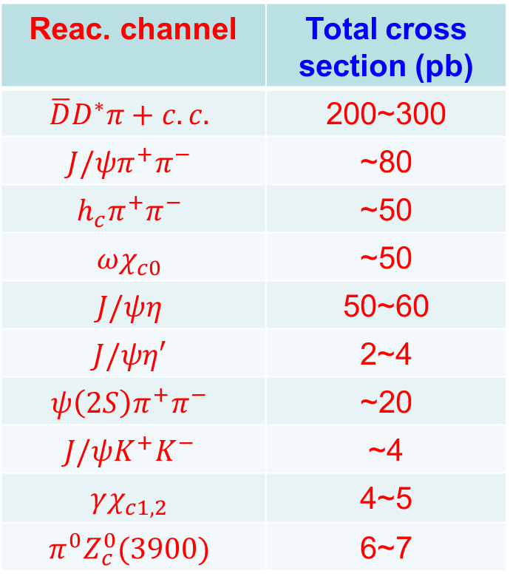
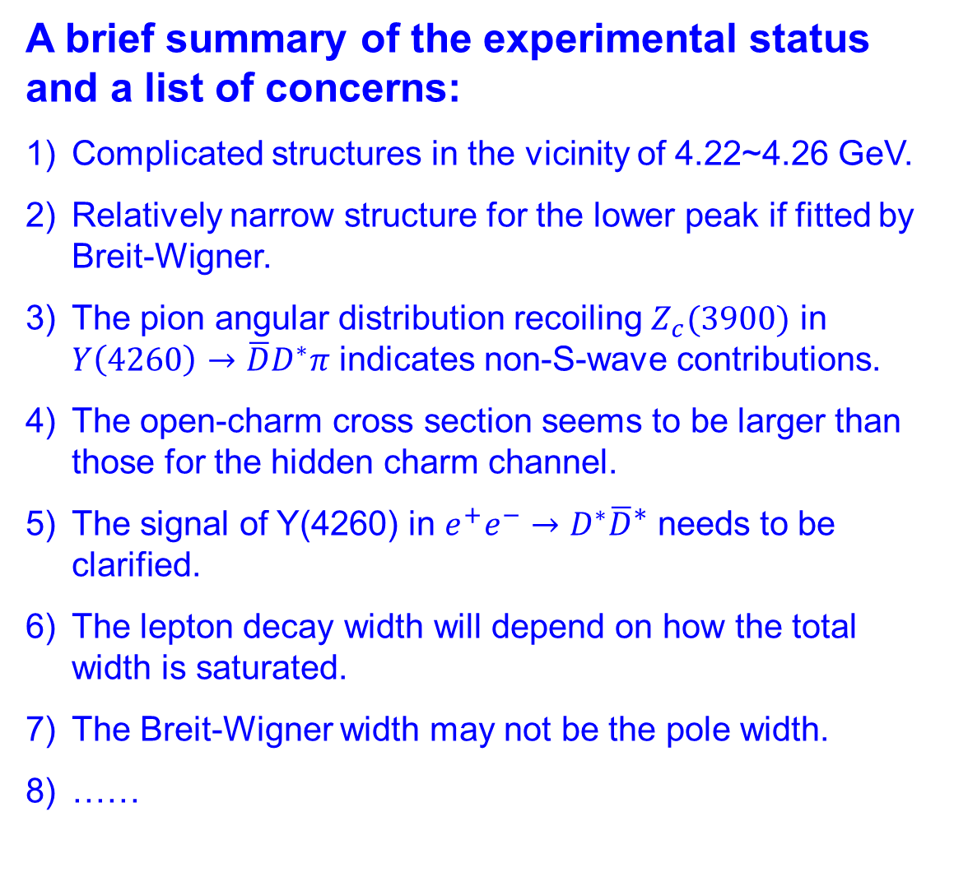
A brief summary of the experimental status and a list of concerns:
Complicated structures in the vicinity of 4.22~4.26 GeV.
Relatively narrow structure for the lower peak if fitted by Breit-Wigner.
The pion angular distribution recoiling $Z_{c}(3900)$ in $Y\left(4260\right)→\overline{D}D^{∗}π$ indicates non-S-wave contributions.
The open-charm cross section seems to be larger than those for the hidden charm channel.
The signal of Y(4260) in $e^{+}e^{−}→D^{∗}{\overline{D}}^{∗}$ needs to be clarified.
The lepton decay width will depend on how the total width is saturated.
The Breit-Wigner width may not be the pole width.
……
Reac. channel | Total cross section (pb)
$$\overline{D}D^{∗}π+c.c.$$ | 200~300
$$J/ψπ^{+}π^{−}$$ | ~80
$$h_{c}π^{+}π^{−}$$ | ~50
$$ωχ_{c0}$$ | ~50
$$J/ψη$$ | 50~60
$$J/ψη′$$ | 2~4
$$ψ\left(2S\right)π^{+}π^{−}$$ | ~20
$$J/ψK^{+}K^{−}$$ | ~4
$$γχ_{c1,2}$$ | 4~5
$$π^{0}Z_{c}^{0}(3900)$$ | 6~7

Slide 21
2) Possible interpretations and reminder of some crucial issues
Tetraquark
Hybrid
Hadro-quarkonium
Hadronic molecule
Non-resonance structure
Many papers on the properties of Y(4260), e.g. see recent reviews and reference therein:
H.-X. Chen, W. Chen, X. Liu and S.-L. Zhu, Phys. Rept. 639, 1 (2016)
F.K. Guo, C. Hanhart, U.-G. Meissner, Q. Wang, Q. Zhao, B.-S. Zou, Rev. Mod. Phys. 90, 015004 (2018)
A. Esposito, A. Pilloni and A.D. Polosa, Phys. Rept. 668, 1 (2017)
Q. Wang and Q. Zhao, arXiv:2508.05304v1 [hep-ph], to appear in Chinese Phys. Lett.

Slide 22
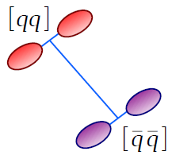

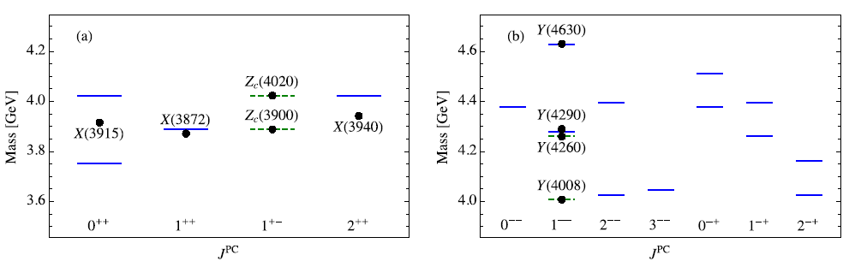
Predictions from the compact tetraquark scenario
The mass of a tetraquark is given by
For a state with given J, the mass can be estimated:
S wave
P wave
Y(4008) needs confirmation!
Extremely rich spectrum is predicted!
L. Maiani et al. PRD 72, 031502(R) (2005)
L. Maiani et al. PRD 89, 114010 (2014)
M. Cleven, F.- K. Guo, C. Hanhart, Q. Wang and Q. Zhao, PRD 92, 014005 (2015);
Q. Wang, PRD 89, 114013 (2014)

Slide 23
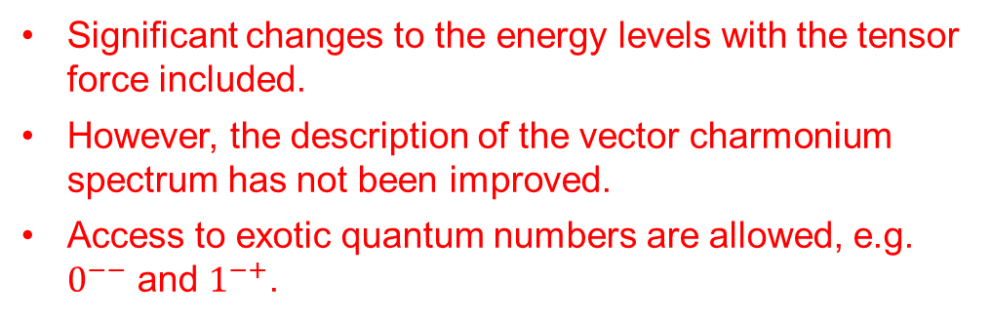
The updated 𝑃-wave tetraquark spectroscopy where the left panel is the spectroscopy with 𝜓(4008) and 𝜓(4230) as inputs, and the right one is the spectroscopy with 𝜓(4230) and 𝜓(4360) as inputs.
The 𝑃-wave diquark-antidiquark tetraquark supermultiplet with tensor force.
Significant changes to the energy levels with the tensor force included.
However, the description of the vector charmonium spectrum has not been improved.
Access to exotic quantum numbers are allowed, e.g. $0^{−−}$ and $1^{−+}$.

Slide 24
Predictions from the hybrid scenario
Lowest gluon fields generate adiabatic potential on which the quark motion can be described.
The flux tube may be excited on which the quark motion in the adiabatic potential of such excited gluon field configurations will give access to hybrid states.
The decays of both conventional and exotic hadrons can be well described by the flux tube breaking mechanism.
Transverse mode
Flux tube model Hamiltonian:
Collinear mode
N. Isgur and J. Paton, PLB124 (1983) 247-251; PRL54 (1985) 869; PRD31 (1985) 2910

Slide 25

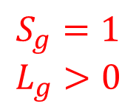

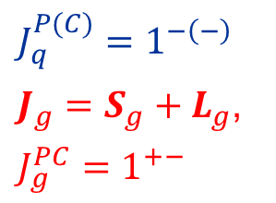


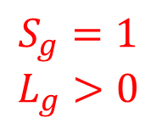






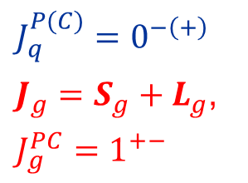
Lowest hybrid in the flux-tube model
Collinear mode
Transverse mode
$$S_{g}=1$$
$$L_{g}>0$$
+
+
$J_{q}^{P(C)}=1^{−\left(−\right)}$
$J_{g}=S_{g}+L_{g}$,
$J_{g}^{PC}=1^{+−}$
$$S_{q}=1$$
$$S_{q}=1$$
$$J^{P\left(C\right)}={\left(0, 1, 2\right)}^{−(+)}$$
−
−
$$L_{q}=0$$
$$L_{q}=0$$
$$S_{g}=1$$
$$L_{g}>0$$
+
+
$J_{q}^{P(C)}=0^{−\left(+\right)}$
$J_{g}=S_{g}+L_{g}$,
$J_{g}^{PC}=1^{+−}$
$$J^{P\left(C\right)}=1^{−−}$$
$$S_{q}=0$$
$$S_{q}=0$$
−
−
$$L_{q}=0$$
$$L_{q}=0$$
N. Isgur and J. Paton, PLB124 (1983) 247-251; PRL54 (1985) 869; PRD31 (1985) 2910

Slide 26
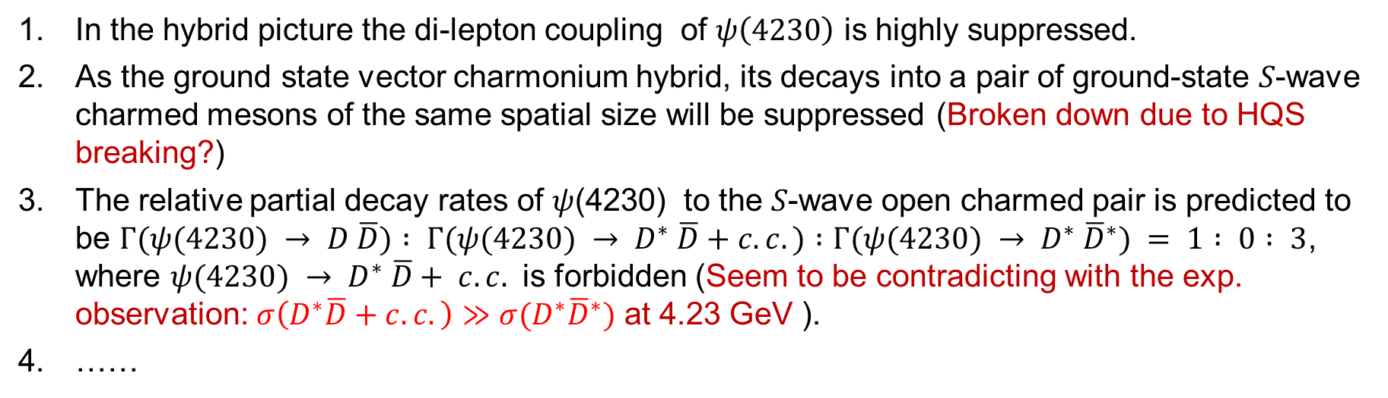
Predictions from the hybrid scenario
In the hybrid picture the di-lepton coupling of $ψ\left(4230\right)$ is highly suppressed.
As the ground state vector charmonium hybrid, its decays into a pair of ground-state 𝑆-wave charmed mesons of the same spatial size will be suppressed (Broken down due to HQS breaking?)
The relative partial decay rates of 𝜓(4230) to the 𝑆-wave open charmed pair is predicted to be $Γ(ψ(4230) → D \overline{D}) : Γ(ψ(4230) → D^{∗} \overline{D}+c.c.) :Γ(ψ(4230) → D^{∗} {\overline{D}}^{∗}) = 1 : 0 : 3$, where $ψ(4230) → D^{∗} \overline{D}+ c.c.$ is forbidden (Seem to be contradicting with the exp. observation: $σ\left(D^{∗}\overline{D}+c.c.\right)≫σ(D^{∗}{\overline{D}}^{∗})$ at 4.23 GeV ).
……
S. L. Zhu, Phys. Lett. B 625, 212 (2005) [arXiv:hep-ph/0507025 [hep-ph]].
F. E. Close and P. R. Page, Phys. Lett. B 628, 215-222 (2005) [arXiv:hep-ph/0507199 [hep-ph]].
E. Kou and O. Pene, Phys. Lett. B 631, 164-169 (2005) [arXiv:hep-ph/0507119 [hep-ph]].
E. Braaten and R. Bruschini, Phys. Rev. D 109, no.9, 094051 (2024)

Slide 27
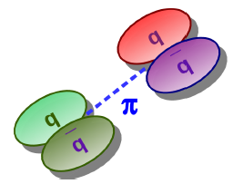









Predictions from the hadronic molecule scenario
Hadronic molecule made of $\overline{D}D1\left(2420\right)+c.c.$ with coupled channel effects.
$$D1 , 1^{+}$$
$$D^{∗}, 1^{−}$$
$D1\left(2420\right), 1^{+}$
$ψ(4230)$, 1⁻⁻
$$ψ(4230)$$
π
$\overline{D}\left(1868\right), 0^{−}$
$$\overline{D}, 0^{−}$$
$\overline{D}0 , 0^{+}$
Depending on the binding mechanism, the isoscalar and isovector may not bind simultaneously:
Q. Wang, C. Hanhart, QZ, PRL111, 132003 (2013)
Q. Wang et al., PRD89, 034001 (2014); M. Cleven et al., PRD90, 074039 (2014);
W. Qin, S.R. Xue, QZ, PRD94, 054035 (2016)

Slide 28




Correlations between Y(4260) and Zc(3900)/X(3872)
e⁺
π
Y(4260)
π
ψ(4415)
The first S-wave narrow open charm threshold in vector channel
e⁻
D*‾D₁
Zc(3900)
J/ψ
Y(4360)
Charmonium spectrum
Y(4260)
D‾D₁
ψ(4160)
$π$
$γ$
The production of Zc(3900) is strongly correlated with Y(4260) and enhanced by the triangle singularity kinematics.
ψ(4040)
X(3872)
D‾D*
ψ(3770)
Zc(3900)
D‾D
ψ′(3686)
$π$
$2π, 3π, γ$
J/ψ
J^{PC} = 1⁻⁻
Q. Wang, C. Hanhart, QZ, PRL111, 132003 (2013); PLB(2013)
Q. Wang et al., PRD89, 034001 (2014); M. Cleven et al., PRD90, 074039 (2014);
W. Qin, S.R. Xue, QZ, PRD94, 054035 (2016)
L. von Detten, V. Baru, C. Hanhart, Q. Wang, D. Winney and QZ., PRD 109, 116002 (2024)

Slide 29
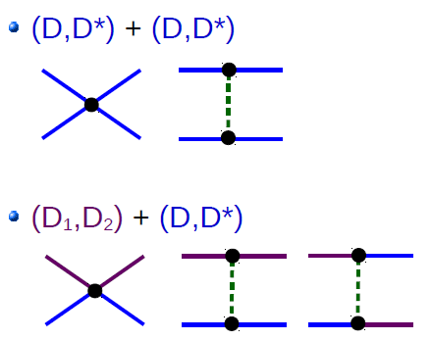
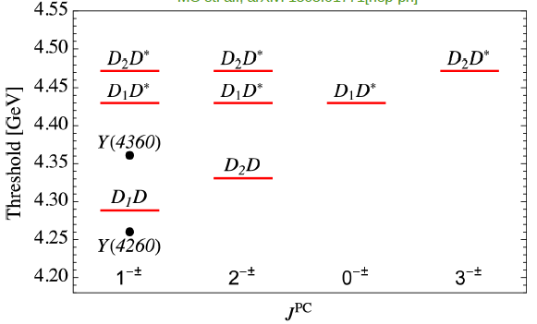
Partners based on the heavy quark spin symmetry (HQSS)
J^{PC} =0⁺⁺, 1⁺⁺, 1⁺⁻, 2⁺⁺
J^{PC} = 1⁻⁻, 1⁻⁺
Experimental search for the $1^{− +}$state in $e^{+}e^{−}→γ \tilde{ψ}\left(1^{− +}\right)→γ\overline{D}D^{∗}π$ could be interesting.
Q. Wang, Phys. Rev. D 89, no.11, 114013 (2014) [arXiv:1403.2243 [hep-ph]].
X. K. Dong, Y. H. Lin and B. S. Zou, Phys. Rev. D 101, no.7, 076003 (2020) [arXiv:1910.14455 [hep-ph]].
X. Y. Zhang, P. P. Shi and F. K. Guo, Phys. Lett. B 867, 139603 (2025) [arXiv:2503.06259 [hep-ph]].

Slide 30
3. Non-perturbative mechanism probed in heavy hadron hadronic weak decays
Y. Cao, Y. Cheng and Q. Zhao, PRD 109, 073002 (2024)

Slide 31
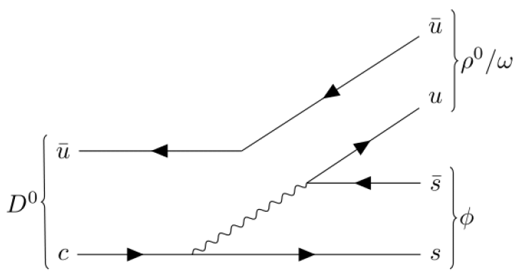
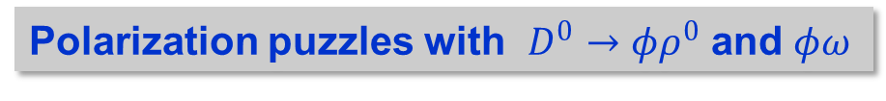

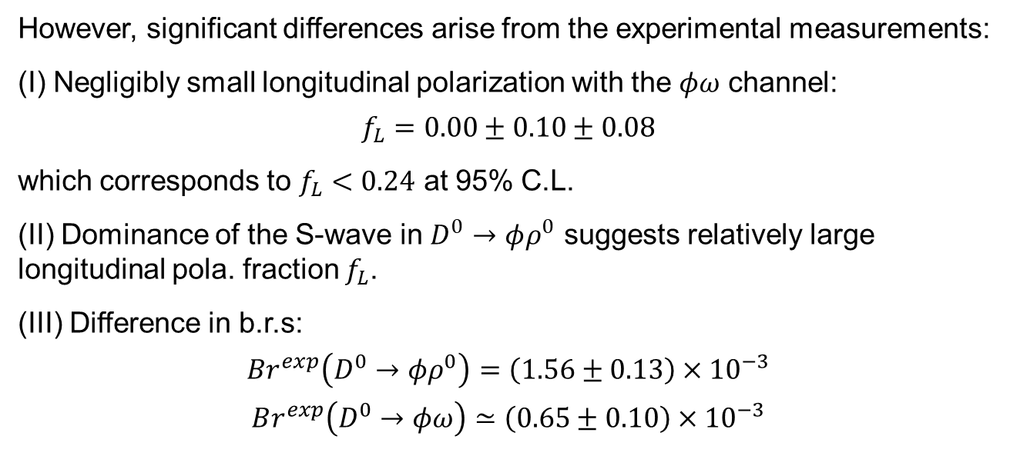
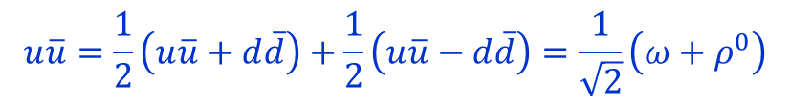
Polarization puzzles with $D^{0}→φρ^{0}$ and $φω$
At the leading order, one would expect $Br\left(D^{0}→φρ^{0}\right)≃Br(D^{0}→φω)$
$$u\overline{u}=\frac{1}{2}\left(u\overline{u}+d\overline{d}\right)+\frac{1}{2}\left(u\overline{u}−d\overline{d}\right)=\frac{1}{\sqrt{2}}\left(ω+ρ^{0}\right)$$
However, significant differences arise from the experimental measurements:
(I) Negligibly small longitudinal polarization with the $φω$ channel:
$$f_{L}=0.00±0.10±0.08$$
which corresponds to $f_{L}<0.24$ at 95% C.L.
(II) Dominance of the S-wave in $D^{0}→φρ^{0}$ suggests relatively large longitudinal pola. fraction $f_{L}$.
(III) Difference in b.r.s:
$$Br^{exp}\left(D^{0}→φρ^{0}\right)=\left(1.56±0.13\right)×{10}^{−3}$$
$$Br^{exp}\left(D^{0}→φω\right)≃\left(0.65±0.10\right)×{10}^{−3}$$
in unit of $(×{10}^{−3})$
[20] M. Ablikim et al., BESIII Colla., Phys. Rev. Lett., 128, 011803 (2022)
[21] P. d'Argent et al., JHEP, 05:143 (2017)
There must be mechanisms beyond the leading tree-level transitions!

Slide 32
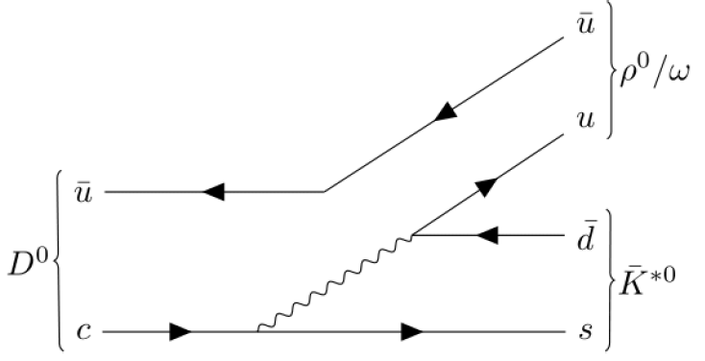
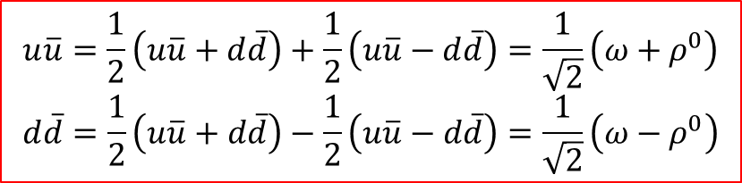
Parametrizing the short-distance transition mechanisms
Cabibbo-favored (CF) decays $(∼V_{cs}V_{ud})$ via color suppressed transitions:
CS emission
IC transition
$$u\overline{u}=\frac{1}{2}\left(u\overline{u}+d\overline{d}\right)+\frac{1}{2}\left(u\overline{u}−d\overline{d}\right)=\frac{1}{\sqrt{2}}\left(ω+ρ^{0}\right)$$
$$d\overline{d}=\frac{1}{2}\left(u\overline{u}+d\overline{d}\right)−\frac{1}{2}\left(u\overline{u}−d\overline{d}\right)=\frac{1}{\sqrt{2}}\left(ω−ρ^{0}\right)$$
B.R. differences can be possibly accounted for by the interferences between the color suppressed emission (CS) and internal conversion (IC) transitions.

Slide 33
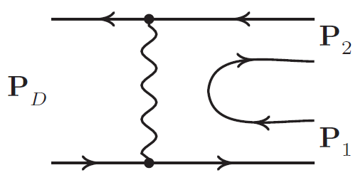
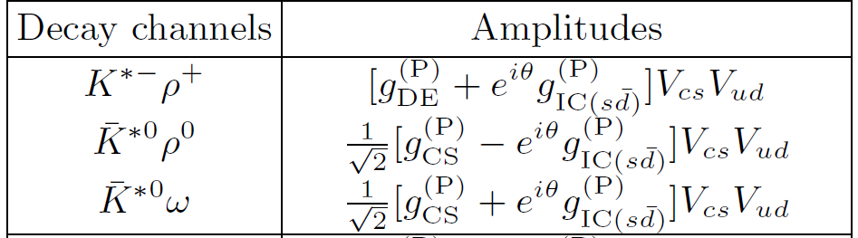
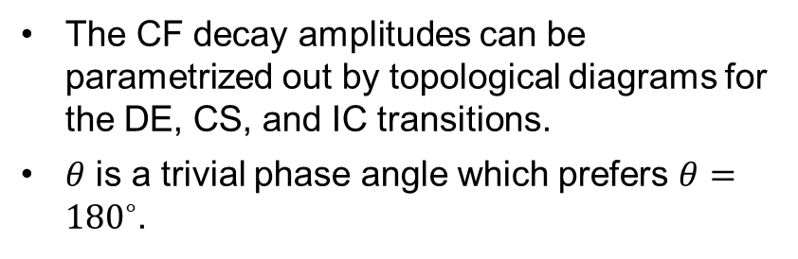






The CF decay of $D^{0}→K^{∗−}ρ^{+}$ with the direct W emission (DE) has not been precisely measured in experiment!
Direct Emission
$$ρ^{+}$$
IC transition
$$ρ^{+}$$
$$D^{0}$$
$$D^{0}$$
$$K^{∗−}$$
$$K^{∗−}$$
$$BR\left(D^{0}→K^{∗−}ρ^{+}\right)=\left(6.5±2.5\right) \%∼5×BR\left(D^{0}→K^{∗0}ρ^{0}\right)$$
H. Albrecht et al., New results on D0 decays, Z. Phys. C56, 7 (1992)
The CF decay amplitudes can be parametrized out by topological diagrams for the DE, CS, and IC transitions.
$θ$ is a trivial phase angle which prefers $θ={180}^{∘}$.
Topological diagram approach (TDA):
Y. Kohara, PRD44, 2799 (1991); L.L. Chau, H.Y. Cheng and B. Tseng, PRD54, 2132 (1996); X.G. He and W. Wang, CPC42, 103108 (2018)

Slide 34












Singly Cabibbo suppressed (SCS) decays $(∼V_{cs}V_{us}/ V_{cd}V_{ud})$:
Transition amplitude:
Direct Emission
$$K^{∗+}$$
IC transition
$$K^{∗+}$$
$$D^{0}$$
$$D^{0}$$
$$K^{∗−}$$
$$K^{∗−}$$
Direct Emission
$$ρ^{+}$$
IC transition
$$ρ^{+}$$
$$D^{0}$$
$$D^{0}$$
$$ρ^{−}$$
$$ρ^{−}$$
The SCS decays of $D^{0}→K^{∗+}K^{∗−}$ and $ρ^{+}ρ^{−}$, which is the only one involving the dominant DE transitions among the SCS decays, have NOT been measured in experiment!

Slide 35

in unit of $(×{10}^{−3})$
The neutral decay channels involves the CS emissions and IC transitions:
IC
CS
DE+IC
[19] J. M. Link et al., FOCUS Colla., Phys. Rev. D, 75:052003, 2007
[20] M. Ablikim et al., BESIII Colla., Phys. Rev. Lett., 128(1):011803, 2022
[21] P. d'Argent et al., JHEP, 05:143, 2017
CS+IC
IC
CS

Slide 36


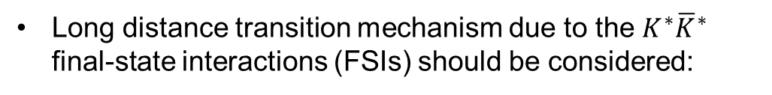

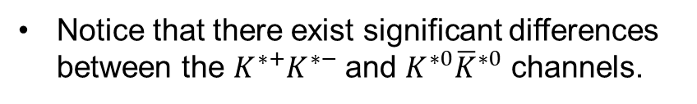



IC
Notice that there exist significant differences between the $K^{∗+}K^{∗−}$ and $K^{∗0}{\overline{K}}^{∗0}$ channels.
DE
IC
IC
$$BR\left(D^{0}→K^{∗+}K^{∗−}\right)≫BR\left(D^{0}→K^{∗0}{\overline{K}}^{∗0}\right)$$
Long distance transition mechanism due to the $K^{∗}{\overline{K}}^{∗}$ final-state interactions (FSIs) should be considered:
$$K^{∗+}/K^{∗0}$$
$$φ$$
$${2m}_{K^{∗}}∼m_{φ}+m_{ρ}∼m_{φ}+m_{ω}$$
$$D^{0}$$
Moreover, FSIs involving other intermediate meson rescatterings can also contribute. A systematic treatment is required.
$$ω/ρ^{0}$$
$$K^{∗−}/{\overline{K}}^{∗0}$$

Slide 37
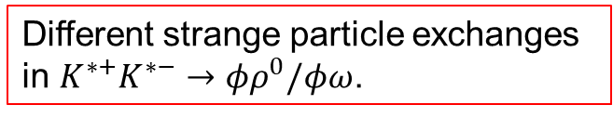
3. Tree-level short-distance transitions vs. long-distance final state interactions
Taking $D^{0}→φρ^{0}/φω$ as an example, the tree-level amplitude reads:
To be calculated explicitly in the NRCQM
The amplitude due to the intermediate $K^{∗+}K^{∗−}$ rescatterings can be written as:
$$K^{∗+}/K^{∗0}$$
$$φ$$
$$D^{0}$$
“P” can be either “PC” or “PV” for parity-conserving or parity-violating amplitudes.
$$ω/ρ^{0}$$
Different strange particle exchanges in $K^{∗+}K^{∗−}→φρ^{0}/φω$.
$$K^{∗−}/{\overline{K}}^{∗0}$$

Slide 38
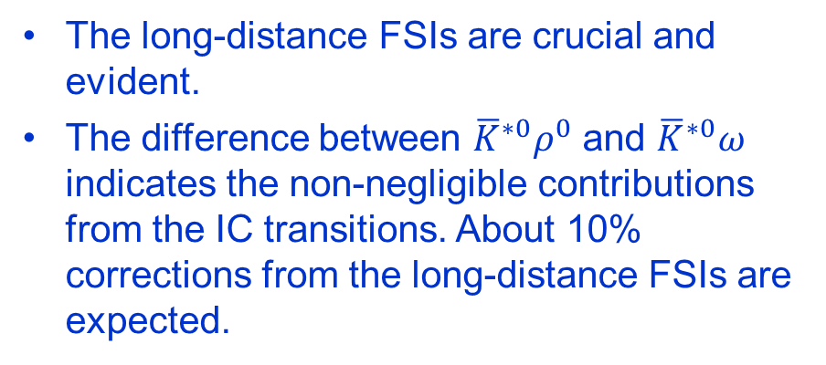

Numerical results in comparison with the data
Leading processes with the DE trans.
CF trans. with CS
SCS trans. with CS
in unit of $(×{10}^{−3})$
The long-distance FSIs are crucial and evident.
The difference between ${\overline{K}}^{∗0}ρ^{0}$ and ${\overline{K}}^{∗0}ω$ indicates the non-negligible contributions from the IC transitions. About 10% corrections from the long-distance FSIs are expected.

Slide 39
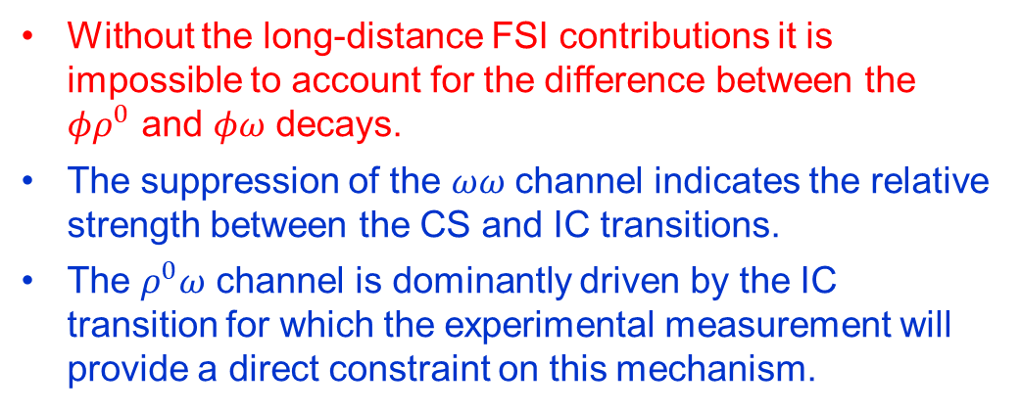

in unit of $(×{10}^{−3})$
Numerical results in comparison with the data
Leading processes with the DE trans.
CF trans. with CS
SCS trans. with CS
Without the long-distance FSI contributions it is impossible to account for the difference between the $φρ^{0}$ and $φω$ decays.
The suppression of the $ωω$ channel indicates the relative strength between the CS and IC transitions.
The $ρ^{0}ω$ channel is dominantly driven by the IC transition for which the experimental measurement will provide a direct constraint on this mechanism.

Slide 40
4. Summary
The limitation of QM is unsurprising.
Rich spectra can arise from the multiquark scenario. In contrast, the hadronic molecule scenario provides an economic solution.
Apart from the hadron spectroscopy, threshold dynamics play a crucial role for understanding many newly observed phenomena in various processes.
Theoretical tools bridging the quark and hadron D.O.F. are still required.
Systematic studies of the threshold effects need inputs from experimental data.
Thanks for your attention!

Slide 41
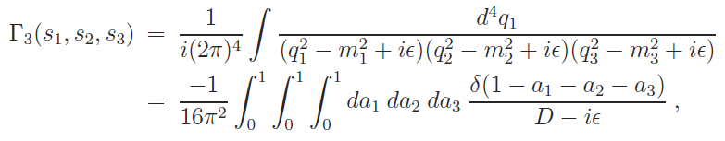



Exotics of Type-III:
Peak structures caused by kinematic effects, in particular, by triangle singularity.
The TS occurs when all the three internal particles can approach their on-shell condition simultaneously:
for all j=1,2,3.
L. D. Landau, Nucl. Phys. 13, 181 (1959);
J.J. Wu, X.-H. Liu, Q. Zhao, B.-S. Zou, Phys. Rev. Lett. 108, 081003 (2012);
Q. Wang, C. Hanhart, Q. Zhao, Phys. Rev. Lett. 111, 132003 (2013); Phys. Lett. B 725, 106 (2013)
X.-H. Liu, M. Oka and Q. Zhao, PLB753, 297(2016);
F.-K. Guo, C. Hanhart, U.-G. Meissner, Q. Wang, Q. Zhao, B.-S. Zou, arXiv:1705.00141[hep-ph], Rev. Mod. Phys. 90, 015004 (2018) ; F.-K. Guo, X.-H. Liu and S. Sakai, Prog. Part. Nucl. Phys. 112, 103757 (2020)
M.-C. Du and Q. Zhao, PRD 104, 036008 (2021); PRD 100, 036005 (2019); Y. Cheng, L. Qiu, and Q. Zhao, PRD in press, arXiv:2407.10234

Slide 42


$$e^{+}e^{−}→ηJ/ψ$$
$$e^{+}e^{−}→ηJ/ψ$$
BESIII, JHEP 10 (2021) 177
BESIII, PRD91, 112005 (2015)
BESIII, PRD102, 031101 (2020)

Slide 43


$$e^{+}e^{−}→η^{′}J/ψ$$
$$e^{+}e^{−}→η^{′}J/ψ$$
BESIII, PRD94, 032009 (2016)
BESIII, PRD101, 012008 (2020)

Slide 44

$$e^{+}e^{−}→π^{+}π^{−}ψ(3686)$$
Phys.Rev.D 104 (2021) 5, 052012; arXiv:2107.09210[hep-ex]

Slide 45
Phys.Rev.D 104 (2021) 5, 052012; arXiv:2107.09210[hep-ex]

Slide 46

$$e^{+}e^{−}→γχ_{cJ}$$
BESIII, Phys.Rev.D 104 (2021) 9, 092001

