Slide 1

Rare charm decays -theory overview
Shi Yu-Ji
East China University of Science and Technology
2025-09-18

Slide 2
Outline
Brief review of Charm
Charm rare decays
Theoretical framework
Theoretical status of rare charm decays

Slide 3
Discovery of Charm

Slide 4
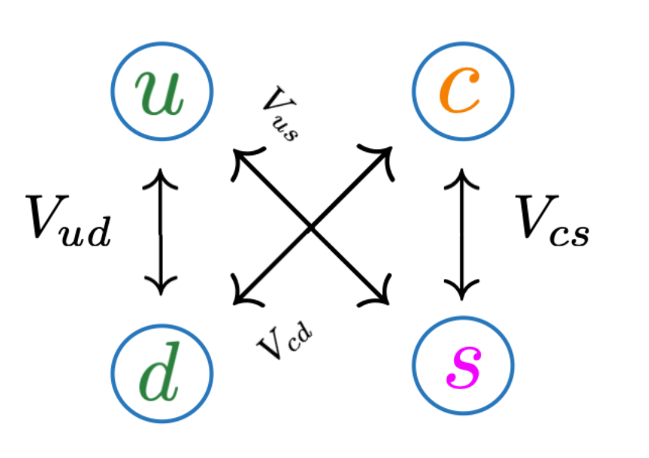
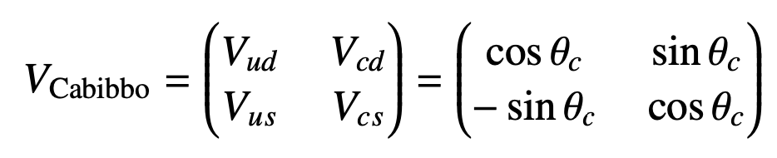
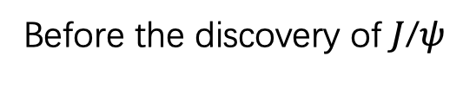
The fourth quark
Before the discovery of $J$/$ψ$
Firstly predicted by Bjorken and Glashow in 1964
Up, Down, Strange quarks
The coupling strength of the weak charged interaction
Make up the dominant part of the ordinary matter i.e. protons and neutrons.

Slide 5
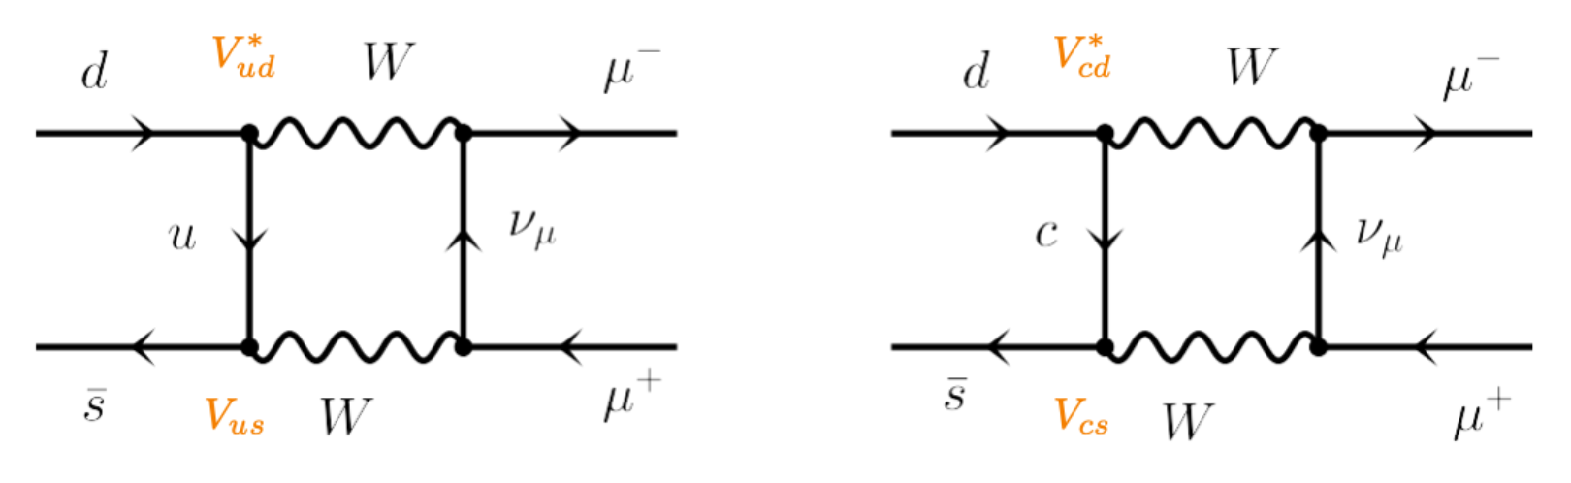
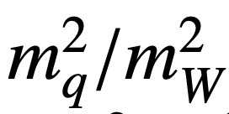
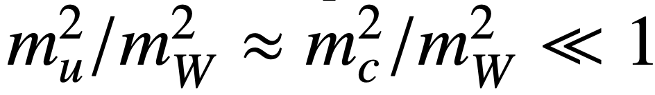

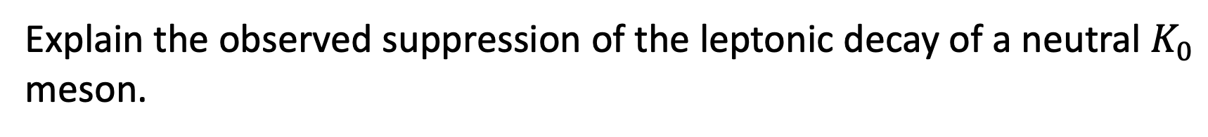

Glashow-Iliopoulos-Maiani (GIM) mechanism
Explain the observed suppression of the leptonic decay of a neutral $K_{0}$ meson.
One generation
Second generation
Proceed via loop diagrams with internal up and charm quarks
$A(m_{q})$ is a function of the mass ratio
$$A\left(m_{c}\right)−A(m_{u})\sim 0$$

Slide 6
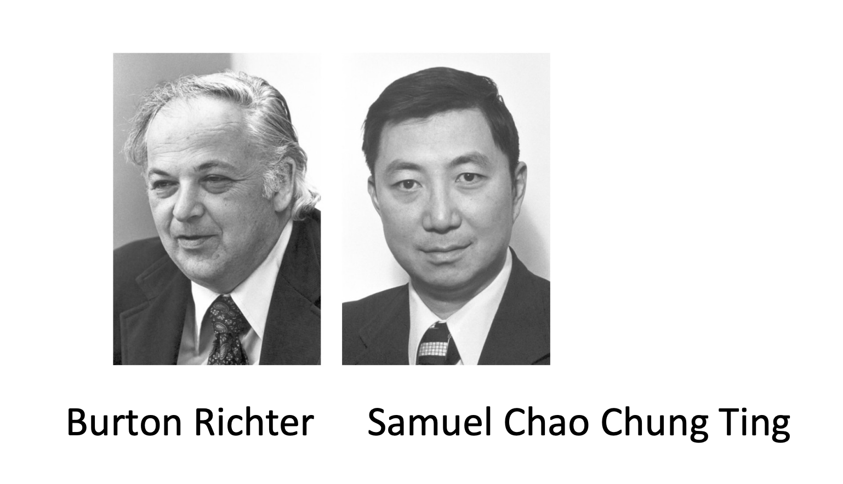

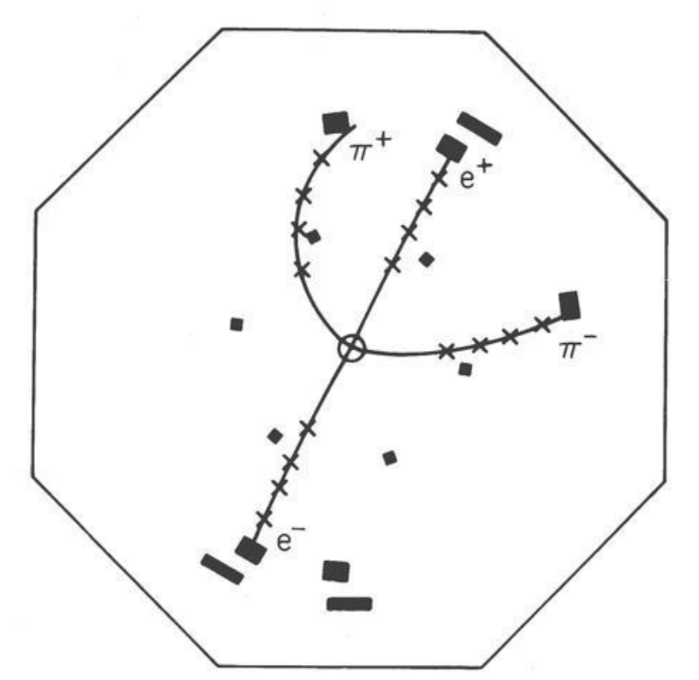
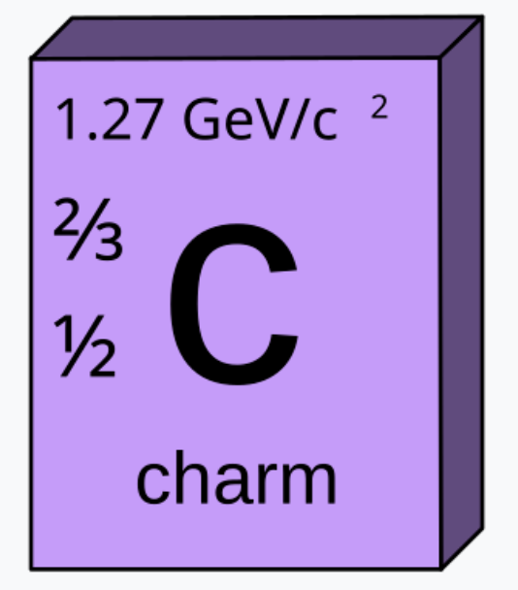






$J/ψ$ discovery
BNL: J.J. Auber et al, PRL 33 (1974) 1404
SLAC: J.-E. Augustin et al, PRL (1974) 1406
$$e^{+}$$
$$h, μ, e$$
$$J/ψ$$
$$γ^{∗}$$
$$e^{−}$$

Slide 7
Rare Charm decays

Slide 8
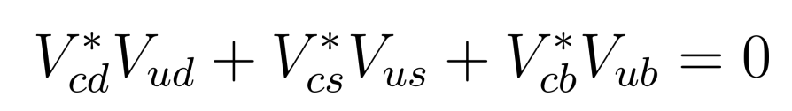
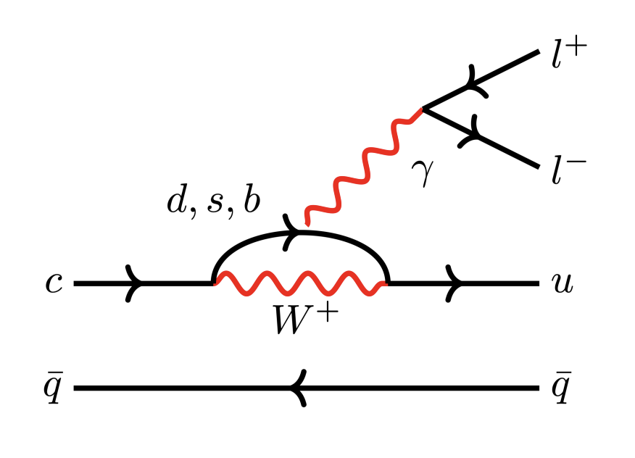
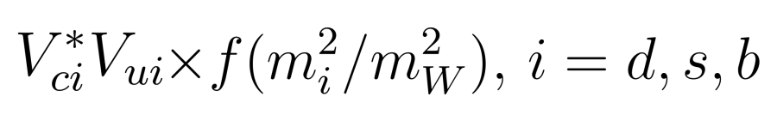
Flavour-changing neutral currents (FCNCs)
Unlike FCNC of b decays, at the loop level, internal quarks are down-type
CKM unitarity + GIM mechanism
Larger suppression compared to b FCNC.
Long-distance-dominated

Slide 9
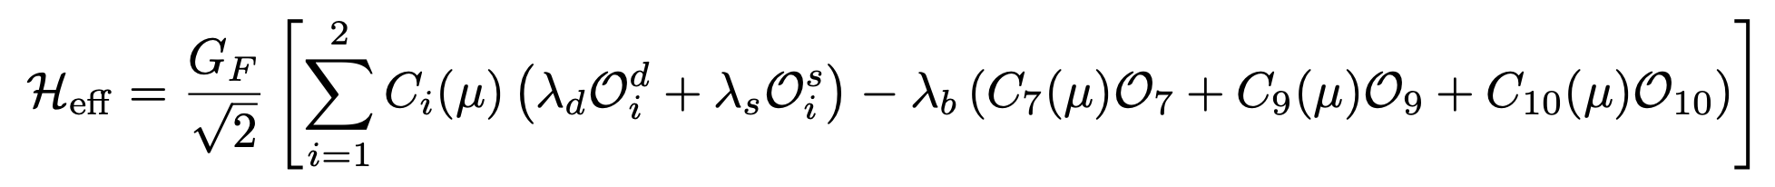
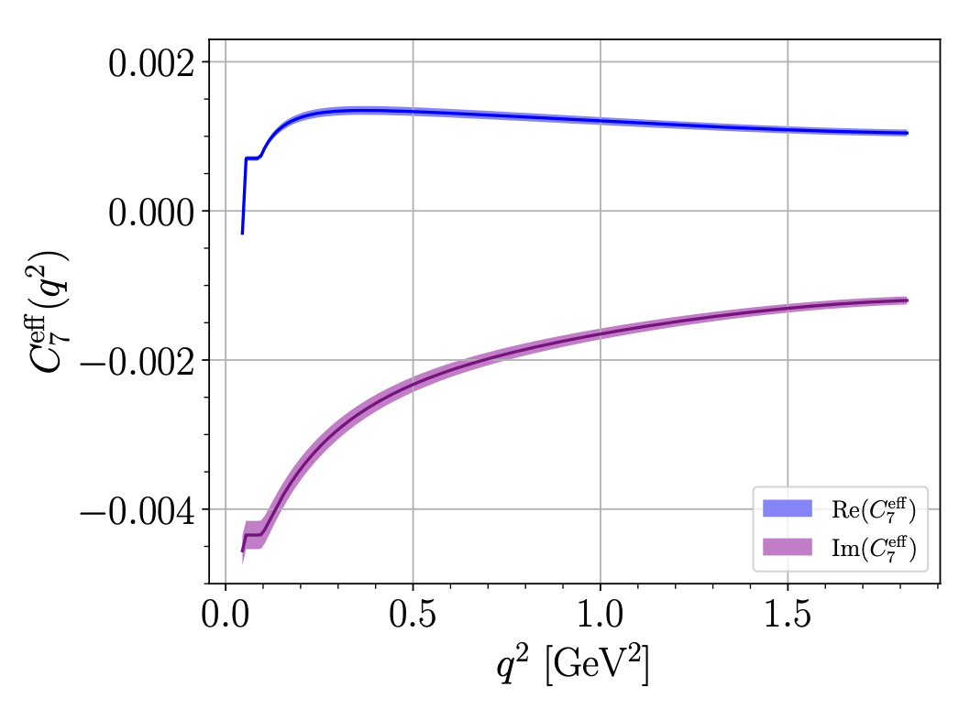
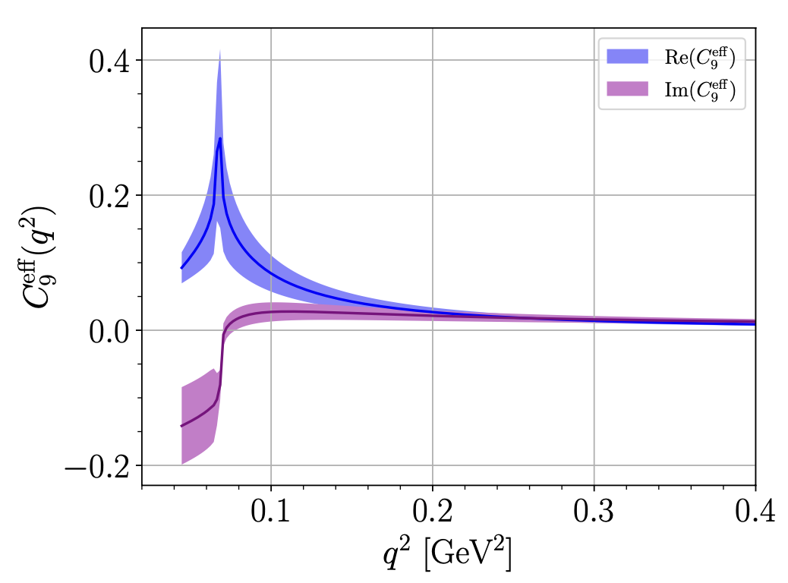
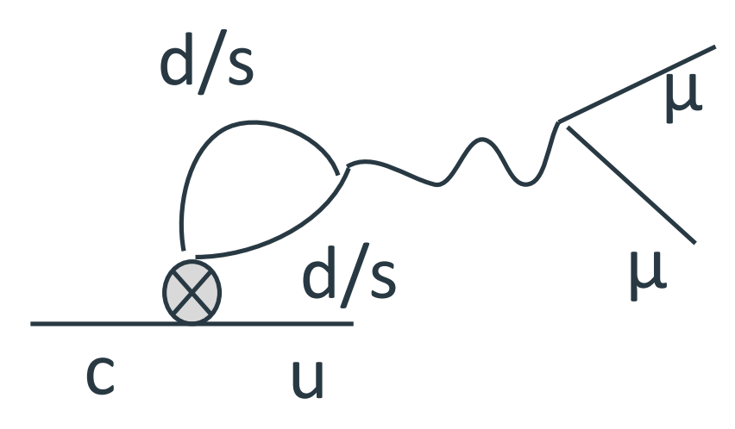


Effective Hamiltonian
4-quark
EM dipole
semileptonic
Relevant to rare charm decays,
but suppressed by GIM
The SM contributions to $O_{7,9,10}$ are induced by the charged-current operators
$${C_{7}, C}_{9}, C_{10}∼0$$
S. de Boer and G. Hiller,
Phys. Rev. D 93 (2016) no.7, 074001

Slide 10
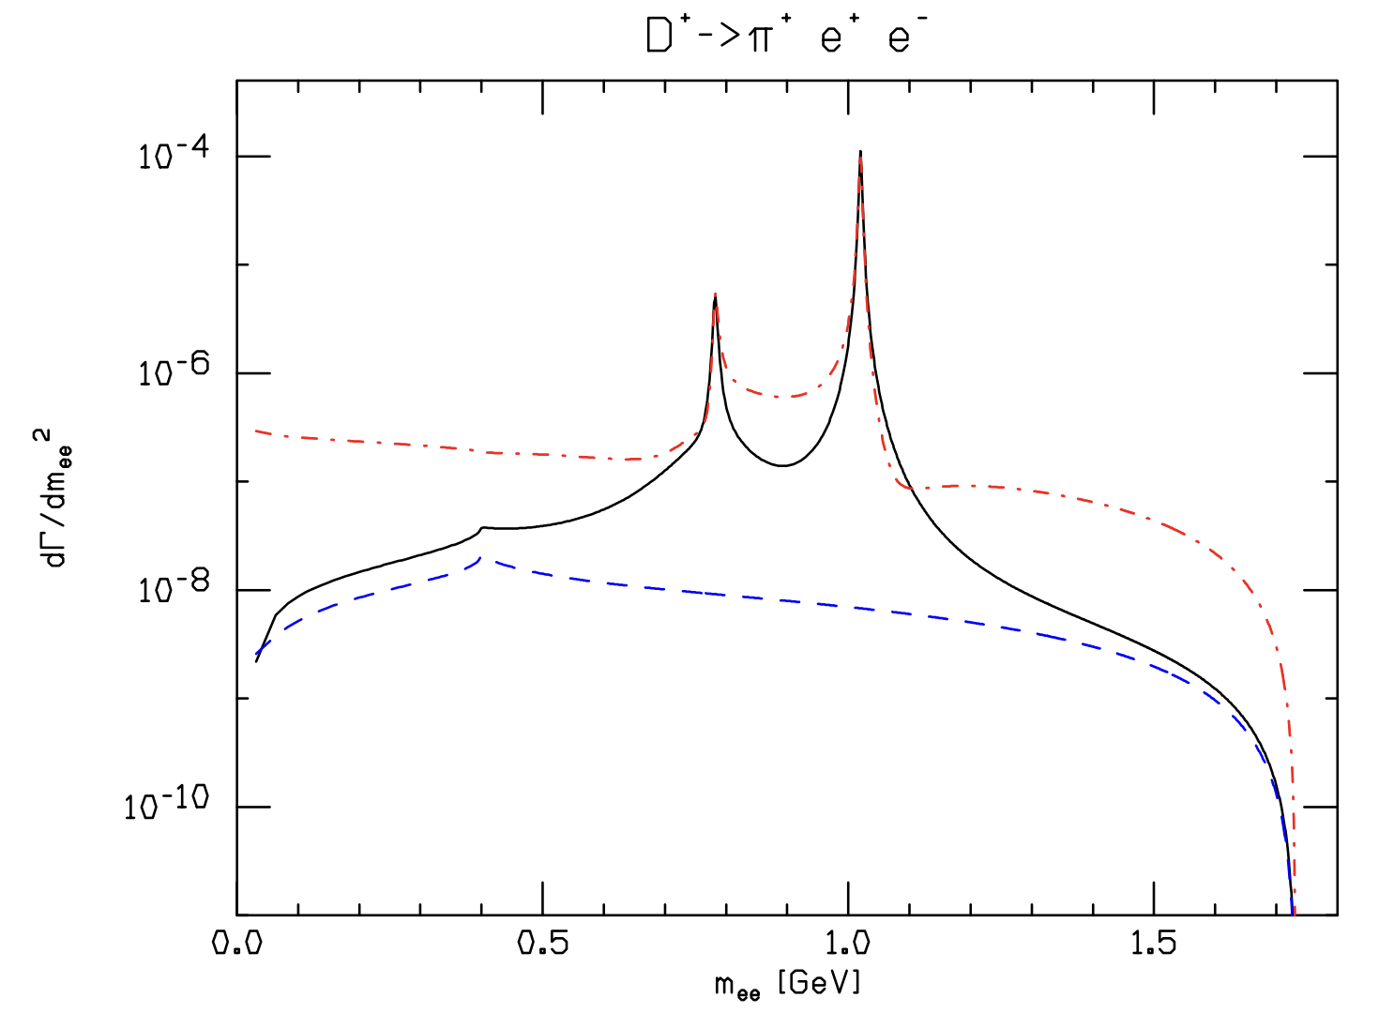
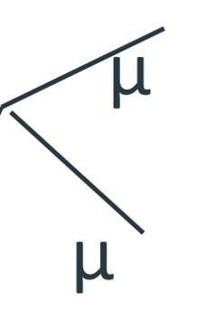

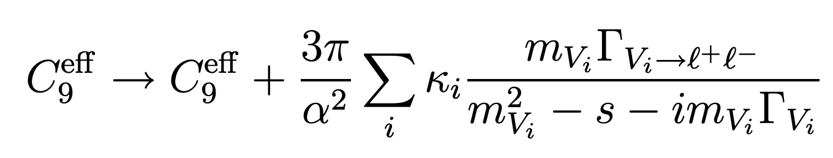
Long distance effects
Without W boson in the loop, the amplitude is dominated by Long distance effects.
One has to introduce resonant contributions:
Resonants
c
u
G. Burdman, E. Golowich, J. L. Hewett, and S. Pakvasa, Phys. Rev. D 66, 014009 (2002)

Slide 11
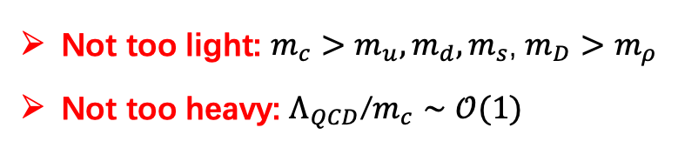


Theoretical framework
Calculate $c→q$ transition form factors
$$m_{c}≈1.3 GeV$$
We need to properly address QCD around the mass of the charm quark & hadrons!
Not too light: $m_{c}>m_{u}, m_{d}, m_{s}$, $m_{D}>m_{ρ}$
Not too heavy: $Λ_{QCD}$/$m_{c}∼𝒪(1)$
Cannot use ChPT
Cannot apply QCD factorization
Reliable theoretical approaches:
QCD sum rules (QCDSR)
Light-cone sum rules (LCSR)
Lattice QCD

Slide 12
Theoretical status -- Transition form factors

Slide 13
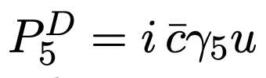

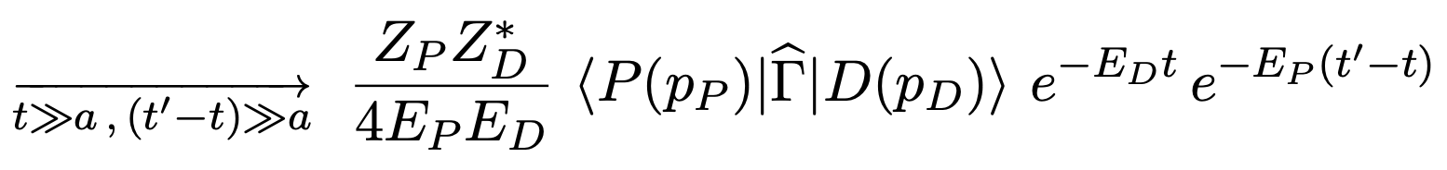
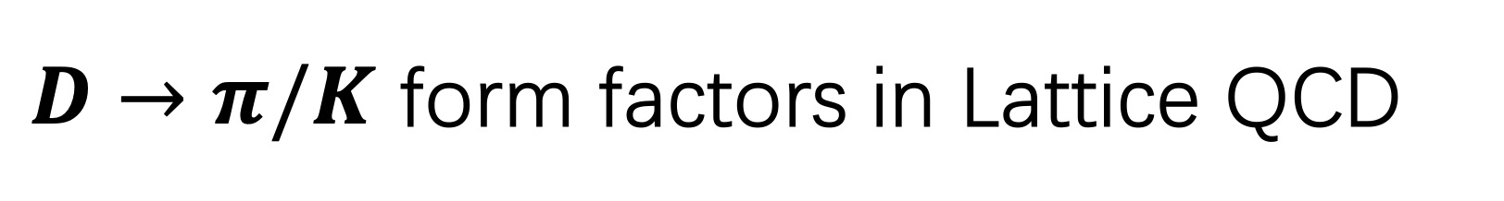
$D→π/K$ form factors in Lattice QCD
V. Lubicz et al., Phys.Rev.D 100 (2019) 7, 079901
Definition:
Define a 3-point correlation function
c
q
At large time distances the correlation function behaves as
This asymptotic behavior can be used to extract the from factors.

Slide 14
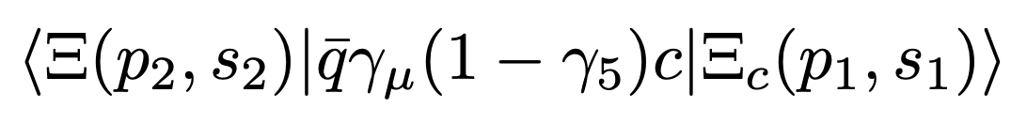
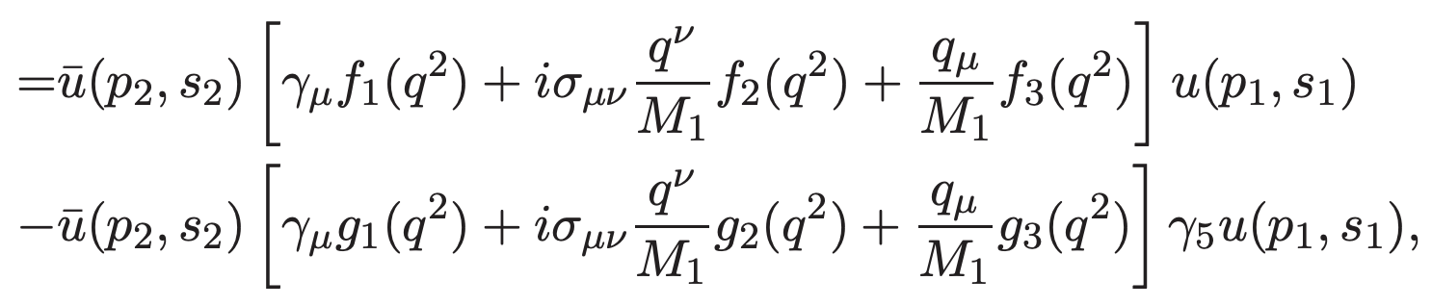
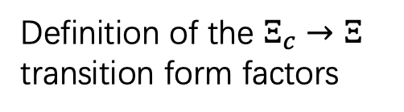

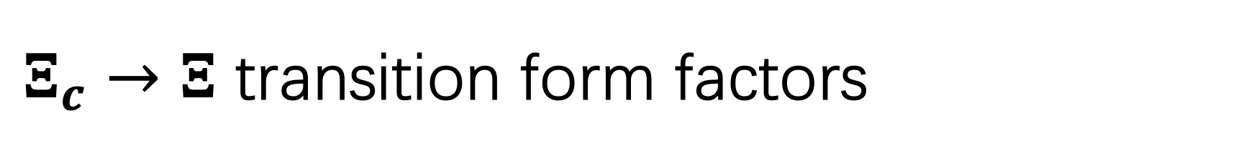

$Ξ_{c}→Ξ$ transition form factors
QCD sum rules calculation
Definition of the $Ξ_{c}→Ξ$ transition form factors
Calculated by a 3-point correlation function
Zhen-Xing Zhao et al., Phys.Rev.D 108 (2023) 11, 116008
Hadron level
c
q
Matching
calculated at
$$J_{Ξ_{c}}$$
$$J_{Ξ}$$
Quark-gluon level
Charm baryon states
Light baryon states

Slide 15
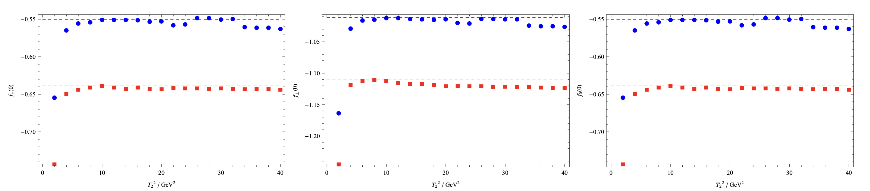
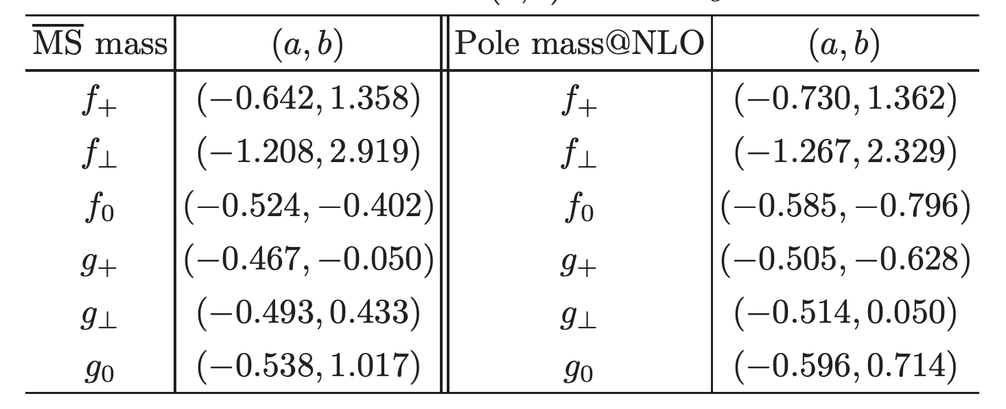
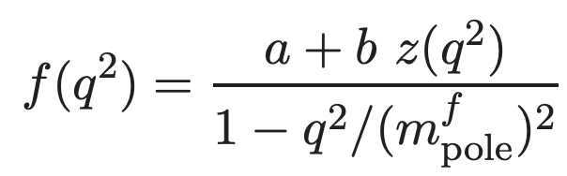
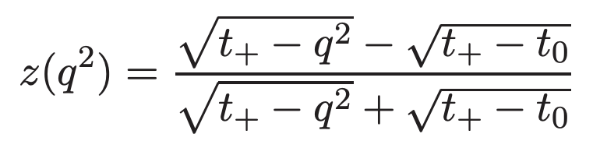


Find stable window of the Borel parameter $T$:
From factors VS $T^{2}$ at fixed $q^{2}$:
Z-series fitting:

Slide 16
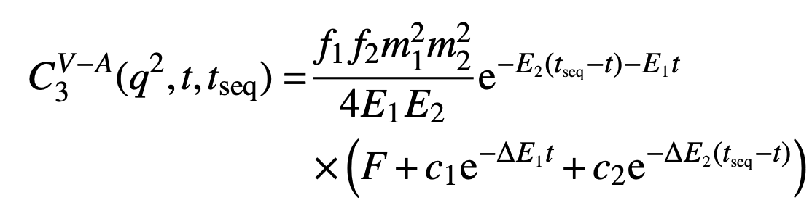
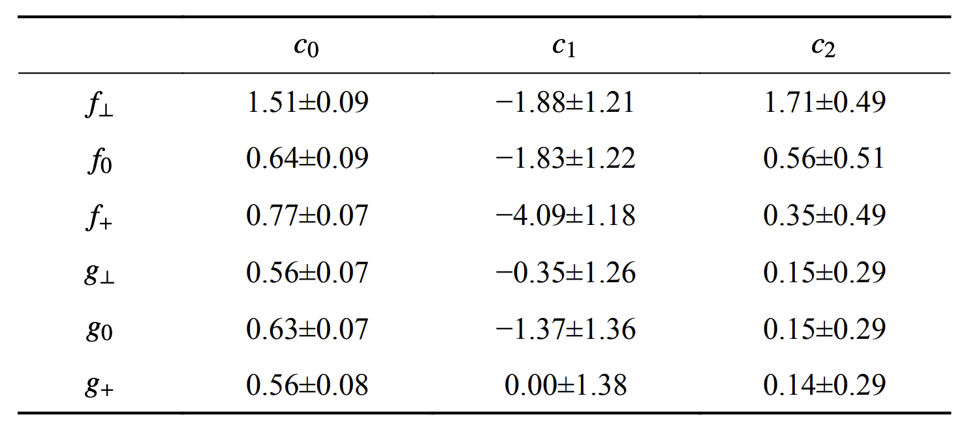

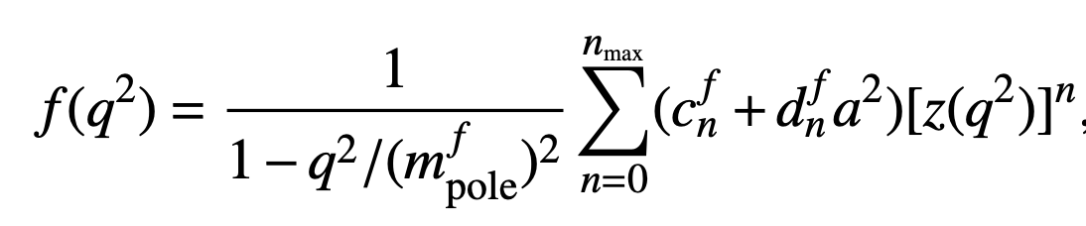


First lattice QCD calculation of $Ξ_{c}→Ξ$ transition form factors
Qi-An Zhang et al., Chin.Phys.C 46 (2022) 1, 011002
c
q
large (Euclidean) time distance behavior :
$$J_{Ξ_{c}}$$
$$J_{Ξ}$$
Z-series fitting:

Slide 17
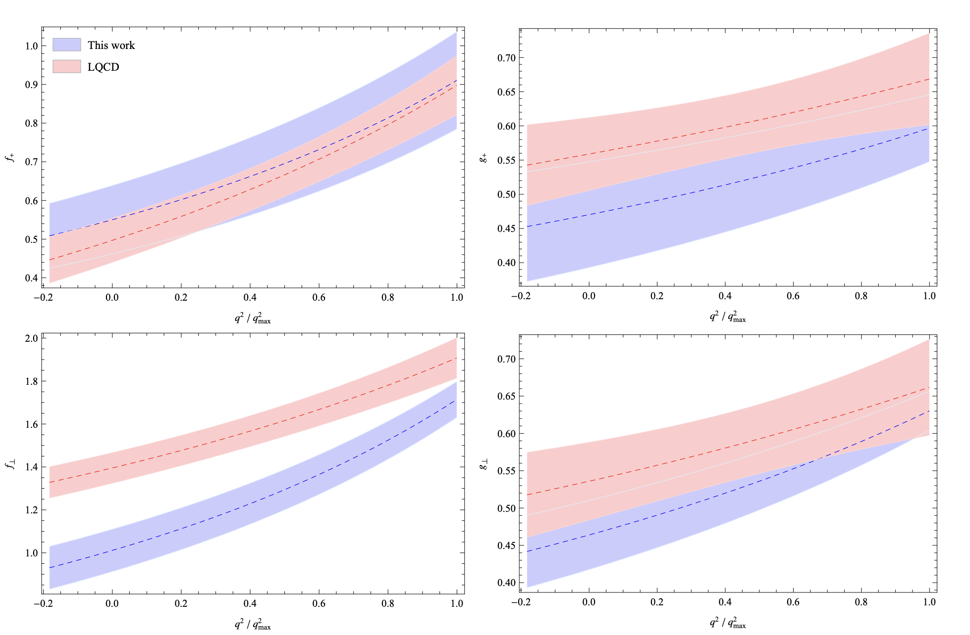
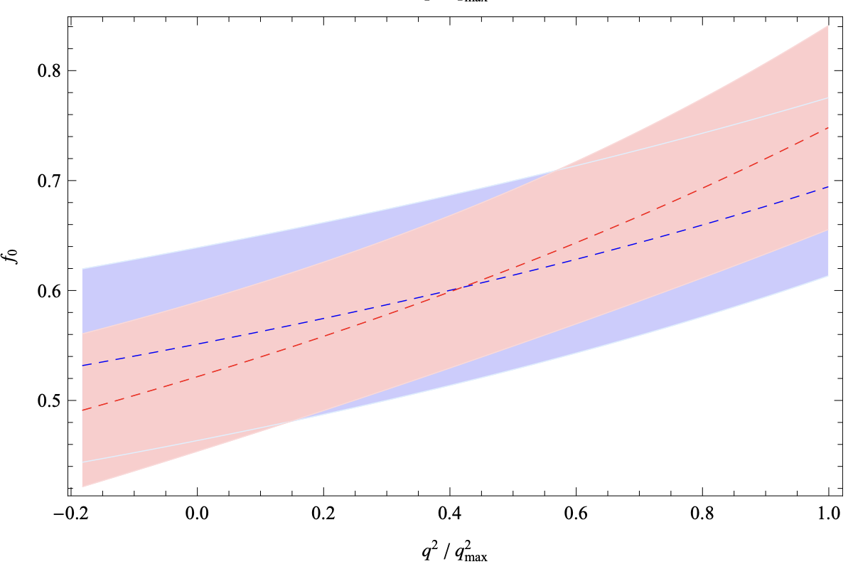
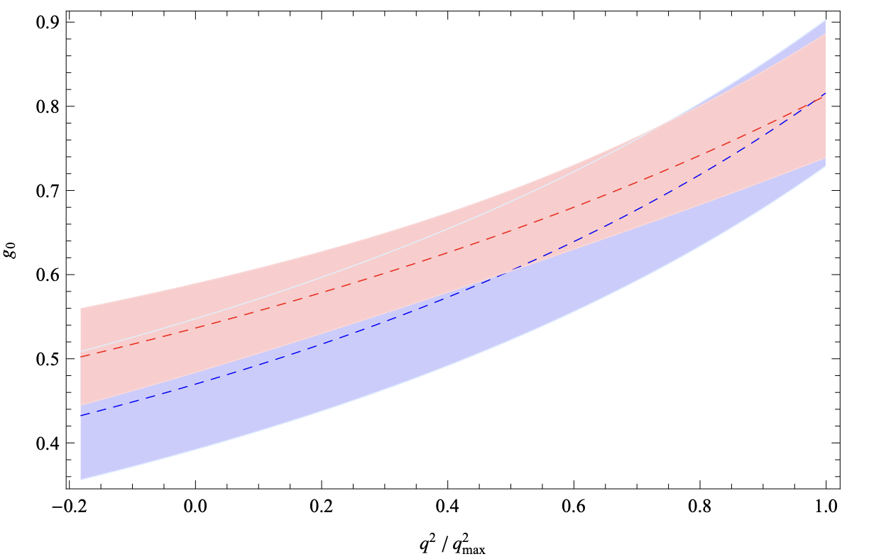
Comparing helicity form factors between QCDSR and Lattice QCD
Zhen-Xing Zhao et al., Phys.Rev.D 108 (2023) 11, 116008

Slide 18
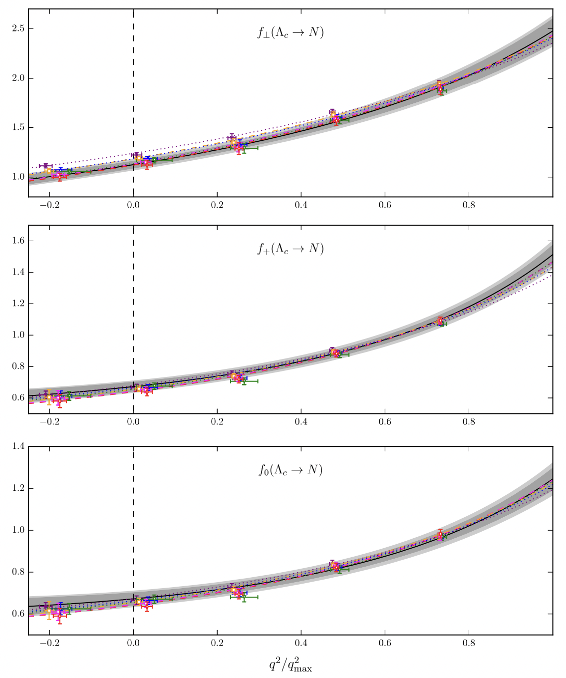
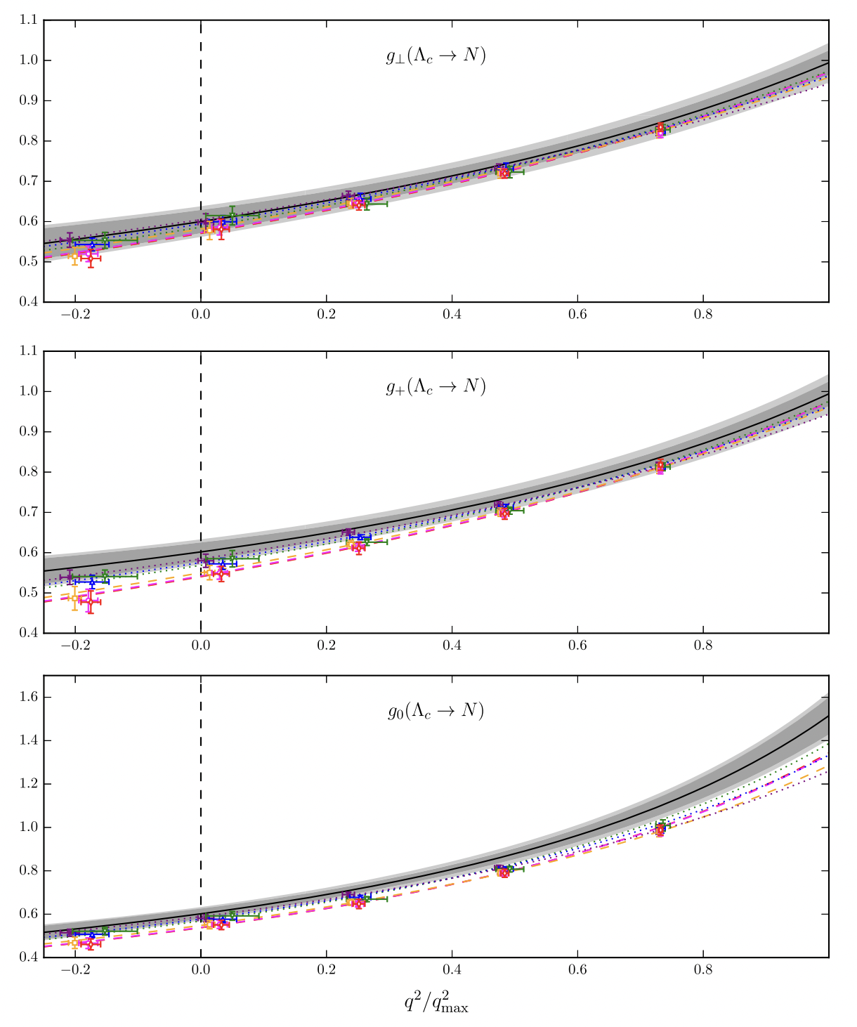
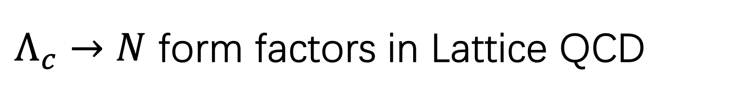
$Λ_{c}→N$ form factors in Lattice QCD
Stefan Meinel, Phys.Rev.D 97 (2018) 3, 034511

Slide 19
Theoretical status – Rare charm decays

Slide 20
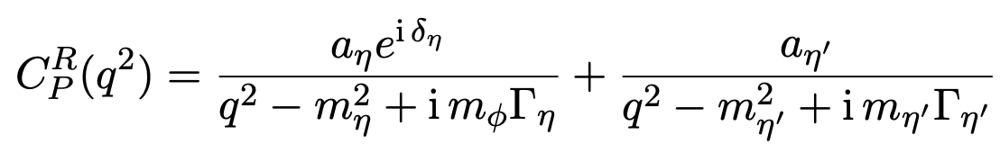
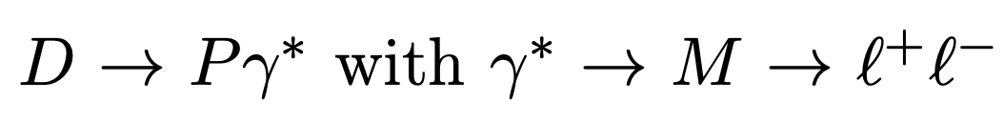
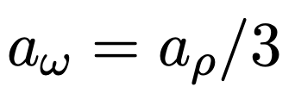
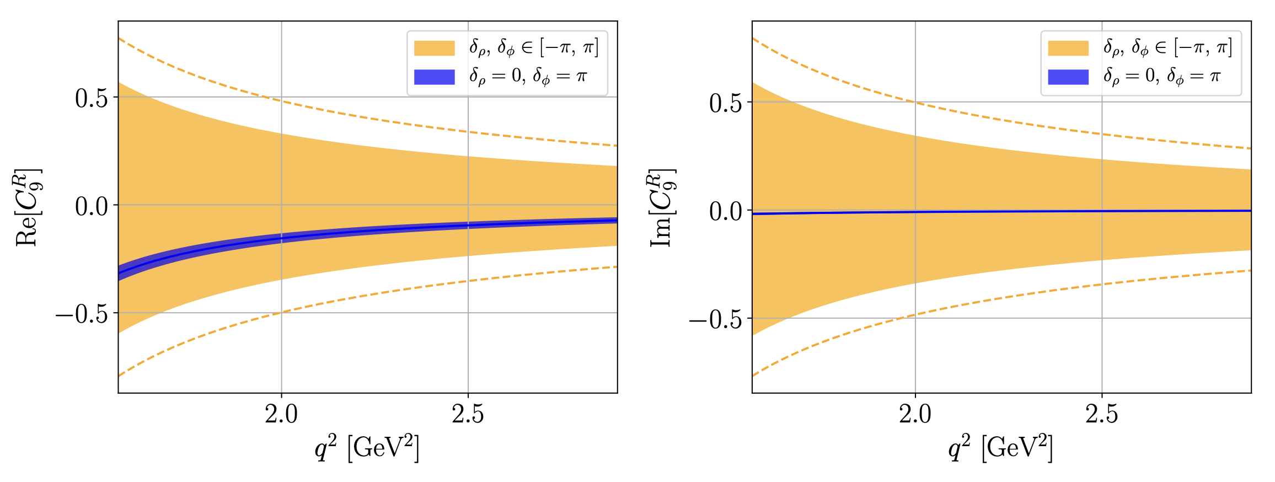

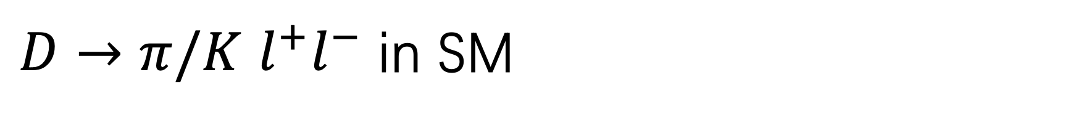


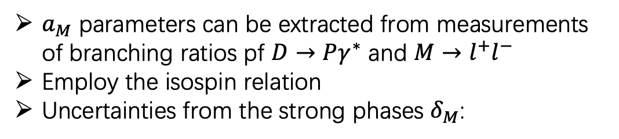
$D→π/K$ $l^{+}l^{−}$ in SM
The dominant process inducing the $𝒪_{9}$ operator:
R. Bause et al. Eur.Phys.J.C 81 (2021) 3, 219
$a_{M}$ parameters can be extracted from measurements of branching ratios pf $D→Pγ^{∗}$ and $M→l^{+}l^{−}$
Employ the isospin relation
Uncertainties from the strong phases $δ_{M}$:
$$l^{+}$$
$$M=ρ, φ, ω$$
$$l^{−}$$
c
u

Slide 21
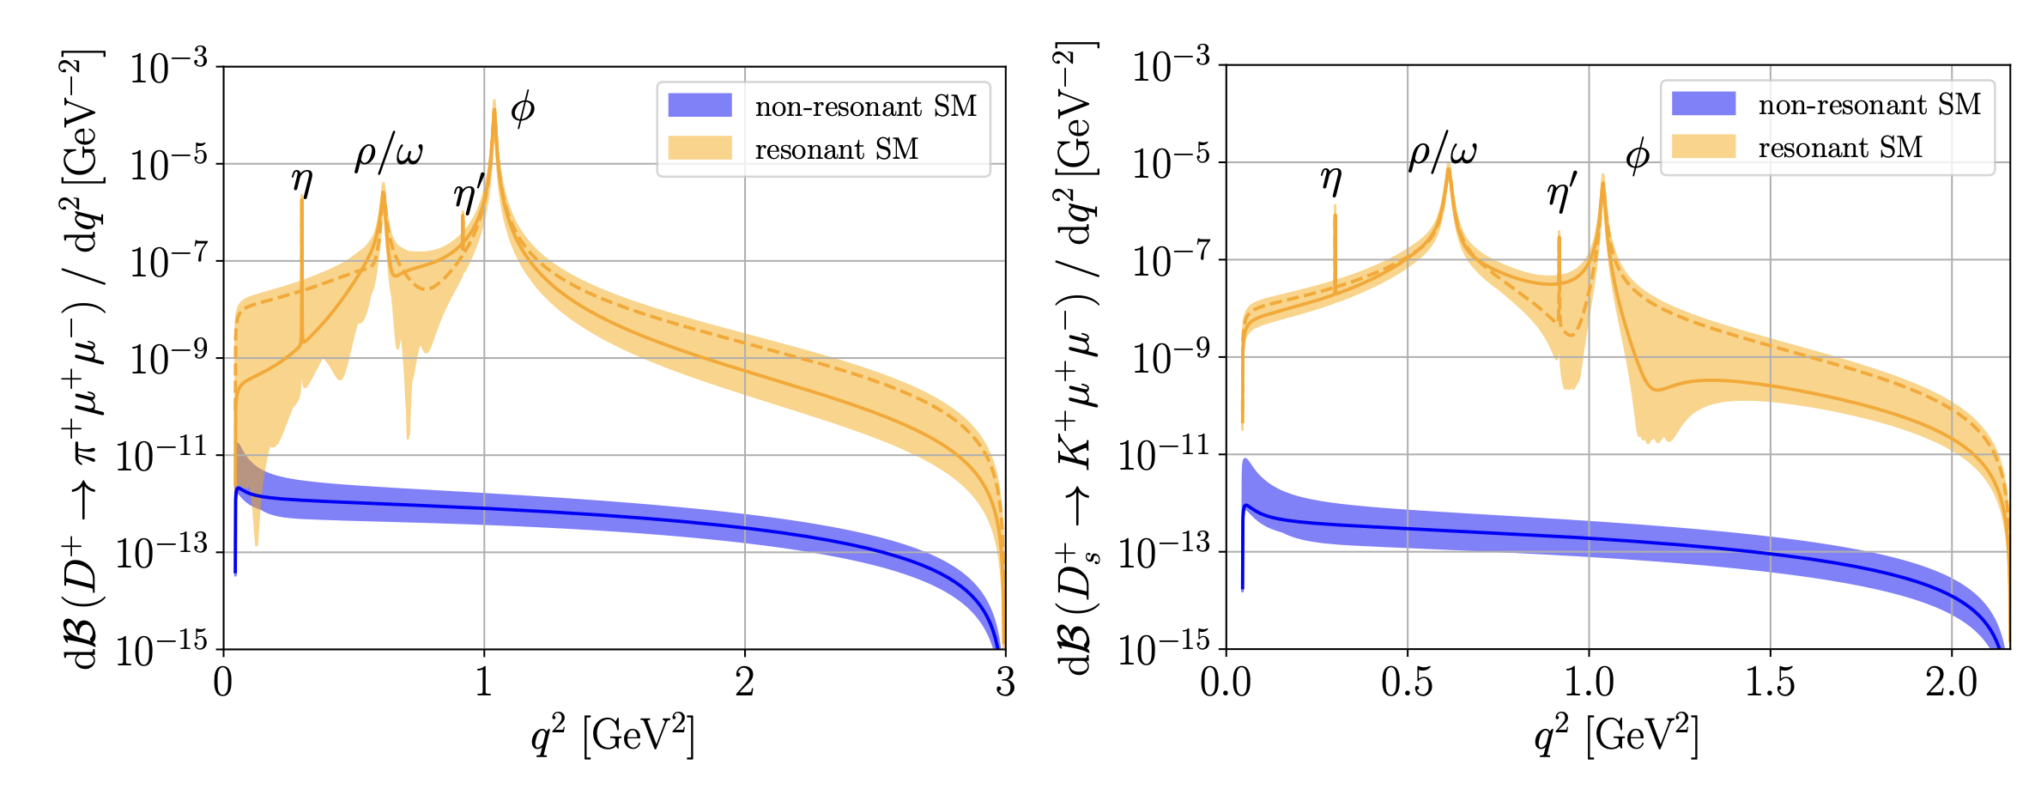
$D→π/K$ $l^{+}l^{−}$ in SM
The differential SM branching fractions:

Slide 22
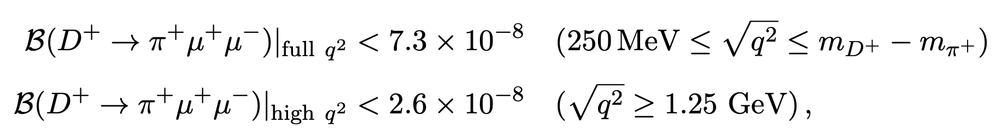
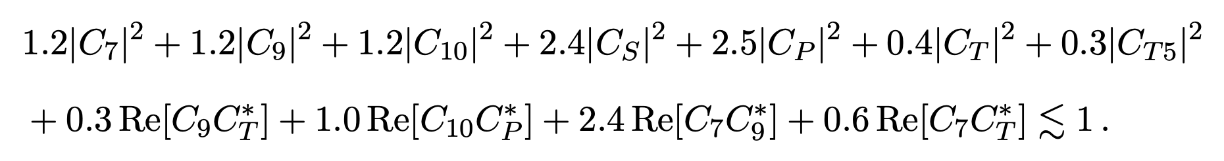






$D→π/K$ $l^{+}l^{−}$ beyond SM
Constraints on Wilson coefficients:
Experimental limits:
LHCb Collaboration, Phys. Lett. B 724 (2013)
Full $q^{2}$ region:
High $q^{2}$ region:
Take benchmark values:

Slide 23





$D→π/K$ $l^{+}l^{−}$ beyond SM
Lepton universality
$$R_{π}^{D}$$
Insensitive to NP
Huge but has large uncertainties
Sensitive to NP
lepton forward-backward asymmetry
Sensitive to the combinations of tensor and (pseudo)scalar operators
Significantly suppressed if only scalar or pseudotensor structure is present

Slide 24




$D→π/K$ $l^{+}l^{−}$ beyond SM
CP–asymmetry
Around the φ resonance
High $q^{2}$ region
Small uncertainties
Useful to extract strong and weak parameters

Slide 25








$$D→(π^{+}π^{−}K^{+}K^{−})μ^{+}μ^{−}$$
Fits of $C_{7}, C_{9}, C_{10}$:
$$C_{7}$$
$$C_{9}$$
The bounds on $C_{7},$ $C_{9}$ are very sensitive to the resonance parameters
The bounds on $C_{10}$ are rather stable over the model scenarios.
$$C_{10}$$
Hector Gisbert , Gudrun Hiller, Dominik Suelmann , JHEP12(2024)102

Slide 26




Rare charm baryon decay
The Wilson coefficient is the same as that of D decays
Marcel Golz, Gudrun Hiller and Tom Magorsch,
JHEP09(2021)208
Resonant contribution:
Experiment upper limit:
SM prediction:

Slide 27


Rare charm baryon decay
Constraints on Wilson coefficients
lepton forward-backward asymmetry
$A_{FB}$ is suppressed around the resonances
even a small $C_{10}$ can induce an $A_{FB}$ value on the order of 0.1
Offer potential signal of NP

Slide 28






Lepton universality ratios
Deviations from the SM can be very large in the low and high $q^{2}$ regions
Hadronic uncertainties are more significant in the high $q^{2}$ region
CP asymmetry:
Full $q^{2}$ region
Resonant region

Slide 29






Rare charm decays with missing energy
Charm FCNC in leptoquark (LQ) model:
Gaber Faisel, Jhih-Ying Su, Jusak Tandean, JHEP 04 (2021) 246
Effective operators:
LQ Yukawa matrices
Dimensionless coupling:
Leptoquark mass
Constrained by $D^{0}−{\overline{D}}^{0}$ mixing

Slide 30

Branching fractions of various FCNC decays of charmed mesons and baryons with missing energy:

Slide 31





Rare charm decays with invisible scalar
Chao-Qiang Geng, Geng Li, Phys.Lett.B 839 (2023) 137811
Experimental upper limit :
M. Ablikim et al. (BESIII), Phys. Rev. D 105, L071102 (2022)
Coupling VS Mass

Slide 32
Summary
SM theoretical approaches make great progress in precision calculation of transition form factors;
Resonant contributions to Wilson coefficients still has large uncertainties;
The obtained constraints on the NP parameters will require test from future experiments.

