Slide 1

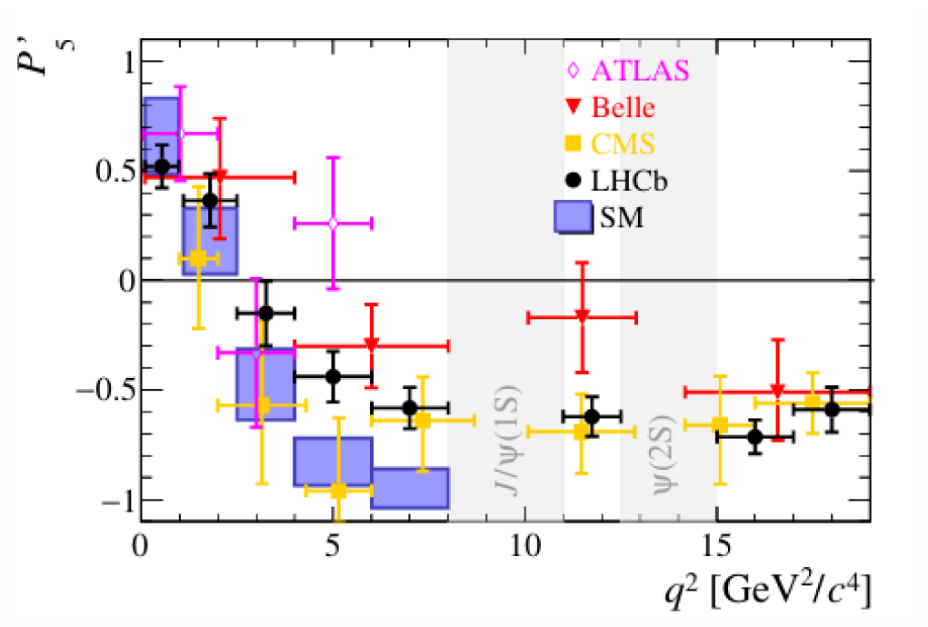
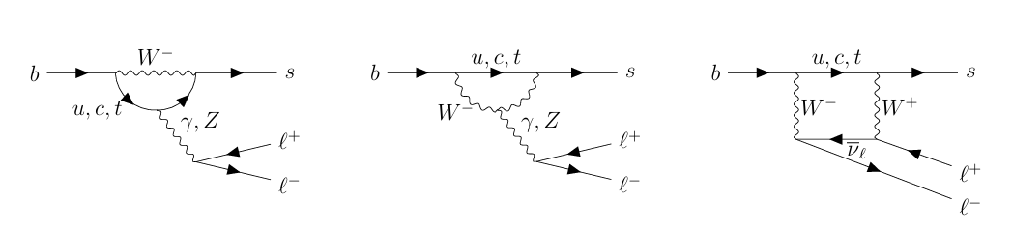
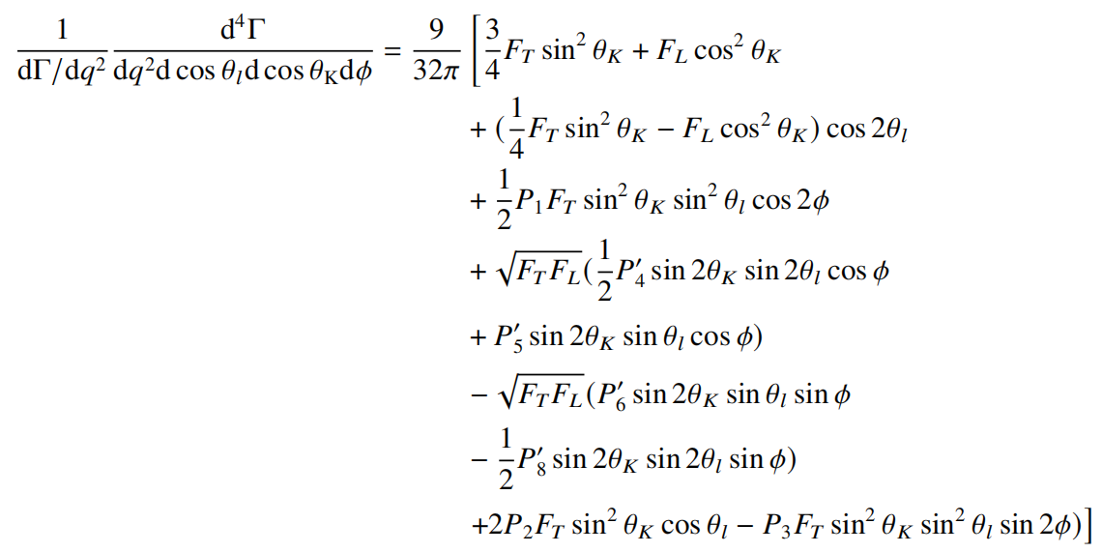
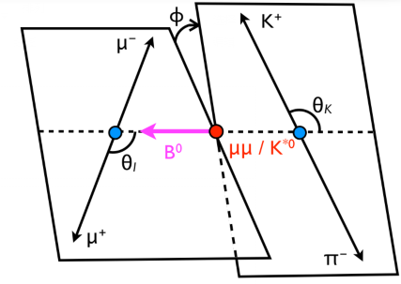
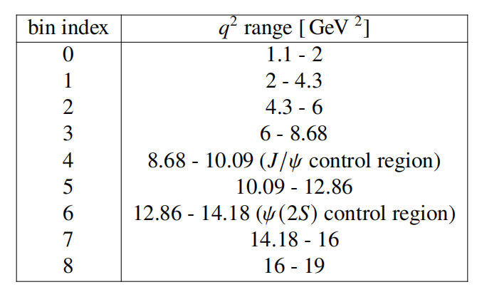
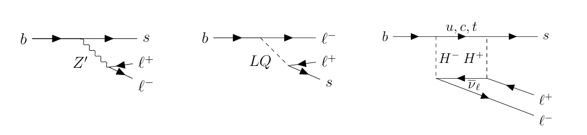
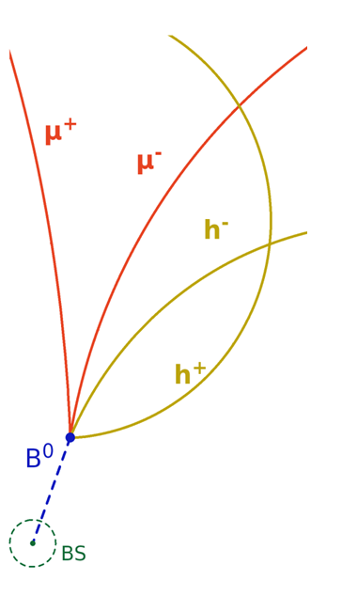
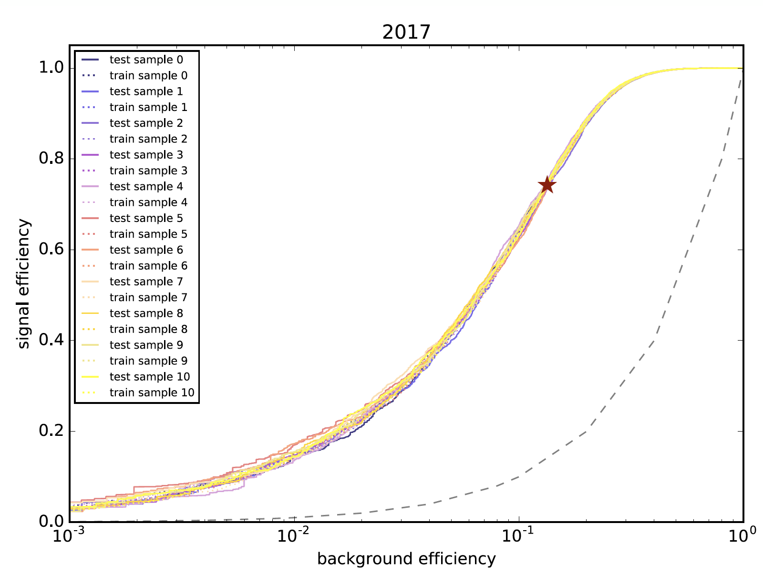
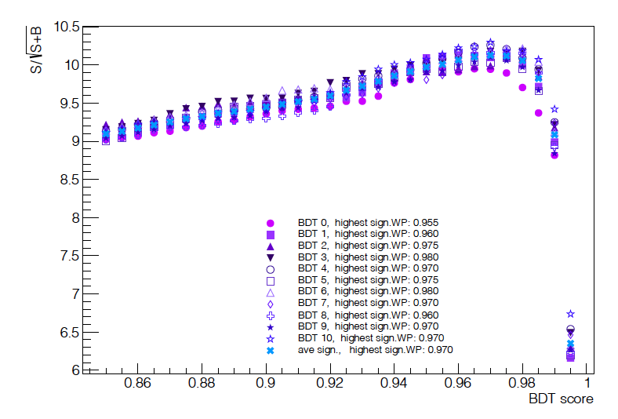
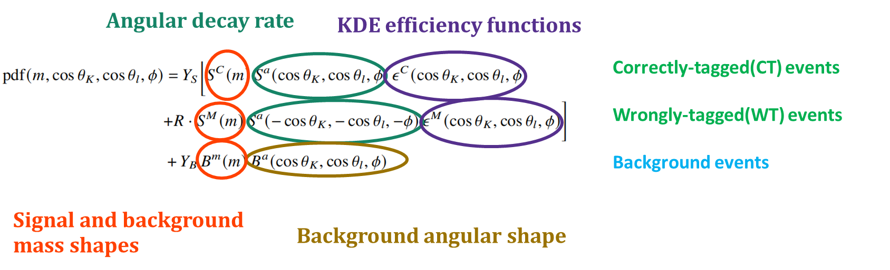
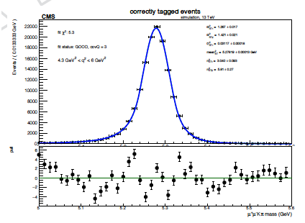
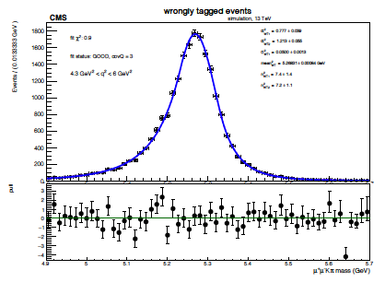
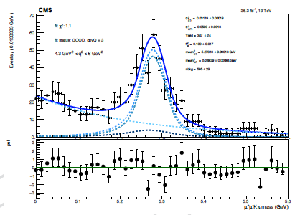
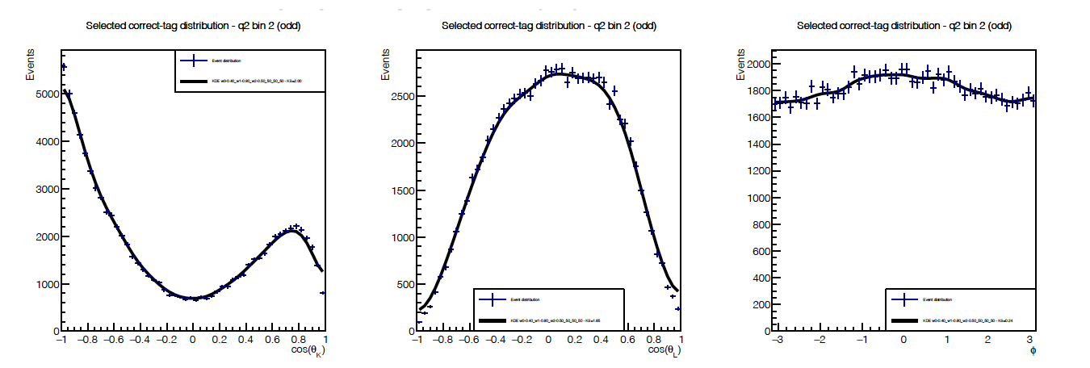
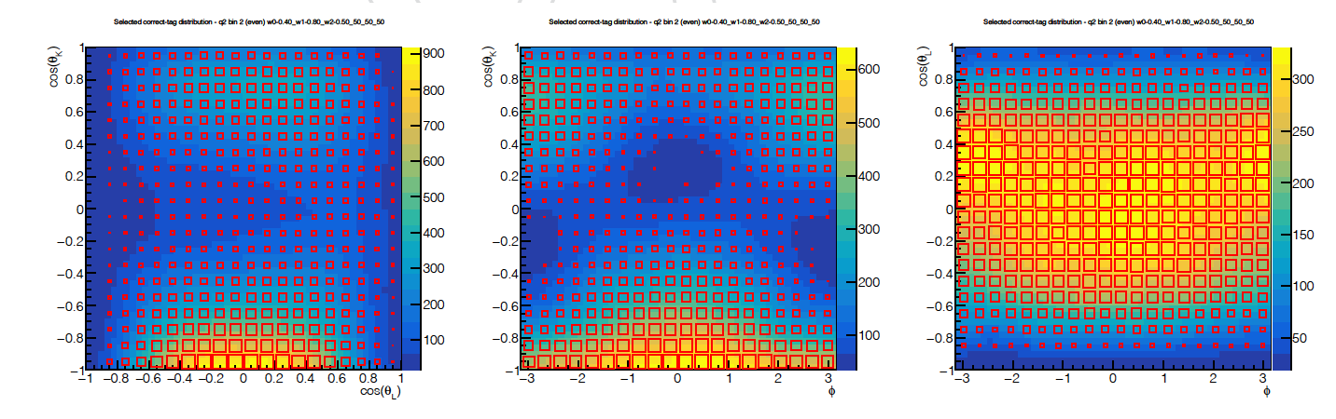
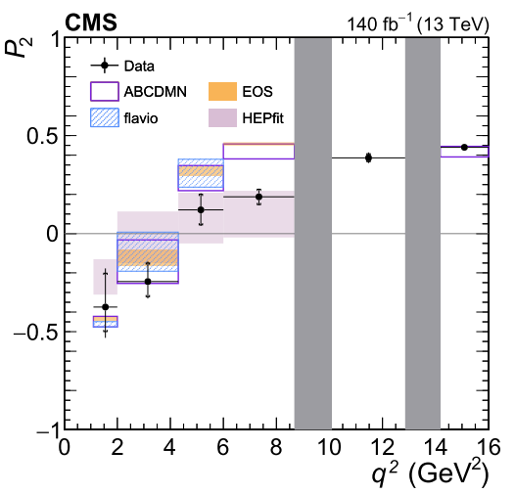
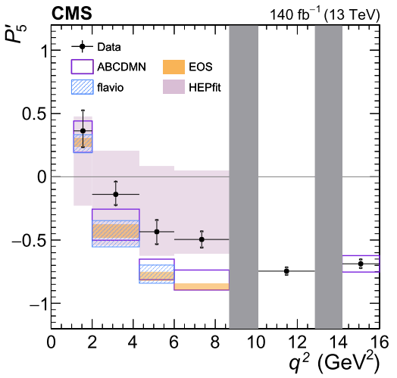
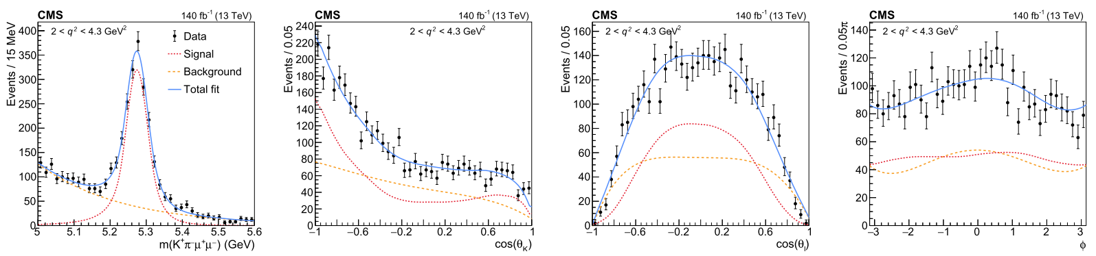
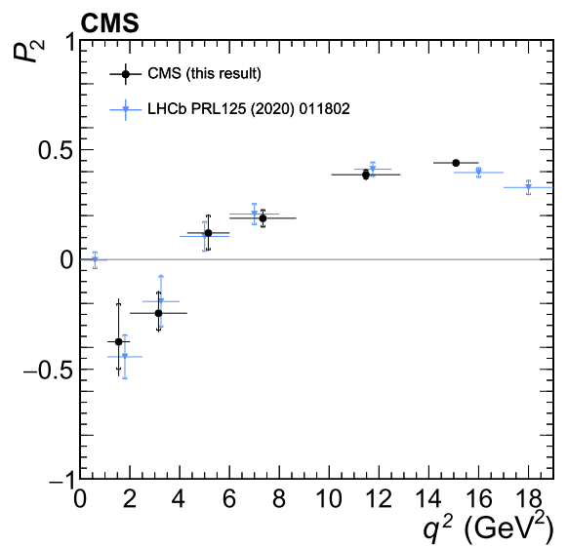
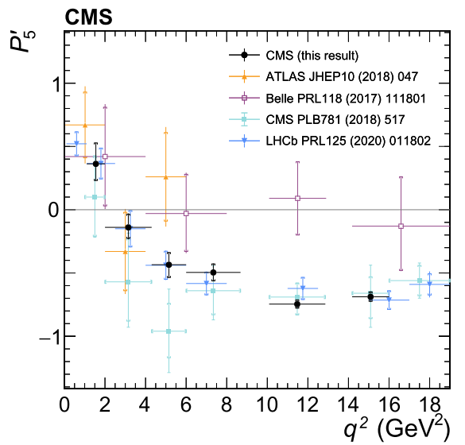
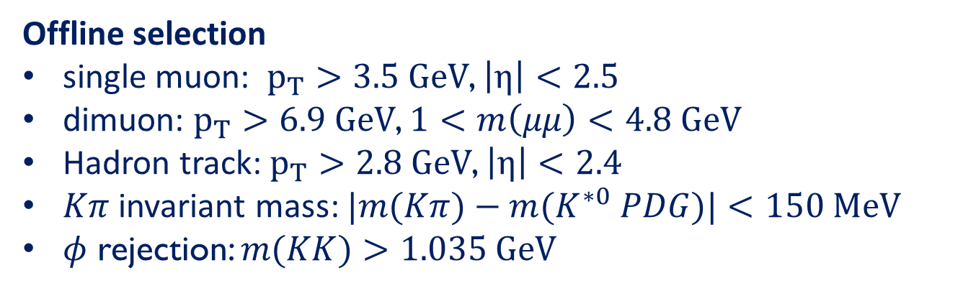
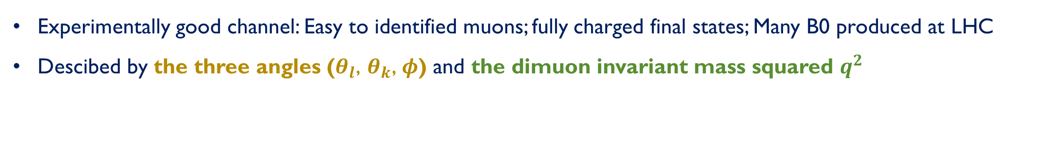

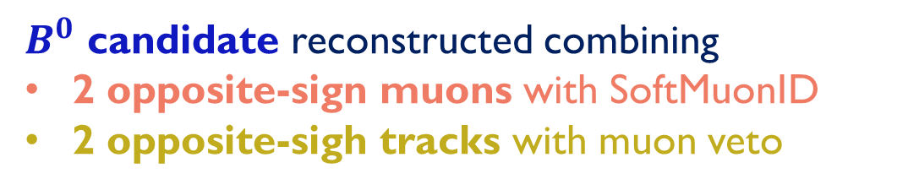

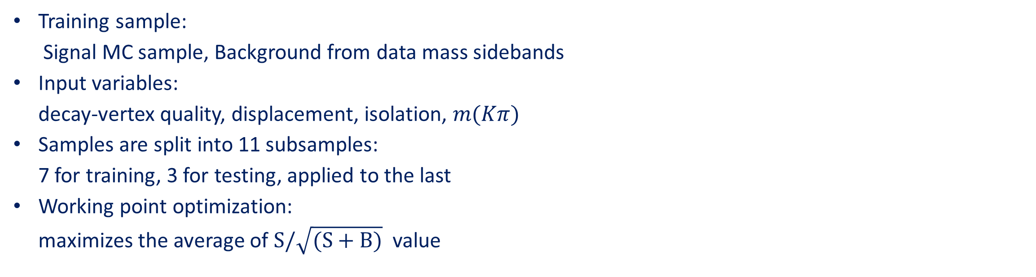
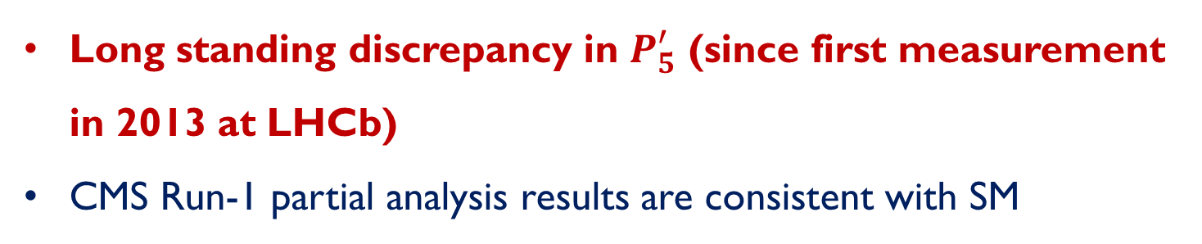
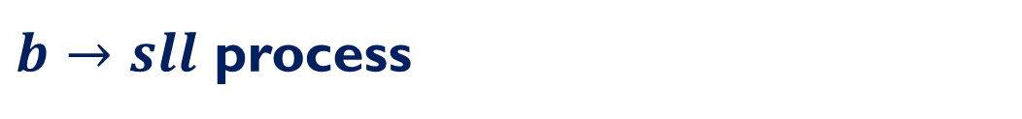
Full angular analysis of the $B^{0}→K^{∗0}μ^{+}μ^{−}$ decay in proton-proton collisions at CMS
Xuelong Qin^{1,2}
on behalf of the CMS collaboration
HQL 2025, Beijing, 16 – Sep 2025
Motivation
1. Peking University 2. Laser Fusion Research Center
$b→sll$ process
$B^{0}→K^{∗0}μμ$
Previous analysis^{[1-4]}
Flavour-changing-neutral-current (FCNC) transition
Forbidden at tree level in SM
Enhanced in many BSM theories
Experimentally good channel: Easy to identified muons; fully charged final states; Many B0 produced at LHC
Descibed by the three angles ($θ_{l}$, $θ_{k}\text{,} φ$) and the dimuon invariant mass squared $q^{2}$
SM
Long standing discrepancy in $P_{5}^{′}$ (since first measurement in 2013 at LHCb)
CMS Run-1 partial analysis results are consistent with SM
NP?
Reconstruction and Preselection
BDT selection
$B^{0}$ candidate reconstructed combining
2 opposite-sign muons with SoftMuonID
2 opposite-sigh tracks with muon veto
Training sample:
Signal MC sample, Background from data mass sidebands
Input variables:
decay-vertex quality, displacement, isolation, $m(Kπ)$
Samples are split into 11 subsamples:
7 for training, 3 for testing, applied to the last
Working point optimization:
maximizes the average of $S/\sqrt{(S+B)}$ value
Offline selection
single muon: $p_{T}>3.5 GeV$, $\left|η\right|<2.5$
dimuon: $p_{T}>6.9 GeV$, $1<m\left(μμ\right)<4.8 GeV$
Hadron track: $p_{T}>2.8 GeV$, $\left|η\right|<2.4$
$Kπ$ invariant mass: $|m(Kπ)−m(K^{∗0} PDG)|<150 MeV$
𝜙 rejection: $m(KK)>1.035 GeV$
Analysis Strategy
Mass shapes
For each q² bin: 4D simultaneous fit on three years’ data samples
Data mass shape is fitted with the shape defined by MC
Signal shape parameters have gaussian constraints to values fitted on signal MC
Background is parametrized using an exponential
CT MC
WT MC
Data
R parameter: mistag correction value
Y_{s}, Y_{B}: yield of signal and background
q² bin2 2016
KDE efficiency functions
Background angular shape
Evaluated from MC for CT and WT separately Using Kernel Density Estimators
Describe distributions as sum of multi-variate Gaussians
Applied on numerators and denominators, then ratio is performed on the functions
Background angular shape extracted from sidebands
Defined to have <6% of signal pollution
Fit with multivariate Bernstein polynomials
cosθ_{K}
cosθ_{l}
ɸ
cosθ_{K} vs cosθ_{l}
cosθ_{K} vs ɸ
cosθ_{l} vs ɸ
Sideband events
Projections of the sideband fit results
1D and 2D projections of KDE function
for CT events (q² bin2 2016)
Result
First full angular analysis of $B^{0}→K^{∗0}μμ$ at CMS, published on PLB^{[5]}
Among the most precise experimental measurements
Deviation for P5’ with EOS predictions
$4.3 {<q}^{2}<6 GeV/c^{2}$: 3.2σ
$4.3 {<q}^{2}<6 GeV/c^{2}$: 4.9σ
Deviation for P2 with EOS predictions
$4.3 {<q}^{2}<6$ $GeV/c^{2}$: 2.2σ
$4.3 {<q}^{2}<6 GeV/c^{2}$: 6.4σ
Measurements are compatible with previous results from CMS Run-1 and other experiments
Projections of fit results（q² bin2 ）
* A. Boletti¹ P. Dini² S. Fioendi³ X. Qin⁴ D. Wang⁴
References
[1] PLB 781 (2018) 517541
[2] PRL 125 (2020) 011802
[3] JHEP 10 (2018) 047
[4] PRL 118 (2017) 111801
[5] PLB 864 (2025) 139406
LIP [PT]
Universita Milano Bicocca and INFN [IT]
CERN [CH]
Peking University [CN]

