Slide 1





Observation of a family of all-charm tetraquarks
Liangliang Chen, Yilin Zhou
The XVII International Conference on Heavy Quarks and Leptons, 16.09.2025

Slide 2
Outline
Motivation
J/ψJ/ψ updated result (Poster from Yilin Zhou)
J/ψψ(2S) result (Poster from Liangliang Chen)
Summary

Slide 3
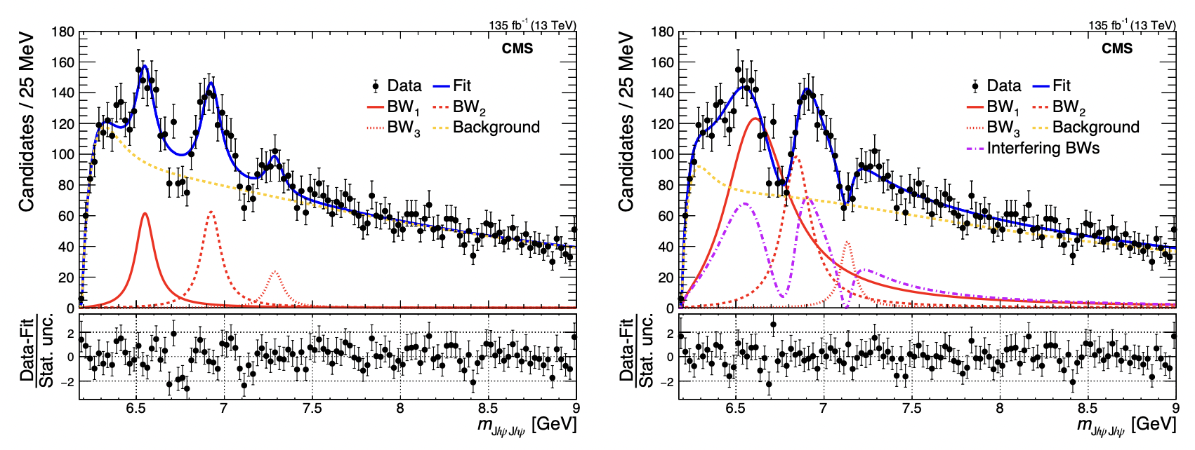
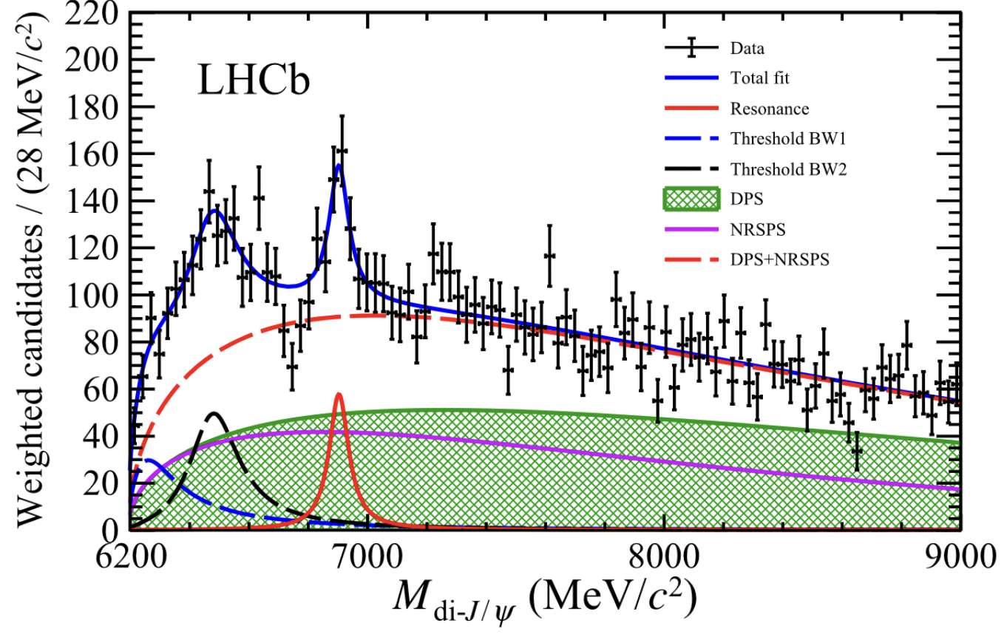
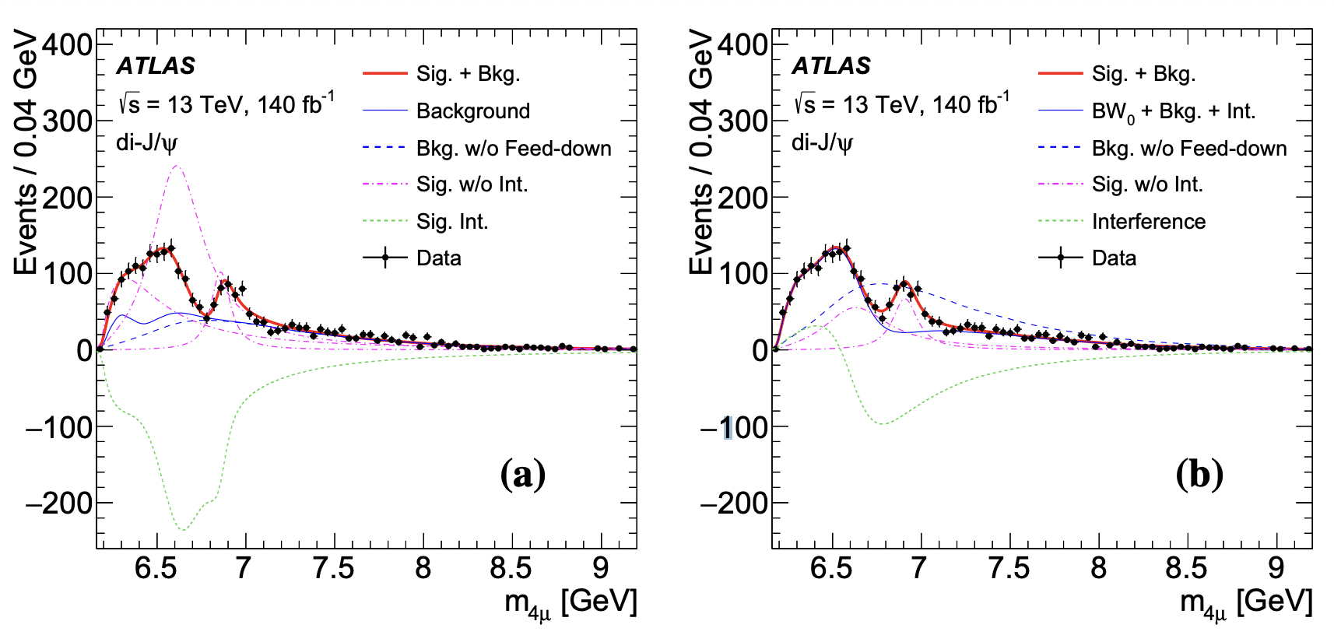
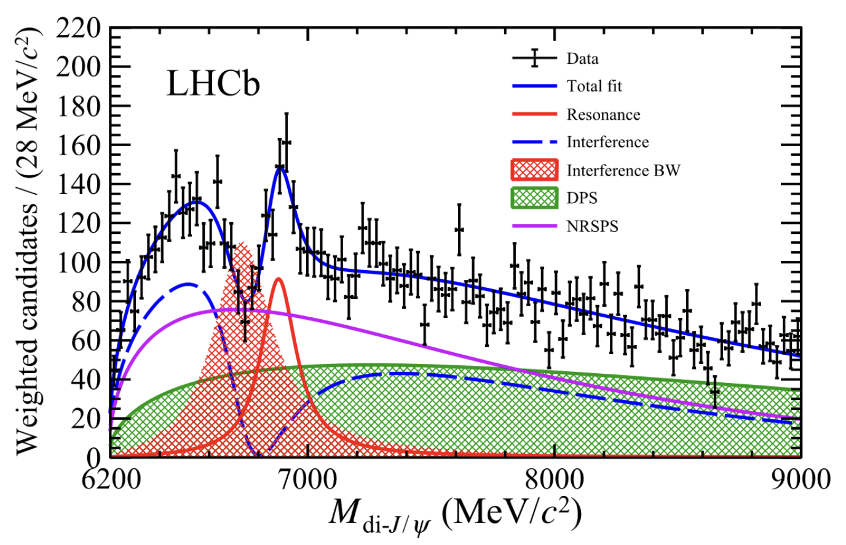
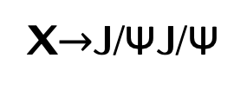
Motivation
LHCb : Sci.Bull.65(2020)1983
CMS : Phys. Rev. Lett. 132, 111901
ATLAS : Phys. Rev. Lett. 131, 151902
X$→$J/ΨJ/Ψ
X
X(6900) consistent with LHCb
X(6900) observed by 3 experiment
CMS adds X(6600) & X(7100)
  X(6600) below J/ΨΨ(2S) threshold
  X(6900)/X(7100) above threshold
Debate: Tetraquark? Dynamical?
Further studies vital:
  More data? Other channels?
Observed structure at 6.9 GeV, > 5σ
M ~ 6900 MeV, Γ ~ 100 MeV
X(6900) consistent with LHCb
New state X(6600) with 6.5σ
Evidence of X(7100) with 4.1σ

Slide 4
Datasets and trigger
Charmonium dataset
135 fb-1 CMS data taken in 2016, 2017 and 2018 LHC runs (13 TeV)
  2017B excluded due to improper trigger
180 fb-1 CMS data taken in 2022, 2023 and 2024 LHC runs (13.6 TeV)
Trigger
  HLT_Dimuon0_Jpsi_Muon (2016)
  HLT_Dimuon0_Jpsi3p5_Muon2 (2017 & 2018)
  HLT_DoubleMu4_3_LowMass_v (2022 & 2023 & 2024)
JSON
  Cert_271036-284044_13TeV_Legacy2016_Collisions16_JSON_MuonPhys.txt
  Cert_294927-306462_13TeV_UL2017_Collisions17_JSON_MuonJSON.txt
  Cert_314472-325175_13TeV_Legacy2018_Collision18_JSON_MuonPhys.txt
  Cert_Collisions2022_355100_362760_Muon.json
  Cert_Collisions2023_366442_370790_Muon.json
  Cert_Collisions2024_378981_386951_Muon.json
315 fb-1

Slide 5
Outline
Motivation
J/ψJ/ψ updated result (Poster from Yilin Zhou)
J/ψψ(2S) result (Poster from Liangliang Chen)
Summary

Slide 6
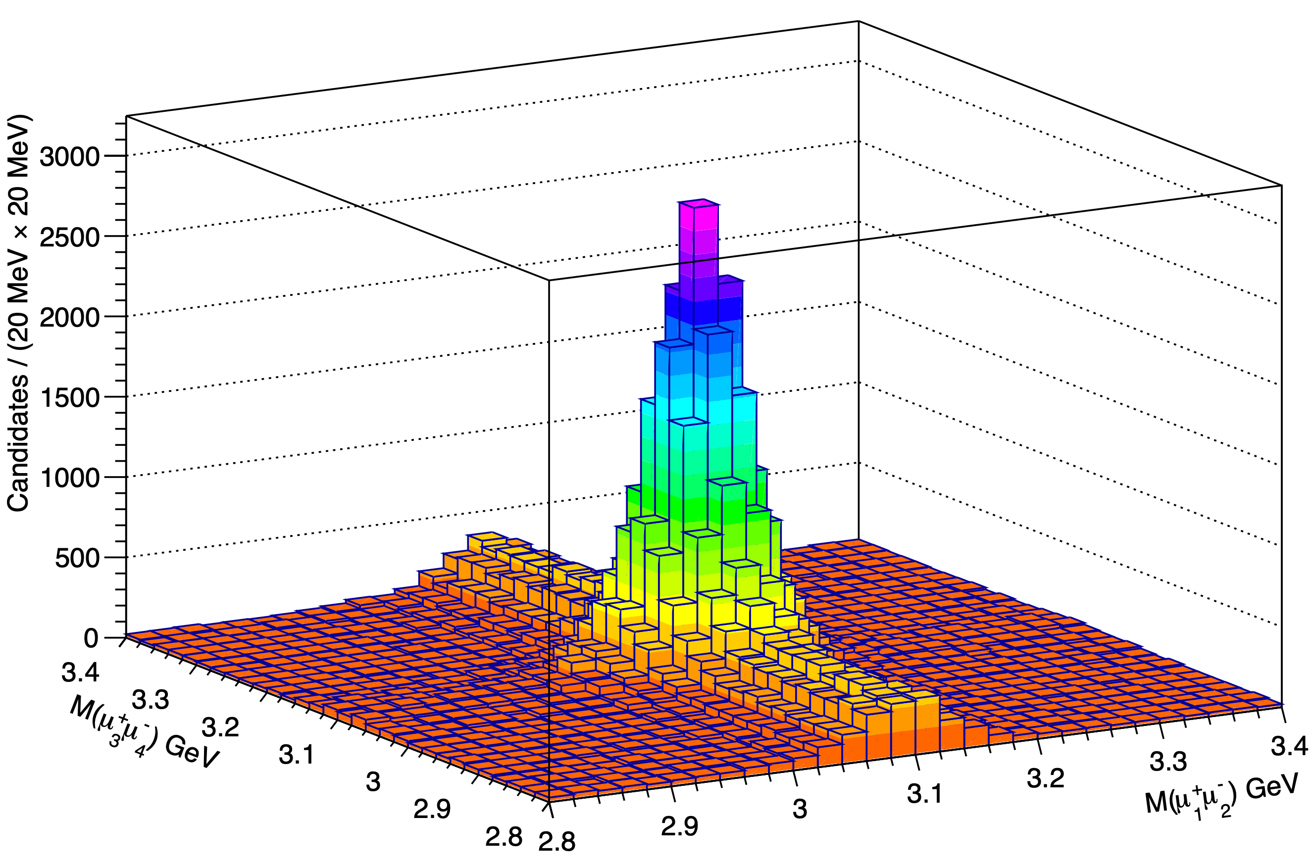
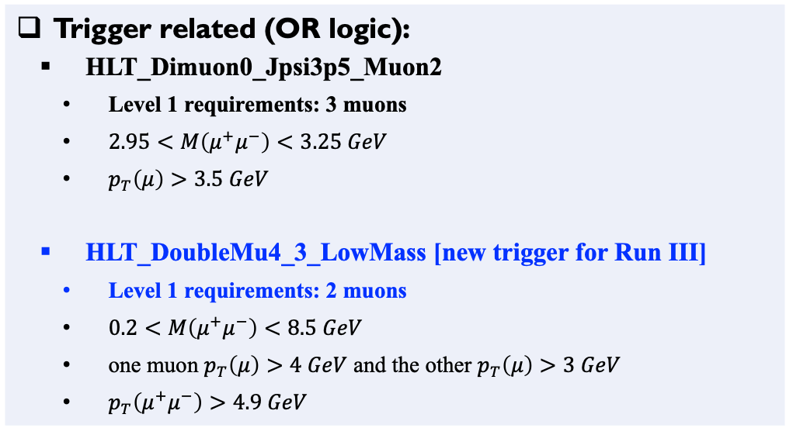
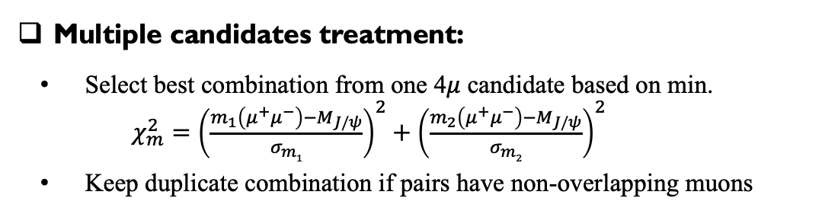
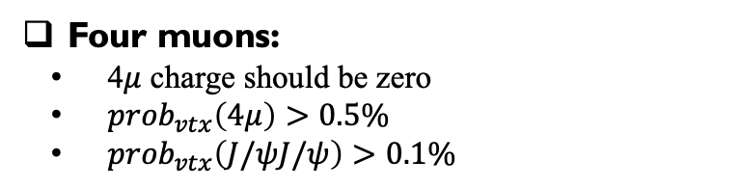
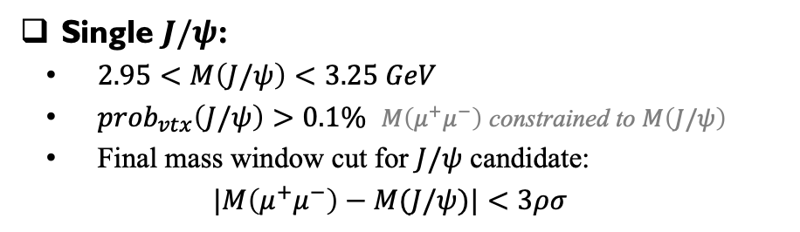
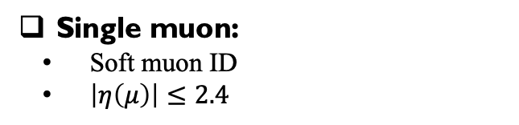
Event selection for Run III data
Trigger related (OR logic):
  HLT_Dimuon0_Jpsi3p5_Muon2
  Level 1 requirements: 3 muons
  $2.95<M\left(μ^{+}μ^{−}\right)<3.25 GeV$
  $p_{T}\left(μ\right)>3.5 GeV$
  HLT_DoubleMu4_3_LowMass [new trigger for Run III]
  Level 1 requirements: 2 muons
  $0.2<M\left(μ^{+}μ^{−}\right)<8.5 GeV$
  one muon $p_{T}\left(μ\right)>4 GeV$ and the other $p_{T}\left(μ\right)>3 GeV$
  $p_{T}\left(μ^{+}μ^{−}\right)>4.9 GeV$
Follow PRL cuts + A new trigger for Run III
Single muon:
Soft muon ID
$\left|η\left(μ\right)\right|≤2.4$
Single $J/ψ$:
$2.95<M\left(J/ψ\right)<3.25 GeV$
${prob}_{vtx}\left(J/ψ\right)>0.1\%$ $M\left(μ^{+}μ^{−}\right)$ constrained to $M\left(J/ψ\right)$
Final mass window cut for $J/ψ$ candidate:
$$|M\left(μ^{+}μ^{−}\right)−M(J/ψ)|<3ρσ$$
Four muons:
4$μ$ charge should be zero
${prob}_{vtx}\left(4μ\right)>0.5\%$
${prob}_{vtx}\left(J/ψJ/ψ\right)>0.1\%$
Multiple candidates treatment:
Select best combination from one 4$μ$ candidate based on min.
$χ_{m}^{2}={\left(\frac{m_{1}\left(μ^{+}μ^{−}\right)−M_{J/ψ}}{σ_{m1}}\right)}^{2}+{\left(\frac{m_{2}\left(μ^{+}μ^{−}\right)−M_{J/ψ}}{σ_{m2}}\right)}^{2}$
Keep duplicate combination if pairs have non-overlapping muons
Yilin Zhou @ Fudan
Observation of a family of all-charm tetraquarks
6

Slide 7
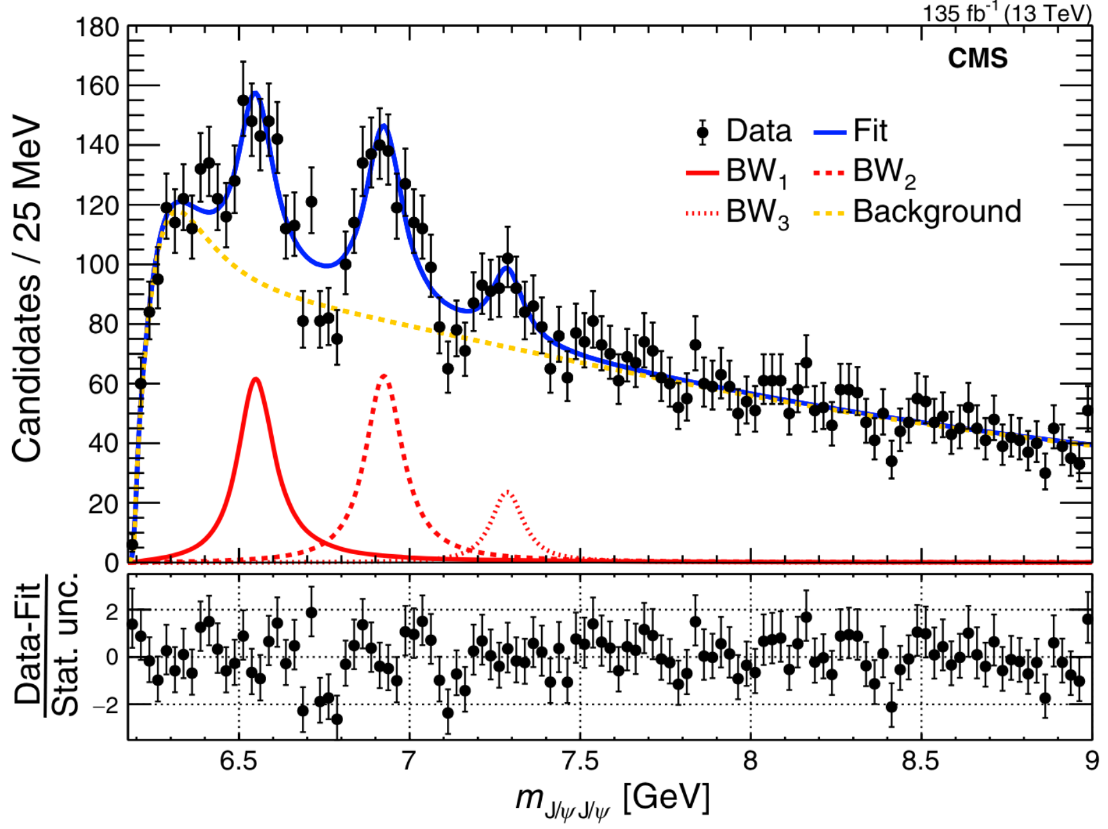
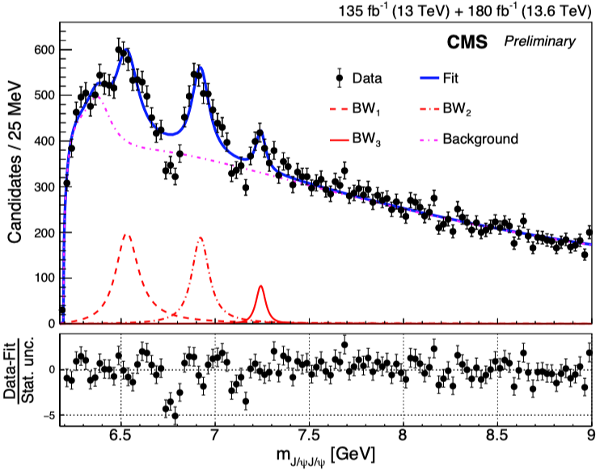
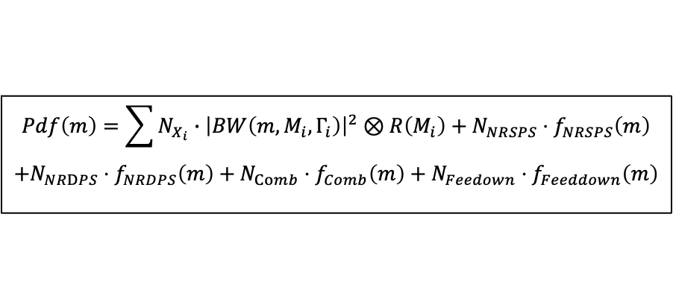
Run II & III No-interference fit result
No-interference model:
  Signal-hypothesis: NRSPS+NRDPS+Comb+Feeddown+BW0+BW1+BW2+BW3
$$Pdf\left(m\right)=\sum{N_{X_{i}}∙{\left|BW\left(m,M_{i},Γ_{i}\right)\right|}^{2}⊗R\left(M_{i}\right)}+N_{NRSPS}⋅f_{NRSPS}\left(m\right)$$
$$+N_{NRDPS}⋅f_{NRDPS}\left(m\right)+N_{Comb}⋅f_{Comb}\left(m\right)+N_{Feedown}⋅f_{Feeddown}\left(m\right)$$
Run 2 No-Interf
Run 2+3 No-Interf
Dips poorly described — no-Interf. model no longer sufficient !
Yilin Zhou @ Fudan
Observation of a family of all-charm tetraquarks
7

Slide 8
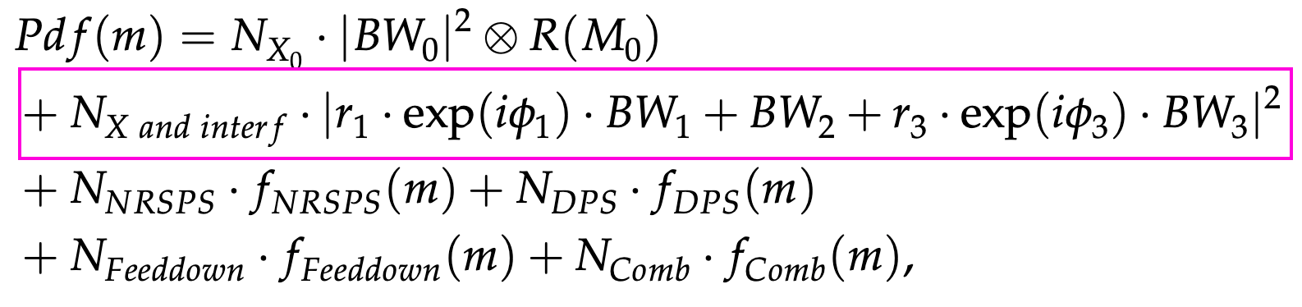
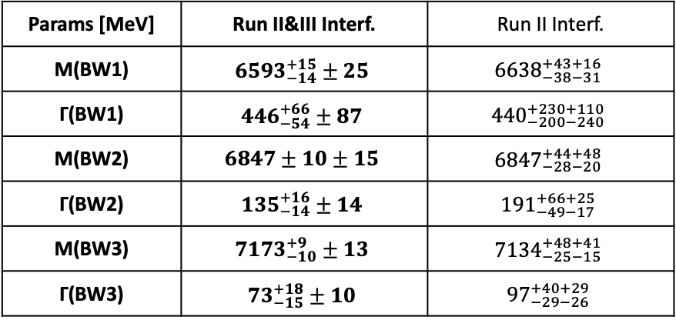
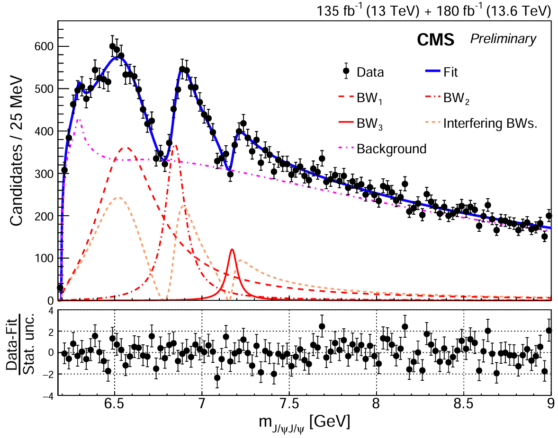
Run II & III interference fit result
Interference model:
  Signal-hypothesis: NRSPS+NRDPS+Comb+Feeddown+BW0+BW123 Interf. Term
15σ
17σ
8σ
Dip1: 10σ
VS. Run II result:
  Statistical uncertainty reduced by a factor of 3
  Systematic uncertainty reduced by about a factor of 2
Dip2: 7σ
All states and dips well above 5σ !
Quantum interference among structures validated!
With improved precision, large mass splittings persist
Yilin Zhou @ Fudan
Observation of a family of all-charm tetraquarks
8

Slide 9
Outline
Motivation
J/ψJ/ψ updated result (Poster from Yilin Zhou)
J/ψψ(2S) result (Poster from Liangliang Chen)
Summary

Slide 10
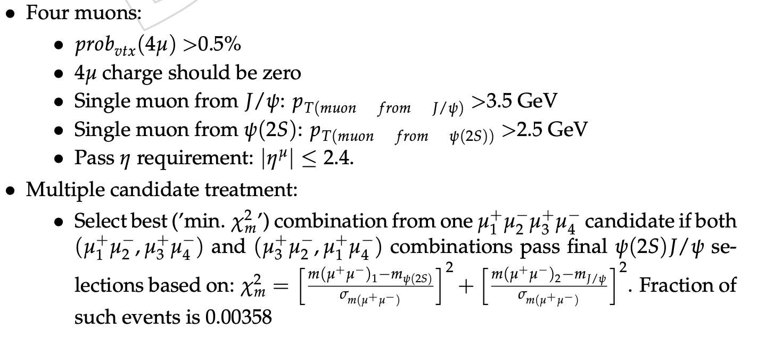
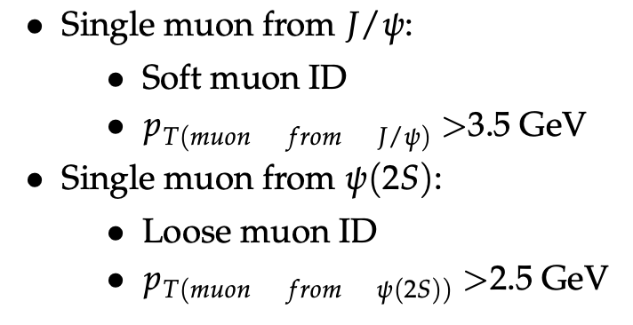
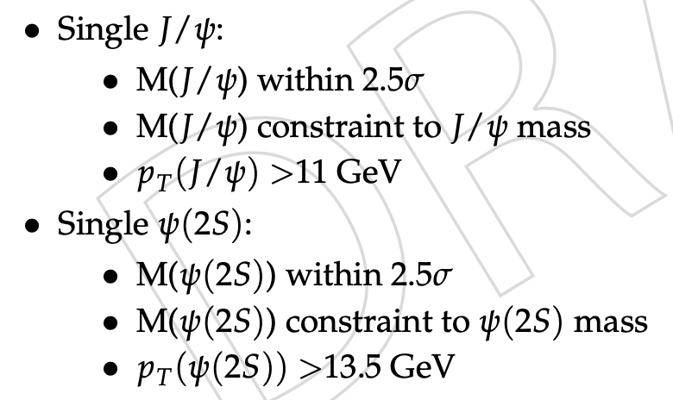
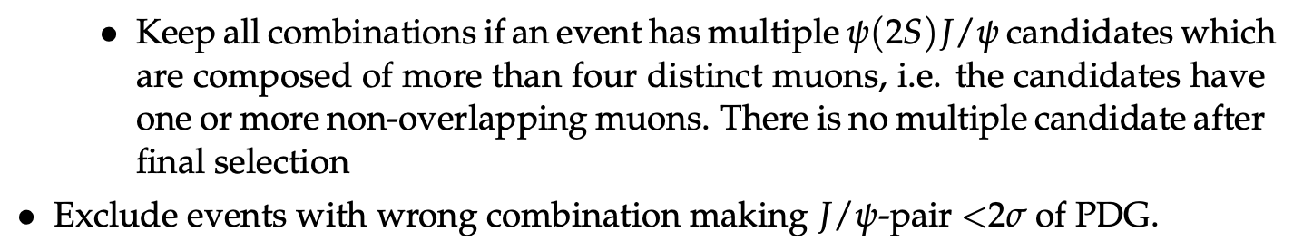
Event selection
Same cuts for Run2 and Run3 data except triggers
Liangliang Chen @ NNU
Observation of a family of all-charm tetraquarks
10

Slide 11
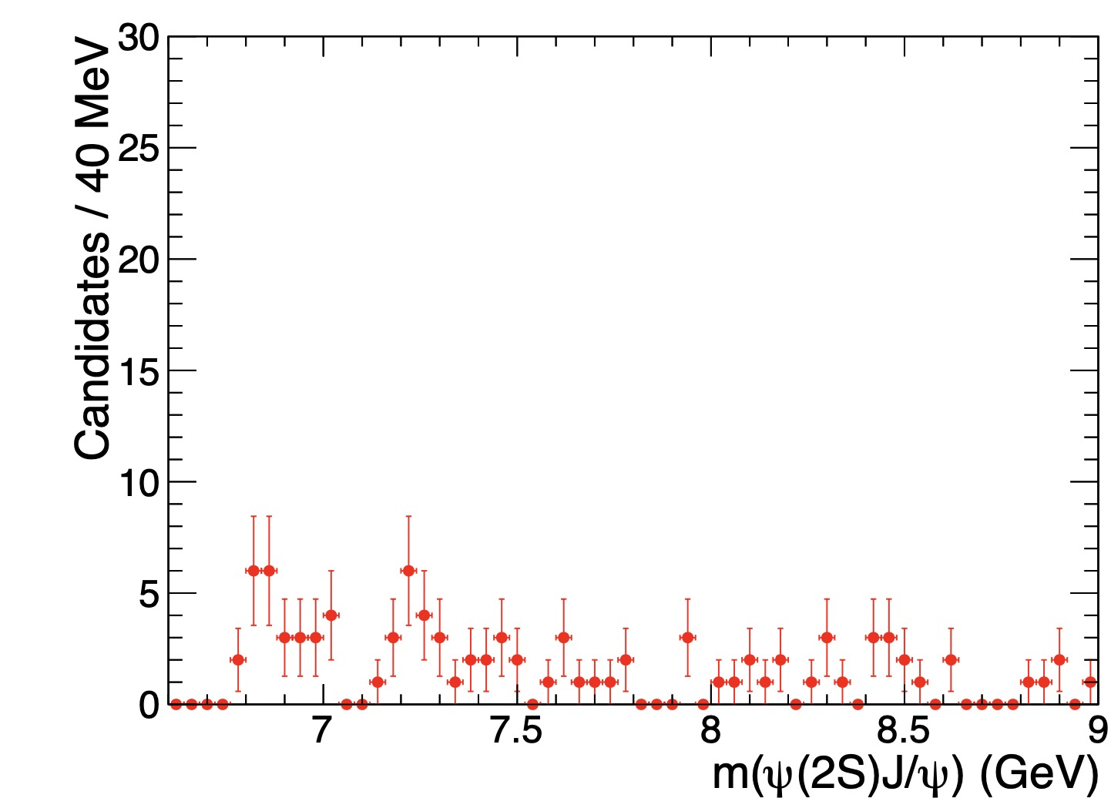
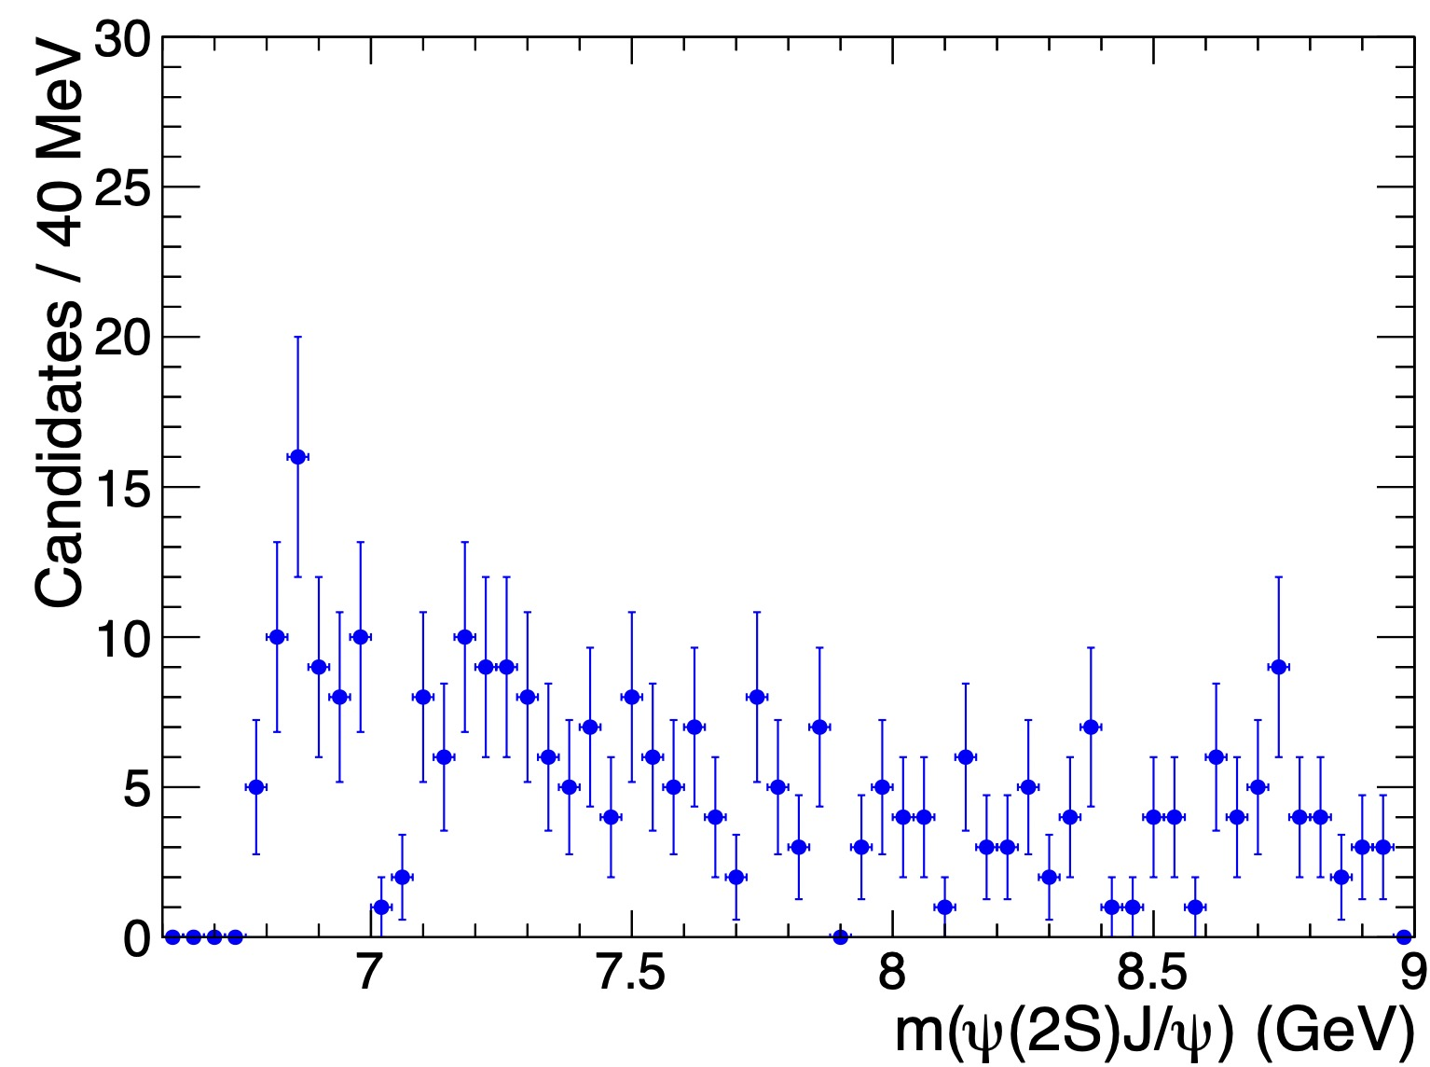
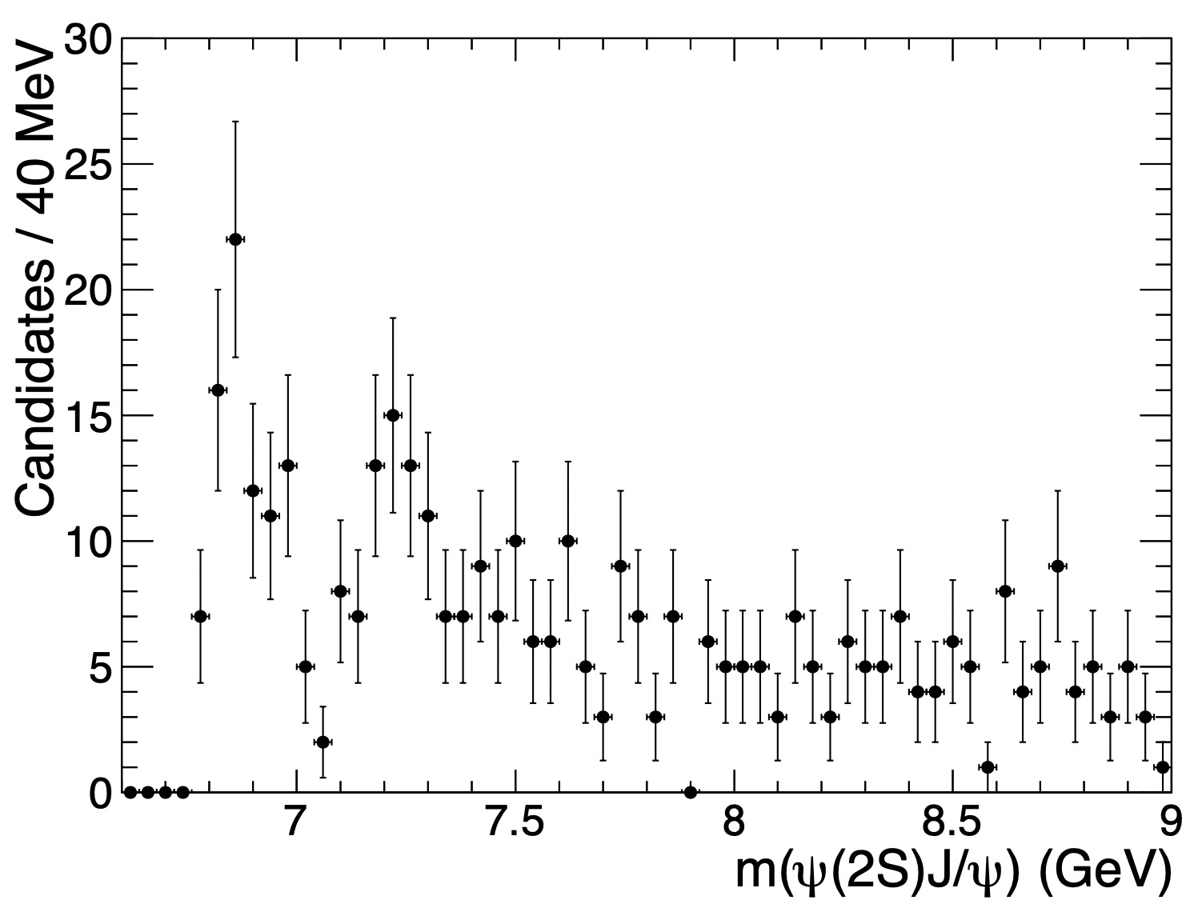
Final 𝑚( 𝐽/𝜓𝜓(𝟐𝐒)) distribution
Threshold peak is obvious
X(7100) is visible
According to J/ψJ/ψ channel, should be an X(6900) and an X(7100)
Signal dominated by Run3
Run2
Run3
Run2+Run3
Liangliang Chen @ NNU
Observation of a family of all-charm tetraquarks
11

Slide 12
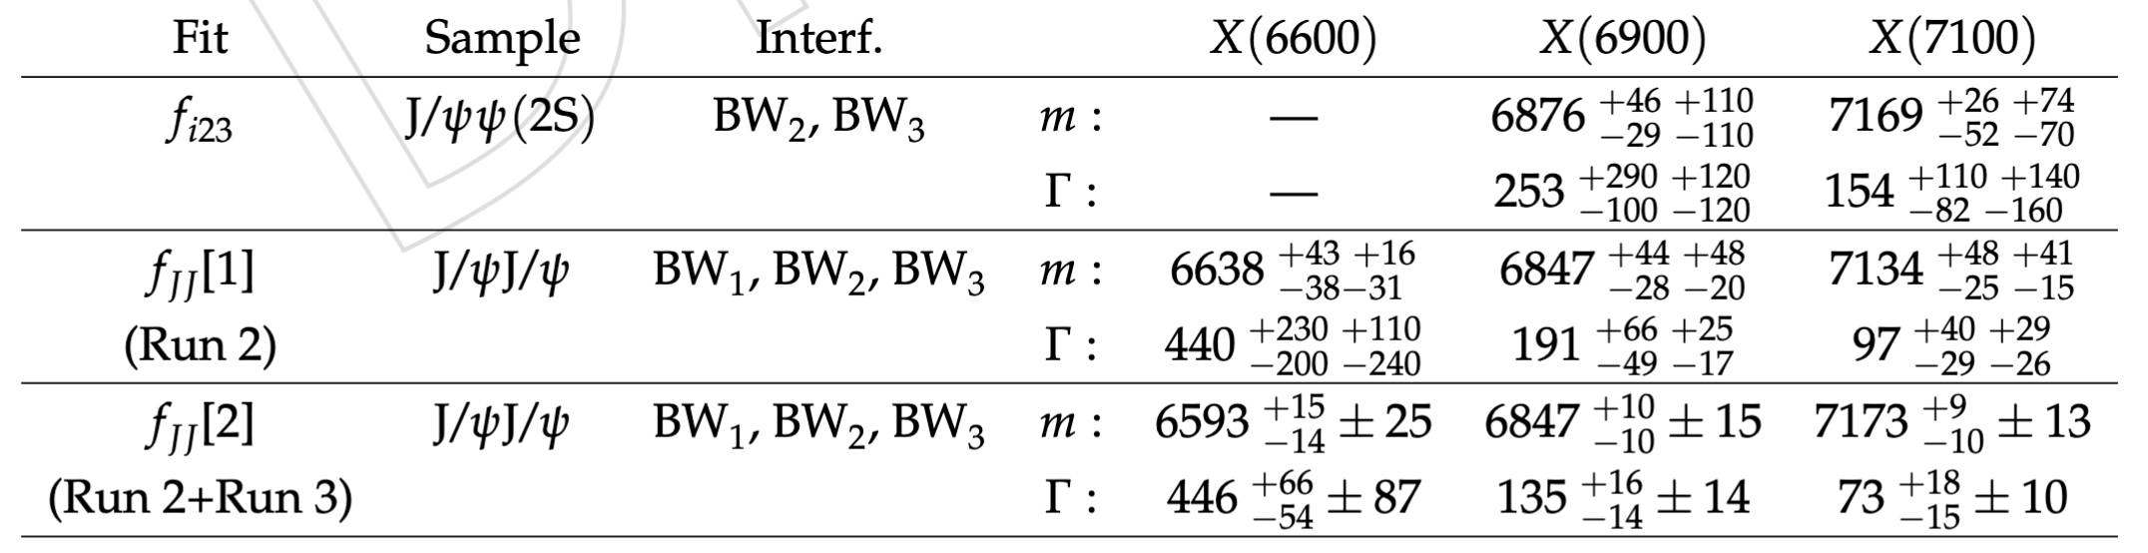
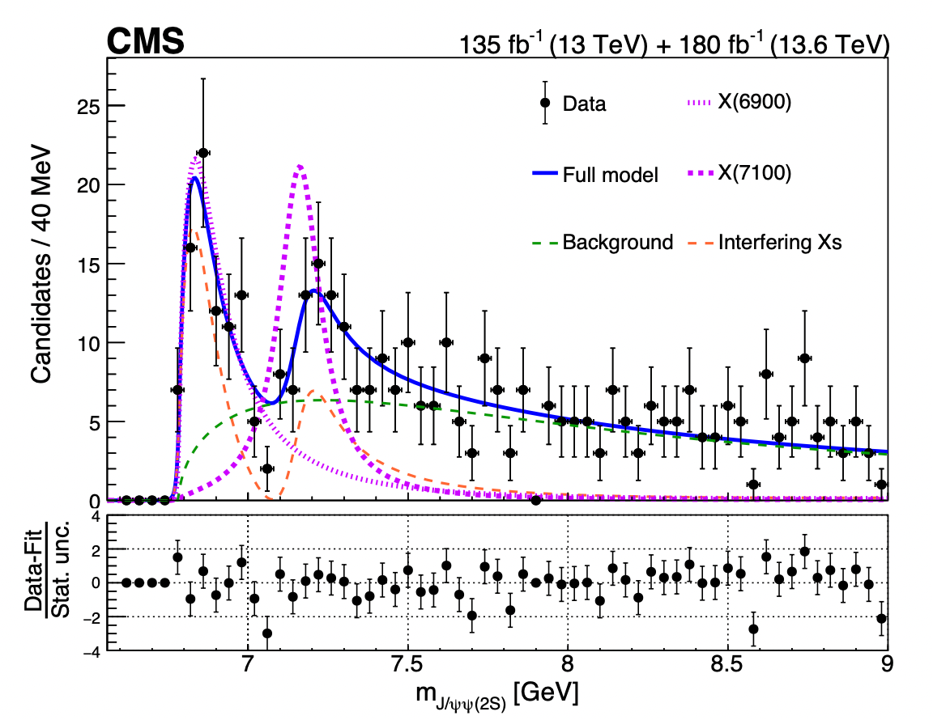
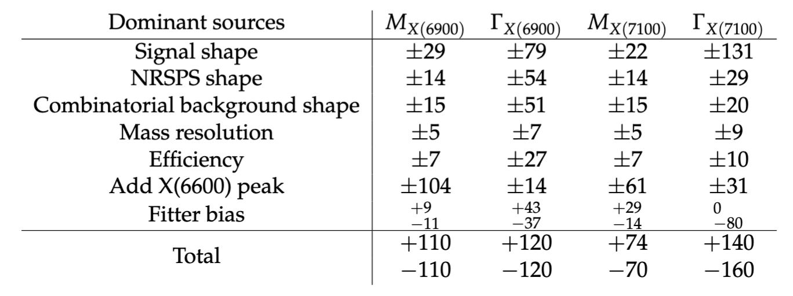
Results listed in PAS
Significance of X(6900) / X(7100) : 8.1σ / 4.3σ
Alternatives with no significant changes are not listed in the table, such as DPS shape
Liangliang Chen @ NNU
Observation of a family of all-charm tetraquarks
12

Slide 13
Outline
Motivation
J/ψJ/ψ updated result (Poster from Yilin Zhou)
J/ψψ(2S) result (Poster from Liangliang Chen)
Summary

Slide 14
Summary
About J/ψJ/ψ result
X(6600), X(6900), and X(7100) well above 5σ
Quantum interference among structures validated well above 5σ
Large mass splittings, more precisely
About J/ψψ(2S) result
CMS observed X(6900) and found evidence of X(7100) in J/ψψ(2S)
They are consistent with those observed in J/ψJ/ψ channel
CMS is painting a coherent and compelling picture of J/ψ J/ψ structures!
Thank you!

Slide 15
Back up

Slide 16
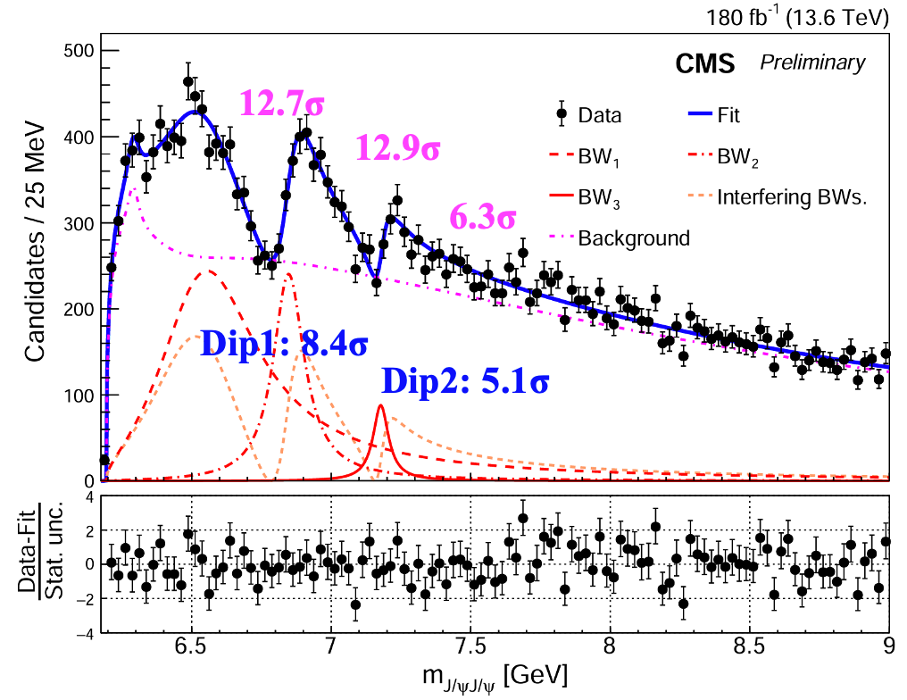
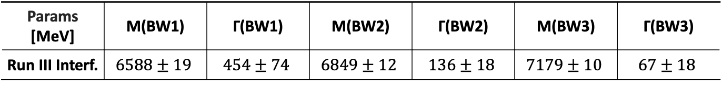
Run III interference fit result
Interference model:
  Signal-hypothesis: NRSPS+NRDPS+Comb+Feeddown+BW0+BW123 Interf. Term
Confirm Run II results with Run III data only
All states and dips above 5σ !
Yilin Zhou @ Fudan
Observation of a family of all-charm tetraquarks
16

Slide 17
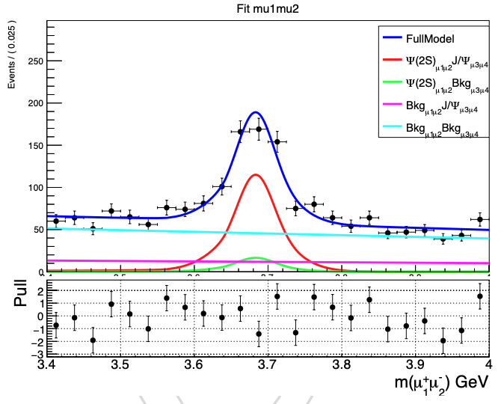
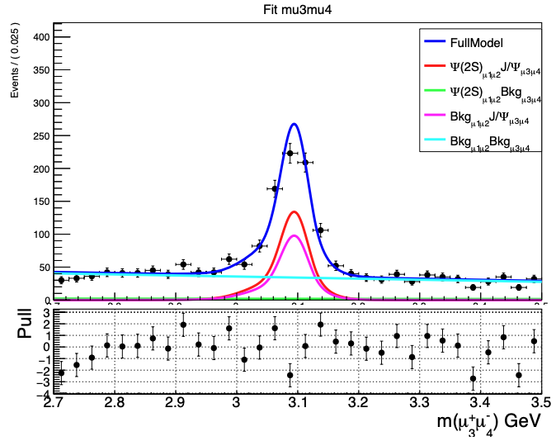
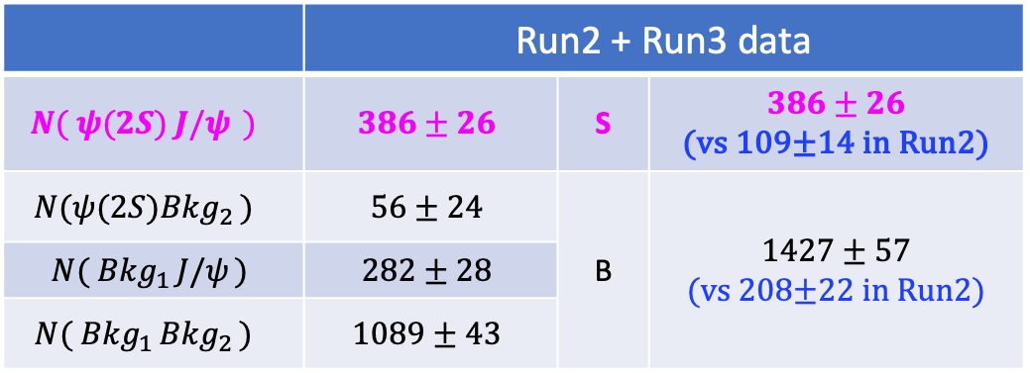
Two dimensional fit for J/ΨΨ(2S) yield
ψ(2S)
J/ψ
Run2 + Run3
 | Run2 + Run3 data
$$N( {ψ(2S)}_{ }{J/ψ}_{ })$$ | $$386±26$$ | S | $$386±26$$ (vs 109±14 in Run2)
$$N(ψ(2S){Bkg}_{2 })$$ | $$56±24$$ | B | $$1427±57$$ (vs 208±22 in Run2)
$$N({ Bkg}_{1 }{J/ψ}_{ })$$ | $$282±28$$
$$N({ Bkg}_{1 }{Bkg}_{2 })$$ | $$1089±43$$
S : 3.5x of Run2
B : 6.9x of Run2
[m(J2s)<15 GeV]
Slight difference
if in signal mass window
Liangliang Chen @ NNU
Observation of a family of all-charm tetraquarks
17

Slide 18
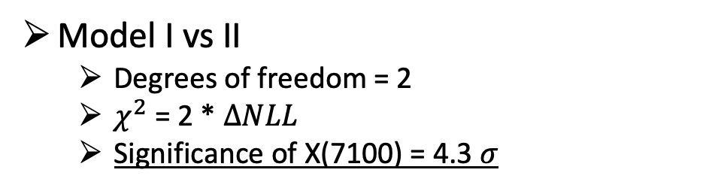
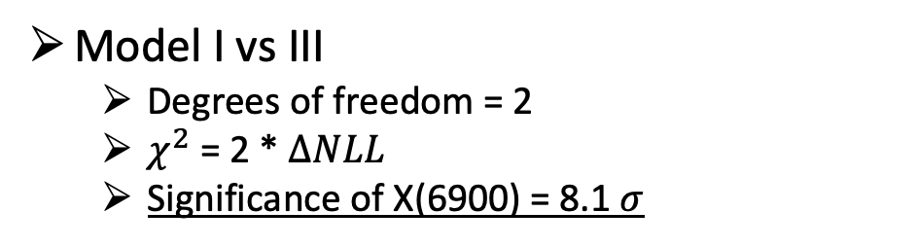
Significance calculation
Constrain mass & width of both peaks within 1σ of J/ψJ/ψ values
Model I: X(6900) & X(7100) with interference (NLL = -2056.83):
Contents: X(6900) + X(7100) Interf. + Background
Floating Params (7) : Number of NRSPS, number of DPS, number of combinatorial bkg, number of X(6900)X(7100), amplitude of X(7100), phi angle of X(7100), p2 of NRSPS
Constrained Params (4, regarded as fixed) : Mass of X(6900) & X(7100), width of X(6900) & X(7100)
Model II: X(6900) only (NLL = -2045.87):
Contents: X(6900) + Background
Floating Params (5) : Number of NRSPS, number of DPS, number of combinatorial bkg, number of X(6900), p2 of NRSPS
Constrained Params (2, regarded as fixed) : Mass of X(6900), width of X(6900)
Model III: X(7100) only (NLL = -2021.63):
Contents: X(7100) + Background
Floating Params (5) : Number of NRSPS, number of DPS, number of combinatorial bkg, number of X(7100), p2 of NRSPS
Constrained Params (2, regarded as fixed) : Mass of X(7100), width of X(7100)
Model I vs III
  Degrees of freedom = 2
  $χ^{2}$ = 2 * $ΔNLL$
  Significance of X(6900) = 8.1 $σ$
Model I vs II
  Degrees of freedom = 2
  $χ^{2}$ = 2 * $ΔNLL$
  Significance of X(7100) = 4.3 $σ$
Can use J/ψψ(2S) to make independent mass & width measurements?
Liangliang Chen @ NNU
Observation of a family of all-charm tetraquarks
18

Slide 19
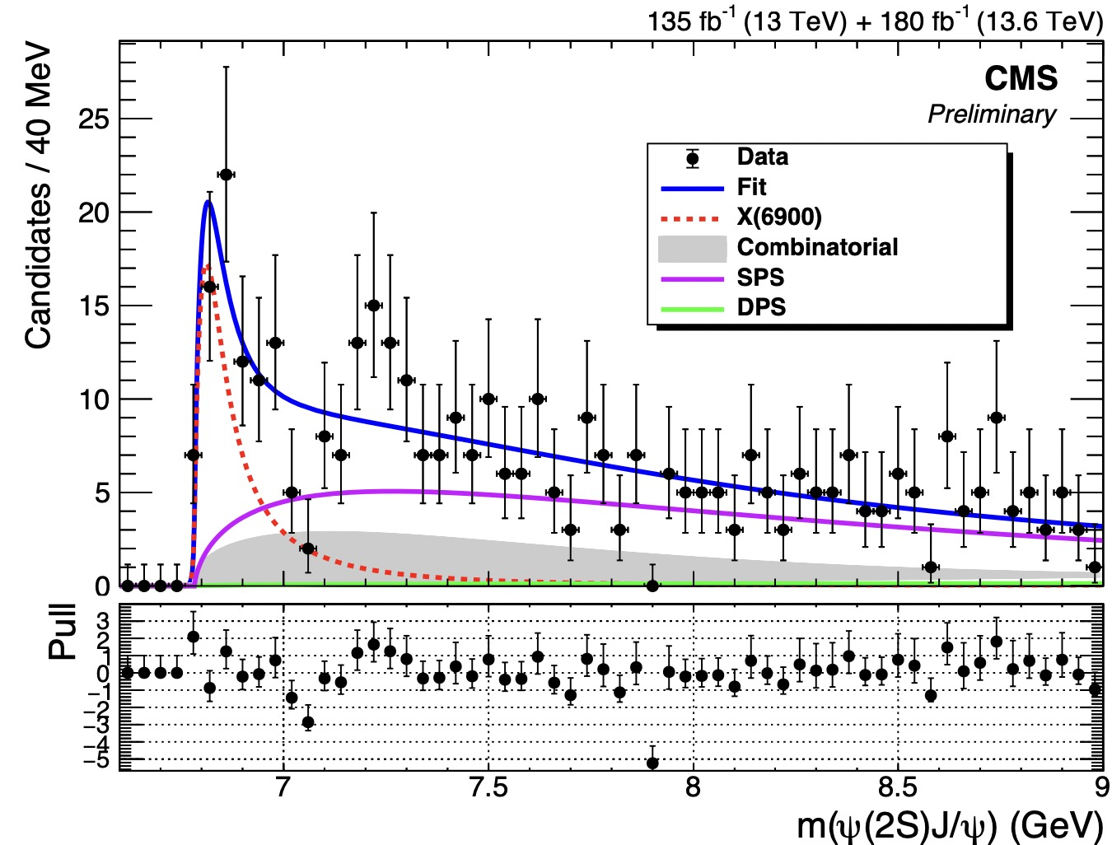
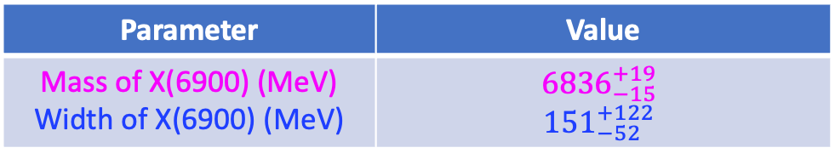
Independent Measurement
  An independent measurement: 1BW - X(6900)
Parameter | Value
Mass of X(6900) (MeV) Width of X(6900) (MeV) | $${6836}_{−15}^{+19}$$ $${151}_{−52}^{+122}$$
NLL = -2040
X(6900)
+ NRSPS + DPS + Comb.
Fit range : 6.6 -- 15 GeV
(J/ψJ/ψ mass/width constraints removed)
Liangliang Chen @ NNU
Observation of a family of all-charm tetraquarks
19

Slide 20
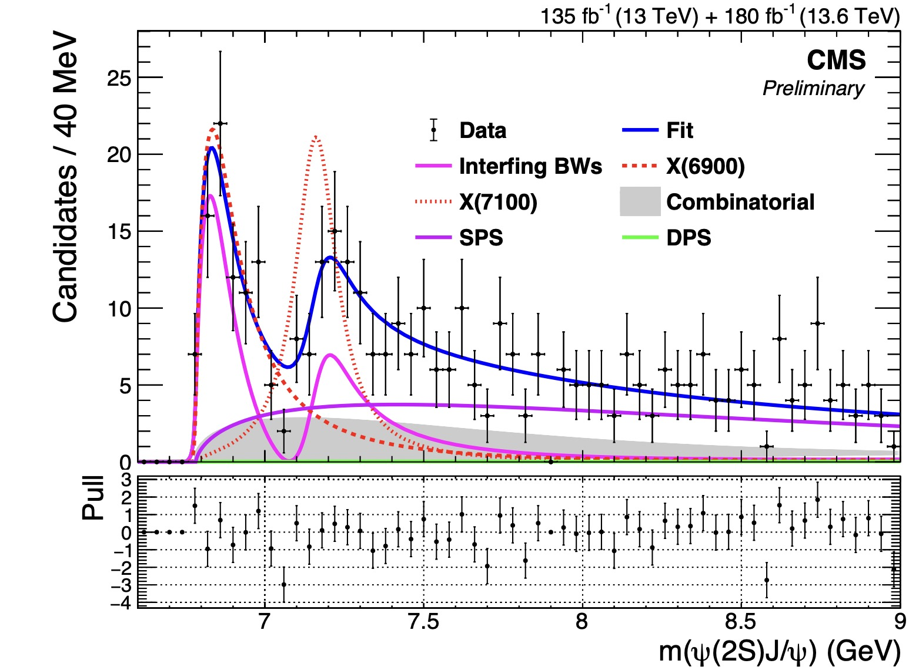
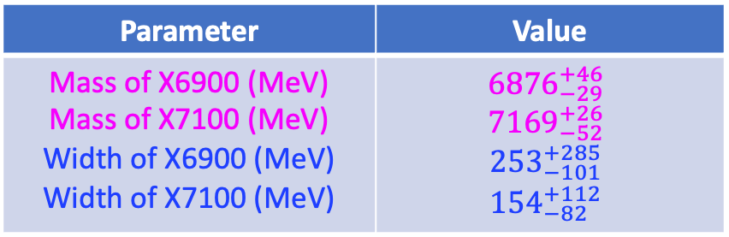
Independent Measurement
  An independent measurement: 2BW (Interference) - X(6900)&X(7100)
Parameter | Value
Mass of X6900 (MeV) Mass of X7100 (MeV) Width of X6900 (MeV) Width of X7100 (MeV) | $${6876}_{−29}^{+46}$$ $${7169}_{−52}^{+26}$$ $${253}_{−101}^{+285}$$ $${154}_{−82}^{+112}$$
NLL = -2045.55
Interfering X(6900) & X(7100)
+ NRSPS + DPS + Comb.
Fit range : 6.6 -- 15 GeV
(J/ψJ/ψ mass/width constraints removed)
Liangliang Chen @ NNU
Observation of a family of all-charm tetraquarks
20

