Slide 1
Finite isospin density with CP break
汇报人：张磊

Slide 2
part 1
Pion superfluidity at finite isospin density

Slide 3
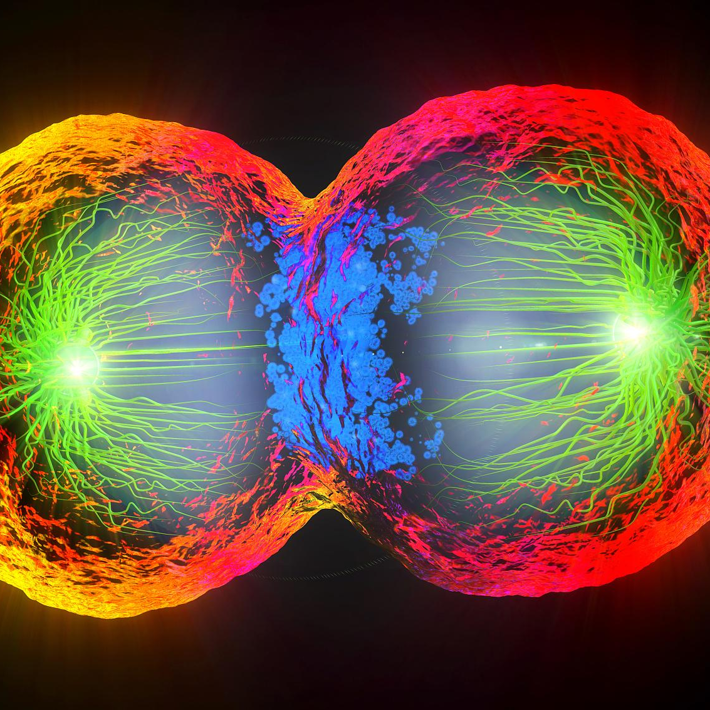
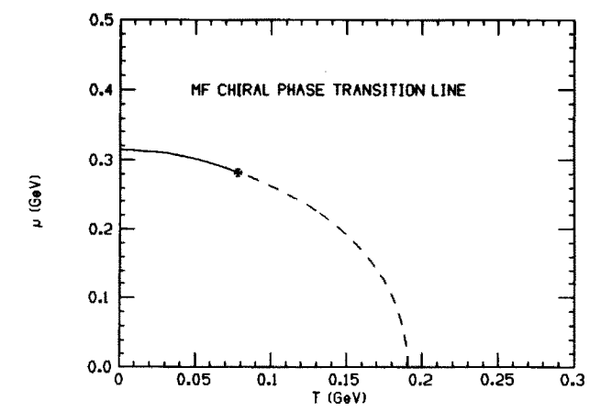
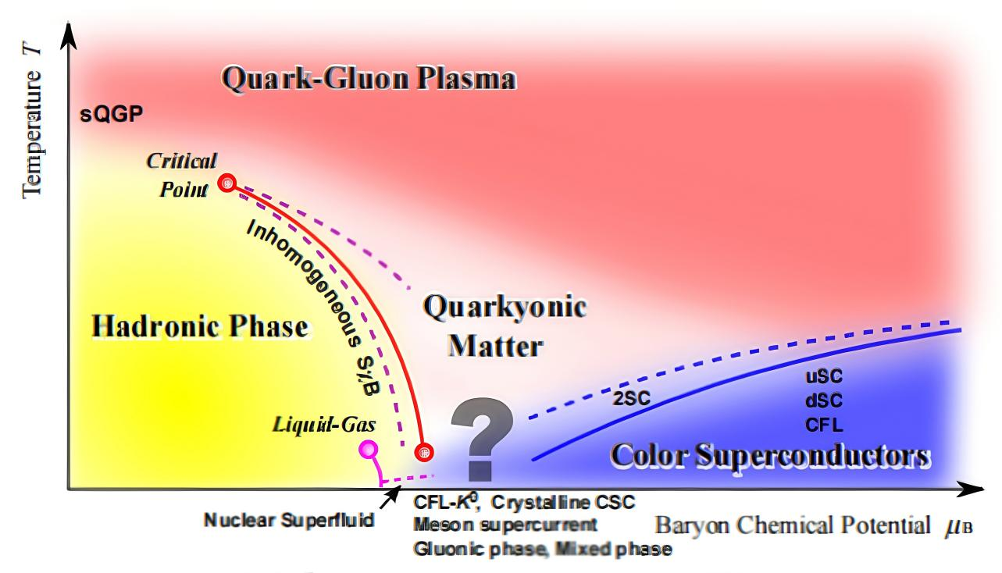
QCD phase structure extended to finite isospin density
Introduction
there exists a rich phase structure of QCD at finite temperature and baryon density:
The physical motivation to study QCD at isospin density and the corresponding pion superfluidity is related to the investigation of compact stars,isospin asymmetric nuclear matter，it has been suggested that charged pions and even kaons are condensed at sufficiently high density.

Slide 4
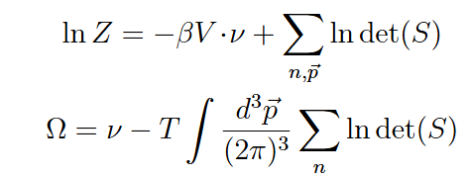
QCD phase structure extended to finite isospin density
mean field approximation.
it is analytically proved at the quark level that the critical isospin chemical potential for pion superfluidity is exactly the pion mass in the vacuum, and this relation is independent of the model parameters, regularization scheme, $U_{A}(1)$ breaking coupling, and color degrees of freedom Nc.

Slide 5
QCD phase structure extended to finite isospin density
mean field approximation.
Random phase approximation (RPA) to mesons in the NJL model can obtain the hadronic mass spectra and the static properties of mesons remarkably well,
However, in the pion superfluidity or the color superconductivity phase, the structure of the bubble summation in RPA is much more complicated than that in the chiral breaking phase.

Slide 6
QCD phase structure extended to finite isospin density
mean field approximation.

Slide 7
QCD phase structure extended to finite isospin density
Thermodynamics.
The gap equations for the condensates are equivalent to the extremum condition of the thermodynamic potential,
Note that when there exist multi roots of the gap equations, only the solution which satisfies the minimum condition

Slide 8
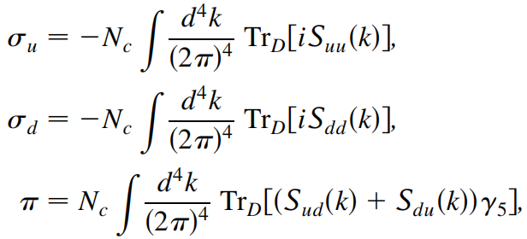
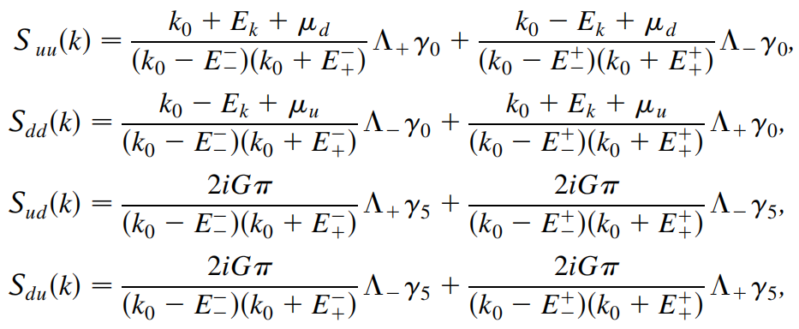
QCD phase structure extended to finite isospin density
mean field approximation.
the method of massive energy projectors to obtain the mean field quark propagator is not

Slide 9
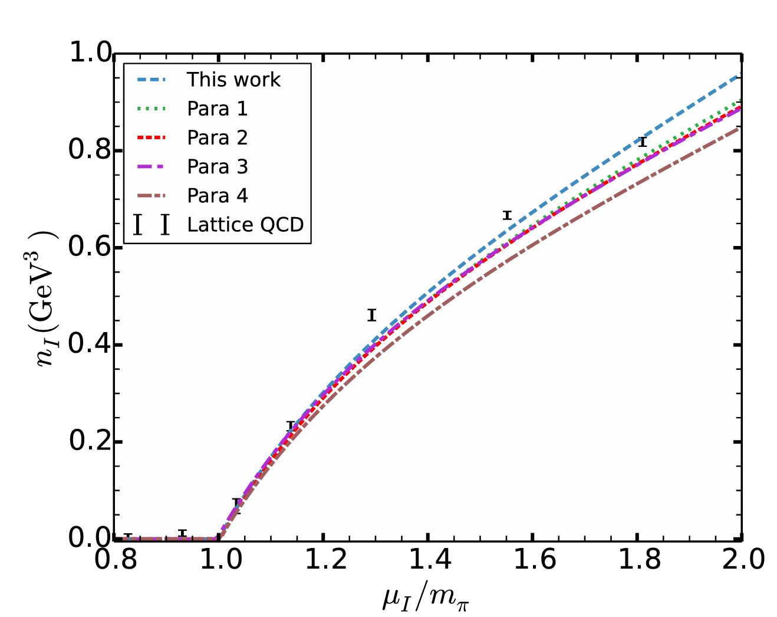
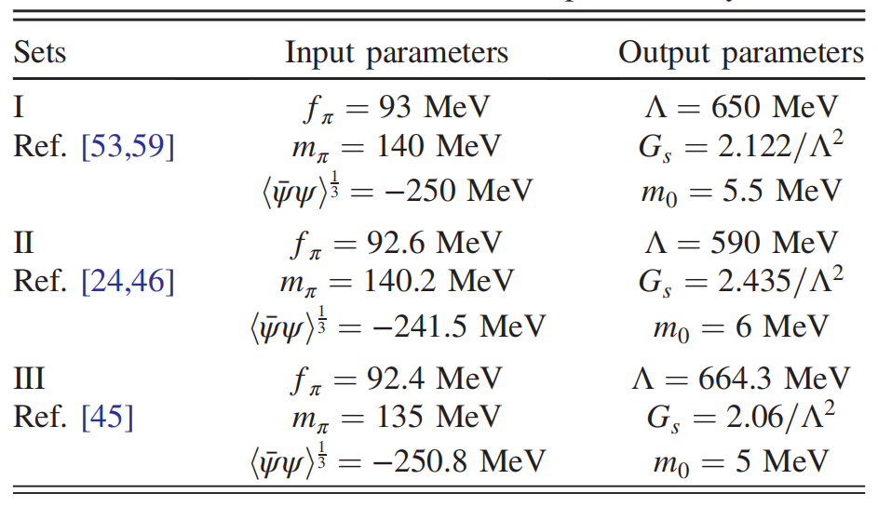
QCD phase structure extended to finite isospin density
Parametrization.
three model parameters:
a hard three-momentum cutoff ,the effective coupling constant G, the current quark mass m0.fixed by fitting the pion mass, the pion decay constant and the quark condensate density in the vacuum.
The normalized isospin number density as a function of μI/mπ at fixed T = 0 compared with recent lattice data.

Slide 10
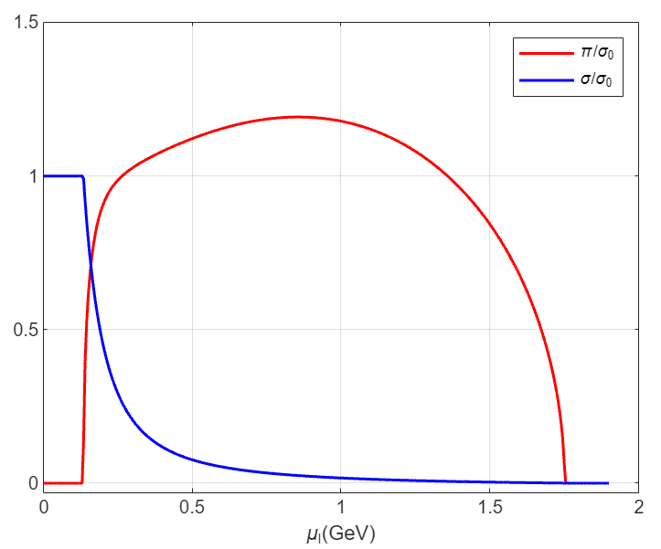
QCD phase structure extended to finite isospin density
Result.
the critical point is at pion mass 0.134 GeV and both the chiral and pion superfluidity phase transitions are of second order.
When the isospin chemical potential is small, the vacuum state is not disturbed. Only when it exceeds the pion mass, the pion condensate goes up with $μ_{I}$ and at the same time the chiral condensate drops down with $μ_{I}$.
The two condensates coexist in a wide region. Different from the result obtained with chiral perturbation theory where the pion condensate at finite $μ_{I}$ is always less than the chiral condensate in the vacuum. It can be larger than that

Slide 11
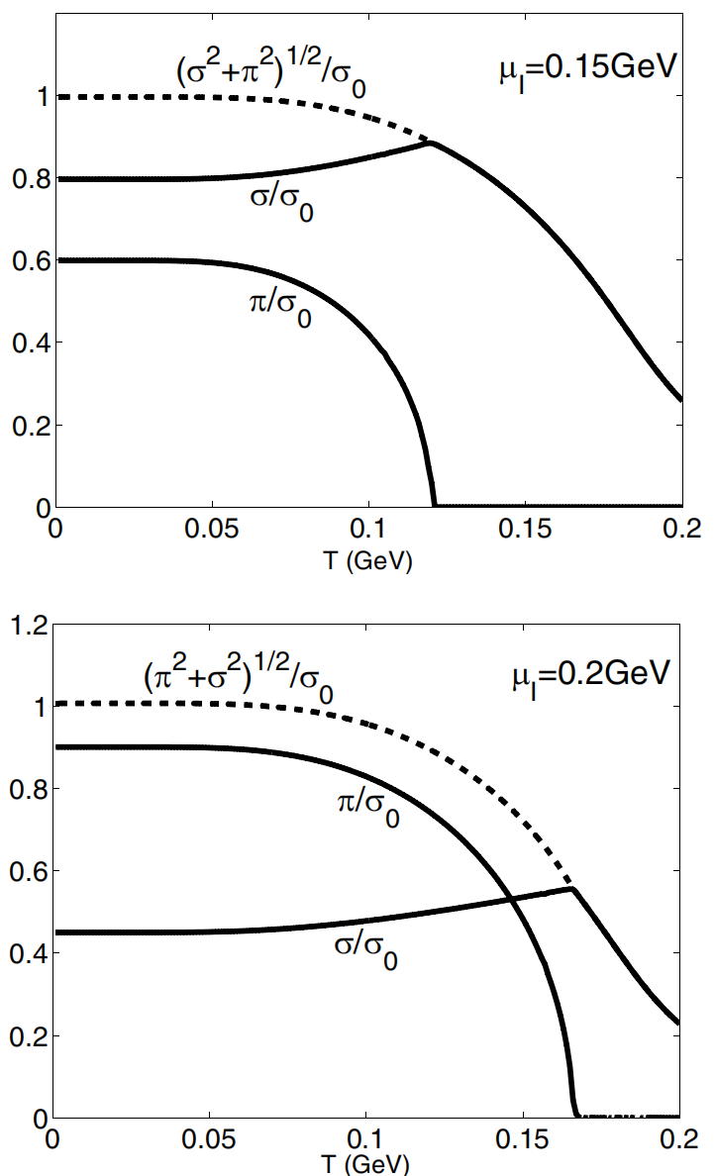
QCD phase structure extended to finite isospin density
Result in the coexistence region .
Qualitatively different from the study on chiral symmetry restoration without considering pion condensation where the chiral condensate decreases with increasing temperature monotonously, here $σ$ goes up continuously in the coexistence region of the two condensates, and drops down only in the region where the isospin symmetry is restored. And the total condensate behaves in a similar way like the $σ$ in the normal study without considering pion condensation.

Slide 12
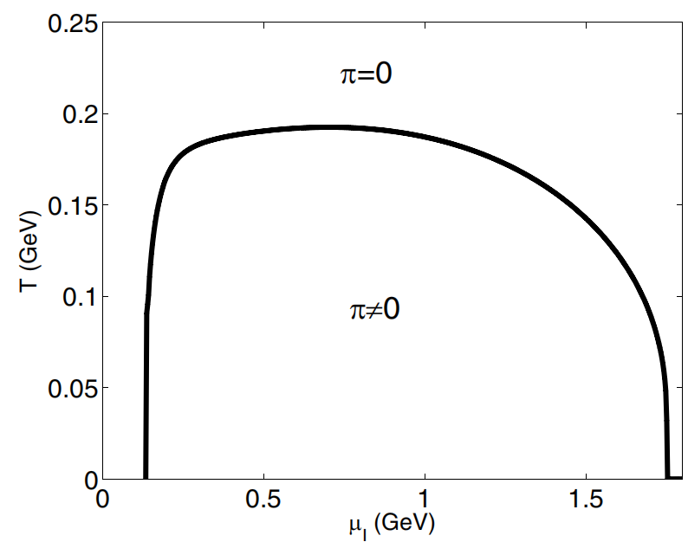
QCD phase structure extended to finite isospin density
Result in $T−μ_{I}$phase graph
For $μ_{I}>m_{π}$ , the pion condensate is already nonzero at the beginning, then drops down due to the temperature effect, and finally disappears at a critical temperature Tc.
Like the standard BCS theory, the critical temperature and the pion condensate at T=0 satisfies the linear relation,

Slide 13
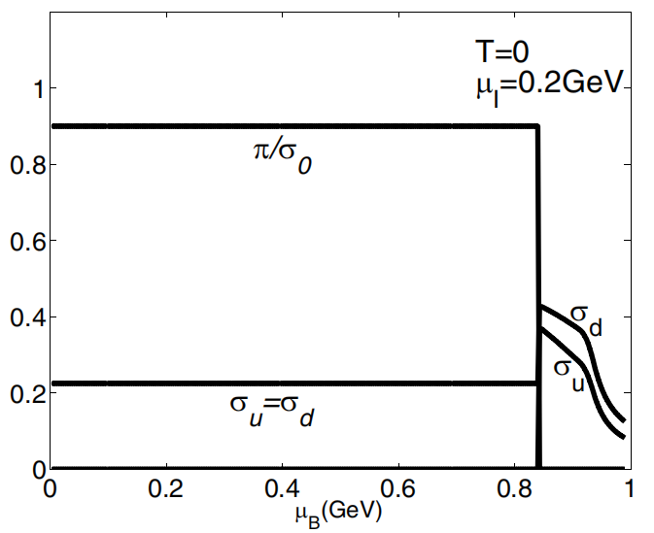
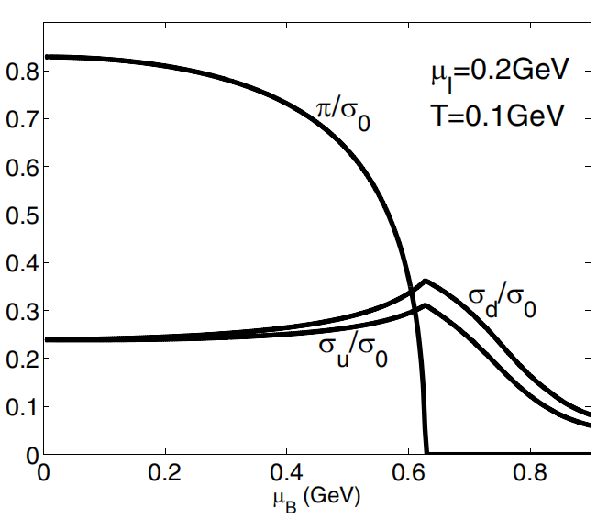
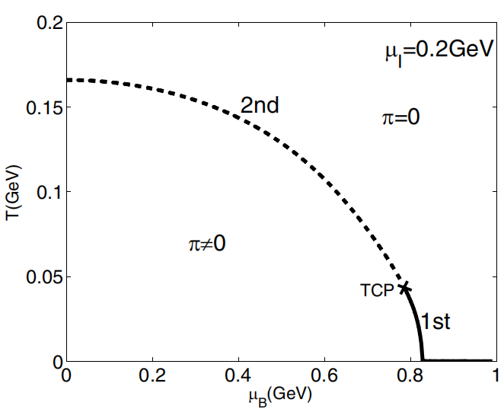
QCD phase structure extended to finite isospin density
Result in Finite baryon density effect
The $μ_{B}$ dependence of the chiral and pion condensates at fixed T and $μ_{I}$ and the phase diagram in the $T−μ_{B}$ plane at fixed $μ_{I}$ are shown in Fig

Slide 14
part 2
Finite isospin density with CP break

Slide 15
Finite isospin density with CP break
Introduction
It is a well-known fact that within the regime of strong interaction instanton contributions can lead to CP violation the QCD Lagrangian density generally contains an extra θ-term,
elevating $θ$ to a field
since
the energy scales are much smaller than the axion symmetry breaking scale fa, we can consider the axion field to be in its vacuum expectation value, so it behaves like a CP violating term added to the QCD action.

Slide 16
Finite isospin density with CP break
mean field approximation.
The inverse of the quark propagator
the Lagrangian no longer possesses CP symmetry, the \( \eta \) condensation and \( \delta \) condensation must also be considered. In the mean-field approximation, we can obtain the inverse of the quark propagator.

Slide 17
Finite isospin density with CP break
mean field approximation.
We chose

Slide 18
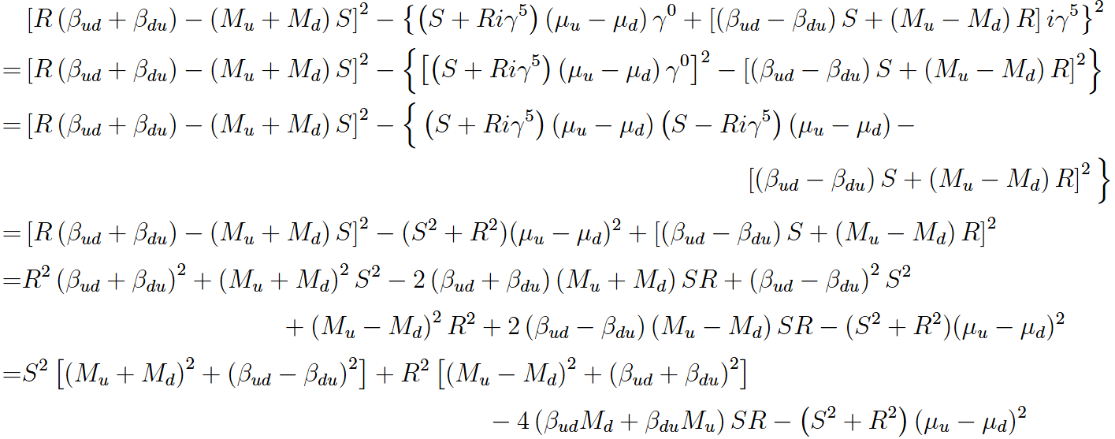
Finite isospin density with CP break
mean field approximation.

Slide 19
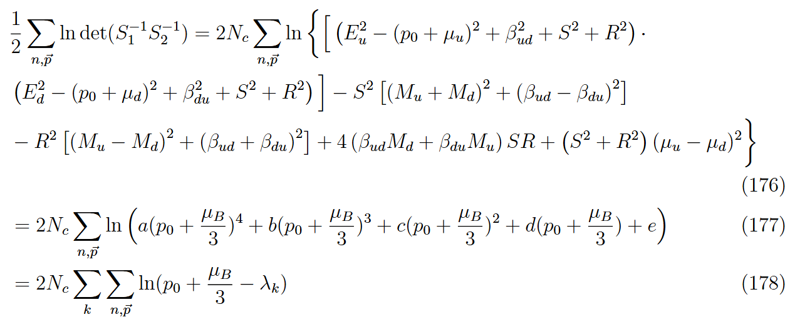
Finite isospin density with CP break
mean field approximation.

Slide 20
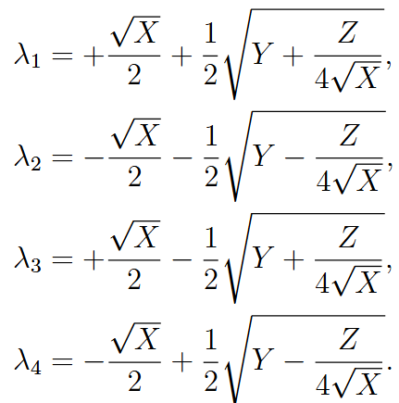
Finite isospin density with CP break
mean field approximation.
Ferrari formula to get the roots
The thermodynamic potential in mean field approximation

Slide 21
Finite isospin density with CP break
mean field approximation.
The method to get the quark propagater

Slide 22
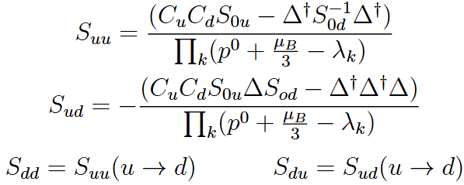
Finite isospin density with CP break
mean field approximation.

Slide 23
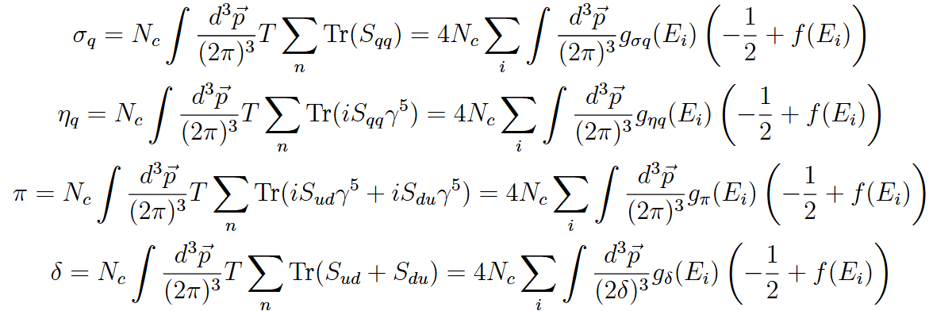
Finite isospin density with CP break
mean field approximation.

Slide 24
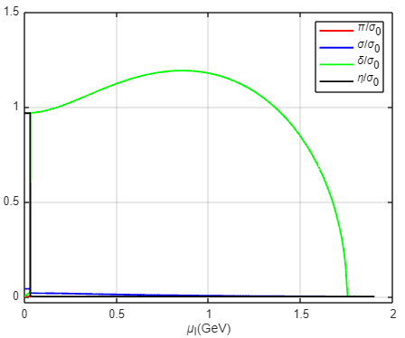
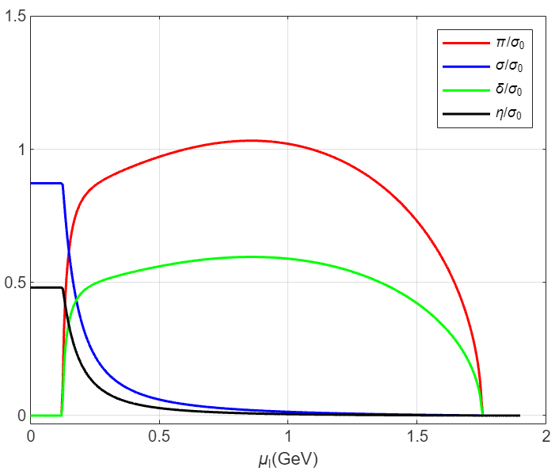
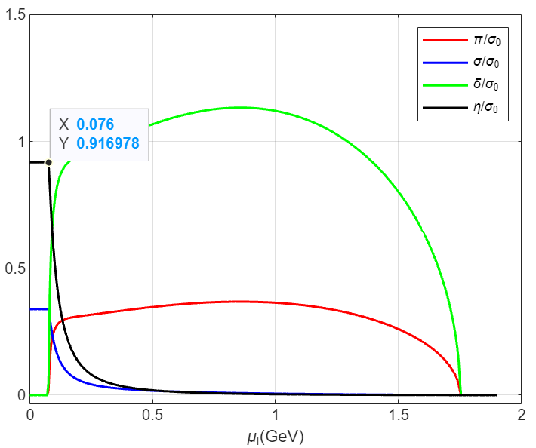
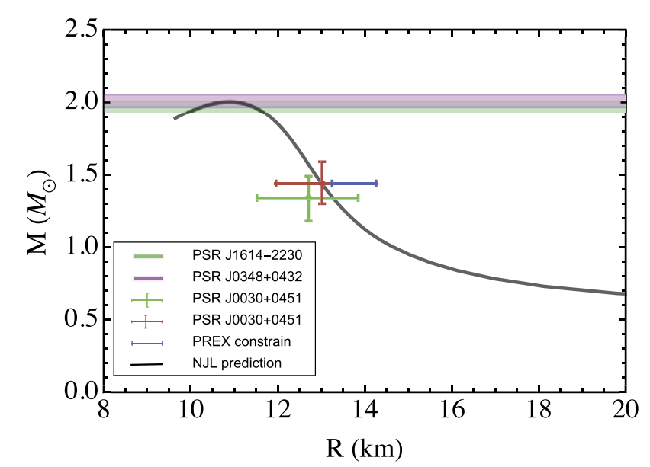
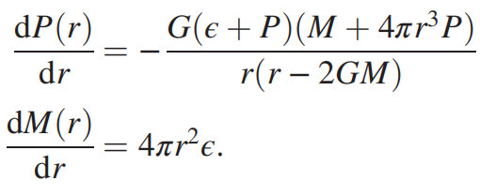
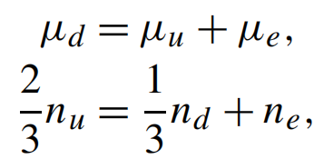
Finite isospin density with CP break
Result.

Slide 25
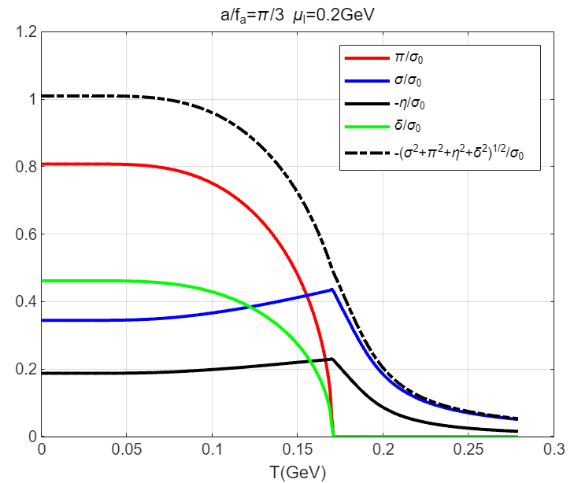
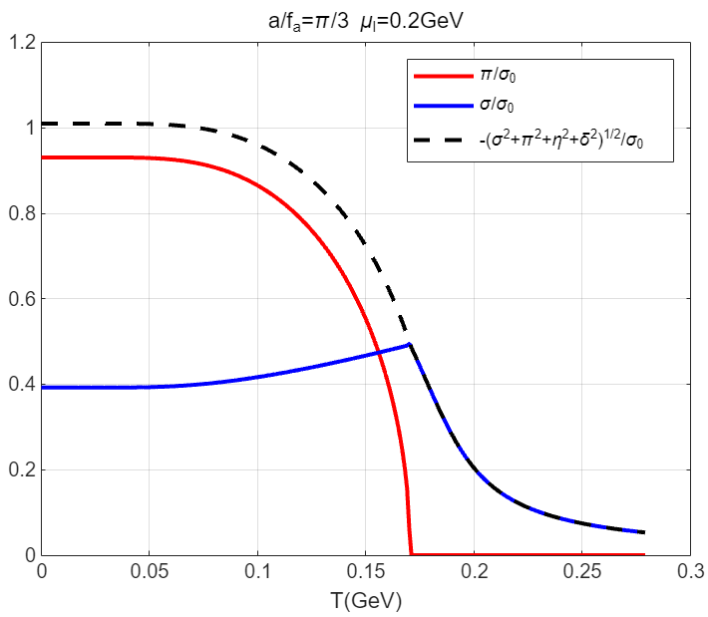
Finite isospin density with CP break
Result.

Slide 26
谢谢

