Slide 1
DAQ stability testing without HV
Mingyi Dong
2025-04-03

Slide 2
DAQ stability testing
HV of CGEM and other sub detector was powered off
Electronics was powered on
Cosmic-ray trigger, trigger rate : ~330Hz
From 19:42 on April 2nd -17:31 on April 3rd
Run84781- Run84792

Slide 3
Check results
 | BES3 event number in data file | CGEM uniq trigger number(all gemrocs same ) | CGEM Last Trigger number(all gemrocs same) | Consistent ? | CGEM Checkbit error?(2 bits) | Remarks
RUN 84781 | 1351530 | 1351530 | 1351530 | Yes | No | Stop Normally
RUN 84782 | 1522945 | 1522945 | 1522945 | Yes | No | Stop Normally
RUN 84783 | 2189615 | 2189615 | 2189615 | Yes | No | Stop Normally
RUN 84784 | 2210141 | 2210141 | 2210141 | Yes | No | Stop Normally
RUN 84785 | 2260342 | 2260539 | 2260539 | No | No | Stop Normally
RUN 84786 | 2517022 | 2517543 | 2517543 | No | No | Stop Normally
RUN 84787 | 2331241 | 2334721 | 2334721 | No | No | Stop Normally
RUN 84788 | 2990052 | 2989985-2990052 | 2990052 | No | No | Beam injecting , trigger rate: 330Hz-3.2kHz Stop Normally
RUN 84789 | 2568596 | 2570579-2570691 | 2570691 | No | No | Beam injecting , trigger rate: 330Hz-3.2kHz Stop Normally
RUN 84790 | 1695658 | 1695658 | 1695658 | Yes | No | Stop Normally
RUN 84791 | 2588934 | 2589279-2589333 | 2589333 | No | No | Beam injecting , trigger rate: 330Hz-3.2kHz Stop Normally
RUN 84792 | 3228401 | 2713298 | 2713298 | No | No | CGEM report error when stop run

Slide 4
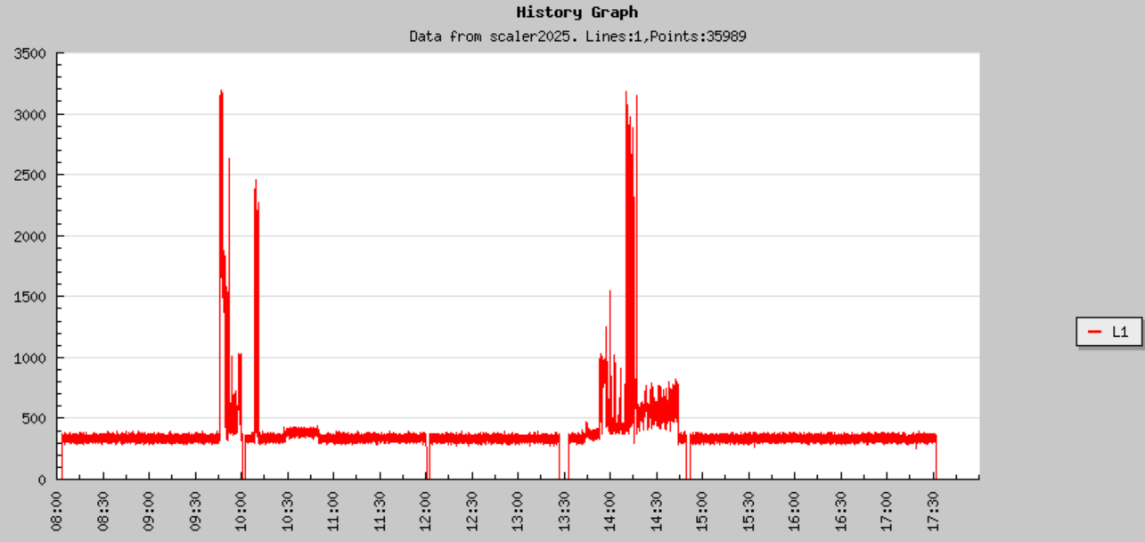
L1 trigger rate on April 3

