Slide 1
Comparison of local and non-local chromatic correction scheme and the possible optimization for CEPC ARC region
Yiwei Wang
CEPC day, Apr. 21, 2025, IHEP

Slide 2
Outline
Comparison of local and non-local chromatic correction scheme
The possible optimization for CEPC ARC region

Slide 3
Nonlinearity and effects in high energy circular e+e- colliders
Lattice非线性
On momentum:
各阶频移：dνx/dJx, dνy/dJy, dνx/dJy, …
3阶共振项： νx, 3νx, νx-2νy, νx+2νy
4阶共振项： 2νx, 4νx, 2νy, 4νy, 2νx-2νy, 2νx+2νy
更高阶共振项…
Off momentum:
各阶optics函数畸变：dβ/dδ, dα/dδ, dη/dδ, …
各阶色品：dν/dδ, d^2ν/dδ^2, d^3ν/dδ^3, …
有能量偏差的共振项：νx(δ), 3νx(δ), νx-2νy(δ), νx+2νy(δ), …
同步辐射的阻尼及量子激发效应
束束相互作用
元件误差

Slide 4
Local and non-local chromatic correction scheme
线性lattice：对不同功能区域分别设计并匹配（interaction region, arc, RF acceleration region, injection region…)
非线性：由于种类很多，且变量数量有限
一般的做法是部分非线性项作局部校正，部分校正受限的非线性项（尤其是与能量相关的）作全局校正
FCCee Global Hybrid chromaticity Correction (GHC) optics，by Oide
对撞区主要局部校正垂直一阶色品；弧区局部校正1阶色品，3、4阶共振项；其余全局校正（直接优化全环DA或寿命，方法简单有效，且适合于对撞这种有很多优化目标的情况，但全环非线性有一定挖掘空间）
对于未来环形正负电子对撞机，Pantaleo Raimondi发展了一套完全的局部校正方法 (PRAB28, 021002, 2025), 在各区域将非线性项作局部校正并且匹配不同区域。Yunhai Cai、Anton、Brinkman等人也是相同思路。
FCCee local chromatic correction (LCC) optics, by P. Raimondi et al
在各区域将非线性项作局部校正并且匹配不同区域（方法较为复杂，但全环非线性校正得更好）
CEPC optics，by Y. Wang et al
对撞区校正1阶频移，3、4 阶共振项、各阶色品；弧区校正3、4阶共振项，1阶色品，1阶optics函数畸变，有能量偏差的3阶共振项；然后作全局校正（方法介于前两者之间）

Slide 5
ARC lattice
线性lattice
FODO cell：large bending filling factor
Number of cells: emittance、magnet strength
LCC optics非线性校正
KQF: horizontal natural emittance, selecting the corresponding μx;
KSF1A and KSF2A: horizontal chromaticity ξx≃0 and first-order variation of horizontal tune with horizontal amplitude ∂Qx/∂x≃0;
KQD: first-order variation of vertical tune with vertical amplitude ∂Qy/∂y≃0 selecting the optimal μy (several μy fulfill this condition, lower values with respect to μy are preferred);
KSD1A and KSD1A: vertical chromaticity ξy ≃ 0 and first-order cross term amplitude detuning ∂Qy/∂y ≃0, ∂Qy/∂x ≃0.

Slide 6
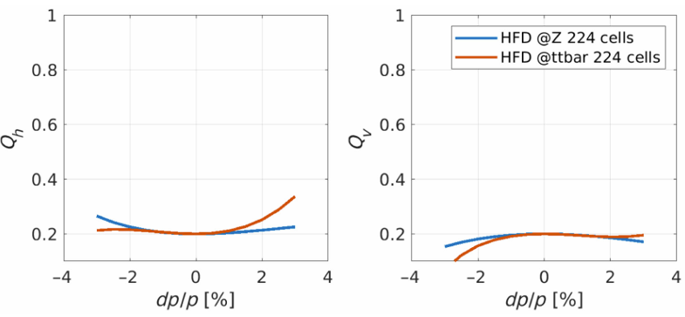
ARC lattice
GHC optics：with noninterleaved sextupoles pairs placed at −I locations is less achromatic but more anharmonic.
HFD arc optics: both anharmonicity and achromaticity can be achieved simultaneously
standard FODO lattice with a sextupole for every quadrupole: very achromatic but not anharmonic.
CEPC optics: Four –I sextupole pairs scheme adopted for Higgs & ttbar modes

Slide 7
IR lattice
CEPC对撞区lattice与LCC类似，经验主要来自FFTB、SuperB对撞区设计及Brinkmann, Yunhai Cai, Anton等人文献。
New：LCC optics校正了有能量偏差的3阶共振项。
LCC IR optics

Slide 8
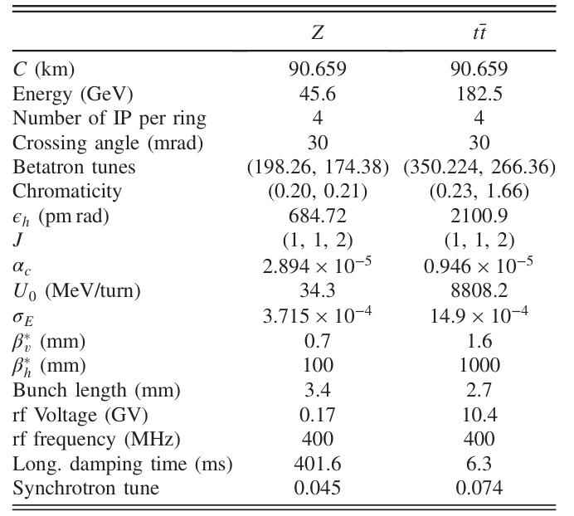
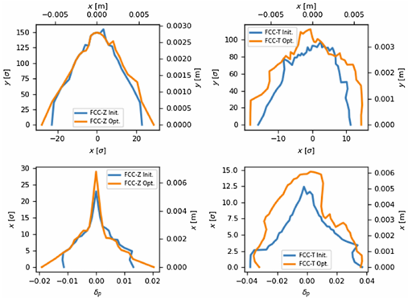
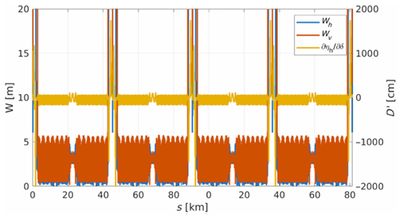
Lattice of whole ring
Further nonlinear optimization using numerical algorithms

Slide 9
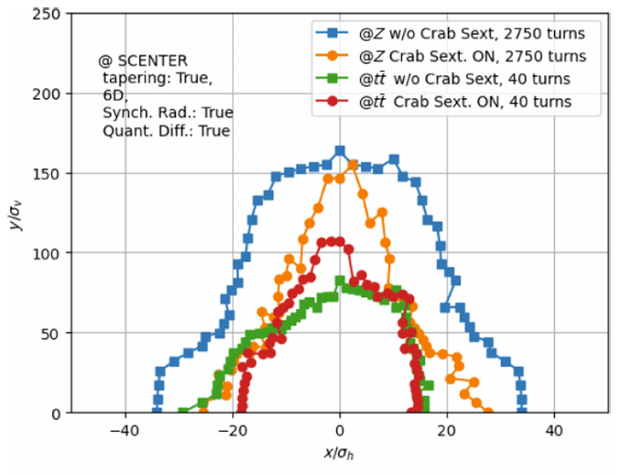
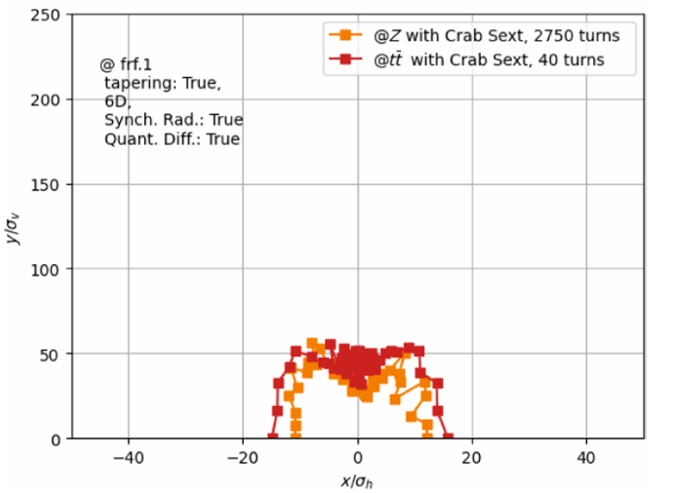
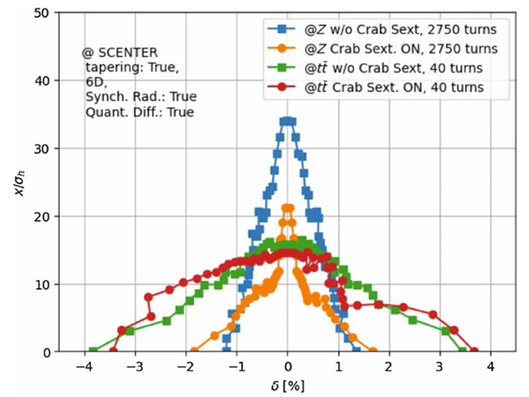
Performance of whole ring
Dynamic aperture for FCC LCC optics and GHC V22 optics at Z and ttbar energy computed in the center of the straight sections.
LCC optics
on momentum
GHC optics
On momentum
LCC optics
Off momentum

Slide 10
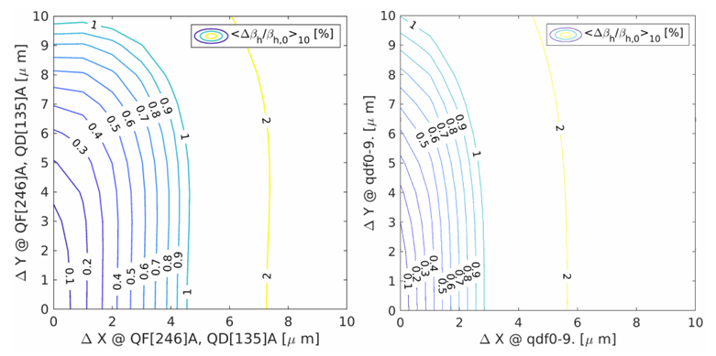
Performance of whole ring
Sensitivity to errors
Horizontal β-beating versus horizontal and vertical alignment errors on arc quardrupoles averaged at all BPMs over ten seeds without corrections
In (PRAB28, 021002, 2025), the comparison table
CEPC Higgs optics provided but not ttbar
CEPC ttbar ex=1.4nm vs FCCee LCC ex=2.1nm
LCCoptics
Z energy
GHC optics
Z energy

Slide 11
The possible optimization for CEPC ARC region
ARC lattice optimization is undergoing.
If the arc region adopted HFD structure and basically keep the machine geometry
 | CEPC TDR | CEPC with LCC | Note
Period | 23 cells | 5 cells
ARC quadrupole number in regular arc section | 46*8*8 | 10*36*8 | +64 quadrupole
ARC sextupole number in regular arc section | 16*8*8 | 8*36*8 | Nominally +320 sextupole, but actually may similar as softer Note CEPC ttbar ex=1.4nm vs FCCee LCC ex=2.1nm
CEPC ARC period
FCCee-LCC ARC period

Slide 12
Summary and further work
Pantaleo Raimondi发展了一套完全的局部校正方法，
相比于全局校正，具有更好的横向动力学孔径及更小的误差敏感度
能量接受度3.5%@ttbar， 1.8%@Z
如果弧区采用LCC设计且基本保持机器几何，弧区磁铁数量可以基本保持，优化正在进行中。

Slide 13
backup

Slide 14
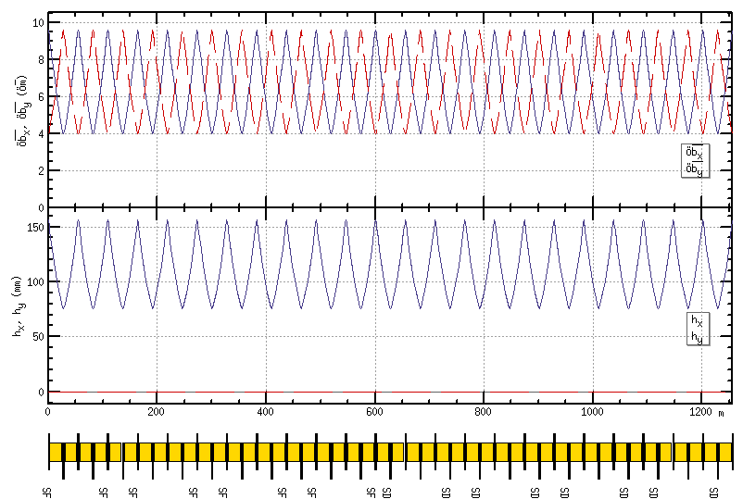
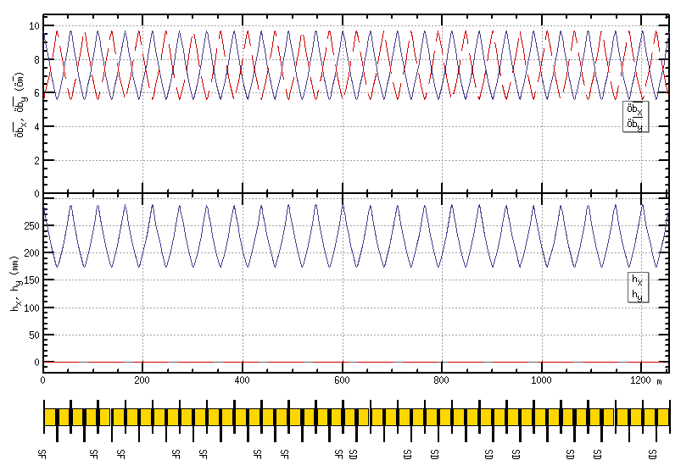
Lattice design of the ARC region
FODO cell to provide a large filling factor.
90/90 degrees’ phase advances for the Higgs and ttbar modes due to the emittance and nonlinearity cancelation.
60/60 degrees’ phase advances for the W and Z modes to fulfil the collective instability requirement.
suppress the impedance induced instability at Z mode
increase stable tune area if considering beam-beam effect and impedance consistently at W and Z modes
The distance 0.35m and opposite polarity between two beams fulfill the requirement technical design of the twin-aperture of dipoles and quadrupoles.
0.35m
Higgs/ttbar
90/90 degree
W/Z
60/60 degree
Dual aperture quadrupole and bend with opposite polarity in two ring

Slide 15
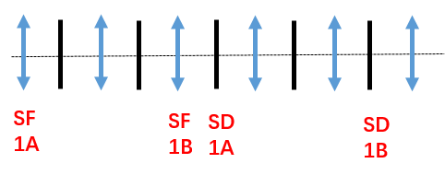
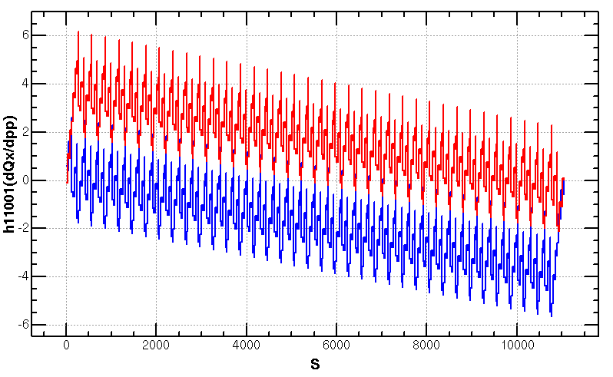
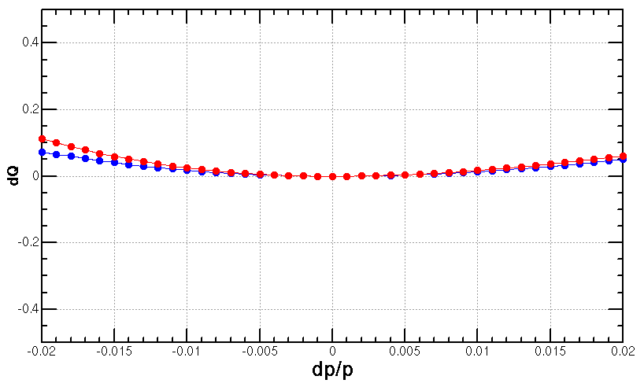
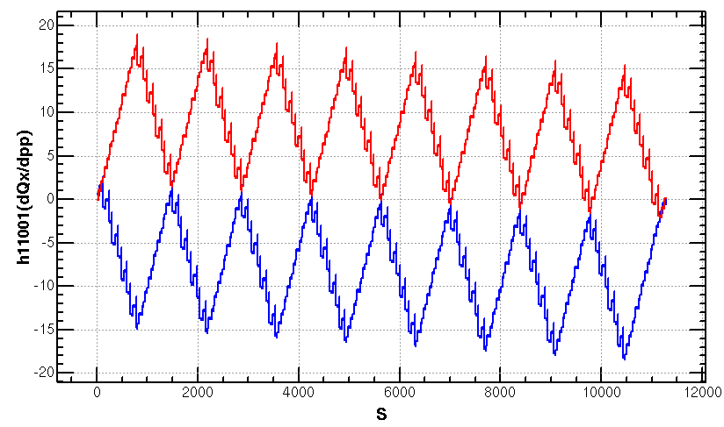
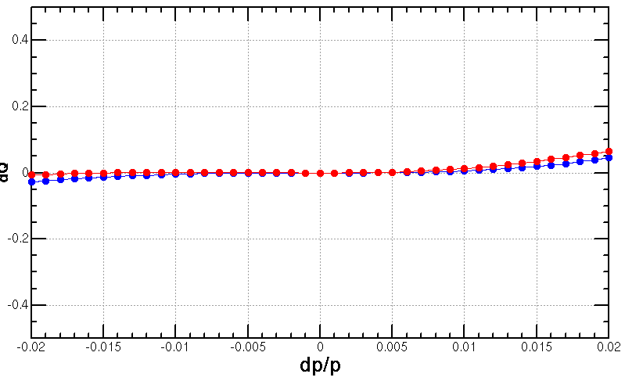
Optimization of ARC aberration for Higgs/ttbar
Four –I sextupole pairs scheme* adopted for Higgs & ttbar modes
nonlinearity cancellation esp. much less horizontal 2nd order chromaticity than the CDR lattice#
* T. Bian, PhD thesis 2018
# CEPC CDR, arXiv:1809.00285, 2018
Q’’=313, 410
Q’’=9, 145

Slide 16
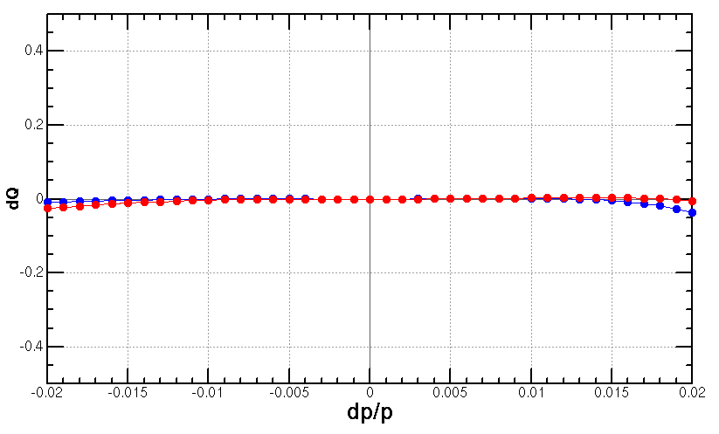
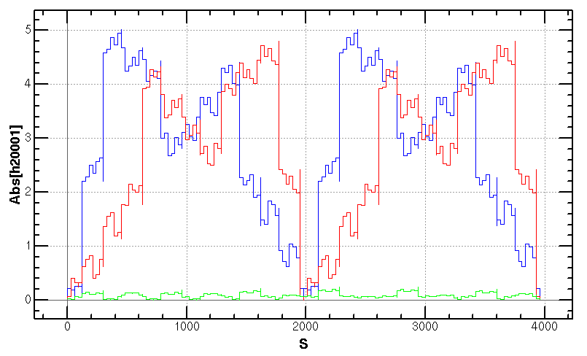
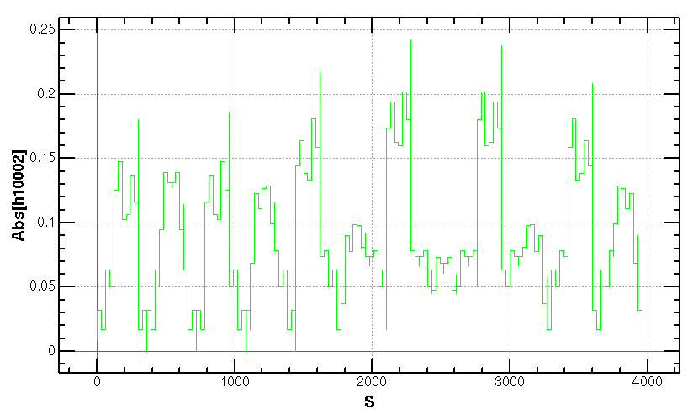
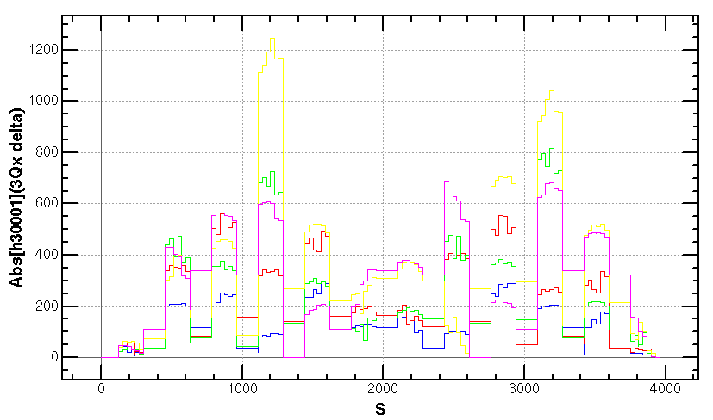
Optimization of ARC aberration for W/Z
The distribution of sextupoles for Higgs & ttbar mode allowed to select –I sextupole pairs for W &Z mode without adding more sextupoles.
Cancellation of main aberration has period of 23*3 cells. Give a good start point for the dynamic aperture optimization.
SF
1A
SF
1B
SF
2A
SF
2B
SF3A
SF
3B
SF
4A
SF
4B
SD
1A
SD
1B
SD
2A
SD
2B
SD3A
SD
3B
SD
4A
SD
4B
-I
-I
-I
-I
dQ vs. dp/p
Cancellation of
beta distortion due to energy deviation
Cancellation of
dispersion distortion due to energy deviation
Cancellation of
3rd RDT due to energy deviation

