Slide 1


Global comparison of CEPC vacuum system design with antechamber of photon absorbers with TDR vacuum system design
Yongsheng Ma
Vacuum group, IHEP,CAS
April 21th 2025

Slide 2
Outline
SR pathway diagram
Antechamber of photon absorbers VS TDR
Influence on vacuum chamber
Structure of vacuum chamber with absorbers
Conclusion

Slide 3
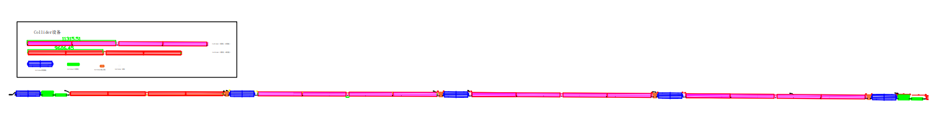
SR pathway diagram
TDR design, vacuum chamber without antechamber
Lead
Lead
A’
B’
26.93m
r
B
A
y
ρ
r
ρ
collider | ρ | 光斑横向宽度 | 吸收器挡光长度对应二级铁长度 L | 真空盒半径 | B点光的打在真空盒上经过的角度 | B点光经过的距离,系数取1.1 | y
 | m | mm | m | mm | φ | m | mm
CEPC | 10700 |  | 5.5 | 28.0 | 0.00228771 | 26.93 | 15.3
FCC | 10700 | 4.00 | 5.5 | 35.0 | 0.00255774 | 30.10 | 16.9
ϴ
ѱ

Slide 4
SR pathway diagram
Vacuum chamber with antechamber
Lead
Lead
Absorber
Antechamber
Antechamber
Antechamber
Absorber
y
A’
26.93m
B’
r
B
A
Antechamber
Antechamber
y
Antechamber
r
反射光
ρ
collider | Ρ | 光斑横向宽度 | 吸收器挡光长度对应二级铁长度 L | 真空盒半径 | B点光的打在真空盒上经过的角度 | B点光经过的距离,系数取1.1 | y
 | m | mm | m | mm | φ | m | mm
CEPC | 10700 |  | 5.5 | 28.0 | 0.00228771 | 26.93 | 15.3
FCC | 10700 | 4.00 | 5.5 | 35.0 | 0.00255774 | 30.10 | 16.9
ϴ
ѱ

Slide 5
Functional layout
Shielded bellows
BPM
Correctors & Quad
Dipole
Dipole
Correctors, Quad, Sext
Ion Pump
Ion Pump
Ion Pump
Ion Pump
Girder
Girder
Synchrotron radiation absorber
Flange connection
~11 m
~4m
~8 m
Synchrotron radiation absorbers are installed in dipoles, shielding also the interconnections and quad/correctors.

Slide 6
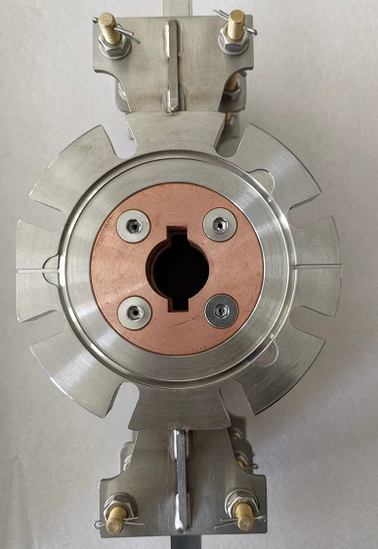
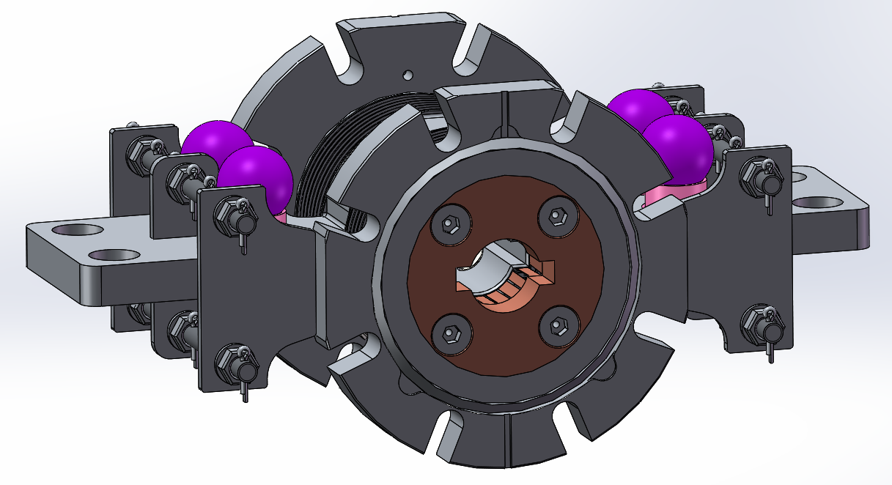
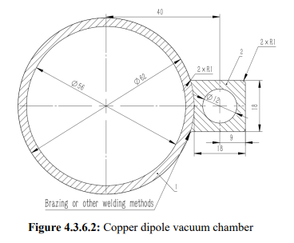
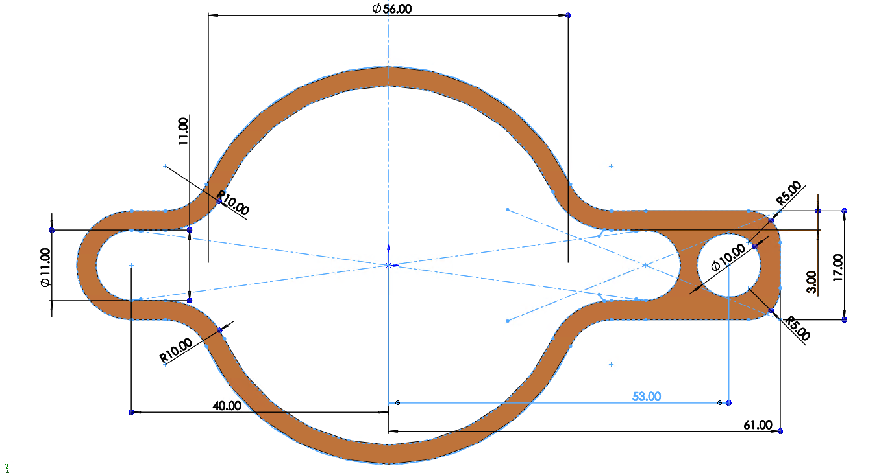
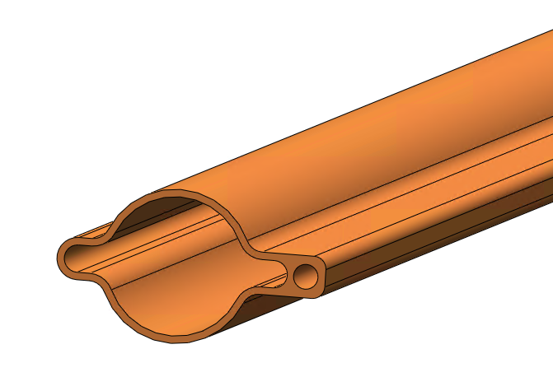
Antechamber of photon absorbers VS TDR
Factors | CEPC TDR | Antechamber with Absorbers
Vacuum chambers | D56 | Details on next page
RF shielding bellows RF shielding All metal gate valves | D56 | Antechamber
BPM | D56 | Antechamber
Impedance | --- | 5% increase
Magnet materials structure | --- | Dipole:
Cost | 3.4 billion | 4.7 billion
56
6

Slide 7
Influence on vacuum chamber
Factors | CEPC TDR | Antechamber with Absorbers
Structure | Simple | There will be 2 or 3 absorbers in one vacuum chamber, if its length is still ~11meters.
Manufacture | Simple | The manufacture of absorber is very challenge; The complex internal geometry of the SRAs calls for the use of additive manufacturing technology; (FCC) Conventional dematerializing manufacturing (mechanical processing)
Risks | Low | Lots risks of vacuum chamber with Absorbers due to the welding between beam pipe and absorbers The risk of leakage has increased due to the large number of welding seals.(焊缝漏的风险) Extra impedance due to mechanical Dimension error； More outgassing due to outer welding;(外焊接带来夹气) Prototypes should be taken out to test feasibility.
NEG coating | Well-distributed | Complexity and difficulty for two wings
Cooling | Simple, uniform | Complexity and higher temperature near to absorbers

Slide 8
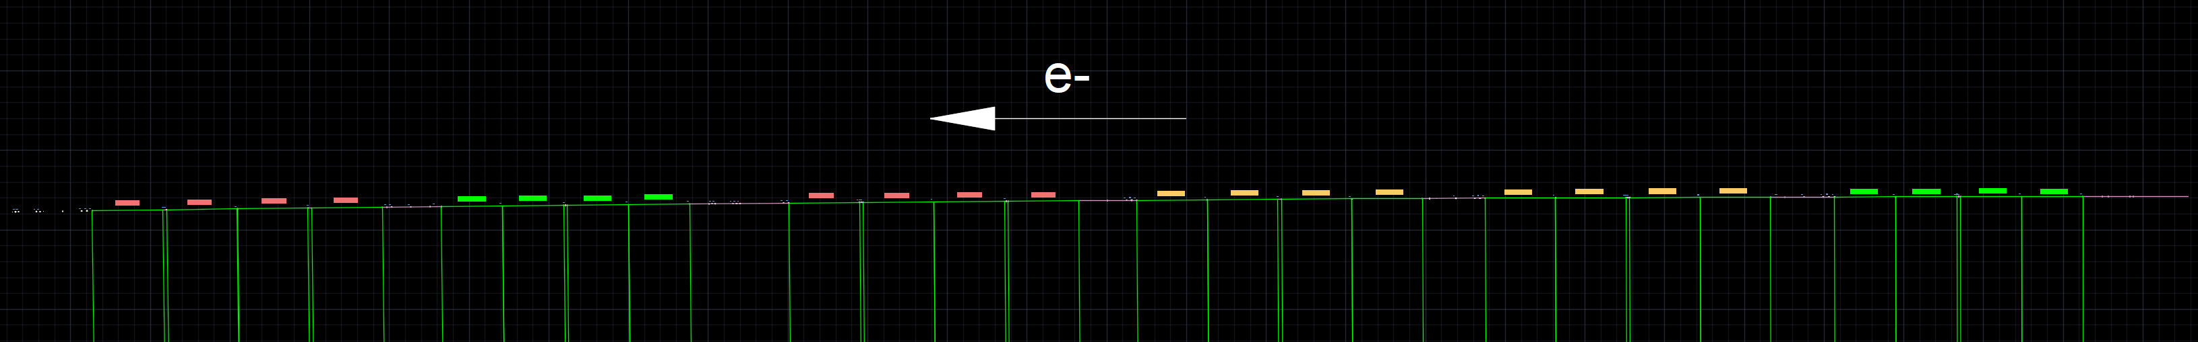
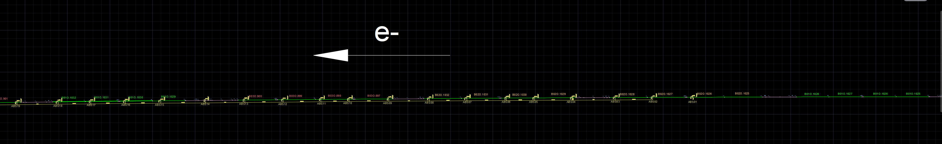
CEPC电子环外环弧区绘图细节及弯铁特征
上游为对撞区
弯铁型号 | 图中颜色 | 弯转半径(m) | 弦长(m) | 弯转角度(º) | 辐射功率（W）
B01O | 绿 | 9966.947 | 4.79 | 0.0275 | 4220
B02O | 黄 | 9966.947 | 5.52 | 0.0317 | 4864
B03O | 红 | 9966.947 | 5.54 | 0.0318 | 4879
循环组1 | 1-1、2、3、4、5、6 1-2、2、3、4、5、6 1-2、2、3、4、5、6 1-2、2、3、4、5
循环组2 | 1-3、2、3、4、5、6 1-2、2、3、4、5、6 1-2、2、3、4、5、6 1-2、2、3、4、5
循环组3 | 1-3、2、3、4、5、6 1-2、2、3、4、5、6 1-2、2、3、4、5、6 1-2、2、3、4、5
… | …
1-1 | 长直线节8.251m | —— | (B01-B01)+(B01-B01) | ——
1-2 | 长直线节7.771m | —— | (B01-B01)+(B01-B01) | ——
1-3 | 长直线节7.844m | —— | (B01-B01)+(B01-B01) | ——
2 | 长直线节5.015m | —— | (B02-B02)+(B02-B02) | ——
3 | 长直线节4.925m | —— | (B02-B02)+(B02-B02) | ——
4 | 长直线节4.544m | —— | B03+(B03-B03)+B03 | ——
5 | 长直线节7.771m | —— | (B01-B01)+(B01-B01) | ——
6 | 长直线节4.634m | —— | B03+(B03-B03)+B03 | ——

Slide 9
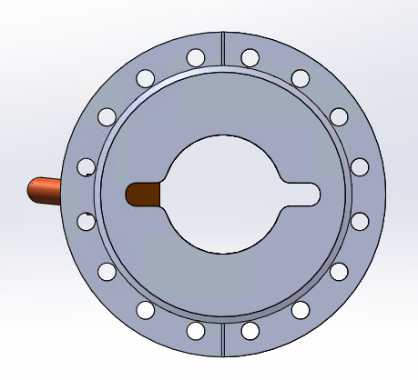
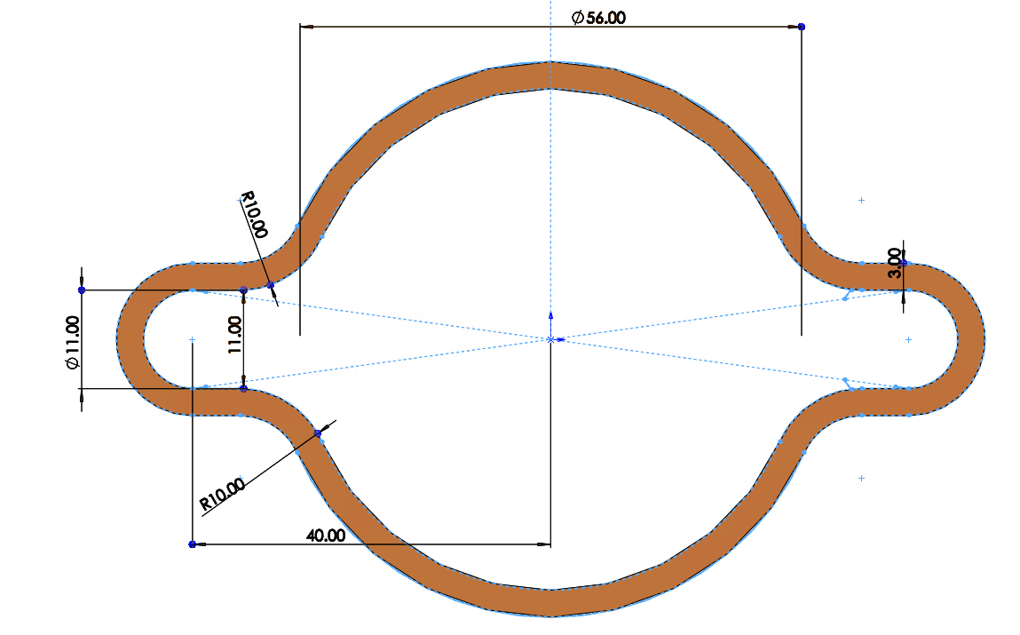
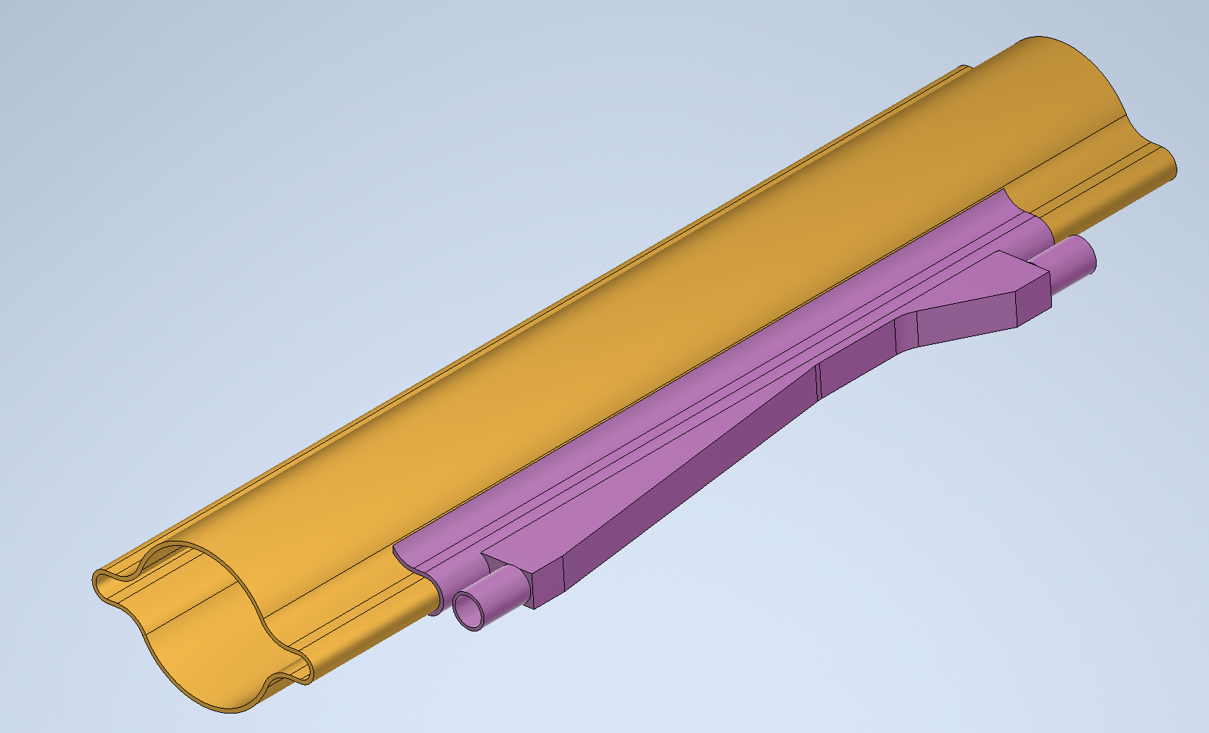
初步设计吸收器布局并计算相关数据
李琦
吸收器 编号 | 布局位置 | 受光功率(W) |  | 吸收器间距(m)
ABS_01 | B02O.1026出口-600 | 4020
ABS_02 | B02O.1027出口-600 | 4204 |  | 5.813
ABS_03 | B02O.1028出口-600 | 4327 |  | 5.527
ABS_04 | B02O.1029入口800 | 4235 |  | 6.325
ABS_05 | B02O.1030入口800 | 3084 |  | 5.527
ABS_06 | B02O.1030出口-600 | 3590 |  | 4.12
ABS_07 | B02O.1031出口-600 | 4219 |  | 5.813
ABS_08 | B02O.1032出口-600 | 4342 |  | 5.527
ABS_09 | B03O.897入口800 | 4020 |  | 5.944
ABS_10 | B03O.898入口800 | 3314 |  | 5.833
ABS_11 | B03O.898出口-600 | 3606 |  | 4.14
ABS_12 | B03O.899出口-600 | 4081 |  | 5.547
ABS_13 | B03O.900出口-800 | 4158 |  | 5.633
ABS_14 | 7771直线节出口-2800 | 3943 |  | 5.771
ABS_15 | B01O.1029出口-1000 | 3590 |  | 6.59
ABS_16 | B01O.1030出口-600 | 3391 |  | 5.197
ABS_17 | B01O.1031出口-600 | 3345 |  | 5.083
ABS_18 | B01O.1032出口-600 | 3698 |  | 4.797
ABS_19 | B03O.901入口800 | 3698 |  | 6.034
ABS_20 | B03O.902入口800 | 3867 |  | 5.832
ABS_21 | B03O.903入口1200 | 4035 |  | 5.947
ABS_22 | B03O.904入口800 | 3989 |  | 5.433

Slide 10

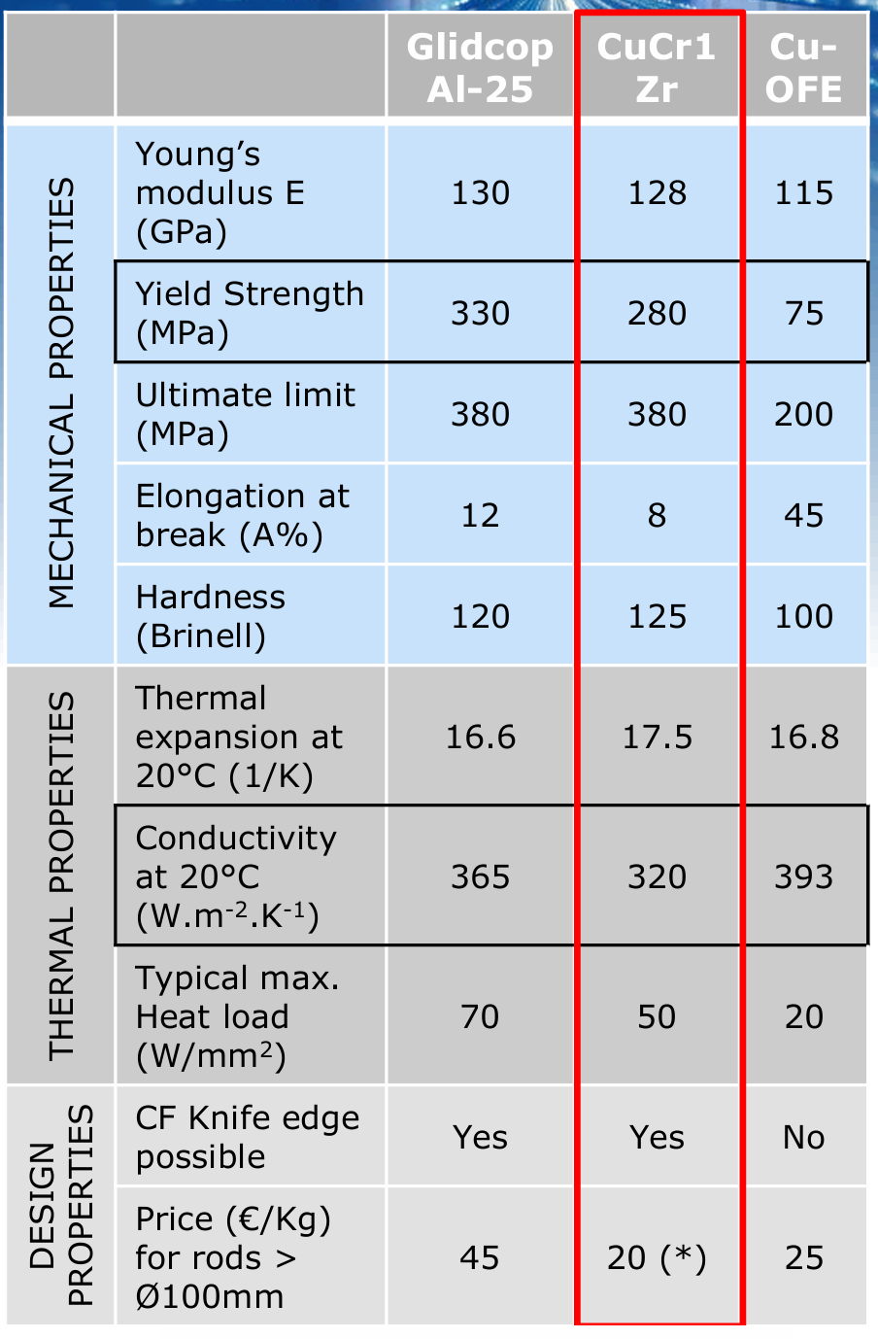
吸收器设计加工难点
全部同步光由吸收器遮挡，部分直线节需有吸收器
按当前布局，吸收器功率密度超过铜及合金设计极限值
  入射位置用铍
  设计挑战——铍相关计算
  加工挑战——铍和铜连接方法（旋压？增材制造嫁接？）
按当前结构需用3D增材制造法加工（新加工方法）
  材料性能与传统加工方法有区别，需要做试验件测试
  测试内容及试验件设计
  测试数据分析比较

Slide 11
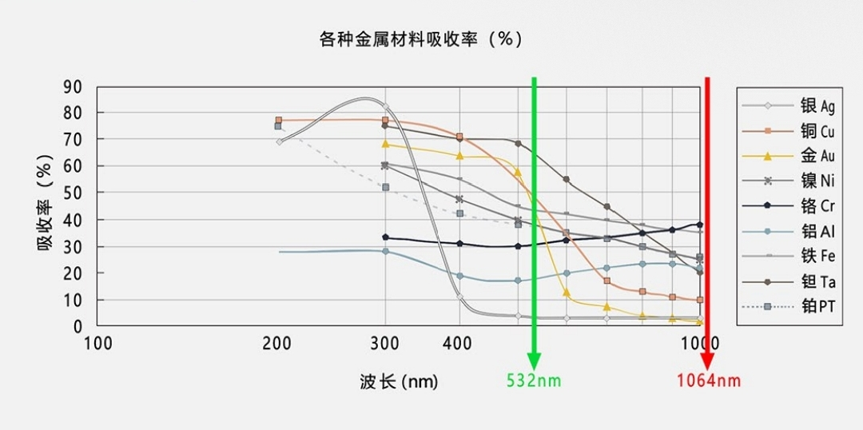
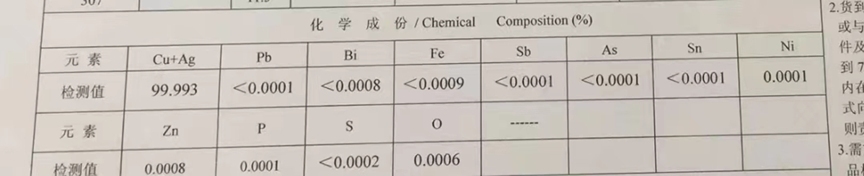
增材制造绿激光打印铜调研情况
 | 德国通快(TRUMP) | 国产希禾
入市时间 | 2018年 | 2023年
铜含量 | 高于 99.9
电导率/IACS | 100％ | 97％
致密度 | 99.9％ | 99.7％
抗拉强度 |  | ≥230MPa
屈服强度 |  | ≥150MPa
延伸率 |  | ≥30%
尺寸精度 |  | ±0.1mm
表面光洁度 |  | 8微米
销售情况 | 国内没有单位采购 | 江苏太仓、天津、北京
原料用国产TU1粉，打印后氧含量会增加

Slide 12
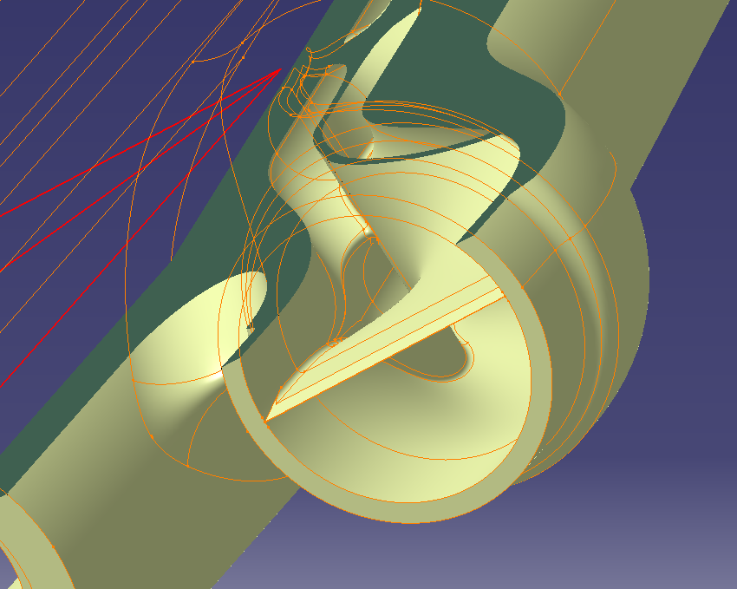
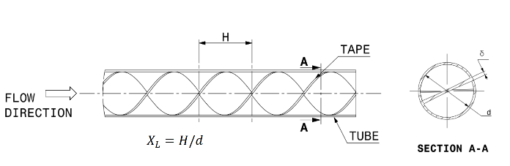
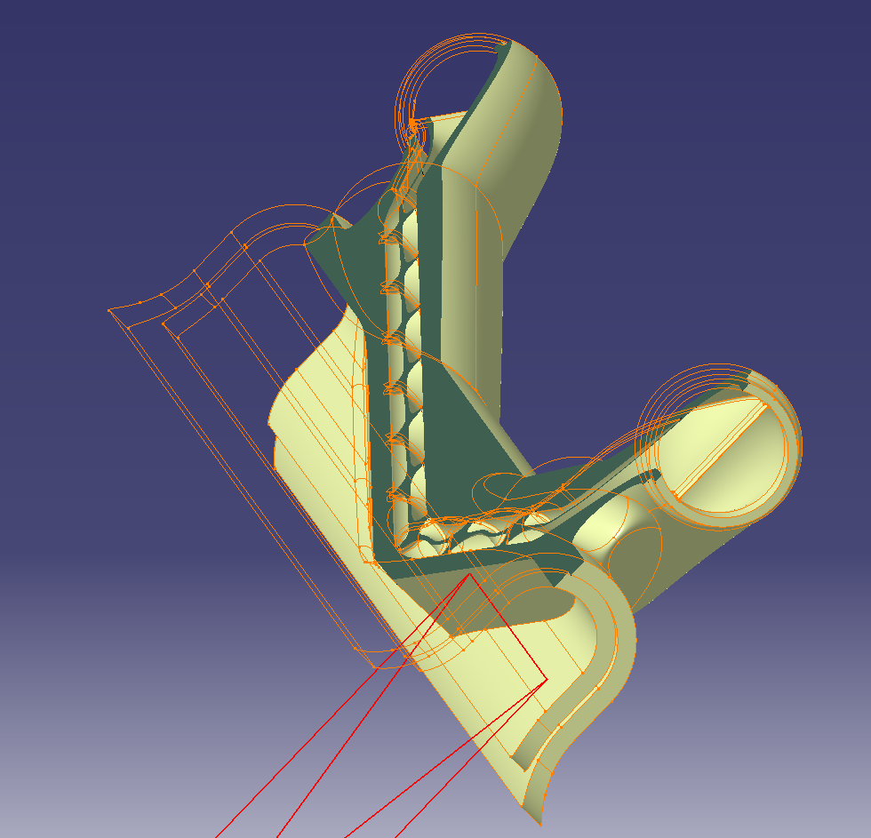
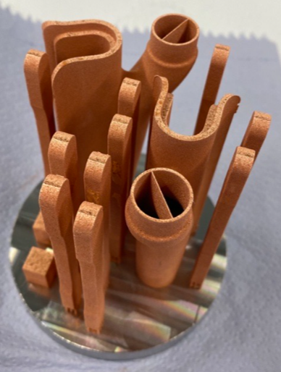
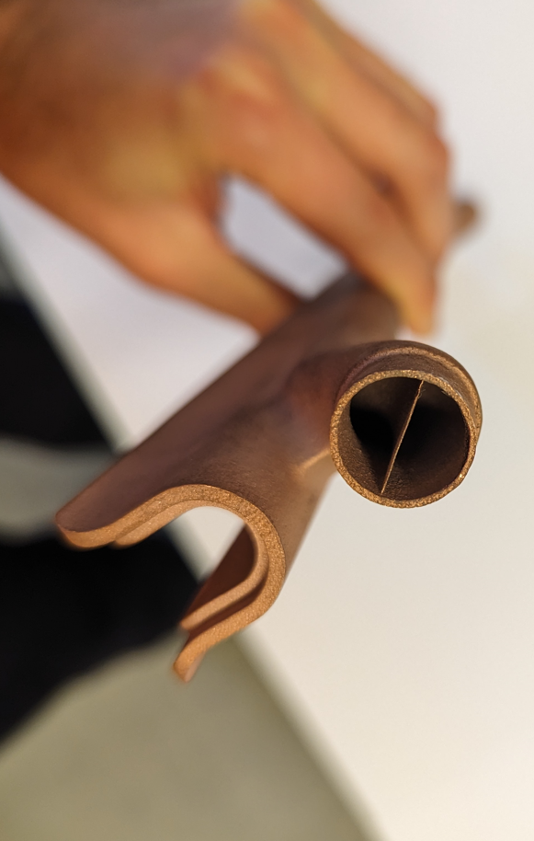
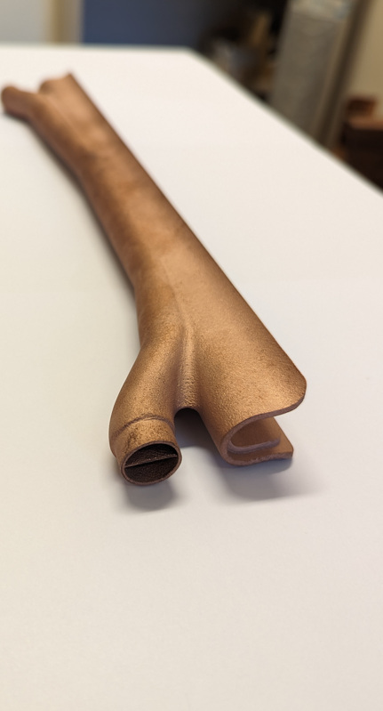
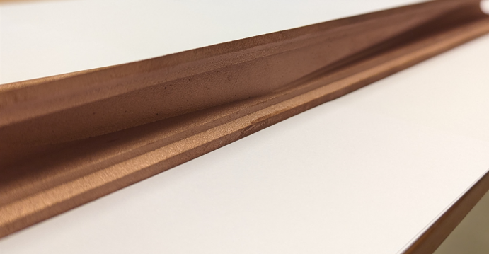
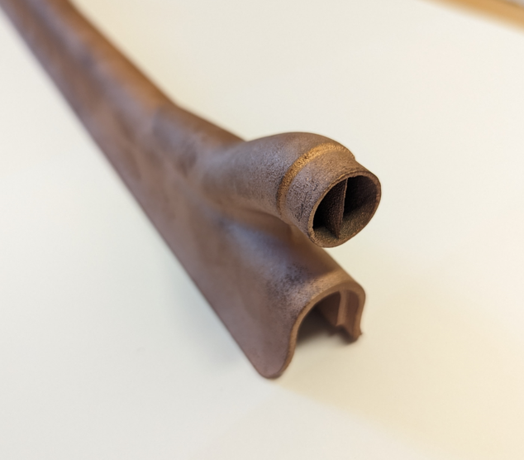
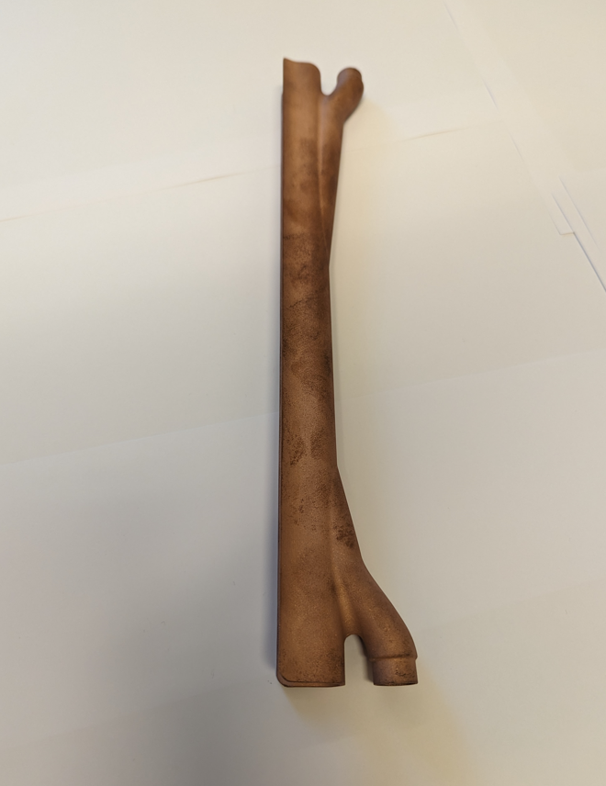
The Synchrotron Radiation Absorber
The complex internal geometry of the SRAs calls for the use of additive manufacturing technology, the water-cooling channels include a twisted-tape ‘insert’. The turbulence generated by the tape improves heat transfer capabilities.
Laser Powder Bed Fusion (LPBF) has been selected as the method for the first prototype.
Internal helical twist tape

Slide 13
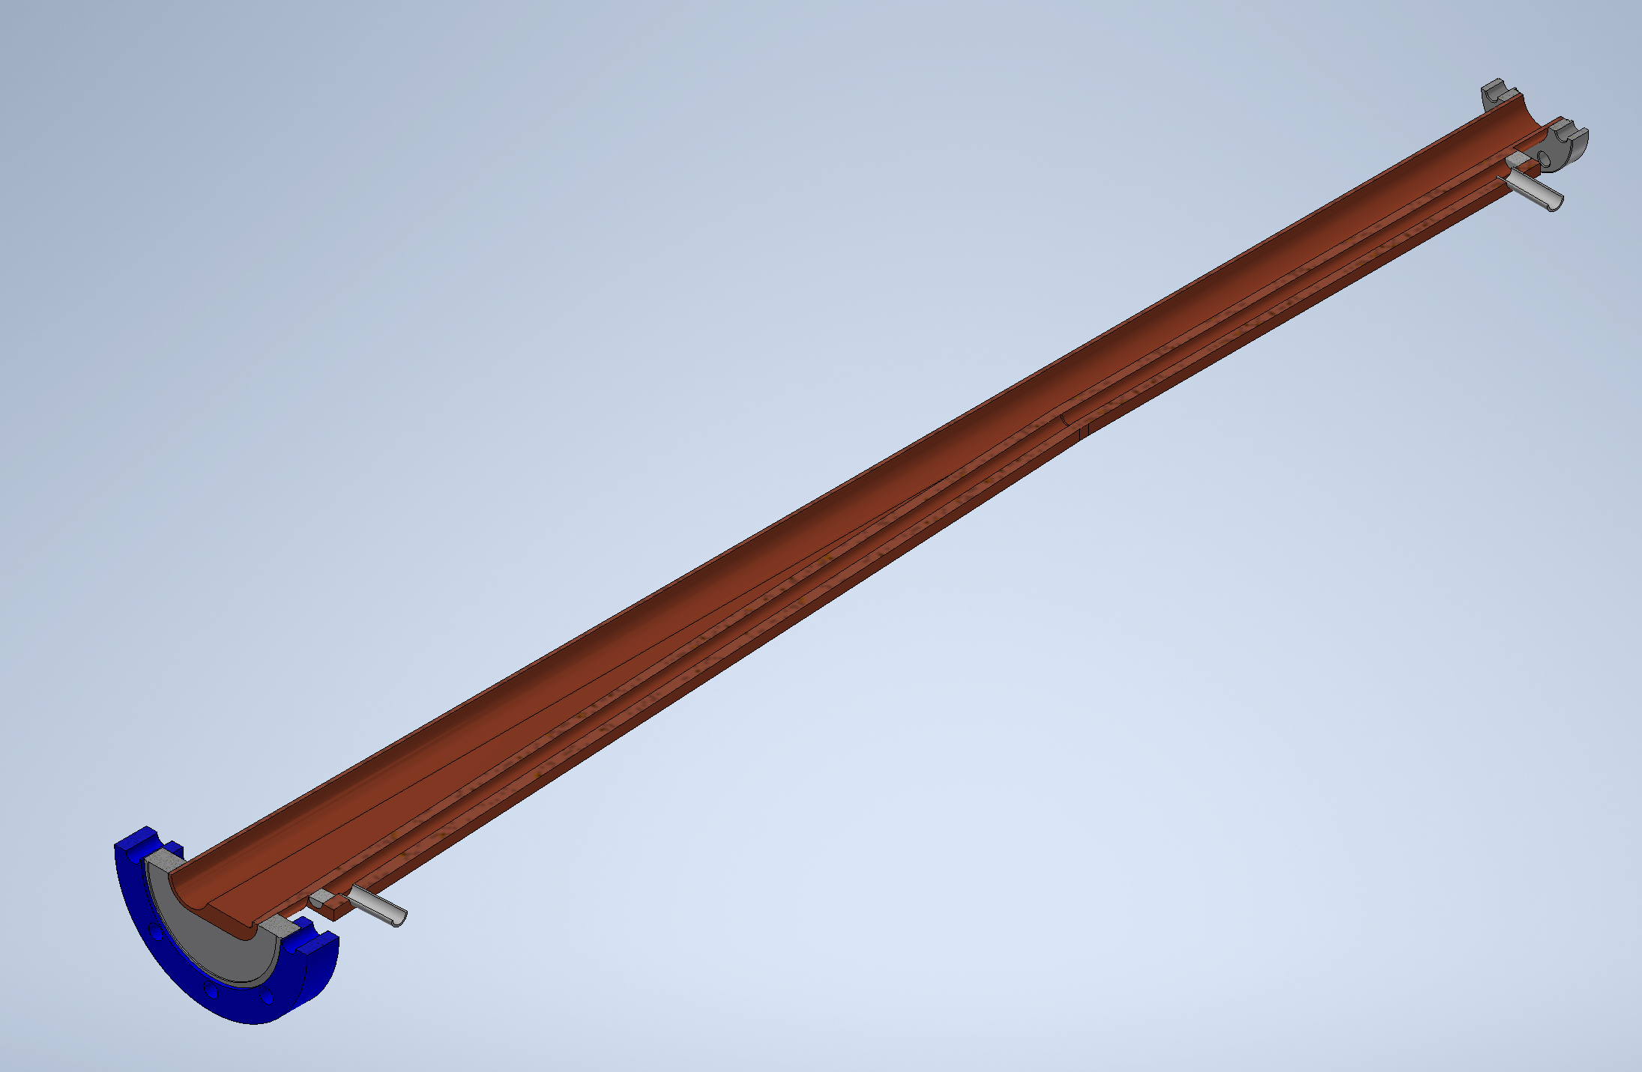
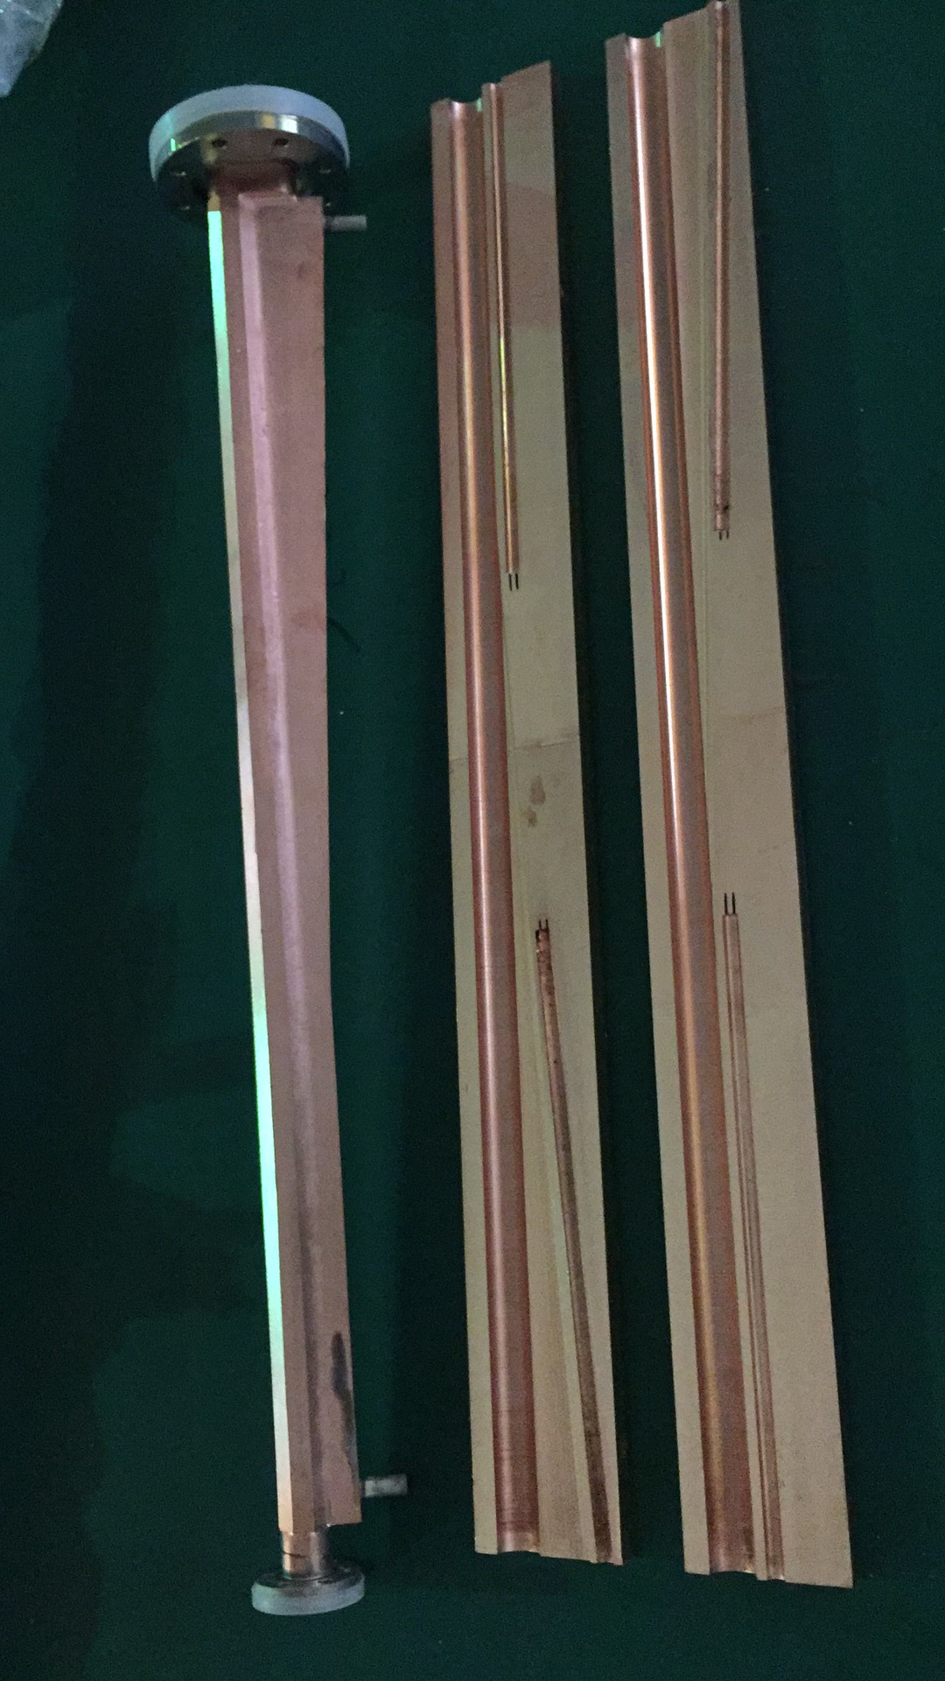
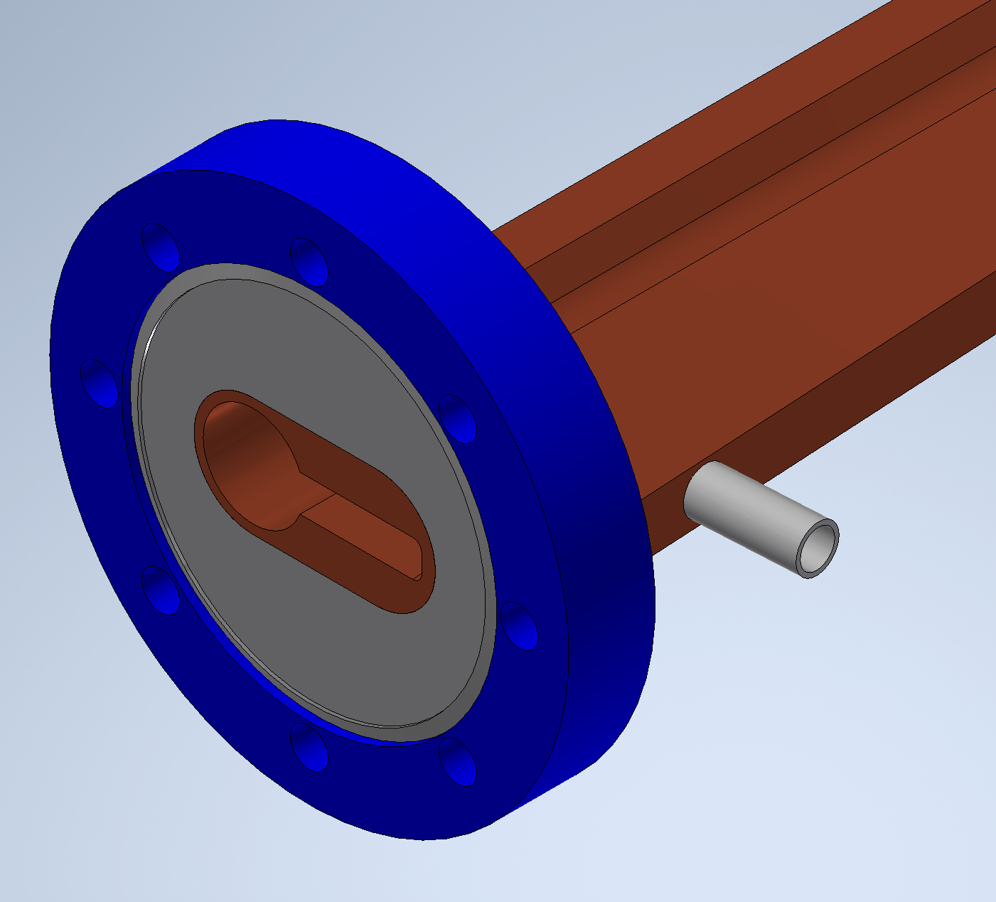
Prototype of Absorber on HEPS-Tf
Conventional dematerializing manufacturing (mechanical processing)

Slide 14
Conclusion
The structure of vacuum chamber will be more complex, NEG coating will be complex and difficulty for two wings.
The structure of BPM, RF shielding bellows, all metal gate valves will be more complex;
The space for absorber needs to be considered, and requiring good machining and installation accuracy;
The impedance increase due to the absorbers are less than 5% of the total budget ⇒ acceptable from the instabilities;
Lots risks of vacuum chamber with Absorbers due to the welding between beam pipe and absorbers;
The cost of vacuum system will increase up to 4.7 billion.
Prototypes should be taken out to access its feasibility.

Slide 15
CEPC光子吸收器方案和TDR方案对比
受影响因素 |  | CEPC TDR方案 | CEPC 光子吸收器方案
阻抗 |  | --- | 光子吸收器阻抗增加5%，从不稳定性角度看可接受。需评估横向单级阻抗。
磁铁线圈绝缘材料 |  | --- | 按环氧树脂设计。需要优化光子吸收器附近铅屏蔽。
真空 |  | --- | 带前室真空盒基本满足要求。但加工、焊接工艺存在困难。
辐射防护概念设计 | 隧道内电缆 | 活动铅挡板屏蔽；近束流管位置采用抗辐照电缆 | （FCC评估）不需要屏蔽
 | 光纤 | 排水沟加盖板
 | 电子学 | 辅助隧道内或磁铁支架间屏蔽体内
 | 其它有机材料 | 放置在低剂量区域，或增加屏蔽 | （FCC评估）不需要屏蔽
评估造价 |  | 1.电缆屏蔽，抗辐照线缆增加17亿； 2.排水沟及盖板；3.磁铁支架间屏蔽；4.其它屏蔽。 | 新增：光子吸收器，前室真空盒约增加约13亿； 减少：铅屏蔽费用减少约1亿； 2.排水沟及盖板；3.磁铁支架间屏蔽；4.其它屏蔽。
工程设计 |  | 设计磁铁内铅支撑、冷却；设计铅挡板工程方案和其它屏蔽；评估感生放射性 | 设计光子吸收器位置；优化铅屏蔽，设计铅冷却；评估感生放射性

Slide 16
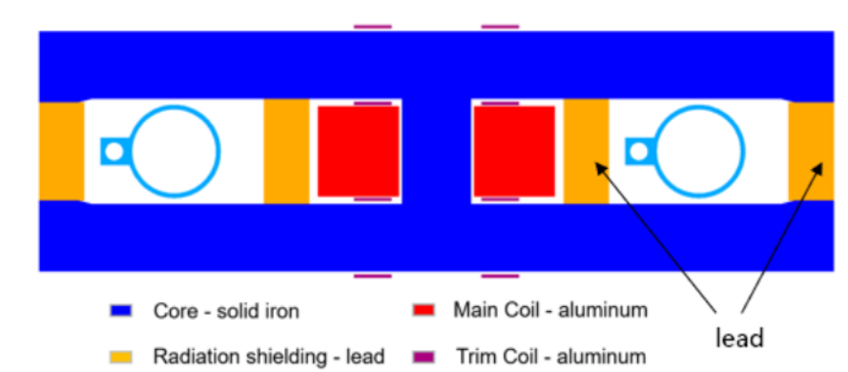
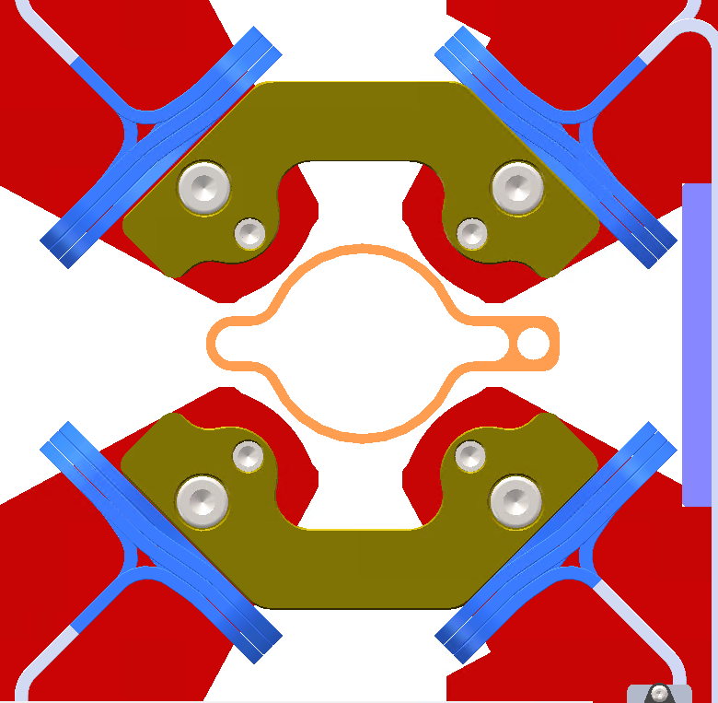
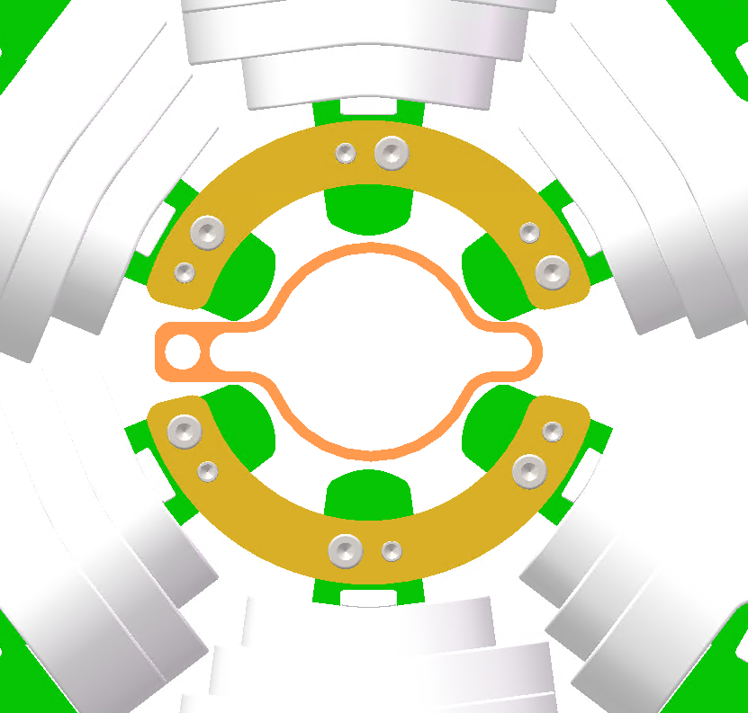
Mechanical adaption with magnets
350
350
190
30
190
10
46
46
70
70
25 in TDR
Dipoles: the space for lead will be compressed from 30 to 10 mm ( too small to lead)
Quadrupoles: ok
Sextpoles: ok
[1]GAO J. CEPC Technical Design Report: Accelerator [J]. Radiation Detection Technology and Methods, 2024, 8(1): 1-1105.

Slide 17
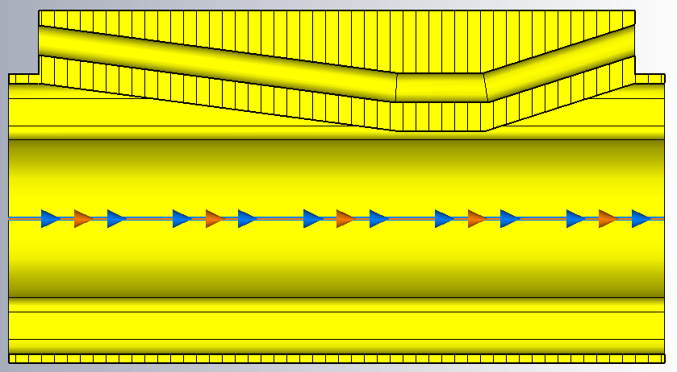
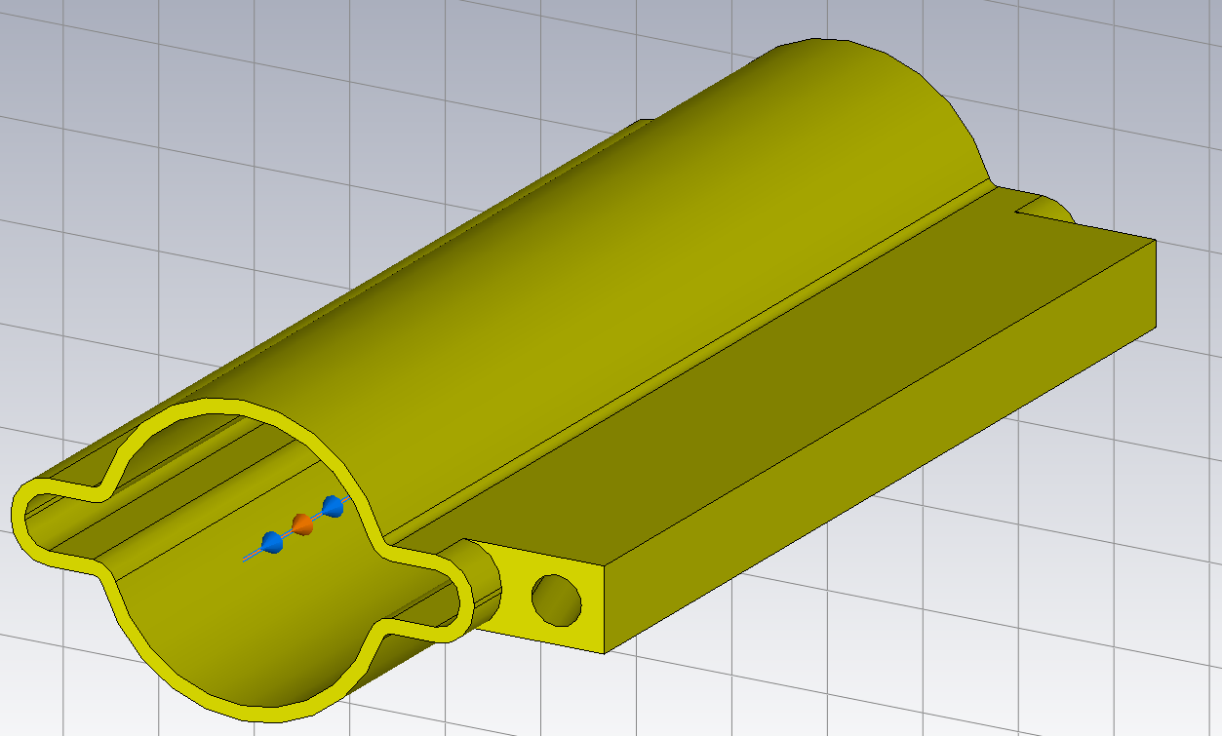
Impedance of absorbers
Wang Na
Main contribution to the ring impedance
  Resistive wall impedance ⇒ no significant change between circular and antechamber
  Longitudinal geometrical impedance
  Horizontal geometrical impedance
⇒ Mainly broadband, no narrowband resonances
Number per ring: 12217
Distance to the beam: 29.5mm
Length of top flat: 30mm
Taper angle upstream: 1/5
Taper angle downstream: 1/3

Slide 18
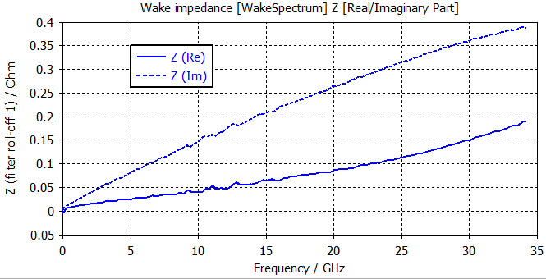
Impedance of absorbers
Wang Na
Main contribution to the ring impedance
  Resistive wall impedance ⇒ no significant change between circular and antechamber
  Longitudinal geometrical impedance
  Horizontal geometrical impedance
With bunch length of 3 mm, the broadband impedance contributions:
  Kloss=1.16E-3 V/pC
  ZL=4.1E-8 Ohm
  Kx=0.223 V/pC/m
Evaluate @σz=3mm
 | Z||/n [mΩ] | kloss [V/pC] | kx [kV/pC/m]
Absorbers | 0.5 | 14.2 | 3.4
Total | 16.5 | 819.8 | 65.5
Occupation | 3% | 2% | 5%
The impedance increase due to the absorbers are less than 5% of the total budget ⇒ acceptable from the instabilities

Slide 19
Cost
Vacuum chamber： unit price increase 30%, Approx. 300 million CNY
Photo absorber： approx. 795 million CNY
RF shielding bellow： unit price increase 20~30% due to antechamber, the quantity may also increases (20819 to 38483)due to high accuracy installation of absorber. approx. 200 million CNY
The total cost increases from 3.4 billion to 4.7 billion
unit price | quantity | total price
10000 CNY | / | 10000 CNY
3.0 | 26500 | 79500
Number
Layout—> dimension of antechamber

Slide 20
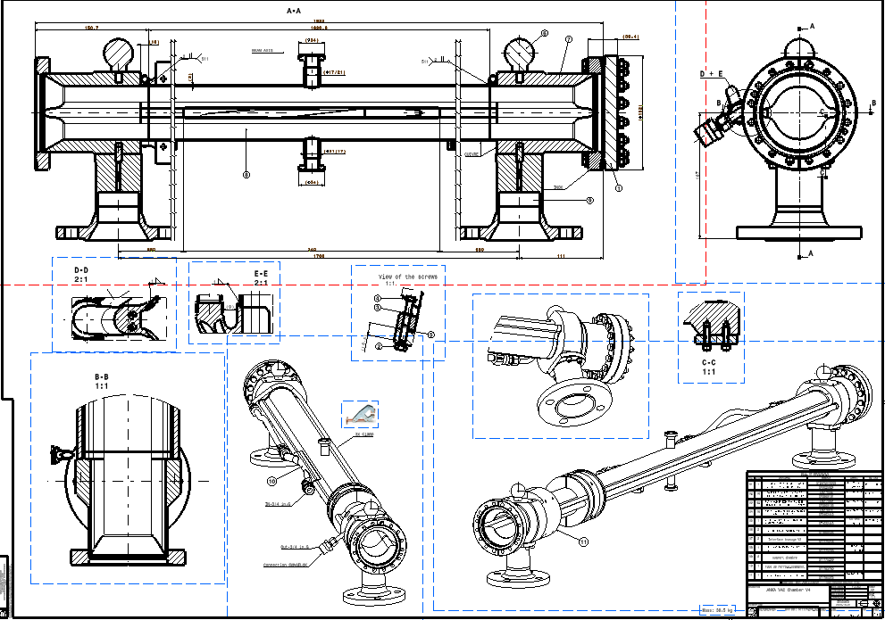
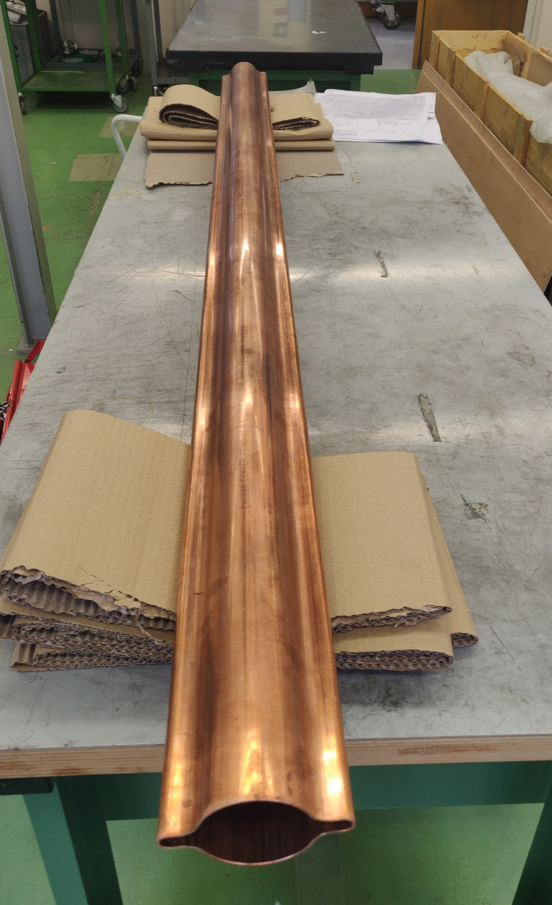
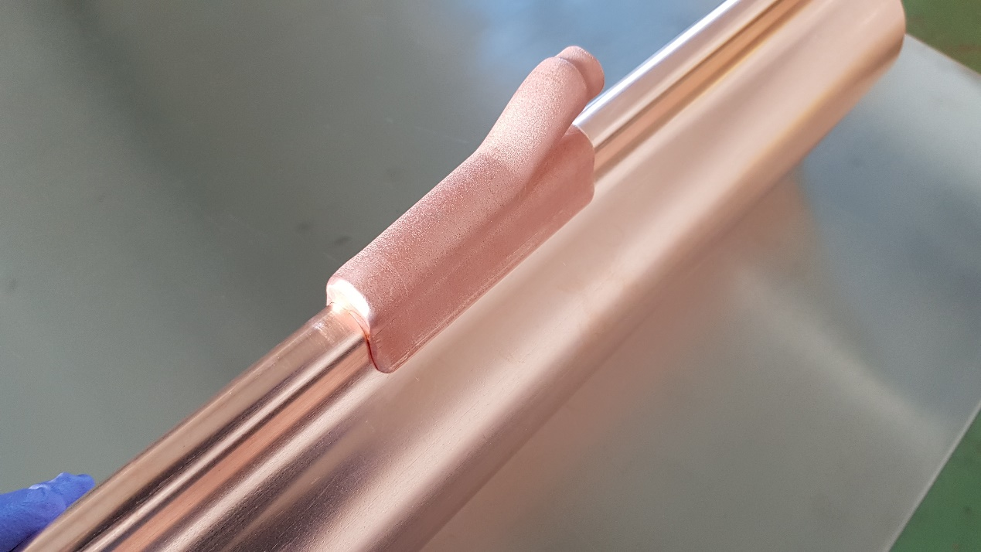
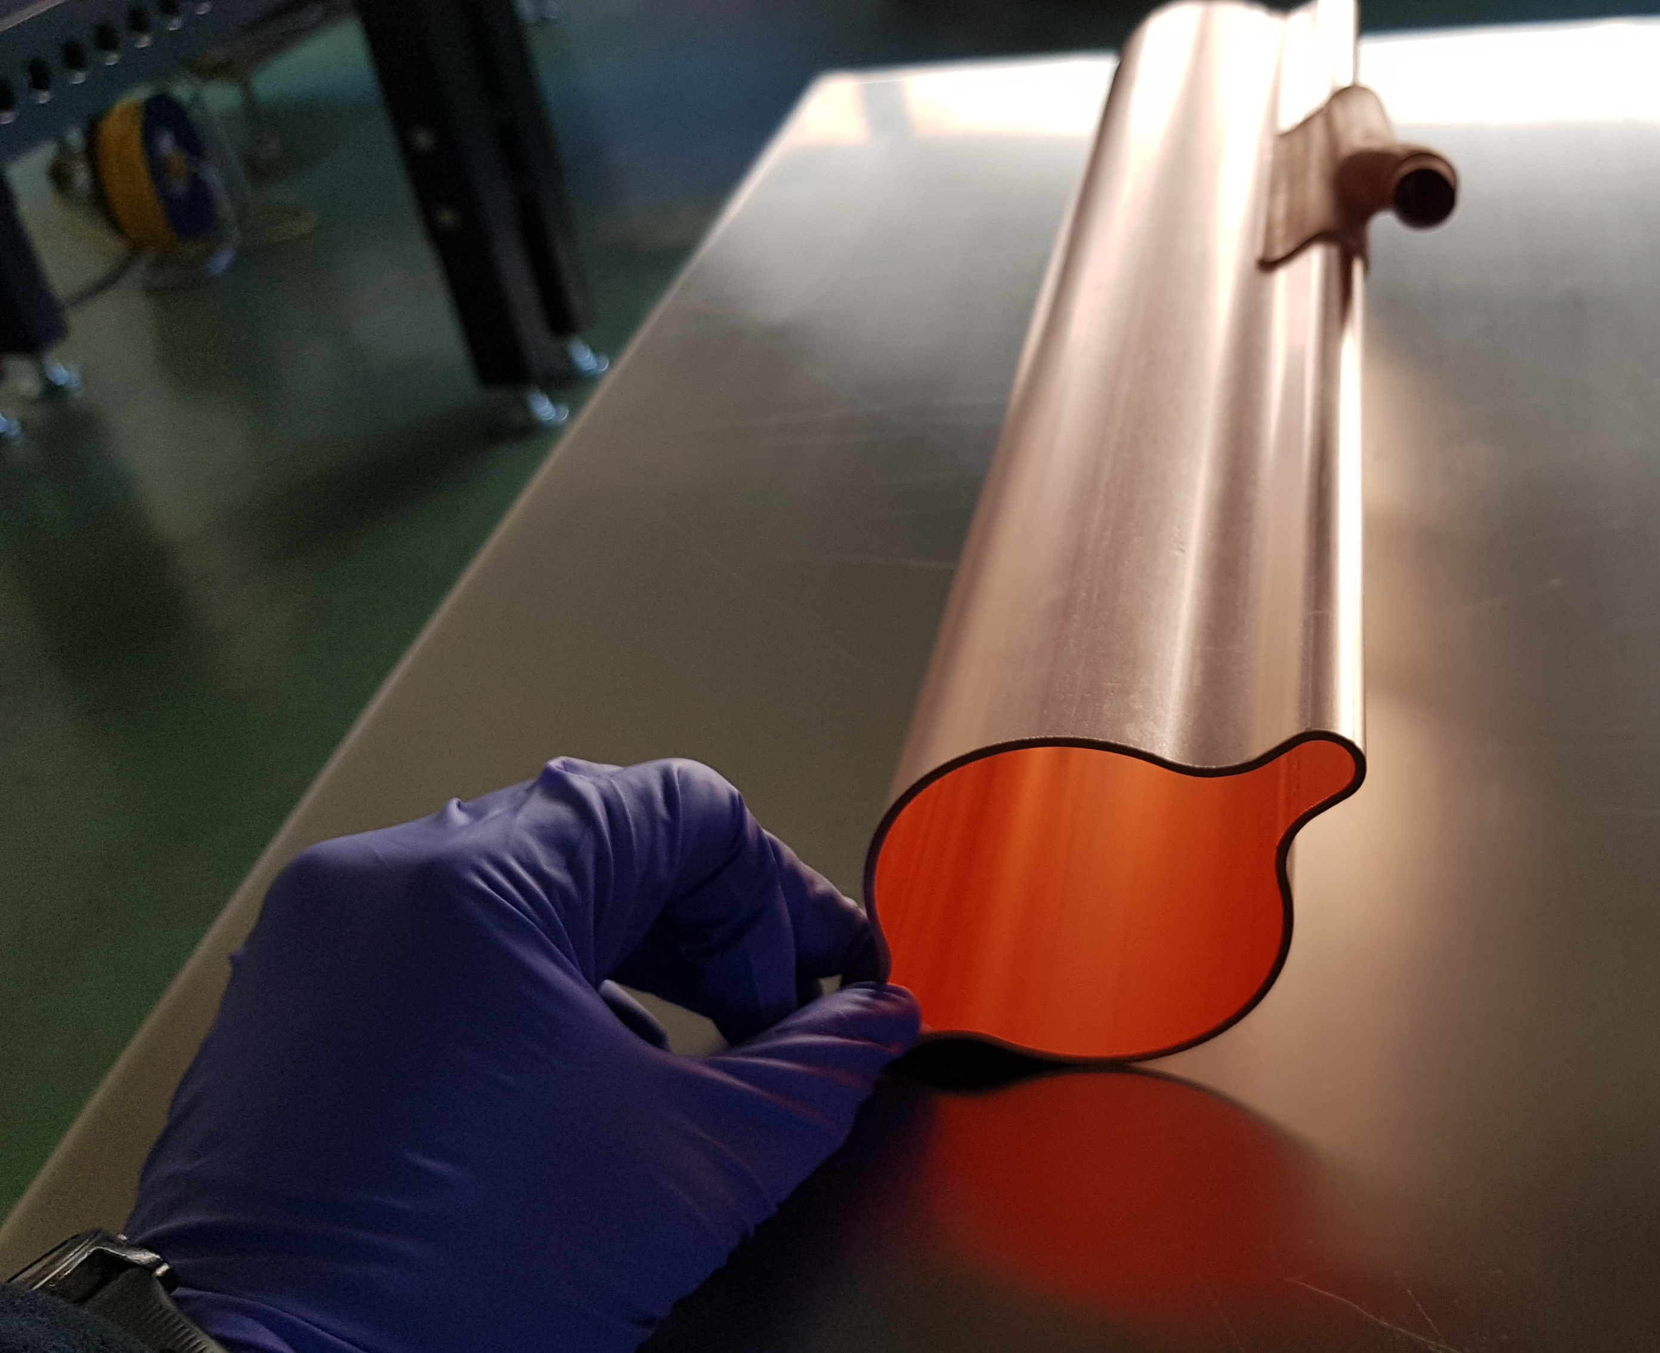
2m long prototype
FCC-ee vacuum chamber prototype
Copper extrusion
Design of chamber prototoype for tests at KARA synchrotron radiation light source
Machining and adjustment for electron beam welding tests

Slide 21
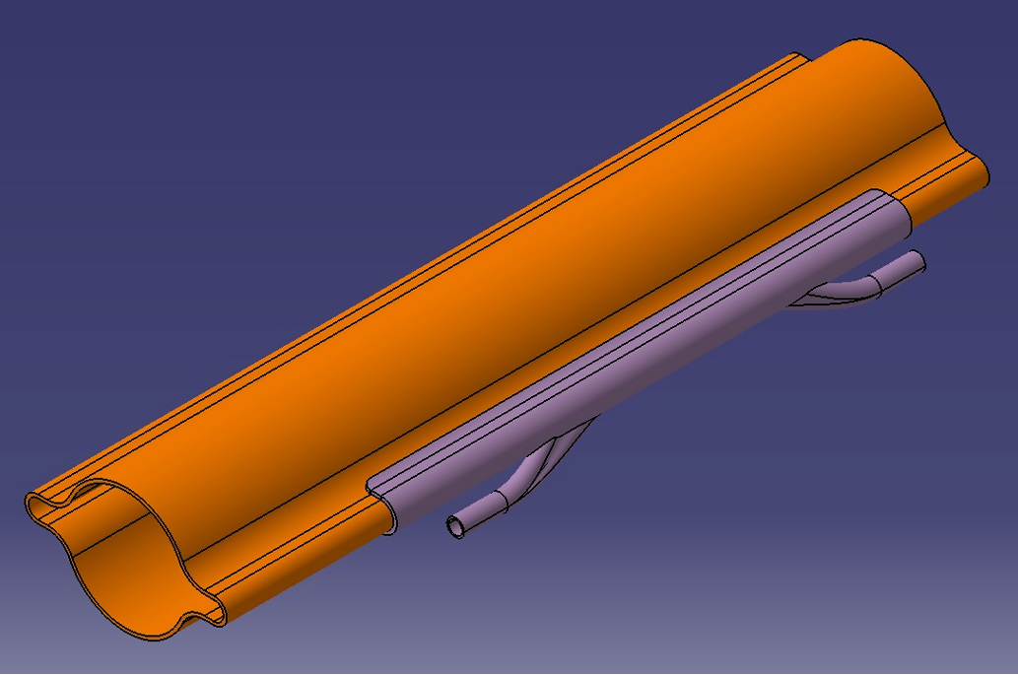
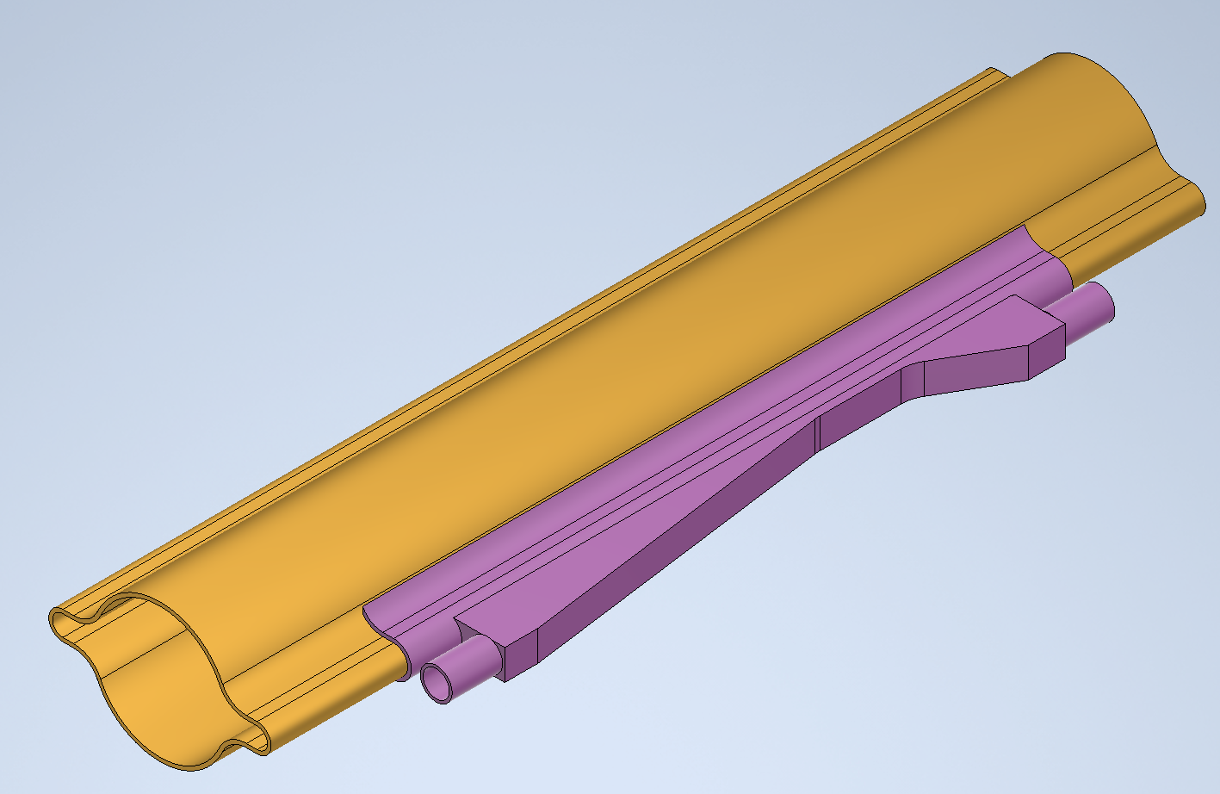
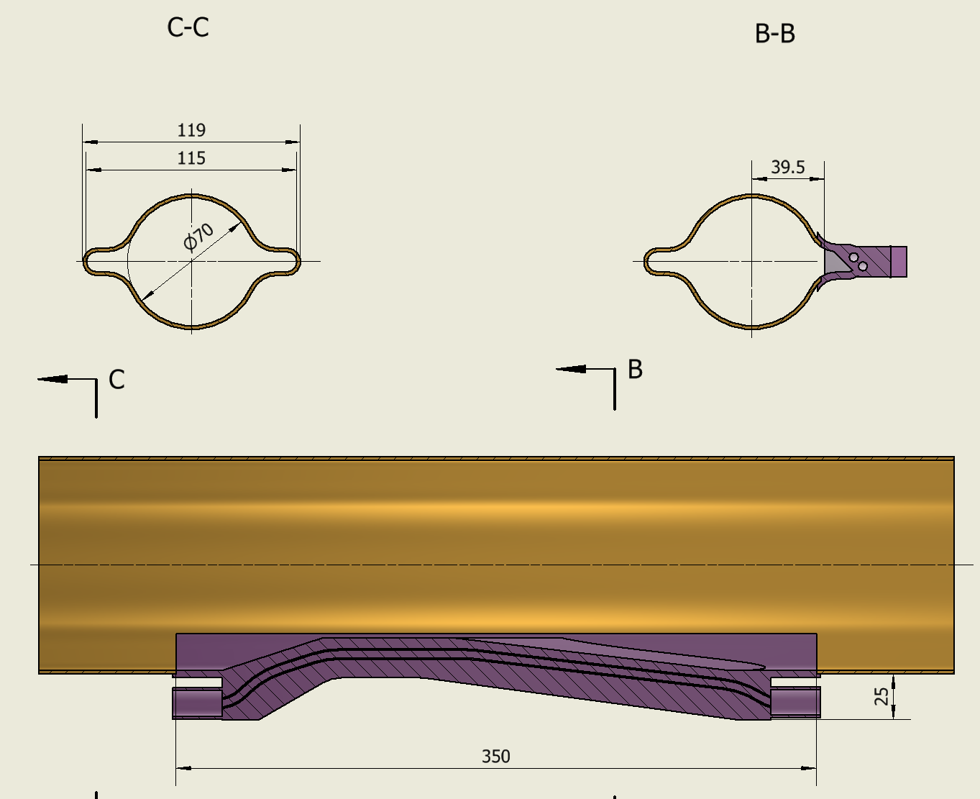

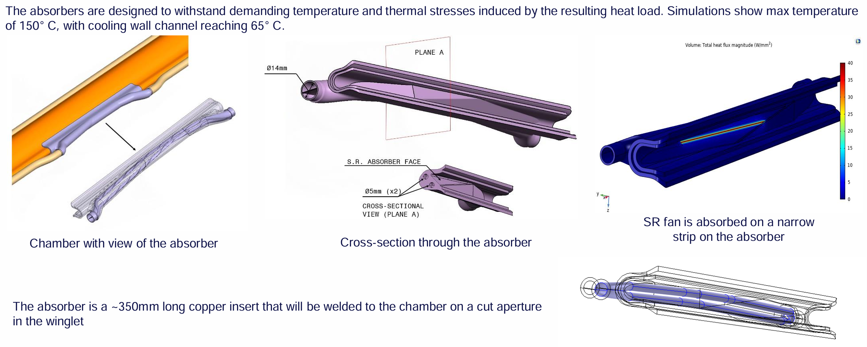
2、FCC吸收器结构尺寸分析
所有磁铁内的真空盒截面一致，部分区域侧面切断后嵌入吸收器，FCC弧区100%由吸收器挡光，需5~6米一个
FCC设计报告相关资料
还原FCC模拟图 估算 关键or关联尺寸

Slide 22
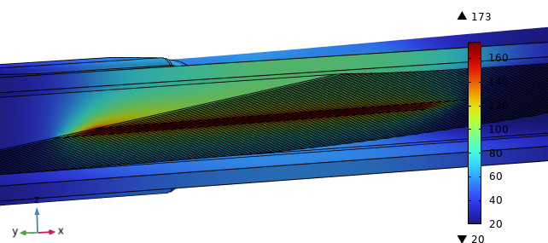
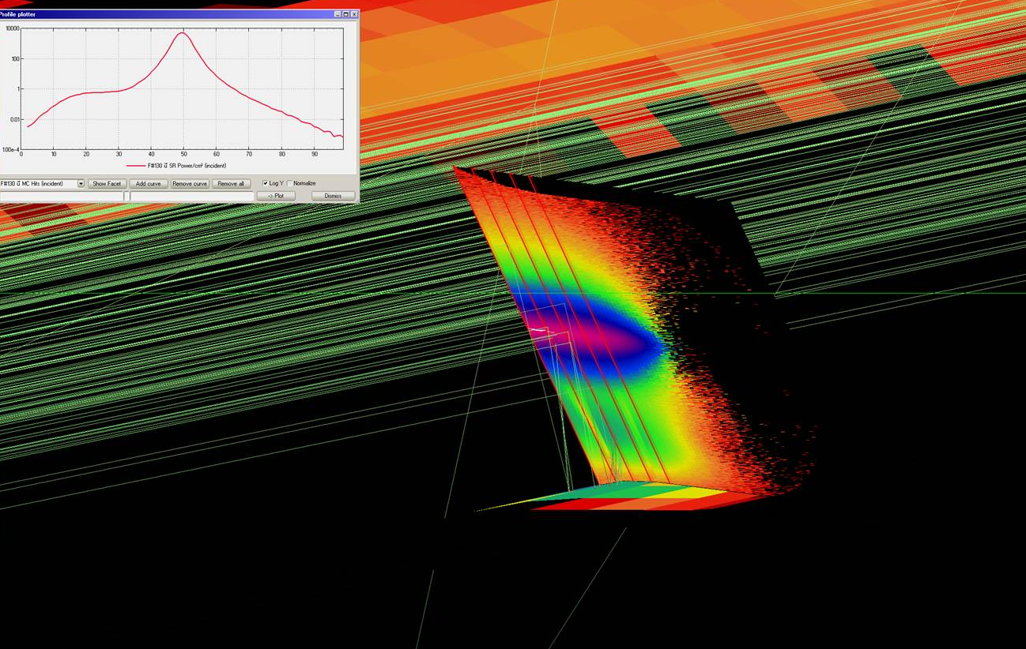
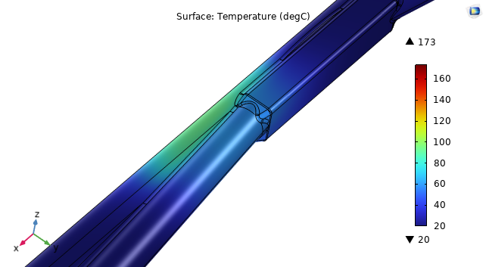
Thermo-mechanical behaviour
Given the beam properties and the magnetic field, the trajectory of the photons and the radiation power density are calculated in Synrad. The updated total power amounts to 2.5 kW/absorber and is assigned to the slanted surfaces.
The heat transfer coefficient considered for the cooling channels is 22000 W/m² K @ 240 g/s.
Simulations show max temperature of around 170° C.

Slide 23
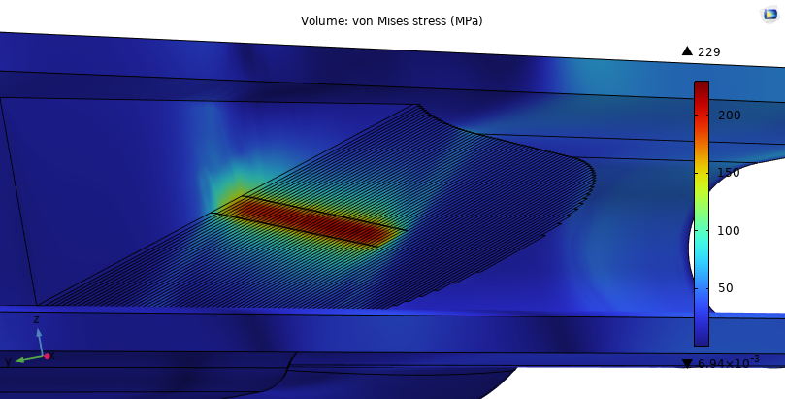
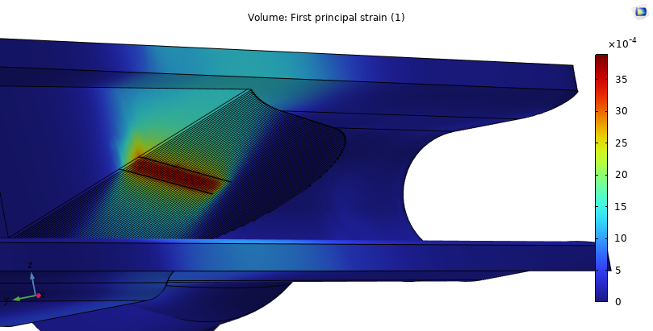
Thermo-mechanical behaviour
The SR heat load leads to an increase of mechanical stress.
Simulations show a max equivalent stress of 229 MPa and a strain of 0.04%.

Slide 24
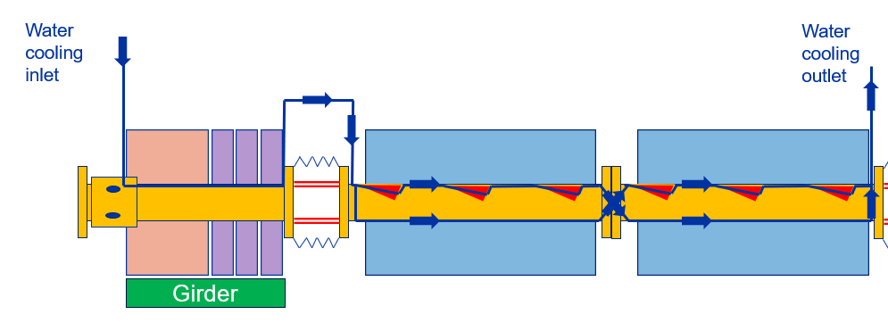
Fluid dynamic behaviour
The analytical formulations of Manglik-Bergles were used to predict the heat transfer coefficient and pressure drop for each absorber.
For an inlet water speed of 3 m/s the pressure drop per absorber is 0.3 bar. Most likely to be higher as material roughness, losses due to the circuit bends and temperature dependent material properties were not considered.
However, 3 absorbers could be connected in series within the same cooling line resulting in a cooling line about 25 m long, see below.
Considering only the heat intercepted by the SR absorbers the water outlet temperature should be around 45 °C (inlet temperature 27 °C).
See Cedric Garion presentation

Slide 25
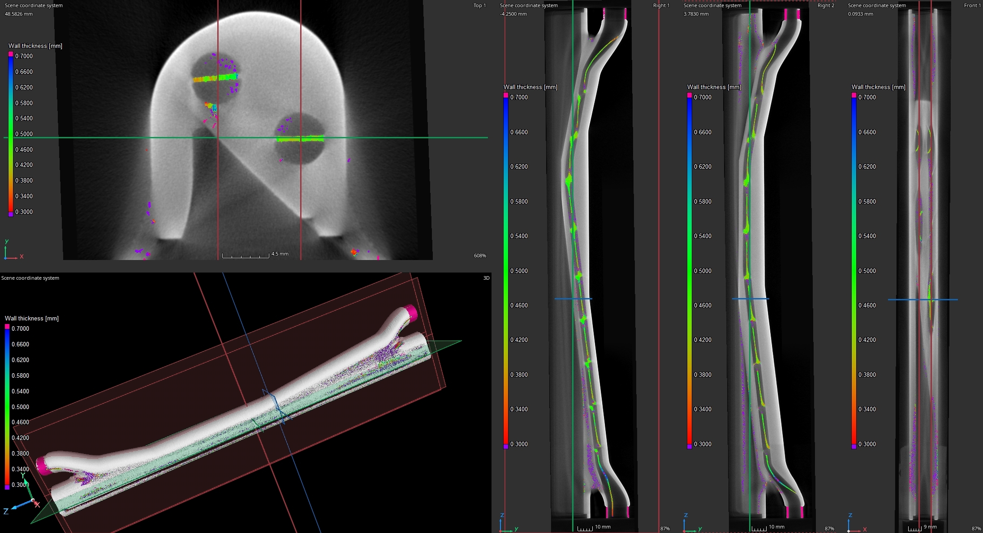
Tests (CT scan)
FCC-SRA – wall thickness analysis.

Slide 26
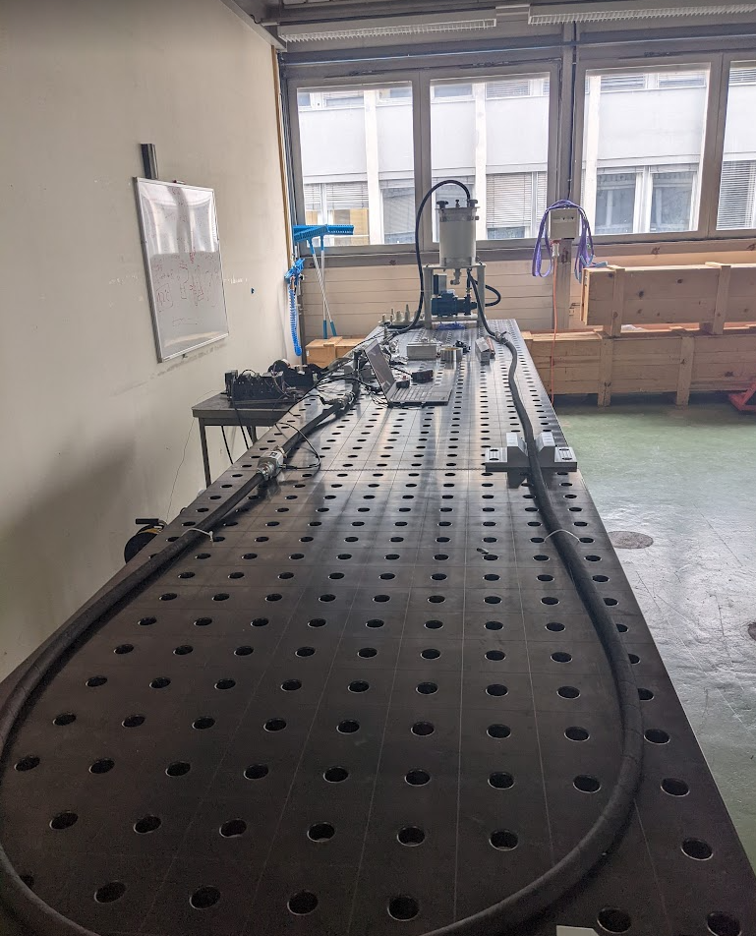
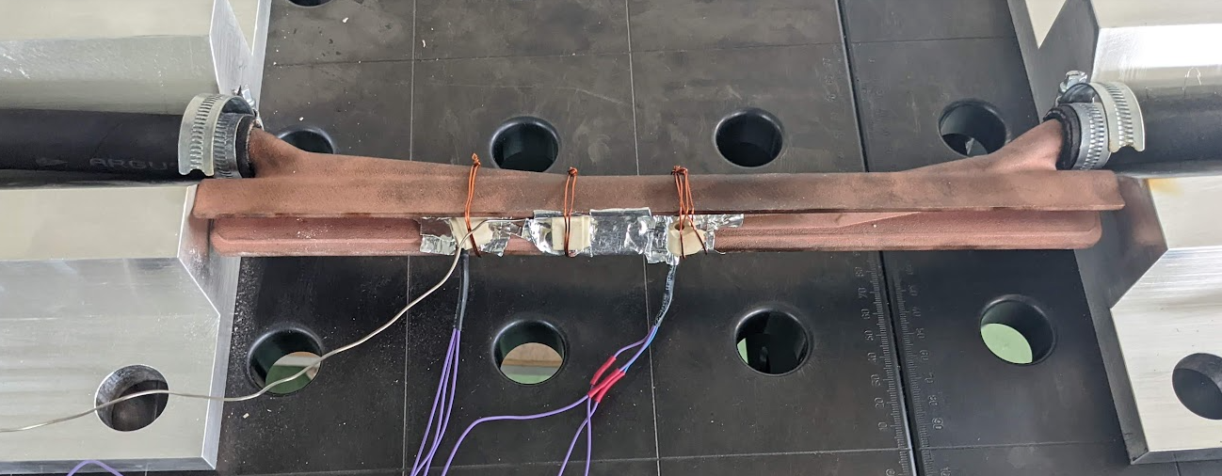
Tests (fluid-dynamic)
Fluid-dynamic test bench developed in our labs to:
Measure pressure drop at different water velocities;
Measure heat transfer coefficients;
Assess erosion and dynamic effects.
Physical properties measurements :
First samples of the SRA and pieces for mechanical characterisation successfully 3D printed in Cu-ETP and CuCrZr
Tensile tests, fracture toughness, hardness
Thermal conductivity, thermal fatigue

Slide 27
