Slide 1
Preliminary results on CEPC IP coupling tuning
Wei Yuanyuan, Wang Yiwei, Zhang Yuan, Bai Sha
CEPC Day，21 April，2025

Slide 2
Content
CEPC baseline lattice
Introduction of IP tuning
    What is “ IP tuning”
    Why is IP tuning important
    When is IP tuning performed
    How is IP tuning performed
Results on coupling tuning
Summary and To-do list

Slide 3
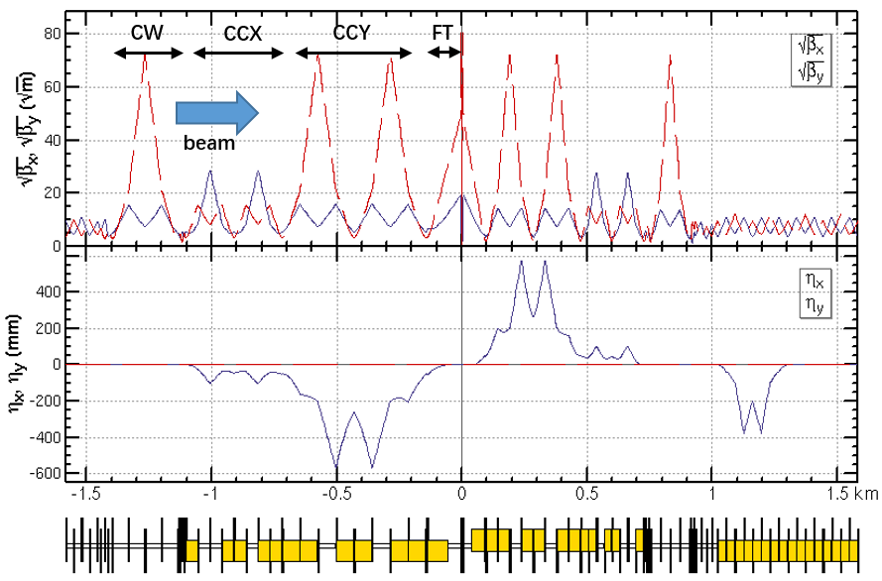
CEPC baseline lattice
CEPC baseline lattice— TDR lattice for Higgs energy

Slide 4
What is “IP tuning”
IP tuning is a process adjusting and optimizing some important optics properties at IP by some knobs
Including knobs of local orbit, orbit angle, β * , waist shift, coupling, dispersion
One knob is to tune specific parameters at IP locally using a set of magnets
The magnets are localized in IR region and the distortion of beam parameters should be closed in this area
Parameters at IP can be tuned linearly by changing the strengths of the sets of magnets

Slide 5
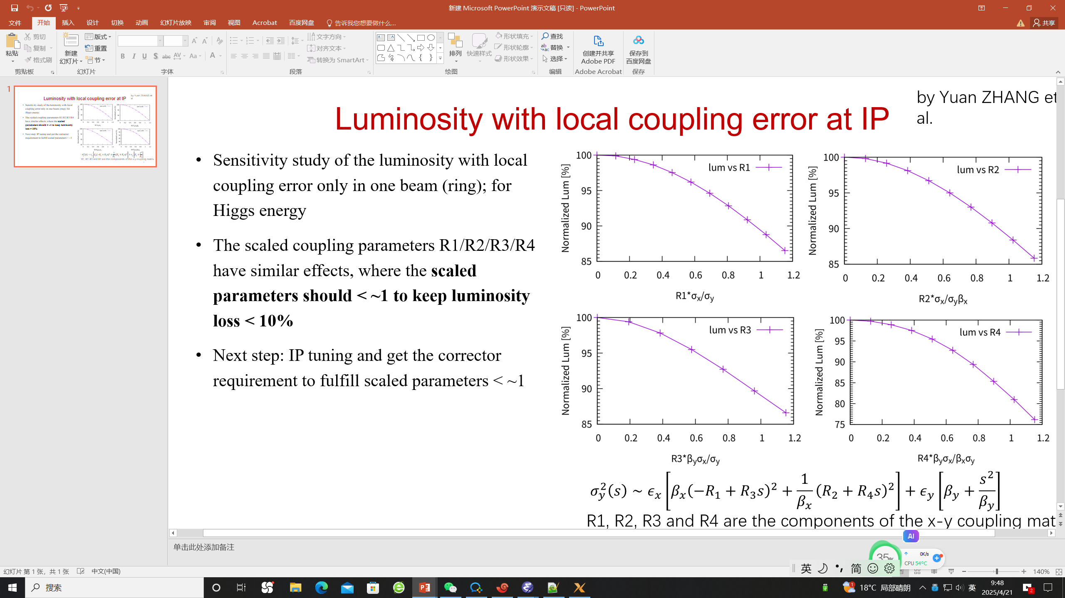
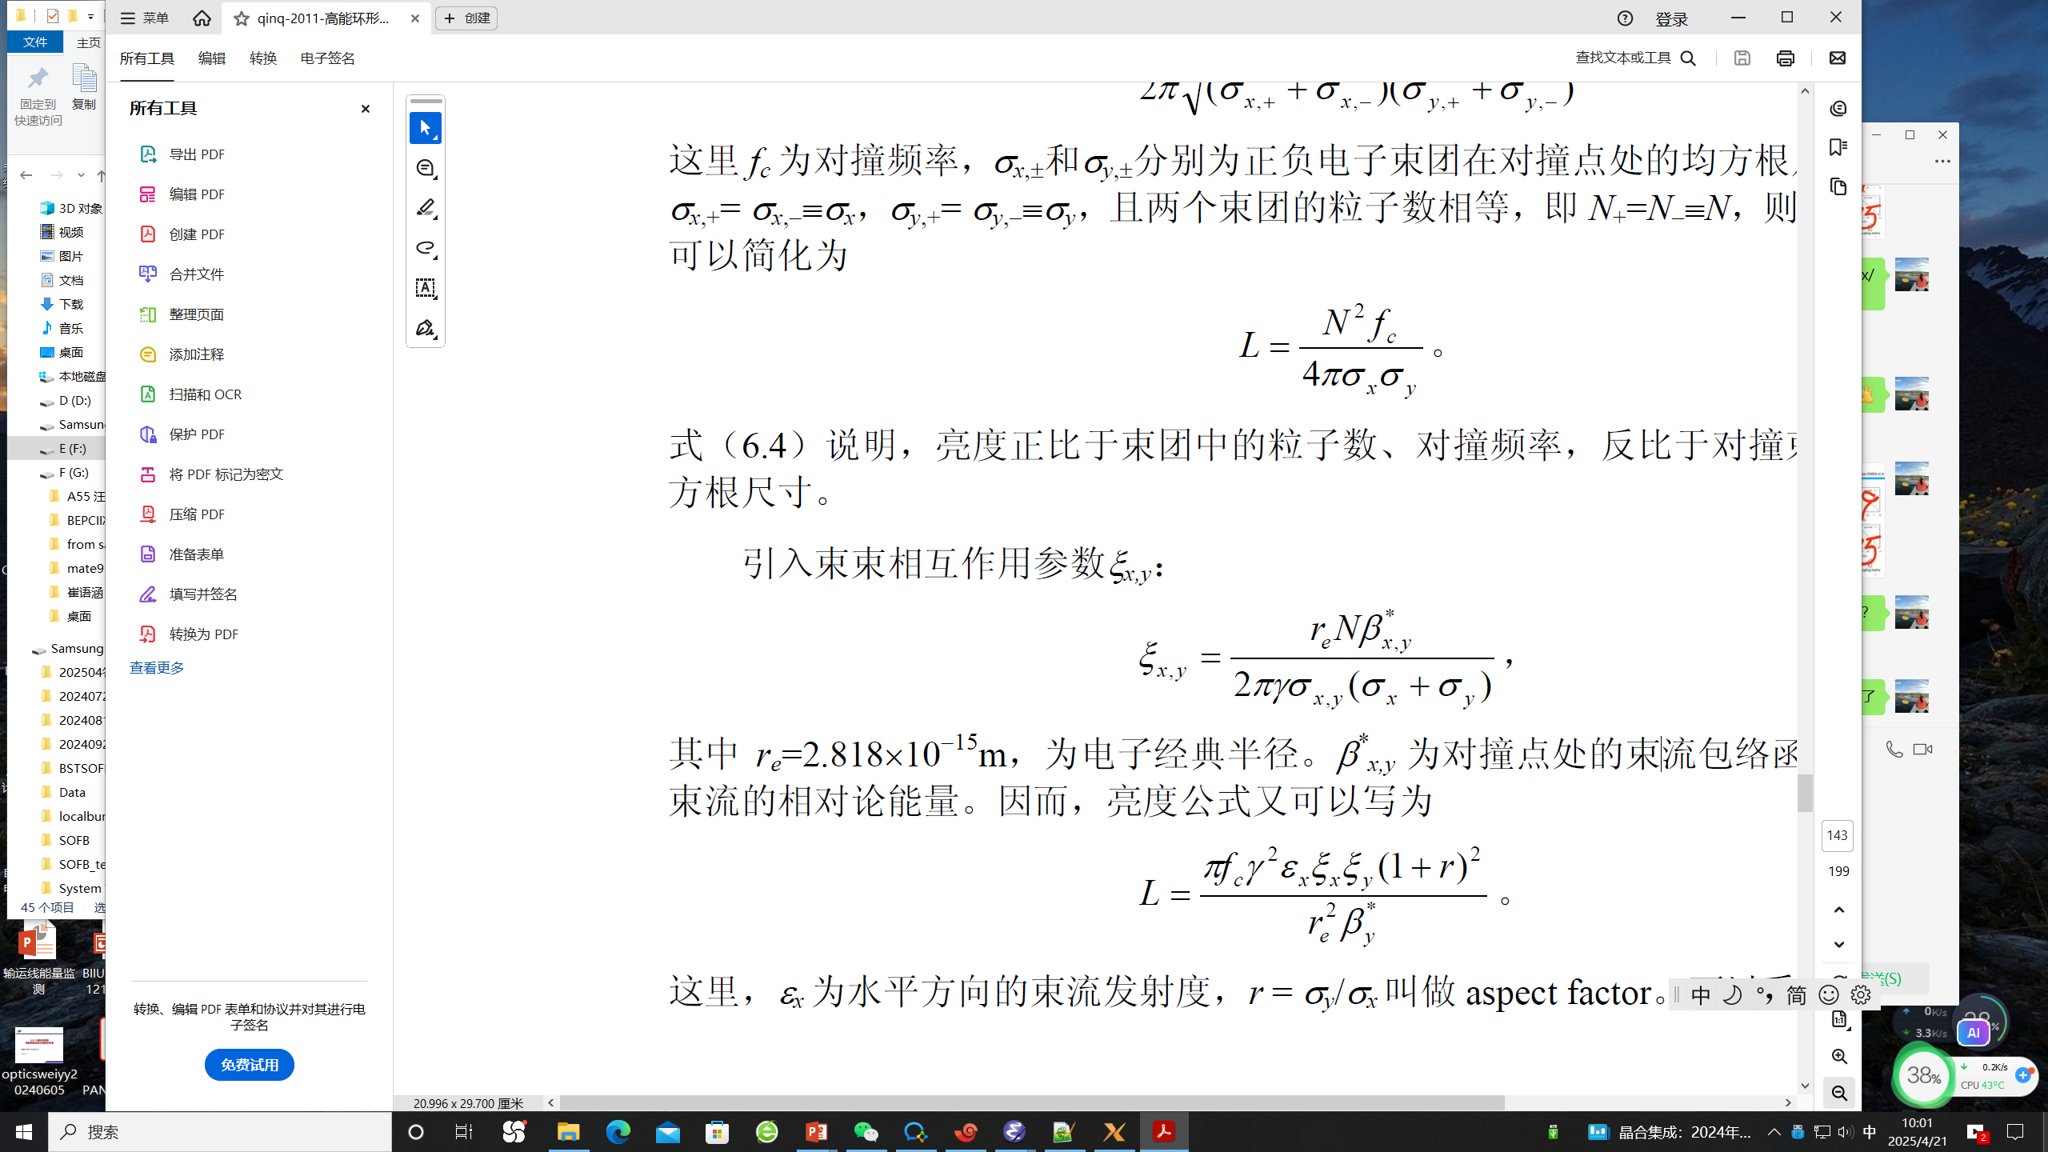
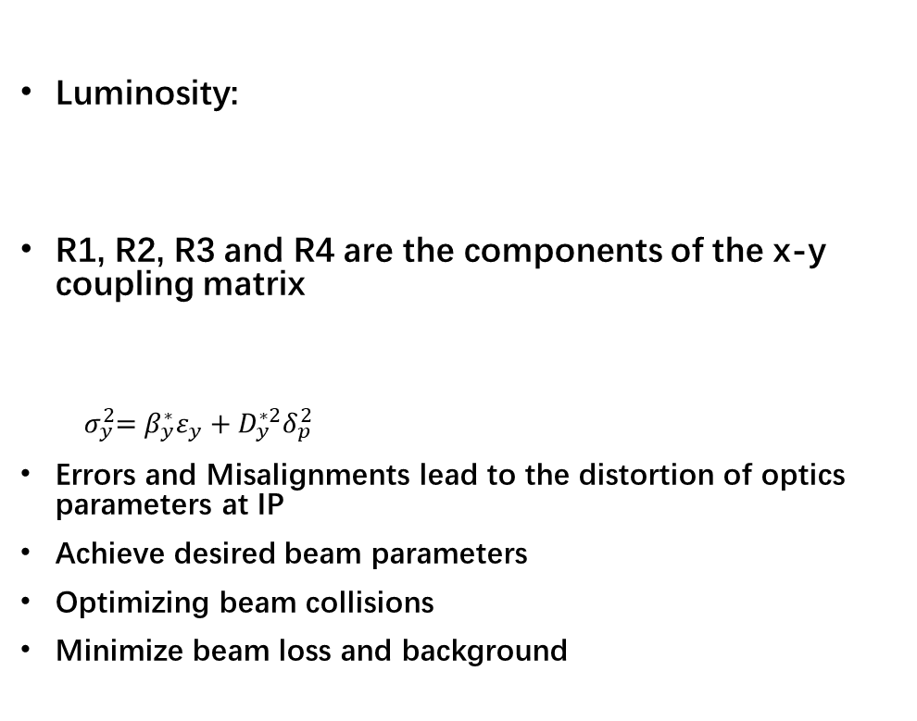
Why is IP tuning important
Luminosity:
R1, R2, R3 and R4 are the components of the x-y coupling matrix
$${ σ}_{y}^{2}=β_{y}^{∗}ε_{y}+D_{y}^{∗2}δ_{p}^{2}$$
Errors and Misalignments lead to the distortion of optics parameters at IP
Achieve desired beam parameters
Optimizing beam collisions
Minimize beam loss and background
Luminosity with local coupling error at IP for Higgs energy from Zhang Yuan’s simulation
Notes:
Optimizing Beam Collisions:
The primary goal of IP tuning is to ensure that particle beams collide precisely at the desired interaction point. This maximizes the probability of successful collisions and the production of meaningful data for physics experiments.
Achieving Desired Beam Parameters:
IP tuning allows for the adjustment of beam properties such as size, position, and angle at the interaction point. These parameters are critical for achieving the desired experimental conditions and ensuring accurate measurements.
Minimizing Beam Loss and Background Noise:
Proper tuning reduces beam loss and minimizes background noise, which can interfere with the detection of collision events. This improves the quality of the experimental data.
Maintaining Beam Stability:
Tuning ensures that the beams remain stable and aligned over time, even as external conditions (e.g., temperature, magnetic fields) change. This stability is essential for long-term experiments.
Correcting Errors and Misalignments:
Imperfections in the accelerator’s magnetic fields or mechanical misalignments can cause deviations in the beam trajectory. IP tuning corrects these errors to maintain optimal beam performance.

Slide 6
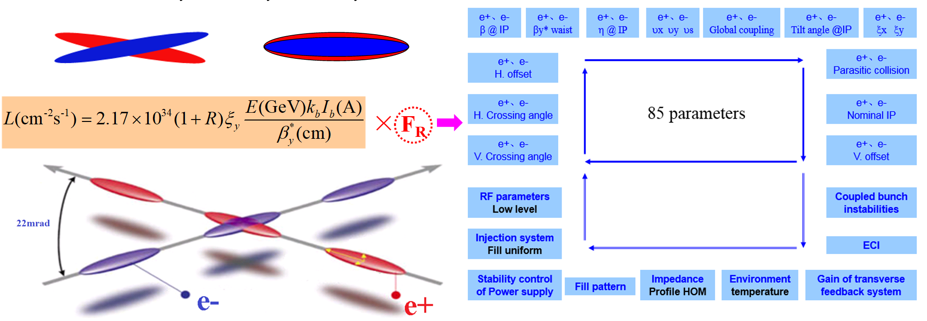
When is IP tuning performed
Optimizing Beam Collisions:
During Initial Beam Commissioning
During Routine Operation:
  When Beam Quality Degrades:
  Maintaining Beam Stability:
Beam stored
Orbit correction
Global optics correction
Beam Collisions
IP
tuning

Slide 7
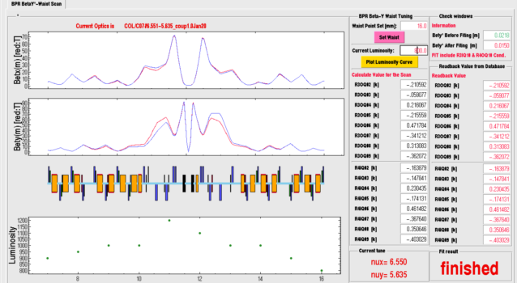
How is IP tuning performed
Determine the knobs according to the simulation
  IP orbit knob, waist shift knob, IP coupling knob
During the IP tuning, Input the desired value at IP，calculate the strength of knob magnets by fitting using SAD online
Record the luminosity corresponding to the specific value
Scan the value to maximize the luminosity
BEPCII coupling tuning
BEPCII waist shift tuning

Slide 8
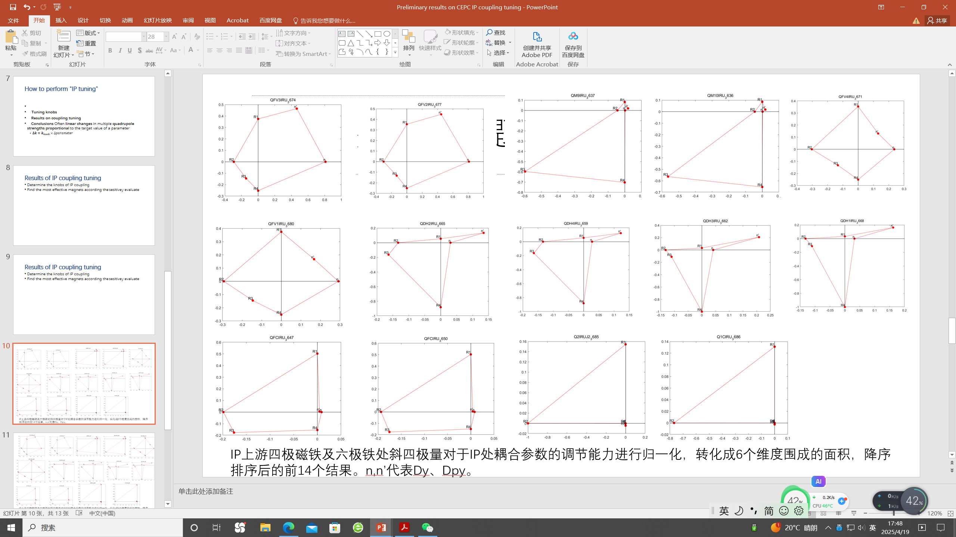
Determine the coupling knobs
Find the most effective magnets according the sensitivity of the response

Slide 9
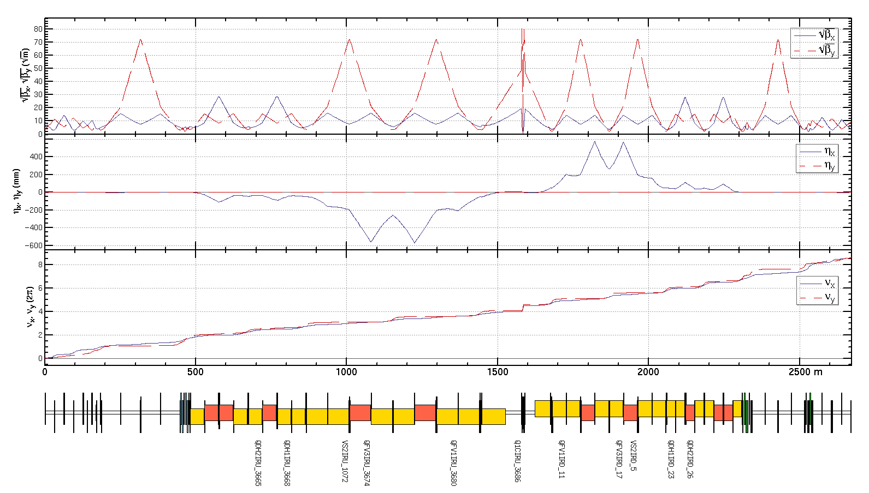
Determine the knobs
Coupling knob:
  1 skew coil on FF quadrupole
  dispersion free
  1 skew coil on sextuple
  4 skew coils on quadrupoles
  dispersive region
Constrains in fitting:
  R1，R2，R3，R4
η_{y}, η_{py} at IP
  optics not disturbed
outside the knob region

Slide 10
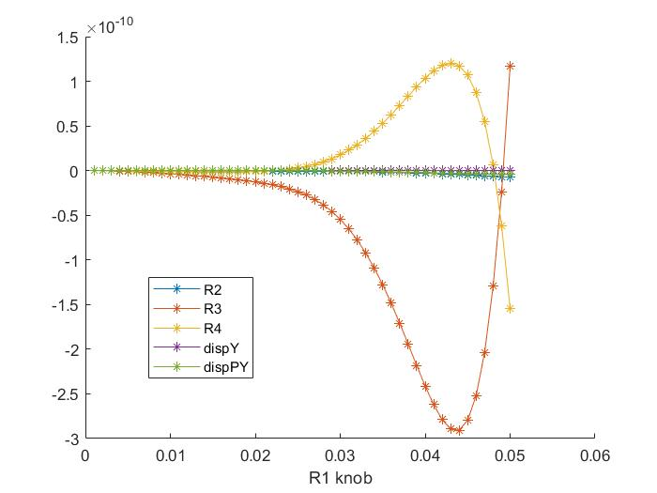
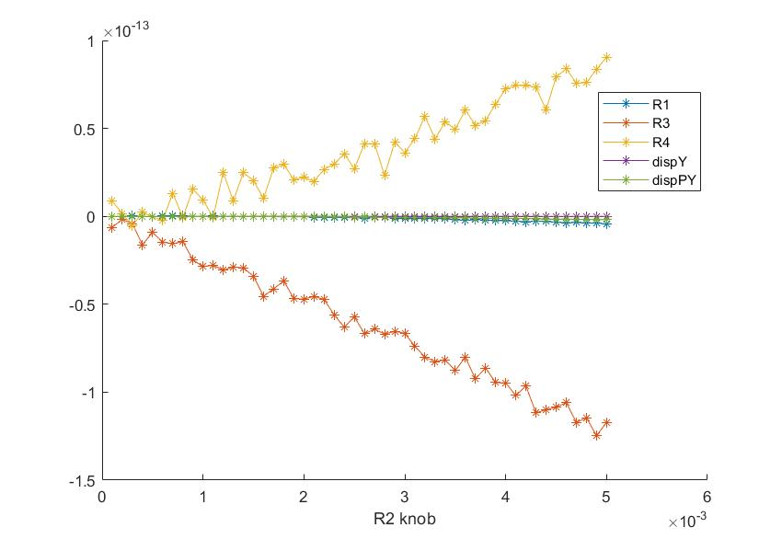
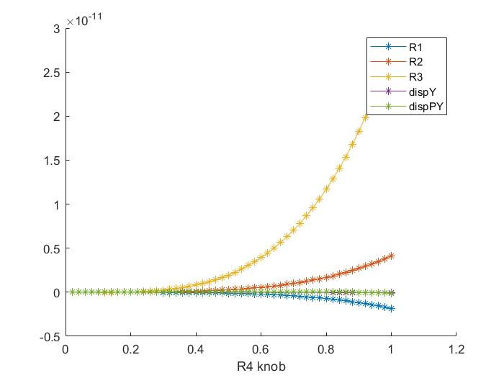
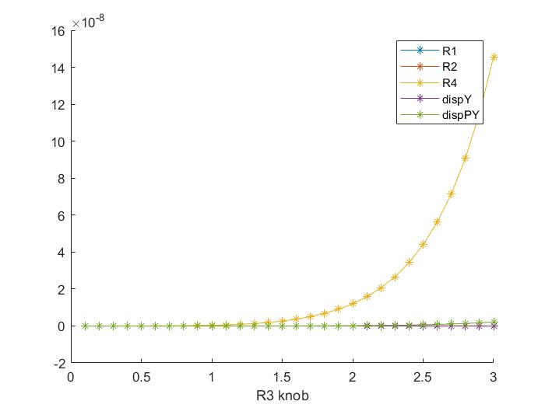
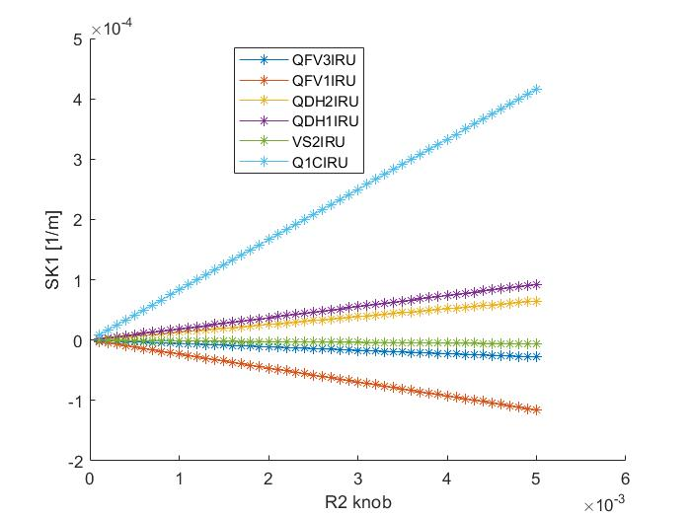
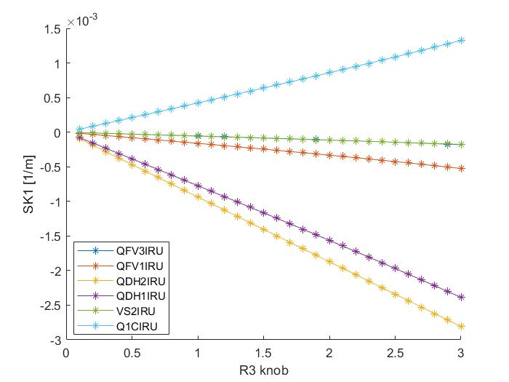
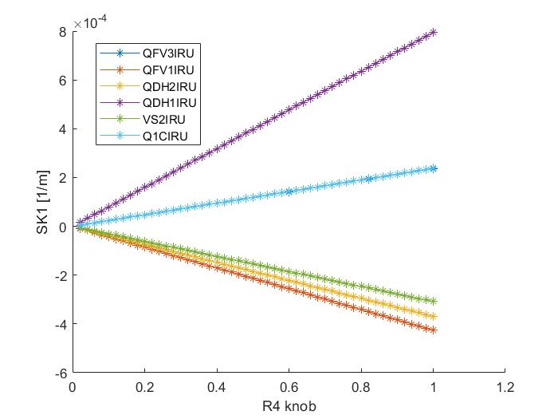
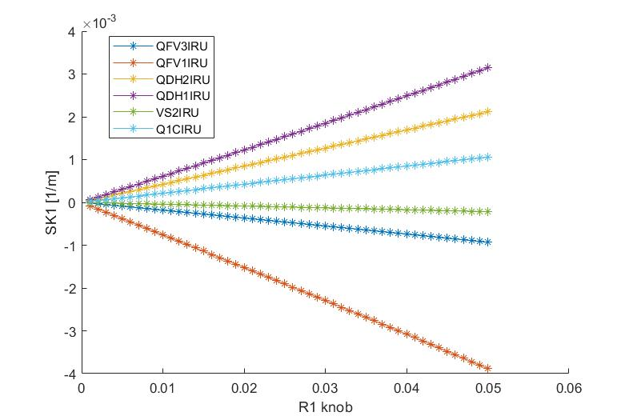
Results of IP coupling tuning
Coupling knobs and strength of skew components

Slide 11
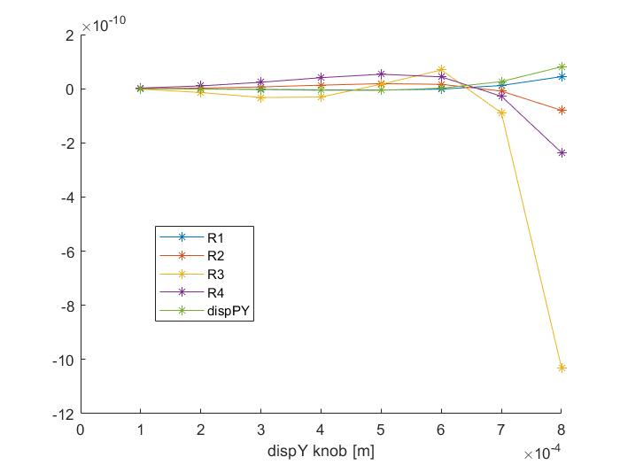
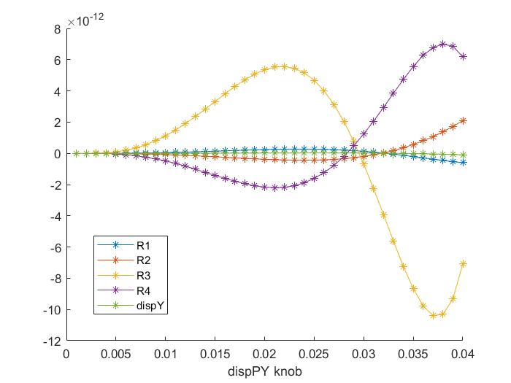
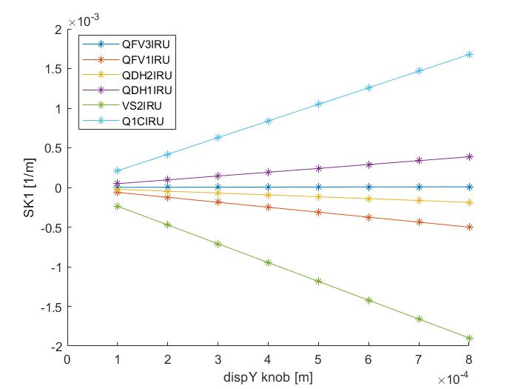
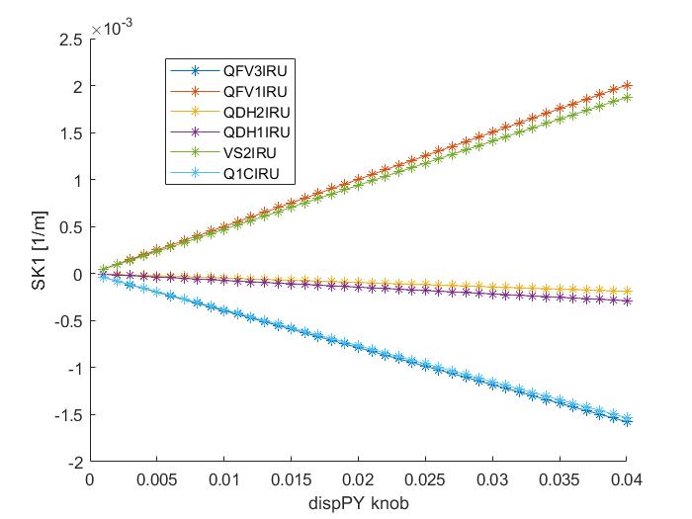
Results of IP coupling tuning
Dispersion knobs and strength of skew components

Slide 12
Results of IP coupling tuning
●
Simulation with errors (*10) after global optics correction
Give the requirement for magnet design
 | R1* | R2*[m] | R3*[m⁻¹] | R4* | Dy*[m] | Dpy*
rms(*10⁻³) | 0.8663 | 0.8875 | 49.7660 | 31.1060 | 0.0052 | 0.0156
 | Q1BIRU | Q2IRUJ2 | QFV1IRU | VS2IRU | QFV3IRU | QDH1IRU | QDH2IRU
L(m) | 1.21 | 1.5 | 1 | 0.3 | 1 | 1 | 1
SK1(m⁻¹) | 0.001334 | 0.001334 | 0.001 | 0.00025 | 0.00025 | 0.0007 | 0.0006
G（T/m) | 0.44 | 0.36 | 0.4 | 0.33 | 0.1 | 0.28 | 0.24

Slide 13
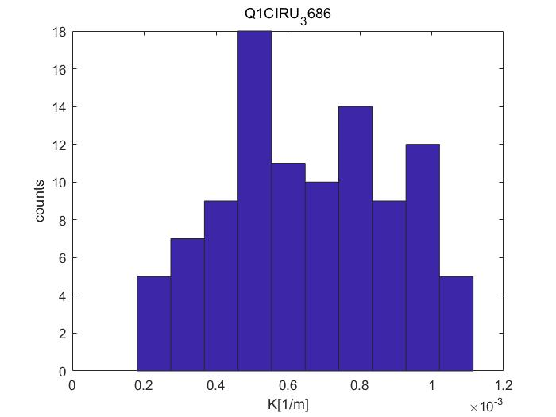
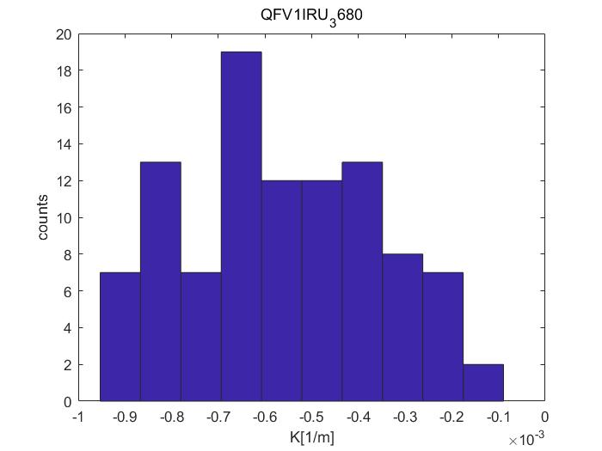
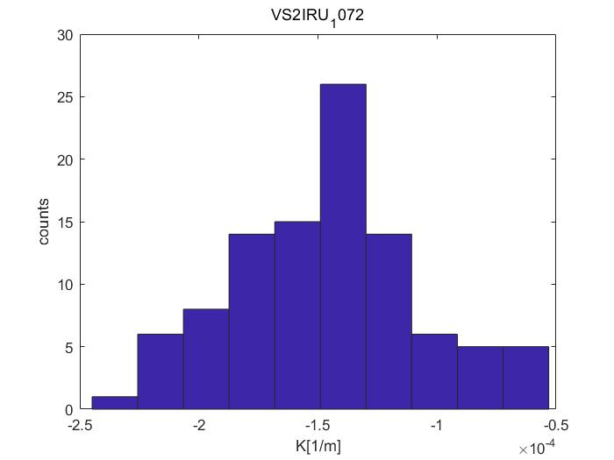
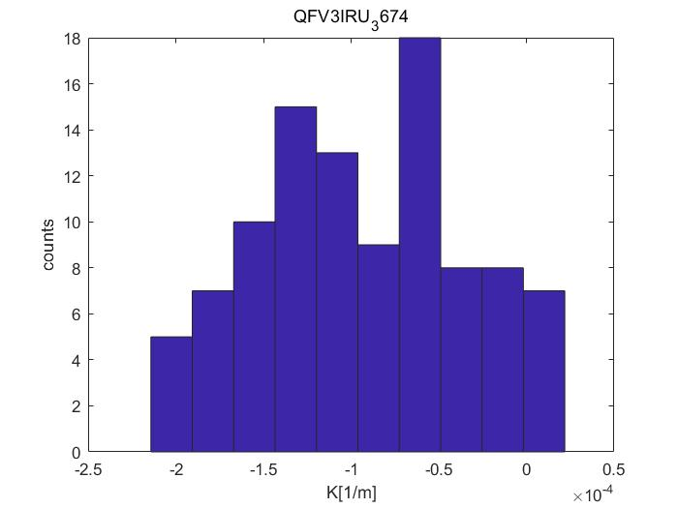
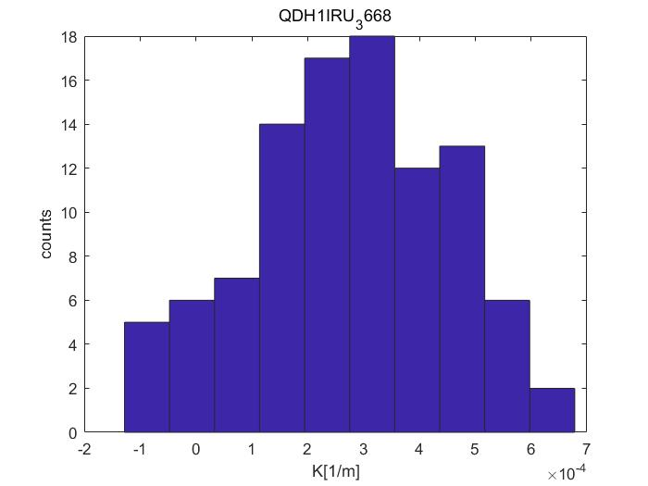
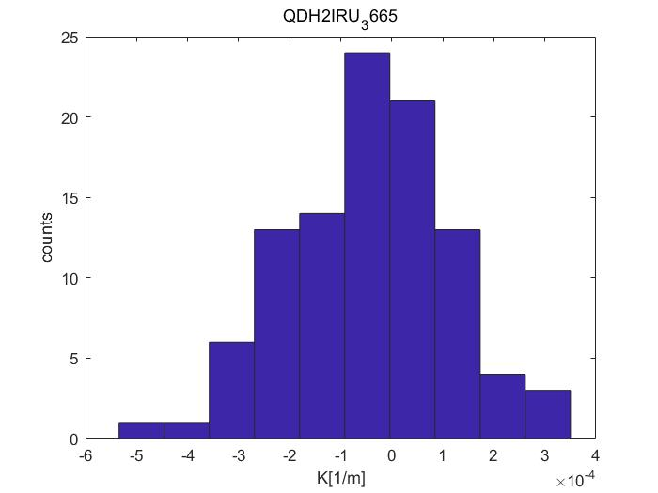
Results of IP coupling tuning
●
Statistic of strength of skew components (Simulation with errors (*10) after global optics correction)

Slide 14
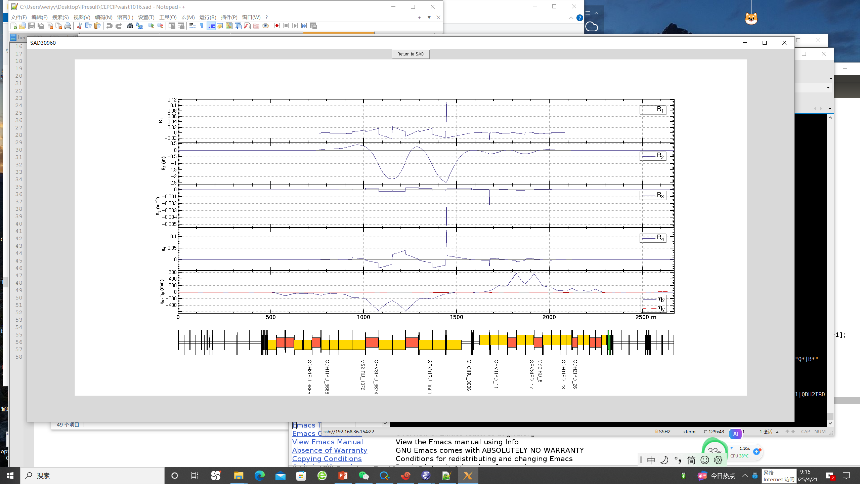
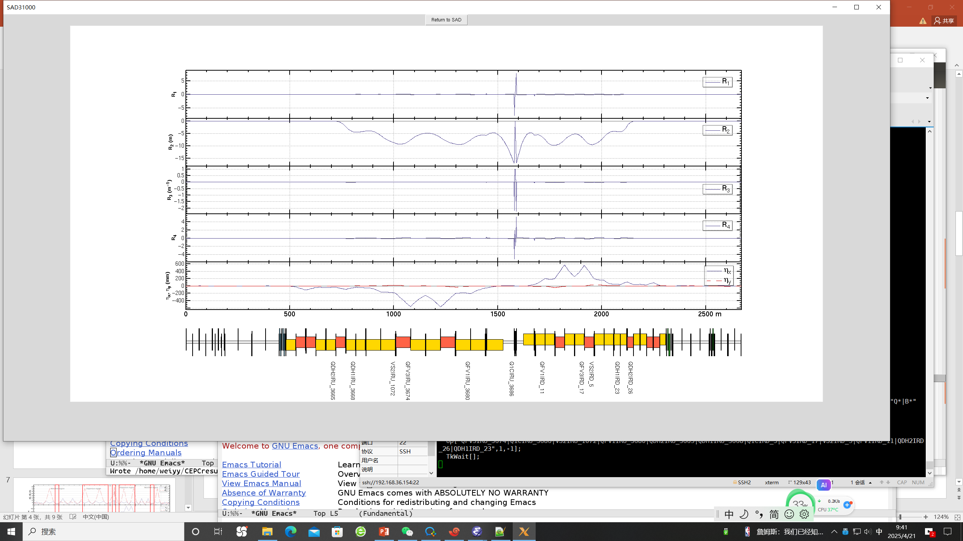
Results of IP coupling tuning
Vertical dispersion knob for D_{y}*=0.1mm*
Coupling knob for R3*=1m^{-1*}

Slide 15
Summary and To-do list
Knobs for IP coupling have been determined
Strengths for magnets design have been evaluated
Investigate the effects of tuning on other optics parameters
Include more magnets or improve the fitting method to expand
the tuning range
Determine the knobs for local orbit, β * waist shift

Slide 16
Thanks for your attention

