Slide 1

24/3/2025
Status Report: H Recoil Mass
Yuji Li

Slide 2
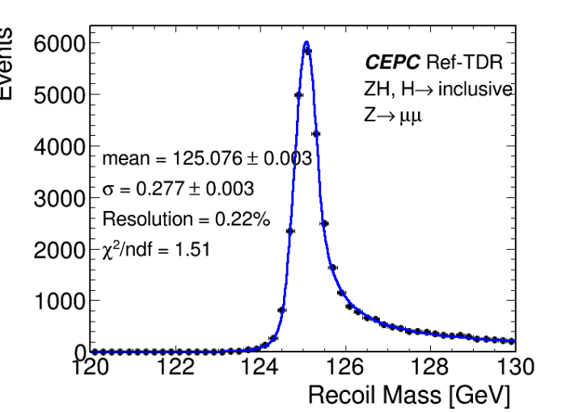
Status
Shifting of the H mass peak exists as we did not performed calibration
Signal Shape was checked with a variance of Gen-level H mass.
ToyMC was generated in mH = 125.

Slide 3
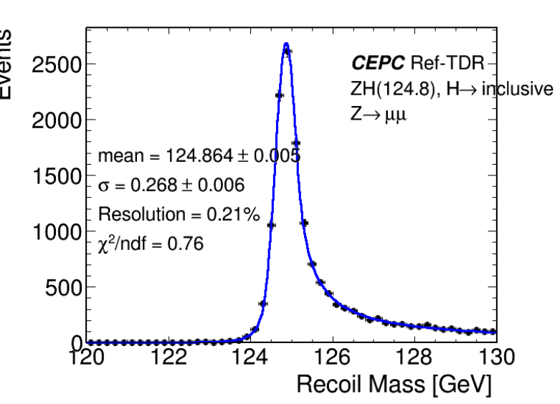
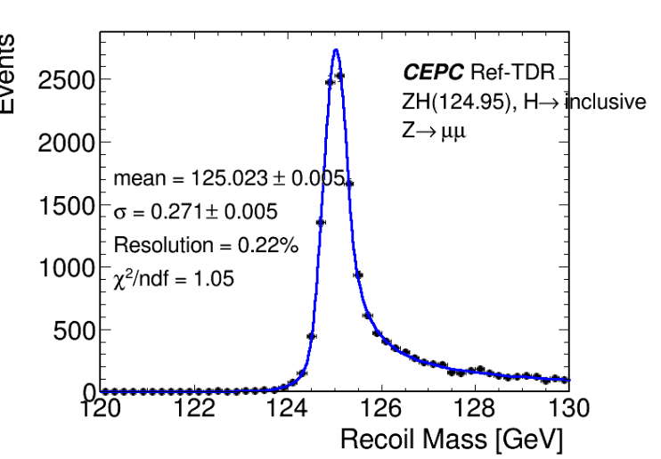
Signal shapes

Slide 4
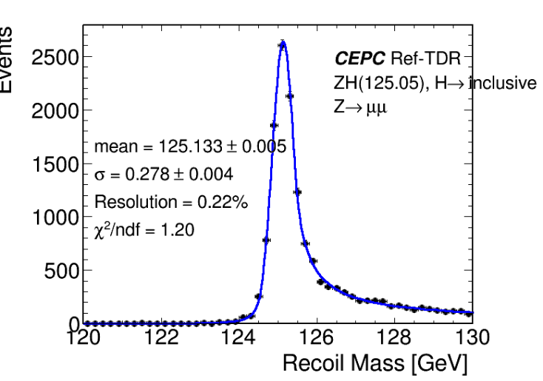
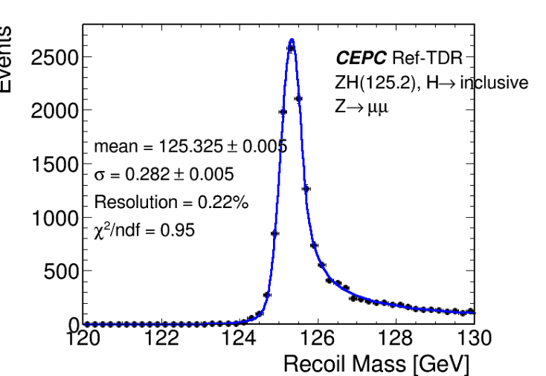
Signal shapes

Slide 5
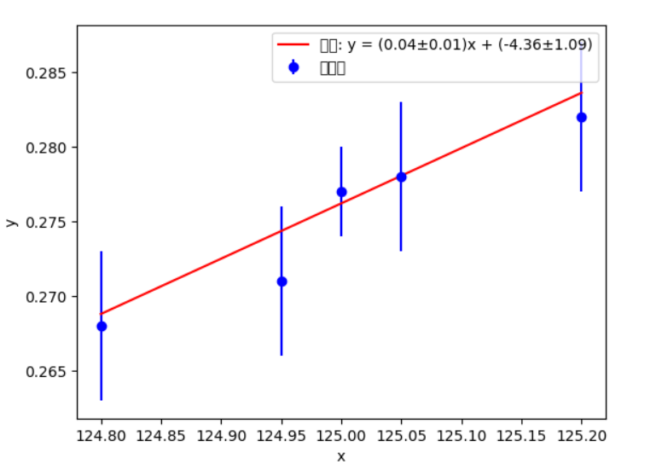
Fittings in mean and sigma in DCB

Slide 6
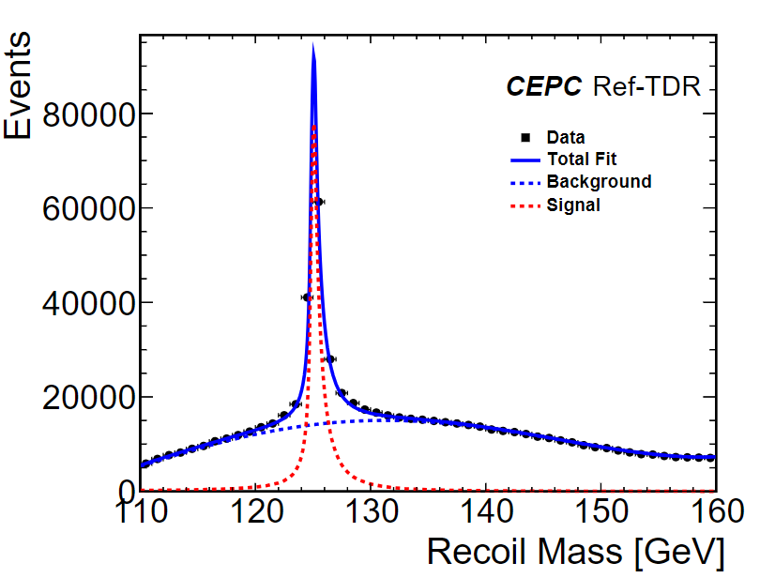
ToyMC in mH = 125
a) Unbinned fitting to determine the parameters of DCB tails.
b) Freezing all the paramaters except for mH, and generate ToyMC.
c) Finally we get the statistic error as 2.3MeV when mH = 125GeV

