Slide 1
Inner Tracker (ITK)

Slide 2
Findings
ITK
The Inner Silicon Tracker (ITK) employs a combination of HV-CMOS pixels (with a 34 μm × 150 μm pixel size) and CMOS strips (2.1 cm x 2.3 cm size, 20 μm pitch) to achieve high spatial resolution, targeting under 10 μm in the bending plane and approximately 50 μm in the longitudinal direction for the barrel region. In the endcap sections, strip sensors are arranged at cross angles to enhance particle identification and momentum measurement, optimizing track resolution in the bending plane. The ITK is designed to sustain hit rates of up to 10⁶ Hz/cm² in high-luminosity environments, covering a sensor area of around 20 m².
The ITK’s HV-CMOS (CAFFEE chip), utilizing a so-called large pixel CMOS sensor design, is fabricated using a 55 nm process and standard reticle size (without stitching), and follows a standard pixel module design comprising modules, sensor with flex, and staves. This process enables the use of high-resistivity substrates (1-2 kΩ·cm), allowing bias voltages around 70 V for a greater depletion depth. Initial CAFFE tests using passive CMOS diodes have been successful, though tests with active cells and peripheral electronics are forthcoming.
The Depleted Active Micro Strips sensors use a separate process (CMSC 180 nm). Limited by reticle size, this design does not require stitching and is considered robust. CMOS passive strips have already been demonstrated; however, the small strip pitch and readout design within the periphery present significant challenges that remain to be resolved.

Slide 3
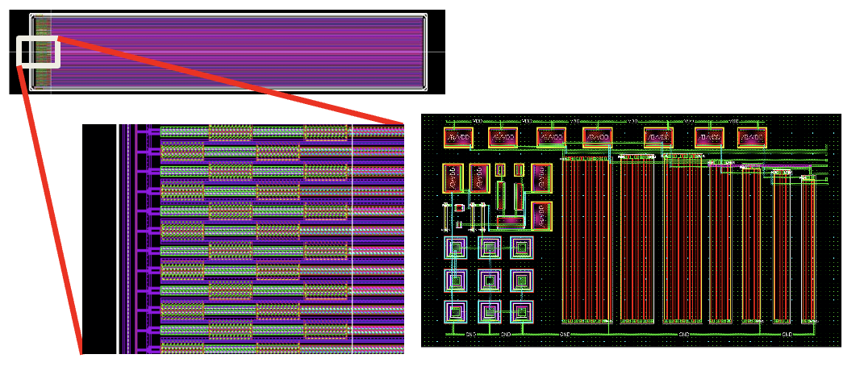
Comments
ITK
There is currently no dedicated effort focused specifically on developing CMOS strip sensors for the Inner Tracker (ITK).
In our Ref-TDR, we delicate an entire section (Section 5.3.1.2) to describe efforts for the development CMOS strip sensor. In addition, the tape-out for the first CMOS chip (CSC1) is scheduled in April.
The design of the strip sensor and ASIC (preamplifier, the 1st stage amplifier, shaper, discriminator, and bandgap)
CSC1 chip for CEPC
The 180 nm process may face limited availability in the coming years, presenting a potential risk.
We spoke with the CSMC foundry, and they preliminarily confirmed that 180 nm process will be maintained for a least the next 20 years. In parallel, we also have a plan to migrate to 55 nm or 28 nm, after the functional test of the 180 nm process.

Slide 4
Comments
ITK
Additionally, integrating readout circuitry within the periphery of strip CMOS sensors is an innovative approach, likely to bring unforeseen challenges.
There are no fundamental barriers to the development of readout circuits in the periphery of strip sensors, as the key components for the strip CMOS sensor has already been incorporated into CSC1 design (full wafer). After the CSC1 tape-out, we will have further insights into the details of the readout circuitry and validate the electric isolation design.

Slide 5
Recommendations
OTK
A detailed plan for the development of the ASICs for both CMOS strips and AC-LGAD (for OTK in this case) is essential. Given the demanding R&D timelines for these low-dissipation, high-time-resolution technologies, careful optimization of power consumption, timing precision, and seamless integration with the sensors is critical. ASIC development should proceed in parallel with sensor design. The process of designing, fabricating, and testing these ASICs is time-intensive, often requiring multiple iterations to achieve the desired performance. Any delays in this pipeline risk cascading effects on the broader project schedule.
We fully agree on the importance of having a detailed plan for the development of ASICs for both CMOS strips and AC-LGAD. To ensure that ASIC development aligns with sensor design, we have established parallel development tracks for both ASICs and sensors, as outlined in the development of AC-LGAD schedule for the next 3 years:
We are also leveraging existing R&D work to accelerate the process. Our ASIC development team has prior experience in developing high-performance time measurement ASICs, such as FPMROC. Many key design components from these previous projects are incorporated into the current ASIC design, helping to shorten the development timeline.
Given the time-intensive nature of ASIC design, fabrication, and testing, we conduct regular reviews and maintain close coordination between the various ASIC teams and sensor teams to mitigate potential risks, ensuring smooth progress and preventing delays that could impact the broader project timeline.

Slide 6
Outer Tracker(OTK)

Slide 7
Findings
OTK
The outer tracker design includes 85 m² of AC-LGAD strip detectors positioned at a radius of 1.85 m and z-coordinates of ±2.35 m, measuring a single coordinate in the bending plane. These sensors will feature 100 μm-wide strips, ranging from 6 to 9 cm in length, targeting a position resolution of approximately 10 μm and a time resolution of 50 ps. Expertise in LGAD technology is largely drawn from the ATLAS HGTD detector, where IME serves as the sole producer of conventional LGADs, with sensor designs developed by IHEP and USTC.
The anticipated power consumption for the ASICs is 300 mW/cm², necessitating active CO₂ cooling. Achieving full coverage will require approximately 3,500 wafers, with two distinct sensor designs for the barrel and 21 different wedge-shaped detectors for the endcaps. The primary objective of the detector is to provide time-of-flight (ToF) measurements for tracks originating from the same vertex, facilitating particle identification (PID).
Initial prototypes using small AC-LGAD sensors (~5 x 2 mm²) have demonstrated promising results, achieving a time resolution of 37 ps and a position resolution of around 8 μm. While the ASIC for this application is yet to be designed, it is expected to closely resemble the current ASICs used for LGAD readout.

Slide 8
Comments
OTK
The large variety of sensor designs required for the endcap adds complexity to the construction process.
The complexity of OTK endcap construction has been carefully considered in the design. With dimensions ranging from 406 mm to 1,816 mm in radius, the OTK endcap is quite substantial (covering 10 m² per endcap). To simplify sensor production and assembly, the current design uses only 4 masks for the silicon wafers, with trapezoidal-shaped sensors. This approach reduces the complexity of sensor production and assembly, as well as the costs, while ensuring effective full detector coverage.

Slide 9
Comments
OTK
Radiation damage may affect electron discharge through the n+ layer, potentially altering sensor performance over the detector’s lifespan.
The devices used in the ATLAS High-Granularity Timing Detector (HGTD) are DC-LGADs, optimized for n+ layer depth and carbon doping, with a primary focus on achieving high tolerance to both Total Ionizing Dose (TID) and Non-Ionizing Energy Loss (NIEL). These sensors have demonstrated sufficient capability to operate in the high-radiation environment of proton-proton collisions, as confirmed by both TID and neutron irradiation tests.
For electron-positron colliders such as the CEPC, the radiation environment is significantly more favorable, particularly for the OTK with its low hit rate. Our estimates show that the expected NIEL in the OTK is <10¹⁰ n_{eq}/cm² and the TID is <0.1 kGy over the full CEPC operational lifetime. For the AC-LGAD sensors used in the OTK, the dominant radiation effect could from TID-induced surface damage, which leads to charge accumulation near the n+ region and dielectric layers, potentially affecting performance, as noted by the Referee.
We have conducted dedicated studies on the TID tolerance of AC-LGADs. Existing strip-type AC-LGAD devices with a strip length of 5.65 mm were irradiated using an X-ray source at various doses (500 Gy, 1 kGy, 10 kGy, 100 kGy, and up to 1 MGy), and subsequently characterized through IV, CV, and timing/position resolution measurements. At a TID dose of 1 kGy, a slight increase in leakage current was observed, but the device maintained its timing and position resolution. These results indicate that AC-LGAD sensors, with TID levels <0.1 kGy, are expected to provide reliable performance throughout the full lifetime of the detector.

Slide 10
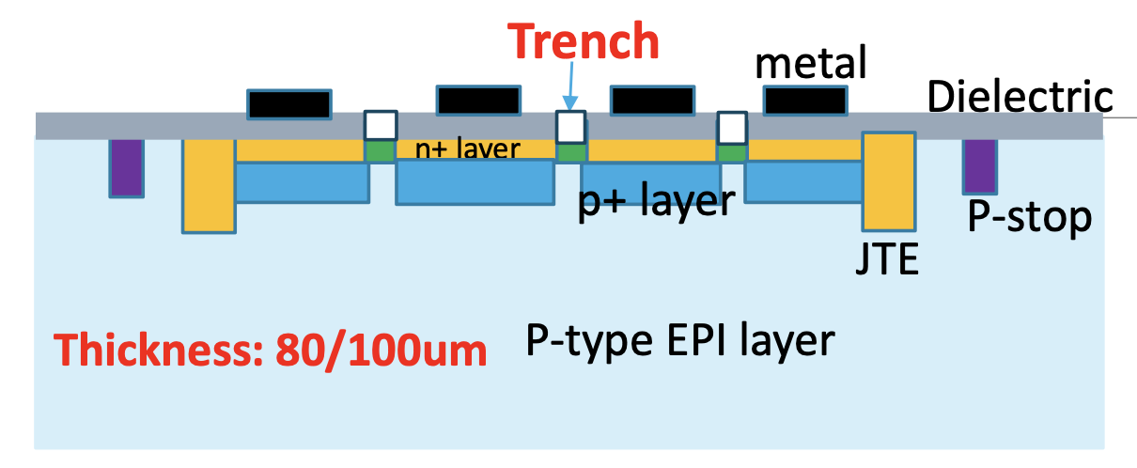
Comments
OTK
Sensors may have high capacitance (up to ~10 pF), which could impact noise jitter and rise time, making it challenging to achieve the desired time resolution.
We appreciate the referee’s concern. Indeed, the relationship between time resolution and capacitance requires further study. To address this, we plan to tape out several prototypes in the coming years to explore this effect more thoroughly. Additionally, our latest sensor design includes options to reduce capacitance (submitted to tap out in Feb 2025), such as introducing an isolated structure or increasing the thickness of the EPI layer:
Introducing isolated structure:
Increasing EPI thickness:
The operation of AC-LGADs may be susceptible to effects from high particle rates, which should be thoroughly understood, especially regarding the size of the LGADs.
In our Ref-TDR, we have a dedicated section (Section 5.7) discussing the estimated particle rates in the ITK and OTK. The highest OTK anticipated hit rate during operation at CEPC (High Lum Z) is ~10³ hits/cm²/s . For a sensor with dimensions of ~4 cm×5 cm, if a hit has already occurred, the probability of having a second hit within the same LGAD sensor and within sensor's charge collection window (~2 ns) is <10⁻⁴, which should not pose any issues.

Slide 11
Comments
OTK
With the specified pitch and thickness, a charge-sharing mechanism is expected to enhance position resolution; however, this should be carefully evaluated for different electrode dimensions, considering potential gain layer variations across the detector.
Our latest AC-LGAD tape-out includes a range of electrode width and pitch size variations to study their effects on charge sharing and position resolution. Specifically, the electrode widths are 25, 50, and 100 µm, and the pitch sizes are 100, 200, and 500 µm. The optimal electrode dimensions will be determined based on the test results. And a comprehensive discussion is provided in our Ref-TDR.
Gain layer variation is indeed an important factor. Significant differences in gain between adjacent strips can affect the accuracy of hit position reconstruction. However, such non-uniformities can be corrected through offline calibration, as demonstrated in “Nucl. Instrum. Methods Phys. Res. A 869, 29 (2017)”. To further improve gain uniformity, we are also working to enhance process control during fabrication. Our team is establishing cooperations with other semiconductor foundries to explore more advanced and stable production capabilities.
The localized power dissipation at the ASIC level should be factored into the cooling design and overall performance assessment.
We appreciate referees’ suggestion. Localized power dissipation at the ASIC has been considered in our cooling design, including the use of thermal vias in PCBs.

Slide 12
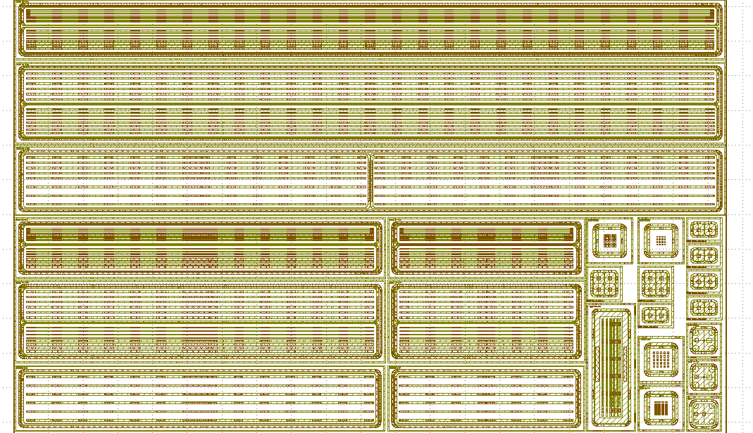
Recommendations
OTK
Reevaluate the size of the AC-LGADs, carefully balancing performance factors—such as rate effects, time resolution, and achievable position accuracy—with expected manufacturing yield to arrive at a cost-effective solution.
We appreciate the referees’ suggestion. Considering the various factors mentioned, along with the evolution of detector technology, we have reduced the sensor size to ~4 cm x 5 cm in the baseline design, while accommodating the 2 cm x 2 cm size as a backup for the OTK in the Ref-TDR (Section 5.4.2.3).
In our latest AC-LGAD tape-out, we have already included sensor with various strip lengths and overall dimensions. These will be evaluated systematically in terms of timing resolution, position accuracy, and yield. The sensor design will be further refined based on the test results. In parallel, we are working to improve process control during fabrication to enhance sensor quality.
Given the CEPC project timeline of over 5 years from construction, the project remains flexible enough to adjust its technical approach and has robust backup plans in place for the engineering phase.
4cm
AC-LGAD
The latest AC-LGAD layout (submitted for tap-out in Feb 2025)
2cm
AC-LGAD
1cm AC-LGAD

Slide 13
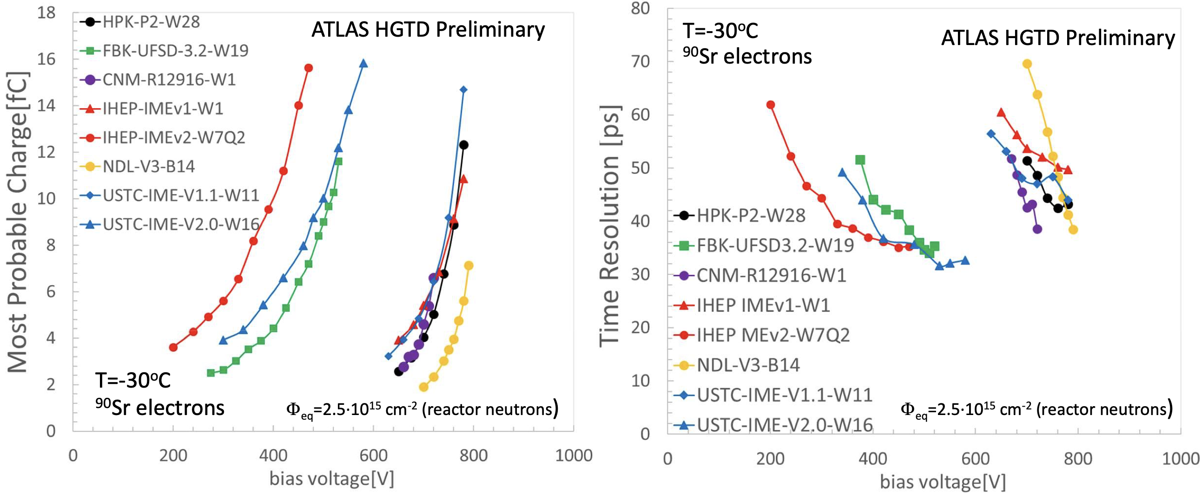
Recommendations
OTK
2. Determine if redundancy is needed in the OTK barrel system.
The necessity of redundancy in the OTK system has been carefully assessed. Recent advancements in LGAD technology by IHEP-IME have shown significant progress. These sensors used in the ATLAS HGTD, have exhibited good charge and timing resolution even after irradiation to a fluence of 2.5×10¹⁵ n_{eq}/cm², as illustrated in the figure below:
40 ps
4fC
Furthermore, recent irradiation tests on AC-LGAD sensors by C. Bishop et al. from BNL and UCSC at a fluence of 1×10¹⁴ n_{eq}/cm² showed only a minor impact on performance. Considering the expected fluence in the OTK is <10¹⁰ n_{eq}/cm² (and TID <0.1 kGy) over the full CEPC operational lifetime, AC-LGAD sensors are expected to maintain reliable performance throughout the detector's lifetime.

Slide 14
OTK
In addition, the OTK mechanical and electrical design features a modular structure. The barrel consists of 880 ladders, while each endcap is divided into 16 replaceable sectors. This design ensures convenient maintenance when necessary, providing a substantial safety margin and enhancing the system's operational reliability.
The combination of robust sensor performance and the flexibility of the modular design ensures sufficient system reliability. Further redundancy measures are not deemed necessary for the OTK system.

