Slide 1
CGEM Cosmic Data Validation
Li Yaxuan, Wang Liangliang, Wu Linghui
2025/4/7

Slide 2
What has been done
CGEM raw data
-> CGEM raw data merged as "events" in DAQ format
-> CGEM raw data “events” integrated into BESIII DAQ data streams
-> decoding, conversion into layers, sheet, strip-ID, time and charge
-> hitmaps, distributions of time and charge
Data used: run 84713, 2025/3/26

Slide 3
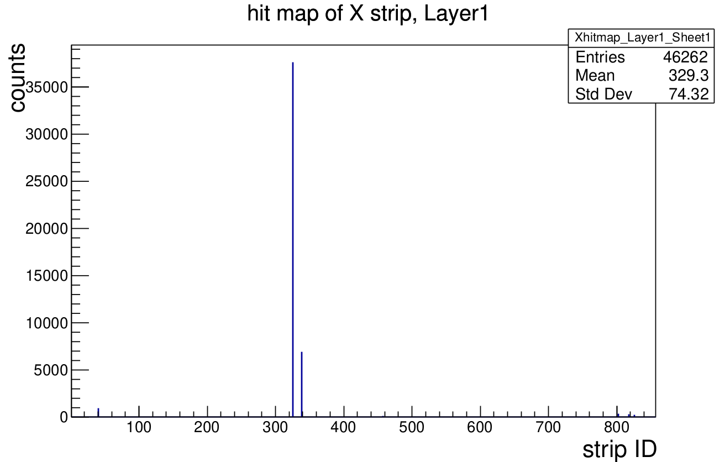
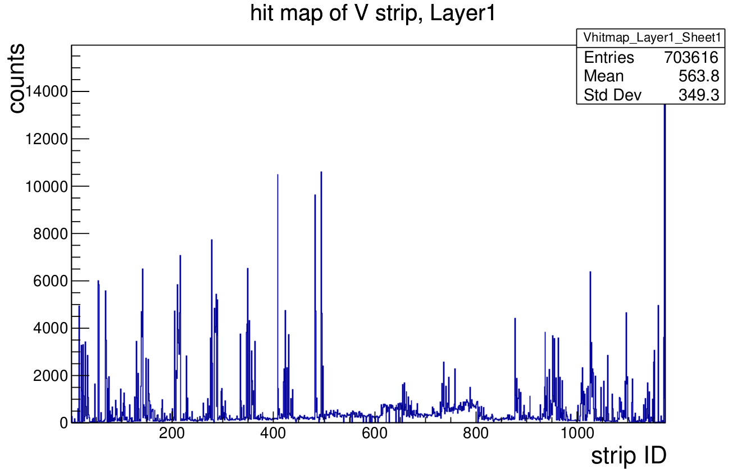
Hitmap run 84713

Slide 4
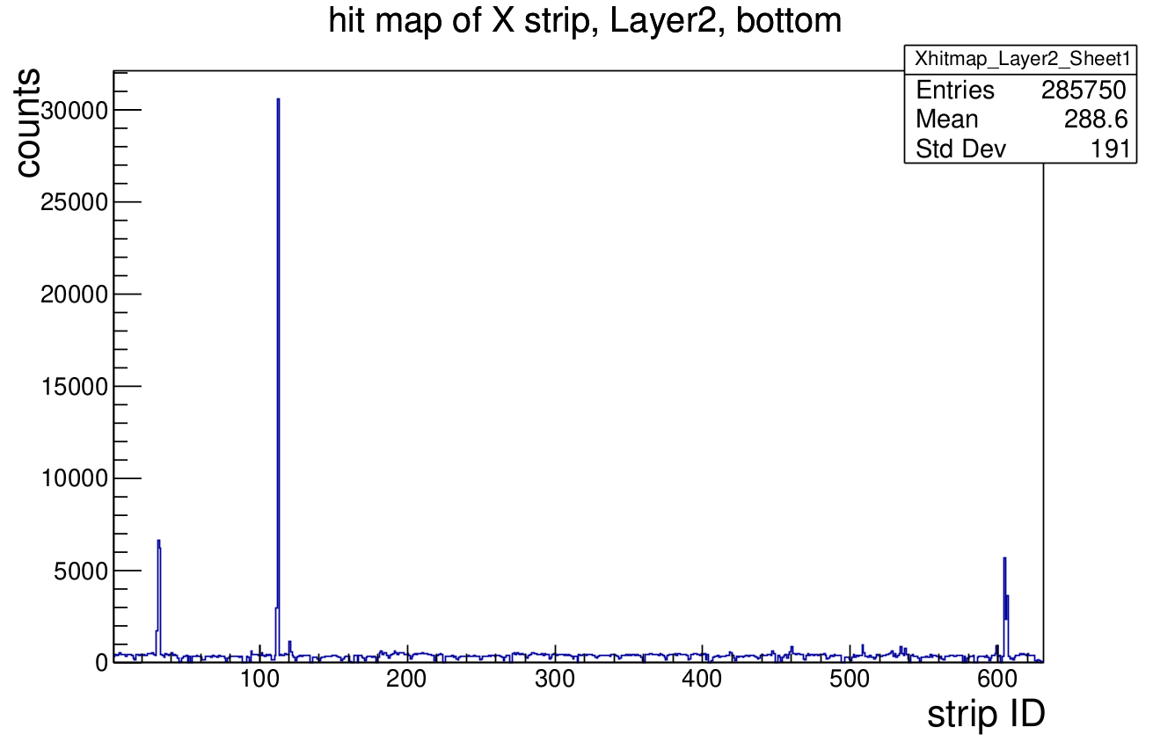
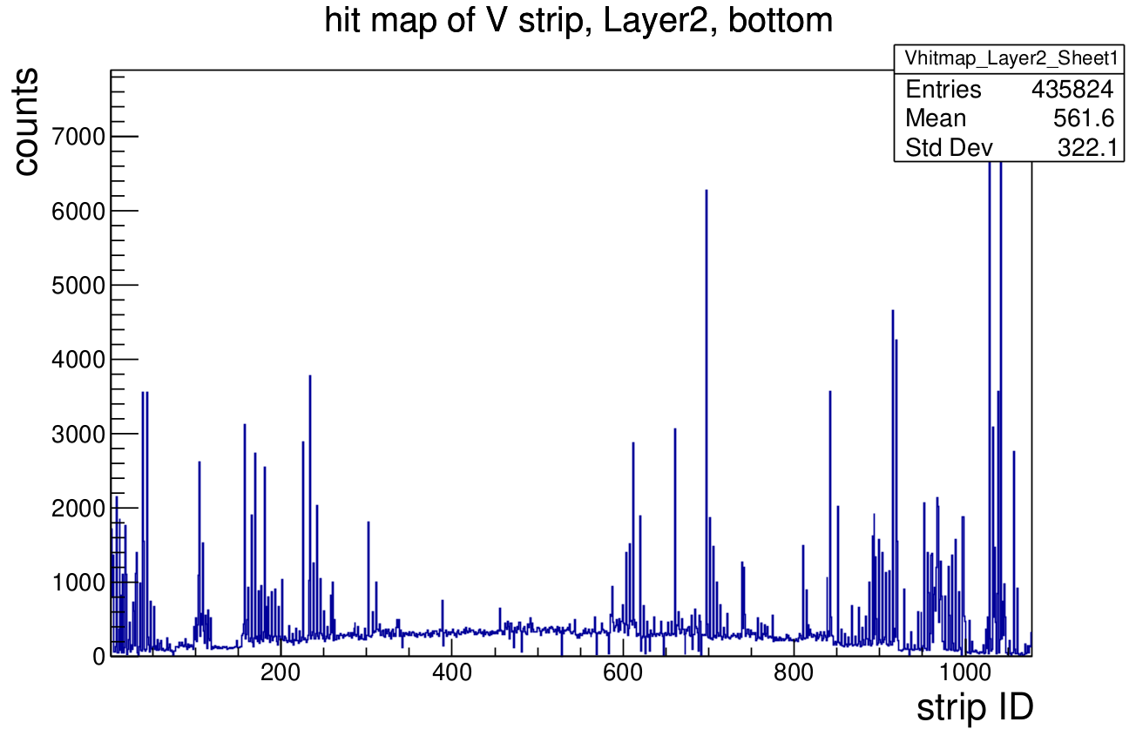
Hitmap run 84713

Slide 5
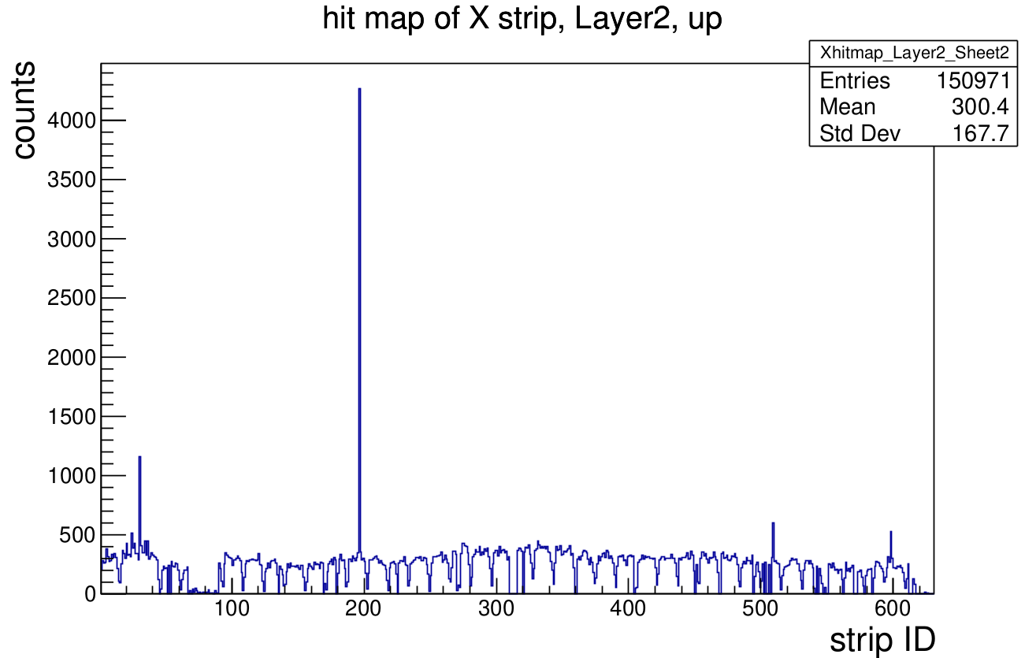
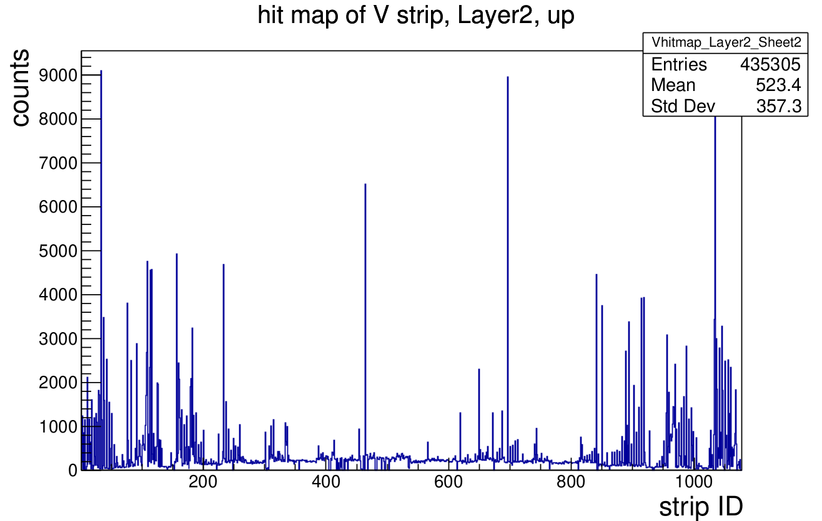
Hitmap run 84713

Slide 6
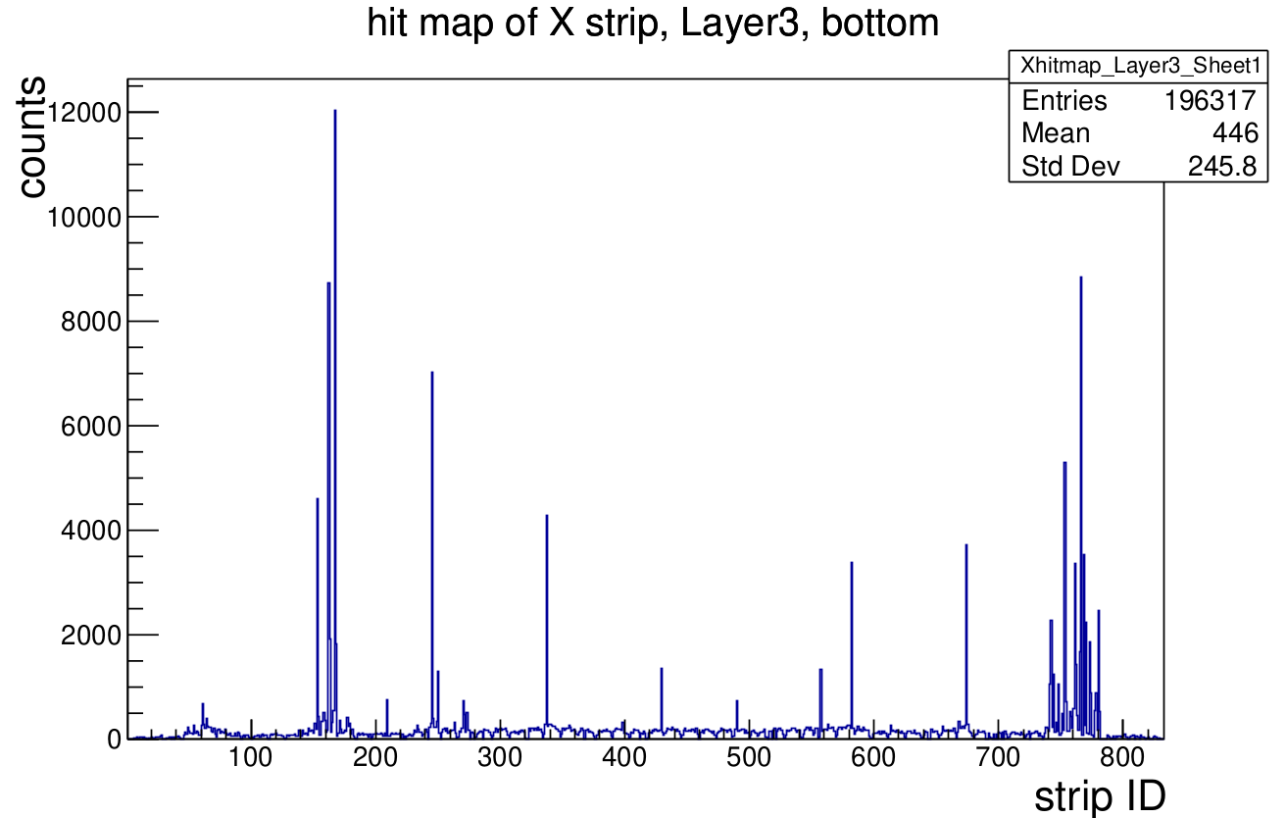
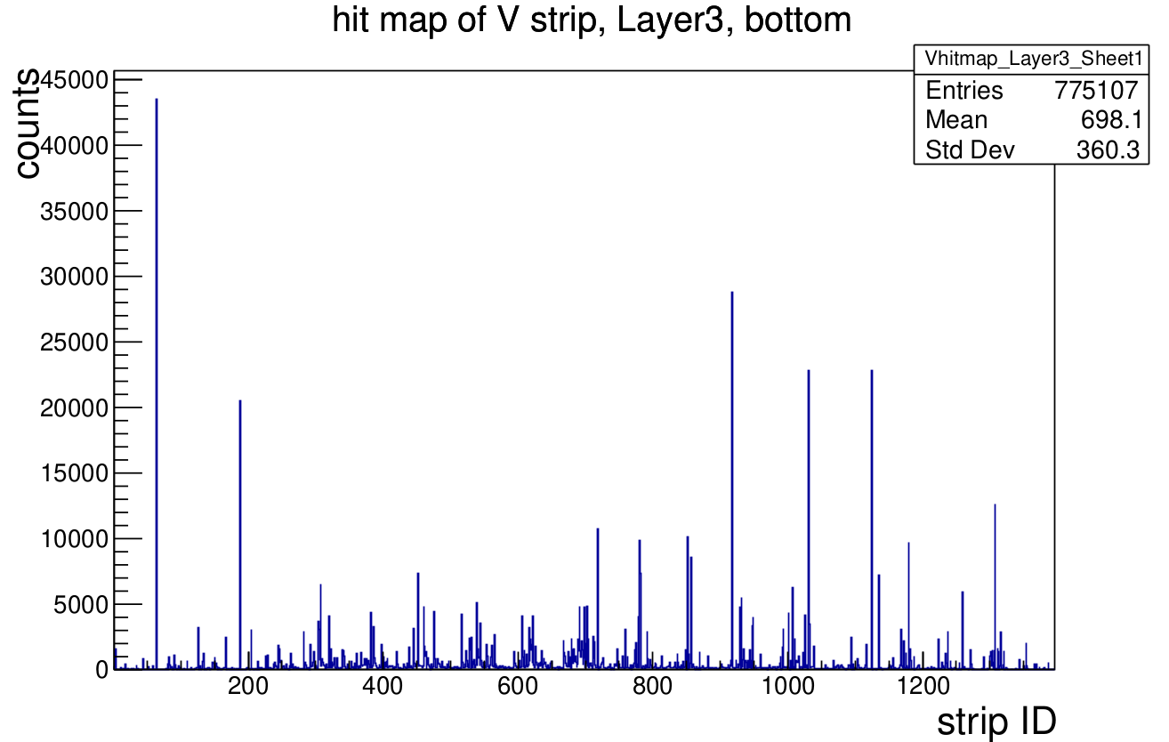
Hitmap run 84713

Slide 7
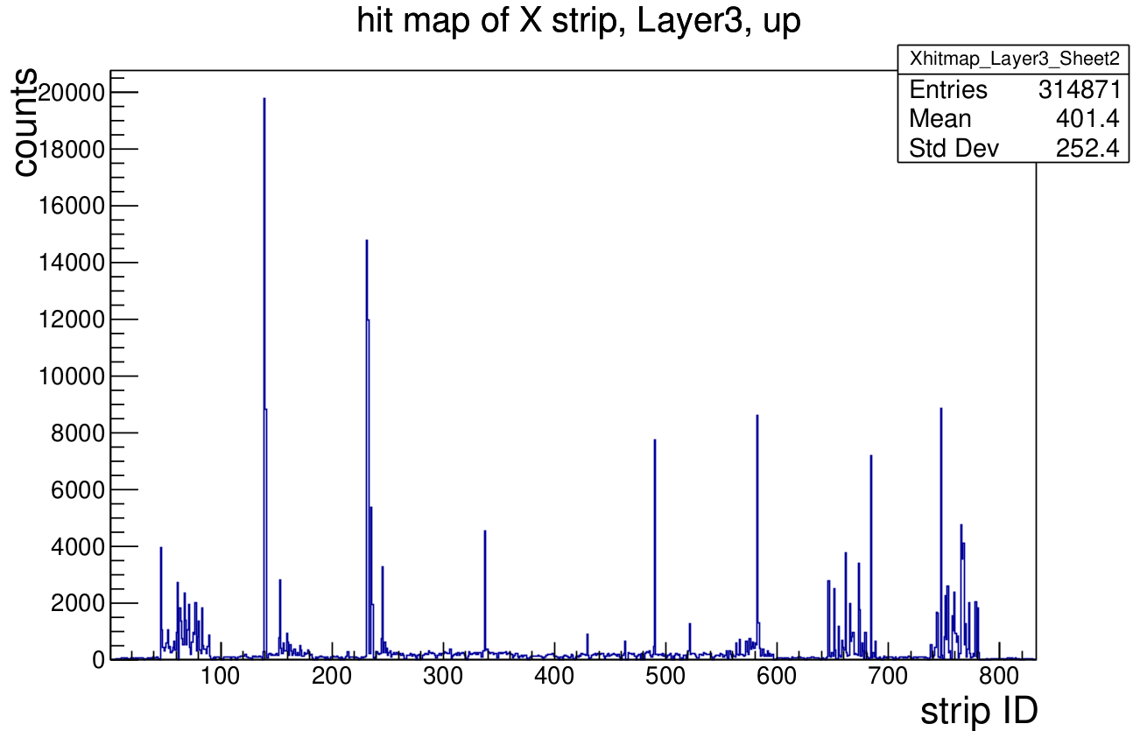
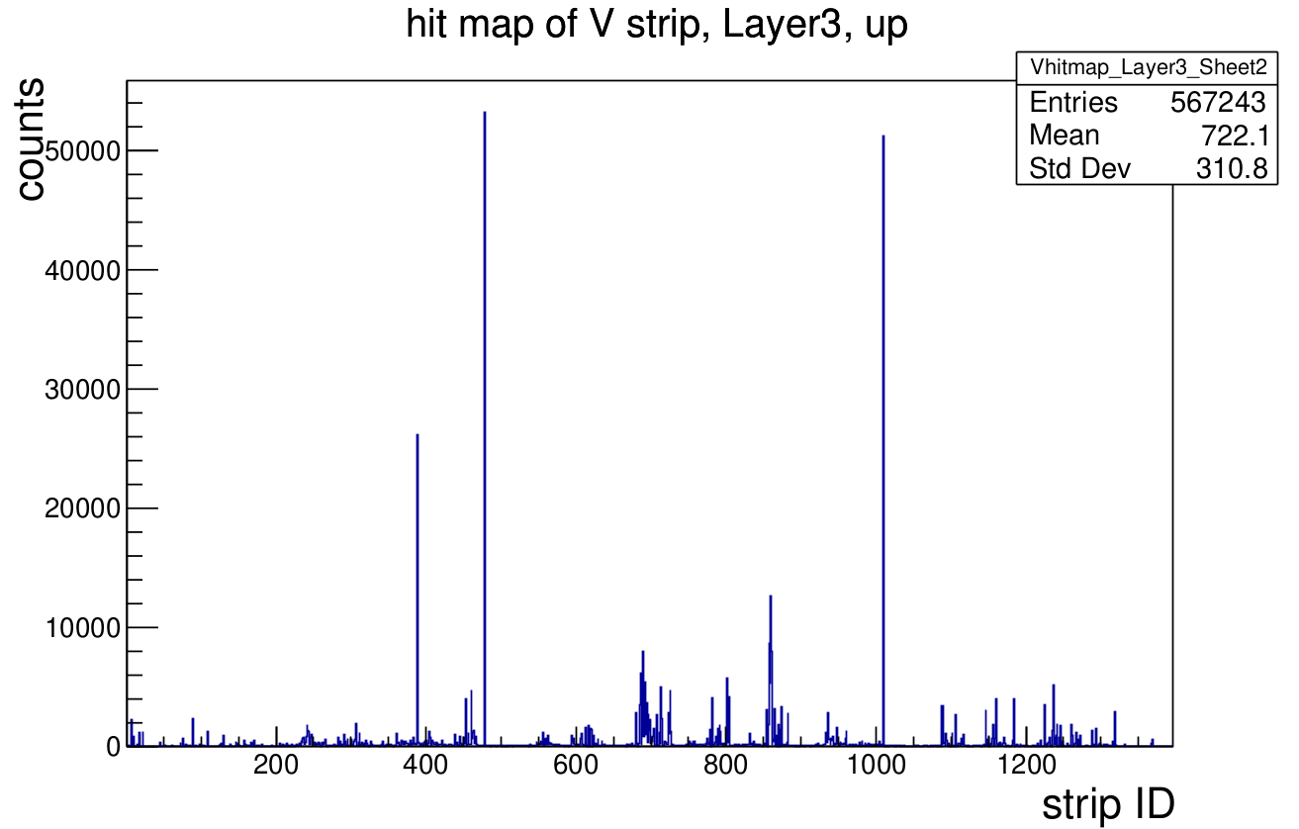
Hitmap run 84713

Slide 8
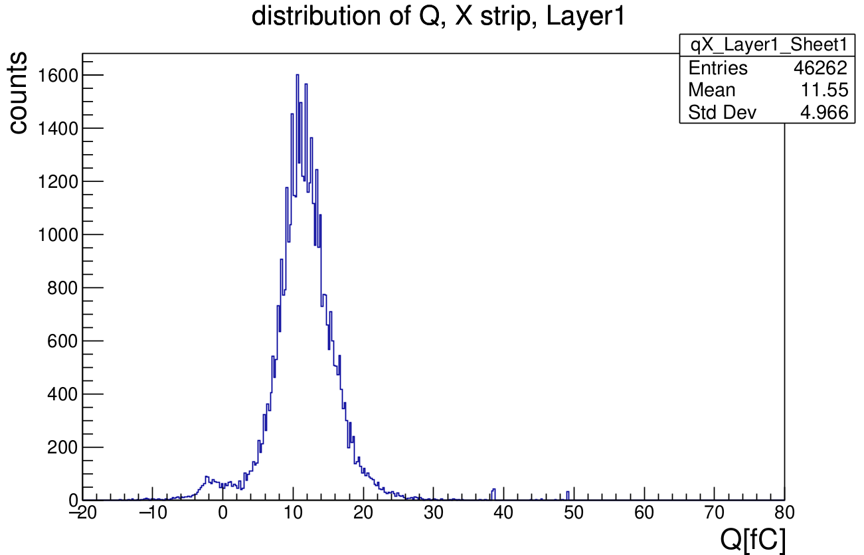
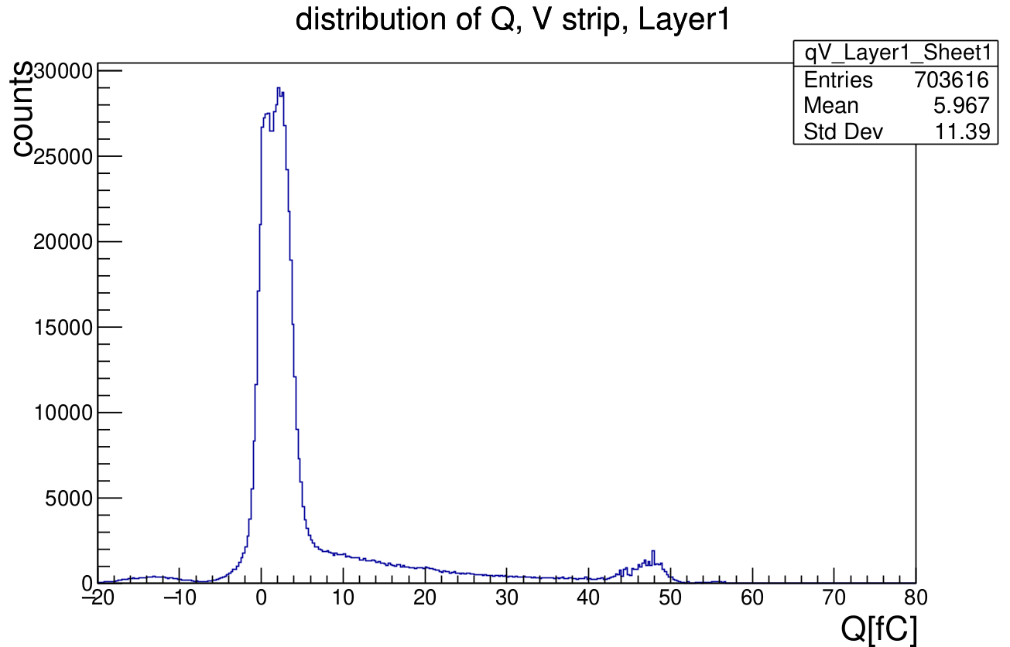
Distribution of Charge run 84713

Slide 9
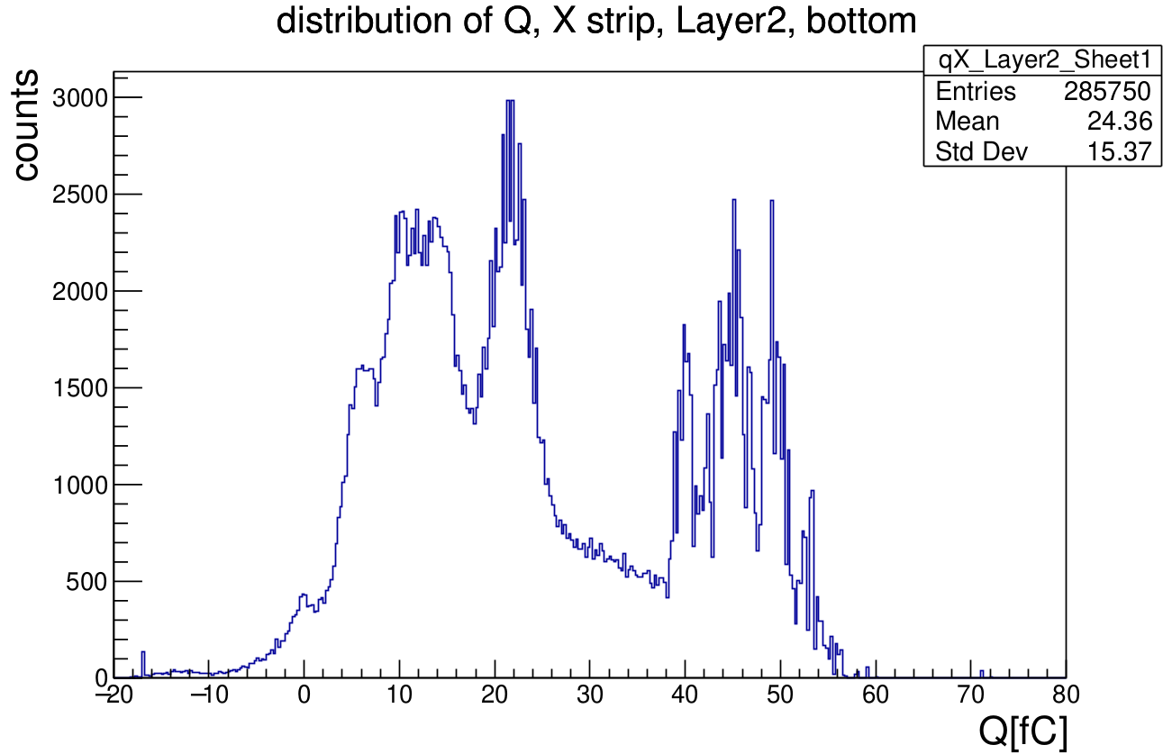
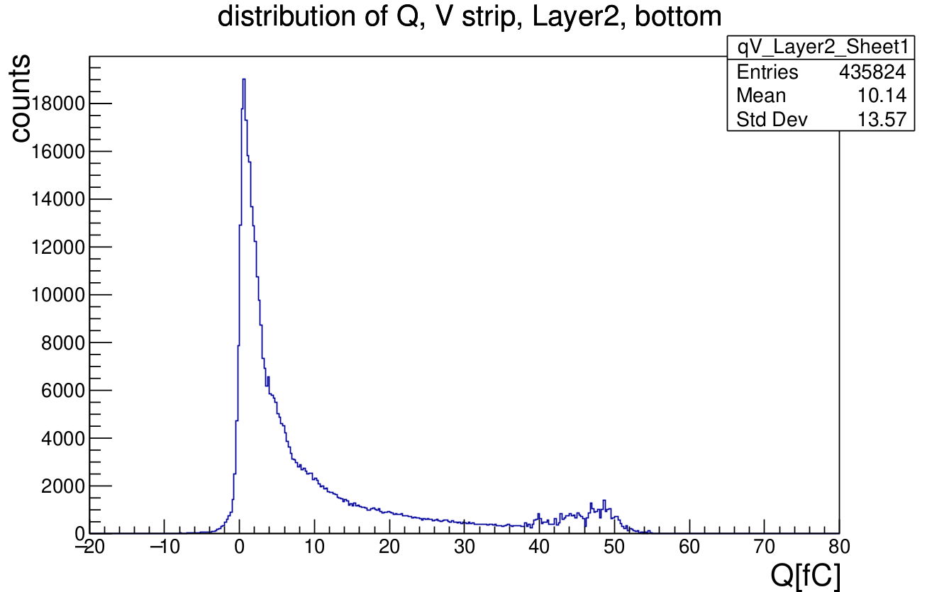
Distribution of Charge run 84713

Slide 10
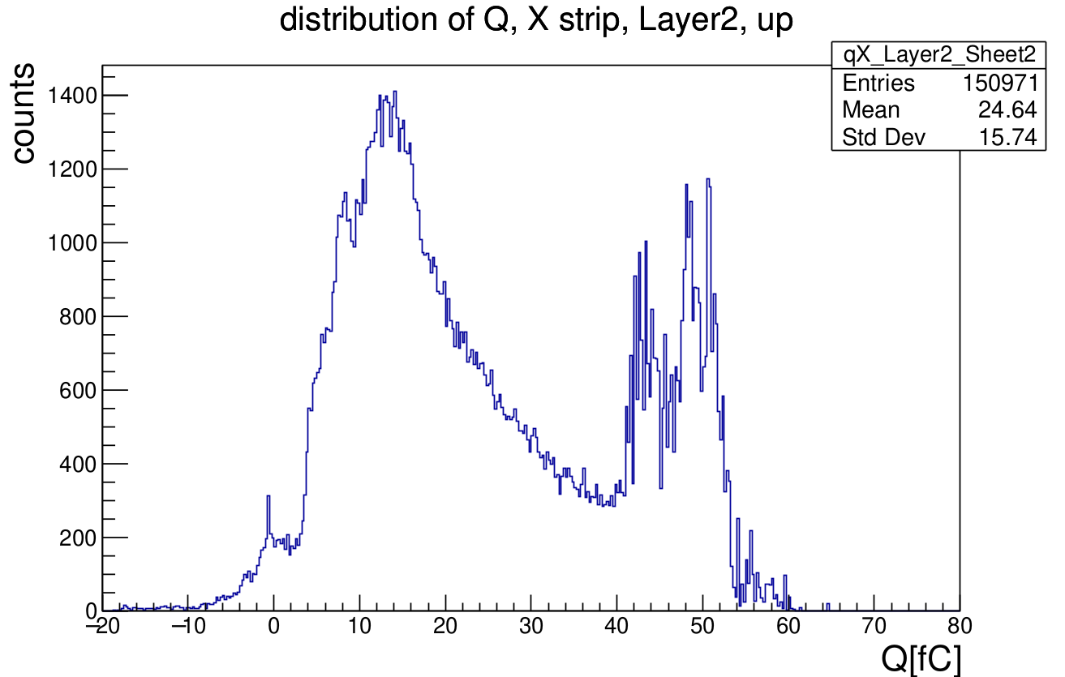
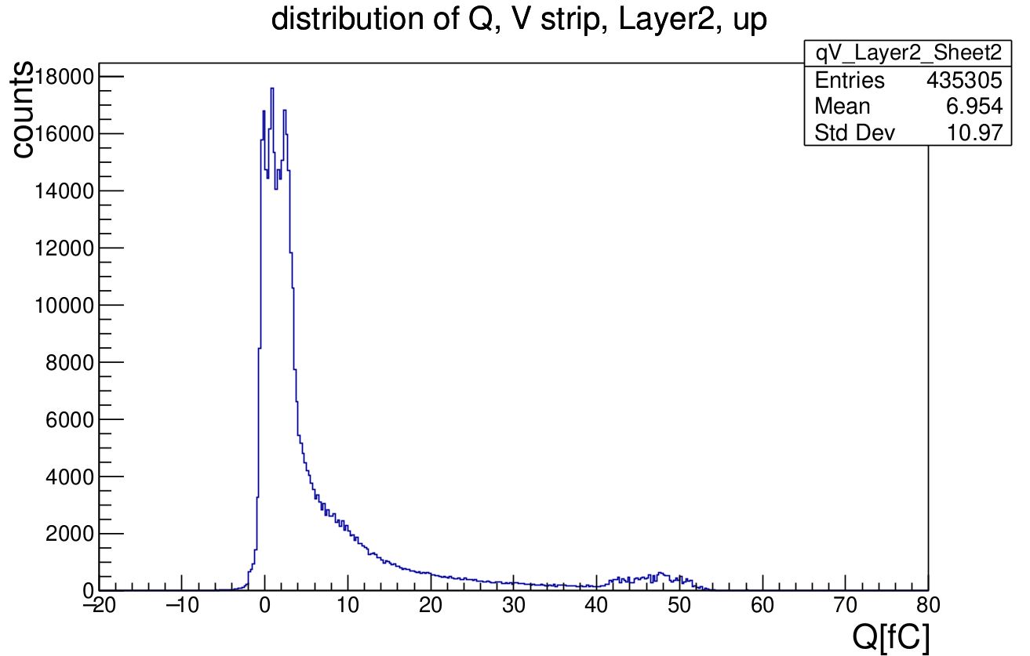
Distribution of Charge run 84713

Slide 11
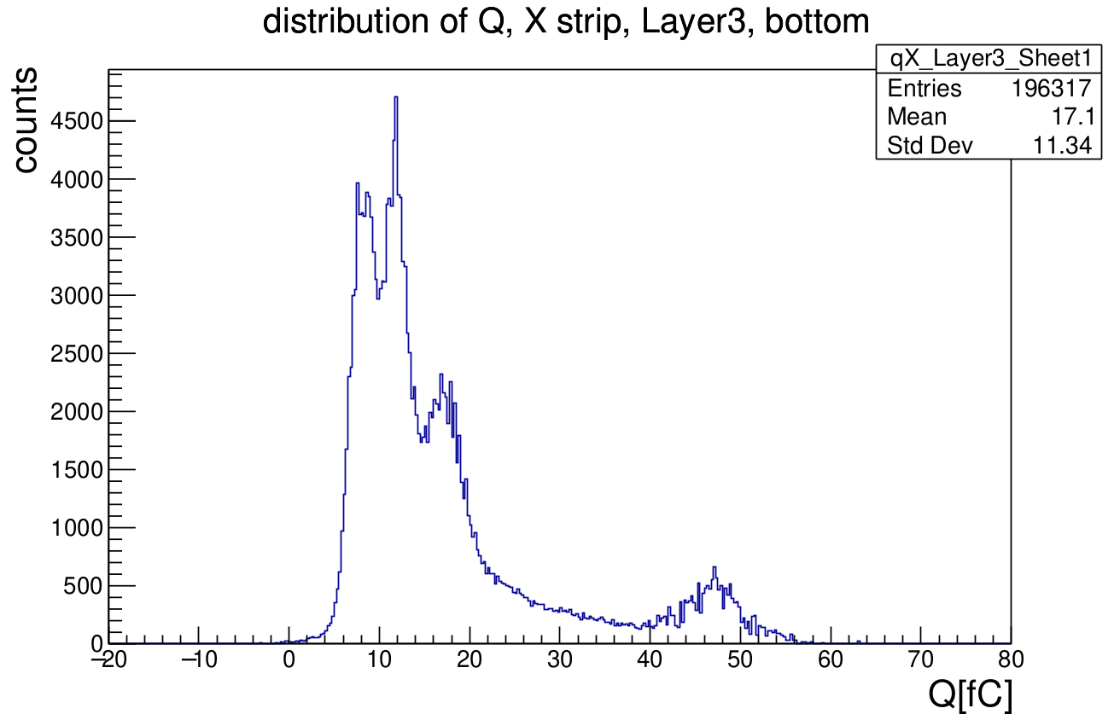
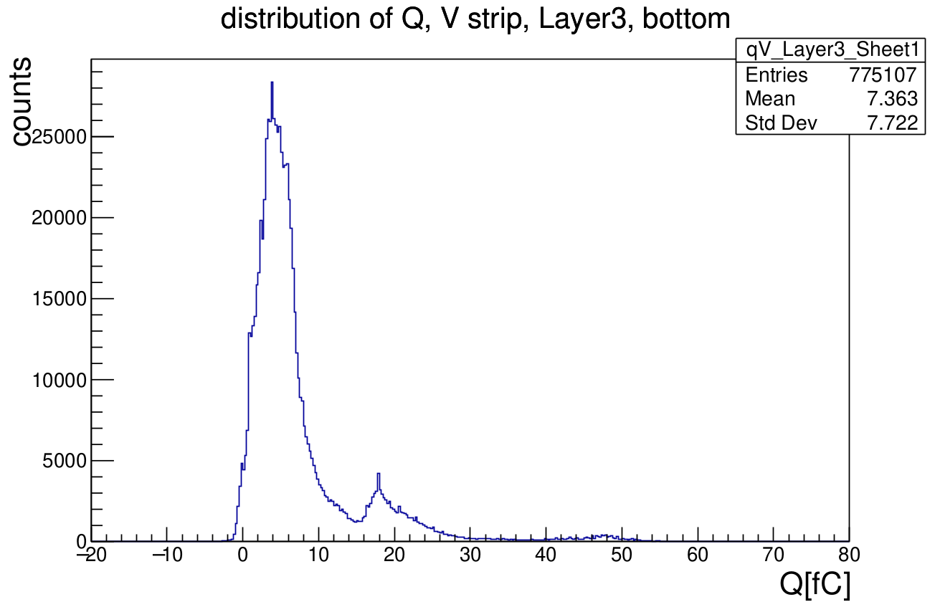
Distribution of Charge run 84713

Slide 12
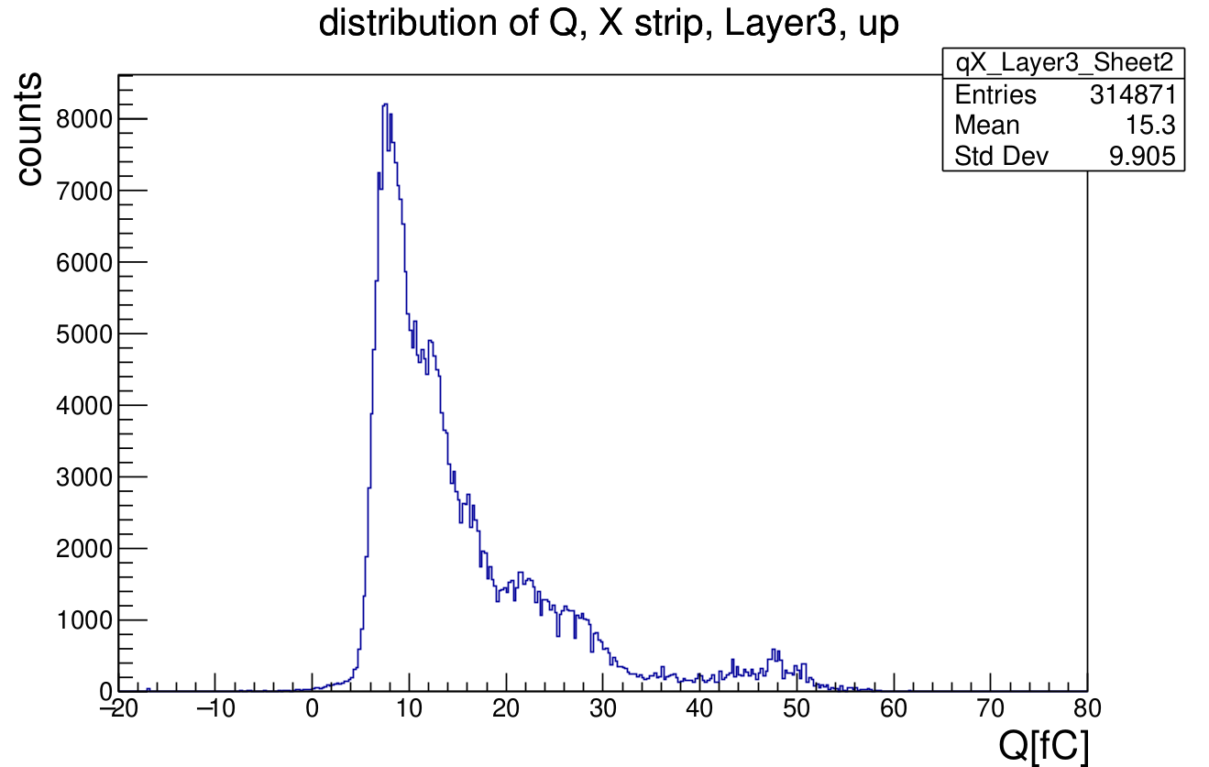
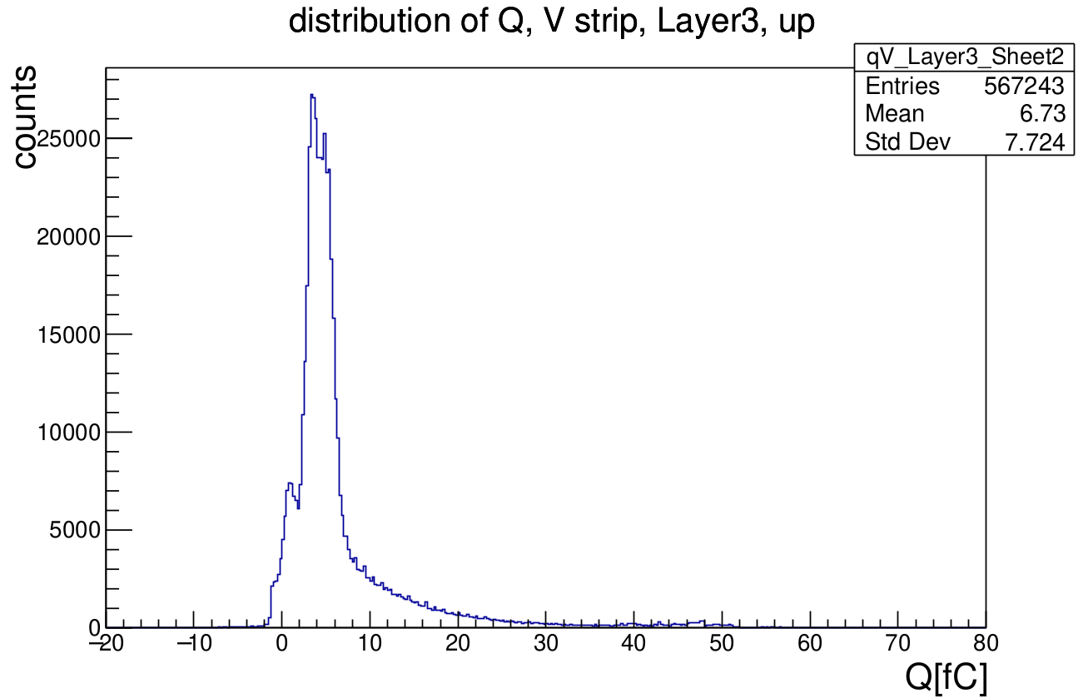
Distribution of Charge run 84713

Slide 13
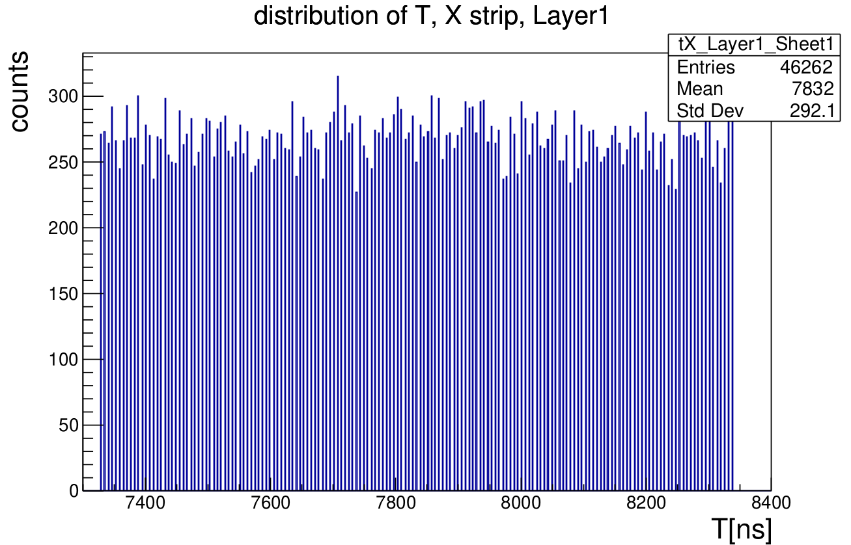
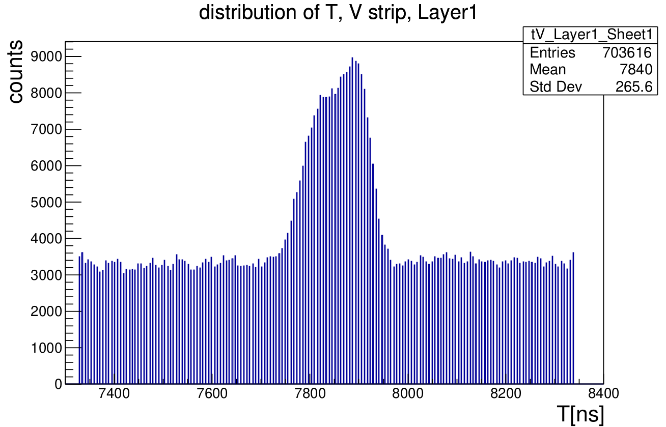
Distribution of Time run 84713

Slide 14
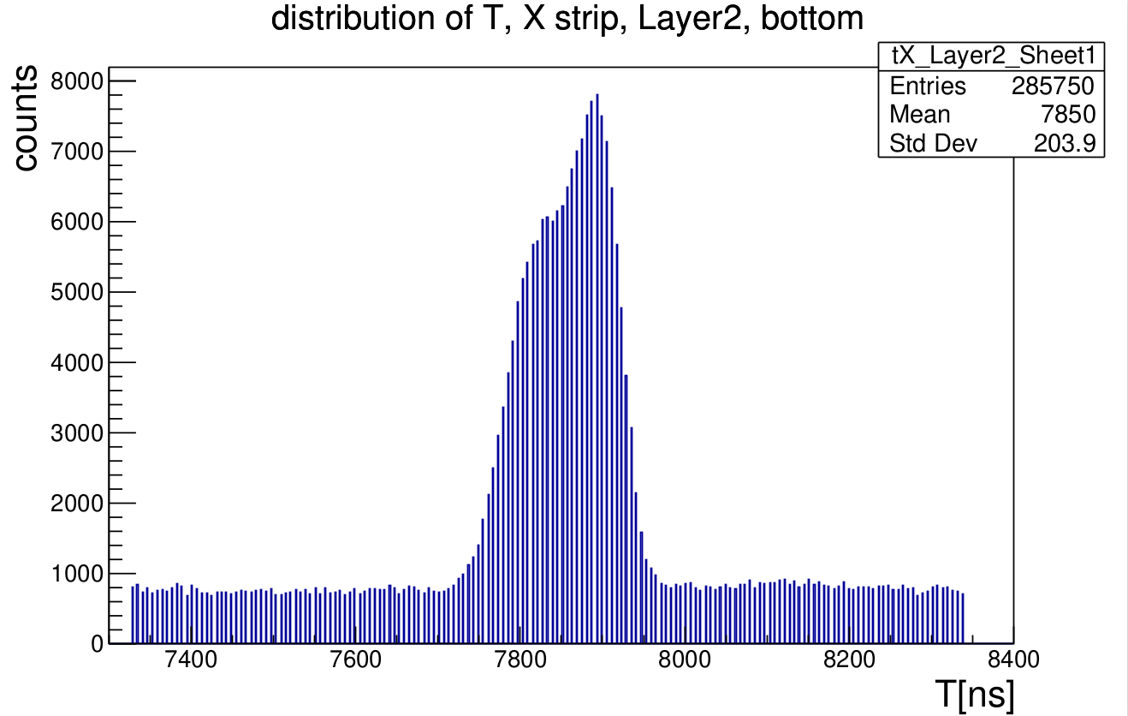
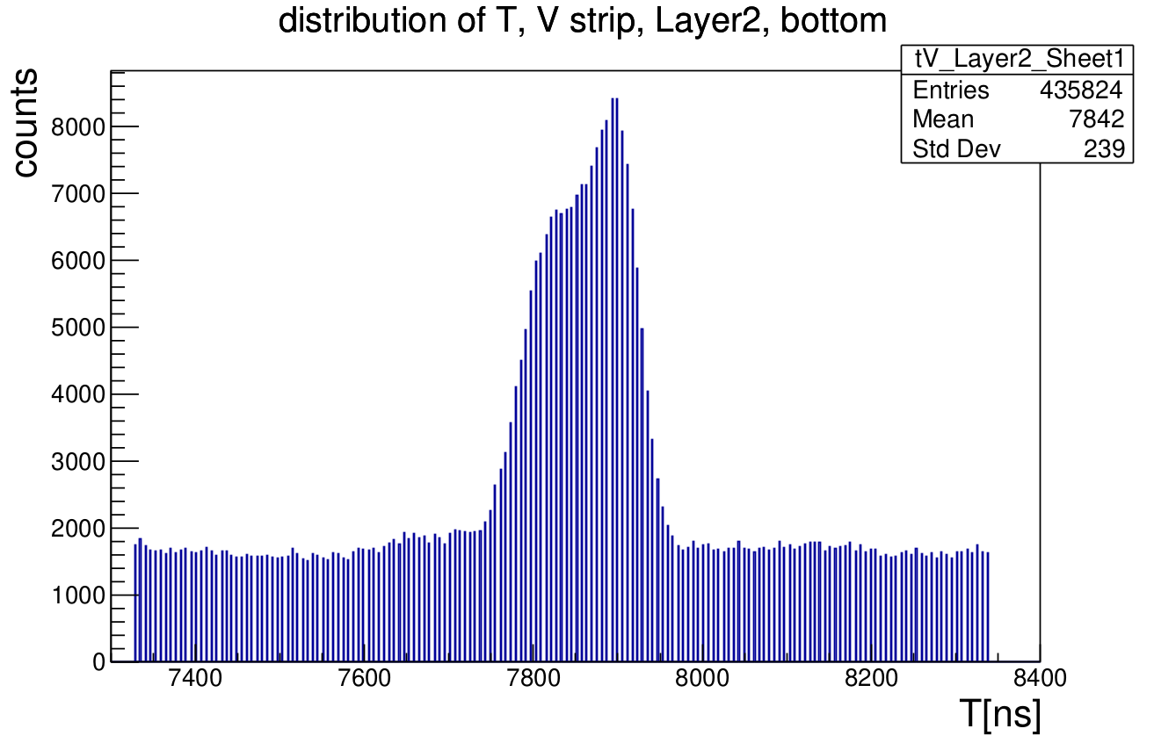
Distribution of Time run 84713

Slide 15
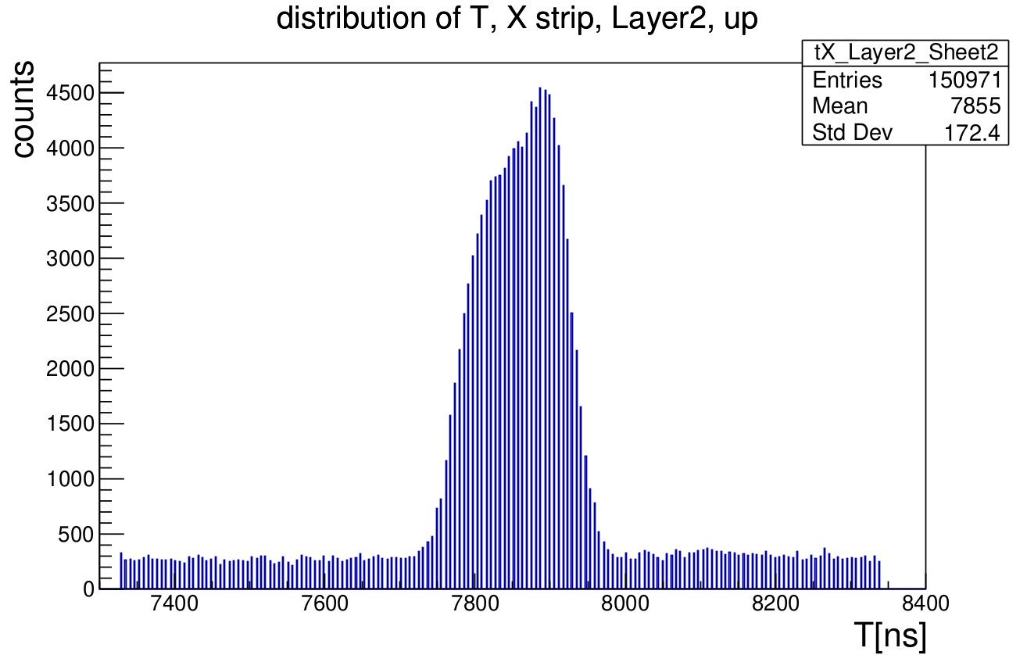
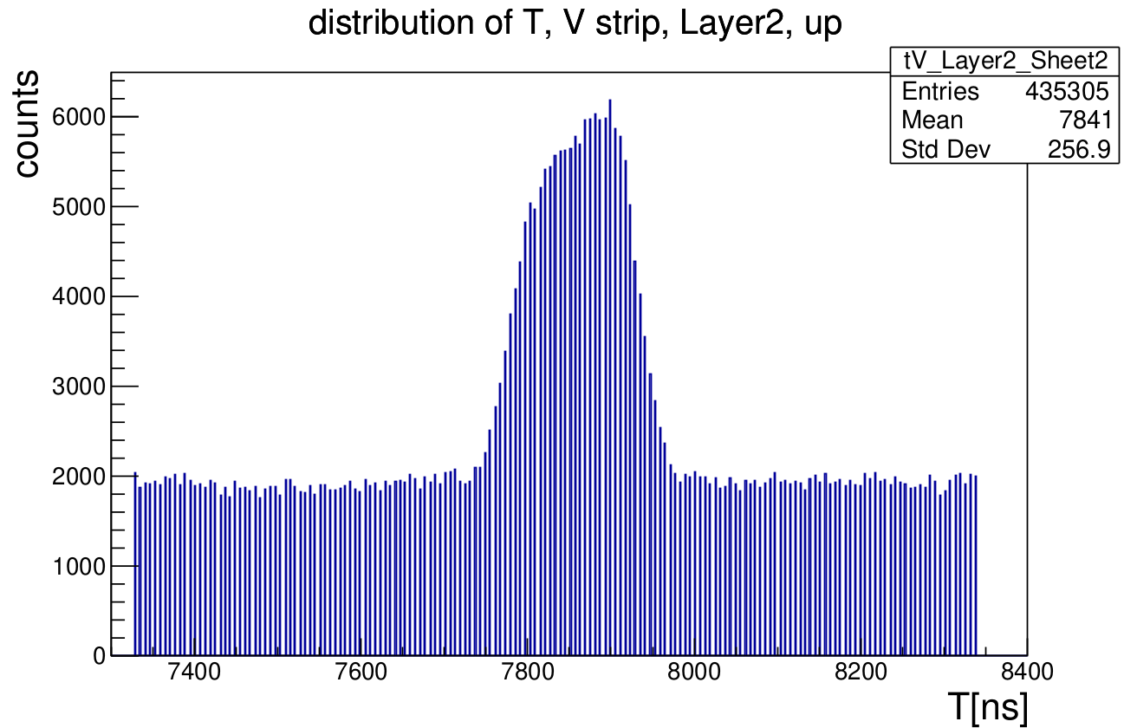
Distribution of Time run 84713

Slide 16
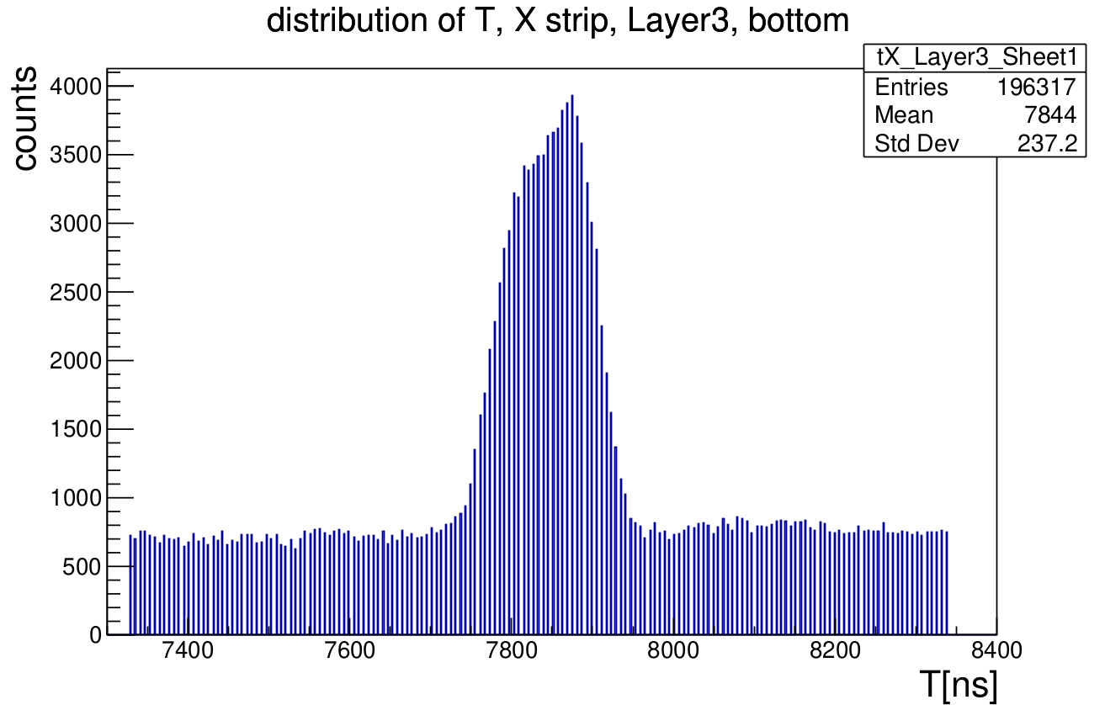
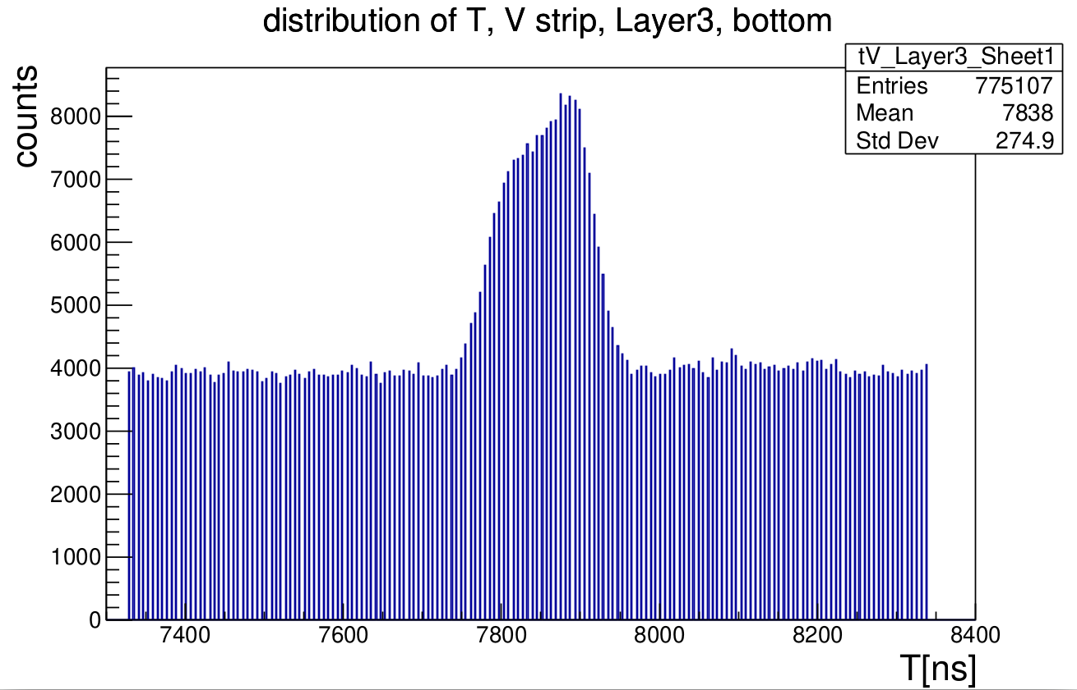
Distribution of Time run 84713

Slide 17
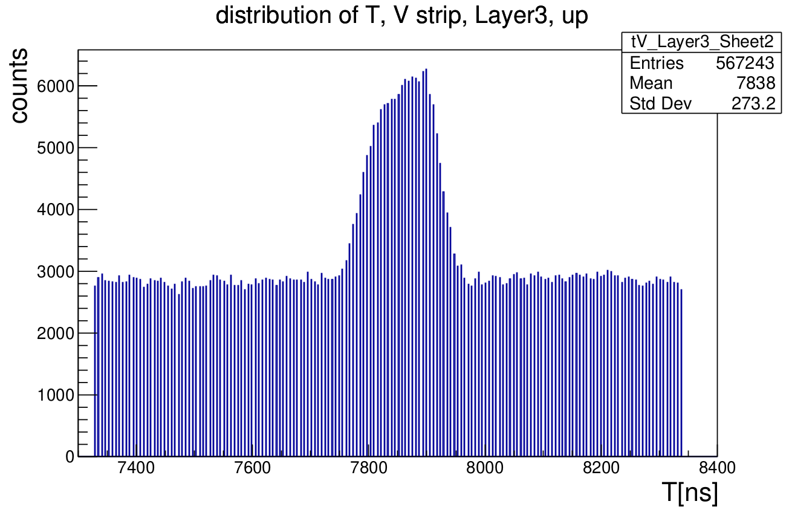
Distribution of Time run 84713

Slide 18
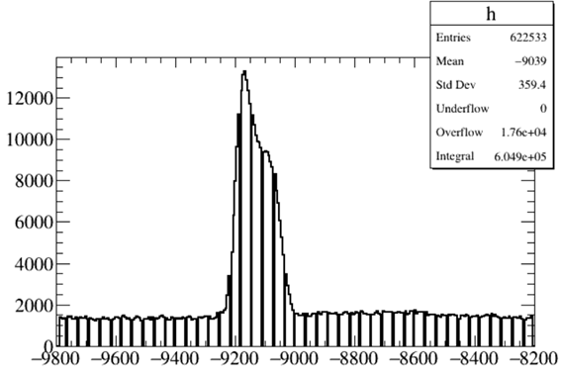
Comparison of T distribution between old and new data
run 84713 (2025/3/26)
run 934 (2024/3)
Significant difference between the old and new data

Slide 19
Summary
Why two strips dominate the X-view hit map of layer 1 ?
Current coarse time conversion is
(LOCAL_L1_Timestamp-T_coarse)*1000./4./41.65 . Do we need to swap LOCAL_L1_Timestamp and T_coarse?
How to ensure a totally correct conversion (number of hits, mapping, time and charge) ?
Any CGEM root data files available for the new runs (like 84710-84716) with the same or similar format as for CGEM standalone cosmic runs?

