Slide 1
Weekly Report
Minghao Li 2025.04.08

Slide 2
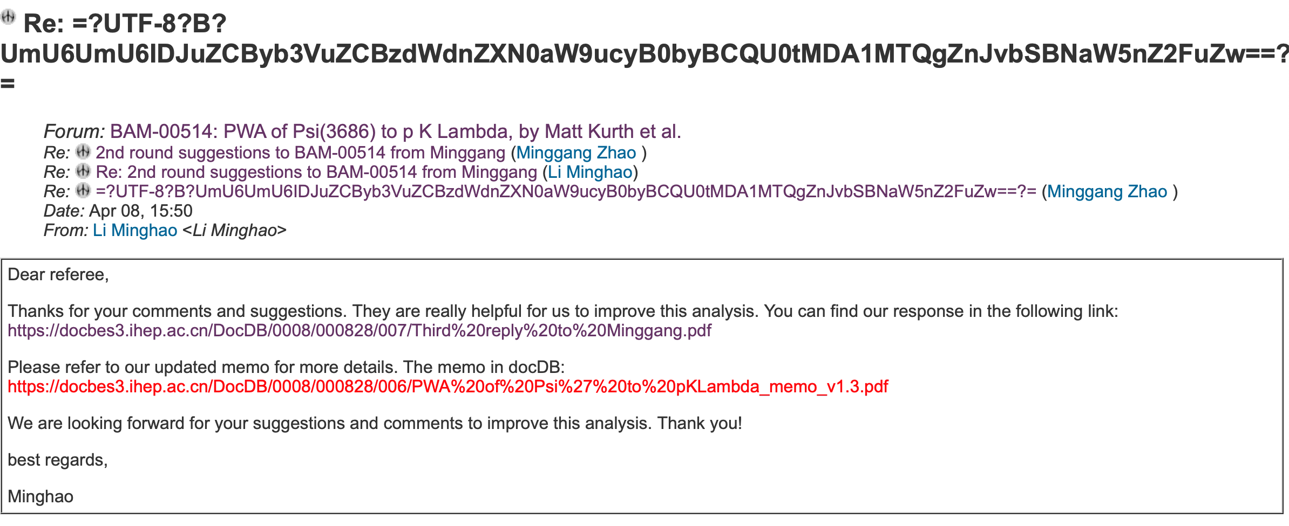
$ψ\left(3686\right)→pK^{−}\overline{Λ}+c.c.$
Replied to Prof. Zhao‘s question and updated the memo.

Slide 3
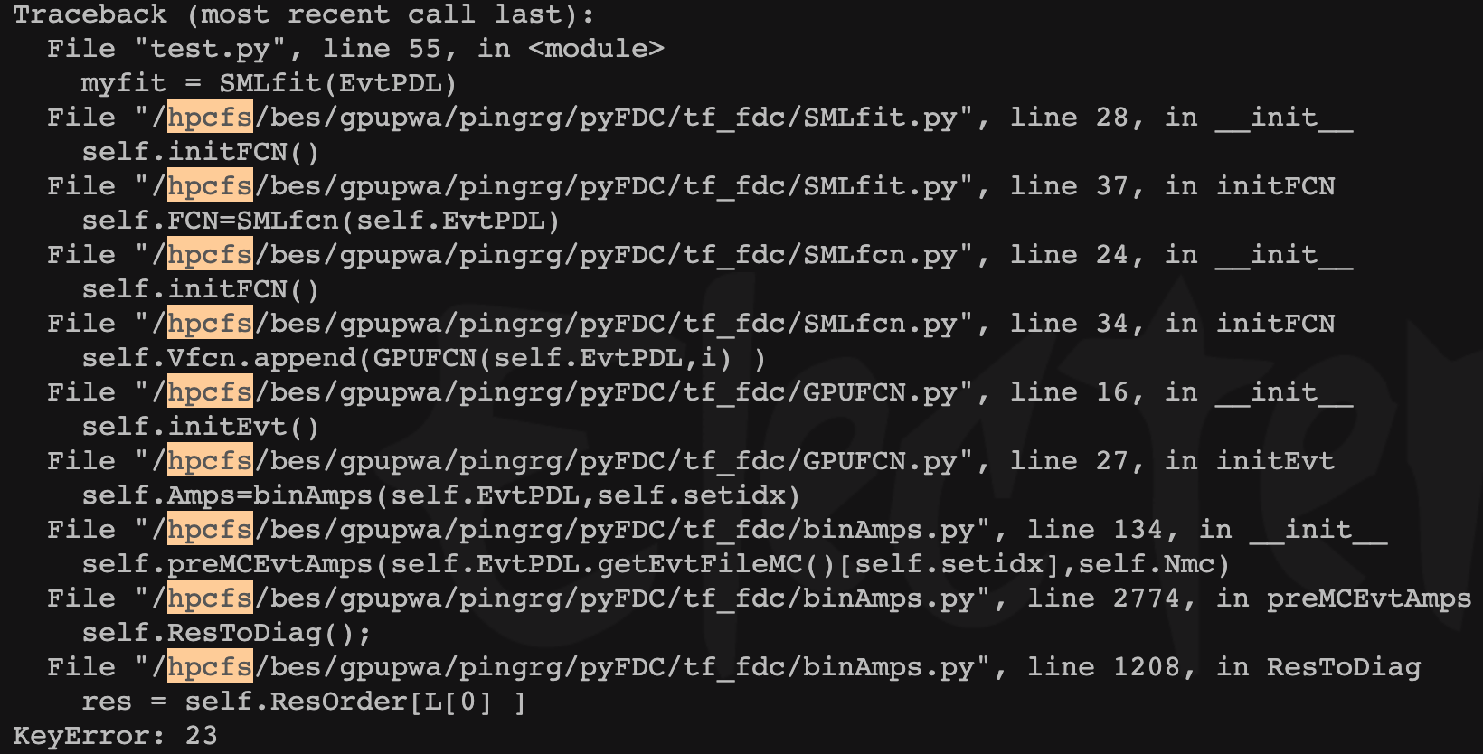
$$ψ\left(3686\right)→pK^{−}\overline{Λ}+c.c.$$
Measuring the systematic uncertainty containing all used abandoned states
the fitting was not successful
the problem was found and solved after Prof. Ping's discussion
currently being fitted.

Slide 4
$$ψ\left(3686\right)→pK^{−}\overline{Λ}+c.c.$$
Uncertainty due to background is estimated by removing it from PWA, the difference of center value is taken to be its uncertainty.
Next planning:
1. Continue to fit and obtain systematic uncertainty.
2. Studying the systematic uncertainty caused by mass resolution.

