Slide 1
Study on production of sample

Slide 2
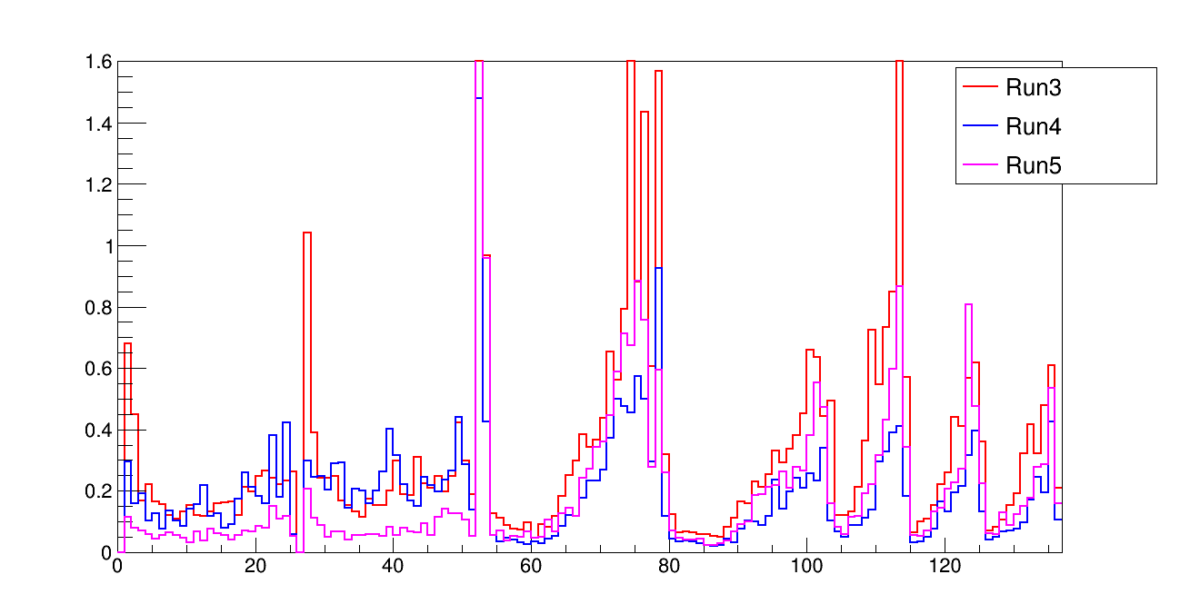
Detector uncertainty of each runs
FC $ν_{e}$CC
PC $ν_{e}$CC
FC $ν_{μ}$CC
PC $ν_{μ}$CC
$π^{0}$ 3channel
reconstructed neutrino energy
There are big difference in each run’s detector uncertainty.

Slide 3
Component of detector sample
Detector sample is divided by following samples:
LYDown
LYRayleigh
WMYZ
WMX
WM$θ_{x}$
WM$θ_{yz}$
LYAttenuation
SCE
Recomb2
Based on above component, samples are further divide into nu_overlay and nue_overlay

Slide 4
Overview of sample’s production
Row sample production part
Sample processed by group
Sample analyzed by analyzer
Based on above, error maybe occurred in following step:
Production of Row sample.
Process of group.
Difference of Sample size
Unknow error

Slide 5
Sample Information
item | Period | Sample species | POT(Before merging) | note
Original recomb2 | Run3b | Nu overlay | 1.11656e+20 | With post-process
Original LYRayleigh | Run3b | Nu overlay | 1.11363e+20 | With post-process
Original WMYZ | Run4 | Nue overlay | 4.16706e+21 | With post-process
Original WMYZ | Run5 | Nu overlay | 1.80711e+20 | With post-process
Reproduced recomb2 | Run3b | Nu overlay | 6.28383e+20 | Without post-process
Reproduced LYRayleigh | Run3b | Nu overlay | 6.11943e+20 | Without post-process
Reproduced WMYZ | Run4 | Nue overlay | 1.26094e+23 | Without post-process
Reproduced WMYZ | Run5 | Nu overlay | 6.91471e+20 | Without post-process
Original file is the file used in PRD.
Reproduced file is the file generated recently.

Slide 6
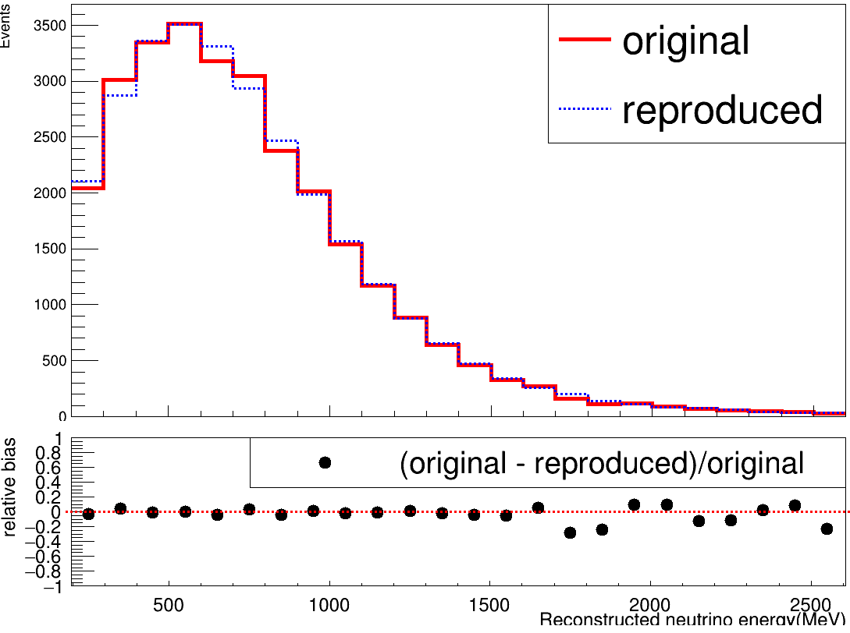
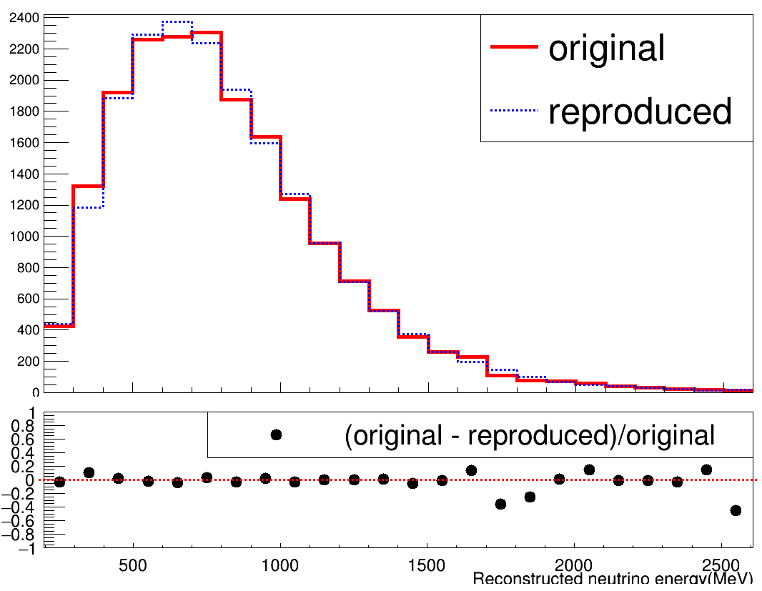
Validation of post-process: Recomb2
Nu overlay
Nu overlay
Before selection
After selection
POT = 1e+20
POT = 1e+20
Selection applied is same with that in PRD efficiency calculation.
Distribution of both new and original sample are similar.

Slide 7
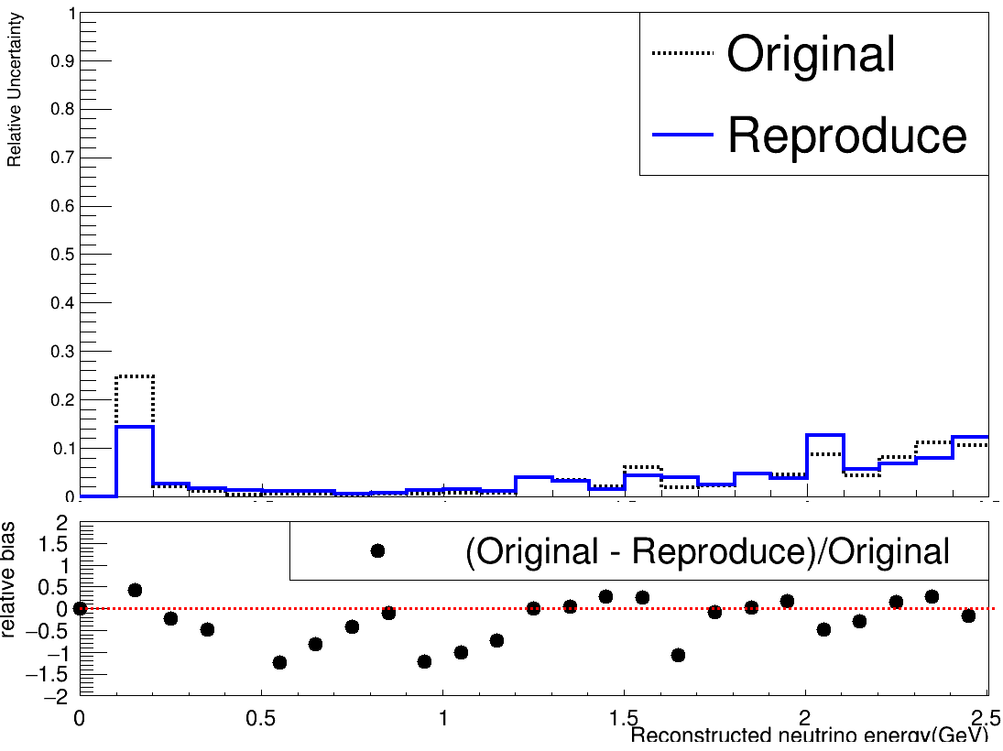
Relative uncertainty of Recomb2
FC $v_{μ}$CC
Relative uncertainty of original and reproduce sample are similar.

Slide 8
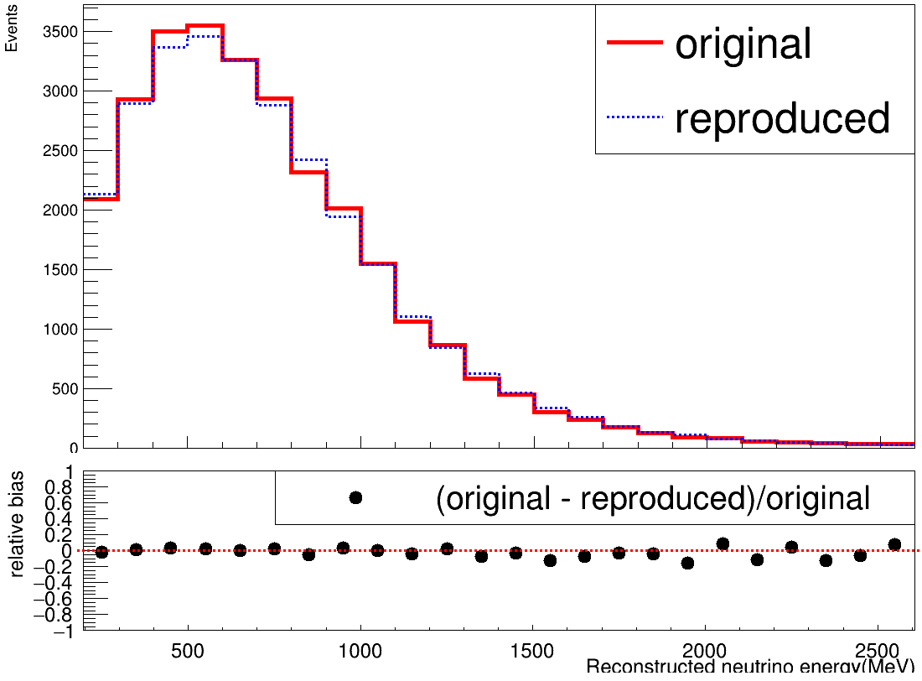
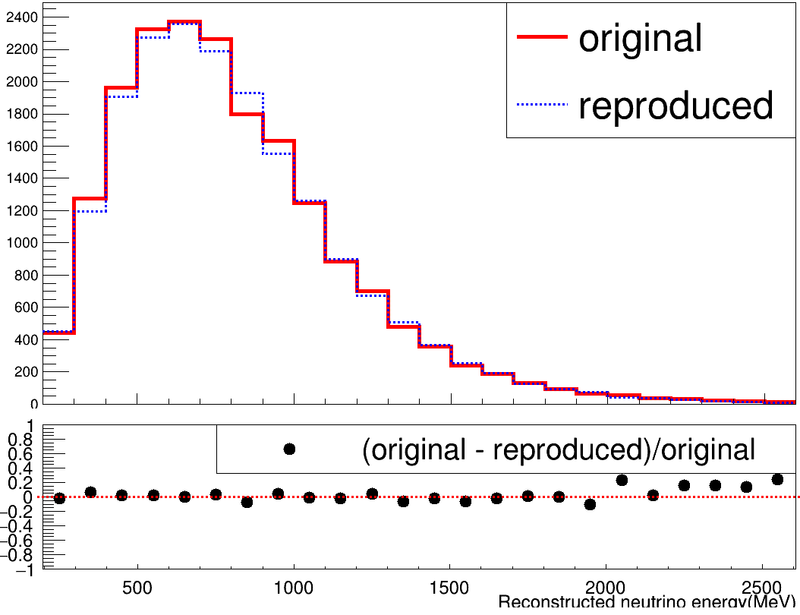
Validation of post-process: LYReyleigh
Nu overlay
Nu overlay
Before selection
After selection
POT = 1e+20
POT = 1e+20
Selection applied is same with that in PRD efficiency calculation.
Distribution of both new and original sample are similar.

Slide 9
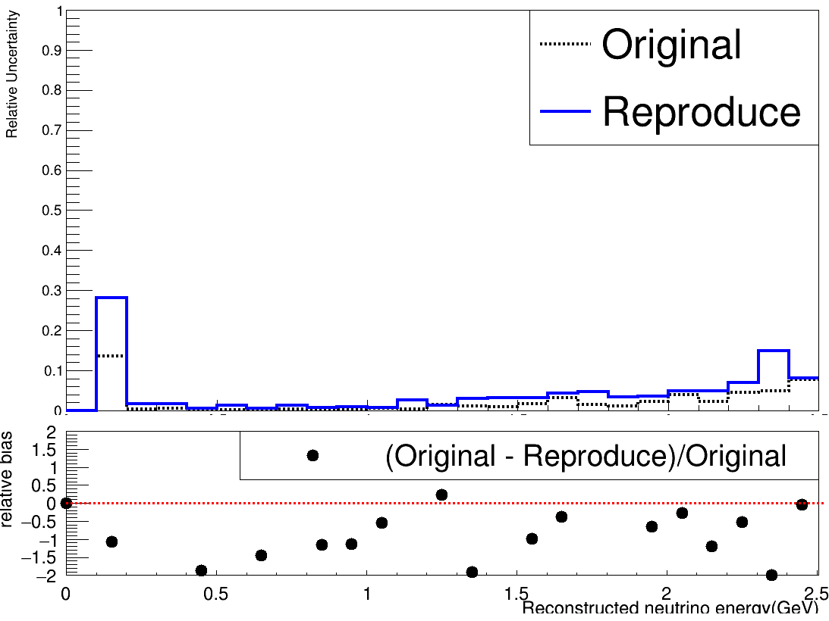
Relative uncertainty of LYRayleigh
FC $v_{μ}$CC
Relative uncertainty of original and reproduce sample are similar.

Slide 10
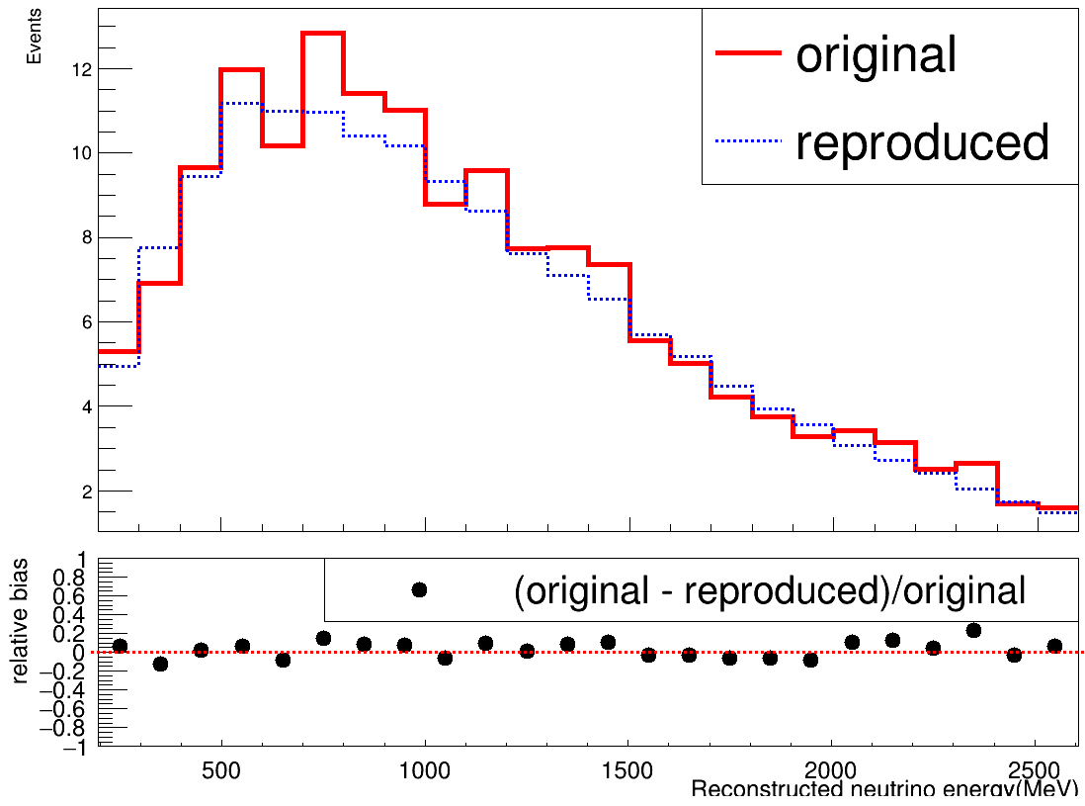
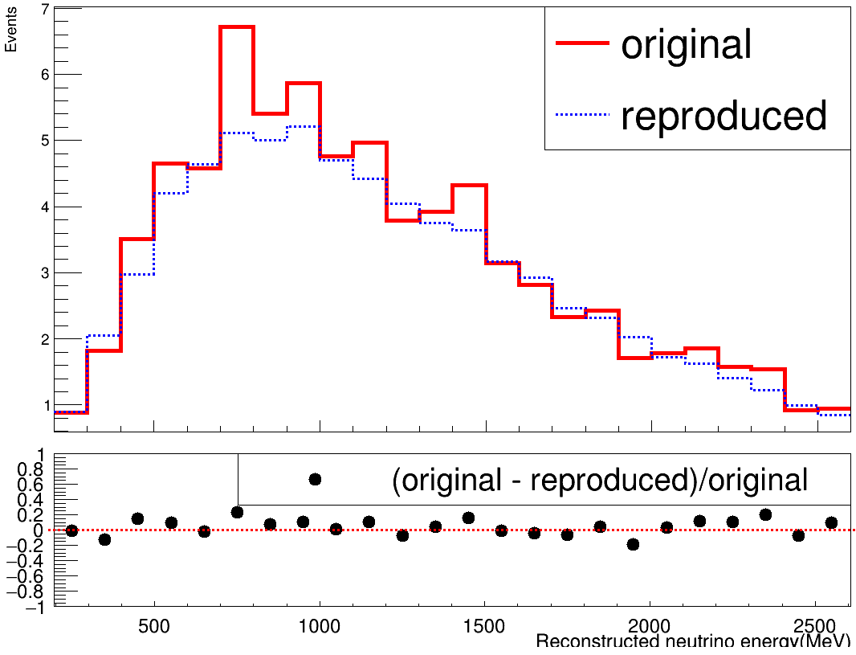
Validation of post-process: Run4 WMYZ
Nue overlay
Nue overlay
Before selection
After selection
POT = 1e+20
POT = 1e+20
Selection applied is same with that in PRD efficiency calculation.
Distribution of both new and original sample are similar.

Slide 11
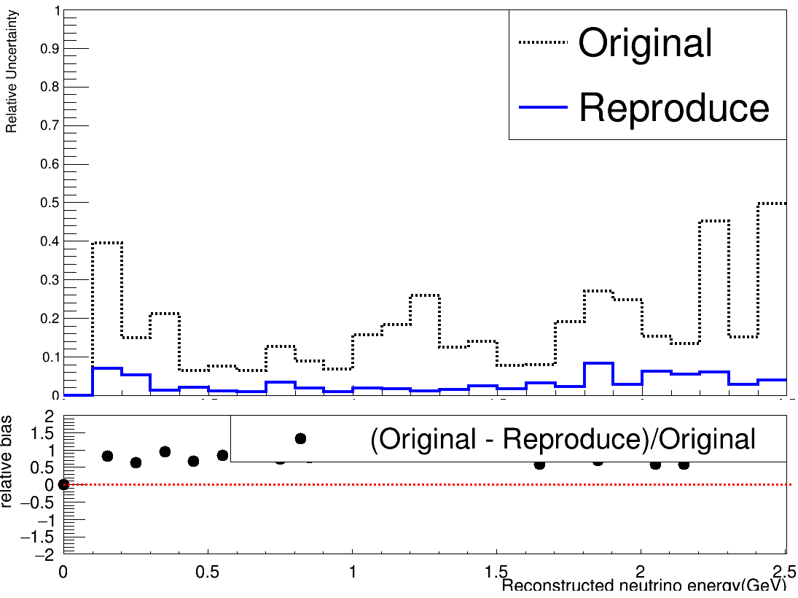
Relative uncertainty of Run4 WMYZ
 | POT(before merging)
Original | 4.16706e+21
Reproduced | 1.26094e+23
FC $v_{e}$CC
Relative uncertainty of original and reproduce sample have a big difference.

Slide 12
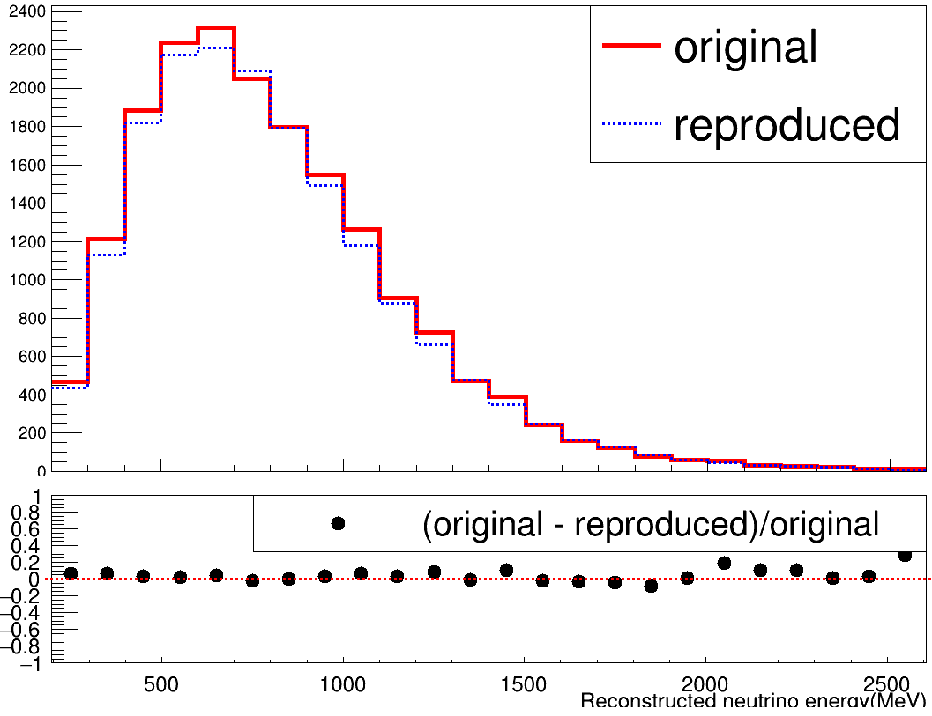
Validation of post-process: Run5 WMYZ
Nu overlay
Nu overlay
Before selection
After selection
POT = 1e+20
POT = 1e+20
Selection applied is same with that in PRD efficiency calculation.
Distribution of both new and original sample are similar.

Slide 13
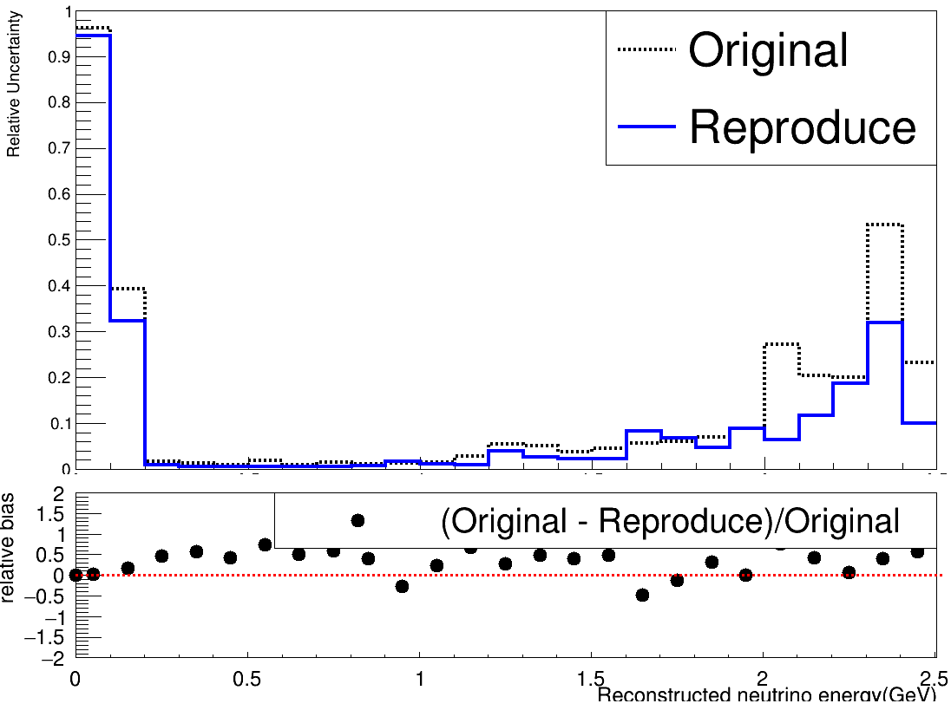
Relative uncertainty of Run4 WMYZ
 | POT(before merging)
Original | 1.80711e+20
Reproduced | 6.91471e+20
FC $v_{μ}$CC
Relative uncertainty of original and reproduce sample are similar(although there has a difference in high energy range).

