Slide 1
Examination of T/CP Invariance in the $e^{+}e^{−}→^{+}^{−}$Reaction at BESIII
Yunhe Yang¹, Ziyu Zhang¹, Zhiyong Wang³, Aiqiang Guo², Chunxu Yu¹
¹NanKai University
²Institute of Modern Physics, Chinese Academy of Sciences
³Institute of High Energy Physics

Slide 2
Outline
Motivation
MC sample
Event selection
Further selection
Background analysis
<A> and R

Slide 3
Motivation
CPV is a key to understand the preponderance of matter over antimatter in our universe.
CPV in Collider Physics:
1964, AGS, $\frac{Br(K_{2}^{0}→π^{+}π^{−})}{Br(K_{2}^{0}→ALL)}=(2.0±0.4)×{10}^{−3}$
DAΦNE (KLOE, 𝜙 peak): Br(𝜙 → K+K-) = 49.2%
e+e- @1019.4 MeV Br(𝜙 → K0K0-bar) = 33.8%
KEKB/BELLE, PEP-II/BABAR Tevatron (D0/CDF) LHC (ATLAS/CMS)
e+e- @10.58 GeV, ץ(4S) pp-bar @1.98 TeV pp @14 TeV
CKM says: no CPV should not occur in the leptonic sector, which must be tested!

Slide 4
Motivation
BESIII VS BELLE

Slide 5
MC sample
BOSS version: 7.0.9
Data:
Inclusive MC: 2300M
Signal MC: $1×{10}^{6}$
MC sample | Generated Model
$$τ^{+}→e^{+}ν_{e}{\overline{ν}}_{τ}$$ $τ^{−}→μ^{−}{\overline{ν}}_{μ}ν_{τ}$ | PHOTOS TAULNUNU
$$τ^{+}→e^{−}ν_{τ}{\overline{ν}}_{e}$$ $τ^{−}→μ^{+}{\overline{ν}}_{τ}ν_{μ}$ | PHOTOS TAULNUNU

Slide 6
Event selection
Good Charged Choose
$\left|V_{r}\right|<1.0cm, \left|V_{Z}\right|<10cm, \left|cosθ\right|<0.93, N_{total}=2$
Good Photon Choose
$N_{γ}=0, dang≥{10}^{◦}, 0≤TDC≤700ns$
$Barrel EMC: \left|cosθ\right|≤0.8, E_{γ}≥25MeV$
$Endcap EMC: 0.86≤\left|cosθ\right|≤0.92, E_{γ}≥50MeV$
PID
$For e: P_{e}>0.001, P_{e}>P_{μ}, P_{e}>P_{π}, P_{e}>P_{K}, P_{e}>P_{p}, n_{e}=1$
$For muon: P_{μ}>0.001, P_{μ}>P_{e}, P_{μ}>P_{π}, P_{μ}>P_{K}, P_{μ}>P_{p}, n_{μ}=1$
Vertex fit

Slide 7
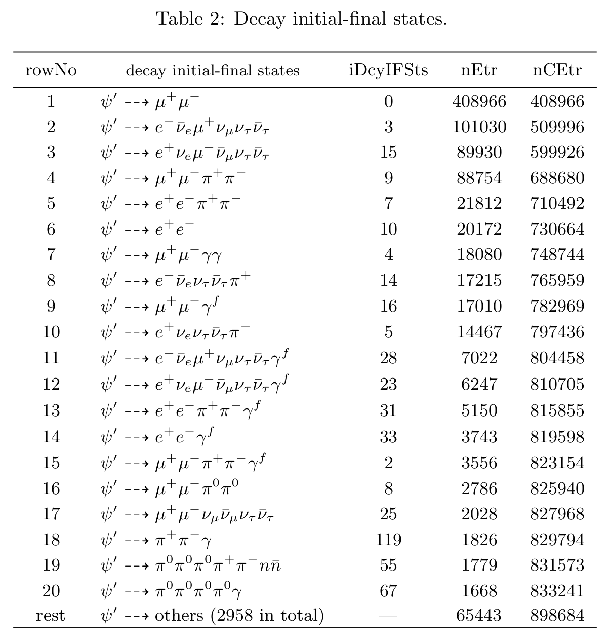
Further selection
$ψ\left(2S\right)→μ^{+}μ^{−}$
$ψ\left(2S\right)→e^{+}e^{−}$
$ψ\left(2S\right)→π^{+}π^{−}J/ψ→μ^{+}μ^{−}π^{+}π^{−}$
$ψ\left(2S\right)→π^{+}π^{−}J/ψ→e^{+}e^{−}π^{+}π^{−}$
$ψ\left(2S\right)→τ^{+}τ^{−}→e^{+}π^{−}3ν+c.c.$
$ψ\left(2S\right)→ηJ/{ψ→}μ^{+}μ^{−}γγ$
……
Need to give more cut!

Slide 8
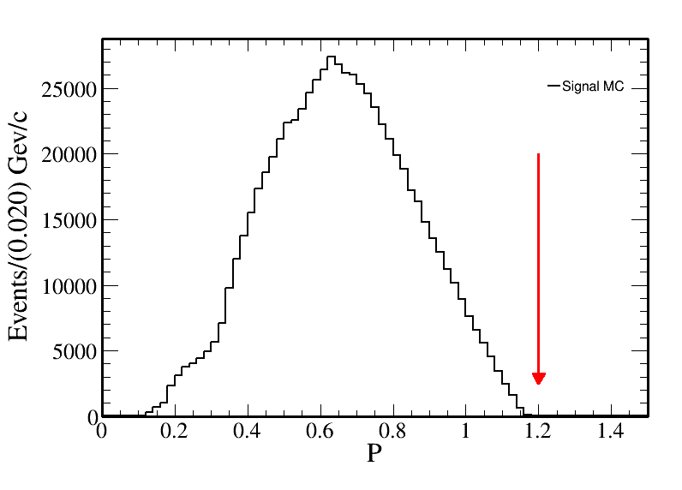
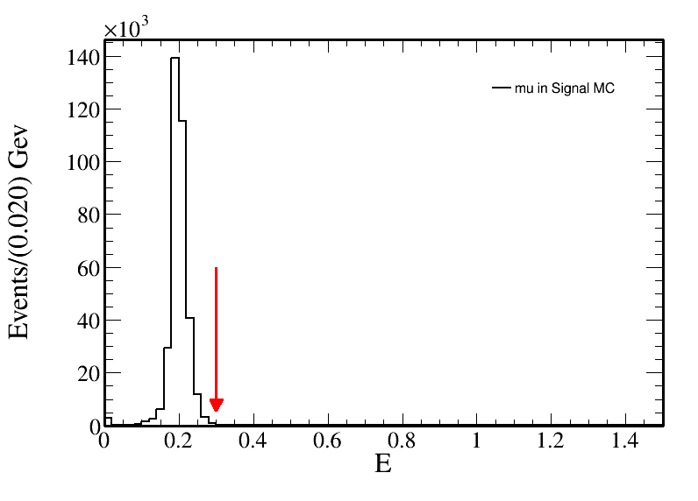
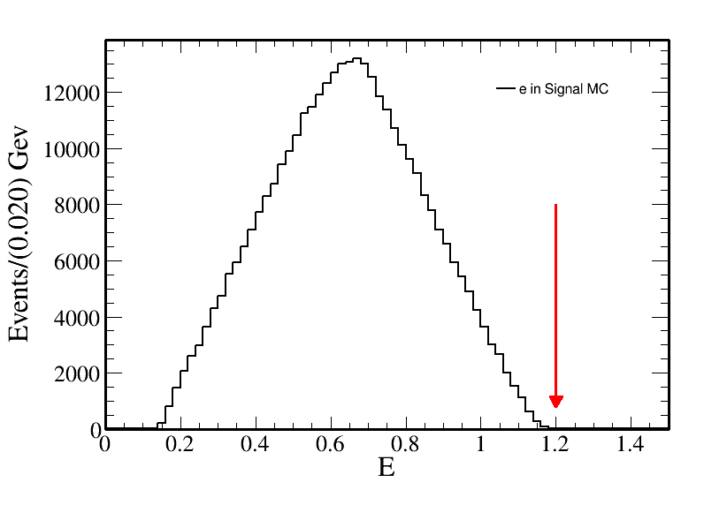
Further selection
For electron and muon:
Momentum in MDC: $P<1.2$
The energy in EMC: $E_{e}<1.2$
The energy in EMC: $E_{μ}<0.3$

Slide 9
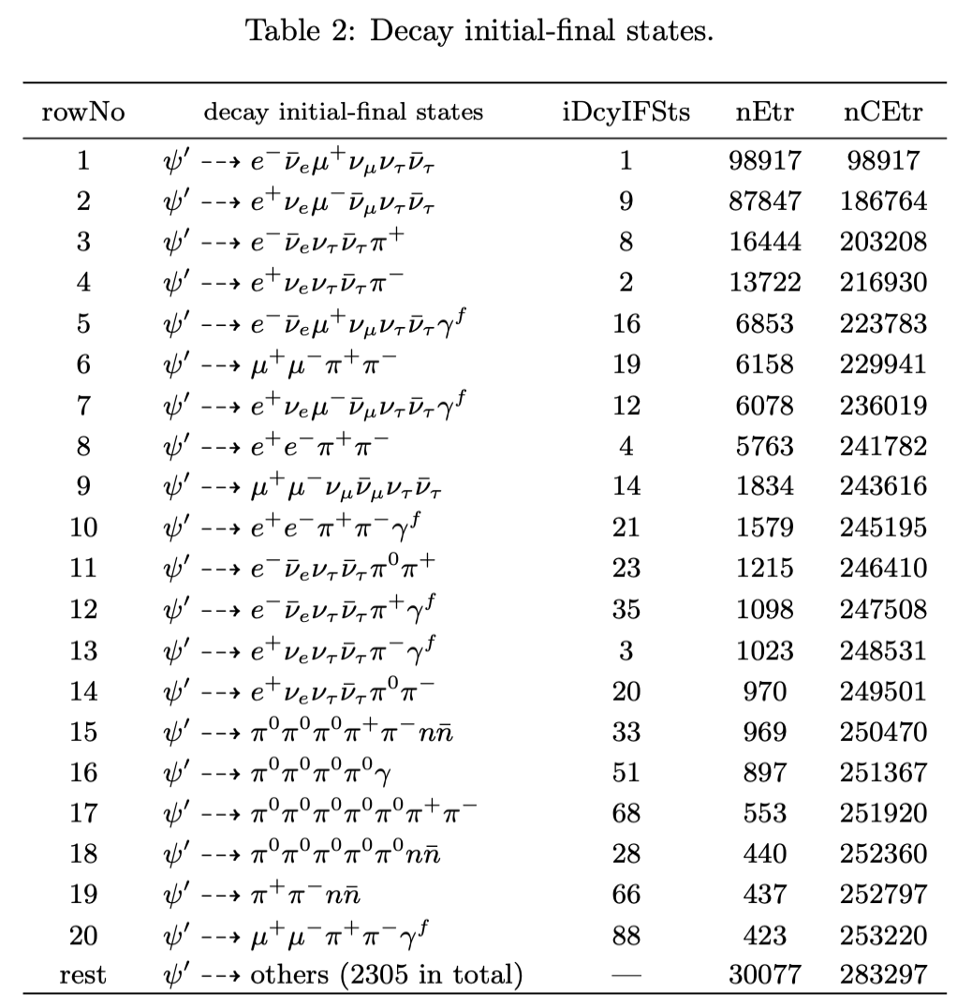
Further selection
Muon and Pion, need MUC information.
Electron, Muon
Need ep-ratio information

Slide 10
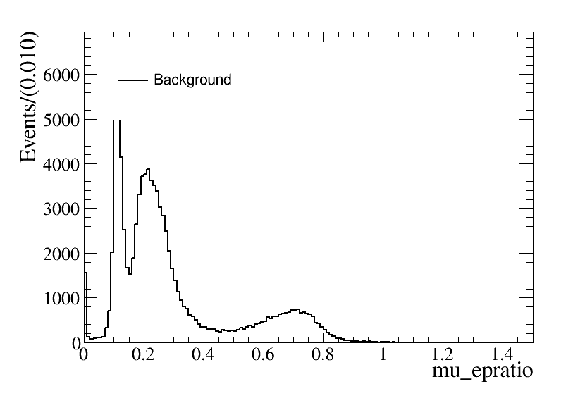
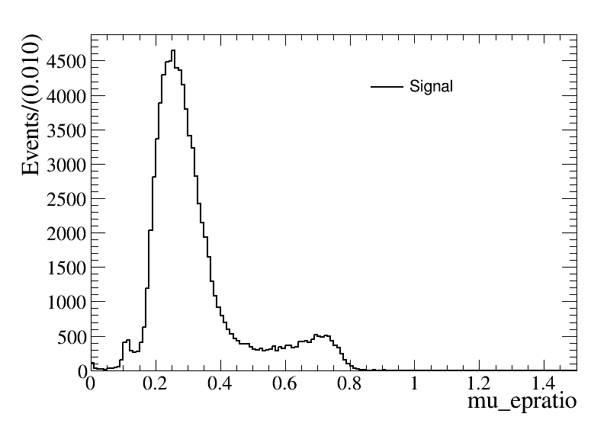
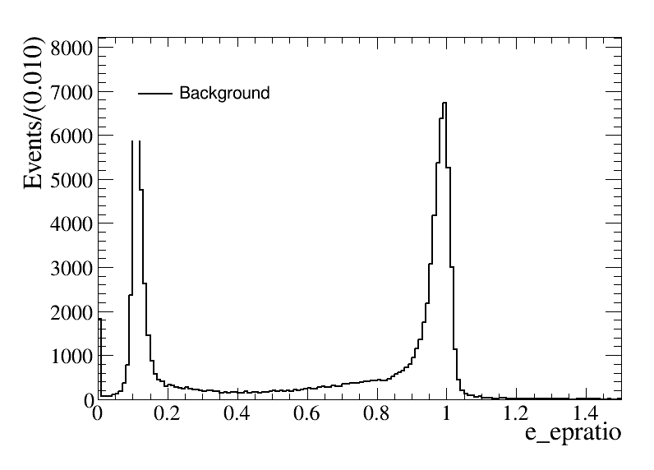
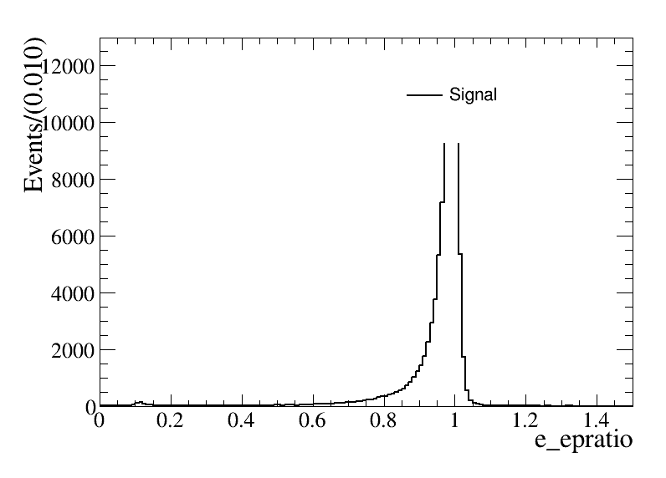
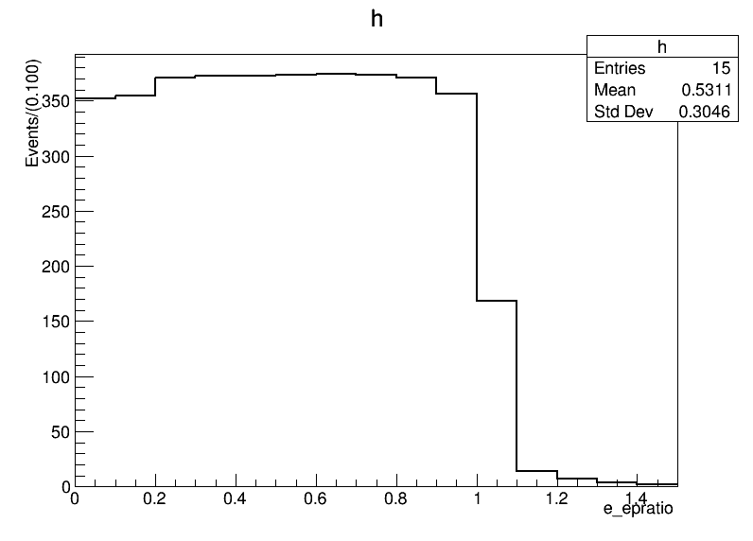
Further selection
For electron:
$FOM=S/{\sqrt{S+B}}$
$E/P>0.6$

Slide 11
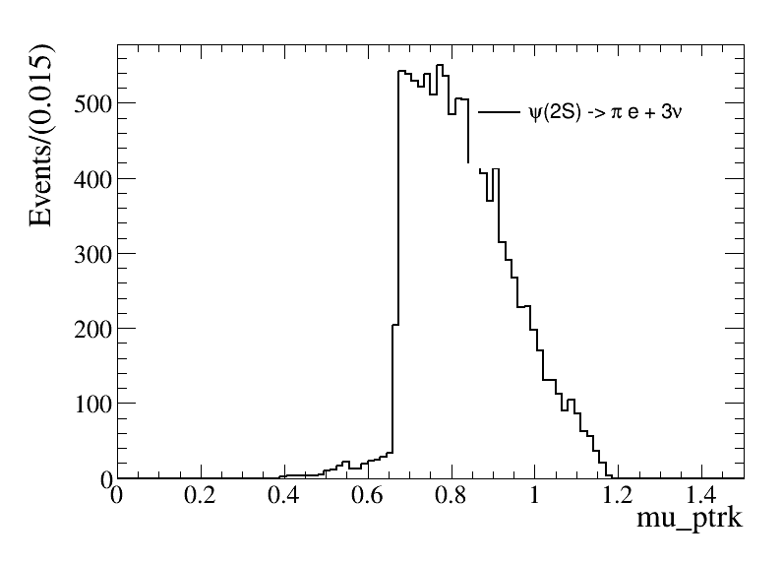
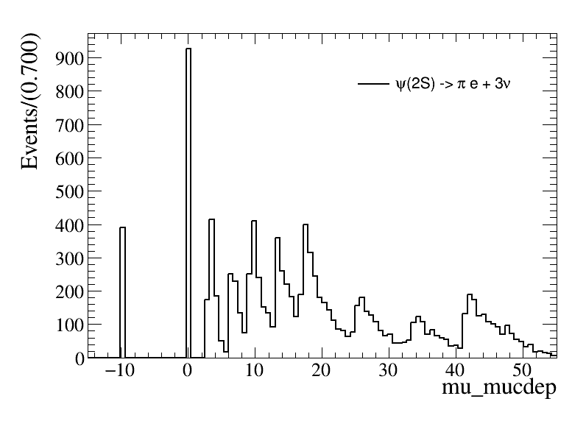
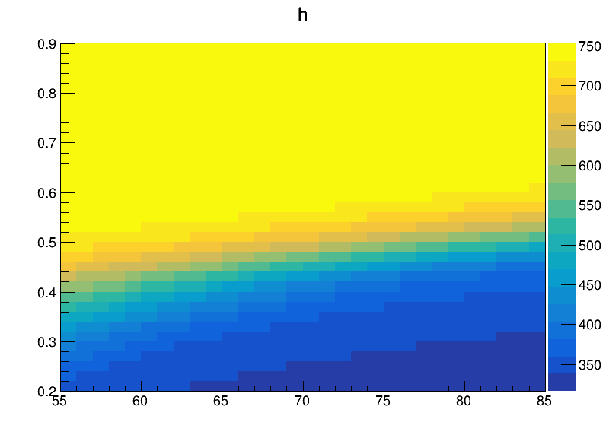
Further selection
Use the relationship between P and depth in the MUC
$FOM=S/{\sqrt{S+B}}$
$MUC_{depth}>81×(P−0.65)$

Slide 12
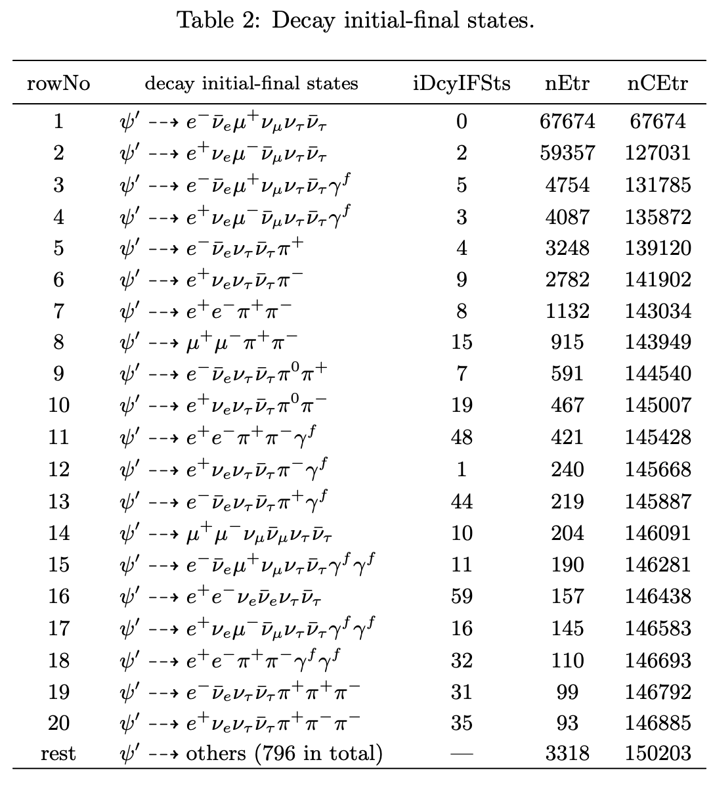
Further selection
The left background
Need the miss mass and miss $cosθ$
$M_{miss}=\left(P4_{ψ\left(2S\right)}−P4_{ll}\right)∙m()$
$cosθ_{miss}=\frac{−{\left(p_{1}+p_{2}\right)}_{z}}{|p_{1}+p_{2}|}$

Slide 13
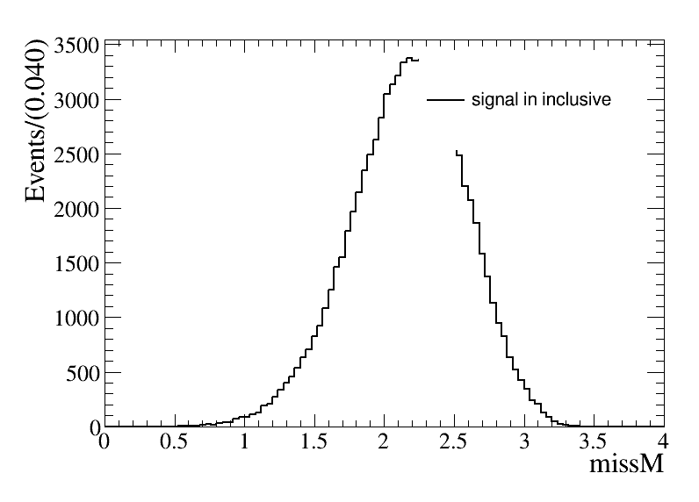
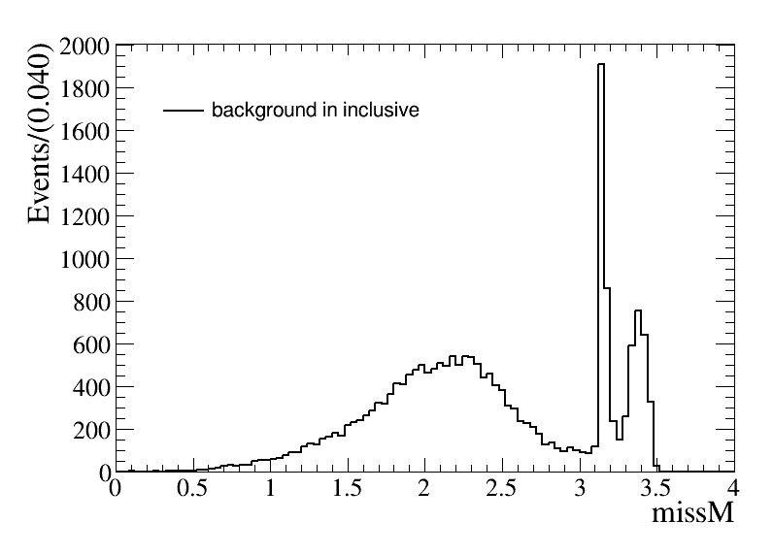
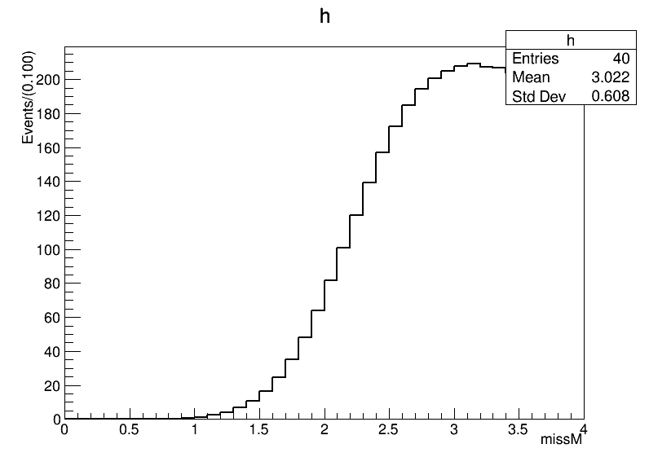
Further selection
$M_{miss}=\left(P4_{ψ\left(2S\right)}−P4_{ll}\right)∙m()$
The missing mass: $M_{miss}<3.05$

Slide 14
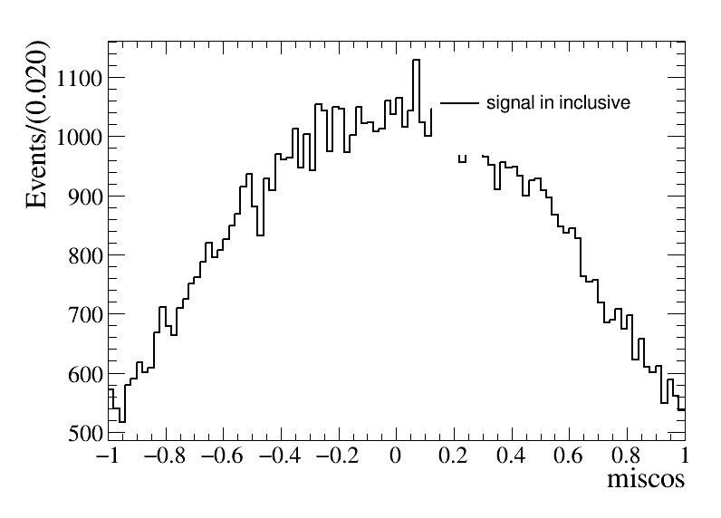
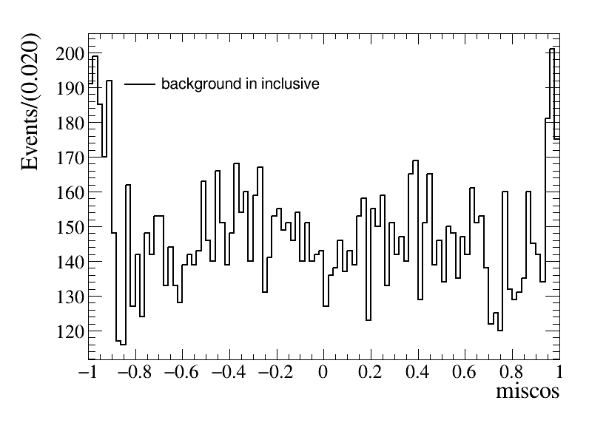
Further selection
$cosθ_{miss}=\frac{−{\left(p_{1}+p_{2}\right)}_{z}}{|p_{1}+p_{2}|}$
The missing $cosθ$: $|cosθ_{miss}|<0.8$

Slide 15
Data Vs MC

Slide 16
Data Vs MC

Slide 17
2025.4.8 Group Meeting

Slide 18
Last week work
Wiriya and Me have solved the problem!

Slide 19
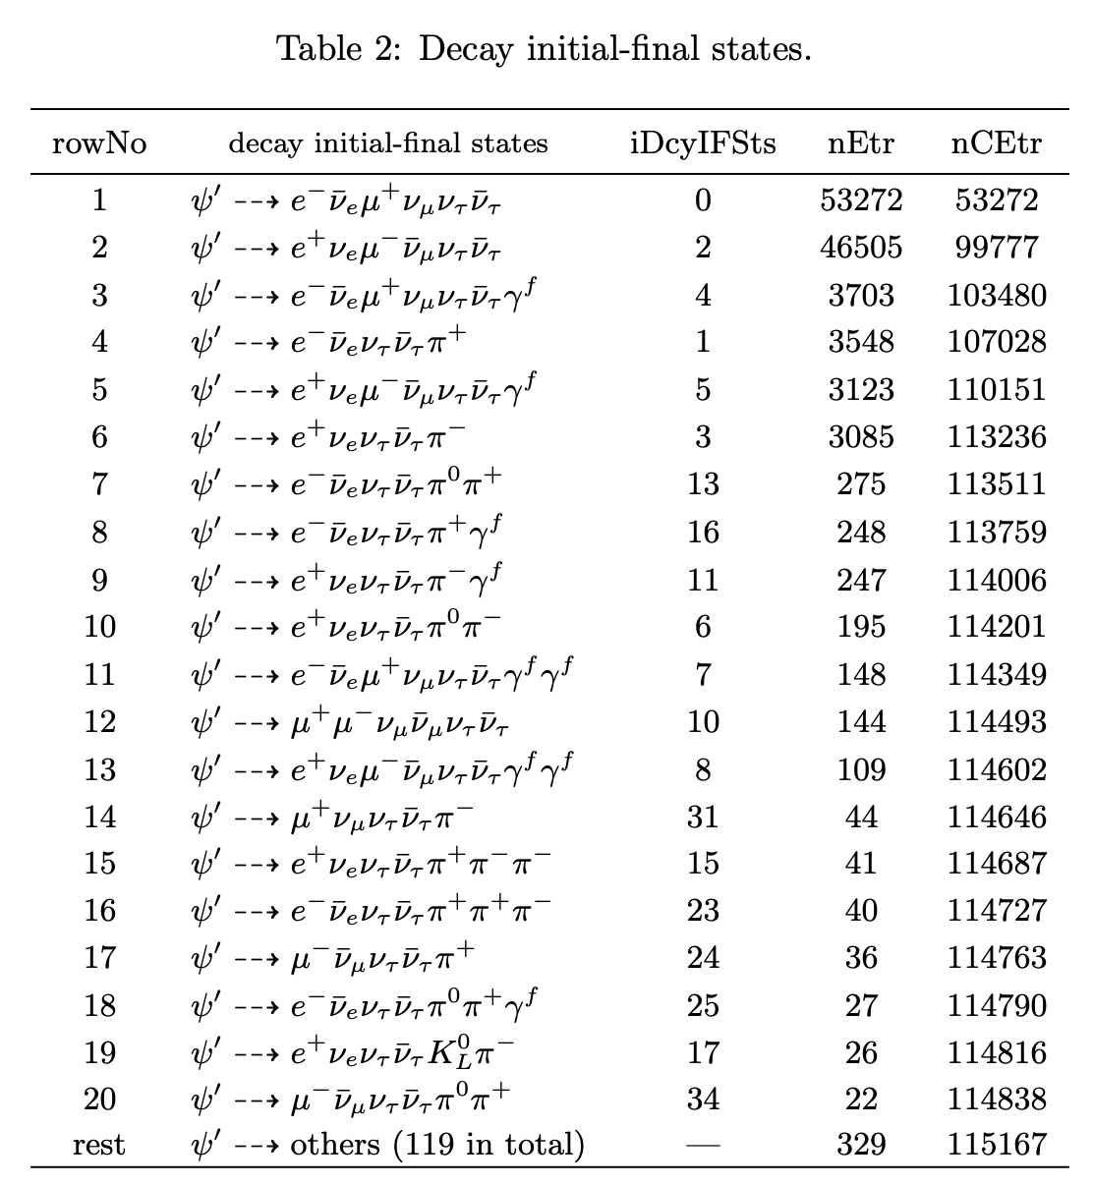
Background analysis
Main background
$ψ\left(2S\right)→τ^{+}τ^{−}→e^{+}π^{−}3ν+c.c.$
The number of background events is about 8564 in total, about 7.40% to inclusive MC.

Slide 20
Cut flow
Events selection | Signal MC | Inclusive MC
Total number | 1000000 (100.0%) | $23×{10}^{8}$
Charge choose | 826526 (82.65%, 82.65%) | $4.09×{10}^{8}$
Photon choose | 678673 (67.87%, 82.11%) | $3.77×{10}^{7}$
PID | 460925 (46.09%, 67.92%) | $9.01×{10}^{5}$
Vertex fit | 460397 (46.04%, 99.89%) | $8.99×{10}^{5}$
$$P<1.2$$ $$E_{e}<1.2,E_{μ}<0.3$$ | 444217 (44.42%, 96.49%) | 255632
$$E/P_{e}>0.6$$ | 432723 (43.27%, 97.41%) | 229257
$$depth_{MDC}>0$$ $$depth_{MDC}>81×(P−0.65)$$ | 278509 (27.85%, 64.36%) | 132928
$$M_{miss}<3.05$$ $$|cosθ_{miss}|<0.8$$ | 241432 (24.14%, 86.69%) | 115167
Detection efficiency | 24.14%

Slide 21
Result
The result from Inclusive MC
$$\tilde{R}=R_{μ^{+}e^{−}}^{T}∙R_{e^{+}μ^{−}}^{T}=R_{μ^{+}e^{−}}^{CP}∙R_{e^{+}μ^{−}}^{CP}=1+4δ$$
$\tilde{R}=1.00242$ and $δ=0.000605$
The result from data
$\tilde{R}=1.01743$ and $δ=0.0043575$
$δ$ is the CP violation part

Slide 22
Statistical error
For statistical error, if we want to measure the value of R
$$R=\frac{N_{1}}{N_{2}}$$
$$δR=R∙\sqrt{{\left(\frac{\sqrt{N_{1}}}{N_{1}}\right)}^{2}+{\left(\frac{\sqrt{N_{2}}}{N_{2}}\right)}^{2}}$$

Slide 23
Systematic uncertainty
For good charge track choose
The tracking eﬃciency uncertainties for electron and muon charged tracks are 0.5% and 0.2%.
Total uncertainty on tracking eﬃciency is 1.0% conservatively.
For good photon choose
Data-MC difference of photon selection eﬀiciencies is assigned as 0.2%.
For PID
Data-MC difference of MDC tracking eﬀiciencies is assigned as 1% per charged particle in analysis.
Total uncertainty on PID is 2.0%.

Slide 24
Systematic uncertainty
Vertex fit
Fit is studied by correcting the track helix parameters to reduce the difference between data and MC.
The systematic uncertainty can be calculated by: ${ε_{1}−ε_{2}}/{ε_{1}}$, where $ε_{1}$ is the efficiency with correction and $ε_{2}$ is the efficiency without correction.
The systematic uncertainty of 4C kinematic fit and vertex fit are calculated as 0%.
Signal window | Use correction | No correction
Final events | 460397 | 460397
Selection efficiency(%) | 46.04% | 46.04%
Uncertainty(%) | 0%

Slide 25
Systematic uncertainty
$π$ and $μ$ cut
Use control sample($ψ\left(2S\right)→π^{+}π^{−}J/ψ$, $J/{ψ→ρπ→π^{+}π^{−}π^{0}}$) corrected the number of $π$.
Decay mode | $$ε_{MC}$$ | $$ε_{DT}$$
$$J/{ψ→π^{+}π^{−}π^{0}}$$ | 0.9958 | 0.9942
$$δ=\left|\frac{ε_{DT}}{ε_{MC}}−1\right|=0.2\%$$

Slide 26
Systematic uncertainty
$M_{miss}$ cut
To evaluate the systematic uncertainty associated with the $M_{miss}$, we changed the $M_{miss}$from 3.05 to 3.10 GeV or 3.00 GeV, the maximum diﬀerence of CP violation between them was taken as the systematic uncertainty.
The systematic uncertainty of $M_{miss}$ is 0.1%.
 | Detection efficiency | $\tilde{R}$ and $δ$
$$M_{miss}<3.00$$ |  | $\tilde{R}=1.01743$ and $δ=0.0043575$
$$M_{miss}<3.05$$ |  | $\tilde{R}=1.01743$ and $δ=0.0043575$
$$M_{miss}<3.10$$ |  | $\tilde{R}=1.01745$ and $δ=0.0043625$

Slide 27
Systematic uncertainty
$cosθ_{miss}$ cut
To evaluate the systematic uncertainty associated with the $cosθ_{miss}$, we changed the $cosθ_{miss}$from 0.80 to 0.75 or 0.85, the maximum diﬀerence of CP violation calculation between them was taken as the systematic uncertainty.
The systematic uncertainty of $cosθ_{miss}$ is 5.6%.
 | Detection efficiency | $\tilde{R}$ and $δ$
$$cosθ_{miss}<0.75$$ |  | $\tilde{R}=1.01714$ and $δ=0.004258$
$$cosθ_{miss}<0.80$$ |  | $\tilde{R}=1.01743$ and $δ=0.0043575$
$$cosθ_{miss}<0.85$$ |  | $\tilde{R}=1.01645$ and $δ=0.0041125$

Slide 28
Systematic uncertainty
Summary of the systematic uncertainties is presented in Table.
The total systematic uncertainty is 6.04%.
Source | Uncertainty | Comment
MDC tracking | 1% | cited
Photon detection | 0.2% | cited
PID | 2% | cited
Vertex fit | 0%
$$π \text{and} μ \text{cut}$$ | 0.2% | cited
$M_{miss}$ cut | 0.1%
$cosθ_{miss}$ cut | 5.6%

