Slide 1
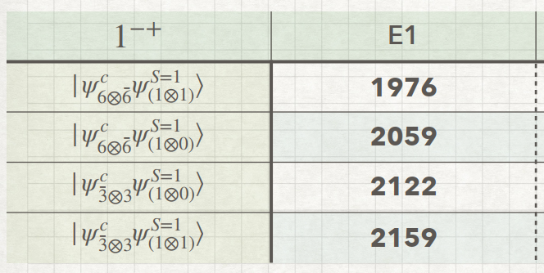
Results

Slide 2
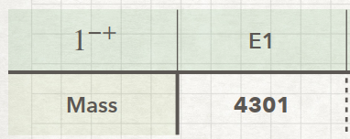

Slide 3
Predictions

Slide 4
Studying Plan
2025.04.08
Current working:
1. Calculate the mass of for the light ($qq\overline{q}\overline{q}$), , fully charm (cc$\overline{c}\overline{c}$), and, charmonium-like ($qc\overline{q}\overline{c}$) tetraquark.
2. Interpret the results and give the prediction.
Next planning:
1. Keep writing thesis.

