Slide 1











Probing Light Dark Matter in direct detection and neutrino experiments
4th 高能物理理论与实验融合发展研讨会 @ LNNU（Dalian）
Lei Wu
Yuanlin Gong, Liangliang Su, Bin Zhu + ...
+ RECODE
+ MARVEL
+ GPEX
Nature 2025 ( 2nd revision )
2509.01538
2504.13007
PRL 134 (2025) 7, 071001
PRL 131 (2023) 4, 041001
+ ……
Notes:
Thanks for invitation. It’s my great honor to come here to share our recent work on hunting for axions in reactor neutrino experiment. It is collaborated with my students, and recode collaboration people. The paper will come out this week.

Slide 2
Outline
From WIMPs to Light Dark Matter
LDM-Nucleus Scattering:
LDM-Electron Scattering:
A new axion factory:
Migdal effect
Quasi-elastic effect
Nature 2025 ( 2nd revision )
2504.13007
PRL 131 (2023) 4, 041001
Collective Excitations
PRL 134 (2025) 7, 071001
Nuclear Reactor
2509.01538
Notes:
Here is the outline of my talk. I will firstly talk about the motivation of light dark matter, and then focus on the inelastic scattering of light DM with the nucleus and also the collective excitations of light DM with the electrons.

Slide 3

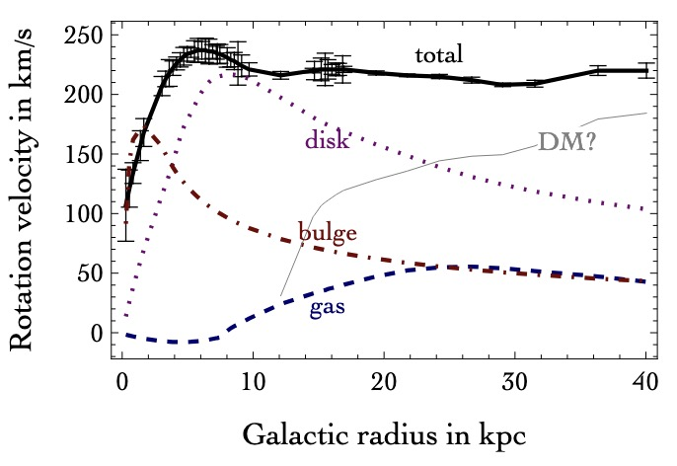
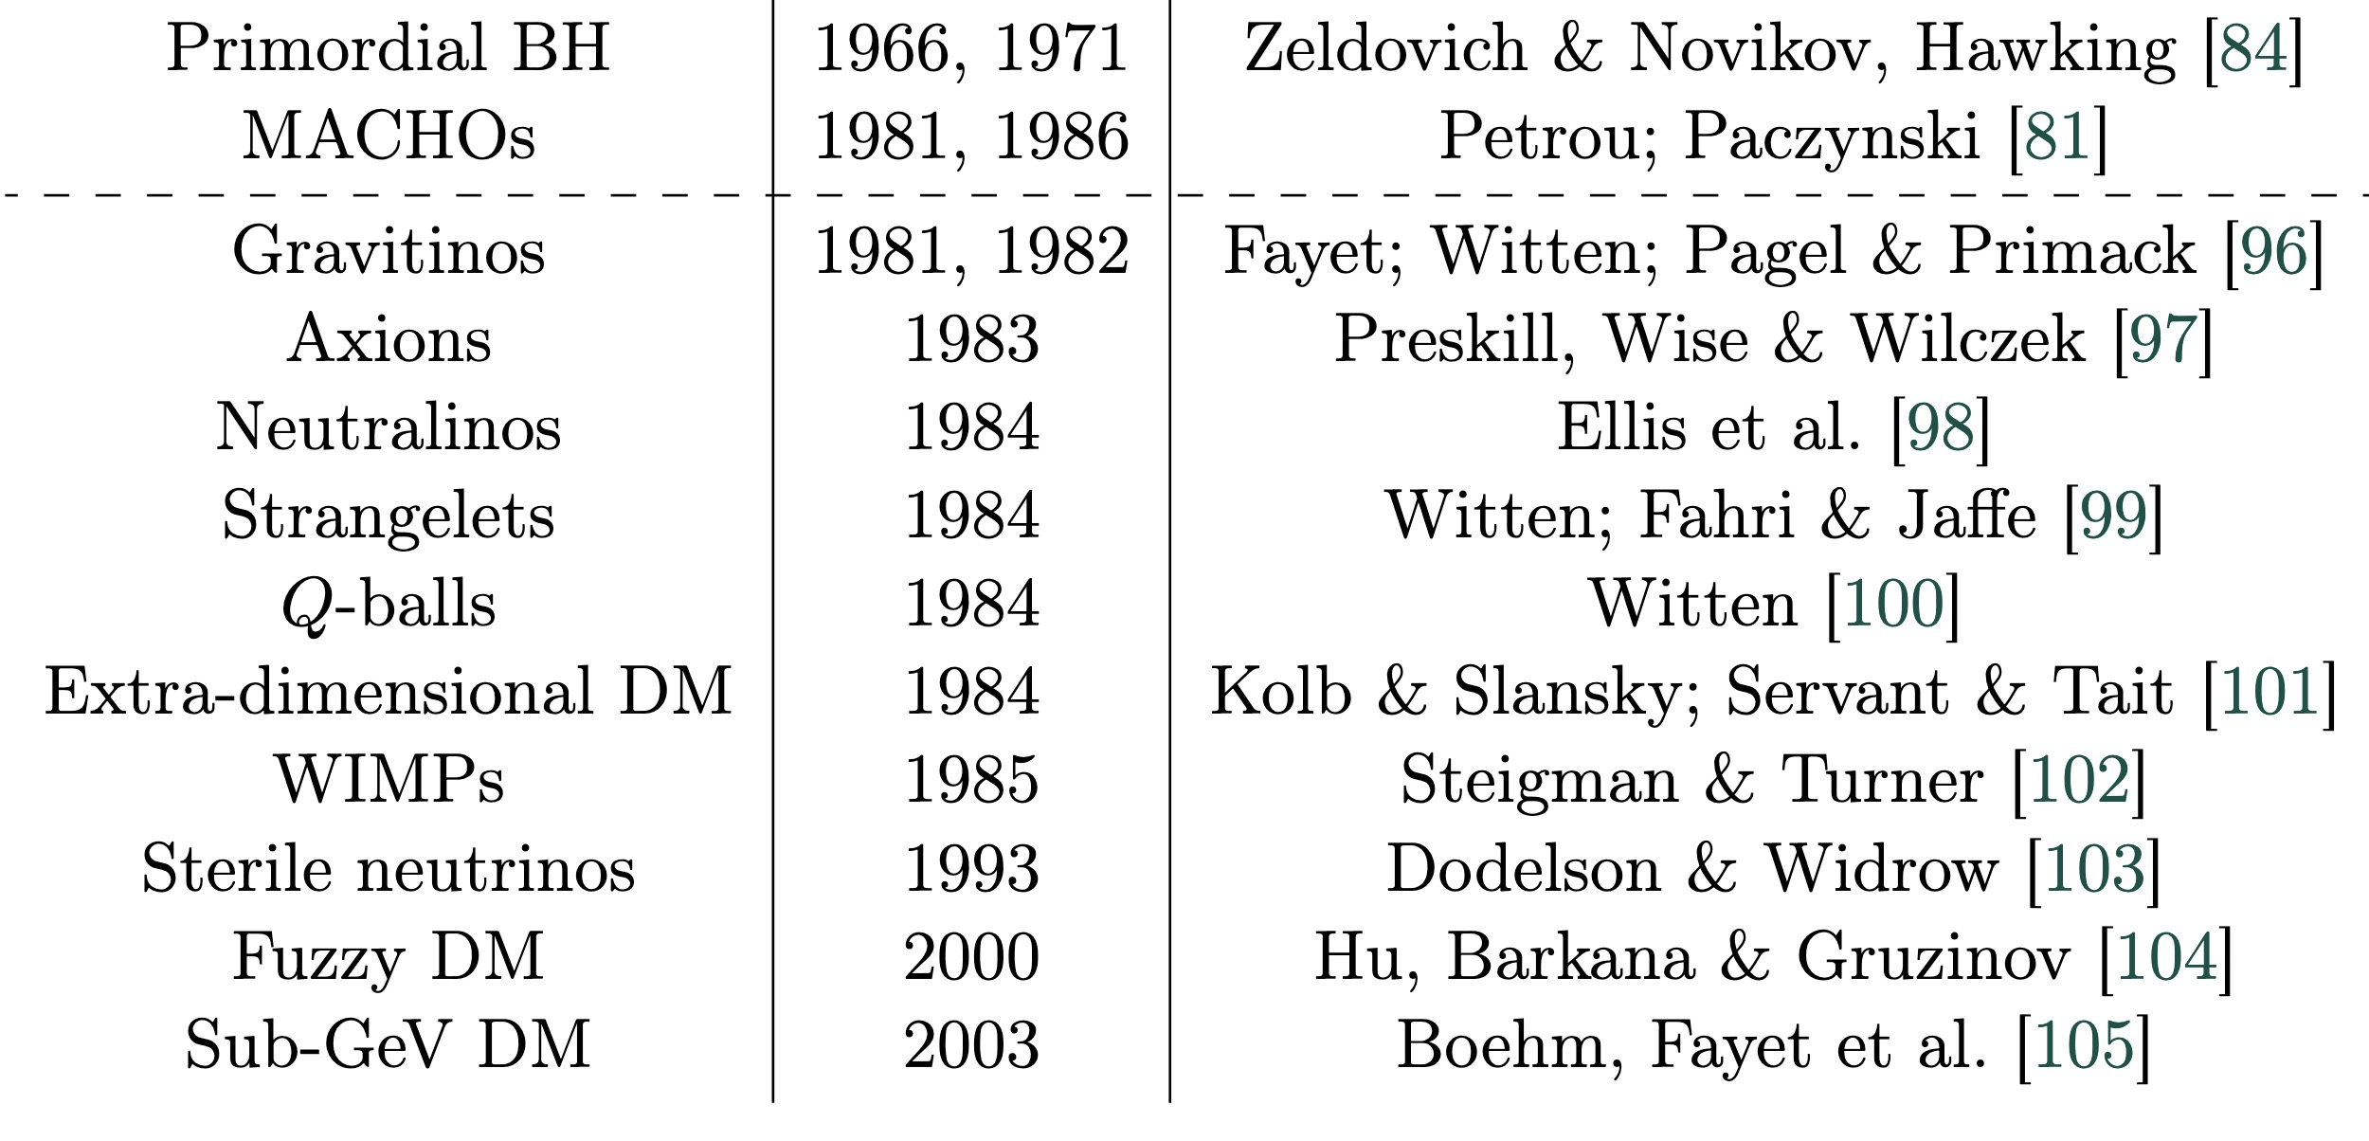
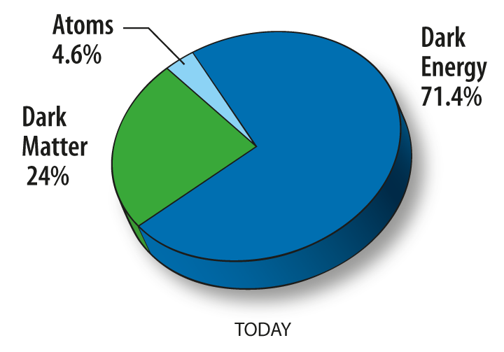
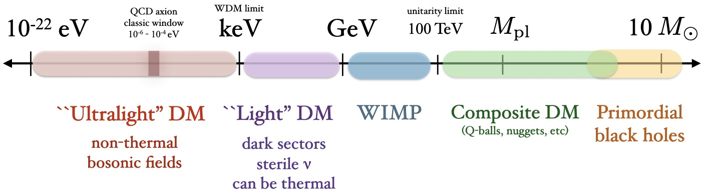
1. From WIMPs to Light DM
Relic Abundance
Solution to Big problems
(naturalness,
neutrino mass…)
T. Lin, 1904.07915
Notes:
There are plenty of dark matter candidates. Their mass ranges from 10⁻²² eV to several solar masses, spanning almost 80 orders of magnitude. Most of these candidates are well-motivated, not only as dark matter, but also relates to other big problems in particle physics and cosmology.

Slide 4
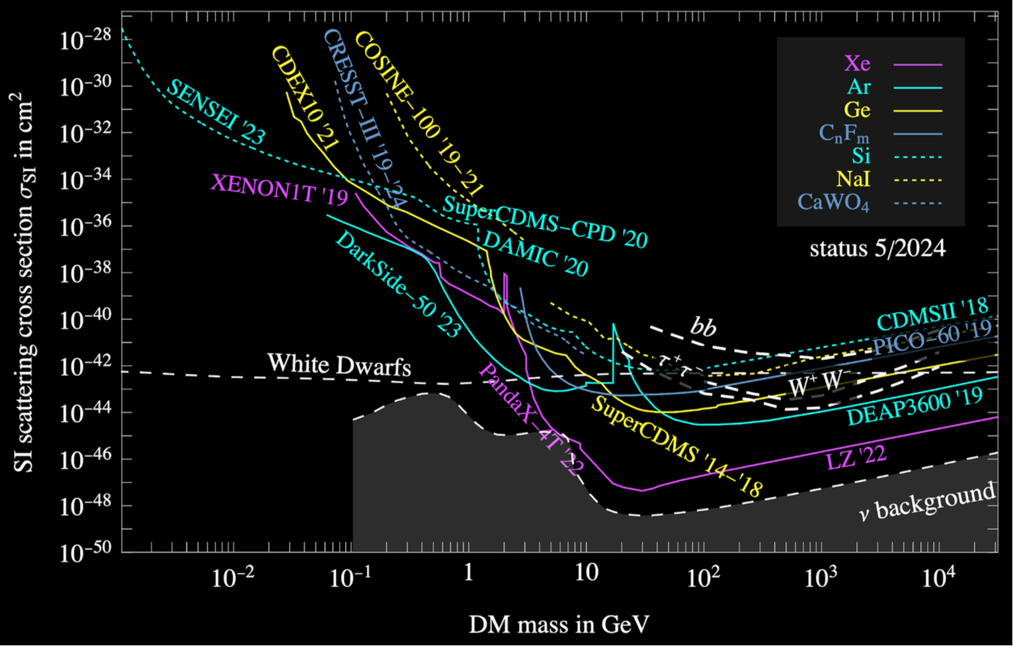
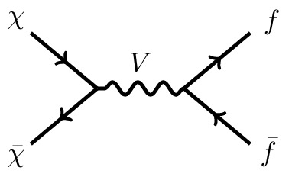
1. From WIMPs to Light DM
WIMPs
Light
Dark
matter
Notes:
WIMP is one of the most popular dark matter candidates. Many new physics models predict the WIMP dark matter, like supersymmetry, extra dimension etc and etc. In the past decades, a large portion of WIMP parameter space has been tested. Unfortunately, no positive signals have been reported. So it is a good time to think about other possibilities. For example, the light dark matter.

Slide 5
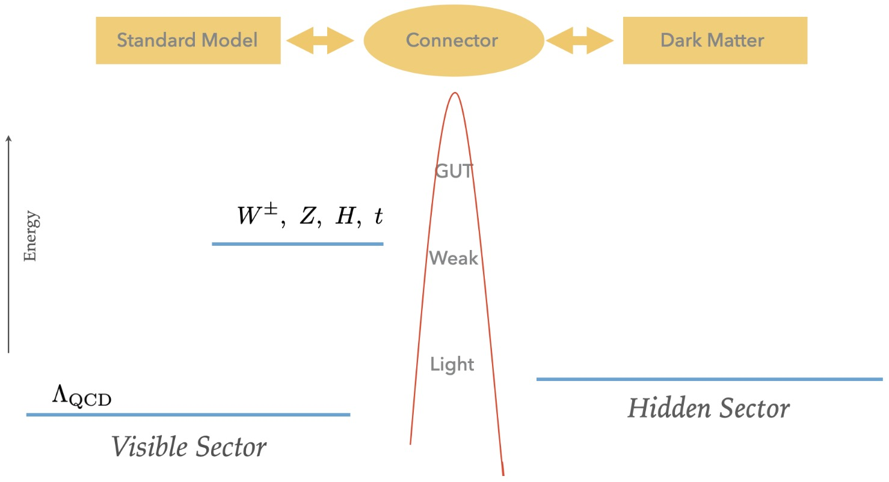
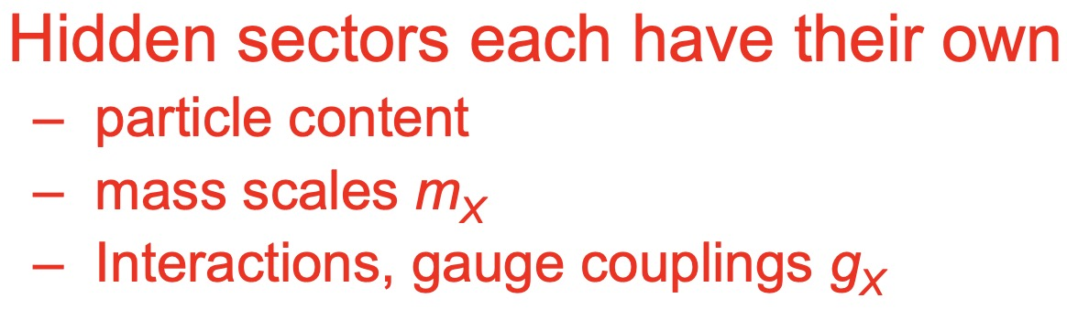
1. From WIMPs to Light DM
LDM Models: Hidden Sectors
A reasonable 1st guess:
Dark matter has no SM gauge
interactions, i.e.,
It is hidden and has hidden charge
U-boson
Secluded DM
WIMPless
Dark sector
Asymmetric DM
Boehm and Fayet, 0305261
Pospelov, Ritz, Voloshin, 0711.4866
Feng and Kumar, 0803.4196
Arkani-Hamed, etc, 0810.0713
Kaplan,
Falkowski, Ruderman, Volansky, 1101.4936
MeV - GeV DM, Freeze-out !
Notes:
The answer is yes. If dark matter lived in a hidden sector, and interact with the SM via some new mediators, then we can have a MeV to GeV thermal dark matter.

Slide 6
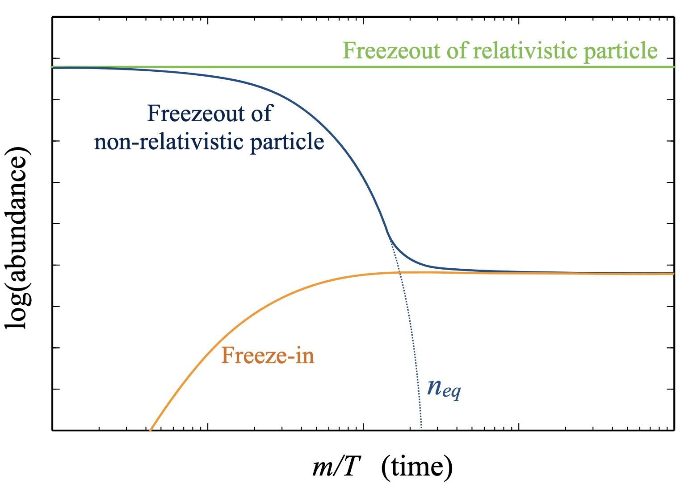
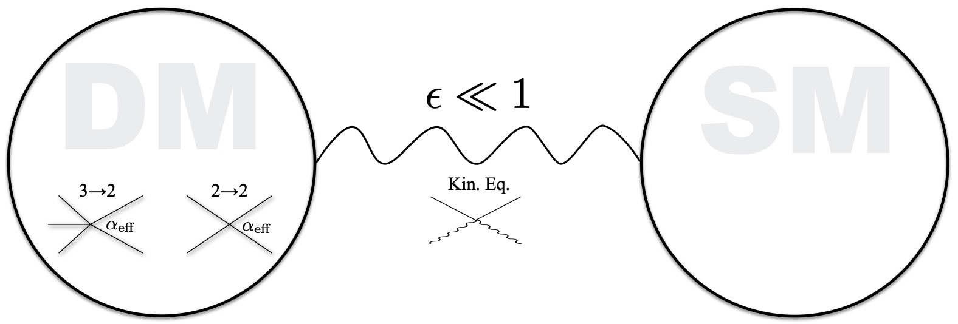
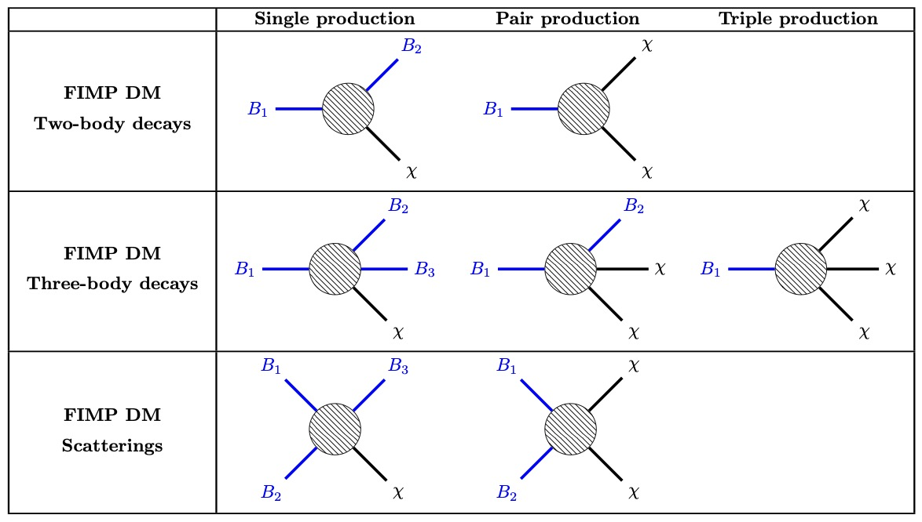


1. From WIMPs to Light DM
LDM Models: FIMPs
LDM Models: SIMPs
JCAP10(2021)045
Hochberg, Eric Kuflik, Volansky, Wacker, 1402.5143
Hall, Jedamzik, March-Russell, West, 0911.1120
keV - MeV DM, Freeze-in !
MeV DM, Cannibalization !
Notes:
Besides, we can also have kev-MeV dark matter via the freeze-in, and a MeV strongly interacting dark matter via cannibalization.

Slide 7
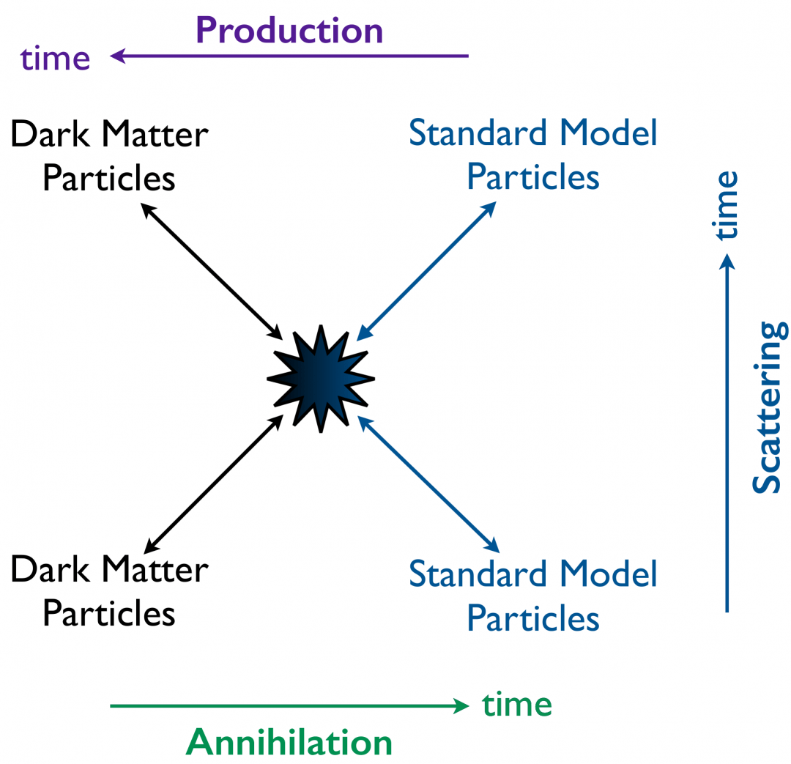
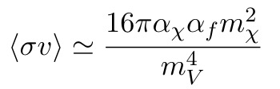



1. From WIMPs to Light DM
LDM Models: Light Mediators
BBN, CMB
Large Scale Structure
Stellar Evolution
……
Light non-SM mediator
Notes:
In most of light dark matter models, a light mediator is usually predicted. It can help us to produce the correct relics.

Slide 8
1. From WIMPs to Light DM
LDM Models: Probes
BBN, CMB
Large Scale Structure
Stellar Evolution and Cooling
……
Notes:
How to test the light dark matter models? Besides the conventional methods, we can also have probes from astrophysics and cosmology. The pheno is very rich. Here, I will focus on the direct detections.

Slide 9
Outline
From WIMPs to Light Dark Matter
LDM-Nucleus Scattering :
LDM-Electron Scattering:
A new axion factory:
Migdal effect
Quasi-elastic effect
Nature 2025 (2nd revision)
2504.13007
PRL 131 (2023) 4, 041001
Collective Excitations
PRL 134 (2025) 7, 071001
Nuclear Reactor
2509.01538
Notes:
Here is the outline of my talk. I will firstly talk about the motivation of light dark matter, and then focus on the inelastic scattering of light DM with the nucleus and also the collective excitations of light DM with the electrons.

Slide 10
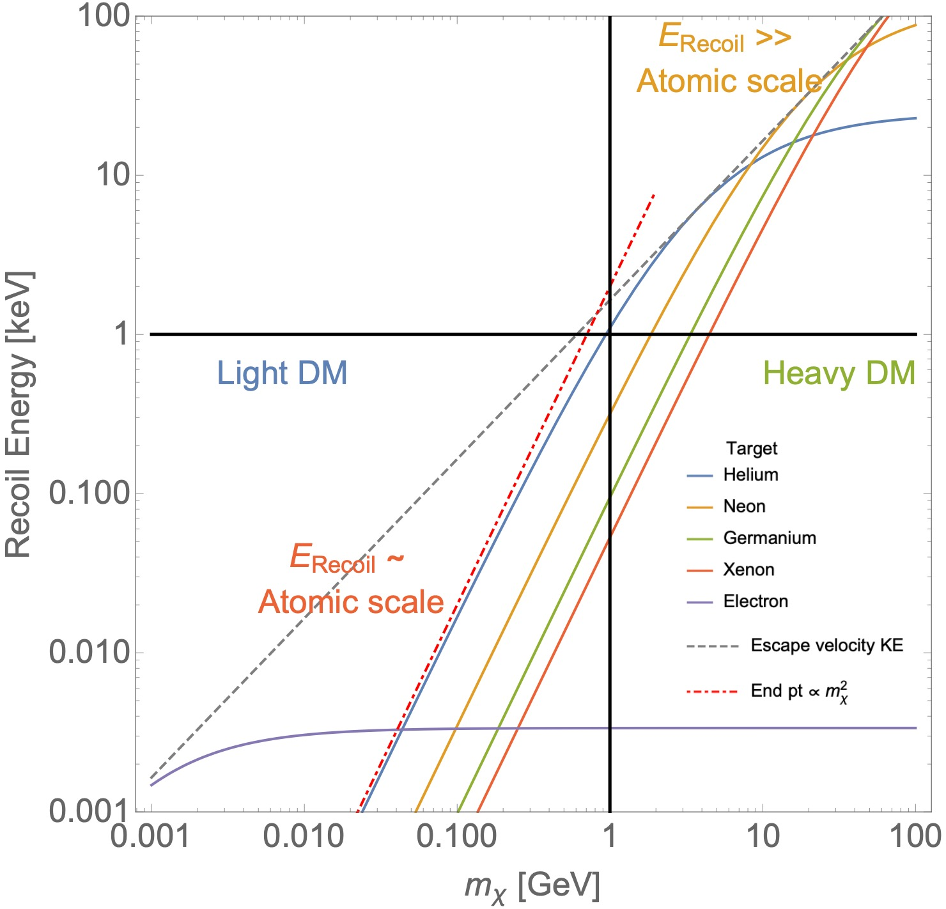
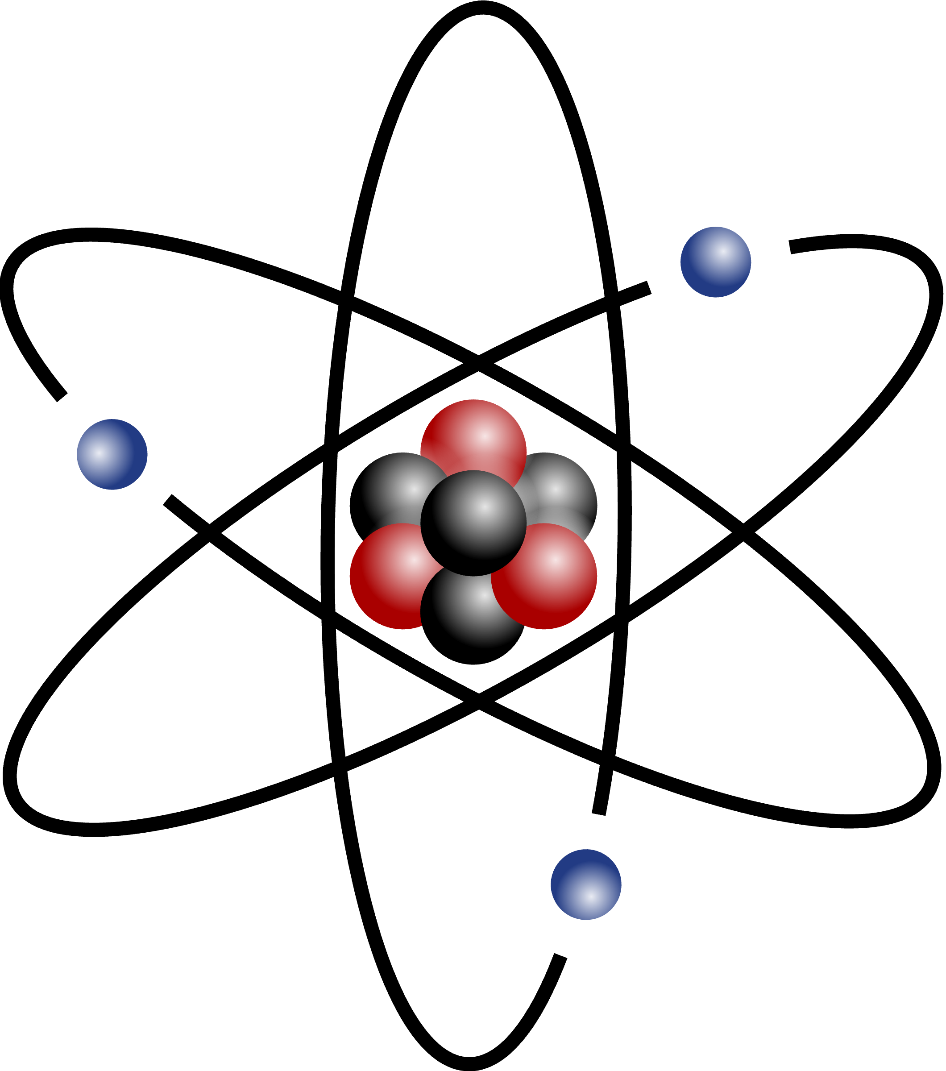

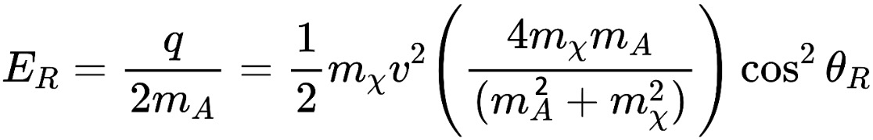
2. DM+Nucleus Scattering: Migdal Effect
DM
DM
2
Atomic effect
Acceleration mechanism
Notes:
Then a question comes out. That is whether we can detect the light dark matter in direct detection experiments. From this plot, we can see if the dark matter mass is lighter than 1 GeV, its nucleus recoil energy in elastic scattering process is usually less than 1 keV, and below the threshold of the detector. It seems impossible.

Slide 11
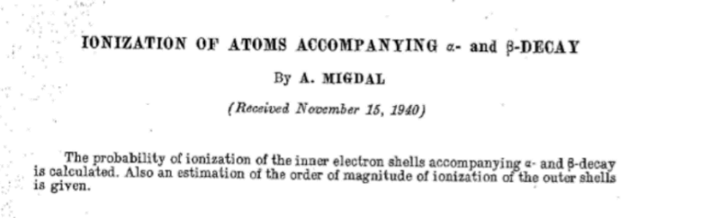
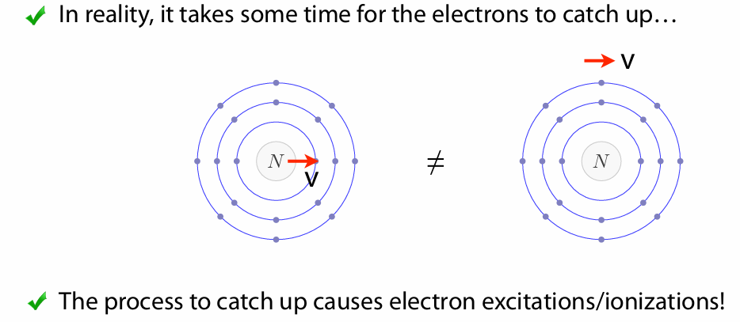
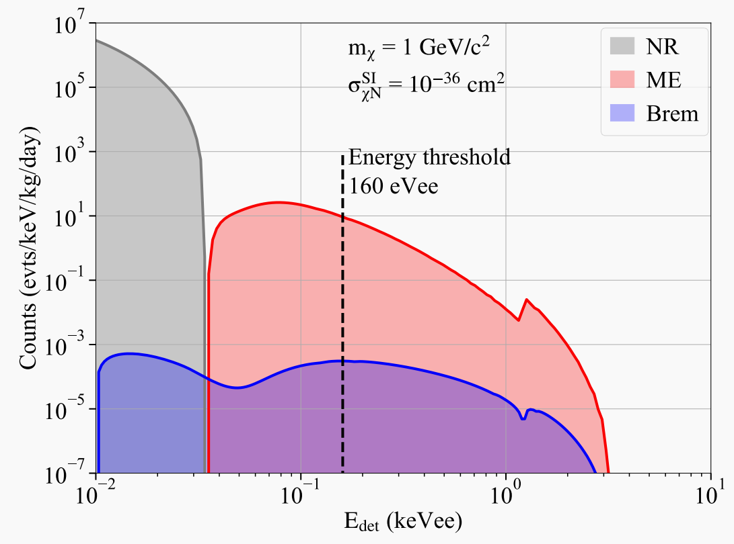
2. DM+Nucleus Scattering: Migdal Effect
Recoiling nuclei
Neutral projectile
Atom
Migdal electron
Energy deposition = nuclear scattering + Migdal effect electron
Migdal effect in a Germanium detector
Notes:
The Migdal effect describes the phenomenon in which the motion of atomic electrons lags behind the recoiling nucleus, resulting in electron excitation and ionization. This effect was first calculated by Migdal in the 1940s. In the conference presentations two days ago, Jianglai Liu and Suerfu Burkhant also discussed this effect and its significant implications for dark matter detection. To illustrate, as shown in this figure, consider a germanium detector with a threshold of 160 eVee, assuming a dark matter cross-section of 10^(-36) and a mass of 1 GeV. If we only consider the nuclear recoil process of dark matter, the maximum nuclear recoil energy would fall below the detector threshold. However, when the Migdal effect of the recoiling nucleus is taken into account, the total deposited energy has a certain probability of exceeding the detector threshold. This theoretically demonstrates that, with the inclusion of the Migdal effect, many direct dark matter detection experiments could gain sensitivity to sub-GeV dark matter.

Slide 12
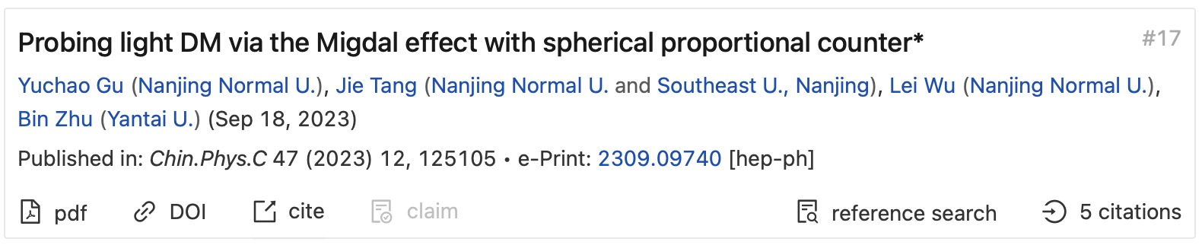
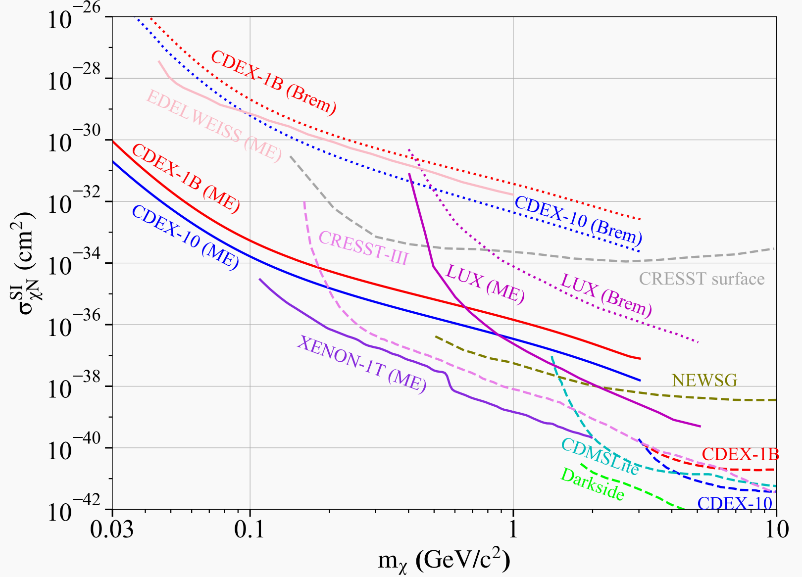
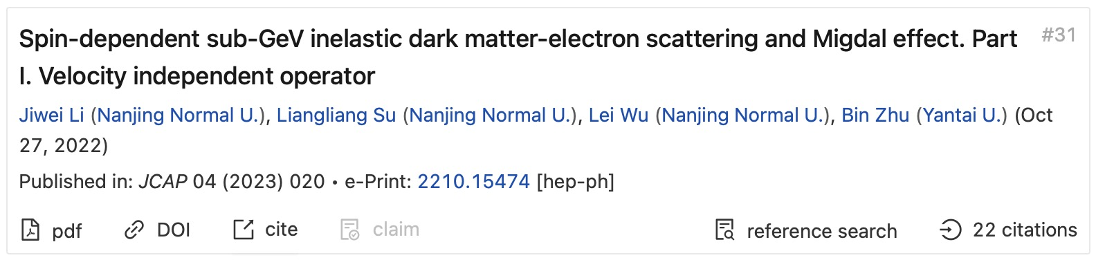
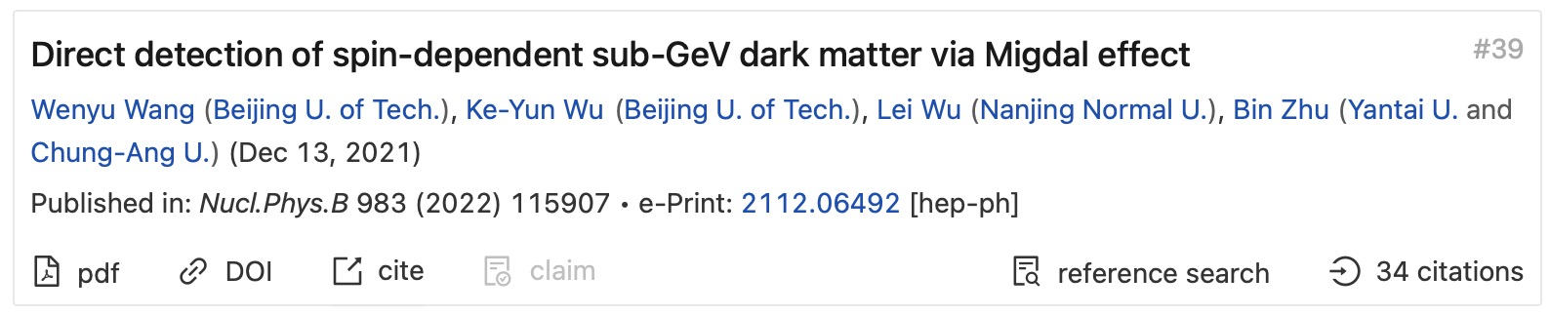
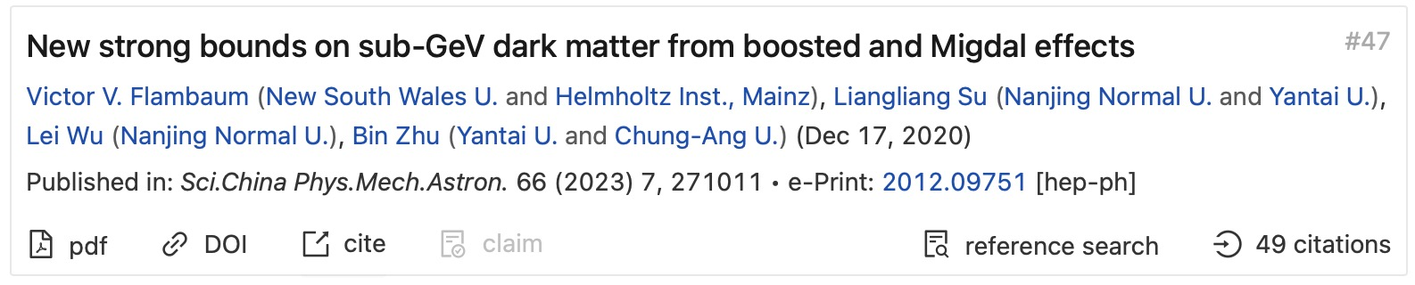
2. DM+Nucleus Scattering: Migdal Effect
Sub-GeV searches increasingly dominated by Migdal
Migdal （ME）
Bremsstrahlung (Brem)
Nuclear recoil
(Z.Liu, [PhD thesis], 2022)
Used but Not verified!
Notes:
The following figure compares the upper limits of dark matter cross-section measurements from several experiments before and after considering the Migdal effect. As can be seen, after incorporating the Migdal effect, many experiments gain sensitivity in the sub-GeV mass range. However, it is important to note that the Migdal effect has so far only been observed in α and β decay processes and has yet to be confirmed in neutral scattering processes. This introduces a potential uncertainty in the current dark matter cross-section estimates based on the Migdal effect. This uncertainty is precisely the motivation behind our proposal of the MARVEL experiment.

Slide 13
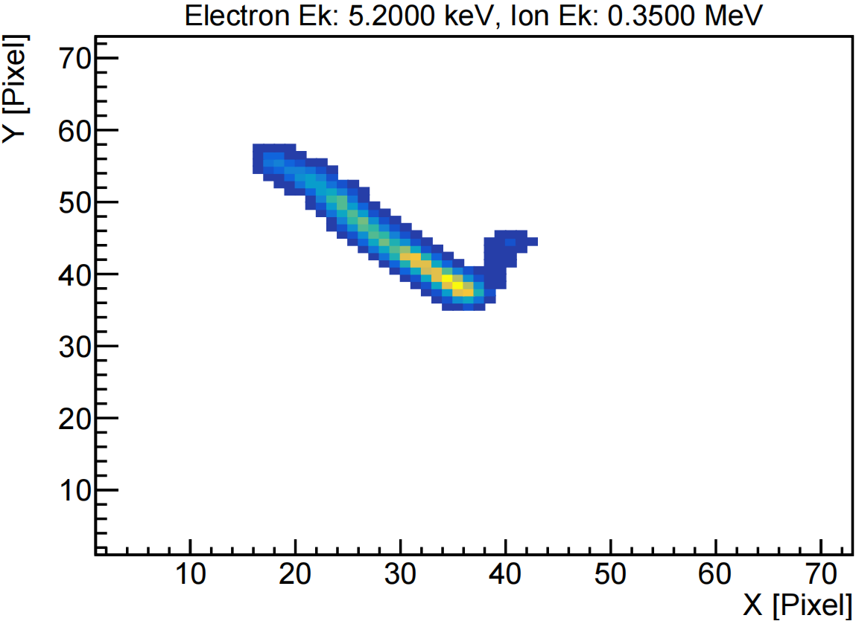
Characteristics of Migdal Events and Detector Requirements
2. DM+Nucleus Scattering: Migdal Effect
Sub-GeV searches increasingly dominated by Migdal
ER ~ keV，NR ~ hundreds keV
Good energy resolution
Large dynamic range.
ER shares vertex with NR
Good vertex resolution
Reduce possible background
Good time resolution
ER
NR
1 mm
Notes:
To confirm and directly observe the Migdal effect, the detector must meet certain performance requirements. The characteristic of the Migdal effect is the sharing of a single vertex by a low-energy electron track and a recoiling nucleus track. This requires that the detector has good energy resolution, especially for electrons, as well as a wide dynamic response range. The feature of sharing a single vertex requires the detector to have excellent vertex resolution. Additionally, since the Migdal effect is a rare event, the detector must possess good time resolution to reduce the impact of accidental coincidences.

Slide 14
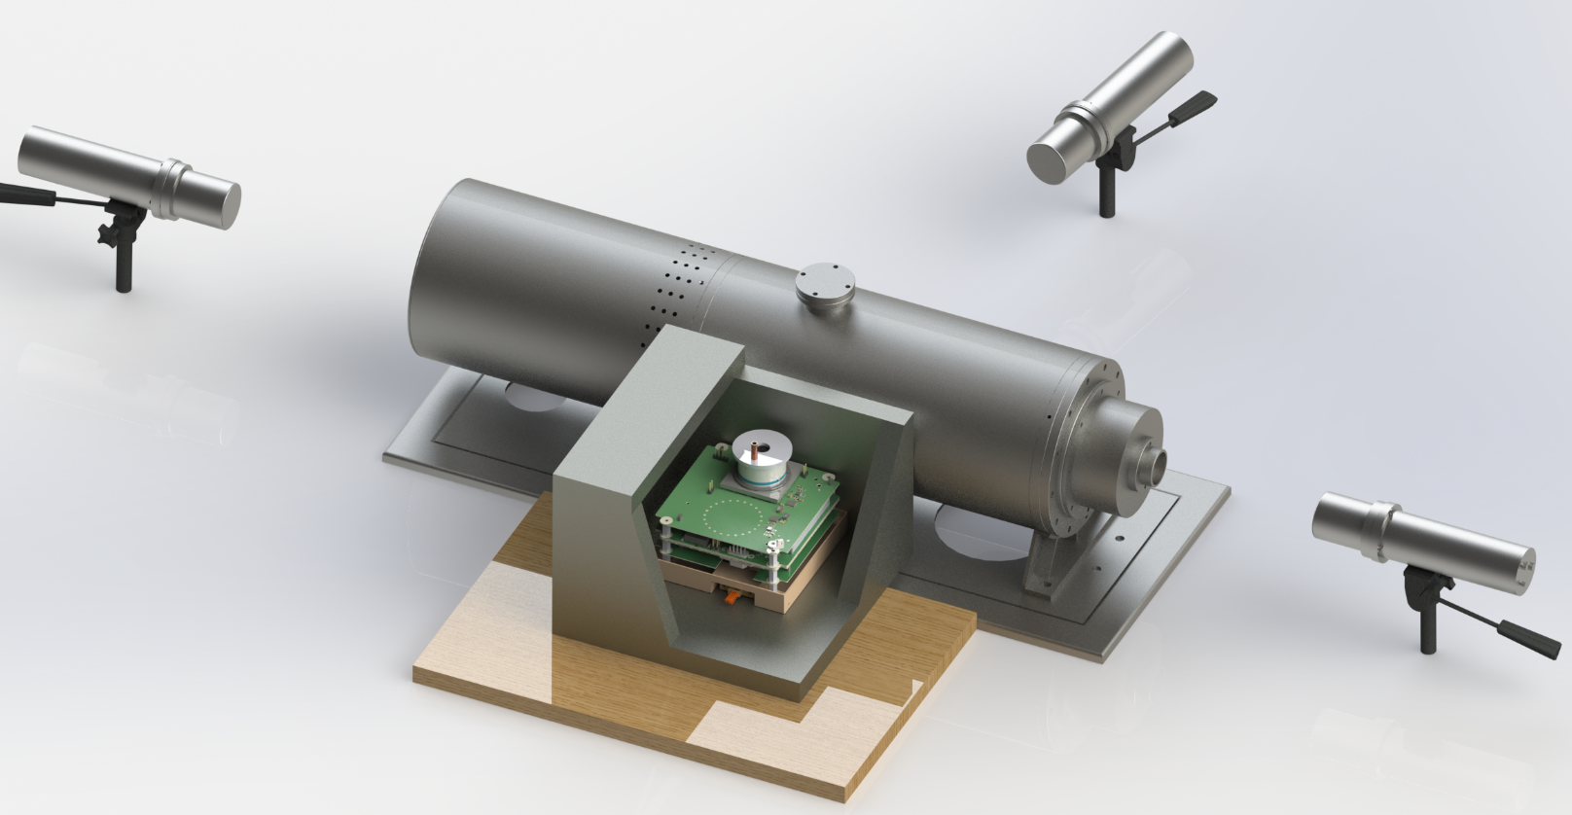
2. DM+Nucleus Scattering: Migdal Effect
Scintillator ②
Scintillator ①
Neutron and gamma spectrum measurement
D-D source monitoring
D-D 2.5 MeV source
Lead box
Scintillator ③
Working gas:
0.8 atm @ ~300 K
40% Helium + Dimethyl ether (DME,C₂H₆O)
Nucleus: hundreds of keV
Electron: 5-10 keV
D-D source monitoring
Migdal detector
Notes:
Next, we present our experimental setup. In the center of this figure is the D-D source, which generates 2.5 MeV neutrons in a 4π direction. The Migdal detector is placed inside a lead shielding box near the D-D source to shield against environmental gamma background. On the opposite side, is a liquid scintillator, used to measure the neutron and environmental gamma spectra. On both axial sides of the D-D source, additional liquid scintillator are placed, which operate synchronously with the Migdal detector to monitor variation of the neutron beam. The working gas we use is at 0.8 atmospheres at room temperature, with a composition of 40% helium mixed with DME. Our target detection range for Migdal electron energy is selected to be within 5-10 keV.

Slide 15
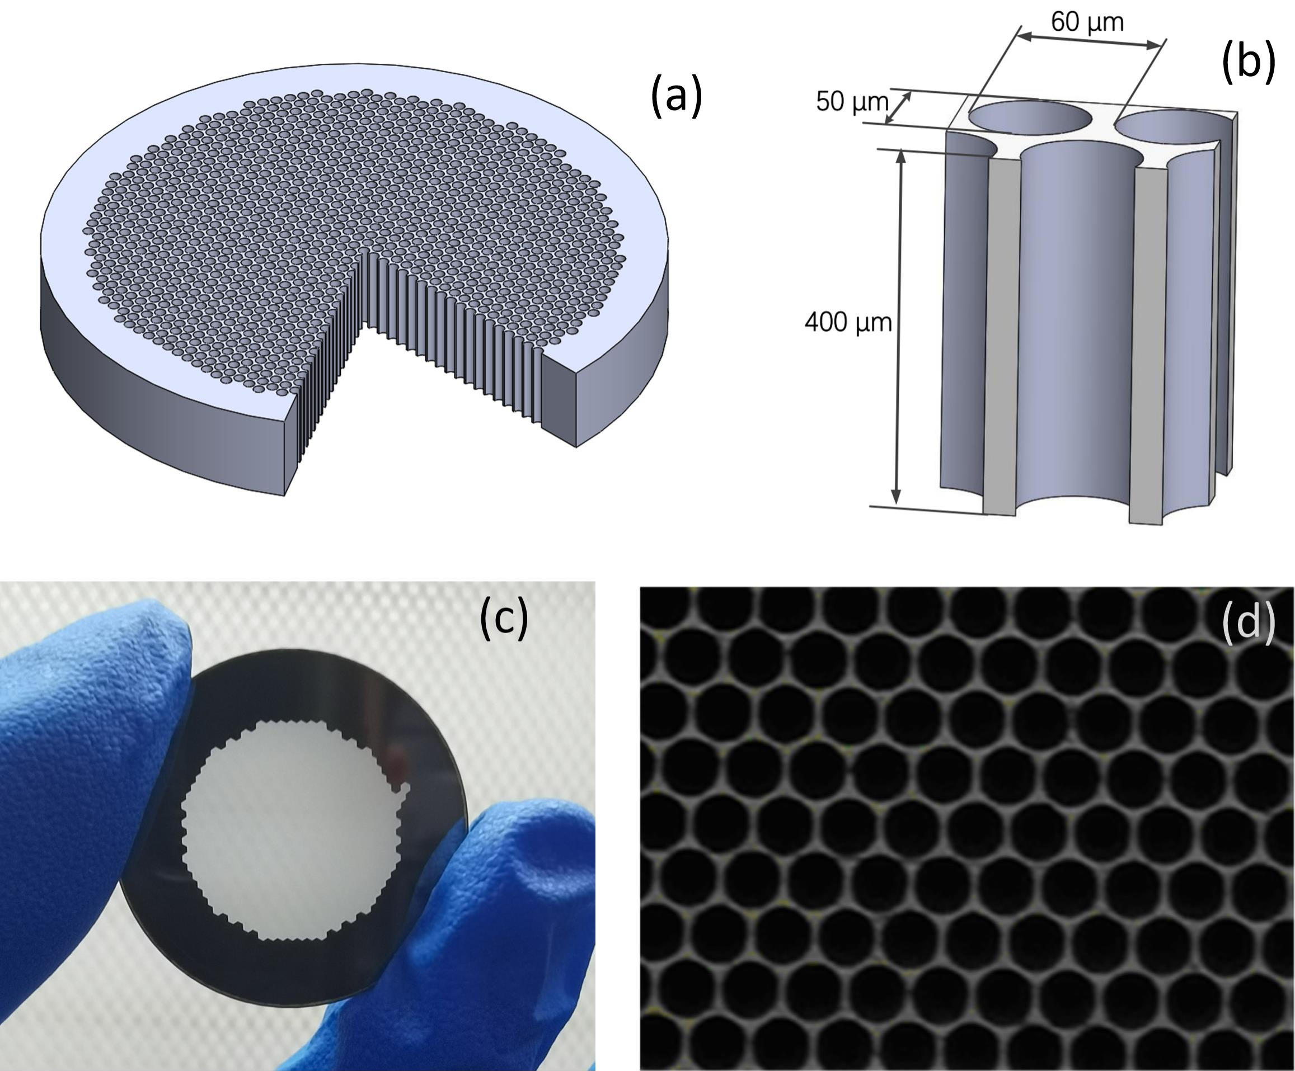
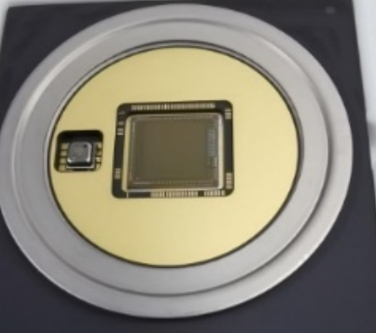
2. DM+Nucleus Scattering: Migdal Effect
GMCP
Topmetal
Notes:
Next, we present our experimental setup. In the center of this figure is the D-D source, which generates 2.5 MeV neutrons in a 4π direction. The Migdal detector is placed inside a lead shielding box near the D-D source to shield against environmental gamma background. On the opposite side, is a liquid scintillator, used to measure the neutron and environmental gamma spectra. On both axial sides of the D-D source, additional liquid scintillator are placed, which operate synchronously with the Migdal detector to monitor variation of the neutron beam. The working gas we use is at 0.8 atmospheres at room temperature, with a composition of 40% helium mixed with DME. Our target detection range for Migdal electron energy is selected to be within 5-10 keV.

Slide 16
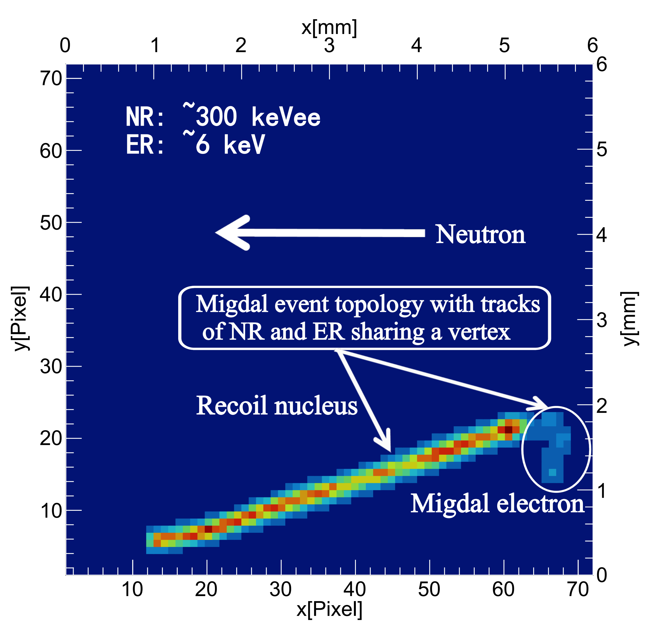

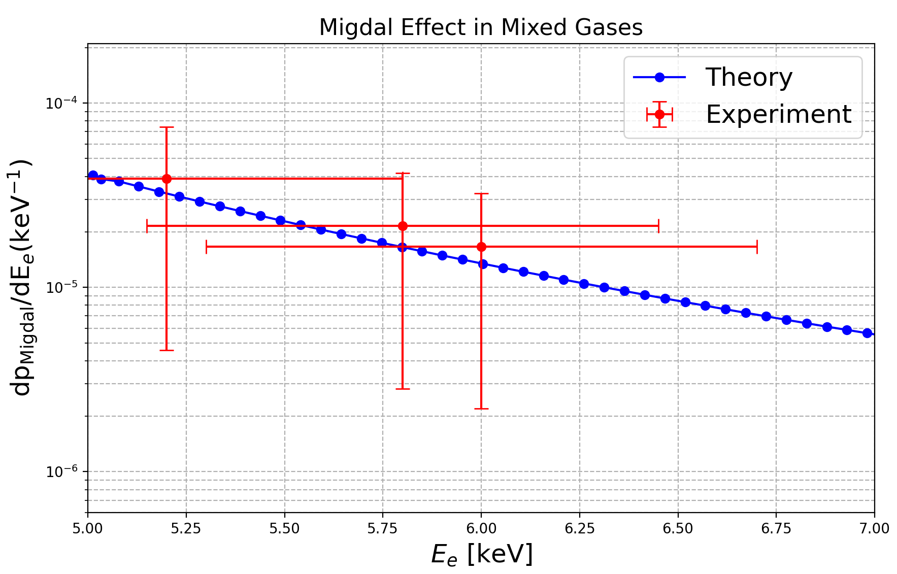
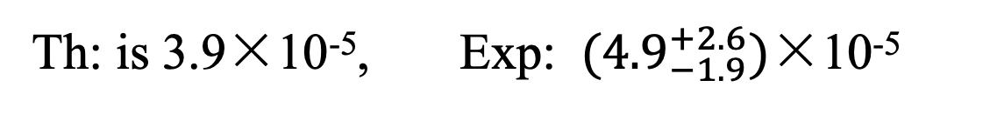
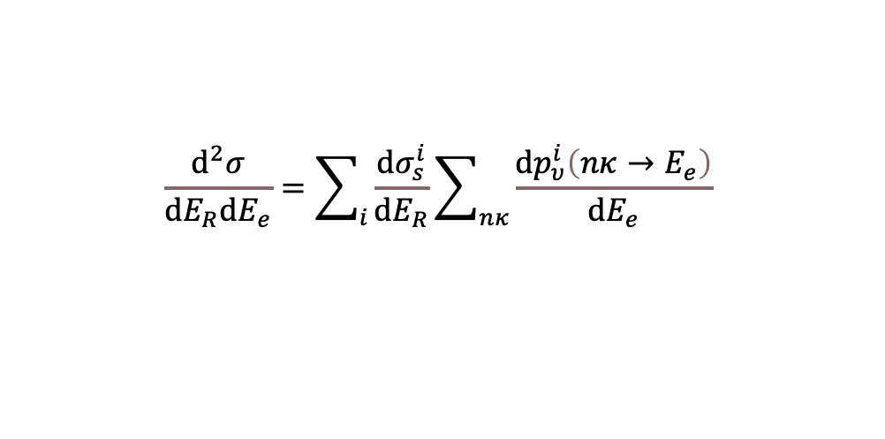
2. DM+Nucleus Scattering: Migdal Effect
$$\frac{d^{2}σ}{dE_{R}dE_{e}}=\sum_{i}{\frac{dσ_{s}^{i}}{dE_{R}}\sum_{nκ}{\frac{dp_{υ}^{i}\left(nκ→E_{e}\right)}{dE_{e}}}}$$
5𝞼
6/10⁶
Th: is 3.9×10⁻⁵, Exp: ${(4.9}_{−1.9}^{+2.6})$×10⁻⁵
Notes:
Next, we present our experimental setup. In the center of this figure is the D-D source, which generates 2.5 MeV neutrons in a 4π direction. The Migdal detector is placed inside a lead shielding box near the D-D source to shield against environmental gamma background. On the opposite side, is a liquid scintillator, used to measure the neutron and environmental gamma spectra. On both axial sides of the D-D source, additional liquid scintillator are placed, which operate synchronously with the Migdal detector to monitor variation of the neutron beam. The working gas we use is at 0.8 atmospheres at room temperature, with a composition of 40% helium mixed with DME. Our target detection range for Migdal electron energy is selected to be within 5-10 keV.

Slide 17
Outline
From WIMPs to Light Dark Matter
LDM-Nucleus Scattering :
LDM-Electron Scattering:
A new axion factory:
Migdal effect
Quasi-elastic effect
Nature 2025 (2nd revision)
2504.13007
PRL 131 (2023) 4, 041001
Collective Excitations
PRL 134 (2025) 7, 071001
Nuclear Reactor
2509.01538
Notes:
Here is the outline of my talk. I will firstly talk about the motivation of light dark matter, and then focus on the inelastic scattering of light DM with the nucleus and also the collective excitations of light DM with the electrons.

Slide 18
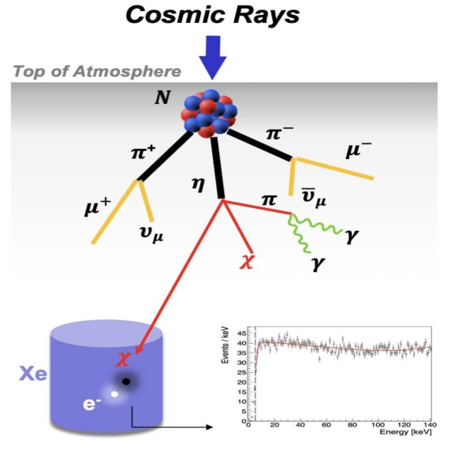
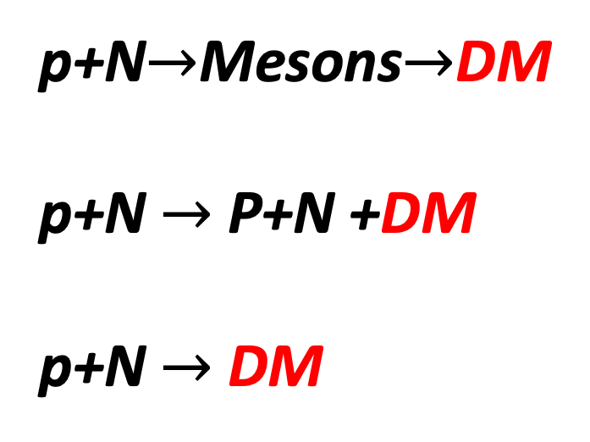
2. DM+Nucleus Scattering: Quasi-elastic Scattering
“Atmospheric DM”
Nucleus recoiling
Su, Wang, Wu, Yang, Zhu, 2006.11837
p+N$→$Mesons$→$DM
p+N $→$ P+N +DM
p+N $→$ DM
Notes:
But on the 2nd thought, it may be possible, because DM-nucleus interactions are not limited in direct detection. They can also appear in many hadronic processes. For example, the light DM can be produced from the meson decay through the inelastic scattering of cosmic rays with the atmosphere, from bremsstrahlang and DIS processes.

Slide 19
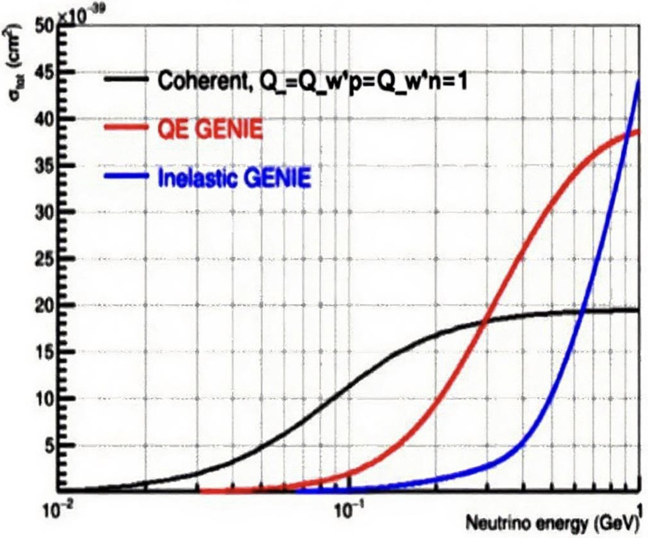
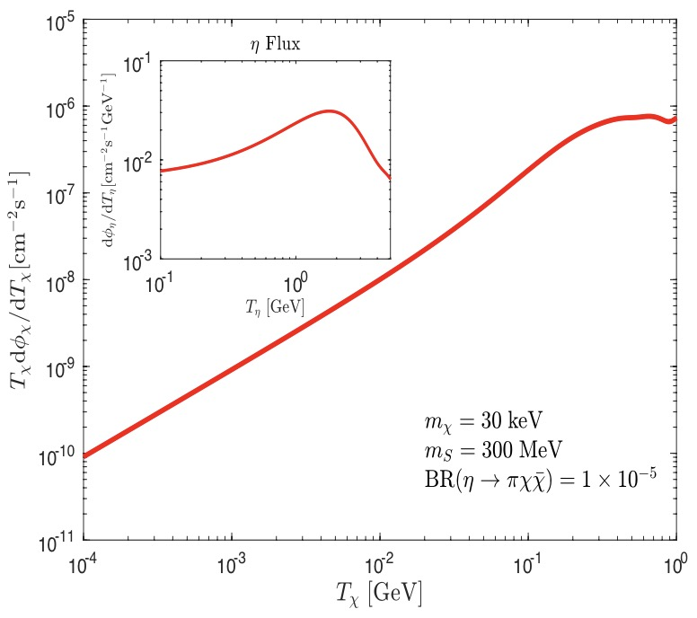
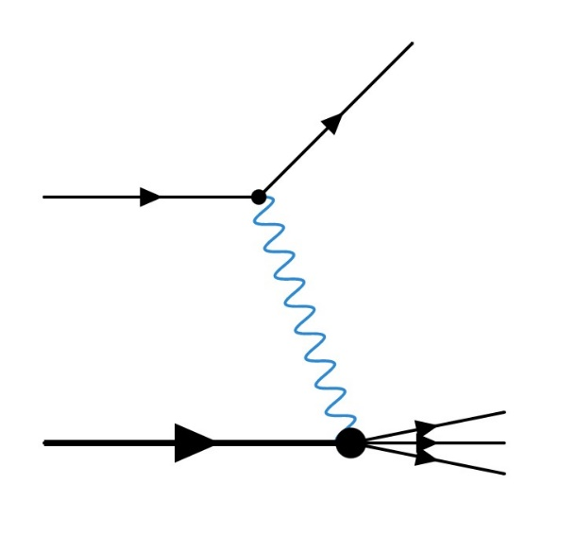
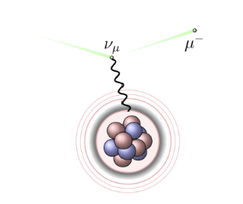

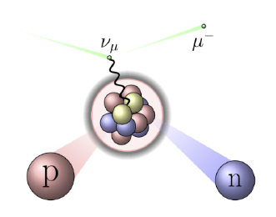
2. DM+Nucleus: Quasi-elastic Scattering
Su, Wu, Zhou, Zhu, 2212.02286
Nucleus recoiling
$$pN→η→πS(→χ\overline{χ})$$
DM-nucleus ES
DM-nucleus QES
DM-nucleus DIS
Notes:
From this plot, we can see that the adm is highly boosted. Its kinetic energy can reach hundreds of MeVs and even larger. This means the interaction between such a boosted dark matter and nucleus is dominated by quasi-elastic scattering and even deep inelastic scattering, rather than elastic scattering. Here I will focus on the DM-nucleus quasi-elastic scattering.

Slide 20
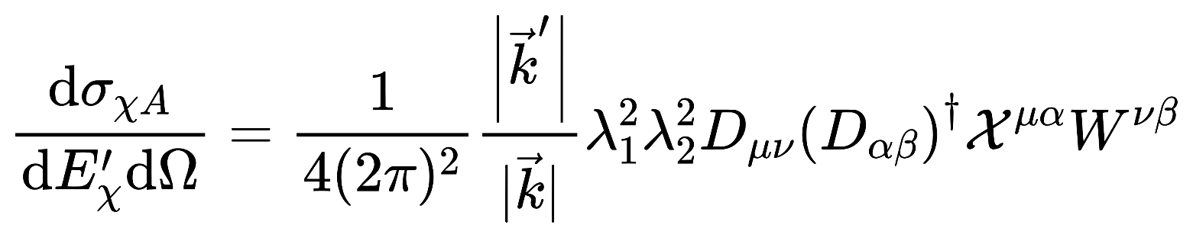
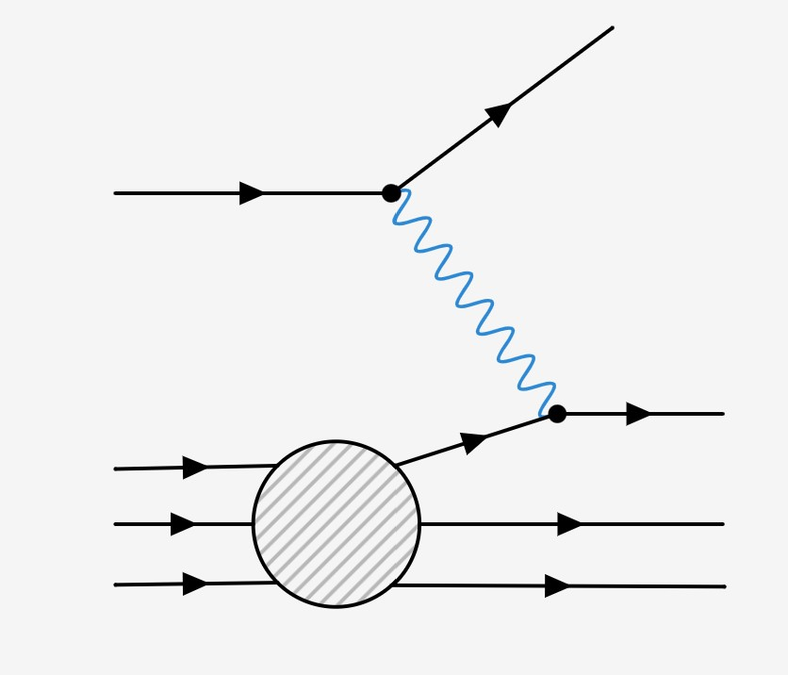



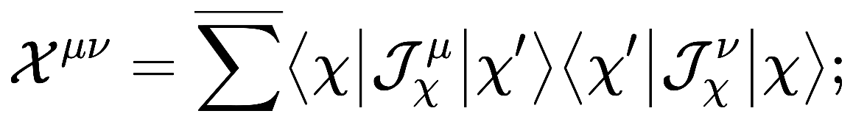







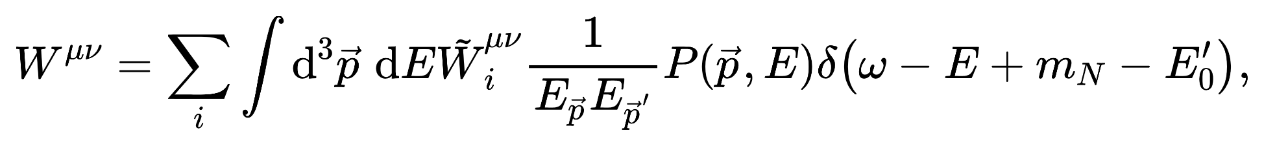


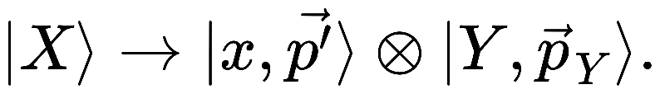
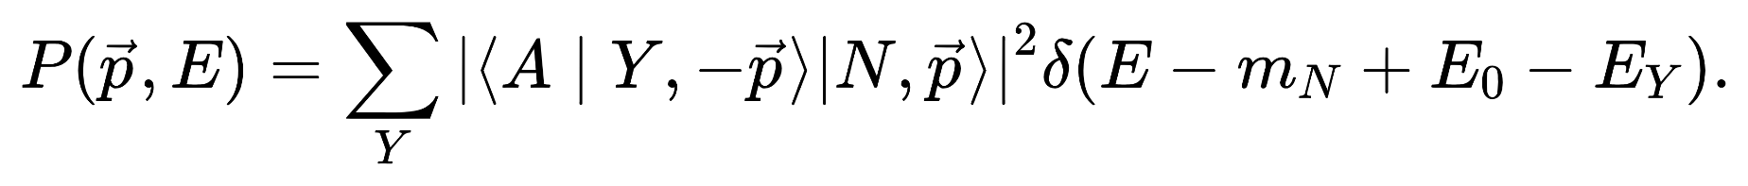
2. DM+Nucleus: Quasi-elastic Scattering
Su, Wu, Zhou, Zhu, 2212.02286
Nucleus recoiling
residual nucleus
Impulse Approximation
Coupling constants
Propagator
DM(hadron) tensor
Spectral Function (probability)
Notes:
Different from elastic scattering, a nucleon will be knocked out of the nucleus. We calculate the differential cross section in the impulse approximation.

Slide 21
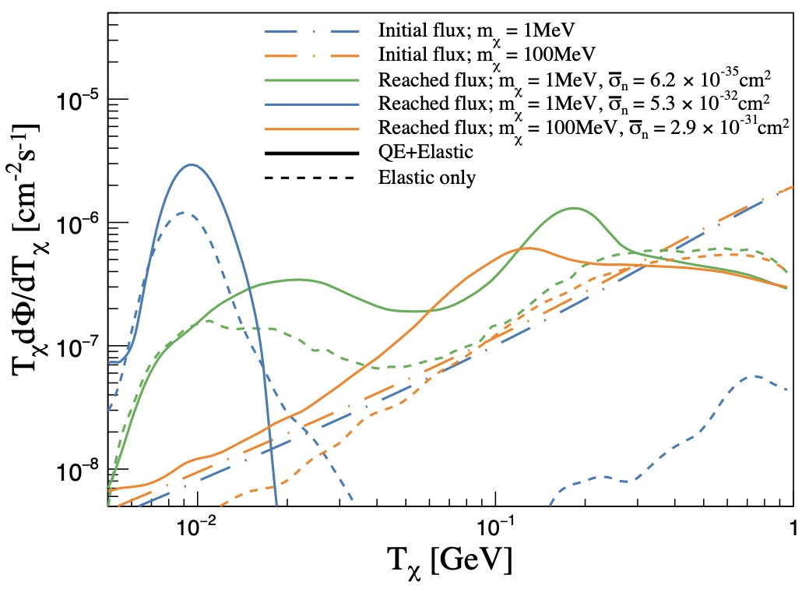
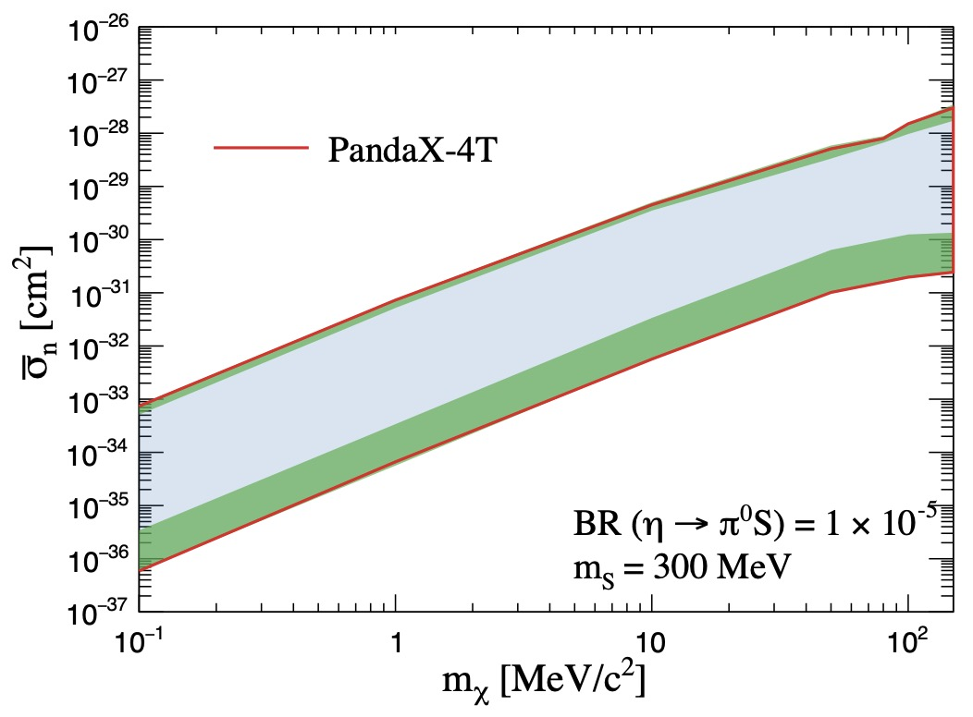
2. DM+Nucleus: Quasi-elastic Scattering
PandaX-4T + Su, Wu, PRL 131 (2023) 4, 041001
Nucleus recoiling
Notes:
Here we can see the reached events in boosted region have been reduced if including the QES contribution. Finally we got the first precise limits on adm.

Slide 22
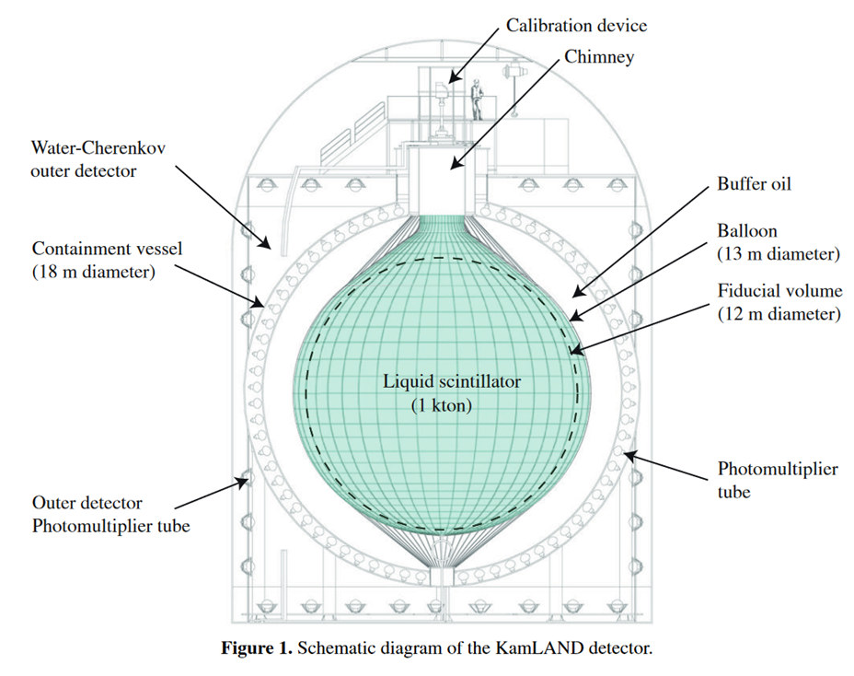

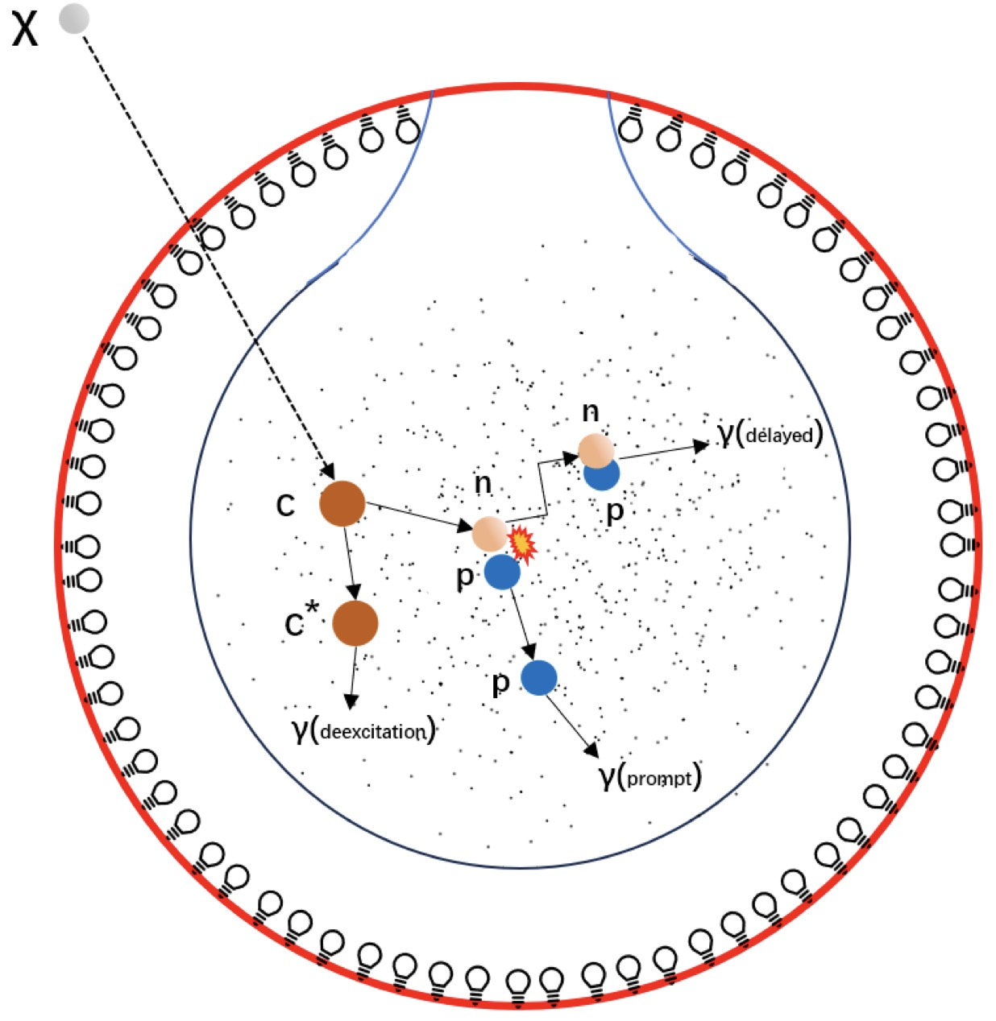


2. DM+Nucleus: Quasi-elastic Scattering
Lin, Liu, Su, Wu, 2504.13007
prompt signal:
delayed signal:
Correlated feature can reduce background.
Events Selection：∆R < 160 cm, 0.5 < ∆t < 1000 μs
Notes:
Besides direct detection, we also considered the possibility of searching for the boosted dark matter in neutrino experiments. Here we focus on the Liquid scintillator detector, like KamLand in Japan. The knock-out neutron can produce the prompt signal through the elastic scattering process n+p \to n+p. Meanwhile, we will also have the delayed signal caused by the radiative capture of knockout neutron. These two signals are correlated in space and time, which is used to suppress the background.

Slide 23

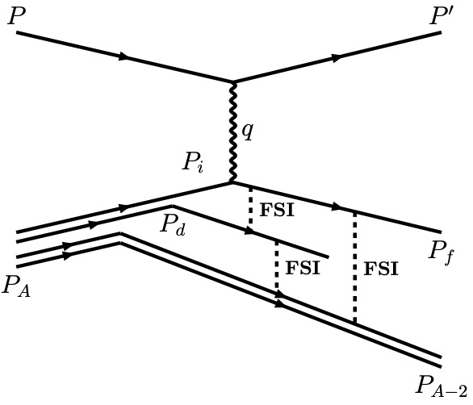

2. DM+Nucleus: Quasi-elastic Scattering
Pauli blocking
χ
χ
Final state Interactions
n
Optical potential
Quenching effect
Birk’s law :
Notes:
To compare with the experimental data, we consider the Pauli blocking effects, final state interactions and quenching effect.

Slide 24




2. DM+Nucleus: Quasi-elastic Scattering
Lin, Liu, Su, Wu, 2504.13007
2311.01667
Lin, Liu, Su, Wu, 2504.13007
Notes:
In this end, using the KamLAND data of neutral current, we show the sensitivity for atmospheric dark matter. We can see that the new bound is more than 1 order of magnitude stronger than the existing ones. In future, JUNO can further improve the limit by about 1 order.

Slide 25
Outline
From WIMPs to Light Dark Matter
DM-Nucleus Scattering :
LDM-Electron Scattering:
A new axion factory:
Migdal effect
Quasi-elastic effect
Nature 2025 (2nd revision)
2504.13007
PRL 131 (2023) 4, 041001
Collective Excitations
PRL 134 (2025) 7, 071001
Nuclear Reactor
2509.01538
Notes:
Here is the outline of my talk. I will firstly talk about the motivation of light dark matter, and then focus on the inelastic scattering of light DM with the nucleus and also the collective excitations of light DM with the electrons.

Slide 26




3. DM+Electron: Collective Excitation
electron gas
+
ionic lattice
Conduction bands
detector
DM
Bandgap: ~ eV
Plasma wave
DM
Plasmon
quanta of electron density fluctuation
Valence bands
Notes:
I will focus on the semiconductor detector because the energy gap between the conduction band and valence band are very small. In principle, we can use it to probe a lighter dark matter. So when a dark matter interact with the electron gas in the semiconductor, it will cause the fluctuation of the electron density, and then produce the plasmon.

Slide 27





3. DM+Electron: Collective Excitation
Liang, Su, LW, Zhu, PRL 134 (2025) 7, 071001
Density-Density correlation function (RPA)
Lindhard function
Dielectric Function
Notes:
In the solid physics, such a response can be described by the dielectric function. We can get it by calculating density-density correlation function.

Slide 28







3. DM+Electron: Collective Excitation
Si
DM velocity
DM scattering rate
Energy Loss Function (ELF)
Scattering potential
Energy Loss Function : Density Functional Theory
Resonance (plasmon) : |Q| < 5 keV, ω ∼ 15 eV
To excite plasmon : V_{min} > q/ω
Notes:
Supposing a vector interaction between dark matter and the electron, we can derive the scattering rate. It is proportional to the imaginary part of the inverse dielectric function. We usually call it energy loss function, which can be calculated by the density functional theory. Here you can see there is a resonance in the low transferred energy and momentum region. To reach this region, the DM should be semi-relativistic.

Slide 29





3. DM+Electron: Collective Excitation
Cosmic Ray Boosted DM
Liang, Su, LW, Zhu, PRL 134 (2025) 7, 071001
CRs
CRs
DM
1810.07705
1810.10543
DM
Notes:
So we considered the cosmic ray boosted dark matter, in which the dark matter get more energy via its interaction with the electron and positron in high energy cosmic rays.

Slide 30




3. DM+Electron: Collective Excitation
SENSEI @ SNOLAB (100.72 g.days)
2312.13342
Liang, Su, LW, Zhu, PRL 134 (2025) 7, 071001
1−6 e⁻ corresponds to (∼1.2–20 eV) energy depositions
Light Dark Matter | Noble Liquid Detector (large volume, high threshold) | Solid detector (small volume, low threshold)
Non-Relativistic | ✔️ | ✔️
Relativistic | ✔️ | Collective Excitations
Notes:
Then, using the sensei data from snolab, we can derive the limits of DM-electron scattering cross sections, which can be stronger than that from the Xenon1T.

Slide 31
Outline
From WIMPs to Light Dark Matter
DM-Nucleus Scattering :
DM-Electron Scattering:
A new axion factory:
Migdal effect
Quasi-elastic effect
Nature 2025 (2nd revision)
2504.13007
PRL 131 (2023) 4, 041001
Collective Excitations
PRL 134 (2025) 7, 071001
Nuclear Reactor
2509.01538
Notes:
Here is the outline of my talk. I will firstly talk about the motivation of light dark matter, and then focus on the inelastic scattering of light DM with the nucleus and also the collective excitations of light DM with the electrons.

Slide 32


4. A new axion factory: Nuclear Reactor
Open Questions
1、Higgs Mass
2、Dark Matter
3、Strong CP
……
A great particle?
Notes:
The discovery of Higgs boson stands for the completion of the SM. But there are still some unsolved problems, such as the naturalness of Higgs mass, the nature of dark matter, and Strong CP problem, etc. Axion was considered as a great particle to solve two of them.

Slide 33




4. A new axion factory: Nuclear Reactor
Detection of Axion
Cavity Haloscope
Nuclear Magnetic Resonance

Slide 34





4. A new axion factory: Nuclear Reactor
“Cosmological triangle”
m_{a} ～ 0.2 keV – 1 MeV; g_{a} ～ 10⁻⁵ GeV⁻¹

Slide 35






2. Reactor Neutrino Experiment: RECODE
REactor neutrino COherent scattering Detection Experiment

Slide 36


2. Reactor Neutrino Experiment: RECODE
reactor core
reactor core
near-point
near-point
far-point
far-point
HPG Detector

Slide 37



2. Reactor Neutrino Experiment: RECODE
Dai, Gong, Gu, Su, LW, Wu, Wang, Yang, 2509.01538
(in future)

Slide 38




3. Prospects of searching for MeV axion
Dai, Gong, Gu, Su, LW, Wu, Wang, Yang, 2509.01538
Compton
⁷²Ge
⁷²Ge
Primakoff
²³⁵U
decay inside detector

Slide 39


3. Prospects of searching for MeV axion
Dominant backgrounds: 1) CR induced muons;
2) reactor neutrons
Sub-dominant backgrounds:
1) natural radioactivity 2) gamma rays CR induced secondary particles
Remaining background:
intrinsic radioactivity: ⁴⁰K decays
Shielding
Scintillator veto detector
100 - 5000 keV, 7 bins Stat. error only
Notes:
potassium

Slide 40

Thank you very much !

Slide 41


Summary
Reactor Neutrino Exp:
1. testing the SM
2. Searching for BSM:
• Neutrino
• Light Dark Matter
• Exotic Particles
PDG
A New Probe
to
cosmological triangle of Axion
Reactor
Exp.

Slide 42

Backup

Slide 43

Backup

Slide 44




4. A new axion factory: Nuclear Reactor
Strong CP Problem
( 𝞱-term, CP )
(gluon term)
(electroweak term)
Fine-tuning
Notes:
In QCD theory, there is a theta term. It will violate the CP symmetry. Viewed the QCD Lagrangian alone, the theta parameter can be understood as an angle determining the vacuum of the theory. However, when embedded in the full SM Lagrangian,the theta receives a contribution from weak interaction. On the other hand, the theta term will induce the non-zero electric dipole momentum of neutron. The current data tells us the value of theta is very tiny. That means we need to tune the two parameters very carefully, if no underlying physics forces it.

Slide 45



1. Axions in a nutshell
PQ symmetry and Axion
Axion Dark Matter
After PQ transition
Misalignment Production Mechanism
U_{PQ}(1)
spontaneously broken
at scale f_{a}
QCD Axion
𝜃_{ini} ≠ 𝜃_{min}
Peccei and Quinn, 1977
Weinberg, 1978; Wilczek, 1978, 1991
global chiral U(1) symmetry
anomalous under QCD
pseudo-Nambu-Goldstone boson
𝜃=a/f_{a}
After QCD transition
Damped oscillations around
the minimum, the energy density scales as ρ_{a} ∝ a⁻³ as cold DM.
PQWW
PQ scalar
KSVZ
heavy quarks + PQ scalar
DFSZ
Higgs doublet+PQ scalar
Notes:
In 1970s, Peccei-Quinn proposed a beautiful solution to this question. They induced a new global chiral U(1) symmetry anomalous under QCD. When it was spontaneously broken at a high energy scale, there will be a new pNG boson, that is“axion”. Then the theta parameter becomes a dynamical field. The key point is that the potential of the axion generated by the QCD dynamics, has a minimum at the CP-conserving value theta = 0. Besides, the axion can also play the role of dark matter via the misalignment mechanism. Generally speaking, the new physics models with the spontaneous breaking of one or more global symmetries at high energies will produce axion-like particles. They are not relevant for the strong CP problem. Their mass and couplings are also independent. They have a plenty of pheno.

Slide 46


1. From WIMPs to Light DM
Freeze-out
+
Weak interaction
Relic Abundance
Notes:
But we know that there is a Lee-Weinberg bound. It told us that the dark matter particle mass should be heavier than about 2 GeV, because of the relic abundance. So is it possible to escape the Lee-Weinberg bound?

Slide 47




2. DM+Nucleus Scattering
Notes:
DM direct detection is inspired by the coherent scattering of neutrino. Many direct detection experiments aim at the WIMP dark matter, such as PandaX and CDEX collaborations in China. PandaX is here.

