Slide 1

Probing detection of dark photon oscillation in a waveguide
Wenyu Wang
Beijing University of Technology
2025.09 @Dalian

Slide 2

超对称场论基础
超对称背景
超对称代数
超场
超对称拉氏量
超对称破缺
超对称粒子物理唯象
最小超对称标准模型
超对称破缺机制
重整化群和质量谱
超对称希格斯粒子唯象
超对称对撞机唯象
超对称暗物质
超出最小超对称标准模型

Slide 3
CONTENT
Introduction to dark matter
Dark U(1) Theory and oscillation of the photon in a wave guide
Detection of oscillation by OTDR
Conclusion
Collaboration with Yu-Xin Tian, Wen-Na Yang and Bin Zhu

Slide 4
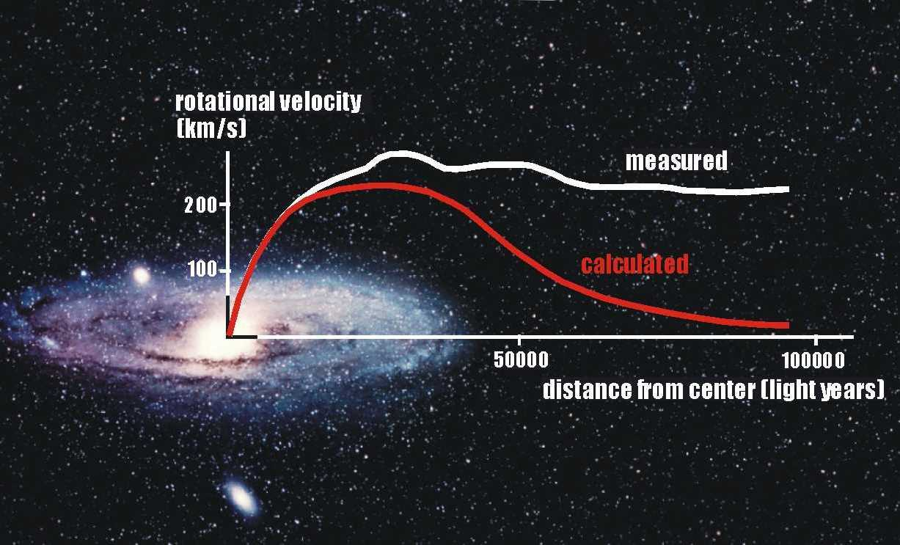

Slide 5
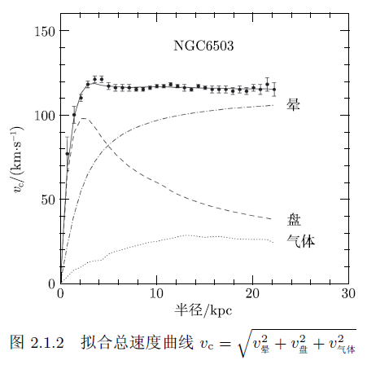

Slide 6
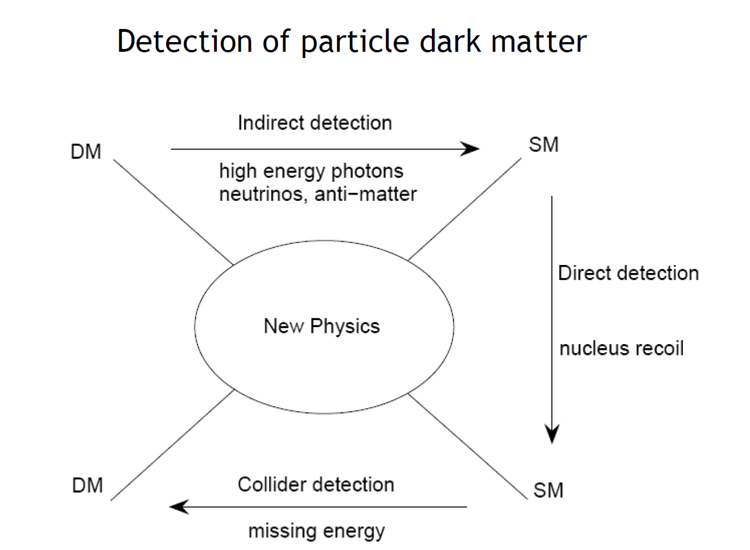
What is self-interactions?
WIMP, EW?

Slide 7
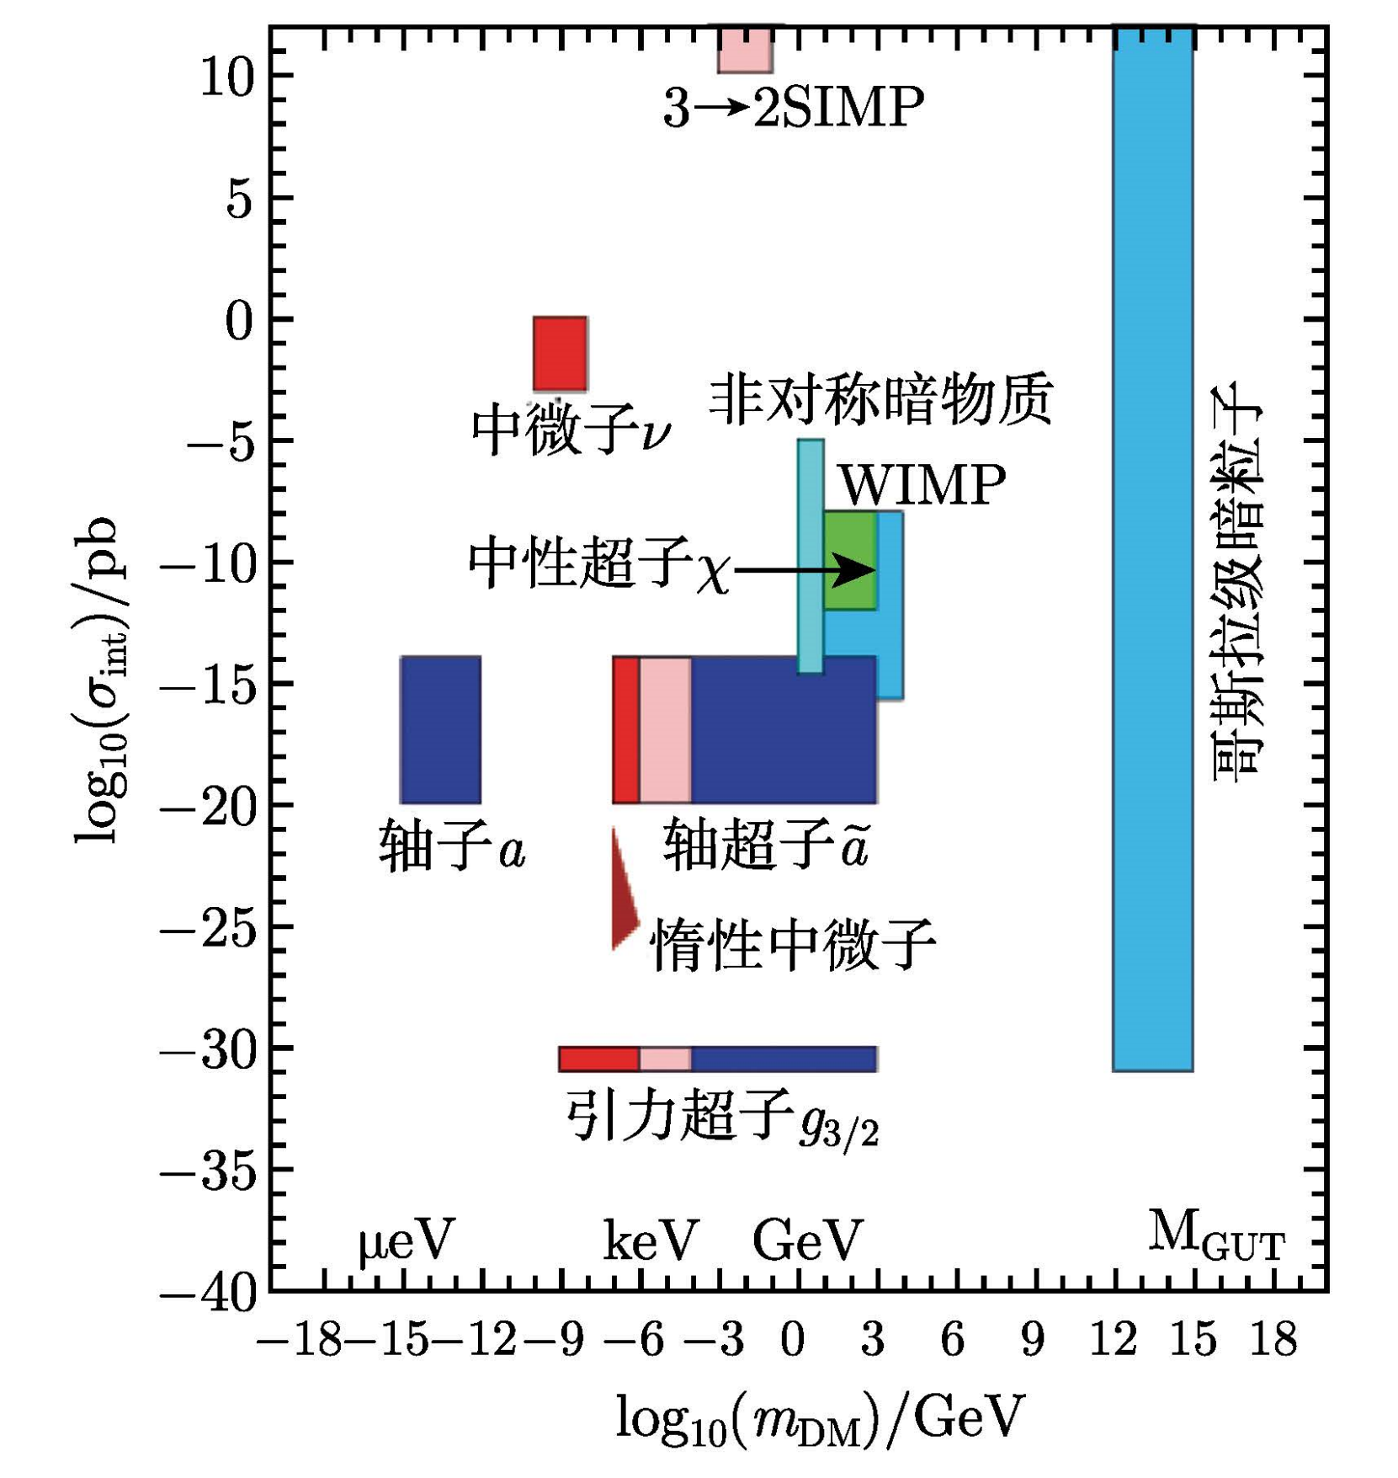

Slide 8
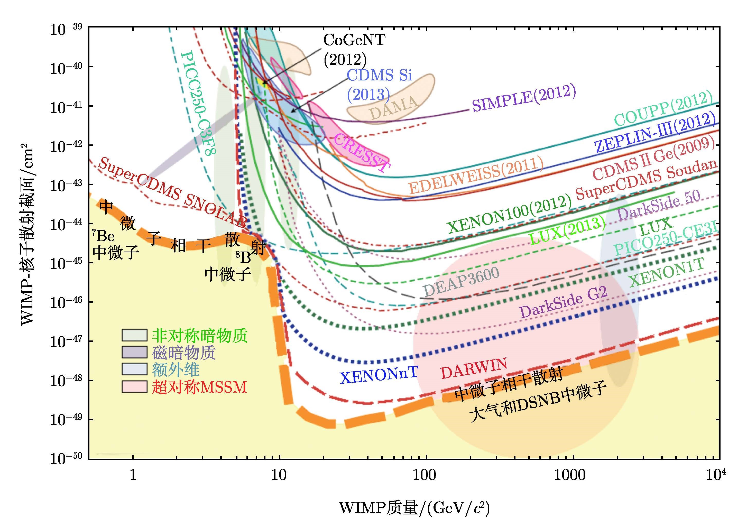
？
！

Slide 9
轴子和暗光子

Slide 10
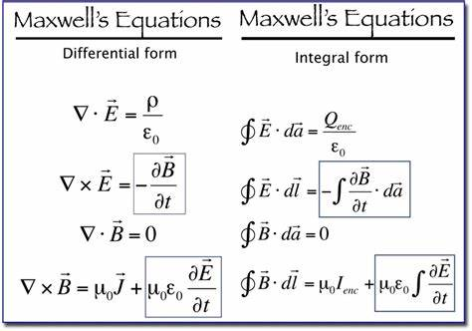
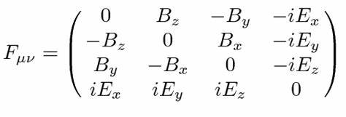


电磁场论
运动方程：
比安基恒等式：

Slide 11


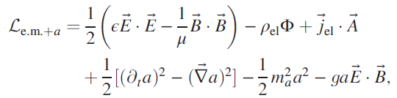
轴子
CP为-1
CP为-1
几何项

Slide 12

修正Maxwell equations

Slide 13
暗电磁作用

Slide 14
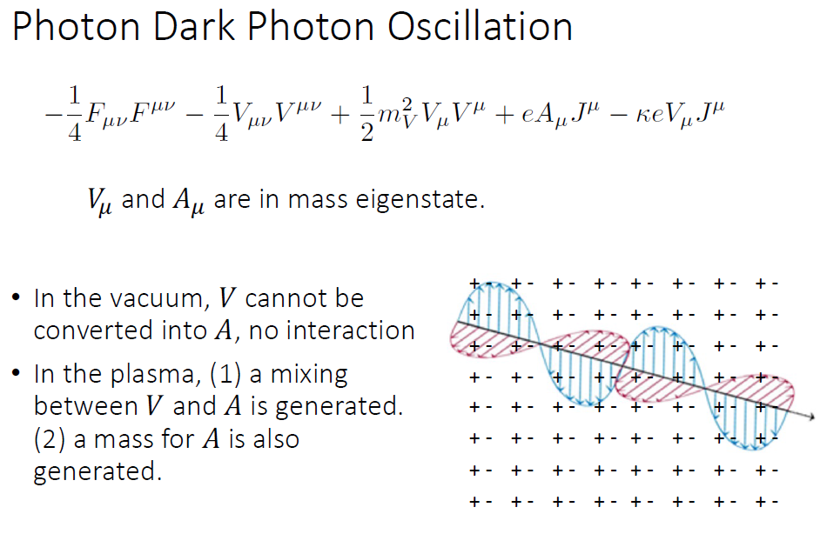

Slide 15
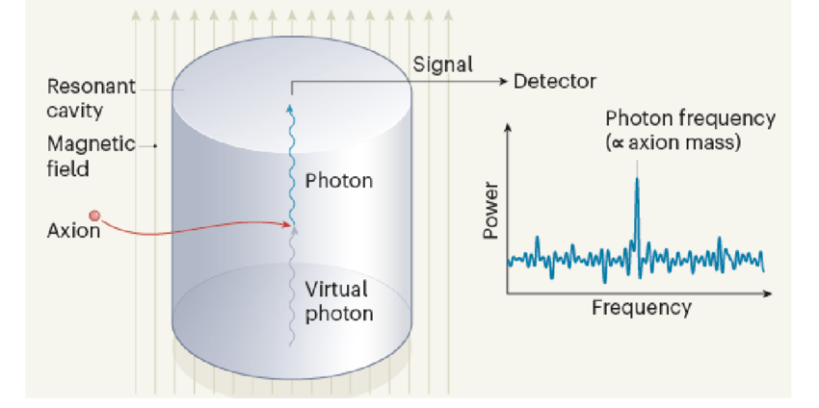
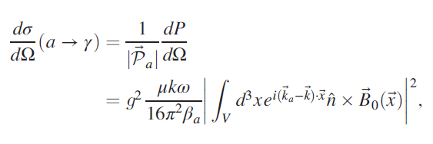

Slide 16
其它探测方案

Slide 17
其它探测方案

Slide 24
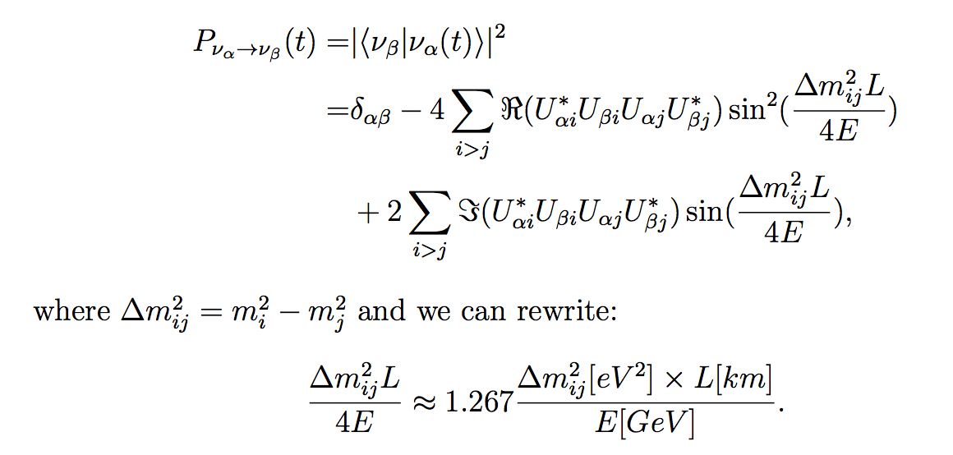
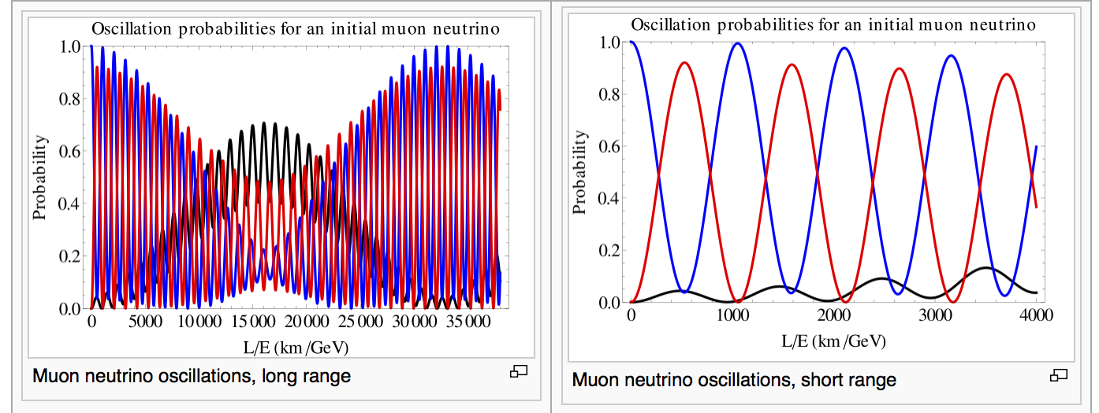
中微子振荡测量

Slide 25
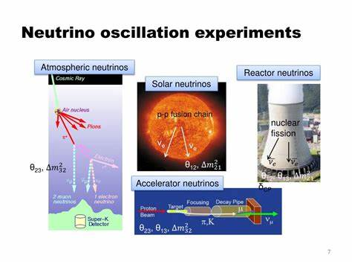

Slide 26
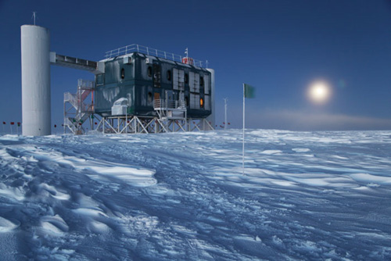
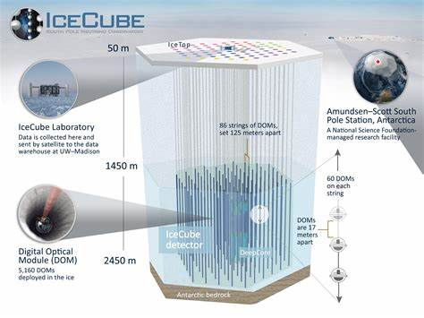

Slide 27

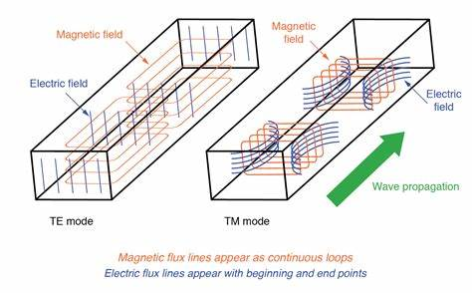
可否用波导或者光纤探测暗光子振荡行为？

Slide 28
Detection of Oscillation by OTDR

Slide 29
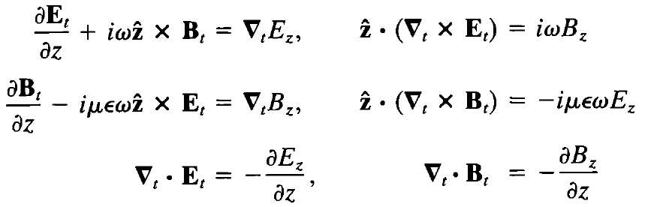

Slide 30
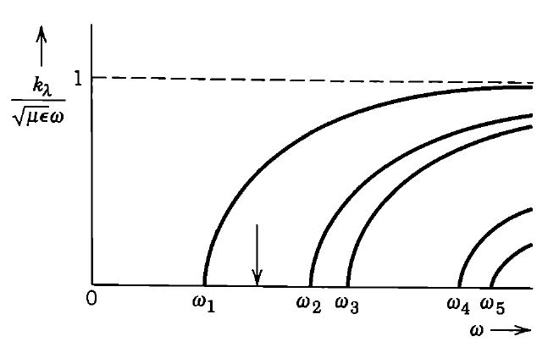
波导管电磁场

Slide 31
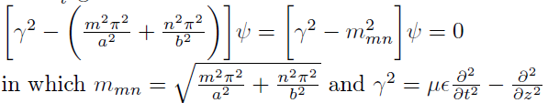
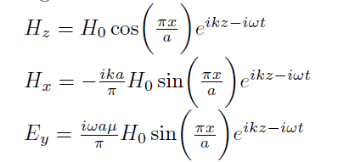
有效质量
TM01 mode:

Slide 32
能流
群速度

Slide 33
衰减

Slide 34

波导管振荡
可见光
暗光子

Slide 35


Slide 36

存在衰减情况

Slide 37
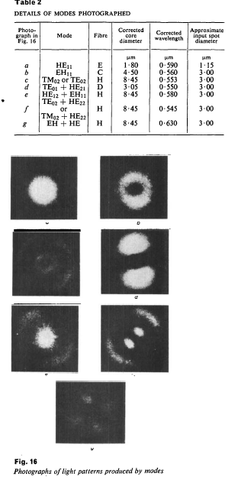
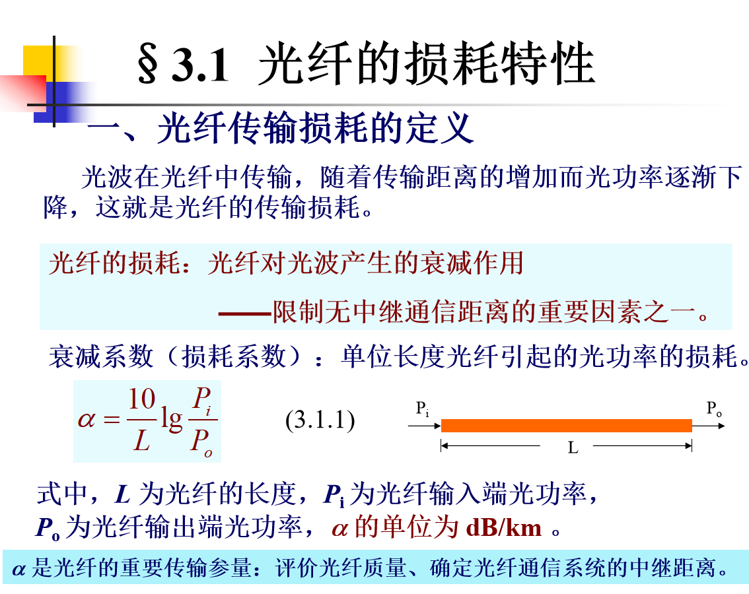

Slide 39
我想的方法：

Slide 41
NOTIFICATION
The reason for the proposal to scan of single mode of the optical fiber is only for a simplest demonstration.
The propagation of light in the real optical fiber may be is modified by medium of the fiber, such as the index of refraction, cladding, etc.
The differences caused by different setup, including interfaces, spools of the fiber, etc. need further mode detailed studies.

Slide 42


Slide 43




Slide 44





Slide 45



Slide 48
Conclusion
Motivated by neutrino oscillation mechanism, strategy for detection of the oscillation between visible and dark photon is proposed
The oscillation is the exchanging of the power flow between visible photon and dark photon, producing an oscillation in the amplitude and power flow. The darkness of dark photon distinguishes the oscillation from the ordinary measurements on the optical fiber.
The optical time-domain relectometry (OTDR) is adopted for the measurement of the oscillation which is found out to be very efficient in the exploration.
The operation in the lab and the data processing are simple. Thus the strategy proposed in the paper may give us a novel and better means to explore the mysterious dark universe.

Slide 49
THANKS

