Slide 1
Gravitational form factors of pion from top-down holographic QCD
arXiv:2407.21113v2
Hiwa A. Ahmed (何瓦)
School of Nuclear Science And Technology, UCAS
Weekly Group Meeting
April 10th, 2025

Slide 2
Introduction
The stress distribution inside hadrons, extracted from the matrix elements of the energy-momentum tensor (EMT).
The form factors that characterize the matrix elements are called gravitational form factors (GFFs), which are calculated theoretically from their coupling with gravity.
In this work for the first time the momentum transfer dependence of the pion GFFs from a top-down holographic QCD approach were calculated using the Sakai-Sugimoto model, a top-down holographic QCD model based on the D4-D8 brane construction.

Slide 3
Formulation
The matrix elements of EMT of a spin-0 particle are expressed as
Within the framework of holographic QCD, perturbations to the metric caused by matter fields in the bulk propagate to the boundary, allowing to extract the expectation values of the EMT in the boundary theory from these perturbations.

Slide 4
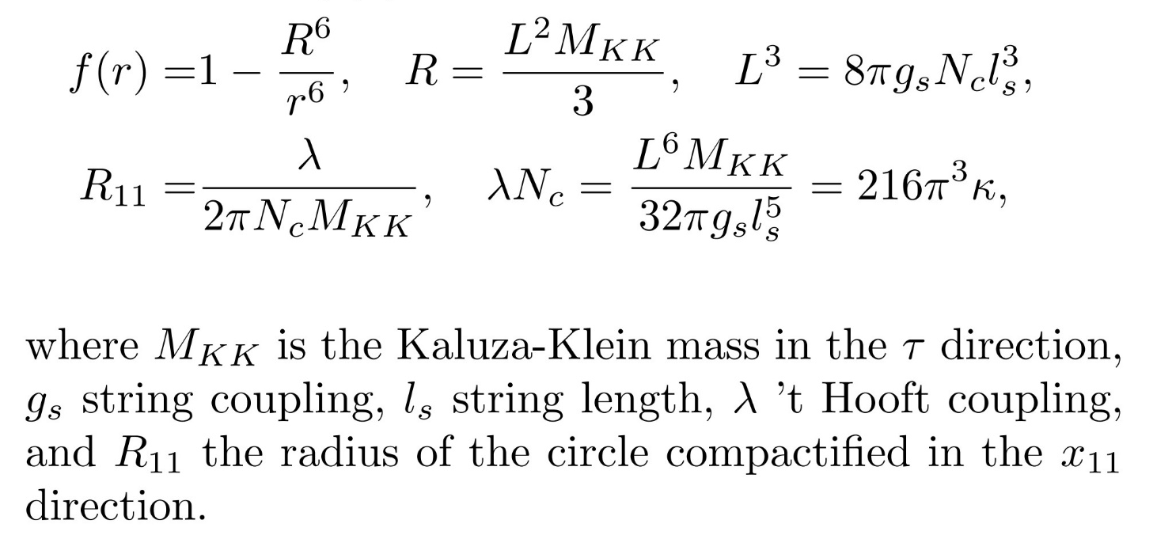
Holographic model
The top-down holographic QCD used in this work is the Sakai-Sugimoto model, consists of $N_{f}$ D8 branes embedded as a probe in black 4-brane background, a holographic dual of $N_{c}$ D4 branes.

Slide 5
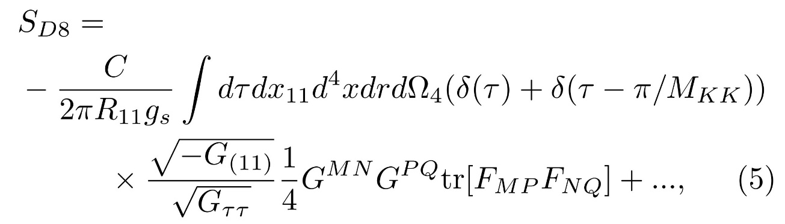
Holographic model
The metric can be written as
$G_{MN}={\overline{G}}_{MN}+δg_{MN}$
The metric fluctuations $δg_{MN}$ of the bulk obey the following linearized Einstein equations:
In order to examine the EMT in the bulk, D8 branes were embed the into the 11-dimensional space, considering the action as

Slide 6
Holographic model
Defining the EMT as
which leads to the following expression:

Slide 7
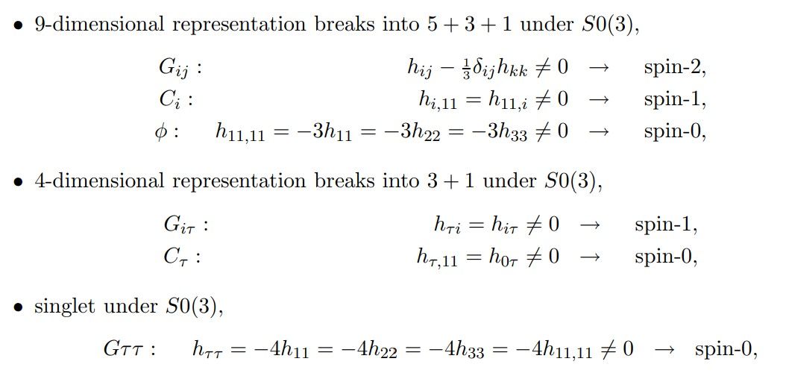
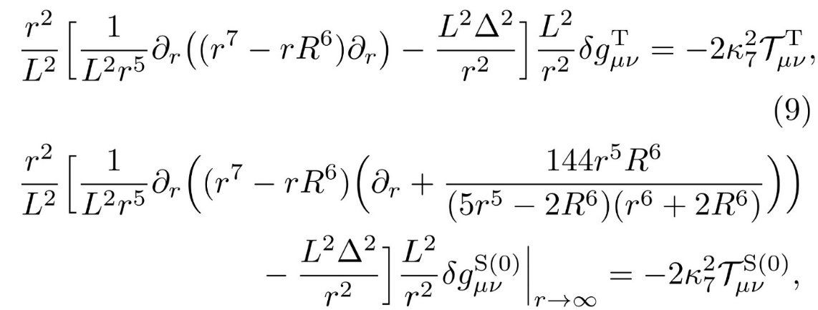
Glueball spectrum
Since the spatial part of the field theory energy momentum tensor is transverse $k^{i}T_{ij}= 0$, near the boundary the metric fluctuation must also be transverse $k^{i}δg_{ij} = 0$and can be parameterized as
Therefore, we consider TT modes in the metric fluctuation, which is nothing but glueball spectra. Among the 14 TT modes, only $T_{4}$ and $S_{4}$ contribute to the EMT (Nucl.Phys.B587:249-276,2000).

Slide 8
Glueball spectrum
Each part of EMT is written as
The perturbation to the metric caused by the pion field as the bulk EMT source using Green’s function method is given by

Slide 9
Glueball spectrum
EOM for tensor and scalar glueball is reduced as

Slide 10
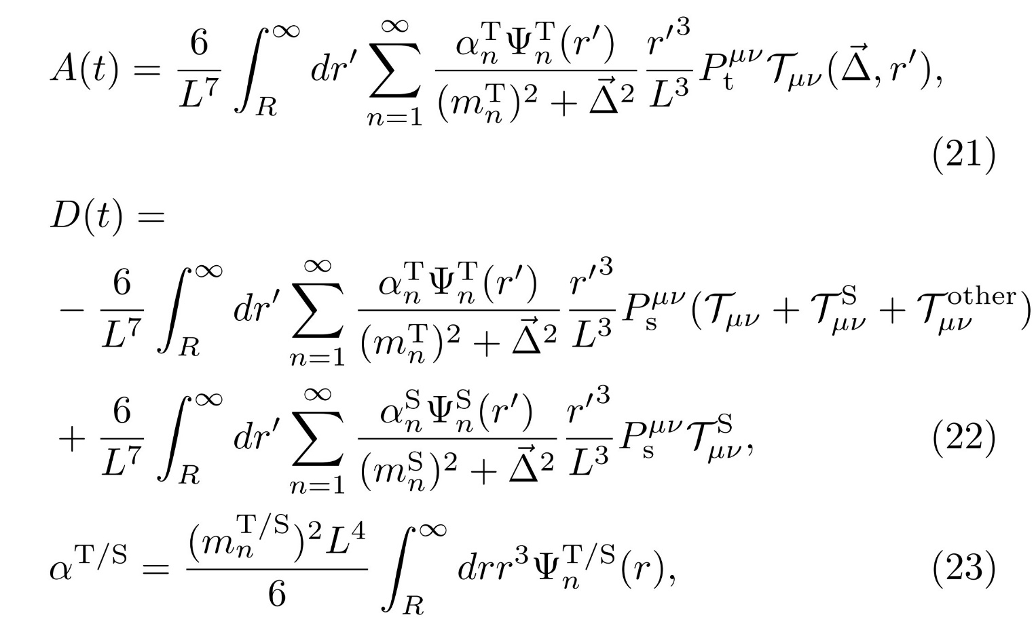
Gravitational Form Factors
Substituting the pion field into the EMT of the bulk, one can read off the matrix elements of the boundary EMT as follows

Slide 11
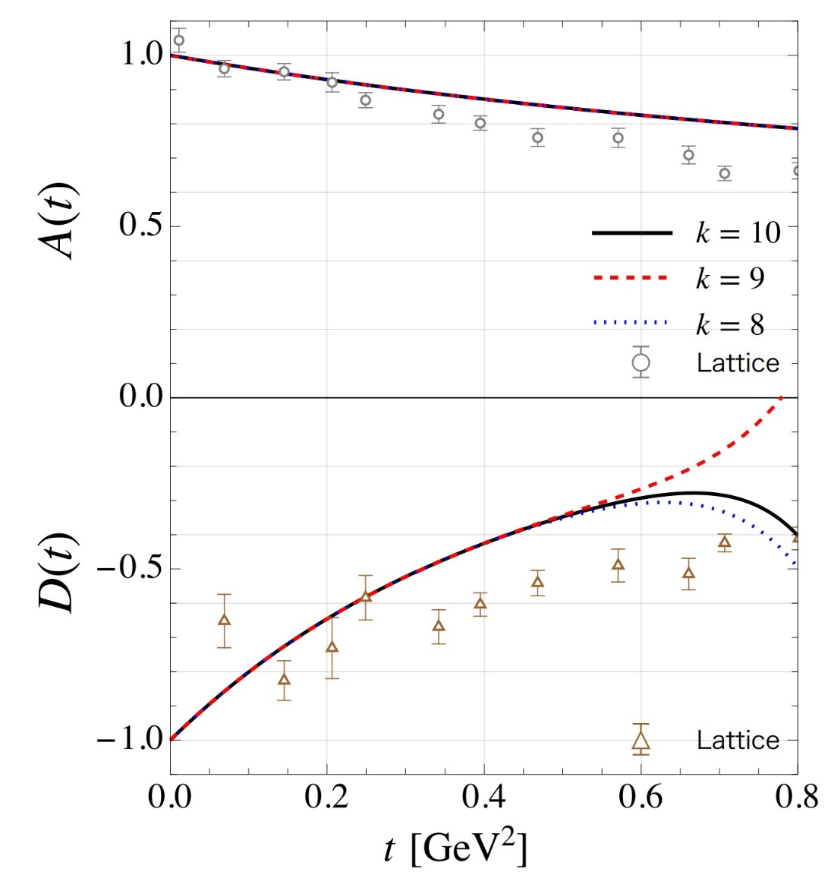
Gravitational Form Factors
In the top-down holographic QCD approach, the amplitude of D(t) dumps more rapidly than that of A(t), which is qualitatively consistent with the results of lattice QCD. These differences are due to the contribution of $S_{4}$ modes to D(t), which is not observed in the bottom-up holographic QCD framework This is because the usual bottom-up model, does not have $S_{4}$. Also in this approach, as in previous studies, we observe the so called glueball dominance, in which pions have gravitational interactions via infinite glueball spectra.

