Slide 1
DAQ stability testing without HV
Mingyi Dong
2025-04-10

Slide 2
DAQ stability testing
HV of CGEM and other sub detector was powered off
Electronics was powered on
MDC noise trigger, trigger rate : ~100Hz-5.5kHz
From 17:58 on April 8 to 0:29 on April 10
Run84858- Run84918

Slide 3
Check results
Run No | start | stop | BESIII event number | CGEM uniq trigger number | CGEM Last trigger number | CGEM check error | event rate kHZ
84858 | 2024.4.8 17:58 | 19:15 | 7750258 | 7750258 | 7750258 |  | 1.293
84862 | 20:07 | 20:29 | 1397854 | 1397854 | 1397854 |  | 2.514
84864 | 20:31 | 21:28 | 8552857 | 8568051 | 8568051 |  | 2
84871 | 22:14 | 23:20 | 1693759 | 1693759 | 1693759 |  | 0.3
84872 | 0:06 | 1:02 | 7815297 | 7815296 | 7815296 |  | 1.4
84876 | 2:01 | 3:09 | 13658910 | 13658973 | 13658973 |  | 5.53
84877 | 3:22 | 4:29 | 7396963 | 7396963 | 7396963
84879 | 4:49 | 5:14 | 5794554 | 5794554 | 5794554 |  | 3.84
84880 | 5:54 | 6:50 | 3090143 | 3090143 | 3090143 |  | 0.176
84901 | 12:26 | 12:46 | 5462063 | 5464994 | No such file |  | 0.418
84902 | 13:13 | 14:20 | 12075590 | 12078072 | 12078072
84907 | 16:45 | 17:10 | 2422985 | 2437683 | 2437683 |  | 4.547
84909 | 17:36 | 18:26 | 5354791 | 5369791 | 5369791 |  | 1.062
84910 | 18:52 | 19:39 | 6264326 | 6264854 | 6264854
84914 | 20:10 | 21:08 | 3694218 | 3706986 | 3706986 |  | 1.096
84915 | 21:20 | 22:12 | 5457490 | 5460056 | 5460056 |  | 2.549
84916 | 22:26 | 23:27 | 7443684 | 7457553 | 7457553 |  | 1.095
84917 | 23:30 | 0:12 | 4236465 | 4637724 | 4637724 |  | 0.467
84918 | 2024.4.10 0:29 | 0:42 | 392400 | 415989 | 415989 |  | 0.002

Slide 4
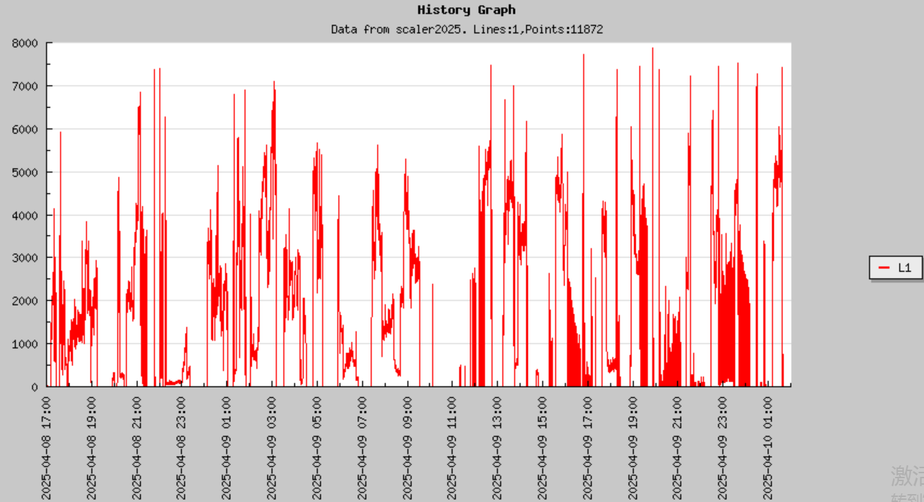
L1 trigger rate on April 8-10

