Slide 1
CGEM Control and Monitoring
masi@ihep.a.cn
2025.4.11

Slide 2
Outline
Special requirements for all CGEM software.
BESIII alarm judgment logic and trip handle for CGEM.
CGEM interlock with other systems.
Configuration archive to BESIII DB.
Summary.

Slide 3
High Voltage Software
Special requirements:
Added a prerun state.
Transitioning to different states, multiple parameters are set differently
V0Set, I0Set, Rup and the order.
The configuration turned out to be much more complicated.
The processing of the trip signal:
Needs to automatically clear the trip and then return to the injectable state.
If clear is unsuccessful more than 3 times, then power off the detector.
Interlock with CGEM FEBs and CGEM Gas status.

Slide 4
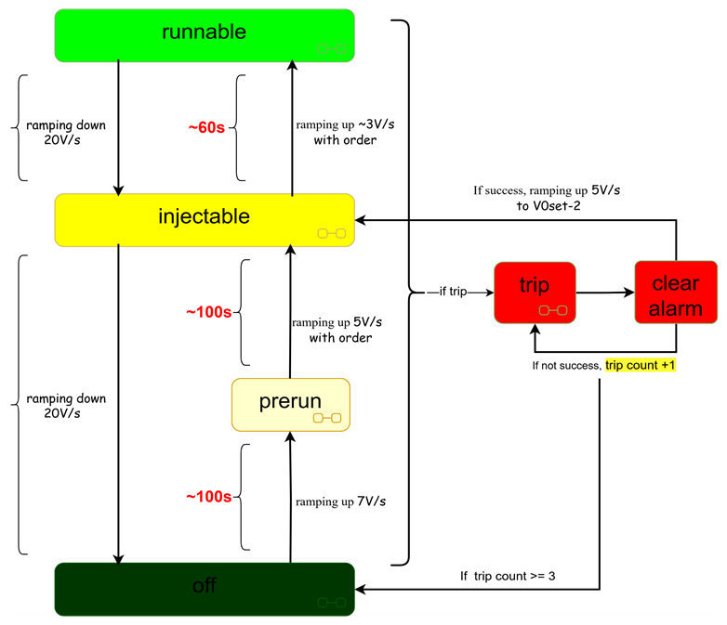
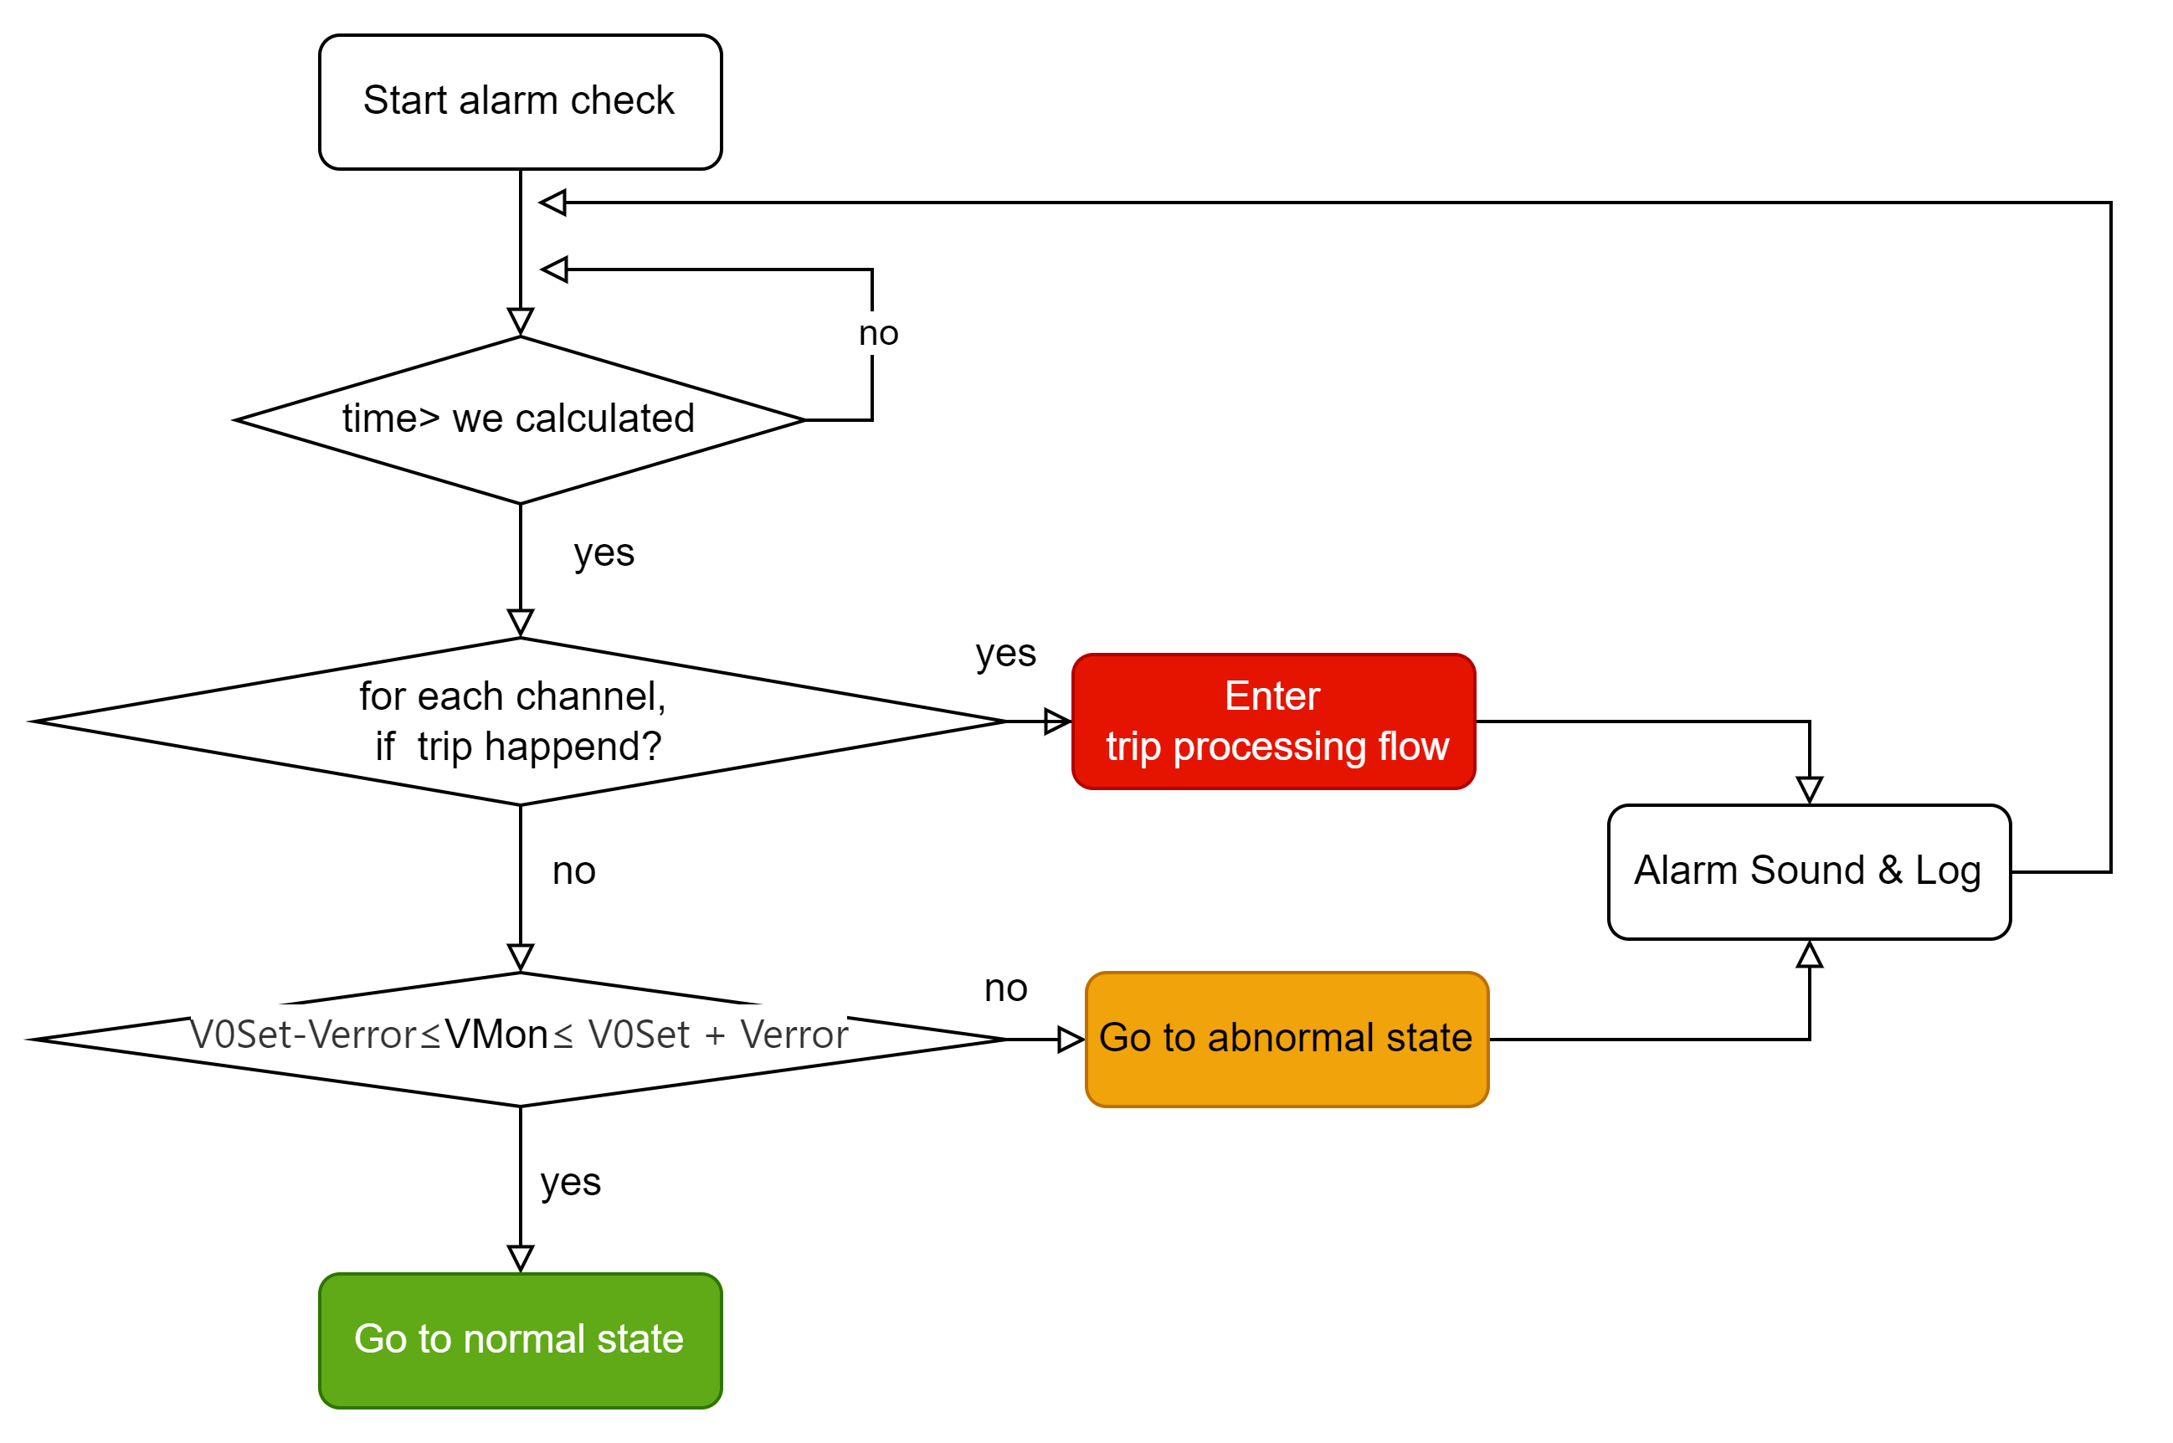
High Voltage flowcharts
High voltage state transition
Alarm judgment logic

Slide 5
Explanation of HV control buttons
Normal State
Desired State
Runnable
Off
Injectable
Runnable
abnormal or trip state, cannot recover on its own.
Injectable
Off

Slide 6
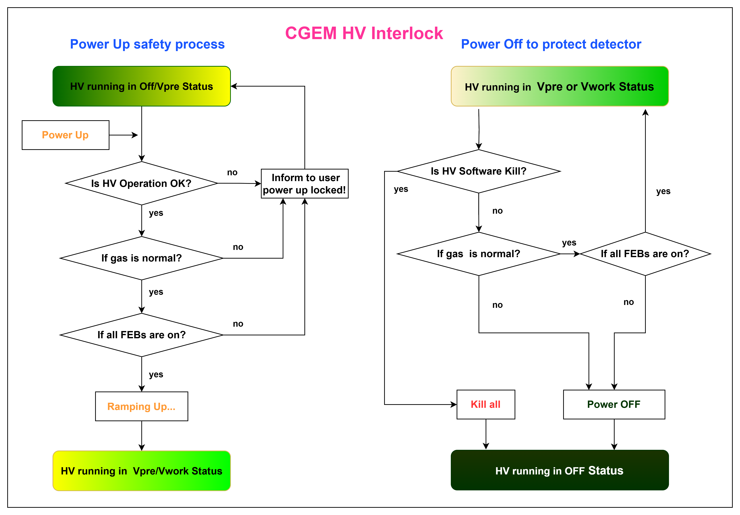
High Voltage Interlock logic

Slide 7
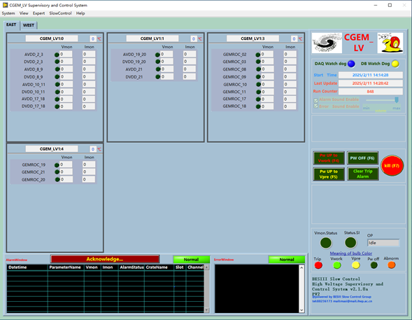
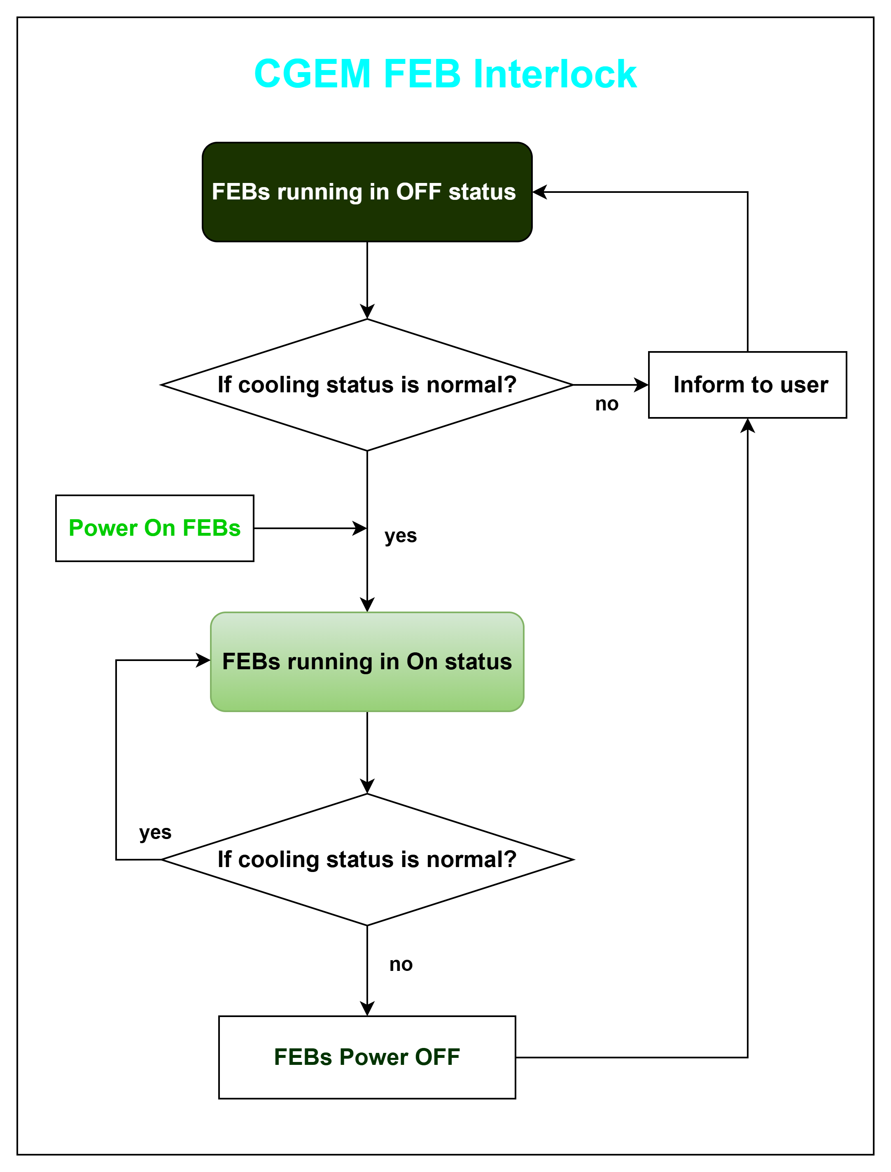
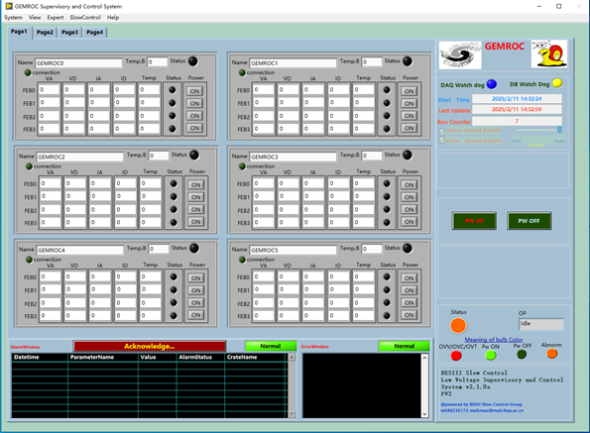
Low Voltage Software
Special requirements:
Interlock with cooling.
Publish FEBs status for HV and Safety interlock.
Alarm judgment logic:
If any GEMROC cannot be connected, FEBs status is off, and generate an alarm.

Slide 8
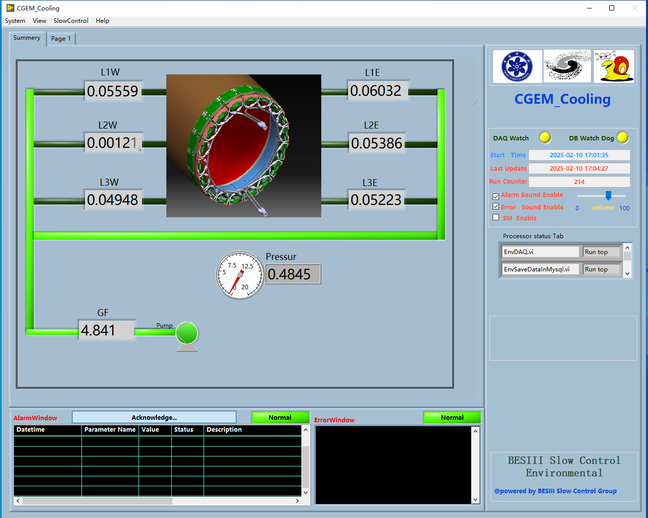
Cooling Software
Special requirements:
Interlock with FEBs.
Alarm judgment logic :
Check WF limit range, if exceed range, cooling status is abnormal, generate an alarm.
WF

Slide 9
Running with all safety Interlock

Slide 10
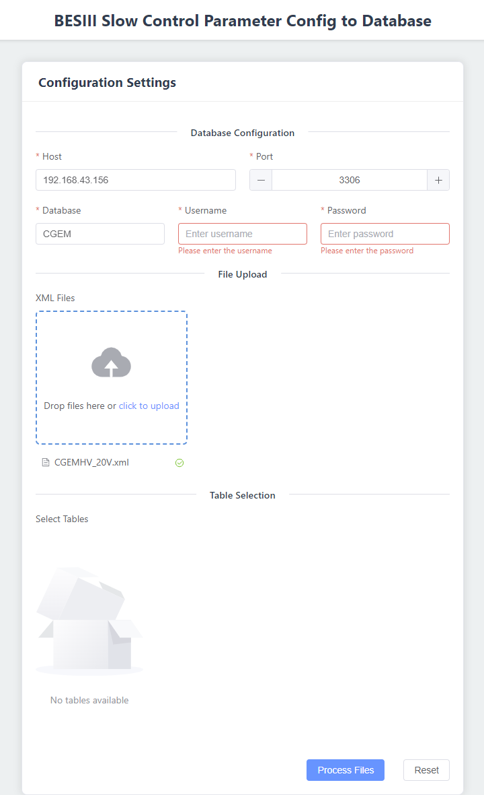
HV and LV Configuration to DB
New features for other system access the configuration files.
Many configuration files with XML format can be uploaded.
Select an existing table or create a new one.
Write data according to the table structure.

Slide 11
Summary
Working hard to communicate the requirements and cooperate with the test operation with CGEM experts.
At present, a stable version of the software has been released, and we have been providing stable services for CGEM test stage recently.
Thanks to all the experts of Italian group and BESIII run team for their feedback and patient discussions during the joint debugging process.

