Slide 1
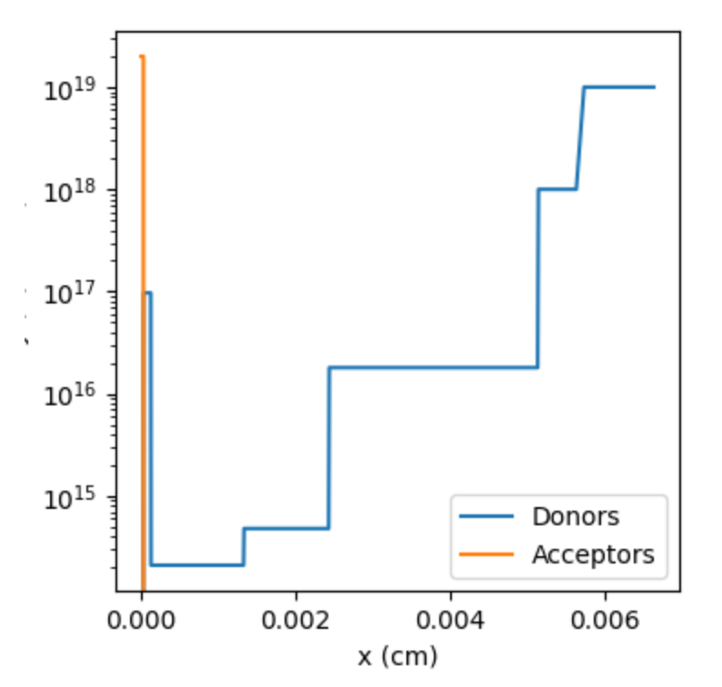
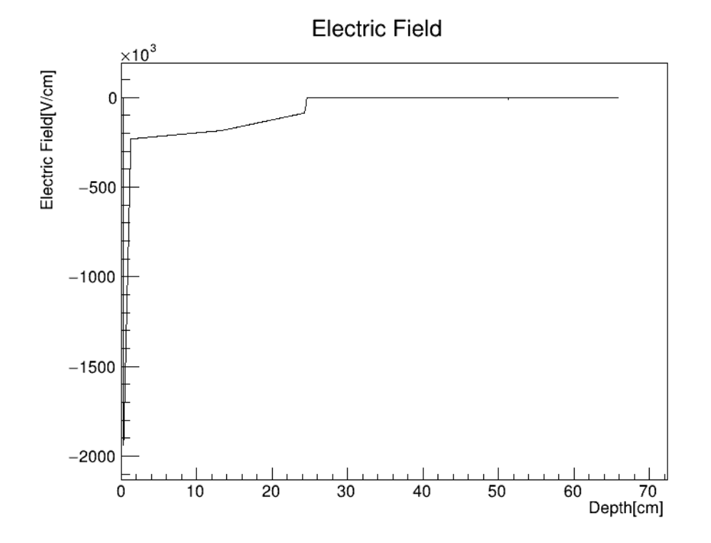
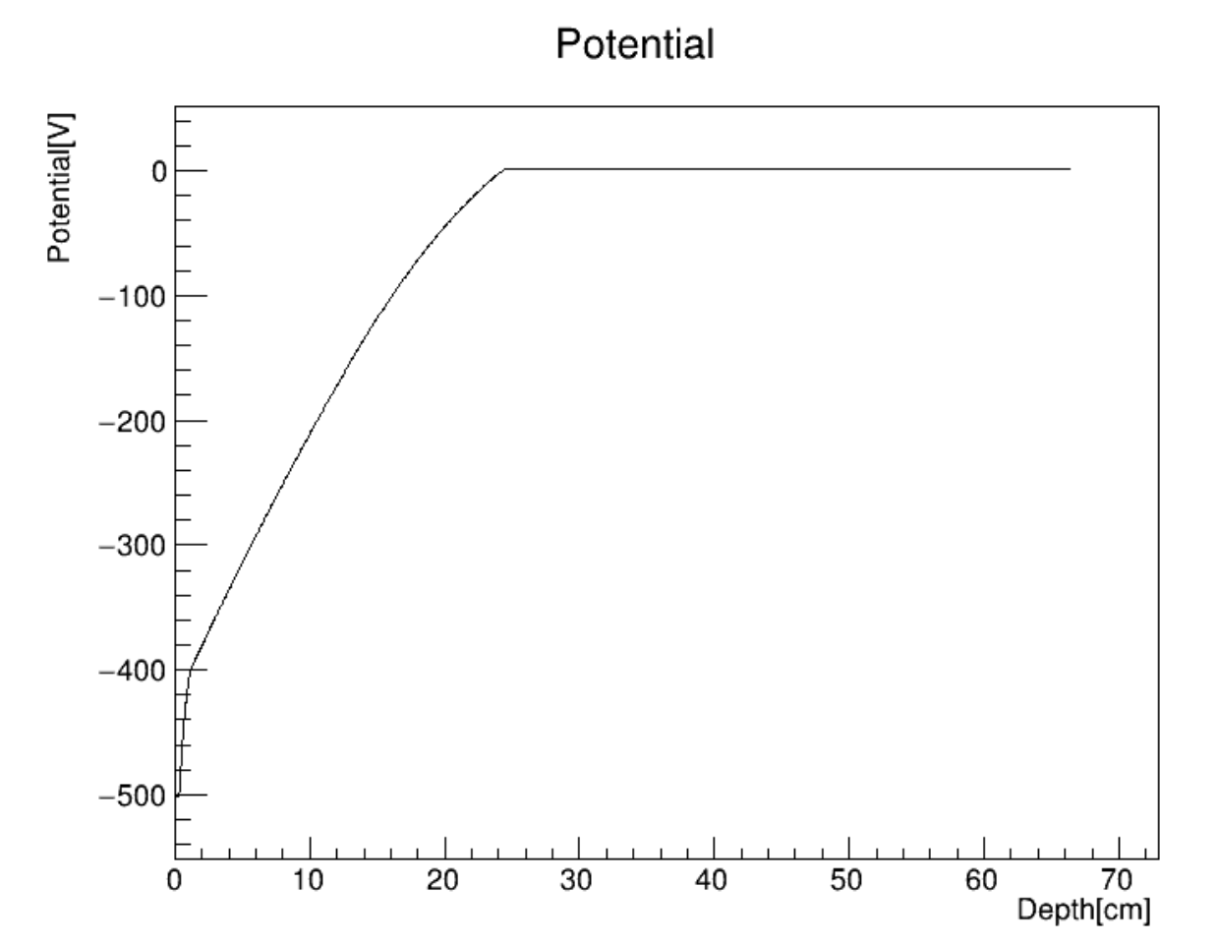
Electric Property Simulation - Electric Field
Solving the Poisson equation and the carrier continuous equations in steady state
  Using Scharfetter - Guemmel framework provided by Devsim
    git repo: http://github.com/devsim/devsim
  Necessary for non-planar like devices (like 3D) under non-depleted voltage
The doping profile of an 1D 4H-SiC LGAD prototype, total thickness 66.4um, active thickness 25.1um.
The Electric field and the potential of the 4H-SiC LGAD, bias voltage -500V on the top.
Under bias voltage enough to deplete the device, the electric field and the potential look just the same as one could obtain from barely the Poisson equation, with doping as charge.

Slide 2
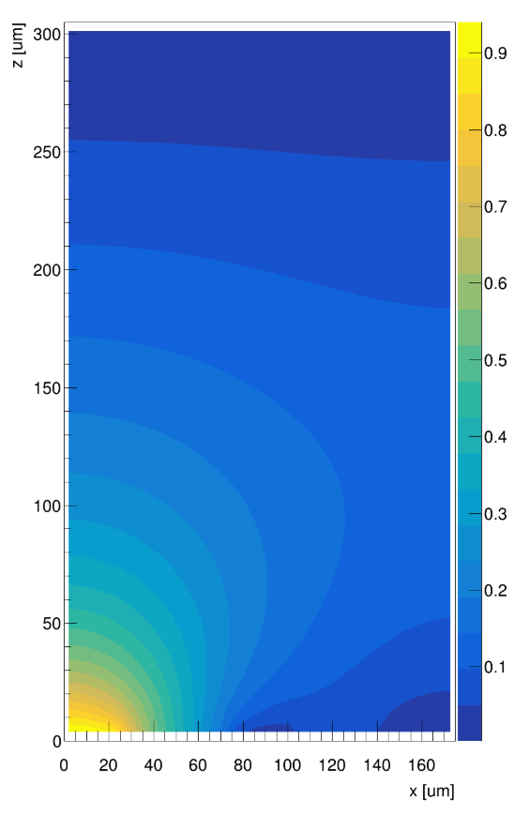
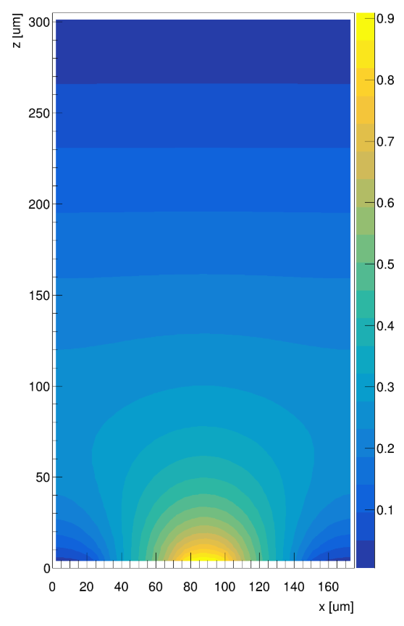
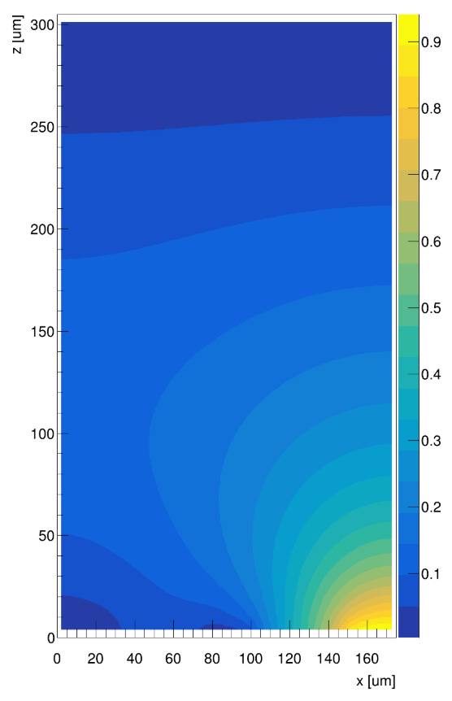
Electric Property Simulation - Weighting Potential
Two approaches
  1: calculate the electric potential of the original system which the charges are all removed and a bias voltage of 1V is set onto the specified electrode
  2: after the original electric potential is calculated, add another 1V bias voltage onto the specified electrode, obtain a new electric field and take the substraction between the new potential and the old potential
The weighting field of a silicon strip sensor prototype with 3 strips (thickness 300um, total width 175um, pitch 75um, strip width 25um).

Slide 3
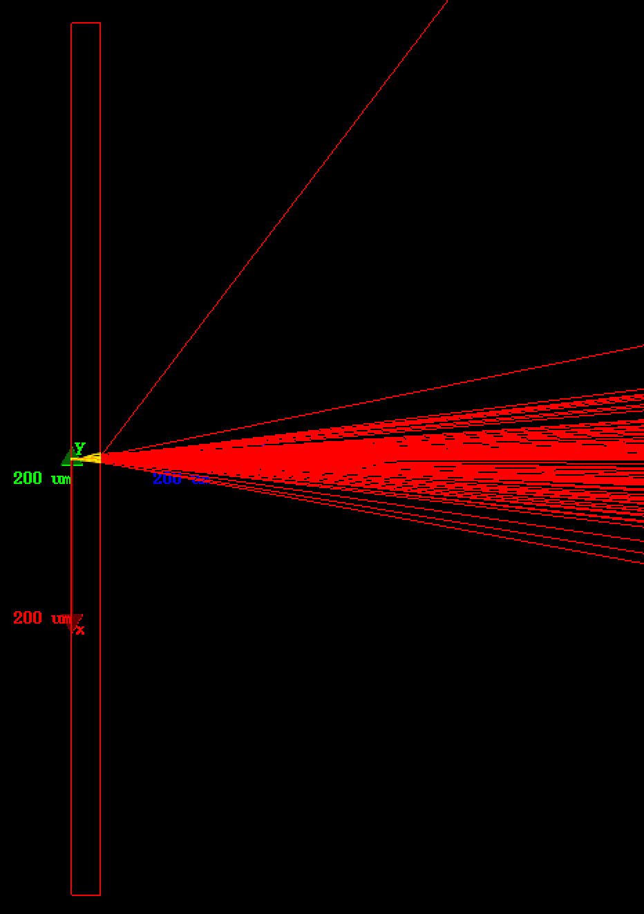
Single Event Simulation - Energy Deposition
The detector geometry need to be constructed in Geant4
After the materials and the geometrys are defined, a particle gun is appended to the system
Several events are generated with different track and energy deposition
The deposited energy is converted to excited carriers, which drift inside the detector and generate signal (next page)
A Sr90 beta source is placed on the left of the DUT (the red rectangle). After passing through the DUT, the beta rays are greatly scattered.

Slide 4
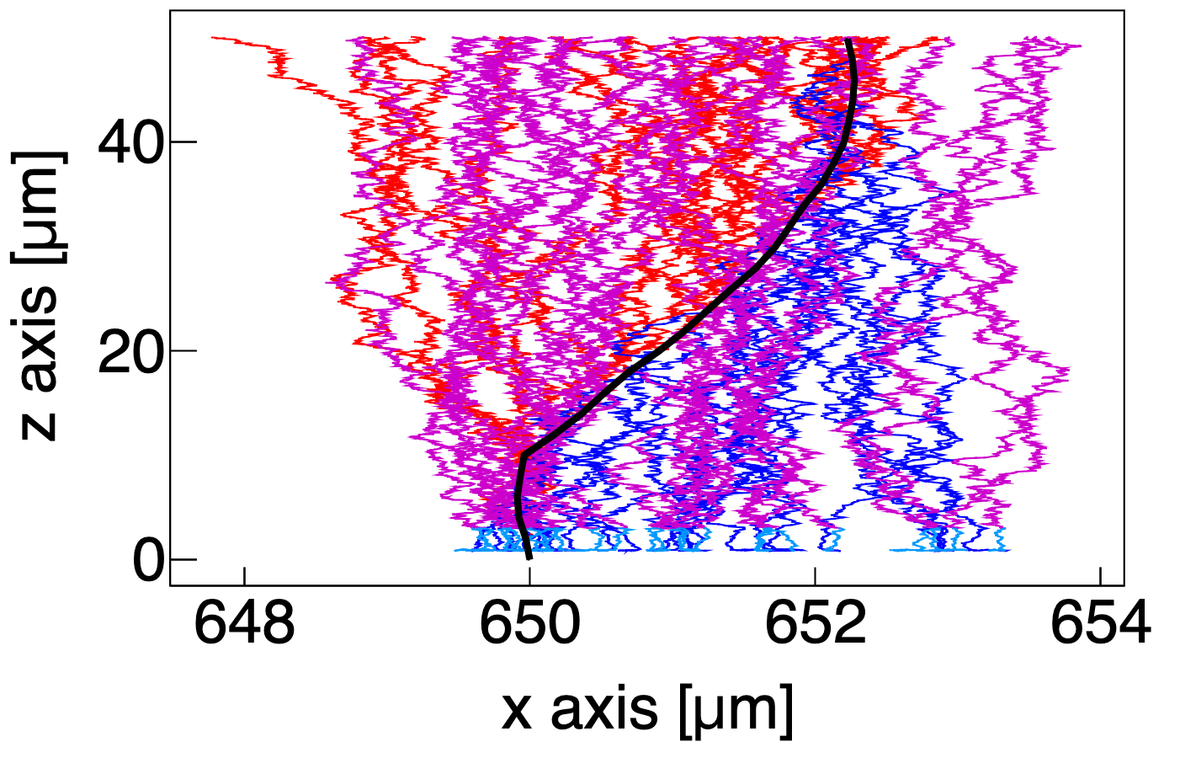
Single Event Simulation - Carrier Transport
Starting at where the injected particle depleted its energy, several pairs of electrons and holes start to drift under the electric field of the device
Drift will end when the carrier reaches the border of the device or enters an area with low electric field intensity (except for non-full-depletion MAPS)
For LGADs, after an carrier reached the gain layer, M (equal to the gain) carriers with opposite sign will be released at the gain layer and start to drift
The black line illustrates how an incoming beta ray passes through a silicon LGAD. The original carriers (red for holes, blue for electrons) start to drift immediately after generated, and when the holes touch the gain layer (the green line), the gain carrier pairs will be generated from avalanche (magenta for holes, cyan for electrons).

Slide 5
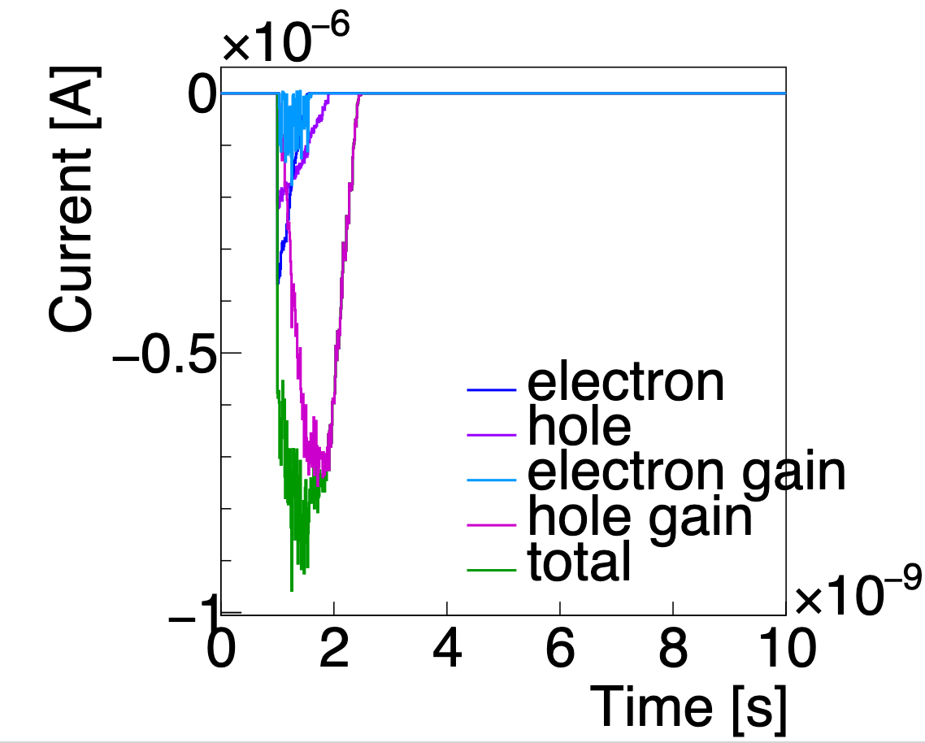
Single Event Simulation - Signal Generation
According to the Shockley-Ramo theorem, a drifting charge will induce a current on certain electrode, the value of which is I = q*v*E_{w}
As there are a great number of carriers, we turn to calculate I*dt = q*dx*E_{w} = q*dU_{w} instead
  avoids differentiating the weighting potential
  shows good compatibility with TH1F format, because we can just Fill() the signal generated by one carrier into the total signal
The generated signal by beta ray in a silicon LGAD. The four components and the overall signal are shown in the legend. The gain of the LGAD is 3.3.

Slide 6
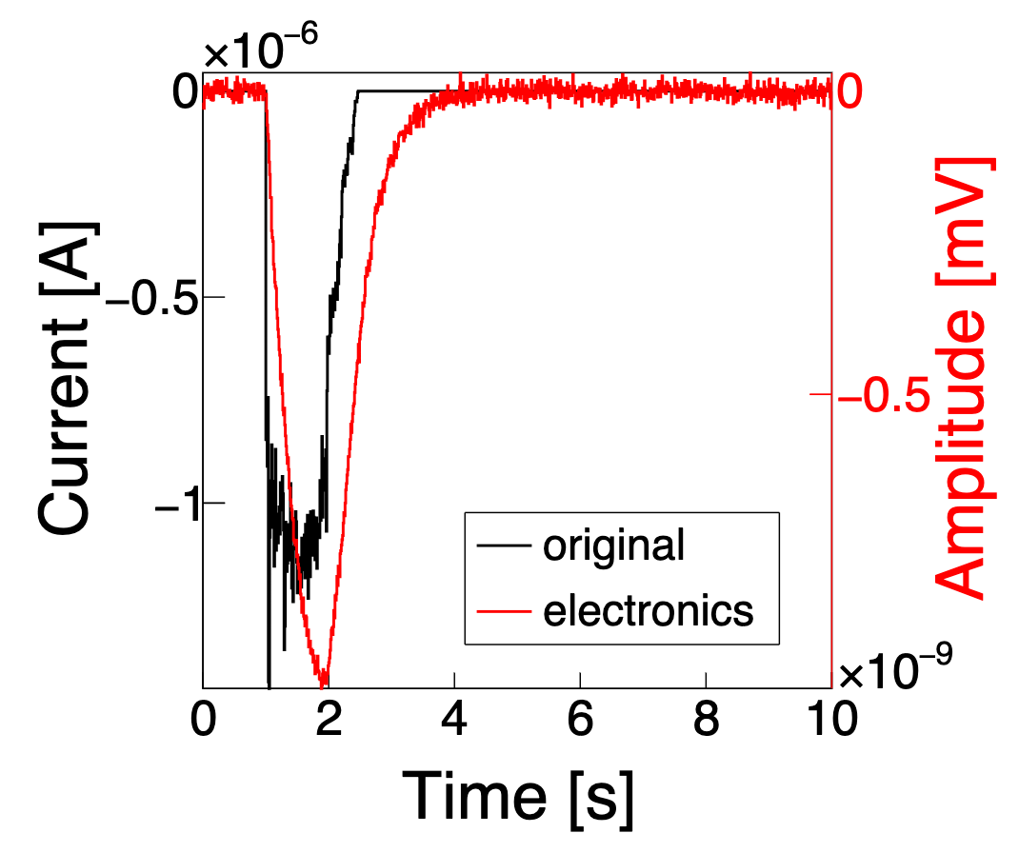
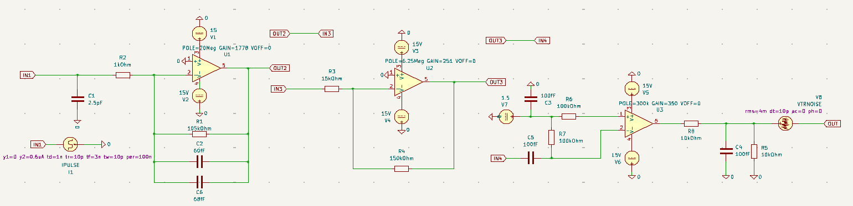
Single Event Simulation - Electronics
Original signal needs to be amplified to be observed or further processed
  Noise are considered too
Two approaches:
  Convoluting the signal with pulse response functions modelled from an amplifier
  Using NGSpice by sending the signal into a .cir netlist file
    NGSpice: https://ngspice.sourceforge.io
    KiCad: https://www.kicad.org
Approach 1: the signal (black line) is convoluted into an amplificated waveform (red line).
Approach 2: an amplifier circuit drawn in KiCad, which could easily converted into an NGSpice netlist, which could be utilized by RASER as the front end electronics.

Slide 7
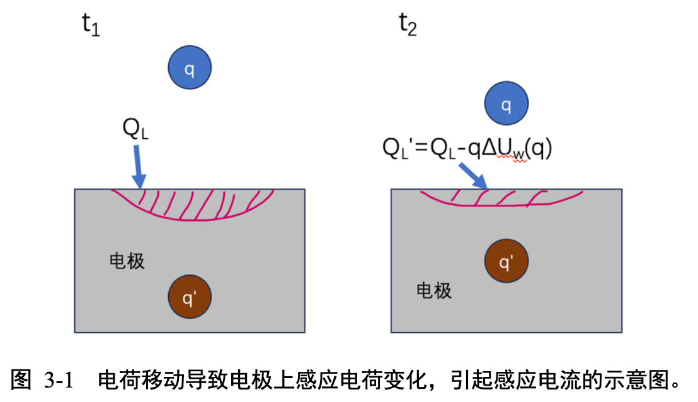
最简单的情况：无限大平板
像电荷跟原电荷等大反号
原电荷越接近电极，像电荷也越接近
  也就是说产生信号的时间是瞬时的
    至少是电场传播速度
板上的真实电荷越来越多
  不断有电荷流入板
  电荷到板前一刻板上电荷量达到顶峰
直到电荷接触到电极，电荷中和
  此时电信号消失，电流为0

Slide 8
实操环节
python src/raser signal HPK-Si-LGAD (或换成任何你已经计算过电场和加权场的器件)
  如果还没有运行电场和加权场，则先运行：
    python src/raser field HPK-Si-LGAD
    python src/raser field -wf HPK-Si-LGAD

