Slide 1

CEPC Fast Luminosity Monitor Introduction
李雁鹏
2025.07.16 RASER Workshop 2025

Slide 2
OUTLINE
CEPC Introduction
Fast Lumi Monitor Project of CEPC
RASER Simulation

Slide 3
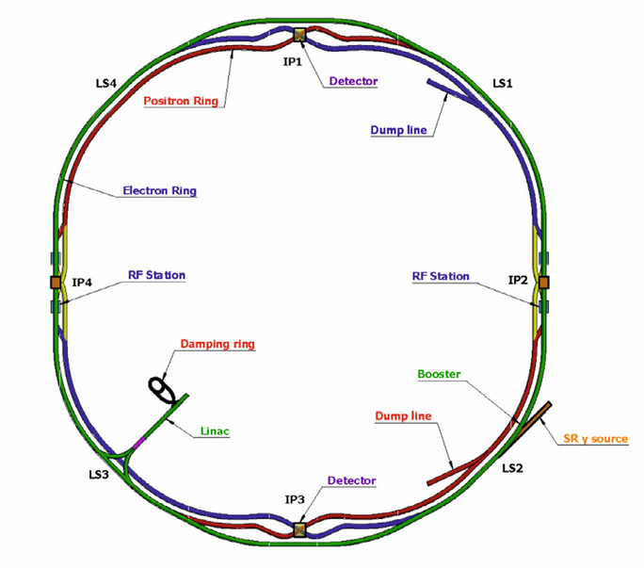

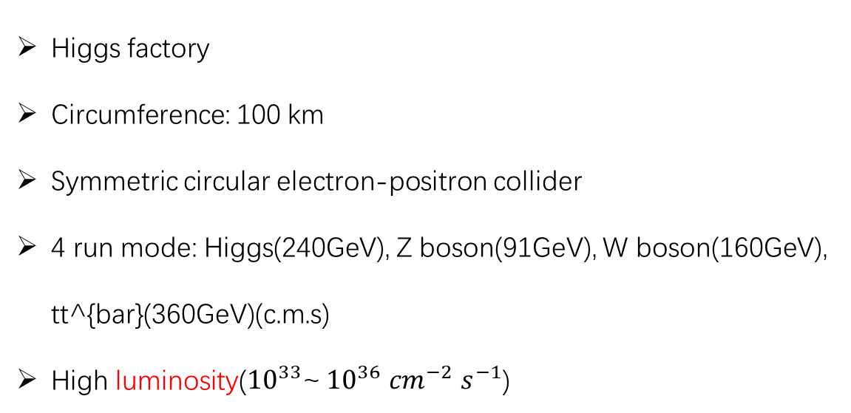
CEPC Introduction
Circular Electron Positron Collider
Higgs factory
Circumference: 100 km
Symmetric circular electron-positron collider
4 run mode: Higgs(240GeV), Z boson(91GeV), W boson(160GeV), tt^{bar}(360GeV)(c.m.s)
High luminosity(${10}^{33}$~ ${10}^{36}$ ${cm}^{−2}$ $s^{−1}$)

Slide 4
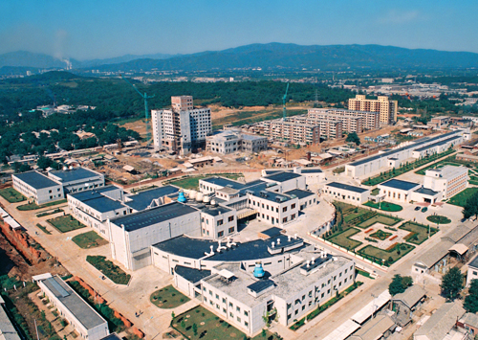
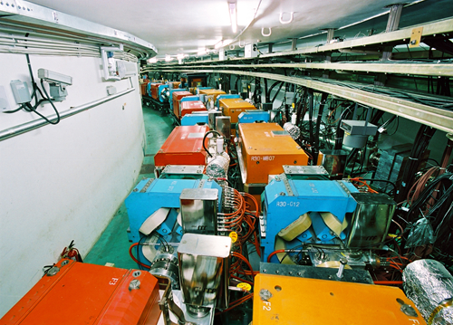
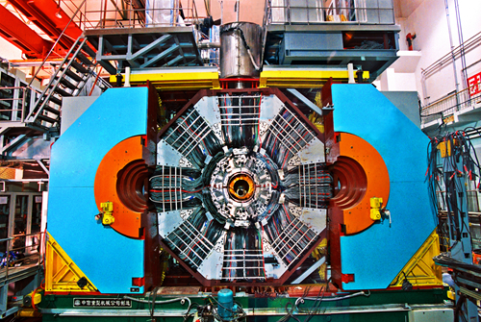
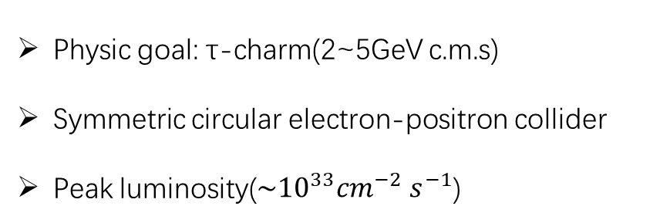
CEPC Introduction
Beijing Electron Positron Collider II(BEPCII, China)
Physic goal: τ-charm(2~5GeV c.m.s)
Symmetric circular electron-positron collider
Peak luminosity(${\sim 10}^{33}{cm}^{−2}$ $s^{−1}$)

Slide 5
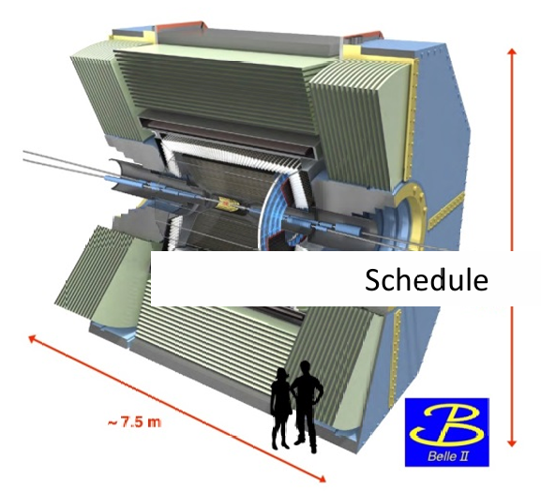
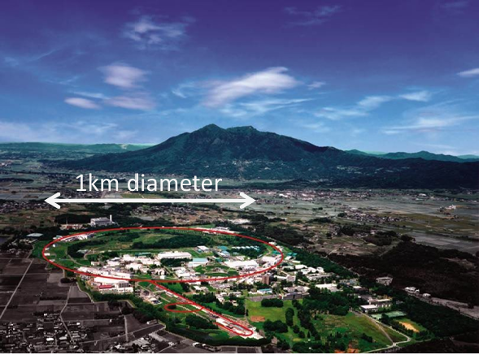
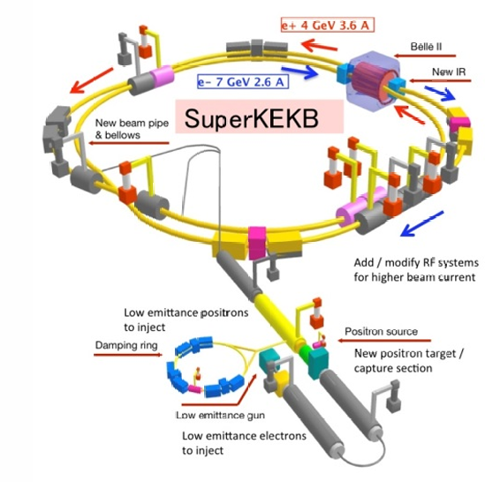
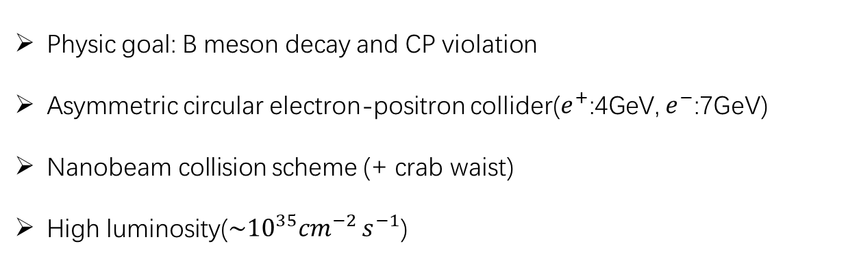
CEPC Introduction
SuperKEKB(Japan)
Physic goal: B meson decay and CP violation
Asymmetric circular electron-positron collider($e^{+}$:4GeV, $e^{−}$:7GeV)
Nanobeam collision scheme (+ crab waist)
High luminosity(${\sim 10}^{35}{cm}^{−2}$ $s^{−1}$)

Slide 6
CEPC Introduction
Higher and Wider energy region
Higher luminosity
More physic targets

Slide 7
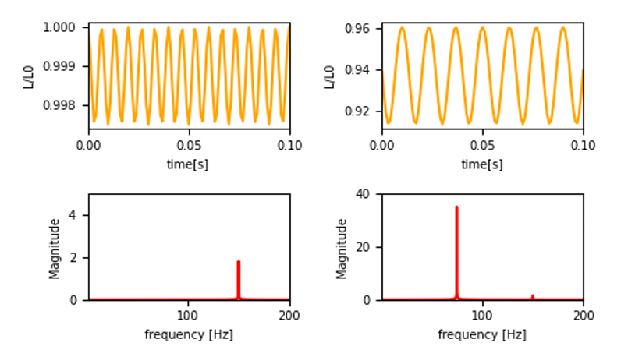
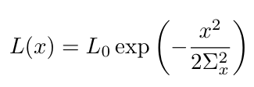

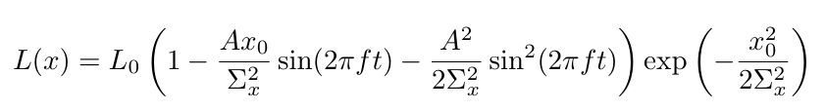
Fast Lumi Monitor Project of CEPC
Based on SuperKEKB fast luminosity project design
Due to various reasons (e.g., GM), the two colliding bunches failed to align properly.
For horizontal IP orbit feedback: Luminosity-driven with a dithering system
weak beam deflection
😃
🙁

Slide 8
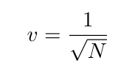

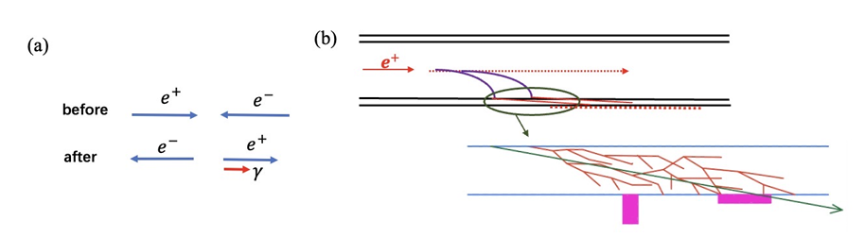
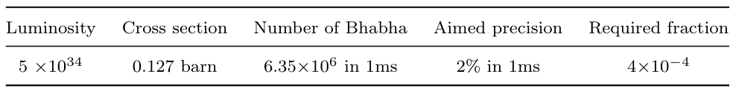
Fast Lumi Monitor Project of CEPC
Monitor based on radiative Bhabha at zero degree
Large cross section

Slide 9
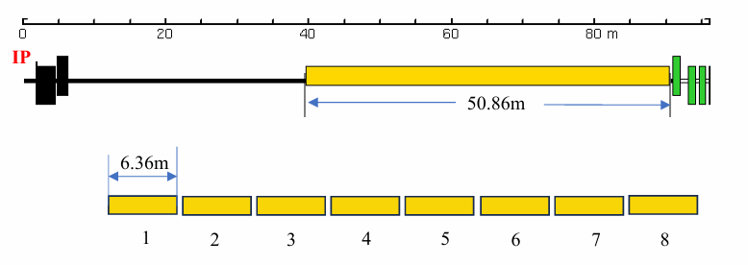
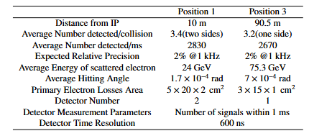
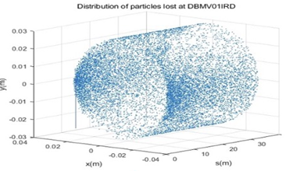
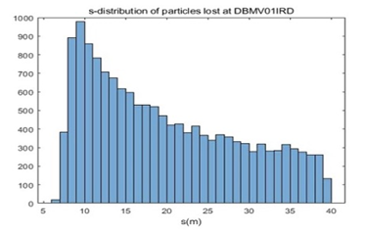
Fast Lumi Monitor Project of CEPC
Where to detect radiative Bhabha electrons?

Slide 10
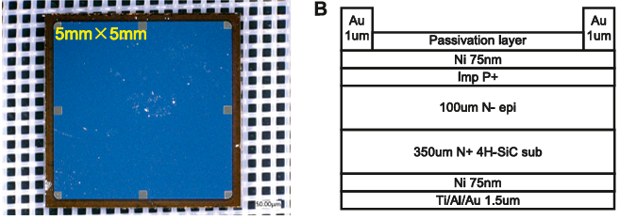
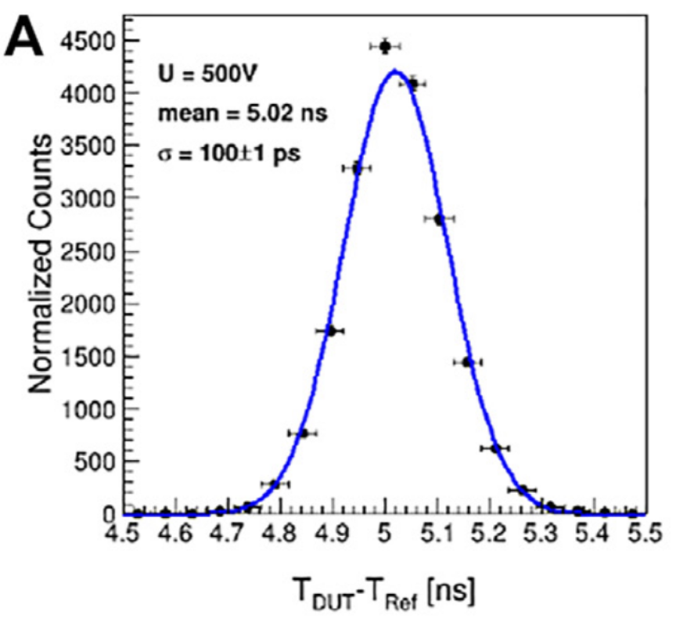
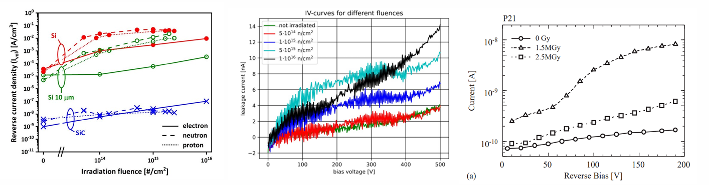

Fast Lumi Monitor Project of CEPC
Monitor candidates: Si, diamond and SiC
Stronger radiative tolerance($n, γ, e^{−}, p^{+}…$)
5mm×5mm PIN-type detector developed by NJU and IHEP
Lower leakage current(~pA)
94ps
4H-SiC
Excellent time resolution(~100ps)
Higher thermal conductivity(RT~500℃)
Cost less

Slide 11
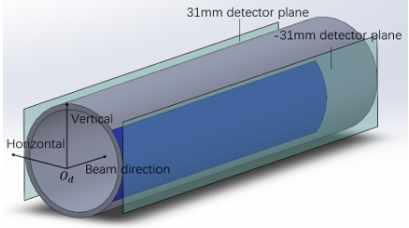
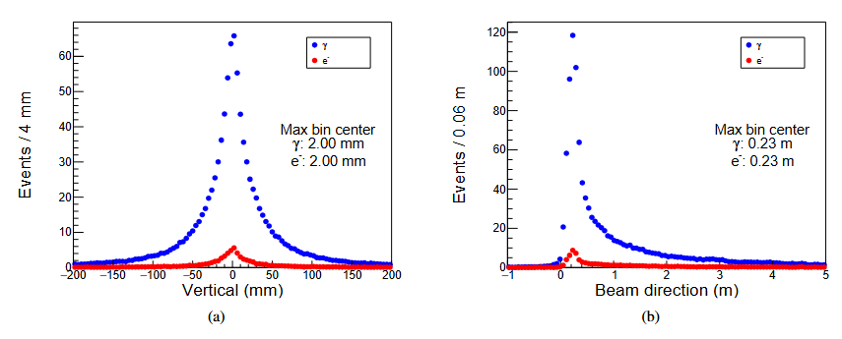

RASER Simulation
Secondary particle distribution
Vertival: 0mm
Beam direction: 230mm
Detector placement postion:
P1=(-31mm, 0, 230mm)
P2=(31mm, 0, 230mm)
Whthin $O_{d}$ coordinate

Slide 12
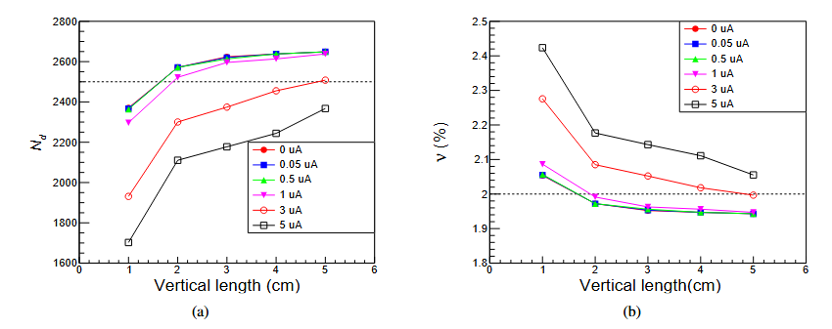
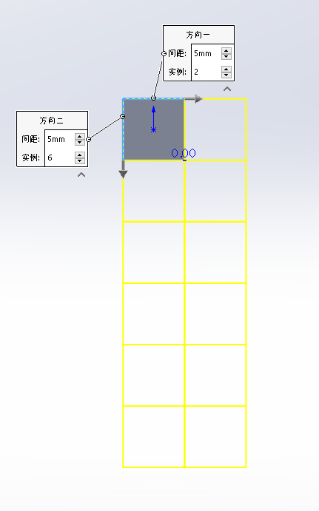
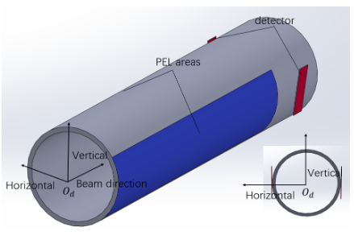
RASER Simulation
Design plan:
Vertical length: 3cm
Beam direction length: 1cm
2*12 pixel
1uA threshold for each channel
2*12 channel

Slide 13
RASER Simulation
How to use RASER to simulate CFLM project?
Example: Simulation for secondary particle distribution
setting/g4experiment/cflm_spd.json
"par_type": "gamma"
"par_type": "e-"
mkdir src/raser/lumi/figs
mkdir src/raser/lumi/input
mkdir src/raser/lumi/output/
Upload input file to src/raser/lumi/input
Setup RASER environment
raser lumi spd_dis
raser lumi spd_dis_plot
About 1h

Slide 14
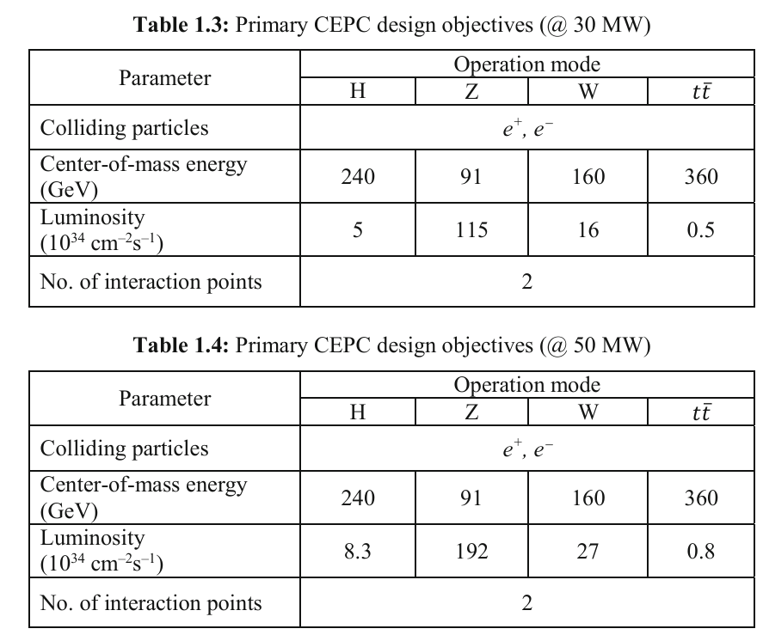
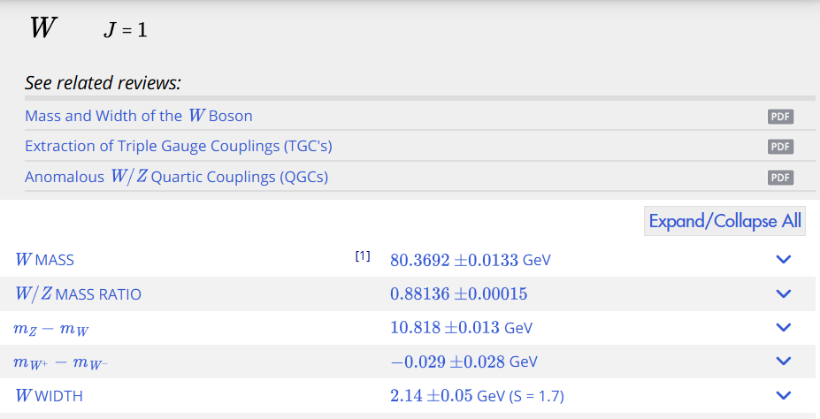
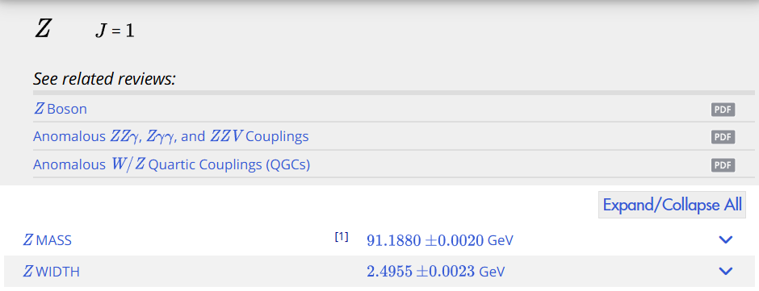
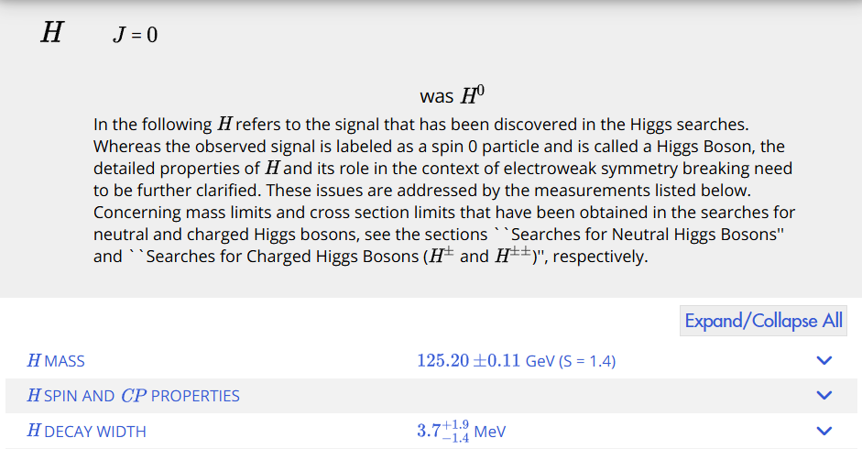
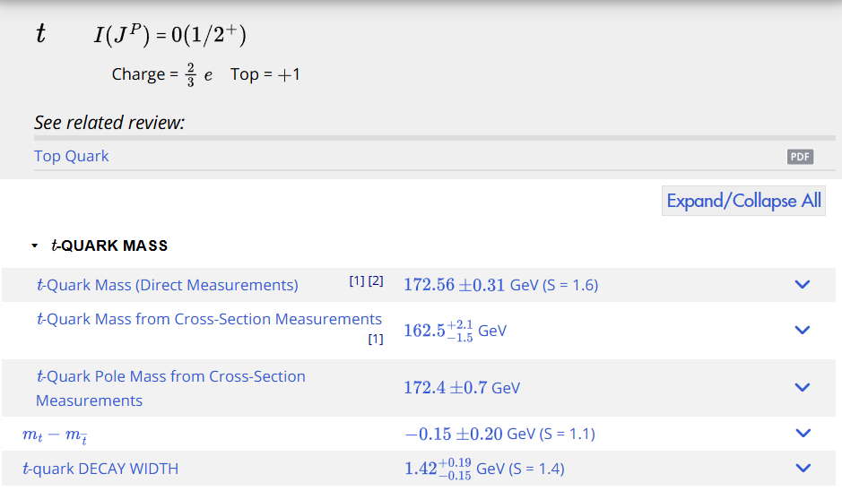
Backup

Slide 15
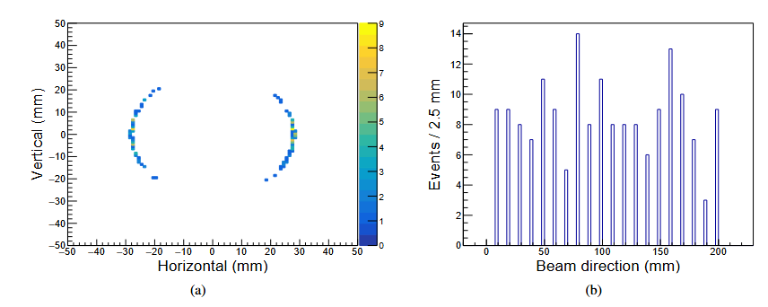
Primary electron distribution

