Slide 1
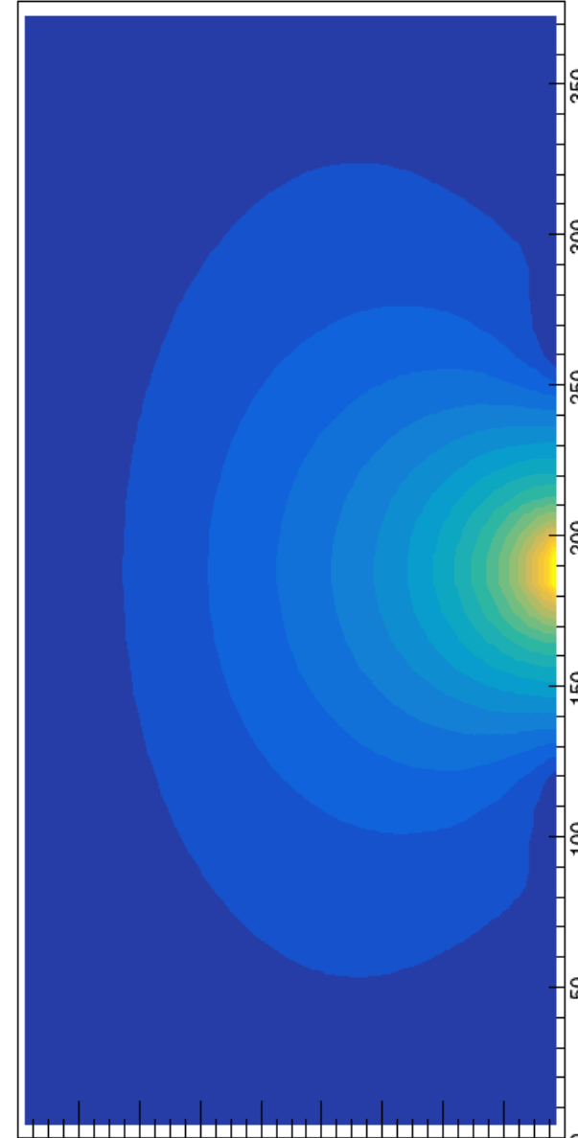
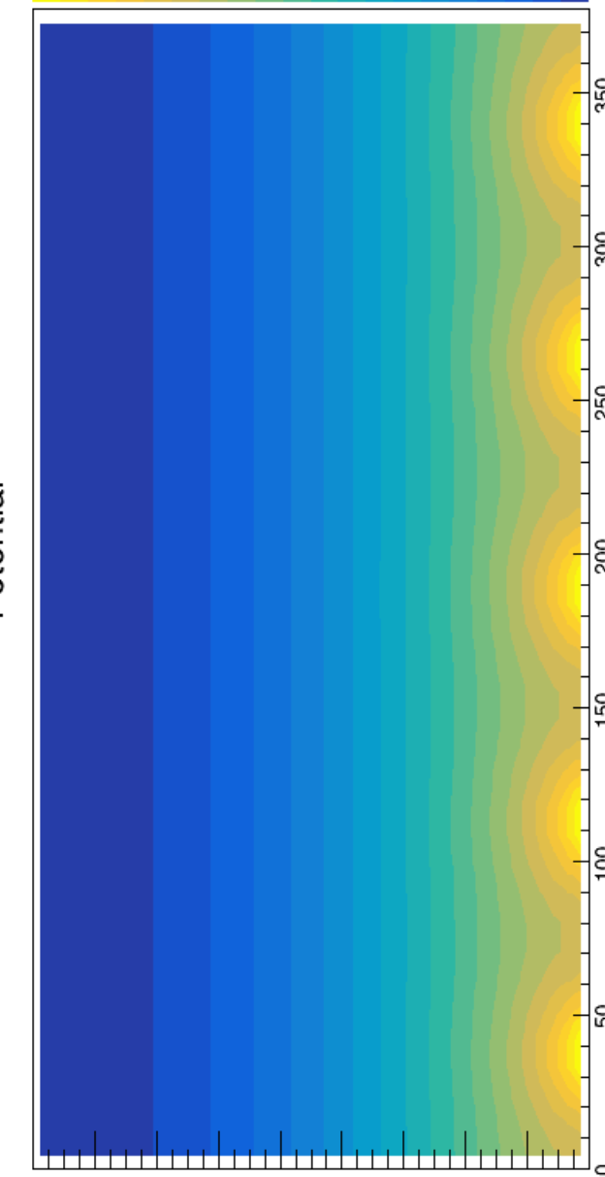
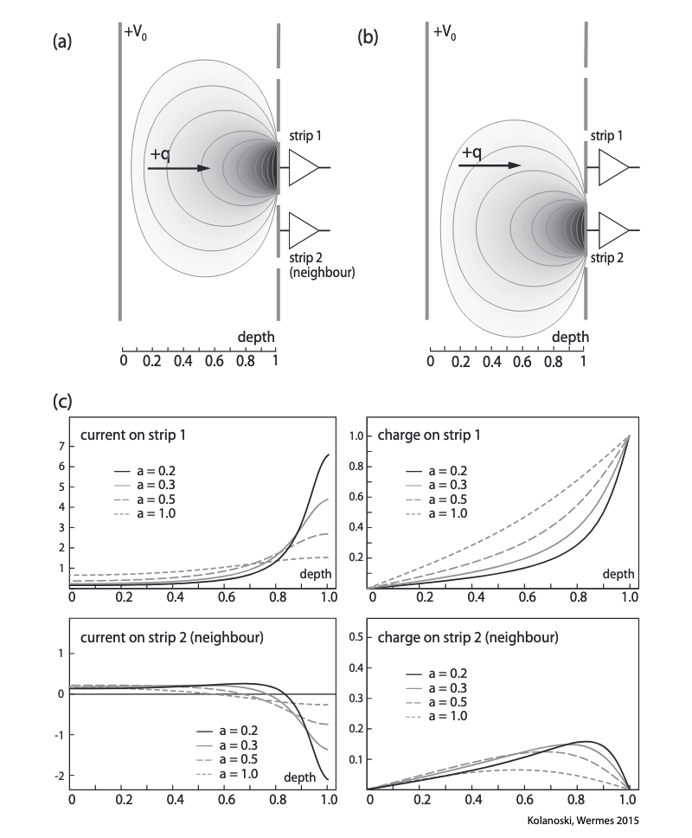
Strip detectors - Adjustments on the Electric Field and Weighting Field
For detectors with many readout electrodes (say > 10), it is hard and unnecessary to solve the fields across the whole detector
After considering the effect from neighbouring electrodes, all the electrodes could be assigned with the same fields because of periodicity
Carriers will not only induce signal on the nearest electrode, but also on other electrodes with non-zero weighting potential at the place of the carrier
For each electrode, the electric nearby is periodic but the weighting field is not, while the weighting field of every electrode looks the same. That is why we could assign the same weighting field into every channel, avoiding calculate them many times. (But this is also true for the real electric field)
An drifting carrier contributes signal to both the destination electrode and its neighbouring electrode (figure from Particle detectors: fundamentals and applications by Hermann Kolanoski & Norbert Wermes)

Slide 2
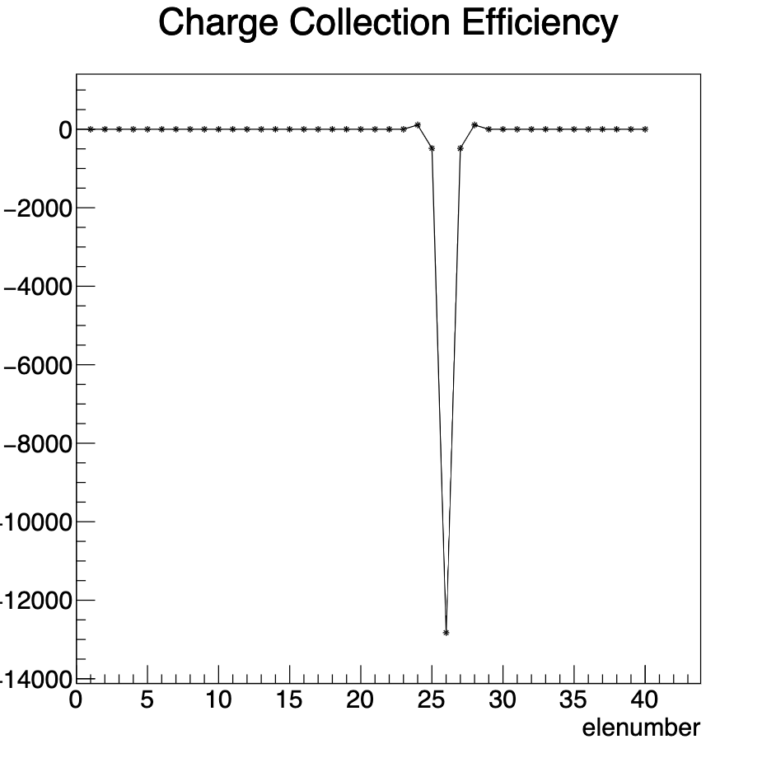
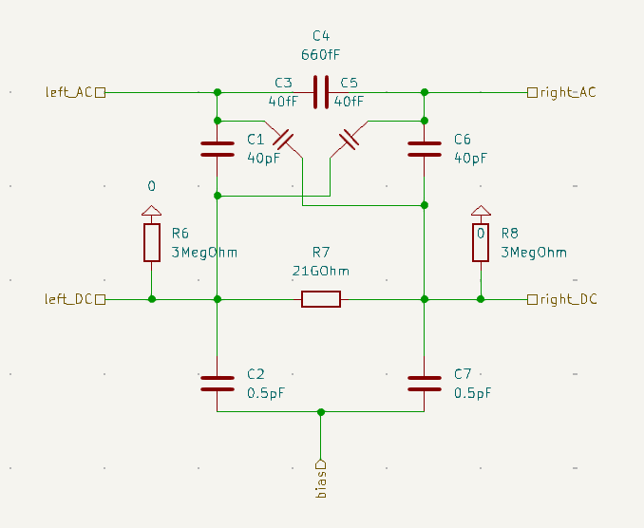
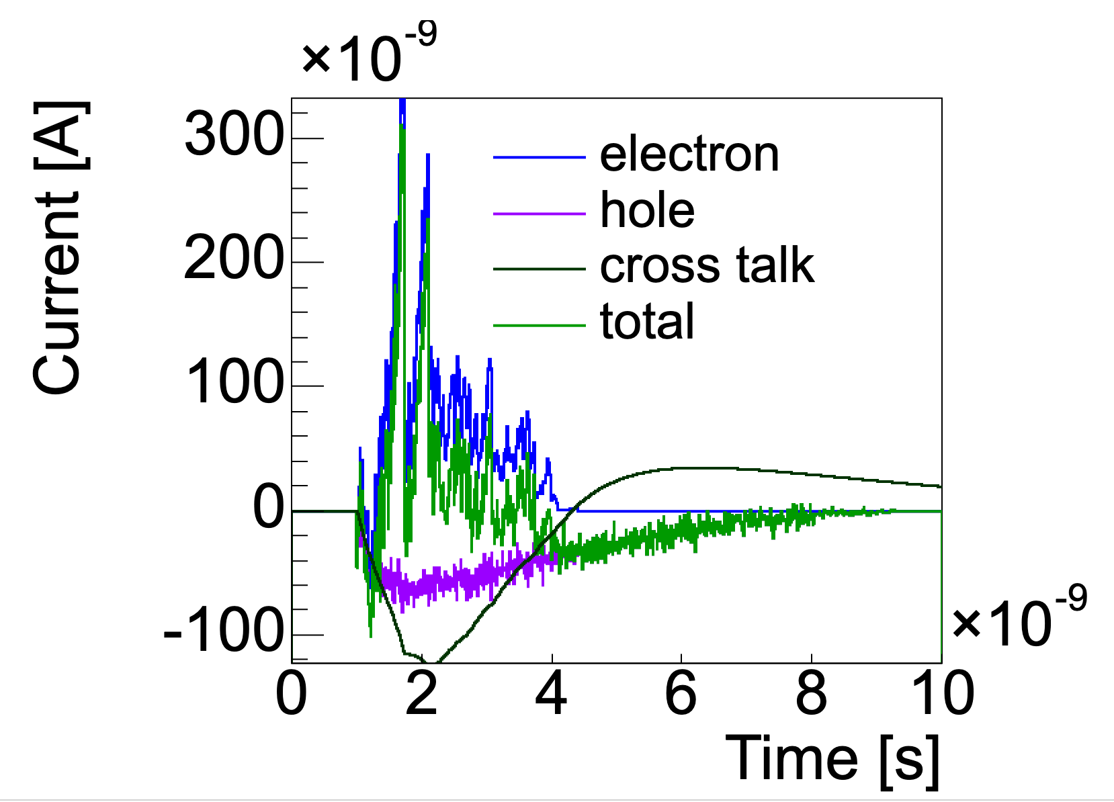
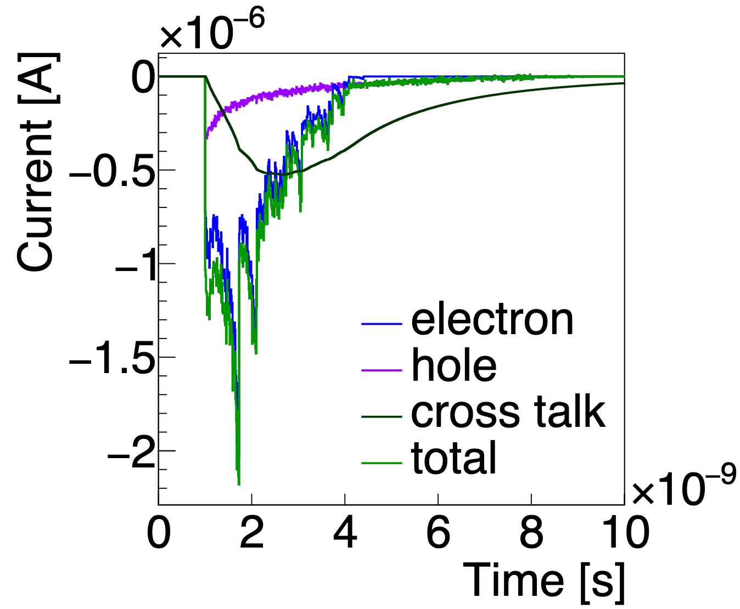
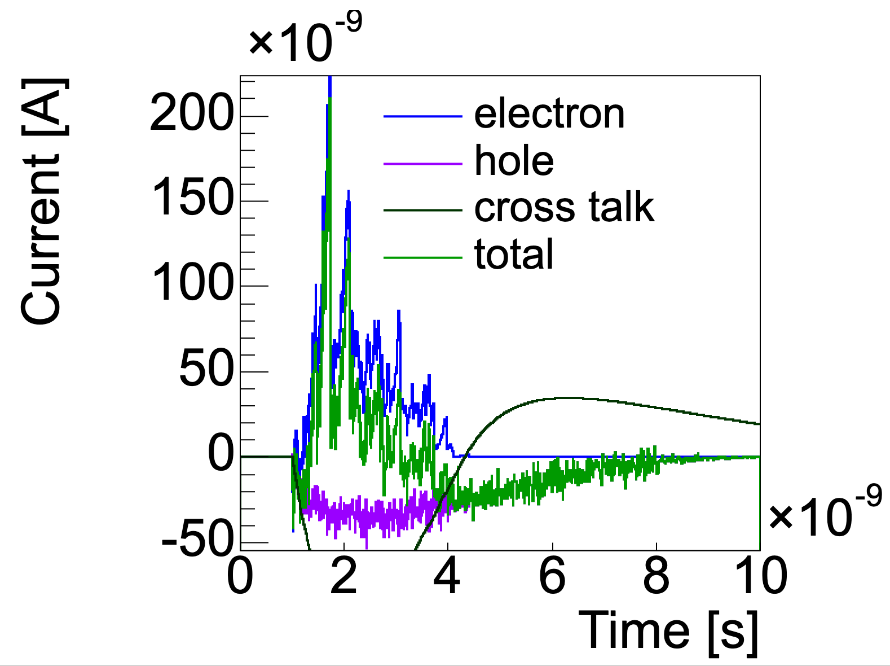
Strip detectors - Cross Talk
Parasitic capacitances between neiboughing electrodes will change the output signal
  Some strip sensor utilizes this feature to reduce readout channels while keeping the space resolution unchanged
signal of electrode 25
signal of electrode 26
signal of electrode 27
charge collection of the 40-channeled sensor
Resistances and capacitances between two readout strips in KiCad.
Signals induced on a 40-channel AC-readout strip sensor (left 3 figures) from a MIP hitting on electrode 26. Without cross talking (merely considering the expansion of the weighting field), the signs of the pulse on the neighbouring electrodes are opposite to the original one. But with cross talking, these signs appear to be the same, and lead to a charge collection with the same sign as the target electrode (right).

Slide 3
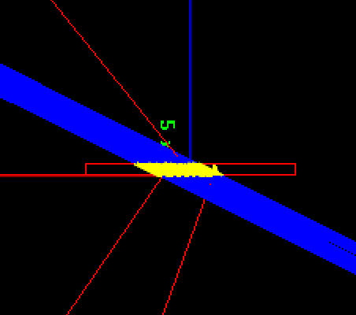
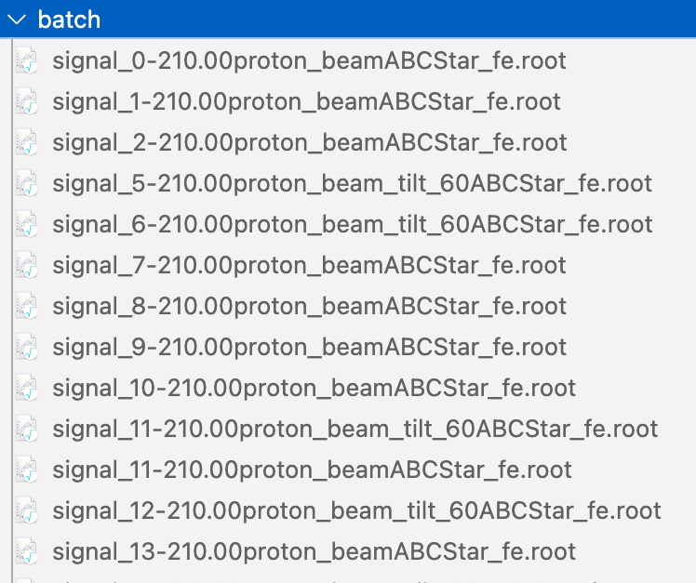
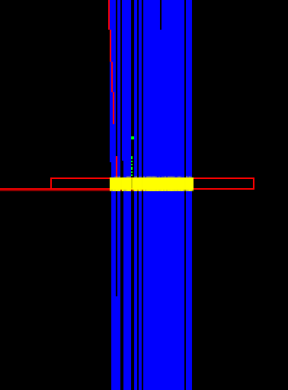
Multiple Events - Batch Job
For obtaining the statistical performances (e.g. the space resolution, the time resolution) of a detector, a great amount of events need to be simulated
HTCondor service is utilized (temporarily only available for IHEP users)
For calculating the space resolution of a strip sensor, about 10000 events are needed. We divide the events in to 100 jobs and send them to compute platforms by HTCondor service. The figures on the left and the right correspond to different injection angles.
Every running result of a job will be filled into an .root file by the form of ROOT TTree object. The TTrees are able to be further analysed.

Slide 4
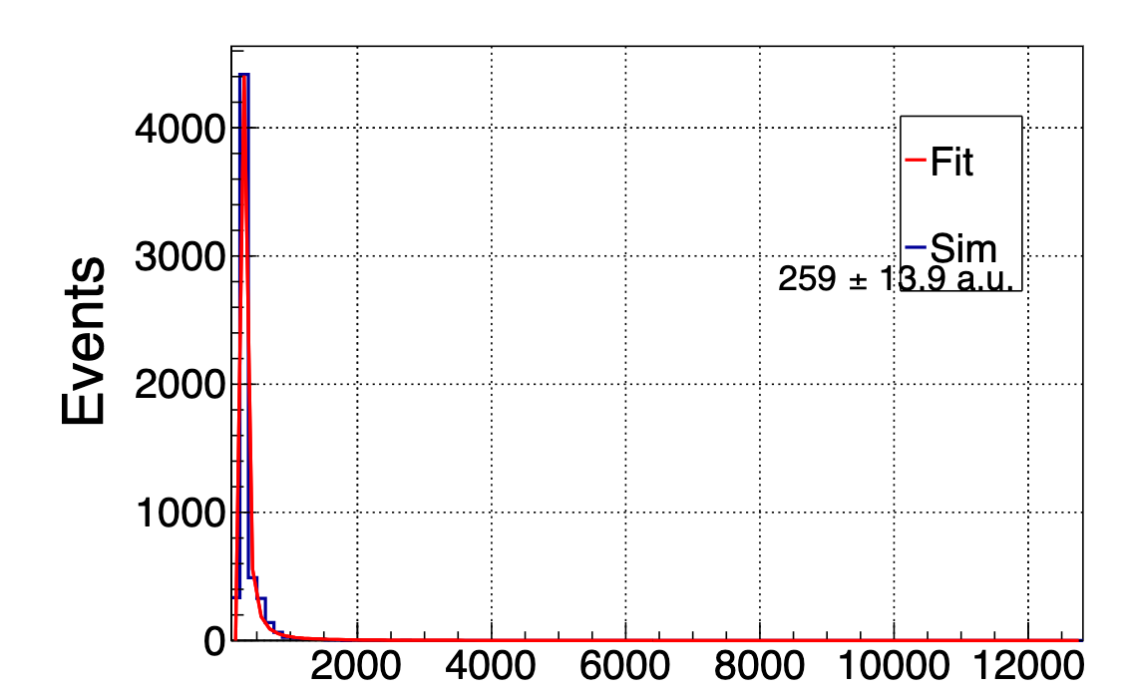
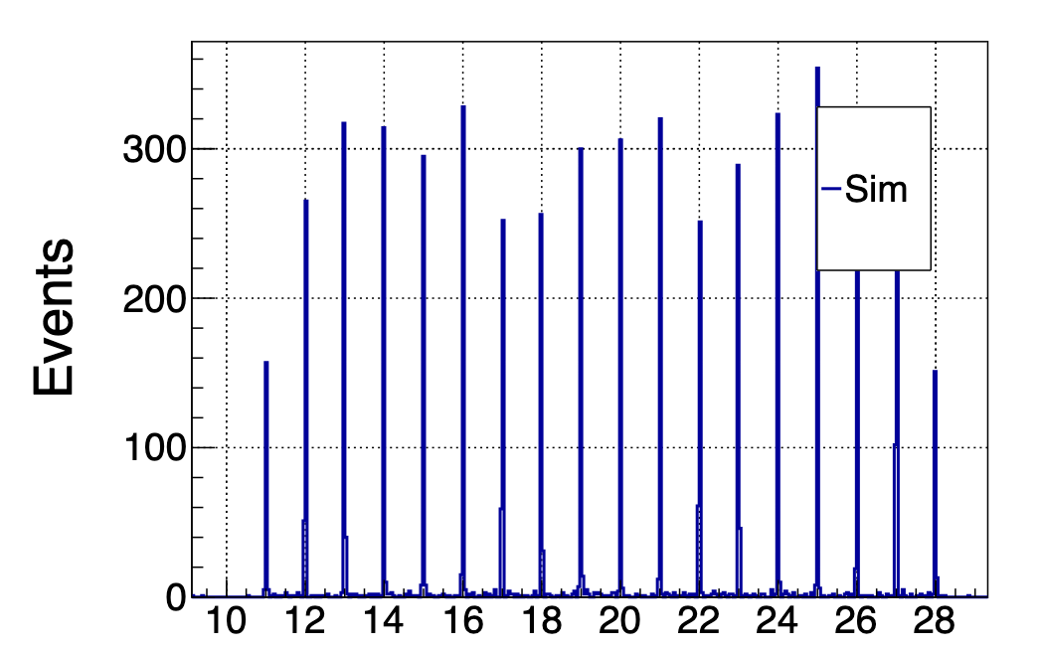
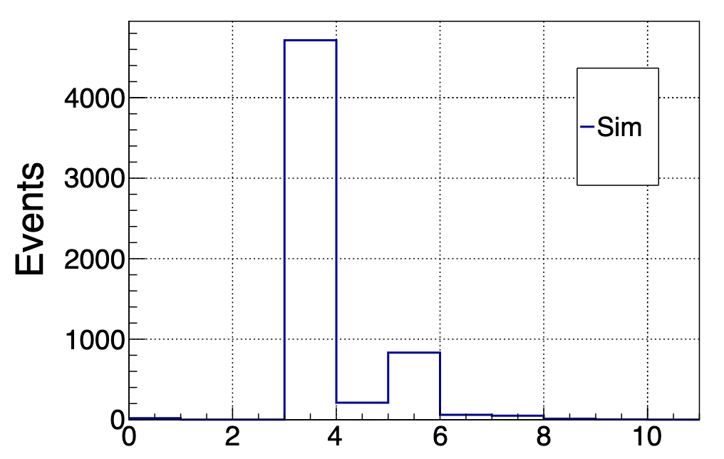
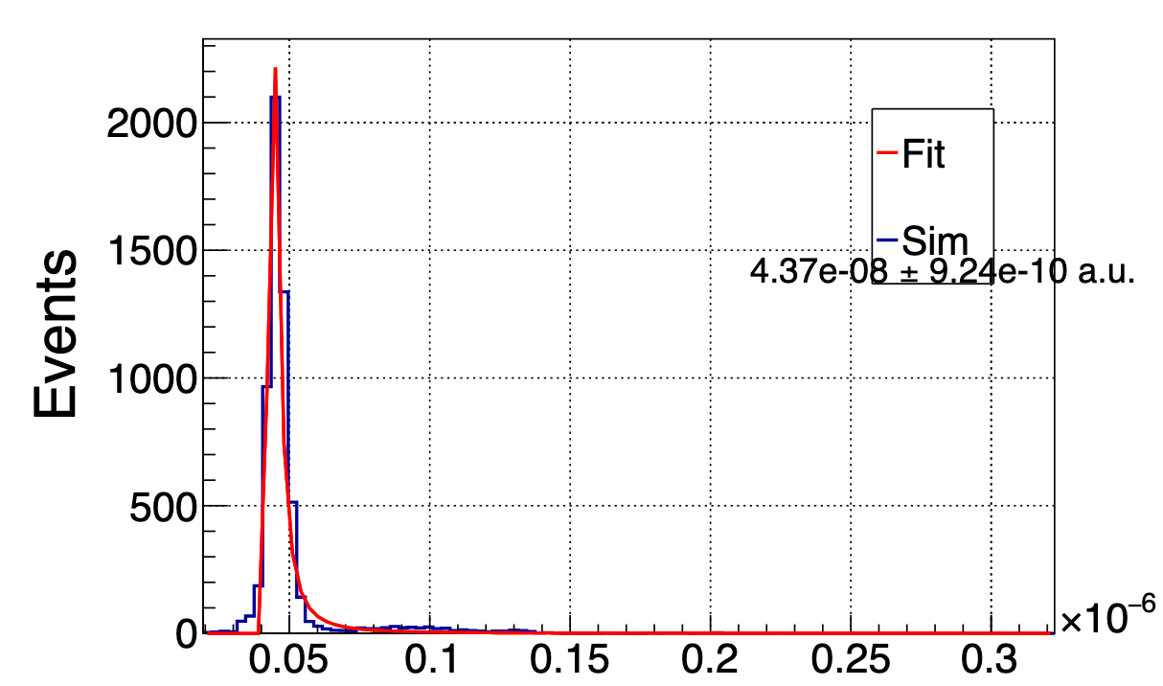
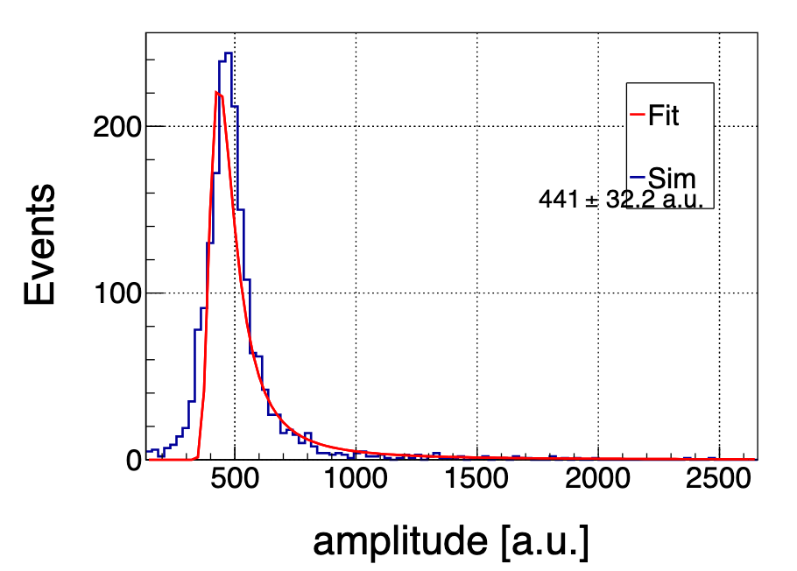
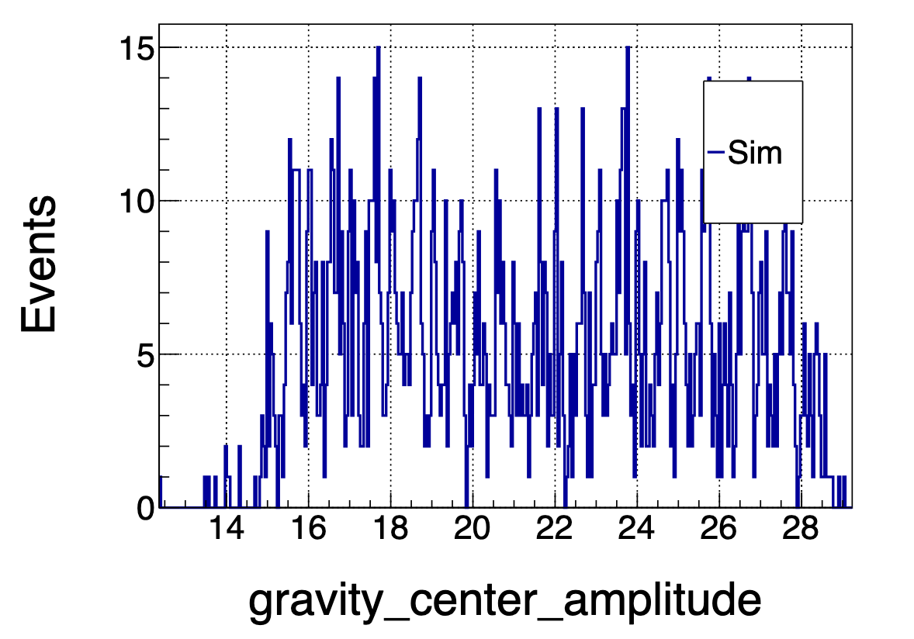
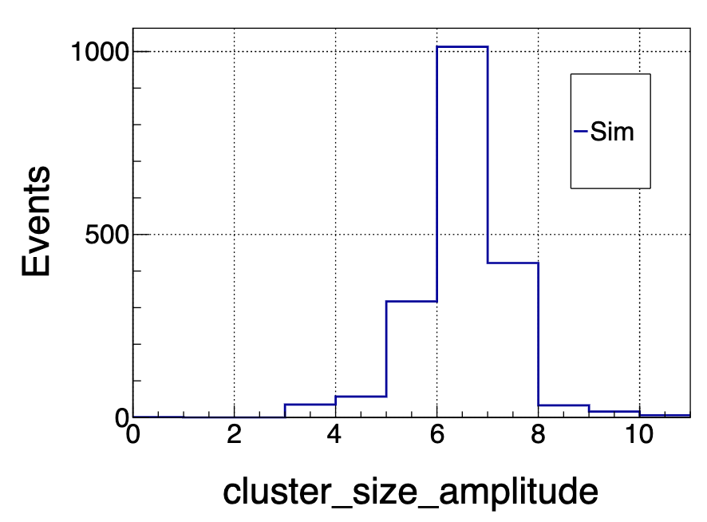
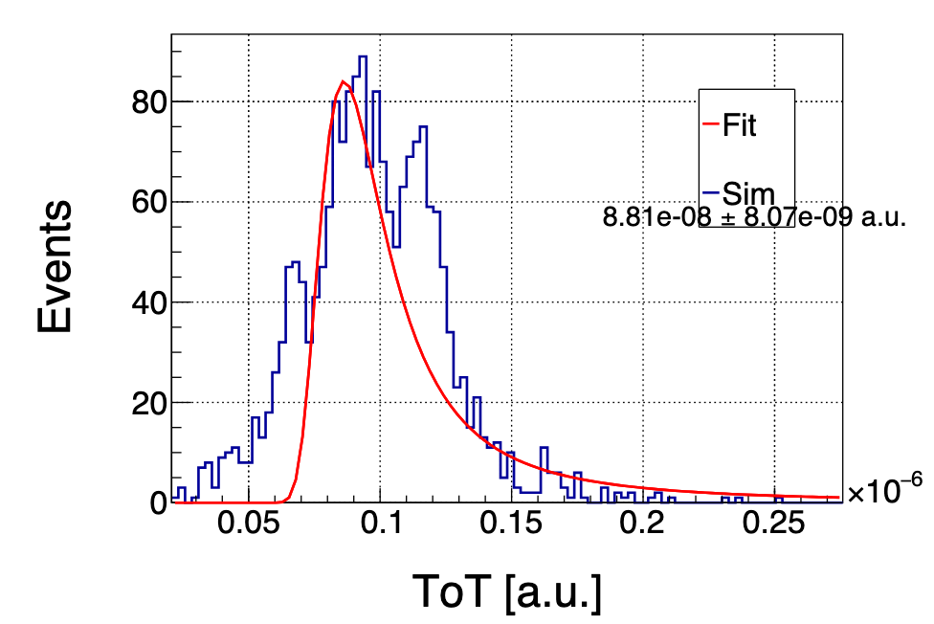
Multiple Events - Statistics from waveforms
Every event brings a list of characterized datas
  total amplitude, gravity center, cluster size, time over threshold, etc.
  their distributions reflect the procedure of particle-detector interaction
The amplitude, c.o.g., cluster size and ToT of an strip sensor under 3 GeV proton beam. The upper figures are for perpendicular injection, while the lower figures corresopnds to an injection tilted for 60 degrees. Beacuse of the existance of a strong cross talk, the cluster sizes tend to be bigger than other strip devices.

Slide 5
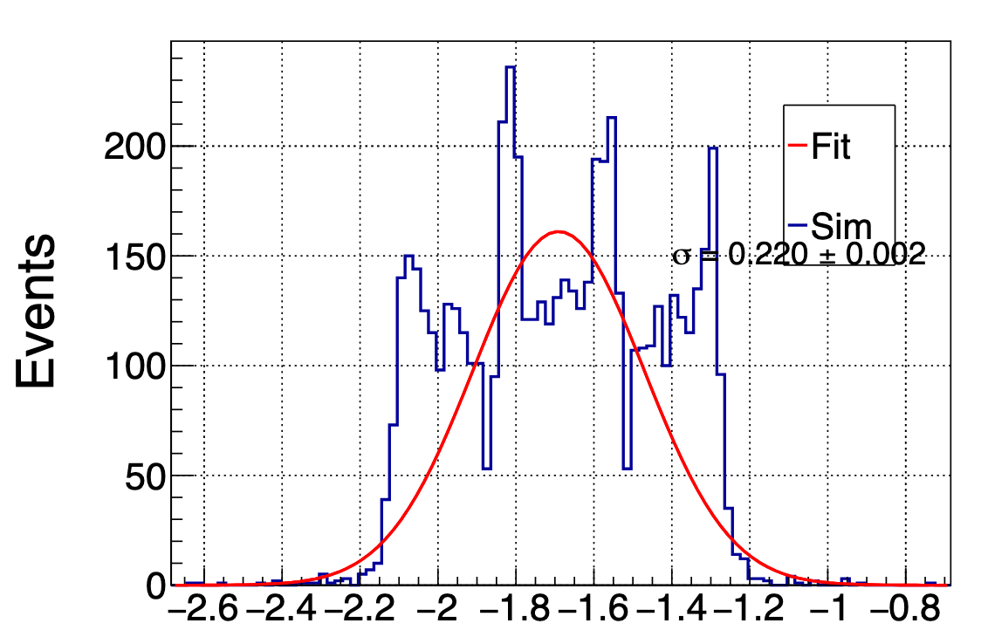
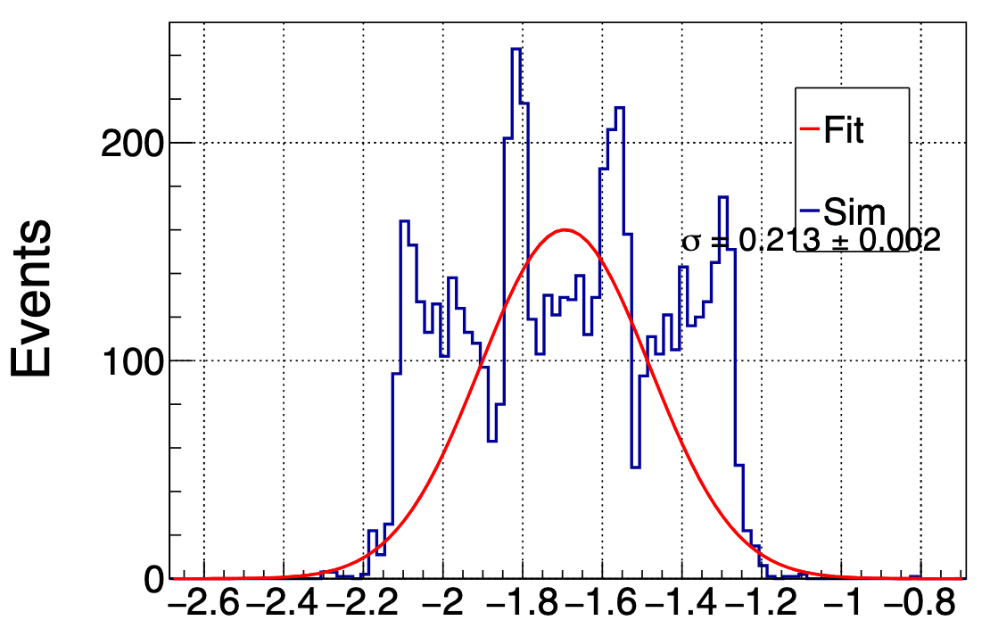
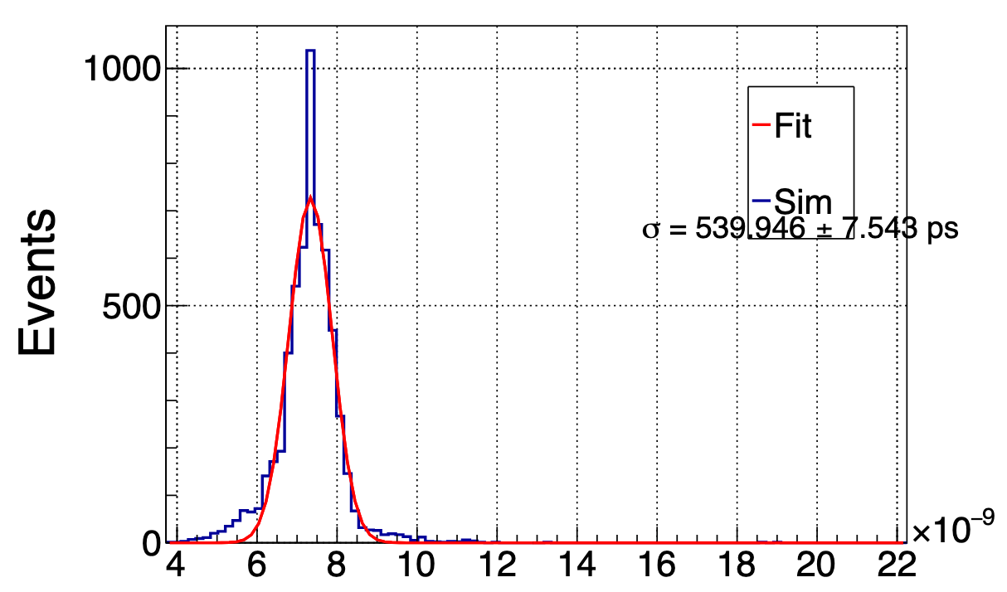
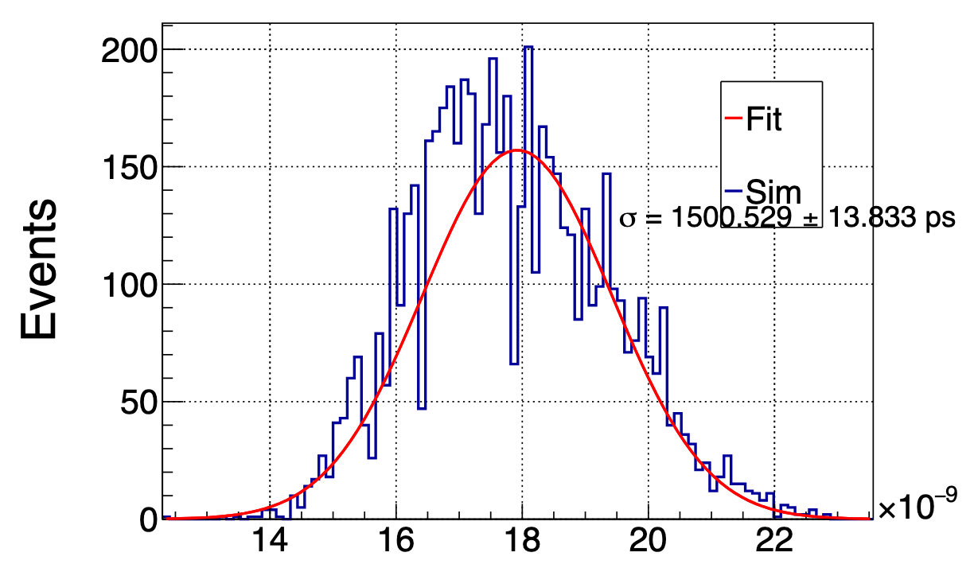
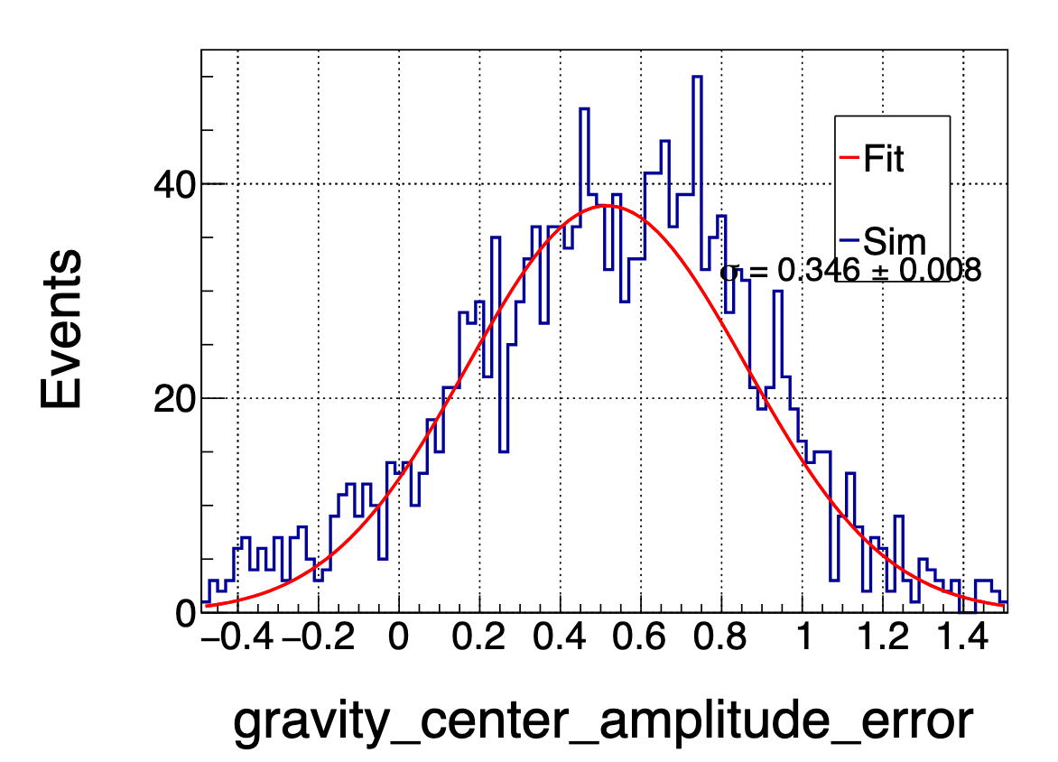
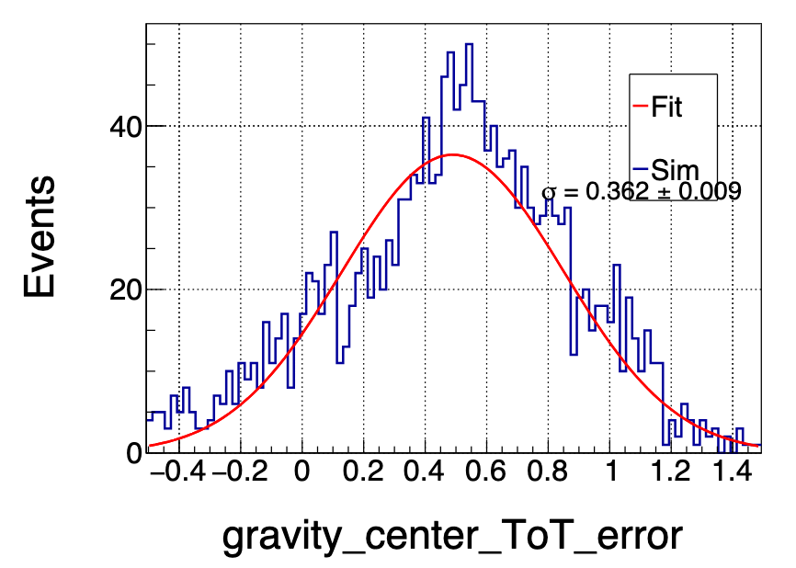
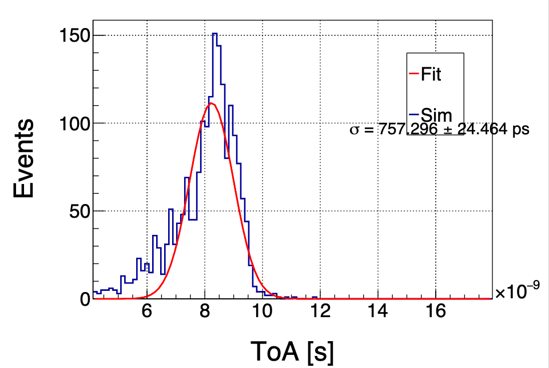
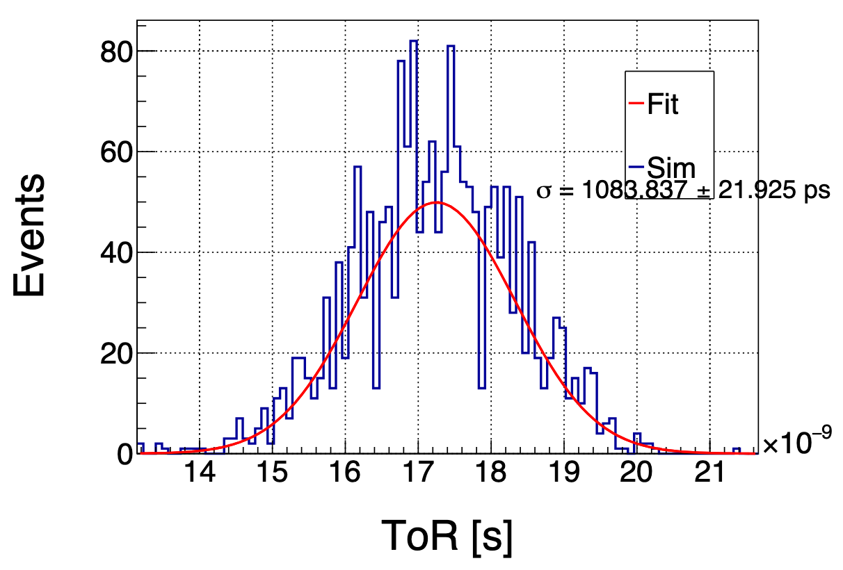
Multiple Events - Resolution Calculation
With proper knowledge of the incoming particle, we could calculate the error of the measured datas from the real ones
  in reality we use telescope or trigger, but in simulation we have already known it
Two kinds of spacial resolution using amplitude and ToT (strip pitch as unit) and two kinds of time resolution using arrival time and constant ratio discriminator. The upper figures are for perpendicular injection (expected distribution of the gravity center error is drawn in green), while the lowers are for an injection tilted for 60 degrees.

Slide 6
实操环节
将数据解压到raser/output/signal/CMOS_strip/batch
python src/raser resolution CMOS_strip

