Slide 1
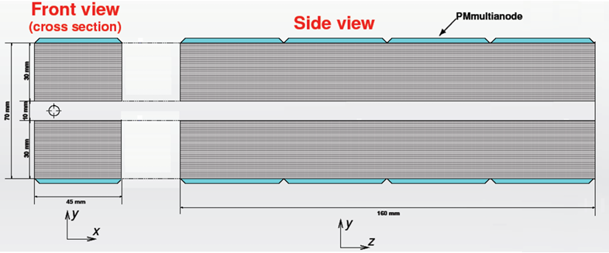
ZDD and Ekhara Generator
Wang Yilun (Nanjing University) Wan Jiawei(Nanjing University)
Zhang Lei (Nanjing University)

Slide 2
Contents
Introduction
Ekhara Generator
Tagging
Results
Conclusion

Slide 3
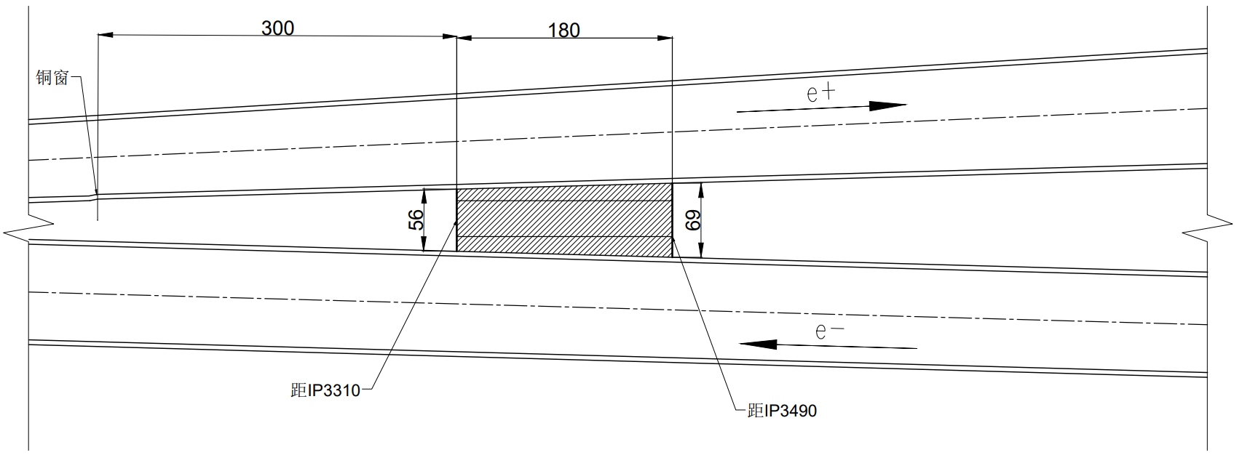
Introduction
Beam Center
Detector Center
Distance from beam to detector center
$$\sim 70 mm$$
Notes:
ZDD探测器中心离束流中心距离,也就是图中红色箭头标出的距离，约为 70 mm，因此在有磁场的情况下，可以近似将探测器中心放在质心系下离束流中心70mm的位置

Slide 4
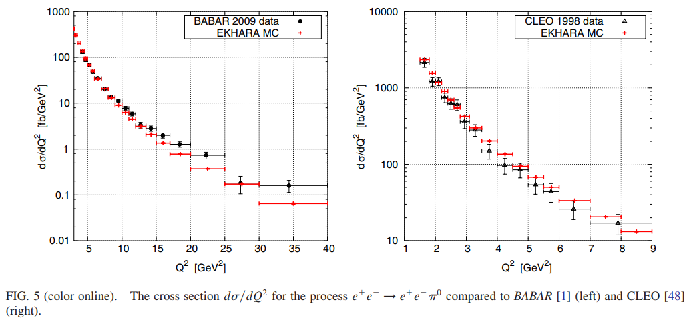
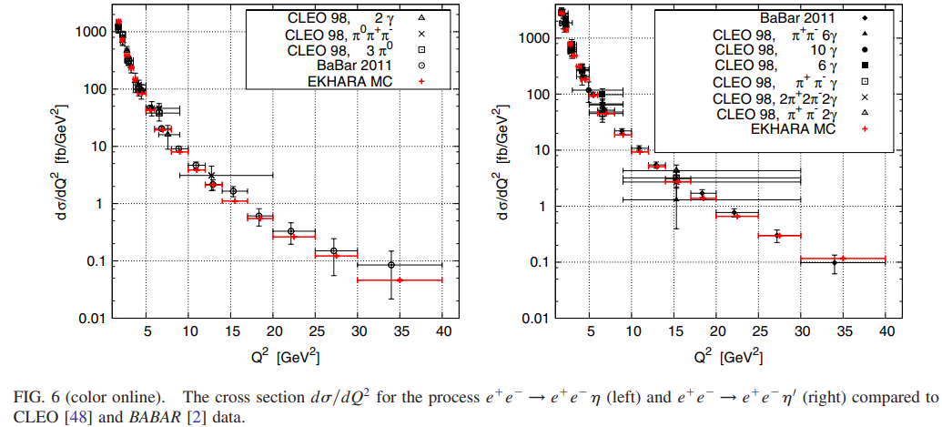
Introduction - Ekhara Generator
Version : EKHARA 3.0
Used in BABAR and CLEO experiments
Environment : Vmware Workstation, Ubuntu 24.04.1 LTS
Compiler : ifort 2021.9.0
Test Run
LO calculation of $π^{0}, η, η^{′}$Passed
NLO calculation of $π^{0}, η, η^{′}$ Failed
Also, NLO calculation is unavailable in unweighted mode
Use LO calculation only
PhysRevD.85.094010
Notes:
使用的Ekhara版本为3.0，其之前已与BABAR和CLEO等实验结果比较过，可见右图。环境为Vmware workstation下的ubuntu 24.04.1 LTS版本linux。编译器为ifort 2021.9.0版本
在测试运行中，pi0, eta,和etaprime的LO计算均通过，但NLO计算未通过，且不能在无权重模式下运行。所以仅使用其LO计算

Slide 5
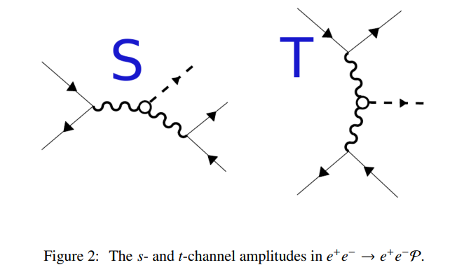
Ekhara Generator - Parameters
input.dat
Vacuum Polarization not included
LO calculation only
card_1pi.dat (also used in $η/η^{′}$)
CMS Energy : 4.68 GeV
sw (mode switch) : 2 (t-channel)
piggFFsw (Form Factor switch) : 10 (Czyz et al. 2017, default)
$e^{±}$ cut : 0-100 GeV, 0-180 degree (no cut, default)
$π(η/η^{′})$ cut : 0-110GeV, 0-180 degree (no cut, default)
Notes:
这里是输入的运行参数，未开启真空极化，仅使用LO计算，质心能量为4.68gev，模式为t道，其他参数，如形状因子和一些常数均为默认设置，出射粒子均没有设置筛选条件

Slide 6
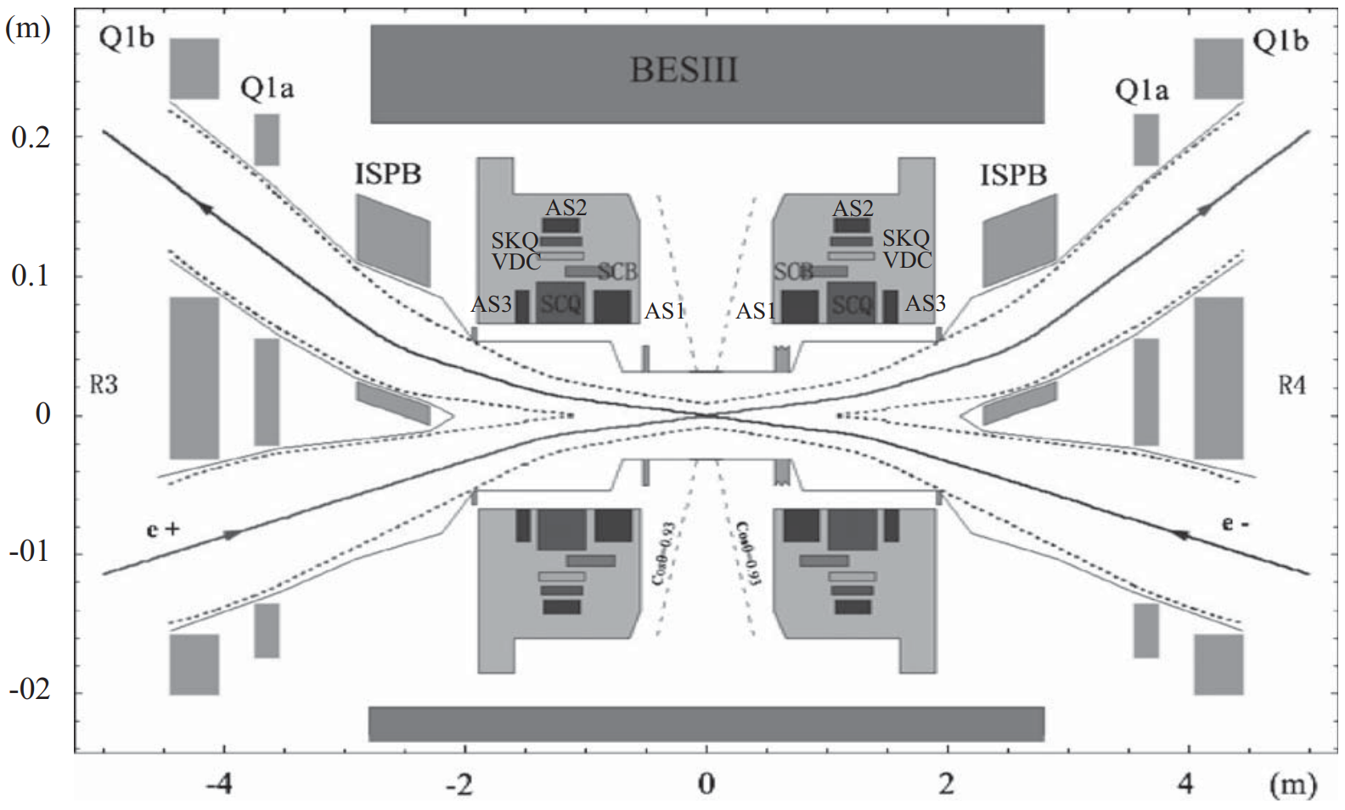
Tagging
Categorize the events by detected electron and positron
If one of the scattered $e^{±}$ is detected, it’s called single tag
If both scattered $e^{±}$ is detected, it’s called double tag
The $π^{0}, η, η^{′}$ are detected by central detector
For double tag, both the electron and positron requires $p_{x}>0$
Notes:
根据探测到的正负电子，将事例分为single tag 和double tag探测到一个电子或正电子即为single tag，两个都探测到为double tag，而双光子产生的pi0等粒子由主探测器探测。由于ZDD位于束流管同一侧，要探测到double tag事例，需要散射的正负电子x方向动量均大于0，如图中箭头所示。

Slide 7
Tagging
Detector : At $z=3310 (detector)$, $47.5<x<92.5, 5<|y|<35 (mm)$
Mirror the particles with $px<0, x=−x$, doubling the effective events
Both $pz<0$ and $pz>0$ particles are mapped to $z=+3310$ for drawing distribution
Single Tag :
Only one electron/positron in detector range
Both in range but $p_{x}\left(e^{−}\right)×p_{x}\left(e^{+}\right)<0$
Double Tag :
Both in range and $p_{x}\left(e^{−}\right)×p_{x}\left(e^{+}\right)>0$
Notes:
探测器探测范围为，在z=3310mm位置，击中位置x>47.5 <92.5, y的绝对值>5 <35
将px小于零的粒子镜像到x>0的位置，使有效事例数增大一倍
也将pz<0的粒子也放到z>0的平面上绘制分布图
对于single tag，探测范围内只有一个电子或正电子，亦或是两个都在范围内但px方向相反
而对于double tag，要求探测到两个电子，且px方向相同

Slide 8
Results

Slide 9
$π^{0}$ Result
$$π^{0}$$ | Number of Events | % | $$σ [pb]$$
Total | $$1×{10}^{6}(5×{10}^{5})$$ | $$100$$ | $$947.0$$
Single Tag | $$4845$$ | $$0.969$$ | $$9.176$$
Double Tag | $$26$$ | $$0.0052$$ | $$0.0492$$
Notes:
首先是pi0的结果，等效产生了100万个事例，总截面为947.0pb，single tag 占比%0.969，截面为9.176pb，double tag占比%0.0052，截面为0.0492 pb

Slide 10
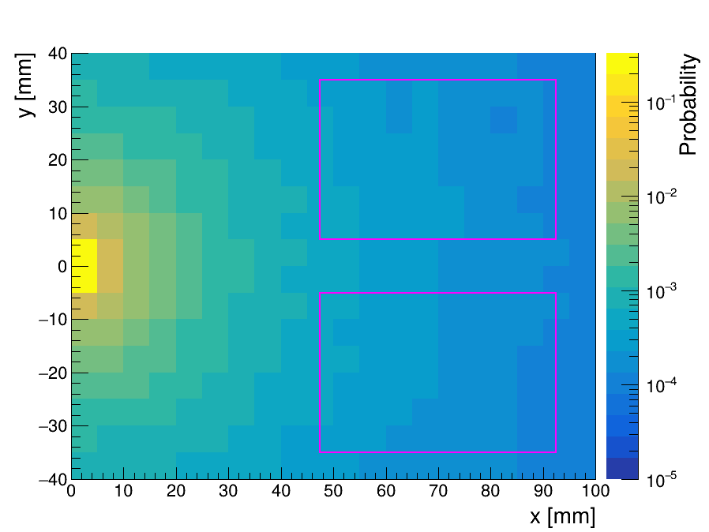
$π^{0}$ Result
Notes:
粒子击中分布如图所示，品红色框为探测器位置

Slide 11
$η$ Result
$$η$$ | Number of Events | % | $$σ [pb]$$
Total | $$1×{10}^{6}(5×{10}^{5})$$ | $$100$$ | $$360.7$$
Single Tag | $$5408$$ | $$1.0816$$ | $$3.901$$
Double Tag | $$53$$ | $$0.0106$$ | $$0.0382$$
Notes:
接着是eta的结果，也是产生了100万个事例，single tag 截面为3.901 pb，double tag为0.00382 pb

Slide 12
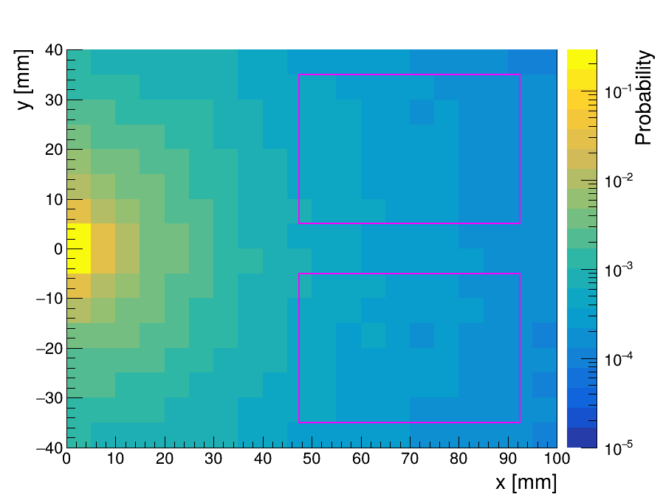
$η$ Result
Notes:
击中分布如图所示

Slide 13
$η′$ Result
$$η^{′}$$ | Number of Events | % | $$σ [pb]$$
Total | $$1×{10}^{6}(5×{10}^{5})$$ | $$100$$ | $$364.8$$
Single Tag | $$5652$$ | $$1.1304$$ | $$4.124$$
Double Tag | $$68$$ | $$0.0136$$ | $$0.0496$$
Notes:
最后是eta prime的结果，single tag 截面 4.124 pb，double tag 0.0496 pb

Slide 14
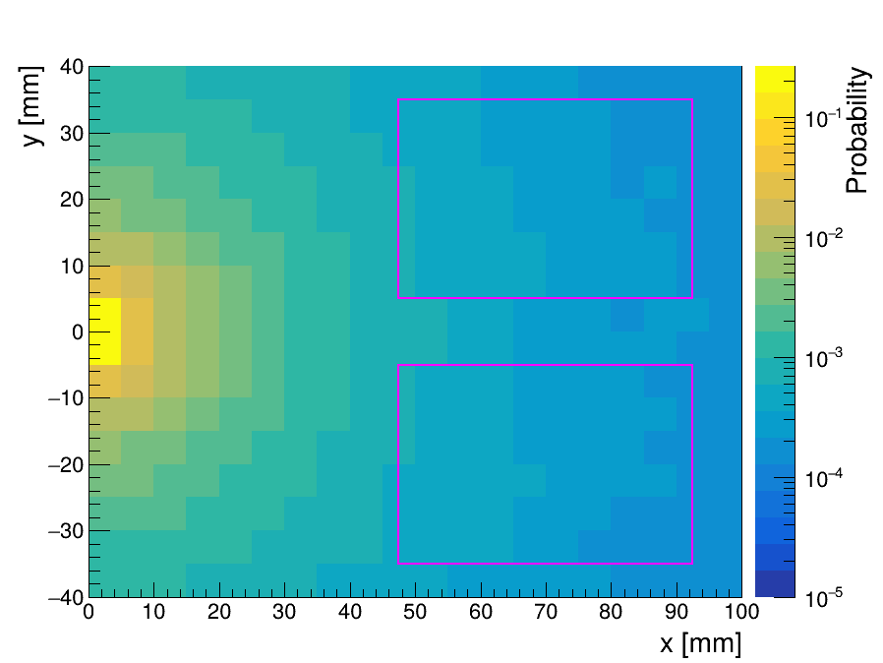
$η′$ Result
Notes:
分布如图所示

Slide 15
Conclusion
With magnetic field, the center of ZDD can be roughly placed at $x=70 mm$
Ekhara generator is used to simulate the scattered $e^{±}$, in $π^{0}, η, η^{′}$ scenarios
Cross sections are shown as follows :
Although $η^{′}$ has higher invariant mass, the cross section is higher than $η$
Distributions of electrons and positrons at detector are drawn
$$σ$$ | $$π^{0}$$ | $$η$$ | $$η^{′}$$
Total | $$947.0$$ | $$360.7$$ | $$364.8$$
Single Tag | $$9.176$$ | $$3.901$$ | $$4.124$$
Double Tag | $$0.0492$$ | $$0.0382$$ | $$0.0496$$
Notes:
总结，在有磁场的情况下，可以看作ZDD的中心位于x=70mm，z=3310mm的位置。使用ekhara产生子模拟在产生pi0，eta和eta prime的情况下散射电子的分布。计算了三种情况下的总散射截面和不同tag方式下的散射截面，总散射截面分别是pi0 947pb, eta 360.7pb, eta prime 364.8pb，而要求single tag后，截面分别为9.176pb, 3.901pb和4.124pb。跟之前用mumu模拟产生不同，etaprime虽然质量比eta更大，但是其截面也比eta大。绘制了散射的正负电子在z=3310mm处的分布。

