Slide 1
Fast Luminosity Monitor
Event rate ~100 kHz @Z
The CEPC instant luminosity is designed for 8.3 × 10³⁴/cm²s and 1.9 × 10³⁶/cm²s at the HZ and Z-pole operation modes (50MW plan), at center of mass energies of √s = 240 and 91 GeV, respectively.
8.3 × 10³⁴/cm²s at HZ operation modes
1 × 10³⁶/cm²s at Z-pole operation modes
Simulation of event rate on Diamond slab region (by Yilun Wang)
Fast luminosity diamond monitor for CEPC

Slide 2
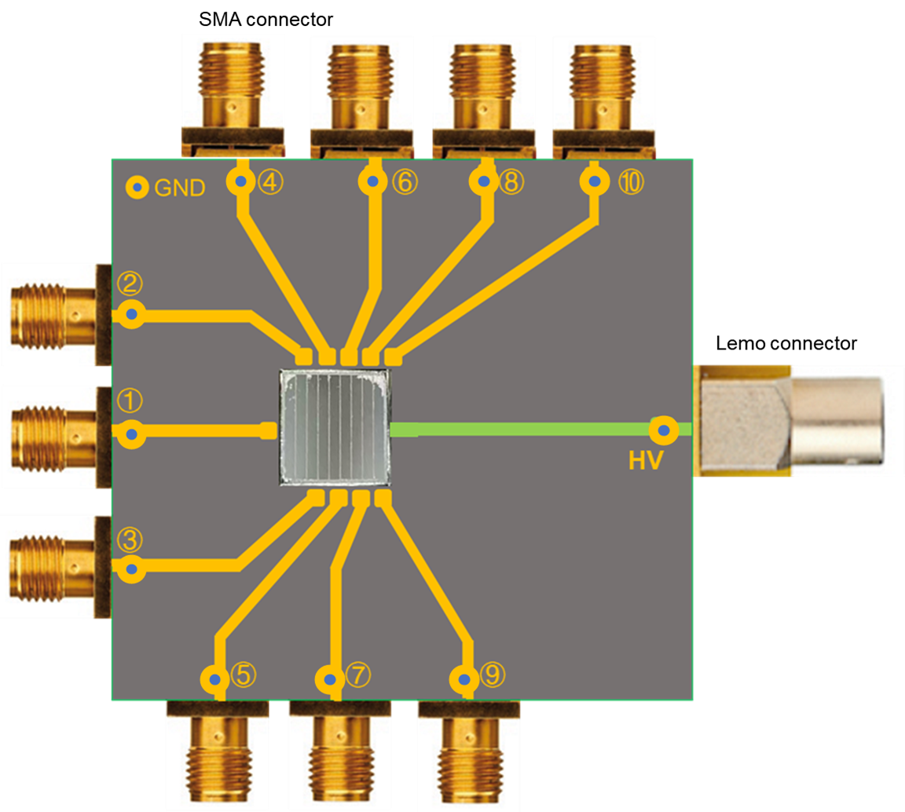
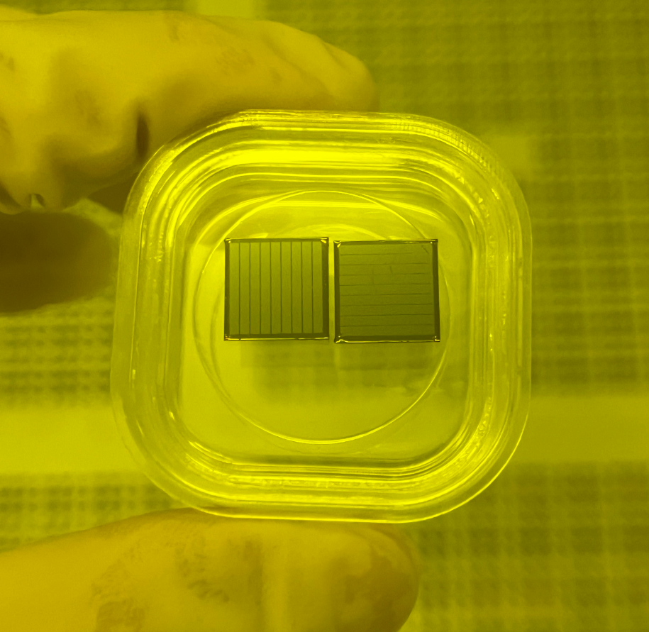
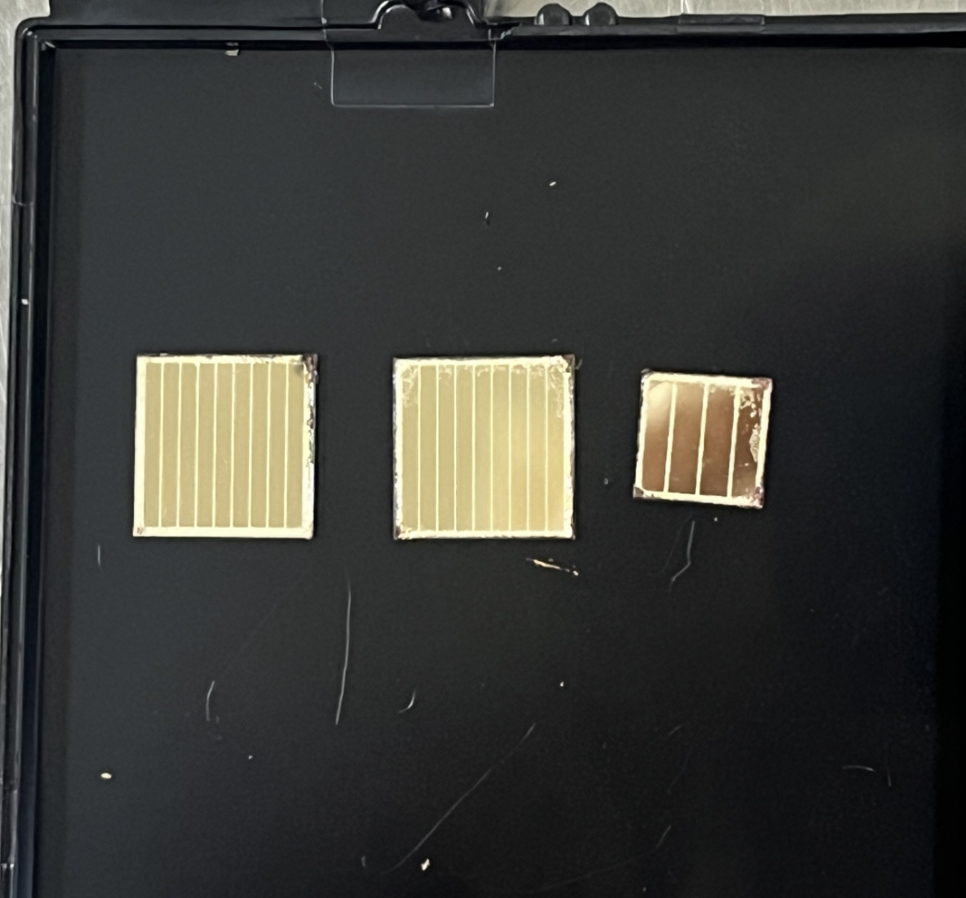
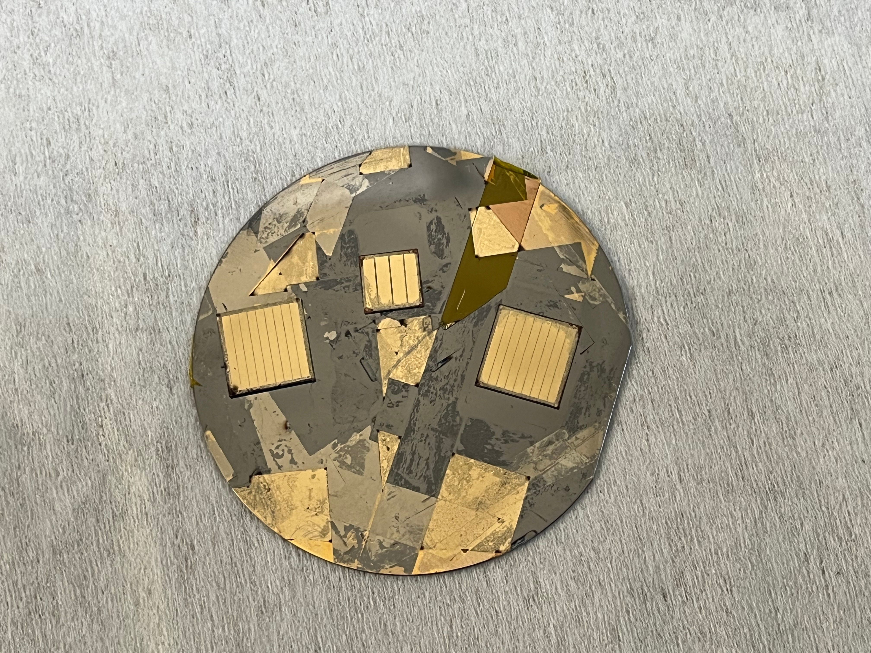
Fabrication of Diamond sensors
Two prototype microstrip diamond sensor has been successfully fabricated at NJU
Pitch of 1.0 mm (featuring 0.9 mm wide electrodes and 0.1 mm gaps) on 10 mm×10 mm diamond
Pitch of 1.35 mm (featuring 1.2 mm wide electrodes and 0.15 mm gaps) on 6 mm×6 mm diamond
Test PCBs are being fabricated in preparation for radiation source signal characterization
Post-litho development
Microscopy images of the electrodes

