Slide 1

What can AI do for High Energy Theory?
Lessons from Three Examples: Inspirations & Limitations
Speaker: Tianji Cai 蔡恬吉 (SLAC→Tongji University)
Date: Aug 20th, 2025
第三届量子计算与机器学习会议
青岛，山东，Aug 19-23, 2025

Slide 2
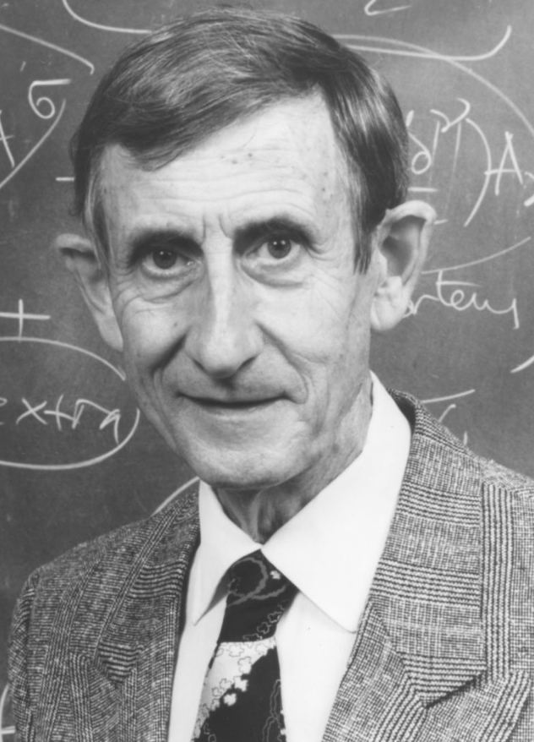
AI: New Tool, New Revolution
“New directions in science are launched by new tools much more often than by new concepts. The effect of a concept-driven revolution is to explain old things in new ways. The effect of a tool-driven revolution is to discover new things that have to be explained.”
By Freeman Dyson

Slide 3
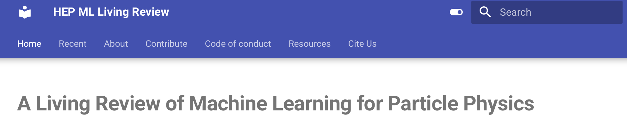
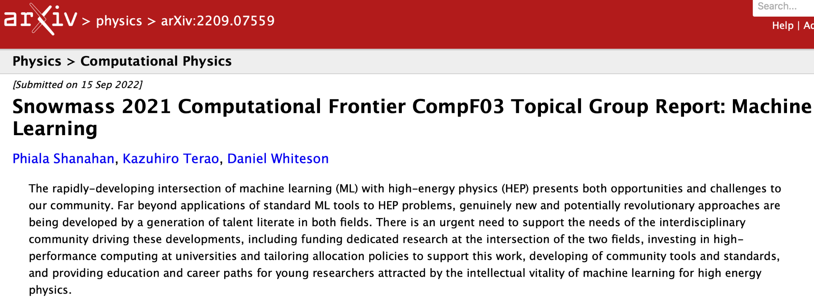
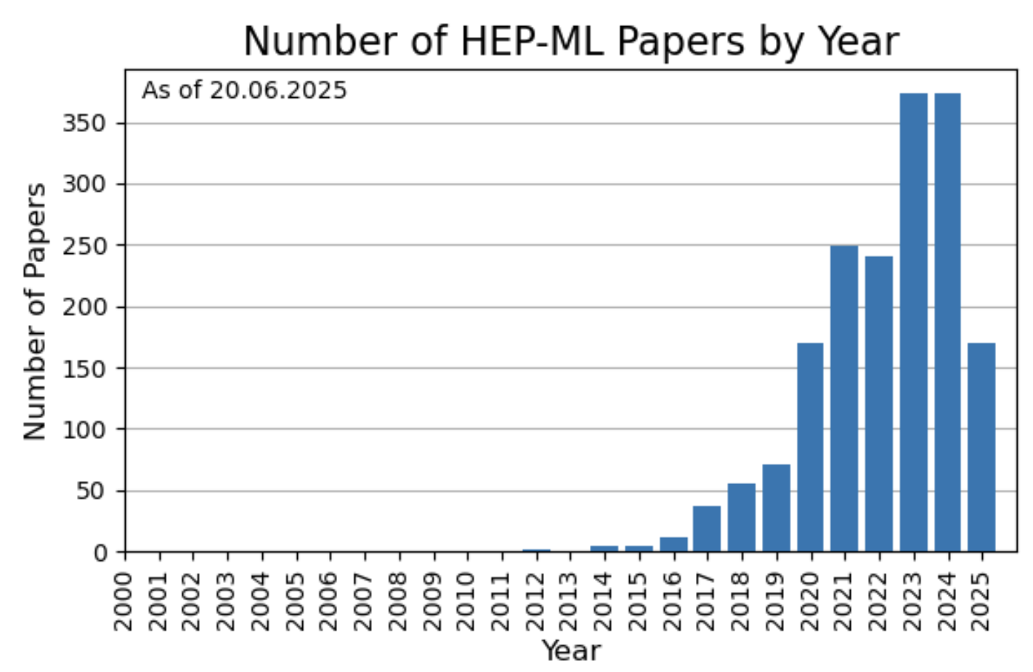
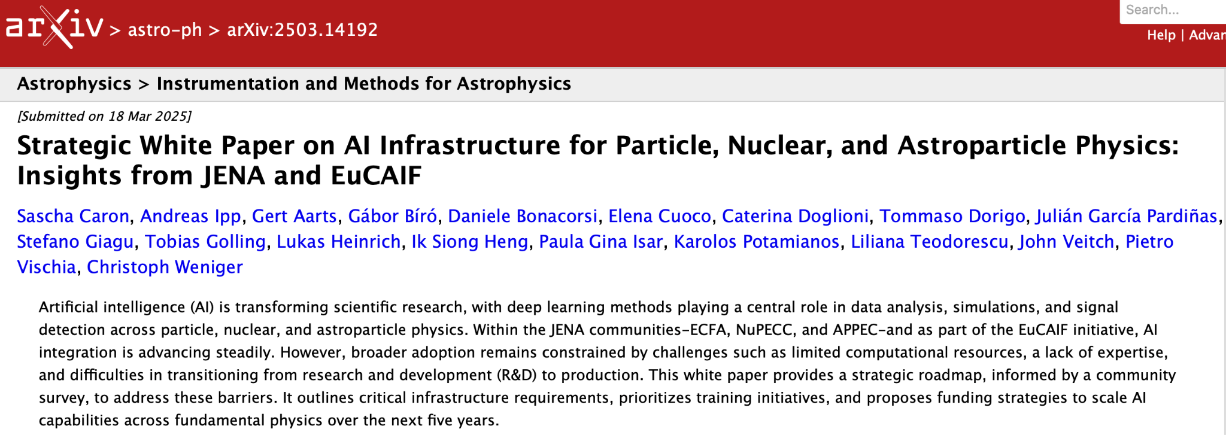
Evolving Landscape of AI+HEP
“AI+HEP” White Papers:
We’re now drafting our own, to be published in 2026.
USA
Europe
Subfields: hep-ex, hep-ph, hep-th, hep-lat, astro-ph.CO…

Slide 4
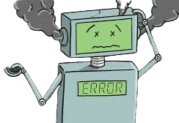
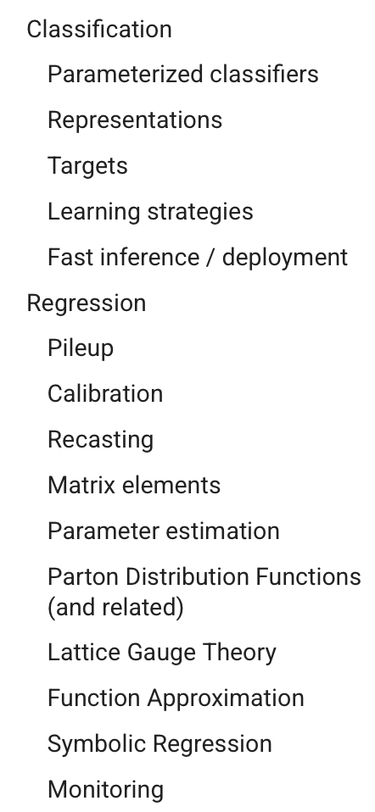
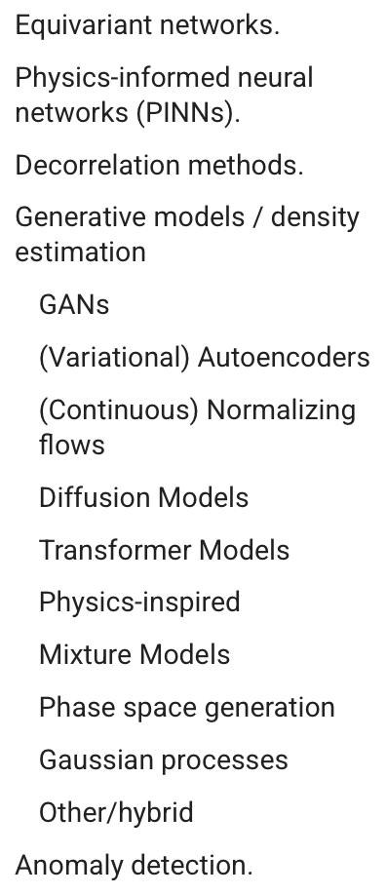
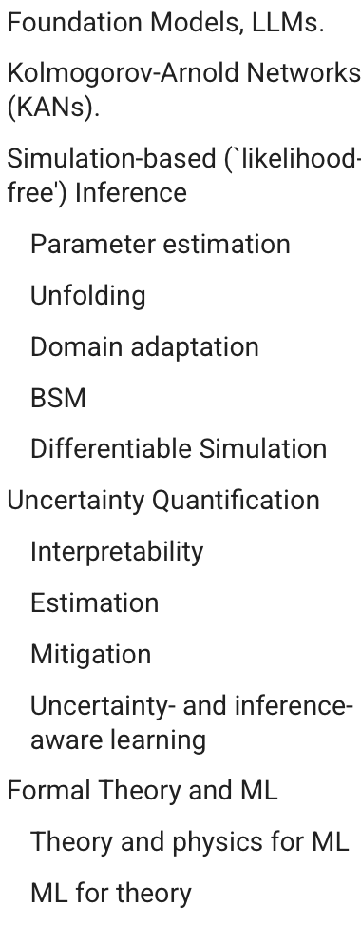
Major Topics in AI+HEP
From HEP ML Living Review
Main Obstacles:
AI not very good at symbolic manipulations.
AI not very good at complex reasoning.
AI not very good at producing exact answers.
AI often fails when data is scarce.
All critical for problems in formal theory.
Is AI still helpful for HEP Theory?
Most studies in HEP-Ph. Relatively few in HEP-Th.

Slide 5

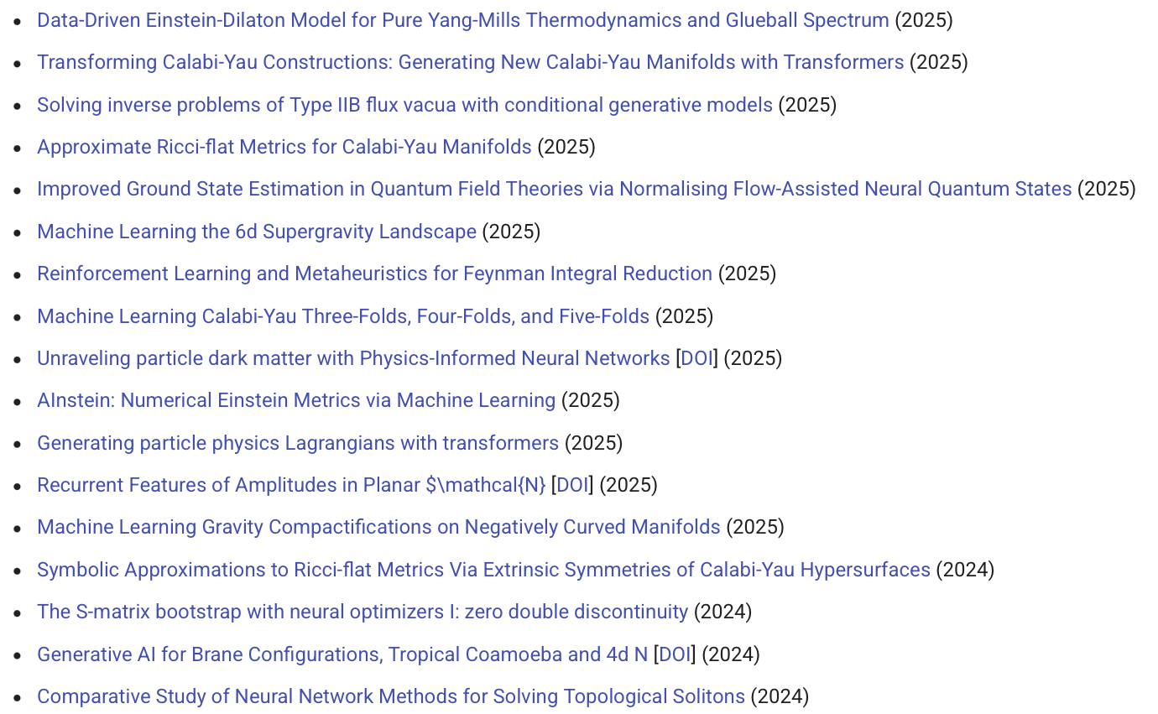
Growing List of AI for HEP Theory Studies
From HEP ML Living Review
Although most are baby steps…
Topics Attempted:
Scattering Amplitudes, Feynman Integrals, Lattice Field Theory, String Theory, Gravity, Lagrangian Construction, Standard Model Rediscovery, New Physics Model Building……
What do these theoretical problems have in common?
Why is AI a good fit for them?
(& When is AI the wrong tool?)

Slide 6
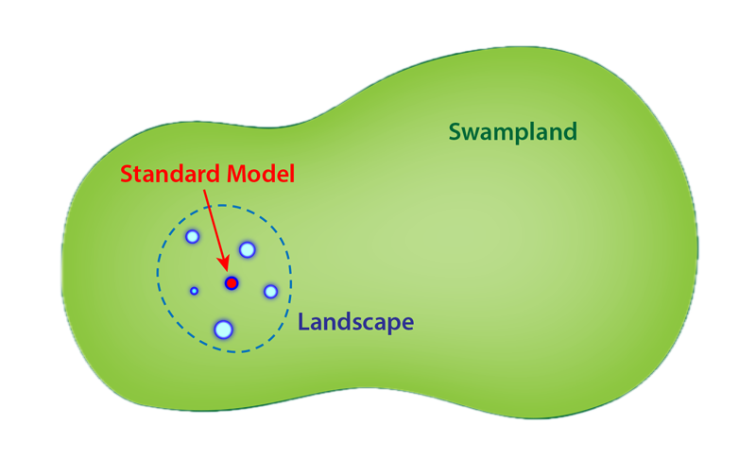

Main Types of AI for HEP-Th Problems
A very limited & personally biased view
Find better/more solutions in a large search space with many (sparse) solutions.
  Sample Problems: Explore the string landscape; New physics model-building…
Find better/shorter paths to navigate from one point to another in a large search space.
  Sample Problems: Simplify complex mathematical expressions; Prove theorem; Untangle knots…
Find the exact solution in a large search space in a more efficient way. Solution is easy to check, but expensive to generate.
  Sample Problems: Find analytical solutions satisfying certain conditions…
What is AI’s main role here?
AI as a Powerful Search Algorithm

Slide 7
Type 1 Problems
Example:
Neutrino Model Building
Find better/more solutions in a large search space with many (sparse) solutions.

Slide 8
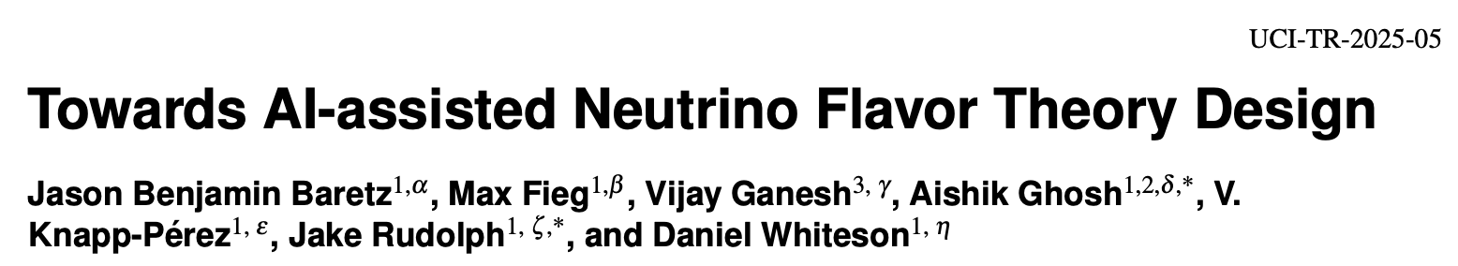
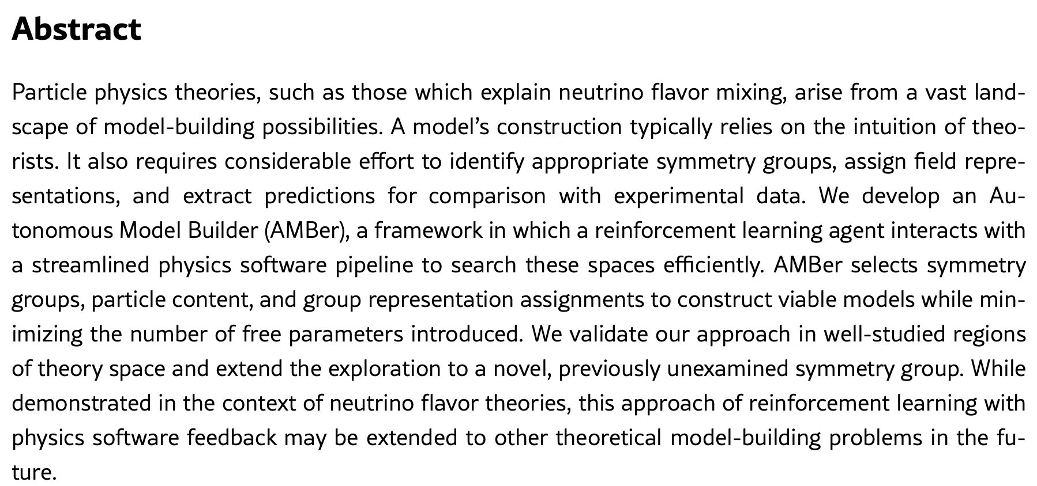
Ref: 2506.08080

Slide 9

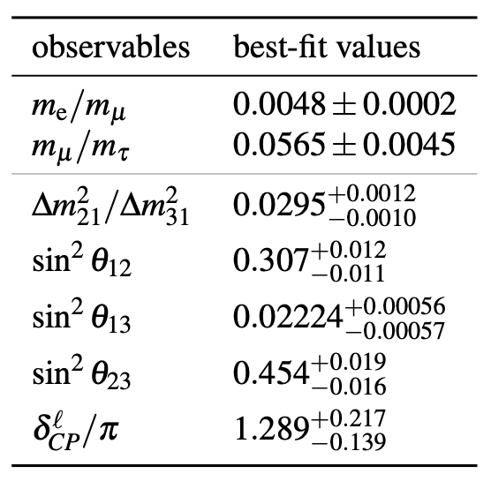
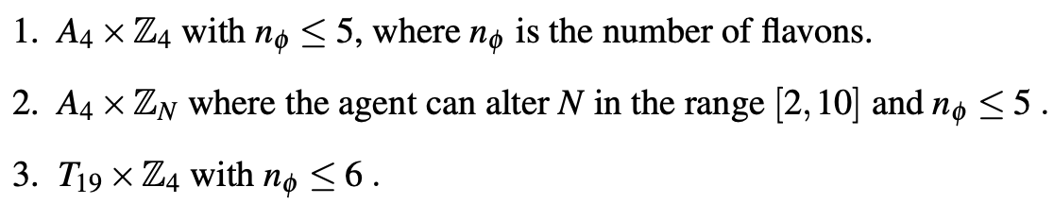
Physics Background
Can AI rediscover known good models?
Can AI find more quality models more efficiently?
Landscape of new physics theories is vast and mostly unexplored. Model-building is expensive. Good theoretical models need to agree with experiments and be simple.
For neutrino physics, a good model should explain the observed neutrino masses and oscillations, and minimize new theoretical elements to maximize predictive power.
Focus on MSSM-seesaw models with non-Abelian flavor symmetries broken via a scalar acquiring a VEV.
Global NuFIT analysis
How to build a neutrino flavor model?
(1𝛔)
choose mass mechanism → select flavor symmetry group → define particle content & assign irreducible representation → construct Lagrangian (flavons to break flavor symmetry) → extract mass matrices → fit free params to data.
Search in the spaces of the following three symmetry groups:
well studied
larger & unexplored

Slide 10
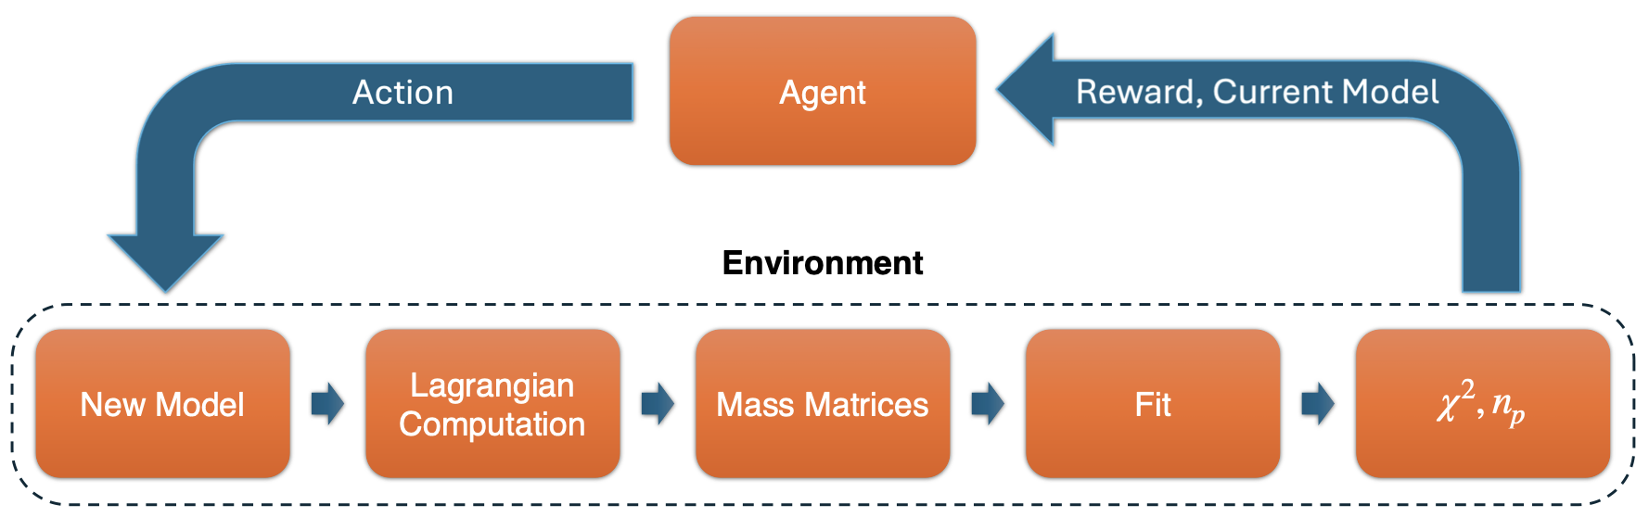
Methodology: Reinforcement Learning with Physics Softwares
AI to effectively & intelligently search the theory space
(PPO)
AI with the same tools as a theorist
Standard physics softwares (new & redesigned)

Slide 11
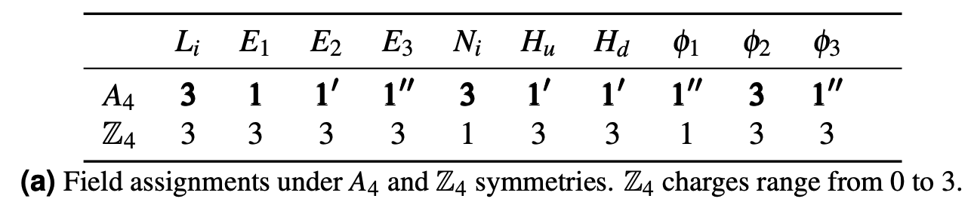
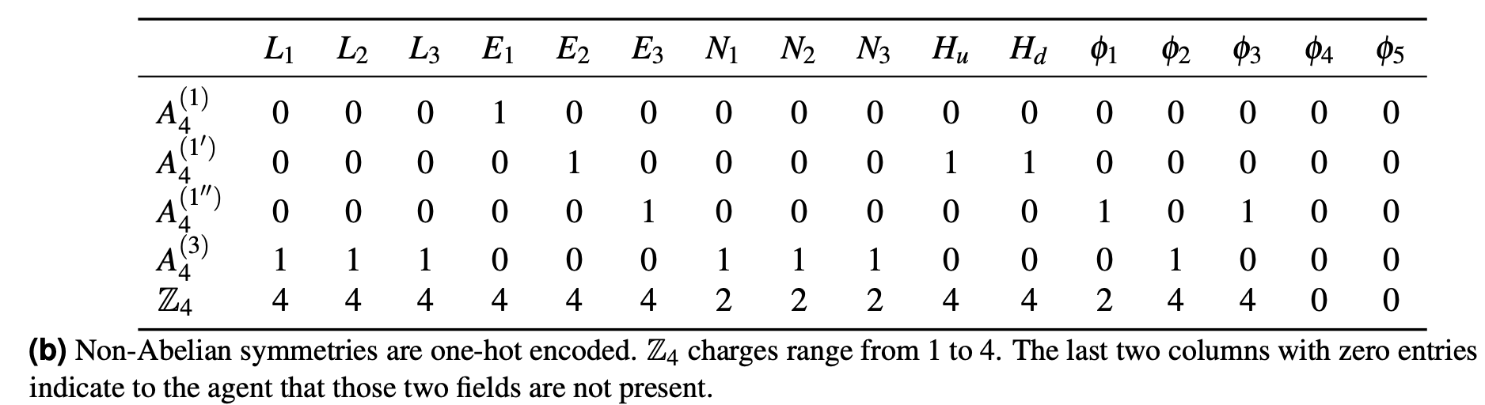
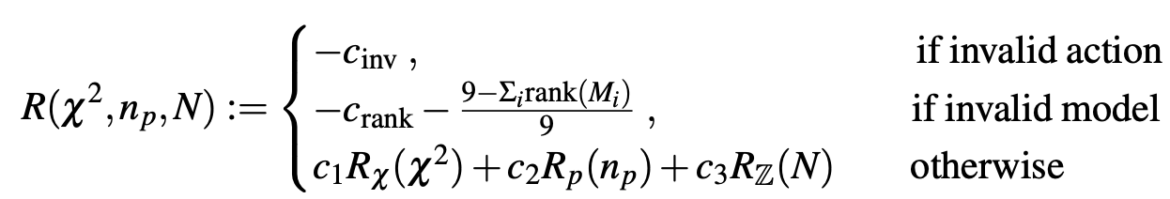
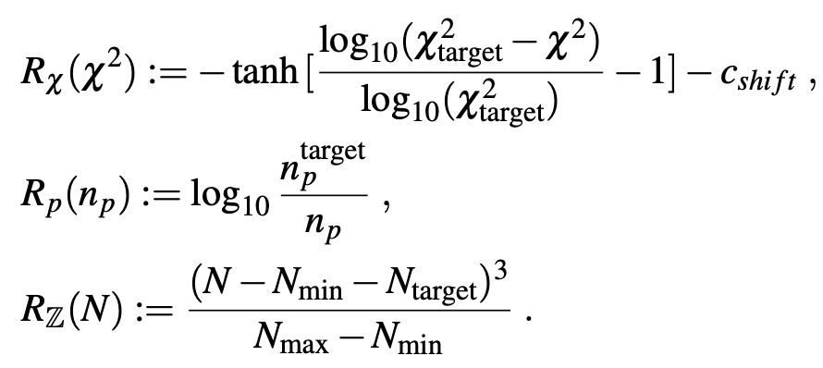
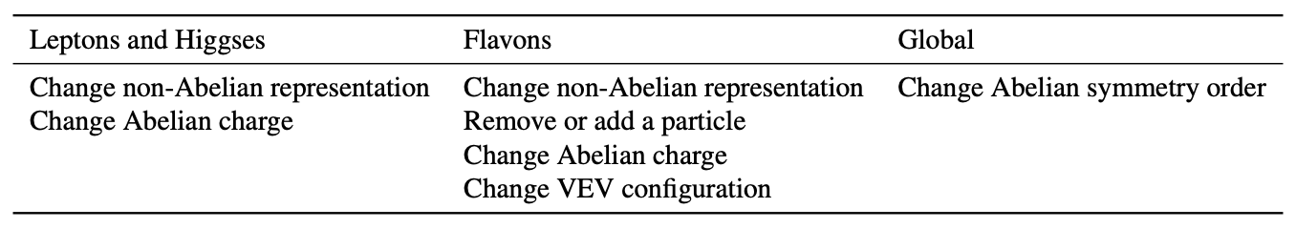
RL Setting
PPO algorithm used for the agent (value & policy networks).
State Space
State: a theory model.
e.g.
shown to the agent
Reward Structure
Parameterized by the model’s ꭓ² and number of param.
A state is represented as a matrix.
minimize ꭓ² fit:
Action Space
Can change particle content, particle repre., symmetries.
minimize # of model params n_{p}:
encourage exploring higher order models (Z_{N} with N=2, …, 10):
Total reward normalized between -1 and 1, and R>0.1 boosted to 1 to emphasize that state.

Slide 12
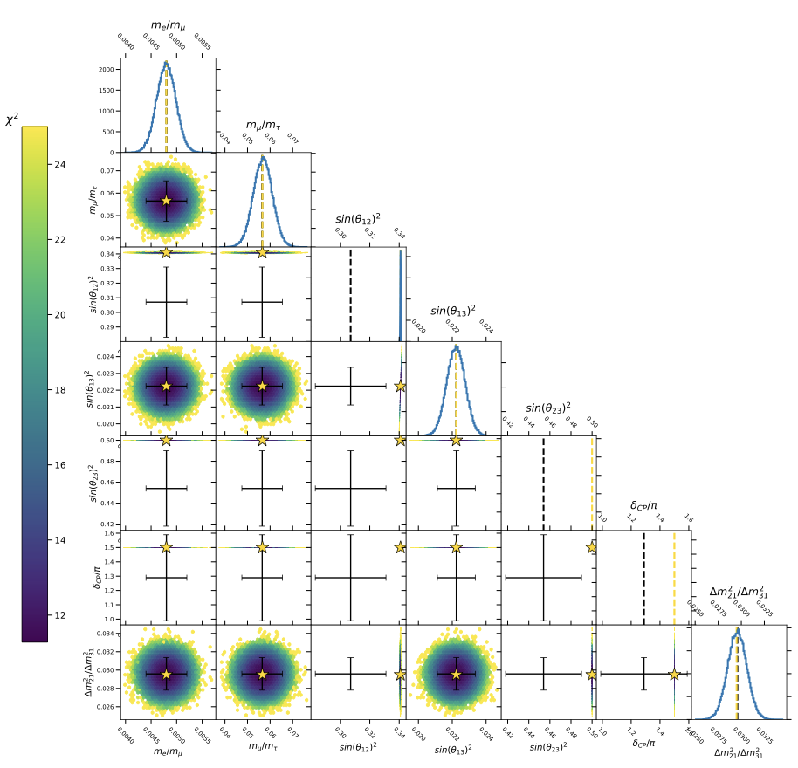

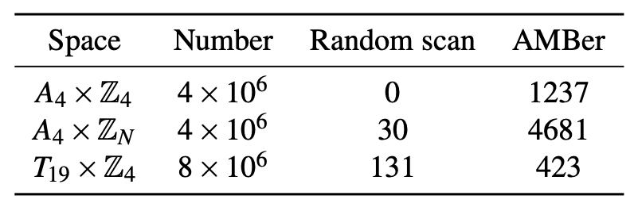
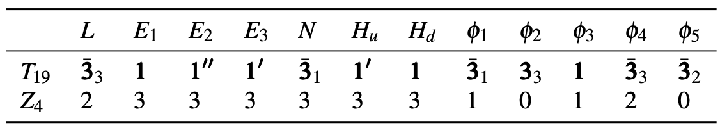
Results
Struggles to fit θ₁₂ and θ₂₃ without making other fits worse.
Number of Good Models Found:
NEW!
models AMBer tried
A NEW model found by AMBer
(ꭓ²≈10 and n_{p}=4):

Slide 13

Discussions
Let’s be critical and ask ourselves some hard questions.
How to transfer the knowledge RL agent learnt from one theory space (e.g. A₄⨉Z₄) to another (e.g. A₄⨉Z_{N}) for more effective exploration?
  How to iteratively build increasingly powerful agents that know more physics? So we don’t need to start from scratch for each new physics problem.
Only discrete flavor symmetries considered, giving rise to discrete actions and a relatively small action space. For more complicated theories with continuous flavor symmetries, the action space may become vast, in which case RL may struggle.
  How generalizable is the RL approach for model building efforts in general?
RL works within a predefined theory framework (e.g., MSSM-seesaw models with non-Abelian flavor symmetries). What if we don’t know where to start with?
  Is RL (and AI in general) capable of coming up with creative solutions and new physics concepts?
Can AI suggest new experiments to run and novel regions of the phase space to focus on?
  How to effectively embed AI theorists into the real-world scientific discovery loop (Exp ↔ Th)?

Slide 14
Type 2 Problems
Example:
Simplify Polylogarithms
Find better/shorter paths to navigate from one point to another in a large search space.

Slide 15
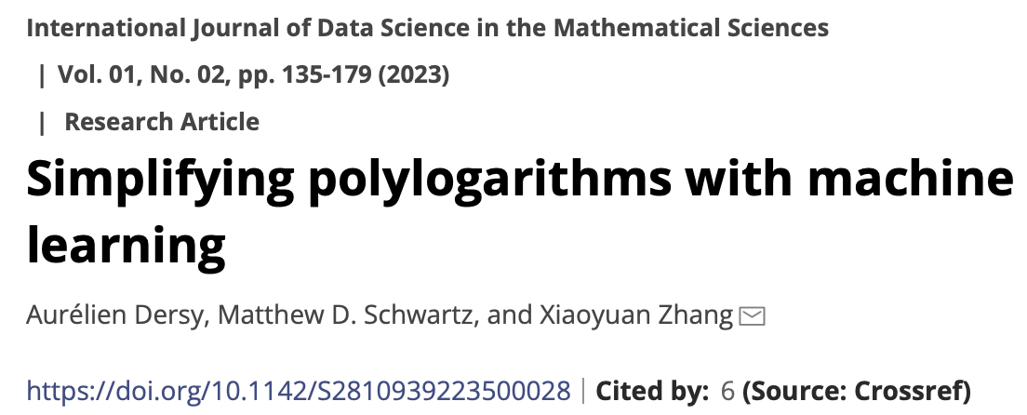
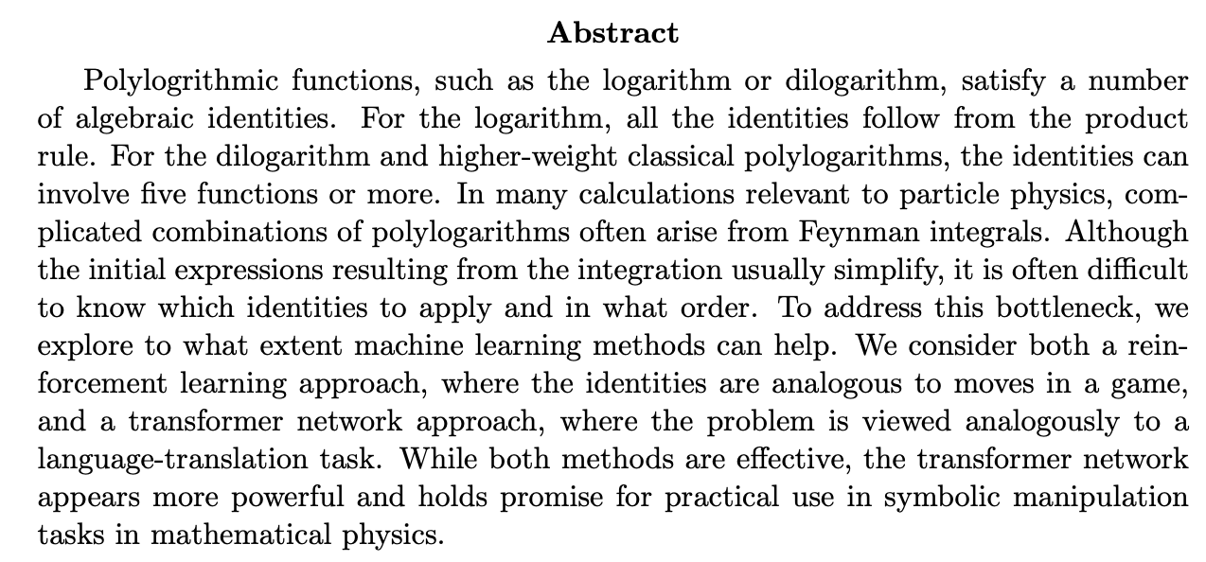
Ref: 2206.04115, Schwartz’s slides

Slide 16
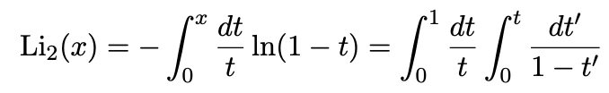
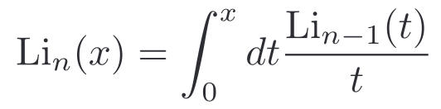
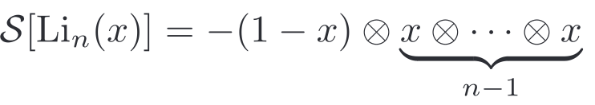
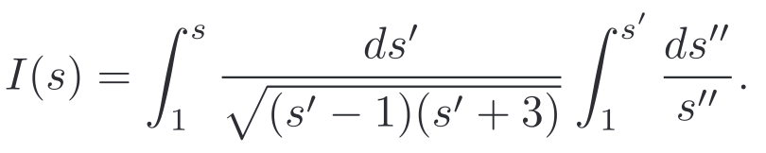
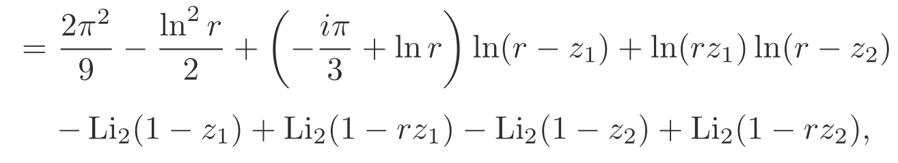

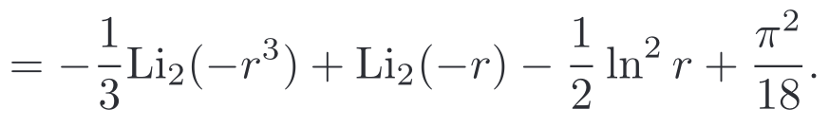
Physics Background
How to simplify a given polylog?
Which identities to apply at what order?
Can AI be better than classical algorithms?
Polylogs ubiquitous in Feynman integrals describing particle scattering. Simplifying polylogs essential to the S-matrix bootstrap program, yet no known automatic way.
Dilogarithm (weight 2)
Classical polylogs (weight n)
Example: Compton Scattering Total Cross-section @ NLO in QED
Symbol
where
No existing software package to do integration & simplification automatically.

Slide 17
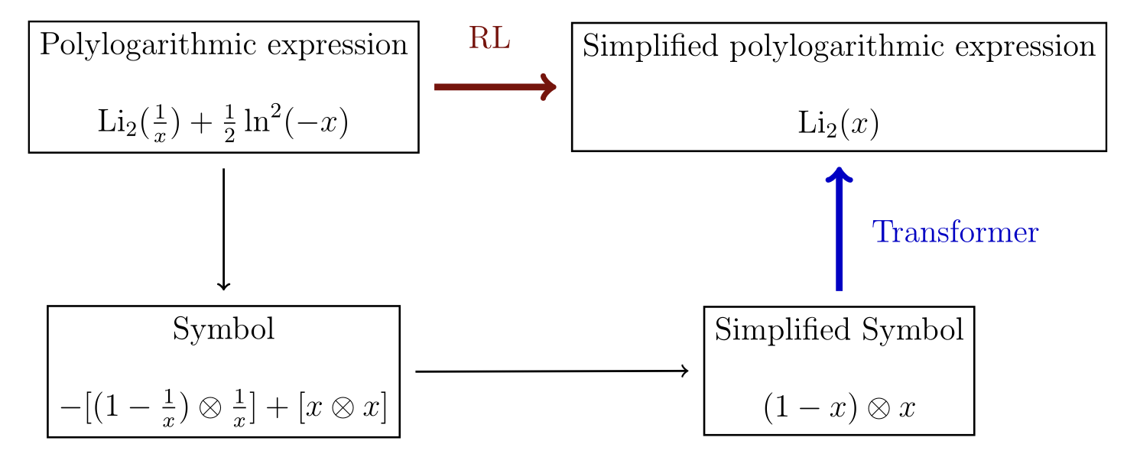
Methodology: Supervised Learning with RL & Transformer
Directly learn the simplification.
✅
Integrate symbol:
symbol ↔ polylog translation task.
(no classical way)
Classical Algorithm: Compute symbol from polylog.
Classical Algorithm: Simplify symbol.

Slide 18
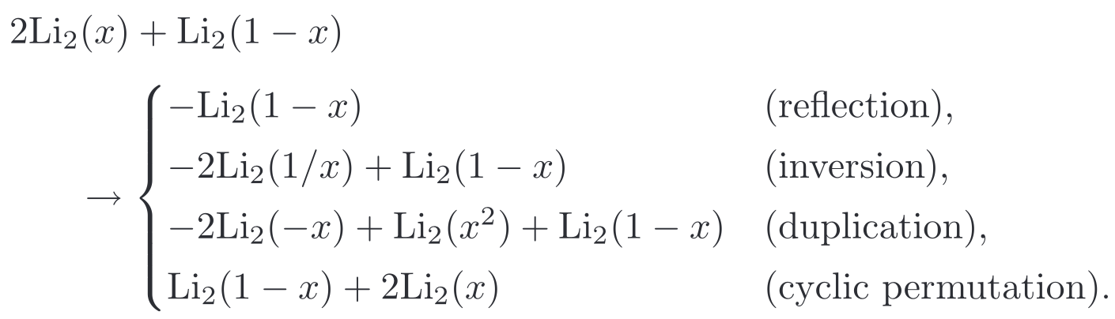
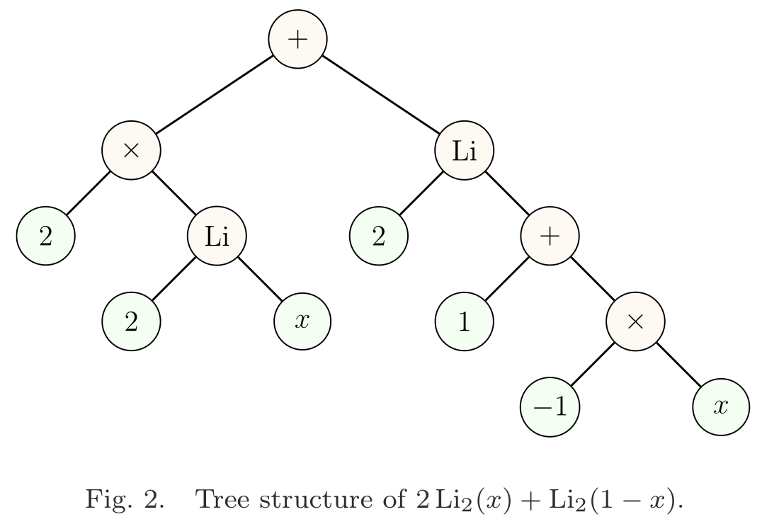
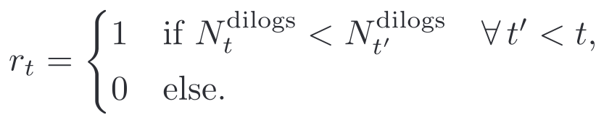
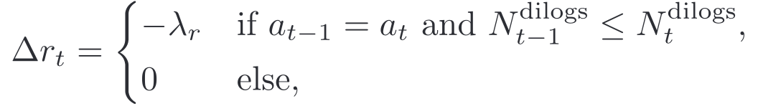
RL Setting
Problem space restricted to simplifying dilogs reducible to 0 only.
Action Space
Four types of actions like moves in a game.
State Space
State: linear combinations of dilogs.
Reward Structure
Goal is to find the simplest combination.
# of distinct dialog terms
Extra penalty:
→ Each item is a word.
→ One-hot encoding for each word.
→ Pad all words & 0’s to form a sentence.
remove cyclic trajectories

Slide 19
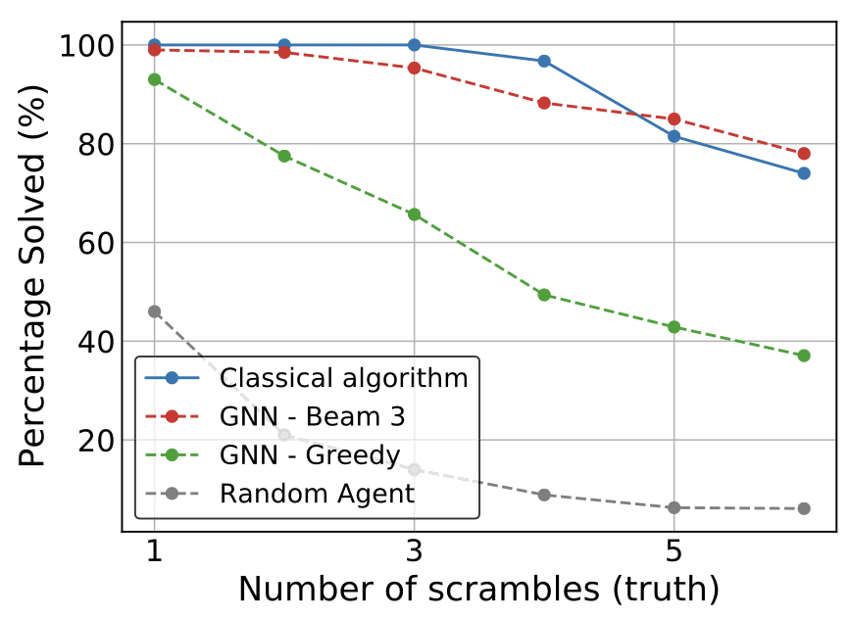
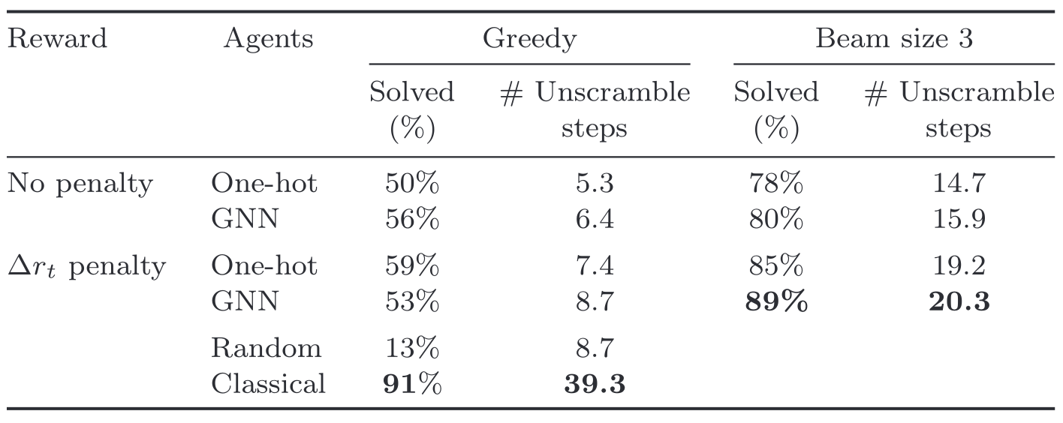
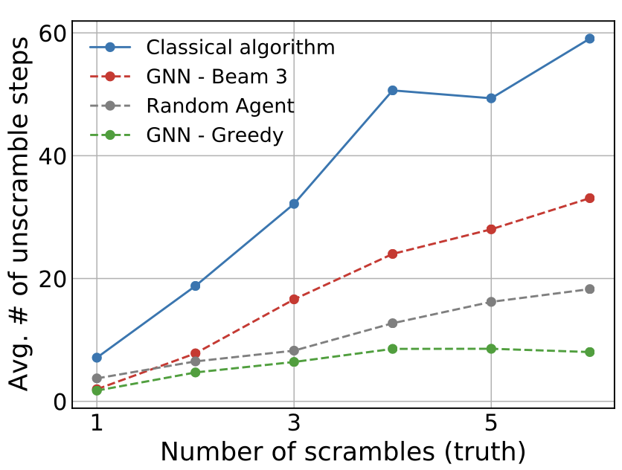
Results
RL (with proper setting) can match the performance of classical algorithms…
… with much fewer evaluations.
→ More efficient!

Slide 20
Discussions
Generalizability: The actions for simplifying each polylog depend on the specific polylog. No clear general rules are learnt, which may then be applied to other polylogs. Has RL perhaps learnt some implicit rules? Can we extract anything from its actions/policies?
Problem Complexity: The action space & state space are much more complex in the real world. Would RL still work?
Evaluation: We need to know the ground truth to check the results (all dialogs simplified to 0 here). What if the ground truth is unknown, as in actual polylog simplification problems?
Data Representation: The embedding of mathematical expressions to language-like words/sentences is artificial, which loses critical structures of the underlying polylogs.
  Same for the representations of many other physics quantities (e.g., particle four-mom) in many HEP-ph studies.

Slide 21
Type 3 Problems
Example:
Solve the Symbols for Scattering Amplitudes
Find the exact solution in a large search space in a more efficient way.

Slide 22
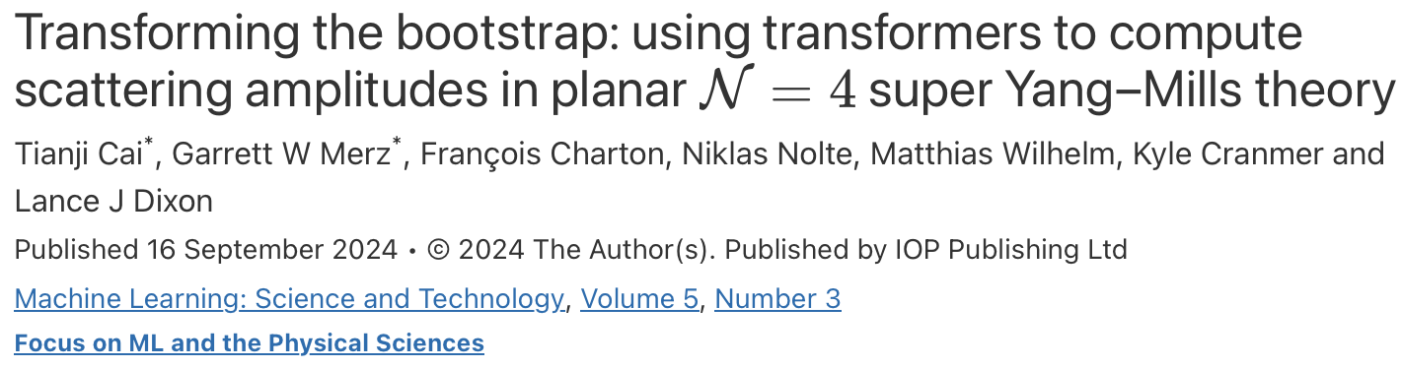
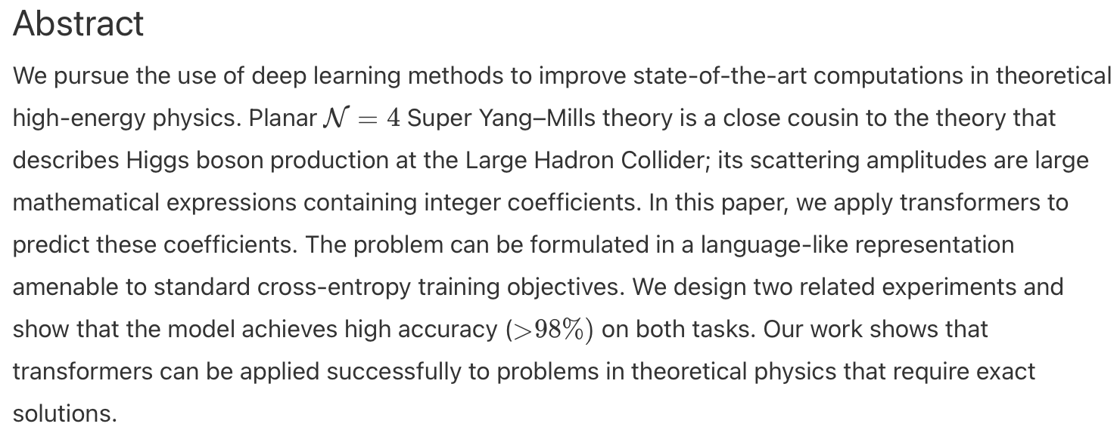
Ref: 2405.06107

Slide 23
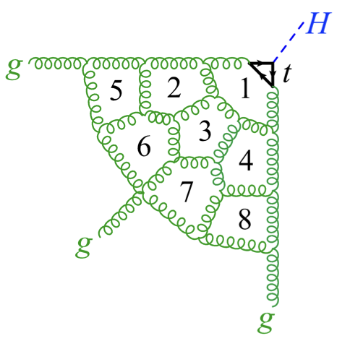
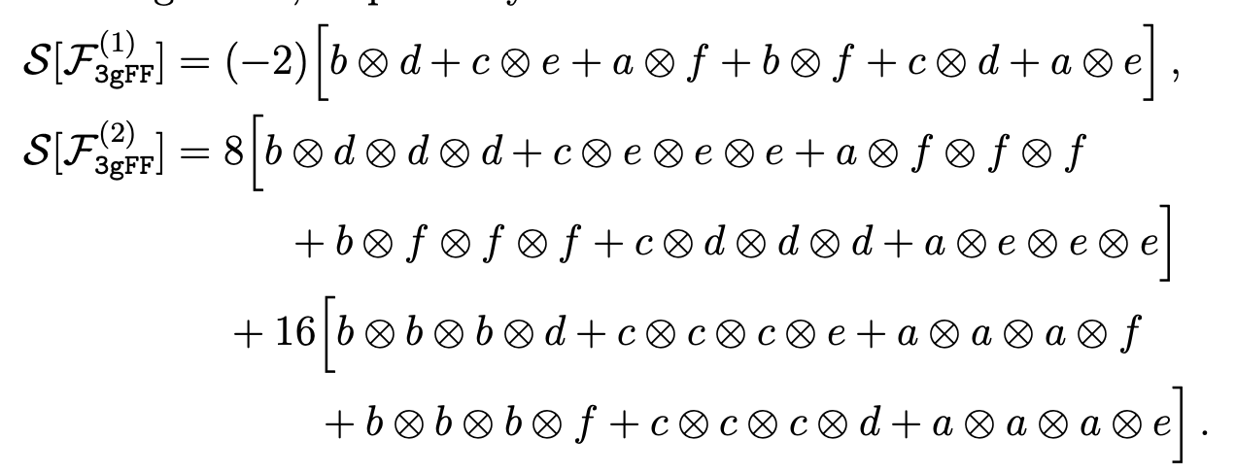
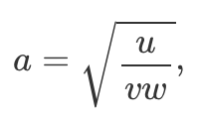
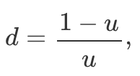

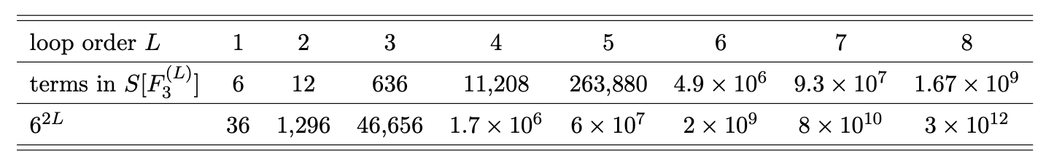


Physics Background
How to compute amplitudes to even higher orders?
Can AI discover new relations with physical insights?
Scattering amplitudes at the heart of high-precision calculations. SYM is the model theory where amplitudes can be calculated to very high orders. Helps to understand QCD better.
Functions of kinematic variables:
Relations!

Slide 24
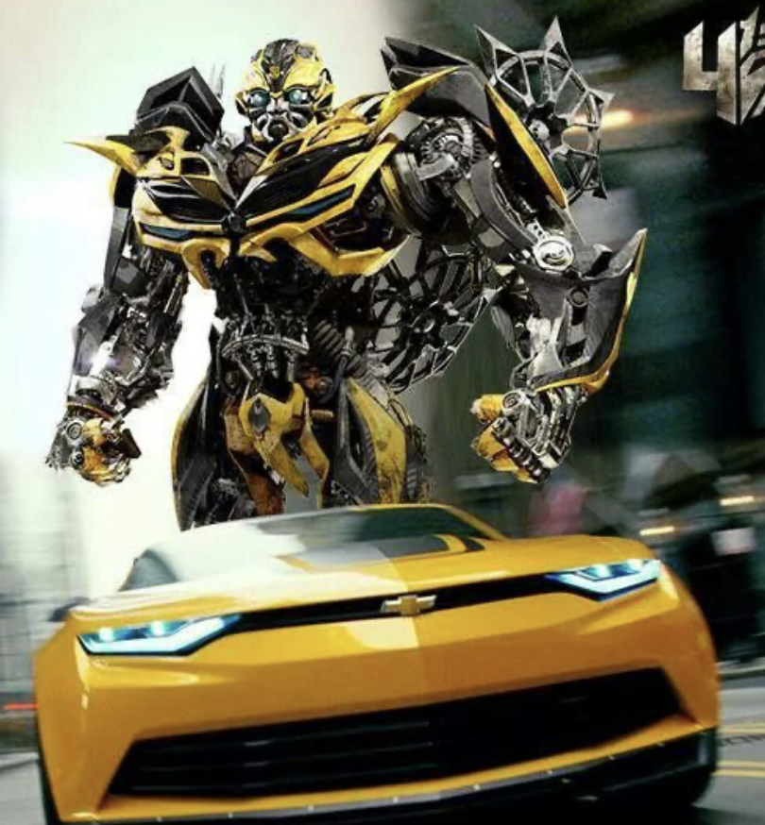
Methodology: Supervised Learning with Transformers
Task: At a fixed loop, can a model predict the coefficient associated to a given word?
In other words, “complete” the symbol.
Same loop L=6
Integer coefficients and words are both encoded as sequences of tokens, as in NLP.
Model trained to minimize the tokenwise cross entropy.
Architecture: Transformers, with both encoder and decoder having
  same number of layers (up to 8);
  same number of attention heads (8 or 16);
  same dimension (d = 256, d = 512 or d = 1024).
Our models have between 4.5 and 245 million trainable parameters → not large at all.
Non-transformer NLP models (LSTM, GRU) also tested → no qualitative difference.
Test Set:
Word: bfaceabdbddd => Coeff: ??
…
Train Set:
(Input: seq => Output: seq)
Word: bddbafbacbdd => Coeff: 704
Word: affacabcccdd => Coeff: -1536
…

Slide 25
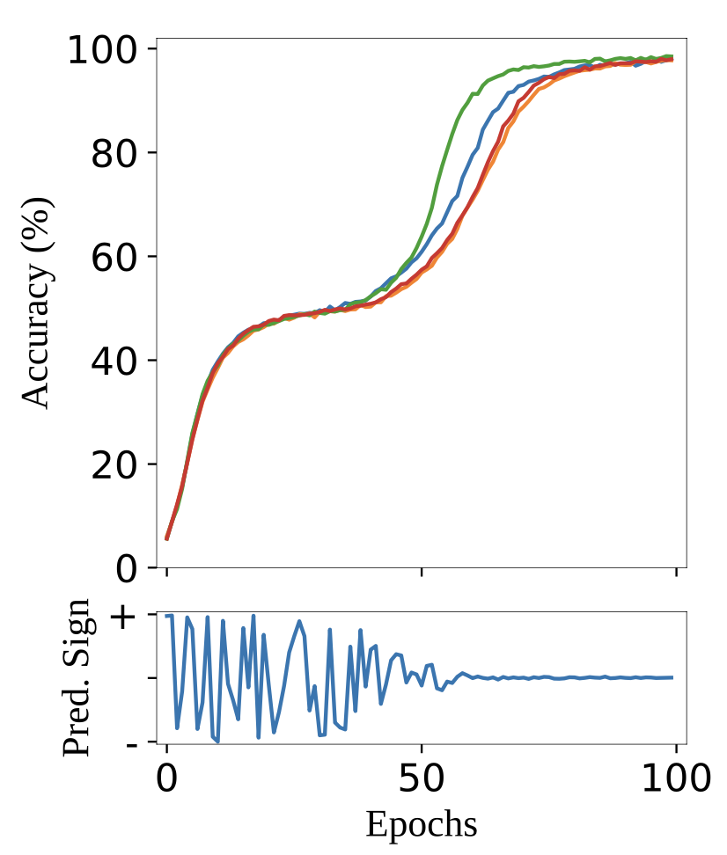
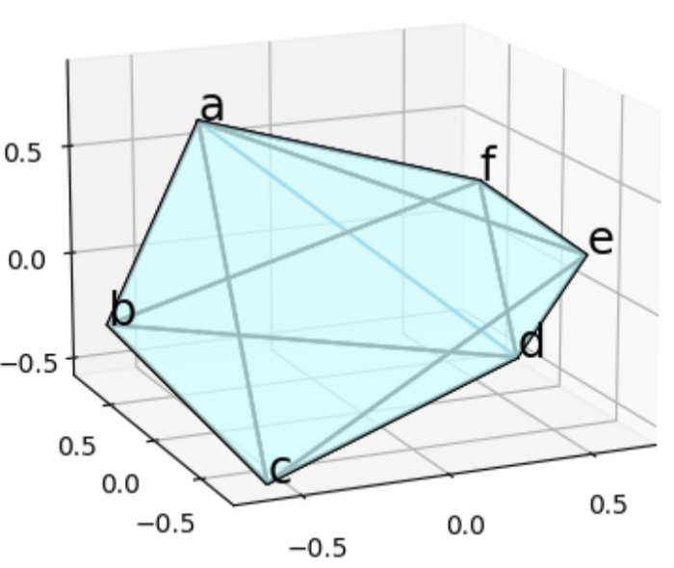
Results @ Loop 6
See 2405.06107 & 2501.05743 for many more studies.
Dihedral symmetry!
curves: 4 initializations

Slide 26
Discussions
Learning Paradigm: Supervised learning requires substantial labeled data. At unknown high loop orders, only very few terms are known. How should we proceed then?
  Other learning paradigms may face similar issues. We need a way to learn rules from data.
  An RL approach with possible rule extraction capacity is under the way.
Evaluation: Ground truth is needed for evaluation, which is not available at unknown loops. Need a way to check the AI solution(s) not based on their correctness, but based on consistency.
  Exactness: When ground truth is unknown, how to check the exact correctness of the solution? More importantly, if some terms are detected to be incorrect, how to correct them in an automated way?
Data Representation: Tokenization for symbol terms is only a compromise for using NLP. What might be better representations that preserve intrinsic data structures?
Generalizability: Can AI trained for certain loops & certain processes improve the performance in other related tasks?
  Something like Curriculum Learning is being considered and tested.
More fundamentally, is a fully AI approach desirable / possible for such problems? Or perhaps a human+AI hybrid approach is more preferable?

Slide 27
Food for Thought
Open Questions to Brainstorm Together

Slide 28

What do we want AI to do for HEP Theory?
AI Wishlist
Better Data Representation that captures its intrinsic structures such as its mathematical relations and physical properties, instead of ad hoc tokenization schemes for NLP.
Some kind of Interpretability in the sense that underlying “physical” rules are learnt by AI, rather than spurious correlations.
Transferability & Generalizability so that more and more powerful AI could be built iteratively upon solving increasingly complex (related) tasks. We don’t want to custom make a specialized model for each different problem. In other words, we want a Foundation Model for similar physics topics, a model that has truly learnt the underlying physics and thus can generalize, even in data-scarce situations.
An Automatic way of Answer Evaluation that do not depend solely on human feedbacks (labeled data), but rooted in the real physical world. Minimize the “human element” in the loop. Design a collaborative AI system where the “AI theorist” propose possible solutions and the “AI experimentalist” design suitable experiments (in a broad sense) to check the solutions.

Slide 29


Towards Scientific AI: What we physicists may contribute
Think Big, Dream Big
Pragmatic AI
Focus purely on task performance with no requirement to model the underlying reality. Only input-output behavior matters.
Scientific AI
An intelligent system (in this case artificial) that can form a scientifically accurate representation of the physical world, regardless of how that representation is encoded.
🎯 A System of Scientific AIs
Great as assistants for automation & education.

Slide 30




Our Era of Design
What’s your vision?
✅
Key Messages:
The Artificial does not have to mimic the Natural.
The Artificial can be (much) better than the Natural.
But the Artificial needs to observe the same rules as the Natural (cuz we all function in the same physical universe).
❓

Slide 31

Thanks for your attention!
For more discussions, please contact me at tianjiresearch@gmail.com.
For Our White Paper Discussions, please prepare a ~5 mins talk in the following format:
Our physics problem is … The traditional approach faces [challenges] ... We are trying [some AI method] to address [the specific issue] ... We have observed [successes], but have also encountered [obstacles] ... Our future direction is [your wishlist for AI on that problem] ... Our general vision on AI+HEP is … We would also like to see [non-physics research aspects] addressed by our community.

Slide 32
Backup Slides

Slide 33


What AI paradigms make good search algorithms?
Reinforcement Learning
Transformer-based FunSearch
Agent to navigate the state space based on feedbacks from the environment.
LLM to generate creative candidate solutions and automated evaluator to check solutions, in an iterative, evolutionary loop.
Evolution!

Slide 34


Towards Scientific AI for Particle Physics
Experimental Data
- Curated by human experts.
- All datasets combined.
- Analyzed by AI.
“Garbage in, garbage out.”
Scientific AI
- Implicitly encode the underlying laws.
- Uncovered by human experts.
“Intelligence remains with humans.”
Laws of Nature

Slide 35







AI development dominated by commercial interests
Common Framework of All Models
Transformer-based architecture
Unsupervised pretraining on diverse internet-sized datasets
Supervised fine-tuning and/or RL from human feedback
⇒ How far can scaling go? Is it sufficient for AGI? Are there different & better paradigms?

Slide 36



What does the current AI paradigm lack?
Pragmatic AI: Focus purely on task performance. Only input-output matters.
More systematic research needed to examine fundamental limits of current AI paradigms & enable next-generation AI with real scientific knowledge.
→ Scientific AI 😇

Slide 37


Community Advertisement
Students welcomed to join!
Volunteer contributors more than needed!
We are building the “AI+HEP Community in East Asia” (pronounced as “I Happier”).
Starting from Fall 2025, we’ll have:
An open community website to host everything;
Biweekly remote journal club for free-style discussions;
Monthly remote seminars from experts around the world;
Occasional 1-3 day remote bootcamps to educate ourselves on a particular topic, mostly hands-on AI training;
Yearly 1-week in-person workshops in East Asia region around Feb-Apr;
Online modular curriculum and possible winter/summer schools, with hands-on jupyter notebook tutorials, toy datasets, mini projects, etc, covering both concepts in particle physics and AI.
Ask me for more learning resources!
Email me to
join our slack workspace!

Slide 38
Neutrino Model Building

Slide 39




Additional Results
Evolution of models as training progresses:
A representative distribution of found models:

Slide 40



Results: A₄ ⨉ Z₄ Space

Slide 41

Results: A₄ ⨉ Z_{N} Space

Slide 42



Results: T₁₉ ⨉ Z₄ Space

Slide 43
Simplify Polylogarithms

Slide 44




Transformer Approach
Guess the answer. May not be correct (unlike RL).
Train / Test Set
Sample Expression:
Manually to the exact form
Trained Transformer
Classical Algorithm

Slide 45



Transformer Results

Slide 46
Scattering Amplitudes

Slide 47


Symbol as Natural Language
We have a small, discrete vocabulary with only six letters, integers, and signs.
Each letter is a unique token; a word is a list of tokens. → Easy!
Two sign tokens, “+” and “-”. → Also easy!
Coefficients tokenized as sequences of digits in base 1000.
  E.g., 12334 as a set of three tokens “+, 123, 344”.
  Magnitudes of non-zero coefficients grow with loop order; see fig → a bit tricky!
  An incorrect coefficient is just incorrect, whether off by 1 or 10000.
Challenges:
Integer structure lost.
Not generalizable to unseen large ints.
Many other ways to tokenize integers and to compress words.
→ Similar behaviors.

Slide 48






Relation Assessment @ Loop 6
Model seem to learn relations in a way similar to humans.
Group 1
Group 2
Group 3
Group 1: Equivalence relations that require two coefficients to be the same. Model predicts the equivalence before able to identify what that coefficient is.
Group 2: Relations where at least two coefficients must have opposite signs.
Group 3: Multi-term relations that may be satisfied by two or more pairs of identical coefficients or by a set of related but non-identical coefficients. Includes relations similar to Group 1.

Slide 49
Task 2: Predict the Next-Loop Symbol
Can a transformer predict a coefficient at loop L from a list of related “parent” coefficients at loop L-1?
Loop L-1
Loop L
Test set:
Strike-two Parents’ Coeffs:
[0, 0, 0, -2, -2, -2]
Test set:
Word: bfff => Coeff: ??
…
Strike-two Method
Train set (Input):
{Parent word: Coeff}
{af: -2, af: -2, aa: 0, af: -2, aa: 0 , aa: 0}
Input L(2L-1) strike-two parents’ coeffs:
[-2, -2, 0, -2, 0, 0]
Train set (Output):
Word: aaaf => Coeff: 16
…
Output child/root word’ coeffs:
16

Slide 50

Task 2 Results: Predict the Next-Loop Symbol @ L5→L6
More variants studied in 2405.06107
Recall the strike-two method:
Input:
→ Output: 0
Implementation Details:
4-layer Transformers with d = 512, 8 heads;
66 parent coefficients at L5 given in strikeout order → predict a single coefficients at L6;
767,500 unique input-output pairs, split into 757,500 training and 10,000 test examples.
Result: Fast Learning; magnitudes and signs of coefficients learned simultaneously.

Slide 51


Task 2 Results: Recover the Cross-loop Symbolic Formula
More in 2501.05743
Inspired by AI’s Task 2 Strike-out Experiment, we humans look for more sequences connecting certain terms at different loop orders, and we’ve found a lot!
An Example Sequence:
& hundreds of similar sequences where first 7 letters are
arbitrary, but followed by (2𝐿−7) 𝑑′𝑠.
Confirmed by loops 7 & 8.
Want more such all-loop sequences to “seed” the AI model!
Can AI help us detect more such sequences?

