Slide 1

第三届量子计算与机器学习研讨会
中国科学技术大学
University of Science and Technology of China
机器学习FPGA加速在STCF触发系统预研中的初步应用
Application of FPGA-accelerated Machine Learning
in the Pre-research of STCF Trigger System
封常青 (Changqing Feng)
中国科学技术大学
University of Science and Technology of China
State Key Laboratory of Particle Detection and Electronics
Qingdao, August 20th, 2025

Slide 2
Outline
1、Research Background
2、Application of Neural Network Algorithms in the STCF Level-1 Trigger
  Design of the MDC Level-1 Trigger Algorithm
  Neural Network–based 3D z-vertex Reconstruction Algorithm
3、Summary and Outlook

Slide 3
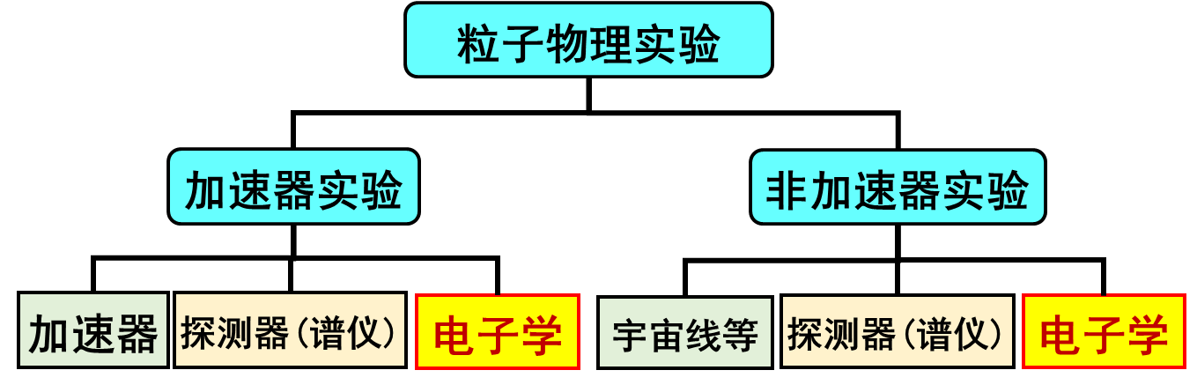
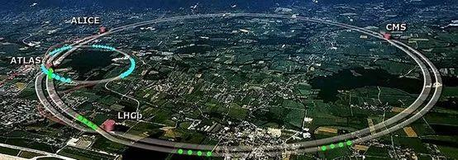
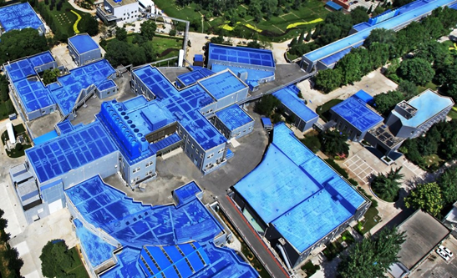
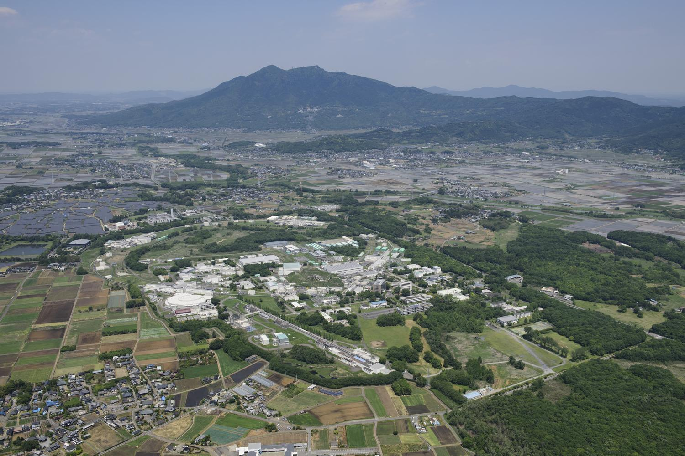
粒子物理实验 Particle Physics Experiments
Probe of matter’s microscopic structure
  Goal: reveal fundamental structure & interactions of particles
  Categories: Accelerator Experiments (High-Energy Colliders, Fix-target Experiments), Non-Accelerator Experiments (Deep Underground Experiments, Cosmic Ray Observatories, Space Payloads……)
  Challenges in data handling:
    Ultra-high event rate, huge data volume (GB - TB/s), complicated noise/background mixed with signals
LHC
BEPC Ⅱ
SuperKEKB
  Difficult (expensive) to store all the scientific data real-timely → Fast Selection is Essential !

Slide 4
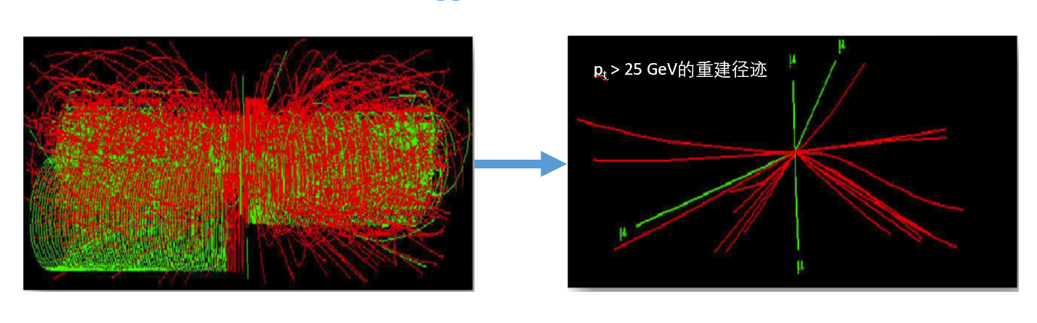
触发系统介绍 Trigger System
Trigger System in particle physics experiments
Position: Front-end of the online data acquisition chain
Function: Select interesting events from massive backgrounds
→ reduce transmission & buffering load, improve storage & offline processing efficiency
Requirements:
  Low latency（低延迟）、Low power（低功耗）
  High throughput（高吞吐率）
  High efficiency & Precision（高效率、高精度）
Traditional Trigger Approach：
  Rule/threshold-based fast decision基于简单的判选逻辑
  Hard to identify complex events (e.g., short tracks, high background) 难以适应新一代实验的触发需求

Slide 5
机器学习与粒子物理实验
Relations of Machine Learning and Physics Experiments
Features of M.L.：
Nuclear and particle physics experiments
Data-driven
naturally generate large amounts of data
Mainstream algorithms (ANN):
High Compatibility
Meet the needs of algorithm iterative optimization at different stages of the experiment
Hierarchical structures
& reconfigurable parameters
Software Level
Nuclear Electronics Area:
Focus on ANN implementation
with hardware (logic circuits)
Conventional:
CPU/GPU
processing
LHC: DNNs improve signal classification
ATLAS: LSTMs optimize track reconstruction
SLAC: Beam stability control
…
Advantages: low latency, low power consumption, high throughput, flexibility
Suitable for small and medium-scale network models in nuclear electronics

Slide 6
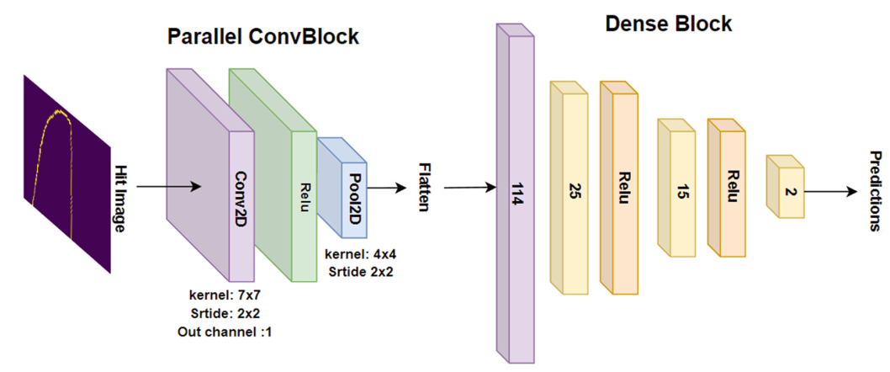
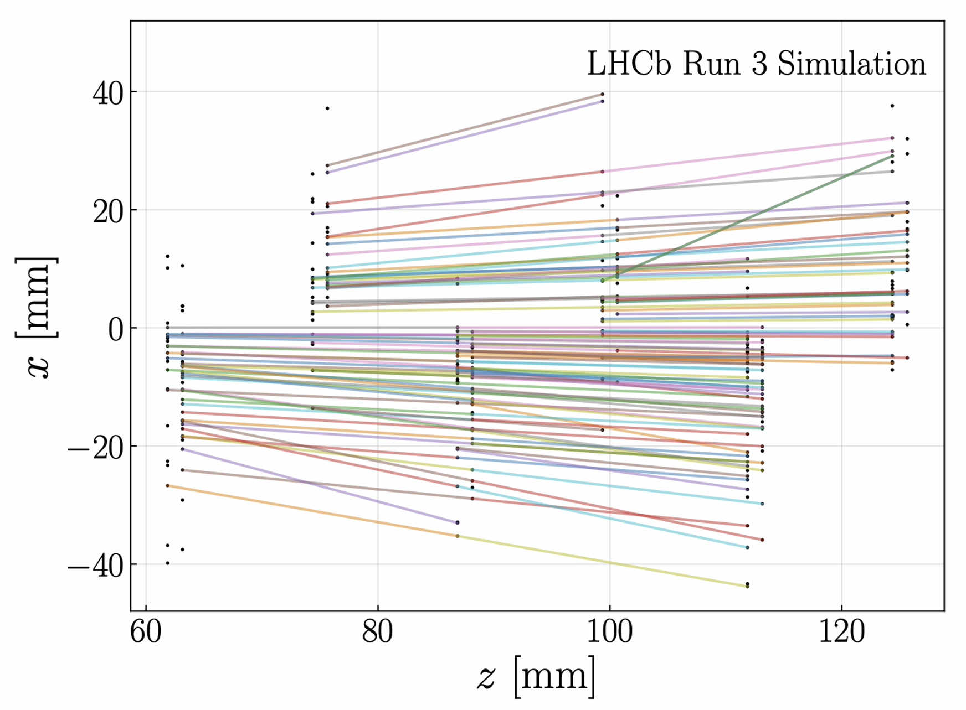
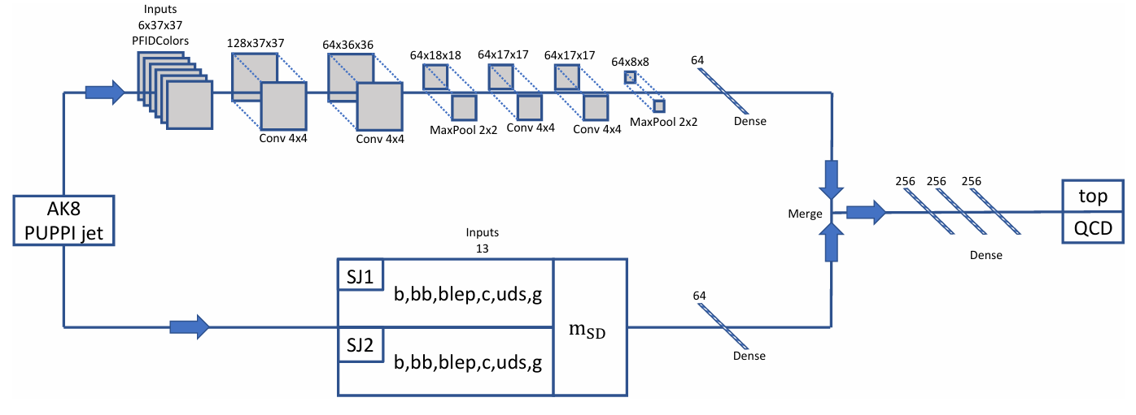
国际研究进展 International Progresses
Belle II: FPGA-based neural network for vertex trigger (low-latency, efficient event selection)
LHCb Upgrade: GNN-based vertex track reconstruction (higher efficiency, reduced fake rate)
DUNE: CNN for particle image classification (enhanced event recognition & categorization)

Slide 7
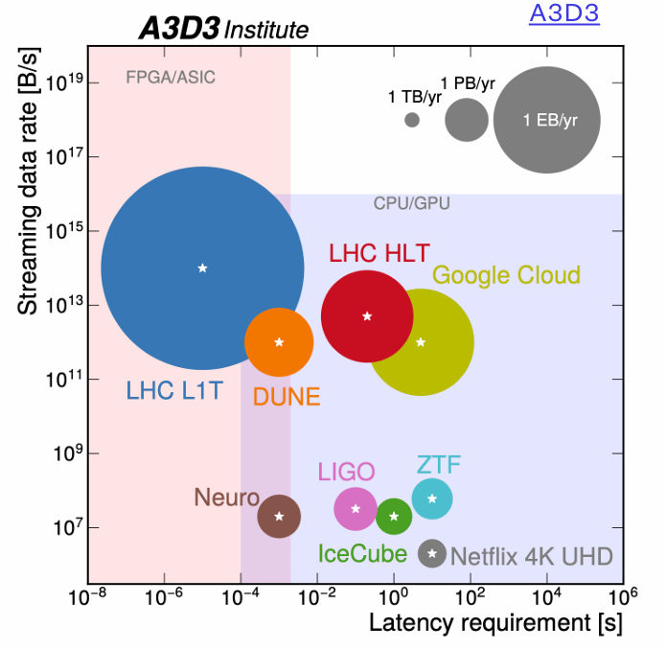
基于高层次综合的机器学习硬件加速
Hardware Accelerated Machine Learning with HLS tools
High‐Level Synthesis (HLS):
Convert high-level language (C++, Python) algorithms into hardware logic (RTL)
Direct deployment on FPGA or ASIC for accelerated computation
Focus on algorithm design without deep circuit-level knowledge
Shorten development cycle and reduce cost
Tools: Vitis™ HLS, Intel HLS Compiler, Cadence Stratus HLS, MyHDL, hls4ml…
isotdaq_mltdaq_2024

Slide 8


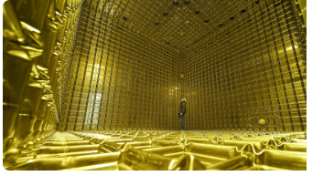
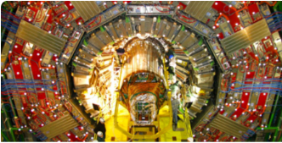
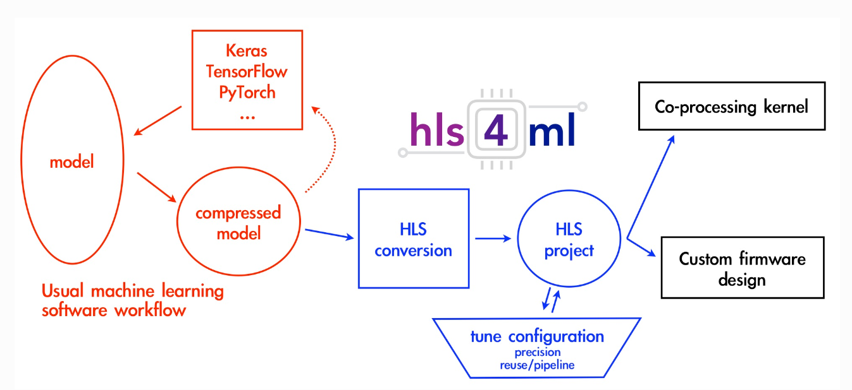
基于高层次综合的机器学习硬件加速
Hardware Accelerated Machine Learning with HLS tools
hls4ml:
  Efficiently converts neural network models into FPGA-deployable HLS code
  Supports rapid prototyping, with optimization for performance, resource utilization, and latency
FastML Lab
FastML Lab | Home
FastML Lab Collaboration (since 2018):
  Focused on ML acceleration for scientific applications, continuously updated and improved
  Achievements include hls4ml and others
Software:
Training with Python
Python+hls4ml
Hardware:
Hardware structure described in Verilog
+hls+Vivado

Slide 9
Outline
1、Research Background
2、Application of Neural Network Algorithms in the STCF Level-1 Trigger
  Design of the MDC Level-1 Trigger Algorithm
  Neural Network–based 3D z-vertex Reconstruction Algorithm
3、Summary and Outlook

Slide 10
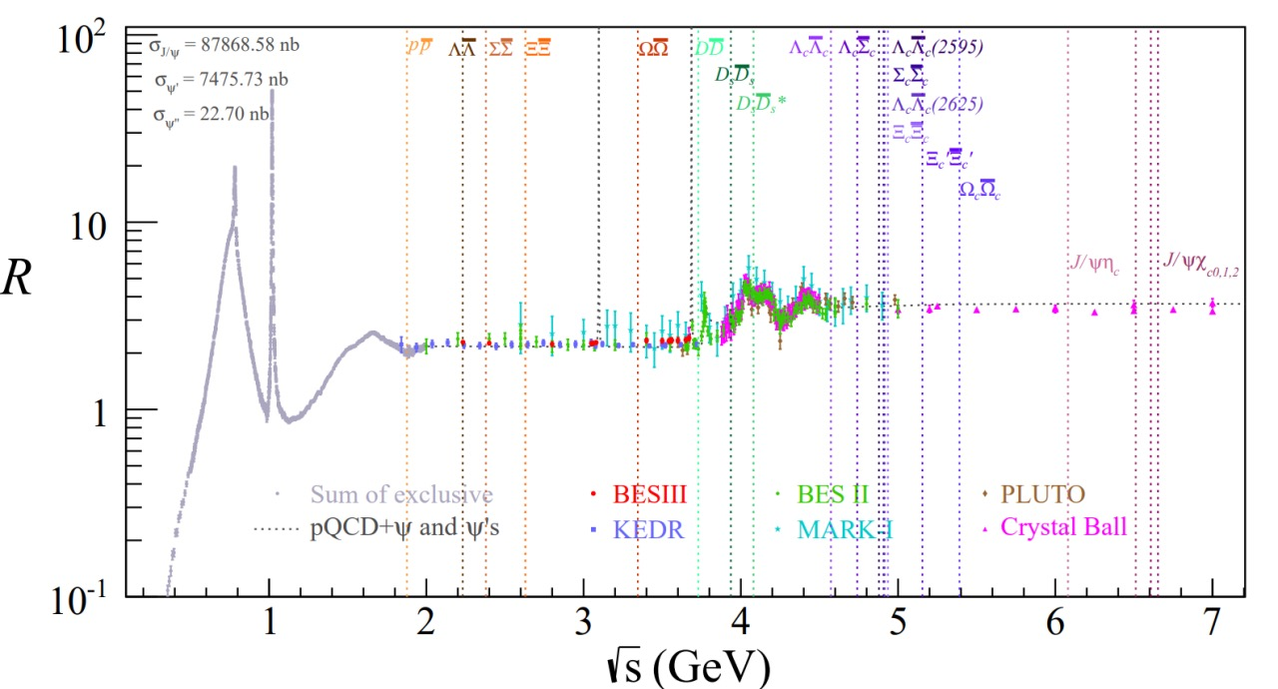

超级陶粲装置 Super Tau-Charm Facility (STCF）
Three frontiers of modern particle physics: high energy, high precision, and cosmology
  Proposed by the Chinese scientific community, the next-generation 2–7 GeV ultra-high luminosity electron–positron collider -- STCF represents the high-precision frontier
τ⁺τ⁻
The 2–7 GeV region uniquely connects perturbative and non-perturbative QCD,
containing rich physics information
Not yet explored
Designed peak luminosity > 0.5 × 10³⁵ cm⁻²s⁻¹, two orders of magnitude higher than BEPCII
Will provide ultra-high statistics data in this energy region, enabling precision measurements
Contributes to addressing major questions in strong interactions and challenges to the Standard Model

Slide 11
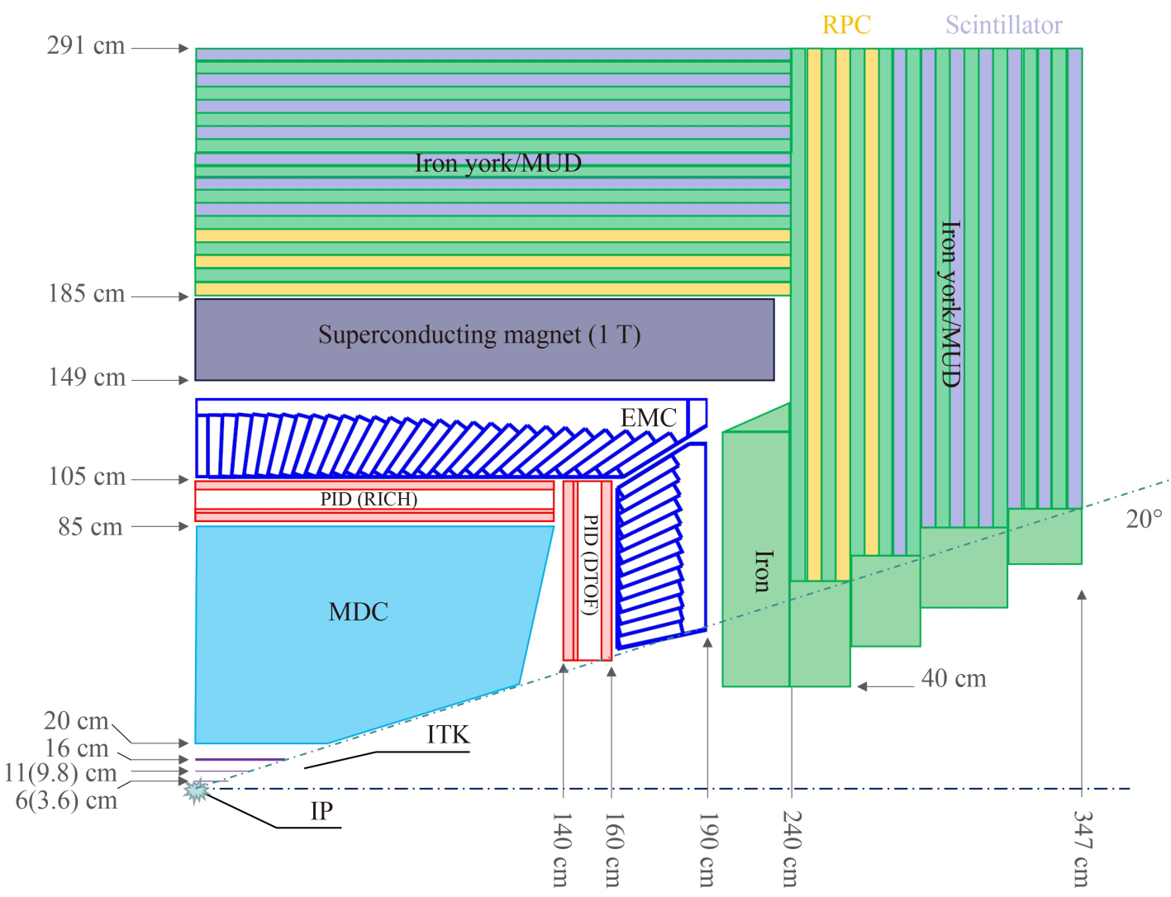
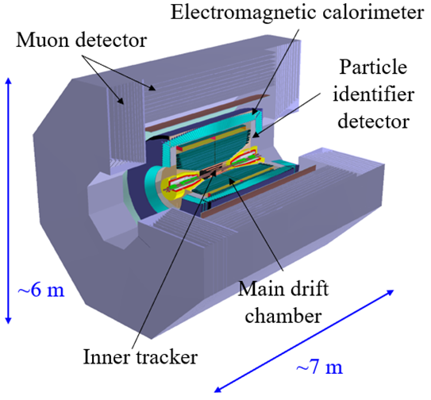
STCF探测器结构 Structure of STCF Detectors
Key Features:
High background
High event rate
Large data volume
Main Drift Chamber

Slide 12
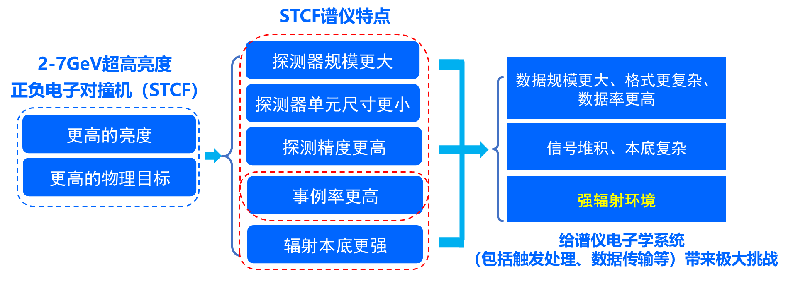
STCF实验面临的挑战 Challenges for STCF
Goals of the STCF Spectrometer:
  Achieve efficient event acquisition, reconstruction, and tagging under high event rate and high radiation conditions

Slide 13
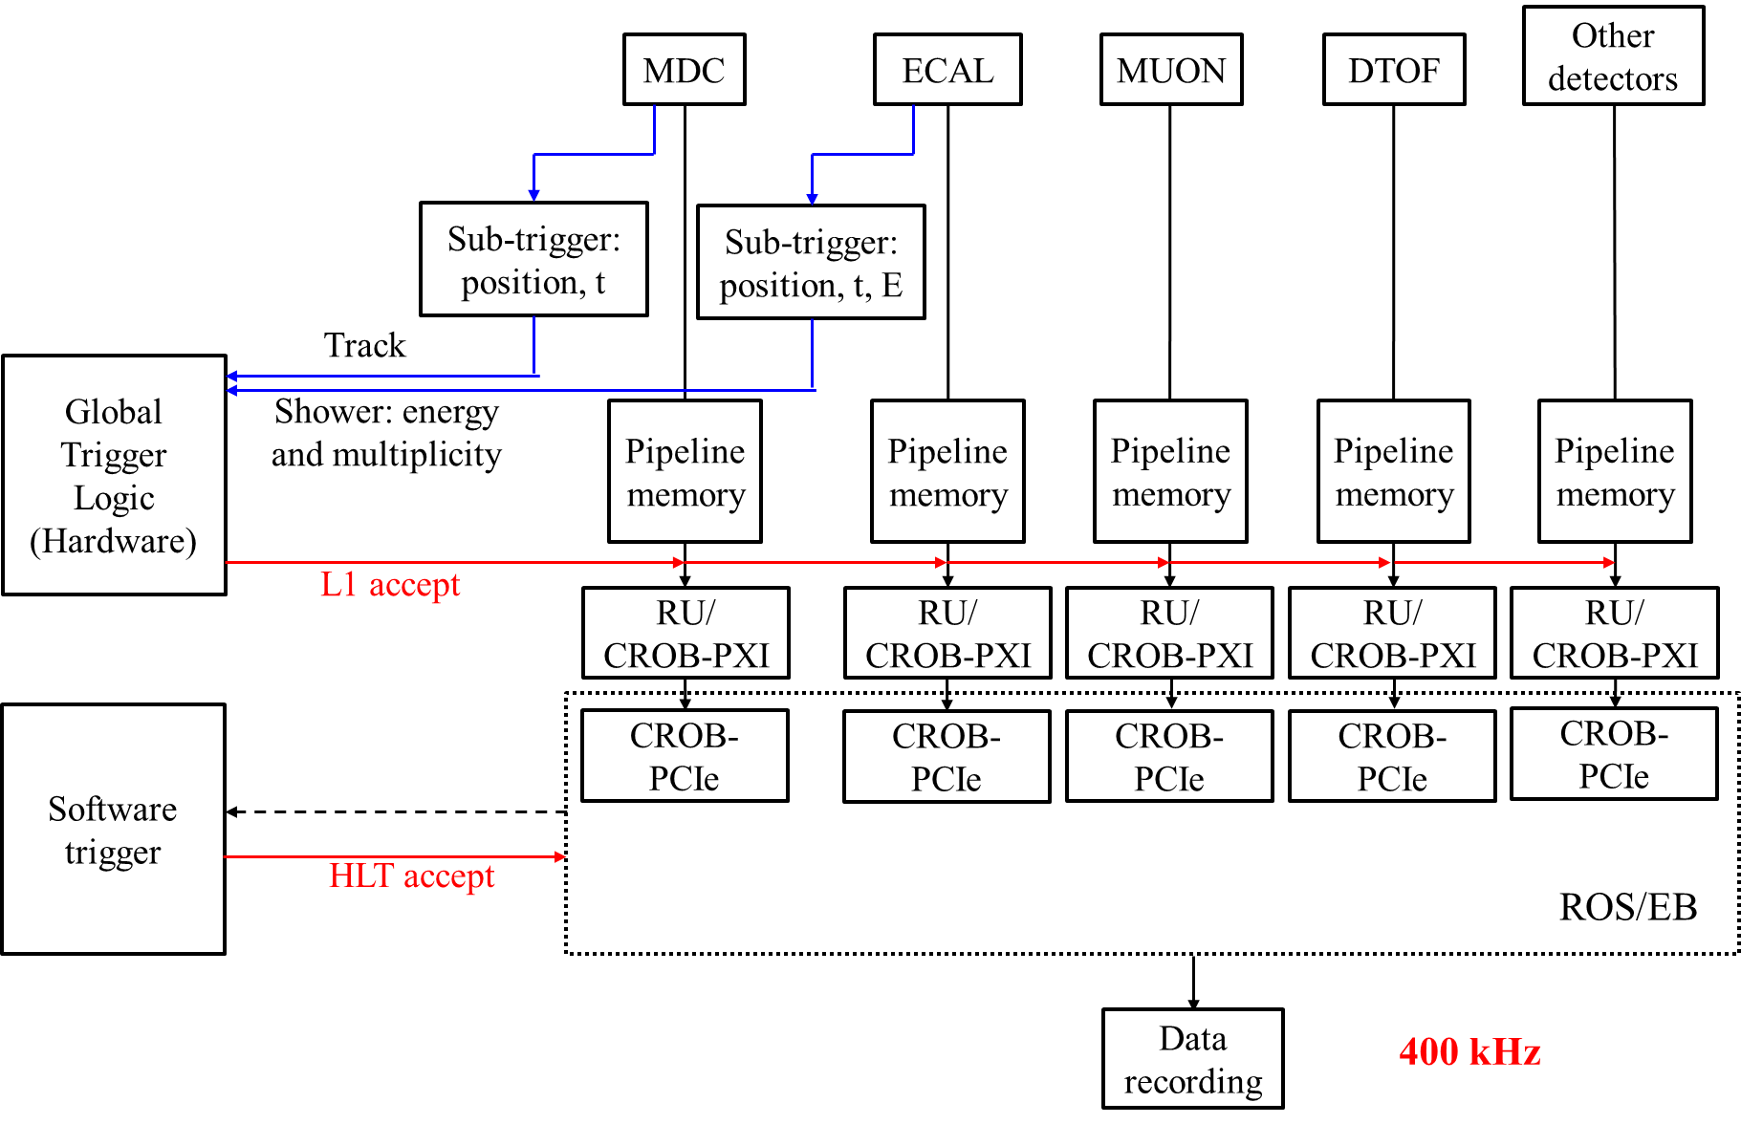
STCF触发系统结构 Structure of STCF Trigger System
STCF Trigger System (Two-Level Structure):
Level-1 Trigger (Hardware Trigger):
  MDC sub-trigger
  Calorimeter sub-trigger
  Global trigger logic
High-Level Trigger
(Software Trigger, HLT)
Fully leverage the unique advantages of modern FPGAs in high-speed parallel processing, moving some complex algorithms, originally feasible only at the software level, into the hardware trigger.
helps achieve precise trigger selection under higher event rates and more complex background conditions

Slide 14
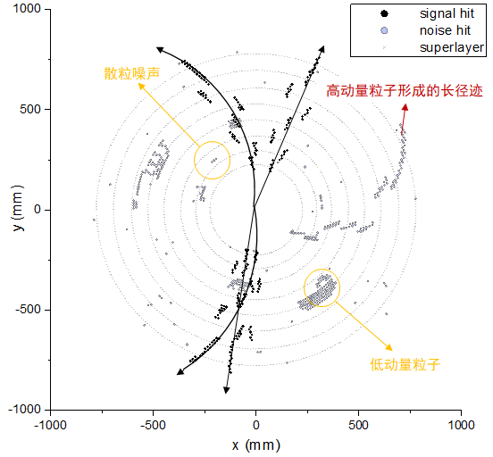
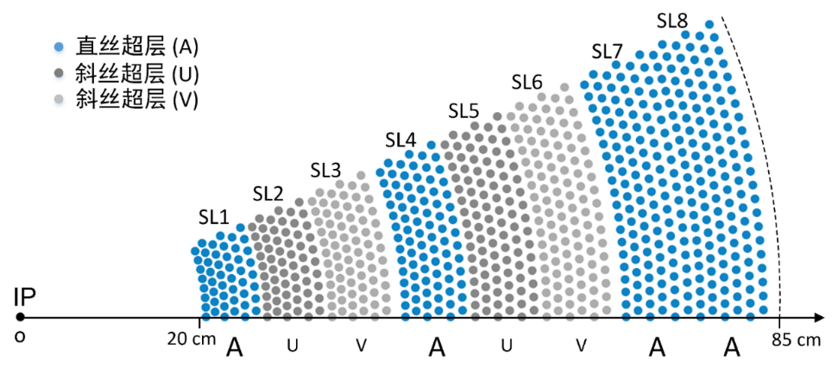
STCF MDC探测器结构 Structure of STCF MDC
Drift Cell Configuration
  Square-shaped small cells, Staggered arrangement
  48 layers totaling 11,520 cells
  4 axial wire superlayers & 4 stereo wire superlayers
  Magnetic field: 1 Tesla
A Typical Event (By simulation)

Slide 15
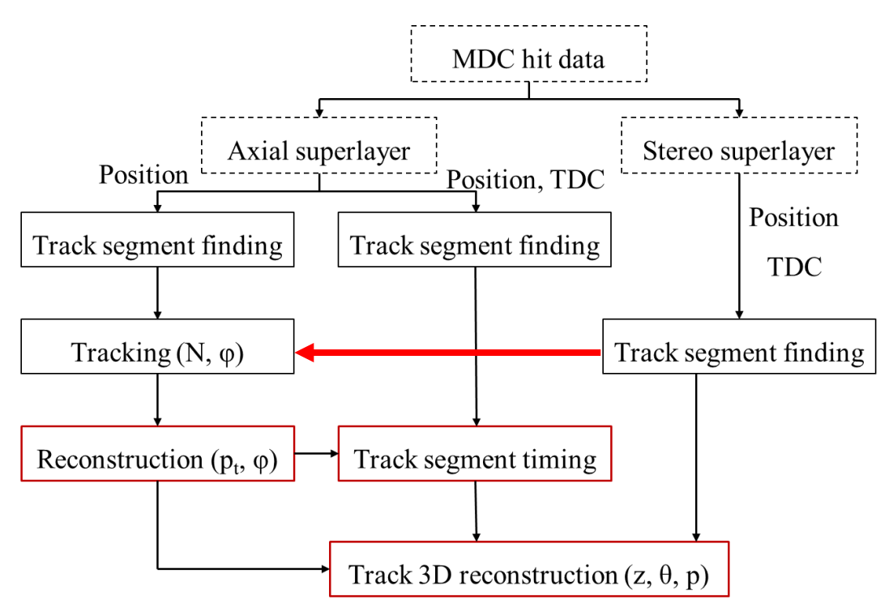
MDC触发需求
Requirements of STCF MDC (sub-)Trigger
  2D寻迹 (Track Finding): Reconstruction Pt & ϕ
    Coordinated operation with other sub-detectors enables enhanced suppression of background signals
    Short track reconstruction: Incorporating stereo superlayers in tracking to reconstruct trajectories emerging from the endcaps
  3D寻迹(Track Finding)、Z顶点重建(Z-vertex reconstruction)：Reject beam-induced background events to reduce the false trigger rate
  事例时间重建(Event Timing Reconstruction)：Alleviate bandwidth load and buffering requirement

Slide 16
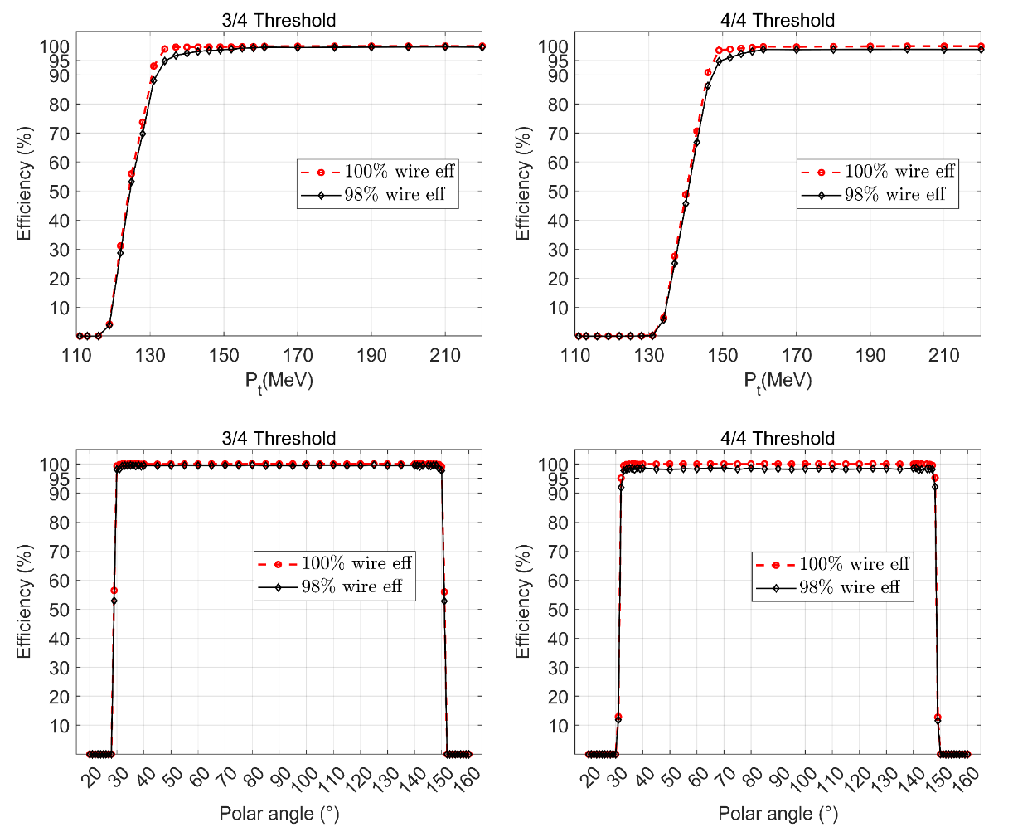
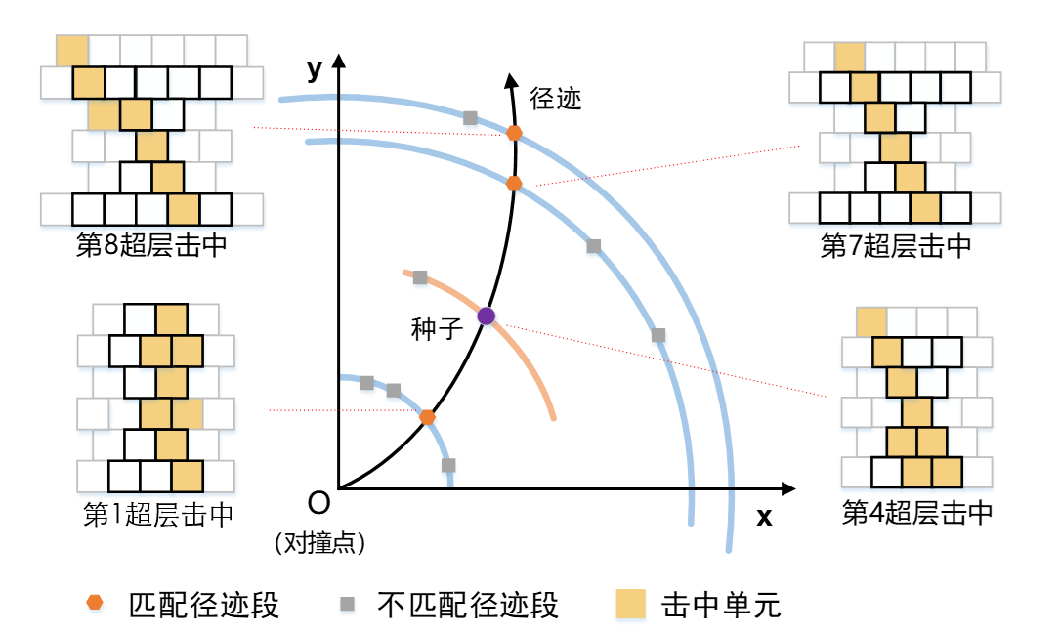
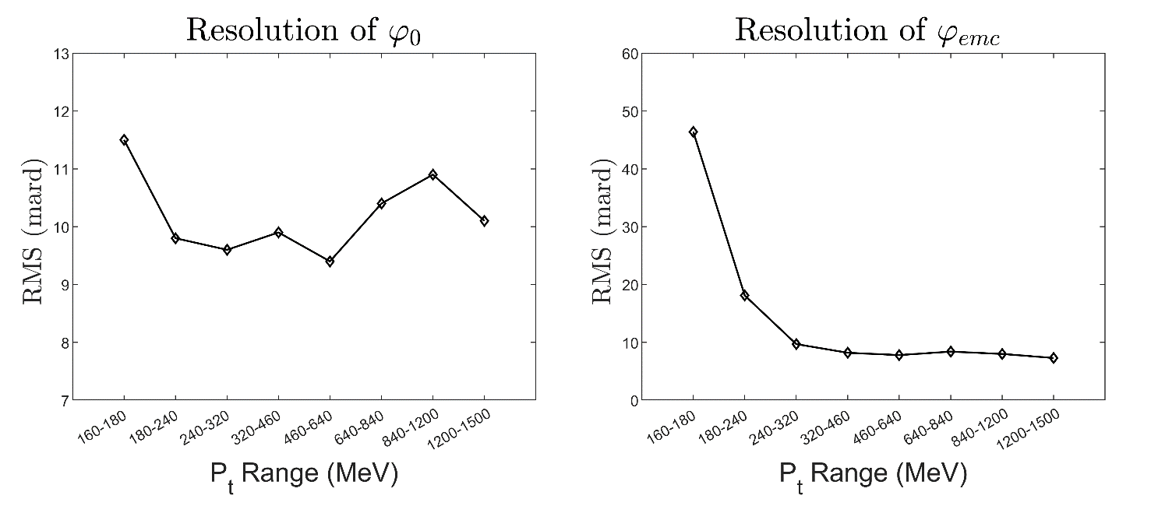
二维寻迹与径迹参数重建
2D Track Finding and Reconstruction
基于FPGA的模式匹配（Pattern Match）
  Pattern library generation via simulated data
    Save in FPGA distributing memory resource
  Event data pattern matching
    High-speed parallel implementation in FPGA
Tracking efficiency & azimuthal angular resolution

Slide 17
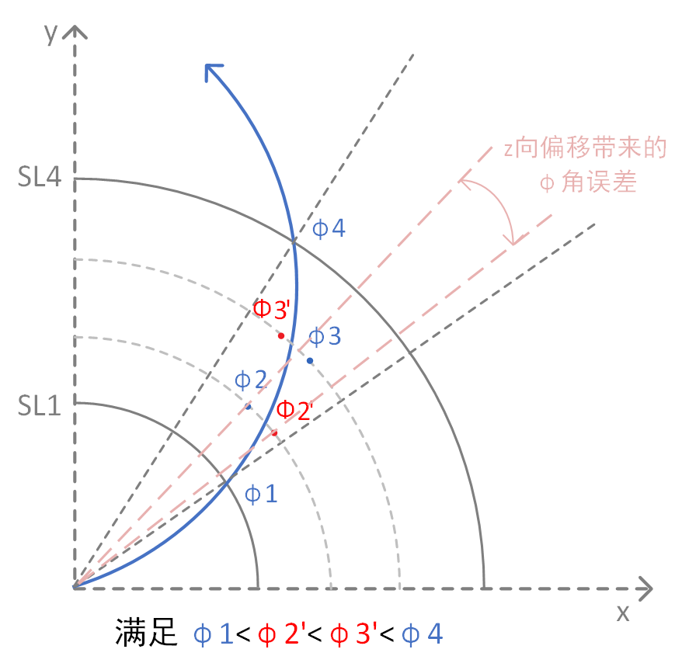
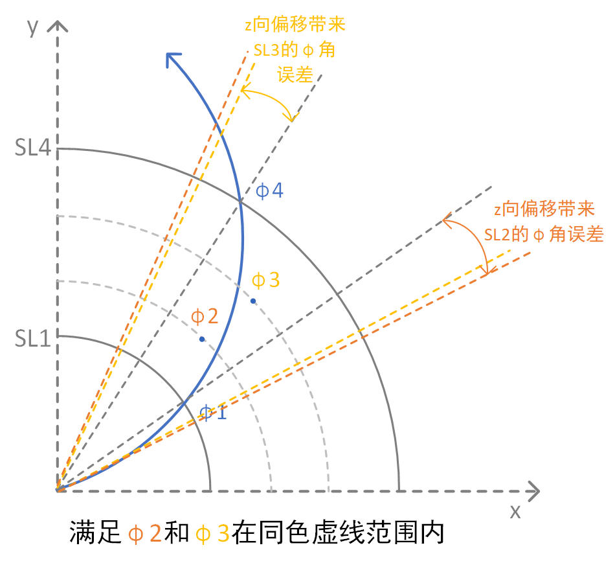
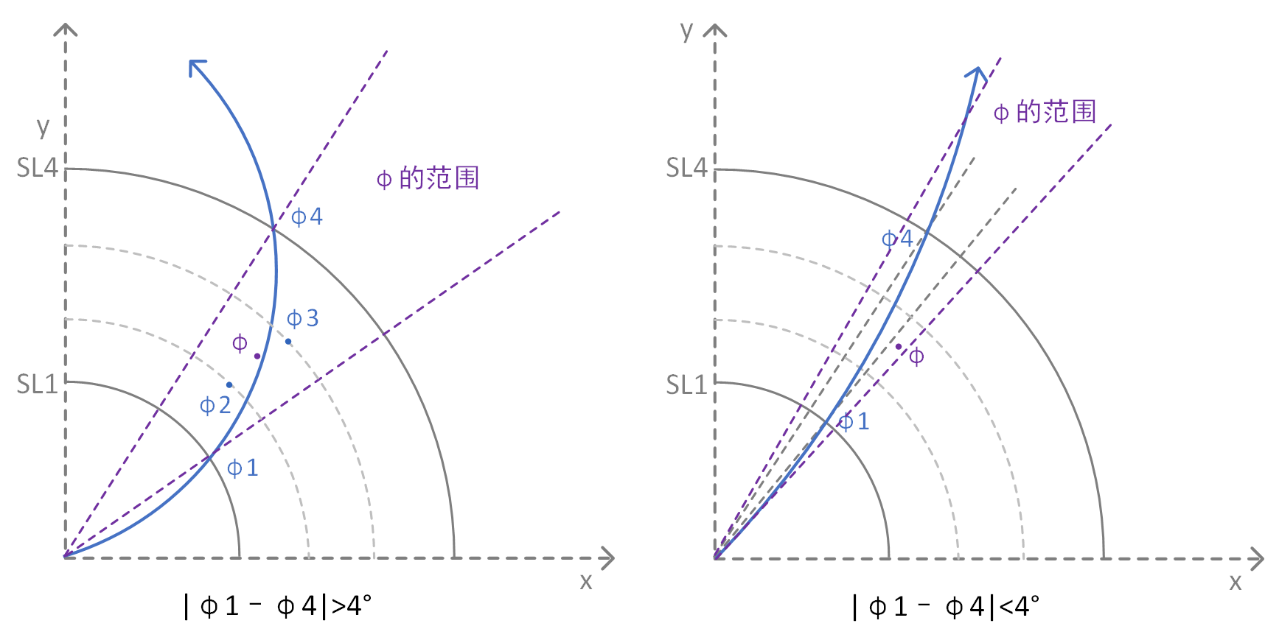
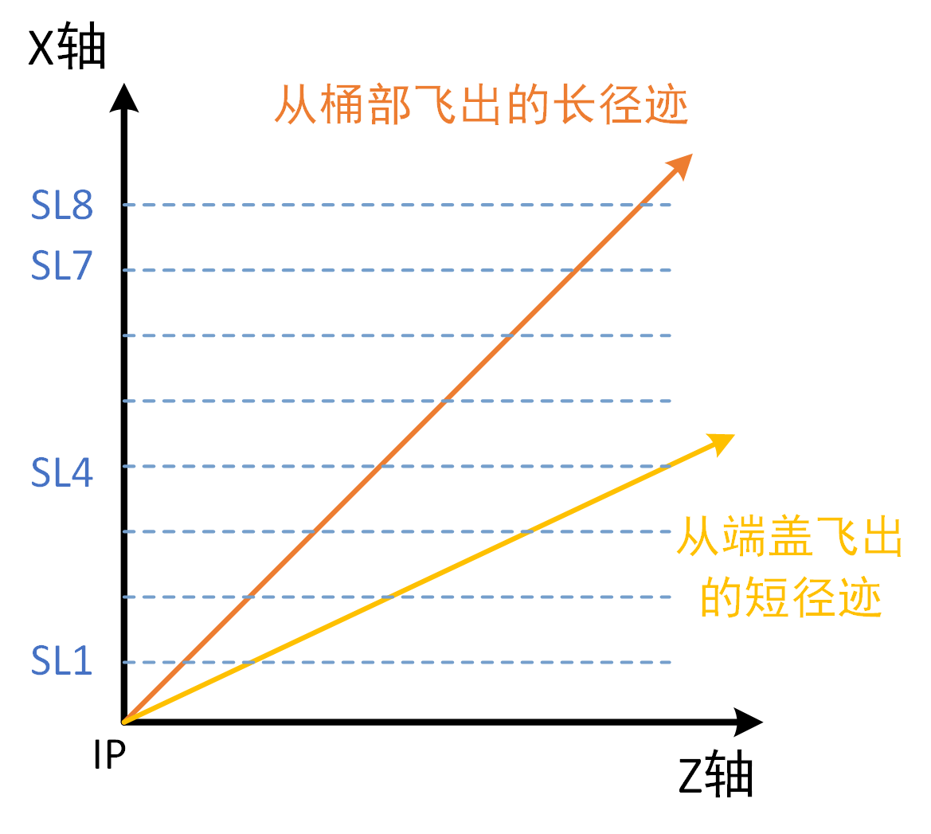
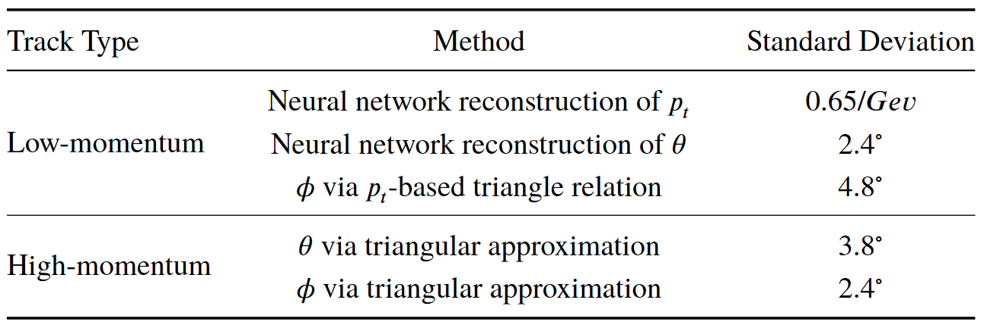
二维寻迹与径迹参数重建
2D Track Finding and Reconstruction
Pre-research on short track reconstruction
Track-finding constraints
Introducing stereo superlayer hit data into 2D tracking：
Advantages:
  Significantly reduces false trigger rate for short tracks, providing better background suppression
  Carries additional 3D information
  Challenge：z-displacement leads to inaccurate hit positions on signal wires
Constraint 1
Constraint 2
Track-finding Constraints
Constraint 3

Slide 18
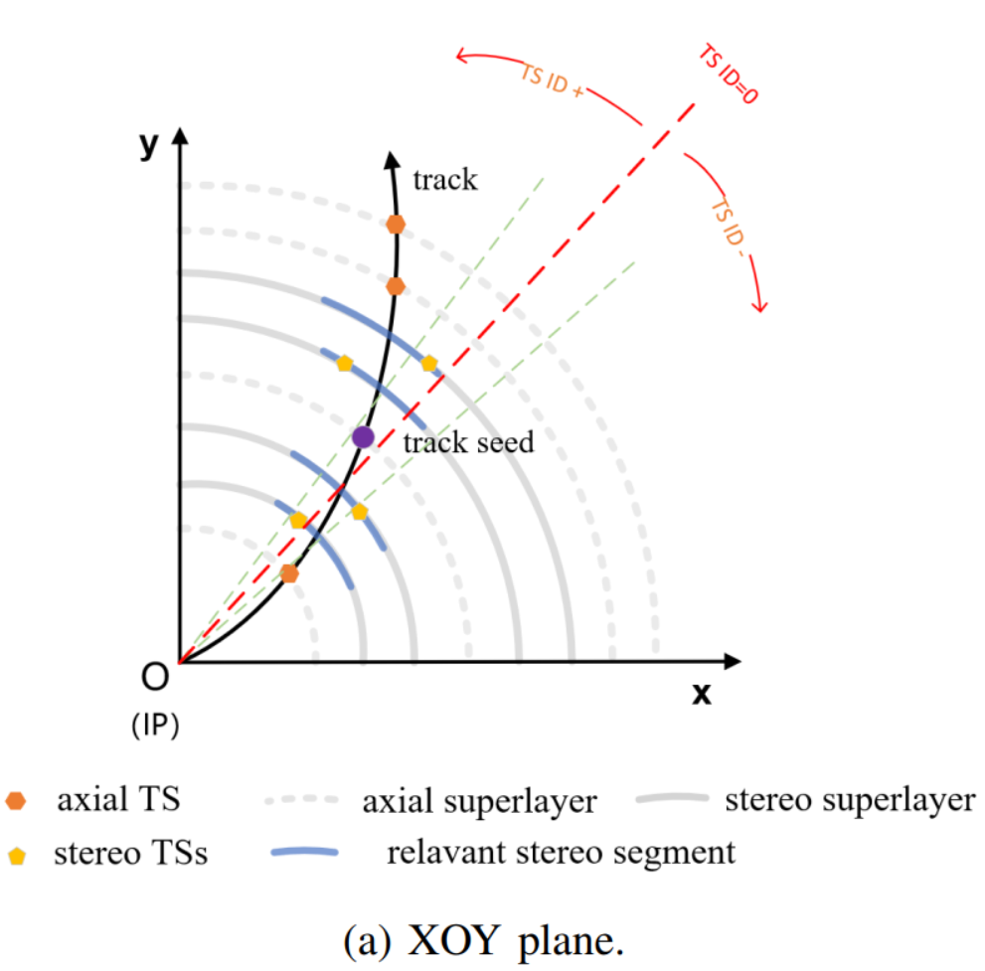
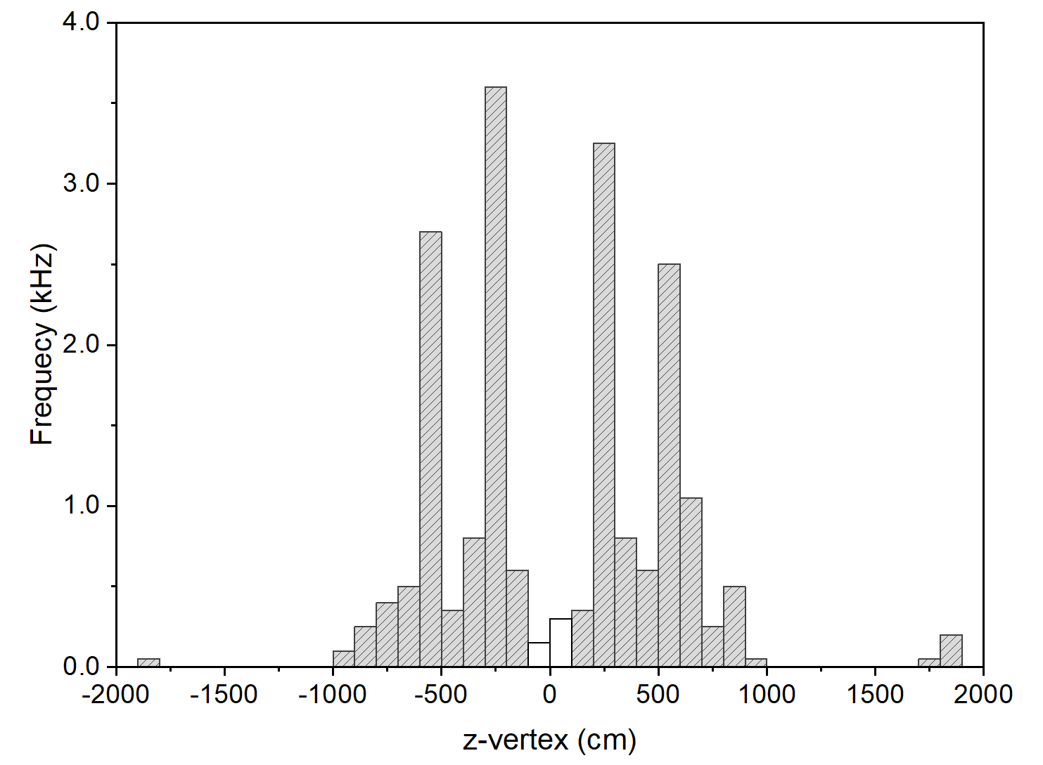
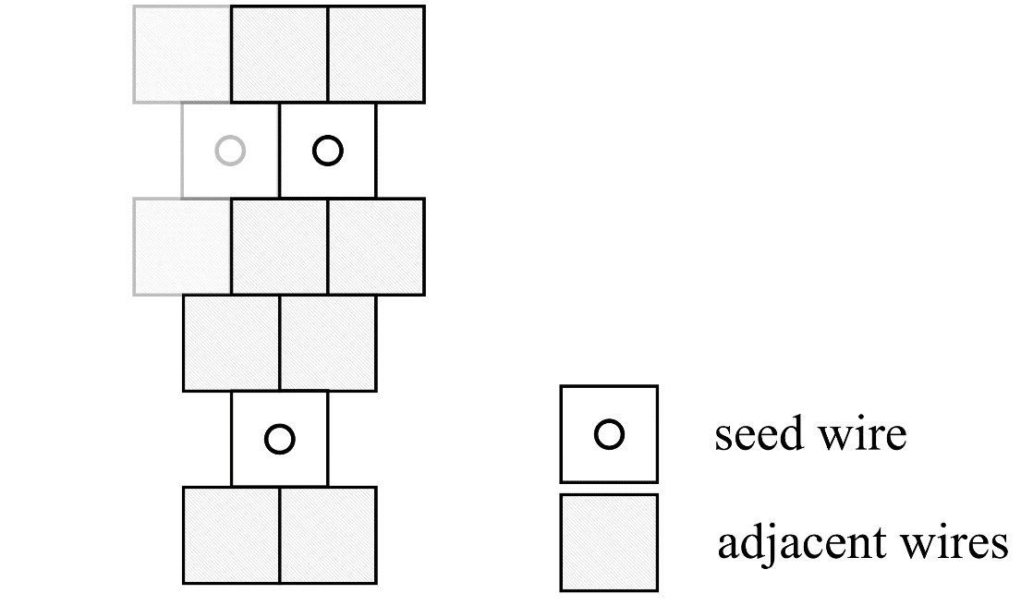
三维寻迹 3D Track Finding
Why we need 3D Track Finding
  Suppress L1 false triggers induced by off-vertex background particles
  Achieving 3cm z-vertex reconstruction precision enables suppression of 97% of beam-induced backgrounds
First Step：Finding valid particle tracks in 3D space
  Stereo superlayer track segment finding
    Dual-seed wire configuration enhances reconstruction precision
  Matching 2D track projections with stereo superlayer segments
  Normalization
    Track segment
    Timestamp
Second Step：Parameter Reconstruction, using ANN algorithm
相比于三角函数及求解二次方程，基于FPGA的神经网络算法在资源量、处理速度方面都具有优势！

Slide 19
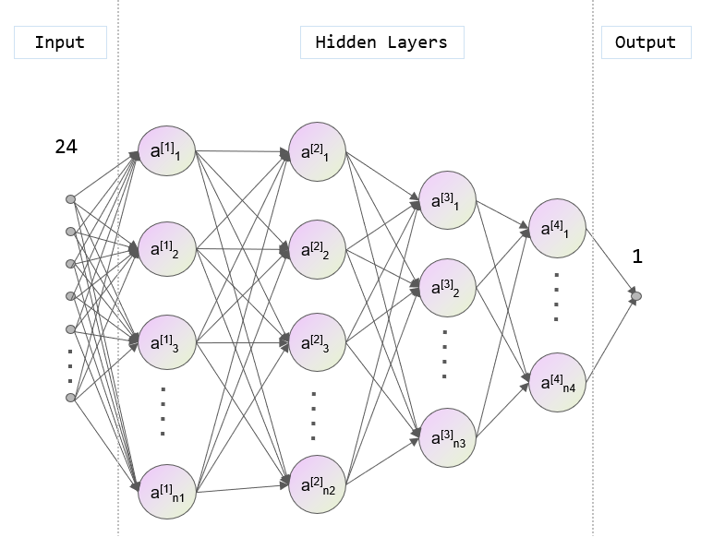
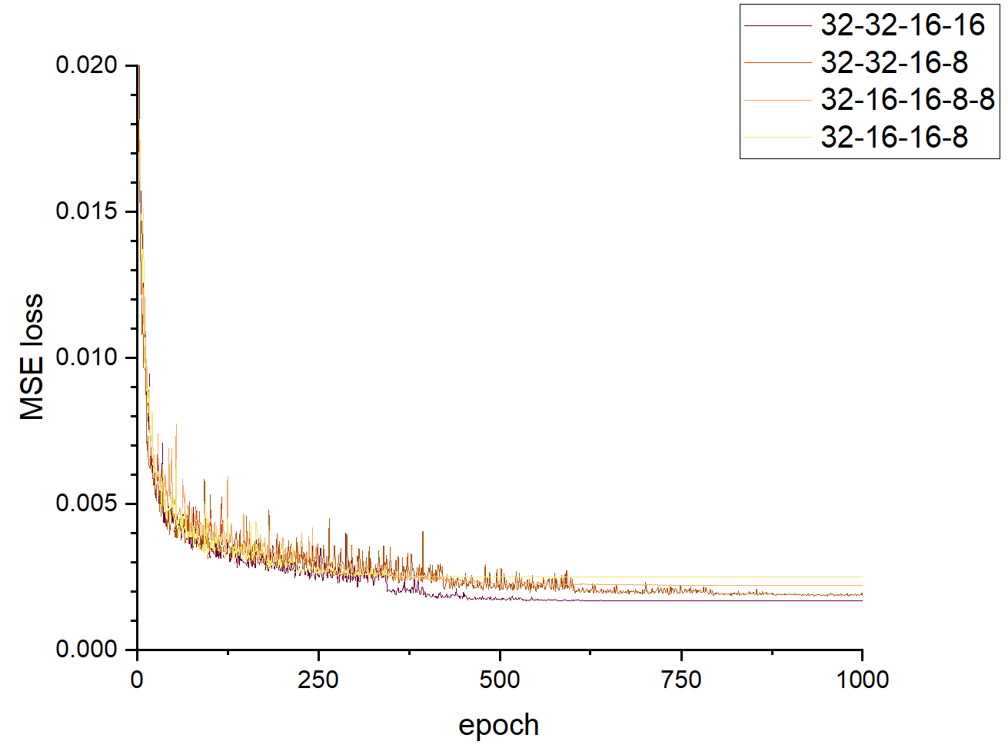
利用神经网络算法实现3D径迹的参数重建
Neural network-based reconstruction of 3D track parameter
原始数据的产生 (Data: M.C. Simulation)
  STCF模拟软件（Oscar），通过蒙卡模拟，生成带电粒子在MDC探测器的击中信号
数据集（Training Data Set + Test Data Set）
  开发Python模拟验证算法，对探测器击中的原始数据进行处理，生成神经网络的数据集
网络训练
  Python：Keras训练框架
网络结构
  MLP的选择：计算量低，精度满足要求
  输入：8个超层的径迹段ID和时间戳信息
  输出：z向顶点
  网络采取四层隐藏层
神经网络的FPGA部署
  利用高层次综合（HLS）工具实现FPGA部署
  工具便捷易用，便于网络模型调试、迭代

Slide 20
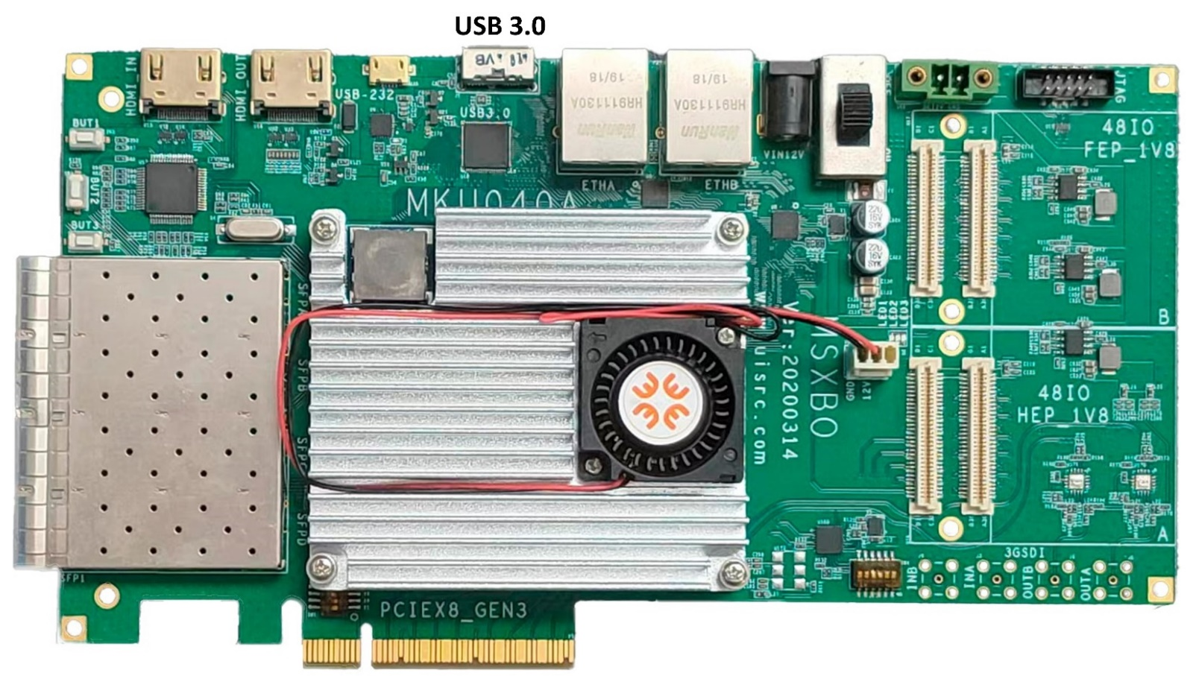
神经网络算法的FPGA部署
FPGA implementation of neural network algorithms
神经网络的FPGA部署面临的挑战 (Challenges in FPGA implementation)
  在数据位宽有限的情况下，保持神经网络算法的精度 (to maintain the precision with limited data bit widths in FPGA)
  在FPGA硬件资源有限的前提下，实现尽可能强大的功能 (to achieve powerful functions, under the constraint of limited FPGA hardware resources,
  实现百ns级的低延时 (low latency, hundreds of ns)
Hardware platform：Low cost Xilinx KU060（当前中端/偏低端的FPGA）

Slide 21
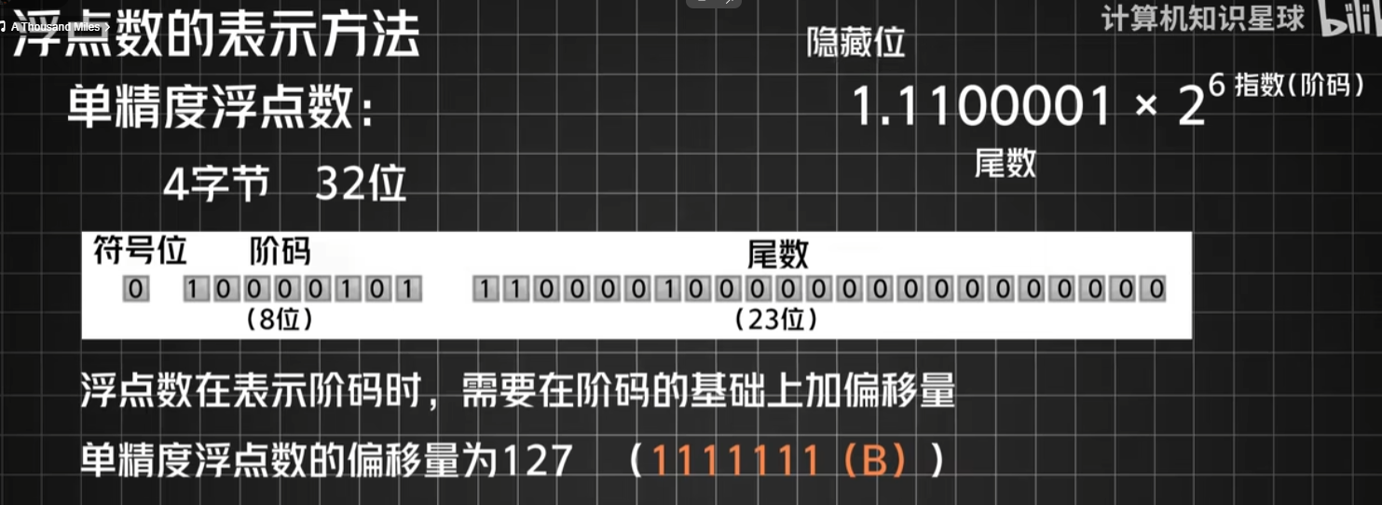
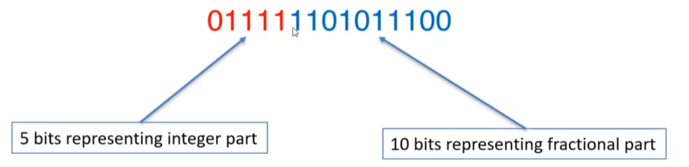
FPGA部署的挑战1：量化导致的精度损失/数值溢出
Challenge 1: Precision Loss and Numerical Overflow from Quantization
浮点数表示的网络参数 → 定点化 → HDL(hardware description language) 代码
精度损失
触发延时限制、FPGA资源限制
2⁻¹⁰ = 0.00098 （10⁻³）
定点数的表示——FPGA计算速度快，消耗资源少
From float number to fixed number
精度损失

Slide 22
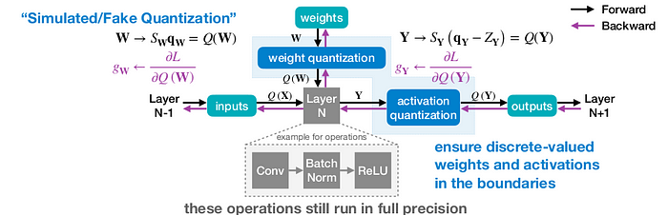
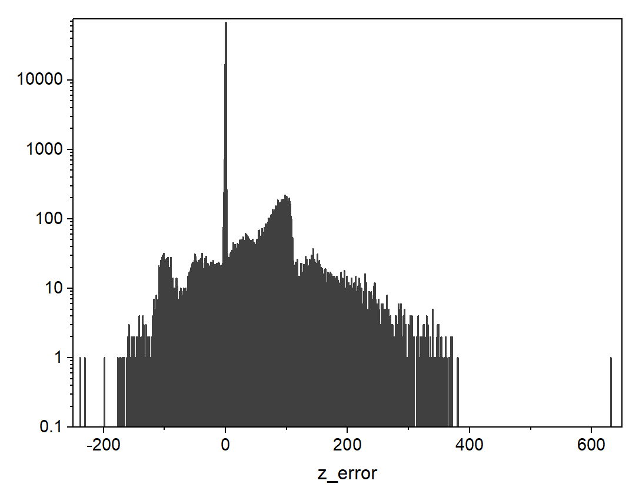
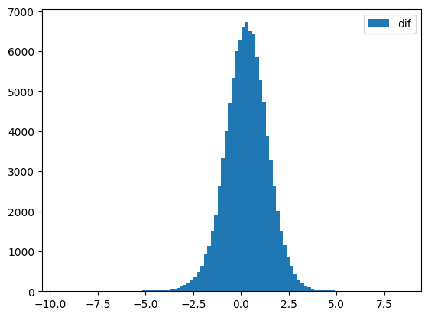
如何避免精度损失/数值溢出问题
How to mitigate precision loss and numerical overflow issues
基于Qkeras的量化感知训练 （Quantization aware training)
  前向传播 (计算损失函数)——定点化参数
  反向传播 (梯度计算更新参数)——浮点数
  减少计算中数值溢出
  减小定点化所需位宽——节约FPGA资源
通过采用定点化网络改善精度
  Quantization after training -> Quantization aware training
Keras
Qkeras

Slide 23
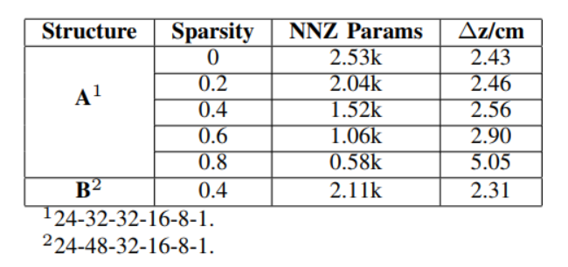
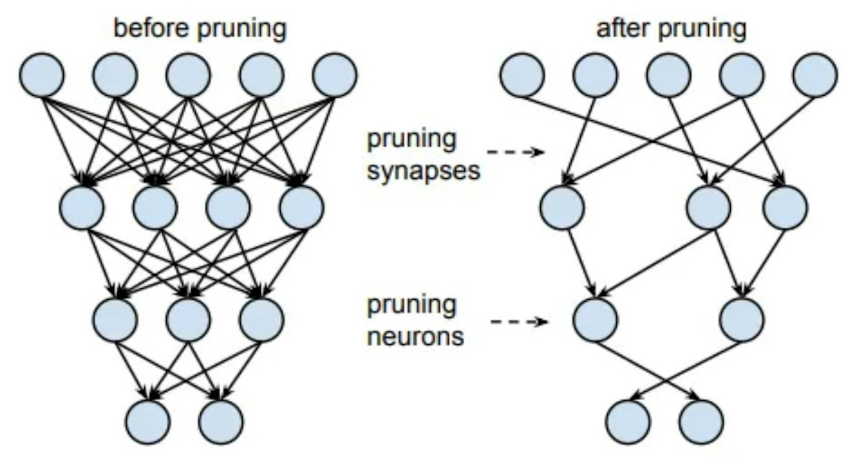
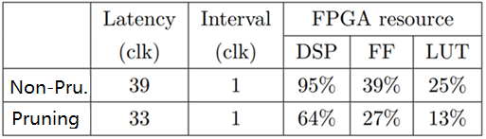
FPGA部署的挑战2：如何节省逻辑资源
Challenge 2: how to save FPGA logic resources
利用神经网络往往存在冗余的特点，进行“剪枝”（pruning）操作
  去除部分节点/参数，对网络精度仅有微小影响
  大而稀疏的结构更具优势
  网络结构选取：24-48-32-16-8-1
  剪枝前后的资源占用量效果对比（Structure B）

Slide 24
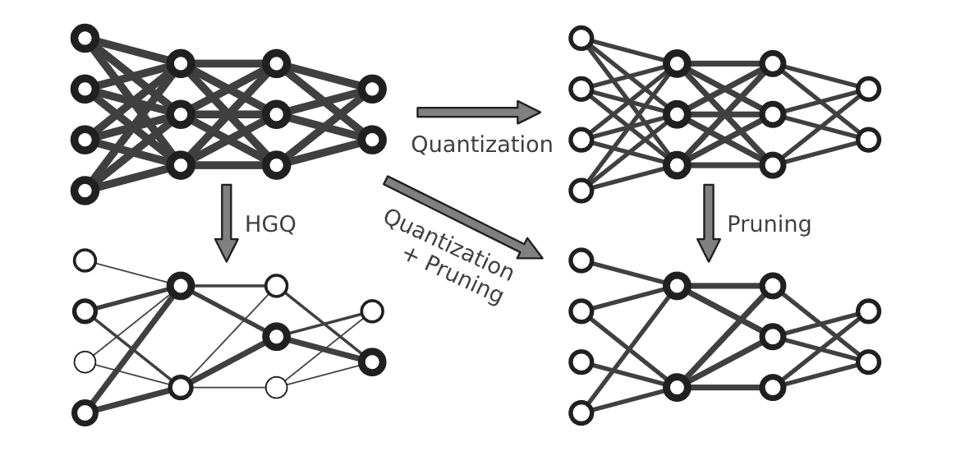
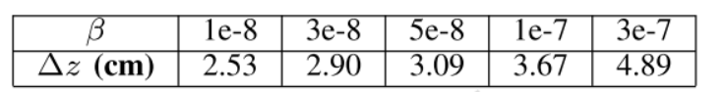
进一步节省资源：逐参数位宽优化
Further improvements: Parameter-wise bitwidth optimization
利用HGQ（High Granularity Quantization）工具
在参数级别优化量化位宽，以最大限度减少硬件资源消耗
  位宽为0就自动进行剪枝
基于梯度优化策略，自动将网络模型转换为hls4ml模型，降低使用门槛
不同优化条件下的参数重建精度对比
（β越接近0，网络越接近原始状态）
最终的选择

Slide 25
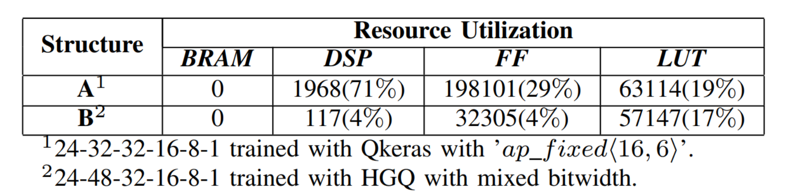
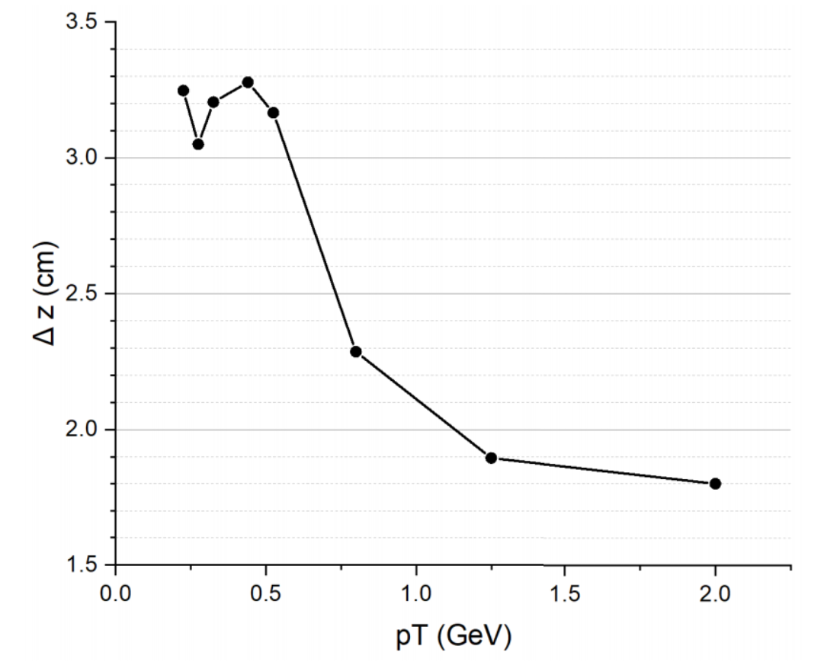
测试验证结果 Test Results
Z vertex reconstruction
  σ_{z} ~= 2.8 cm (Optimized with HGQ)
  97% background events from beam can be discrarded
FPGA Implementation (XCKU060)
  Vivado HLS资源消耗
  Vivado 综合结果：资源占用 < 10%
MLP层 | LUT(%) | FF(%) | DSP(%)
48 | 3.71 | 1.43 | 3.88
32 | 2.58 | 1.05 | 0.29
16 | 0.51 | 0.29 | 0.51
8 | 0.02 | <0.01 | 0.18
1 | <0.01 | <0.01 | 0.04
总计 | 6.93 | 2.85 | 4.89
Publication：IEEE TNS, 2024. DOI: 10.1109/TNS.2024.3503068

Slide 26
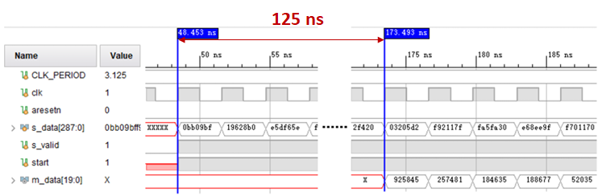
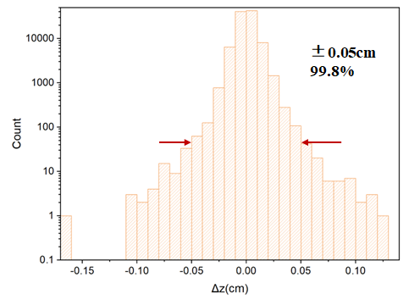
测试验证结果 Test Results
  Simulation of ANN IP core
    Dead time: 1 clock （~3ns）
    Latency: 40 clocks （~120ns）
Comparison of FPGA Core and Python Program
Data set: 100k tracks (by simulation)
Max. deviation = 0.16 cm (much better than σ=2.8cm）

Slide 27
Outline
1、 Research Background
2、Application of Neural Network Algorithms in the STCF Level-1 Trigger
  Design of the MDC Level-1 Trigger Algorithm
  Neural Network–based 3D z-vertex Reconstruction Algorithm
3、Summary and Outlook

Slide 28
Summary
Compared to CPUs and GPUs, machine learning algorithms implemented in FPGAs offer significant advantages
  Low latency（低延迟）, low power consumption（低功耗）, shorter development cycles and lower costs （短开发周期、低成本）
The usage of High-Level Synthesis (HLS) and supporting tools enables direct compilation and synthesis of high-level language algorithms (e.g., Python) into digital logic circuits, facilitating relatively straightforward performance optimization.
  This provides significant convenience for the deployment of machine learning algorithms implementation on FPGA
Over the past decade, the presenter has explored the application of FPGA-based neural network algorithms for high-speed information processing in particle detectors, achieving notable results in preliminary research for the STCF trigger system
The STCF Key technology research project is still on going
  Current work includes：optimization of MDC track reconstruction algorithms & design of ECAL trigger algorithms
  Future efforts will focus on: improved handling of complex scenarios (e.g., high-background environments, multiple tracks), gradual expansion of neural network applications to more parameter reconstructions and algorithm industrialization and implementation

Slide 29
Outlook: ANN algorithm for ECAL sub-trigger
  簇团重建（Cluster Reconstruction）：Finding center TC of cluster and reconstruction the energy
  簇团分割（Cluster segmentation）: Separate overlapping particle showers into distinct clusters
    Coordinate with other sub-detectors to achieve enhanced background suppression
Cluster Segmentation
  Why cluster segmentation is needed
    Boundary merged between two clusters
  Change in energy gradient is identified as a cluster boundary
    TC is preferentially assigned to the cluster with higher energy
  For high-background environments with complex cluster topologies, future upgrades utilizing neural network algorithms for cluster segmentation are under consideration

Slide 30
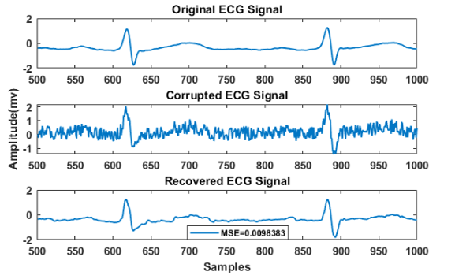
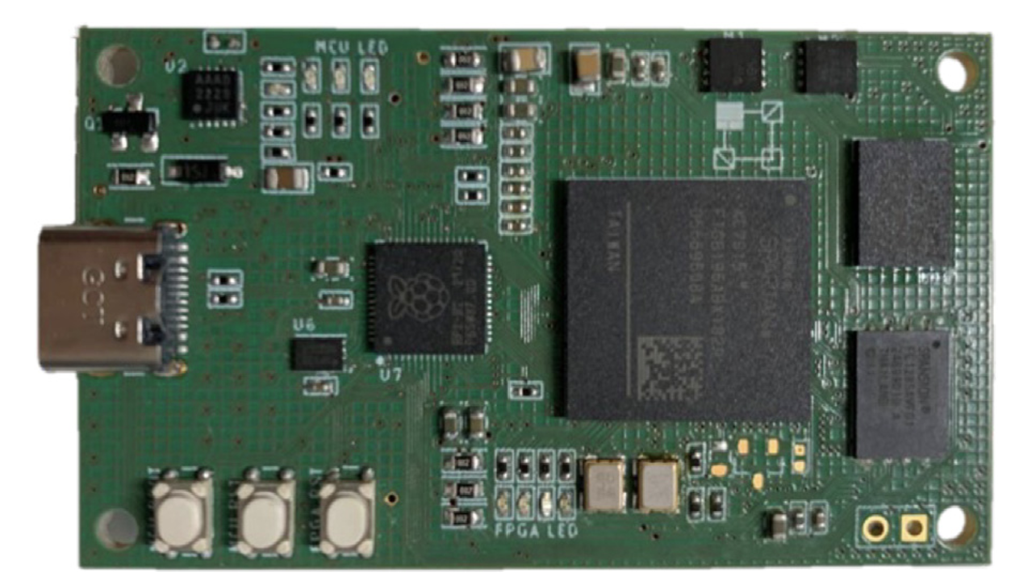


Outlook: RNN for trigger system?
循环神经网络(Recurrent Neural Network)
  Proposed by Jeffrey Elman in 1990, a recurrent layer was added, where the input to the hidden layer includes both the output from the input layer and the output from the hidden layer at the previous time step
  Including variants such as Long Short-Term Memory (LSTM) and Gated Recurrent Unit (GRU)
  Application Areas: Time series prediction (e.g., particle identification), signal processing (e.g., noise reduction), etc.
Characteristics
  Suitable for handling nonlinear time-invariant systems
  Provides adaptive and nonlinear filtering capabilities
ECG Waveform Denoising
Elbedwehy A N ,2022
A FPGA based LSTM Network
C. Qian et al. Journal of Systems Architecture 152 (2024)

Slide 31




Outlook: SNN for trigger system?
脉冲神经网络(Spiking Neural Networks，SNN)
  Neural networks that use spikes as fundamental units for transmitting and processing information
  Information is encoded in the timing of spikes
  Inputs accumulate, and an output is generated when the threshold is reached
Advantage
  Ultra low power consumption，high temporal resolution and dynamic temporal processing capabilities
The CMS experiment utilized a Leaky Integrate-and-Fire (LIF) spiking neural network for particle track identification
  achieved promising results
arXiv:2001.01587
Emanuele Coradin, 4th MODE workshop Valencia 23 september 2024

Slide 32
参与本工作的研究生骨干：董文豪（2022博士毕业）、郝艺迪（2025硕士毕业）、 王君宸（博士生）、杨诚（硕士生），周子煊（本科毕业保研）、周毅涵（大四本科生）；该工作得到了中科大近代物理系粒子物理专业方竹君带领的研究生团队的合作与支持，包括周杭（博士生）、黄钰贺（博士生）、包一宁（硕士生）等。
本工作得到了国家自然基金专项（重点）项目、合肥综合国家科学中心STCF关键技术攻关项目支持 This work was supported by the National Natural Science Foundation of China under Grant No. 12341503, and the Hefei Comprehensive National Science Center (STCF key technology research project).
谢 谢 ！

