Slide 1
Intelligence Photon Source Brain 2.0
智慧光源大脑2.0平台
Lina ZHAO（赵丽娜）
Institute of High Energy Physics, Chinese Academy of Sciences
Aug. 21, 2025

Slide 2
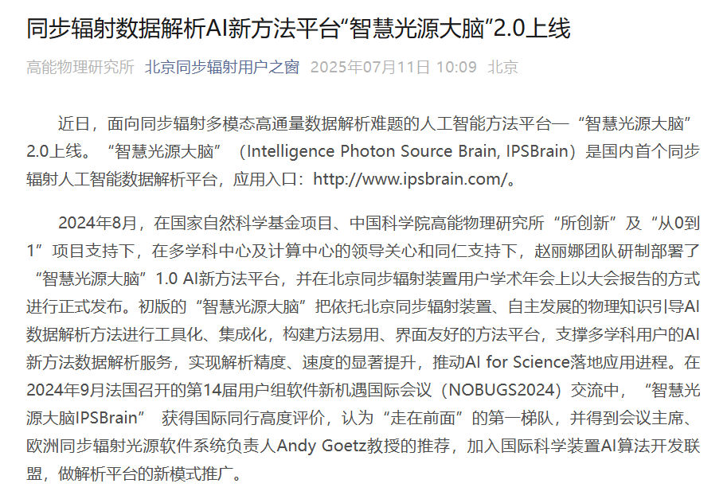
0. Intelligence Photon Source Brain (IPSBrain)
《人民日报》、《科技日报》、《中国科学报》等报道推荐
Notes:
You have visited BSRF on this Monday.

Slide 3
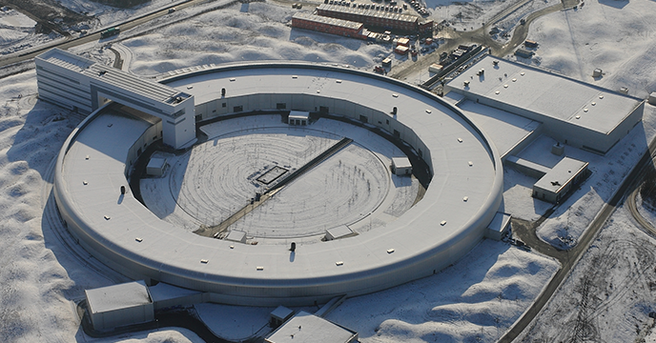

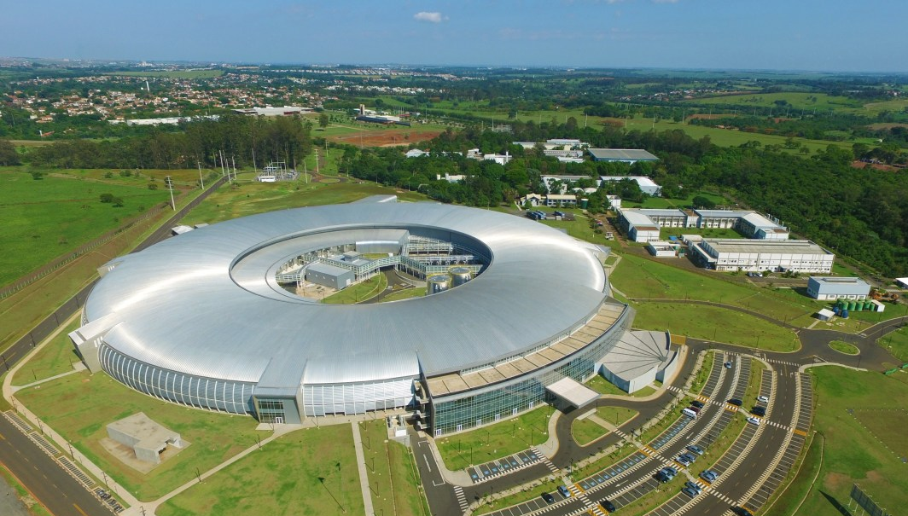



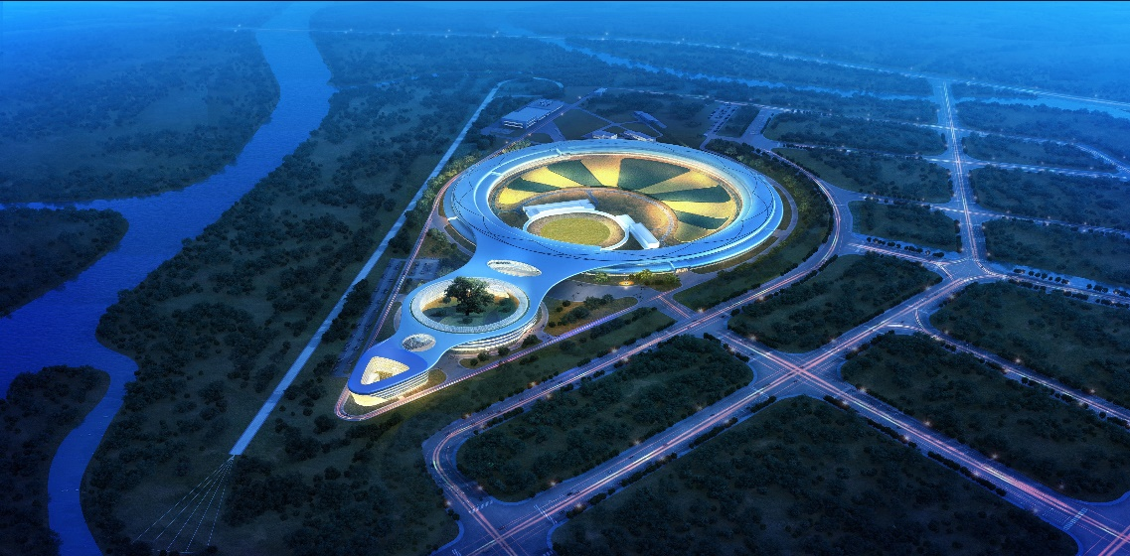
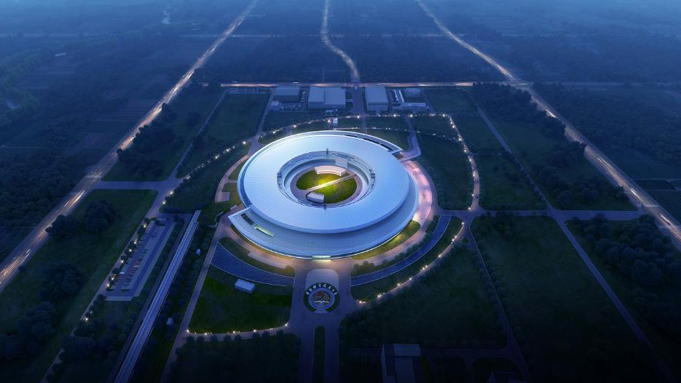
1. Background: 4th-generation synchrotron source
MAX IV Laboratory 2016
ESRF-BES 2020
SIRIUS3 2020
In China, two 4th-generation synchrotron radiation facilities are being constructed:
High Energy Photon Source – HEPS 2025
Hefei Advanced Light Facility – HALF 2028
Multidisciplinary Research Platforms
Major Science and Technology Infrastructure

Slide 4
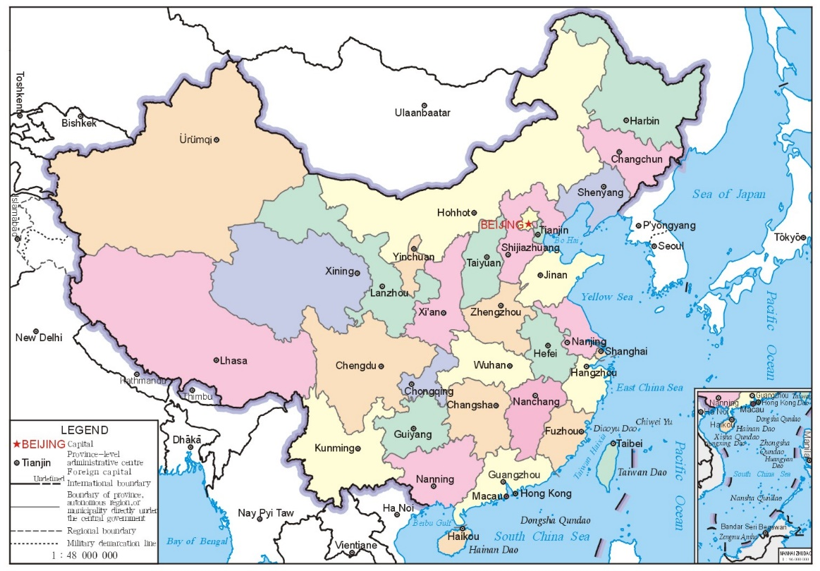
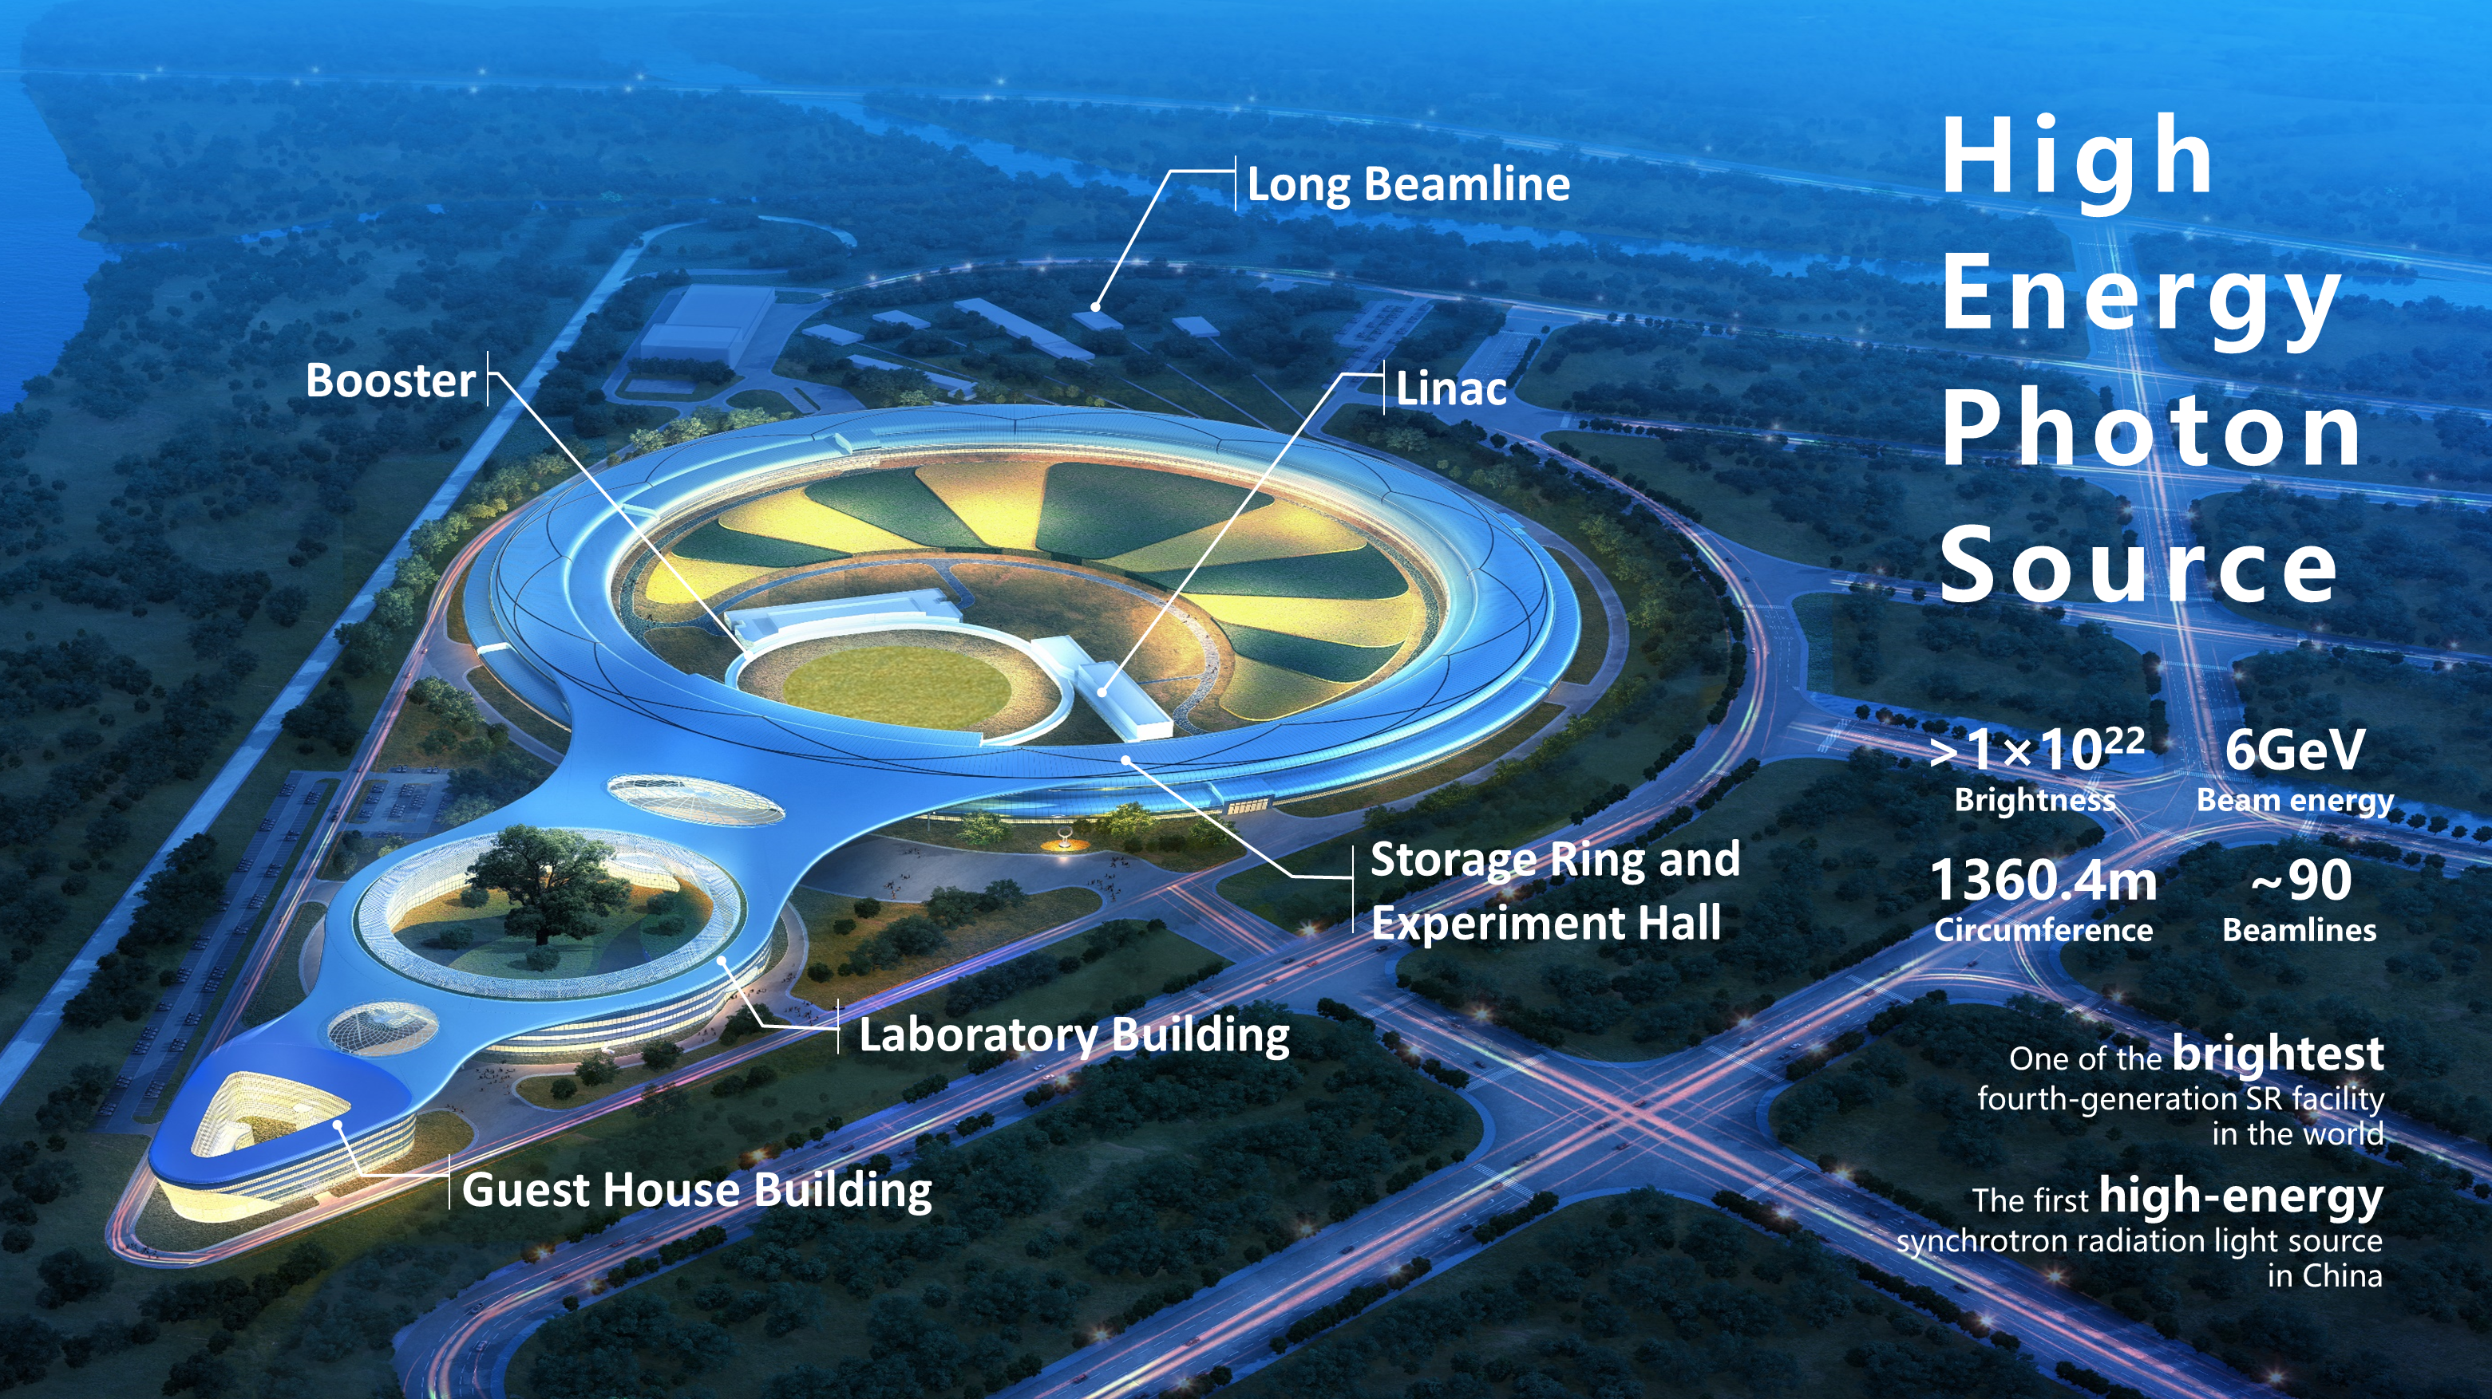

1. Background: High Energy Photon Source (HEPS)
Huairou, Beijing
The beam energy is 6 GeV
The brightness is more than 1×10²² phs/s/mm²/mrad²/0.1% BW
The horizontal emittance of the electron beam becomes better than 60 pm·rad
More than 90 high-performance beamlines and stations can be constructed
Provide highly brilliant and highly coherent X-rays with photon energy up to 300 keV

Slide 5
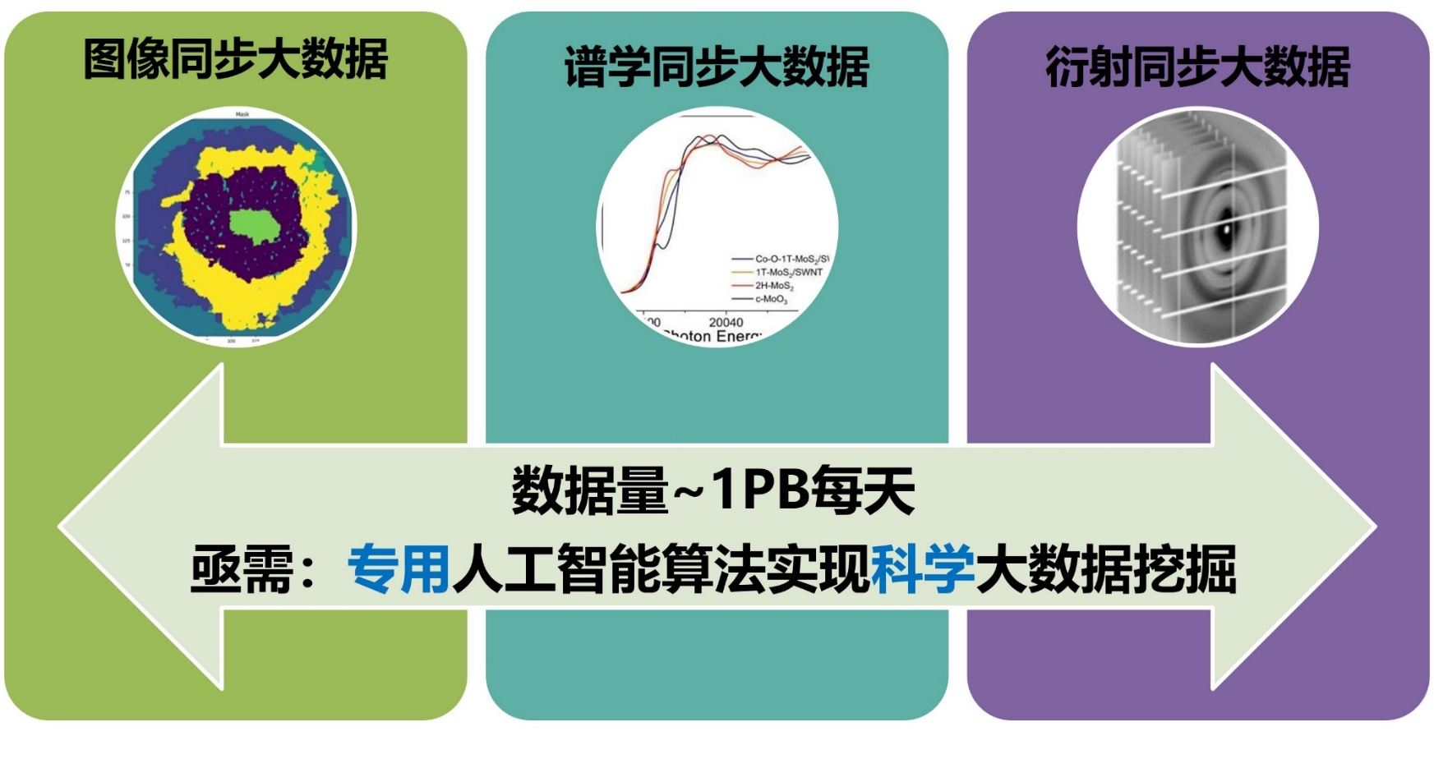
2. Multimodal Data Analysis Demand
    Urgent demand for the application of 4th generation synchrotron source including HEPS
Image
Big Data
Spectroscopy
Big Data
Diffraction
Big Data
Data volume ~ 3 PB/day
Urgent need: dedicated artificial intelligence algorithms to achieve scientific big data mining
Notes:
So we performed AI aided data analysis corresponding to these multimodal experimental data.

Slide 6

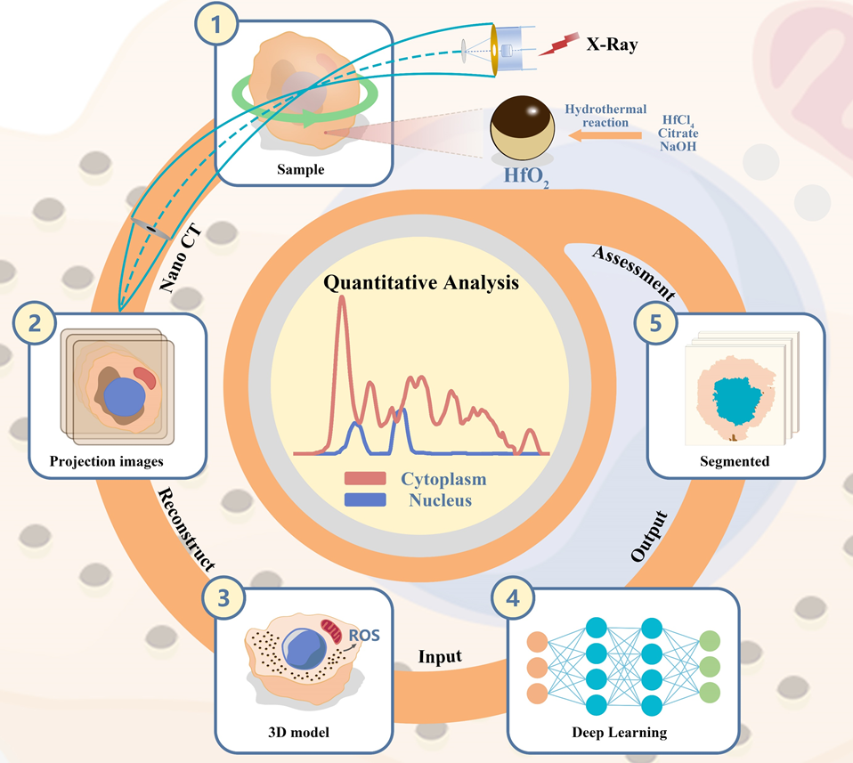
2.1 Image Data Analysis by AI Aiding
    Image
Quantitative three-dimensional imaging analysis of HfO₂ NPs in single cells via deep learning aided Nano-CT
https://github.com/LinaZhaoAIGroup/Nano-CT

Slide 7
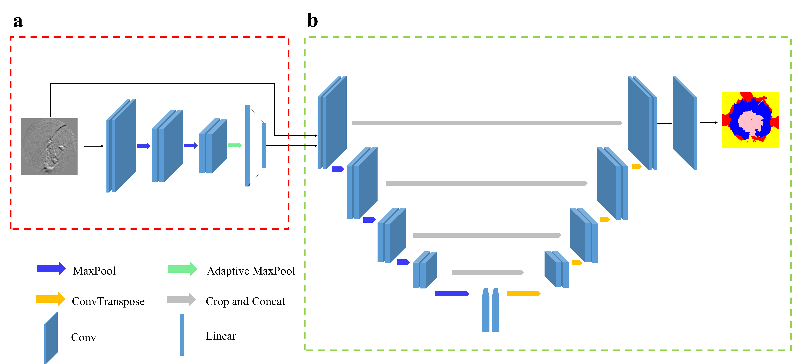
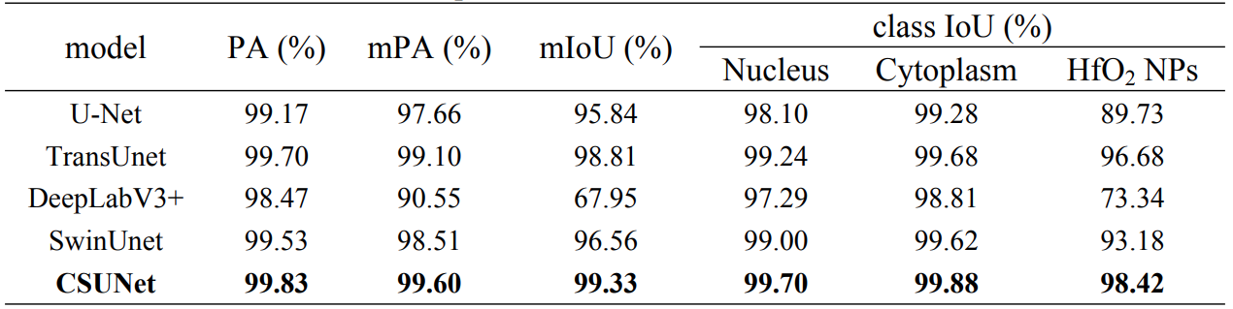
2.1 Image Data Analysis by AI Aiding
    Image
Quantitative three-dimensional imaging analysis of HfO₂ NPs in single cells via deep learning aided Nano-CT
Training dataset: 284 images (>300 pixels)
Comparison test results of different models
The comprehensive layout of the CSUNet network
    Zuoxin Xi, …, Lina Zhao*, ACS Nano 18, 22378, 2024.

Slide 8
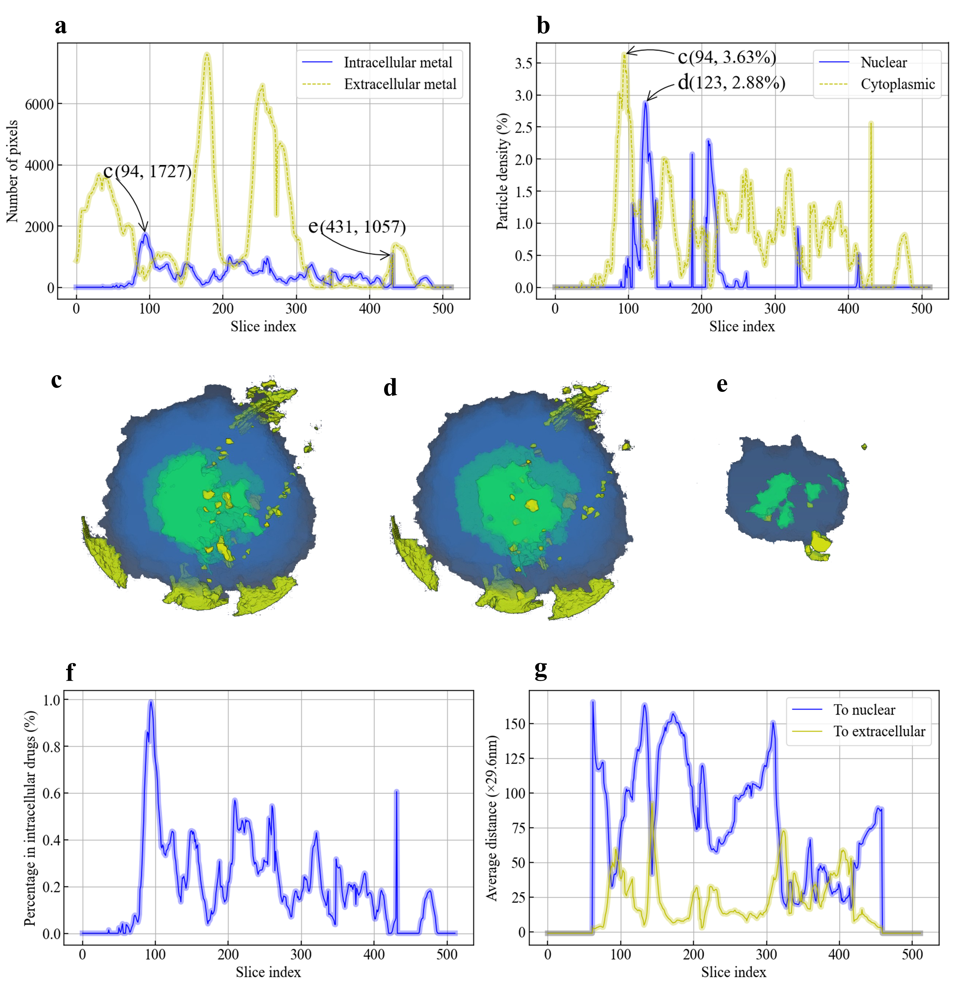
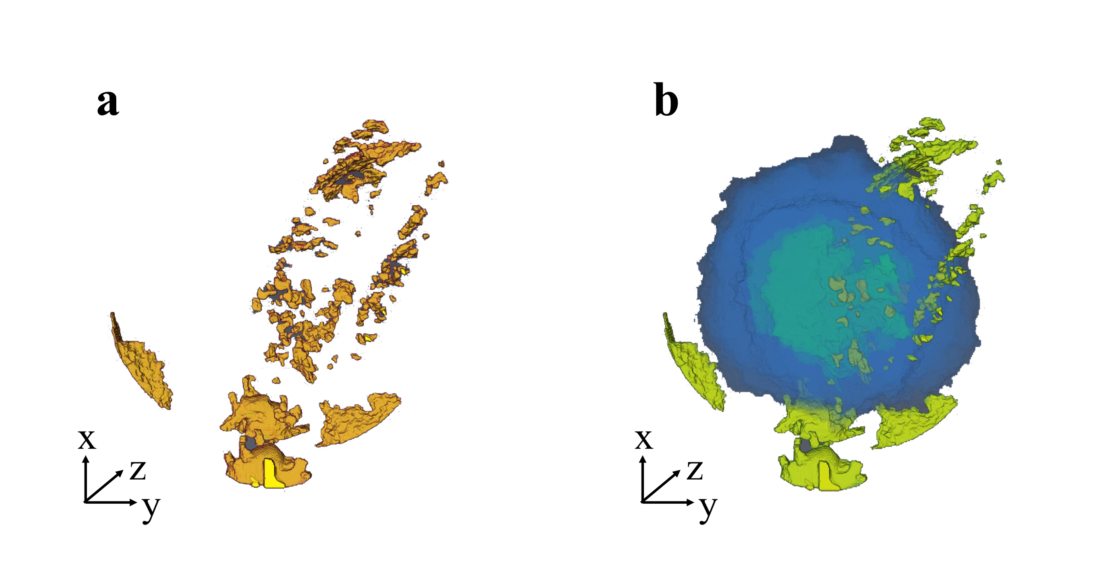
2.1 Image Data Analysis by AI Aiding
    Image
Quantitative three-dimensional imaging analysis of HfO₂ NPs in single cells via deep learning aided Nano-CT
Visualization of the 3D structure for MCF-7 cells and HfO₂ NPs.
  Quantitative analysis of metal NP uptake
  by cancer cells: basis for nanomedicine design
    Zuoxin Xi, …, Lina Zhao*, ACS Nano 18, 22378, 2024.
Notes:
More important, based on the spatial distribution construction, we proposed a precise quantitative method to compute the metallic dioxide distribution density.
The precise quantitative method is crucial for nanomedicine design.
AI aided data analysis here makes this helpful technique possible.
In this way, we yield deep insights into the efficacy and safety of HfO2 NPs in tumor treatment by building up a precise quantitative understanding of their distribution within single tumor cell.

Slide 9
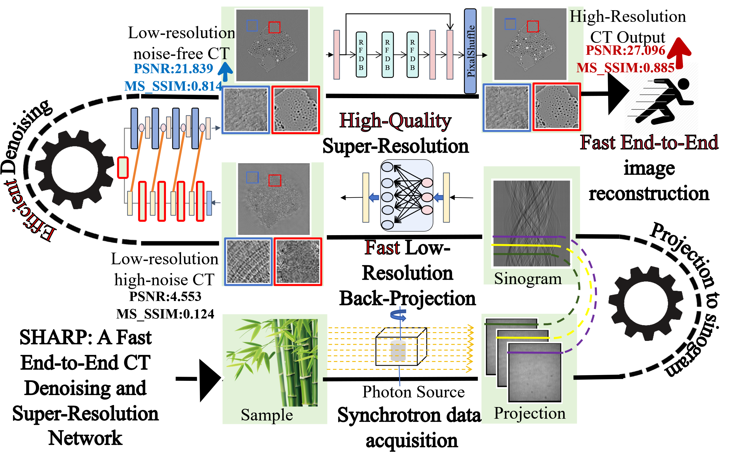

2.2 SHARP: Fast, High-quality Synchrotron CT Reconstruction
Research Background
  SRCT offers µm-level, non-destructive 3D imaging.
  High-pixel data (TB-scale) makes reconstruction bottleneck—fast, accurate algorithms are critical.
SHARP：
Super High-Resolution Artifacts Removal
and Back-Projection
What’s New
  Unified end-to-end pipeline that maps sinograms directly to tomograms.
  Low-res latent reconstruction plus super-res upscaling slashes compute and artifacts.
    Under Review
Notes:
同步辐射X光源提供高亮度、高相干性X光，可实现高分辨率的结构成像，投影分辨率可达微米级。
传统CT重建方法的问题：常用算法如滤波反投影（FBP）和代数重建（SART）在高分辨率大视场、大规模数据下效率低下。处理高像素数的投影数据需要大量计算资源和长时间重建。此外，传统重建易出现噪声和环状伪影，影响图像质量。
需求： 为满足高像素同步辐射CT的快速高精度成像需求，需要提高重建速度、抑制噪声伪影，从而提出端到端深度学习模型 SHARP 来解决这一问题。
Synchrotron X-ray sources deliver high-brightness, highly coherent beams, enabling micro-scale-resolution structural imaging.
Limitations of traditional CT reconstruction: Standard algorithms such as filtered back-projection (FBP) and algebraic reconstruction (SART) become inefficient on high-resolution, large-field datasets; high-pixel projections demand extensive compute time and resources, and the results often suffer from noise and ring artifacts.
Need & motivation: To obtain fast, high-fidelity reconstructions from high-pixel synchrotron CT data, we must accelerate processing and suppress artifacts—hence the development of the end-to-end deep-learning model SHARP.

Slide 10
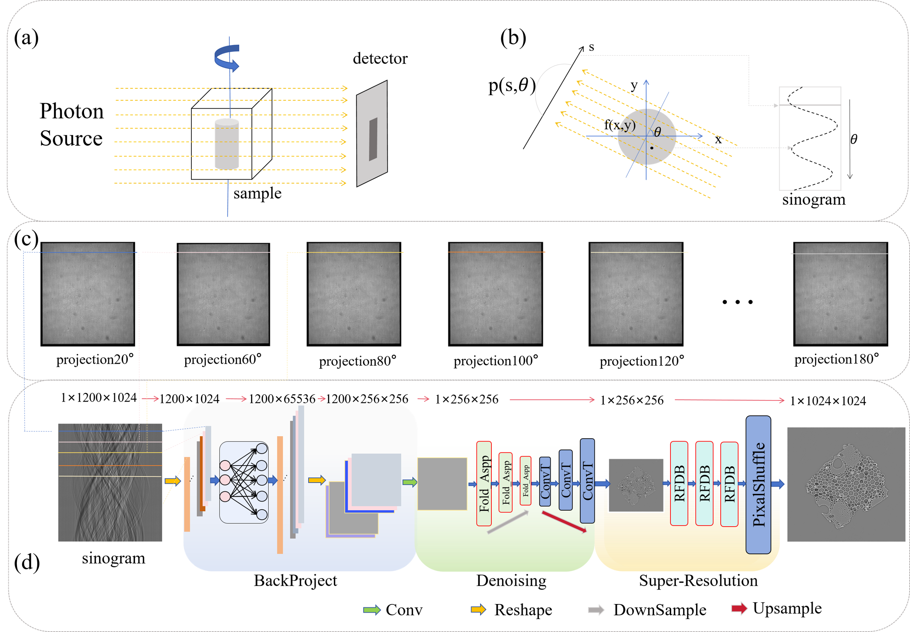
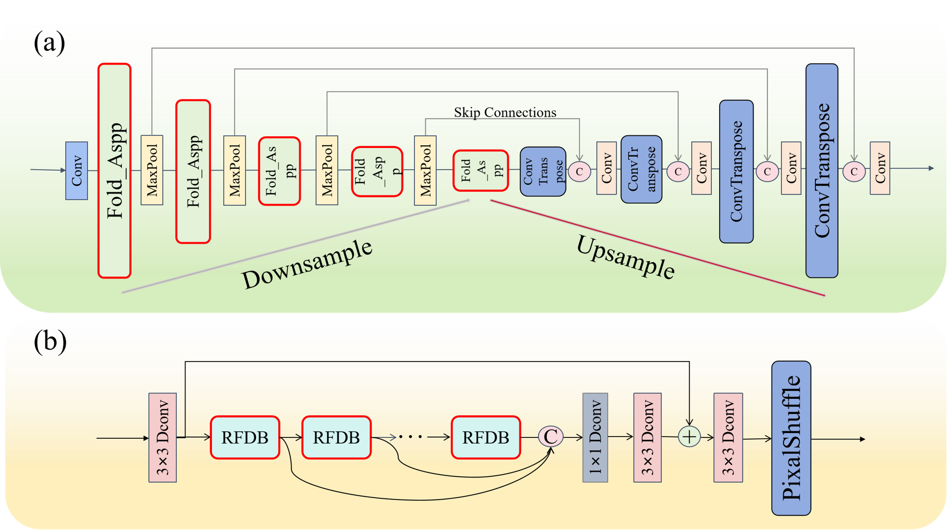
2.2 SHARP: Fast, High-quality Synchrotron CT Reconstruction
Three-Stage End-to-End Pipeline
  FC Back-Projection: maps raw sinograms to a low-res latent image, slashing parameters while keeping structure.
  U-Net Denoiser: multi-scale encoder-decoder removes noise & ring artifacts.
  RFDN Super-Resolution: residual feature distillation upsamples to full resolution with fine detail.
Why It’s Different
  Consolidates the traditional pipeline into a single end-to-end network.
  Performs reconstruction in a low-resolution latent space, then restores full detail via super-resolution—achieving high throughput while effectively suppressing artifacts.
Notes:
SHARP网络架构： 包含三大模块：全连接反投影模块、U-Net去噪模块、超分辨率重建模块。首先通过全连接层实现低分辨率反投影，将原始正弦投影数据高效映射到低维潜在空间，保留结构信息同时大幅降低计算量。接着引入基于U-Net的深度去噪模块，融合多尺度特征去除噪声和伪影。最后采用残差特征蒸馏网络的超分辨率模块对低分辨率重建进行放大复原，重建出清晰的高分辨率CT图像。
创新：将传统“反投影-滤波-去噪”过程压缩进神经网络的端到端流程，以低分辨率重建 + 深度去噪 + 超分辨率的级联策略实现高效高质重建。它直接学习从投影到图像的映射；针对高像素数据设计，在高分辨率下表现出色。这一架构有效抑制伪影和噪声干扰，并显著提升重建效率。
SHARP network architecture: Comprises three primary modules: a fully connected back-projection module, a U-Net denoising module, and a super-resolution reconstruction module. First, the fully connected layer performs low-resolution back-projection, efficiently mapping raw sinogram data into a low-dimensional latent space, preserving structural information while greatly reducing computation. Next, a U-Net–based deep denoising module integrates multi-scale features to remove noise and artifacts. Finally, a residual feature distillation network super-resolution module enlarges and restores the low-resolution reconstruction, outputting a clear high-resolution CT image.
Innovation: Compresses the traditional “back-projection–filtering–denoising” workflow into an end-to-end neural network, achieving efficient, high-quality reconstruction through the cascade of low-resolution reconstruction + deep denoising + super-resolution. It learns the mapping from projections to images directly; tailored for high-pixel data, it excels at high resolution. This architecture effectively suppresses artifacts and noise and markedly boosts reconstruction efficiency.

Slide 11
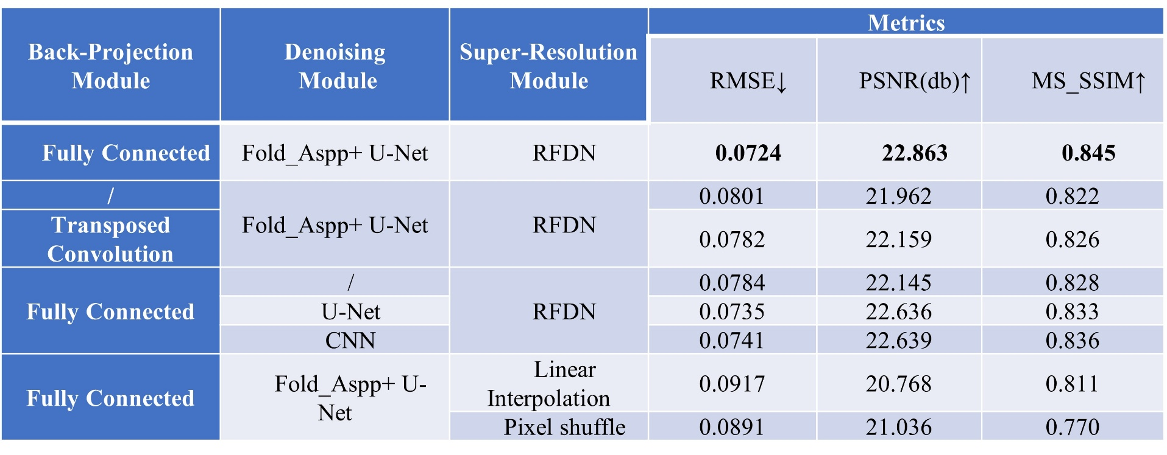
2.2 SHARP: Fast, High-quality Synchrotron CT Reconstruction
How We Tested (Ablation Experiments)
  Sequentially disabled one of the three modules while keeping the others fixed.
  Compared image quality and visual artifacts to the full SHARP network.
Take-aways
  FC Back-Projection delivers ~2 % MS-SSIM gain over transposed convolution, improving structural fidelity.
  Fold-ASPP U-Net Denoiser is essential for removing rings/noise, adding ~0.7 dB PSNR.
  RFDN Super-Resolution restores fine detail; simpler upsampling drops PSNR by >2 dB.
Notes:
SHARP的模块消融实验结果。
方法：固定其中两个模块，仅禁用或替换剩下的一个，比较指标和视觉效果。
完整模型（全连接反投影 + Fold-ASPP U-Net + RFDN）取得 RMSE 0.0724、PSNR 22.86 dB、MS-SSIM 0.845。
去掉或替换模块的影响：
用反卷积替代全连接，MS-SSIM 降约 2 %，结构保真度下降。
去掉去噪模块，PSNR 下降 0.7 dB，环伪影和噪声重新出现。
改用普通上采样（线性插值或 Pixel-shuffle），PSNR 至少下降 1.8 dB，细节明显模糊。
结论：三大模块协同工作才能兼顾速度、噪声抑制和分辨率；任何简化都会明显损伤重建质量，验证了我们架构设计的必要性。
Results of the SHARP module-ablation experiment.
Method: Two modules are kept fixed while the remaining one is disabled or replaced; metrics and visual effects are then compared.
Complete model (fully connected back-projection + Fold-ASPP U-Net + RFDN) achieves RMSE 0.0724, PSNR 22.86 dB, and MS-SSIM 0.845.
Impact of removing or replacing modules:
Replacing the fully connected layer with transposed convolution lowers MS-SSIM by about 2 %, reducing structural fidelity.
Removing the denoising module drops PSNR by 0.7 dB; ring artifacts and noise reappear.
Using standard upsampling (linear interpolation or pixel shuffle) instead lowers PSNR by at least 1.8 dB and noticeably blurs details.
Conclusion: The three modules must work together to balance speed, noise suppression, and resolution; any simplification significantly harms reconstruction quality, confirming the necessity of our architecture.

Slide 12
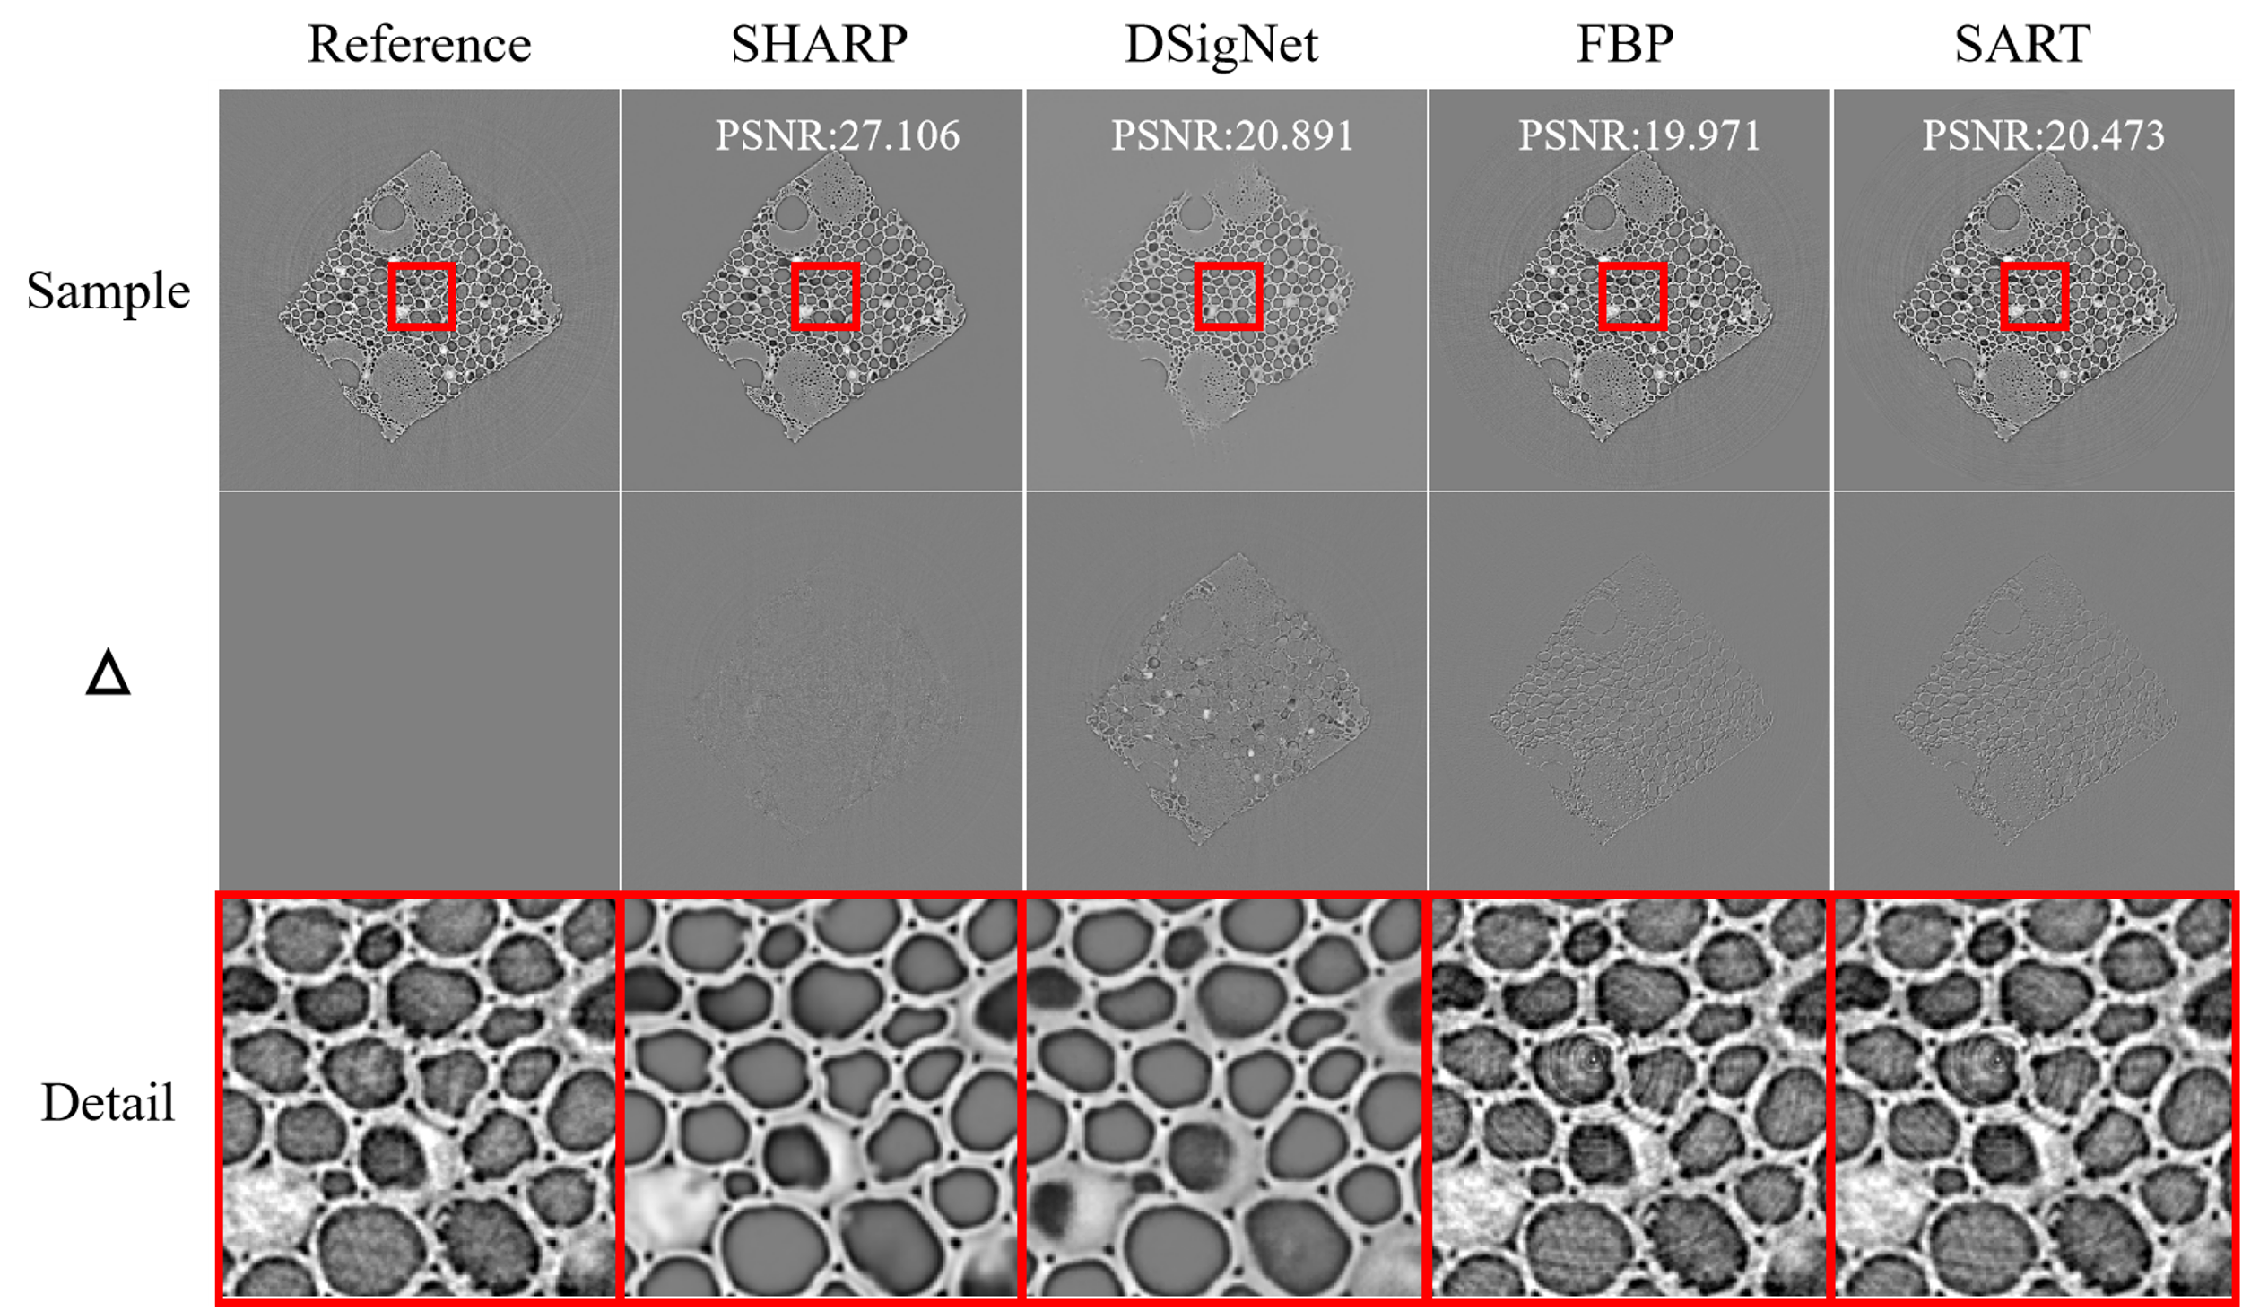
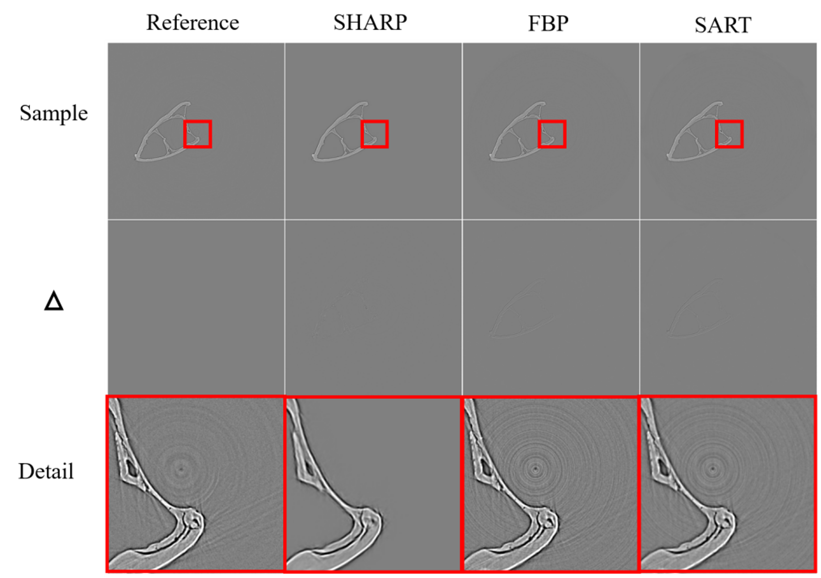
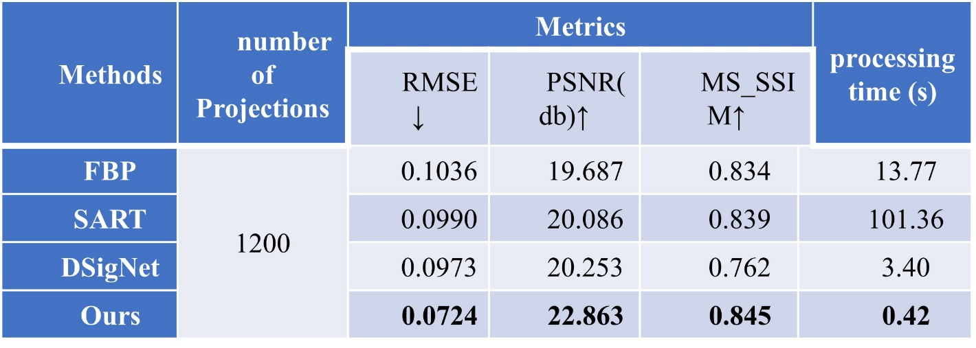
2.2 SHARP: Fast, High-quality Synchrotron CT Reconstruction
Experimental Results
Take-aways
  Highest fidelity: best PSNR & MS-SSIM, virtually no artifacts.
  Fastest reconstruction: ~30 × faster than FBP—providing rapid feedback during experiments.
  Robust across specimens: consistent improvements on highly different biological samples.
Notes:
在竹子截面和螳螂虾钳等同步辐射CT数据上验证SHARP性能。
展示不同方法的同一横截面重建结果（参考真值、SHARP、DSigNet、FBP、SART）：传统FBP和SART重建图像中出现明显的环状伪影和噪声；深度学习方法DSigNet虽减少了一部分伪影，但重建结构不完整，局部对比度和亮度偏低；相比之下，SHARP重建图像与参考接近，几乎无伪影噪声，细节清晰。
定量指标与速度：列出了各方法在竹子数据中相同投影数（1200个角度）下的性能指标：SHARP的RMSE最低 (例如竹子数据集RMSE≈0.0724)，PSNR最高 (22.86 dB)，MS-SSIM最高 (0.845)。同时，SHARP重建速度快于传统算法：单张重建耗时约0.42秒，仅为FBP的1/30。
结论：SHARP在重建图像质量和效率上均优于FBP、SART等传统算法和已有深度模型DSigNet。实现了高像素同步辐射CT数据的精准重建，输出图像几乎无噪声伪影，细节清楚；以端到端方式大幅降低重建时间。
Validation of SHARP was performed on synchrotron CT data of bamboo cross-sections and mantis-shrimp dactyls.
Reconstruction results of the same slice from different methods (ground truth, SHARP, DSigNet, FBP, SART) are shown: traditional FBP and SART images exhibit pronounced ring artifacts and noise; the deep-learning method DSigNet removes some artifacts but yields incomplete structures and low local contrast and brightness; in contrast, SHARP’s reconstruction is close to the reference, with almost no artifacts or noise and clear details.
Quantitative metrics and speed (bamboo, 1200 views): SHARP attains the lowest RMSE (≈0.0724), the highest PSNR (22.86 dB), and the highest MS-SSIM (0.845). SHARP is also faster than traditional algorithms, taking about 0.42 s per slice—only 1/30 of FBP.
Conclusion: SHARP outperforms FBP, SART, and the deep-learning model DSigNet in both reconstruction quality and efficiency. It achieves precise high-pixel synchrotron CT reconstruction with images that are virtually free of noise and artifacts and have clear details, while its end-to-end design greatly shortens reconstruction time.

Slide 13
2.3 Diffraction Data Analysis by AI Aiding
    Diffraction
Physical knowledge guided machine learning on diffraction data
Training dataset: more than 100,000 samples
Contribution: Achieve high precision (R²>0.91) and fast (~10⁴ times faster than existing fitting methods) analysis of experimental data, and be able to apply across light sources and beamlines, and lay the foundation for knowledge-driven machine learning analysis.
https://github.com/LinaZhaoAIGroup/nanofiber
Minghui Sun, …, Lina Zhao*, IUCrJ 10, 297, 2023.

Slide 14
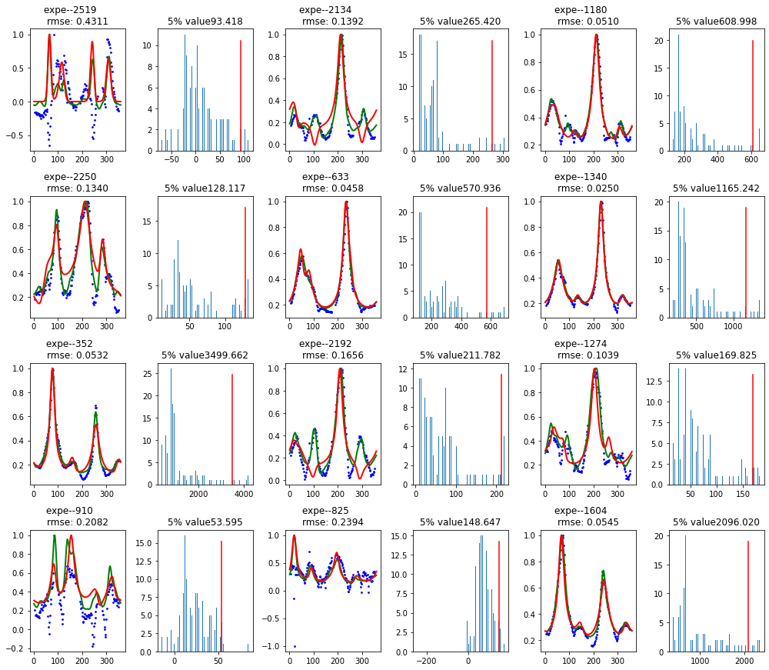
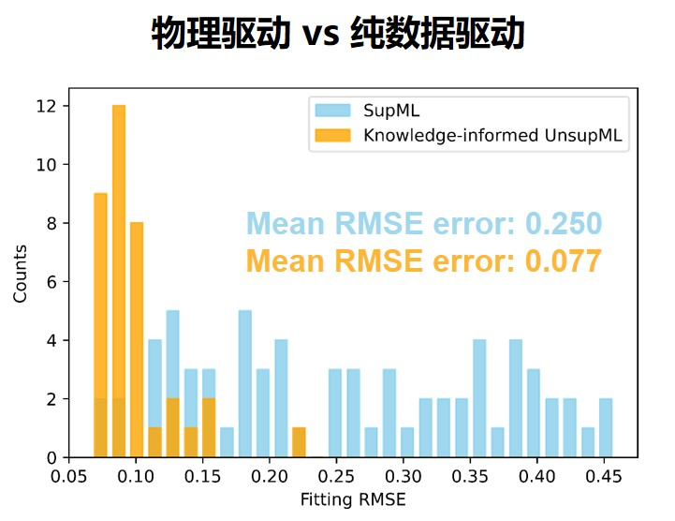
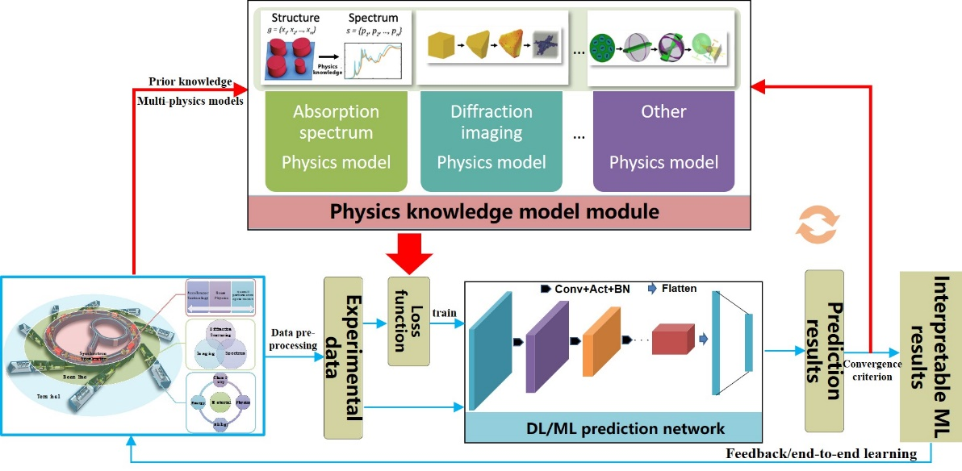
2.3 Diffraction Data Analysis by AI Aiding
    Diffraction
Physical knowledge guided machine learning on diffraction data
physics-driven vs data-driven
Contribution:
X-ray diffraction knowledge-driven ML method achieves high-precision, self-supervised, interpretable analysis
It makes online data analysis come true without tagging.
Qingmeng Li, …, Lina Zhao*, Manuscript 2025.

Slide 15
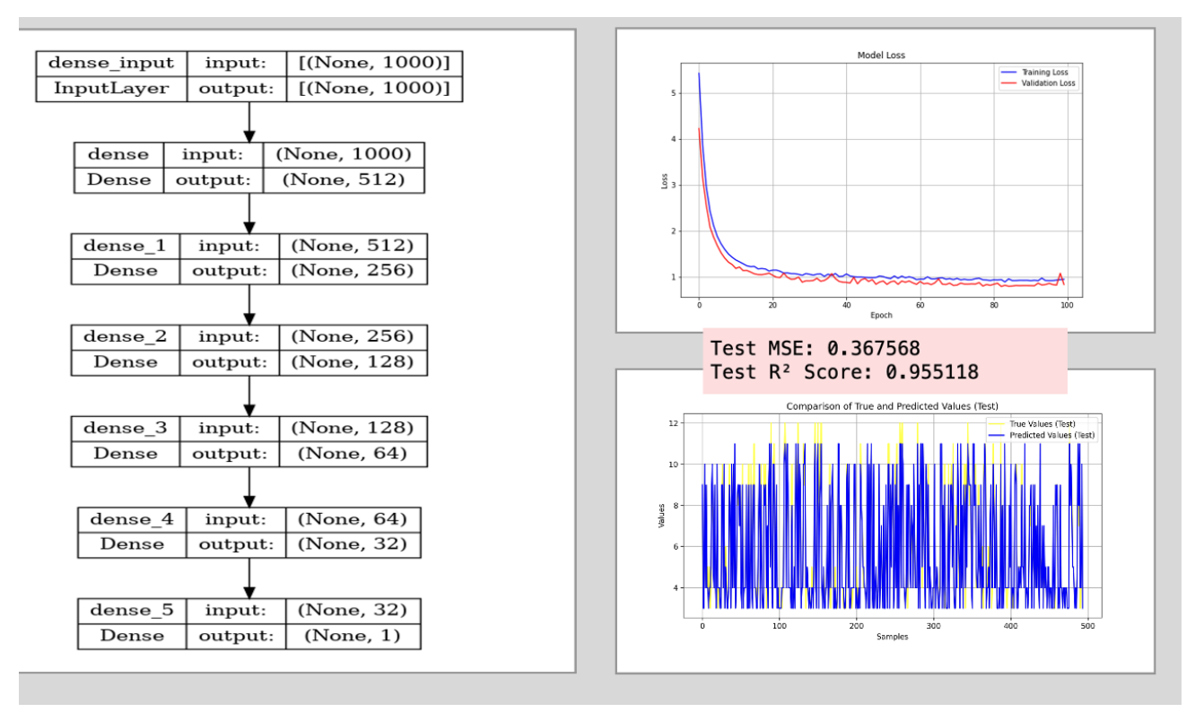
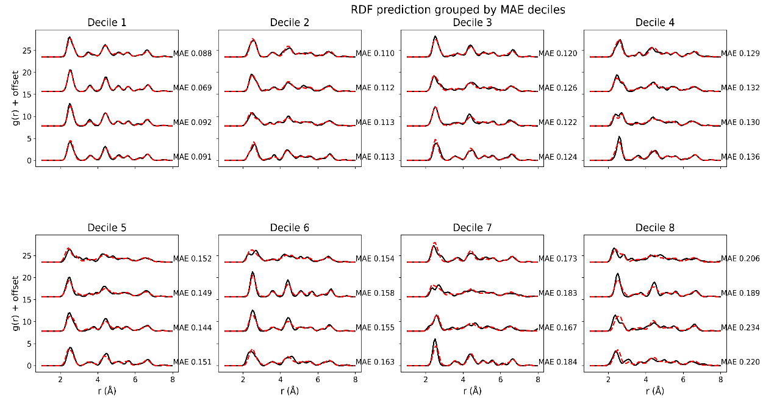
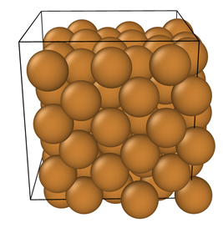

2.4 EXAFS Data Analysis by AI Aiding
Predict Cu structural parameters from X-ray absorption spectra (CN, CR, RDF)
  Dataset construction: 5,000 Cu configurations generated via MD; FEFF spectra computed (μ(E)).
  Preprocessing: ΔE₀ / energy-axis alignment, normalization; threshold-based filtering.
  Supervised learning: MLP predicts CN (test R² ≈ 0.95, MSE ≈ 0.37); RF regresses RDF (MAE ≈ 0.134).
  Transfer to experiment: First-shell CN = 12 predicted for Cu foil, demonstrating pipeline transferability.
Prediction of the first-shell CN in the Cu system using the MLP model, illustrating prediction accuracy and error metrics on the Cu dataset.
Performance of the random-forest model on the test set, ranked by RDF MAE and split into deciles; four samples per decile are shown.
J. Synchrotron Radiat., 32, 5, 2025.

Slide 16
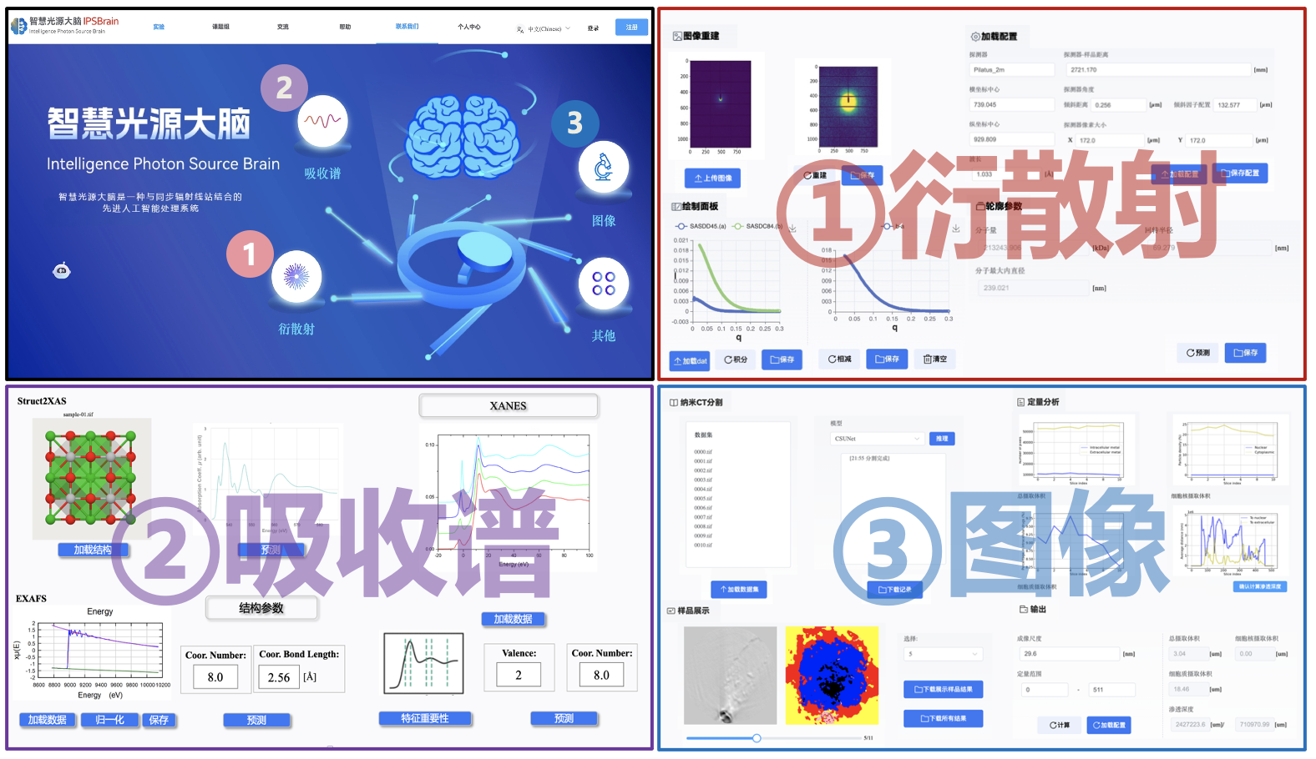
3. Deployment of AI Aided Data Analysis
Intelligence Photon Brain (IPSBrain)
Notes:
Then, we can support AI aided data analysis toolkit for facility users.
Intelligence photon source brain denoted as IPSBrain.
Here is a demo on the AI aided scattering data analysis.
users can upload their scattering data into the first module, a image deep learning network can do denoising.
Then, we can simplify the process from image data into strength curves.
The third module presents a size prediction from the strength curves by a machine learning model.
Also some helpful links from my group website for technique communications.

Slide 17
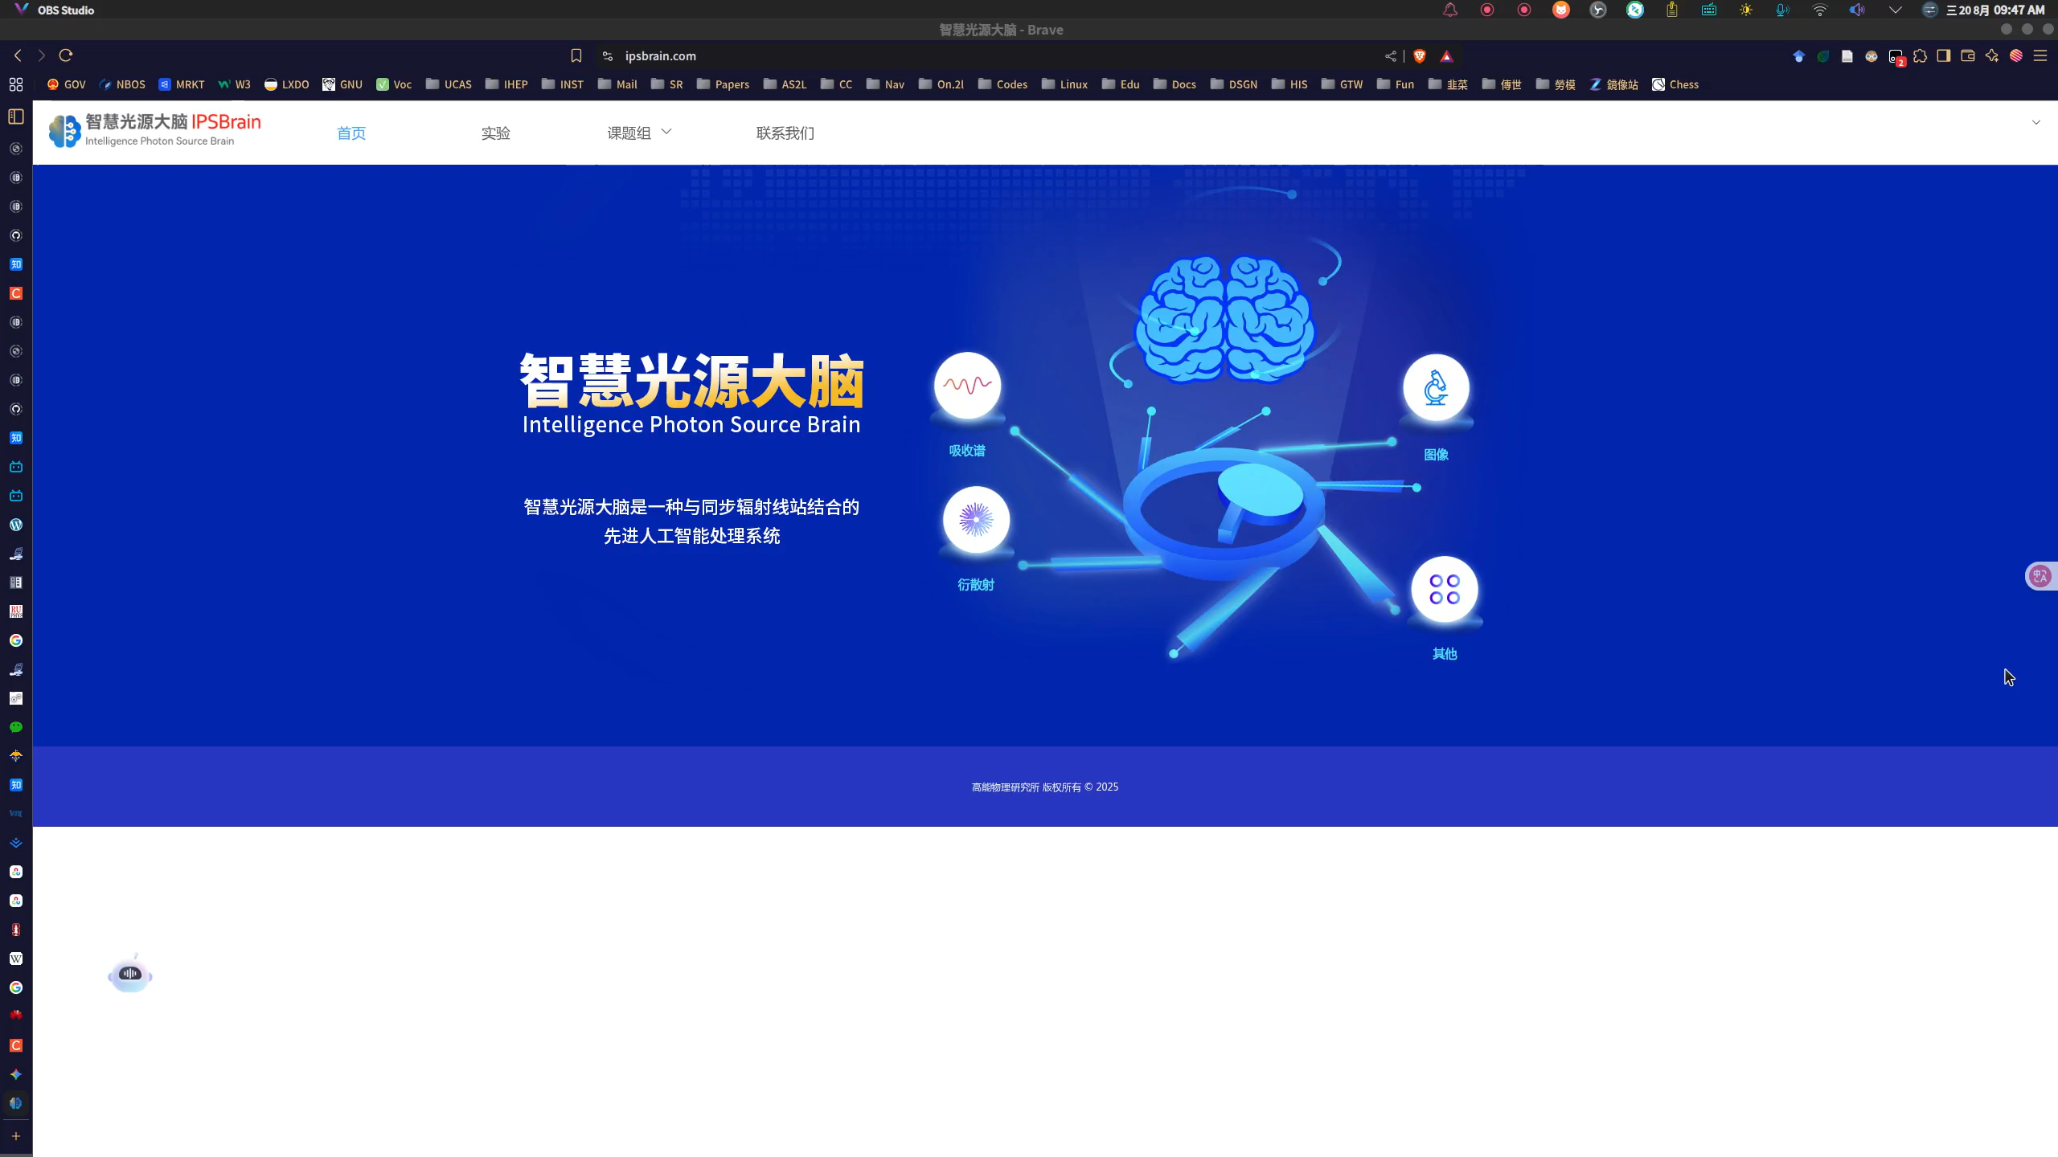
3. Deployment of AI Aided Data Analysis
IPSBrain: www.ipsbrain.com
Notes:
Then, we can support AI aided data analysis toolkit for facility users.
Intelligence photon source brain denoted as IPSBrain.
Here is a demo on the AI aided scattering data analysis.
users can upload their scattering data into the first module, a image deep learning network can do denoising.
Then, we can simplify the process from image data into strength curves.
The third module presents a size prediction from the strength curves by a machine learning model.
Also some helpful links from my group website for technique communications.

Slide 18

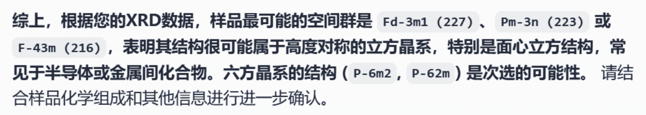
4. Deployment Based on Large Language Model
Notes:
Then, we can support AI aided data analysis toolkit for facility users.
Intelligence photon source brain denoted as IPSBrain.
Here is a demo on the AI aided scattering data analysis.
users can upload their scattering data into the first module, a image deep learning network can do denoising.
Then, we can simplify the process from image data into strength curves.
The third module presents a size prediction from the strength curves by a machine learning model.
Also some helpful links from my group website for technique communications.

Slide 19
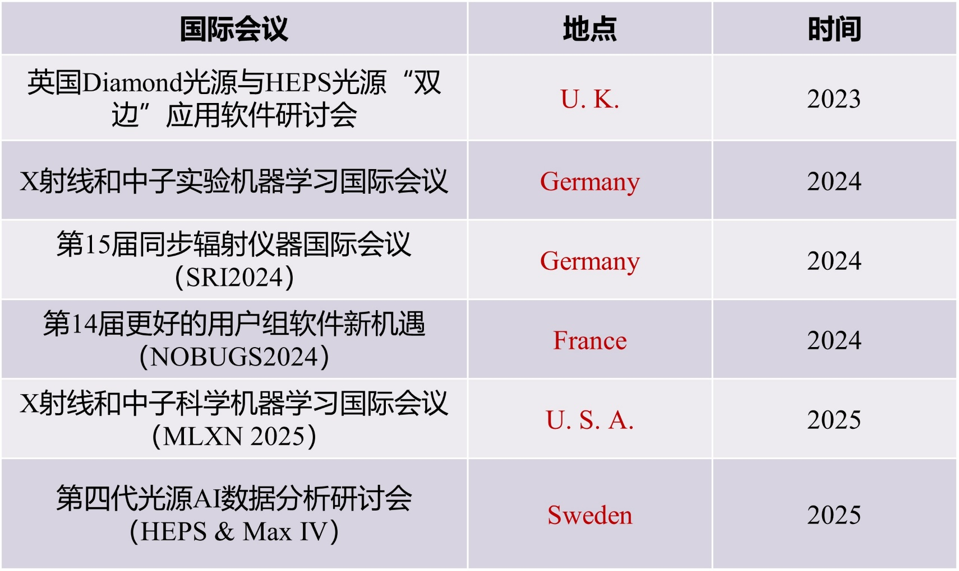

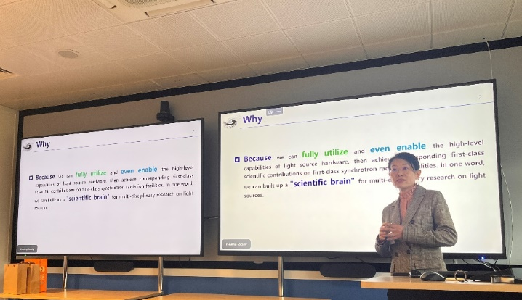
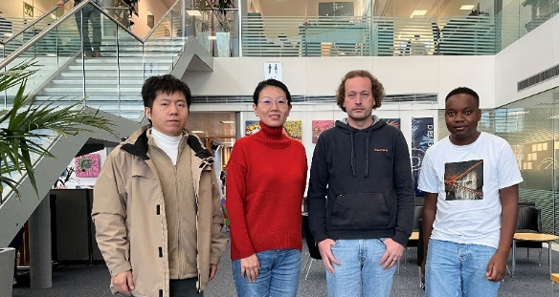
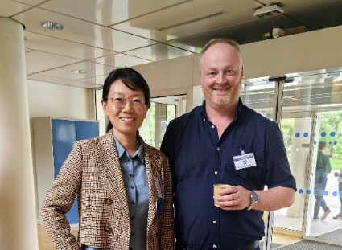
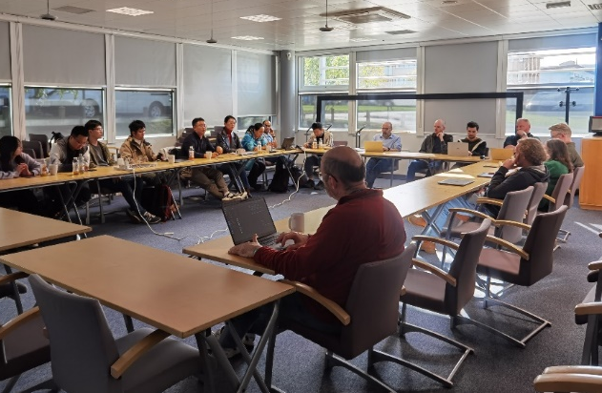
5. International Exchange
Dr. Andy Goetz
欧洲光源（ESRF）
软件及控制
系统负责人
第14届更好的用户组软件 新机遇的国际会议（NOBUGS2024），
领域顶会公开评述：
“走在前面，已进入国际同类
研究第一梯队。”
借鉴IPSBrain建设、推广IPSBrain应用
Notes:
Then, we can support AI aided data analysis toolkit for facility users.
Intelligence photon source brain denoted as IPSBrain.
Here is a demo on the AI aided scattering data analysis.
users can upload their scattering data into the first module, a image deep learning network can do denoising.
Then, we can simplify the process from image data into strength curves.
The third module presents a size prediction from the strength curves by a machine learning model.
Also some helpful links from my group website for technique communications.

Slide 20

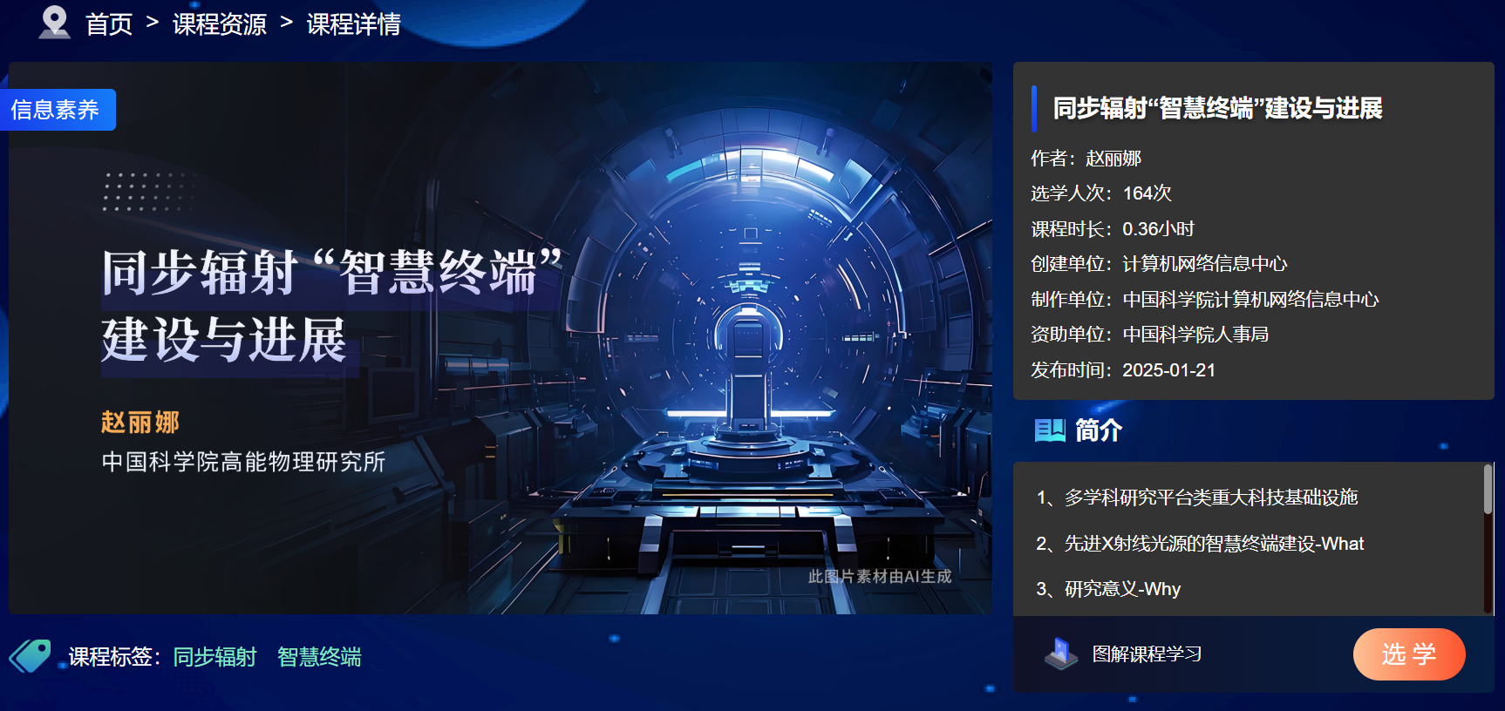
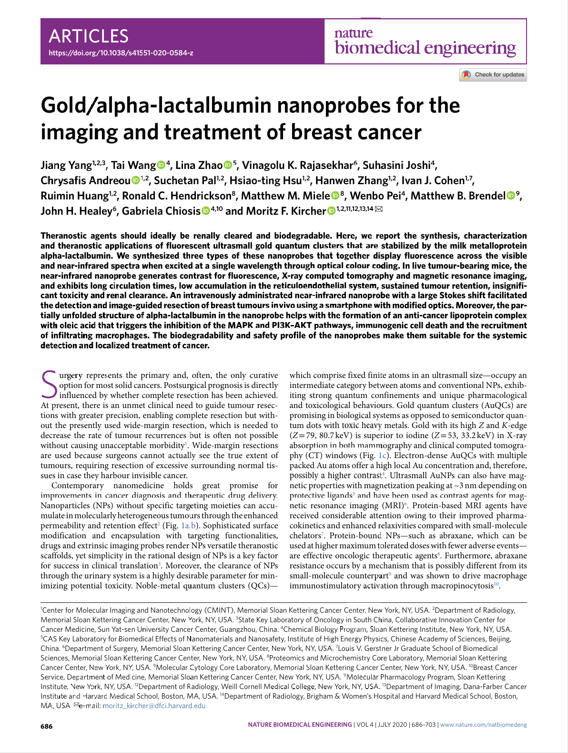
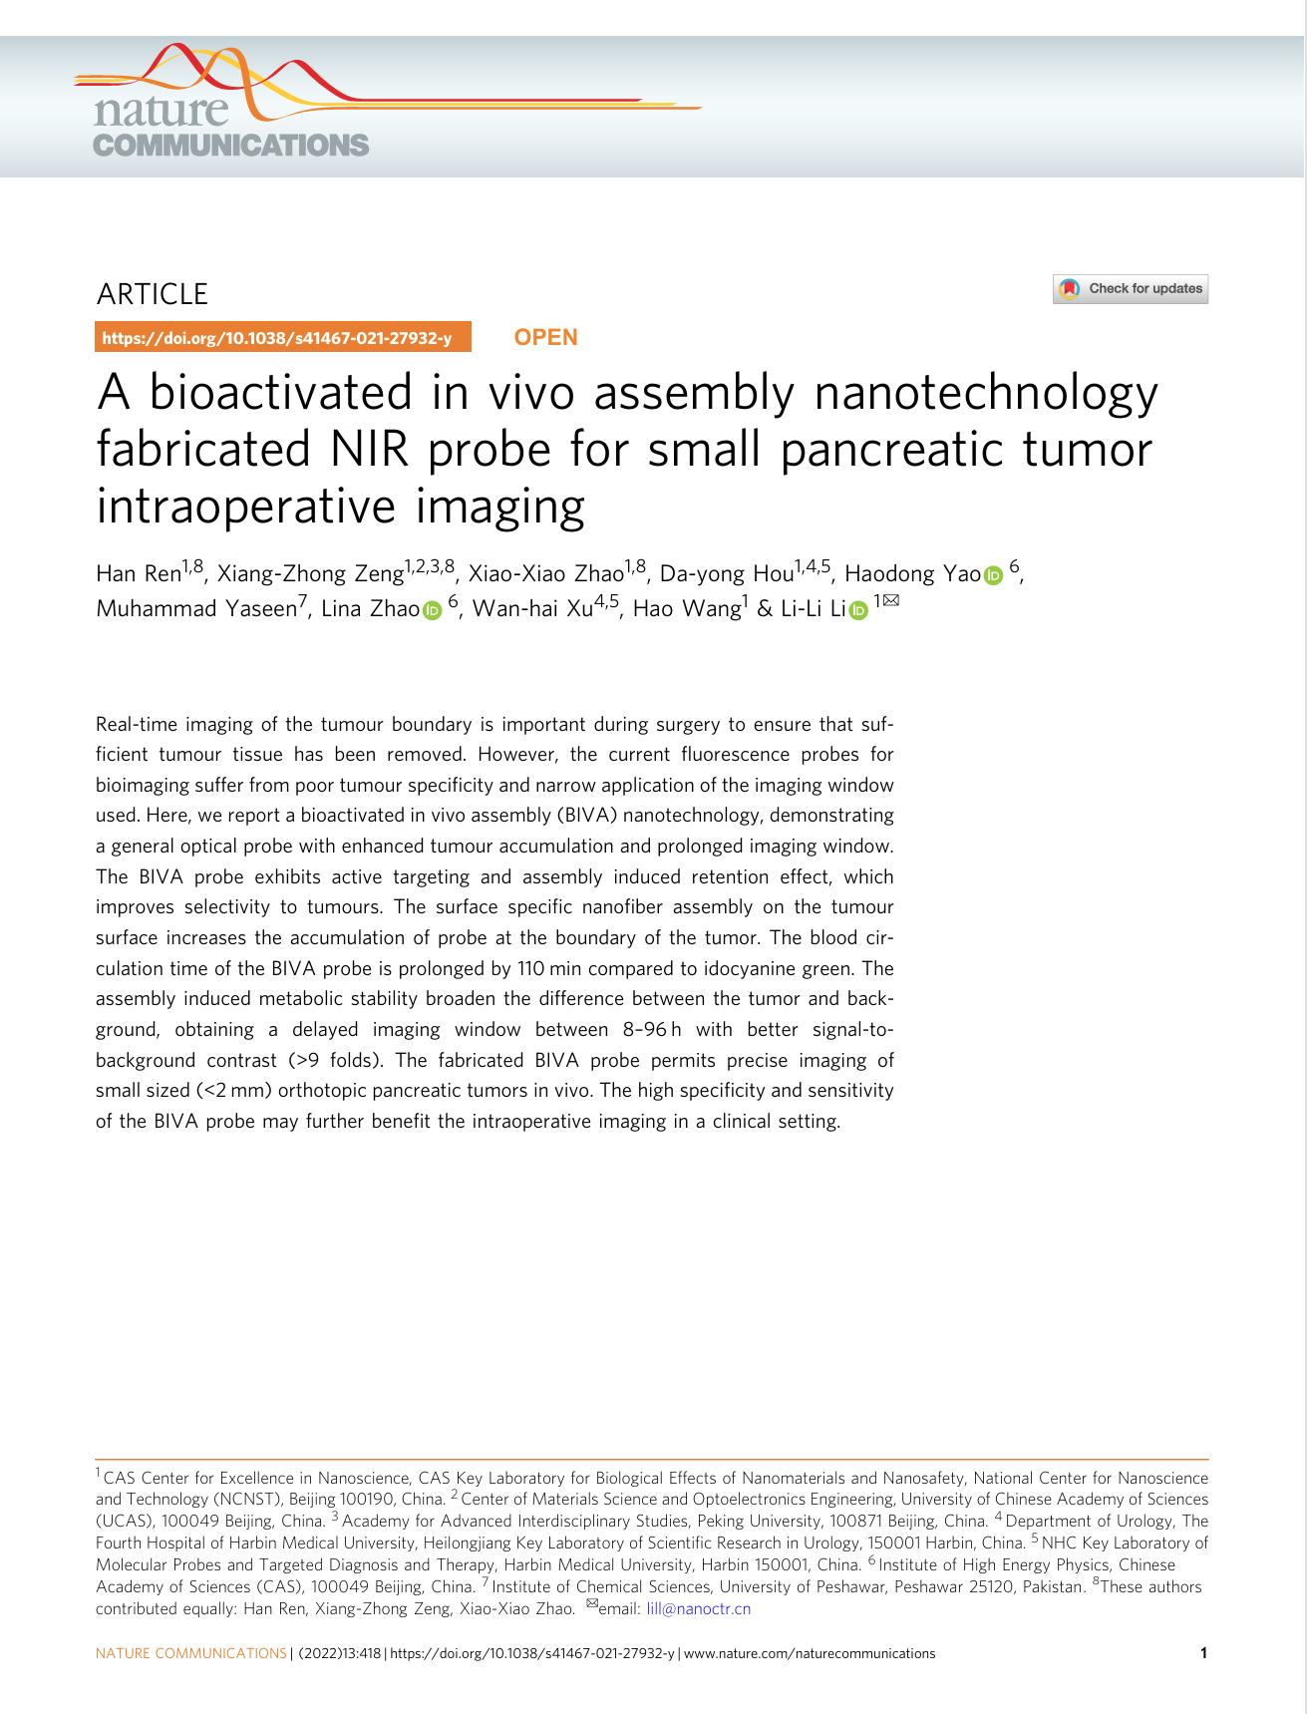
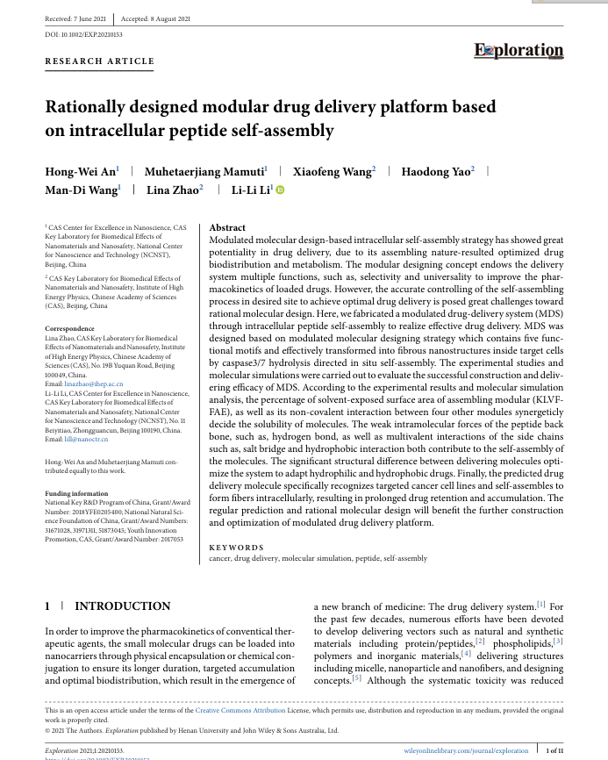
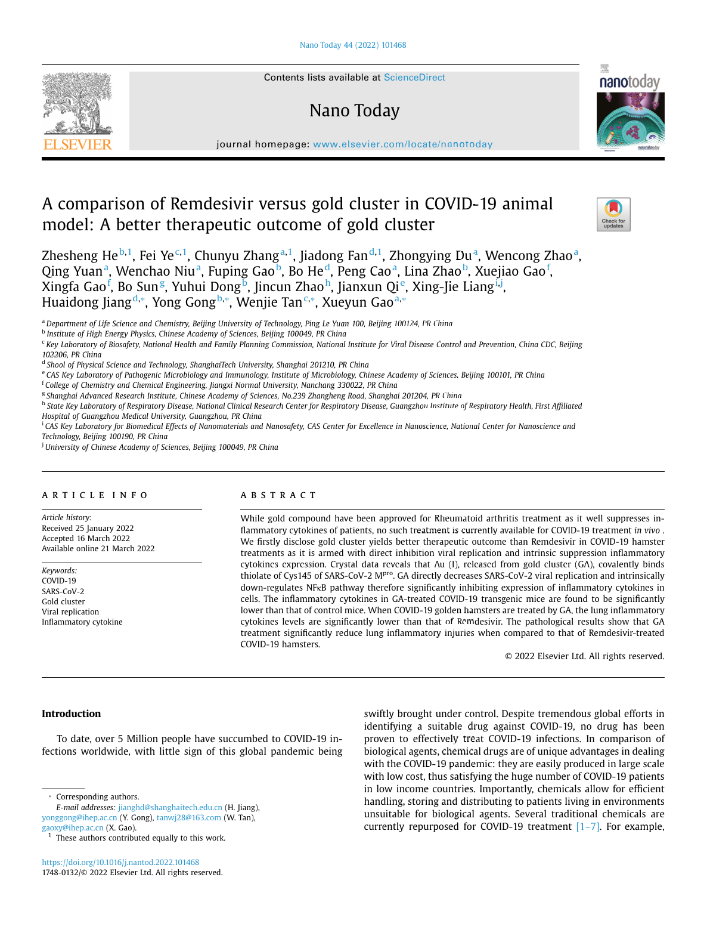
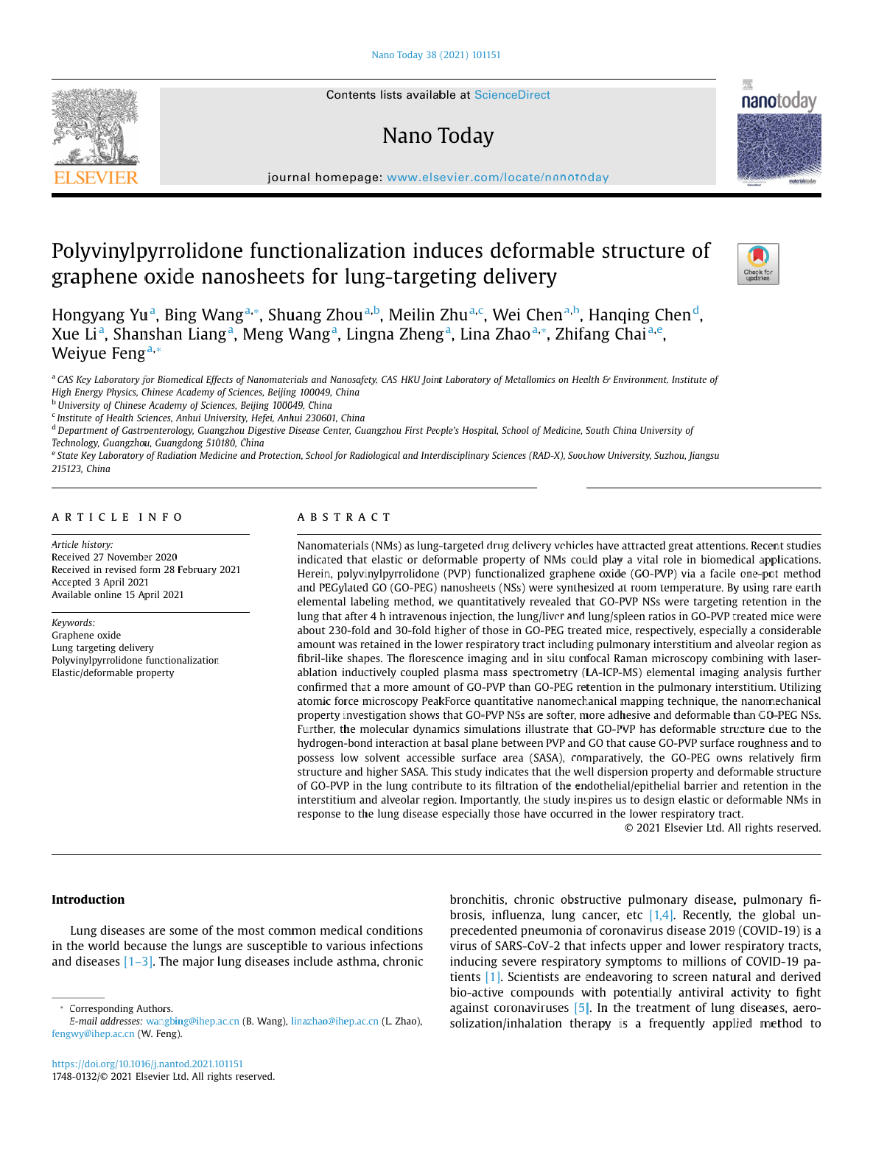
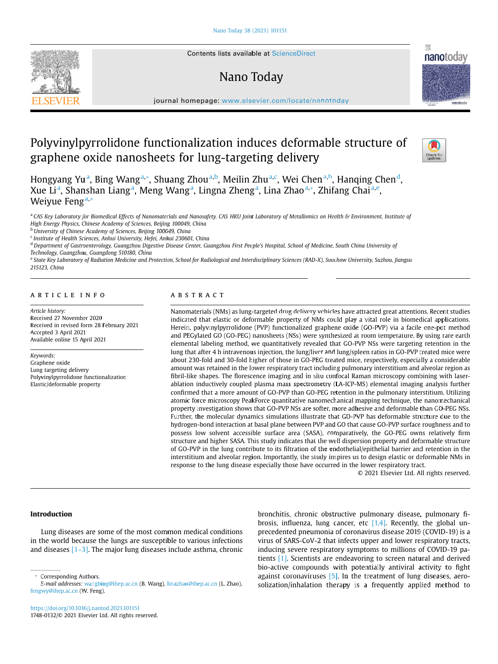
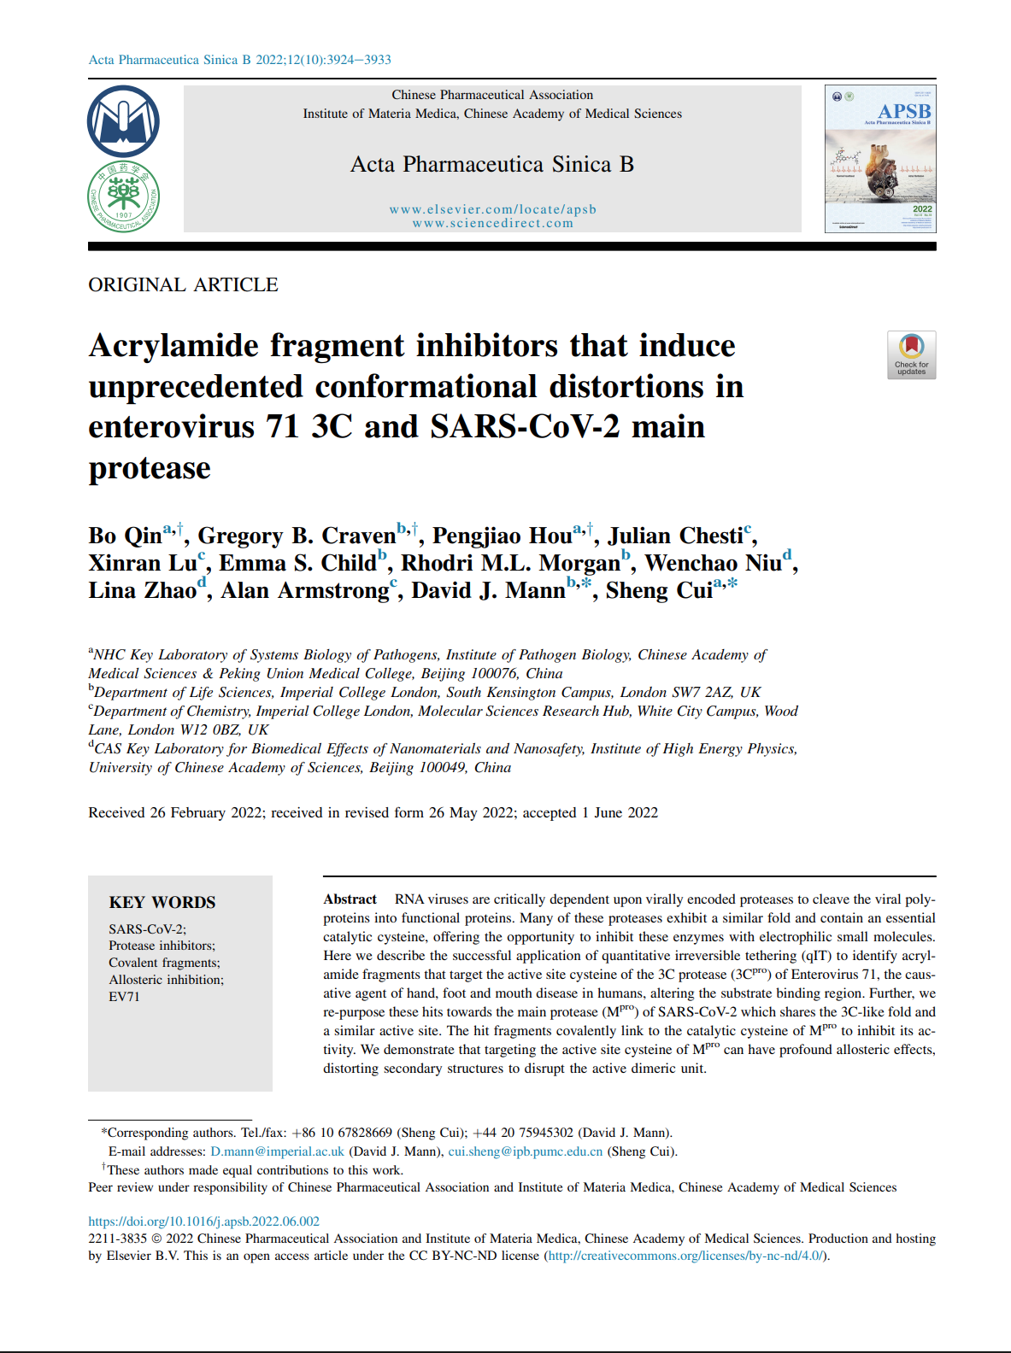
6. Promotion and Application
IPSBrain Promotion
Online Training 1000⁺ People
2024.8：Release
Face-to-face Training 200 ⁺ People
Supporting users’ research achievement
Nature Biomedical Engineering 2020, 4, 686
Nature Communications 2022, 13, 418
Exploration
2021, 1, 20210153
Nano Today
2022, 44, 101468
Nano Today
2021, 38, 101151
Nano Today
2021, 37, 101079
Acta Pharmaceutica Sinica B 2022, 12, 3924

Slide 21

7. Welcome to Join Us
IPSBrain Wechat Group
IPSBrain: www.ipsbrain.com

Slide 22
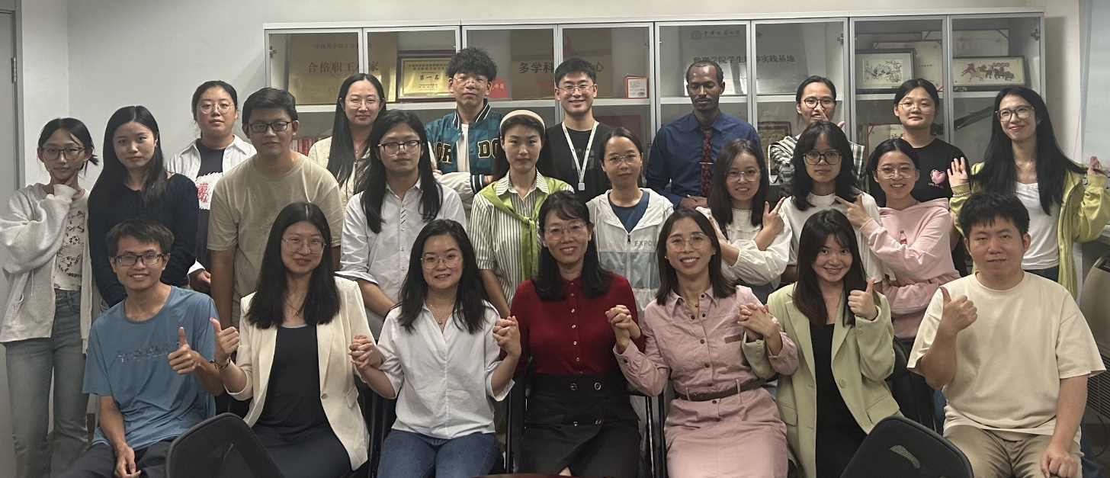
Thank you for your attention
Thank all collaborators for their support!
Thank all colleagues and students for their help!
Group website: www.zhaolinalab.com
My Email: linazhao@ihep.ac.cn

