Slide 1

Some recent progress on generating configurations in Lattice QCD: standard approach vs machine learning
---a biased report
Wei Wang
Shanghai Jiao Tong University
Notes:
各位老师，同学，大家下午好，我是来自上海交通大学的谭金鑫，很荣幸能来到这次重味高精度计算研讨会和各位同行进行交流。我的报告题目是Collins-Soper Kernel from Lattice QCD

Slide 2
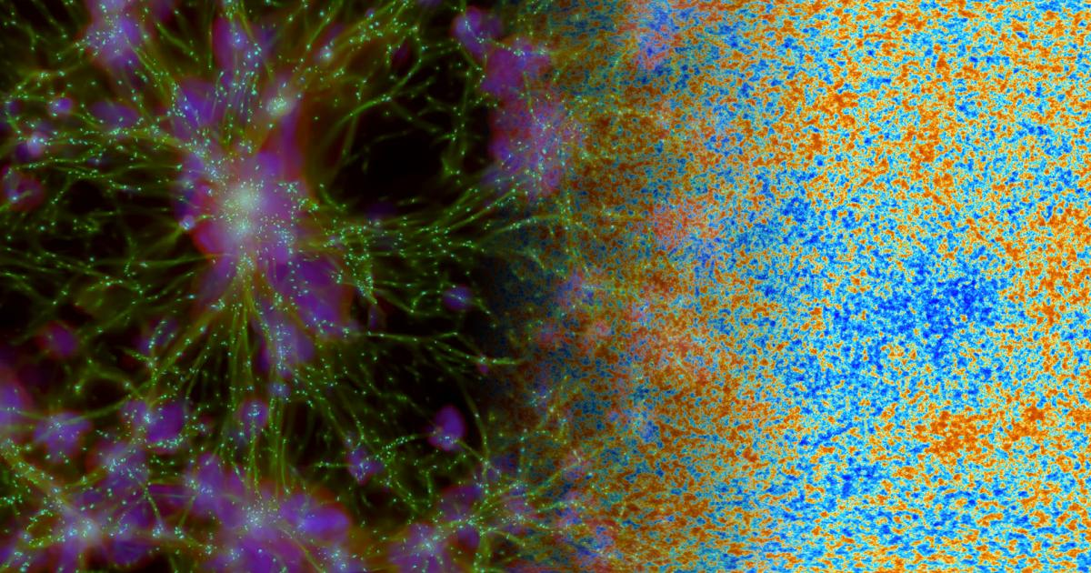
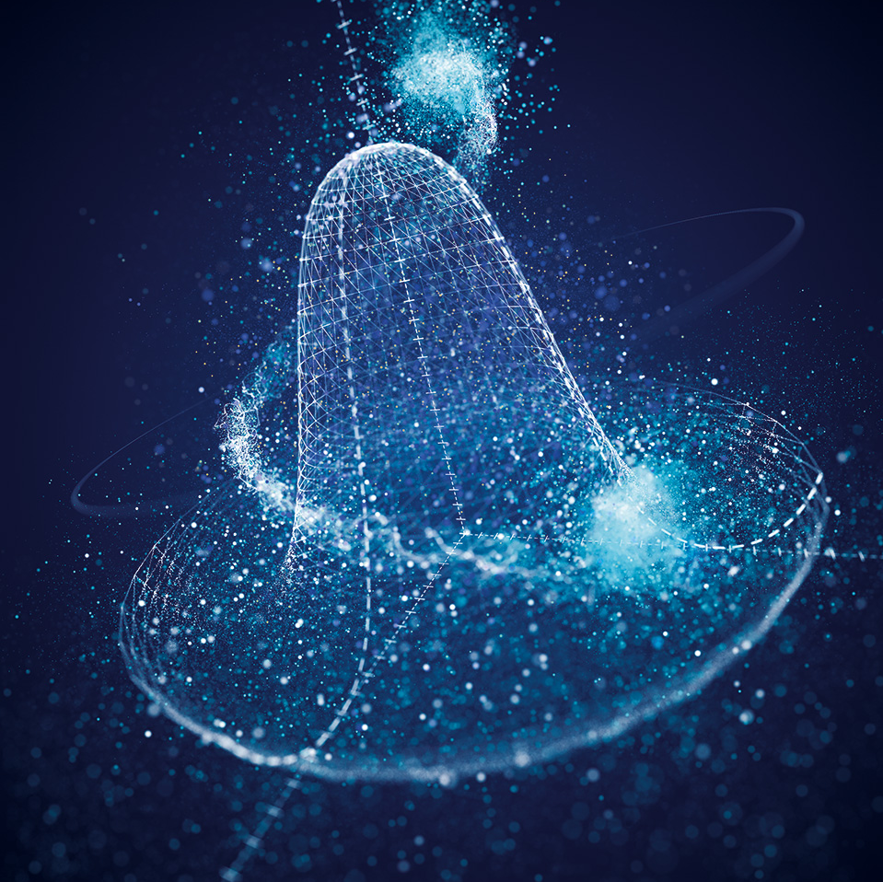
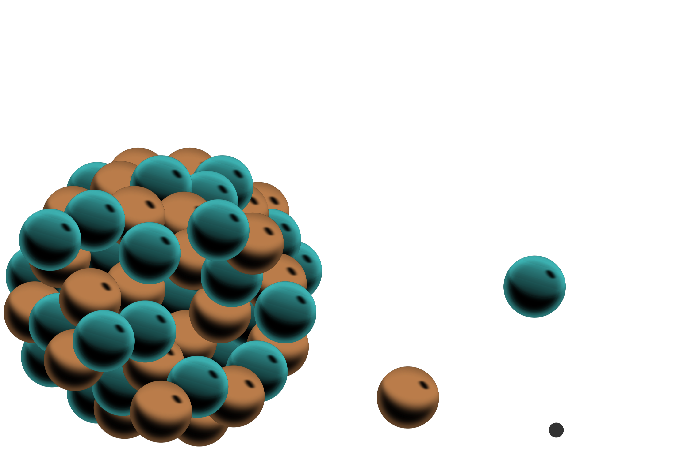
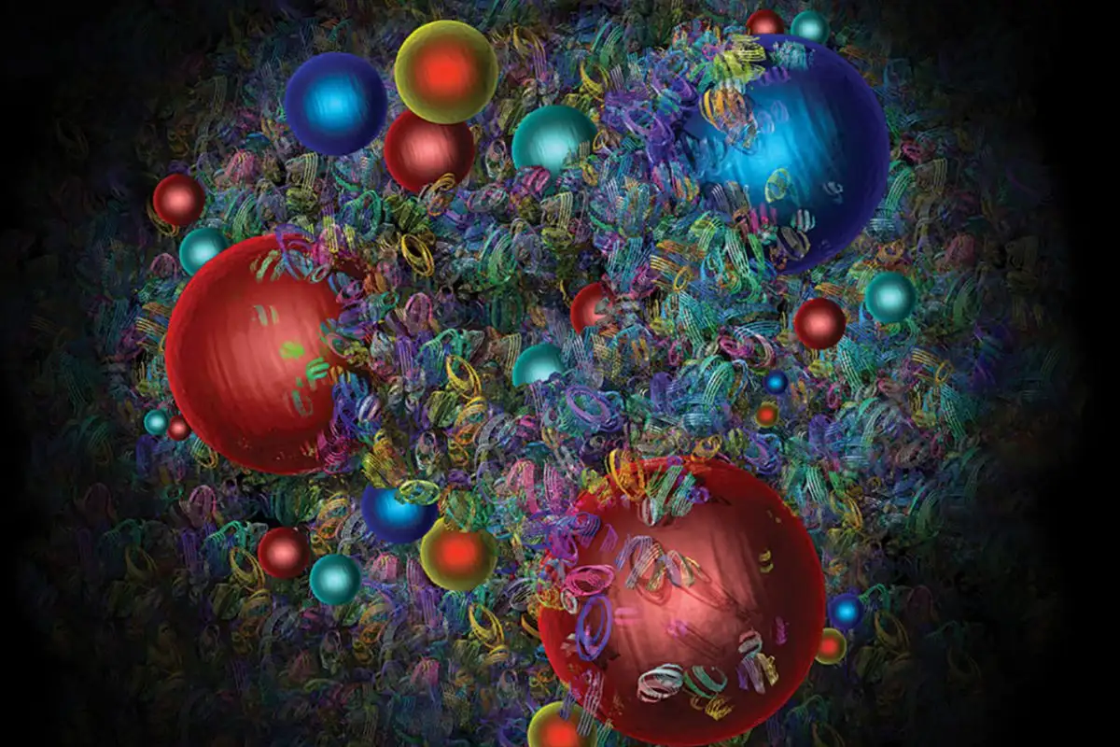
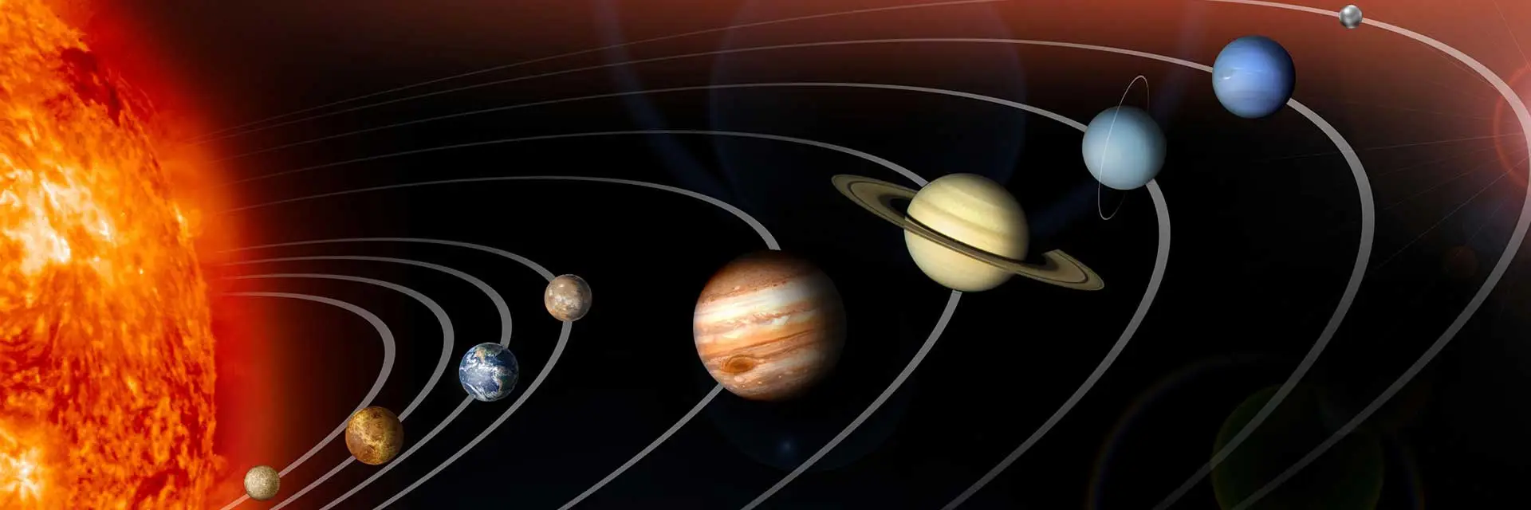
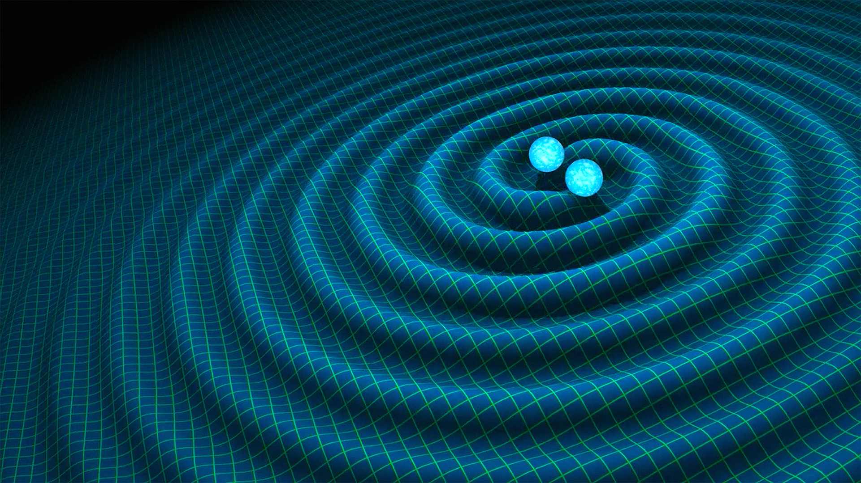
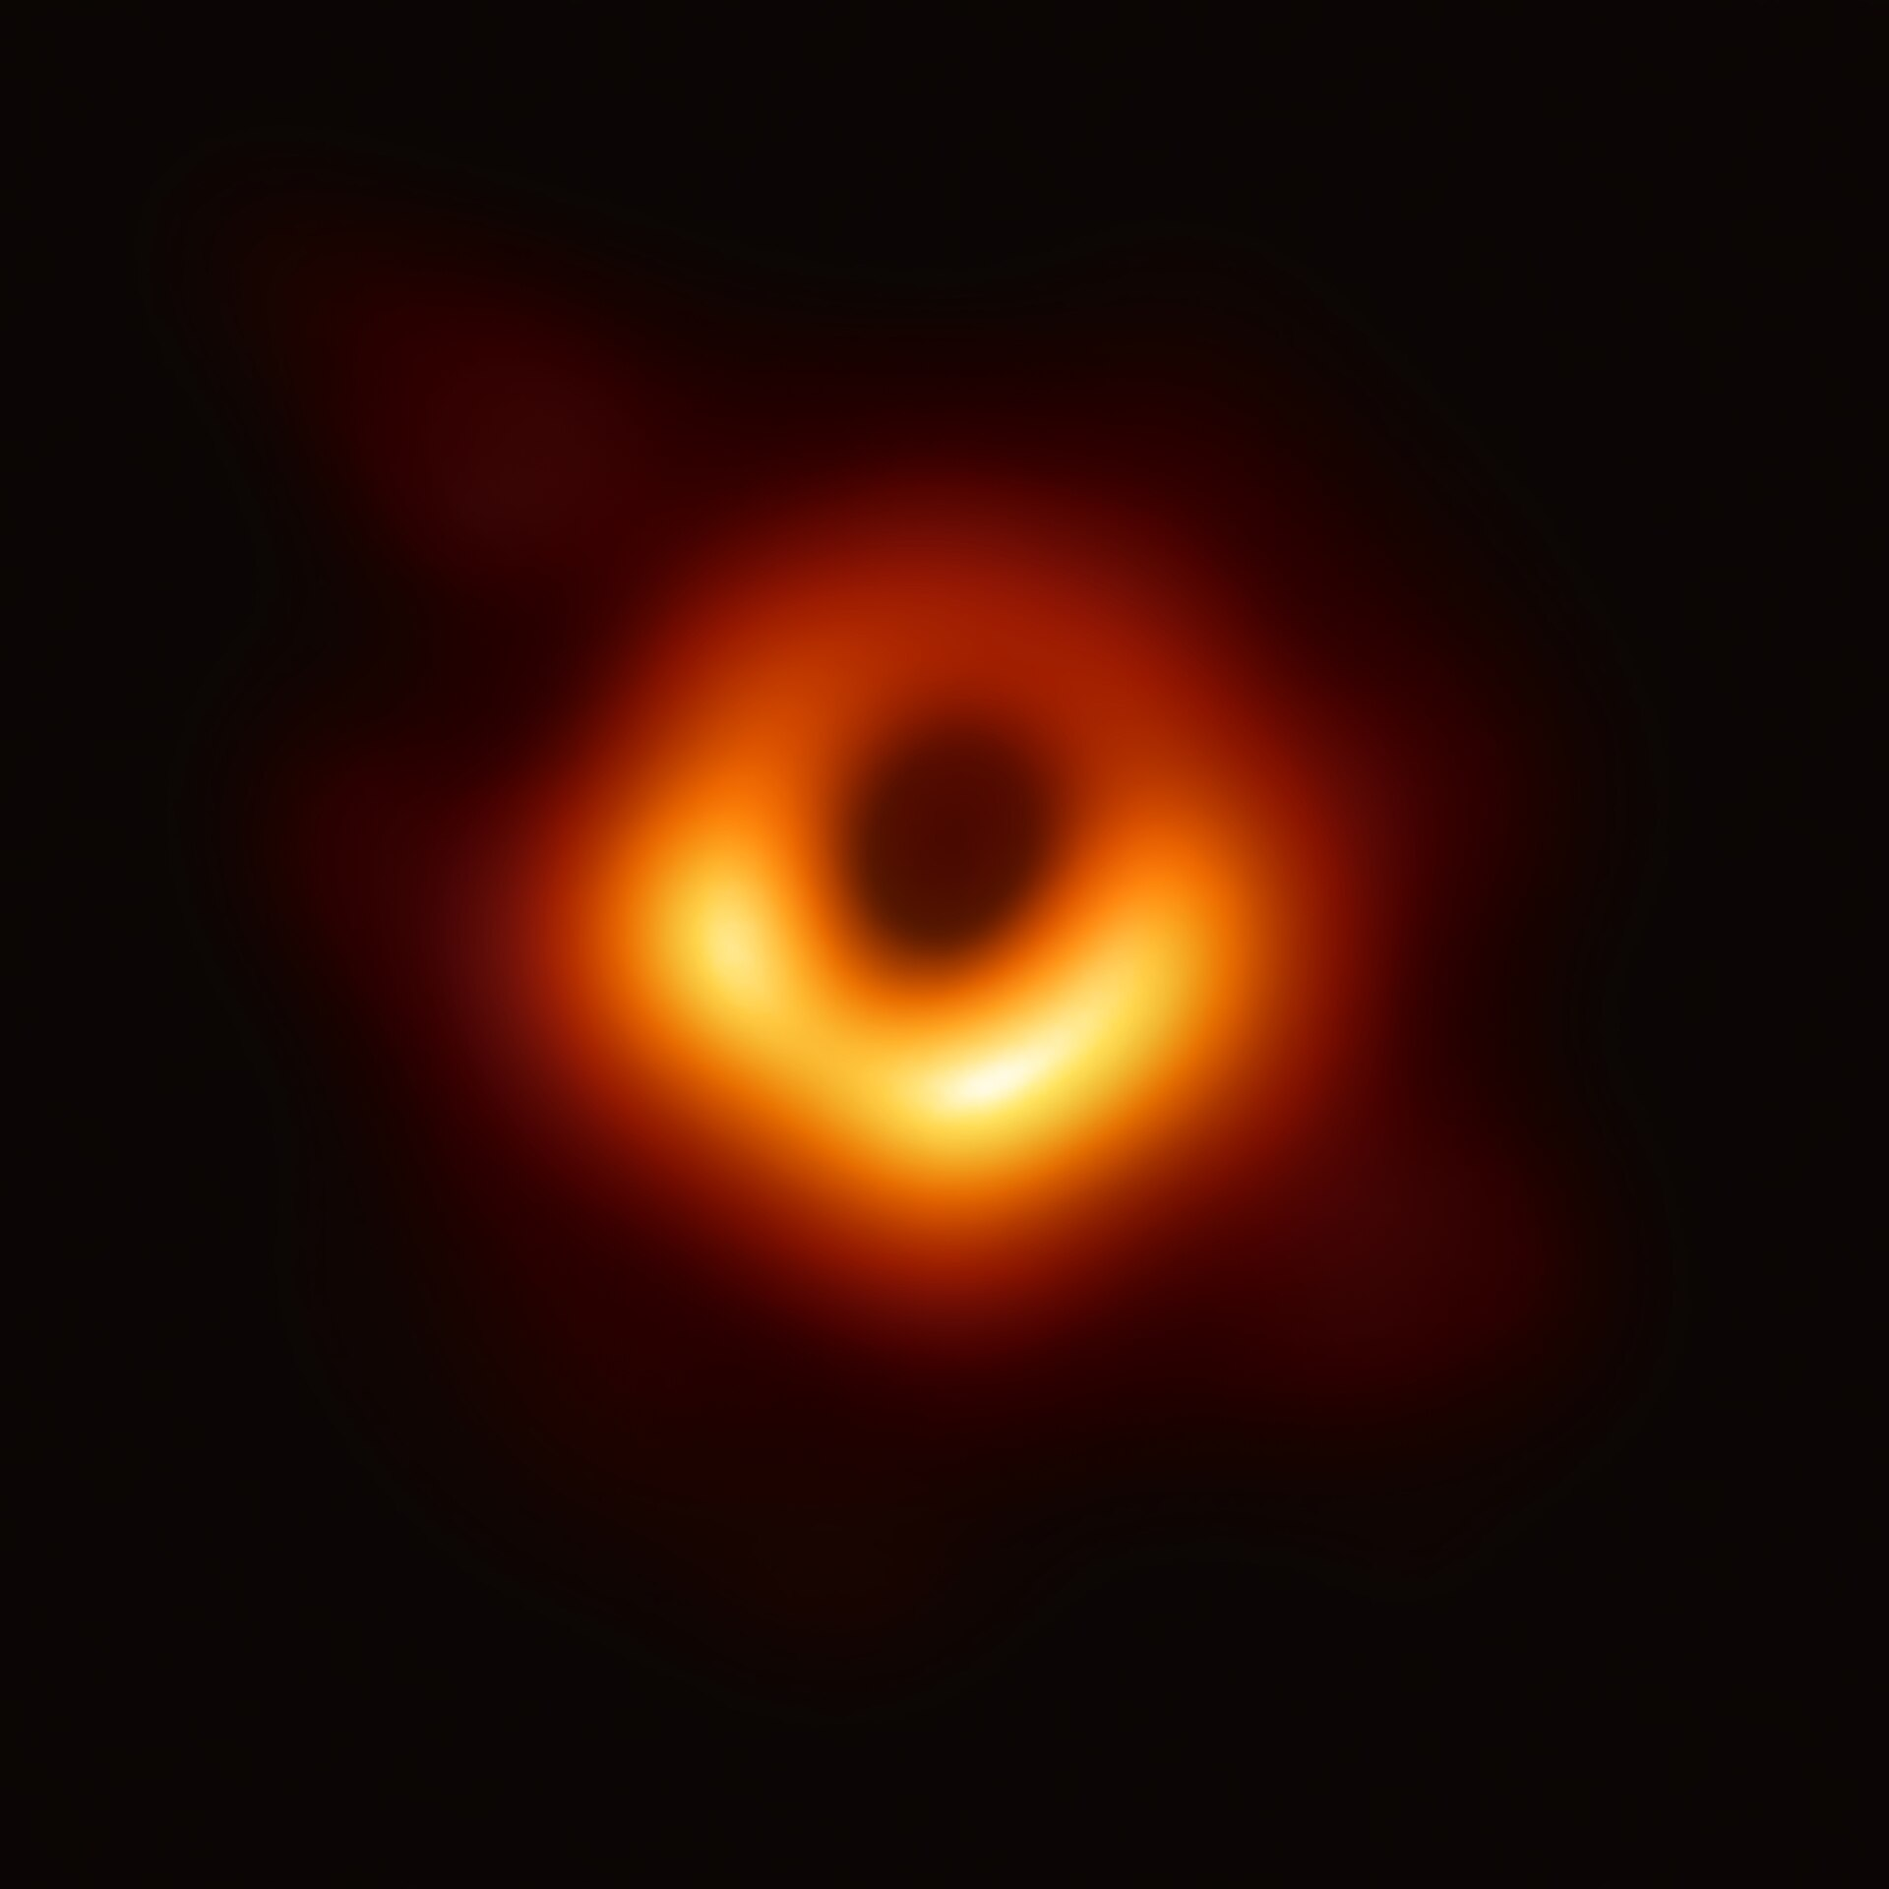
Higgs boson
neutrino
charm
Neptune in Solar
Gravitational
wave
Black
hole
The most incomprehensible thing about the Universe is that it is comprehensible.
---Einstein

Slide 3
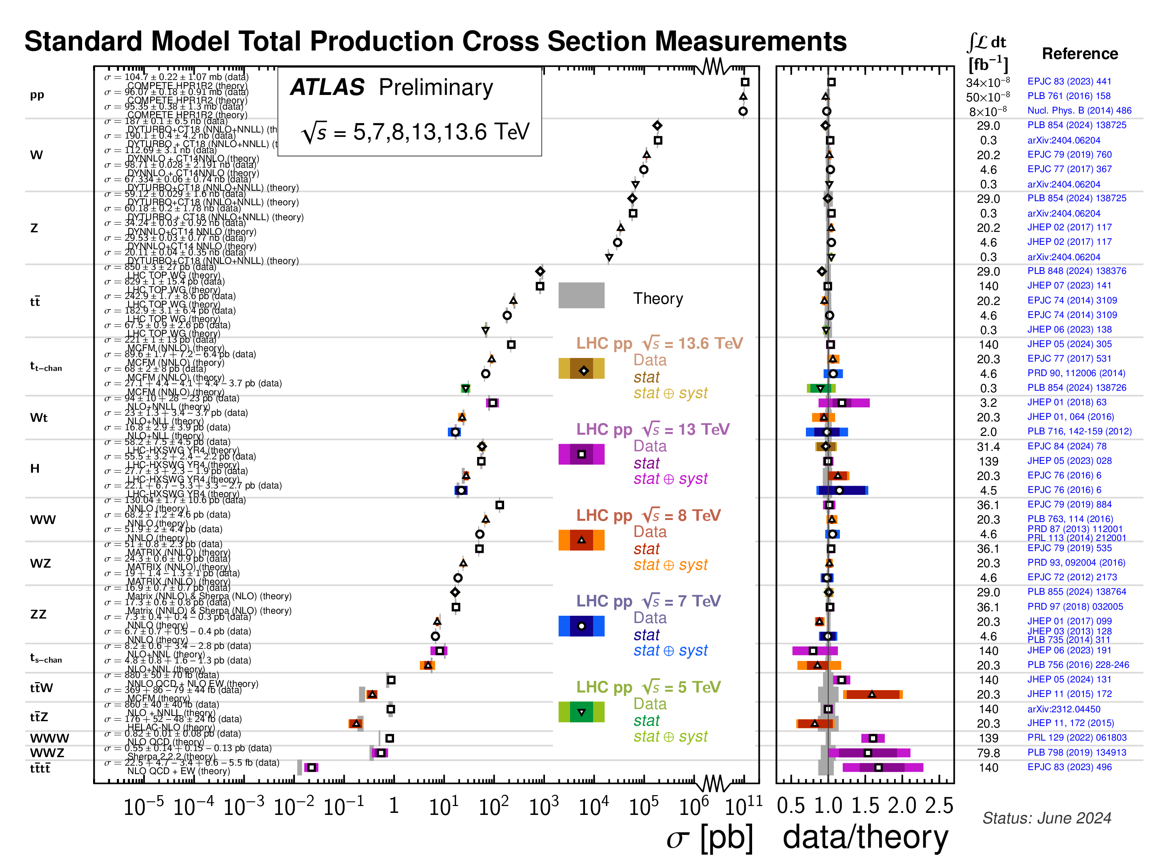
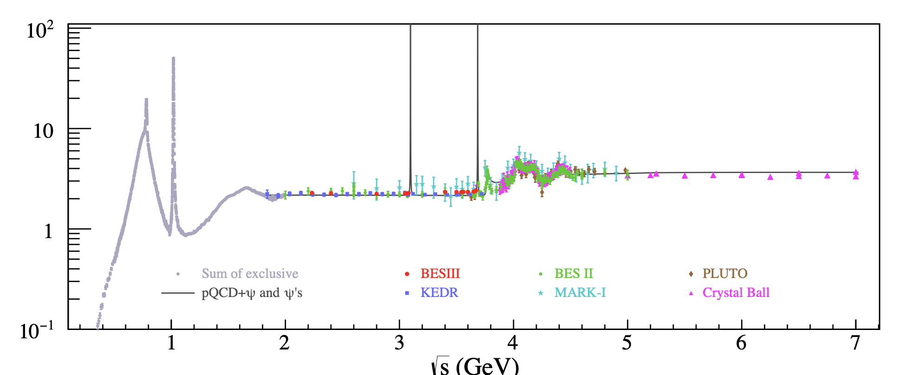
From Quantum Field Theory to Particle Phenomena
Strong interaction
  SU(3) x SU(2) x U(1):
  LHC实验测量结果
From Jiyuan Tian， 2025年第十届R值与QCD强子结构研讨会
From ATLAS

Slide 4
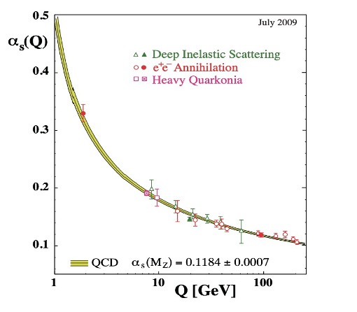

Strong interactions and QCD
Strong interaction
  QCD, fundamental theory for strong interactions： SU(3) gauge theory
  When the energy scale decreases, interactions become stronger, and QCD enters the non-perturbative regime, and must be handled using a nonperturbative method.
Perturbative QCD fails for low energy hadronic interaction

Slide 5
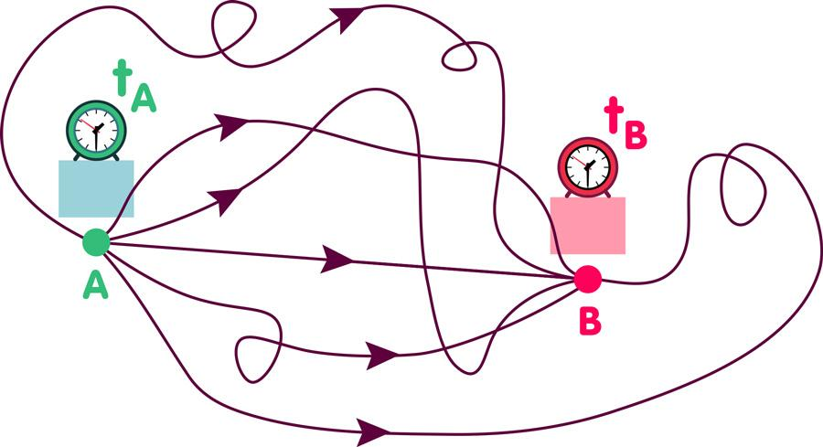

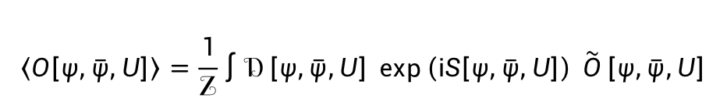
Path Integral
Correlation functions are expressed as a sum over all paths with weight $e^{iS}:$
$$𝒵= \int{𝒟\left[ψ,\overline{ψ},U\right]} \exp\left(iS\left[ψ,\overline{ψ},U\right]\right)$$
$$\left\langle O\left[ψ,\overline{ψ},U\right]\right\rangle =\frac{1}{𝒵}\int{𝒟\left[ψ,\overline{ψ},U\right]} \exp\left(iS\left[ψ,\overline{ψ},U\right]\right) \tilde{O}\left[ψ,\overline{ψ},U\right]$$
Path integral gives another useful approach for quantum mechanics and quantum field theory

Slide 6
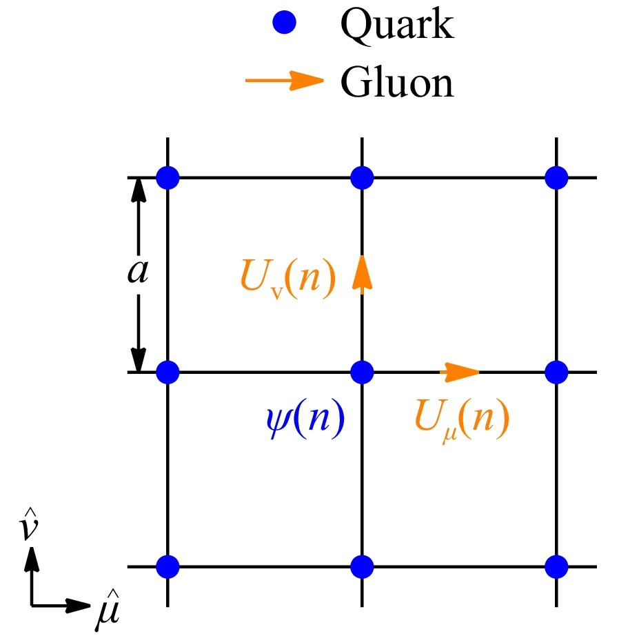
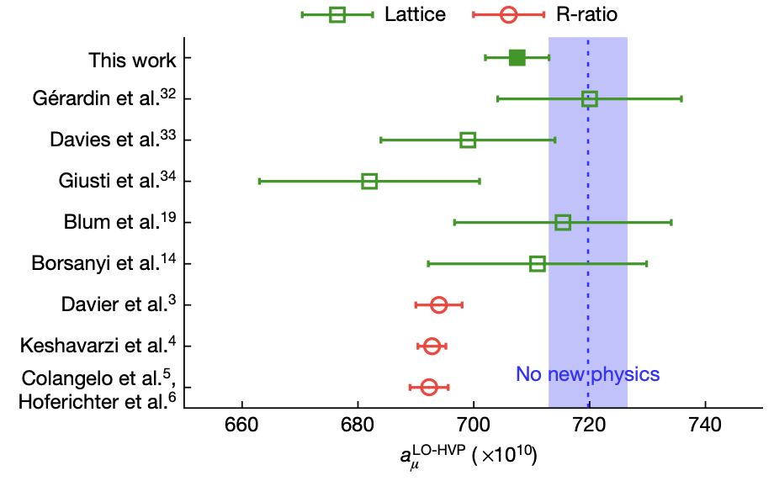
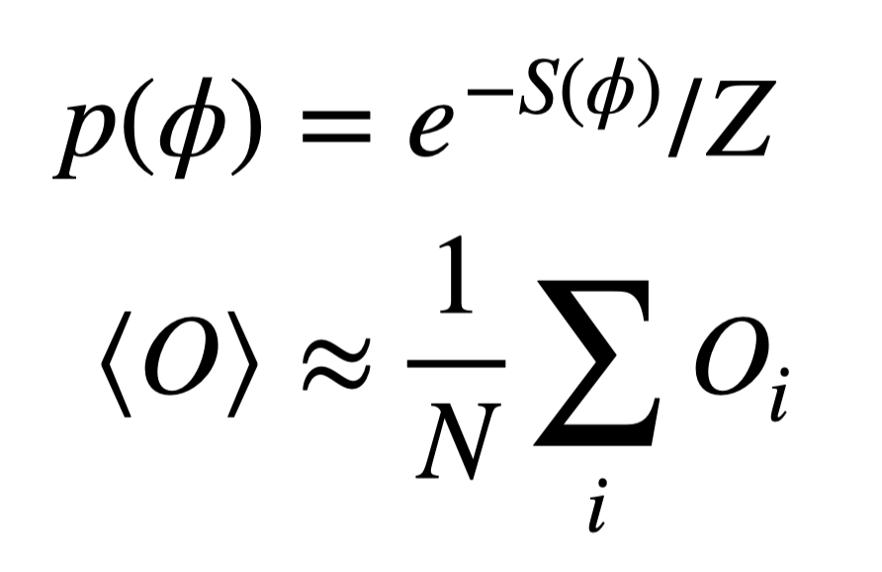
Lattice Gauge Theory and Lattice QCD
Discrete Lattice
Nature 593, 51–55 (2021)
Lattice QCD provides a numerical way to solve the nonperturbative nature of QCD
and great successes have been achieved.

Slide 7
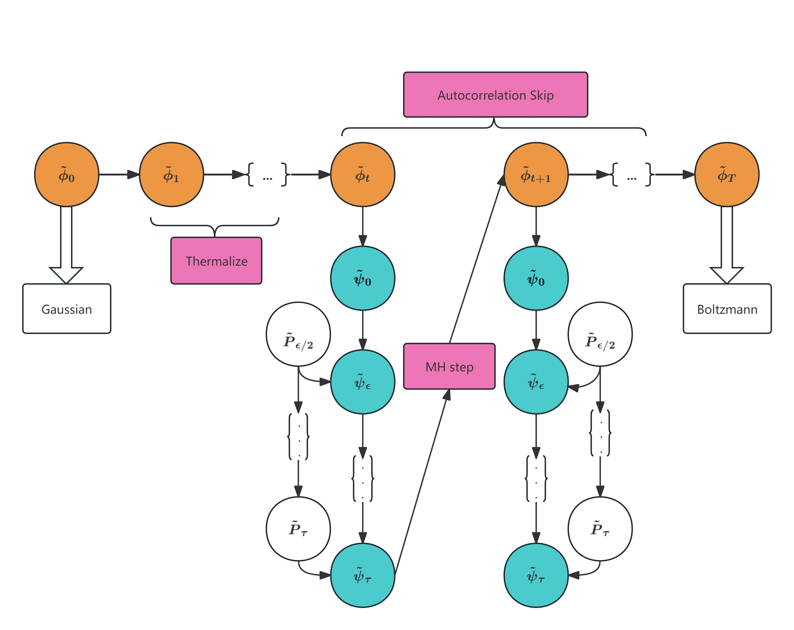
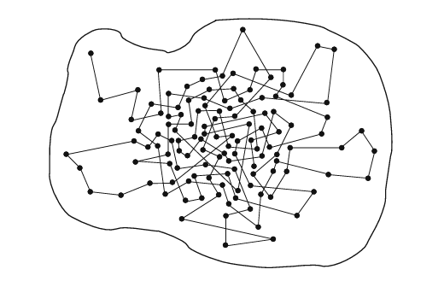
Configurations (paths): from Metropolis to HMC
Hybrid Monte Carlo
Markov chain Monte Carlo: Metropolis
Configurations in Lattice gauge theory are important!

Slide 8
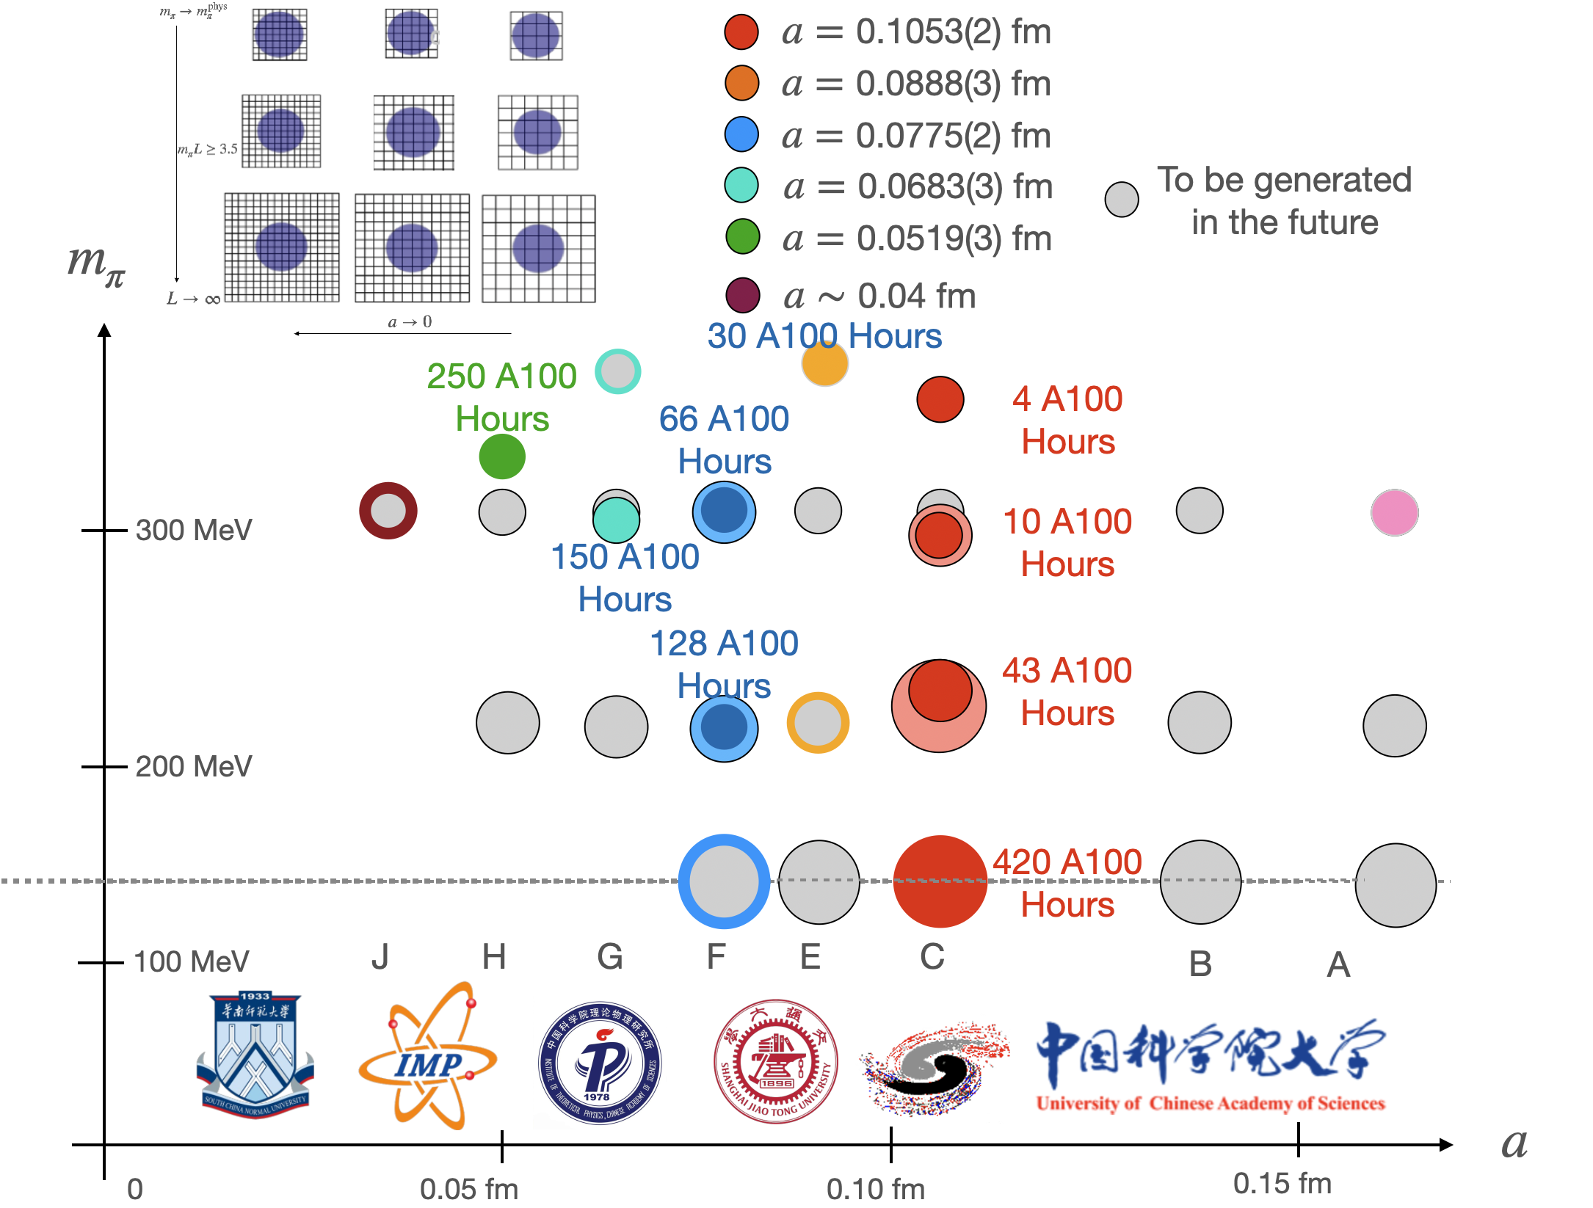
Lattice QCD configurations
Lattice QCD configurations from CLQCD
利用国内超算平台，采用tadpole-improved的作用量，生成了一套2+1味的动力学格点组态
已有十多篇学术论文采用该套组态进行科学研究
PRD 109, 054507 (2024)
A new set of dynamical lattice configurations is generated.

Slide 9
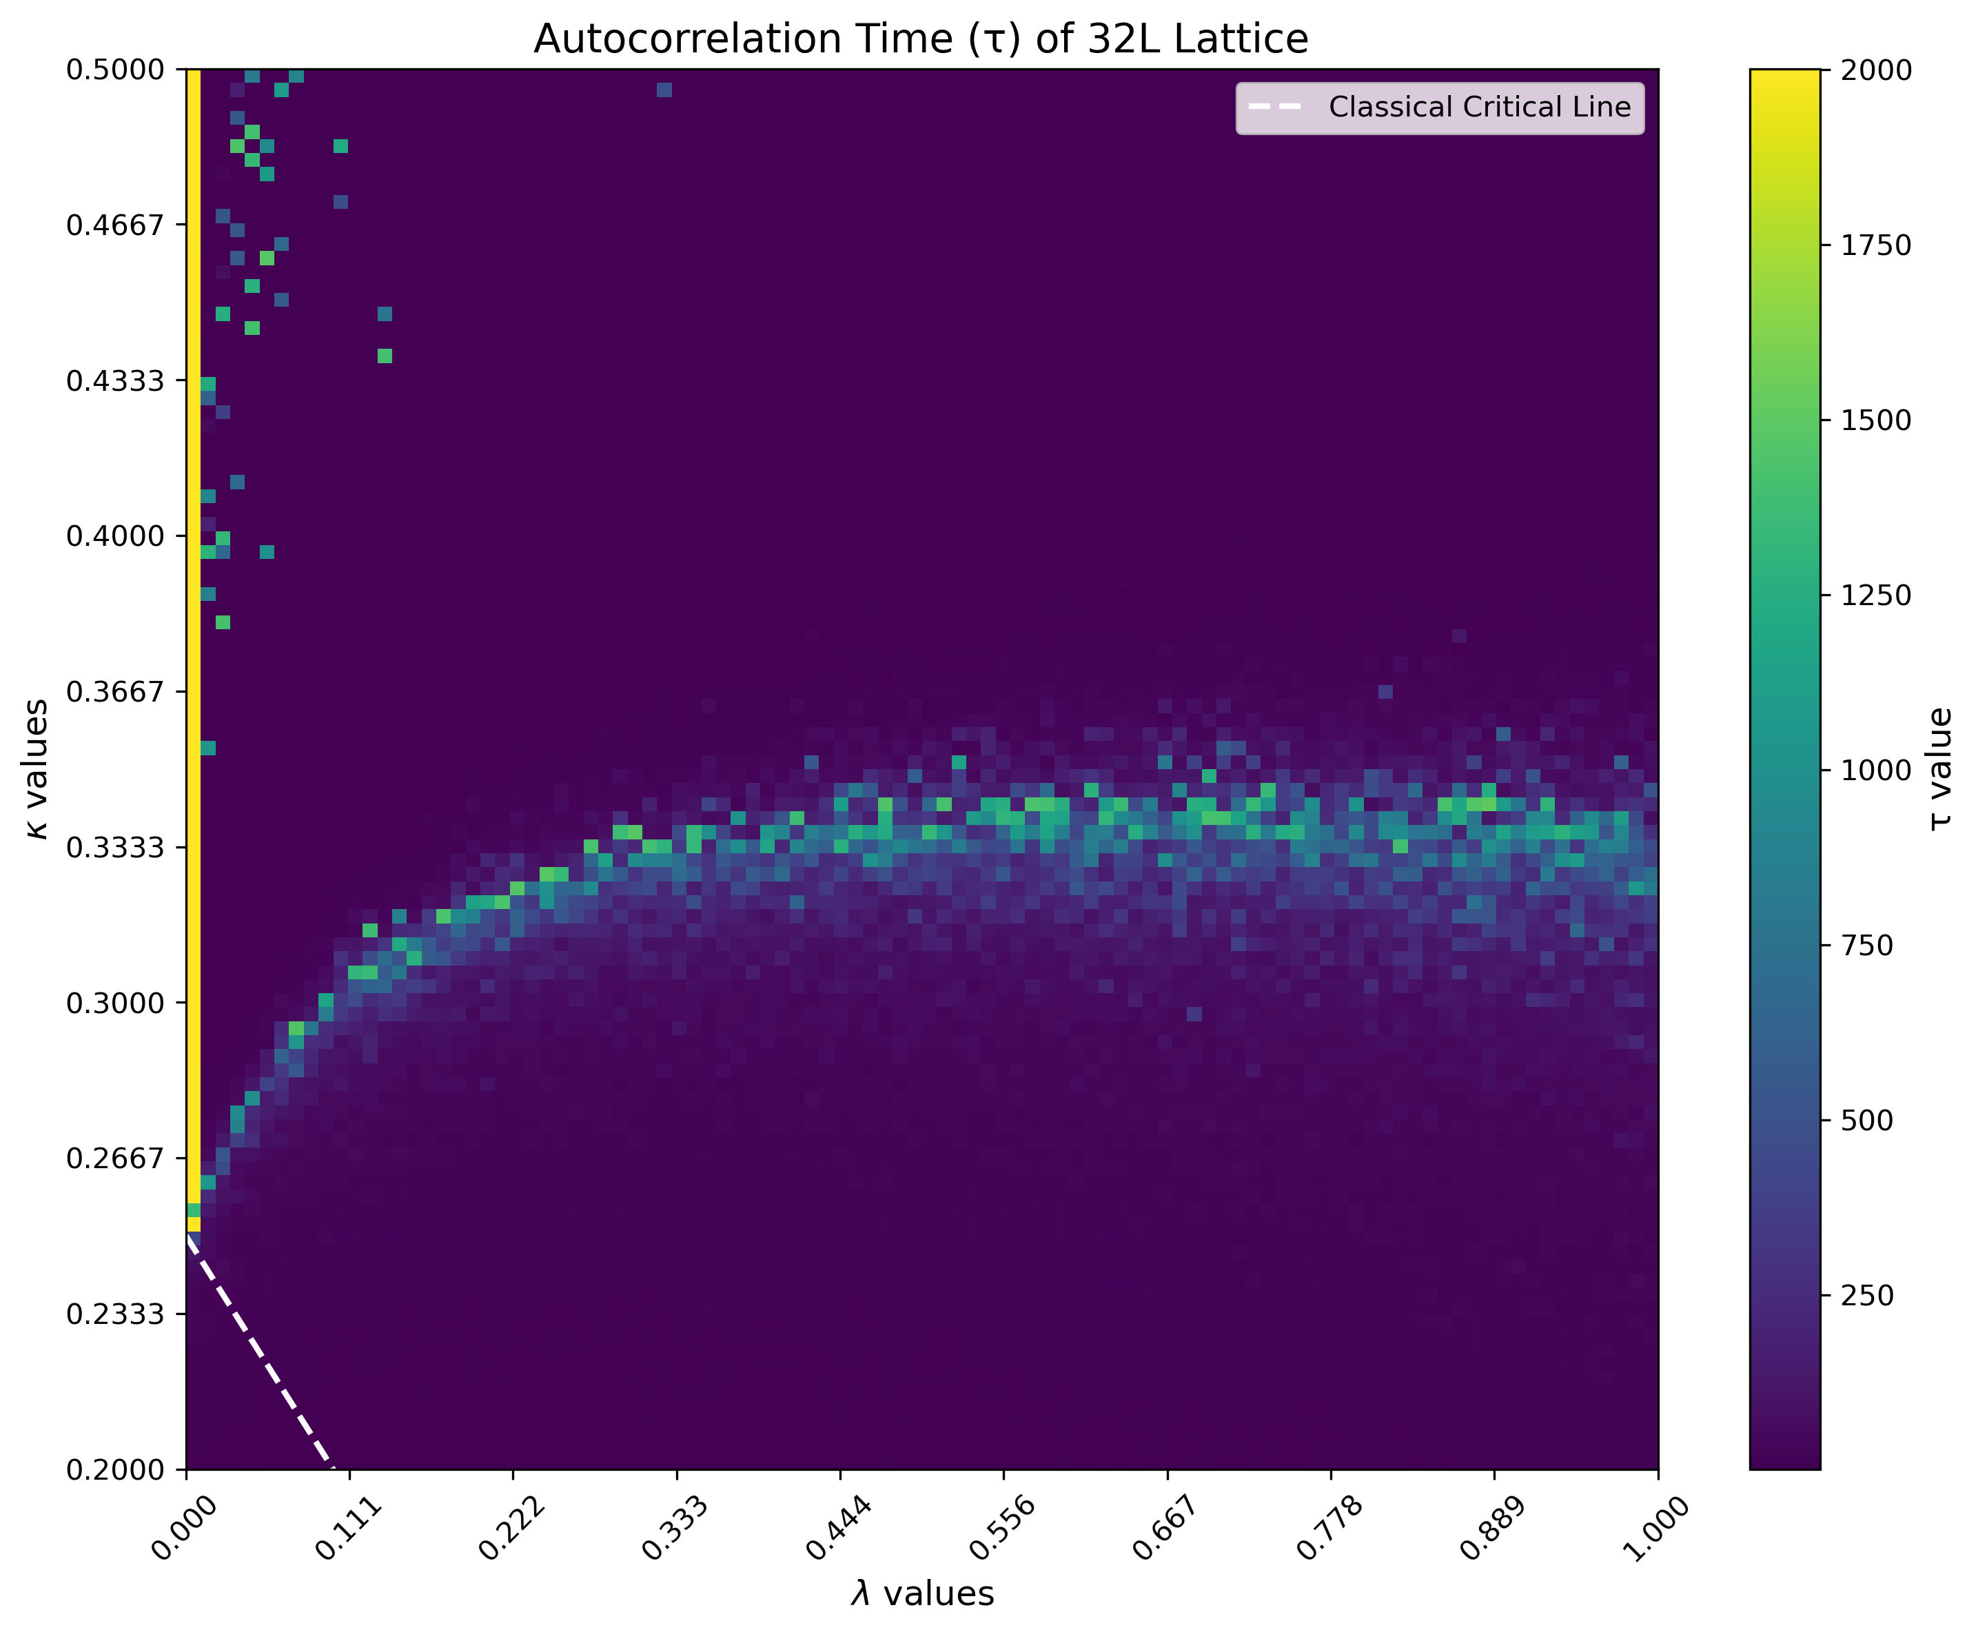
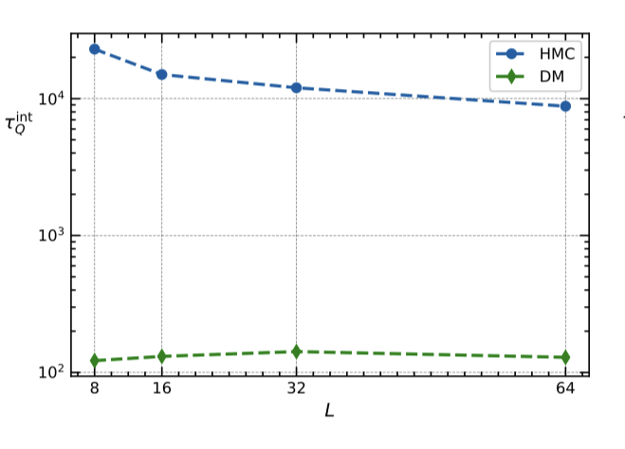
HMC: autocorrelation time
phi4
U(1)
Autocorrelation time increases with the increase of beta: 10⁴ for beta=7

Slide 10
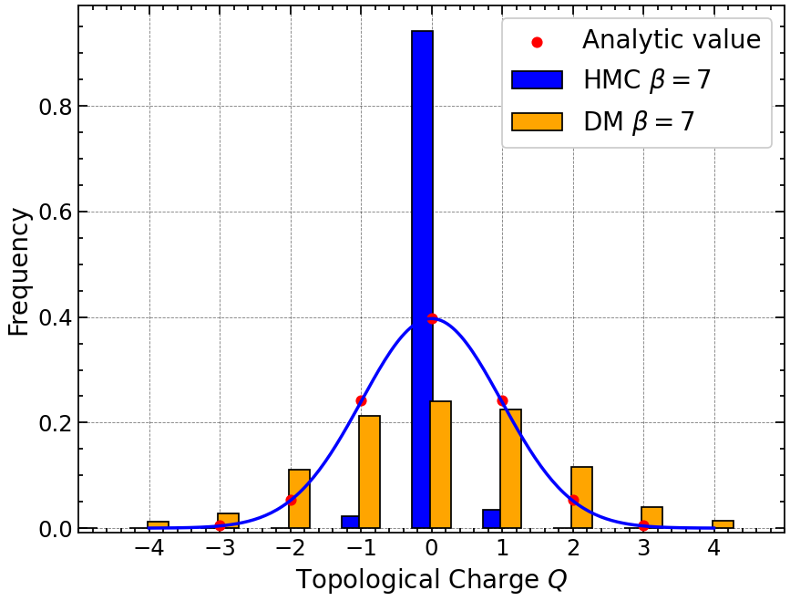
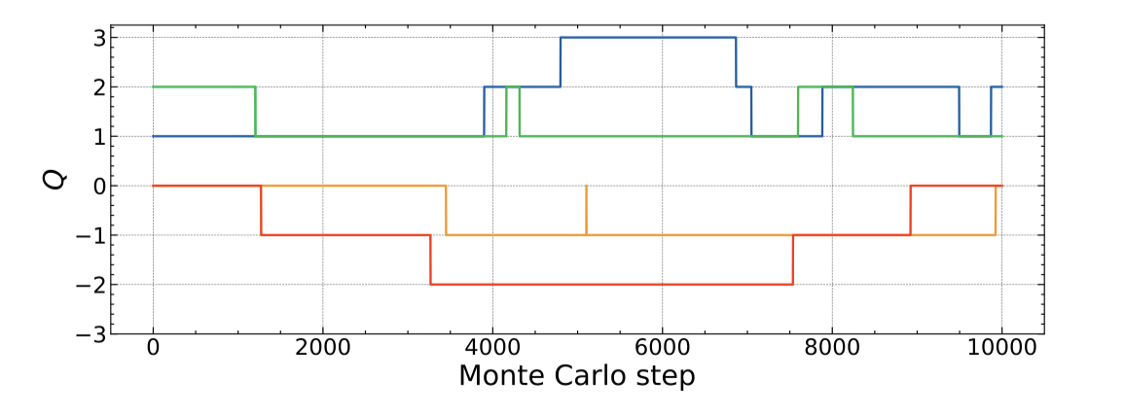
HMC: topological freezing
Topological charge
Topological freezing: Thousands of steps are needed

Slide 11

Critical slowing down (CSD)
Easy to jump out
Markov chain: local updates
Small β
β increase
Action barrier
prevent transition between separated sectors
Hard to jump out
$$∝ β$$
Large β
CSD: Nucl.Phys.B Proc.Suppl. 17 (1990) 93-102, Phys.Rev.Lett. 58 (1987) 86-88, Phys.Lett.B 594 (2004) 315-323

Slide 12
ML for generating configurations
Flow-based model
Diffusion model
Review: Michael S. Albergo, et.al, 2101.08176
Gert Aarts, Lingxiao Wang, Kai Zhou, Qian-Teng Zhu, et.al
Review: Nat. Rev. Phy., 7, 154 (2025), Prog.Part.Nucl.Phys. 104084(2023);
Normalizing flow
2003.06413
Stochastic flow
2210.03139
Winding HMC
2106.14234
phi4 lattice theory: 2309.17082
U(1) lattice theory: 2502.05504
Only use one model we can:
Different couplings
Different sizes
ML may provide a new hope to generate configurations

Slide 13
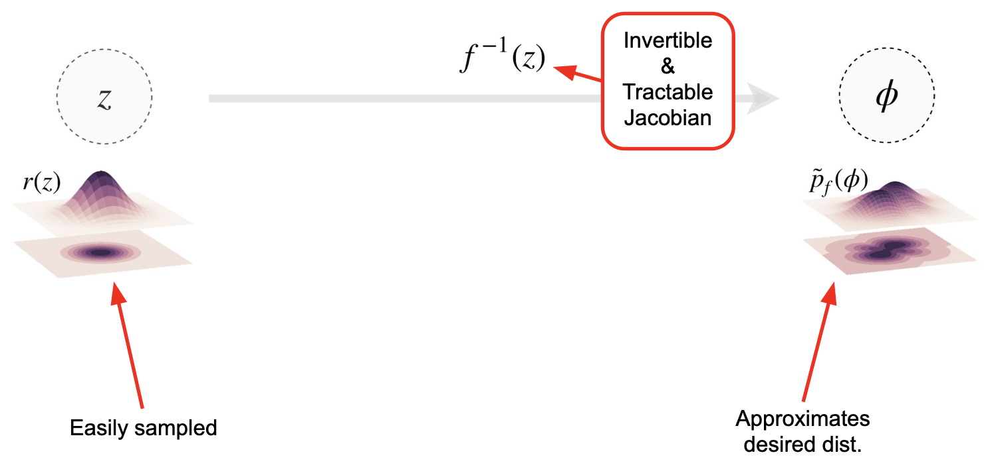
Flow-based models
Using a change-of-variables, produce a distribution approximating what you want.
[Rezende & Mohamed 1505.05770]
Credit: Phiala E. Shanahan

Slide 14
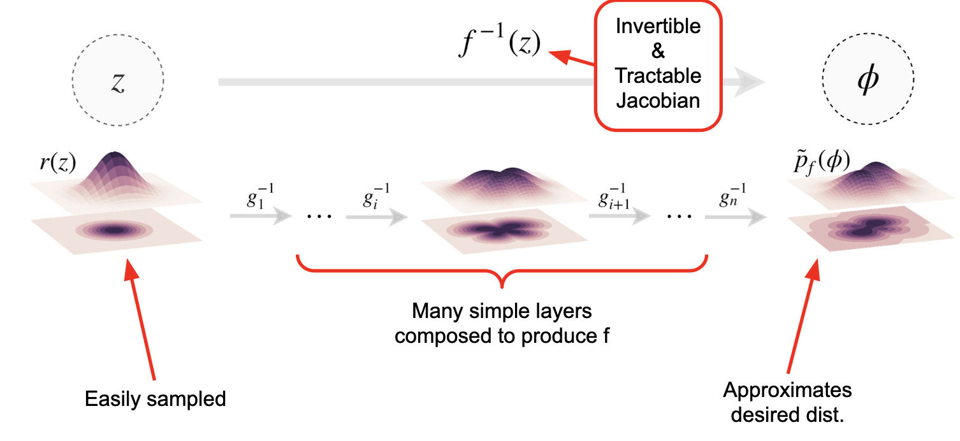
Flow-based models
Using a change-of-variables, produce a distribution approximating what you want.
[Rezende & Mohamed 1505.05770]
Credit: Phiala E. Shanahan

Slide 15
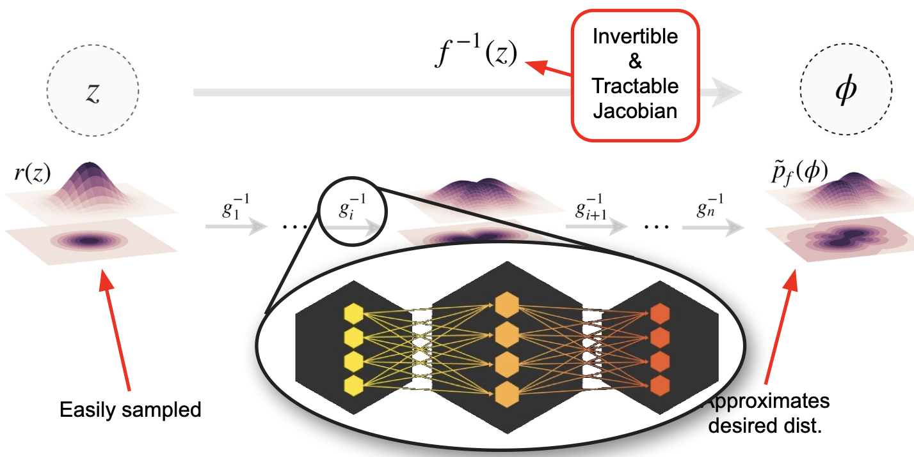
Flow-based models
Using a change-of-variables, produce a distribution approximating what you want.
[Rezende & Mohamed 1505.05770]
Credit: Phiala E. Shanahan

Slide 16
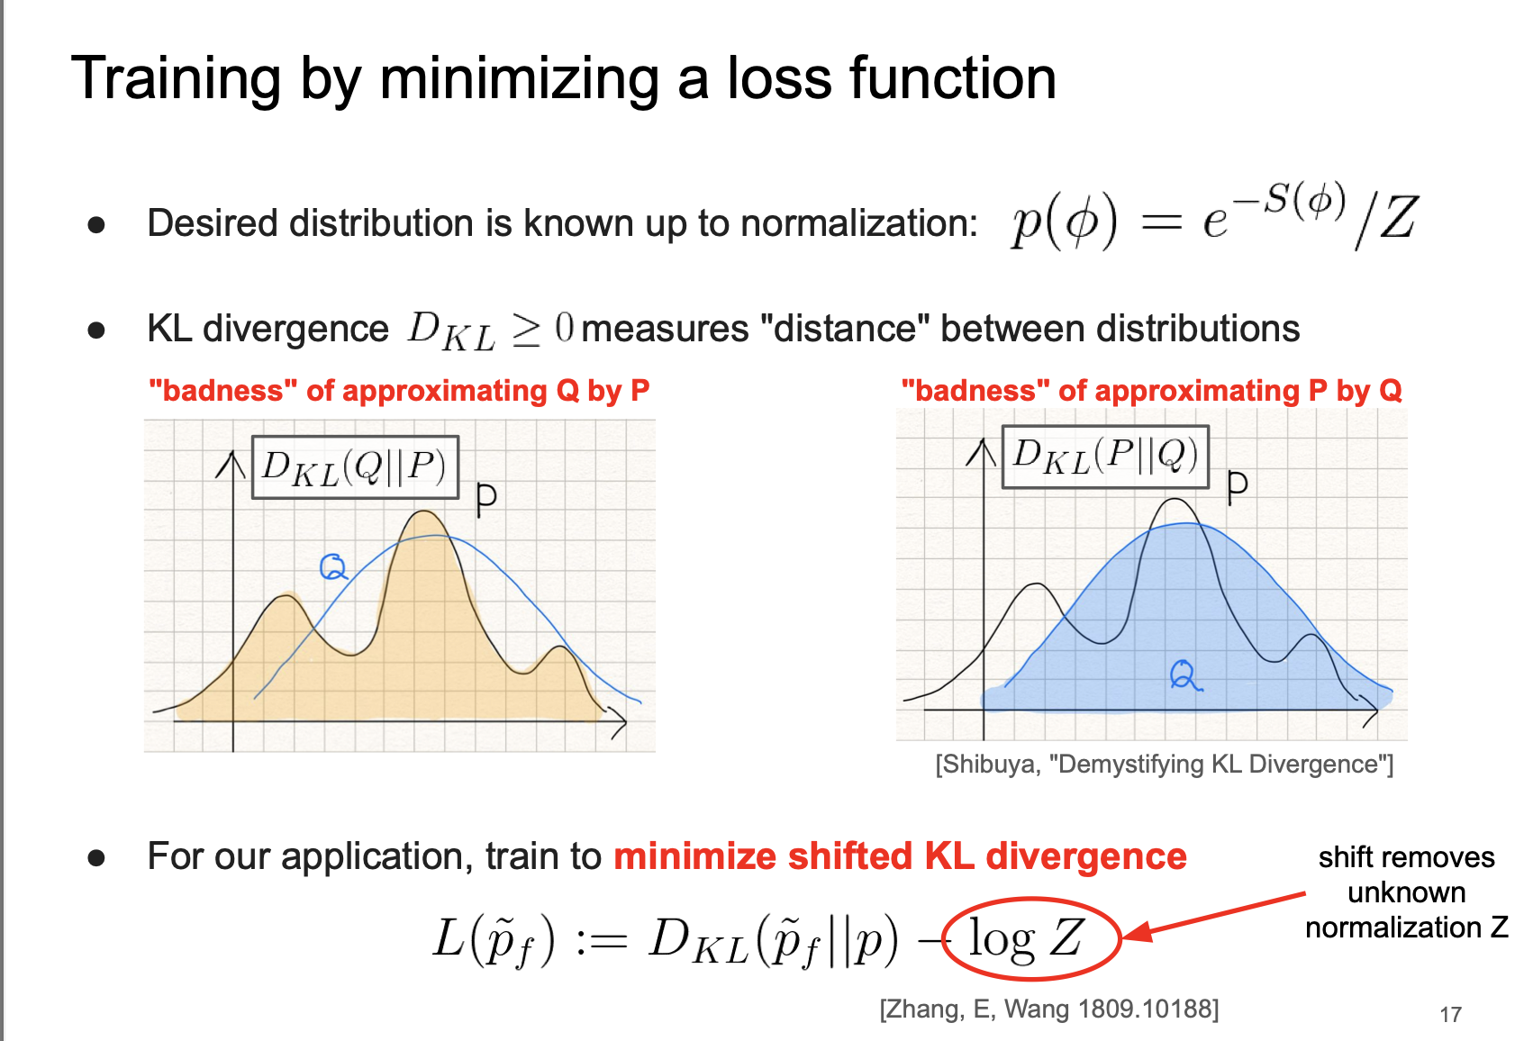
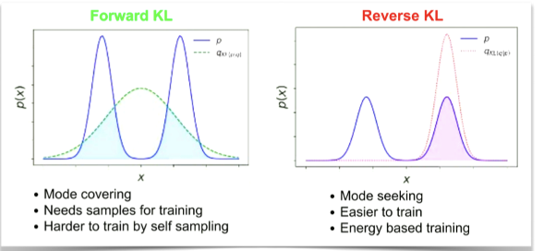
Flow-based models
mode-callapse
See 2107.00734, :2302.14082
Credit: Phiala E. Shanahan

Slide 17
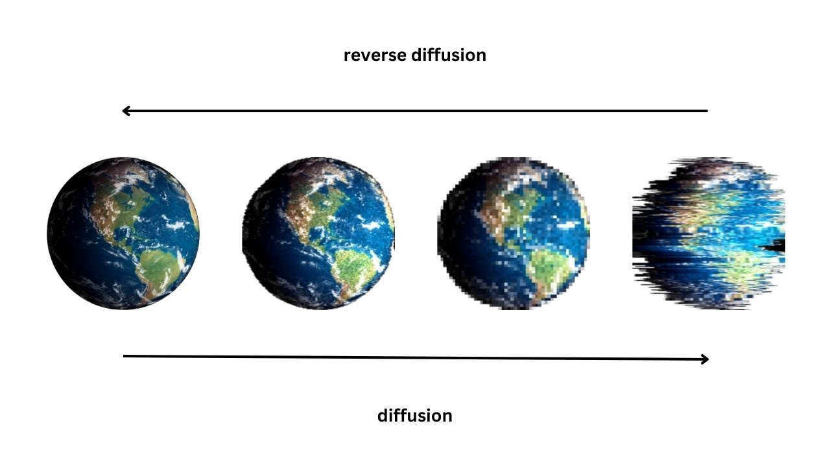
Diffusion model
减少噪声
增加噪声
Jonathan Ho, Ajay Jain, Pieter Abbeel , Denoising Diffusion Probabilistic Models, 2006.11239

Slide 18
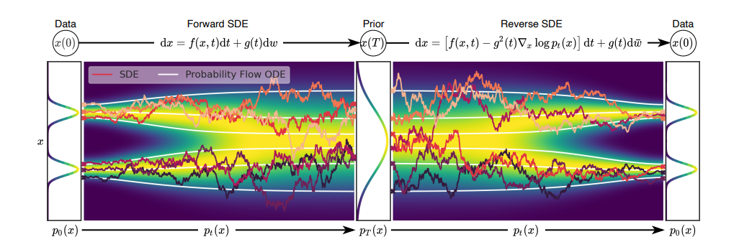
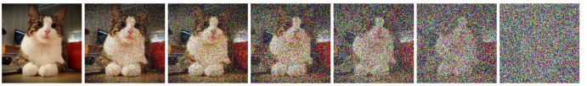
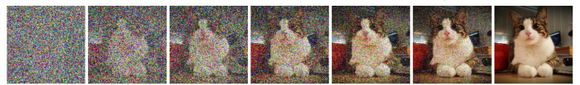

Diffusion model
前向过程逐渐增加噪声
反向过程逐渐减少噪声
Y. Song, et.al
2011.13456

Slide 19
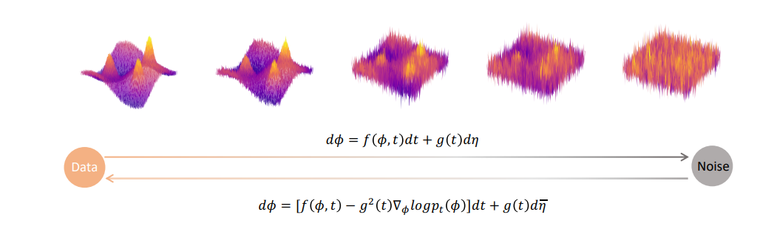
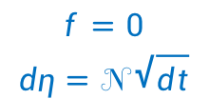





Diffusion model: Forward/reverse SDE
$$p_{0}[φ]$$
$$p_{0.1}[φ]$$
$$p_{0.2}[φ]$$
$$p_{t}[φ]⋯$$
$$p_{T}[φ]$$
$$f=0$$
$$dη=𝒩\sqrt{dt}$$
t is noise scale
Fitted by Score net

Slide 20
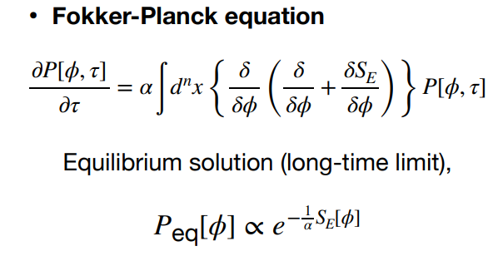
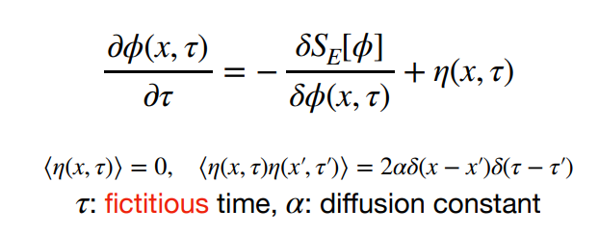
Stochastic quantization
Stochastic differential equation:

Slide 21
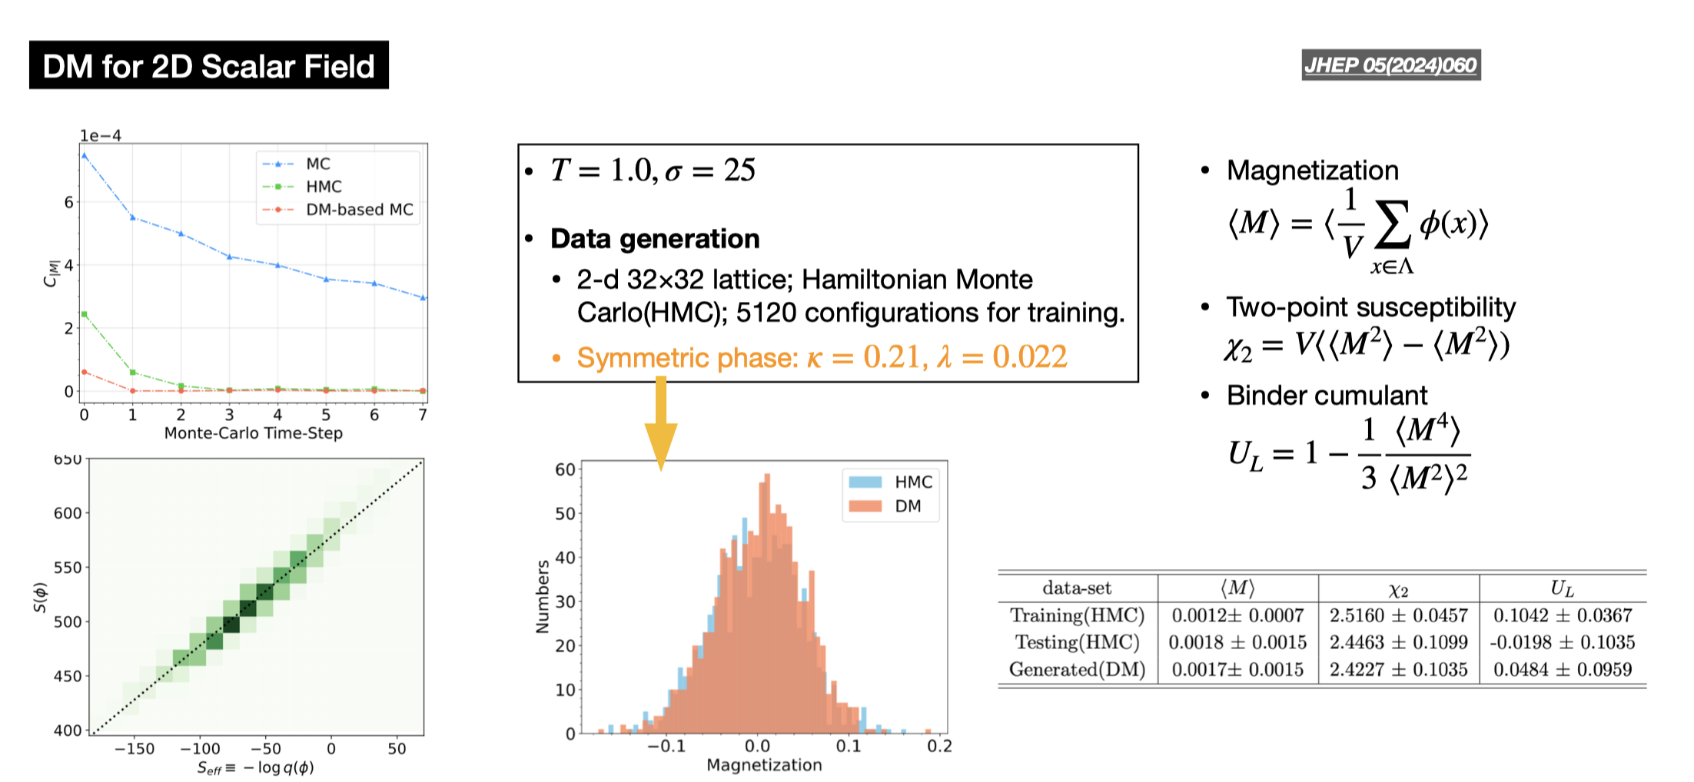
Diffusion model for phi4
Credit: Lingxiao Wang

Slide 22
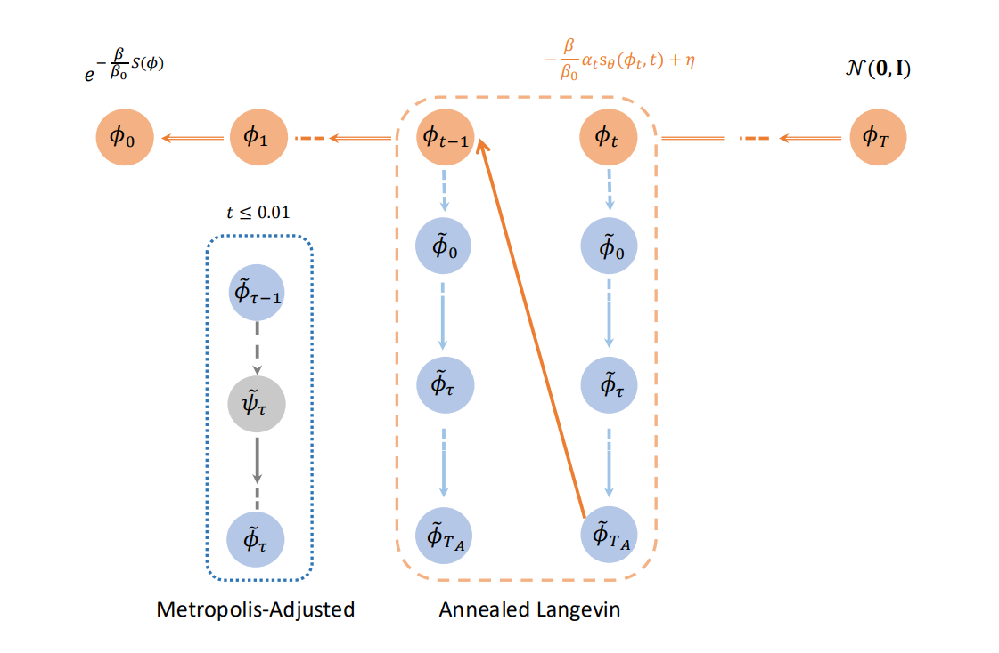






Diffusion model for U(1): Annealed Langevin + metropolis
1 Horizontal : gradually decrease noise
3 Detail balance
2 Vertical: ensure equilibrium at each noise scale
$$\frac{∂φ(x,τ)}{∂τ}={{(β}_{target}/β_{0})∙s}_{\hat{θ}}\left(φ\left(x,τ\right),t_{i}\right)+η(x,t)$$
Fix $t_{i}$
Train once, use for all.
Qianteng Zhu, et.al, 2502.05504

Slide 23
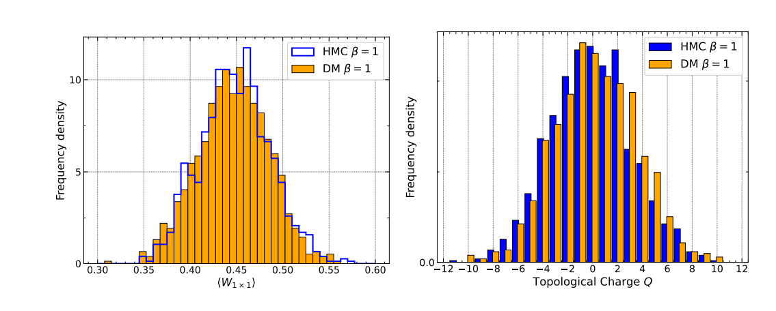
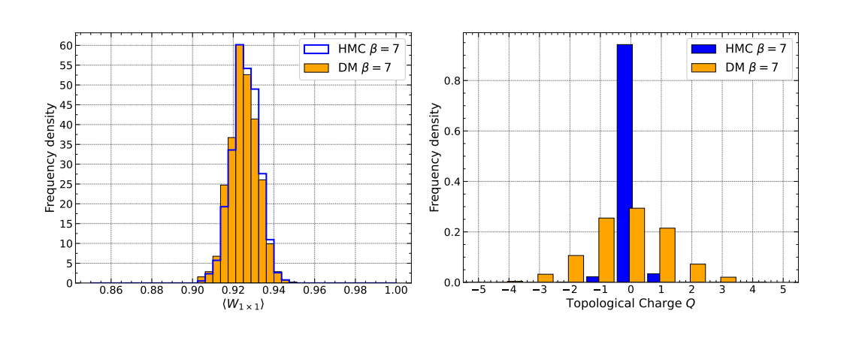
Results
Training and sampling at β=1,L=16
Generation at larger coupling

Slide 24
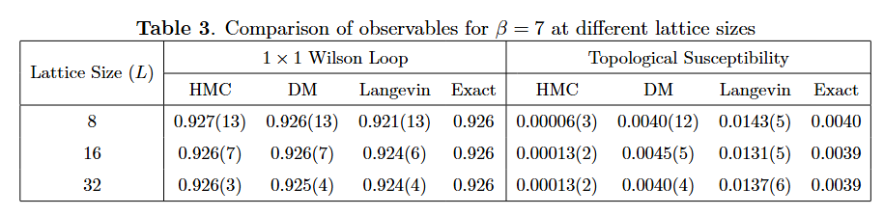
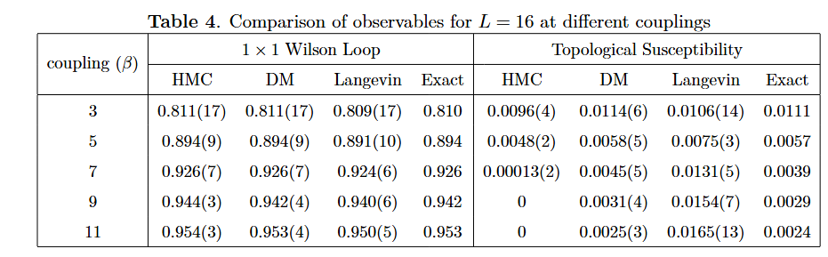
Numerical tables

Slide 25
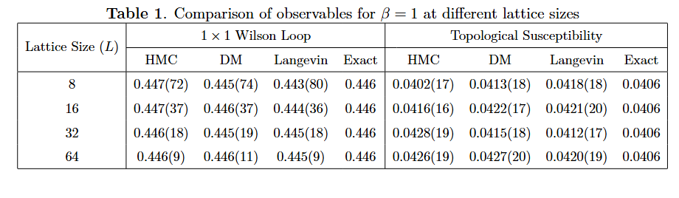
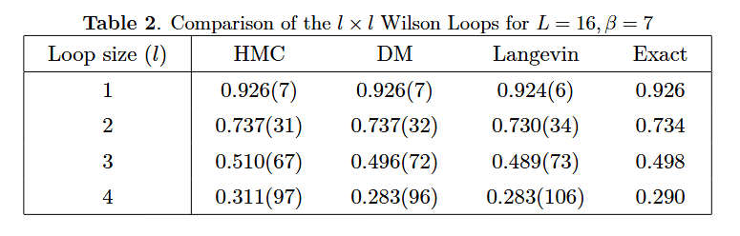
Numerical tables

Slide 26
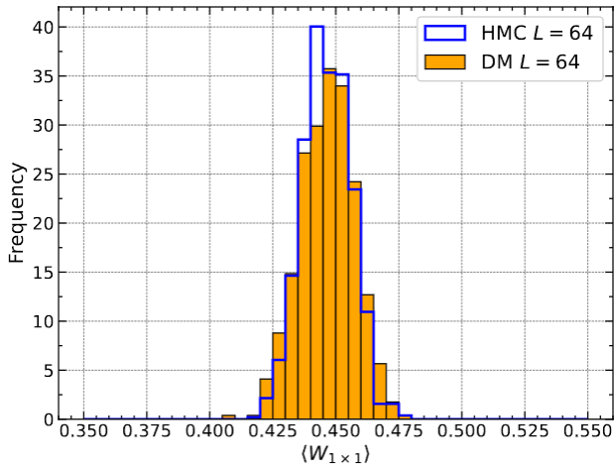
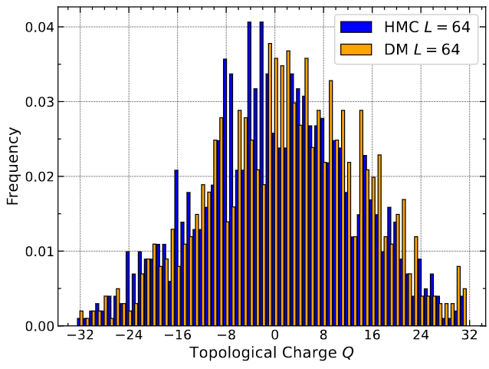
Results
Generation at larger lattice size

Slide 27
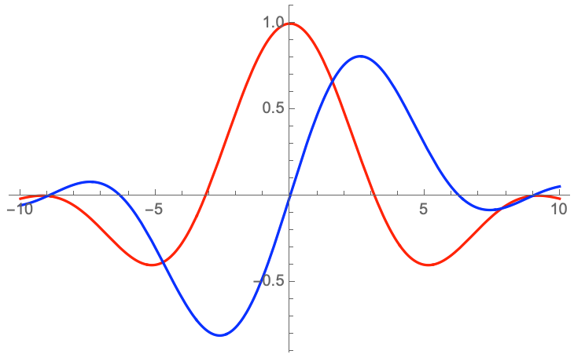
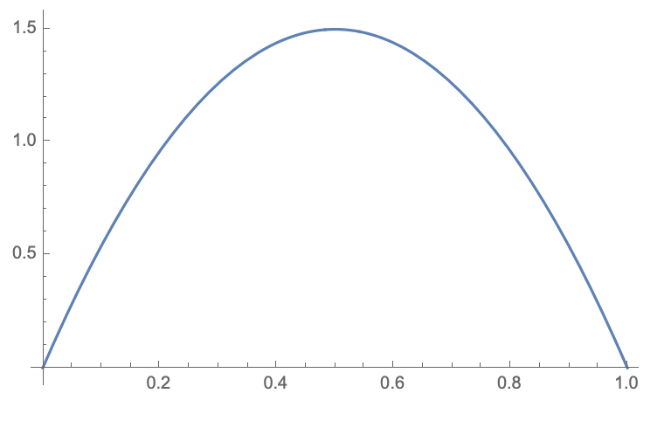
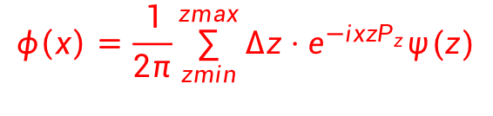


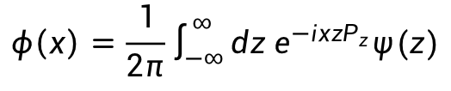
An Inverse problem: Limited Discrete Fourier Transform
$ψ(z)$ in coordinate space
$ψ(x)$ in momentum space
$$φ\left(x\right)=\frac{1}{2π}\int_{−∞}^{∞}{dz e^{−ix{zP}_{z}}ψ(z)}$$
$$φ\left(x\right)=\frac{1}{2π}\sum_{zmin}^{zmax}{{Δz⋅e}^{−ix{zP}_{z}}ψ(z)}$$
Well-posedness criteria:
Existence: ✓
Uniqueness: ✓
Stability: ✕
ill-posed inverse problem
But physics-conditioned!
A.S.Xiong, J.Hua, Q.A.Zhang arXiv:2506.16689
Notes:
我们在格点通过LaMET研究LCDA的过程中，做了最简单的NN的应用。由于LaMET在坐标空间计算的quasi需要通过傅立叶变换到动量空间，而这个FT由于格点的特性，会由原本well defined的FT，变成一个有限截断的离散的FT。那么，这样的一个问题，就变成了重建动量空间函数的反问题。最近在arXiv:2506.16689就证明了，这样的一个反问题，从well posedness条件判断的话，它满足解的存在性和唯一性，但不满足解的稳定性。那么这个问题形式上，就可以formed as ill-posed inverse problem。 尽管进一步的证明也可以证明这是一个比较容易处理的反问题，但大家也知道格点上是存在一些非常困难的反问题的，所以在这个离散截断的FT问题上，很长时间也存在一些争议。那么，我们不妨用神经网络来尝试一下这个问题

Slide 28
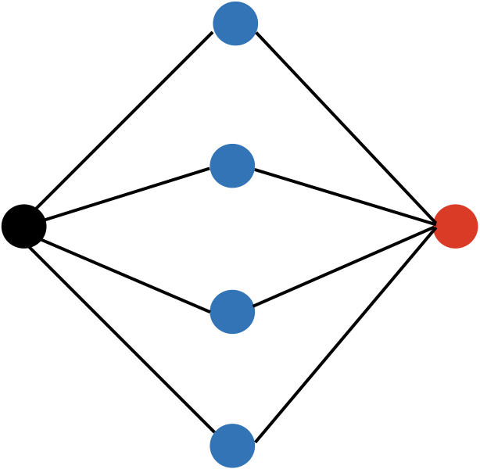







An Inverse problem: Limited Discrete Fourier Transform
$$φ\left(x\right)=\frac{1}{2π}\sum_{zmin}^{zmax}{{Δz⋅e}^{−ix{zP}_{z}}ψ(z)} → φ\left(x\right)=H\left(x,z\right)ψ(z)$$
Hidden layer
$$h_{i}=φ_{i}(x)=tanh(w_{i}x+b_{i})$$
$$φ(x)$$
$$ψ(z)$$
Input layer
Output layer
$$ψ(z)=g(h_{i})=\sum_{i}{W_{i}h_{i}+B}$$
genetic algorithm
Minimization $χ^{2}$
Notes:
从这个离散截断的FT出发，它从形式上，就非常适合做成AI反解的形式。无非就是坐标空间与动量空间的函数存在一个kernel的映射。那么，我们就可以构造一个最简单的神经网络，这个神经网络的input层就是动量空间的函数，output层就是坐标空间的函数，隐藏层我们就选了一个比较平滑的激活函数作为神经元。那很自然的，我们就可以用input的phi(x)做FT到坐标空间与lattice数据的phi(z)把损失函数定义出来。定义式中的N式格点sample的求和。这个问题的复杂度很低，我们也要求训练的效率，因此我们用遗传算法就可以把minimal的损失函数求解出来。那刚刚提到这个问题我们只需要最最简单的神经网络就可以做，在实际做的过程中，我们尝试了最低的复杂度，只需要一层的隐藏层，以及5个神经元就可以把LCDA的情形重建好。
（遗传算法其实算一个不知道怎么做更合适时候的保底选择，像一些最速下降之类的会在更复杂的系统里需要）

Slide 29


An Inverse problem: Limited Discrete Fourier Transform
A comparison with regulator approach for Inverse problem
J.Hua, et.al. In process…
Notes:
那这边就可以看下NN做出来的效果和传统的，用regulator的方法来处理反问题的方法，在我们这个问题中的表现。Regulator的方法上，我们采用的最经典的Tikhonov以及现在比较流行的Bayesian重建的两种方法。这两张图我们都是用的mock data，所以虚线的真解其实是已知的。左边的图，对应我们关心的LCDA问题的一个case，那可以看到对于这样一个平滑函数的重建，对NN来说非常简单。它给出的误差要比regulator方法给出的误差都要小。右边这张图是我们魔改了一下mock data，让问题变成一个双峰问题。那这个时候，我们这个单层，而且还只有5个神经元的神经网络就不太够了，不过还是可以看到，它有能做好的趋势。
当然，目前神经网络处理反问题其实是一个已经有很多研究的领域，这边我们只是针对一个很简单的具体问题，来应用它。但对于合适的问题，如果应用得当，其实可以得出不错的结果，也可以避免一些不同观点之间的争议。

Slide 30
Summary and outlook
Lattice QCD provides a nonperturbative approach for strong interacts, and HMC is a most useful tools for generating lattice configurations.
HMC has the long autocorrelation length and topological freeing problem.
ML can contribute to resolve these problems: phi4 + U(1)
Work under progress:
  SU2 HEATBATH+HMC
  U1+fermions
  Thank you for your attention.

Slide 31


Drift term
外力，告诉系统如何运动

