Slide 1
Cosmic ray data taking with HV
Mingyi Dong
2025-04-15

Slide 2
Cosmic –ray test
HV of CGEM and other sub detector were powered on
BESIII normal trigger configuration, trigger rate : ~370Hz
From April 12 to April 14

Slide 3
Check results
Run No | start | stop | BESIII event number | CGEM uniq trigger number | CGEM Last trigger number | CGEM check error | event rate (HZ)
85003 | 2025.4.12 11:40 |  | 1396729 | 1396729 | 1396729 | No | 370
85004 | 13:41 |  | 2625919 | 2625919 | 2625919 | No | 370
85007 | 15:56 |  | 10023361 | 10023361 | 10023361 | No | 370
85010 | 16:49 |  | 1460765 | 1460765 | 1460765 | No | 370
85029 | 2025.4.139:28 |  | 2102443 | 2102443 | 2102443 | No | 370
85033 | 11:20 |  | 1195060 | 1195060 | 1195060 | No | 370
85036 | 12.23 |  | 2205273 | 2206754 | 2206754 | No | 370
85038 | 14:12 |  | 1011328 | 1011327 | 1011327 | No | 370
85039 | 15:05 |  | 1111989 | 1111989 | 1111989 | No | 370
85040 | 16:04 |  | 354119 | 354119 | 354119 | No | 370
85041 | 16:23 |  | 1653503 | 1653503 | 1653503 | No | 370
85060 | 2025.4.13 9:32 |  | 1016952 | 1016952 | 1016952 | No | 370
85061 | 11:23 |  | 1029055 | 1029055 | 1029055 | No | 370
85067 | 13:15 |  | 3491803 | 3492646 | 3492646 | No | 370
85069 | 16:09 |  | 3265130 | 3265130 | 3265130 | No | 370

Slide 4
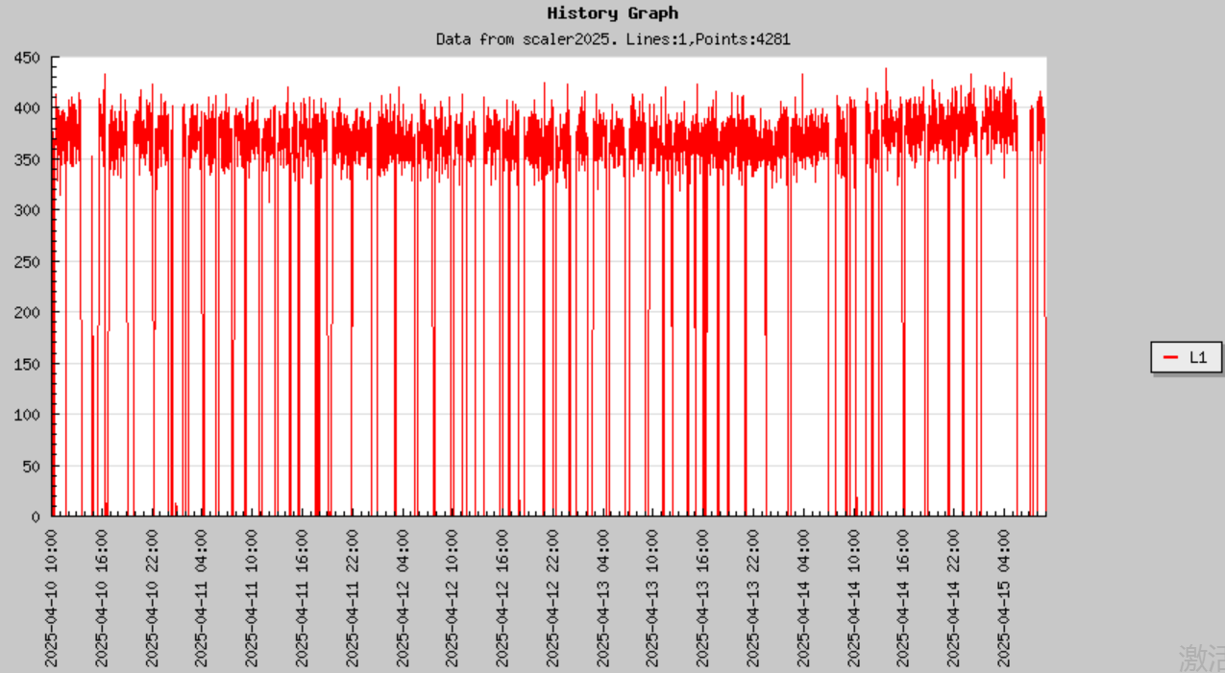
L1 trigger rate on April 12-14

