Slide 1
Group meeting
张旺
2025.4.11

Slide 2
Work done
BBbar Background
Signal Yield
Bootstrap cal
Bachelor thesis draft
Next to do
CS MC vs offres data

Slide 3
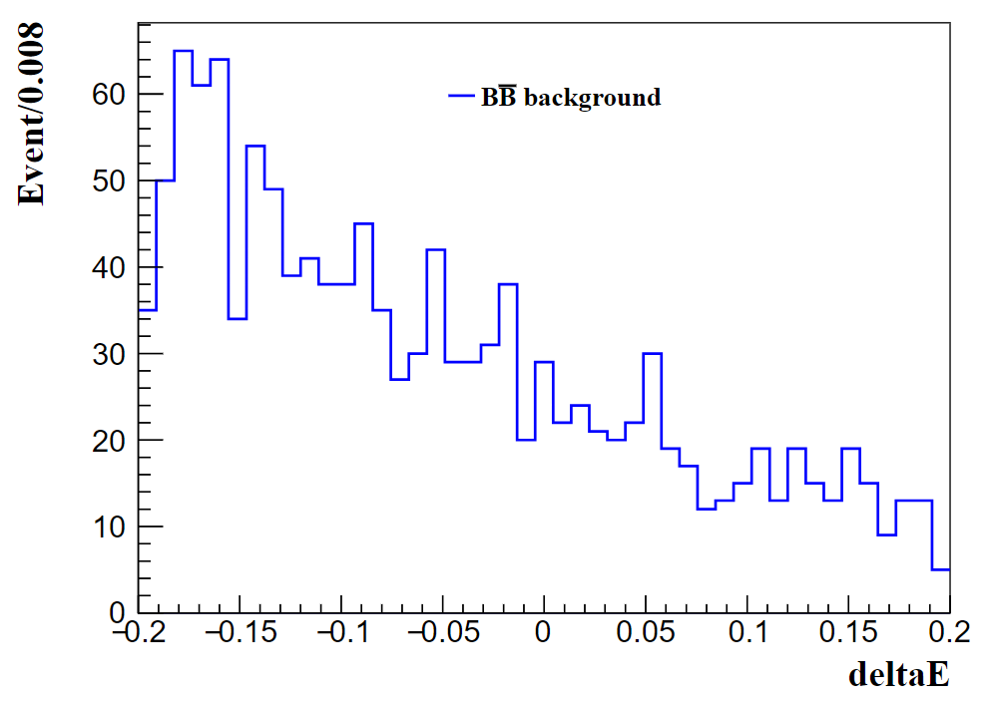
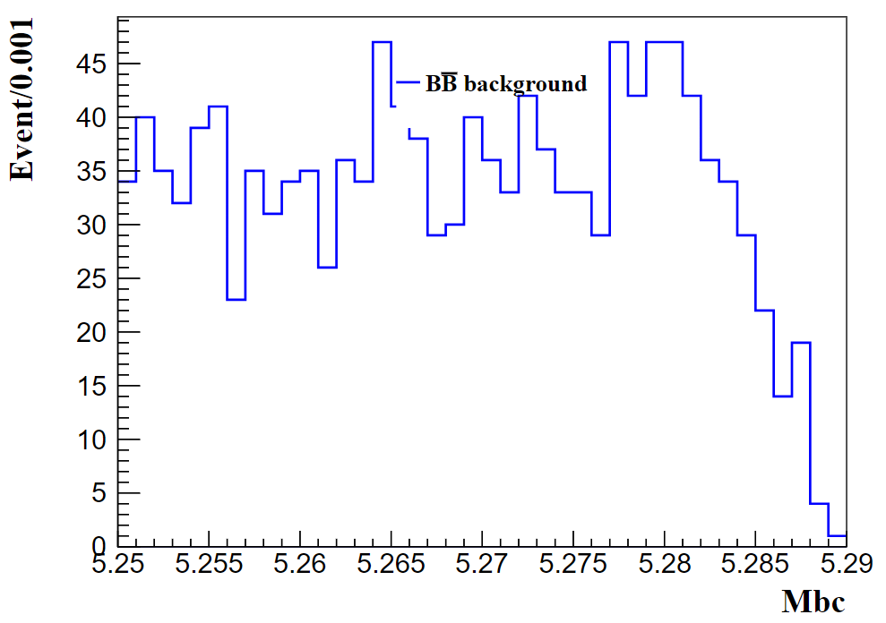
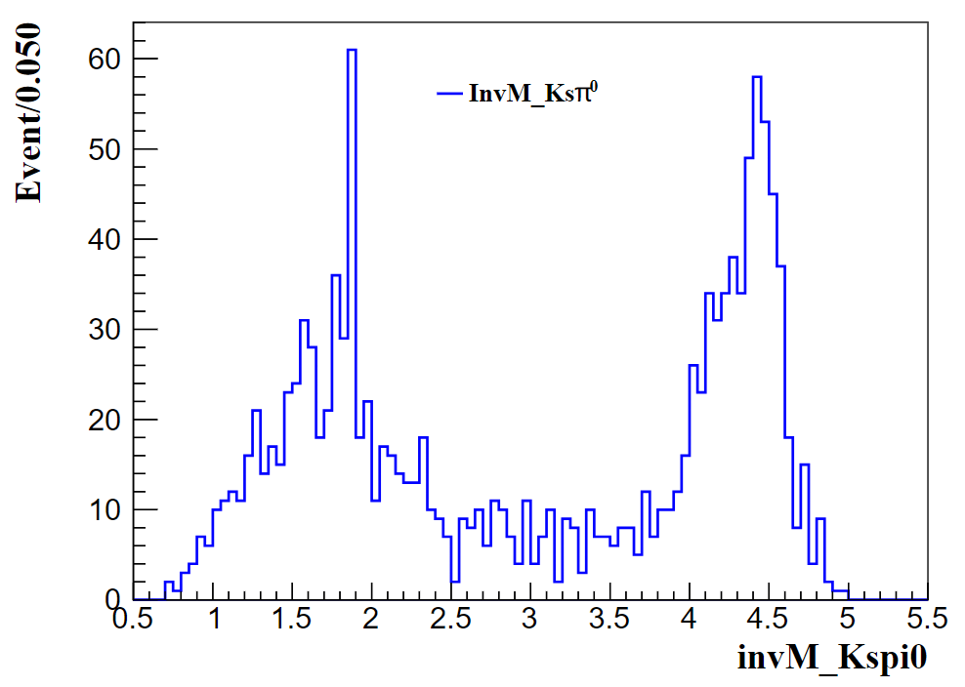
BBbar background

Slide 4
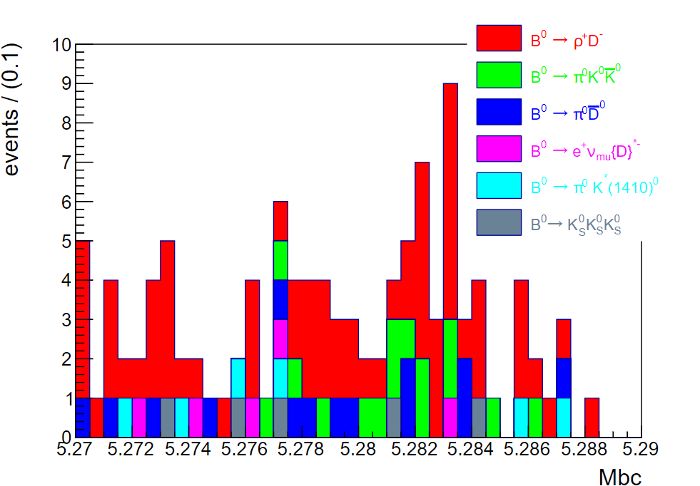
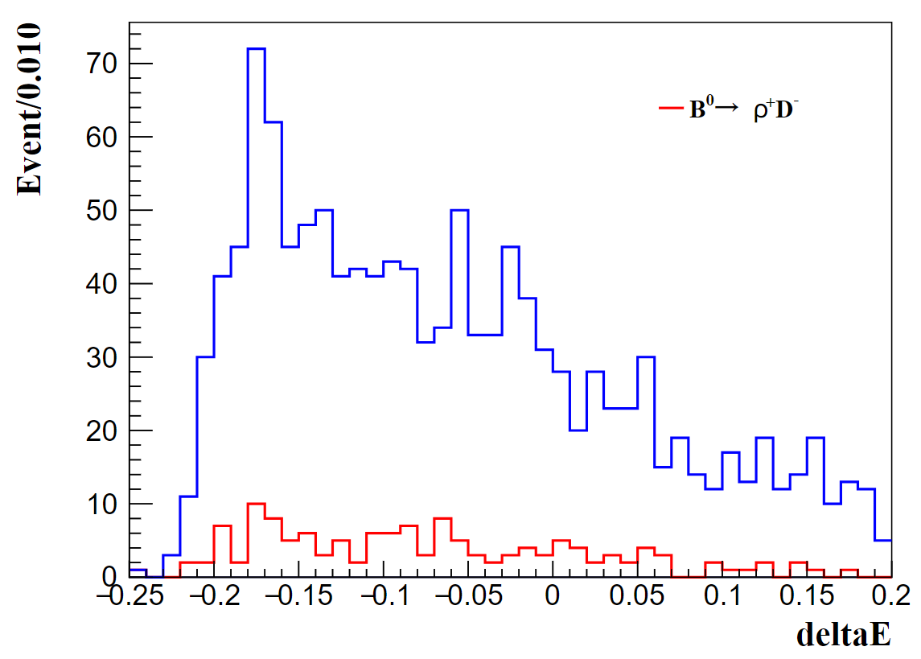
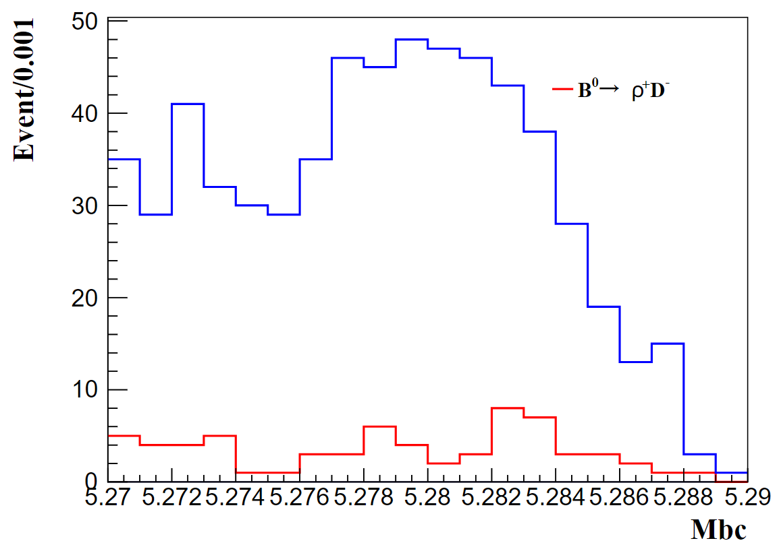
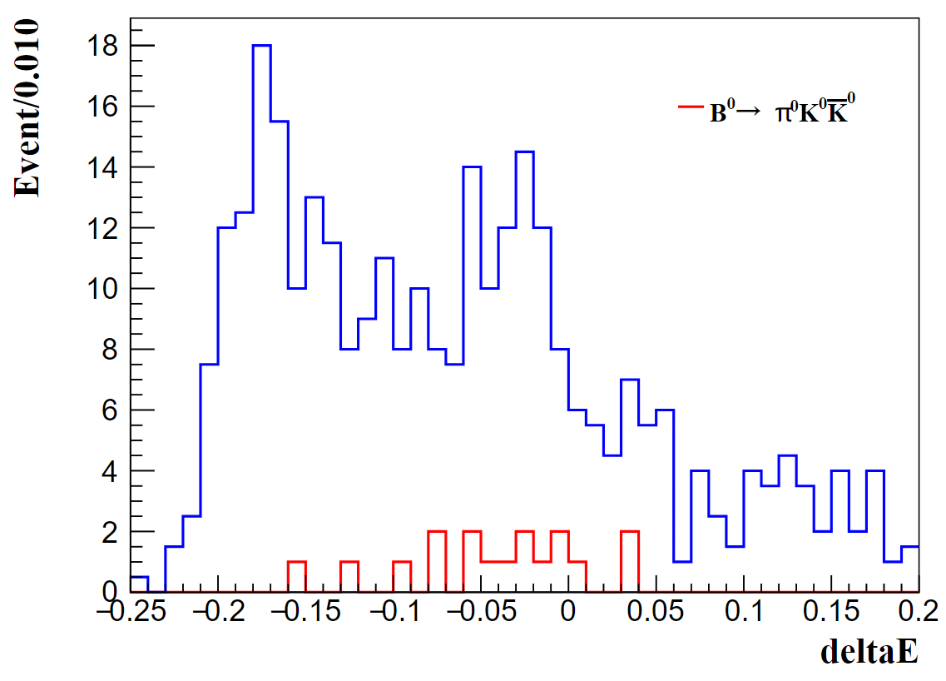
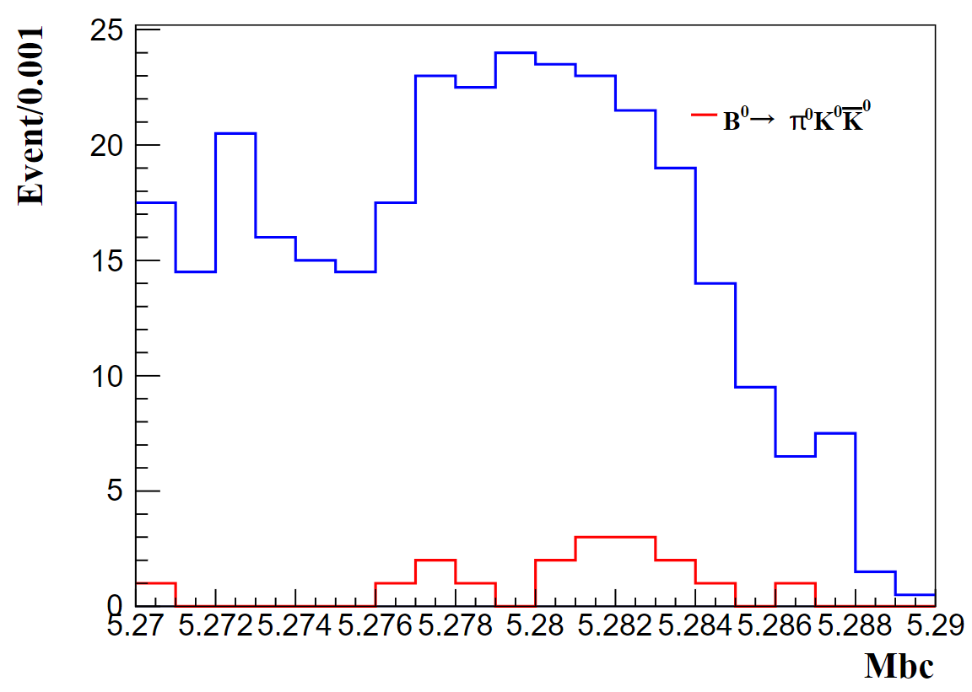
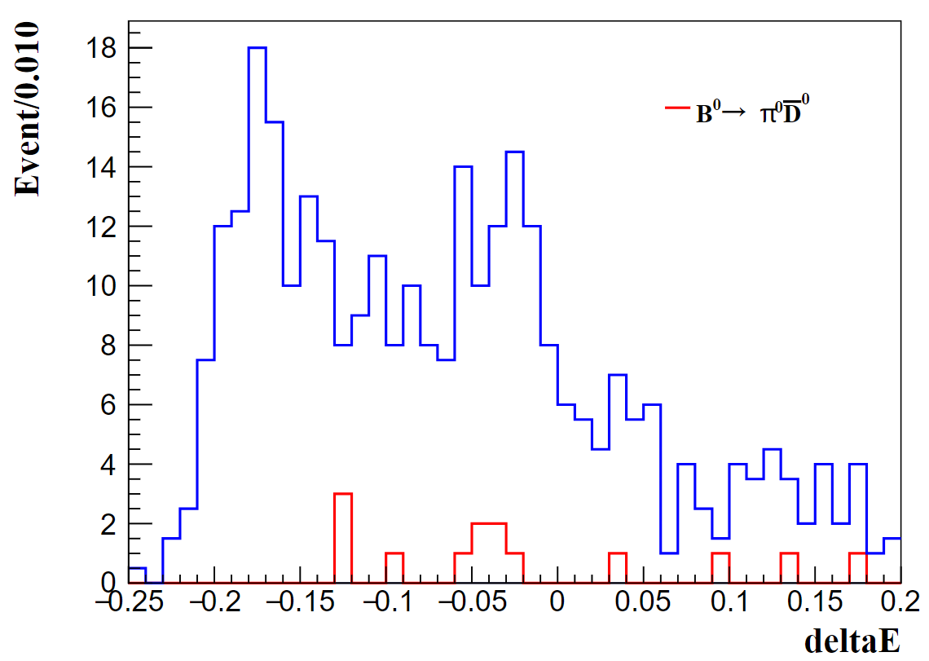
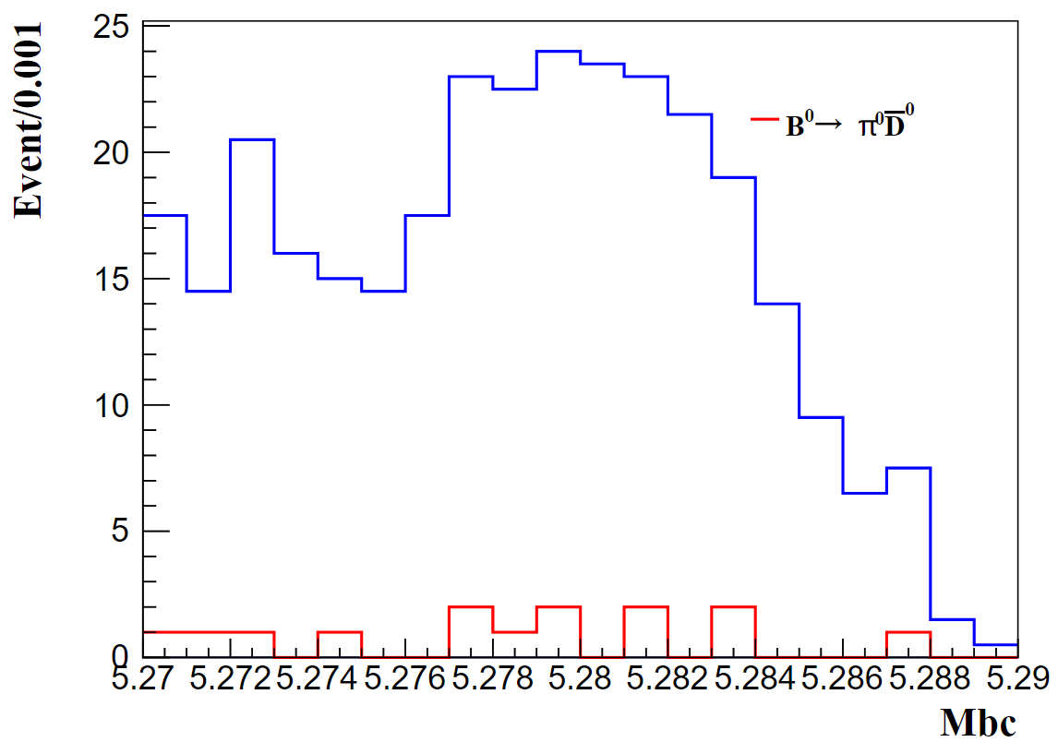
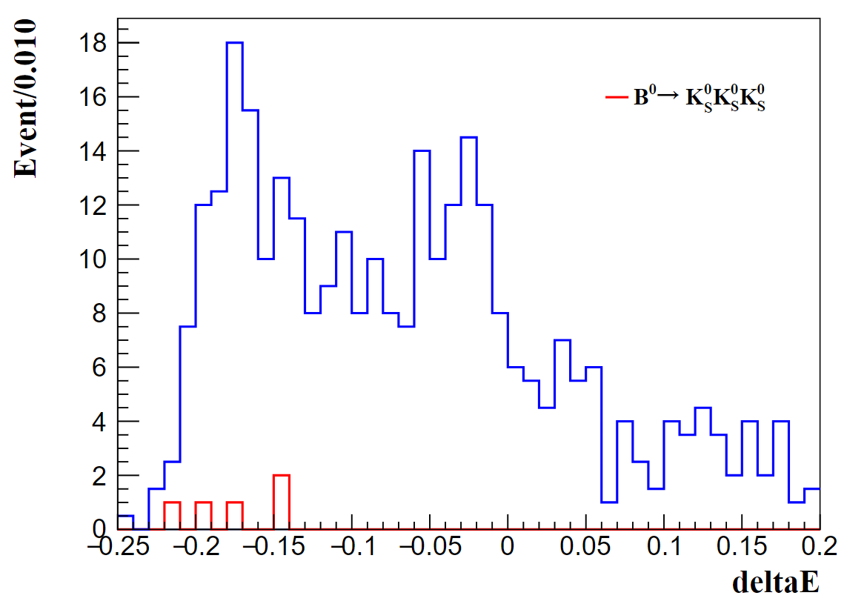
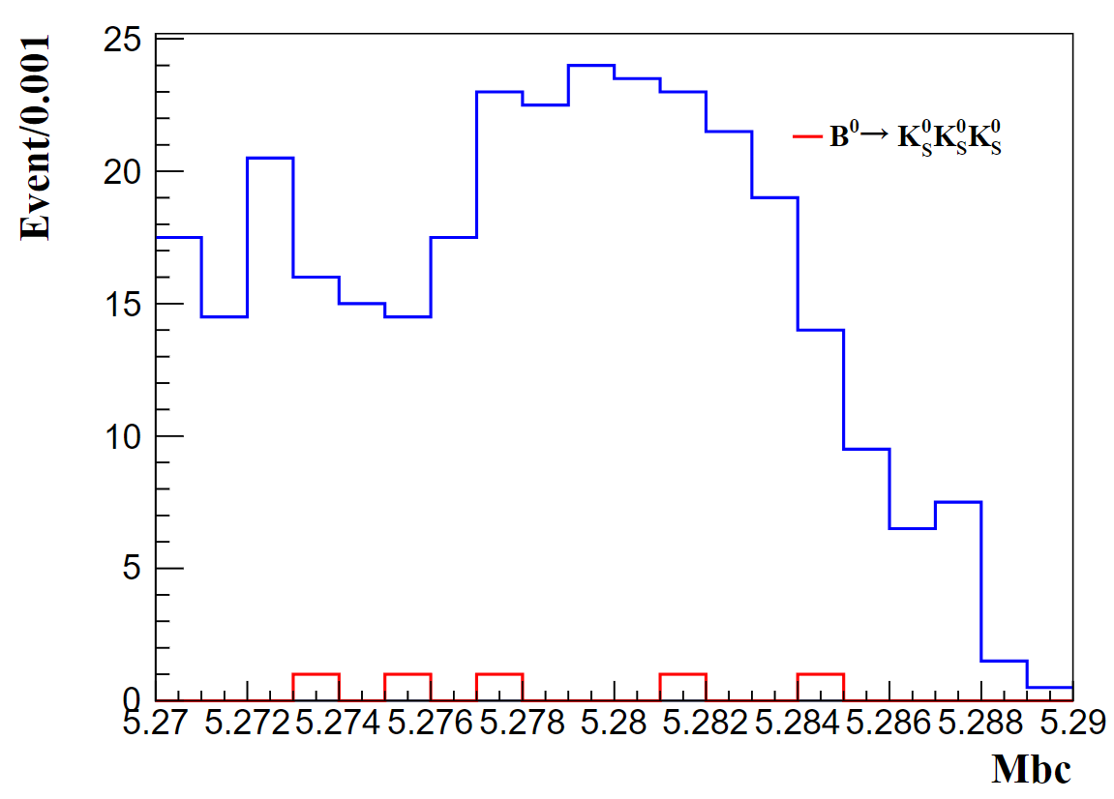
BBbar background--peaking bkg search
cut: 5.27<Mbc<5.29
topoana

Slide 5
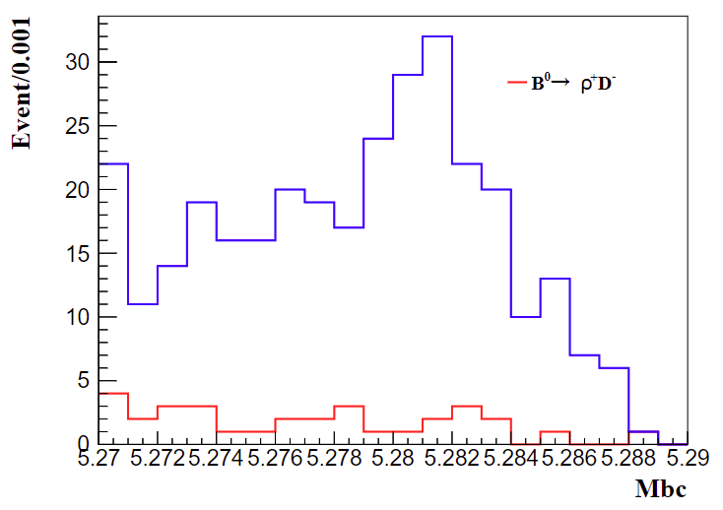
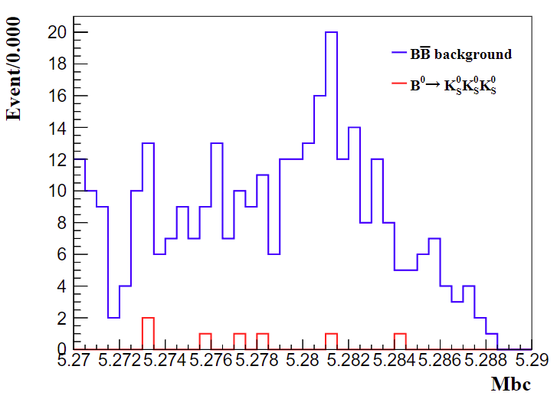
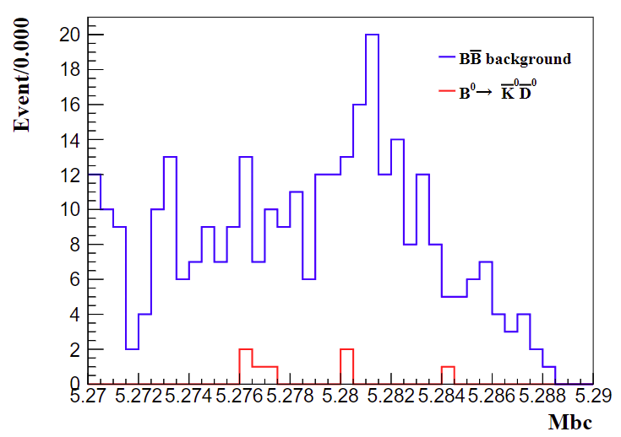
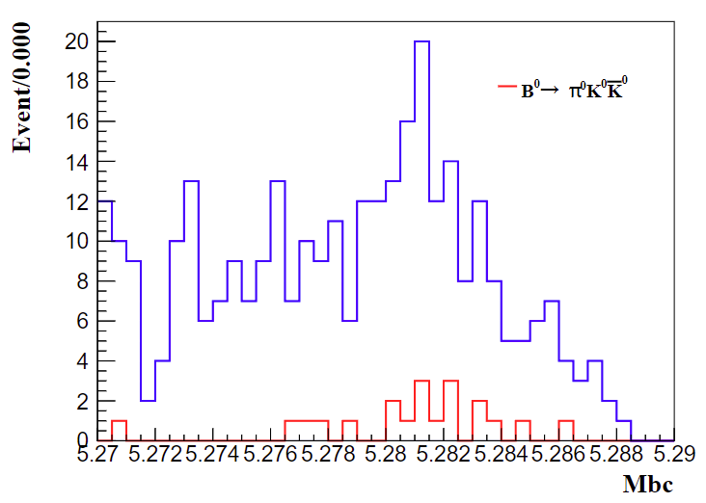
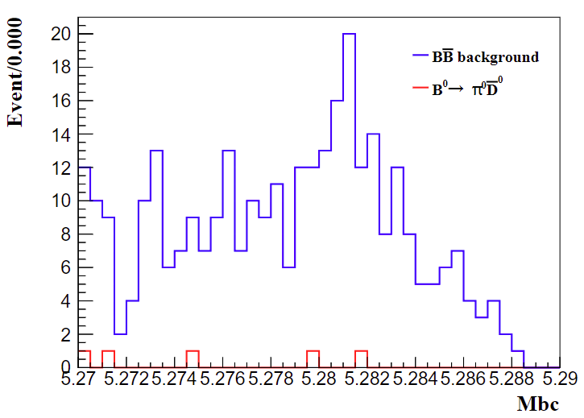
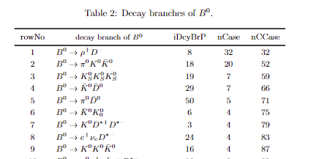
BBbar background--peaking bkg search
cut: 5.27<Mbc<5.29
topoana

Slide 6
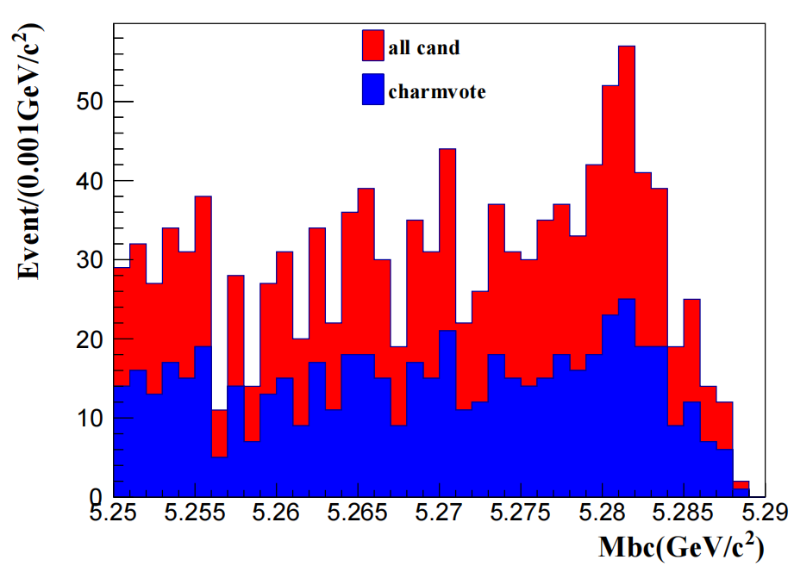
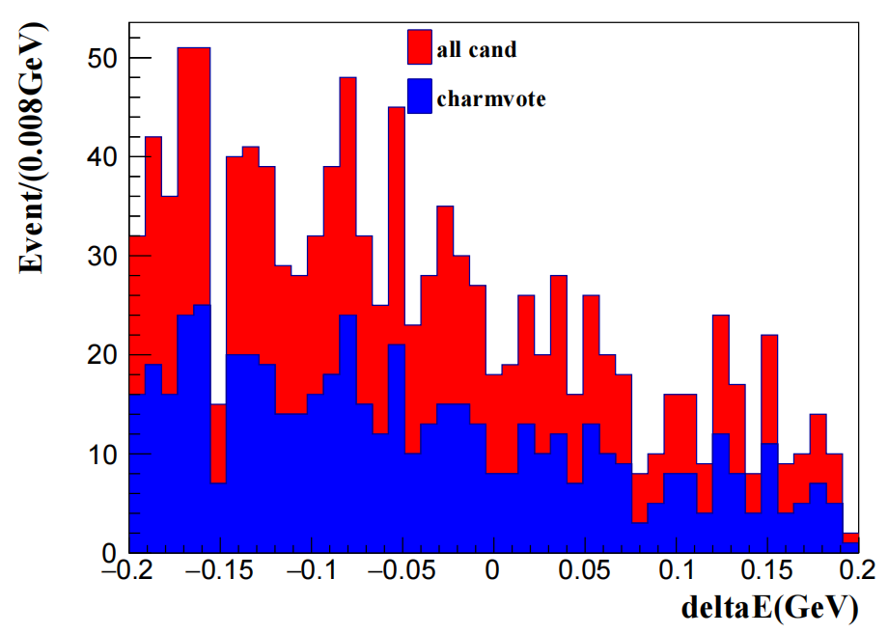
BBbar background--charm veto
cut: 5.27<Mbc<5.29
charm veto :$1.815<InvM(Kspi0)<1.899 GeV/c2$
after all cuts, eff = 14.11% SCF = 6.24%

Slide 7
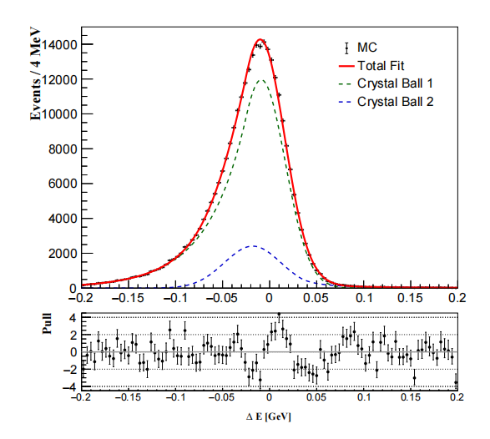
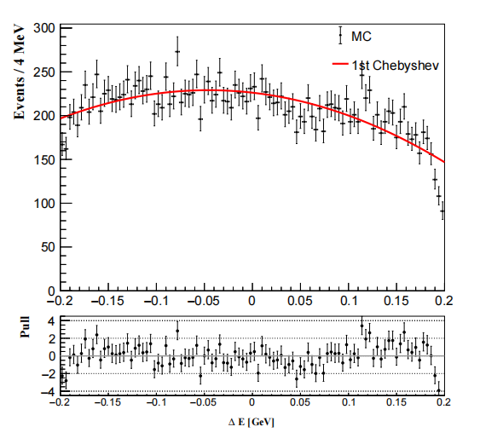
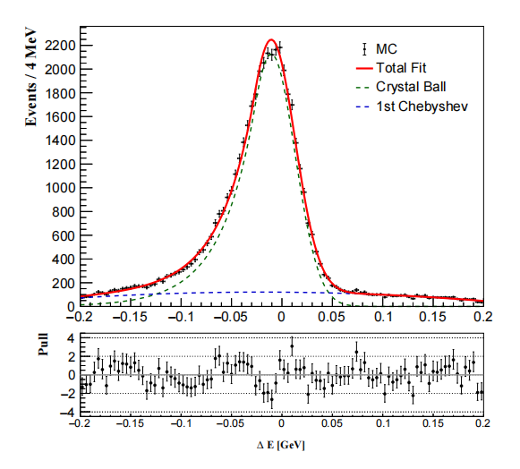
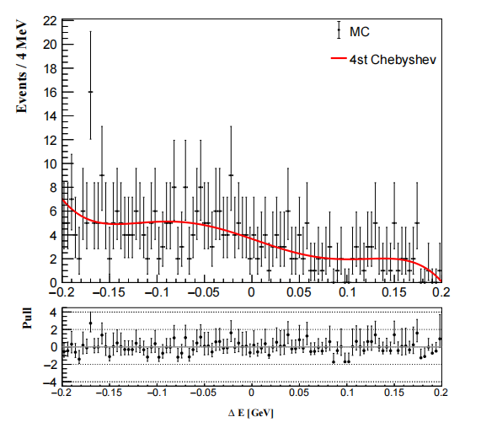
Signal Yield
components
CR Signal
SCF Signal
qqbar
BBbar
1D maximum likelihood---deltaE
Signal region:[-0.2, 0.2 GeV]
PDF
CR double CB function
SCF CB + 1st Chebyshev
qqbar 1st Chebyshev
BBbar 4st Chebyshev
CR Signal
qqbar
SCF Signal
BBbar

Slide 8
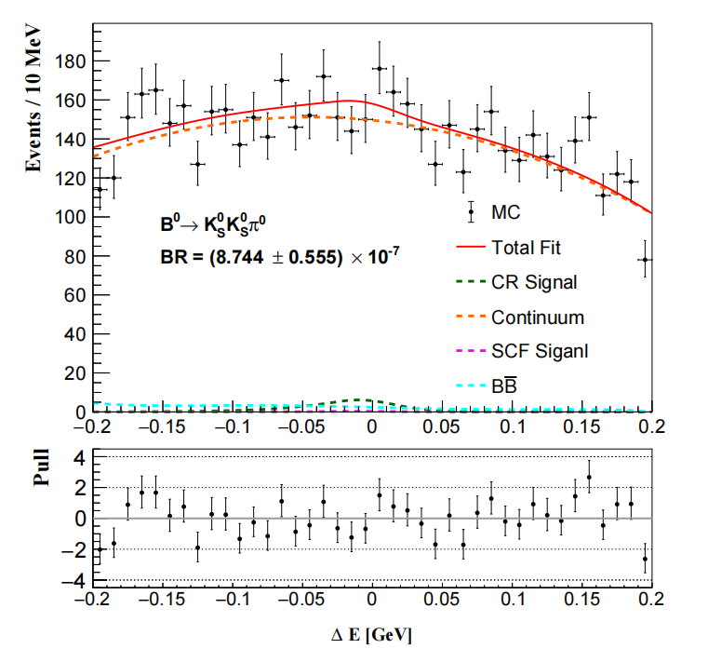
Signal Yield
1D maximum likelihood---deltaE
Signal region:[-0.2, 0.2 GeV]
Bootstrap --- scaled to 365 fb⁻¹
Input entires
CR : 48
SCF : 3
qqbar : 5539
BBbar : 96
fit result
CR : 49.98 ± 3.17
SCF : 3.12 ± 0.20
qqbar : 5540.58 ± 67.67
BBbar : 93.39 ± 3.94

