Slide 1
Some feedback from IDRC review 1
“Our response to the previous evaluation (Oct. 2024) has been excellent”
The scope of the physics performance studies has significantly broadened
Many improvements are still possible and recommended
The text should be improved and shortened, by considering a more compact presentation of various aspects (PID, jet, etc.), in a clear and transparent way
Technical improvements related to a detailed simulation should be pursued: noise/events overlap, mis/alignments, calibration effects etc. and their effect on the physics performance
Photon conversion can be included as a test for tracking and material probe
Some random points out of my head:
Photon – behavior below 1 GeV
JER for light jets (ee->qq(uds))
Missing energy reconstruction: study with b- and c-jets with tagged leptons and/or with BSM channels with large Emiss
Benchmark points of b/c-tagging efficiencies versus misID at Z-pole and ZH should be given to give consistent performance comparison between BDT jet flavor tagging and JOI algorithm
A reference list/database of samples produced and their statistics should be established and updated, as well as “technical samples” for electron/muons or decaying K etc. which are also useful for PFA studies

Slide 2
Some feedback from IDRC review 2
Analysis review team composed of 11 senior colleagues established to ensure a correct and timely publication of results in TDR
Presentation and motivation should be enforced and oriented to the scope of the present TDR: demonstrate the feasibility and the physics reach/potential of the reference detector
The discussion of each item listed in the benchmark table should be further addressed, e.g. what advantages/disadvantages are expected with/without the corresponding detector performance
Longer term
Tracking performance may be tested with exotic configuration (e.g. LLP)
Photon conversion can be considered/described in PFA
Might be better to have a separate chapter for jet flavor tagging, as JOI is almost an assembly of most of the sub-detectors, and and it would be interesting to give an “ideal vs. compromised” performance comparison of these sub-systems, and see how experimental systematic uncertainties can be derived in this AI approach
As the confusion matrix M11 suggests that JOI can distinguish b/c/s quarks from their antiquarks, physics benchmarks of flavor AFB measurements of b/c/s-quarks should be added
“Data challenges”

Slide 3
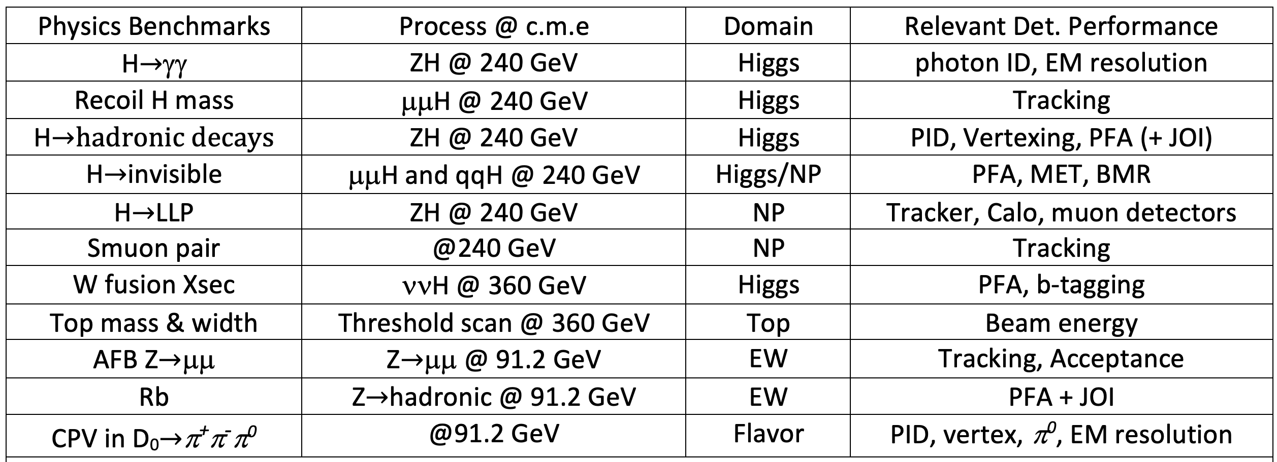
Benchmarks and relevant Det. Perf.

