Slide 1

24/3/2025
Status Report: H Recoil Mass
Yuji Li

Slide 2

Status
Validation for MuID in all Samples
New cut-flow checking with PID
PID WP: 90% & 20<p<80 for each muon
Best Z candidate: mimimize the chisquare
Limitation: Low statistic for fitting

Slide 3
Event Selections: Summary and cutflow(PID)
Process | zz_l0mumu | 4mu | sznu_l0mumu | sl0mu_down | sl0mu_up | zzorww_ll | 2fermion | H->incl.
xs | 19.38 | 15.56 | 43.32 | 136.14 | 87.39 | 221.1 | 5332.71 | 6.77
input | 40000 | 40000 | 40000 | 40000 | 40000 | 40000 | 40000 | 40000
2 muons | 10179 | 14600 | 6304 | 9889 | 8940 | 11117 | 4056 | 30691
110<recoil mass<150 | 2156 | 5166 | 2048 | 2166 | 2008 | 4221 | 1544 | 29961
MEZ<50 | 1264 | 3470 | 1355 | 1951 | 1760 | 3446 | 557 | 29586
E_ll<110 | 1137 | 3145 | 1222 | 1762 | 1581 | 2399 | 464 | 29396
20<P_ll<60 | 778 | 1926 | 855 | 1144 | 999 | 1454 | 90 | 26347
50<m_ll<120 | 772 | 1696 | 845 | 918 | 767 | 1413 | 90 | 26324
selected | 390 | 1696 | 845 | 918 | 767 | 1413 | 90 | 26324
eff | 0.0193 | 0.0424 | 0.0211 | 0.0229 | 0.0192 | 0.0353 | 0.002 | 0.658

Slide 4
Event Selections: Summary and cutflow(GENMatch)
Process | zz_l0mumu | 4mu | sznu_l0mumu | sl0mu_down | sl0mu_up | zzorww_ll | 2fermion | H->incl.
xs | 19.38 | 15.56 | 43.32 | 136.14 | 87.39 | 221.1 | 5332.71 | 6.77
input | 20000 | 20000 | 19800 | 18400 | 18600 | 20000 | 98000 | 44000
2 muons | 4842 | 6923 | 2953 | 4386 | 4053 | 5584 | 10391 | 34690
110<recoil mass<150 | 1063 | 2383 | 1001 | 976 | 957 | 2209 | 3802 | 33636
MEZ<50 | 676 | 1768 | 681 | 929 | 904 | 1834 | 1506 | 33267
E_ll<110 | 607 | 1514 | 630 | 830 | 818 | 1291 | 933 | 33052
20<P_ll<60 | 402 | 933 | 434 | 514 | 518 | 812 | 133 | 29780
50<m_ll<120 | 390 | 831 | 425 | 414 | 405 | 783 | 109 | 29752
selected | 390 | 831 | 425 | 414 | 405 | 783 | 109 | 29752
eff | 0.0195 | 0.0415 | 0.0215 | 0.0225 | 0.0221 | 0.0391 | 0.0011 | 0.676

Slide 5
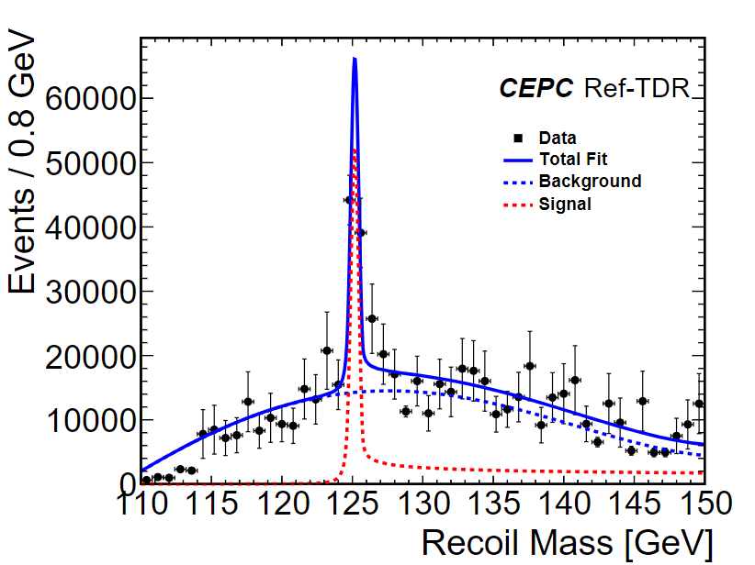
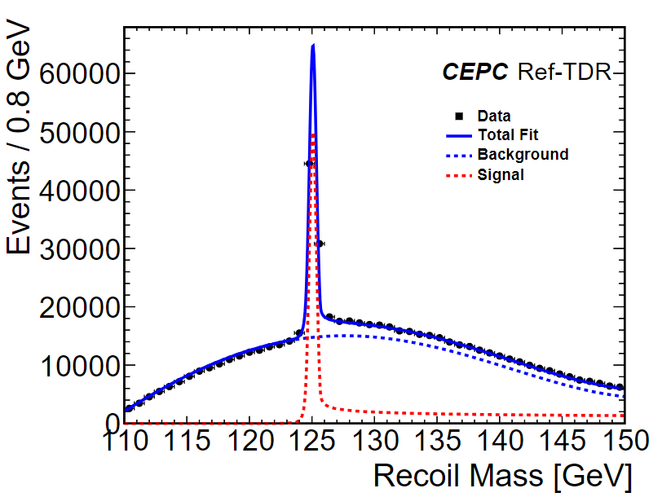
Fitting performance in MuID, Error(mH=125)=1.7MeV
simulation
GenMatch

