Slide 1
Low-Level RF Systems Based on MicroTCA.4
Gan Nan
Institute of High Energy Physics, CAS
2025.09.15

Slide 2
1
2
Introduction
MTCA.4 LLRF
System Hardware
CONTENT
3
4
FPGA Framework & Software Implementation
Summary

Slide 3
LLRF Introduction
01

Slide 4
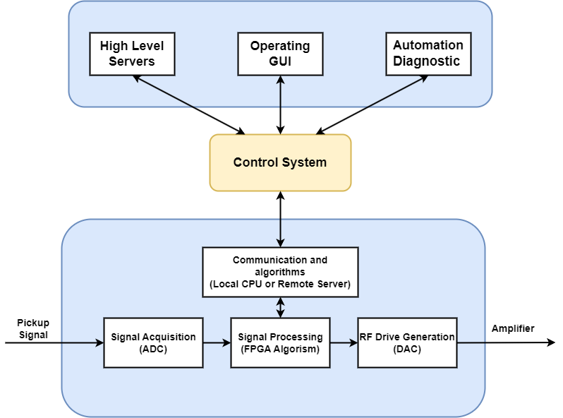
LLRF System
Low Level Radio Frequency
Regulates the amplitude and the phase of the accelerating voltage inside a RF cavity is essential to ensure the stable operation of charged particle accelerator
Basic requirements:
Cavity Field Control (RF loops)
Cavity Resonance Control (frequency loops)
High speed data acquisition
Built-in system diagnosis
Automation commission
Exception handling procedures
System Architecture:
Pizza box: Individually developed and purpose-built hardware
Crate-based: Highly modularity and scalability

Slide 5
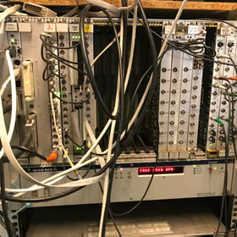
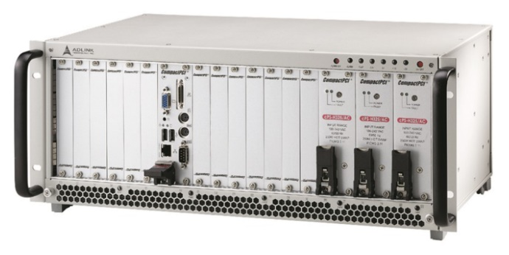
Motivation for MicroTCA.4
Limitations of VME/CPCI/PXI:
Low bus bandwidth
Lack of support for serial fabrics
Insufficient intelligent control support
Requirements in the High-Energy Physics
High data rate
Scalable modular system
Shelf management and monitoring
Redundancy
Hot swap capability
Evolved from ATCA/MTCA
Modern, high-speed data transfer
Redundant fans/power supply
Intelligent platform management
Excellent signal quality
Internal clock & trigger distribution

Slide 6
MTCA.4 LLRF
System Hardware
03

Slide 7
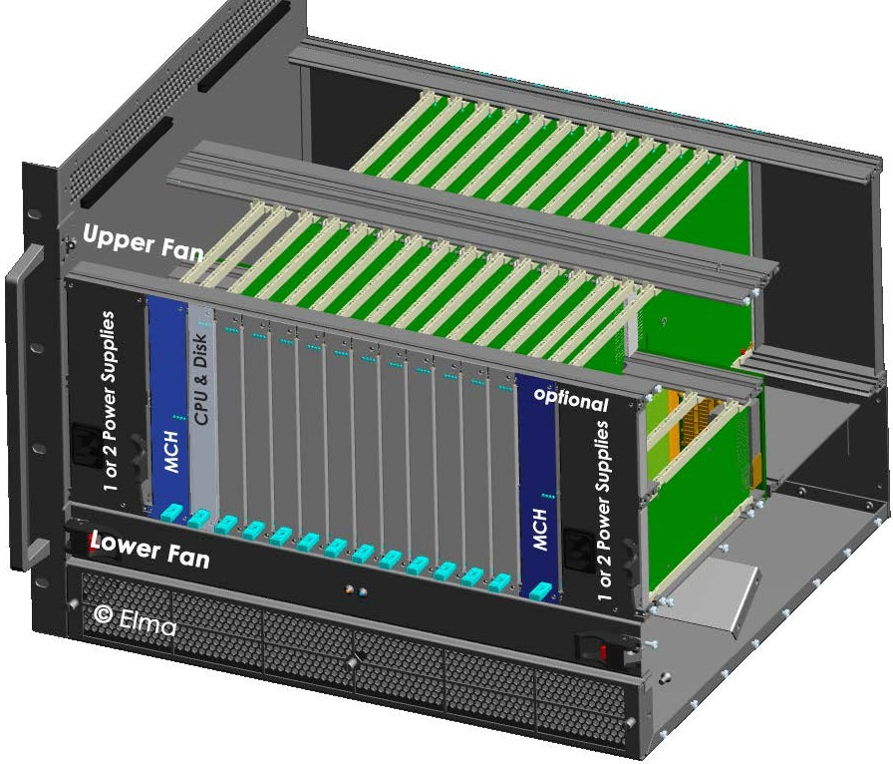
MTCA.4 LLRF: Overview
ADC, DAC, FPGA
Mostly COTS
RTM
Boards
RF interface, I/O extension
In-house development or COTS
AMC
Boards
Power Supply
MicroTCA Carrier Hub
Processor
Board
Redundant
PSU & MCH

Slide 8
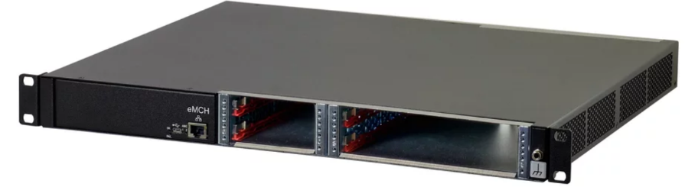
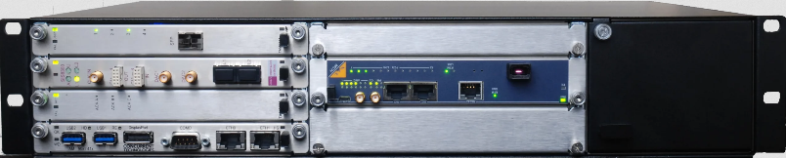
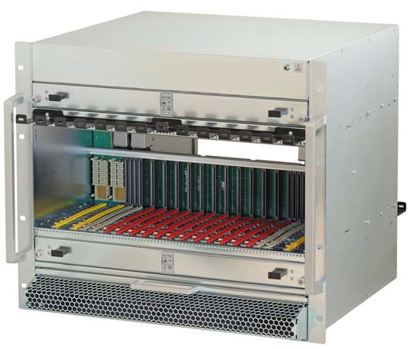
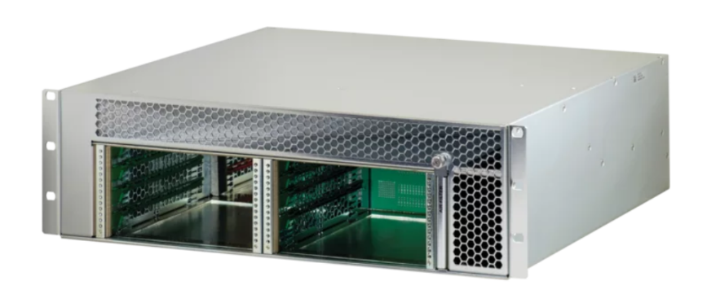
Chassis selection
1U Chassis
• Integrated eMCH
• 2-slot Double Mid-Size AMC w/ RTM
• 2-slot Single Mid-Size AMC
• Integrated PSU
2U Chassis
• 5-slot Double Mid-Size AMC w/ RTM
• 1-slot Double Full-size AMC
• 1-slot Double Full-size MCH w/ RTM
• 1 Double Full-size PM
3U Chassis
• 4-slot Double Mid-Size AMC w/ RTM
• 1-slot Double Mid-size AMC
• 1-slot Double Full-size MCH
• 2 Double Full-size PM
9U Chassis
• 12-slot Double Mid-Size AMC
slots w/ RTM
• 2-slot Double Full-size MCH w/ RTM
• 4 Double Full-size PM

Slide 9
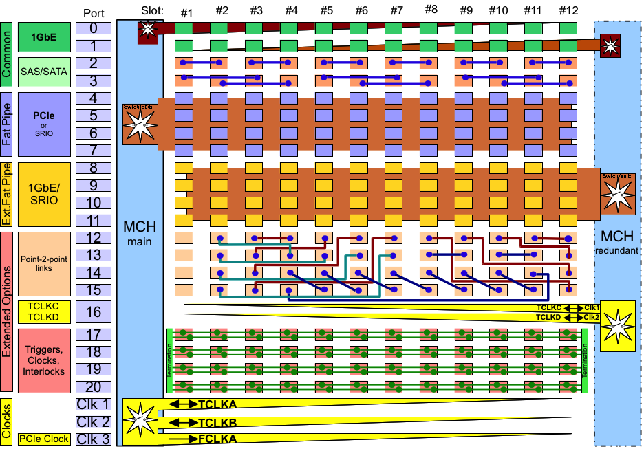
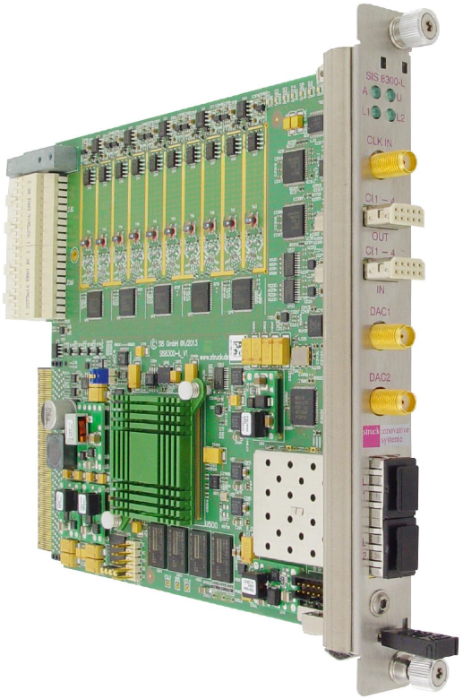
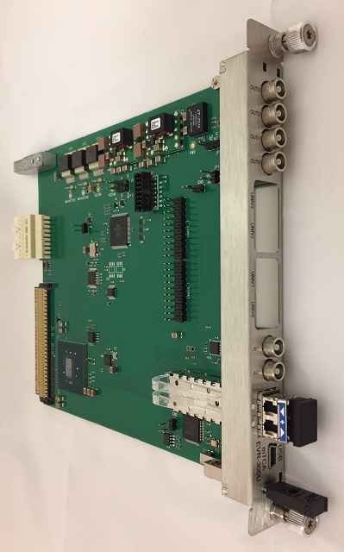
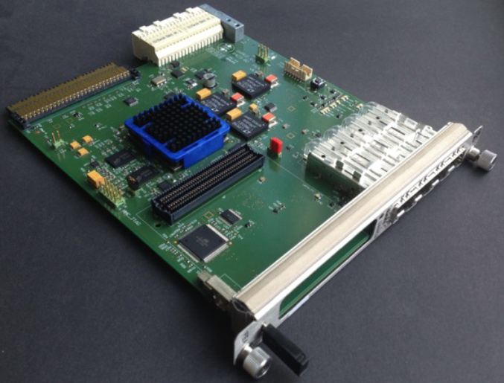
Backplane Connections
MLVDS
Shared between all slots
200Mbps max
Triggers, interlocks, clocks, ...
Usually one transmitter and multiple receivers
Example: interlock and trigger interconnect between digitizer, EVR or interlock board
Timing
Trigger
MPS Interlock
mTCA-EVR-300U
SIS8300L2
DAMC2

Slide 10
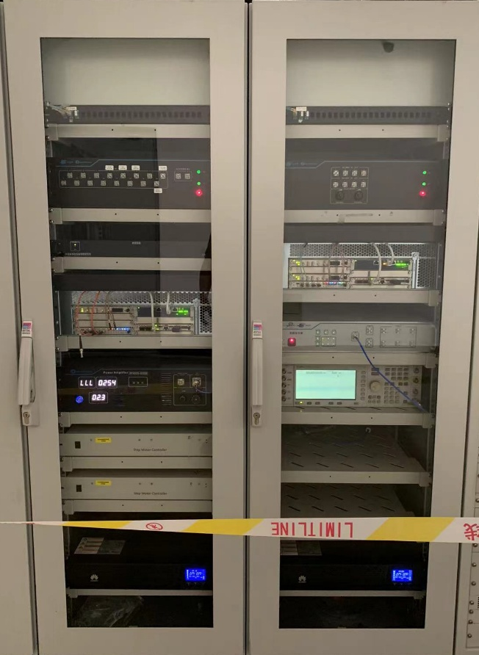
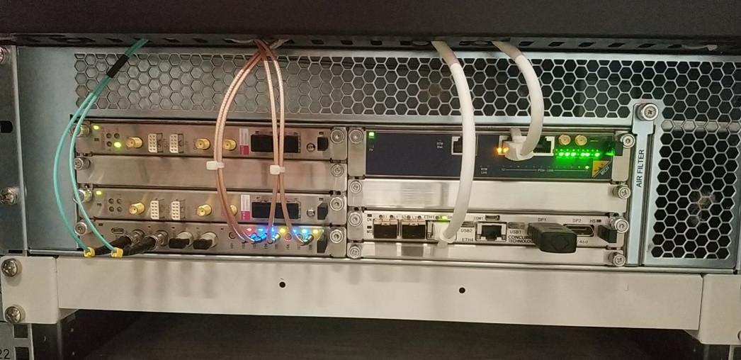
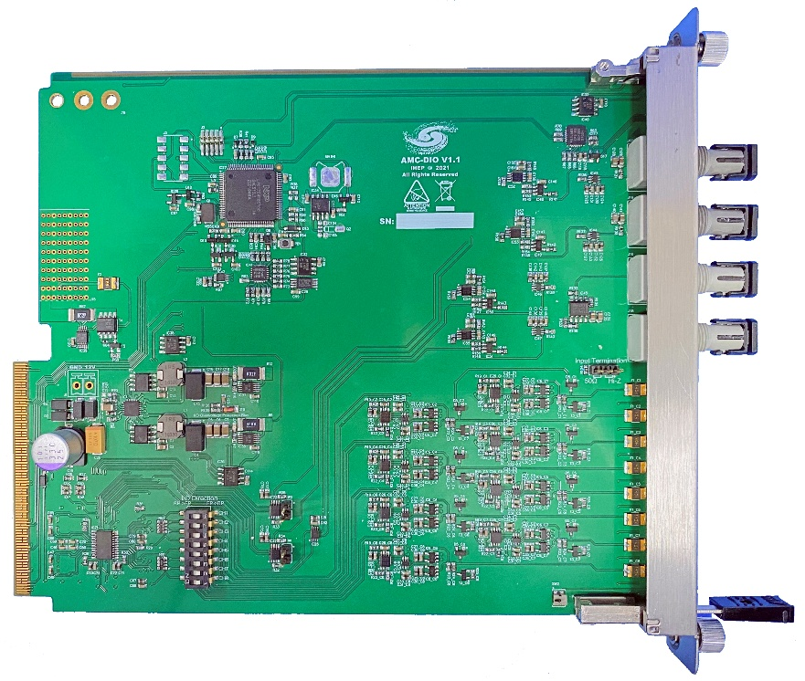
Backplane Connections
Digital I/O AMC in the IHEP LLRF System
A multi-channel digital signal input/output AMC module compliant with the MTCA.4 standard, primarily designed for Low-Level RF (LLRF) systems to manage timing distribution and interlock signal fan-out.
Key Features:
Form Factor: Dual-width MTCA.4 AMC module
Electrical I/O: 8-channel digital signal input/output with configurable direction
Optical I/O: 2-channel optical signal input and 2-channel optical signal output
Backplane Interface: M-LVDS fan-out via backplane
Management: Integrated MMC management module, Voltage, current, and temperature monitoring
Flexibility: Configurable input/output impedance

Slide 11
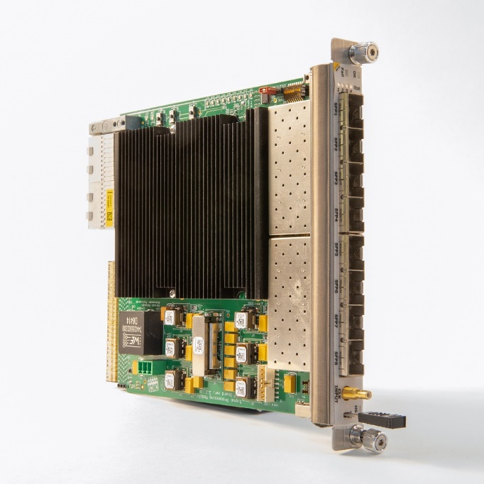
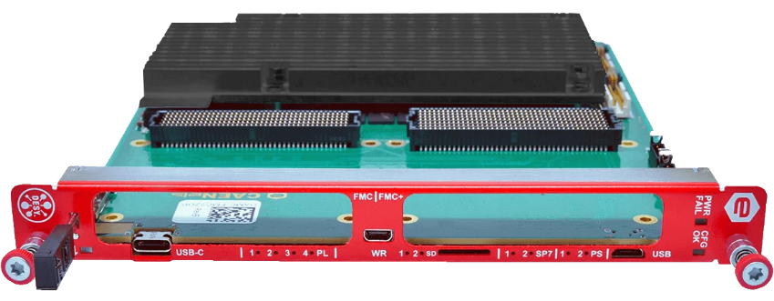
Backplane Connections
Point-to-point links
Direct communication between boards, used for data aggregation
Protocol selection up to application: Aurora, 8b/10b, (10)G Ethernet
Example: Data exchange between master-slave digitizer for multi-cavity LLRF control, superconducting cavity with resonance controller
Data
Processing
Cavity
Tunning
Processing Board
Digitizer
FMC Carrier

Slide 12
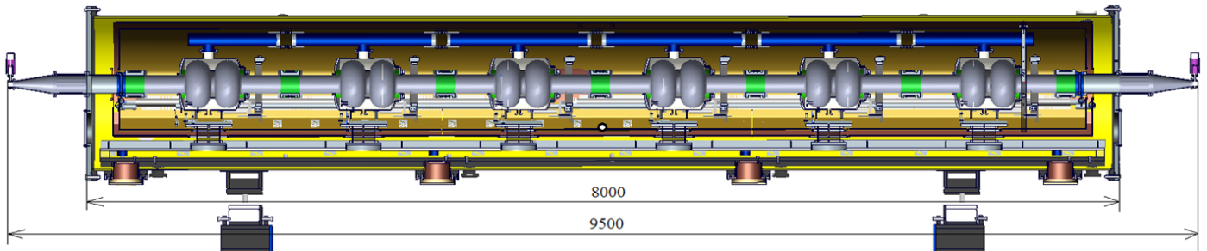
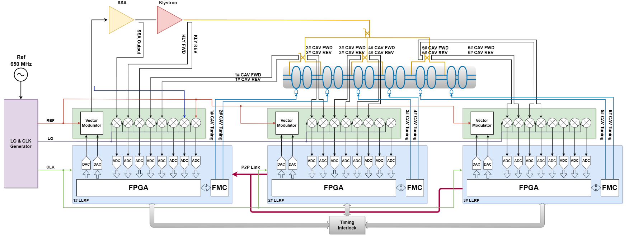
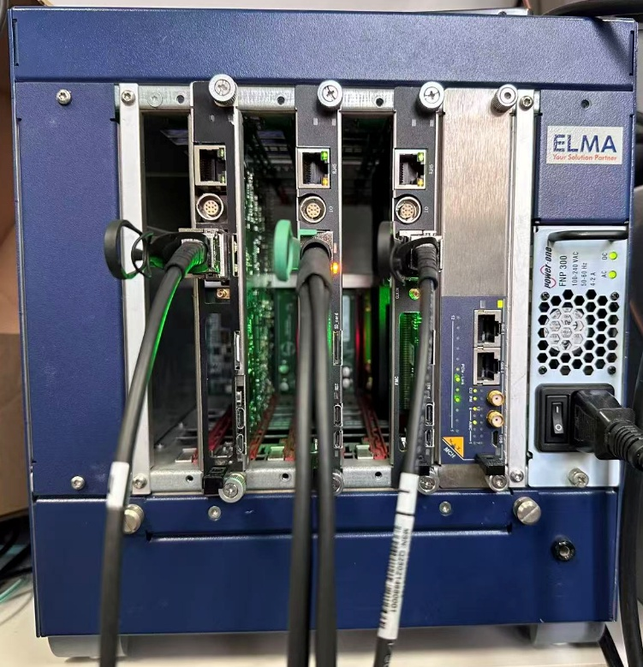
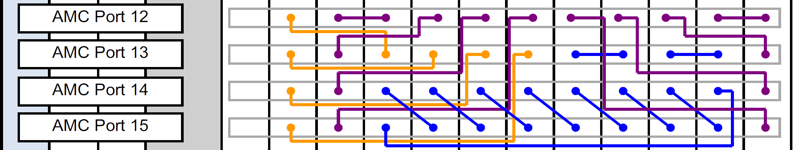
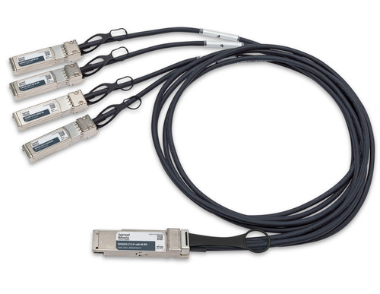
Backplane Connections
LLRF system for CEPC EDR Full-scale 650 MHz cryomodule
Cryomodule Design:
Six 2-cell superconducting cavities
Operating gradient: 25 MV/m
Quality factor Q₀=3×10¹⁰
1 klystron RF system powers all 6 cavities
Vector-Sum LLRF Control System
Multi-FPGA architecture for cavity signal acquisition and processing
Low-latency point-to-point links transmit probe, forward, and reflected signals to the master controller
Simplify the system architecture while ensuring high performance, flexibility and reliability
Different topologies: Daisy Chain, Concentrator

Slide 13
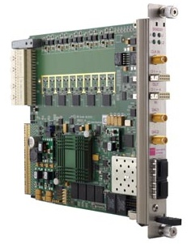
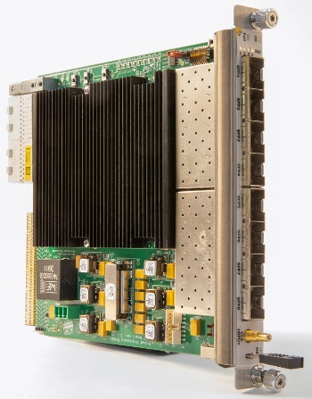
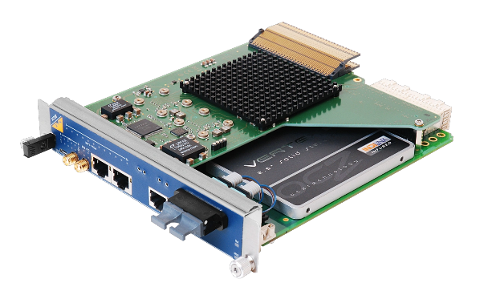
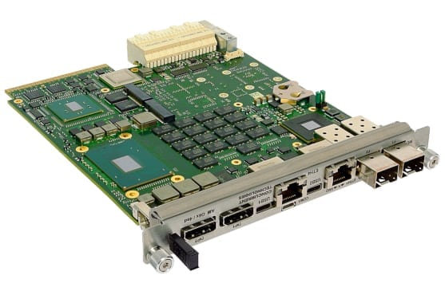
Backplane Connections
Gigabit Ethernet
1000BASE-KX
TX and RX diff pair at 1.25 Gbps
Examples: Ethernet interface of Zynq-based boards, UDP transceiver on FPGA
PCI Express
Gen 3 (8 GT/s), x4 (x8 in special crates) choice for many apps
Support for PCI Express Gen 4 and 5 in the latest specification and crate
Other protocols available (SRIO, 10/40Gb Ethernet )
PCIe Switch
ETH Switch

Slide 14


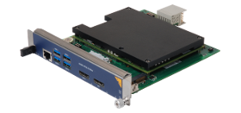

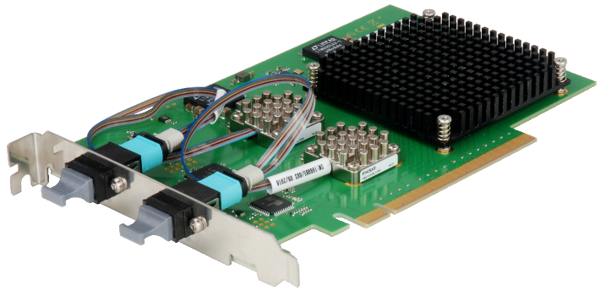
Computing Module
CPU module inside of crate
Processor performance limited by 80 W per slot power limit
Easy to operate and maintain
PCIe interface card for operation in PCs / servers
Optical PCIe Gen3 x8/x16 uplink
Obtaining higher computing and storage performance at a lower cost
optical uplink
PCIe interface card
NAT-PHYS80 MCH

Slide 15
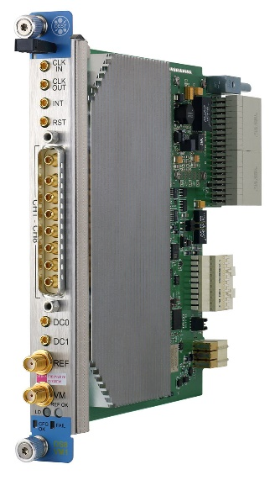
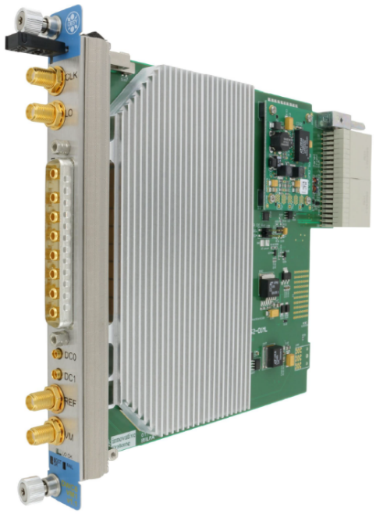
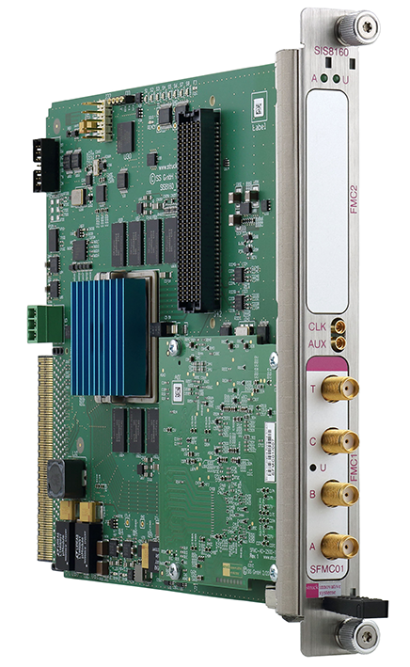
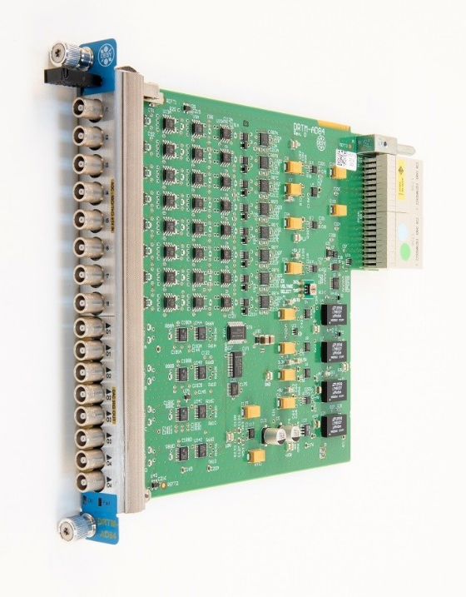

AMC & RTM Selection
Many AMCs and RTMs available on the market, LLRF system needs to make appropriate choices based on the system architecture and operating frequency band

Slide 16
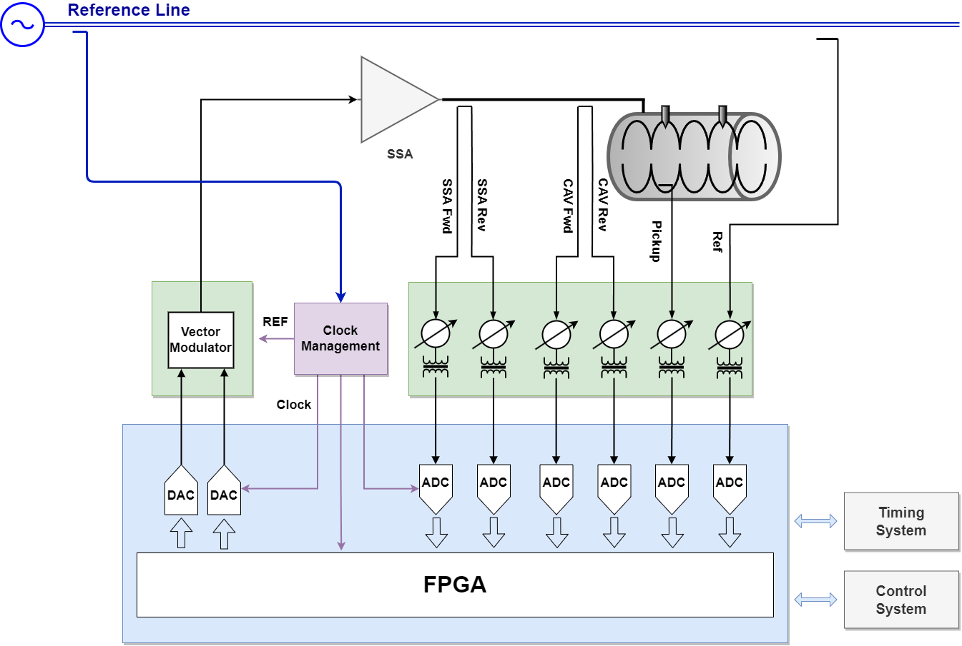
Direct Sampling Schemes with RTM
Latest generation of RF sampling ADCs digitize signals at frequency up to several GHz, which makes it possible to sample RF signal directly
Direct-sampling architecture provides flexibility and simplification for LLRF
Direct Sampling RTM
DC to 400 MHz DS front-end from struck
AMC Digitizer
10 channel 125MHz/16Bit digitizer

Slide 17
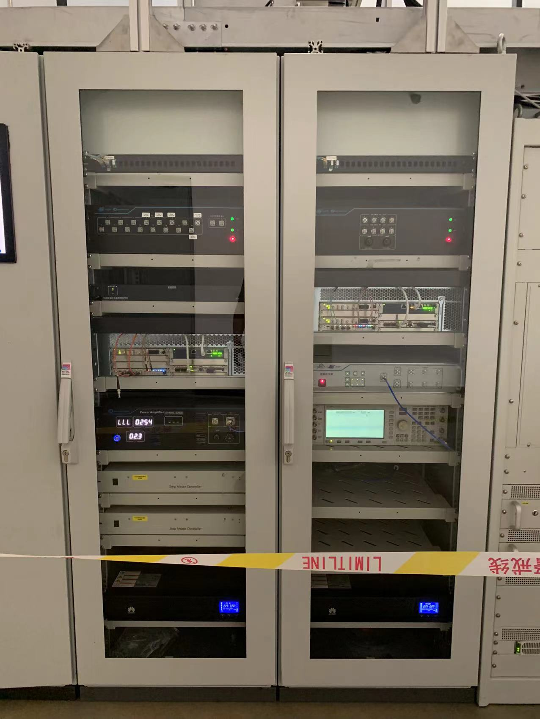
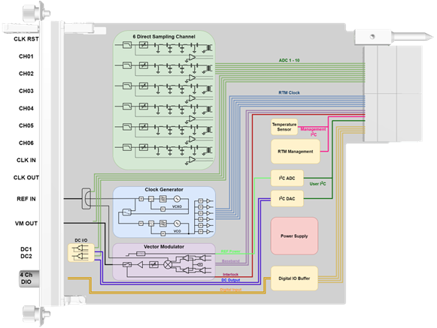
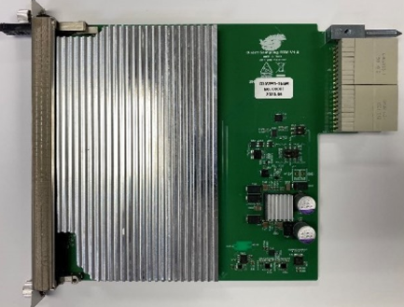
Direct Sampling Schemes with RTM
Direct-Sampling LLRF System with In-House Developed RTM at IHEP
Applied in the BEPCII sub-harmonic buncher LLRF system (142.8 / 571.2 MHz) and the HEPS sub-harmonic buncher LLRF system (166.6 / 499.8 MHz)
Phase Stability (RMS): 0.007° @ 166.6 MHz, 0.02° @ 499.8 MHz
6 × RF direct-sampling channels (DC – 600 MHz) plus VM/REF monitoring channels
Sampling clock generation from external clock or reference source
Dual-loop clock generator with external VCXO and selectable internal/external VCO, enabling a flexible and configurable clock scheme

Slide 18
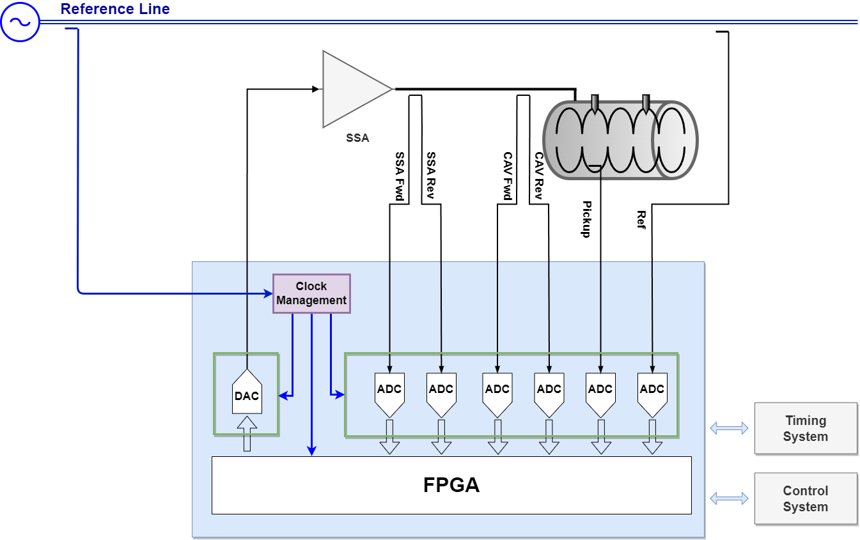
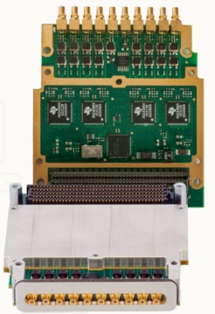
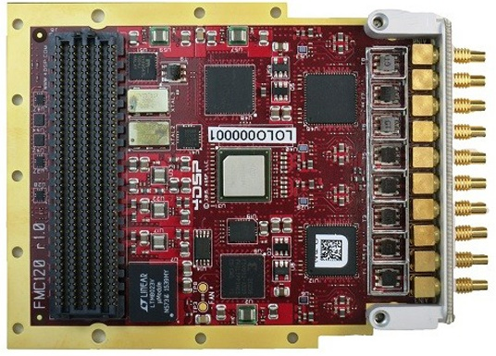
Direct Sampling Schemes with AMC Carrier
High frequency analog signal transfer over Zone3 can leads to crosstalk between different channels
Get rid of Zone 3 analog bandwidth limitations using carrier + FMC
Many COTS components for GSPS ADC and DAC
Carrier AMC
Dual HPC FMC Carrier
FMC Card

Slide 19
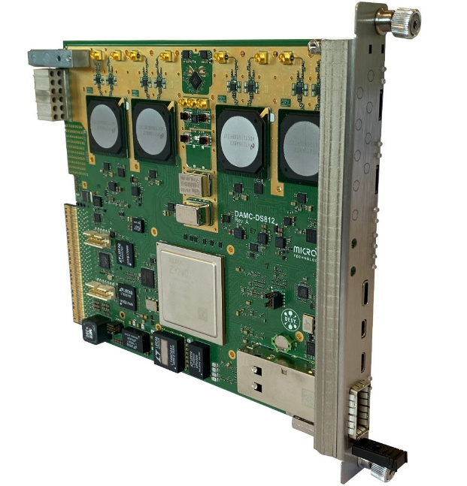
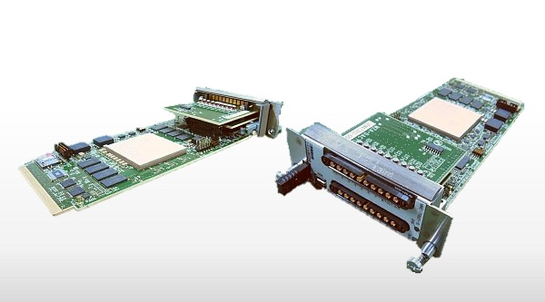
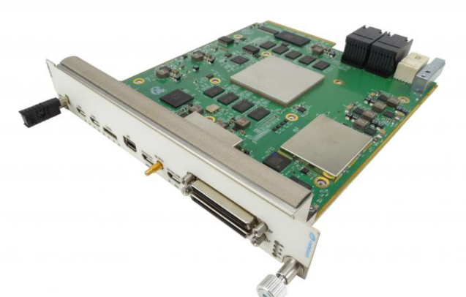
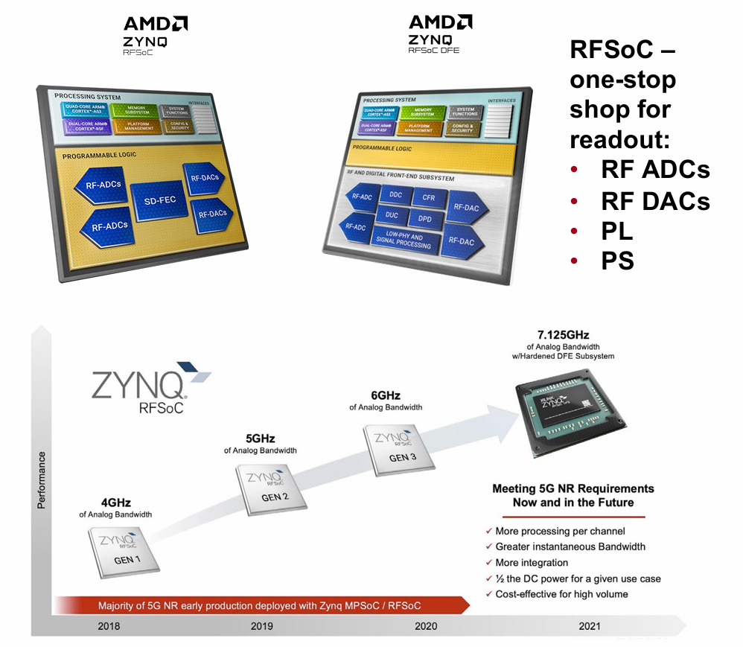
Other Direct Sampling Schemes
High sampling rate digitizer using single-ended analog RTM connection (Class RF1.0)
Zynq RF-SoC digitizer: highly integrated, more flexible, lower latency
DAMC-DS812ZUP
8 channels, 800 MSPS, 12 bit digitizer
MMC-TRX02-B RF-SoC
12bit, Sampling: 4GSPS, Bandwidth: 4GHz, Channels: 8ch
AMC576 RF-SoC
16 ADC (12-bit @ 2 GSPS)
16 DAC (14-bit @ 6.4 GSPS)
DAMC-DS5014DR
XCZU47DR
8ch 14 bits ADC, 5 GSPS, 6GHz analog BW
8ch 14 bits DAC, 10 GSPS, 4GHz analog BW

Slide 20
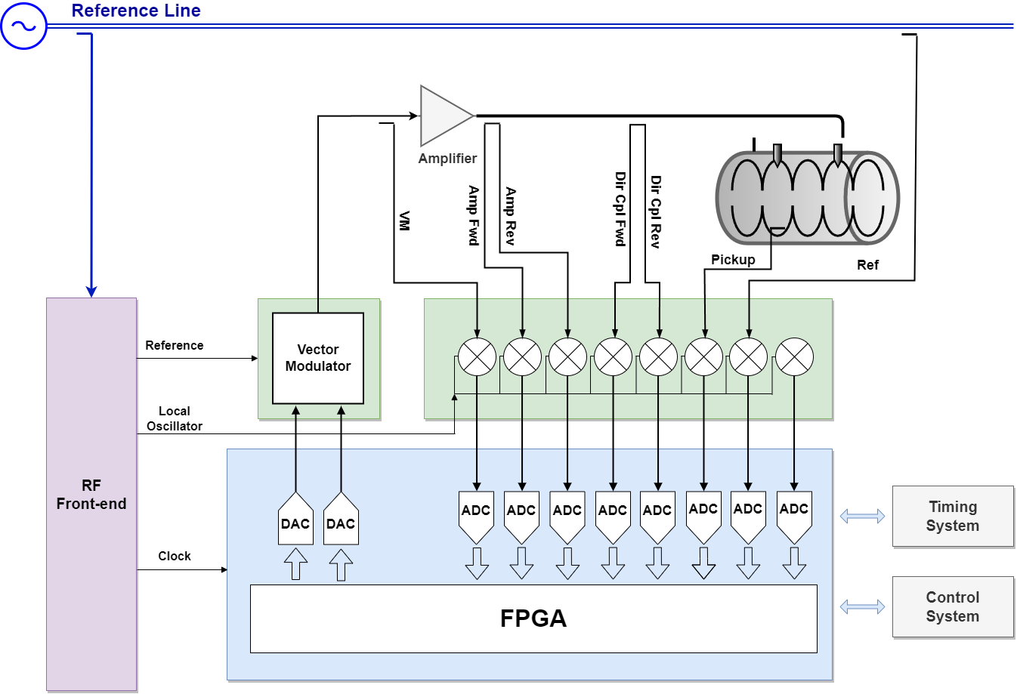
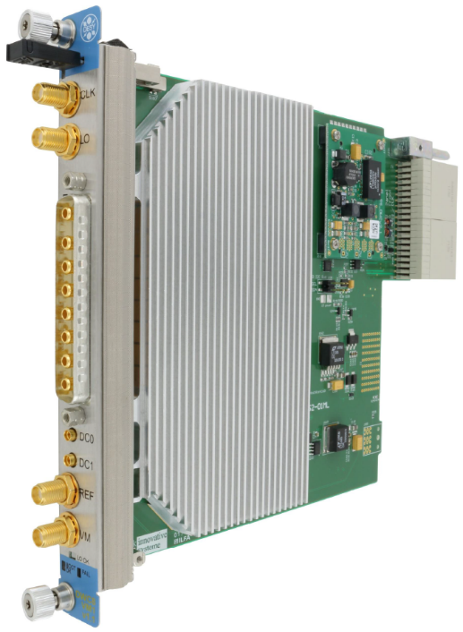


Down-conversion Schemes
For L, S, C band LLRF, RF signal is typically down-converted in RTM front-end
For higher frequency (X-band) LLRF, conversion between X, S or C out of crate may required
RTM Front-end
500MHz to 6GHz Down/VM converter
LO & Clock
Generator
AMC Digitizer
10 channel 125MSPS/16Bit digitizer

Slide 21
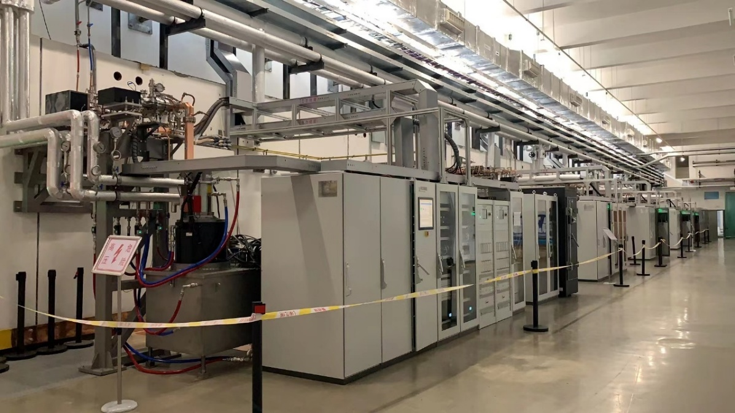
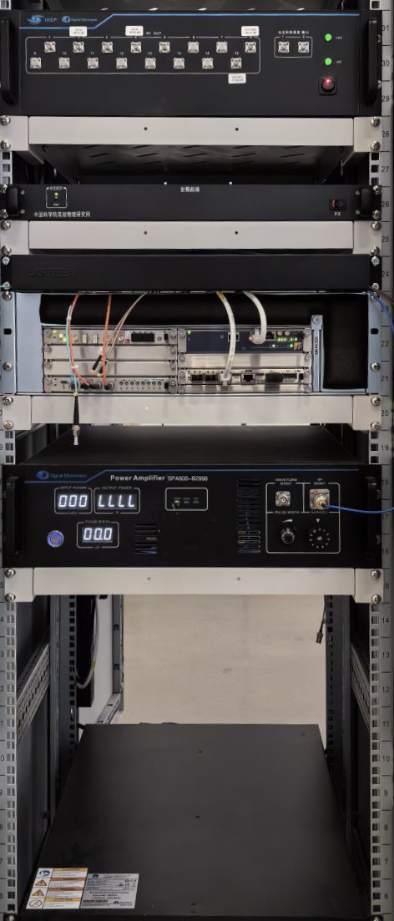
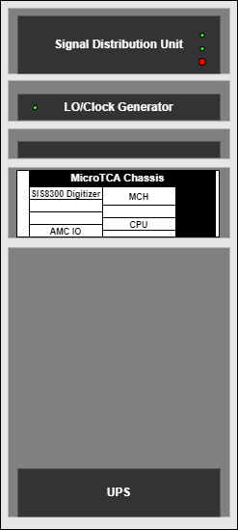
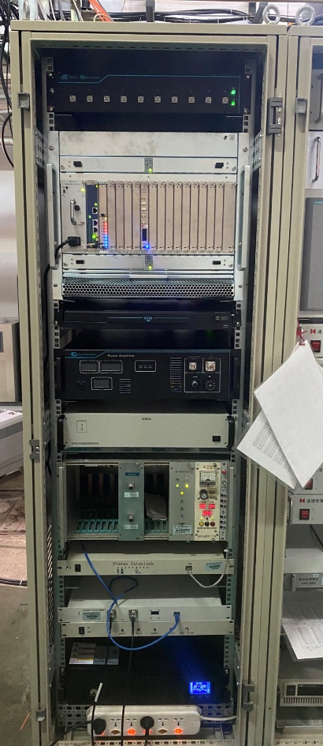
Down-conversion Schemes
Down-Conversion Architecture for S-band LLRF at IHEP
HEPS 500MeV LINAC
BEPCII 2.5GeV LINAC
Mature Down-Conversion Architecture
Proven design with widespread deployment in HEPS and BEPCII Linac
System Deployment
HEPS: 5 sets @ 2998.8 MHz
BEPCII: 22 sets @ 2856 MHz
Hardware Configuration
Chassis: 3U / 9U
Control: 1 CPU / PS / MCH
Digitizer: 1 × SIS8300L2
Custom RTMs: wideband (650 MHz – 6 GHz)
1 × Trigger Distribution AMC Board
1 × SSA

Slide 22
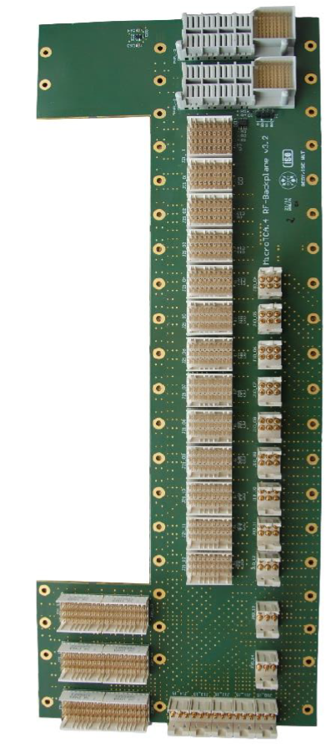




Down-conversion Schemes with RF Backplane
RF backplane introduced in MicroTCA 4.1
Extra slots for RF/clock signal generation and distribution modules, supports up to 3 extended RTMs (RTMs without AMC)
Up to 2 power supply RTMs with low-noise, separated, analog, bipolar power distribution
RF signal distribution over backplane, eliminates RF coaxial cable, more compact system, improves reliability
LO-RTM at IHEP
See report this afternoon:
LO&CLK distribution RTM board development progress
Xinpeng MA
DRTM-LOG1300
eRTM-508MHz
Candox Systems, Inc.

Slide 23





Cavity Tuning
Piezo RTM
DRTM-PZT4
2 independent channels operation(0 to +200V)
Operation as an actuator or a sensor
Motor control

Slide 24






Cavity Tuning
LLRF Tuning and Control Solution at IHEP
LPC FMC
24 channel TTL/CMOS logic levels input/output
8 channel serial interface DACs with analog front-end(0~5V, 0~10V,±5V, ±10V configurable)
8 channel serial interface ADCs with integrated analog front-end(±10V max)
plan to use a dedicated FMC carrier board in the future
Tuning FMC
See report Tuesday morning:
Universal Dual-channel FMC Carrier Board based on the mTCA.4
Yajie Mu
Step Motor Driver
Piezo Driver

Slide 25
FPGA Framework and Software Implementation
03

Slide 26

FPGA Framework
BSP
PCIe、DMA、DDR, configuration of peripherals on the board (clocks, I/O buffers, ADCs, DACs, etc.)
APP
User specific algorithms（LLRF control , DAQ logic, etc. ）

Slide 27

Typical PCIe block design
Xilinx XDMA is provided as an option to transfer data between the FPGA and the instance's CPU memory
Open-source driver
Easy to install and use, and does not require driver development expertise to use
Support multiple channels per FPGA for high performance
DMA (S2MM)
DAQ Stream Input
XDMA
MIG
Register Access

Slide 28

XDMA Device Driver
Official Driver:
https://github.com/Xilinx/dma_ip_drivers
Driver Customization:
Board startup configuration support
Crate slot mapping
Driver installation script
Udev rules and dkms support for the Xilinx XDMA driver，example：
https://github.com/MicroTCA-Tech-Lab/xdma-metapackage
User space character device structure :
C2H: AXI4 port (DMA from device)
H2C: AXI4 port (DMA to device)
Register: AXI4-Lite port

Slide 29

Typical processing system block design
Typically involves integrating a Processing System IP with DMA, peripherals, memory, or programmable logic in a block design environment
Capable of implementing an embedded EPICS IOC for control and data access via Ethernet
Interrupt Controller
Register Access
DAQ Stream Input
PS
AXI DMA

Slide 30
User Space Driver
Linux kernel driver for the general purpose DMA
Xilinx provides "DMA proxy" kernel driver
https://www.xilinx.com/video/soc/linux-dma-from-user-space.html
https://github.com/Xilinx-Wiki-Projects/software-prototypes/tree/master/linux-user-space-dma
The drivers use the Linux DMA Engine subsystem and provide the ability for user to write their own Linux driver which uses the Xilinx driver in kernel space through the DMA Engine subsystem
Other open source driver:
A zero-copy, high-bandwidth Linux driver and user space interface library for Xilinx's AXI DMA and VDMA IP blocks:
https://github.com/bperez77/xilinx_axidma
Linux Driver for the Zynq FPGA DMA engine
https://github.com/bmartini/zynq-xdma

Slide 31



User Space Driver
User space application/driver through the UIO framework
Add the UIO driver to the kernel
Setup IP core in the device tree to use the UIO driver
Develop API to access IP cores via UIO device
Add access to memory:
  reserved memory region in device tree
  u-dma-buf kernel driver: https://github.com/ikwzm/udmabuf
Control AXI DMA engine read from/write to memory space
Example: libudmaio from MTCA Tech Lab
https://github.com/MicroTCA-Tech-Lab/libudmaio
Simplify the use of the Xilinx AXI DMA controller when used in S2MM (Stream to Memory-Mapped) mode
Over PCIe with xdma driver
From ARM over the Userspace I/O
S2MM for example
Clear IRQs (S2MM_DMASR)
Set config (S2MM_DMACR)
Set Dst mem address (S2MM_DA)
Set length (S2MM_LENGTH)
Register Interface
DMA Controller

Slide 32



EPICS Integration
Build EPICS application
Develop device support using XDMA API or user space API
  Board initialization / configuration
  Wrapper for register r/w and DMA r/w
Re-write db record (ai/ao, li/lo, waveform, interrupt…) using device support
Develop complete EPICS IOC and OPI

Slide 33
Summary
04

Slide 34
Summary
MicroTCA is widely adopted in accelerators due to its high performance, modular design, cost-effectiveness, and reliability. It also enables rapid deployment and benefits from the support of a broad user community.
A relatively standardized MicroTCA.4-based LLRF architecture has now been established, which simplifies system development, promotes hardware reusability, minimizes redundant efforts, and reduces overall costs.
In addition, mainstream FPGA vendors offers a wide range of mature IP cores, together with numerous open-source drivers and software packages, which greatly facilitate high-speed data transmission.

Slide 35
Thank you for your attention!

