Slide 1
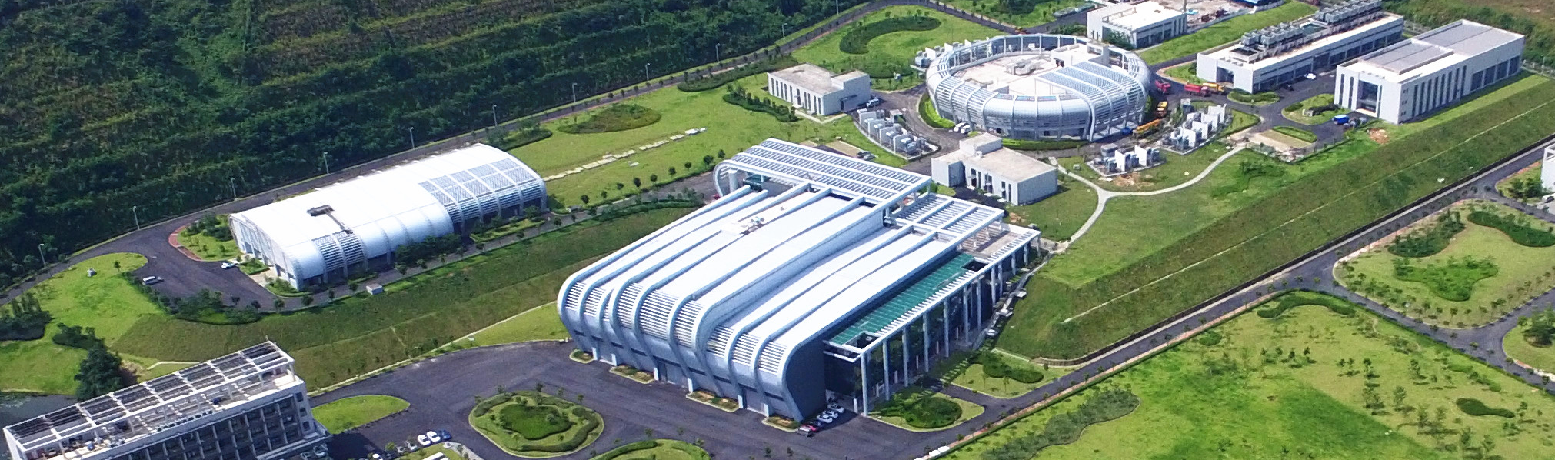

The Fast Protection System for CSNS-II
Peng Zhu
The MicroTCA/ATCA International Workshop For Large Scientific Facility Control
Sep.15-Sep.17, 2025, Chongqing, China

Slide 2
Outline
Overview of FPS for CSNS
Current status
Design and development for CSNS-II
Summary

Slide 3
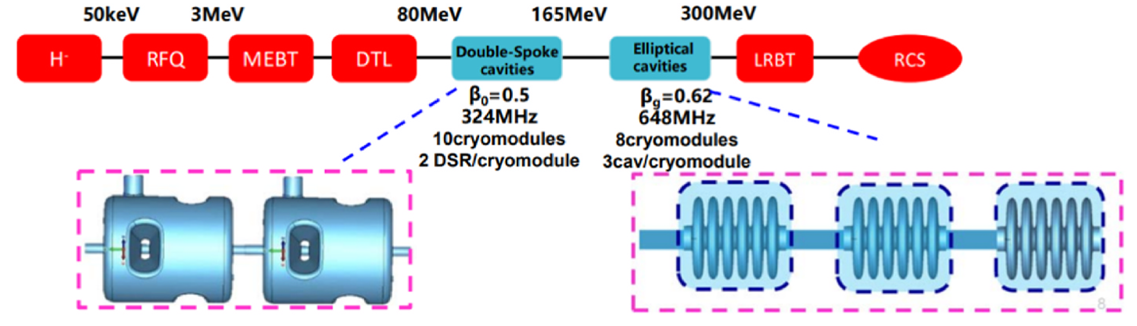
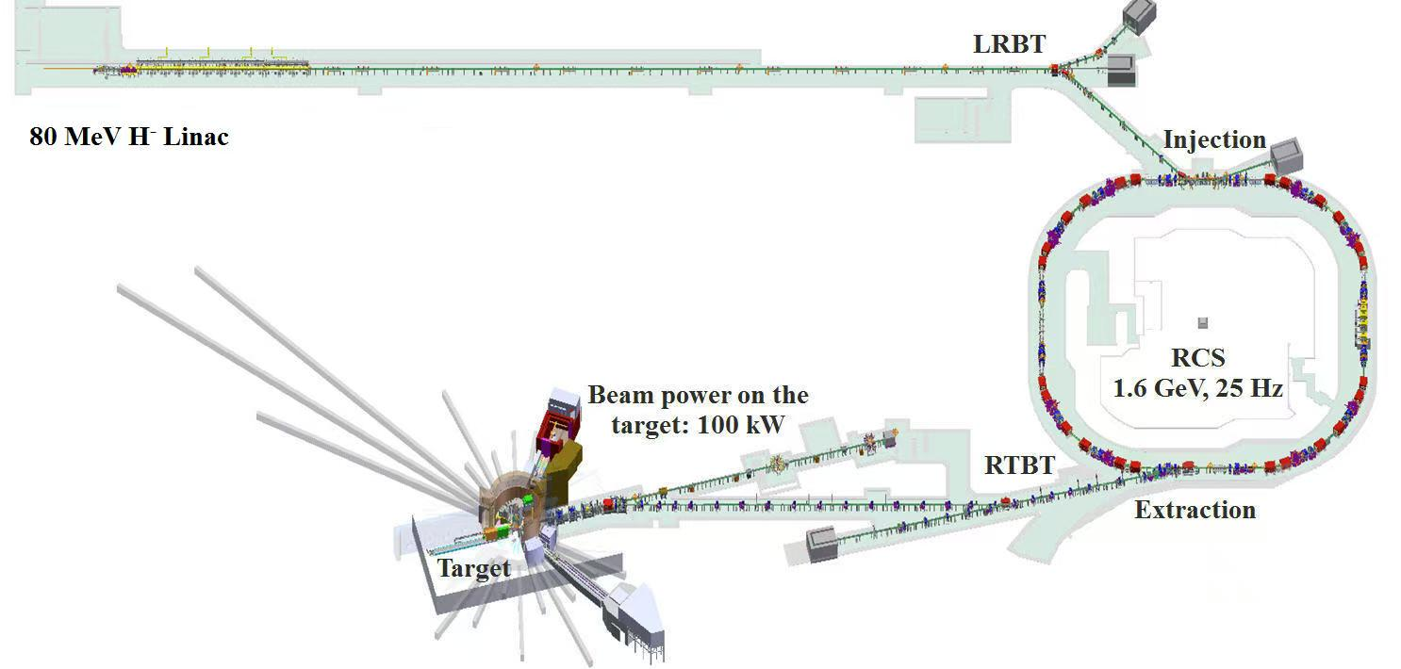

Overview of the CSNS Linac
The fourth pulsed spallation neutron source worldwide
National acceptance on August 23, 2018
Operating efficiently and stably for seven years
Update approved in 2024, total about six years
25 Hz @ ~600 μs
Phase I: 80MeV, running now
Phase II: 300MeV, preparation stage.20 Spoke & 28 Ellip Cavities
SC Linac 300 MeV

Slide 4
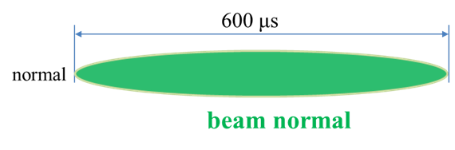
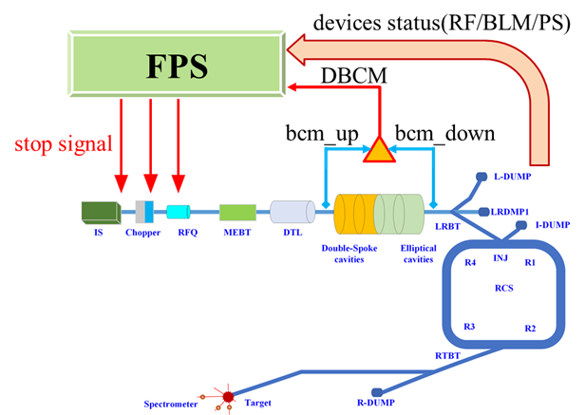
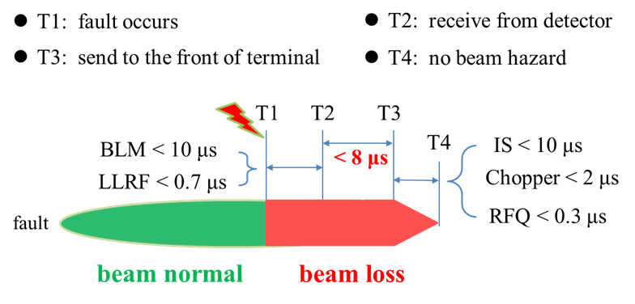
Objectives and Performance
Objectives：
High availability, high reliability, and high efficiency, ensuring the long-term stable and safe operation.
Metrics ：
Must be controlled within 8 μs, including fiber-optic transmission delay, intrinsic device delay, and interlock signal debouncing.

Slide 5
Outline
Overview of FPS for CSNS
Current status
Design and development for CSNS-II
Summary

Slide 6
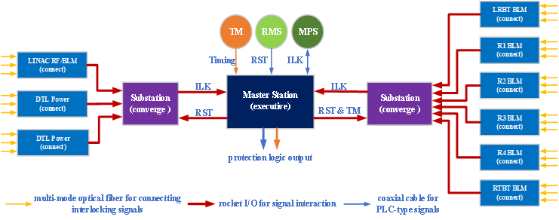
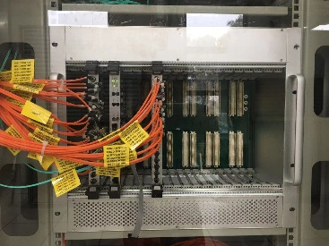
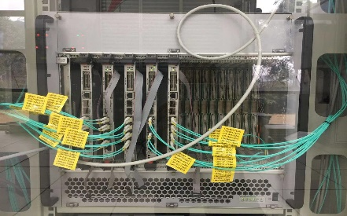
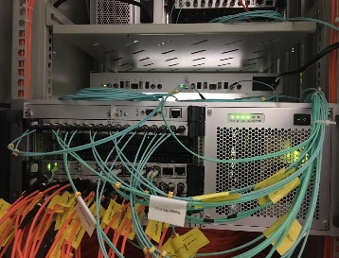
Current Status for CSNS
Architecture: VME-based on the access layer, aggregation layer, and execution layer
Interface between FPS and equipment systems
 | Device | Quantity
Input | MPS | 4
 | TM | 1
 | RMS | 1
 | LLRF | 8
 | PS | 120
 | BLM | 176
Output | IS | 1
 | Chopper | 1
 | RFQ | 1
 | LLRF | 8
layout of interlock chain
access station
aggregation station
execution station

Slide 7
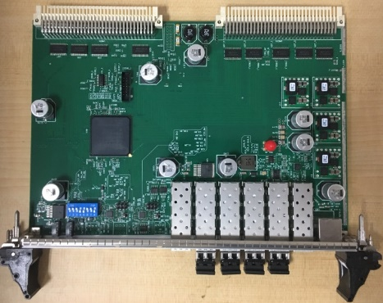
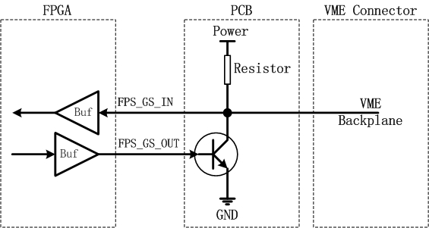
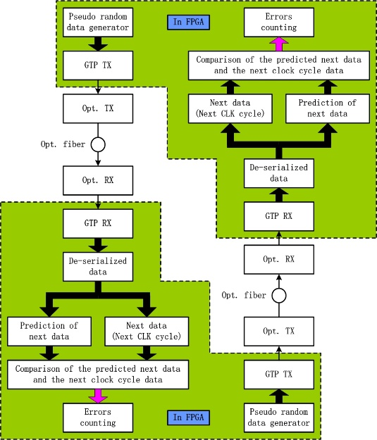
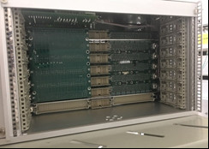
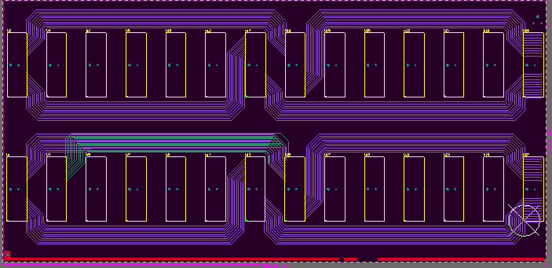
Current Status for CSNS
Advantage: Fully hardware-based architecture to minimize signal transmission delay
Point-to-point transmission via custom backplane bus in chassis
Intra-Site:
Inter-Site:
High-speed transmission using rocket I/O
the main logic board
“OC”for sharing logic
the custom backplane and the point-to-point transmission
the high-speed transmission link based on 2.5 Gbps

Slide 8
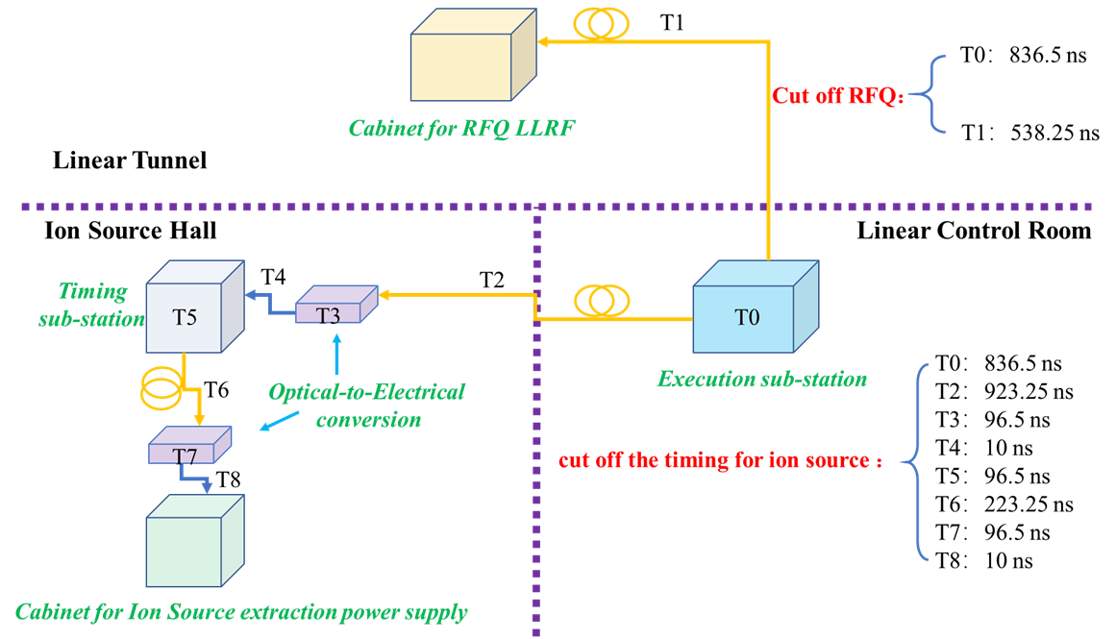
Current Status for CSNS
Performance: The response time for Linac
large-scale scientific facility (Linac) | response time
SNS | ≈ 8.0 μs
J-PARC | ≈ 7.5 μs
CSNS | ≈ 2.2 μs
 | total time from receiving the fault signal to cut off the timing for ion source | total time from receiving the fault signal to cut off RFQ Power
Results | ≈ 2.2 μs | ≈ 1.4 μs

Slide 9
Outline
Overview of FPS for CSNS
Current status
Design and development for CSNS-II
Summary

Slide 10
New architecture for CSNS-II
Signal link : Between each substation and the executing station
DC-DC Power Supply
(DTL #1)
LTBT BLM
DC-DC Power Supply
(DTL #2)
R1 BLM
TM
RMS
MPS
TM
DC-DC Power Supply
(MEBT / SC #1)
Timing
RST
ILK
Timing
R2 BLM
executing
station
ILK
aggregating
substation
R3 BLM
DC-DC Power Supply
(MEBT / SC #2)
RST
R4 BLM
Linac
RF LLRF
14*7*4
RTBT BLM #1
Linac
BLM #1
interlock logic output
RTBT BLM #2
Linac
BLM #2
Beamline BLM
Each substation independently connects to 100 interlocking signals.
Each Rocket IO channel processes 16 signals, and the maximum number of signals that the master station can handle：≈1800（14*100 + 14*7*4）

Slide 11
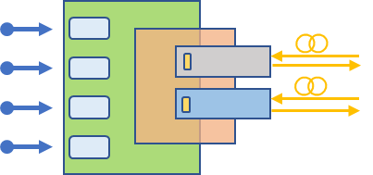
New architecture for CSNS-II
Response time estimation in Linac(including fiber-optic transmission delay)
Total time from beam loss to RFQ power reduction：≈ 3.6 μs
Total time from beam loss to chopper timing shutdown.：≈ 4 μs
Total time from beam loss to shutdown timing of the ion source extraction power supply.：≈ 4.5 μs
DC-DC Power Supply
(DTL #1)
DC-DC Power Supply
(DTL #1)
TM
RMS
MPS
TM
DC-DC Power Supply
(MEBT / SC #1）
Timing
RST
ILK
~ 800 ns
Timing
executing
station
ILK
aggregating
substation
DC-DC Power Supply
(MEBT / SC #1）
B
Linac
RF LLRF
RST
BLM
Linac
BLM #1
~ 500 ns
~ 800 ns
~ 1.2
μ
s
L
-
Linac
BLM #2
DUMP
~ 250 ns
~ 800 ns
LRDMP1
250 ns ~ 1000 ns
LRBT
IS
Chopper
RFQ
MEBT
DTL
Double
Elliptical
-
Spoke
cavities
cavities

Slide 12
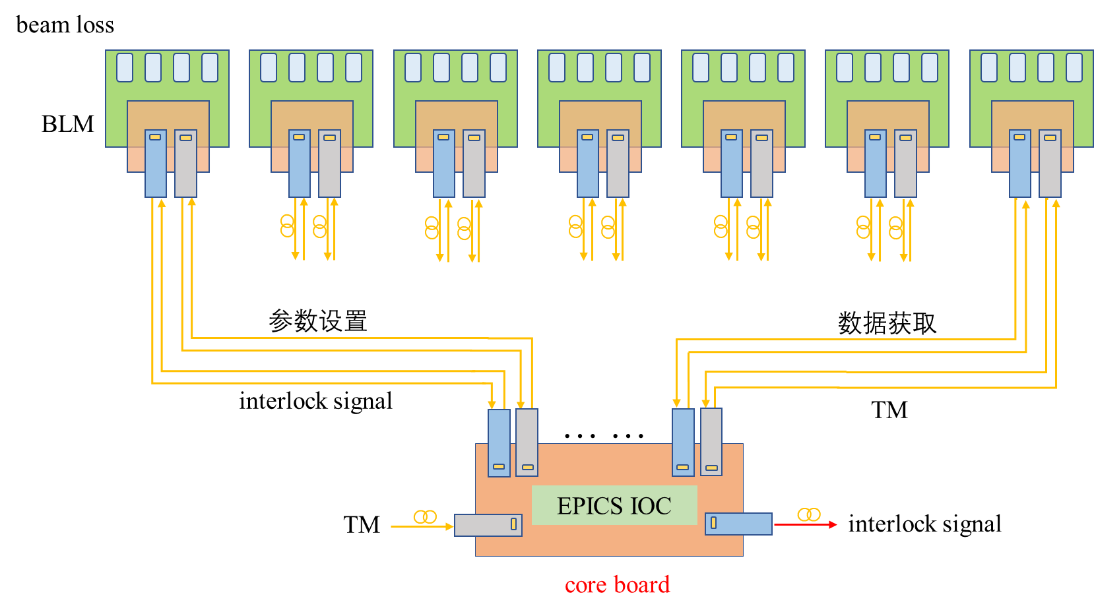
Integrate beam loss and FPS
Benefit: Provide real-time beam loss data with high-precision timestamps for beam commissioning and machine studies
Double-Spoke cavities
Elliptical cavities
H⁻
RFQ
MEBT
DTL
LRBT
Challenges：
parameter acquisition
Real-Data acquisition
Ultra-high reliability
Ultra-high accuracy
High-precision timestamps(EVR)
Integrity and immunity
… …

Slide 13
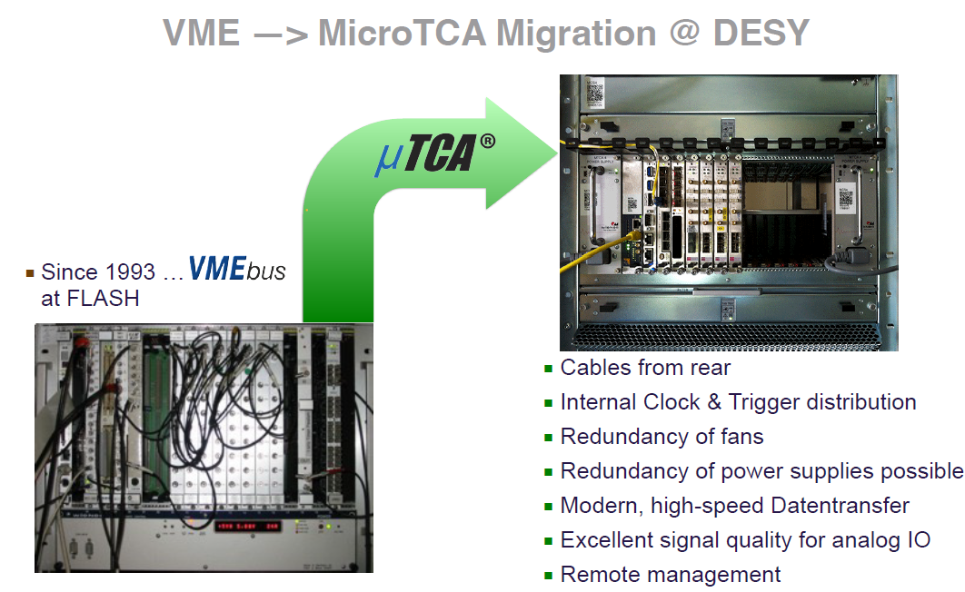
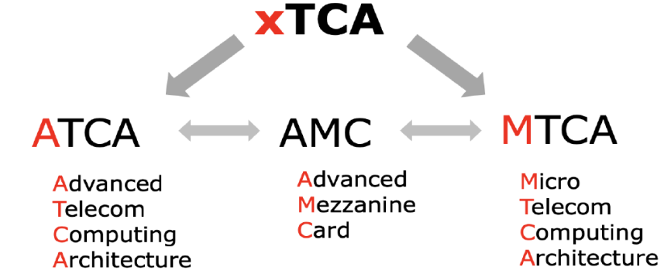
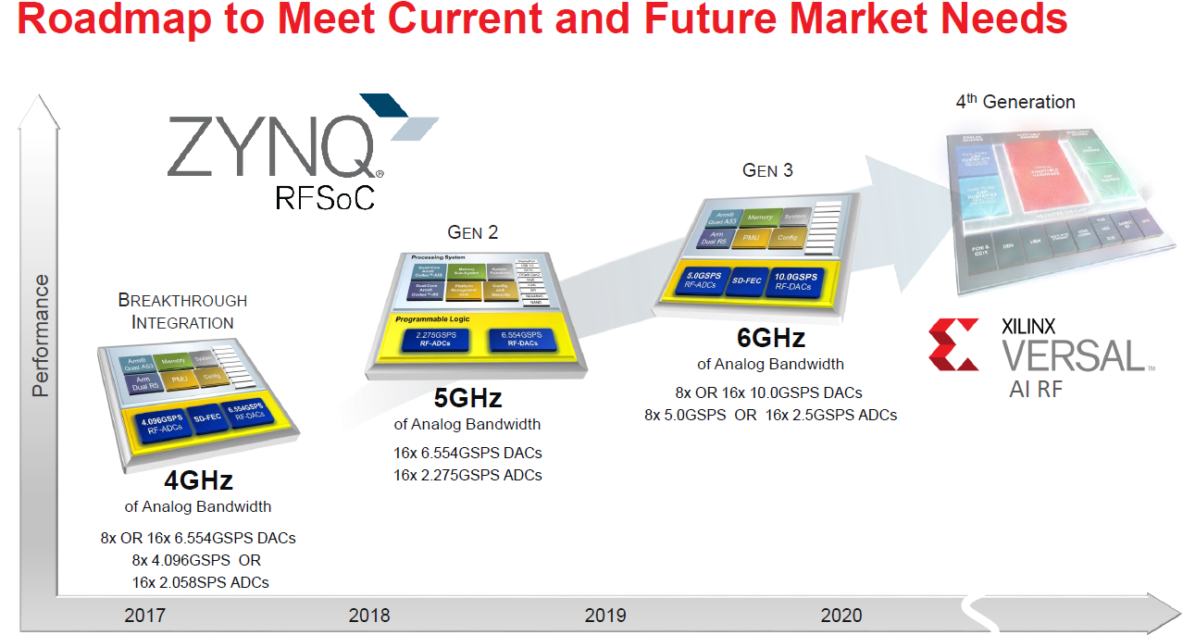
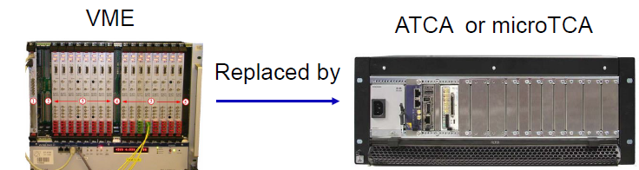
Considerations for Hardware
Tendency: (1) VME --> xTCA,
(2) demo FPGA --> RAM + Linux + EPICS (Embedded IOC),
(3) distributed data --> Associated data with high-precision timestamps (EVR).
VME system was a huge success, which can be upgraded to switch-based communication such as ATCA/microTCA.

Slide 14
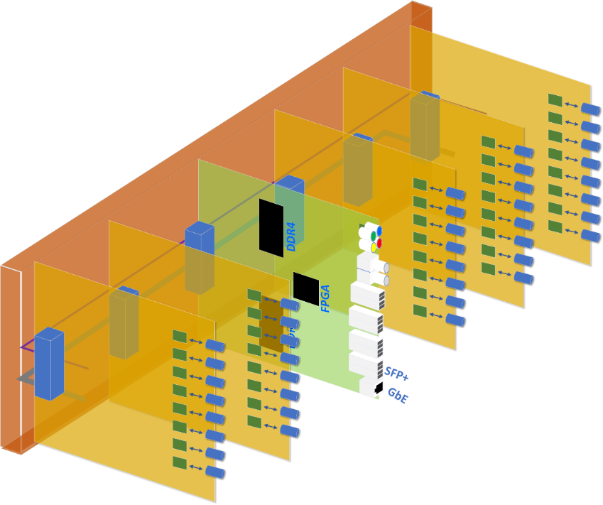
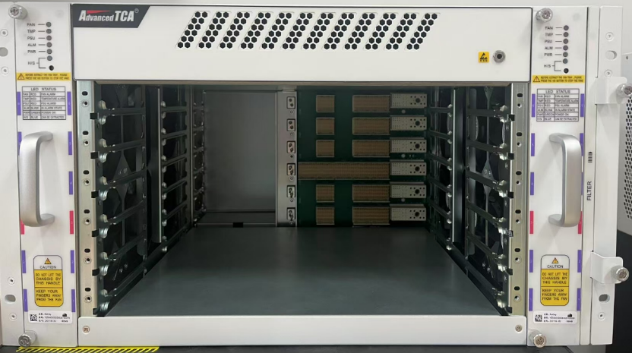
Hardware for CSNS-II
Motivation:
The front-end electronics for beam loss via SFP at superconducting cavities,
Real-time beam loss data with high-precision timestamps.
Approach: ATCA + FPGA + Rocket I/O
Interface board
Based on the ATCA mechanical architecture,
Integrating functions of fast protection, timing, beam loss configuration, and data readout.
Interface board
Interface board
Master logic board
Interface board
Interface board
6U ATCA
250 MHz
Customized Backplane & RTM
5 Gbps

Slide 15
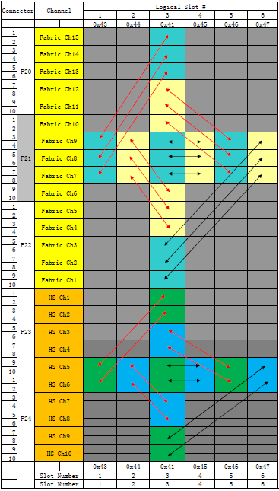
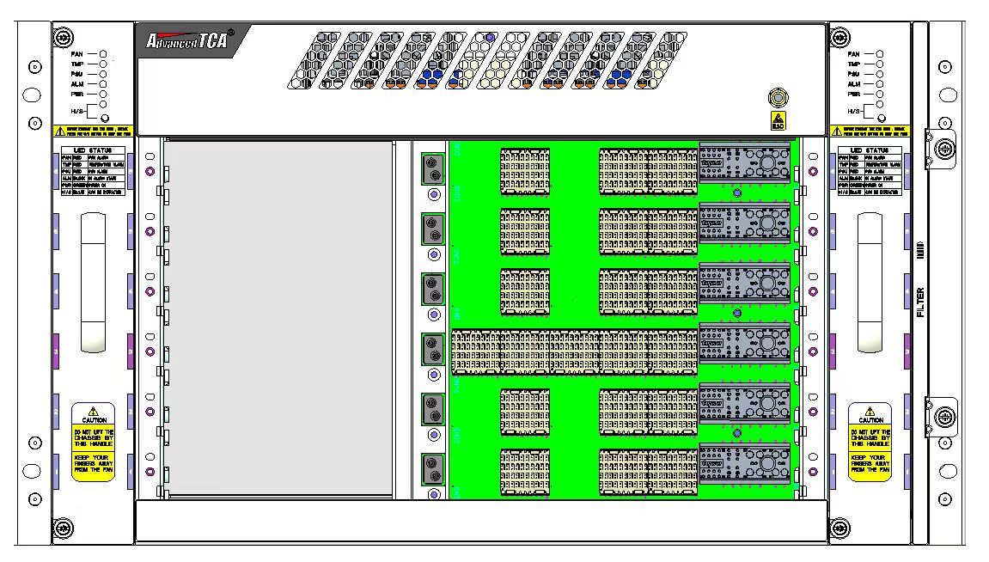
Backplane board for CSNS-II
Self-developed backplane with signal interfacing
LVDS
250 MHz
Rocket I/O
5 Gbps
6# slot
24
16
3# slot
1#slot
Master: slot #3, while slave: slots #1, #2, #4, #5, and #6.
Master slot is responsible for logical processing, parameter configuration, status readback, and on-board IOC.
Slave slots handle external signal input and internal signal output.
Master slot is directly connected to each slave slot via 40 pairs of high-speed differential signals through pin-to-pin routing on the backplane.

Slide 16
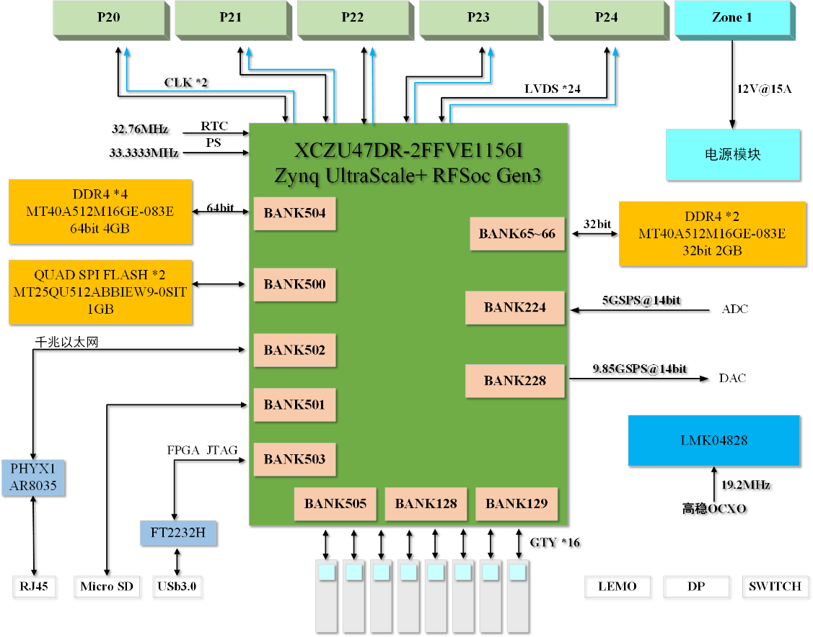
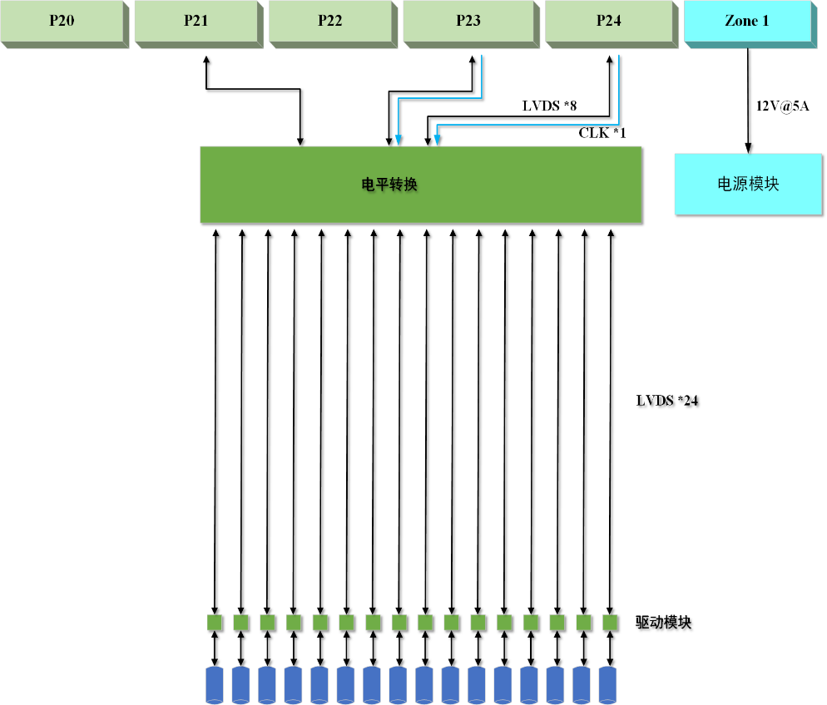
Front boards for CSNS-II
Flexible & Scalability : Multi-channel / Homogeneous / Independent links
Master logic board
Interface board
Global_Timing
Stop current beam
Interlock

Slide 17
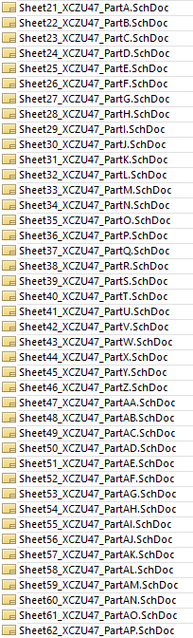
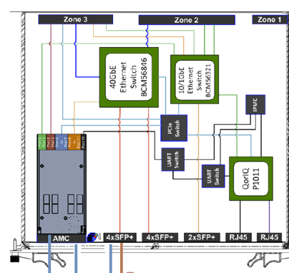
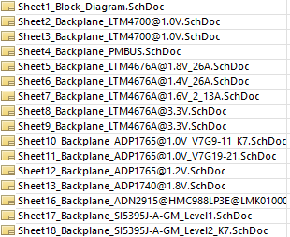
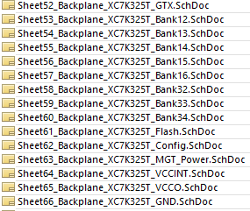
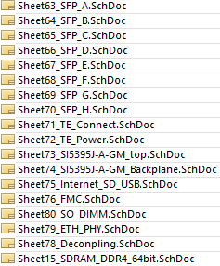
Front boards : Master logic board (in progress)
High:2-2.5Gbps / 3-4 3-10 5Gbps
Low:200MHz,250MHz
Power
RF Soc
8 QSFP
K7
Si5395
FMC
DDR4

Slide 18
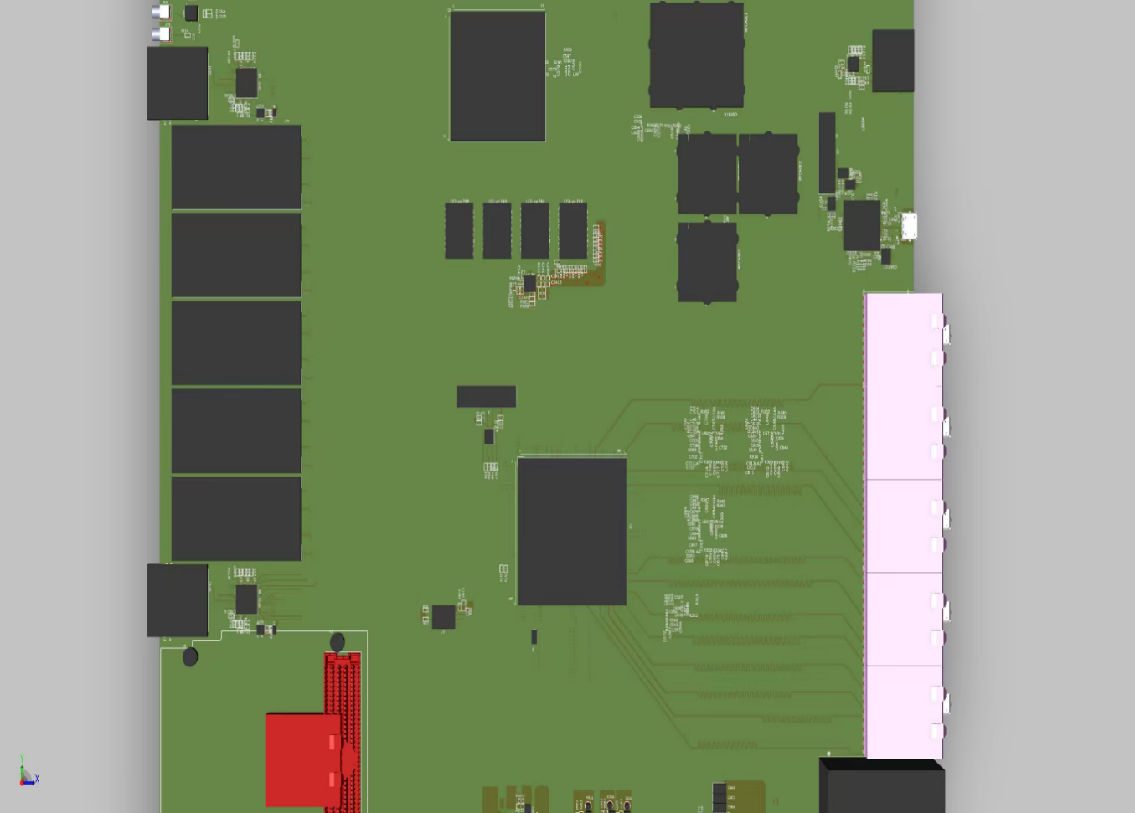
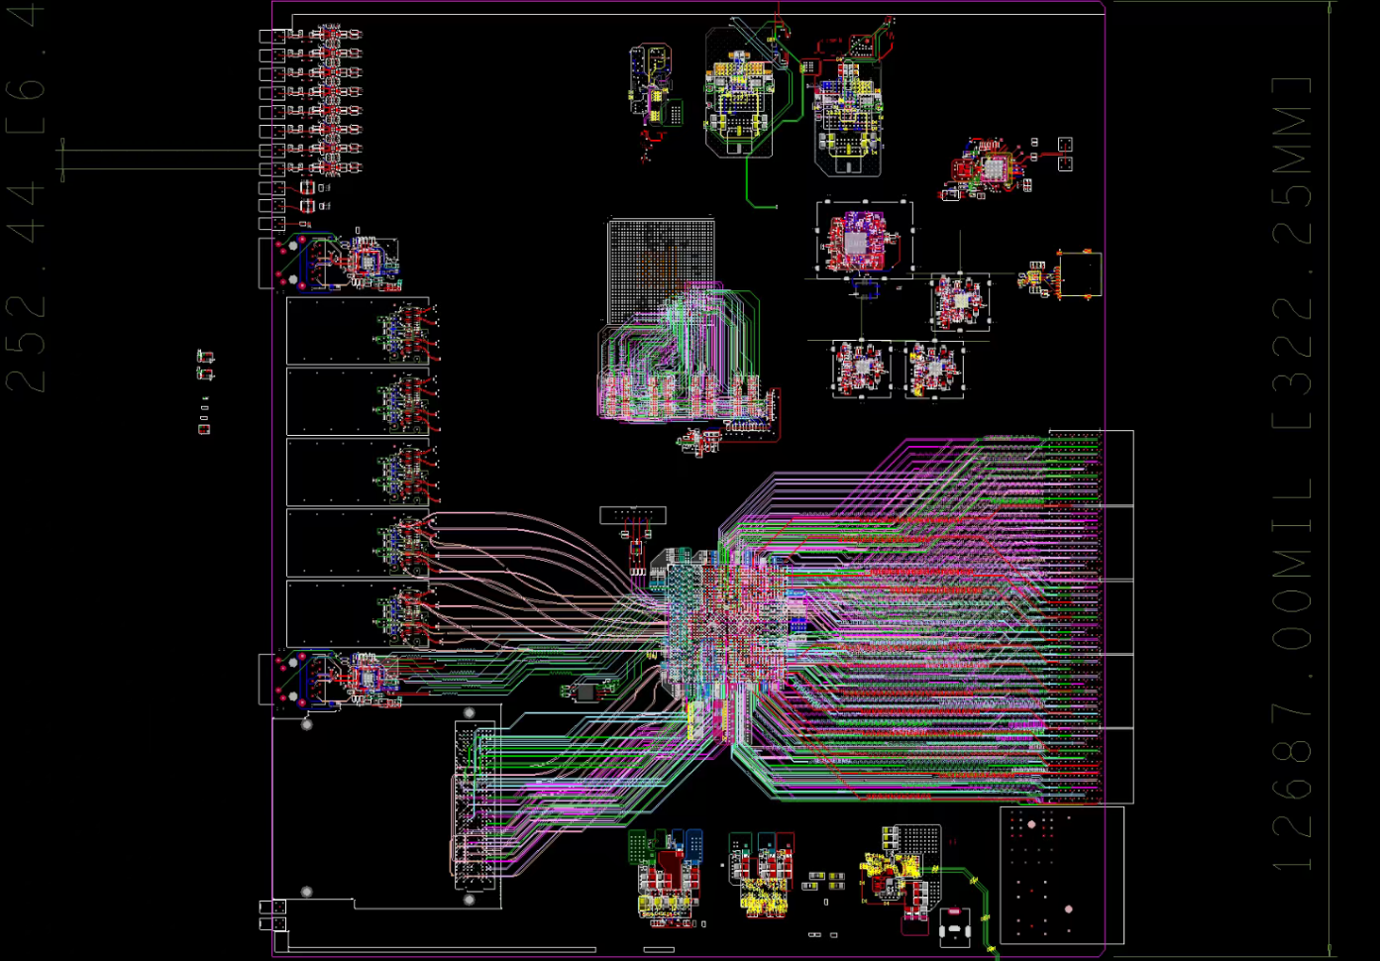
Front boards : Master logic board (in progress)
4 QSFP + 1 PCIE
Event timing support
HPC FMC
8x 14 bits ADC, 5 GSPS, 6GHz analog BW
8 x 14 bits DAC, 10 GSPS, 4GHz analog BW
Megtron-6, 24 Layer
AD/DA
PCIE
ZU47DR
（Embedded IOC）
Power tree 01
QSFP
(64*SFP)
7V690T
5*TE
5*40
SFP for EVR
HPC FMC
DC12V
Power tree 02
3D view
the PCB layout

Slide 19
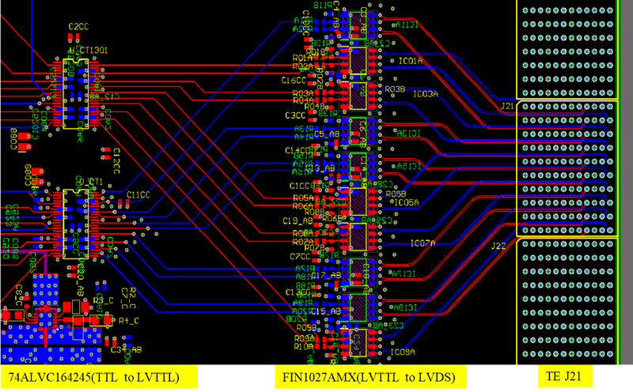
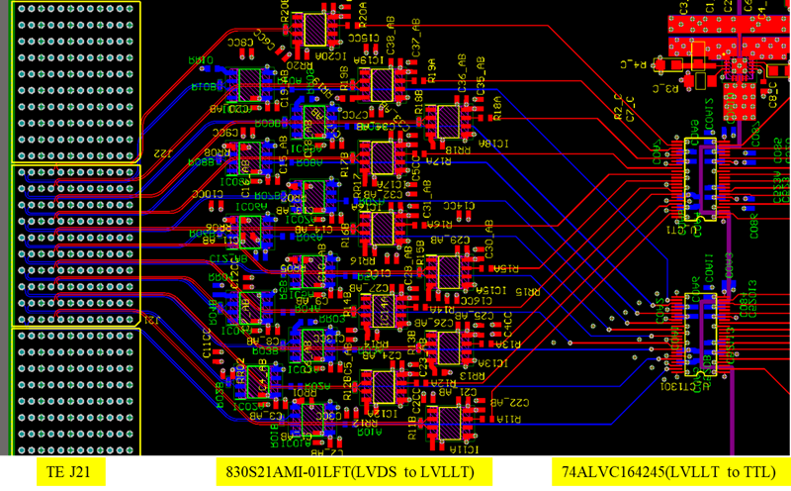
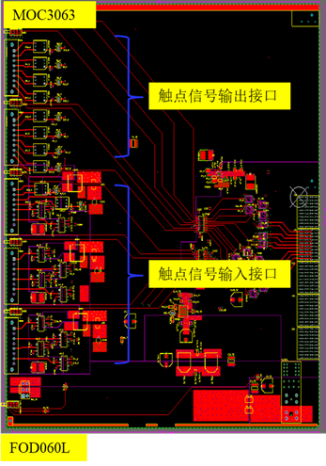
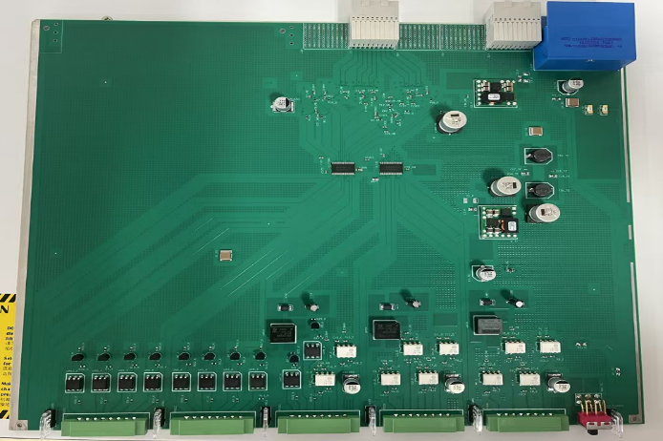
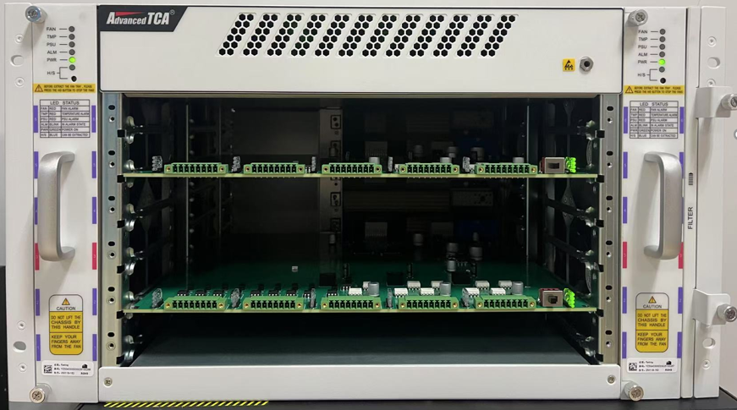
Front boards : Interface board (in progress)
Opt-type input : HFBR2412T => 74ALVC164245 =>FIN1027AMX(LVTTL to LVDS) => TE
Opt-type output : TE => 830S21AMI-01LFT(LVDS to LVLLT)=> 74ALVC164245=> HFBR1414T
Self-developed backplane
input
output
1*40
1*40
Master board
PLC-type input : phoenix => FOD060L => 74ALVC164245=>FIN1027AMX(LVTTL to LVDS) => TE
PLC-type output : TE => 830S21AMI-01LFT74ALVC164245(LVLLT to TTL) => MOC3063 => phoenix
6U ATCA

Slide 20
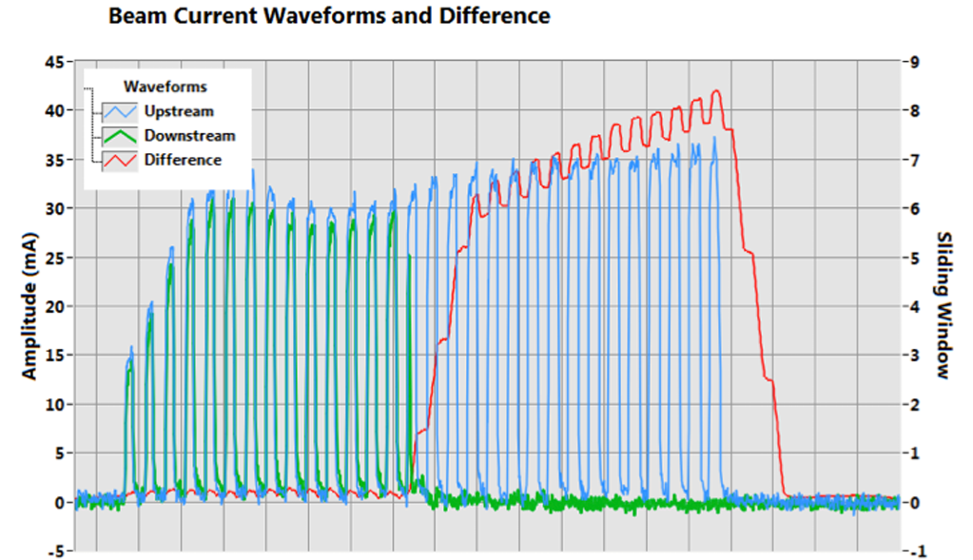
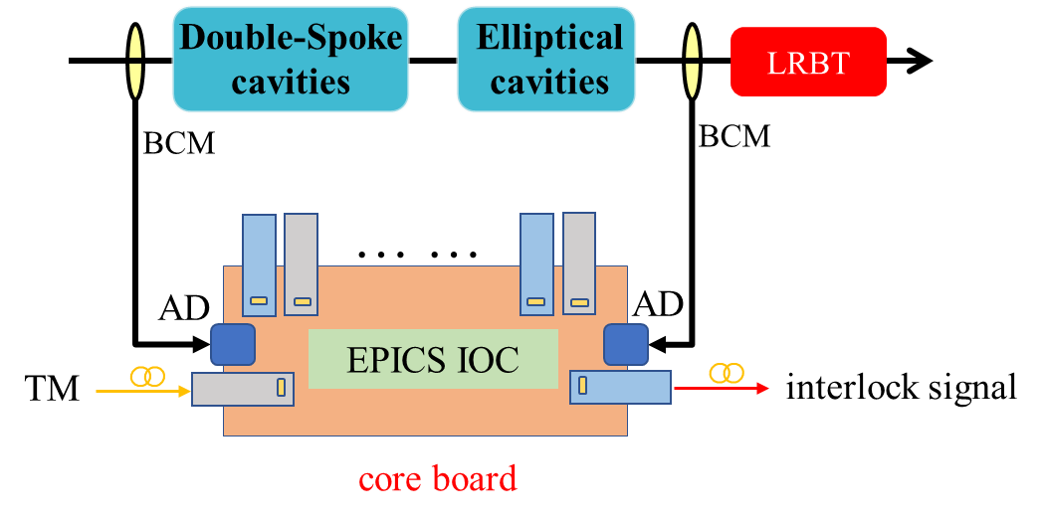
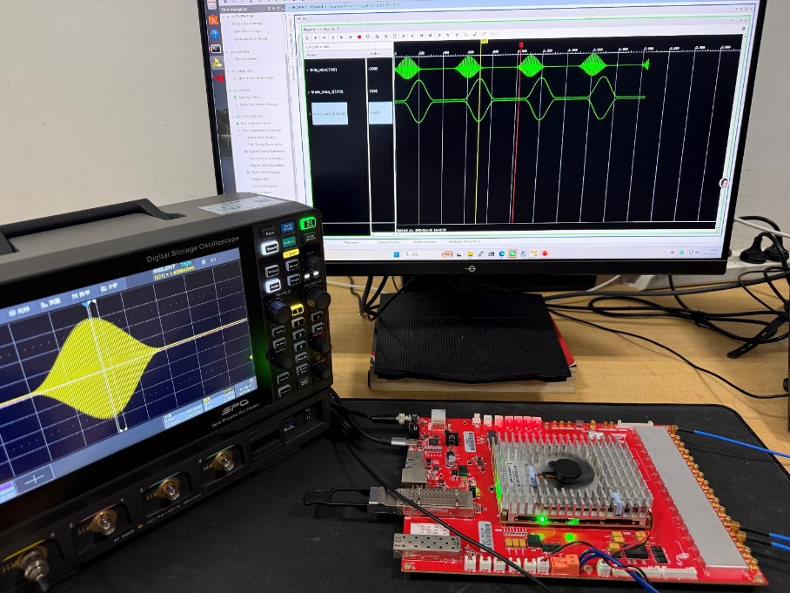
Differential BCM system for SC Linac
Principles and methods
-- Graduate Research Topic
Synchronously acquire bunch-by-bunch BCM waveform (14-bit, 5 Gbps).
Analysis and decision-making, minimizing machine protection response.
Will implement an edge AI to determine the optimal timing for beam stop.
DBCM(SNS)
commissioning(laboratory)

Slide 21
Summary
Adopt ATCA architecture based on a customized backplane and self-developed front boards as the solution.
Using one main logic board (Embedded IOC) and four types of interface boards to cover most applications.
Integrating BLM and the FPS into a unified platform is challenging, and the real-data with high-precision timestamps is worthwhile to attempt (EVR function).
Combining DBCM with AI in the linear superconducting section are expected to further enhance the performance.
A significant amount of preliminary research and development work has been successfully completed.
New hardware circuits and algorithms have been proposed, and are being progressively verified and implemented.
The technological advancement offers an opportunity to enhance the operational performance of the upgrade.

Slide 22
Thank you for your attention ！

