Slide 1

Construction and testing of the LLRF test platform for the 1.0 GeV linear accelerator of Wuhan Advanced Light Source Research Center
Presenter: Yue Hongwei
Supervisor: Nie Yuancun
Wuhan Advanced Light Source Research Center

Slide 2
Contents
1 Introduction of 1.0 GeV Linear Accelerator
2 Overall Design of LLRF Test Platform
3.1 S-band Solid-state Amplifier Test
3.2 Low Level RF Control System Test
3.3 Timing and Signal Distribution System Test
4 Summary and Prospect of LLRF Test Platform

Slide 3
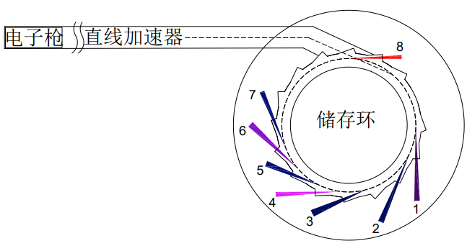
1 Introduction of 1.0 GeV Linear Accelerator
1.0GeV LINAC
Application Platform
High-Energy Electron Imaging
Gun
LINAC
Medical Applications，FLASH
Advanced Acceleration
The Starting Point of the Light Source
1.0GeV LINAC
Storage Ring
Advanced Materials Modification
Laser Inverse Compton Scattering
Motivation: multipurpose 1.0 GeV electron beam application research platform / future 1.5 GeV injector of the WALS（high-energy electron beams have many potential applications）
Extensive efforts have been made in physical design, technical study, and the mass production of 1.0 GeV components (with an investment exceeding 100 million RMB)

Slide 4
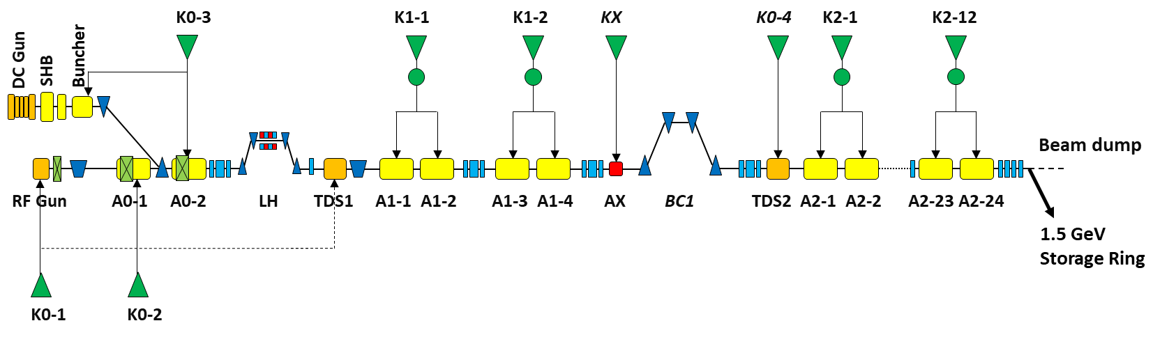
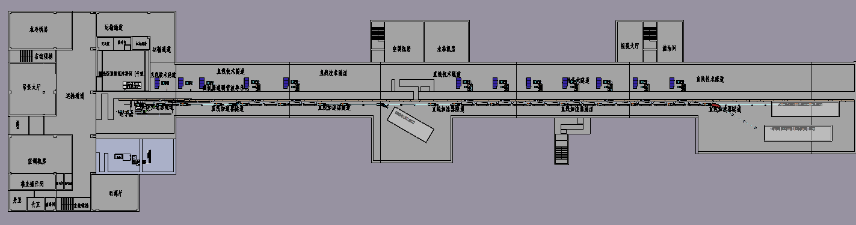
1 Introduction of 1.0 GeV Linear Accelerator
From 2021 to 2023, the physical design, the project CDR (conceptual design report) and TDR (technical design report) were completed successively.
Parameters | Values
Energy | 1.0 GeV
Energy Spread（RMS） | ≤1%
Normalized Emittance（RMS） | ≤50 mm·mrad
Bunch Charge | 1-2 nC
Macro Pulse Repetition Frequency | 10 Hz
Micro-pulse Repetition Frequency | 500 MHz
Conceptual design
LINAC tunnel

Slide 5
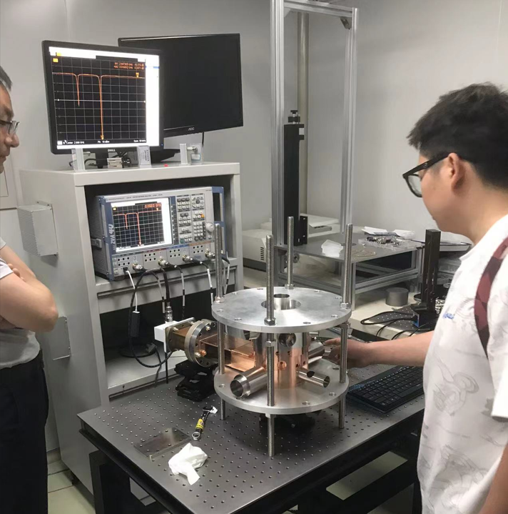
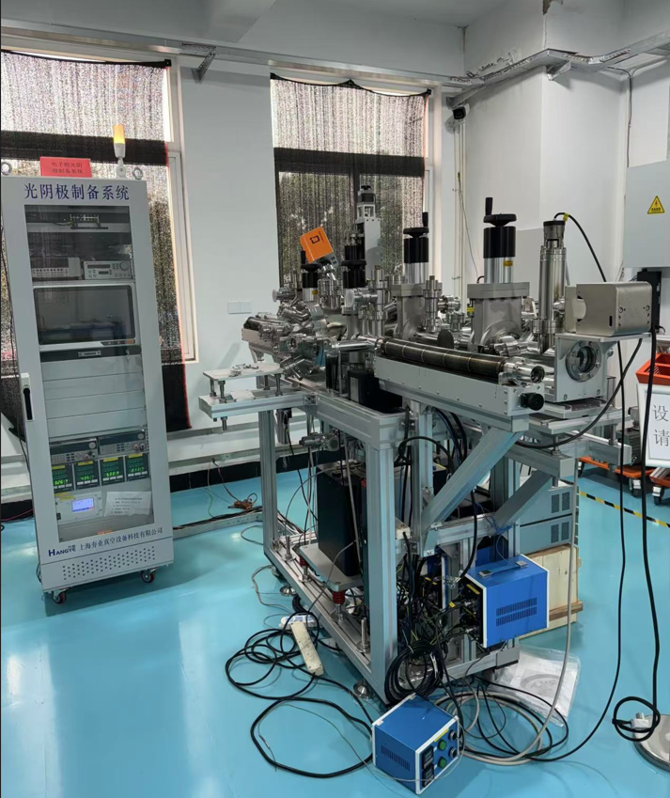
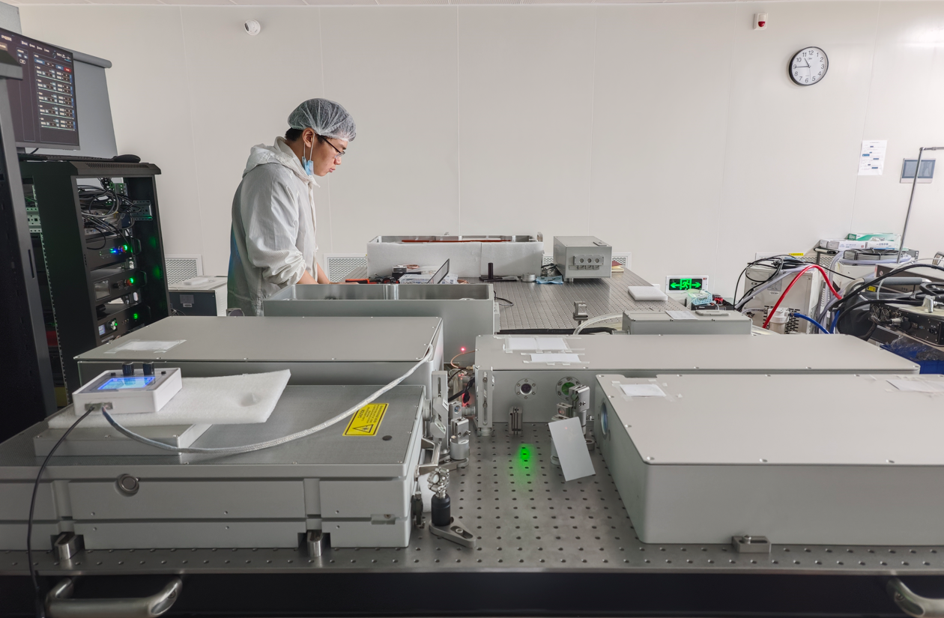
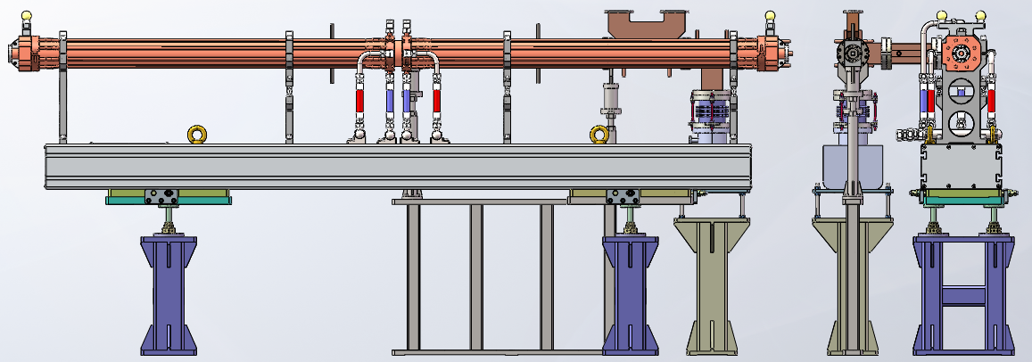
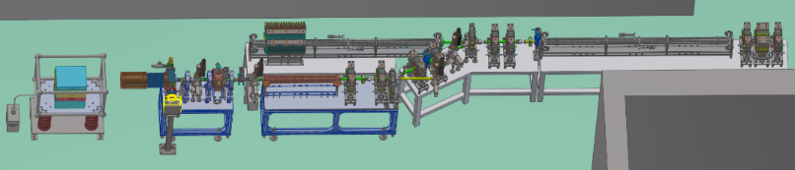
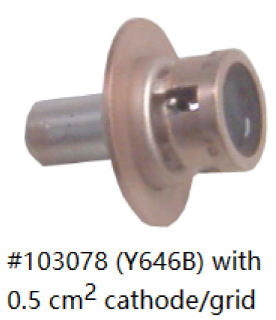
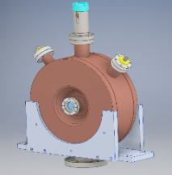
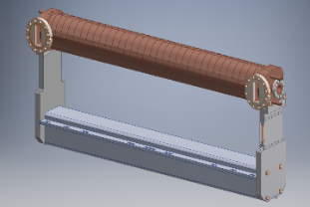
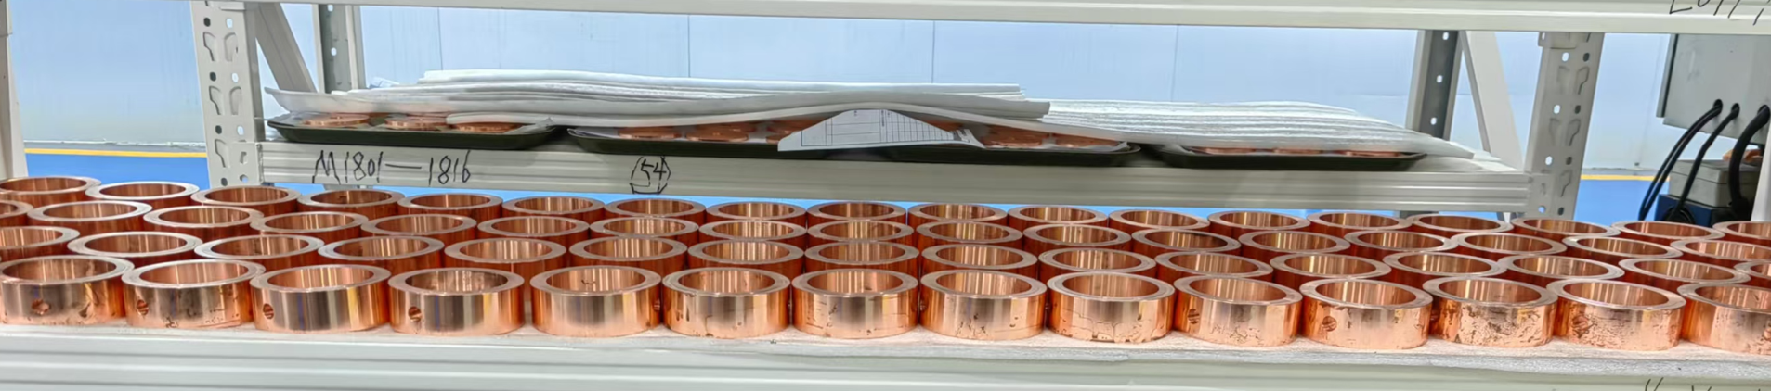
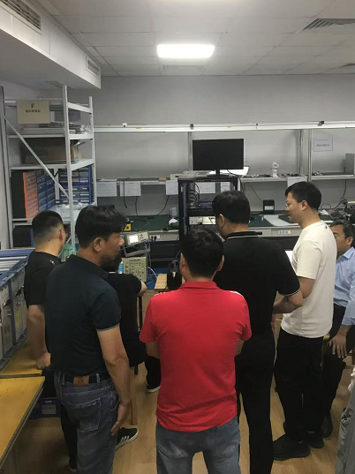
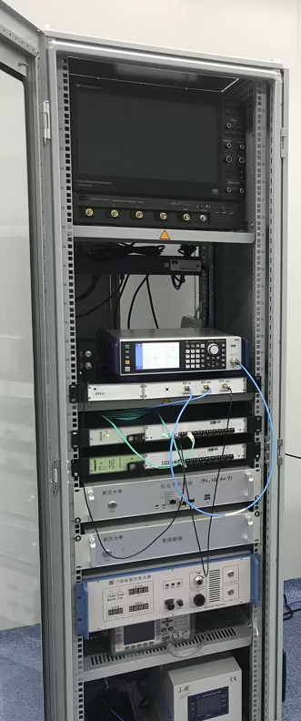
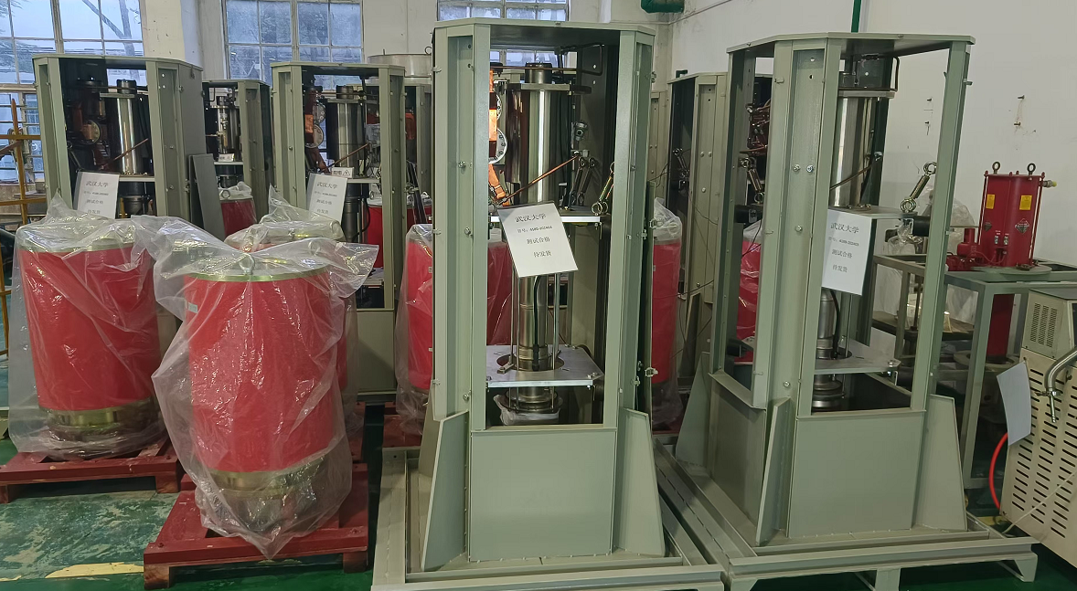
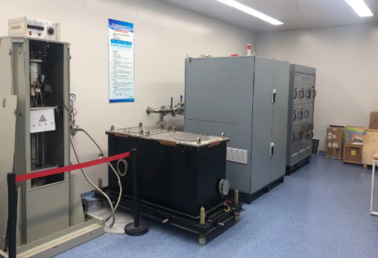
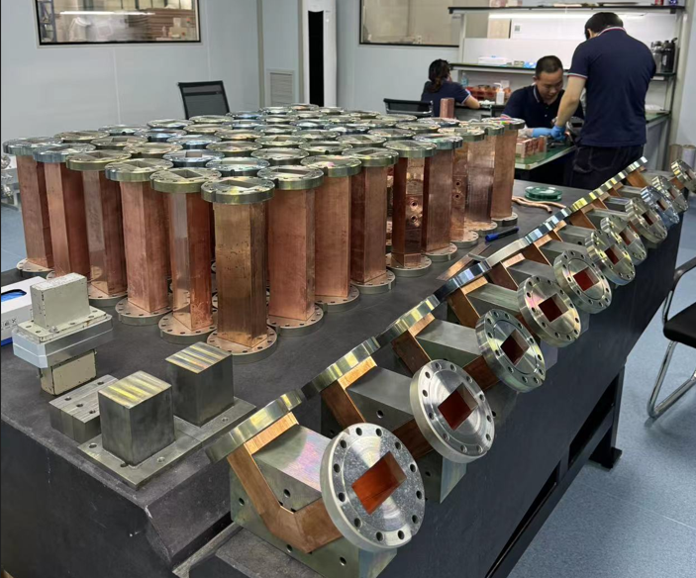
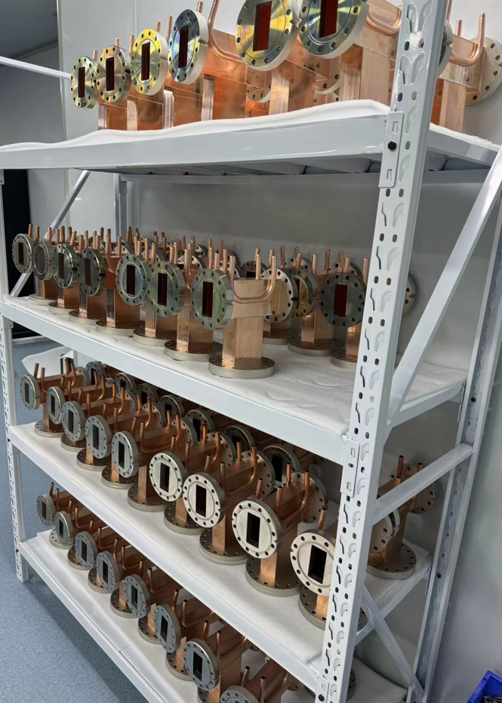
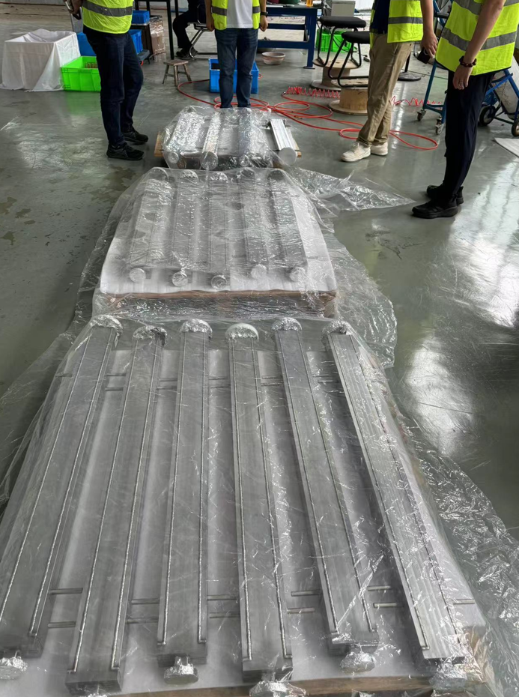
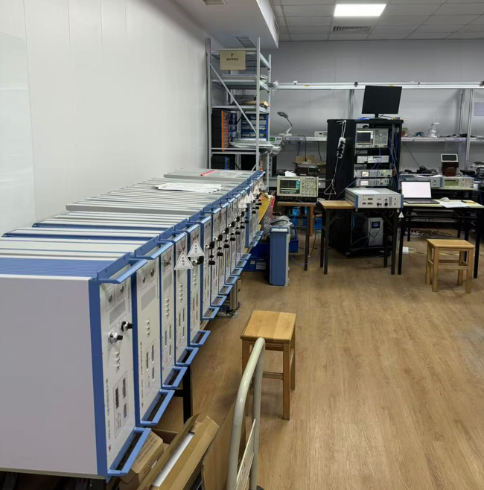
1 Introduction of 1.0 GeV Linear Accelerator
Technical support for facility performance
Electron Gun: 10^-8 Pa high vacuum, replaceable photocathode.
Accelerator Tube: New type of dual-feed traveling wave tube, segmented external water cooling design.
Klystron: Domestic 50MW
LLRF: Long-term amplitude and phase stability better than 0.04% and 0.02°.
RF gun
Driver laser
Dual-feed accelerator tube
Photocathode production
Thermionic components
科技创新，点亮武汉
High-power klystron
High-voltage pulse modulator
Microwave elements
LLRF test platform

Slide 6
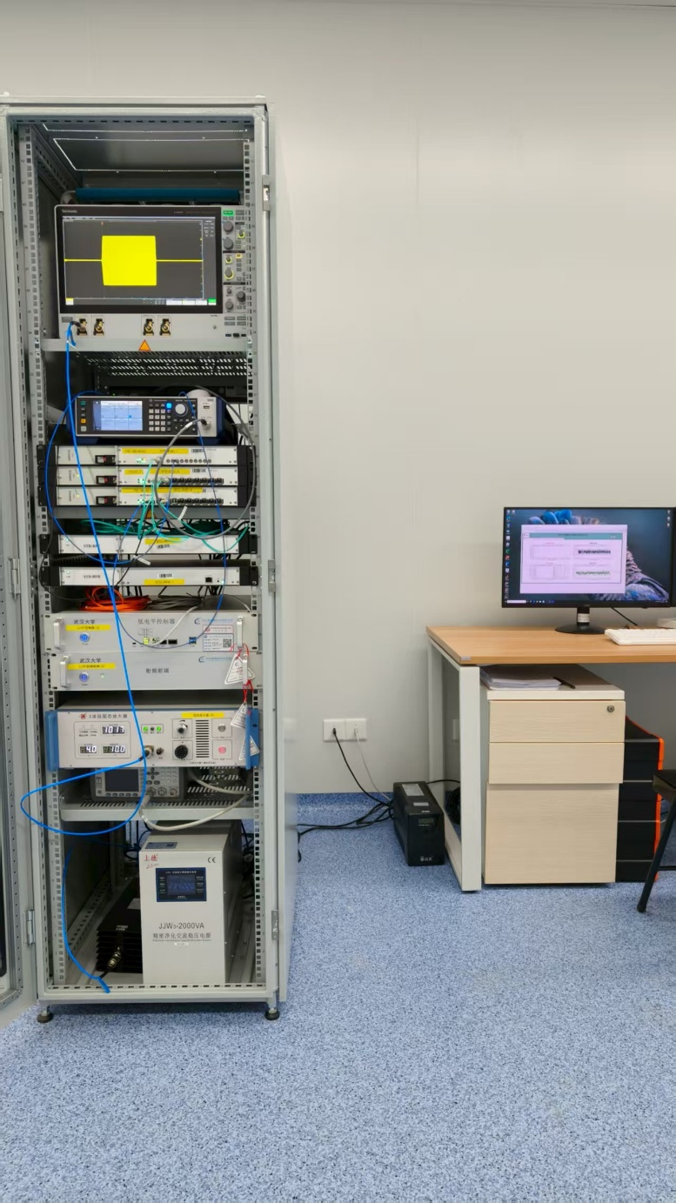
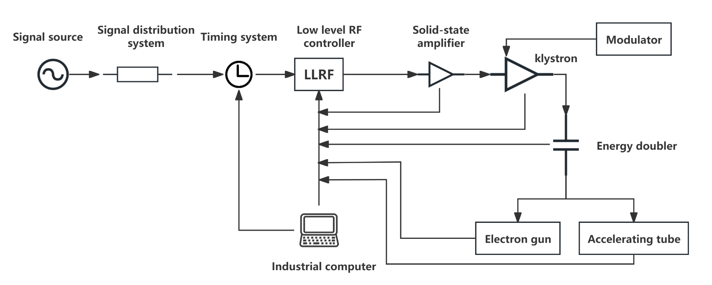
2 Overall Design of LLRF Test Platform
Design goal
A LLRF test platform for Wuhan Light Source 1.0 GeV linear accelerator is built.
Verify the performance of key subsystems ( solid state amplifier, low level control system, timing and signal distribution system ).
Provide technical support for subsequent engineering construction and optimization.
Timing system
Signal distribution system
Low level RF controller
Solid-state amplifier
Design of LLRF test platform
LLRF test platform

Slide 7
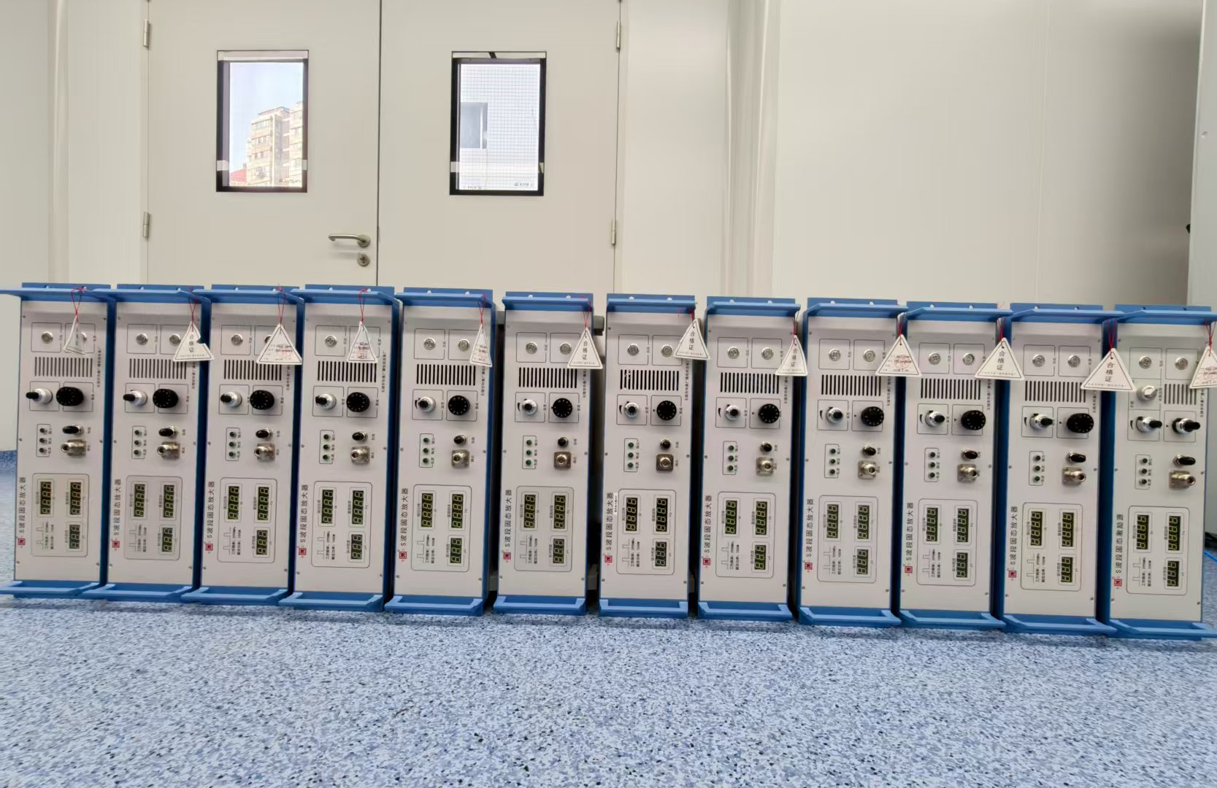
3.1 S-band Solid-state Amplifier Test
S-band Solid-state
Function : The solid-state amplifier is the driver stage of the klystron, which needs to provide stable and low-noise RF power input.
Performance : The output power and phase need to have high stability and consistency.
Test : The key indicators of the solid-state amplifier are systematically tested.
Parameters | Values
Operating Frequency | 2997.924 MHz±3 MHz
Output Power | 50-1280W
Amplitude Stability(RMS) | ≤0.02%
Phase Stability(RMS) | ≤0.02°
Pulse Width | 1-10μs
Pulse Repetition Frequency | 1-100Hz
Rising and Failing Edge | ≤0.05us
Pulse Leading Edge Jitter | ≤0.3ns
Input and Output Isolation | ≥85dBc
Solid-state amplifier physical diagram

Slide 8
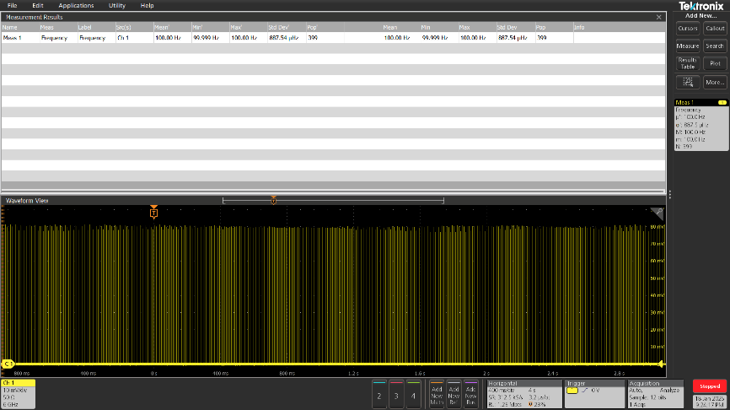
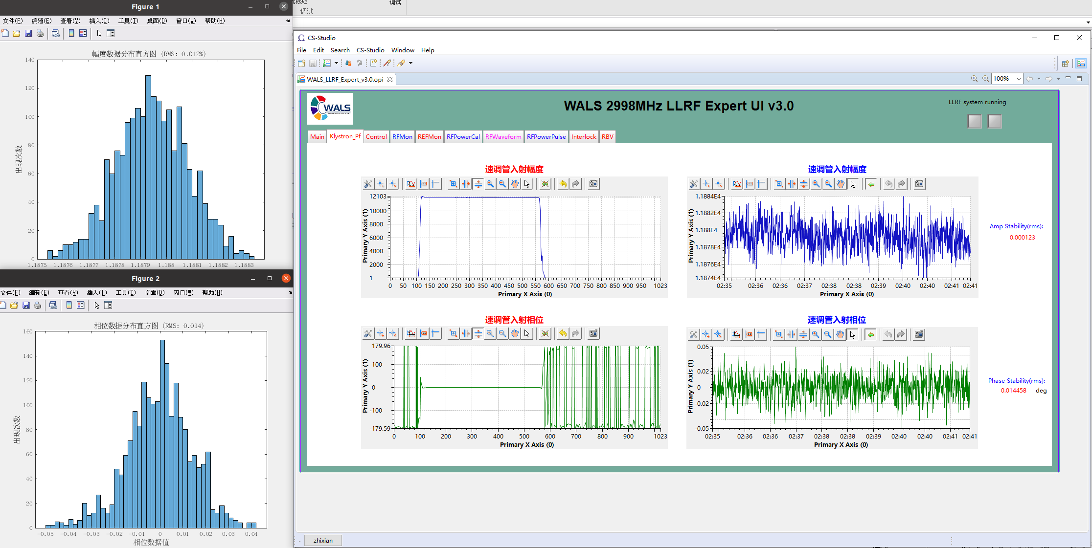
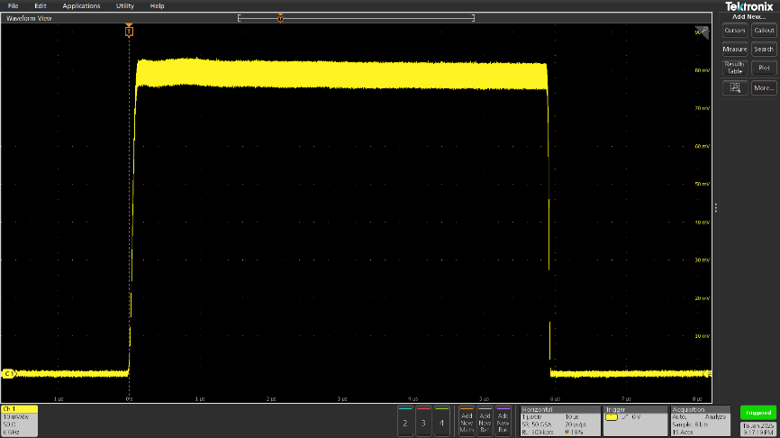
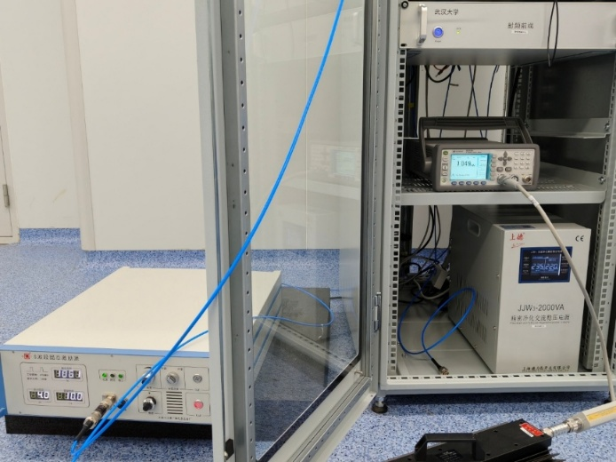
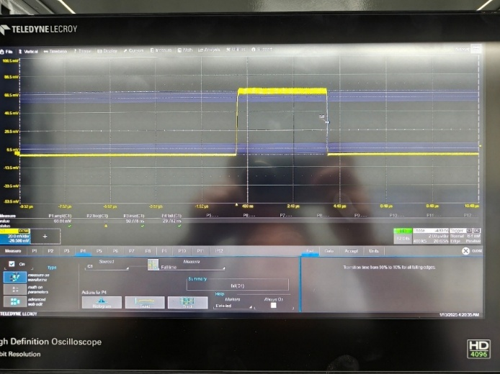
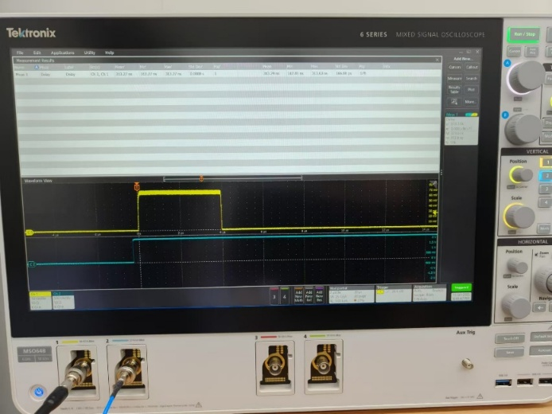
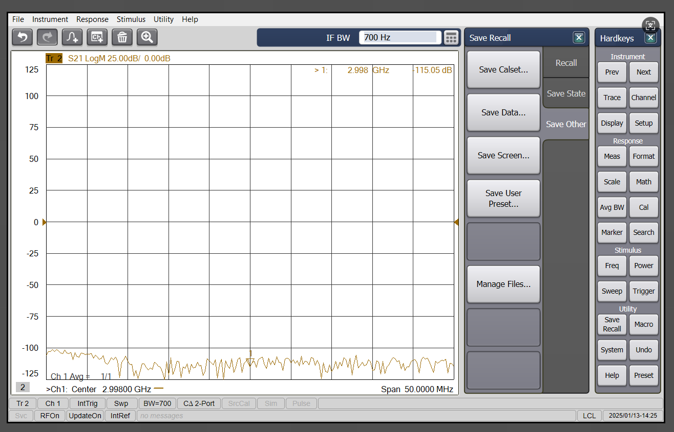
3.1 S-band Solid-state Amplifier Test
Especially, the amplitude and phase stability ( RMS value ) of the solid-state amplifier is better than 0.02 % and 0.02 °.
Pulse repetition frequency
Amplitude and phase stability
Pulse width
Output power
Rising and failing edge
Pulse leading edge jitter
Input and output isolation

Slide 9
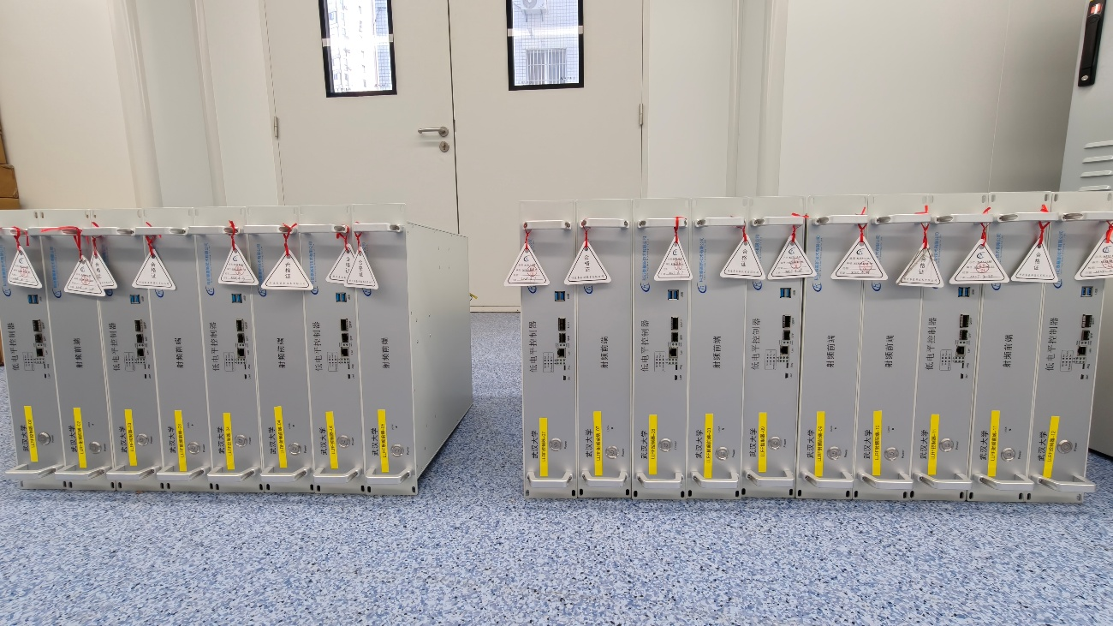
3.2 Low Level RF Control System Test
Low Level RF Control System
Function : Be responsible for the real-time stable control of the amplitude and phase of the acceleration cavity.
Performance :
  The resolution of amplitude and phase measurement is better than 0.02 % and 0.02 °;
  Support open-loop and closed-loop feedback control mode ;
  Support internal and external trigger mode ;
  Have the ability of temperature drift compensation and suppression.
Test : Open-loop closed-loop test with solid-state amplifier and timing device.
Parameters | Values
Operating Frequency | 2997.924 MHz
Output Power | ≥10dBm
Amplitude Measurement Resolution(rms) | ≤0.02%
Phase Amplitude Measurement Resolution(rms) | ≤0.02°
Amplitude Stability with Solid-state Amplifier(rms) | ≤0.02%
Phase Stability with Solid-state Amplifier(rms) | ≤0.02°
Timing Trigger Adjustment Resolution | ≤6ns
Reflection Protection Response Time | ≤1us
Channel Isolation Degree | ≥60dB
Low level controllers produced

Slide 10
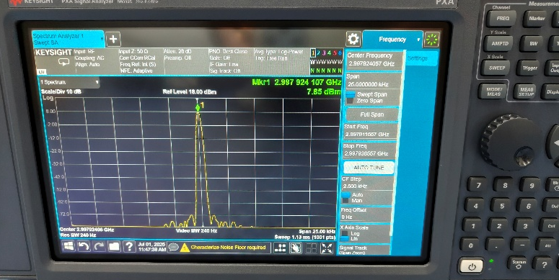
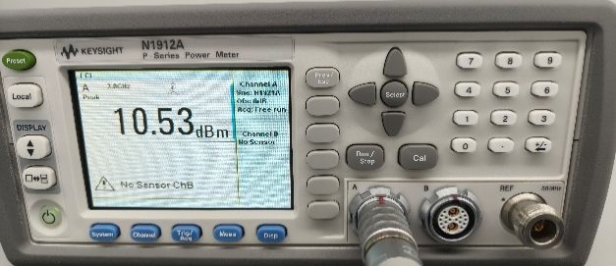
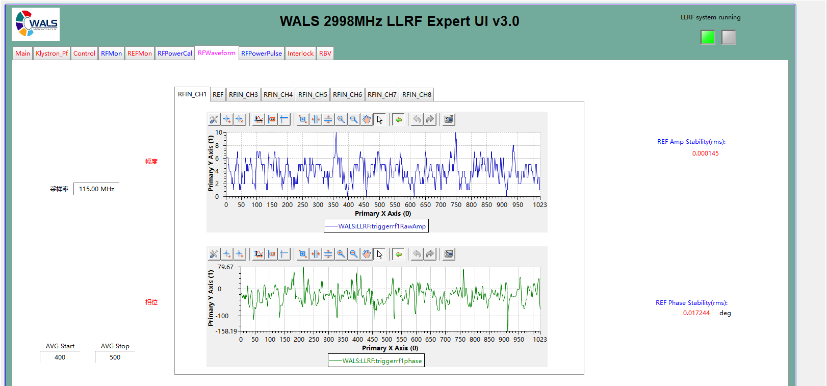
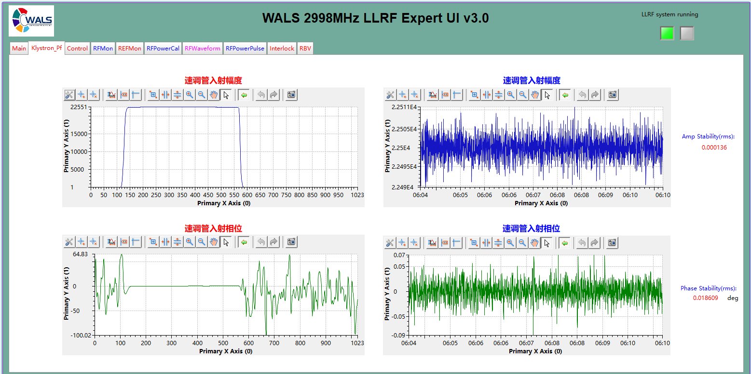
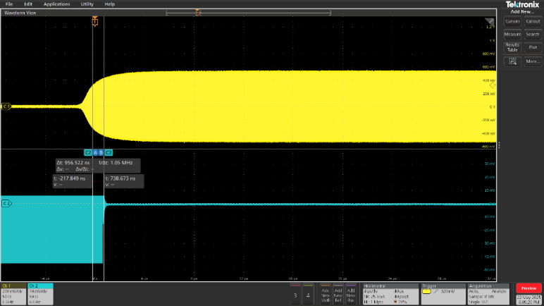
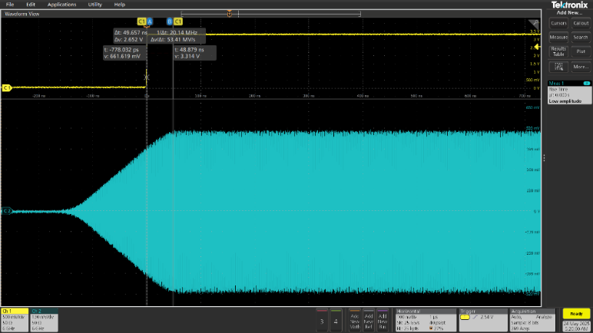
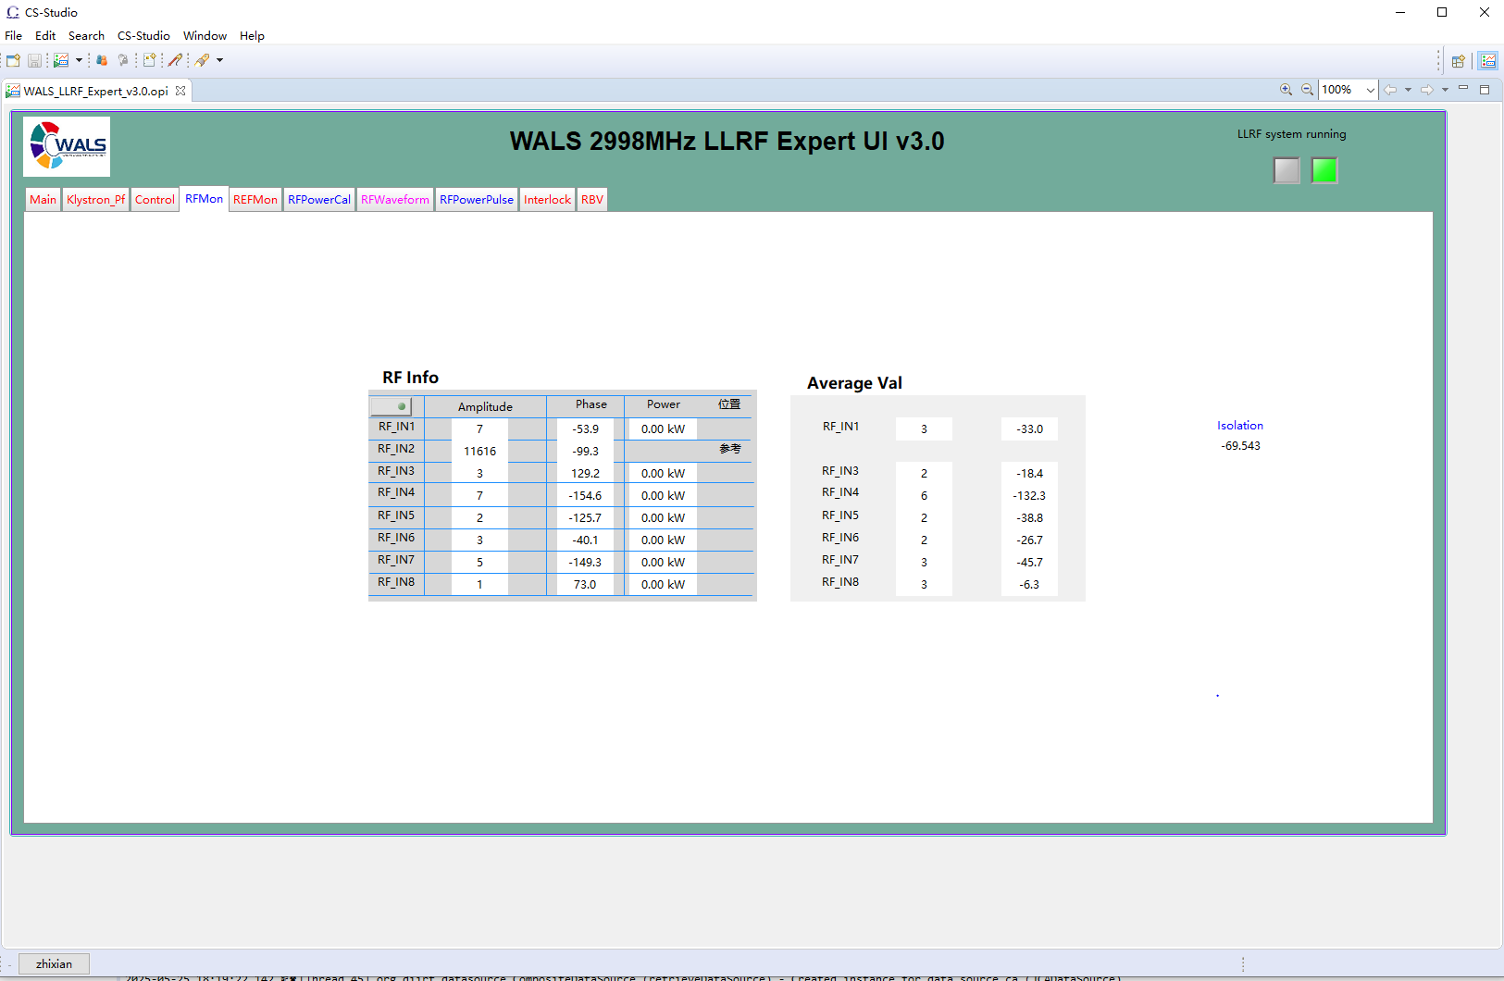
3.2 Low Level RF Control System Test
Amplitude and phase measurement resolution(RMS)
Operating Frequency
Output Power
Amplitude and Phase stability with solid-state amplifier(RMS)
Reflection protection response time
Timing trigger adjustment resolution
Channel isolation degree

Slide 11
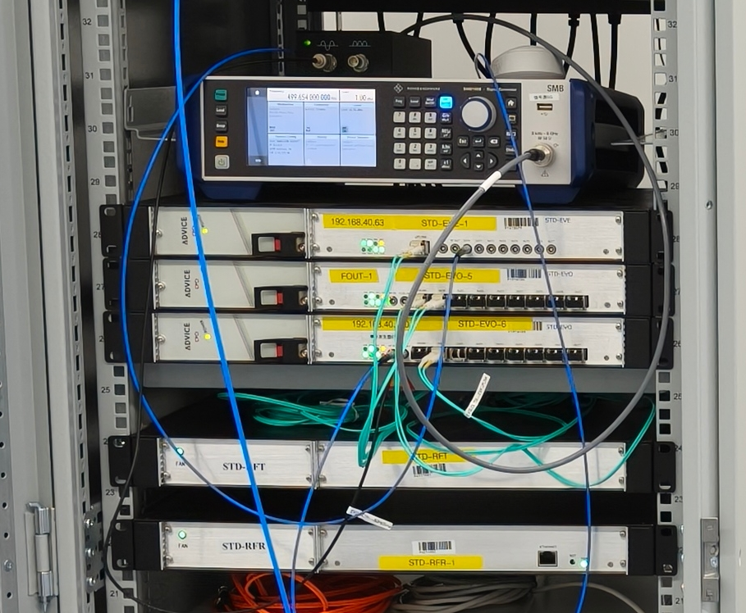
3.3 Timing and Signal Distribution System Test
Timing and Signal Distribution System
Function : Provides a unified clock reference and trigger signal for linear accelerators.
Performance :
  The timing device has low signal jitter, stable rising edge, 5 ps delay time accuracy adjustment, 1 / 20 event clock accuracy adjustment and event clock accuracy adjustment;
  The signal distribution system needs to ensure low phase jitter and low drift performance.
Test : Timing and signal distribution devices have been cross-tested and meet the design requirements.
Parameters | Values
Shake Of Timing Output Signal Relative To Rf Reference Input Signal | ≤7ps
Timing Output Signal Rising Edge | ≤0.7ns
5ps Delay Time Precision Adjustment | √
1 / 20 Event Clock Precision Adjustment | √
Event Clock Precision Adjustment | √
The Phase Jitter Of The Output Of The Signal Distribution Receiver | ≤0.01°
Phase Drift Of Signal Distribution Receiver Output | ≤0.7°
Timing and signal distribution system diagram

Slide 12
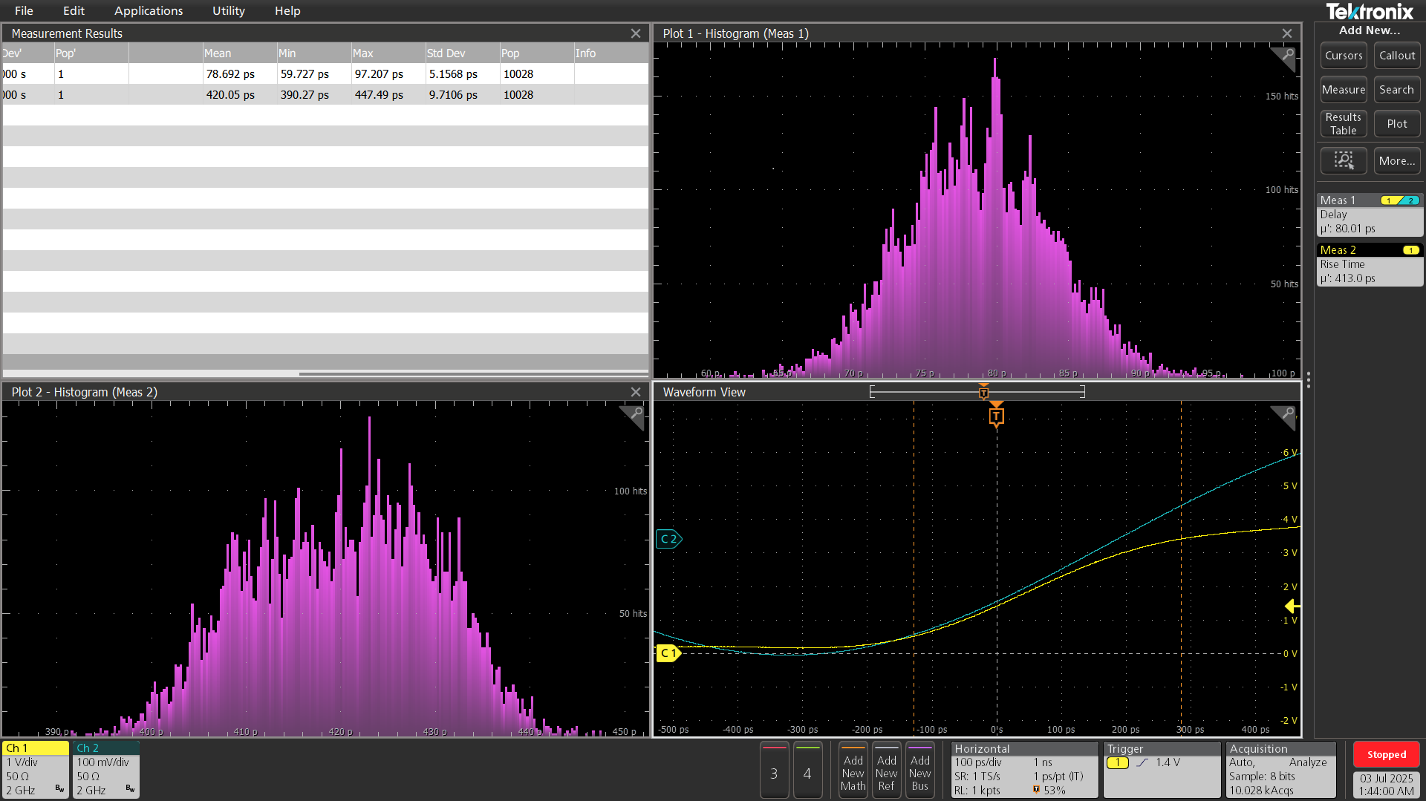
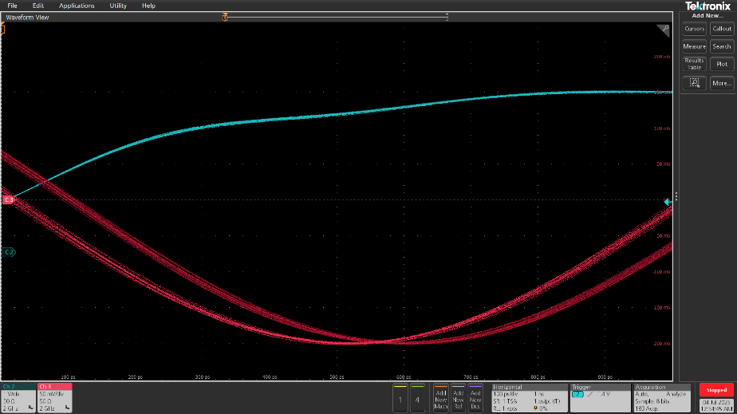
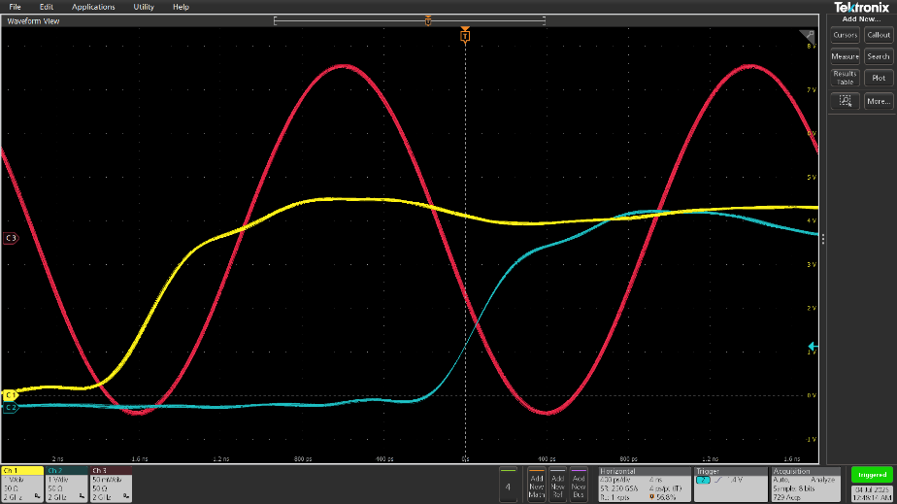
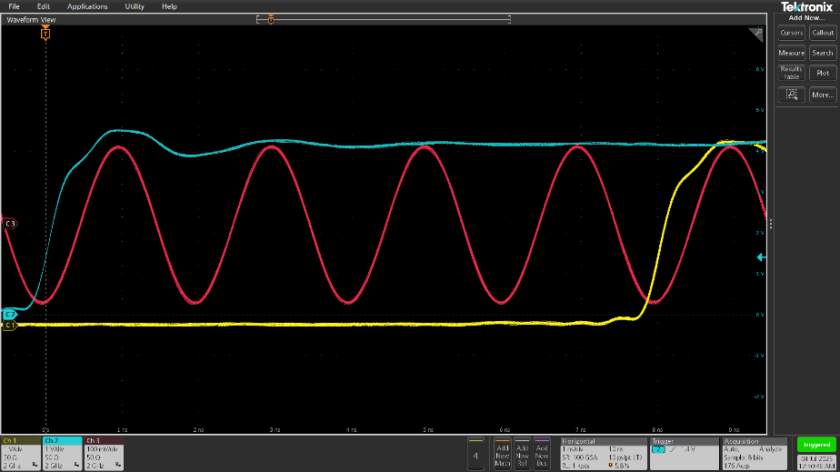
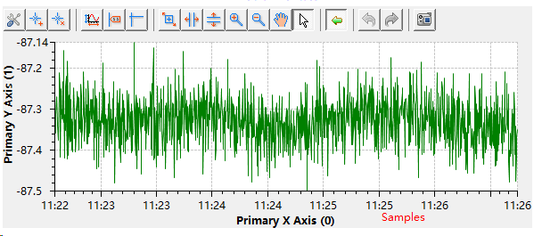
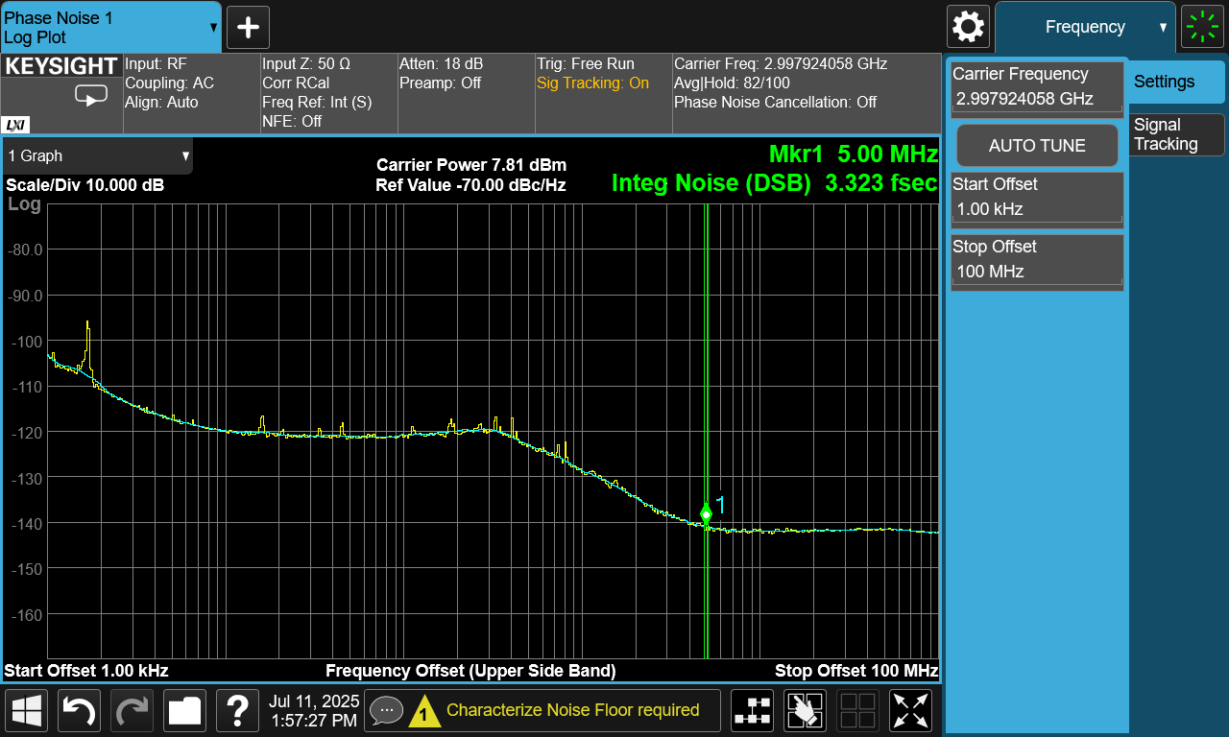
3.3 Timing and Signal Distribution System Test
Timing device phase jitter and rising edge
5ps delay time precision adjustment
1 / 20 event clock precision adjustment
Event clock precision adjustment
Phase drift of signal distribution receiver output
The phase jitter of the output of the signal distribution receiver

Slide 13
4 Summary and Prospect of LLRF Test Platform
The test platform has been successfully built, and the individual and joint tests of S-band solid-state amplifier, low-level control system and timing and signal distribution system have been completed.
The system construction, debugging and optimization methods have been mastered, and it has the ability to support the subsequent accelerator operation.
Summary
Upgrade the test platform to achieve joint debugging and performance verification with the klystron ;
Optimize and upgrade the hardware and software of the platform ;
It provides a reliable experimental verification platform for linear accelerator and free electron laser LLRF systems.
Prospect

Slide 14
Thanks for your attention!

