Slide 1


`
IOC Deployment and Management
Based on Container Technology
In S³FEL
Junhua Zhu, IASF
Notes:
Hello everyone, I’m Zhu Junhua from IASF in Shenzhen.
I’m going to talk about How we realized IOC Deployment and Management Based on Container Technology in S3FEL.

Slide 2

Backgrounds
Backgrounds
Large-scale scientific facility place a high standard to its control system to ensure maximum reliability.
IOC, as the most important component of EPICS, is used extensively within the control system.
Facts
There are approximately 500 IOCs needed to be deployed into the control system of S³FEL.
These IOCs are distributed separately across many different servers.
To build, deploy and manage these IOC projects will be a very time-consuming and labor-intensive work.
How to deploy and manage such many IOCs efficiently and reliably is a challenge we are facing
Notes:
So we get to the problem, How to deploy and manage such many IOC projects with efficiency and reliability is an urgent challenge we are facing with.

Slide 3
Challenges
How to manage IOCs efficiently
Standardized running environment
Fast and Automated build for IOC projects
Centralized project management
create, delete, build, deploy, start, stop, search, make backups, …
How to run IOCs reliably
Status monitoring
IOC or OS metrics (CPU, memory, filesystem, disk, network, I/O, custom metrics…)
program logs
Alert from abnormal situation
set threshold and send alerts
High availability
recover from IOC crash or OS crash
Notes:
As you know, there are many IOC projects and they are distributed across many servers.
For each IOC, you will have a lot to do to manage it well. You may need to create it, then build and deploy it, you may need to start or stop it as convenient as possible, you may need to find out the exact one from all deployed IOCs then do some updates for it, or you want to make a backup for a specific one.
Under this situation, a centralized project management is needed, with a centralized project repository of IOCs, you can manage IOCs on one machine as manager, and you don’t need to telnet or ssh everywhere to do further operations..
To run these IOC projects, A standardized running environment for all IOC projects is preferred, it is easy to maintain a unified running environment rather than a unique one for each IOC.
Then let us talk about the reliability.
If you want to run IOC with reliability, you’d better be able to track all their running status as metrics and logs in real time.
High availability is also very important. To achieve this, IOC should be able to automatically recover from breakdown in most cases, such as the crash of IOC process, or the crash of the host OS.

Slide 4
Our Solution —— Run IOC in Container
IOC Containerization: Split IOC projects in proper structure for running in container
pre-built docker image
OS libraries and packages
EPICS base
EPICS modules and extensions
IOC executable files
project-related running files
configuration file
database files
protocol files
settings files
Configuration file and source files are collected as a smallest manageable unit, which contains all information to run a specific IOC.
source files
running files
config file
IOC
container
docker
image
source files
Notes:
To solve the problems mentioned above, We turned to run IOC in container for our control system.
To run IOC in container, we split an IOC project into two parts, one part is the pre-built dockers image, it contains necessary dependencies for operating system such as basic libraries and packages, it also contains EPICS base, EPICS modules and extensions, and pre-compiled IOC project files that provide an executable entry for IOC program.
Another part is about project-related running files, it also consists of two parts, one part is the configuration file, all the IOC related configurations are collected here. Another part contains database files, protocol files and other settings files, they are source files of an IOC.
Given by this structure, to run an IOC project, you just let container image load the running files and start at the entry of IOC executable file.
Configuration file and the source files contain all the information needed to run an specific IOC, they can be treated as a smallest manageable unit to represent an IOC.

Slide 5
Advantages of IOC containerization
Standardized running environment
docker image as standardized environment
read-only, portable and cross-platform
Resource isolation and limitation
allocate fixed quotas of system resources
prevent single point failures from spreading
High availability
running status monitored by container orchestration
automatically recover from failures
Advanced architecture with plenty of powerful toolkits
container monitoring toolkits
Notes:
There are many advantages to run IOC in container.
Firstly, images are fixed, we pack all the dependencies that are needed to run a program into an image, so to make it a standardized and portable and cross-platform running environment.
Secondly, Container technology supports resource isolation and limitation in container, programs running in container could get limited resources allocated, which prevents single point failures from spreading to the entire operating system.
Third, Programs deployed in container can have high availability. Container orchestration tool continuously detect container status and try to maintain the running status of container programs according to the declared status configuration. It attempts to schedule and restart container programs automatically when a failure occurs.
At last, Currently, container technology is the most popular way to deploy and manage programs and applications. It has a rich ecosystem that provide various useful tools for program deployment and management, we could use them to build a more automated and intelligent control system.

Slide 6
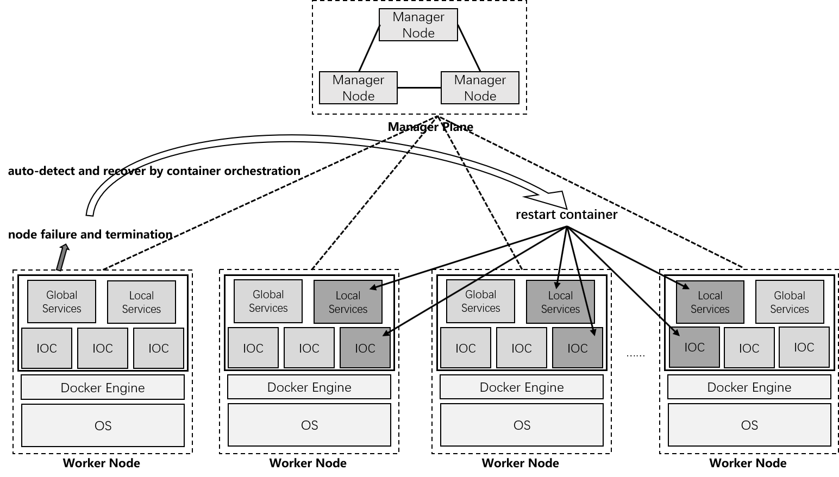
Advantages of IOC containerization
An example of high availability achieved by container orchestration
Notes:
This is the picture shows the ability of self-healing of containerized IOC projects under cluster deployment.
When a node encountered some failures and get unexpected termination, container orchestration will automatically restart the affected containers at other nodes in the cluster to keep the services running in it as the status we hoped.

Slide 7
IocDock: A deployment and management toolkit for IOC projects
We developed IocDock
An out-of-box toolkit with CLI for quickly setting up a well-configured cluster for the deployment and management of containerized IOC
Main Features
toolkit to build and manage server cluster in control system
IOC project management based on a centralized repository
IOC deployment based on container orchestration
well-configured metrics monitoring and alerting
well-configured logs collecting and alerting
Notes:
To make our control system more convenient and automated when dealing with so much IOC projects, we developed a project named IocDock.
It is an out-of-box toolkit with command line interface for quickly setting up a well-configured cluster for the deployment and management of containerized IOC.
It contains the following five major functions as its features:
It is a toolkit to build and manage the server cluster in control system, it has many automated scripts help to set up cluster environment and A CLI to interact with.
It realized IOC project management based on a centralized repository
It realized IOC deployment based on container orchestration
It has well-configured metrics monitoring and alerting mechanism
It has well-configured logs analysis and alerting mechanism
These five major functions help to build a highly available and an easy-to-maintain infrastructure of control system.

Slide 8
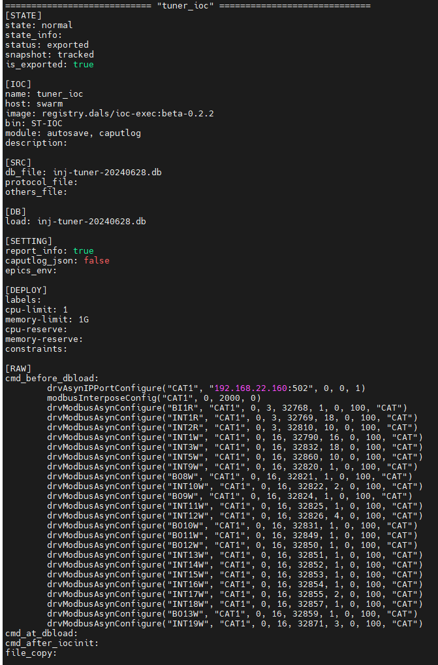
Use IocDock CLI to manage and deploy IOC
A Configuration File Example
5 steps to create and deploy an IOC project
1) Create an empty IOC project by IocDock
Deploy Configurations
2) Collect source files for IOC project
3) Set deploy configurations
4) Set module load strings as expected in st.cmd
5) Build and deploy
Module init string for st.cmd
Notes:
This is how the CLI helps to conveniently manage IOC projects.
Just like the command shows in picture, You can use a simple command to create, manage, build and deploy IOC projects.
The right picture is an Example of IOC configuration file, to configure an IOC project to run, all you need to do is to edit this file.
It collects and abstracts all necessary configurations and deployment options to run an IOC project.

Slide 9
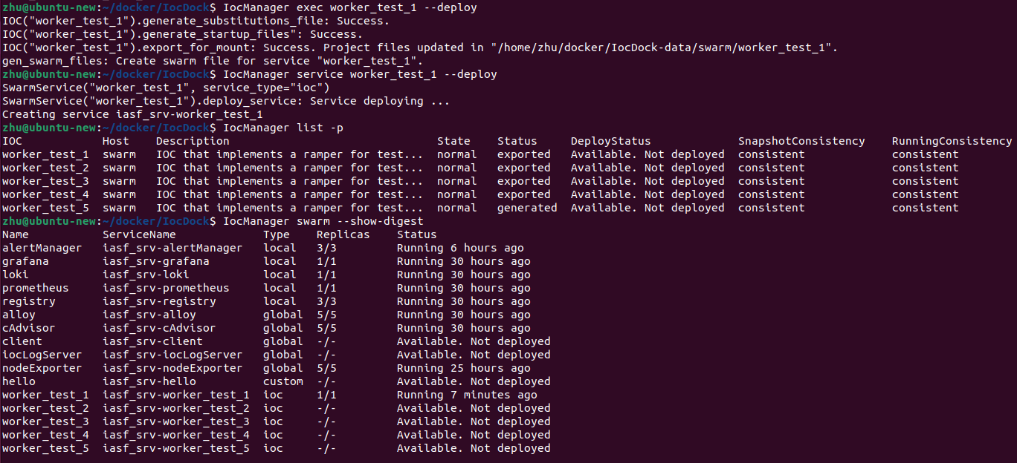
Use IocDock CLI to manage and deploy IOC
Commands for generating deployment files and deploying automatically
Information panel for management
Notes:
This is the picture shows how to use CLI command to generate deployment files and deploy an IOC project.
After the IOC is deployed, you can use CLI command to see the running status of the cluster.

Slide 10
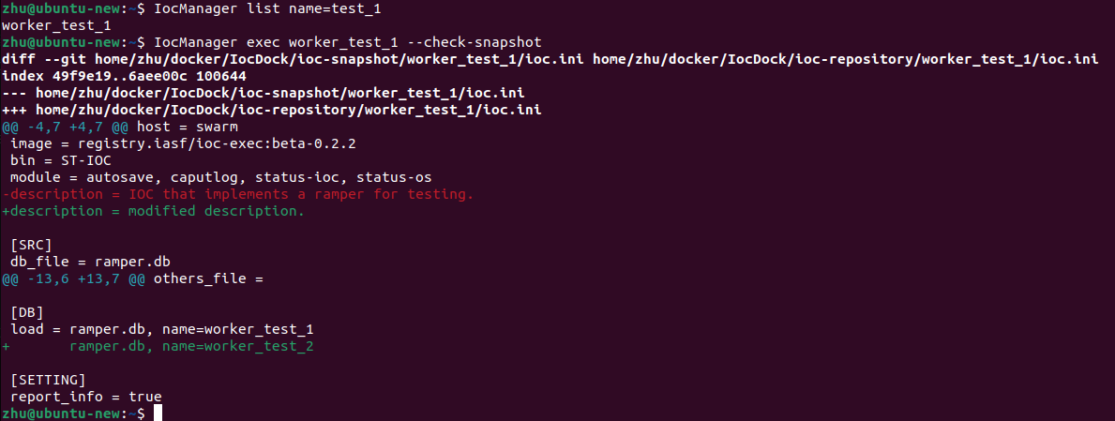
Use IocDock CLI to manage and deploy IOC
Use filter to search through IOC
project file difference detection
Notes:
CLI command also provides many other management functions such as condition filtering for IOC projects, and file content difference detection for IOC project files.
We developed it to do life-cycle management of IOC projects.

Slide 11
Works for automated system status monitoring and alerting
1. A code architecture for managing container services in cluster
2. IocDock Integrate with well-configured toolkits
Integrate Prometheus with pre-defined metrics monitoring and alerting
Prometheus, cAdvisor, nodeExporter, alertmaneger
Integrate Loki with pre-defined logs collecting and alerting
Loki, Alloy
Integrate Grafana with provisioned dashboard for data visualization
Dashboard for containers in cluster and nodes in cluster
Notes:
Besides the tools for managing IOC projects, we do more works for provisioning automated system status monitoring and alerting.
Firstly, we develop a code architecture to manage container services in cluster, it contains all well-configured services that are not IOC as the cluster infrastructure.
Then we integrate Prometheus toolkit, Loki toolkits and Grafana, These toolkits help to achieve high availability as they monitor system status and program logs, and send alerts if the metrics value meets the condition, this can help the operators quickly locating and solving problems before things gets worse.

Slide 12
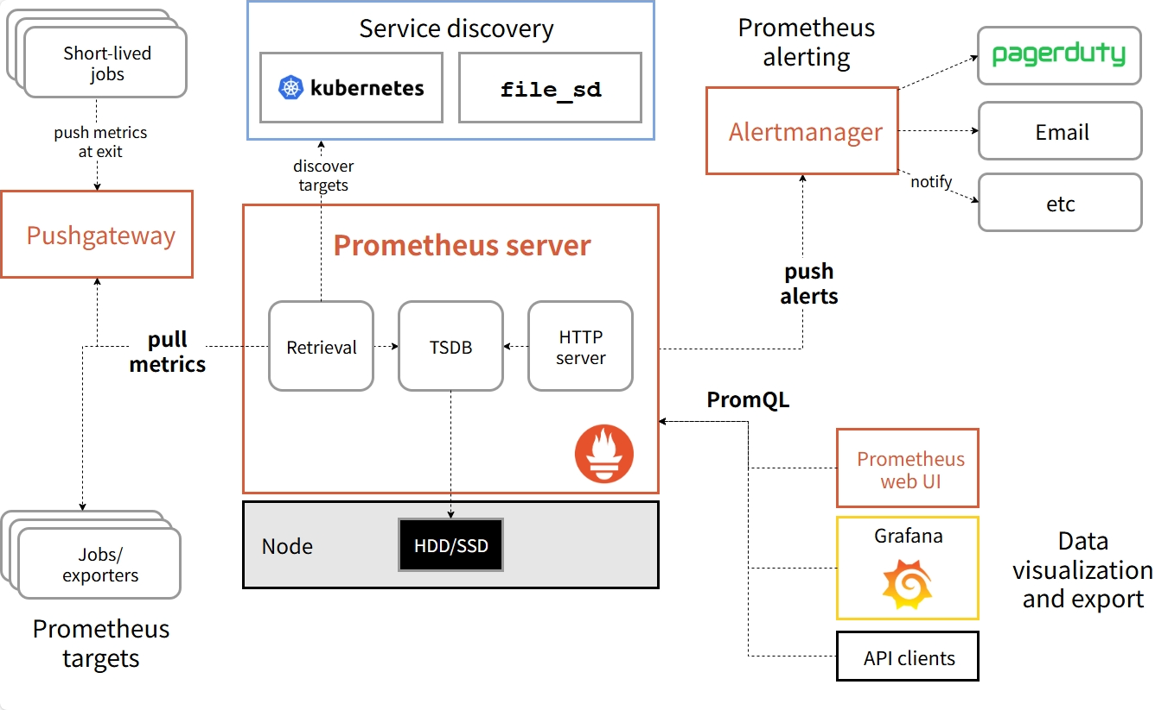
IocDock integrated with Prometheus
Prometheus is an open-source toolkits for system monitoring and alerting.
Prometheus server
抓取指标并存储至时序数据库，执行数值计算与逻辑计算，判断报警状态，并向外提供基于PromQL的指标查询、计算，以及推送报警等服务
Exporter
采集业务端各项运行指标，包括 CPU、内存、磁盘、I/O等，以供抓取
Alertmanager
接受告警，对告警进行分组、抑制、静默处理，并向外部发送告警通知(支持多个第三方平台，如邮箱，微信…)
Pushgateway
中间代理组件，与 Prometheus 的默认拉取模式互补，适用于无法主动暴露 /metrics 接口的目标
DataVisualization
数据可视化，Prometheus UI，grafana
Notes:
Firstly Let me introduce with Prometheus, Prometheus is an open-source toolkits for system monitoring and alerting, it is very popular now.
It scrape all system metrics from exporter and save them into its time serial database. It do aggregation and calculation for metrics, determine whether the alerts should be sent.
It also supports query with historical system data, further analysis could be made based on these historical data to check running status of the system .

Slide 13
IocDock integrated with Prometheus
Metrics currently being monitored by Prometheus and its alerting threshold:
Container CPU usage (threshold: 70% of one core, warning)
Container memory usage (threshold: 70% of max allowed quota, warning)
Container disk device I/O rate (threshold:10 MB/s, warning)
Container filesystem usage (threshold: 70% of max capacity, warning)
Container filesystem read/write rate (threshold:10 MB/s, warning)
Container network package error or drop rate (threshold: 10 pack/s, warning)
Offline detection (threshold: 60 s of no heartbeat, info for containers, warning for tasks, critical for services)
Node CPU usage (threshold: 70% of all cores averaged, warning)
Node memory usage (threshold: 70% of node max memory, warning)
Node disk device I/O rate (threshold:10 MB/s, warning)
Node filesystem usage (threshold: 70% of max capacity, warning)
Node network I/O rate (threshold: 500 MB/s, warning)
Offline detection for scrape mechanism
Notes:
We configured Prometheus to monitor many common metrics to track system running status.
These are the metrics and the related alerting threshold we are currently using.
They are mainly about CPU, memory, I/O and specific container or mechanism offline detection.
These are not all, we could add more if in need.

Slide 14
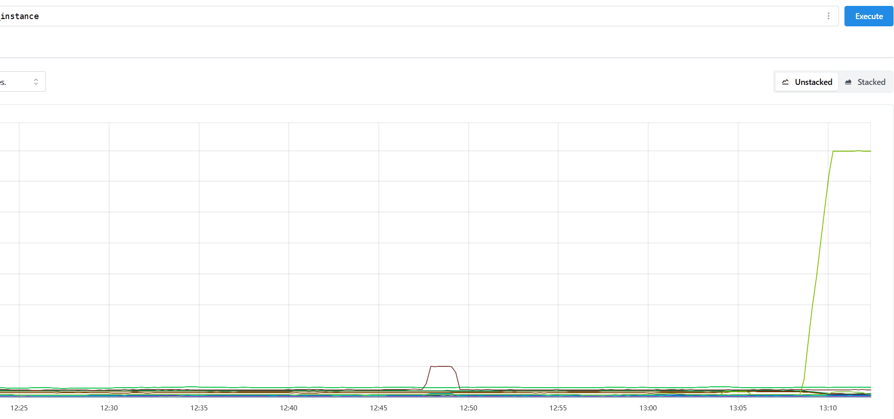
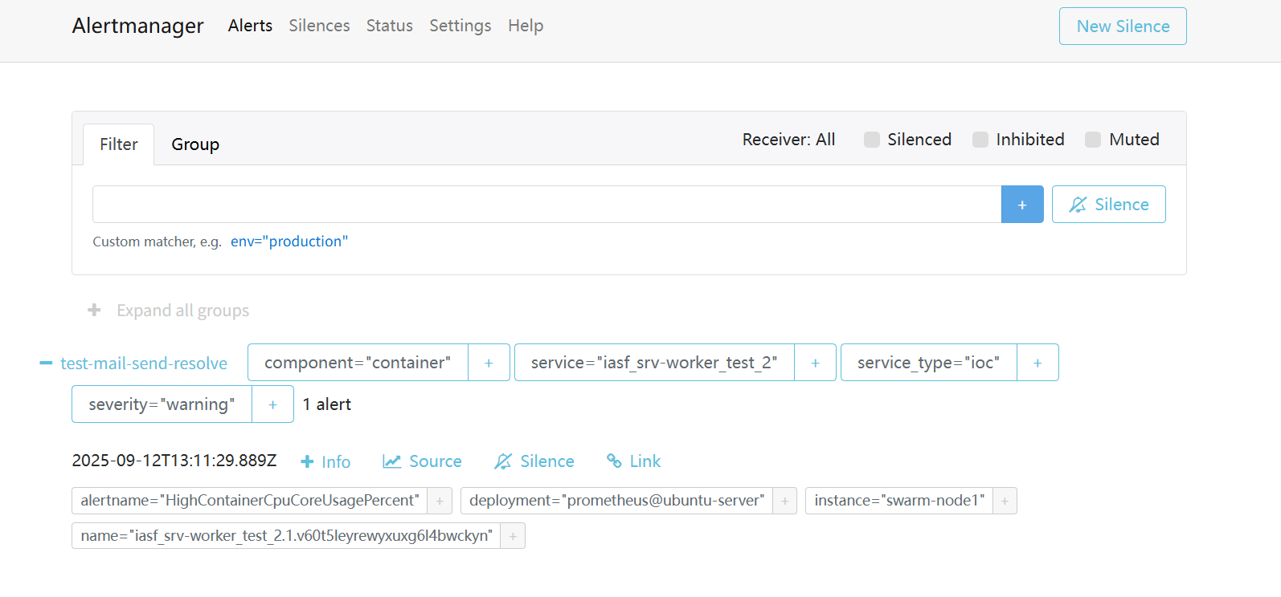
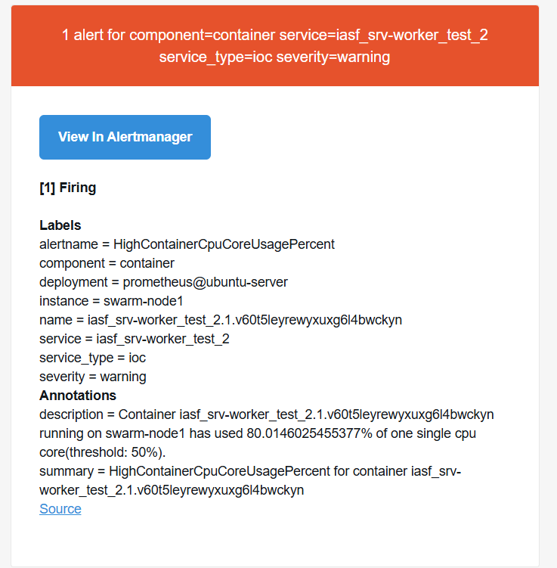
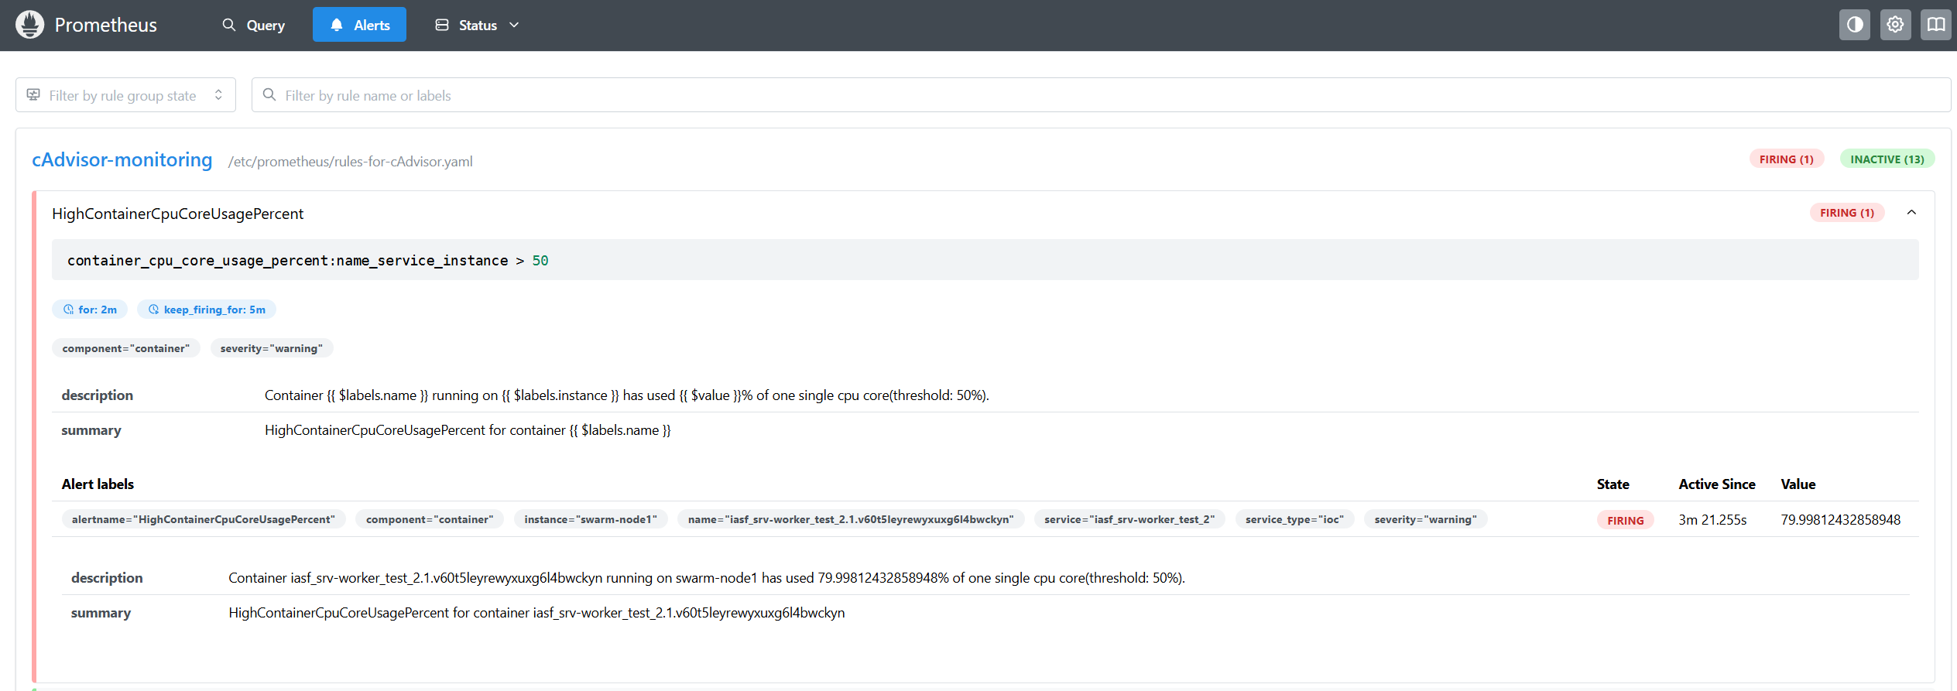
IocDock integrated with Prometheus
A abnormal increased metric of CPU usage and the consequent firing alert in AlertManager
1
3
2
4
Notes:
This is the pictures shows how Prometheus works in our system.
At first, we do a CPU stress test, let the value of the CPU metric increases, Prometheus will continuously monitor this, after reaching the threshold for specified time interval, as step2 shows, Prometheus will firing the alert to suggest that CPU usage is beyond the threshold we have set.
Then Prometheus will send all firing alerts to Alertmanager, which is responsible for alerts routing and dispatching, we configured email as the alerts receiver so finally the operators should get the message that CPU usage in a container has exceed the threshold, and he may need to do troubleshooting to figure out what is actually happening.

Slide 15
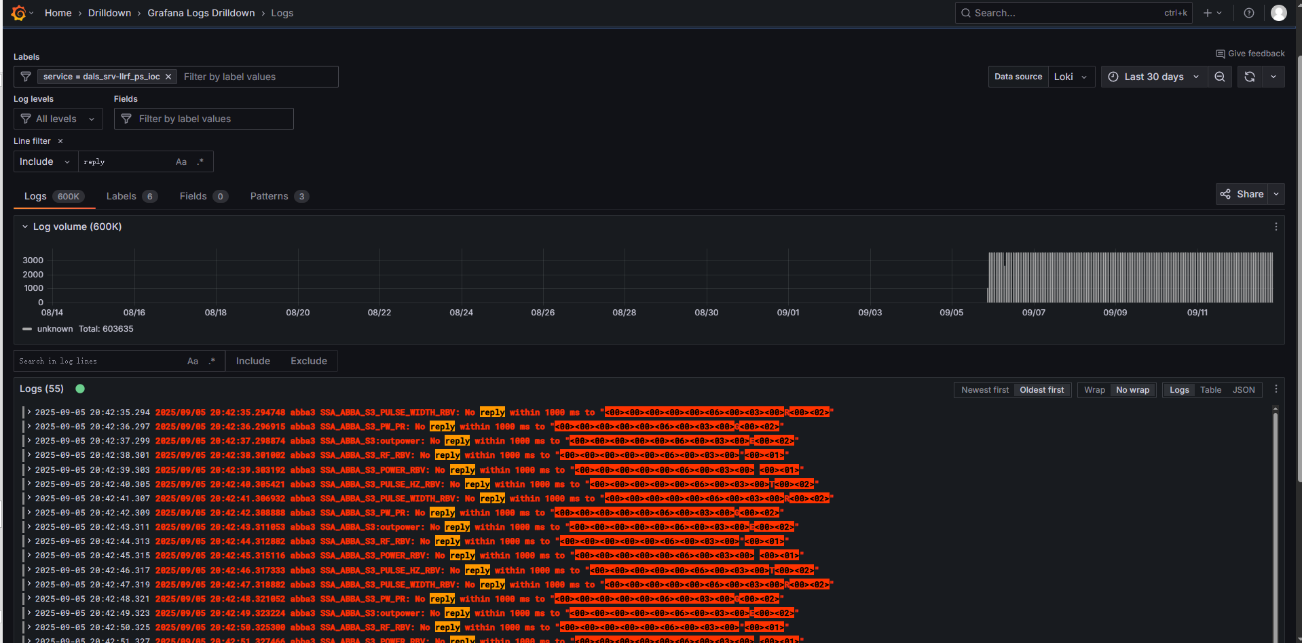
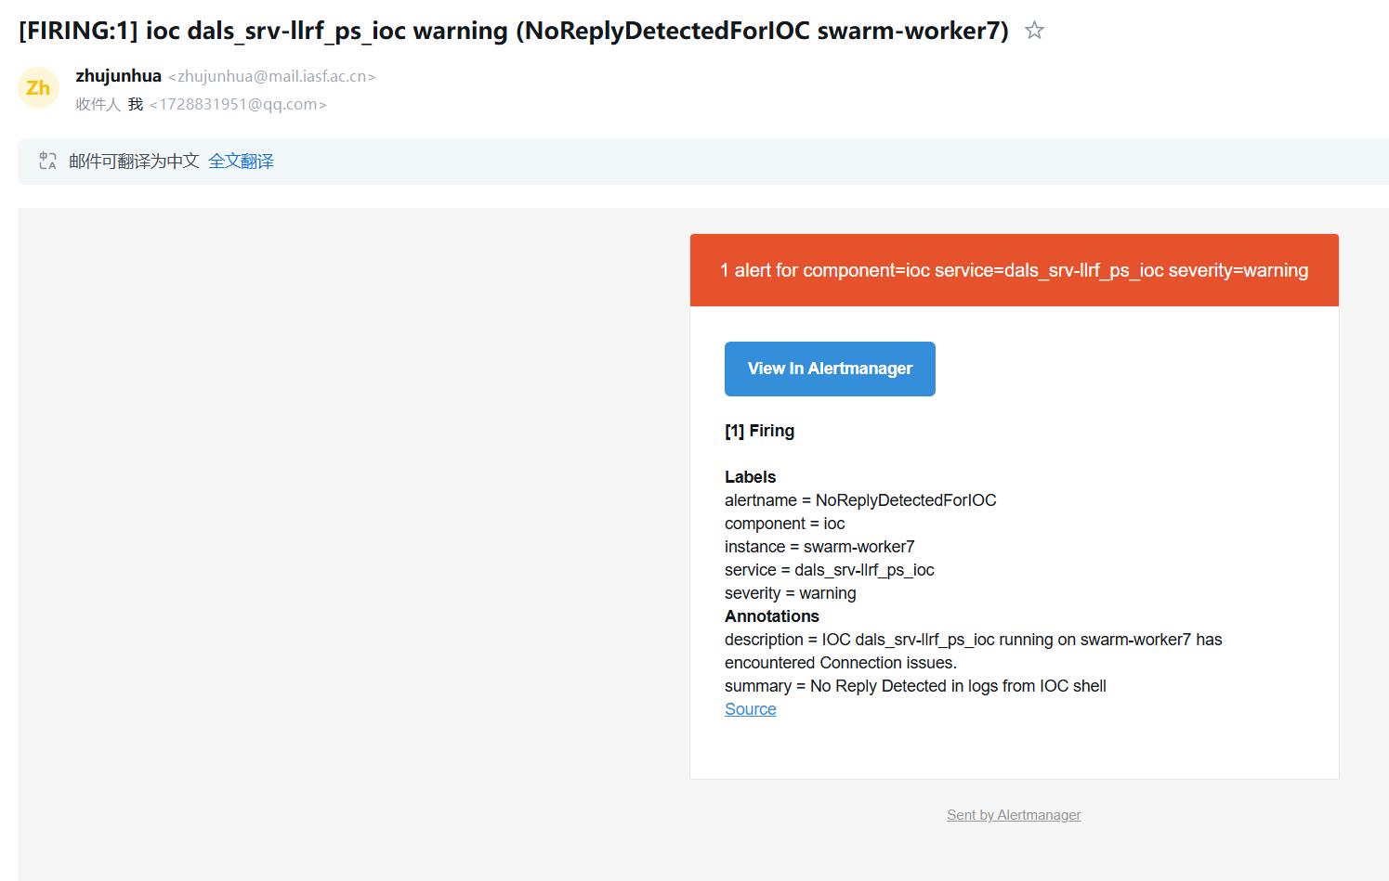
IocDock integrated with Loki
Loki is a set of open source components that can be composed into a fully featured logging stack.
We configured Loki with A query WEB UI and to send alerts when keywords detected in collected logs
Received alert email
Filtered log lines by regex
Notes:
Then Let me introduce with Loki.
Loki is a set of open source components that can be composed into a fully featured logging stack.
We use Loki to collect and store the logs from programs running in the containers, we could use the query Language provided by Loki to perform filtering of log lines just like the left picture shows.
This helps us make quickly Troubleshooting if something gets wrong and we want to see its logs to see what is happening.
Loki is configured to detect the keywords in logs from IOC shell such as “error” “disconnect” “warning”, it will send alerts when these key words are detected in IOC log line.
The right picture shows that when a keyword named “no reply” occurred in the log lines of IOC shell, the alert was send to specified email receiver automatically at once.
With these mechanisms, we could observe the comprehensive running status of programs running in container, which also helps us a lot to achieve high availability of control system.

Slide 16
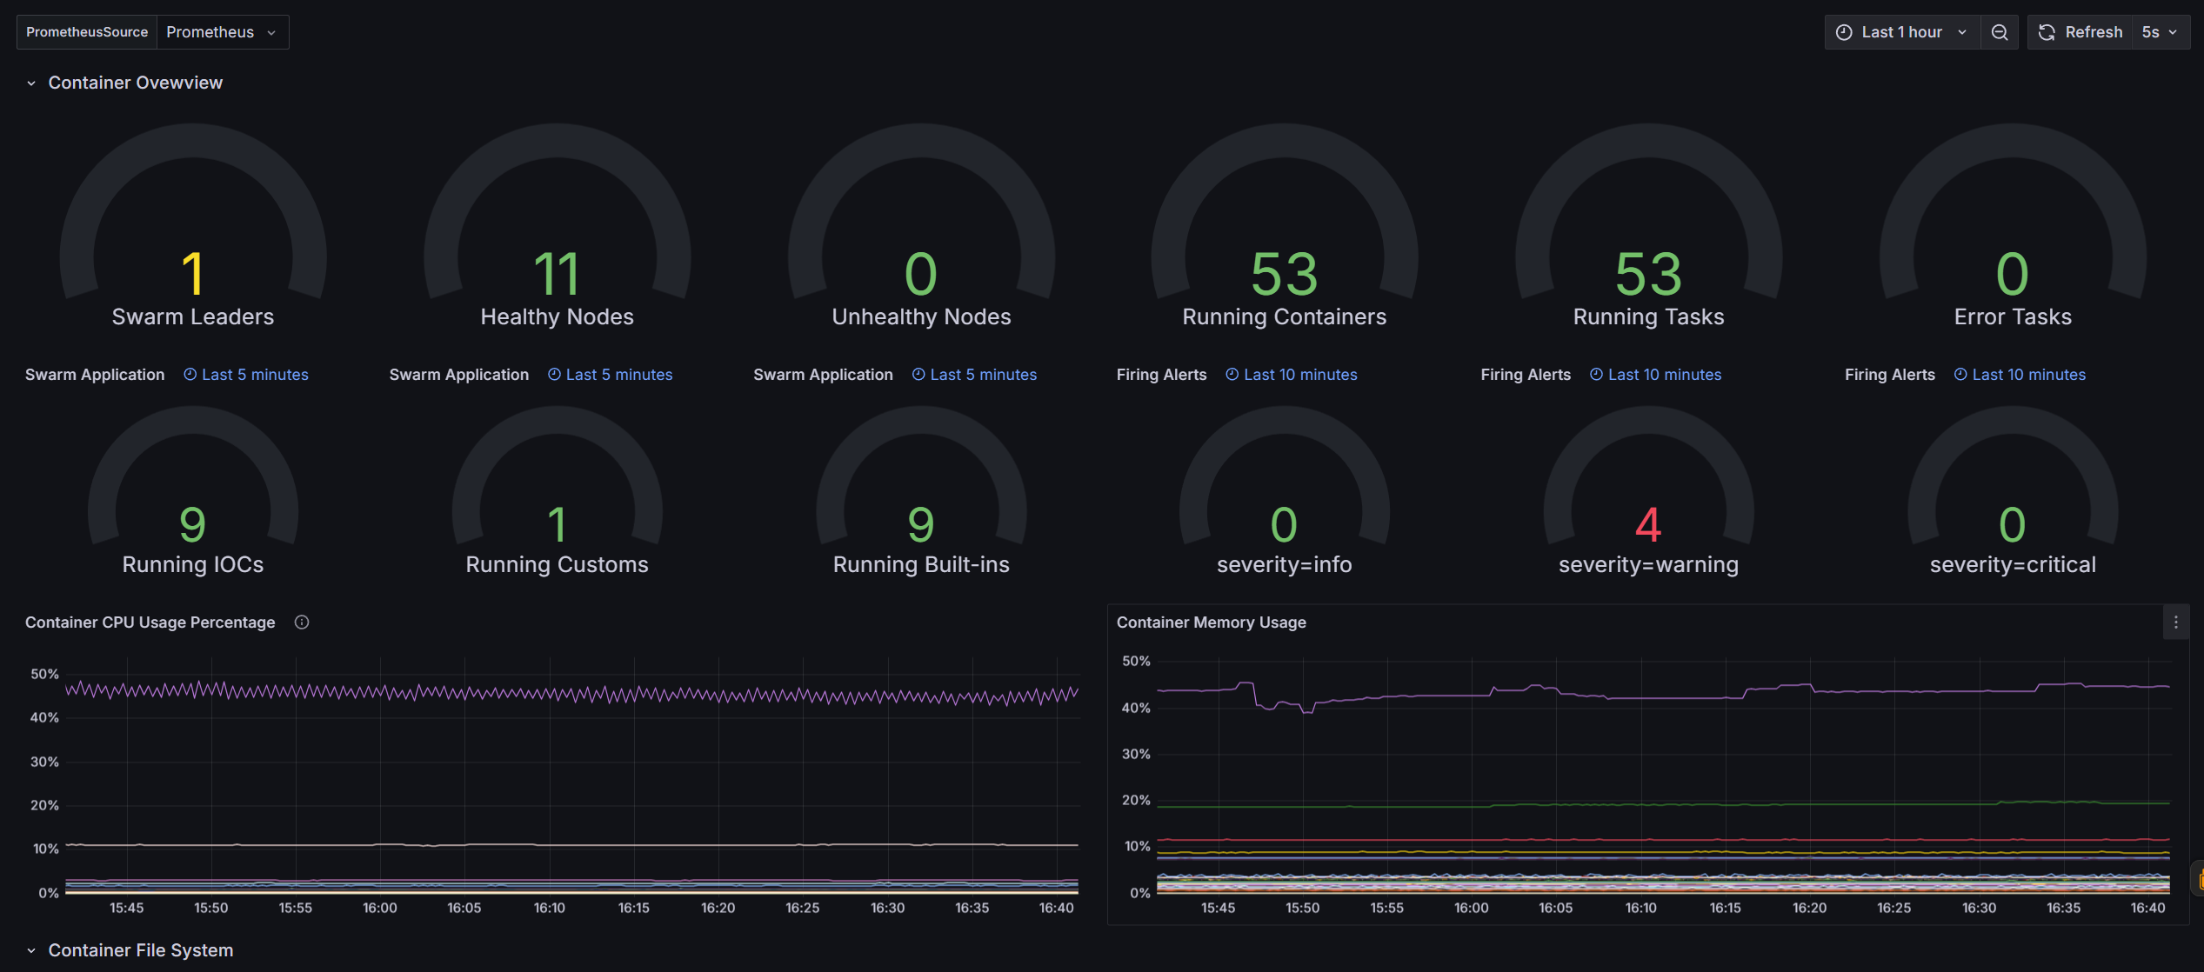
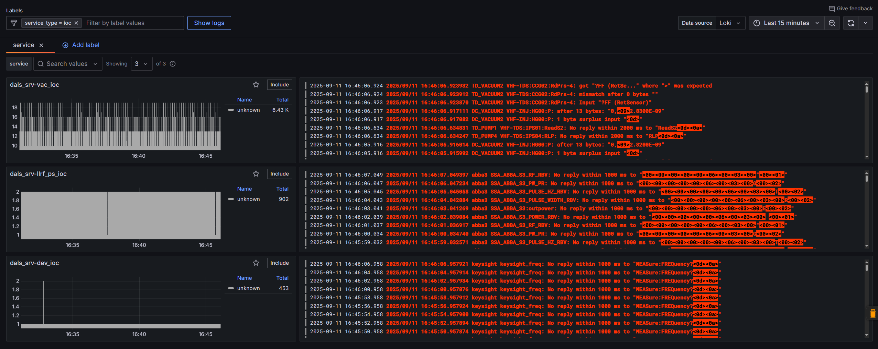
Control System in DALS
use IocDock for IOC management
use docker swarm as container orchestration
server cluster running in VMware
3 virtual machine as manager nodes
4 virtual machine as worker nodes
a NFS server for shared storage
12 IOCs with about 11000 PVs (not all)
comprehensive metrics monitoring with dashboard
convenient log query WEB UI
automatically sending alarm through email
no records of abnormal termination for more than a year
apply in S3FEL in future
Notes:
Then I will give an introduction of how IocDock is working in the control system of DALS.
We test IocDock in DALS, use it to do IOC management, it helps to form a standardized project structure, and improves the management efficiency.
We choose docker swarm as our container orchestration. Our cluster servers are running in VMware, with 3 virtual machines as manager nodes and 4 virtual machines as worker nodes.
There are 12 IOCs with about 11000 process values now running in IocDock. However, it is not of them, for example, IOCs in machine protection system are not included, but they also can be deployed in this system if we want.
It contains comprehensive metrics monitoring with dashboard, convenient log query WEB UI and a alarming mechanism that automatically sending alarm through email.
We have run this system in DALS for more than a year, it shows good efficiency and reliability, there is no record of abnormal termination about container running, and we are going to apply it in the construction of control system in S3FEL.

Slide 17
Summary
IOC containerization
IocDock, an out-of-box toolkit with efficient managing CLI and well-configured metrics or logs monitoring and alerting mechanism.
No need for further configuration, auto-discover mechanism works well for newly deployed IOCs
Not only for IOC, but for all programs that can run in container.
To experience or co-develop to make it better, find project at:
https://github.com/zhuzzzzzz/IocDock.git
Notes:
Let’s make a summary the speech.
We have talked about IOC containerization and a developed project named IocDock to do IOC deployment and management.
IocDock is an out-of-box toolkit with CLI to do IOC management and it has well-configured metrics and logs monitoring and alerting mechanism.
We established a set of operation and maintenance workflows of control system based on it to improve efficiency and reliability.
It is well-configured for most common system users, auto-discover mechanism works well for newly deployed IOCs, there is no need for further configuration,
It is developed mainly to manage IOC but not only for IOC, but for all programs that can run in container.
If you are interested in this project, you can find it at this github address.

Slide 18
THANK YOU
深圳市光明区新湖街道
圳园路268号3号楼
268 Zhenyuan St, Building A3, Floor 3-6, Guangming District,
Shenzhen, Guangdong, P.R.China

