Slide 1



Progress of the UTEF Low Energy Light Source
Bocheng Jiang
Sep. 15, 2025, Chongqing

Slide 2
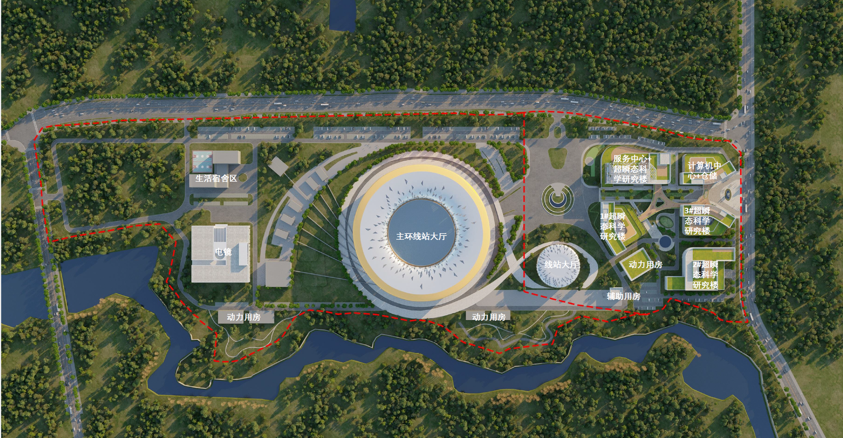
Ultrafast Transient Experimental Facility-UTEF
UTEF consists of a synchrotron radiation source and electron microscopes, integrating both photon and electron probes
Facilities
0.5GeV SR (UV-EUV)
+3 Electron Microscopes
3.0GeV SR
+ Multiple Electron Microscopes
Phase Ⅱ : ~2.4×10⁵ m²
Phase Ⅰ:~10⁵ m²
High flux
SR
Cluster of Electron Microscopes
Advantages
Wide spectral range
High flux
wide field of view

Slide 3
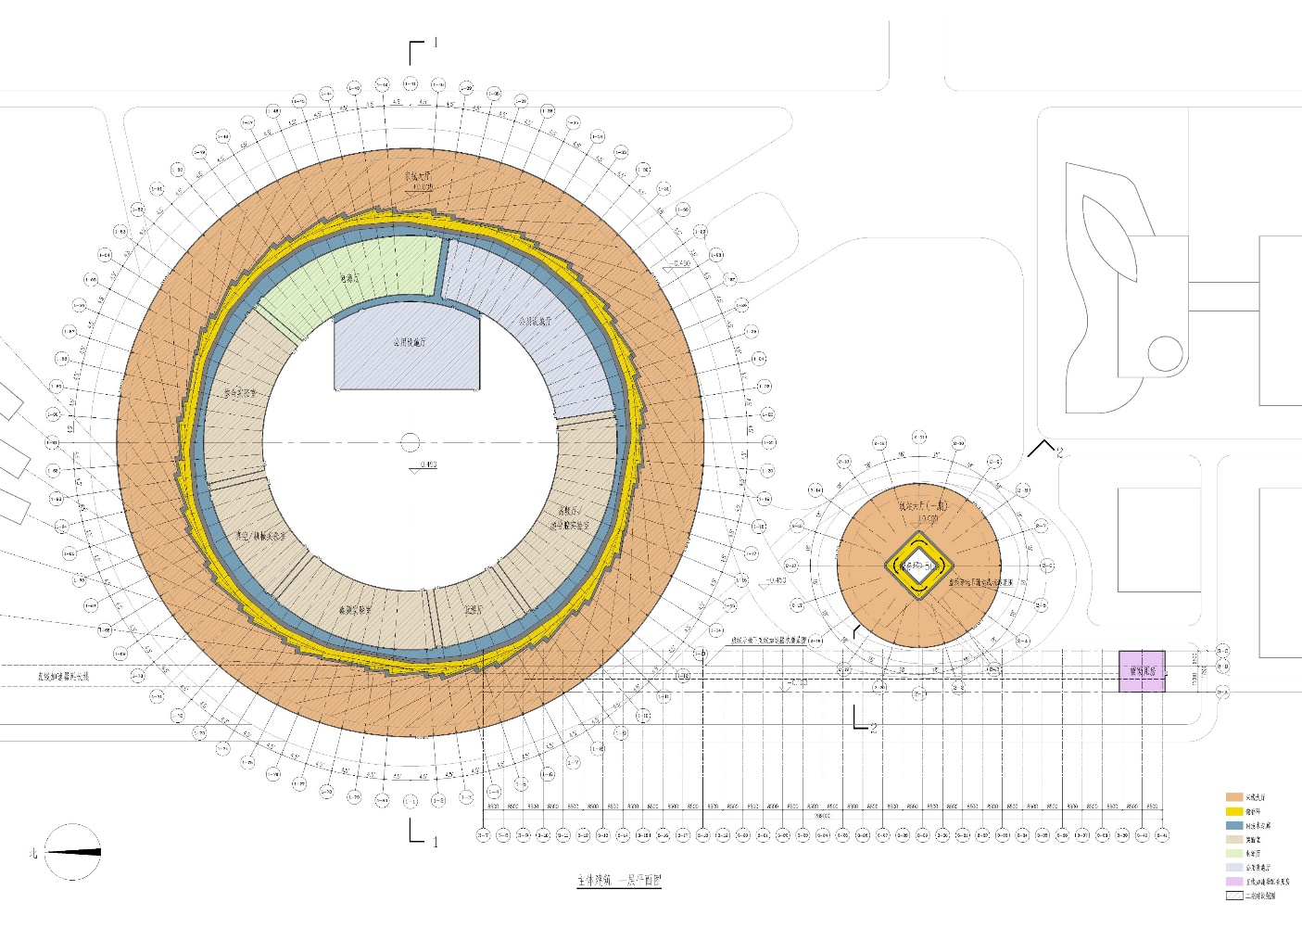
UTEF Complex
Phase Ⅱ
胡焕庸线
Phase Ⅰ
3GeV SR
Electron Microscopes
0.5GeV SR
Circumference:590 m
Beamlines: >30
Electron Microscopes
Circumference: 76.78m
Beamlines: 6

Slide 4
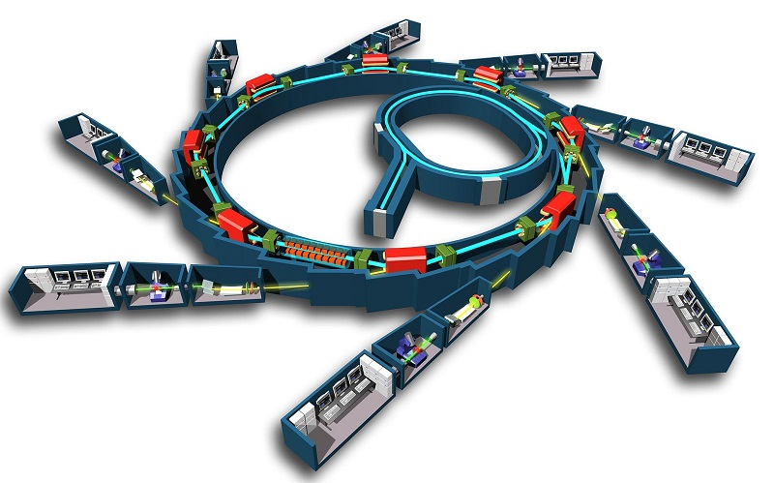
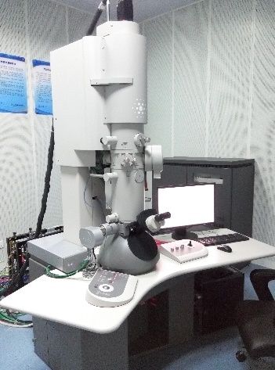
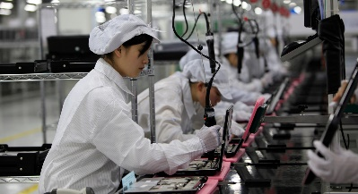



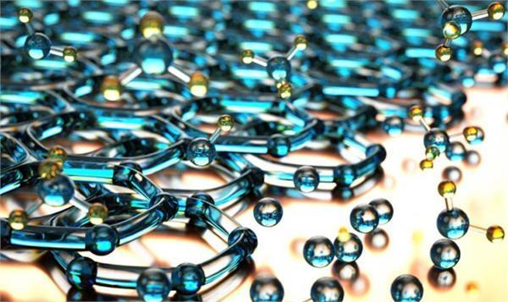

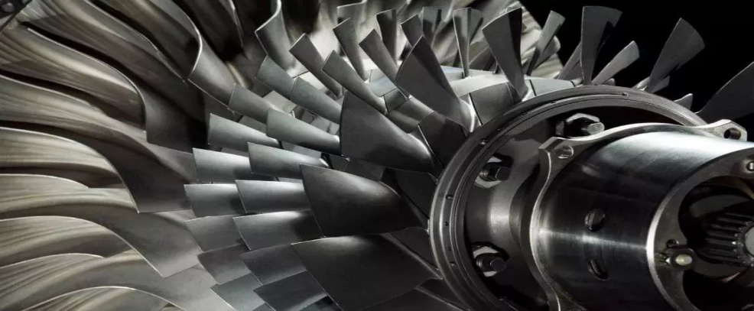
UTEF Complex
Electron Microscopes
synchrotron radiation source
Comprising two core components: a synchrotron radiation facility delivering high-brilliance and high-flux photon sources, and an advanced cluster of electron microscopes.
Enabling investigations of the dynamic evolution and regulation of matter across multiple dimensions and scales, with ultrahigh spatial resolution (10⁻¹⁰ m) and ultrafast temporal resolution (10⁻¹²–10⁻¹⁵ s).
Providing indispensable experimental conditions for addressing fundamental scientific questions
Electronic Information
New Energy Vehicle
新能源
New Material
Life Science and Medicine
Advanced Manufacturing

Slide 5
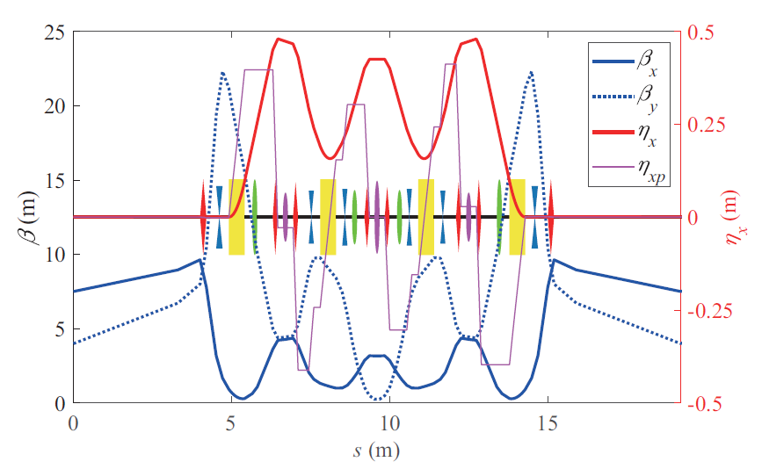
0.5GeV Light Source
Main parameters of storage ring
Parameter | Value | Unit
Energy | 0.5 | GeV
Circumference | 76.78 | m
Natural emittance | 8.59 | nm rad
Period | 4 | -
RF frequency | 499.784 | MHz
Current | 500-1000 | mA
Bunch length | 2.7-12.2 | mm
Damping time | 59/59/29.5（H/V/Z) | ms
Straight section length | 8 | m

Slide 6
RF Cavity Impedance
Longitudinal HOM impedance
Transverse HOM impedance
Fundamental frequency cavity
Fundamental frequency cavity
Third harmonic cavity
Third harmonic cavity
Threshold, w/o FB
Threshold, w/o FB
Threshold, w/o HC
Achieving high beam intensity while suppressing beam instability has become a key technical challenge.
1. Optimize impedance and increase the radius of the vacuum chamber to suppress the impedance, optimize HOM of the RF cavity.
2. Use the third harmonic cavity to stretch the bunch, reduce charge density, and provide Landau damping.
3. Implement a transverse feedback system to suppress transverse instability.
4. Adopt a higher RF cavity voltage to increase the longitudinal oscillation frequency and suppress instability.

Slide 7
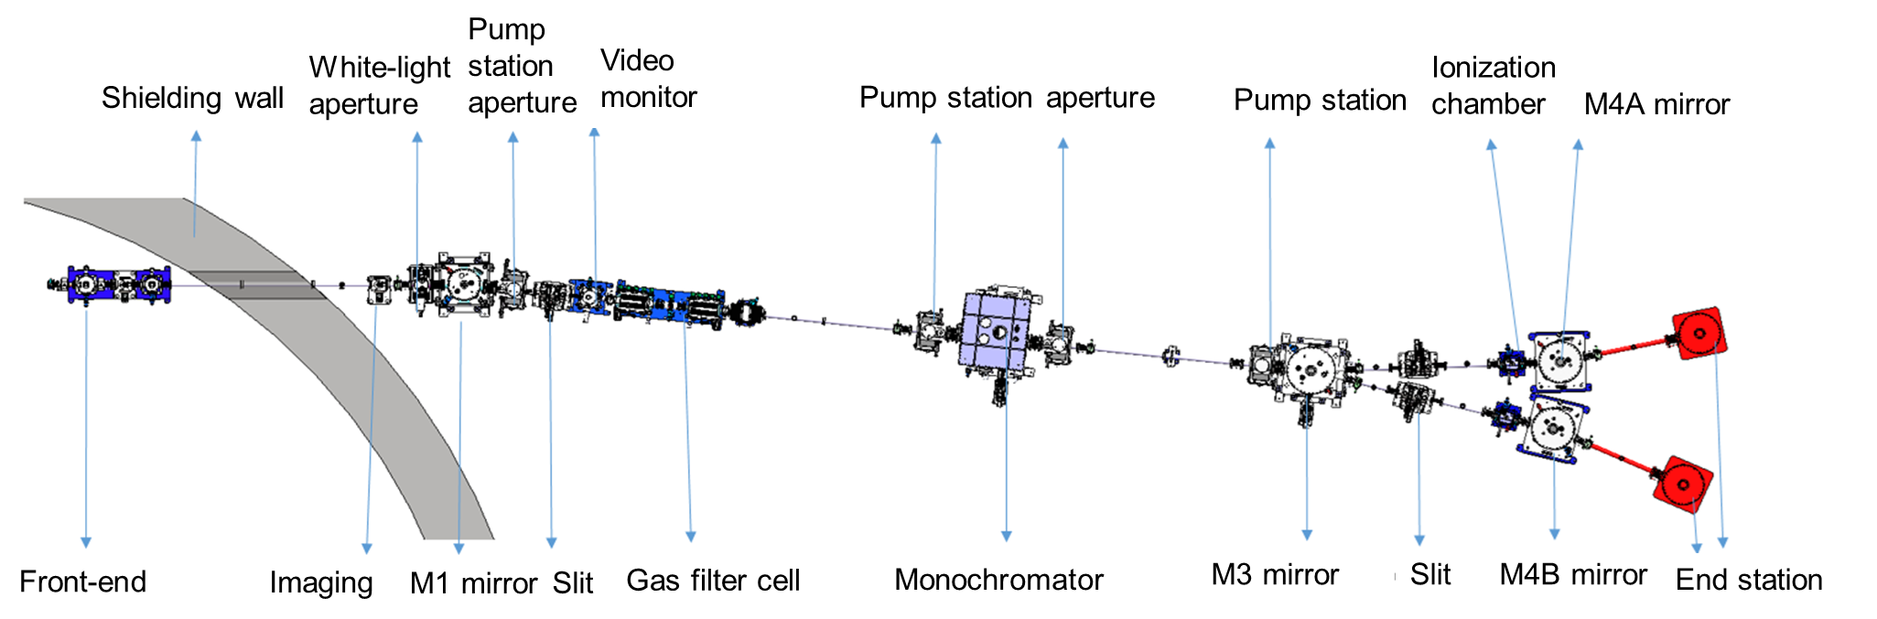
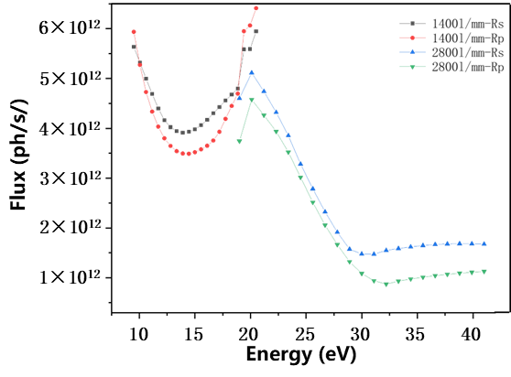
ARPES Beamline (Under construction)
Undulator parameters
Photon energy: 10-40eV
Energy resolution: ＜0.4meV
Photon flux at the sample:＞1×10¹⁴ ph/s@0.1%B.W
Photon polarization can be tuned
Sample temperature: Main station-1K, Sub-station-5K
Beam size@sample: 20 μm × 20 μm
Two analytical chamber: ultra-low temperature high energy resolution, large angle high flux spin resolution
Configuration: Equipped with PLD, MBE thin film growth sample chamber, ozone system for oxide growth, vacuum interconnected glove box, and offline vacuum transfer sample chamber.
Parameter | EPU
Period length | 62mm
Period number | 78
Total length | 4836mm
Peak magnetic field (circular polarization) | 0.37T
Peak magnetic field (vertical polarization) | 0.45T
Peak magnetic field (horizontally polarized) | 0.7T
Minimum gap | 20mm
UV-EUV photon flux 10 times higher than existing facilities!

Slide 8
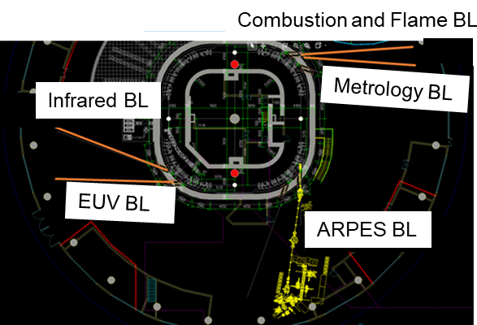
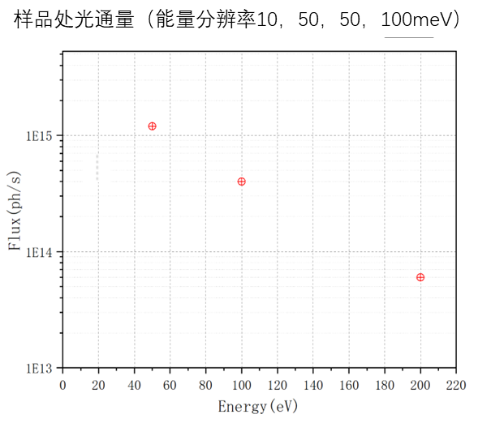
EUV Metrology Beamline (Planned)
 | General Test | Angular divergence
Wavelength range | 5-70nm (17eV-250eV) | 5-20nm (62eV-250eV)
Wavelength resolution | ≤0.005nm (12meV-250meV) | ≤0.01nm (31meV-500meV)
Divergence angle | ≤5mrad@13.5nm | ≤0.5mrad
Wavelength stability (RMS) | <0.1% | <0.1%
Future Expansion
Irradiation & Contamination Test
Max power density: ≥3.5 W/cm² @13.5nm
Background vacuum: <1×10⁻⁵ Pa
In-situ characterization: Reflectometry, XPS, SEM, TEM, EDS
Operation time: >100 hours
Wave Aberration Measurement
Photon flux: ≥2×10¹⁴ ph/s @13.5nm
Stability: within ±15%
Beam diameter: 10mm
Brightness: ≥1×10¹⁷ ph/s/mm²/mrad²/@13.5nm±0.1% BW
RMS accuracy: <0.1 nm
Photon flux@sample

Slide 9
3GeV Light Source
Main parameters of the storage ring
Long Straight
Parameter | Sym. | Value | Unit
Energy | E₀ | 3 | GeV
Circumference | C | 590 | m
Average Current | I_{t} | 600 | mA
Natural Emittance | ϵ_{x0} | 349 | pm
Coupling | - | 100% | -
Momentum comp. factor | α_{c} | 1.2 × 10⁻⁴ | -
Energy loss per turn | U₀ | 447 | keV
RMS energy spread | σ_{δ} | 7.0 × 10⁻⁴ | -
Beam size@Short Str. Sec. | σ_{xb,yb} | 8.2/12.5 | μm
Beam size@Long Str. Sec. | σ_{xc,yc} | 32.3/32.3 | μm
Horizontal/Vertical tune | ν_{x}/ν_{y} | 61.371/23.154 | -
Natural chromaticity | ξ_{x0}/ξ_{y0} | -141.4/-167.9 | -
Natural damping time (x/y/z) | τ_{x}/τ_{y}/τ_{s} | 26.4/26.4/13.2 | ms
RF frequency | f_{RF} | 499.993 | MHz
Max. Bend field | B | 1.05 | Tesla
Short Straight

Slide 10
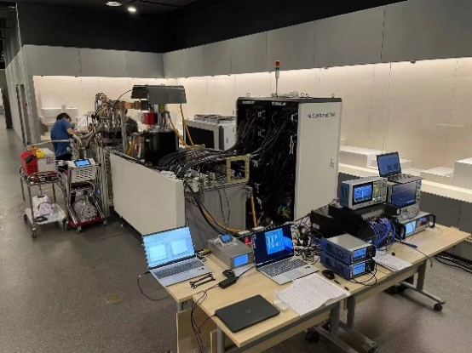
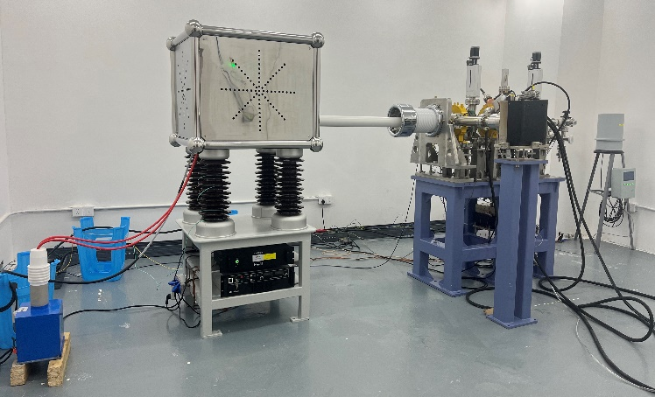
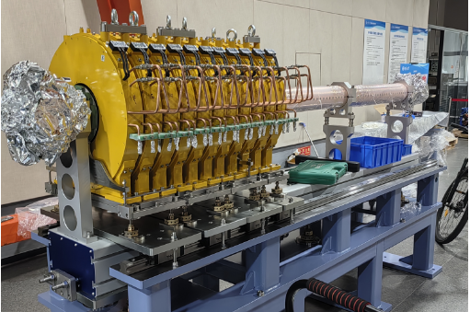
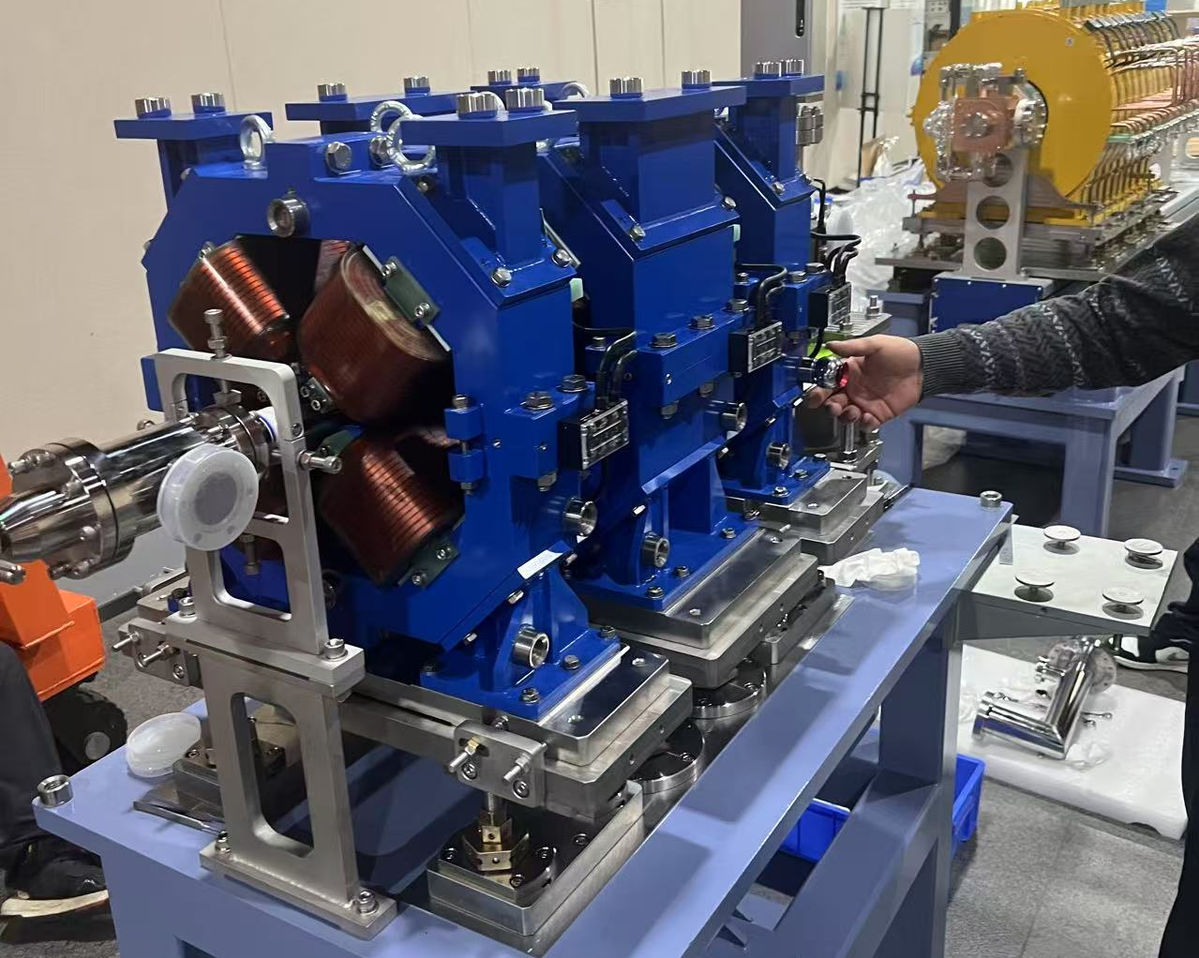
Progress of 0.5GeV Light Source
For linac, all equipment has been delivered; core systems finished acceptance tests
Klystron: high-power microwave generation, (Canon, Japan)
Modulator: high-voltage pulsed power supply, (Wuhu Micovey, China)
Low-Level Radio Frequency (LLRF) system: phase & amplitude control, in-house developed
Electron gun unit, A1 accelerating structure and triplet magnets fully assembled and commissioned
Klystron test platform
Electron gun unit
A1 accelerating structure
Triplet magnets

Slide 11
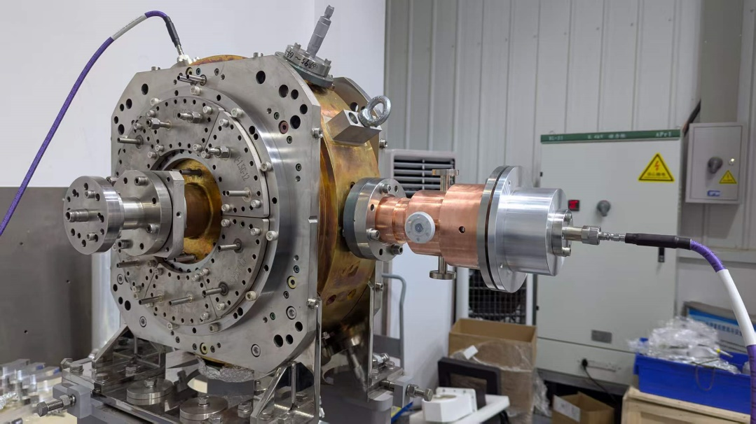
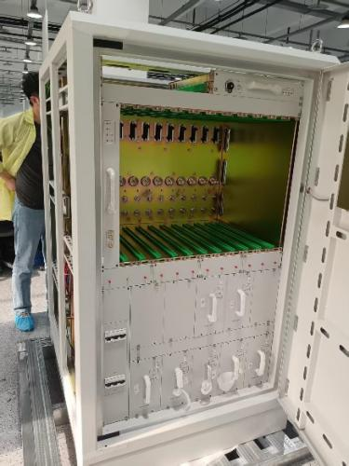
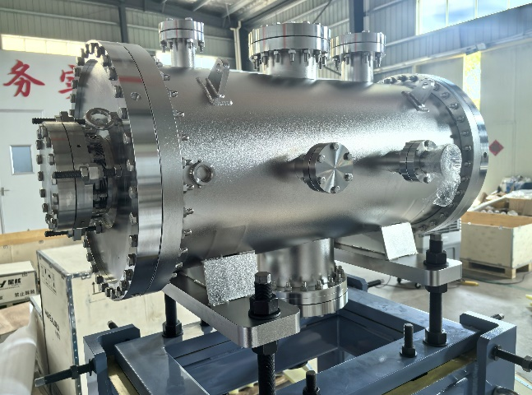
RF system of storage ring
Third Harmonic Cavity (1.5 GHz TM020)
Manufacturing completed
Cold test results meet all specifications
High-Frequency Solid-state Power Source
Assembly completed
Performance commission in progress
Nonlinear Kicker Magnet
Component processing completed
Assembly in progress
Third harmonic cavity
Solid-state power source
Nonlinear Kicker Magnet

Slide 12
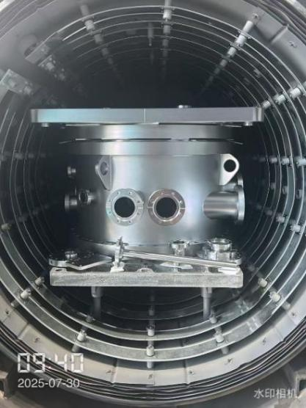
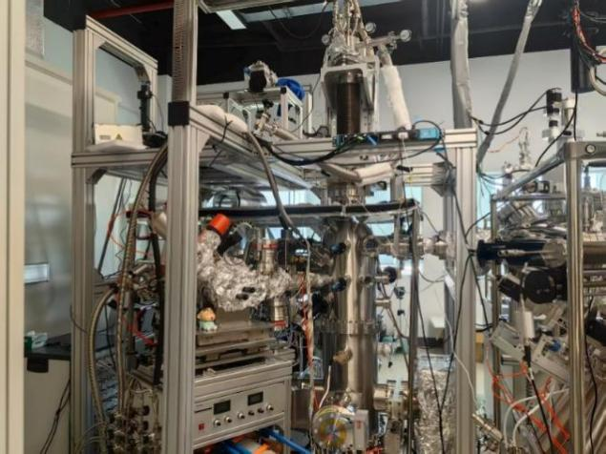
ARPES beamline
Optical & engineering design completed, and energy resolution< 0.4 meV, world-leading performance
The detailed design and engineering drawings of key components have been completed and in production
Key Components: Detailed designs and engineering drawings finalized; currently in production
1.5K ultra-low temperature sample holder
Cryogenic high magnetic field sample transfer chamber
M4 mirror
End station

Slide 13
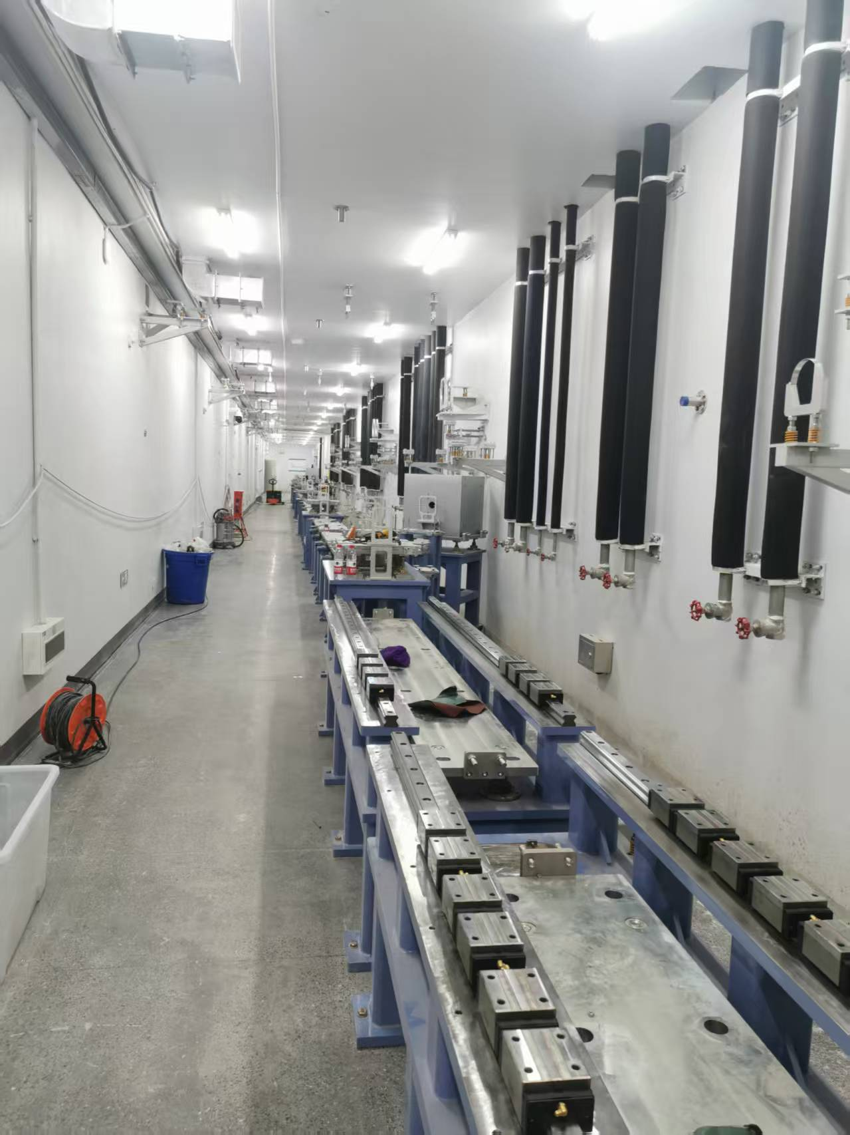
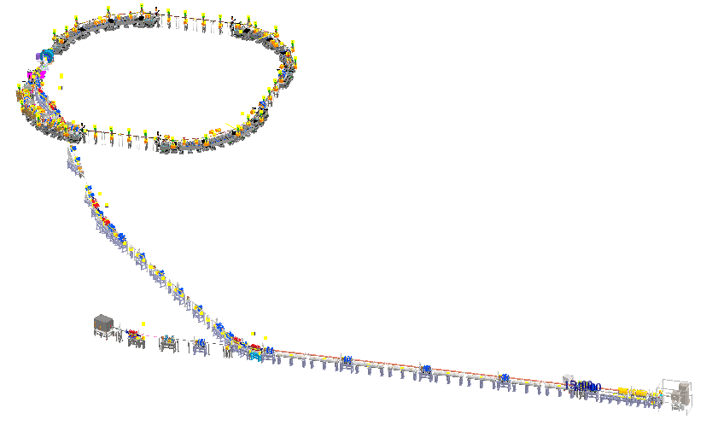
LINAC
Installation start: June 2025
Pre-installation milestones Achieved:
Installation positions confirmed through alignment survey.
Primary and secondary control networks established.
Majority of Linac support girders installed.
Storage ring
500MeV Linac
Layout of the UTEF accelerator
Linac tunnel(Sep. 2025)

Slide 14
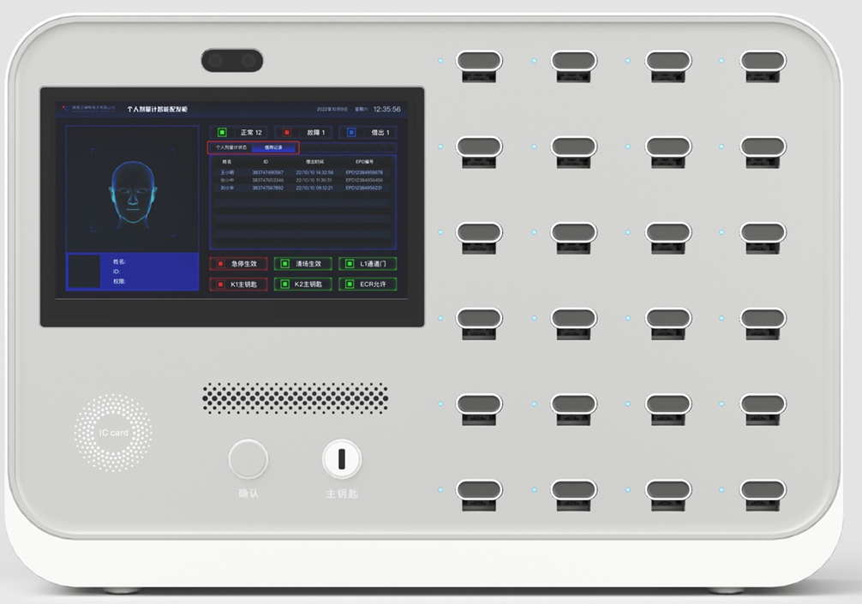
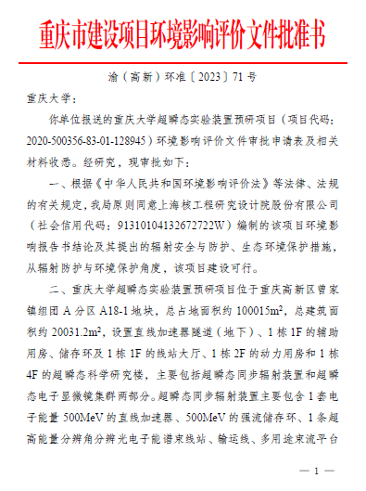
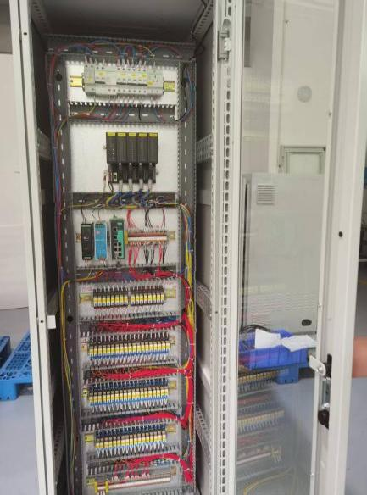
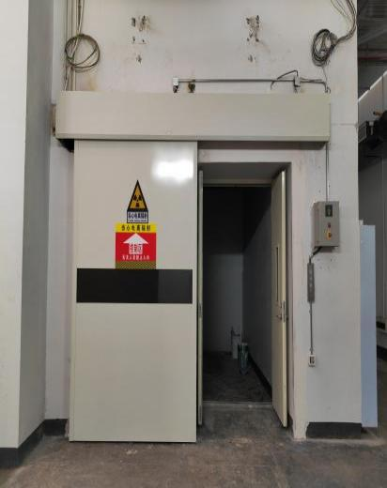
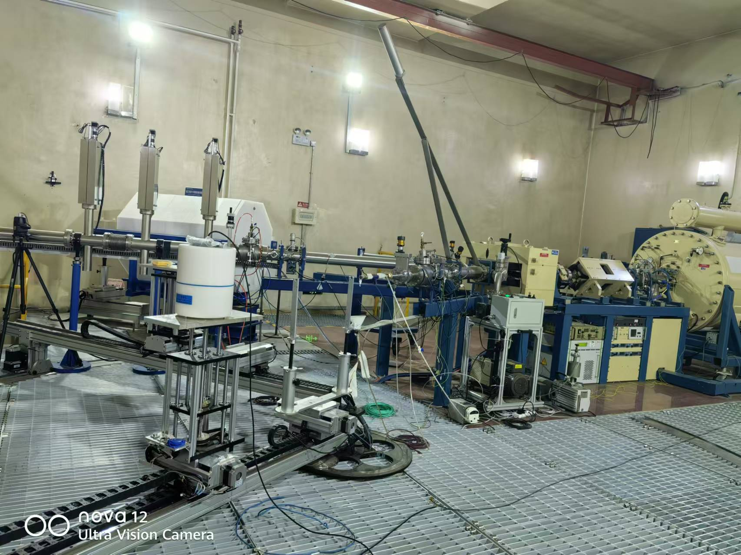
Radiation Safety
Environmental & Occupational Health Approvals Obtained (Oct 2023)
Radiation Safety License Application in Progress
Key Safety Equipment Ready:
Radiation monitoring and personnel protection system (PPS) system: fabrication and testing complete.
Shielding doors installation completed
Radiation safety regulations established
Personnel access control (with EPD)
EIA report approved (Oct. 2023)
PLC control in PPS
Shielding door in linac
Calibration test of neutron dosimeter

Slide 15
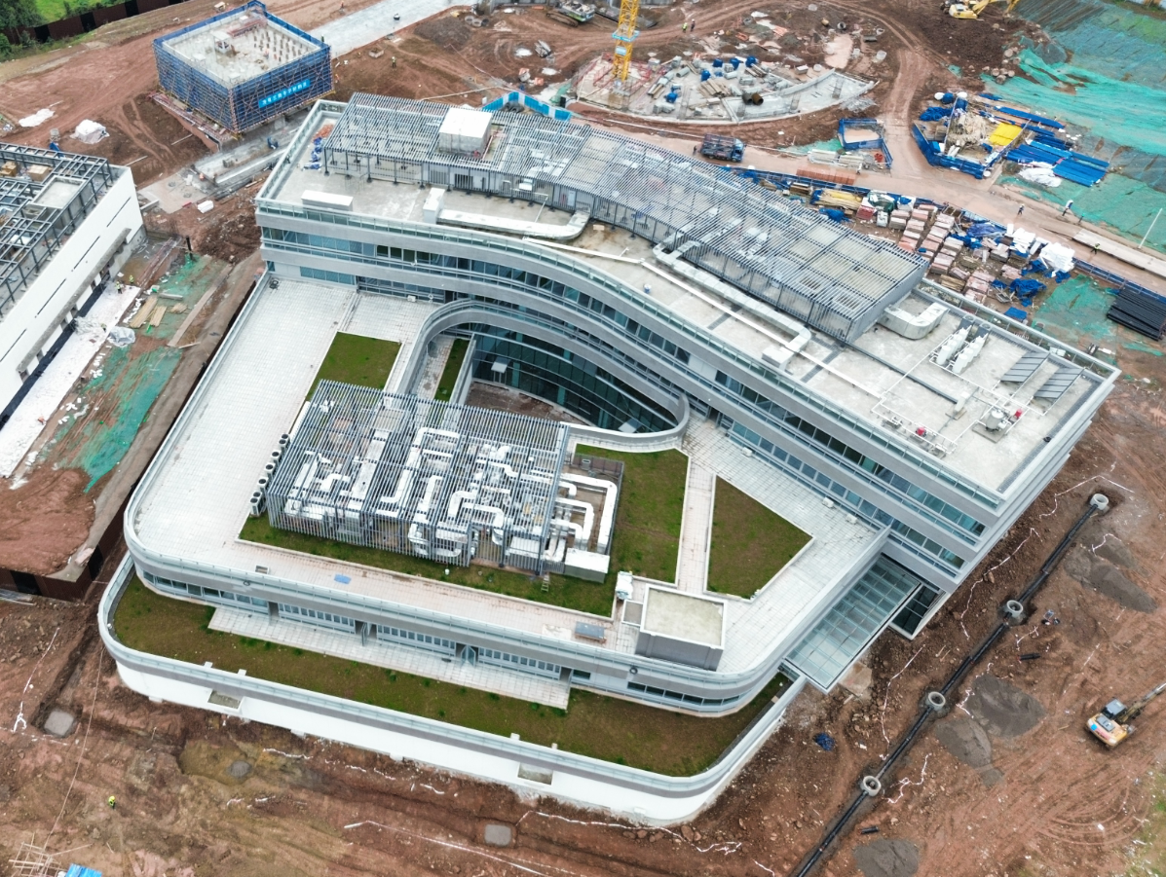
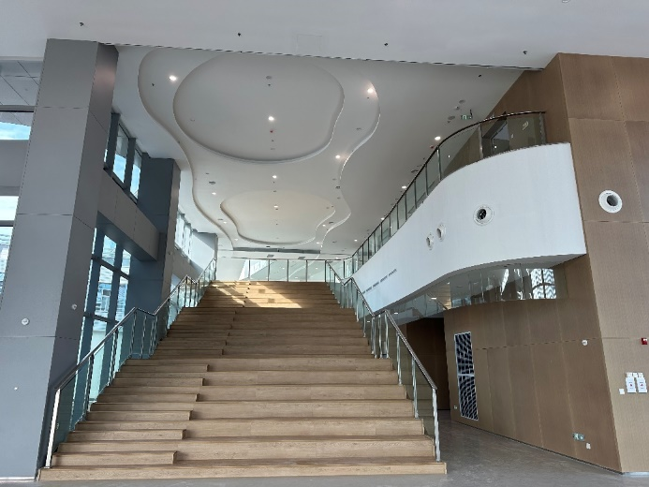
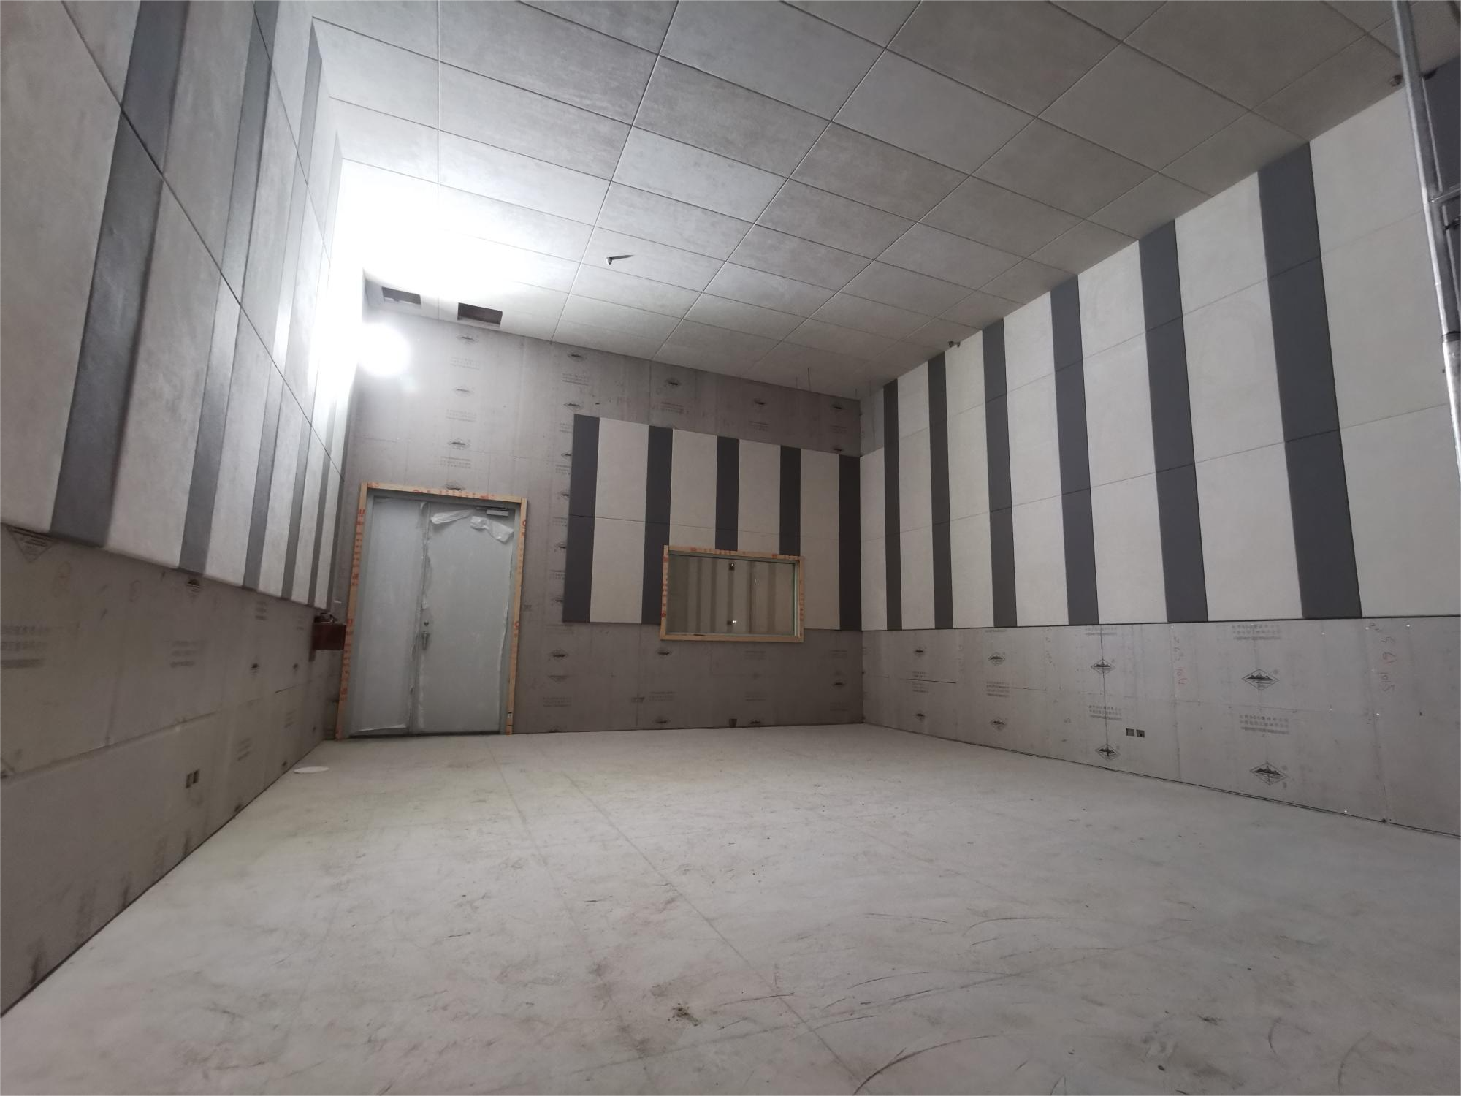
Construction Progress-Science and Research Building
Oct. 2024: Completion of individual building works; passed energy-saving (green building) acceptance.
Dec. 26, 2024: Passed final construction quality acceptance by the High-tech Zone Construction Bureau.
Electron Microscopy Laboratory Area (#1-15 room) environmental renovation completed.
Science and research building
Interior photos of the building
Electron microscopy laboratory

Slide 16
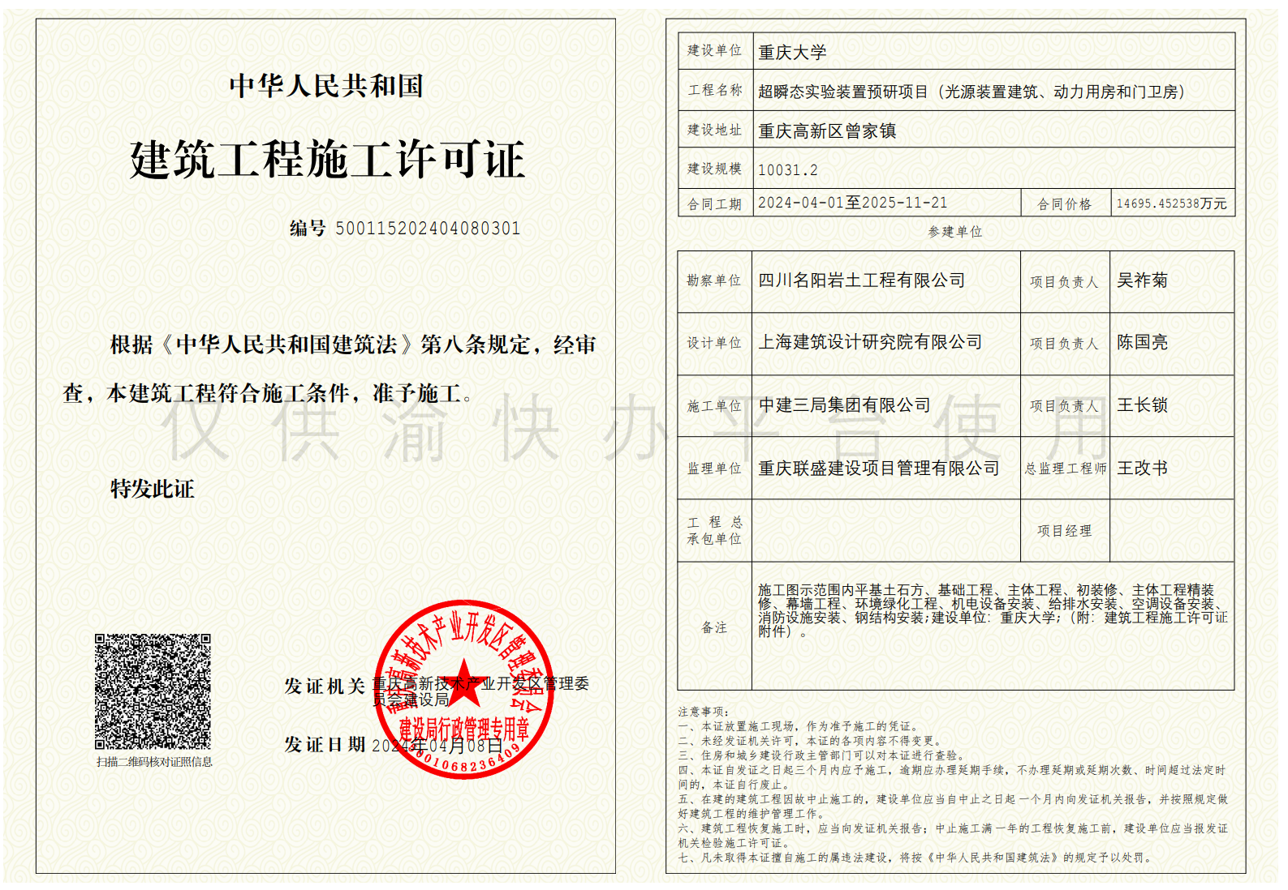
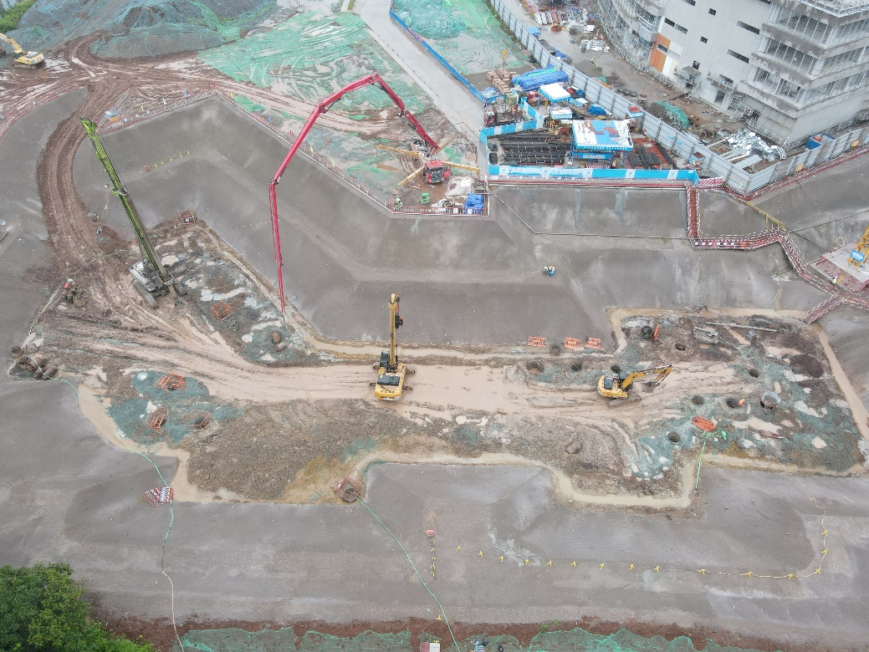
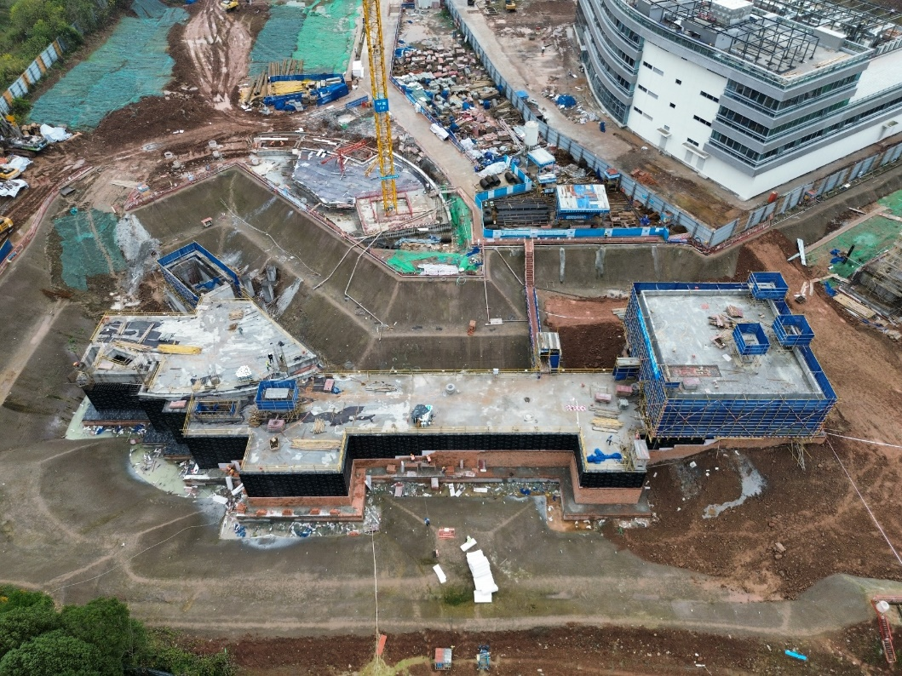
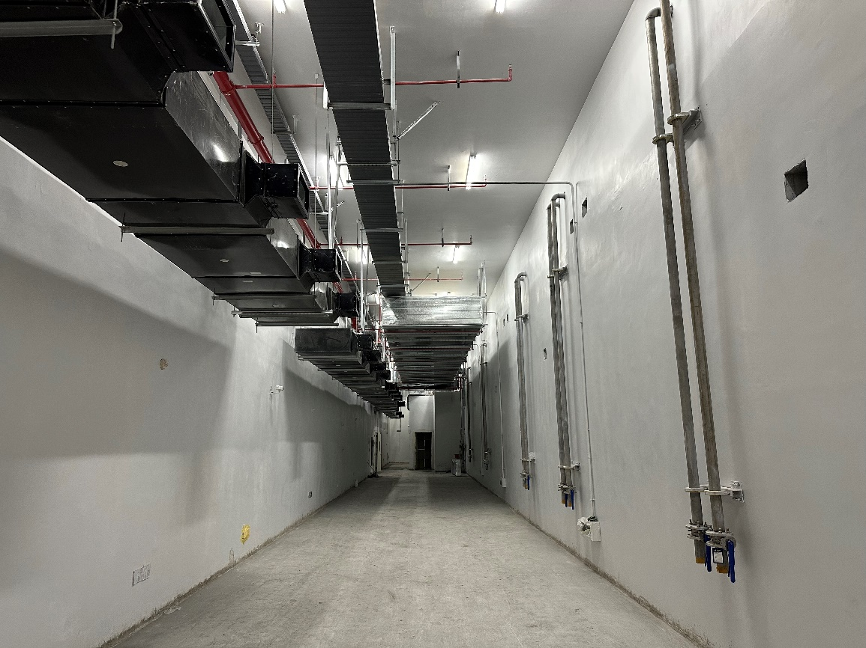
Construction Progress-Linac
April 8, 2024: Construction permits approved for the light source, utility building, and guardhouse; project officially launched.
Dec. 2024: Main structure of the linear accelerator topped out.
May 18, 2025: Civil construction of the linear tunnel completed, enabling installation of support systems.
Construction Permit
Excavation & Foundation Work of Linac
Main Structure of Linac Topped Out
Linac Tunnel
April 2024
May 2024
Dec. 2024
May. 2025

Slide 17
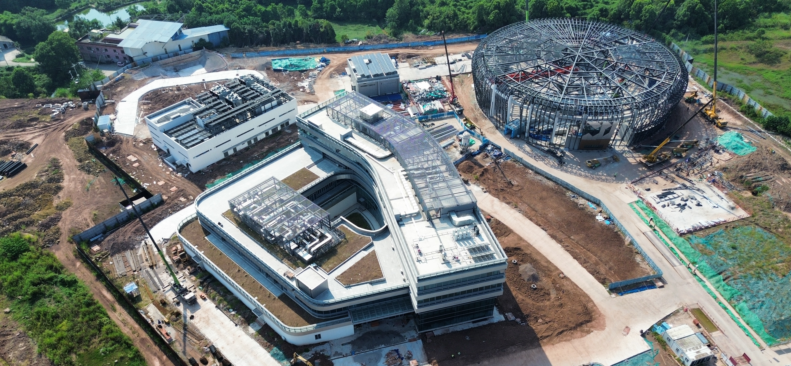
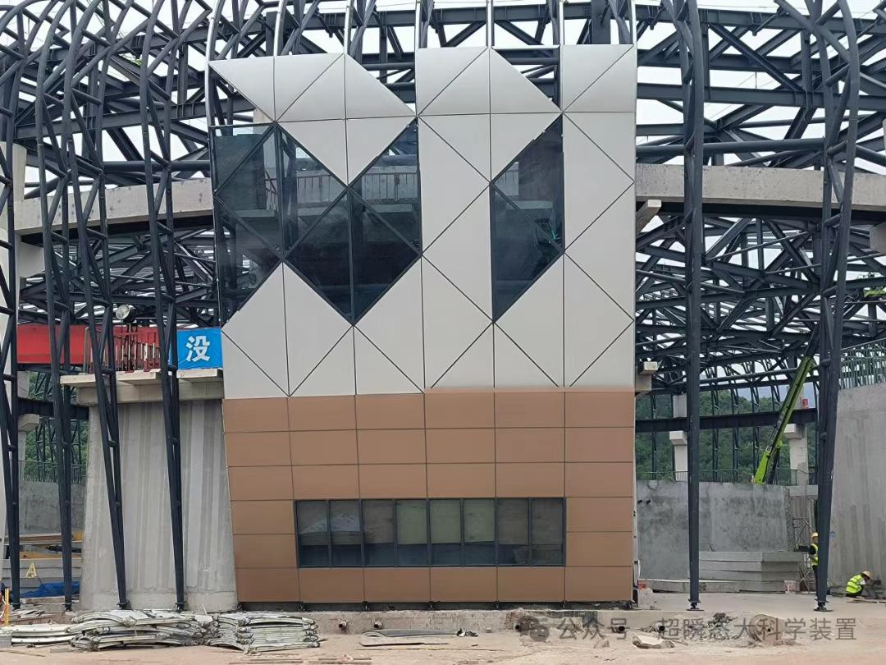
Construction Progress-Storage Ring
Light Source Beamline Hall: Base slab and main structure completed; roof steel structure installed; 15t overhead crane installed, Installation of exterior curtain wall trusses and curtain wall mock-ups in progress
Outdoor Works: Site grading, perimeter walls, stormwater/sewage pipelines, and road construction
Storage Ring
Science and Research Building
Bird’s-eye view of storage ring
Curtain wall mock-up

Slide 18
Thanks for your attention!
Welcome to Chongqing!

