Slide 1
Precision Timing & Advanced RF Solutions for Particle Accelerators
Sub – fs Main Oscillator
Local Oscillator Generation in MicroTCA.4
X-Band Middleware
Dr. Jiaoni Bai

Slide 2
Agenda
KVG Introduction
Quartz Crystal Products
Main Oscillator with high Power and sub-fs Resolution
High Performance Local Oscillator Generation
X-Band Middleware

Slide 3
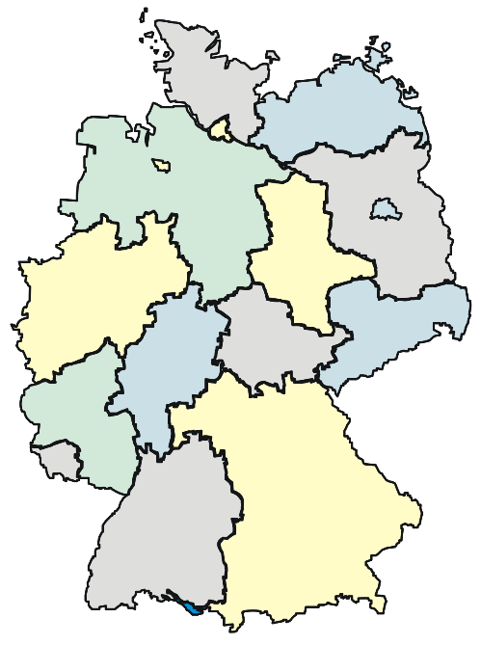

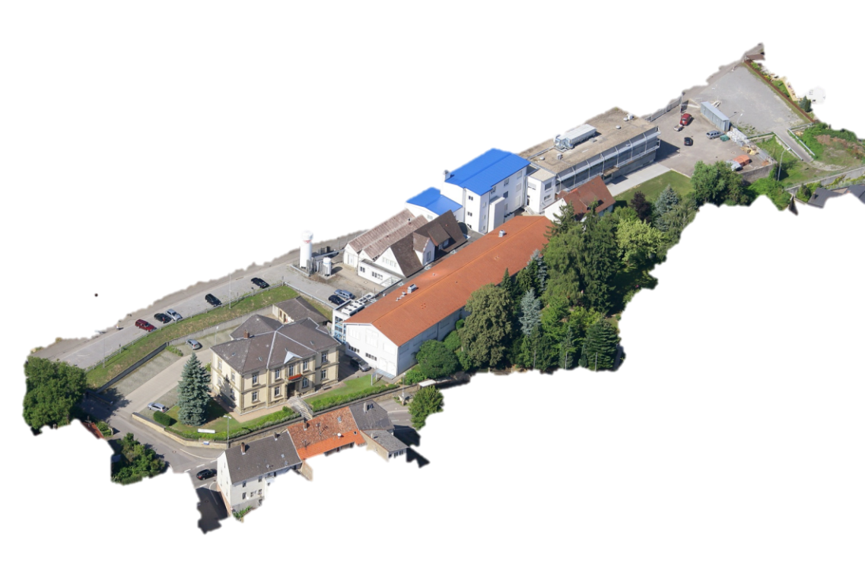
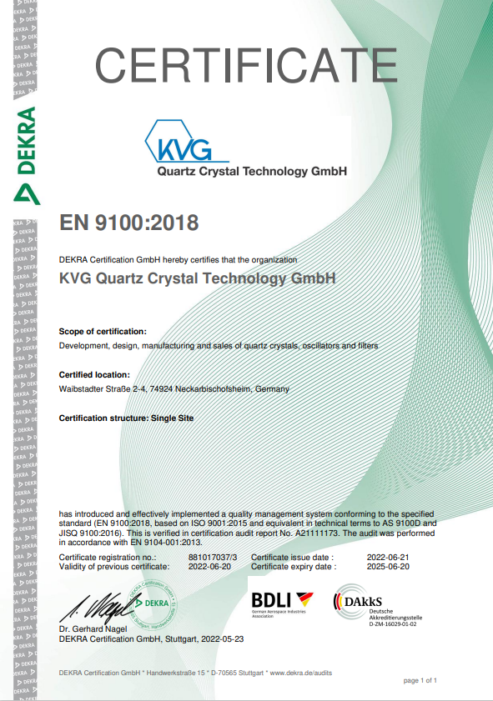
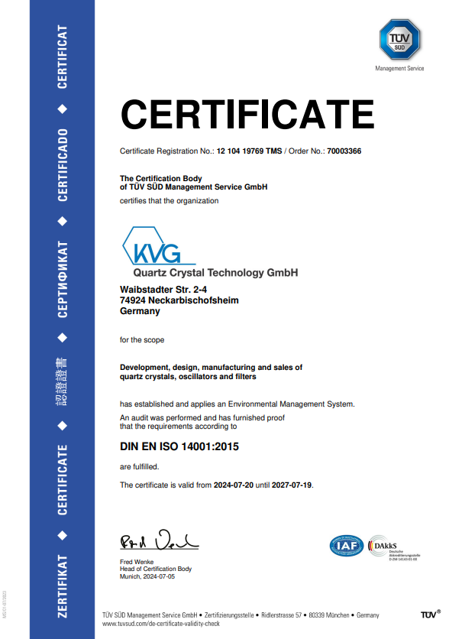
Company Facts
KVG Quartz Crystal Technology GmbH
Location / Headquarter: Neckarbischofsheim, Germany
We provide
State-of-the-art frequency control products for Science & Industry
e.g., crystals, oscillators, filters, specific quartz crystal products, etc.
Customized products, solution and excellent service
Certification EN9100 and ISO14001

Slide 4
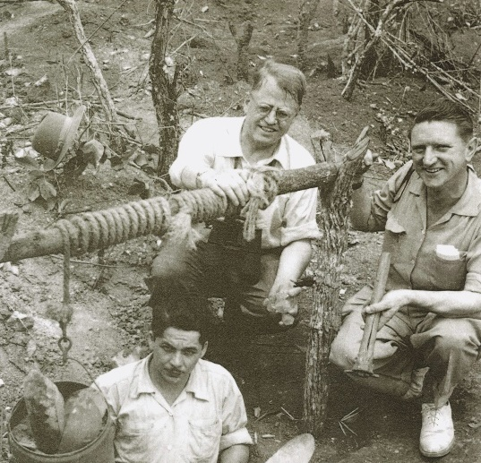
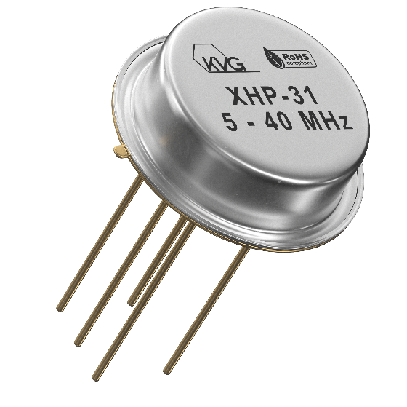
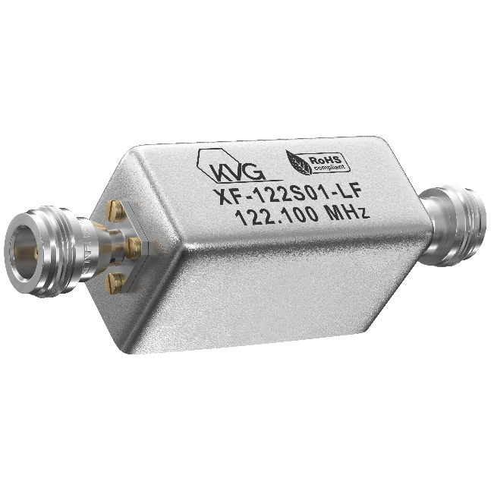
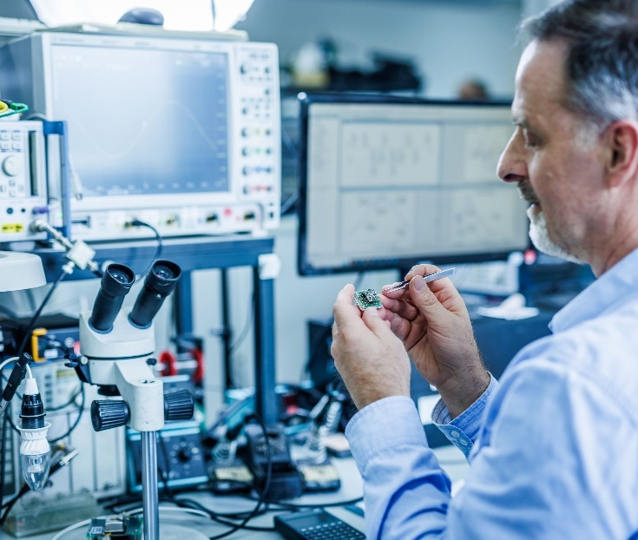
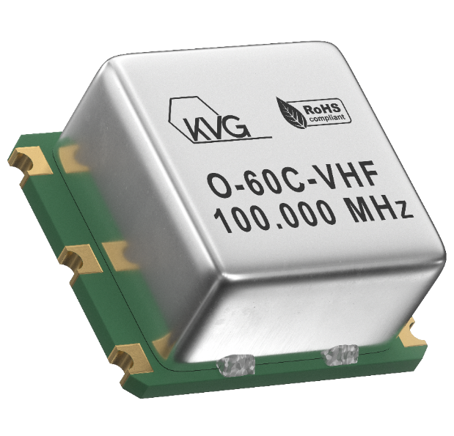
Company Timeline
1946: KVG was founded by Kurt Klingsporn as “Kristallverarbeitung Neckarbischofsheim”
1964: Start of Production of Crystal Filters
1983: Manufacturing of Sensor Crystals
1984: First supplier for NMT- Base stations, Crystal filters and OCXO.
1986: Surface Mount Technology (SMT) for Filters and Oscillators
1990: First supplier to Nokia Corporation and Alcatel of OCXO’s for GSM-Base stations
1995: Introduction of IM HFF Crystals
1997: Main supplier for Pager Crystals to customer Motorola
1998: Implementation of ASIC Technology for TCXOs
2002: private owned “KVG Quartz Crystal Technology GmbH”
2005: Low Phase Noise OCXOs and RF TCXOs
2010: Low G-Sensitivity OCXOs
2014: Introduction of mechanical damped OCXO modules
2015: Ultra low Phase Noise RF-OCXO and very low G-Sensitivity OCXO
2016: EN9100 certification
2017: PLL-OCXO Module 10/100 MHz
2019: Frequency sources up to 10 GHz
2022: Research cooperation with DESY for precision timing & advanced RF solutions for particle accelerators
2024: Research cooperation with PTB Braunschweig

Slide 5
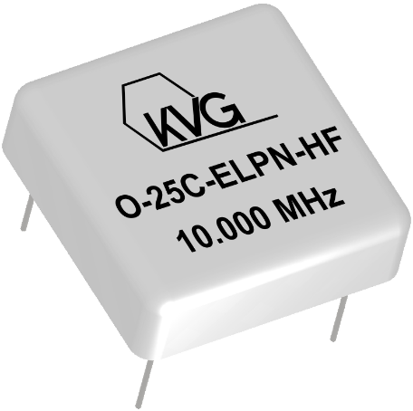
Quartz Crystal Products
Ultra-low Phase Noise OCXO Series 10 MHz
Phase noise:
≤ - 90 dBc/Hz at 0.1 Hz
  ≤ - 124 dBc/Hz at 1 Hz
  ≤ - 149 dBc/Hz at 10 Hz
  ≤ - 162 dBc/Hz at 100 Hz
  ≤ - 166 dBc/Hz at 1 kHz
  ≤ - 166 dBc/Hz at 10 kHz
Case: 51x51x16 mm THT
Supply voltage: 12.0V
Current consumption:
  Warm-up ≤ 7.2 W max.
  Steady State ≤ 3 W max
Frequency stability:
  20°C ~ 70°C ≤ ± 2 ppb
Output power:
≥ +5 dBm, Sine wave, 50 Ohm
  Short-term stability:
  ≤ 9 x 10⁻¹⁴ @ tau = 1 sec
Low aging:
< ± 20ppb per year

Slide 6
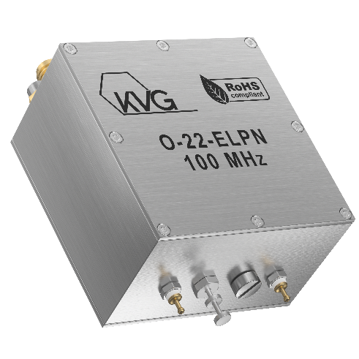
Quartz Crystal Products
Phase noise:
  ≤ - 110 dBc/Hz at 10 Hz
  ≤ - 140 dBc/Hz at 100 Hz
  ≤ - 170 dBc/Hz at 1 kHz
  ≤ - 185 dBc/Hz at 10 kHz
  ≤ - 190 dBc/Hz at 100 kHz
  ≤ - 190 dBc/Hz at 1 MHz
Ultra-low Phase Noise OCXO Series 100 MHz
Case: 51 x 51 x 29 mm SMA
Supply voltage: 12.0V
Current consumption:
  Warm-up ≤ 500 mA (6.0 W max.)
  Steady State ≤ 250 mA (3.0W max.)
Frequency stability:
  -20°C ~ 70°C ≤ ± 100 ppb
Output power:
≥ +18 dBm, Sine wave, 50 Ohm
  Low aging:
  per year ≤ ±300 ppb

Slide 7
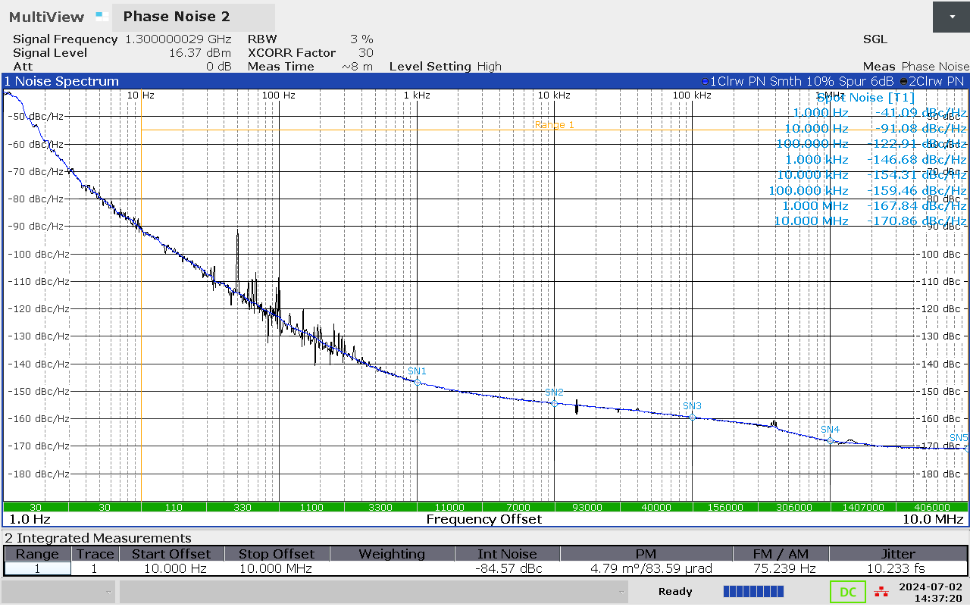
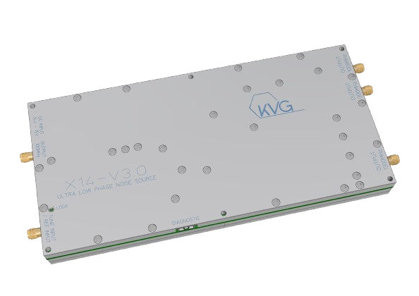
Quartz Crystal Products
Customizable RF signal source X14
Frequency options:
  100 MHz, 300 MHz, 1 GHz,
  1.3 GHz Up to 24 GHz
External reference input options:
  10 MHz, 20 MHz or 100 MHz
External tuning voltage options:
  0 …. 5 V or 0 …. 10 V
Supply voltage: 14.7V Current: 1.5A
Diagnostic outputs
Dimensions:
  Max. 96.3 mm x 215 mm x 28.8 mm
  incl. connectors
Phase noise will be improved 8-14 dB in 2026.
Ultra-low phase noise at 1.3 GHz
≤ -91 dBc/Hz at 10 Hz
≤ -122 dBc/Hz at 100 Hz
≤ -146 dBc/Hz at 1 kHz
≤ -154 dBc/Hz at 10 kHz
≤ -159 dBc/Hz at 100 kHz
≤ -167 dBc/Hz at 1 MHz
≤ -170 dBc/Hz at 10 MHz
RMS jitter [10 Hz – 10 MHz] typ. < 10 fs @ 1300 MHz

Slide 8
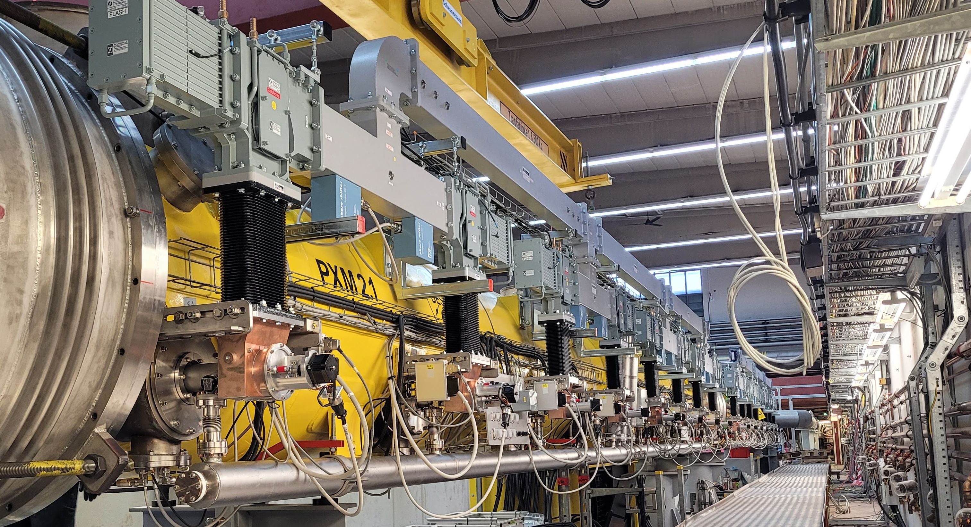
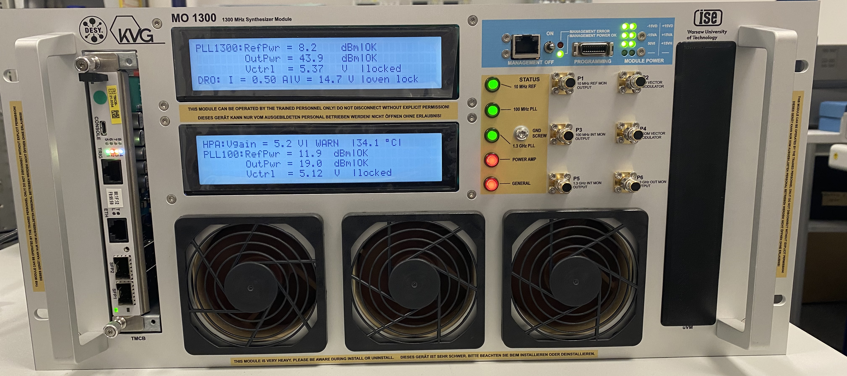

Main Oscillator (MO)
MO provides high-power and ultra-low phase noise RF-signals in modern accelerators.
Application for XFEL and FLASH in DESY.
Custom designed 19″ 600 mm 5U housing
Excellent short-term phase noise and sub-fs jitter
Frequency stability better than 10⁻¹² (hours-days)
Support high power outputs ≥ +46 dBm
Provide different frequencies (optional)
Support remote diagnostic for maintenance
Tight operational reliability
Under license from DESY

Slide 9
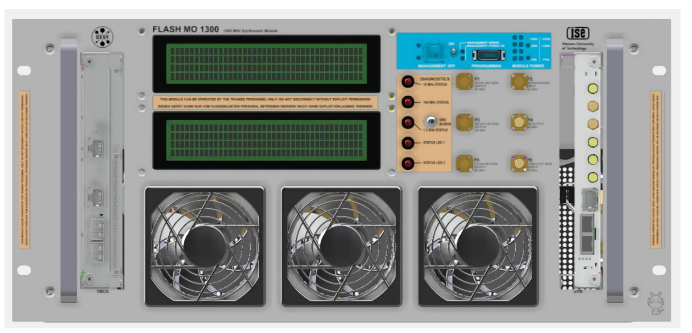

MO1300
MO synchronizes an ultra-low phase noise DRO output signal with a 1.3 GHz signal synthesized from an ultra-stable GPSDO 10 MHz signal.
Lock module 10 MHz to 100 MHz
Multiplier module 100MHz to 1.3 GHz
Lock module 1.3 GHz multiplier to DRO
1.3 GHz Dielectric Resonator Oscillator DRO
1.3 GHz high power amplifier
GPSDO
10 MHz
1.3 GHz
≥ +46 dBm

Slide 10
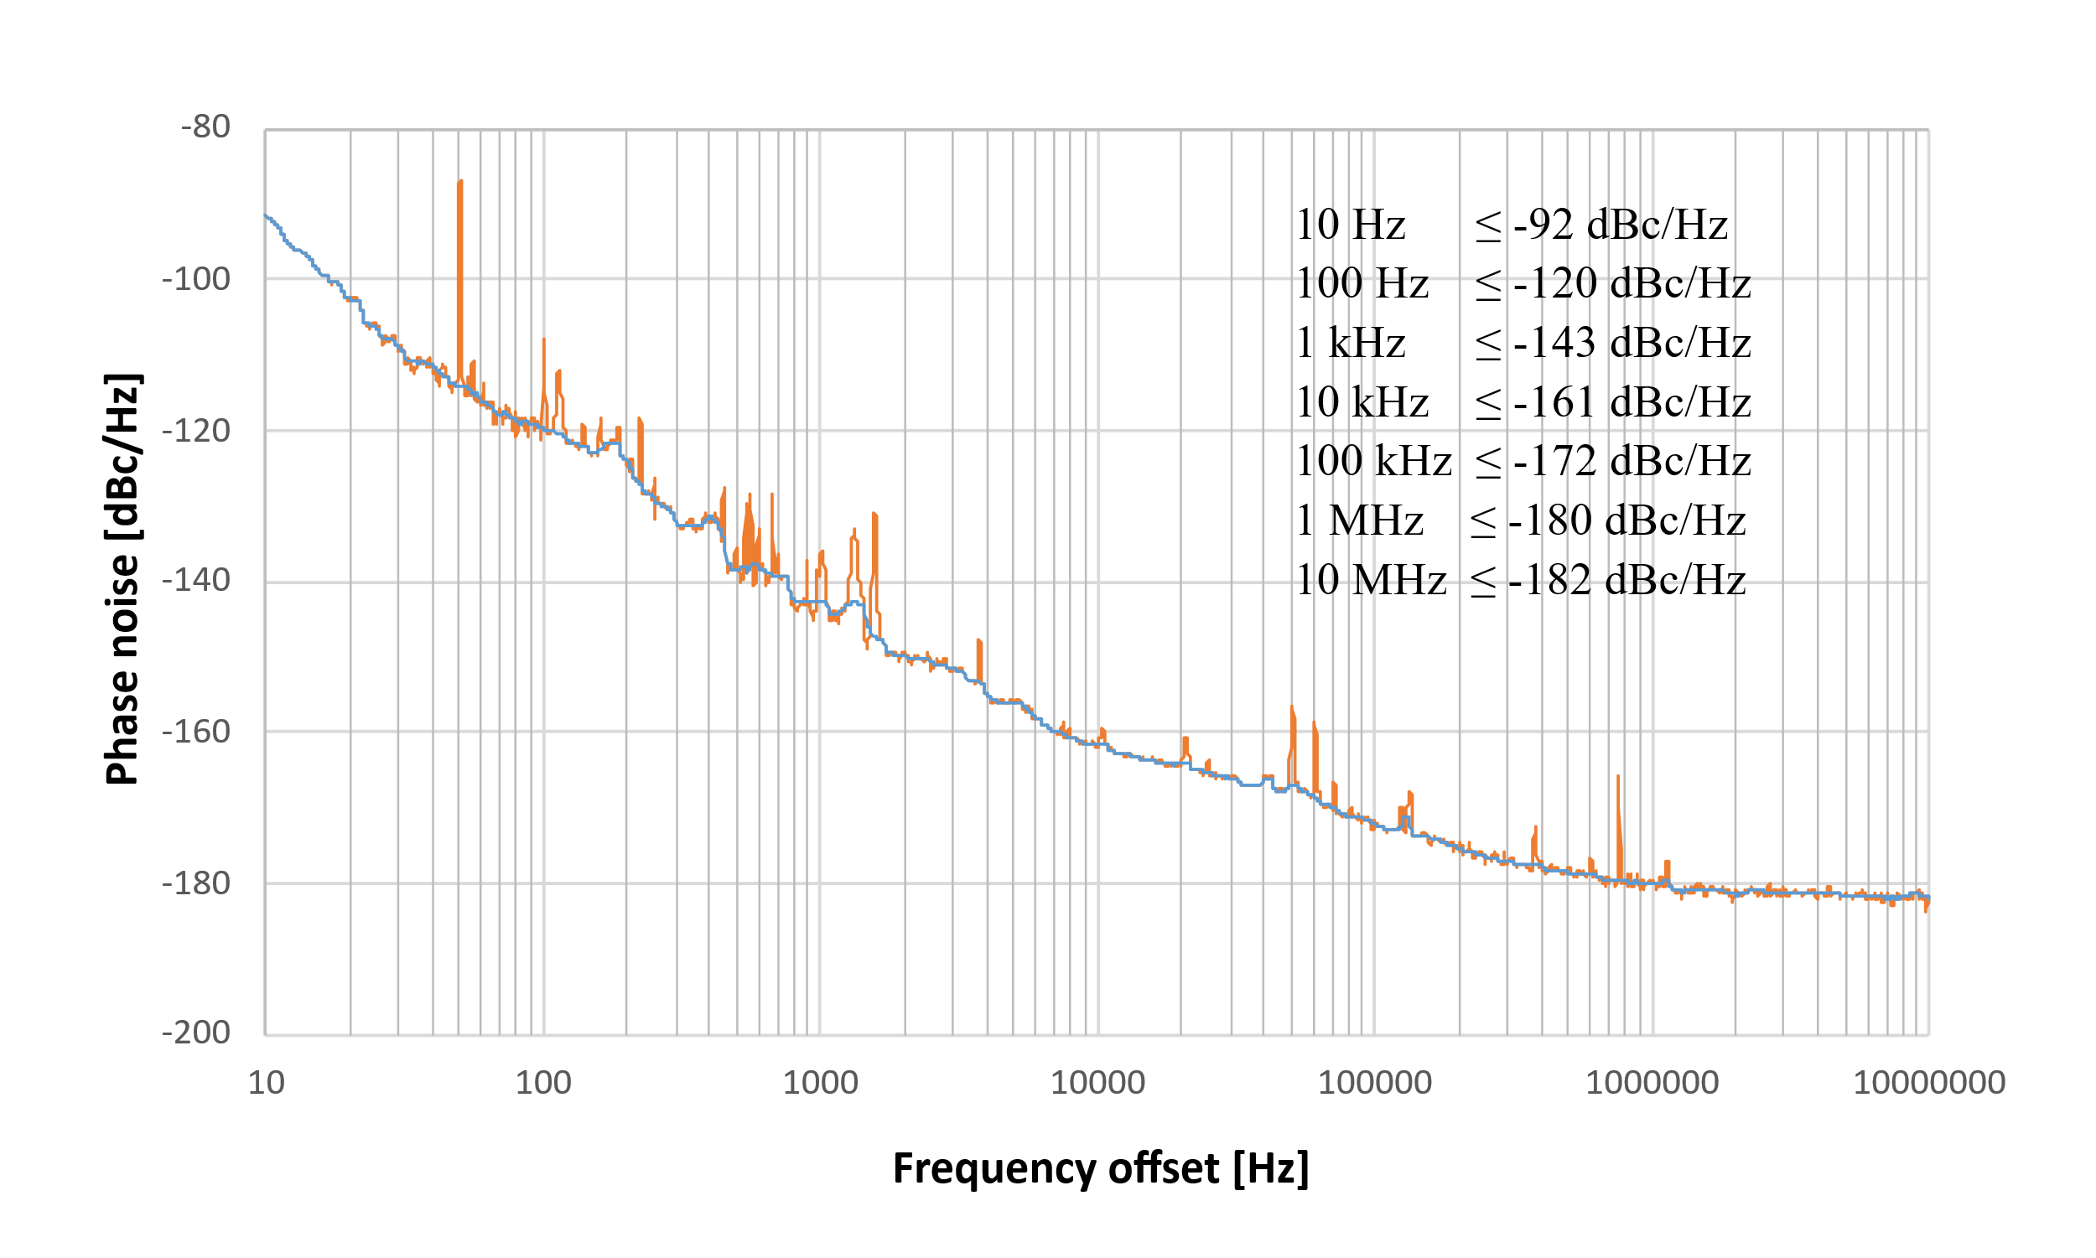
MO1300 RF Performance
Ultra-low phase noise at 1.3 GHz
Measurement result provided by F.Ludwig and H.Pryschelski (MSK, DESY)

Slide 11
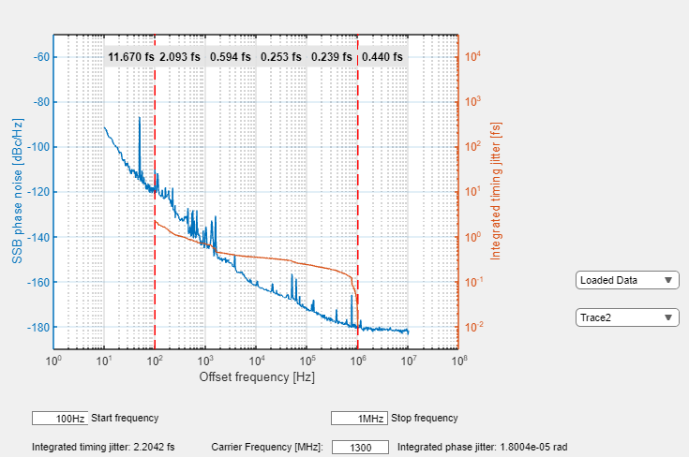
MO1300 RF Performance
Ultra-low integrated jitter at 1.3 GHz
< 12 fs [10 Hz to 100 Hz]
< 2.1 fs [100 Hz to 1 kHz]
< 0.8 fs [1 kHz to 1 MHz]
Measurement result provided by F.Ludwig and H.Pryschelski (MSK, DESY)

Slide 12
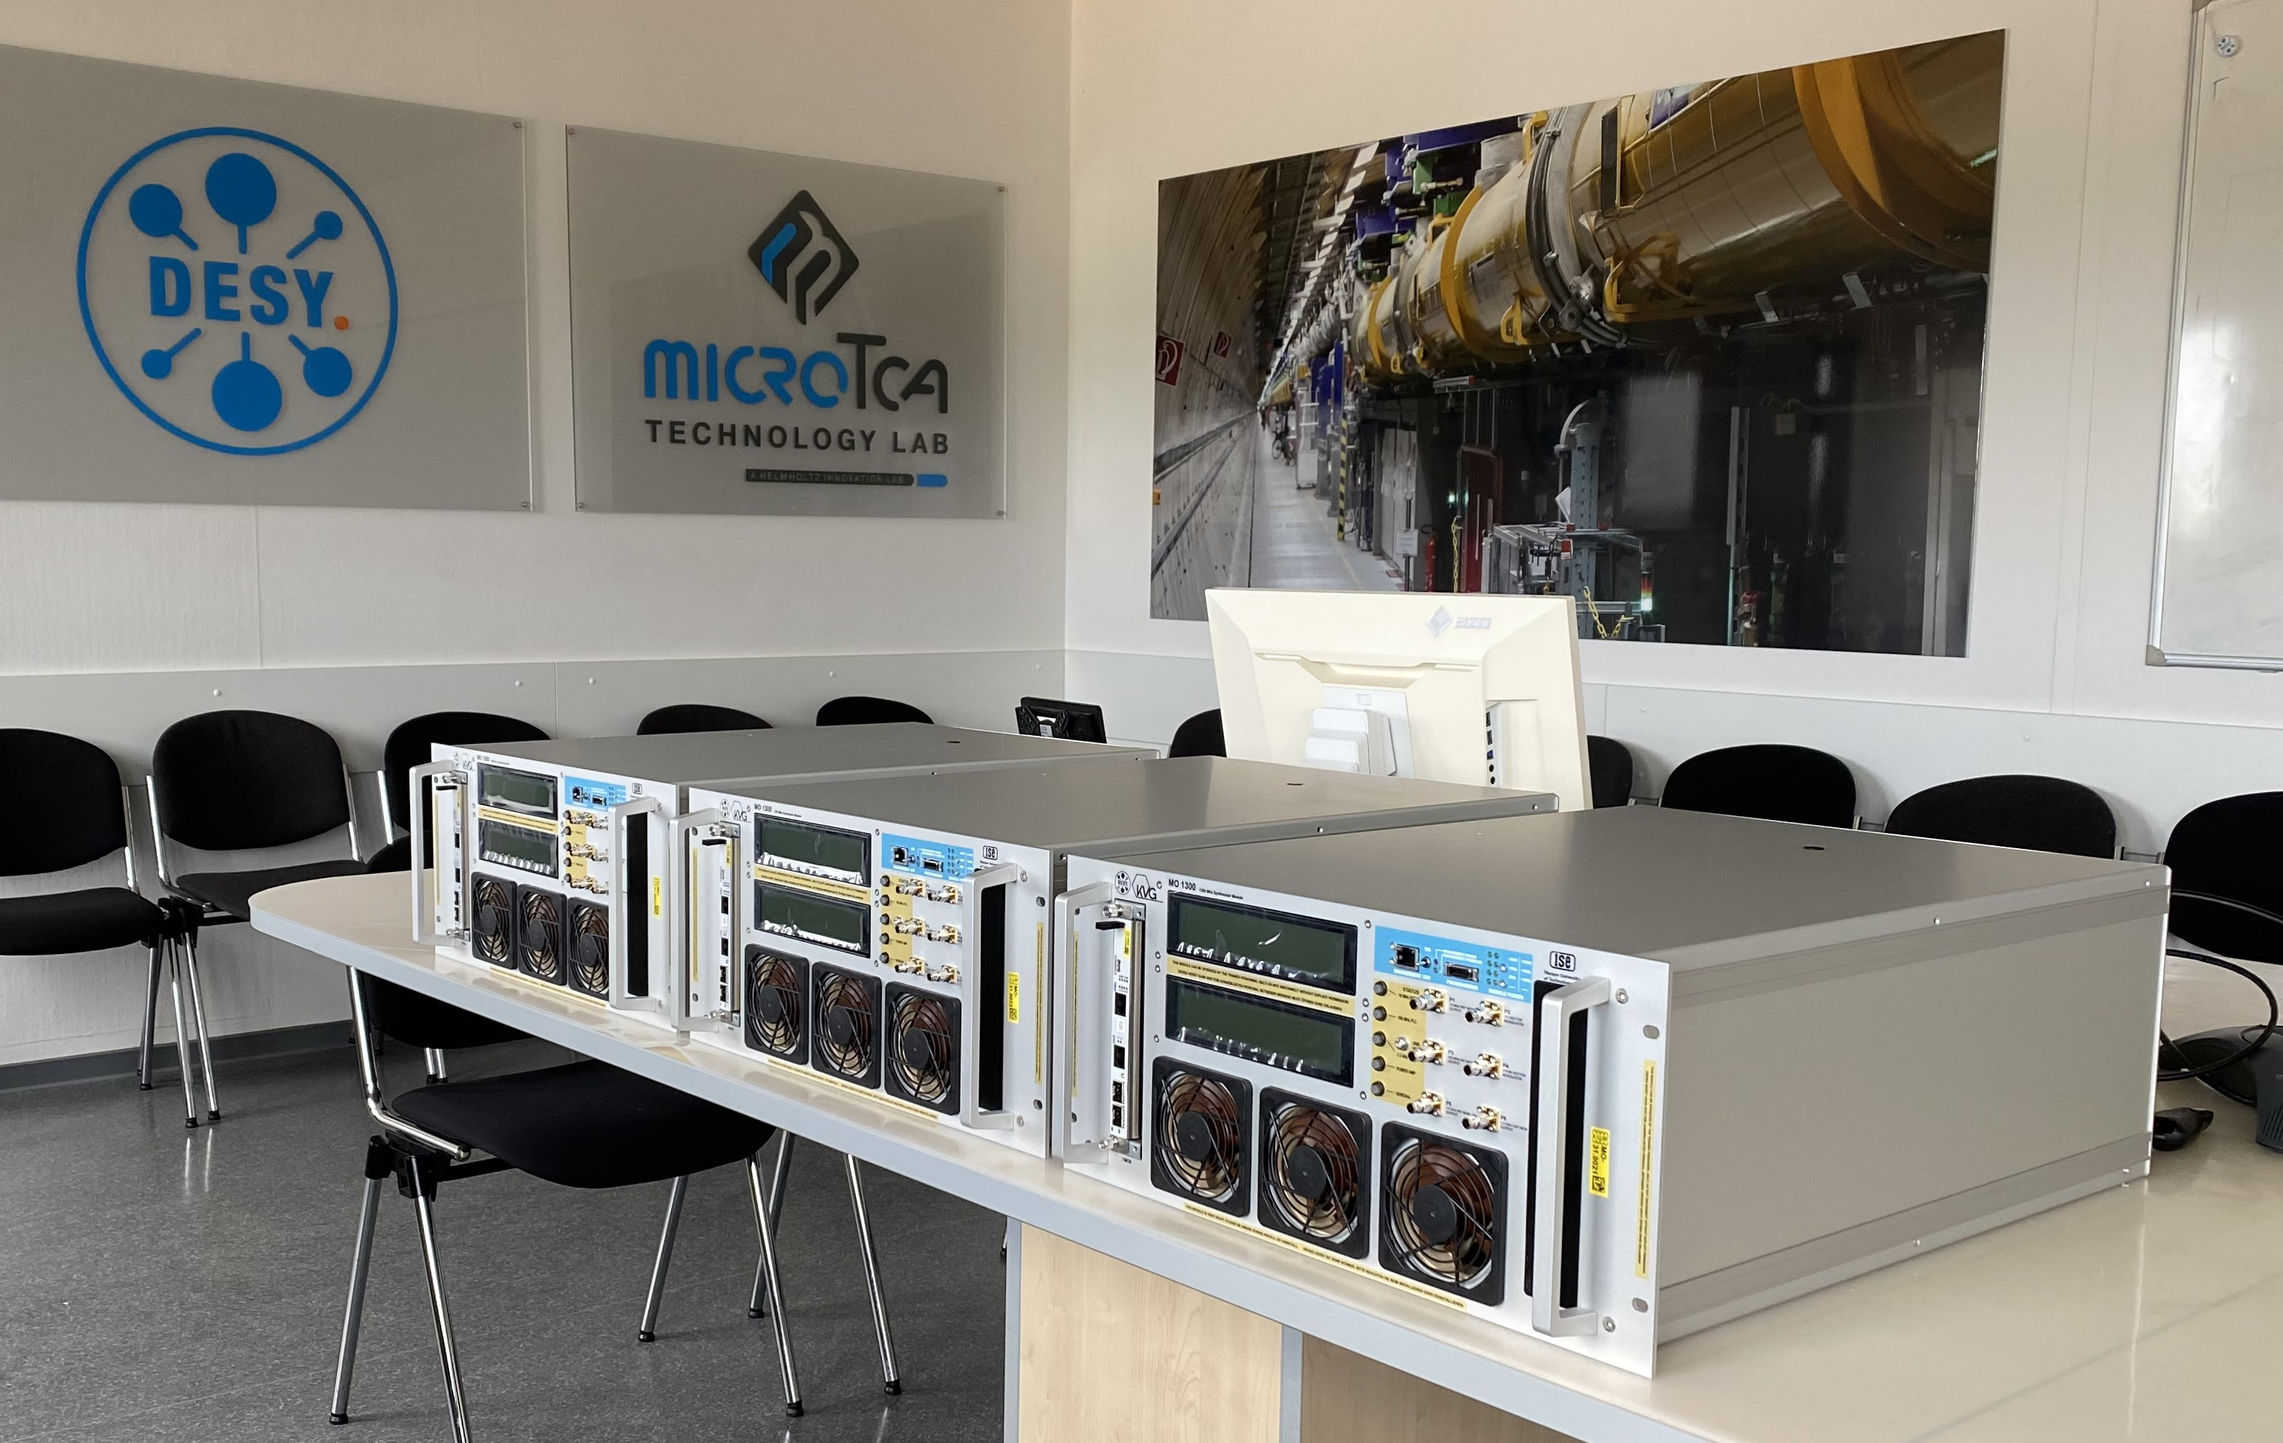
Main Oscillator (MO)
We provide Main Oscillator for your frequency application.

Slide 13
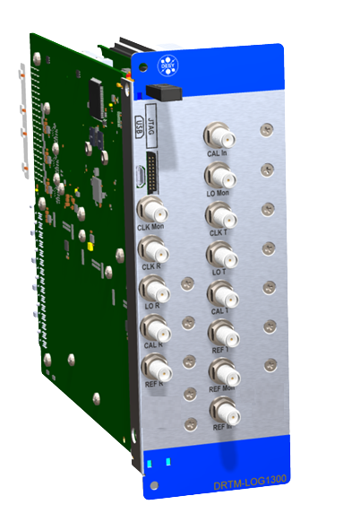

Local Oscillator Generation (DeRTM-LOG)
The DeRTM-LOG module is a critical component in LLRF systems responsible for generating local oscillator, RF reference and clock signals for the MicroTCA.4 standard.
A multi-channel local oscillator, RF signal and clock generator
Two double-width, full-height, MicroTCA.4 compliant
LO residual phase noise @ 1.354 GHz [10 Hz to 1 MHz] < 5 fs (rms)
On/Off switching of output clocks and RF signals
Temperature regulation for long-term stability of RF signals
  Diagnostic for RF power, DC voltage, temperature, humidity
Under license from DESY

Slide 14
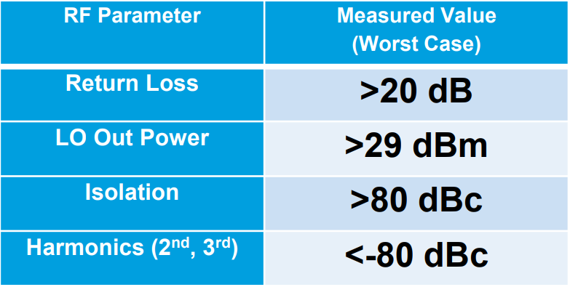
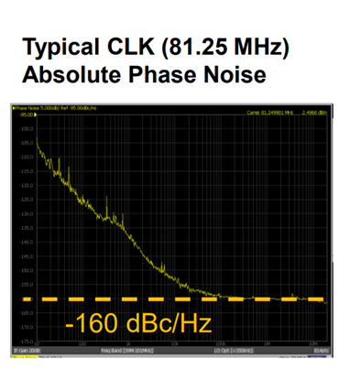
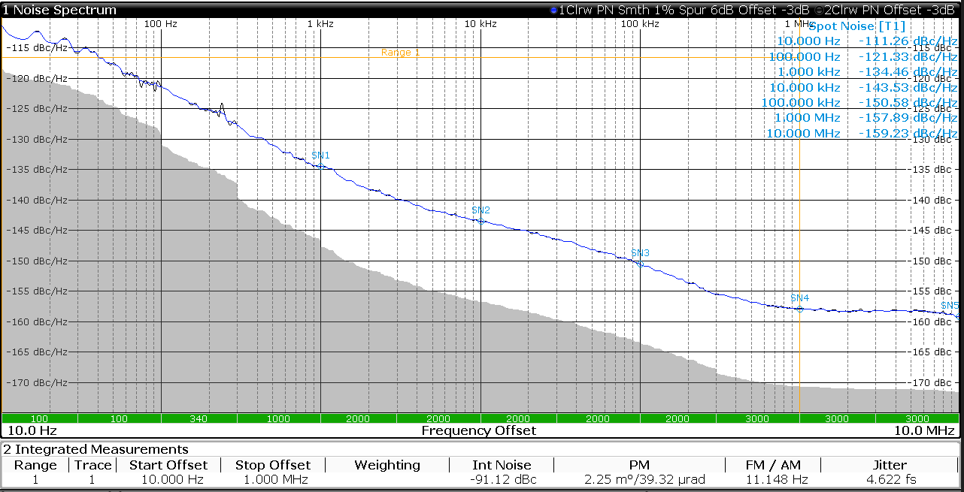
DeRTM-LOG 1.3 GHz
DeRTM-LOG 1.3 GHz:
REF 1.300 GHz
LO 1.354 GHz
CLK 81.25 MHz
Application for XFEL and FLASH in DESY
Measured Residual Phase Noise
LO 1.354 GHz 4.6 fs [10 Hz to 1 MHz]
Measurement results provided by U.Mavrič (MSK, DESY)

Slide 15
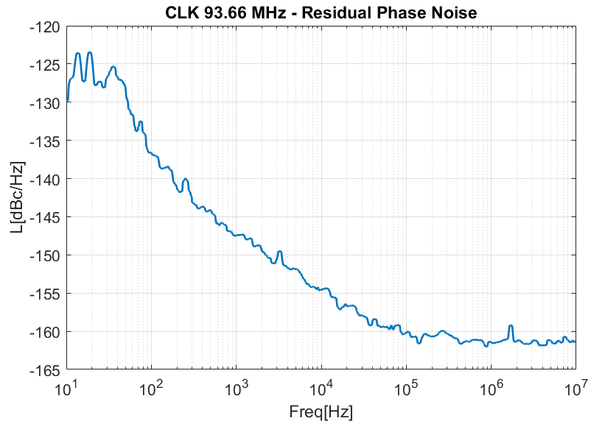
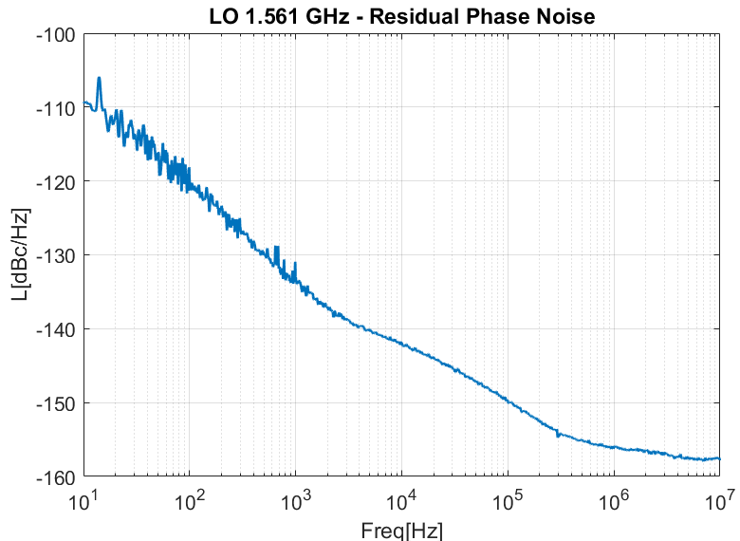
DeRTM-LOG 1.5 Ghz
DeRTM-LOG 1.5 GHz:
REF 1.500 GHz
LO 1.561 GHz
CLK 93.66 MHz
Application for BESSY II Light Source in Helmholtz-Zentrum Berlin (HZB)
Measurement results provided by U.Mavrič (MSK, DESY)

Slide 16
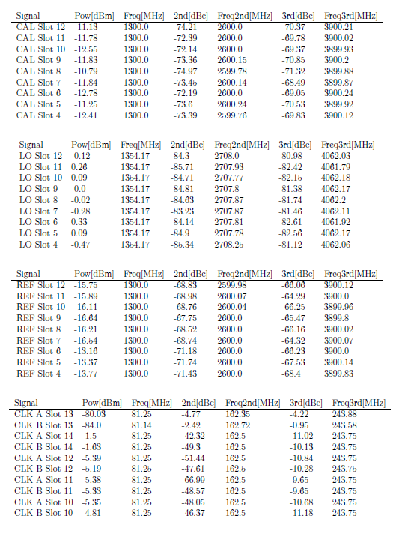
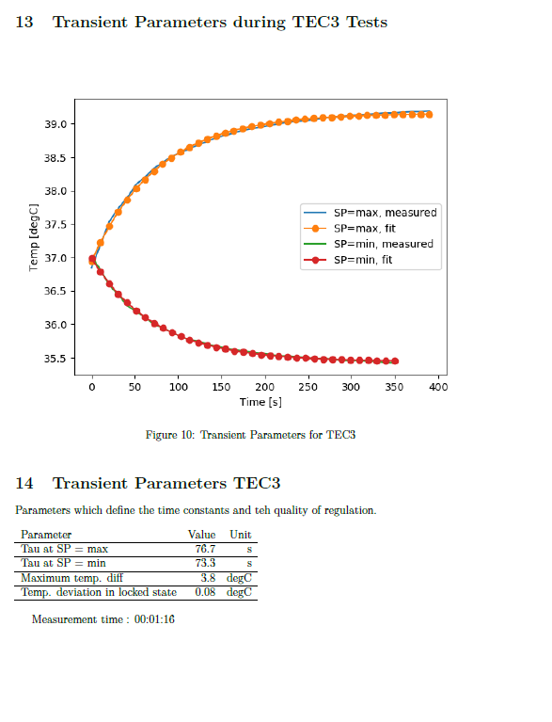
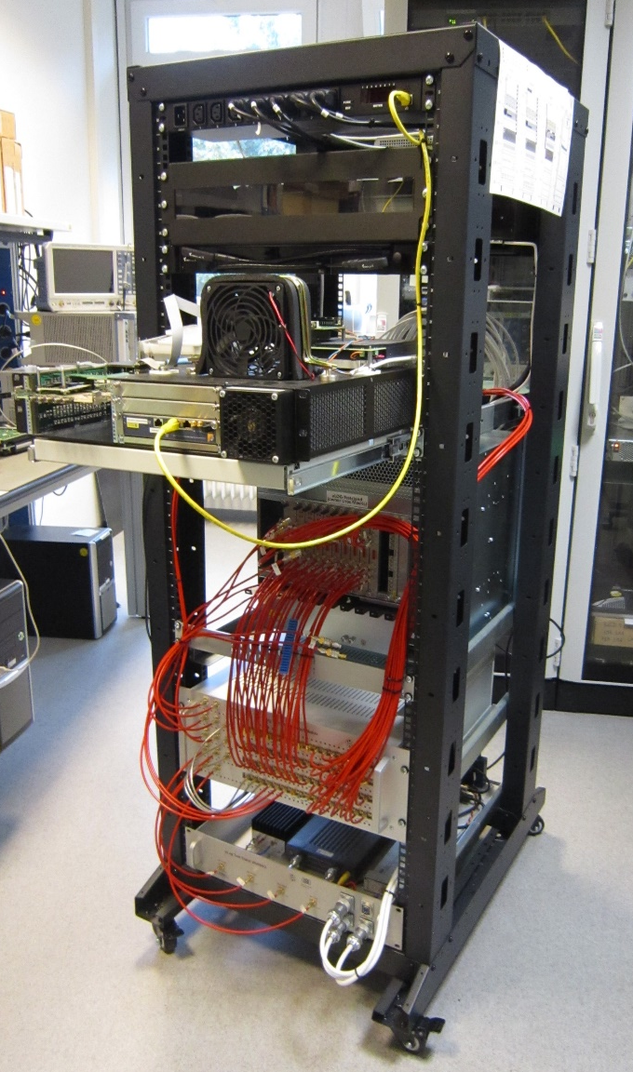
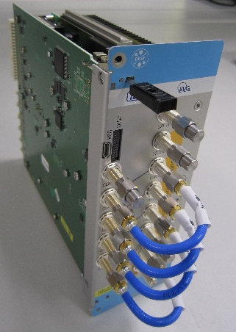
DeRTM-LOG Test-Stand
A fully automated test stand developed and provided
by DESY to check possible production errors.
Measure:
  individual mezzanines
  (DC/DC mezz., RF mezz., ...)
  A fully assembled module
Test:
  CLK frequency [1 MHz to 500 MHz]
  LO, REF and calibration signals
  [1 MHz to 6 GHz]

Slide 17
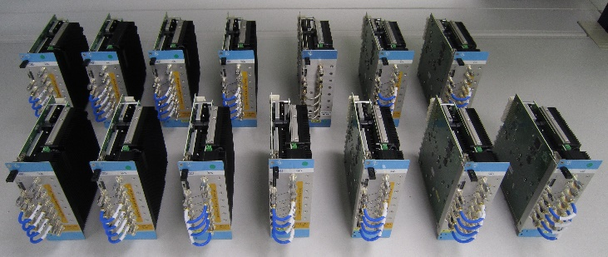
DeRTM-LOG
Production and Future Development
Available Options: DeRTM-LOG 1.3 GHz and 1.5 GHz
Further developments by DESY with new architecture
Cover various LO and CLK generation scenarios
Cover more REF frequencies applications
Residual phase noise of the LO and CLK generation
  ≤ -165 dBc/Hz white noise
We provide DeRTM-LOG for your frequency application.

Slide 18
X-Band Middleware
12 GHz
new cavity Polarizable X-band Transverse Deflecting Structure (PolariX TDS)
X-Band Middleware
X-band Local Oscillator Generation Module (XLOGM)
X-band Downconverter Module and Upconverter (XDWCM_UPC)
existing 3 GHz RF frontend
Application for PolariX TDS in DESY.

Slide 19
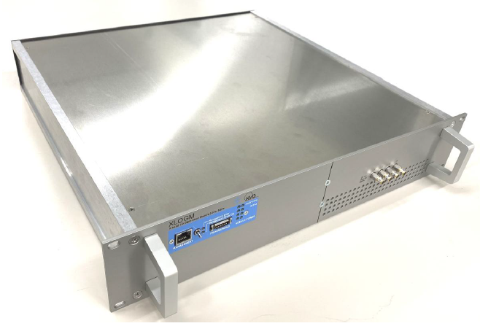
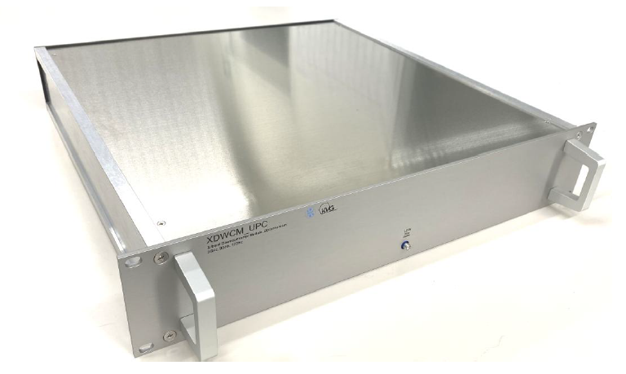
X-Band Middleware
XLOGM
1 REF input 3 GHz
4-Ch. LO output 9 GHz
Dimensions [H × W × D]: 2U ×19“ × 450 mm
XDWCM_UPC
7-Ch. downconverter und 1 channel upconverter
1-Ch. LO input 9 GHz
7-Ch. RF input 12 GHz
7-Ch. IF output 3 GHz
1-Ch. IF input 3 GHz
1-Ch. RF output 12 GHz
Dimensions [H × W × D]: 2U ×19“ × 450 mm

Slide 20
Thank You
For Your Attention
Further questions, please contact us.
Email: jbai@kvg-gmbh.de

