Slide 1


More than 10 Years Struck mTCA Modules for LLRFcontrol and Beam Instrumentation
RONG LIU
muTCA/ATCA product page (struck.de)
The 2025 MTCA/ATCA for Large Scientific Facility Control Workshop, CQU Chongqing, 17.09.2025
© 2025 Copyright Struck Innovative Systeme GmbH

Slide 2
Outline
Digitizers
Mid Speed High Resolution (125/250 MSPS 16-bit) Data Streaming
LLRF BPM
High Speed High Resolution (2.5 GSPS 14-bit) FCT
Picoammeter Spin off (1MSPS 20-bit)
Digital I/O SIS8864 I/O
SIS8800 Multi Purpose Scaler
The 2025 MTCA/ATCA for Large Scientific Facility Control Workshop, CQU Chongqing, 17.09.2025
© 2025 Copyright Struck Innovative Systeme GmbH

Slide 3
SIS8300-KU
10 channel 125 MSPS 16-bit digitizer (250 MSPS 14-bit stuffing option)
SIS8300
SIS8300-L
SIS8300-L2
SIS8300-KU
SIS8325
History
Virtex 5 based
2010 SIS8300 initial development, first MTCA.4 board worldwide
2011 SIS8300 V2 > 370 units in field (in part 8 channel 250 MSPS 14-bit BPM)
Virtex 6 based
2014 SIS8300-L > 150 units in field
2015 SIS8300-L2x > 930 units in field (L2S, L2D,…)
The 2025 MTCA/ATCA for Large Scientific Facility Control Workshop, CQU Chongqing, 17.09.2025
© 2025 Copyright Struck Innovative Systeme GmbH

Slide 4
SIS8300-KU Properties
10 Channels 125 MS/s 16-bit or 250 MS/s 14-bit ADC
10 MS/s to 125 MS/s Per Channel Sampling Speed
AC or DC Input Stage
Internal, Front Panel, RTM and Backplane Clock Sources
Two 16-bit 250 MS/s DACs for Fast Feedback Implementation
High Precision Clock Distribution Circuitry
Programmable Delay of Dual Channel Digitizer Groups
Multi Gigabit Link Port Implementation to Backplane
Twin SFP+ Card Cage for High Speed System Interconnects
White Rabbit Clock Option for SFP+ Ports
Two RJ45 Connectors (One Clock + 3 Data or 4 Data In/Out)
XCKU040-1FFVA1156C Kintex Ultrascale FPGA
2 GByte DDR4 Memory (flexible partitioning scheme)
4 lane PCI Express Gen3 Connectivity
Dual boot
MMC1.0 under DESY license LV91
In Field Firmware Upgrade Support
Vivado Project for Custom Firmware Development
Zone 3 class A1.0, A1.0C or A1.1CO Compatible
The 2025 MTCA/ATCA for Large Scientific Facility Control Workshop, CQU Chongqing, 17.09.2025
© 2025 Copyright Struck Innovative Systeme GmbH

Slide 5
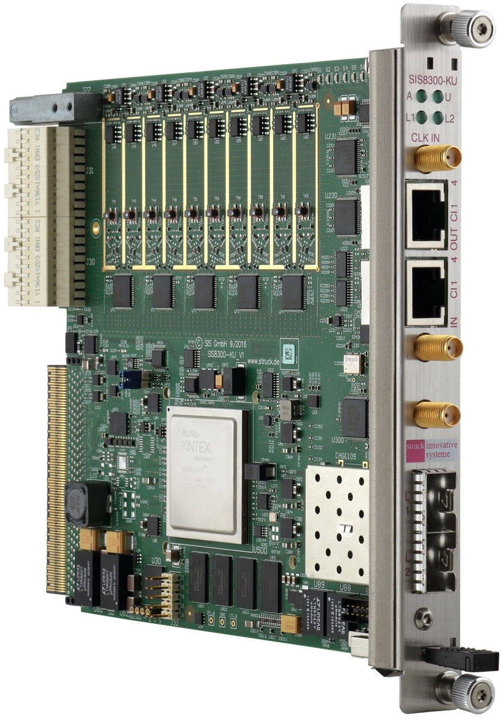


SIS8300-KU White Rabbit (WR) Ready
PLL Clock Synthesizer
VCO, VCXO
DACs for VCO Control
Additional Power
CERN Kintex Ultrascale White Rabbit PTP Core First DESY Techlab Tests
What is WR?
Sub ns synchronisation Synchronous Ethernet IEEE 1588 PTP
The 2025 MTCA/ATCA for Large Scientific Facility Control Workshop, CQU Chongqing, 17.09.2025
© 2025 Copyright Struck Innovative Systeme GmbH

Slide 6
FPGA Resources/Performance
Used FPGA | XC6VLX130T-2FFG1156C (SIS8300-L2) | XCKU040-1FFVA1156C (SIS8300-KU)
System Logic Cells | 128 K | 500 K
CLB LUTS/Flip-Flops | 80/160 K | 242/484 K
Block RAM/FIFO w/ECC (36Kb each) | 264 | 600
Block RAM/FIFO (18Kb each) | 528 | 1200
Total Block RAM (Mb) | 9.5 | 21.1
DSP Slices | 480 | 1920
GTH speed | 6.6 Gb/s | 16.3 Gb/s
PCIe | Gen2 | Gen3
Memory Controller | DDR3 | DDR4
The 2025 MTCA/ATCA for Large Scientific Facility Control Workshop, CQU Chongqing, 17.09.2025
© 2025 Copyright Struck Innovative Systeme GmbH

Slide 7
SIS8300-KU
AXI Based VIVADO Project
Cooperation Lund University/ESS/Struck
To Meet ESS/ERIC Firmware Specs
ESS Version → COSYLAB EPICS
Struck Version available to all users
The 2025 MTCA/ATCA for Large Scientific Facility Control Workshop, CQU Chongqing, 17.09.2025
© 2025 Copyright Struck Innovative Systeme GmbH

Slide 8
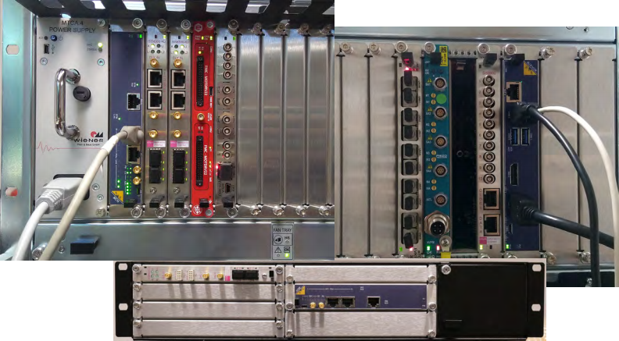
System Integration Examples
The 2025 MTCA/ATCA for Large Scientific Facility Control Workshop, CQU Chongqing, 17.09.2025
© 2025 Copyright Struck Innovative Systeme GmbH

Slide 9
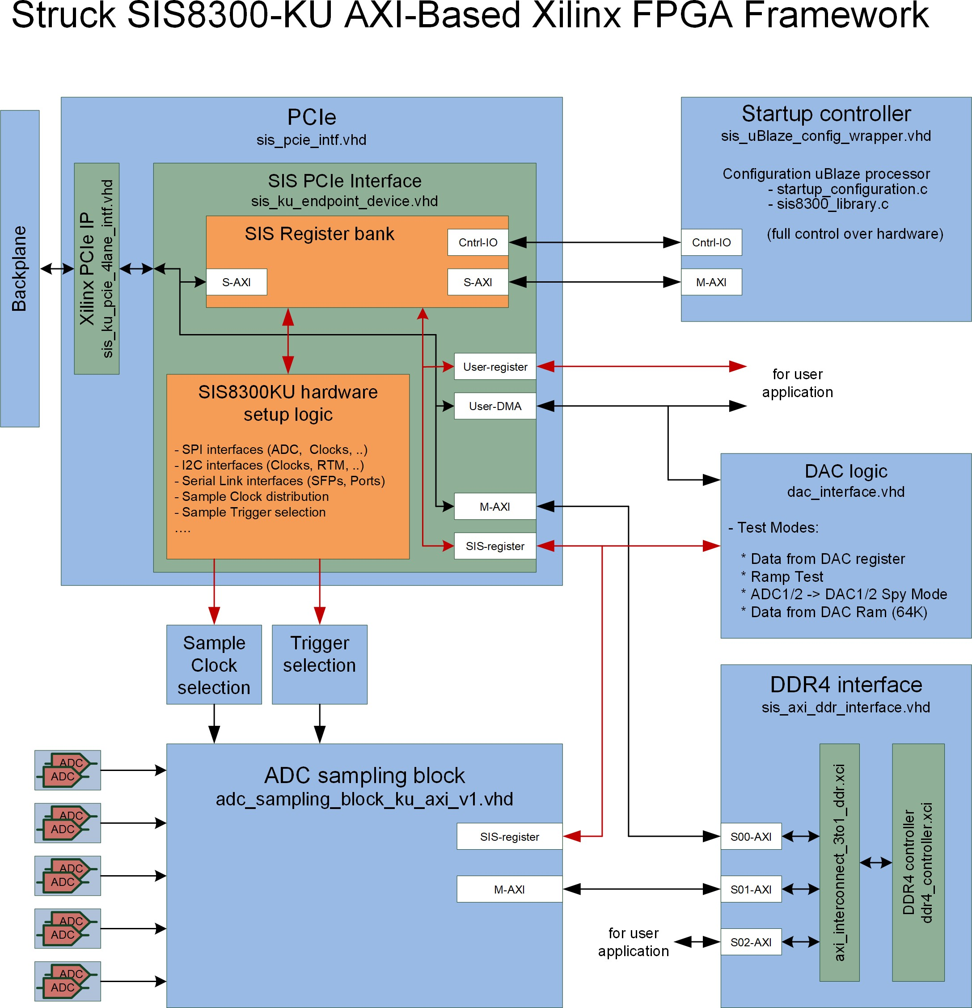
The 2025 MTCA/ATCA for Large Scientific Facility Control Workshop, CQU Chongqing, 17.09.2025
© 2025 Copyright Struck Innovative Systeme GmbH

Slide 10
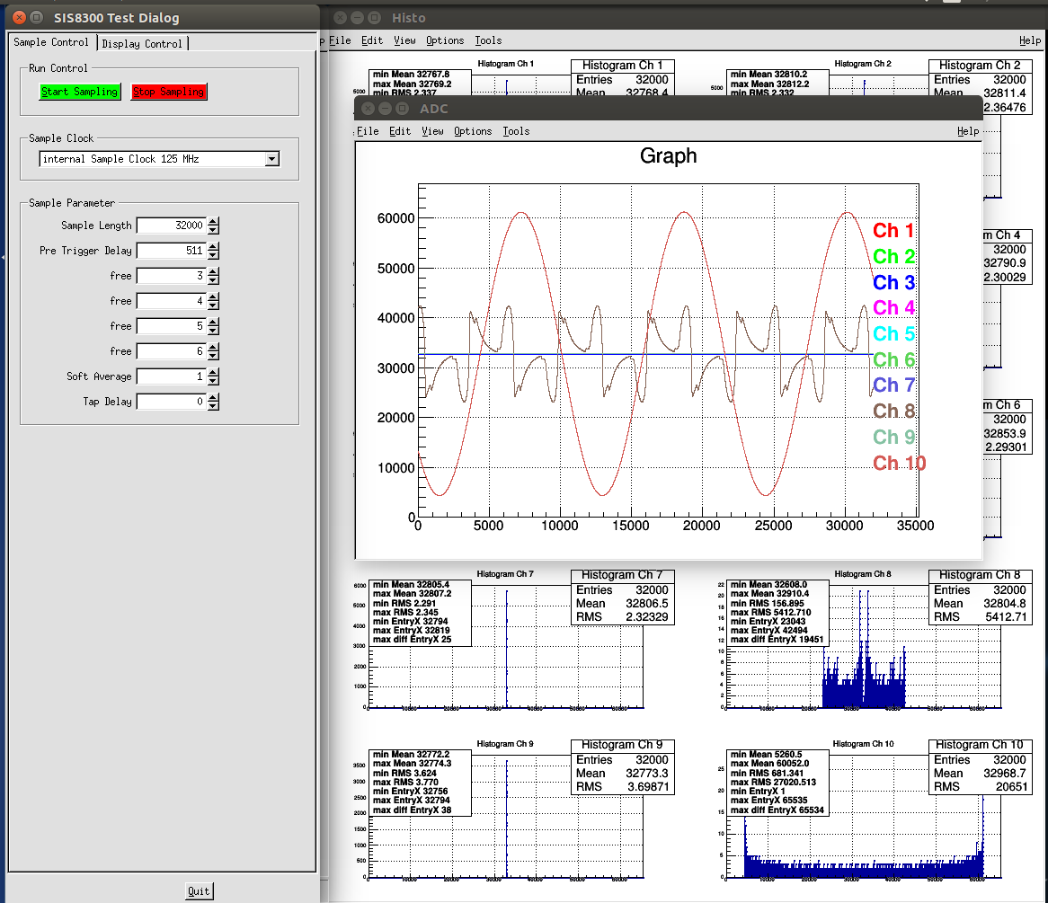
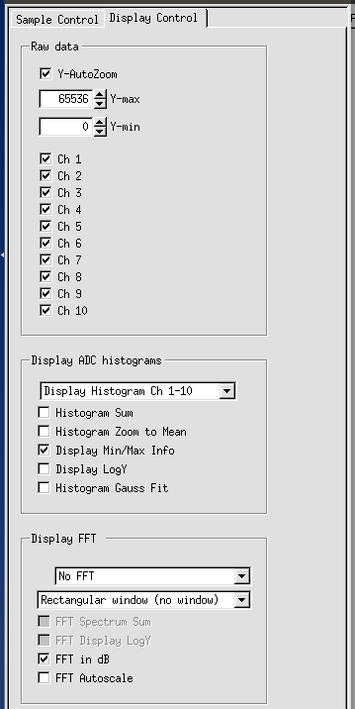
SIS8300-x ROOT GUI
SIS8300-KU 8AC2DC with SIS8900 RTM
RMS for open AC/DC channel
The 2025 MTCA/ATCA for Large Scientific Facility Control Workshop, CQU Chongqing, 17.09.2025
© 2025 Copyright Struck Innovative Systeme GmbH

Slide 11
SIS8300-KU Wendelstein X7 Application 40 Channel Streaming System
Native R5 MTCA.4 Crate
empty | empty | empty | SIS8900 | SIS8900 | SIS8900 | SIS8900 | empty | empty
AC600D | MCH | empty | SIS8300-KU | SIS8300-KU | SIS8300-KU | SIS8300-KU | empty | empty
Rear
Card Cage
Front
Card Cage
MCH
NAT PHYS80
8 Lane optical PCIe Uplink
16 Lane future option
8 Lane PCIe
Uplink
Uplink
8 Lane optical PCIe Uplink
16 Lane future option
DAQ PC/Workstation
The 2025 MTCA/ATCA for Large Scientific Facility Control Workshop, CQU Chongqing, 17.09.2025
© 2025 Copyright Struck Innovative Systeme GmbH

Slide 12
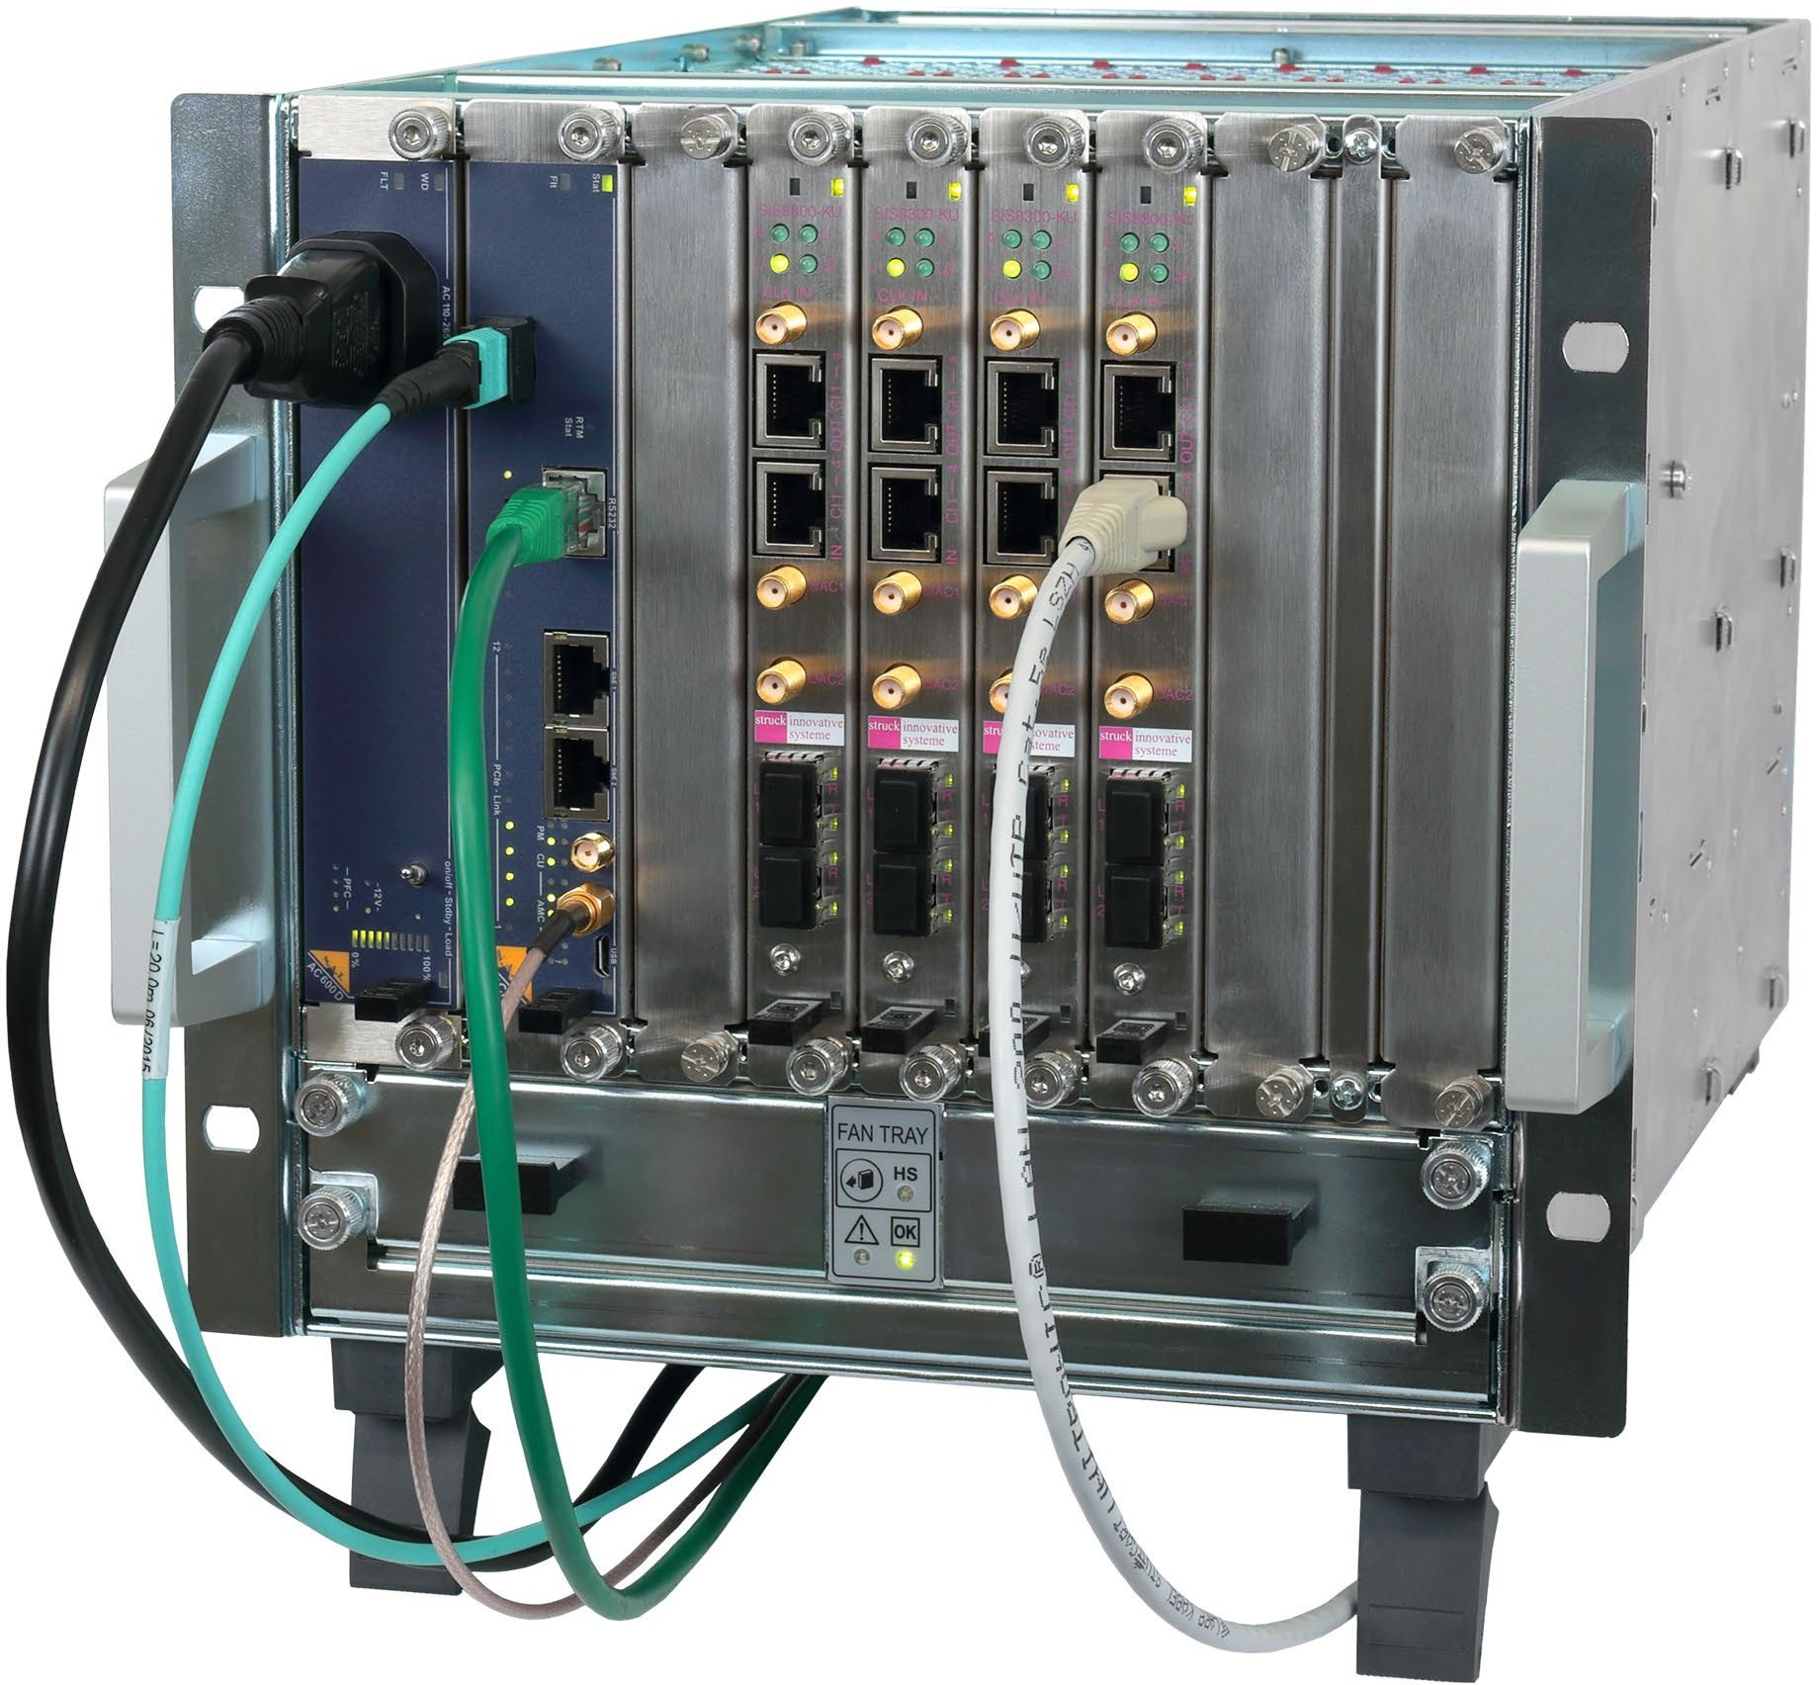
SIS8300-KU Application Example 40 Channel Streaming System (Front)
NAT PHYS80
4 x SIS8300-KU
PCIe Link Led
8 Lane PCIe Uplink
PCIe Uplink Led
External Trigger Input
RJ45 LVDS Input 1
External Sample Clock
Input Voltage: 0.3V to 5V
Input Frequency: 1 MHz to 50 MHz
The 2025 MTCA/ATCA for Large Scientific Facility Control Workshop, CQU Chongqing, 17.09.2025
© 2025 Copyright Struck Innovative Systeme GmbH

Slide 13
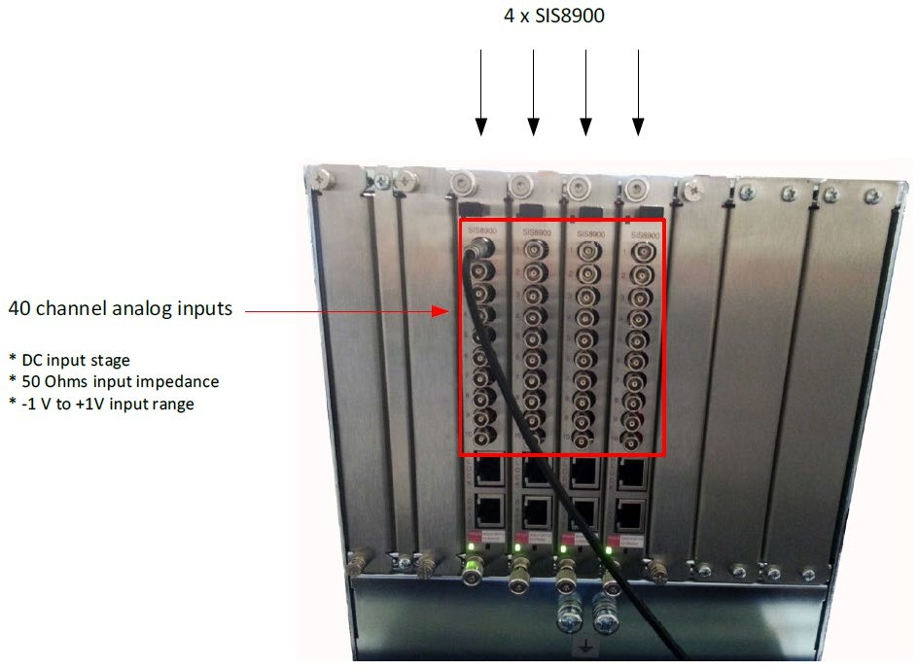
SIS8300-KU System Example
40 Channel Streaming System (Rear)
The 2025 MTCA/ATCA for Large Scientific Facility Control Workshop, CQU Chongqing, 17.09.2025
© 2025 Copyright Struck Innovative Systeme GmbH

Slide 14

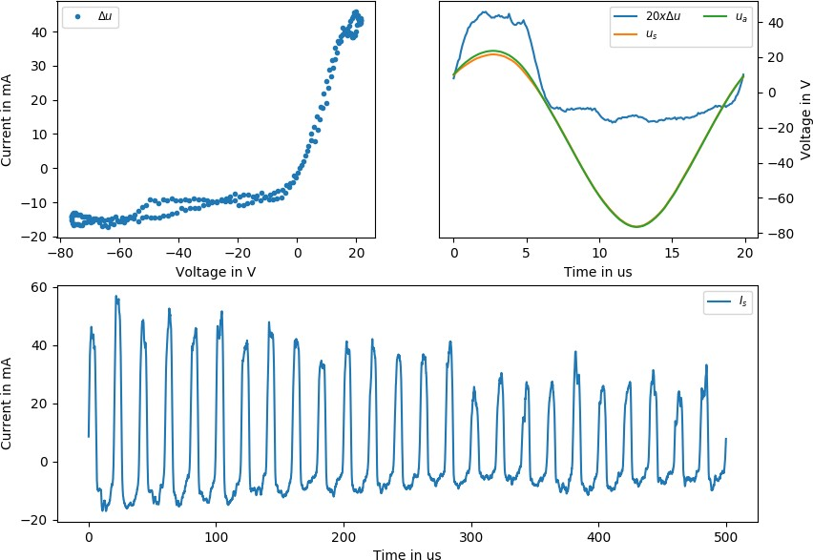
Fast Langmuir Probes on Wendelstein 7-X
Wendelstein 7-X is a nuclear fusion experiment in Greifswald, Germany at the Max-Planck-Institute for Plasma Physics
Langmuir probes measure plasma density and temperature
Fast probes can resolve turbulence
40 ADC channels with 16b at 10 MS/s
Synchronised with
~50 other systems
In operation for
~500 experiments of up to 100s
Courtesy Lukas Rudischauser, IPP
The 2025 MTCA/ATCA for Large Scientific Facility Control Workshop, CQU Chongqing, 17.09.2025
© 2025 Copyright Struck Innovative Systeme GmbH

Slide 15
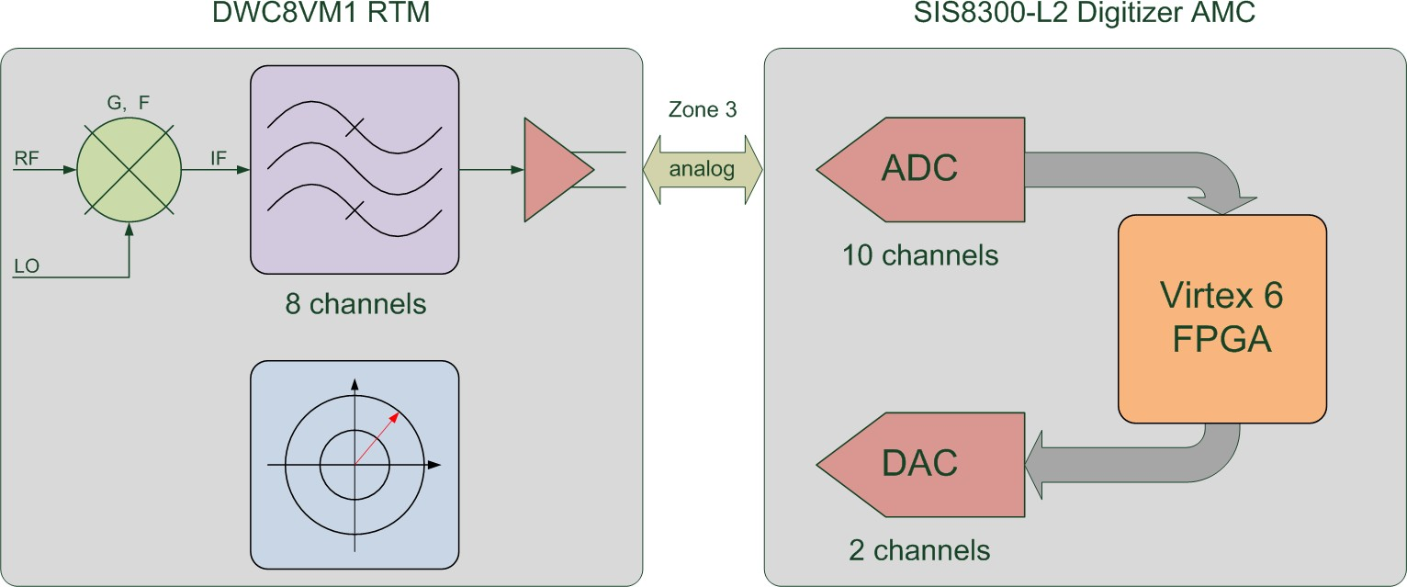
SIS8300-x/DWC8VM1
as single cavity LLRF solution covering 350 MHz to 6 GHz
Current combination: SIS8300-KU Kintex Ultrascale Digitizer and DWC8VM1
The 2025 MTCA/ATCA for Large Scientific Facility Control Workshop, CQU Chongqing, 17.09.2025
© 2025 Copyright Struck Innovative Systeme GmbH

Slide 16
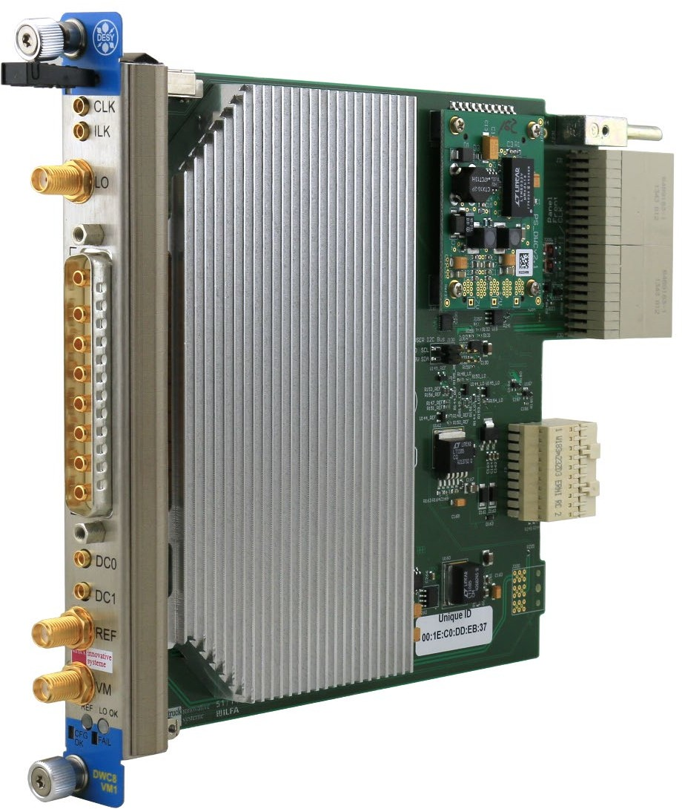
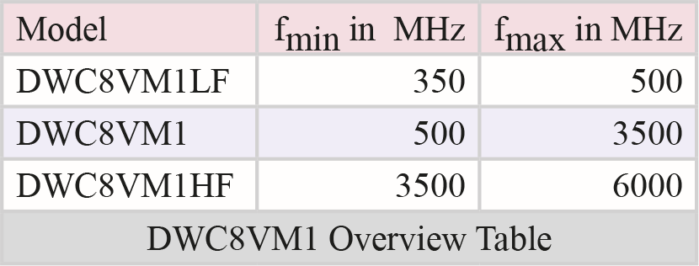
DWC8VM1
8 Channel Downconverter One Channel Vectormodulator*
*under license from DESY
The 2025 MTCA/ATCA for Large Scientific Facility Control Workshop, CQU Chongqing, 17.09.2025
© 2025 Copyright Struck Innovative Systeme GmbH

Slide 17
DWC8VM1 Properties
MTCA.4 RTM Implementation
8 Channels Downconverter
350 MHz - 6 GHz (3 different types)
8 Channel FBM Multi Coax. Connector (CH1 to CH8)
2 Auxilliary Channels
One Channel Vector Modulator
VM Output 50 MHz to 6 GHz
SMA Vector Modulator Output
Various Intermediate Frequencies
Switchable Front End Attenuators
LO Clock From Front Panel or RF Backplane
LO Power Level Monitor
Interlock Scheme
I2C Support
Zone 3 Class A1.1 compatible
The 2025 MTCA/ATCA for Large Scientific Facility Control Workshop, CQU Chongqing, 17.09.2025
© 2025 Copyright Struck Innovative Systeme GmbH

Slide 18
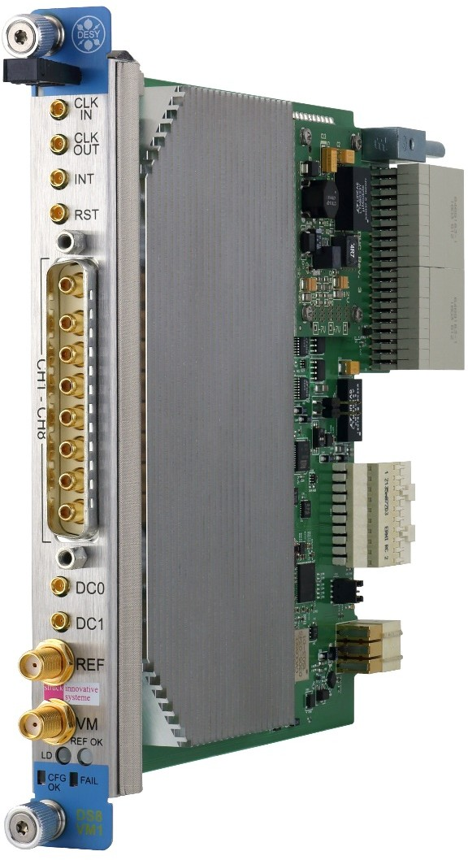
DS8VM1
8 Channel Direct Sampling One channel vectormodulator*
SIS8300-x/DS8VM1
as single cavity LLRF solution covering 5 MHz to 700 MHz Undersampling in some cases
*under license from DESY
The 2025 MTCA/ATCA for Large Scientific Facility Control Workshop, CQU Chongqing, 17.09.2025
© 2025 Copyright Struck Innovative Systeme GmbH

Slide 19
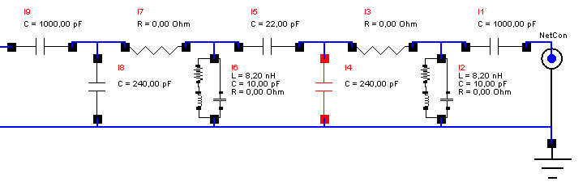
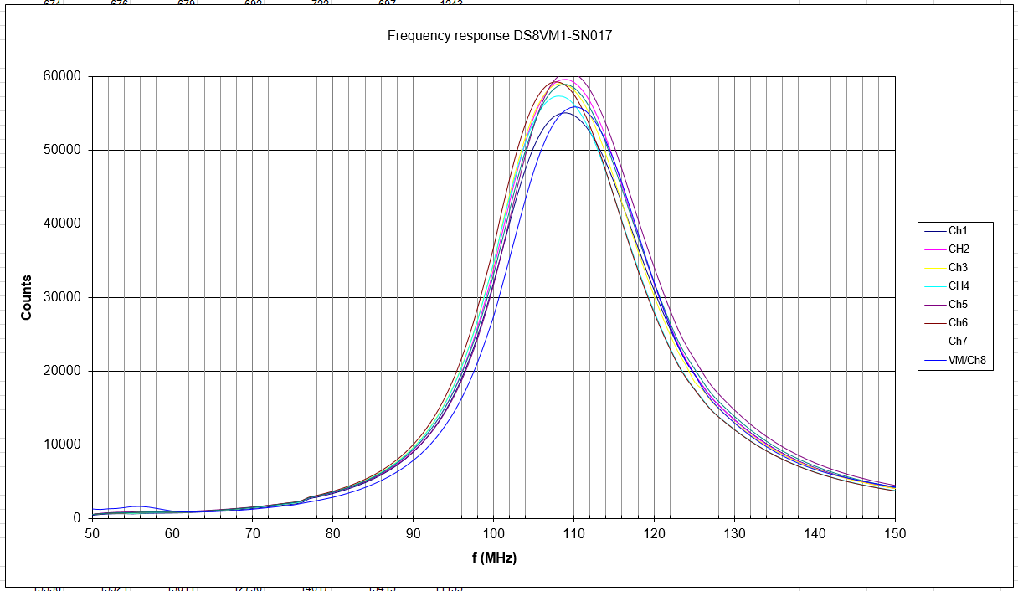
DS8VM1 GSI 108 MHz Input Filter and Input Response
Jens Zappai et. al. LLRF2017
The 2025 MTCA/ATCA for Large Scientific Facility Control Workshop, CQU Chongqing, 17.09.2025
© 2025 Copyright Struck Innovative Systeme GmbH

Slide 20
SIS8300-x BPM Application
PAL FEL
144 Stripline BPMs SIS8300 V2
in 8 channel 250 MSPS configuration SLAC RTM
56 Cavity BPMs SIS8300-L2/SLAC RTM DESY FLASH
SIS8300-L2/DESY Interleaving RTM ESS
SIS8300-KU/DWC10LF
The 2025 MTCA/ATCA for Large Scientific Facility Control Workshop, CQU Chongqing, 17.09.2025
© 2025 Copyright Struck Innovative Systeme GmbH

Slide 21
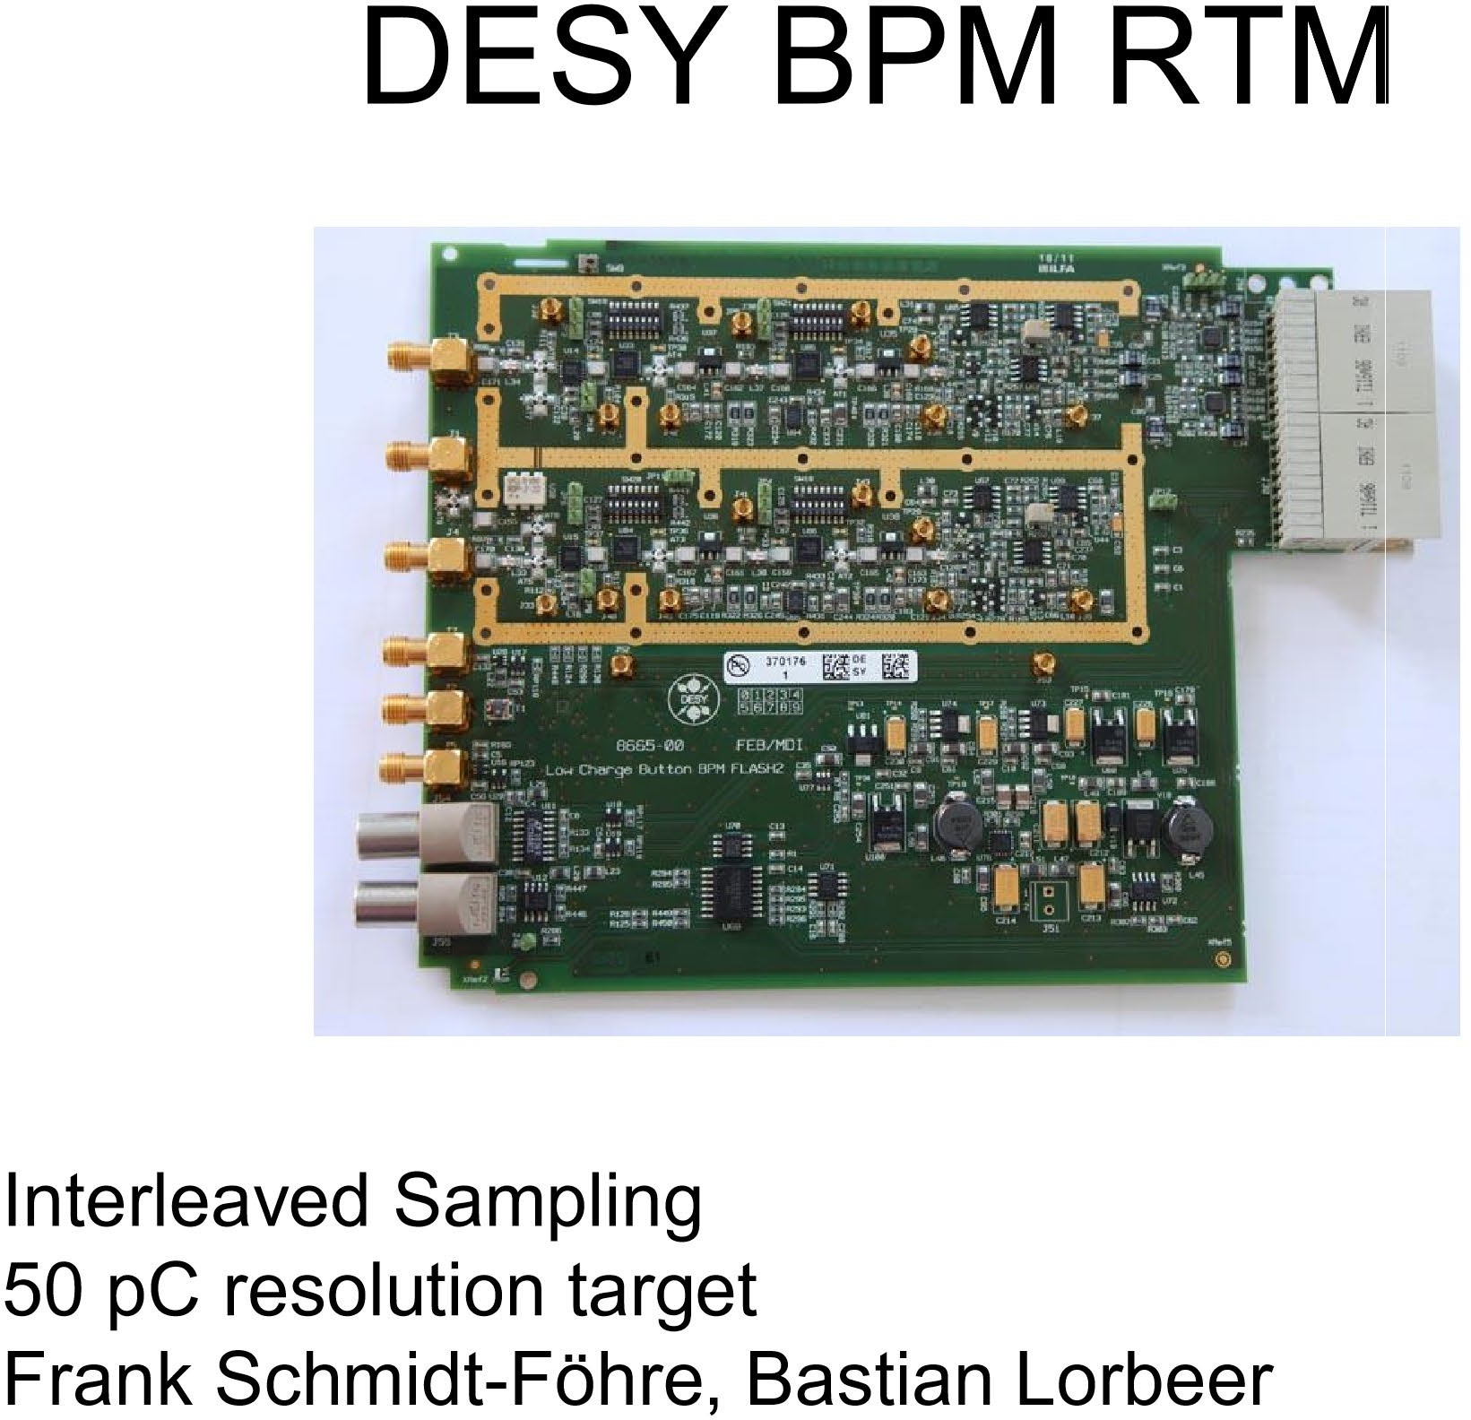
The 2025 MTCA/ATCA for Large Scientific Facility Control Workshop, CQU Chongqing, 17.09.2025
© 2025 Copyright Struck Innovative Systeme GmbH

Slide 22
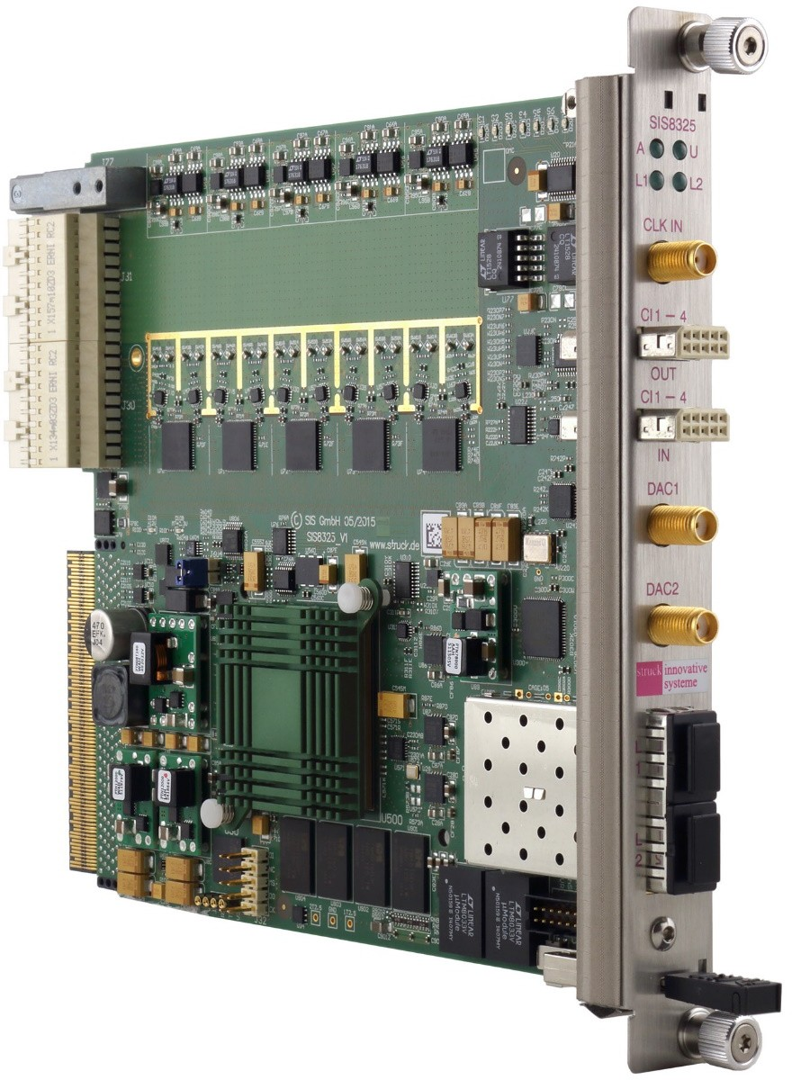
SIS8325 250 MSPS 16-bit Digitizer (Helmholtz Validation fund project)
MTCA.4
4 lane PCI Express Connectivity
10 Channels 250 MS/s 16-bit ADC
10 MS/s to 250 MS/s Per Channel Sampling Speed
AC and DC Input Stage
Internal, Front Panel, RTM and Backplane Clock Sources
Two 16-bit DACs for Fast Feedback Implementation
High Precision Clock Distribution Circuitry
Programmable Delay of Dual Channel Digitizer Groups
Gigabit Link Port Implemenation to Backplane
Twin SFP Card Cage for High Speed System Interconnects
Virtex 6 FPGA
One GSample Memory (flexible partitioning scheme)
In Field Firmware Upgrade Support
The 2025 MTCA/ATCA for Large Scientific Facility Control Workshop, CQU Chongqing, 17.09.2025
© 2025 Copyright Struck Innovative Systeme GmbH

Slide 23
Application FAIR FCT (Fast Current Transformer)
Test System with SIS3350 500 MSPS 12- bit VME Digitizer
Development of new MTCA FMC Carrier and 2.5 GSPS 14-bit Digitizer FMC
The 2025 MTCA/ATCA for Large Scientific Facility Control Workshop, CQU Chongqing, 17.09.2025
© 2025 Copyright Struck Innovative Systeme GmbH

Slide 24
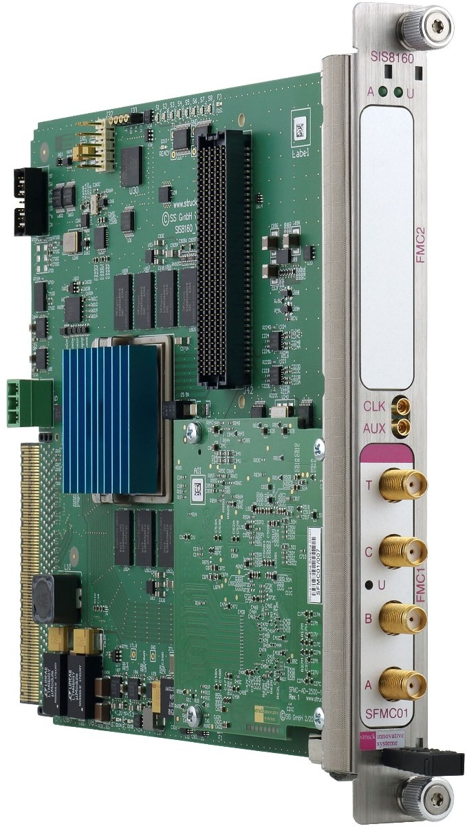
SIS8160 Dual FMC Carrier AMC
4-lane PCI Express Gen3 Connectivity
Xilinx XCKU40- or XCKU060- 1FFVA1156C Kintex Ultrascale FPGA
Dual Boot
Front Panel MMCX Clock Input
Front Panel MMCX Digital In-/Output (HW Configuration)
Point to Point Links
4 MLVDS µTCA Ports (AMC Ports 17-
20) → 8 MLVDS lines
2 HPC FMC Sites
Variable FMC VADJ (1,0V - 1,8V)
Low Jitter Clock Generation and Management
2 x 2 GByte DDR4 Memory with two Memory Controllers
White Rabbit Option (over FMC 2)
Stand Alone Operation Option
MMC1.0 under DESY LV91
The 2025 MTCA/ATCA for Large Scientific Facility Control Workshop, CQU Chongqing, 17.09.2025
© 2025 Copyright Struck Innovative Systeme GmbH

Slide 25
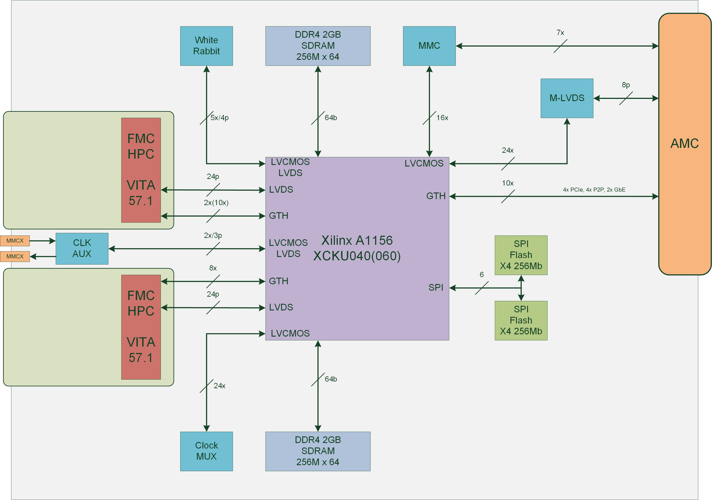
SIS8160 Block Diagram
The 2025 MTCA/ATCA for Large Scientific Facility Control Workshop, CQU Chongqing, 17.09.2025
© 2025 Copyright Struck Innovative Systeme GmbH

Slide 26
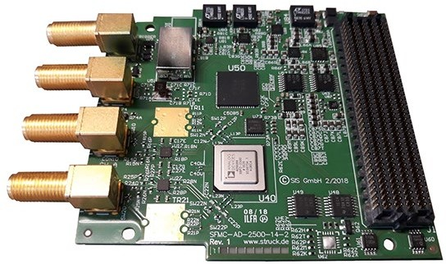
SFMC01
2 Channel 2.5 GSPS 14-Bit
Single width, 10mm stacking height, air cooled commercial grade HPC FMC Module
Analog front-end factory configurable for DC- or AC (Balun) input coupling
Up to 5 GHz AC Analog BW
Up to 1 GHz DC Analog BW
Dual channel 14-Bit, 2.5 GSPS with JESD204B Interface
50 Ohm Input Termination
4 Front panel SMA Inputs for Analog A/B, Clock and Trigger
Ultra low phase noise 100 MHz on board clock source
High performance jitter attenuating frequency generator for JESD204B
one green Front panel user LED
System management EEPROM and Temperature Sensor with Thermal Watchdog
The 2025 MTCA/ATCA for Large Scientific Facility Control Workshop, CQU Chongqing, 17.09.2025
© 2025 Copyright Struck Innovative Systeme GmbH

Slide 27
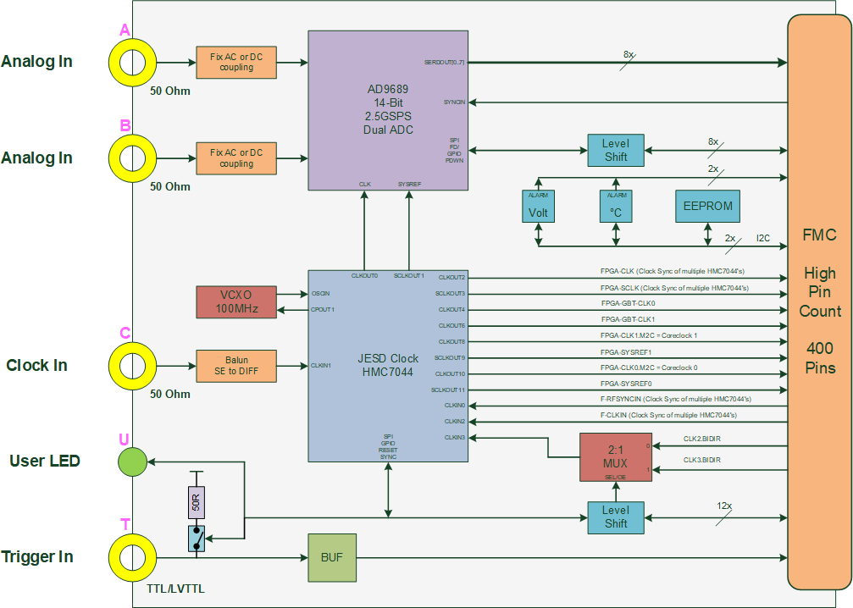
SFMC01
2 Channel 2.5 GSPS 14-Bit
The 2025 MTCA/ATCA for Large Scientific Facility Control Workshop, CQU Chongqing, 17.09.2025
© 2025 Copyright Struck Innovative Systeme GmbH

Slide 28
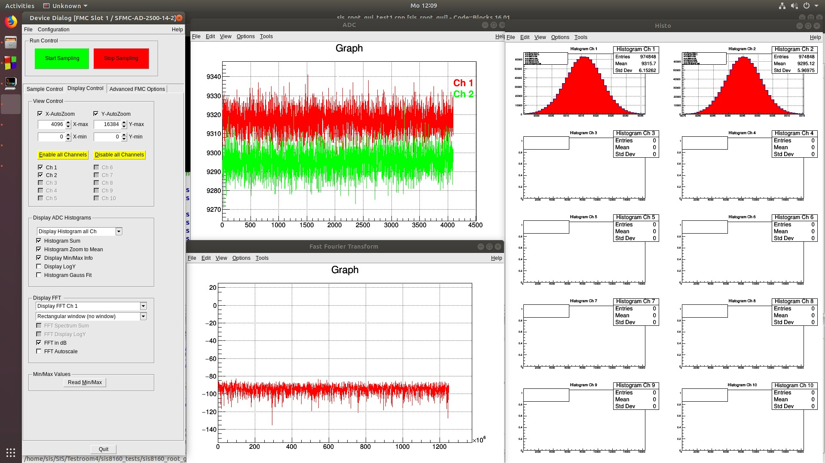
SIS8160/SFMC01 RROT GUI
DC Configuration 1 GHz BW
The 2025 MTCA/ATCA for Large Scientific Facility Control Workshop, CQU Chongqing, 17.09.2025
© 2025 Copyright Struck Innovative Systeme GmbH

Slide 29
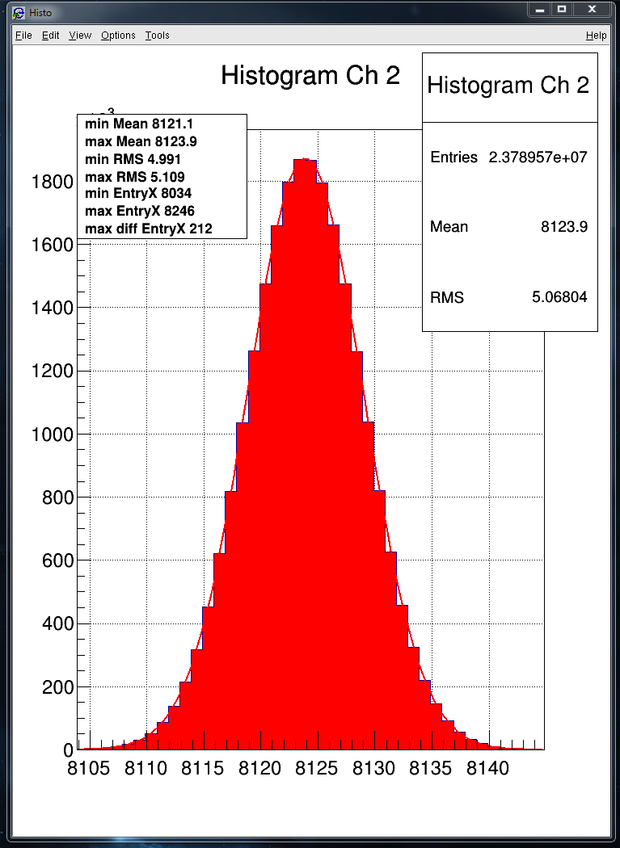
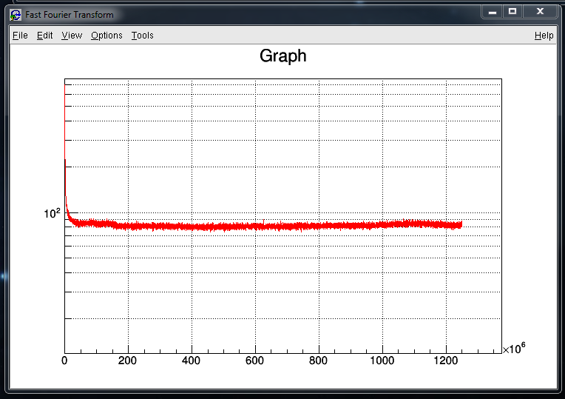
SFMC01 AC 5 GHz BW Open Input
The 2025 MTCA/ATCA for Large Scientific Facility Control Workshop, CQU Chongqing, 17.09.2025
© 2025 Copyright Struck Innovative Systeme GmbH

Slide 30
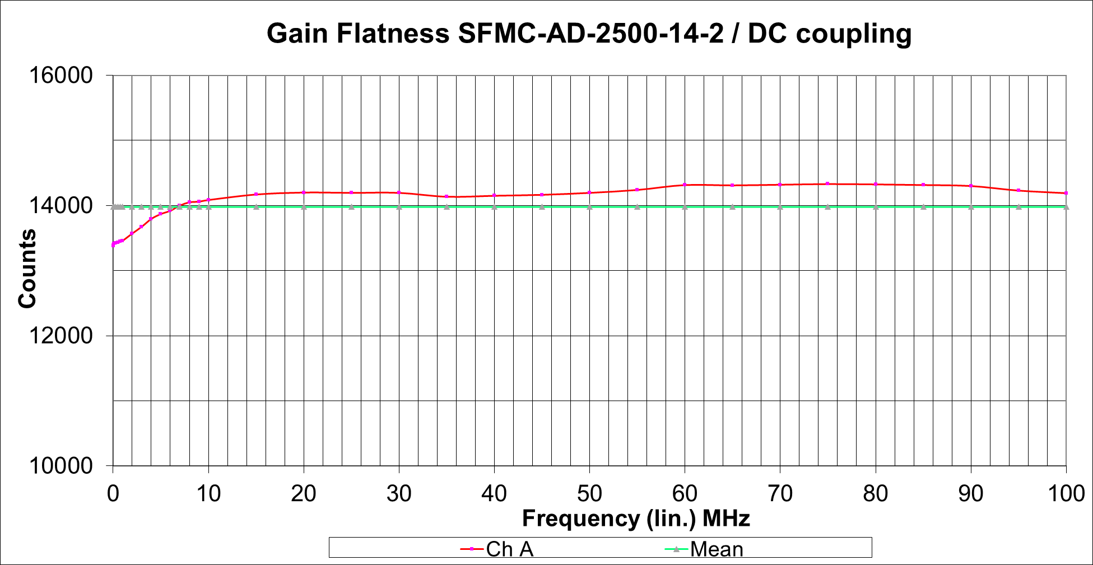
SFMC01 Gain Flatness request: +/- 0,5 dB 0-100 MHz
The 2025 MTCA/ATCA for Large Scientific Facility Control Workshop, CQU Chongqing, 17.09.2025
© 2025 Copyright Struck Innovative Systeme GmbH
Notes:
Possible next FMC JESD Developments
4 Channel GSPS 16-bit Digitizer
8 Channel 500 MSPS 14-bit Digitizer
Project Driven …
ADC/DAC Combination …

Slide 31
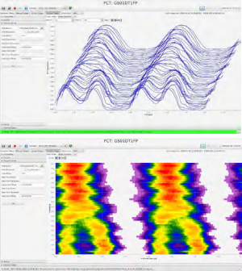
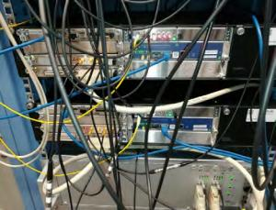
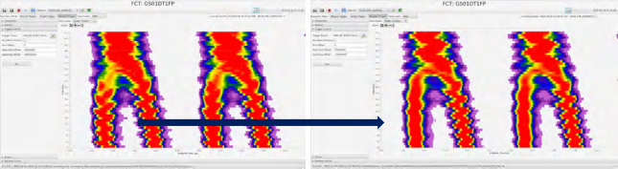
Initial Application: FAIR Fast Current Transformer (FCT) System
Front End Electronics
operational at SIS18 and ESR
state-of-the-art DAQ based on µTCA 2.5 GSa/s, 14-bit ADC
rf-triggered multi-event acquisition (programmable rate divider for long acqusition times in development by BEA)
DAQ and operator GUI by BEA
SIS18 FCT
Waterfall view
Contour view
l
l
l
l
l
FCT is used for optimization of the „ bunch merging 4 → 2“ process: cancelling bunch oscillations | Measurement 1 Measurement 2
The 2025 MTCA/ATCA for Large Scientific Facility Control Workshop, CQU Chongqing, 17.09.2025
© 2025 Copyright Struck Innovative Systeme GmbH

Slide 32
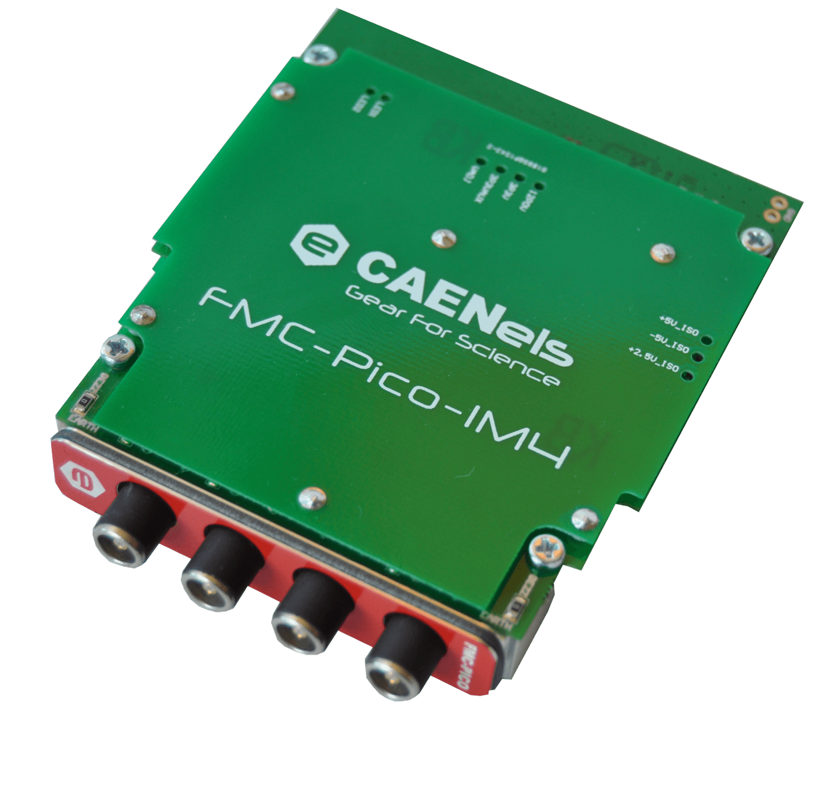
SIS8160 Application CAENELS FMC-Pico-1M4(-C3)
4 Channel Pico Ammeter
20-Bit 1 MSPS (BW 10/C3 300 KHz)
RNG0: ± 1 mA, RNG1: ± 1 µA
C3: RNG0: ± 10 mA, RNG1: ± 500 µA
BPM, SR Beamline,…
SIS8300-KU like FW framework
Vivado upgrade path to older carrier HW
Picture courtesy CAENELS
The 2025 MTCA/ATCA for Large Scientific Facility Control Workshop, CQU Chongqing, 17.09.2025
© 2025 Copyright Struck Innovative Systeme GmbH

Slide 33
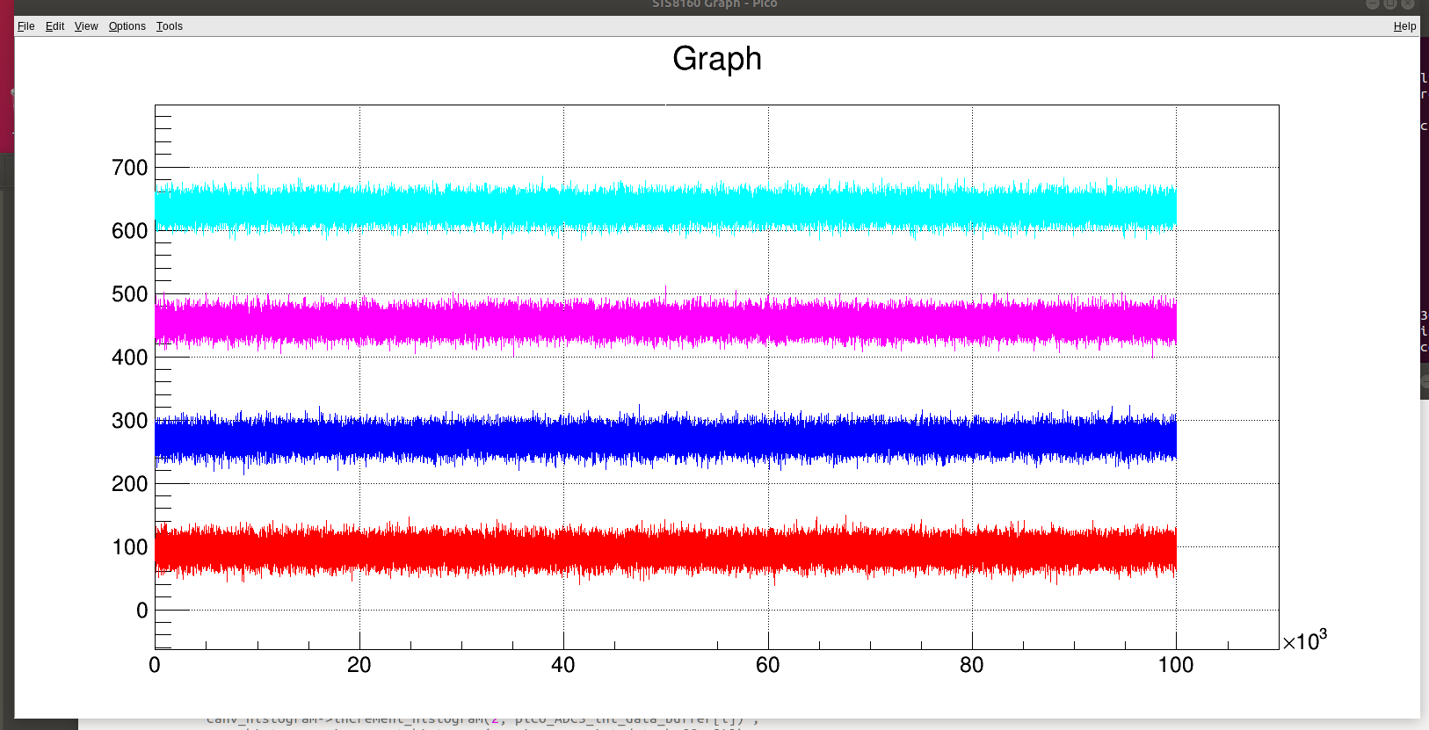
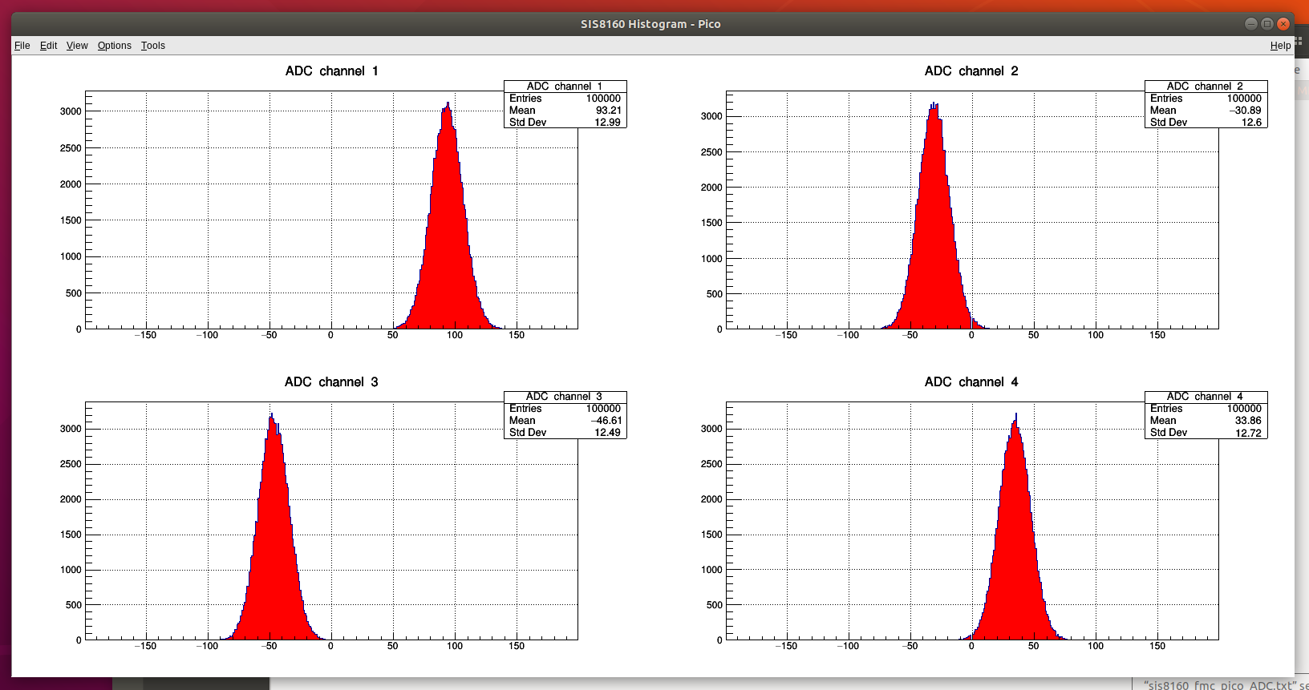
SIS8160/FMC Pico Noise Distribution (reminder 20-bit)
The 2025 MTCA/ATCA for Large Scientific Facility Control Workshop, CQU Chongqing, 17.09.2025
© 2025 Copyright Struck Innovative Systeme GmbH

Slide 34
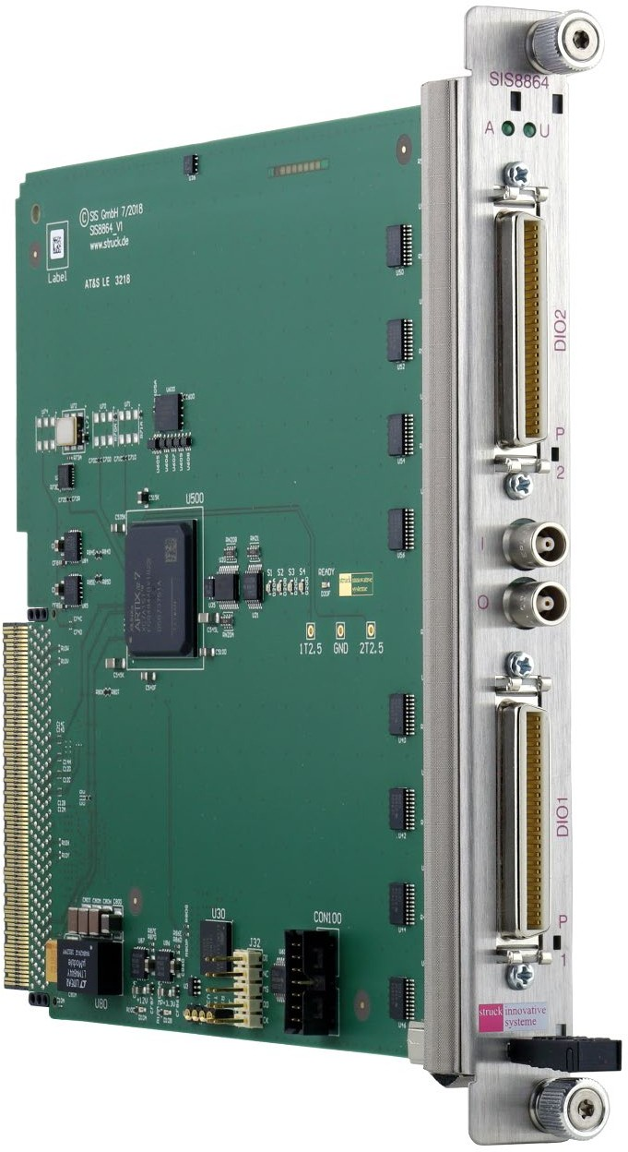
SIS8864 64 channel LVTTL Digital I/O AMC
Machine cycle dependent & generic ouput pattern with digital input
Alternative to OHWR FMC carrier and two I/O FMC‘s
Ready to run firmware
Application specific firmware adaptations
The 2025 MTCA/ATCA for Large Scientific Facility Control Workshop, CQU Chongqing, 17.09.2025
© 2025 Copyright Struck Innovative Systeme GmbH

Slide 35
SIS8864 64 channel LVTTL Digital I/O AMC Properties
AMC with Double Width Mid-Size form factor
Xilinx XC7A15T-2FGG484C Artix-7 FPGA
Single lane PCI Express Gen2 Interface
1 AMC Port GbE
2 AMC Ports Point-to-Point Serial Link
4 AMC Ports MLVDS (8 MLVDS lines)
2 Front panel 32 data I/O: Mini D Ribbon (MDR) (TTL/LVTTL)
I/O direction programmable in 8-Bit Groups
1 Front panel control Input: LEMO (TTL/LVTTL)
1 Front panel control Output: LEMO (LVTTL)
In field firmware upgrade capability
Module Management Controller ATxmega128A1U, IPMB-L interface
DESY MMC1.0 (under LV 91)
In production
The 2025 MTCA/ATCA for Large Scientific Facility Control Workshop, CQU Chongqing, 17.09.2025
© 2025 Copyright Struck Innovative Systeme GmbH

Slide 36
Typical FAIR SIS8864 Digital I/O Use Case
The 2025 MTCA/ATCA for Large Scientific Facility Control Workshop, CQU Chongqing, 17.09.2025
© 2025 Copyright Struck Innovative Systeme GmbH

Slide 37
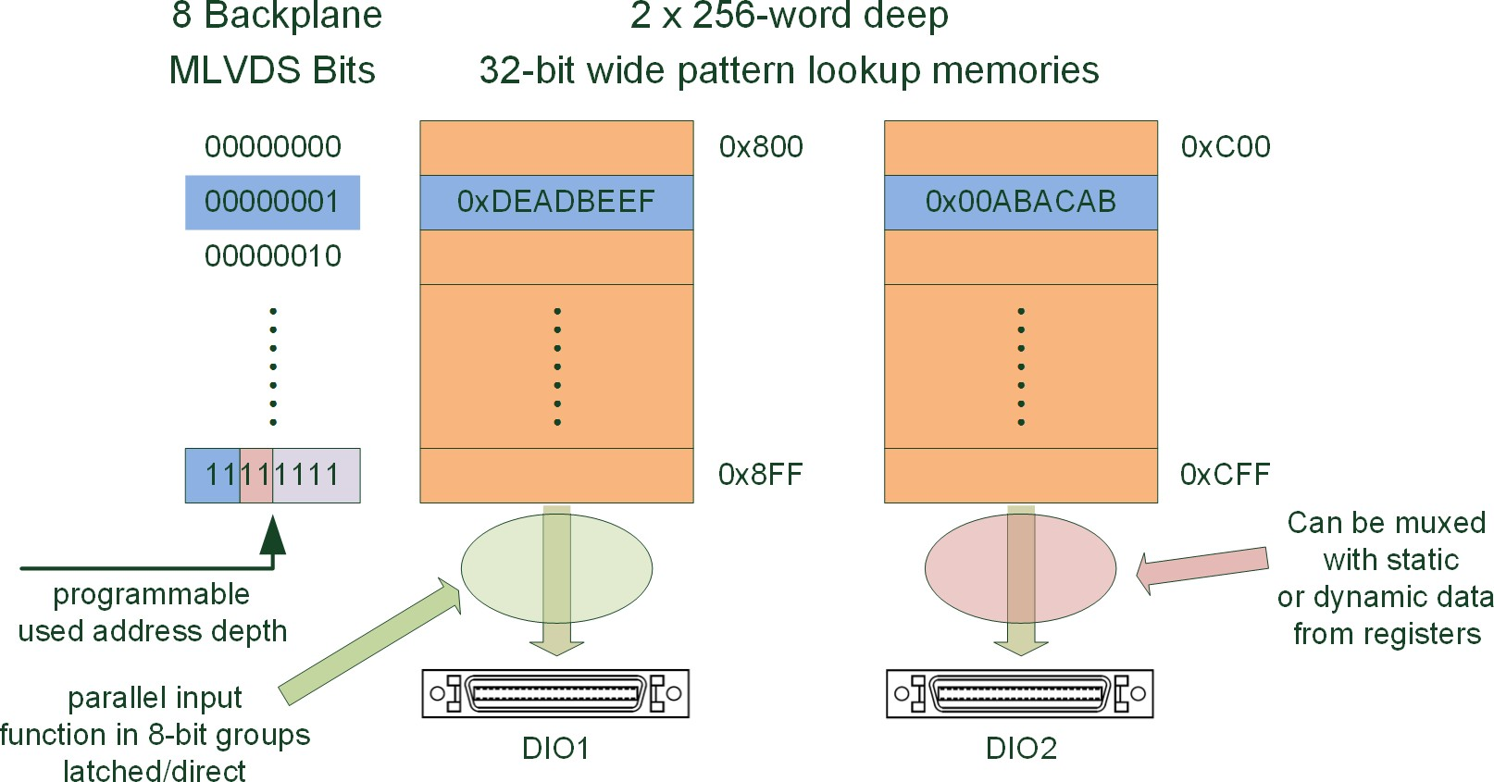
SIS8864 Digital I/O Firmware Detail
Event Receiver/MLVDS → Pattern Memory
The 2025 MTCA/ATCA for Large Scientific Facility Control Workshop, CQU Chongqing, 17.09.2025
© 2025 Copyright Struck Innovative Systeme GmbH

Slide 38
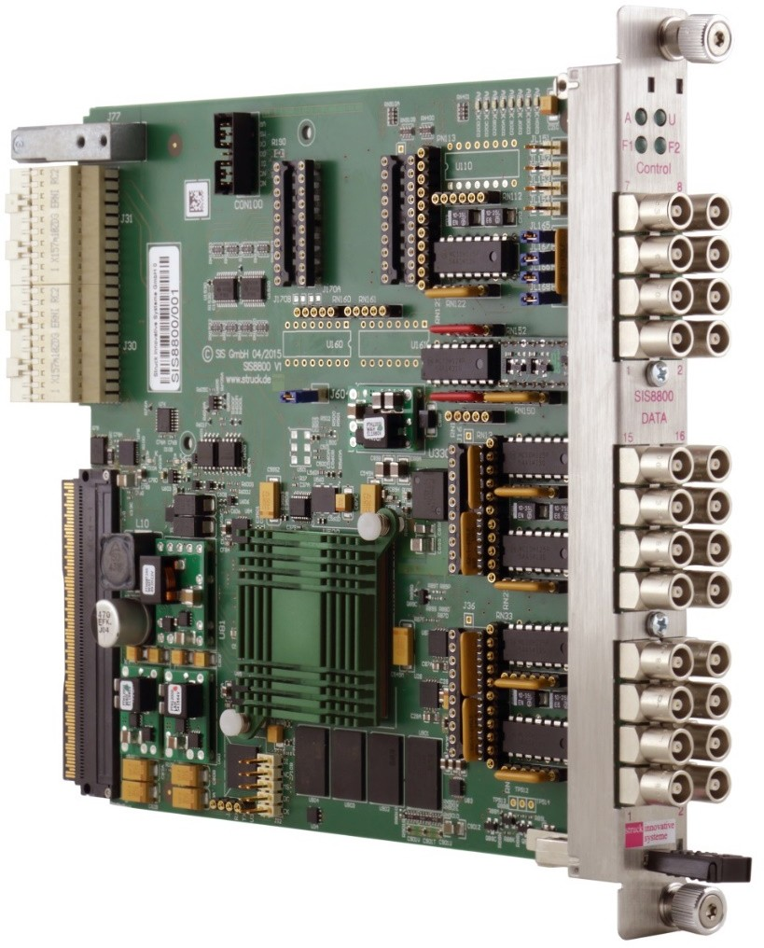
SIS8800 Multi Purpose Scaler
Functionality
MTCA.4 AMC
4 Lane PCI Express connectivity
XC6VLX130T-2FFG1156C Xilinx
Dual boot
Redundant PCIe implementation
2 GByte DDR3 memory
16 front inputs NIM or TTL/LEMO, TTL,ECL or LVDS/flat cable
200 MHz count rate (NIM/ECL)
4 control in-/4 control front outputs
Zone 3 Class D1.1 compatible
MMC 1.0 under DESY license LV91
The 2025 MTCA/ATCA for Large Scientific Facility Control Workshop, CQU Chongqing, 17.09.2025
© 2025 Copyright Struck Innovative Systeme GmbH

Slide 39
SIS8890 Discriminator RTM for SIS8800 Multi Purpose Scaler
Functionality
MTCA.4 RTM
16 Discriminator Inputs, Connector Type MMCX
Leading Edge
50 Ω Input Termination
14 Bit Threshold DAC for each Channel, 0.4 mV/Step
16 Outputs to Zone 3 (to Scalers on SIS8800)
16 Front Outputs, Connector Type MMCX
Programmable Pulse Width 10 ns -250
Zone 3 Class D1.1 Compatible
MMC1.0 Compatible
The 2025 MTCA/ATCA for Large Scientific Facility Control Workshop, CQU Chongqing, 17.09.2025
© 2025 Copyright Struck Innovative Systeme GmbH

Slide 40
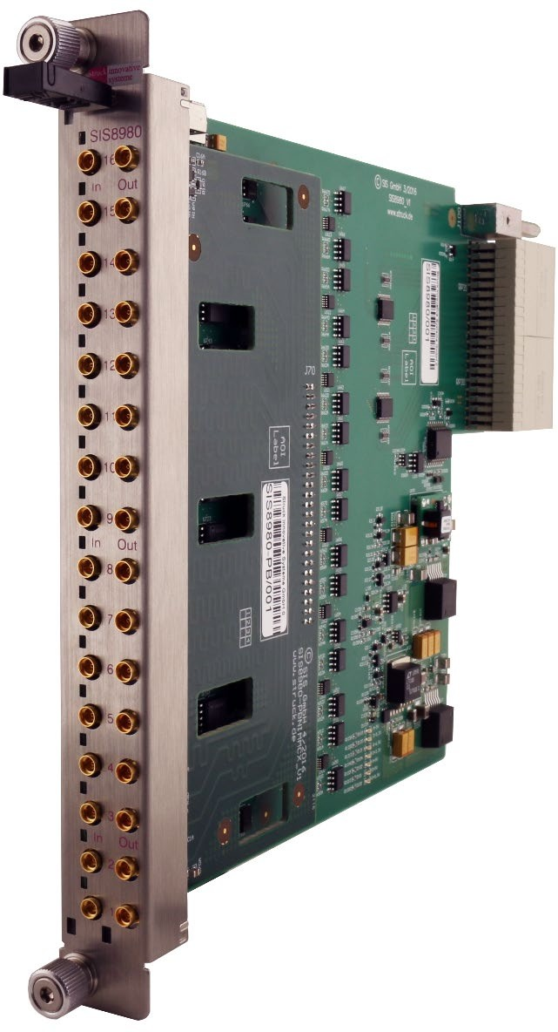
SIS8980 in NIM/MMCX Configuration
The 2025 MTCA/ATCA for Large Scientific Facility Control Workshop, CQU Chongqing, 17.09.2025
© 2025 Copyright Struck Innovative Systeme GmbH

Slide 41
MTCA.4 Relevance, current Struck user base
AU | Australian Synchrotron
BR | LNLS
CH | CERN
CN | IHEP, SINAP, USTC, CIAE,CSNS,IMP,DLS,IASF,PKU,THU,CQU,…
CZ | ELI (Inst of Physics, Praha)
DE | DESY, HZDR, PTB, MPG, KIT, HZB, GSI, DESY Zeuthen, HMI
ES | ESS Bilbao, GMV
FR | ITER, Saclay
GB | Diamond, STFC
IN | TIFR
JP | KEK, SPring-8
KR | PAL
RU | ITER, JINR (Techlab/Bevatech)
SE | ESS, Lund University
TR | TARLA
TW | NSRRC
US | SLAC, NSCL/FRIB, ANL, ORNL
The 2025 MTCA/ATCA for Large Scientific Facility Control Workshop, CQU Chongqing, 17.09.2025
© 2025 Copyright Struck Innovative Systeme GmbH

Slide 42

Conclusion/QA/&thanks
MTCA(.4) standard widely adopted, Companies and DESY as incubators
Increasing number of users and mtca based designs and solutions in China now
Looking forward to more exchanges and discussions to promote the development of this technology and the community
partner
Beijing DAQ Technology Co. Ltd.
The 2025 MTCA/ATCA for Large Scientific Facility Control Workshop, CQU Chongqing, 17.09.2025
© 2025 Copyright Struck Innovative Systeme GmbH

