Slide 1
The upgrade of CSNS-II RCS LLRF
Long Wei
The 2025 MicroTCA/ATCA International Workshop for Large Scientific Facility Control
15-17 Sep 2025, Chongqing, China
Notes:
Hello every one, My name is Long wei. I’m from China Spallation Neutron Source.
I am pleased to give a report about our SOC based AMC module for CSNS-II RCS LLRF and SAPS-TP Cavity Regulation.

Slide 2
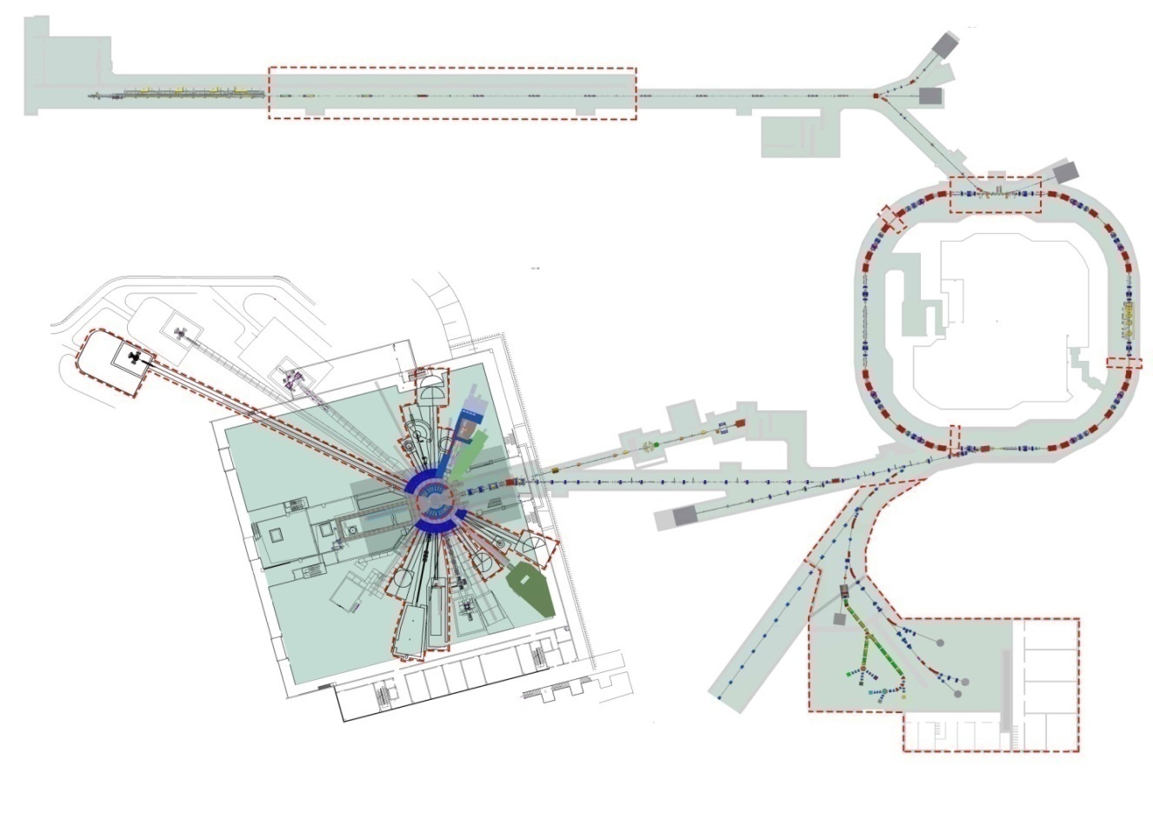
CSNS-II RCS LLRF upgrade
Linac 80 MeV to 300 MeV
3 additional 2nd harmonic (MA) cavities
Beam power
100 kW to 500 kW
RCS
1.6 GeV, 25 Hz
To enhance the bunching factor
CSNS-II RCS LLRF → upgrade
1.6GeV
CSNS II upgrade
Phase | CSNS I | CSNS II
Beam power on target | 100 kW | 500 kW
Linac energy | 80MeV | 300MeV
Extraction beam energy | 1.6GeV | 1.6GeV
Average Beam current | 62.5µA | 312.5µA
Repetition | 25Hz | 25Hz
Protons per pulse | 1.56E13 | 7.8E13
11 new spectrometers
experimental terminals
Proton & muon
Experimental station
Notes:
This is the CSNS China’s pulsed /pʌlst/ neutron source.
Its accelerator consists of a 80 MeV (Mega electron Volts) (H- negative hydrogen ion) Linac and a 1.6 GeV rapid cycling synchrotron (RCS).
The CSNS II is the upgrade of CSNS.
The beam power on the target will be improved from 100 kW to 500 kW.
The Linac energy will increase from 80 MeV to 300 MeV;
324MHz spoke cavities and 648MHz elliptical cavities will be added to the superconducting RF section.
To enhance the bunching factor, three additional 2nd harmonic cavities, loaded with magnetic-alloy (MA) material, will be integrated into the RCS. And the CSNS-II RCS LLRF system is also need to be updated.

Slide 3
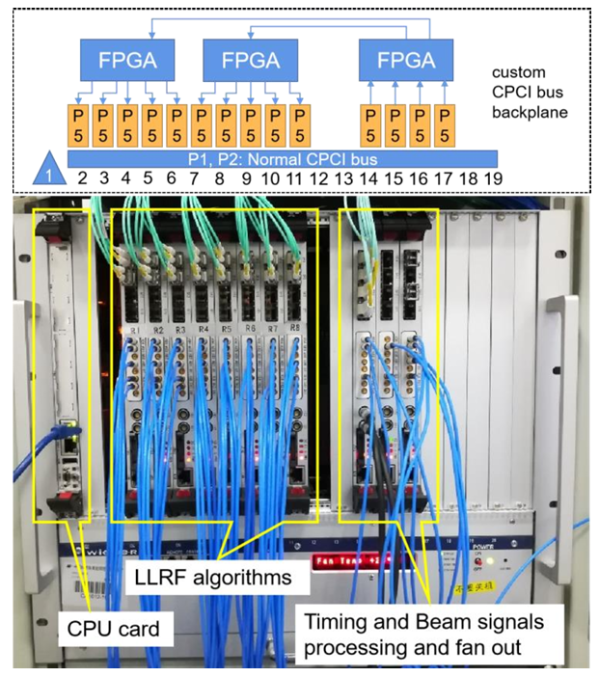
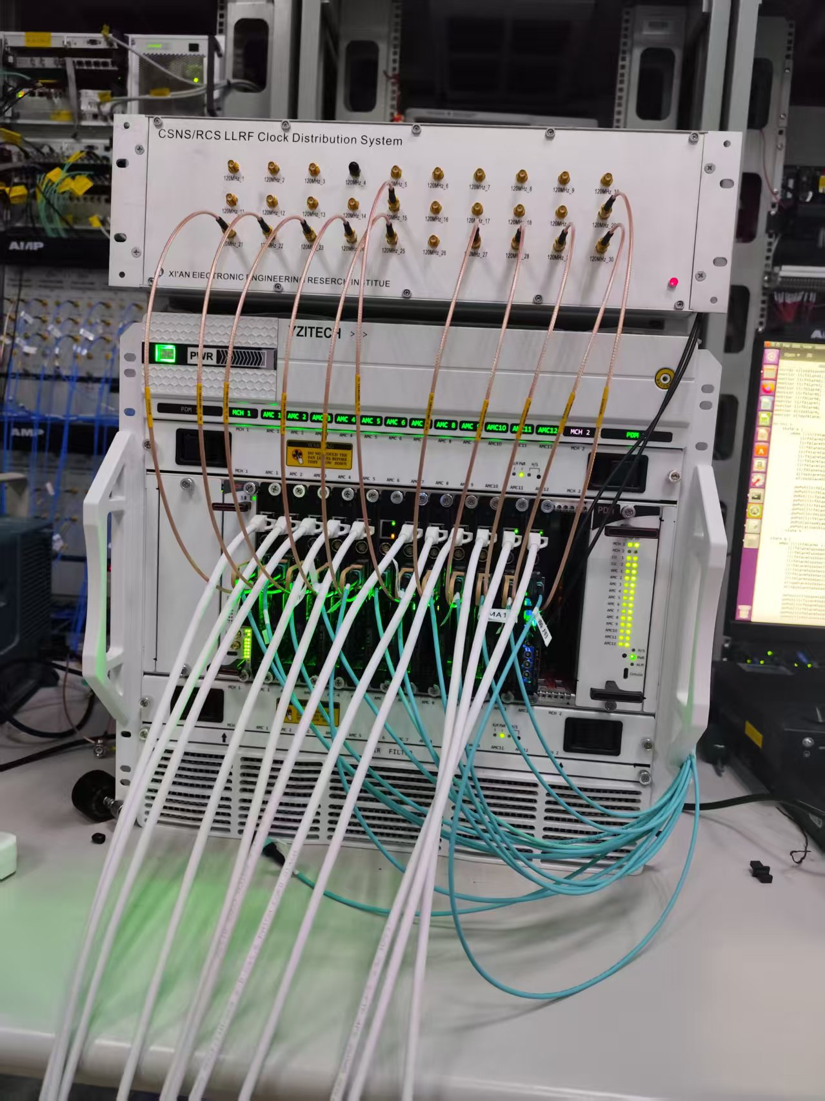
CSNS-II RCS LLRF upgrade
upgrade
Main reason!
Some CPCI chips have been discontinued and are no longer available.
Can’t back up the hardware!
CSNS-I RCS LLRF based on CPCI bus
CSNS-II RCS LLRF based on MTCA.4
Notes:
The fundamental reason we need to upgrade our LLRF system is that certain CPCI chips have been discontinued, making it impossible to back up the hardware.

Slide 4
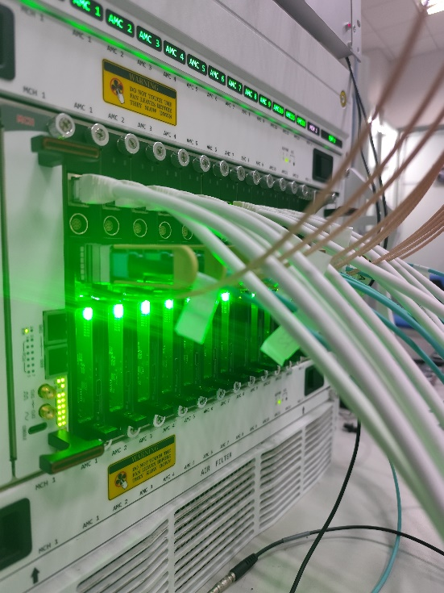
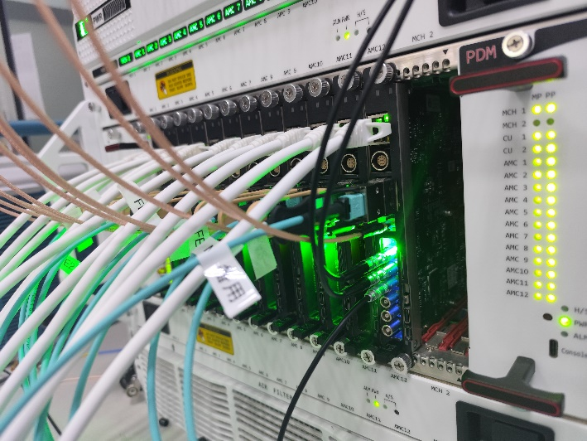
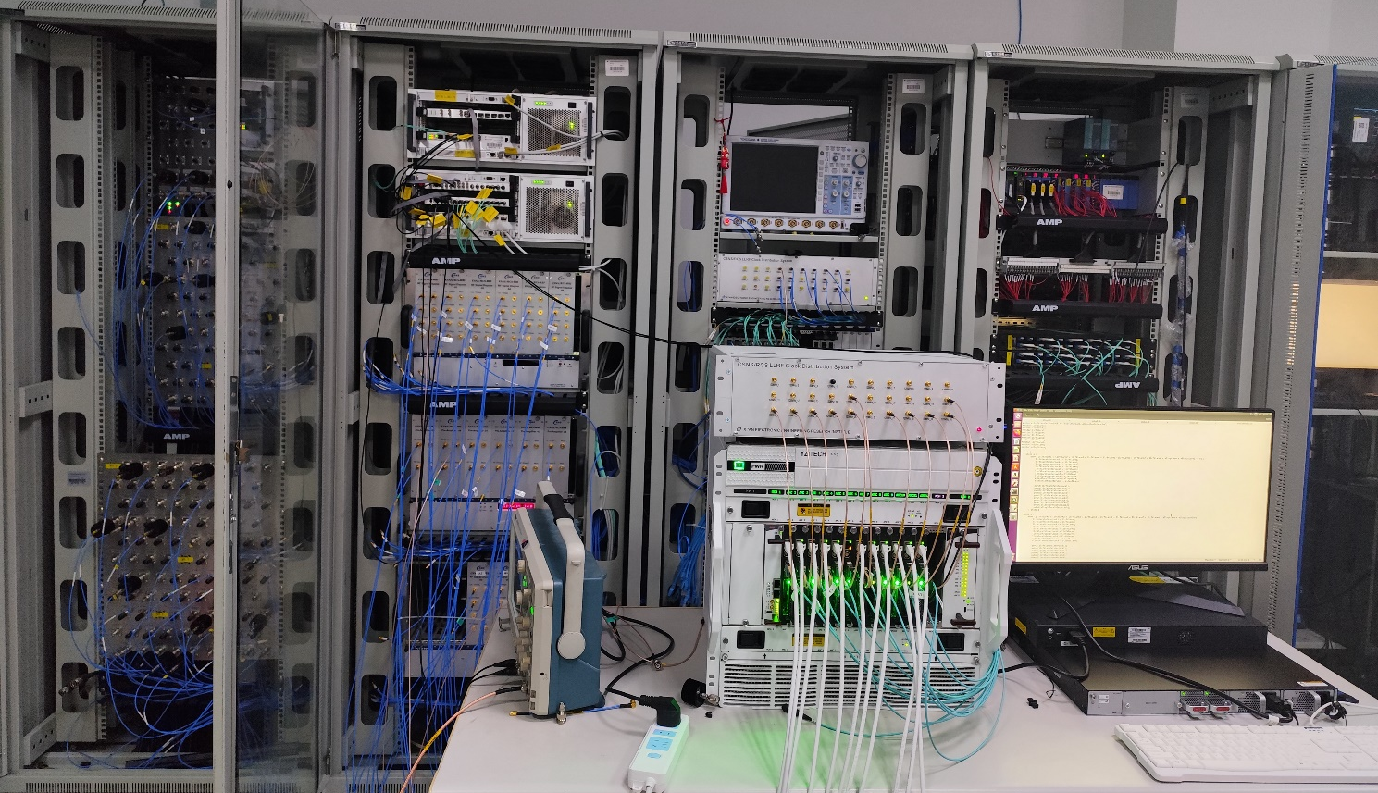
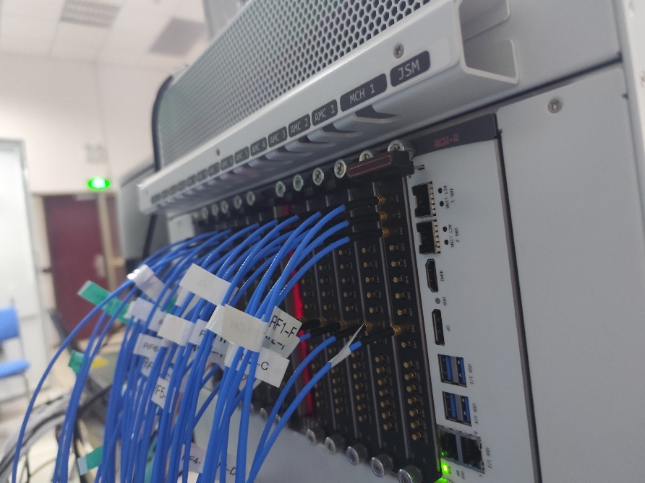
CSNS-II RCS LLRF upgrade
Front View
Rear view
We have just completed this upgrade project, replacing the CPCI-based hardware platform with an MTCA.4-based low-level hardware platform.
Since the entire installation and commissioning period was very short—about three weeks—we decided, for safety’s sake, not to dismantle the original system, but instead to temporarily place the new system on the table in front.

Slide 5
LLRF System Based on MTCA.4
The system topology is very simple, consisting of 12 of the same digital signal processing AMC boards and 10 of the same analog signal adaptation RTM boards.
Timing Board
Two AMC boards without RTM boards connected are used as a timing board and a Chopper Kicker BPM trigger signal fan-out board, respectively.
AMC
Chopper Kicker BPM fanout board
25 Hz timing trigger of the CSNS RCS
MLVDS
Beam trigger for beam tuning
The remaining 10 sets are used for the LLRF of 8 ferrite loaded cavities and 2 installed magnetic alloy cavities. Another magnetic alloy cavity will be installed next year.
RTM

Slide 6
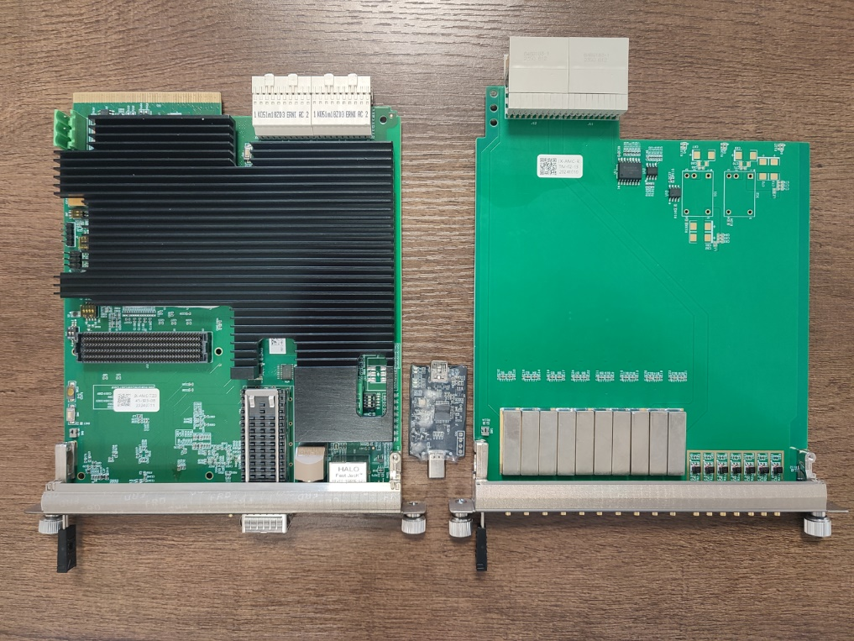
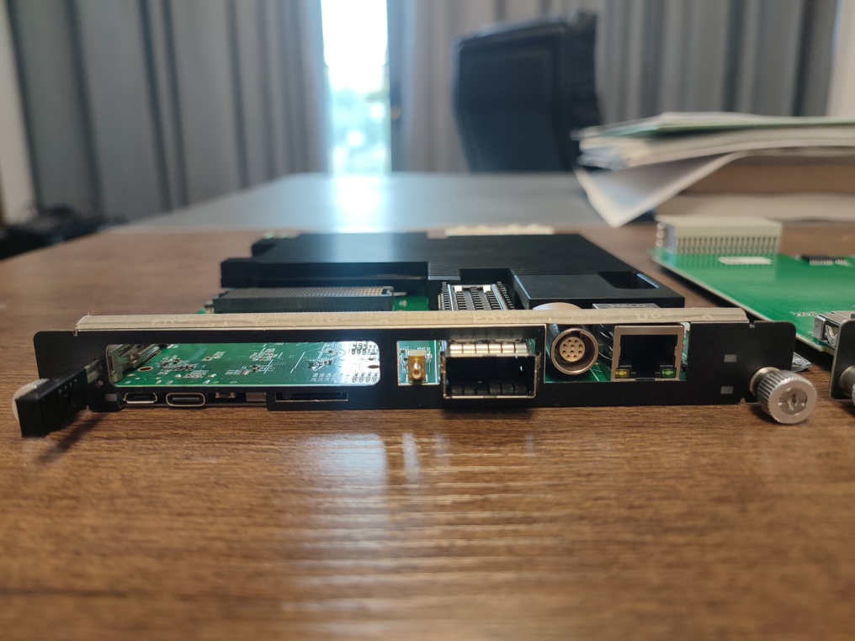
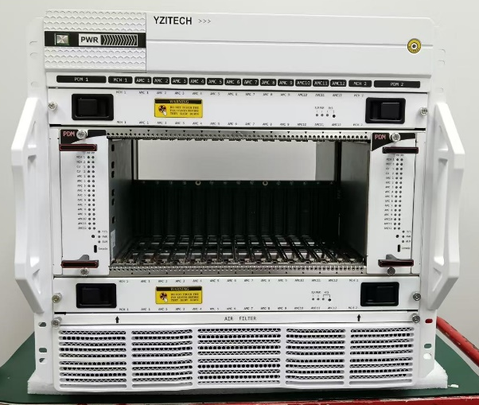
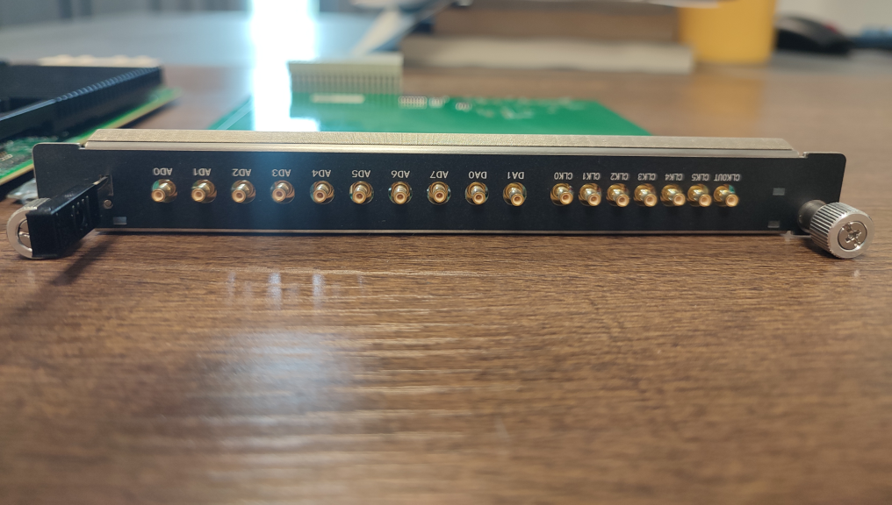

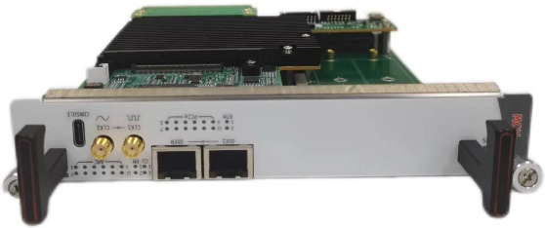


Hardware Modules
FMC
CLK
DIO
Serial JTAG RST SD
QSFP
Ethernet
AMC front panel
AMC
RTM
MTCA.4 chassis with power and cooling modules
6 CLK_IN
8 AD
2 DA
1 CLK_OUT
MCH
RTM front panel

Slide 7
LLRF System Based on MTCA.4
Clock Distribution System (used in CSNS-I RCS LLRF) → 120MHz clock → AMC front plane SMP Ext clock input
AMC
RTM
Grid Signal
The YZ MCH has no configurable clock fan-out to TCLKA yet.
ZYNQ
Ext Clock
Cavity
Pick up
The AMC’s ADC acquires the cavity pickup signals and grid signals through the RTM board for cavity voltage and tuning control. The AMC’s DAC outputs the RF drive signal generated by the LLRF algorithm to control the amplitude and phase of the RF field.
QSFP
RF power
RF driving signal
QSFP to 4 SFP
Bias current
RF
Power
Source
Bias
Current
Source
Tetrode
tube
The front-panel QSFP optical fiber is converted into four SFP channels via a conversion module, which is used to control the bias current and to modulate the tetrode tube’s screen grid signals.

Slide 8
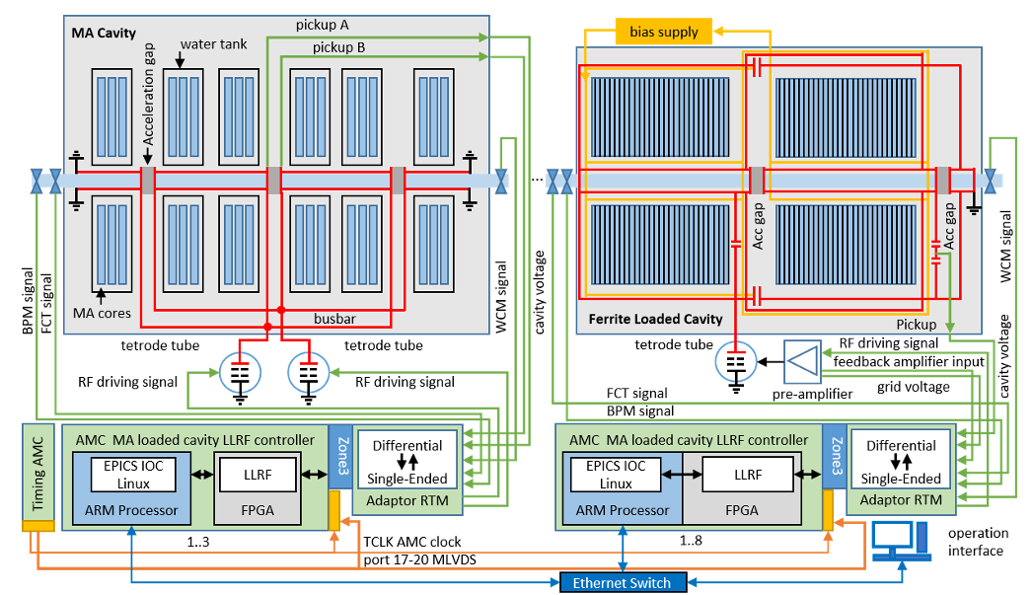
LLRF System Based on MTCA.4
As the beam power increases, additional functions, including beam loading compensation and longitudinal oscillation damping, may be implemented.
Schematic of the CSNS-II RCS LLRF system

Slide 9
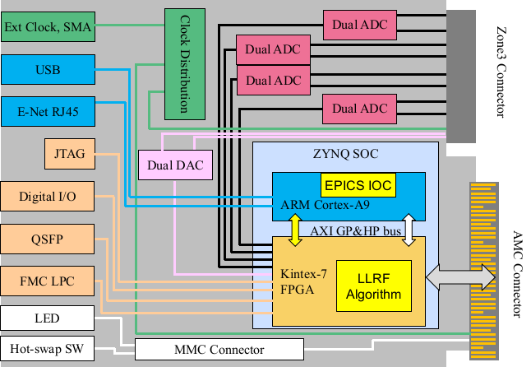
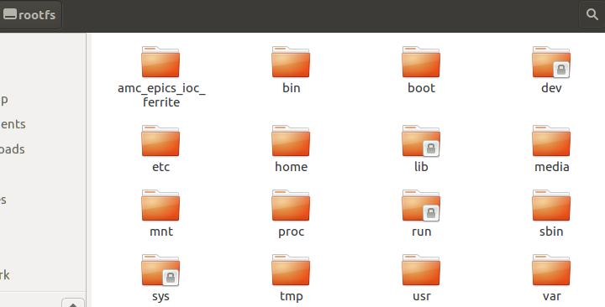
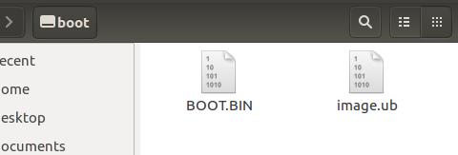
AMC Based on SOC
AMC Module based on Zynq-7045
We runs an EPICS IOC in the SOC PS part which is the ARM processor for remote control, and runs a Low Level RF algorithm in SOC PL FPGA.
EPICS IOC
Linux Image
MTCA.4 / Zone3 class A1.1 CO / double-width Mid-size
BOOT image include: FSBL（First Stage Boot Loader）、FPGA bitstream、U-Boot
8 ADC 16-bit 125 MSPS, 2 DAC 16-bit 250 MSPS
LPC FMC connector / 2GBytes DDR3 memory
Notes:
This is the AMC Module based on Zynq-7045, it’s double-width Mid-size, Compliant with the MTCA.4 / Zone 3 Class A1.1 CO standard.
It has 8 ADC 16-bit 125 MSPS, 2 DAC 16-bit 250 MSPS.
The SD card consists of a boot partition and a rootfs partition. The boot partition contains the BOOT image file and the Linux image file. The BOOT image integrates the FSBL (First Stage Boot Loader), the FPGA bitstream, and U-Boot. The rootfs partition contains the Linux root file system and the EPICS IOC program.

Slide 10
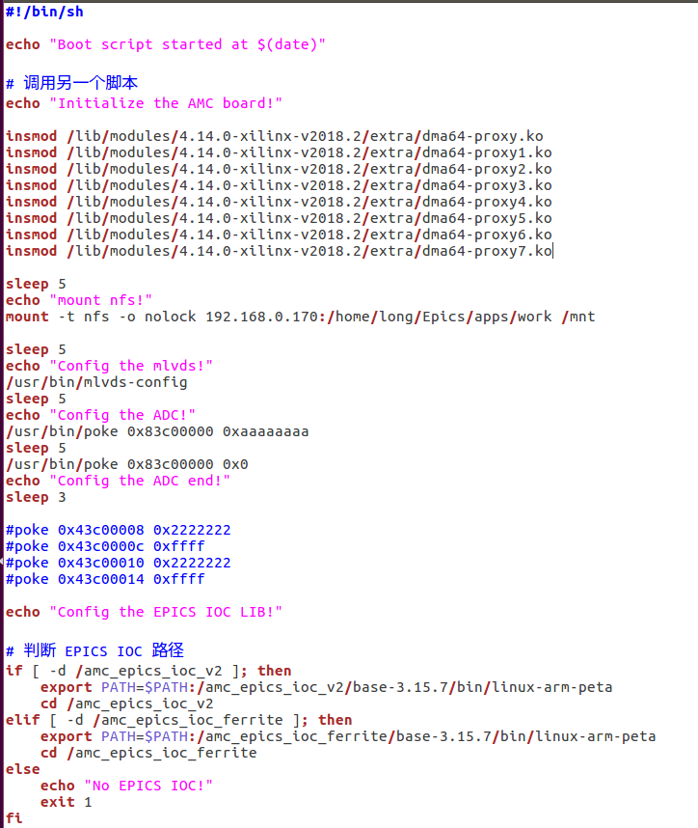
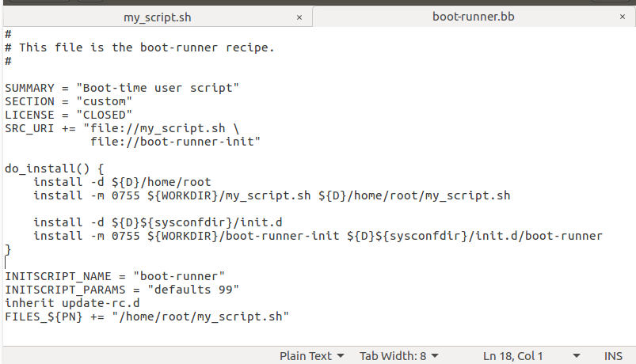
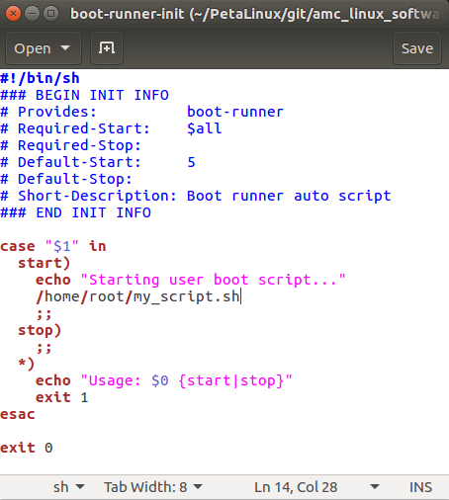
Auto start shell script
After the board is powered on, the FPGA program and PetaLinux are sequentially loaded. An auto-start shell script is then executed to load the DMA driver module, mount the NFS, and launch the EPICS IOC.
n a PetaLinux recipe (.bb) file, the do_install function installs scripts into Linux’s init.d directory, allowing them to execute automatically at system startup.

Slide 11
Software structure
ZYNQ
FPGA
The EPICS IOC includes an automated RF power ramping program, which automatically sets the PI parameters, cavity voltage amplitude, and the open/closed loop switch, enabling smooth ramp-up and ramp-down of the RF power. These parameters are adjusted during operation, saved in configuration files on the NFS, and loaded into the EPICS IOC.
AXI BUS
ARM
Central control LAN
Ethernet switcher
The software also includes an RF pattern mode curve download function, which loads the physically defined frequency, amplitude, and phase pattern mode curves into EPICS IOC PVs and transfers them via DMA to the FPGA’s dual-port RAM. This allows the RF field’s amplitude, frequency, and phase to precisely follow the physically specified pattern mode curves.
OPI
Phoebus
NFS Server
Configure
files

Slide 12
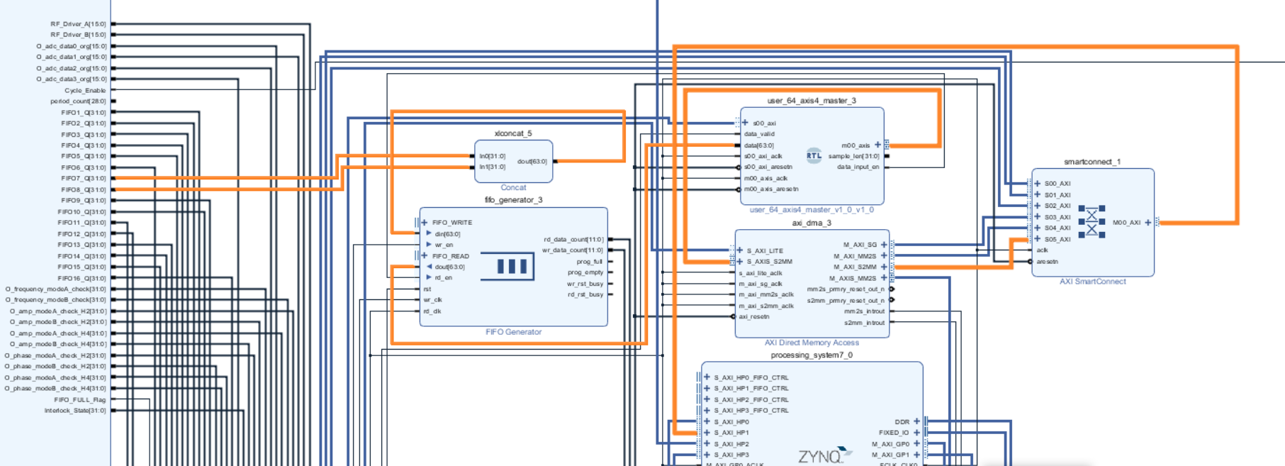
DMA Transmission Path PL to PS
LLRF
The state curve data generated by the LLRF logic is first buffered in a FIFO. Within the 20 ms operation window of each 25 Hz pulse, a total of 2,048 samples are uniformly acquired. These data are then formatted into an AXI Stream sequence by the user-defined AXI Master module and subsequently transferred to the ARM-based host system via AXI DMA.

Slide 13
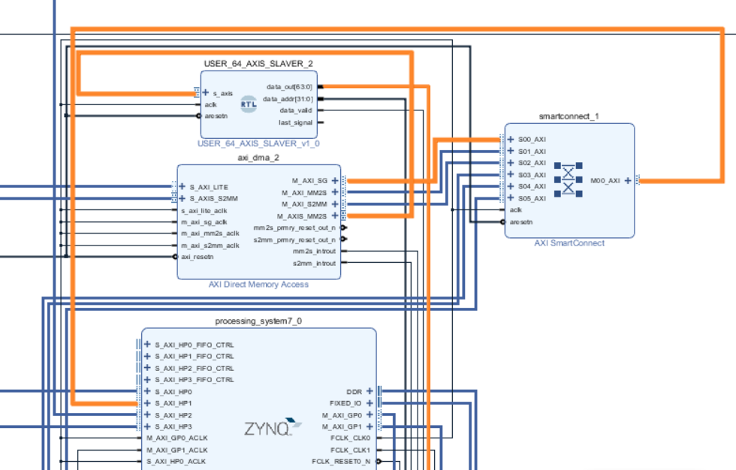
DMA Transmission Path PS to PL for pattern mode curve download
The ARM transfers the pattern mode curves to the FPGA via AXI DMA, and through a user-defined AXI Slave, converts the AXI timing into dual-port RAM operation timing, writing the data into the dual-port RAM.

Slide 14
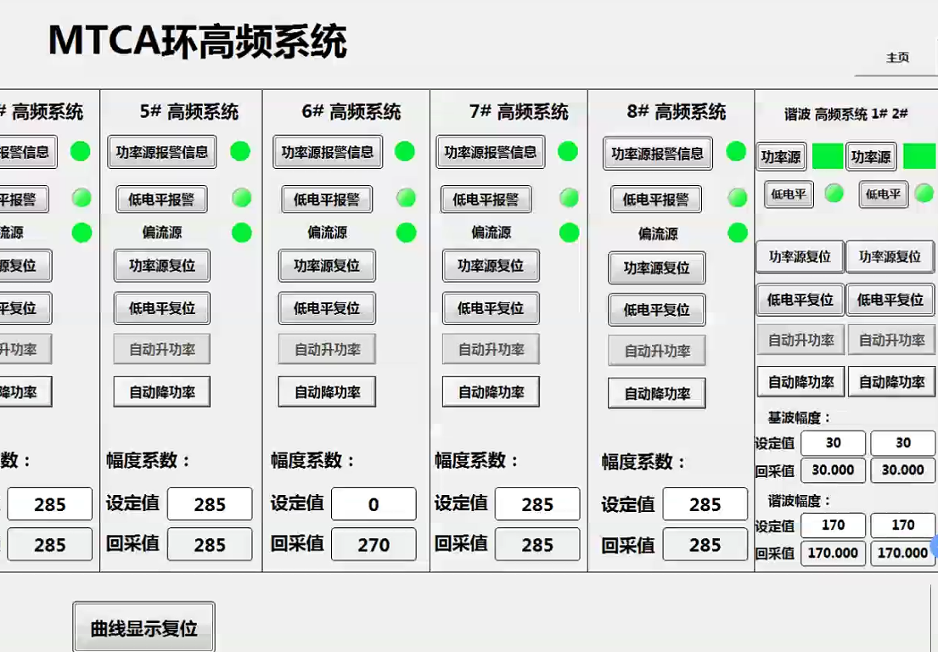
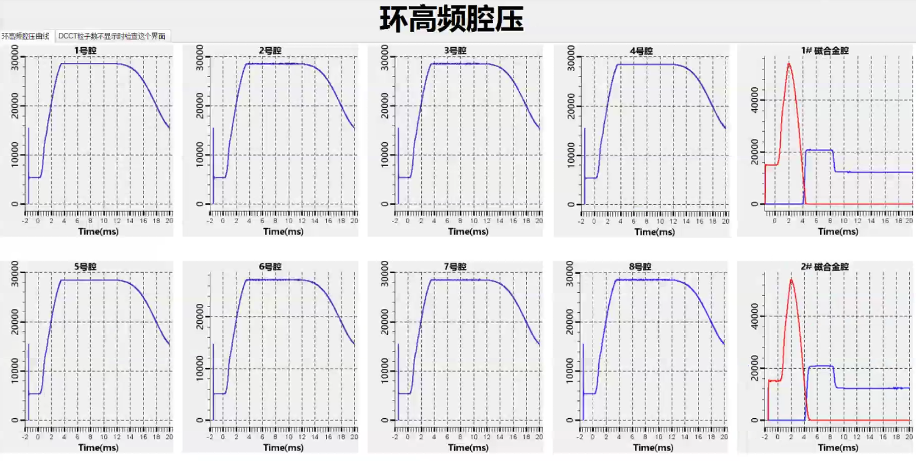
Control OPI
This is the OPI interface delivered to the operations staff on duty.
Fundamental cavity voltage
Ring RF Operation Control OPI
Second-harmonic cavity voltage

Slide 15
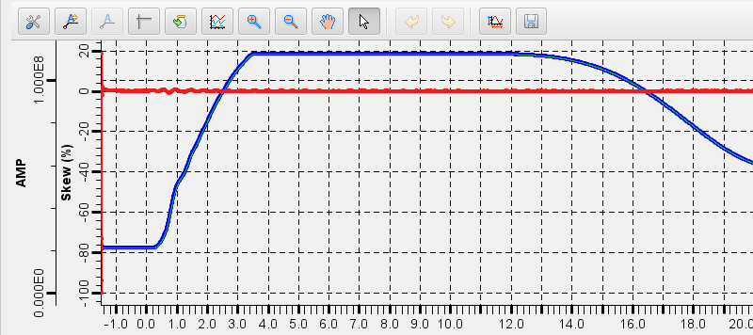
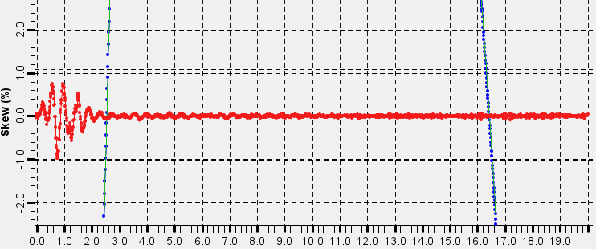
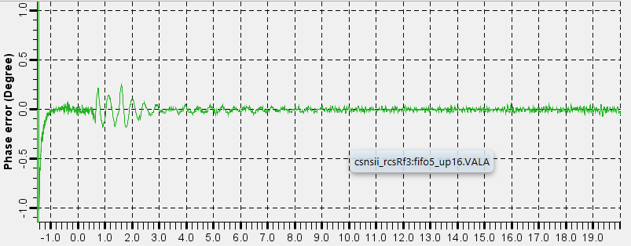
RF field amplitude and phase error
maintaining the amplitude error well below 1% (required) and 1°(required)

Slide 16
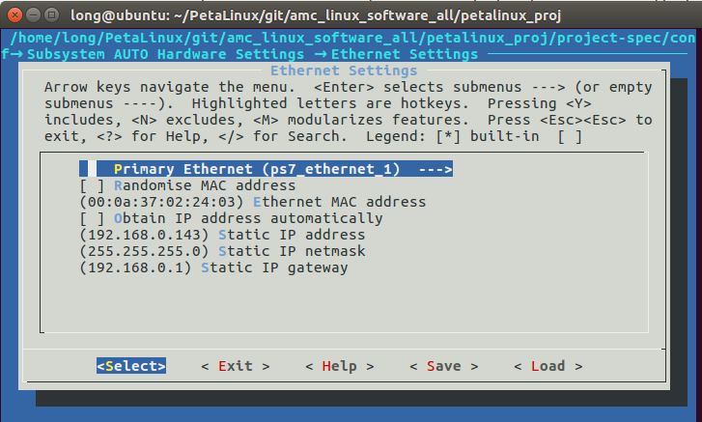
Here are some pitfalls
SPI
On the AMC board, there are four ADC chips that share a common configuration SPI bus, so each ADC chip can only be configured sequentially. This results in phase differences among the accompanying clocks of the ADCs, making it necessary to add FIFOs for data synchronization. Consequently, both the program complexity and the loop latency are increased, and additional phase differences are introduced among signals from different channels.
ADC
9268
ADC
9268
ADC
9268
The ZYNQ uses virtual MAC addresses, so it is essential to ensure that different boards have distinct MAC and IP addresses, and that random MAC addresses are not used. Otherwise, the switch will report a MAC flapping fault, causing the connection between the EPICS IOC and the OPI interface to repeatedly connect and disconnect.
ADC
9268

Slide 17
Thanks for your attention! longw@ihep.ac.cn
Notes:
That’s all, thanks for your attention!

